Slide 1
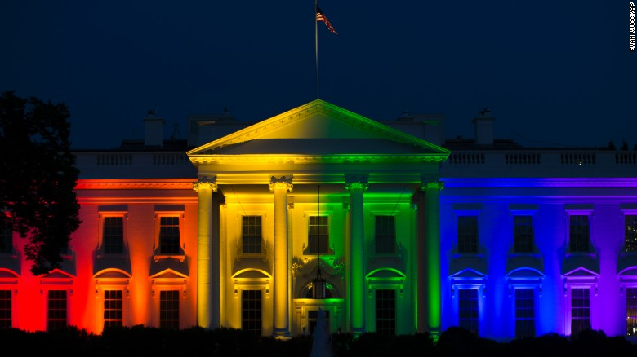
المثلية الجنسية
د. ريك جريفيث • مؤسسة الدراسات اللاهوتية الأردنية • BibleStudyDownloads.org

Slide 2
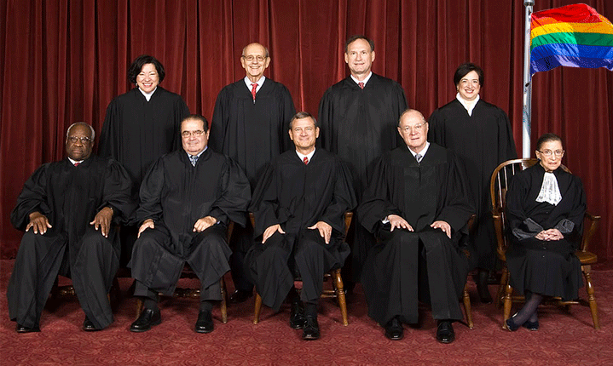
إعادة تعريف الزواج في المحكمة العليا
26 حزيران 2015

Slide 3
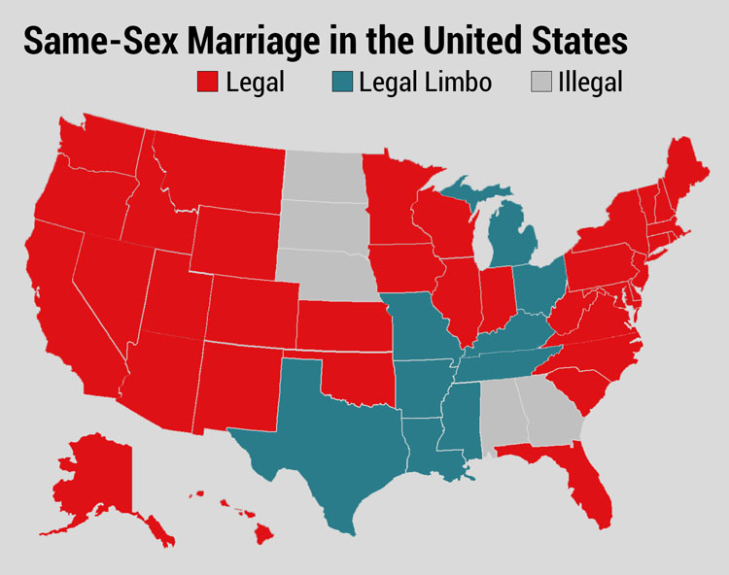
قبل القرار
زواج مثليي الجنس في الولايات المتحدة
قانوني
مأزق قانوني
غير قانوني
Notes:
Before the decision, the states were divided on the issue of same-sex marriage.

Slide 4
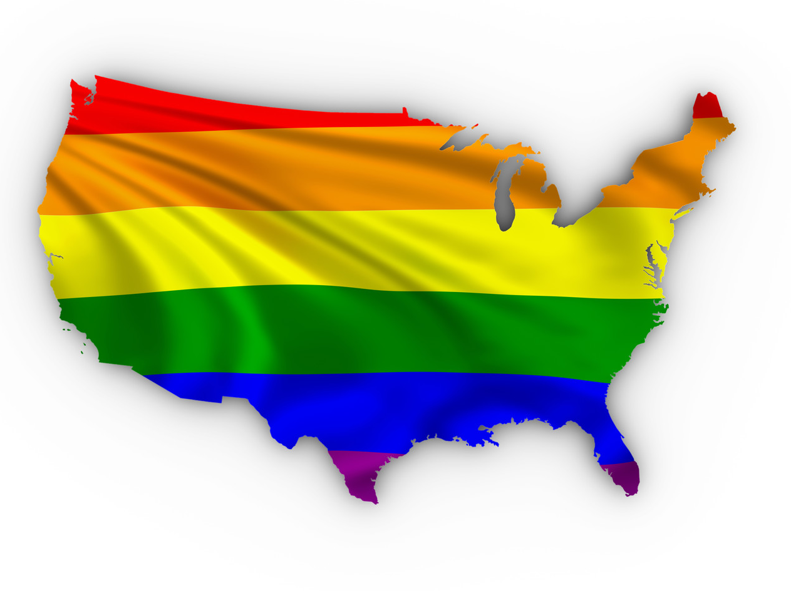
بعد القرار
Notes:
The Supreme Court overturned all states that prohibited homosexual marriage, making the entire USA redefine this thousands-of-years-old institution.

Slide 5
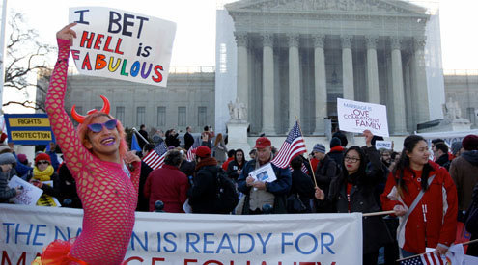
إعادة تعريف الزواج في المحكمة العليا
26 حزيران 2015

Slide 6
إعادة تعريف الزواج في المحكمة العليا
26 حزيران 2015
Notes:
President Obama even ordered the White House lit in the homosexual rainbows in celebration.

Slide 7

يمتلك الفيسبوك الآن 51 خيار لتحديد الجنس

Slide 8
التداعيات

Slide 9
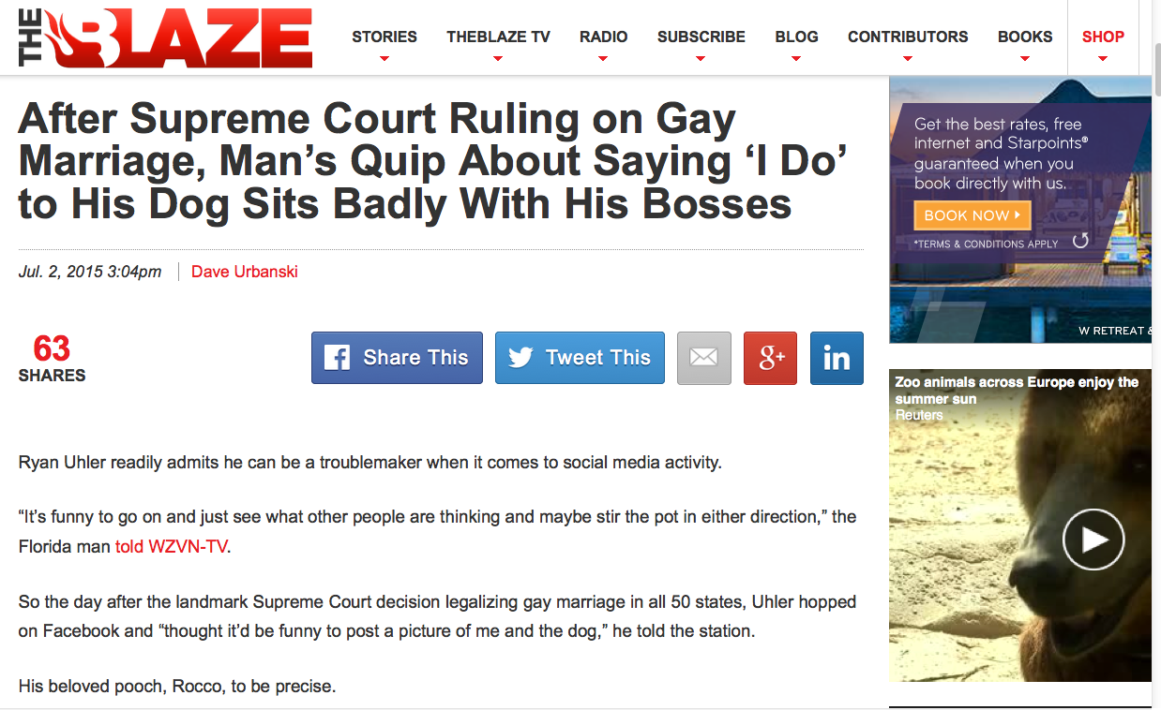
إلى أي مدى ستصل عملية إعادة التعريف؟
بعد حكم المحكمة العليا بشأن زواج المثليين سخرية رجل من قول أفعل لكلبه لا تلقى استحسانًا لدى رؤسائه
Notes:
Dave Urbanski, "After Supreme Court Ruling on Gay Marriage, Man's Quip About Saying 'I Do' to His Dog Sits Badly With His Bosses"
His tech computer fired him for this facebook quote.
"Uhler said the company where he'd worked as a digital marketing specialist for the last two years — Grace Tax Advisory Group in Fort Myers — fired him because of his post.
"What happened was, they took it out of context," he told WZVN.
Trial lawyer Scot Goldberg told the station that while the company's actions are "a little bit over the line," Uhler's former bosses have legal recourse since Florida is an "at will" state — meaning no reason is needed for firing without notice.
Now relegated to hoofing it for a new job — you might call it "Ryan Uhler's Day Off" and then some — his affection for Rocco remains steadfast.
"God, I love my dog," he told the station, "just as much as I love my wife and my kid."
No word yet on how that's going over with the family."
July 2, 2015 (accessed 3 July 2015) at http://www.theblaze.com/stories/2015/07/02/after-supreme-court-ruling-on-gay-marriage-mans-quip-about-saying-i-do-to-his-dog-sits-badly-with-his-bosses/

Slide 10
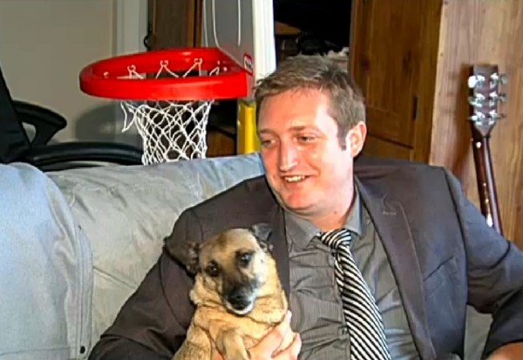
كيف يكون الزواج من كلب مختلفاً إذا كنت تحبه؟ أتمنى اليوم أن نستطيع التركيز على الحل على غرار الكلاب. أحب كلبي روكو وهو يحبني وأتمنى أن نستطيع الزواج يوماً ما.
Notes:
Dave Urbanski, "After Supreme Court Ruling on Gay Marriage, Man's Quip About Saying 'I Do' to His Dog Sits Badly With His Bosses"
His tech computer fired him for this facebook quote.
"[Ryan] Uhler said the company where he'd worked as a digital marketing specialist for the last two years — Grace Tax Advisory Group in Fort Myers — fired him because of his post.
"What happened was, they took it out of context," he told WZVN.
Trial lawyer Scot Goldberg told the station that while the company's actions are "a little bit over the line," Uhler's former bosses have legal recourse since Florida is an "at will" state — meaning no reason is needed for firing without notice.
Now relegated to hoofing it for a new job — you might call it "Ryan Uhler's Day Off" and then some — his affection for Rocco remains steadfast.
"God, I love my dog," he told the station, "just as much as I love my wife and my kid."
No word yet on how that's going over with the family."
July 2, 2015 (accessed 3 July 2015) at http://www.theblaze.com/stories/2015/07/02/after-supreme-court-ruling-on-gay-marriage-mans-quip-about-saying-i-do-to-his-dog-sits-badly-with-his-bosses/

Slide 11
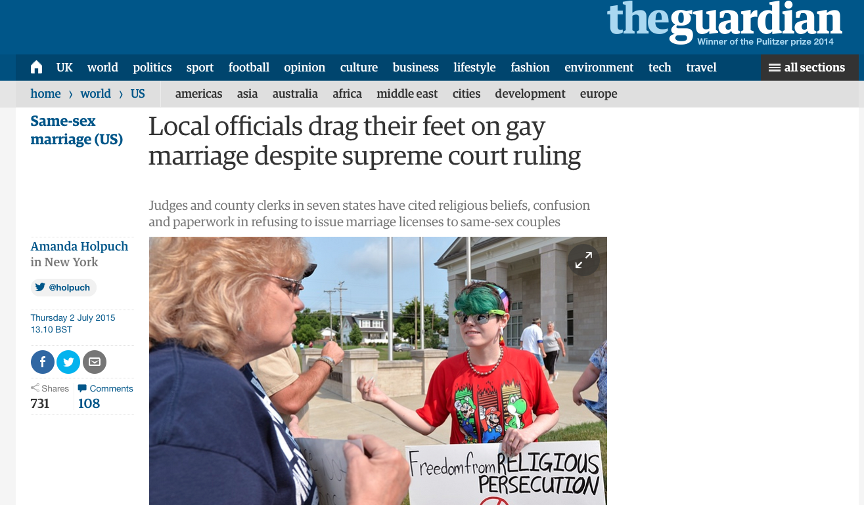
إعادة تعريف المحكمة العليا للزواج
26 حزيران 2015
المسؤولون المحليون يماطلون في زواج المثليين على الرغم من حكم المحكمة العليا
Notes:
Tony Perkins (President of Family Research Council) wrote on 1 July 2015 at http://www.frc.org/updatearticle/20150701/keep-calm-clerk-on
The five justices of the Supreme Court weren't the only ones with a strong opinion on marriage. And dozens of county clerks are risking everything to prove it. Five days after five justices bulldozed the votes of 50 million people, the Left was wrong to assume everyone would just fall in line. They didn't count on an army of local officials standing in the wreckage of judicial activism, refusing to budge.
For most of them, it wasn't a question of if their beliefs would come under attack, but when. Like Jennifer Schoenrock, the wife of a disabled veteran and family breadwinner, they knew the day was coming when they'd have to choose between their convictions and their career. "I want to do the right thing," Jennifer explained. And that means obeying God's law -- not man's. After last week, these clerks take seriously the reality that their offices are the new front lines in the battle for religious liberty -- and many of them have no intention of going quietly. As far as they're concerned, a lot of things have changed since Friday, but their First Amendment rights weren't one of them.
From small counties in Arkansas to busy towns in Texas, there are hundreds of people ready to defend the ground five unelected justices took from voters. The Court may have changed their definition of marriage, Kentucky clerk Chris Cockrell explained, but he isn't prepared to change his. If that means going to jail, so be it. And according to the state's ACLU, that's no empty threat. "Two things can happen if a Kentucky clerk won't issue a marriage license to a same-sex couple," warned one law professor. "They can resign or go to jail."
And don't think the Left won't send them. This week, the Kentucky County Clerks Association says it's been swamped with cries for help from local officials after Governor Steve Beshear (D) ordered government workers to abide by the ruling. Resistance comes with a heavy price: a year in prison for "first-degree official misconduct." That doesn't scare Rowan County clerk (and Democrat) Kim Davis. Like a lot of offices, hers shut down the marriage license window altogether -- in part because so many of her co-workers object. "What has happened is that five lawyers have imposed their personal view of what the definition of marriage should be on the rest of us. And I, as a Christian, have strong views too. And I know I don't stand alone."
Gay activists have started picketing Davis's office, but she refuses to resign. If the government won't force her, the ACLU vows to. Which may be why the only people busier than state officials are U.S. attorneys. On both sides, offices have been inundated with requests for legal help. In Texas, Attorney General Ken Paxton has promised to find legal representation for any government official whose beliefs are under attack.
That could be several. Of the 254 counties in Texas, less than half (114) told the AP they were "ready and willing" to issue same-sex marriage licenses. Nationally, nonprofit groups like Alliance Defending Freedom and Liberty Institute are already responding to the marriage whirlwind, flying to the aid of clerks and other officials everywhere.
In some states, the turmoil is even splitting the executive and legislative branches. After Governor Asa Hutchinson (R) insisted that Arkansas comply with the Court, state representatives swore to stand by clerks who refuse. "We affirm our support for Amendment 83 of the Arkansas Constitution as overwhelmingly passed by the people in 2004. We refuse to simply shrug our shoulders and abandon basic principles that have guided our country successfully the past 239 years. We will work with other conservative leaders in our state and across the nation... [to] explore all available options."
Down in Mississippi, the handful of clerks handing in their resignation letters includes Linda Barnette. After 24 years, the Grenada County Baptist said that when it came to her job or her faith, there was never any real debate. "My final authority is the Bible," she told Fox News's Todd Starnes. In her mind, the battle is finally at the church's door. "Christians are being put to the test," she said. 'We're going to see the true Christians who stand. It's going to be time to stop talking the talk. It's going to come down to that."
One man who knows about walking the walk is Governor Bobby Jindal (R-La.). Fortunately, the Louisiana governor was as prepared for this as he would be for any local disaster and had the foresight to protect religious liberty in law. People in Indiana and Arizona weren't so lucky. Their governors either watered down their legislation -- or refused to pass it altogether -- leaving officials without the legal firewall they need to keep the Left at bay. If the ACLU wants to sue Governor Jindal, let them. "The Left likes to pick and choose which liberties they support at any given time," he jabbed.
The reality is, the First Amendment has been around a lot longer than whatever "rights" the Court invented June 26. And with a growing chorus of conservative leaders, Bobby Jindal is willing to go to the mat to defend them. Your state officials should too. Contact your leaders and ask them to follow in the footsteps of courageous conservatives like Governor Jindal and Ken Paxton. Also, don't miss the Governor in his own words from yesterday's radio interview on "Washington Watch."

Slide 12
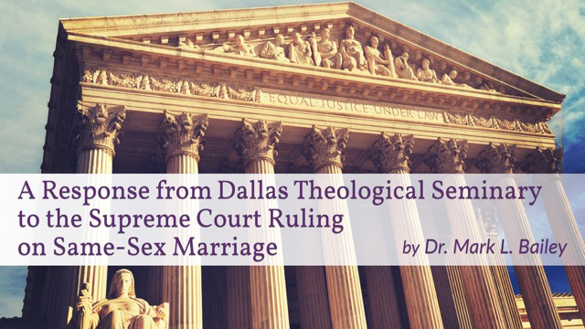
كيف يجب أن نرد على هذا الحكم 5-4؟
رد من كلية دالاس اللاهوتية على قرار المحكمة العليا بخصوص زواج المثليين
مارك ل. بيلي
Notes:
Tony Perkins (President of Family Research Council) wrote on his Action Alert on 30 June 2015:
"Last week, the Supreme Court ruled in Obergefell v. Hodges that all states must license and recognize marriages between same-sex couples. This decision could have devastating implications for institutions and individuals that hold the belief that marriage is between one man and one woman. We have seen state discrimination, and we need you to urge Congress to prevent federal discrimination against those who support natural marriage!"

Slide 13
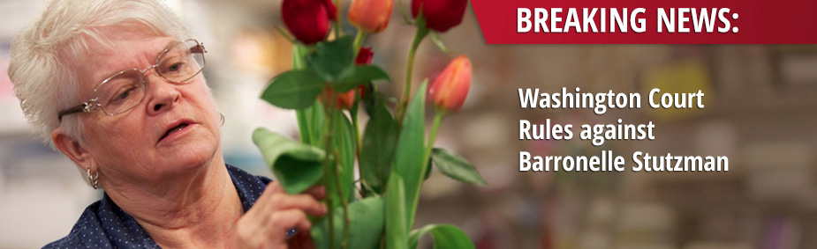
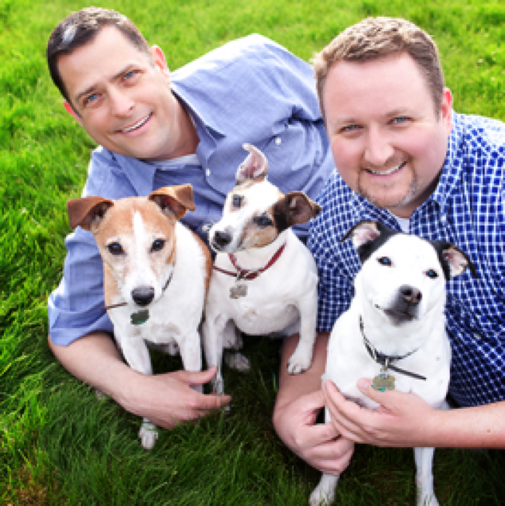
هل نستطيع أن نقول لا؟
أخبار عاجلة:
قواعد محكمة واشنطن ضد بارونيل ستوتزمان
200 ألف دولار غرامة ورسوم قانونية
Notes:
Tony Perkins (President of Family Research Council) wrote on his Action Alert on 30 June 2015:
"Businesses and organizations continue to be threatened because of their owners' faith. An Oregon bakery owned by Aaron and Melissa Klein was fined $135,000 simply for declining to make a wedding cake for a same-sex wedding. Barronelle Stutzman, a grandmother in Washington state, had to close her floral business because of the crippling fees imposed on her for not providing flower arrangements for a same-sex wedding [of the two men in the picture here].
Child welfare organizations, such as Lutheran Community Services and Catholic Charities, are being threatened by this decision to recognize same-sex marriage or face losing their ability to participate in federal programs or apply for federal grants.
Our Founders envisioned a nation where the moral and religious beliefs of individuals, faith-based organizations, and business owners would be protected, not a nation where one's convictions about marriage could be used as a disqualifying factor for interaction with the federal government.
To stop the federal government from discriminating against people because of their beliefs in marriage, Senator Mike Lee (R-UT) has introduced the First Amendment Defense Act, S.1598, in the Senate, and Representative Raúl Labrador (R-UT) has introduced the companion bill, H.R. 2802, in the House. Simply put, FADA would prohibit the federal government from penalizing persons for their personal moral or religious beliefs in natural marriage in areas such as federal employment, grants, contracts, tax treatment, and other programs.

Slide 14
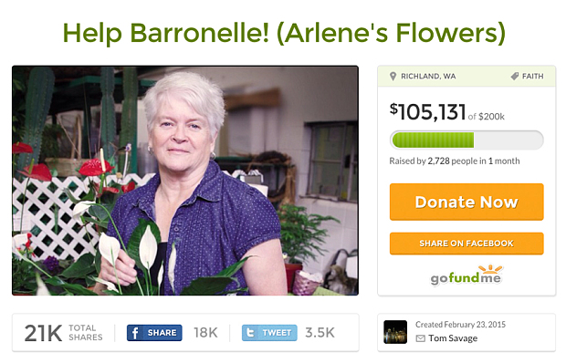
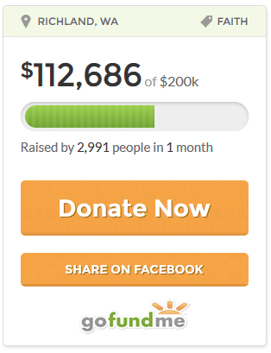
هل نستطيع المساعدة؟
مساعدة بارونيل (زهور آرلين)
Donate Now
Donate Now
Notes:
Her legal fees topped $200,000 but after raising $112,000 or so for the case, homosexual activists pressured gofundme.com as they were offended that the website would collect money to fight their cause. The result was that gofundme cancelled her account!

Slide 15
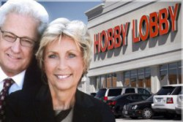
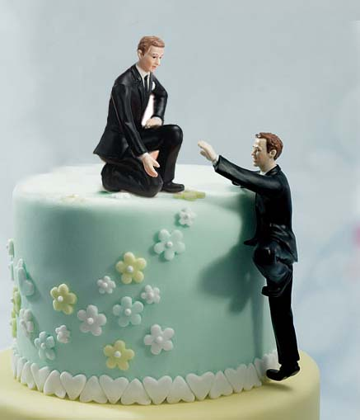
قضايا أخرى
Notes:
The Hobby-Lobby franchise won an exception from needing to provide spousal benefits to "married" homosexual couples based on their Catholic faith, but amazingly this does not apply to other businesses owned by Christians.

Slide 16
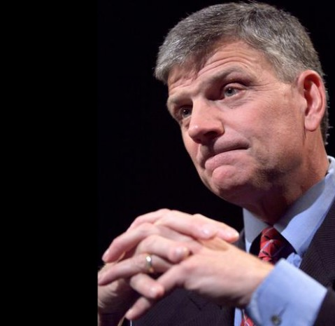
من الأفضل أن تكون جاهزاً ومن الأفضل أن تكون مستعداً لأنه سيأتي. سيكون هناك اضطهاد على المسيحيين بسبب موقفنا
القس فرانكلين غريهام

Slide 17
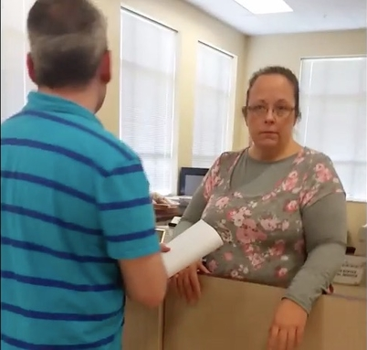
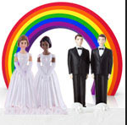

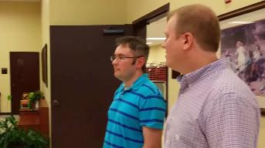
كيم ديفيس
(1 أيلول 2015)
Notes:
Scout FinchFollowRSS
Daily Kos staff
Wed Jul 08, 2015 at 01:39 PM PDT
Kentucky clerk filmed refusing to issue marriage license to same-sex couple
by Jen HaydenFollow
24 Comments / 24 New
attribution: screenshot from video
It's our belief Kim Davis needs a new job that is more suited to her personal convictions.
David V. Moore and David Ermold have been together for 17 years and have lived in Rowan County, Kentucky, for the last 10 of those years together. With the Supreme Court ruling in hand (they literally brought a copy of it with them, along with a letter from Governor Beshear directing clerks to issue licenses), they walked into the County Clerk's office to get their marriage license. And that's when they ran into trouble as staffers in the clerk's office first ignored them entirely, then rudely told them to go to another county while onlookers began mocking them. Rowan County Clerk Kimberly Davis is at the center of a lawsuit filed by the ACLU for refusing to issue the marriage licenses.
"It's a deep-rooted conviction; my conscience won't allow me to do that," Davis told The Associated Press. "It goes against everything I hold dear, everything sacred in my life." Davis is an elected employee who swore an oath of office to uphold the laws of Kentucky, which now provides for same-sex marriages. It is her duty to issue these licenses and if she is not up to the task, it is probably time for her to move along to a job more suited to her beliefs. For what it's worth, Kimberly Davis is a Democrat and won her primary in 2014 by a mere 24 votes. Her mother, Jean Bailey, preceded Kimberly in the very same elected position for more than 30 years before retiring.
A friend of the couple came along to film the interaction. Someone in the clerk's office even called the police to intimidate the couple as they patiently waited their turn to speak with the clerk, who demanded they stop filming, even though it was their legal right to do so. WATCH the video…
http://www.dailykos.com/story/2015/07/08/1400496/-Kentucky-clerk-filmed-refusing-to-issue-marriage-license-to-same-sex-couple
Accessed 2 Sep 2015
A judge ruled that she must issue the license on 1 September 2015, but she also refused that day.

Slide 18
أشعياء 5: 20
ويل للقائلين للشر خيراً وللخير شراً الجاعلين الظلام نوراً والنور ظلاماً الجاعلين المر حلواً والحلو مراً

Slide 19
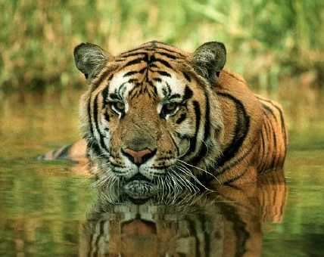
Animals
خلق الله .... اليوم ٦
448
وقال الله لتخرج الأرض ذوات أنفس حية كجنسها بهائم ودبابات ووحوش كأجناسها وكان كذلك فعمل الله وحوش الأرض كاجناسها والبهائم كأجناسها وجميع دبابات الأرض كأجناسها ورأى الله ذلك أنه حسن .
(تكوين ١: ٢٤-٢٥)

Slide 20
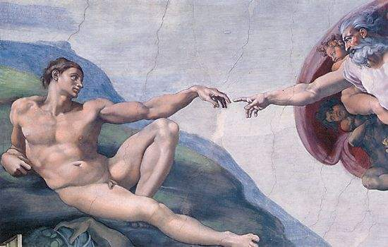
Man
خلق الله .... اليوم ٦
448
وقال الله نعمل الإنسان على صورتنا كشبهنا فيتسلطون على سمك البحر وعلى طير السماء وعلى البهائم وعلى كل الأرض وعلى جميع الدبابات التي تدب على الأرض
(تكوين ١ : ٢٦)
Notes:
______
ES-07-Dispensational Premillennialism-92
OS-01-Gen1-3-slide 91

Slide 21

المرأة
خلق الله .... اليوم ٦
فخلق الله الإنسان على صورته
على صورة الله خلقه
ذكراً وأنثى خلقهم (تكوين ١ : ٢٧)
Notes:
______
ES-07-Dispensational Premillennialism-93
OS-01-Gen1-3-slide 92

Slide 22

Mandate
448
وعلى طير السماء
وباركهم الله وقال لهم أثمروا واكثروا واملأوا الأرض وأخضعوها
وتسلطوا على سمك البحر
وعلى كل حيوان يدب على الأرض (تكوين ١ : ٢٨)
Notes:
______
ES-07-Dispensational Premillennialism-94
OS-01-Gen1-3-slide 93

Slide 23
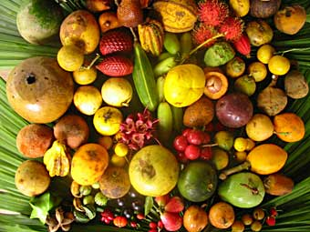
Food
وقال الله إني قد أعطيتكم كل بقل يبزر بزراً على وجه كل الأرض وكل شجر فيه ثمر يبزر بزراً لكم يكون طعاماً (٢٩)

Slide 24
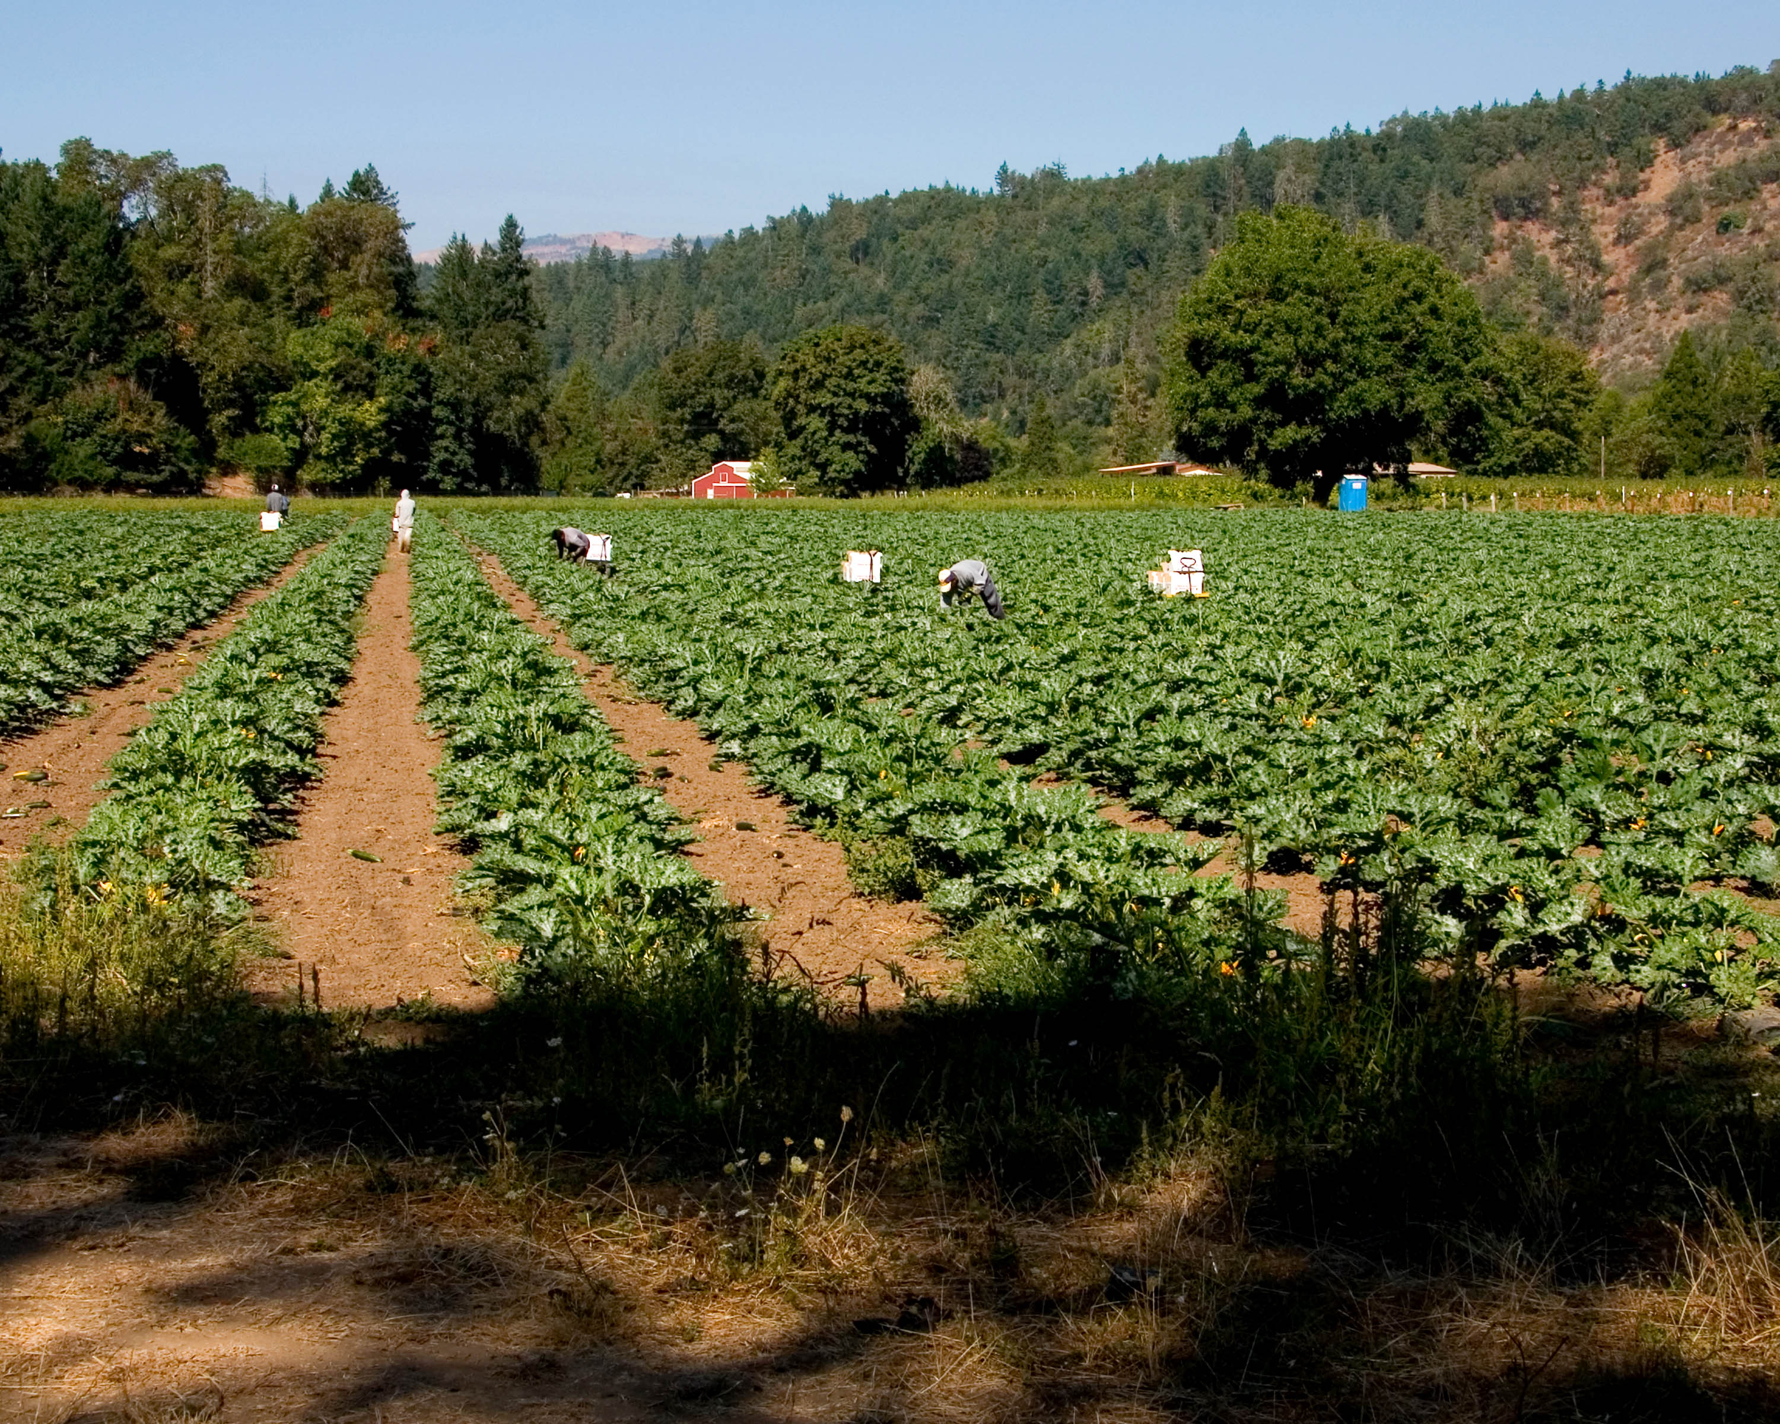
Food
ولكل حيوان الأرض وكل طير السماء وكل دبابة على الأرض فيها نفس حية أعطيت كل عشب أخضر طعاماً (30)

Slide 25
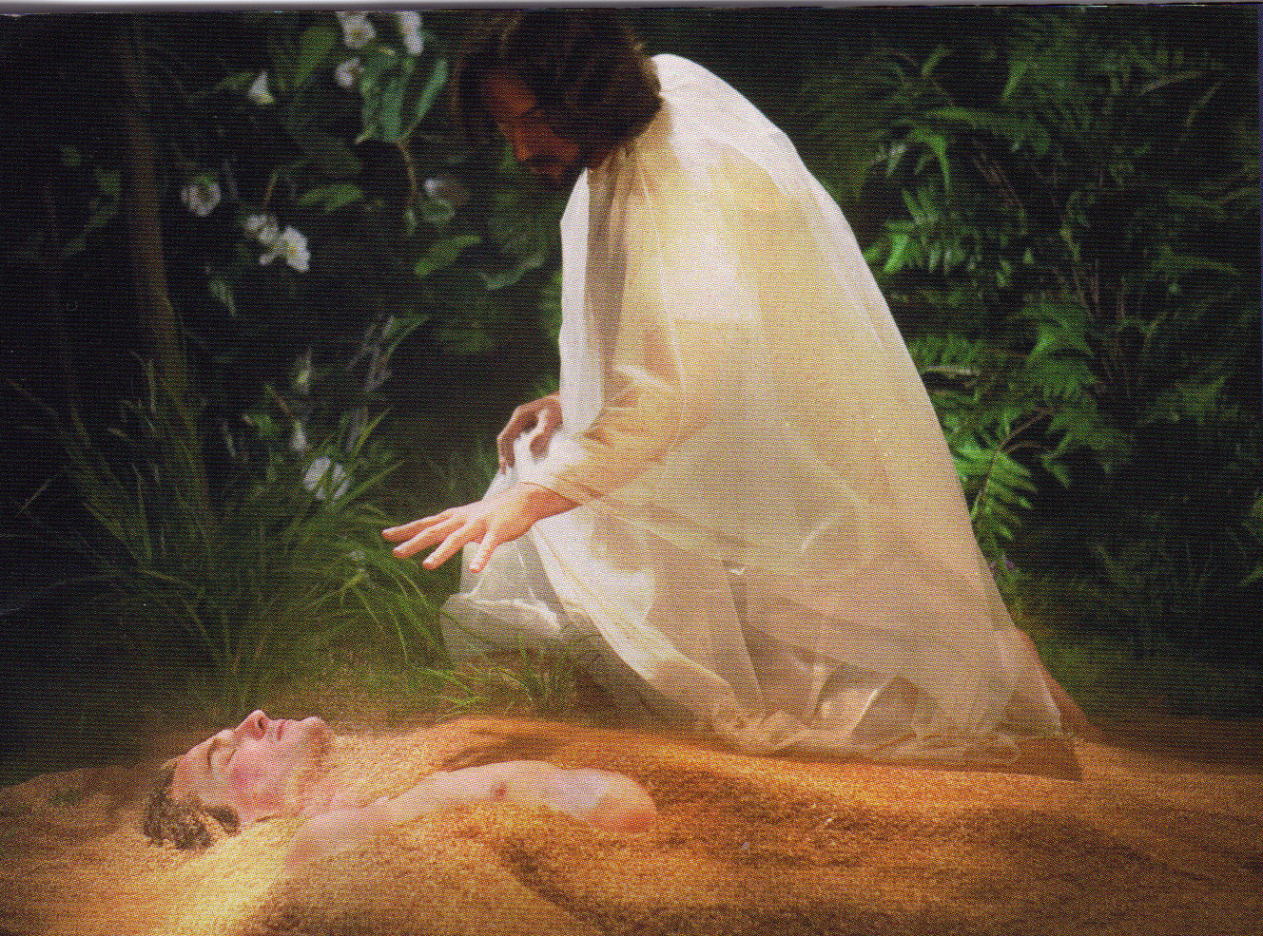
شكل يسوع آدم من التراب
(يو 1 : 3, تك 2 : 7)

Slide 26
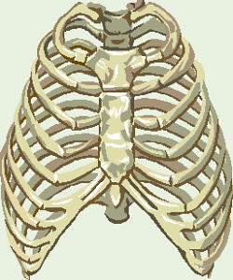
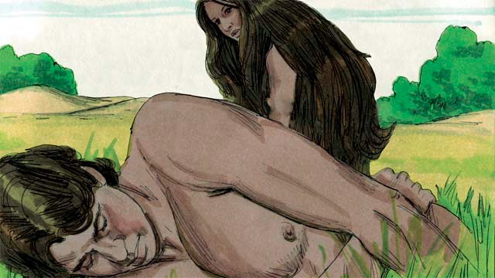
Gen. 2:22 NAS
وبنى الرب الإله الضلع التي أخذها من آدم امرأة وأحضرها إلى آدم
تكوين 2 : 22
Notes:
My definition of woman = the very best "spare rib" the world has ever known!
Eve was also a miraculous creation of God from Adam.

Slide 27
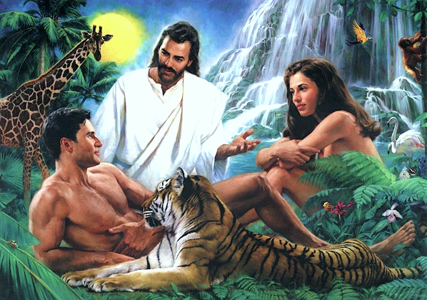
خلق يسوع
آدم وحواء
(تك2 : 21 – 23,
يو 1 : 3)

Slide 28
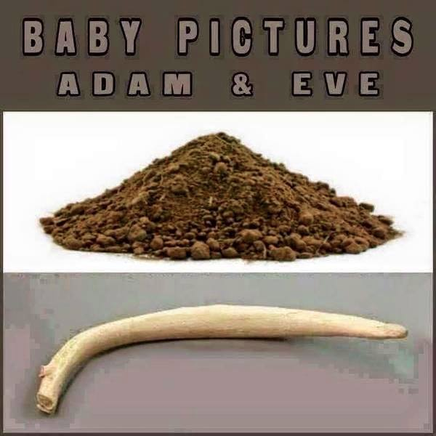
من هذا؟
Notes:
Do you recognize these? Do you know what these are? They are baby pictures!
One woman noted, "Sure God created man before woman, but then again you always make a rough draft before creating the final masterpiece."
(http://cher-homespun.blogspot.sg/2011/06/firewater-friday-sure-god-created-man.html accessed 15 August 2015)

Slide 29
صورة الأطفال آدم وحواء
Notes:
Do you recognize these? Do you know what these are? They are baby pictures!
One woman noted, "Sure God created man before woman, but then again you always make a rough draft before creating the final masterpiece."
(http://cher-homespun.blogspot.sg/2011/06/firewater-friday-sure-god-created-man.html accessed 15 August 2015)

Slide 30
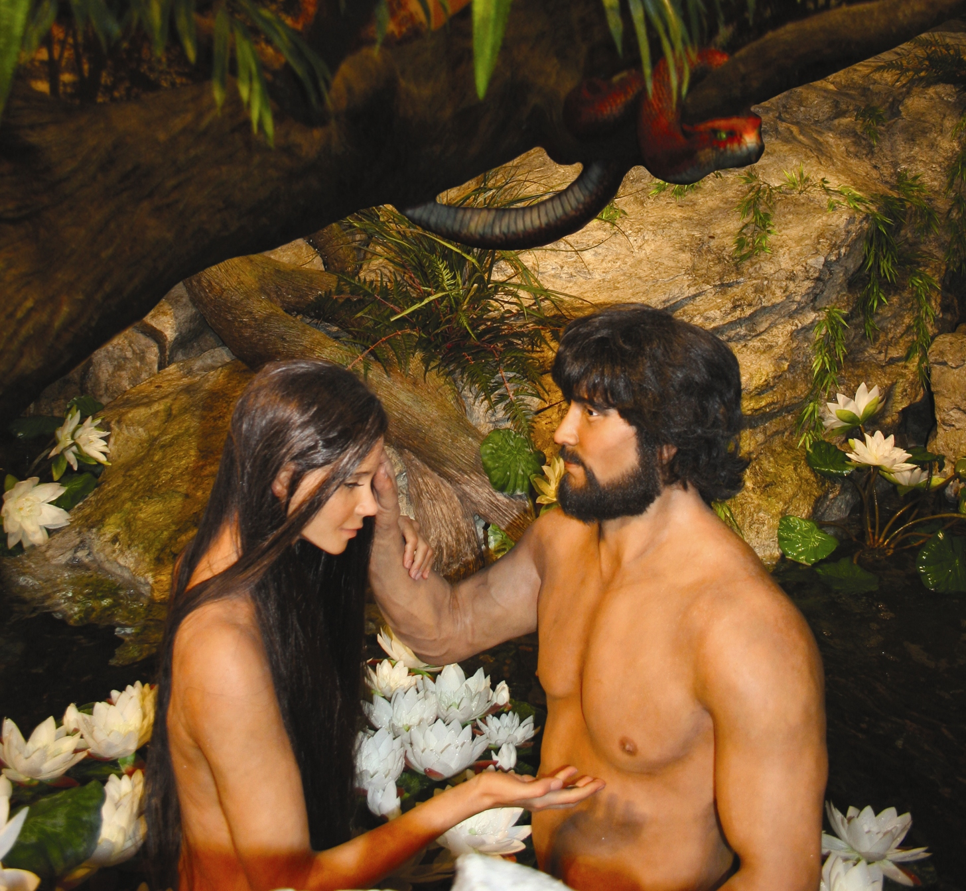
آدم وحواء مع الحية
Notes:
30

Slide 31
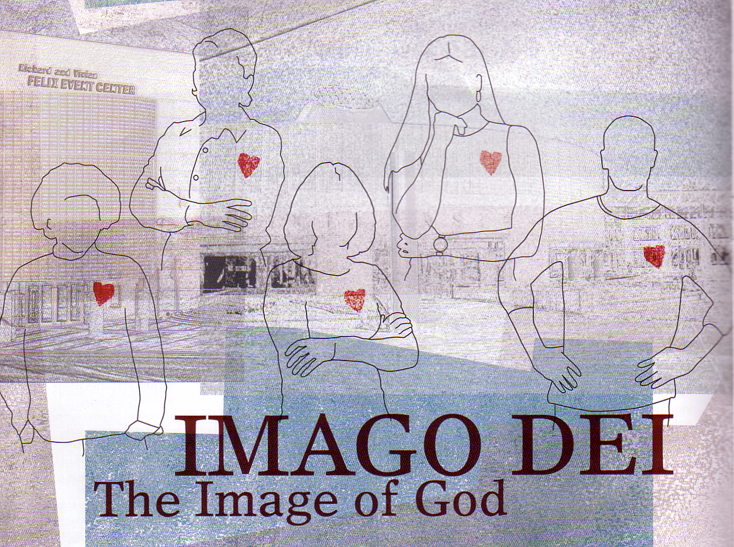
The Image of God
35
ما هو ؟
البشر متميزين عن الحيوانات :
* حق حكم الخليقة (1 : 26)
* كرامة البشر (9 : 6)
* القدرة على التواصل مع الله (2 : 16 وما يليها)
Notes:
God made man in his own image: (1) to rule creation, (2) with dignity, and (3) able to relate to him.

Slide 32
Black

Slide 33


الرابط للعرض التقديميِّ "دراساتٌ نقديَّةٌ في العهد الجديد" متاحٌ على الموقع الإلكترونيّ:
BibleStudyDownloads.org
أحصل على هذا العرض التقديمي مجاناً
Notes:
NC NT Criticism (nc) Arabic
_____________
Common-32

