Slide 1
السابقية
474
د. ريك جريفيث • مؤسسة الدراسات اللاهوتية الأردنية • BibleStudyDownloads.org • تم تحريره من عرض تقديمي قدمه جوشوا دانييل رونجسونج وبيني كويك وجوني سياو
Notes:
_________
NC-13-Preterism-1
NS-27-Rev20-22—slide 367

Slide 2
1. مقدمة
475

Slide 3
70 م
475
ضيقة؟
Notes:
What is meant by the term "Tribulation"? Is it the burning of Jerusalem's temple in AD 70?

Slide 4
غير قادر على إيجاد مكان اصطفاف
475
ضيقة؟
Notes:
Sometimes we use the term loosely even to describe not being able to find a parking space!

Slide 5
11 / 9
475
ضيقة؟
Notes:
Certainly, 9/11 was a tribulation for the Americans.

Slide 6
تسونامي
475
ضيقة؟
Notes:
And the tsunami of 26 Dec 2004 was a great trial for those who endured it.

Slide 7
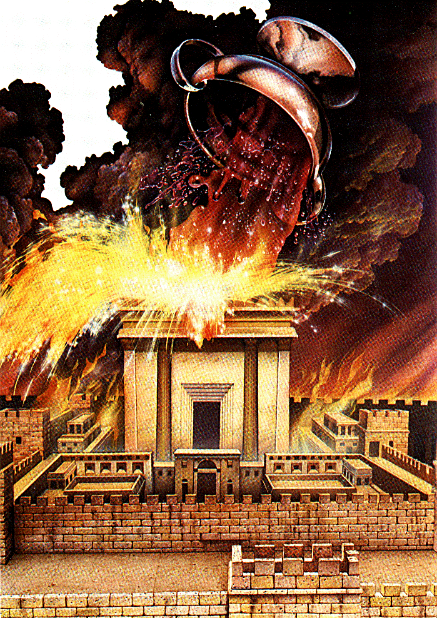
دينونة الجامات
475
ضيقة؟
Notes:
Whereas others will use the term only for the bowl judgments of Rev 6.

Slide 8
أربع وجهات نظر أخروية رئيسية
475
السابقية | الماضي
التاريخية | الحاضر
المستقبلية | المستقبل
المثالية | زمن غير محدد
Notes:
When speaking about the biblical prophecies and the timing of tribulation in history, there are four possibilities to which time is being referred:
Preterism – the tribulation is “past”
Historicism – the tribulation is “present”
Futurism – the tribulation is “future”
Idealism – the tribulation is “timeless”
In a very brief way of summarizing these four views, the preterist (the Latin word, meaning “past”) believes that most, if not all, prophecy has already been fulfilled during the destruction of Jerusalem in A.D. 70. The historicist (remember we said this is “present”) sees much of the current church age as part of the tribulation period. In other words, the prophecies in the Bible are being fulfilled right now. This may overlap with the view of the idealist as well.
The futurist, on the other hand, usually believes that most of the prophetic events will take place in the future. To him, the tribulation of the seven years, the Second Coming of Christ, the 1000-year millennium as well as the eternal state are all future events. The idealist does not believe that the prophecies in the Bible have timing for the events nor does it believe that one can determine the timing of these prophecies. They see prophetic passages as teachings of great truth about God and are to be used as an application to our present lives.

Slide 9
التعريف
475
وجهة نظر أخروية ترى أن معظم أو كل النبوة الكتابية قد تمت في وقت ما في الماضي(القرن الأول الميلادي بعد موت المسيح، عند دمار أورشليم في 70 م)
Notes:
Preterism is an eschatological viewpoint that sees most or all of Bible prophecy as being fulfilled sometime in the past. In other words, preterism holds that some or all of the Bible prophecies concerning the end times were fulfilled in the 1st century AD after the death of Christ, at the destruction of Jerusalem in A.D. 70. Those who believe in Preterism are called Preterists.

Slide 10
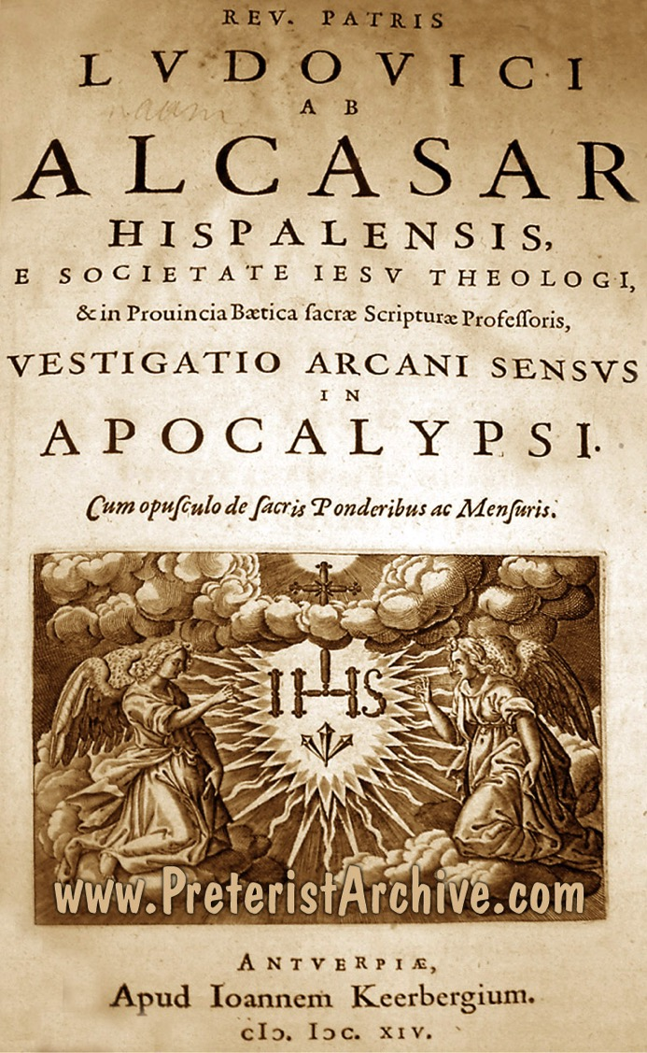
التاريخ
475
كُتِب أول تفسير نظامي سابقي للنبوة من قبل لويس دي آلكاسار في 1614
جونسون
Notes:
Historically, there is a general agreement that the first systematic Preterist exposition of prophecy was written in 1614 by the Spanish Jesuit named Luis De Alcasar.
—Alan Johnson, “Revelation.” In Expositors Bible Commentary, Vol. 12, Edited by Frank E. Gaebelein, 397-603 (Grand Rapids: Zondervan, 1981), 409.

Slide 11
كينيث ل. جينتري، الإبن
475
كلمة preterist مأخوذة من المصطلح اللاتيني praeterotus والتي تعني مَرَّ أو سابق. تحمل كلمة السابق فكرة أن نبوات الضيقة (في متى ورؤيا) حدثت في القرن الأول.
Notes:
Kenneth Gentry, a modern preterist, has defined preterism as follows: “The word ‘preterist’ is based on the Latin term praeteritus, which means ‘gone by,’ or past. Preterism holds that the tribulation prophecies (of Matthew and Revelation) occurred in the first century, thus in our past.”
The view of the Preterist is not new to the prophetic debate. Proponents of Preterism argue that this position was the original eschatological understanding of the early Christian church. This claim, of course, is contested by the historicists and others as well. Some other Preterists, however, hold that the view was developed in the 17th century. This brings us to the variants of Preterism but this shall be introduced in just a short while.
Kenneth Gentry claimed that the preterist view had a powerful influence in the last few centuries and many writings by famous scholars such as John Calvin (1509-1564), Hugo Grotius (1583-1645), Henry Hammond (1605-1660), Thomas Scott (1747-1821), Moses Stuart (1780-1852) and Milton Terry (1840-1914) have been found.
Kenneth L. Gentry Jr. & Thomas Ice, The Great Tribulation: Past or Future? (Grand Rapids: Kregel, 1999), 13.
—Kenneth L. Gentry Jr. & Thomas Ice, The Great Tribulation: Past or Future? (Grand Rapids: Kregel, 1999), 13.

Slide 12
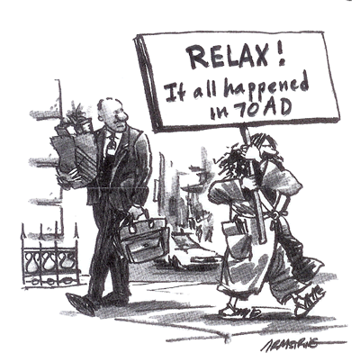
أنواع السابقية
476
السابقية المتطرفة
(أصحاب التتميم السابق الراديكالي/الكامل/
المتناسق) يرون أن الضيقة، القيامة،
المجيء الثاني والدينونة كأحداث سابقة
السابقية الخفيفة
أدان الله اليهود (70 م) وروما (313 م)
ولا زالوا يتطلعون لمجيء المسيح ثانية
السابقية المعتدلة
(التتميم السابق الجزئي(– تقريباً كل النبوات قد تمت في 70 م،
المجيء الثاني المستقبلي
Notes:
Preterists can be classified into three broad categories. There are the Extreme Preterists, the Mild Preterists and the Moderate Preterists
Extreme Preterists: They are also known as Radical Preterists, Full Preterists or Consistent Preterists. They believe that all events predicted in the Scripture, including the Second Coming, the resurrection of the dead and the final judgments have already taken place. Sproul writes concerning them, “Radical Preterism sees all future prophecies of the New Testament as having already taken place.” The Moderate Preterists and the non-Preterists see Radical Preterists as outside of Christian orthodoxy.
Mild Preterists: The Mild Preterists believe that the tribulation was fulfilled within the first 300 years of Christianity when God judged His two enemies: (1) the Jews in A.D. 70 and (2) Rome by A.D. 313. However, these adherents still look towards the future Second Coming of Jesus Christ.
Moderate Preterists: They are also known as Partial Preterists. They teach that almost all prophecies have been fulfilled in the destruction of Jerusalem in A.D. 70, but they also hold to a future Second Coming and bodily resurrection. Some of the proponents of Moderate Preterists are R C Sproul, Kenneth Gentry, etc.
Alan Johnson responds to the presupposition of the Preterists that Revelation 4-22 are events contemporary to John’s time, “This approach identifies the book with the Jewish apocalyptic method of producing ‘tracts for the times’ to encourage faithfulness during intense persecution.” It needs to be noted that even if these prophecies were written to bring comfort and encouragement to those who are going through suffering, it does not rule out the fulfillment of the prophetic contents of God’s word in the near or distant future.
For the sake of our presentation today, we will discuss some of the key issues that go across the various views of Preterists by analyzing their arguments and our responses.
Paul N. Benware, Understanding End Times Prophecy: A Comprehensive Approach (Chicago: Moody Publishers, 1995, 2006), 156.
R.C. Sproul, The Last Days According to Jesus (Grand Rapids: Baker Books, 1998, 2000), 24.
Benware, Understanding End Times Prophecy, 157.
Johnson, Revelation, 409. Johnson affirms that liberal interpreters have taken this particular methodology. He gives a bibliography of the books written by the Preterists and for further studies on Preterism, one can look it up at page 412.

Slide 13
2. حجج السابقية والرد عليها
476
Notes:
This presentation cannot cover all the views for supporting the Preterists of various forms, but we will highlight a few critical areas that would be important for our discussion.

Slide 14
أ. الدليل الخارجي
476
من الأمور الحاسمة لموقف االسابقية المتطرفة هو أنهم بحاجة إلى تأريخ سفر الرؤيا قبل عام 70 م
Notes:
A. The dating of Revelation: External evidence
Critical to the position of the Radical Preterists is that they need to hold the dating of Revelation before A.D. 70 to affirm that all the prophecies of the book of Revelation and the Olivet Discourse of Matthew 23–24 have been fulfilled by A.D. 70. It is also important to note that Preterists believe that “when John wrote Revelation, it was prophecy.” Benware, Understanding End Times Prophecy, 164.

Slide 15
ادعاء راديكالي
476
تأريخ سفر الرؤيا من قبل آباء الكنيسة هو تأريخ خاطئ
ديفيد تشيلتون
Notes:
David Chilton supported an early dating of Revelation based on the conclusion that the “second-century church Father Irenaeus and most other ancient witnesses were wrong in dating the book.” Chilton further cites “Athanasius as proof of the canon’s completion by A.D. 70.” Thomas critiques Chilton’s view by writing, “Careful scrutiny of Athanasius’ quotation, his comment on Gabriel’s words in Daniel 9:24, reflects that Chilton’s interpretation of it is quite forced.”
——Robert L. Thomas, Revelation 1-7, Wycliff Exegetical Commentary, Vol.1 (Chicago: Moody, 1992), 21.
Ibid.

Slide 16
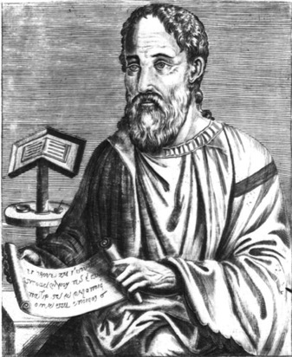
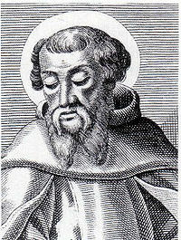
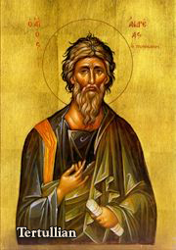
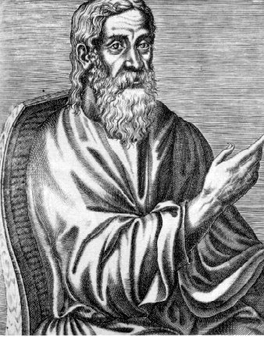
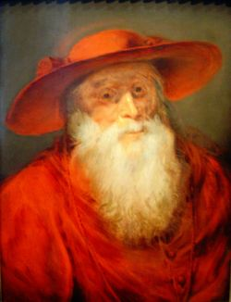
آباء الكنيسة والعلماء المعاصرون
الرد
476
يتفق آباء الكنيسة ومعظم العلماء المعاصرين على تاريخ 95/96 م
لا تعود ضيقة سفر الرؤيا إلى 70 م
Notes:
The traditional view of the dating of Revelation is around A.D. 95/96. Irenaeus states that the time when the apostle John wrote the book of Revelation was during the reign of the Roman Emperor Domitian. Eusebius quotes Irenaeus and confirms the same. Most of the early Church fathers agree with Eusebius and Irenaeus, such as Tertullian, Clement of Alexandria, Jerome and numerous others, also dating the book of Revelation in the reign of Domitian, the Roman Emperor. Beale affirms as well that “the difference of dating could alter the interpretation of the book, since the occasion prompting John to write might be different.” Thomas affirms the same that “most modern scholars concur” with the view that Revelation was written around A.D. 95/96.
With such a vast testimony to the dating of Revelation in the A.D. 90s, the Full Preterists’ basis of the argument that the tribulations of Rev. 6–19 (particularly the seal, trumpet, and bowl judgments as well as the “beast of the book of Revelation”) to have occurred during the time of Nero stands unjustified for the simple fact that Revelation was not yet written at that point of time.
The argument of the Full Preterists that the Second Coming, the resurrection of the dead, and the final judgment have taken place finds no scriptural support and most, if not all, of the other eschatological persuasions would deem the view held by them as unorthodox and unbiblical.
Eusebius, The History of the Church, trans. By G.A. Williamson (New York, Penguin, 1989), 81. Eusebius noted that “There is ample evidence that at that time the apostle and evangelist John was still alive.”
Benware, Understanding End Times Prophecy, 164.
G. K. Beale, The Book of Revelation: A Commentary on the Greek Text (Grand Rapids: Eerdmans, 1999), 4. Beale dated the book around 95 A.D. and affirmed that this is the current scholarly opinion. This view is held broadly across various eschatological views and there is a consensus on the same.
Thomas, Revelation 1-7, 21. He clarified that if Irenaeus had been wrong, later church fathers and witnesses would have corrected him. Aune also discussed the external evidence for the dating of Revelation in his introduction to his commentary on Revelation 1-5 and affirmed from early church fathers like Justin Martyr, Polycarp and others that the book has to be dated during the reign of Domitian. For further details see, David E. Aune, Revelation 1-5, Word Biblical Commentary, Vol.52 (Waco, Texas: Word Books, 1997), lviii-lx.

Slide 17
ب. الدليل الداخلي على تأريخ الرؤيا قبل 70 م
477

Slide 18
يرى أصحاب النظرة السابقية أن الهيكل في رؤ 11: 1-2 لا يزال قائماً
477
Notes:
In Revelation 11:1-2, according to the Preterists, John mentions the temple as standing when he was given the vision. So, in their view, if the temple was still standing when John recorded his vision, then the book of Revelation must have been written before the temple was destroyed in A.D. 70. Sproul, a moderate Preterist, does acknowledge that that “this is an argument from silence, but the silence is deafening.”
Kim Riddlebager, The Man of Sin: Uncovering the Truth about Antichrist (Grand Rapids: Baker Books, 2006), 181. Benware also advanced this as one of the three main arguments from the internal evidence that seems to favor the Preterist view of the dating of Revelation before A.D. 70. For further details, see Benware, Understanding End Times Prophecy, 167. Beale brilliantly covers the arguments and responds to the early dating based on internal evidence in his commentary (Beale, The Book of Revelation, 20-27). Beale responds based on his idealistic eschatological view that they were symbolic and that it does not refer to any literal temple, neither to Herod’s nor to any future temple.
R.C. Sproul, The Last Days According to Jesus (Grand Rapids: Baker Books, 1998), 147. Sproul admits that it would seem strange for the author of Revelation not to mention the destruction of Jerusalem had it been destroyed in A.D. 70 and the book was written in A.D. 96. This seems like a strong argument for the Preterists, but as we shall see, the internal evidence and the background setting of Revelation favors the dating of the 90s.

Slide 19
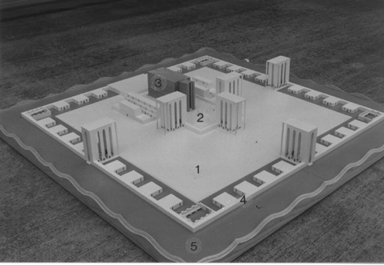
الرد:
477
رؤية الهيكل في حزقيال 40-48 أعطيت عندما كان هيكل أورشليم قد دُمِر. بنفس الطريقة فليس من الضروري للهيكل أن يكون موجوداً عند يوحنا
Notes:
The presuppositions of various eschatological viewpoints greatly affect one’s interpretation of the book of Revelation. This affects whether we see the book of Revelation symbolically, allegorically, literally, historically or as a mixture of some of these hermeneutical presuppositions. It is therefore beneficial to study the fulfillment of the OT texts, especially those that pertain to prophecy and how they have been fulfilled literally. For example, a literal fulfillment would see that kings would come from Abraham’s loins (Gen. 17:6) and Micah’s prophecy tells where Jesus would be born (Micah 5:2). Since there is literal fulfillment of OT prophecies, it would seem reasonable to assume a literal fulfillment of prophecies in the New Testament as well.
The simple response formulated by Benware seems to be the most appropriate. When Ezekiel had the vision of the Temple in Ezekiel 40–48, the temple in Jerusalem was already destroyed in 586 B.C. In the same way, it is not necessary for the temple to be standing for John to measure it. Herod’s temple was destroyed in A.D. 70 and John received this prophetic vision during the reign of Domitian. Hitchcock, after analyzing in detail the temple passages from Ezekiel, Daniel, and Revelation, concludes that John was not measuring Herod’s temple anyway: “In light of Revelation 11:3-13 and the parallels in Daniel and Ezekiel it is best to view the temple in Revelation 11:1-2 as a future, reconstituted temple.”
—Mark L. Hitchcock, ‘A Critique of the Preterist view of the Temple in Revelation 11:1-2,’ Bibliotheca Sacra 164 (2007): 219-236 (236).

Slide 20
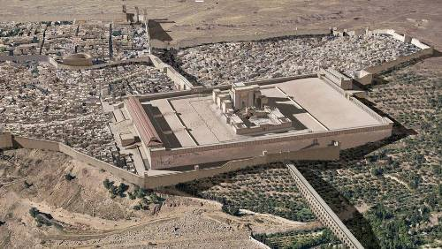
هل دُمرت أورشليم بحلول هذا الوقت؟
320
هل 11: 1-2 تعني أن الهيكل ما زال قائماً؟
1 ثُمَّ أُعْطِيتُ قَصَبَةً شِبْهَ عَصًا، وَوَقَفَ الْمَلاَكُ قَائِلًا لِي: «قُمْ وَقِسْ هَيْكَلَ اللهِ وَالْمَذْبَحَ وَالسَّاجِدِينَ فِيهِ.
2 وَأَمَّا الدَّارُ الَّتِي هِيَ خَارِجَ الْهَيْكَلِ، فَاطْرَحْهَا خَارِجًا وَلاَ تَقِسْهَا
لا ، هذا النص يشير إلى هيكل مستقبلي فعلي أثناء الضيقة.
هذه رؤية.
كذلك ، فإن الجامة السابعة (16: 17-21) لا يصور "المدينة العظيمة" على أنها مدمرة بالكامل إلى ما بعد عهد يوحنا ، لذلك كانت تتطلع إلى الدمار في المستقبل.
Notes:
_________
NC-13-Preterism-20
NS-27-Rev1 Intro-72

Slide 21
رؤيا 13: 18
478
يرى السابقيون أن الرقم 666 في
رؤيا 13: 18 هو نيرون، لذلك يجب أن يكون
سفر الرؤيا قد كتب في زمن نيرون.
Notes:
A second line of defense for the Preterists is the number of the beast, which is 666 in Rev. 13:18. This number is said to be the numerical value of Nero’s name and hence, Revelation must have been written during Nero’s time.
Benware, Understanding End Times Prophecy, 168.

Slide 22
الرد: التوجيه المستقبلي
478
تذكر رؤيا 1: 1 و4: 1 أن يوحنا (الكاتب) سيظهر له
مَا لَابُدَّ أَنْ يَكُونَ عَنْ قَرِيبٍ ومَا لَا بُدَّ أَنْ يَصِيرَ بَعْدَ هَذَا.
هذا يزيل أي شك في أن عدد الوحش يجب أن يكون مستقبلاً وليس ماضياً أو حاضراً.
Notes:
As discussed above, since Revelation was written in the A.D. 90s, this removes the possibility of linking the number of the beast back to Nero. Some eschatological groups that consider Revelation as history and not prophetic may also point it back to Nero as a possible point of argument. However, the statement in Rev. 1:1 and 4:1 which states that the author of Revelation would be shown “what must soon take place” or “what must take place after this,” shows that the number of the beast must be future and not past or present. This is one of the contextual arguments for Revelation 13:18 favoring a future view.
Secondly, as Benware points out, “nowhere in Scripture is any number given specific theological meaning.” The text surrounding Rev. 13 about the beast which exercises authority for “forty-two months” (Rev. 13:5) must be interpreted with other similar texts in Scripture. One must go to Daniel 9:24-27 and consider the context of that chapter. Nero did not exercise authority for just “forty-two months” and neither did any other Roman emperor in the first three centuries. Neither did “all inhabitants of the earth” worship Nero or other Roman emperors (Rev. 13:8). Hence Rev. 13:8 does not refer to Nero or any Roman emperor, but it has a future referent.
Benware, Understanding End Times Prophecy, 168. Benware, quoting John J. Davis, further explained that such methodologies of giving theological values is of Greek origin and finds its development primarily among the Gnostics, Neo-Pythagoreans, and Jewish allegorists. Furthermore, he also points to the inconsistency of the Preterists as to why they should take the number of the beasts literally whilst the other numbers and judgments in Revelation are taken symbolically or allegorically.

Slide 23
رؤيا 17: 10
478
يرى السابقيون أن الملوك السبعة هم سبعة ملوك رومان من القرن الأول. ثم يجادلون بأن الملك السادس هو نيرون.
Notes:
The third internal evidence for Preterists for dating Revelation before A.D. 70 is Rev. 17:10. Preterists see the “seven kings” as describing seven Roman kings from the first century. Then they argue that the sixth king is Nero.

Slide 24
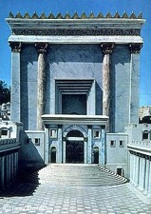
متى كتب يوحنا الرؤيا؟
320، 39-41
من كان الإمبراطور الروماني آنذاك؟
صلب المسيح 33 م
تدمير أورشليم
70 م
كتابة الرؤيا
95 م
طيباريوس
14-37
كاليجولا 37-41
كلوديوس 41-54
نيرو 54-68
فيسباسيان
69-79
تيطس 79-81
دوميتيان 81-96
يضع معظم علماء ما قبل الماضي السفر هنا
بدعم من: إيريناوس فيكتورينوس من بيتاو كليمان من الإسكندرية يوسابيوس
Notes:
Emperors in black persecuted Christians
This course teaches that Revelation was written during the reign of Domitian at the end of the first century.
Claudius expelled all Jews from Rome in AD 49, leaving a 100% Gentile church in Rome (Acts 18:2). But after Nero came to the throne five years later, Jews began to return. No doubt this caused problems within the church that had become more Gentile in terms of sacred days
(Rom 14:5-6a), food (Rom 14:6b), and other gray matters (Rom 14–15).
_______
NC-13-Preterism-24
NS-06-Romans1-2—slide 65
NS-21-1 Peter-63
NS-27_Rev1-slide 94
NS-27-Rev4-6-slide 36

Slide 25
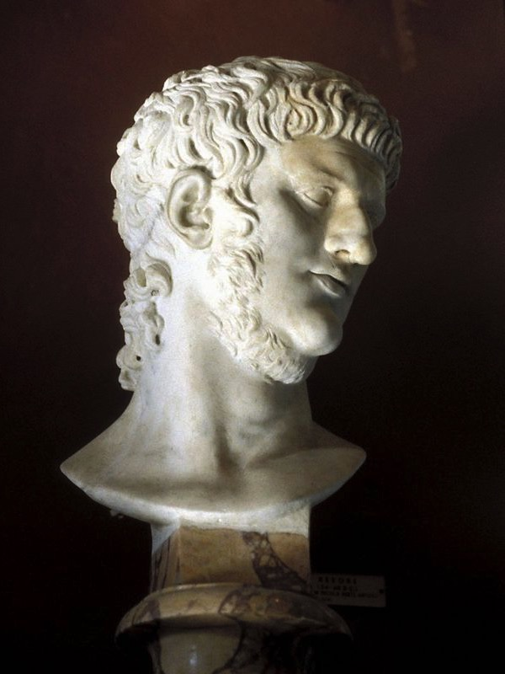
رد: لماذا لا يكون نيرون هو الـ 666؟
479
مارس نيرون السلطة
من 54 إلى 68 ميلادي
وليس 42 شهرًا
(رؤيا 13: 5).
لم يعبد جميع سكان الأرض نيرون (رؤيا 13: 8).
Notes:
The Preterist exegesis and hermeneutics become creative here. “In order for Nero to be the sixth king, certain kings were not counted.” They also ignore other scriptural texts like the prophecies of Daniel, which form the basis for this prophecy. Some do not want to connect Daniel’s prophecy with the book of Revelation as it weakens their theological persuasion. Osborne has a warning for such an approach to the Scripture. He writes, “Do not impose your theological system upon the text.” He further notes, “Non-dispensationalists stress the symbolic more.” It will be important to note that OT prophets repeat similar judgments on the nations and Israel, and similar language like the “day of the Lord” is commonly used. It would be hermeneutical suicide to ignore other Scriptures that bear high similarity, especially those that pertain to end times.
__________
Benware, Understanding End Times Prophecy, 169.
Grant R. Osborne, The Hermeneutical Spiral: A Comprehensive Introduction to Biblical Interpretation (Downers Grove: InterVarsity, 1991), 219.

Slide 26
العلاقة مع دانيال
479
دانيال 7: 1- 8 | رؤيا 13:1 -2؛ 17: 9- 12
أربعة حيوانات (أسد، دب، نمر، وحيوان هائل وقوي وله عشرة قرون) | وحش واحد مثل النمر، والدب، والأسد، (13: 2) وله عشرة قرون (13: 1؛ 17: 3)
سبعة رؤوس تمثل أربع ممالك متعاقبة | سبعة رؤوس تمثل سبع ممالك متعاقبة
أربعة ممالك | سبعة ممالك
عشرة قرون (العدد 7) | عشرة قرون (13: 1؛ 17: 3، 12)
مارك ل. هيتشكوك، "نقد لوجهة النظر السابقيّة لرؤيا 17: 9- 11 ونيرون،
مكتبة ساكرا 164 (يوليو - سبتمبر 2007): 484
Notes:
Hitchcock draws a parallel between Daniel and Revelation, showing successive kingdoms rather than interpreting them symbolically.
_________
OS-27-Daniel-312
NC-13-Preterism-24
NS-27-Rev13-19—slide 118

Slide 27
ثماني ممالك متعاقبة (17: 10 -11)
479
مصر (الفراعنة)
آشور (الملوك الآشوريون)
3. بابل الجديدة (نبوخذنصر)
4. مادي وفارس (كورش)
5. اليونان (الإسكندر الأكبر)
6. روما (القياصرة، الواحد)
7. إعادة توحيد الإمبراطورية الرومانية (عشرة ملوك، ليس بعد)
8. مملكة عالم الأمم النهائية (ضد المسيح)
مارك ل. هيتشكوك، "نقد لوجهة النظر السابقيّة لرؤيا 17: 9- 11 ونيرون،
مكتبة ساكرا 164 (يوليو - سبتمبر 2007): 484

Slide 28
المؤيدون لوجهة نظر الممالك المتعاقبة
479-480
تتجنب وجهة نظر الممالك المتعاقبة الطبيعة الغامضة لوجهة
النظر الرمزية وتتوافق مع صور العهد القديم من دانيال 7
وتقدم تفسيرًا متسقًا للملوك الثمانية. ولهذه الأسباب فهذه
هي وجهة النظر المفضلة. لذلك فإن رؤيا 17: 9- 11 لا تقدم
أي دعم للتاريخ المبكر لسفر الرؤيا على أساس فكرة أن
نيرون هو الملك السادس
مارك ل. هيتشكوك، "نقد لوجهة النظر السابقيّة لرؤيا 17: 9- 11 ونيرون،
مكتبة ساكرا 164 (يوليو - سبتمبر 2007): 484

Slide 29
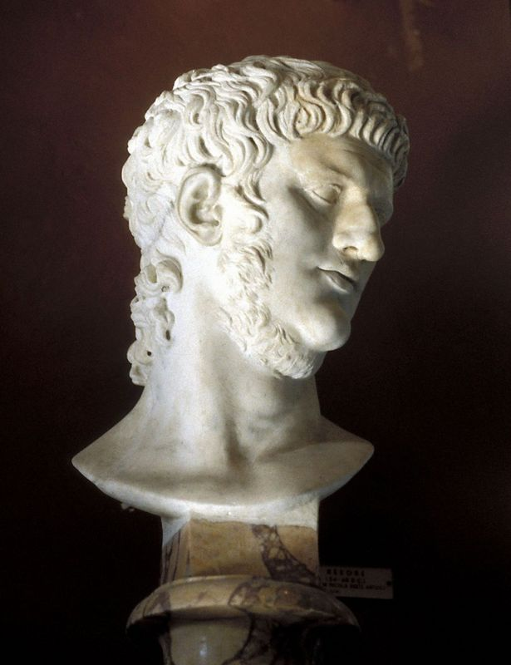
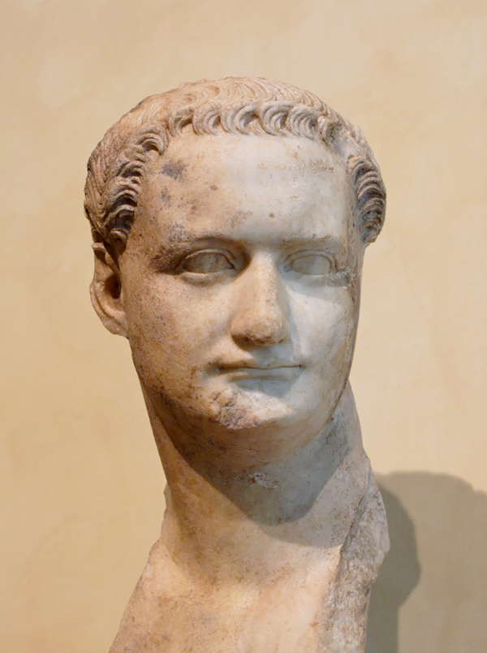
كما يؤكد بيّل أنه لا يوجد إشارة إلى نيرون أو دوميتيان في رؤيا 17: 10
480
نيرون (54 – 68 م)
دوميتيان (81 – 96 م)
Notes:
Rev. 17:10 has no reference to Nero or Domitian as Beale affirms. It is best to see it considering the book of Daniel and Rev. 1:1 and 4:1 as in the future.
Beale, The Book of Revelation, 870-875.

Slide 30
ت. توقيت تتميم نبوات سفر الرؤيا
480
يرى السابقيون أن كلمات عن قريب أو قريب مرتبطة بفترة زمنية قصيرة (رؤ 1: 1)
Notes:
It is very important to Preterists who accept the A.D. 96 dating for the book of Revelation that the prophecies will be fulfilled very soon. Their support lies in the phrase “must shortly take place” (Rev. 1:1, etc.). Preterists will see the words like “shortly” or “soon” to be relating to a short time and will see the fulfillment of the many prophecies of Revelation as taking place during the first three centuries. This helps them to conclude the prophetic fulfillment of Revelation in the first three centuries.

Slide 31
على كل حال فهم لا يستطيعون تفسير ها أنا آتي سريعاً (رؤ 2: 16، 3: 11، 22: 7، 12، 20)
480

Slide 32
صعوبات السابقيين
480
تفسيرهم ليس متناسق
تتطلب إبداع عظيم لإثبات أن يسوع قد جاء
Notes:
The Preterists are inconsistent in their arguments. On one hand, they reiterate the literal view of “shortly coming.” On the other, they cannot explain the phrase “I am coming quickly” (Rev. 2:16; 3:11; 22:7, 12, 20). All Preterists (other than the Full Preterist) await the Second Coming.
When Osborne writes, “Prophecies of future events occur frequently,” he is not just referring to an immediate future, but also to a distant future. A good example is the promise of the “seed” in Genesis 3:15 which was realized in Christ thousands of years later.
Secondly, they are not consistent in using the principles of hermeneutics as they use a literal understanding for phrases like “shortly,” while they employ symbolism for the Rev. 6–19 judgments within the same genre. Hitchcock argues from grammatical and syntactical analysis, concluding that the usage of words like “soon” in prophetic literature does not mean “immediate future” but it has the sense of the type of the “soon return of Christ” which can be distant future.
Thirdly, as noted above, bodily resurrection, the Second Coming and the “wrath of God” (Rev. 6:17) through the seal, trumpet, and bowl judgments have not occurred yet and are future events. For a commentator to see these judgments as symbolic and current ongoing events requires high creativity. They must also draw in a lot of extra-biblical sources and pagan background literature to back up their claims.
Osborne, The Hermeneutical Spiral, 212.
Mark L. Hitchcock, ‘A Critique of the Preterist view of “soon” and “near” in Revelation,’ Bibliotheca Sacra 163 (2006): 467-478 (470-473).

Slide 33
ث. توقيت تتميم متى 10: 23، 16: 28 و24: 34
480
Notes:
Important to the Preterists’ position is their understanding of the texts in Matthew. Matthew 10:23 says, “You shall not finish going through the cities of the land of Israel, until the Son of man comes.” In Matt. 16:28, Jesus declares to his listeners that some of them would “not taste death until they see the Son of Man coming in His kingdom.” These two verses coupled with “this generation” of Matt. 24:34 are understood by the Radical Preterists to “prove that the Lord had to have come in the first century.”
—Benware, Understanding End Times Prophecy, 173-174.

Slide 34
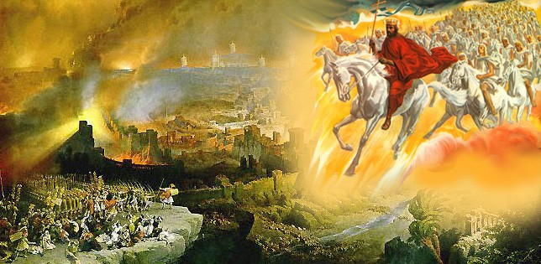
ادعائهم
480
يستخدم السابقيون الراديكاليون مت 10: 23 كدعم أن الرب يجب أن يأتي في القرن الأول. ومتى طردوكم في هذه المدينة فاهربوا إلى الأخرى. فإني الحق أقول لكم: لا تكملون مدن إسرائيل حتى يأتي ابن الإنسان

Slide 35
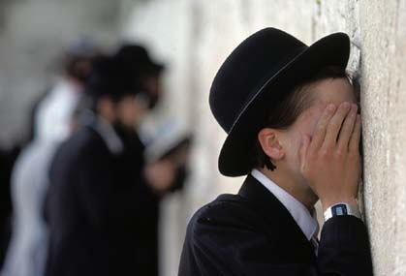
الرد
481 الجزء 1
إن تبشير أمة إسرائيل المتمردة لن ينتهي بواسطتهم بل سينتظر عودته وهي النقطة التي أشار إليها بولس (راجع رو 11: 25-29) والأنبياء (زك 12: 10)
بينوير
Notes:
The text in Matt 10:23 is understood in its larger context to mean “the evangelization of the rebellious nation of Israel will not be finished by them but will await His return, which is the point made by Paul (cf. Rom. 11:25-29) and the prophets (Zech. 12:10).” It is true that some portions of the text in Matt. 10:16-22 had been fulfilled in that generation. However, those persecutions cannot be equated with the tribulation of Revelation, which will initiate the millennium.
Benware, Understanding End Times Prophecy, 175.

Slide 36
يرى السابقيون الراديكاليون أن مت 16: 28 تقول أن يسوع سوف يأتي في نفس ذلك الجيل
481 الجزء 2
Notes:
The context of Matthew 16:28 is the “Son of Man coming in His kingdom.” In order to understand what kingdom Jesus is referring to, one must connect this with Matt. 22–25 and Revelation 19–20. Then this must be compared with OT texts like Isa. 9, 11; Daniel 2, 9 and the Davidic covenant in 2 Sam. 7.

Slide 37
إنه يشير في الواقع إلى الأشخاص الذين سيكونون أحياء جسديًا عندما يأتي يسوع في نهاية الزمان
481 الجزء 2
Notes:
Putting these texts together in their respective contexts, the “kingdom” refers to the unscheduled future after Daniel’s Seventieth Week and specifically refers to the millennium. The burden of proof lies with the Preterists to demonstrate the reality that the Son of Man has come. The text further says that we will “see” the Son of Man coming, and it is in our judgment that it has not taken place. This kingdom does not refer to the spiritual kingdom but one that will be established at the coming of the Son of Man.

Slide 38
يرى السابقيون أن هذا الجيل في مت 24: 34 هو ذلك الجيل نفسه الذي سمع يسوع
481 الجزء 3

Slide 39
End Times?
481 الجزء 3
هذا الجيل تشير إلى الفترة الزمنية عند حدوث مبتدأ الأوجاع (مت 24: 8)
تستمر حتى يكرز بالإنجيل في كل العالم (مت 24: 14)
رجسة الخراب التي تكلم عنها دانيال (مت 24: 15، راجع دا 9: 24-27) سوف تحدث
الضيقة العظيمة (مت 24: 21) سوف تحدث
أخيراً سوف يأتي ابن الإنسان (مت 24: 27)
Notes:
“This generation” of Matt. 24:34 does not refer to that generation who heard Jesus. Its preceding and following passages give the context of what Jesus was trying to say. “This generation” refers to a time when the “birth pain begins” (Matt. 24:8). It will continue until “the gospel is preached to the whole world” (Matt. 24:14), the “abomination of desolation” spoken of by Daniel (Matt. 24:15; cf. Dan. 9:24-27) has taken place, the “great tribulation” (Matt. 24:21) has happened and the “the Son of Man will come” (Matt. 24:27). There are partial fulfillments of this prophecy at the destruction of the Jerusalem Temple in A.D. 70, but it does not parallel the complete prophetic data given and hence, it awaits future fulfillment. This is consistent with prophetic literature, as the prophets would integrate immediate present prophecy with distant future prophetic utterances. A case in point would be Isa. 61:1ff, which Jesus Himself reads in Luke 4:18-19a but stops at “… to proclaim the year of the Lord’s favor” (Luke 4:19a; cf. Isa. 61:1-2a). He sees Isa. 61:2bff as future. This would not have been obvious to the Jews in the OT times. Hence to draw on Jewish “apocalyptic understanding” can be off tangent, considering the total revelation in the Canon.

Slide 40
ج. خطاب جبل الزيتون في متى 24-25
481
ينظرون إلى كل أو أغلب هذه النبوات على أنها تمت في خراب الهيكل عام 70 م
Notes:
Central to Preterist position is their interpretation of the Olivet Discourse of Matthew 24–25. They view all or most of these prophecies as fulfilled in the destruction of the Temple in A.D. 70. They would strongly depend on the phrase “this generation” of Matt. 24:34 to mean that generation who heard the Olivet Discourse. We have addressed some issues from Matthew above.

Slide 41
متى 24: 3
482
قل لنا متى يكون هذا؟
Notes:
Some important points to this text are addressed above. Some further contextual observations are necessary. Benware rightly points out that the preceding section of Matt. 23:35-39 clearly demonstrates Christ telling the Jews that the Jerusalem temple would be destroyed.

Slide 42
متى 24: 3
482
ما هي علامة مجيئك؟
Notes:
However, Matt. 23:39 also looks into the future to a time when Israel will welcome the Messiah. The OT prophets foresaw into the future a time when Israel, as a nation, would be restored to their land.
The texts are too numerous but we will highlight a few sample texts without priority or importance given to the order. Many texts see Israel restored in the future, such as Isa. 54 where God affirms an eternal covenant of peace. Ezekiel 36–48 sees Israel in the restored Temple worship. It is strange that we should bring our modern understanding into the text of this temple vision and make it symbolic. It needs to be noted that the vision of the ark and the holy place given to Moses was done exactly according to the given measurements (Exod. 39:32). It would seem even stranger to a non-Christian scholar to change the methodology of interpretation for Ezekiel’s vision of the temple within the same OT Canon.

Slide 43
متى 24: 3
482
.... وانقضاء الدهر؟

Slide 44
رجسة الخراب
482
يرى السابقيون هذا في 70 م على أيدي الرومان
Notes:
The “abomination of desolation” in Matt. 24:15 is seen to have occurred by the Preterists during the temple destruction in A.D. 70 by the Romans. However, Benware points out that the “differences between Matthew 24 and Vespasian’s destruction of the temple are great.” The incidence and the texts surrounding Matthew 24 and Daniel 9 need to be taken into consideration. The background to the text lies in the three questions posed by the disciples in Matt. 24:3.
—Benware, Understanding End Times Prophecy, 179.

Slide 45
لا يمكن أن يكون قد حدث
482
سياق متى 24
أنبياء العهد القديم يرونه كمستقبل.
دانيال 9 :27؛ 11 :31؛ 12 :11
Notes:
First, they ask Him, “Tell us, when will all these things take place?” “These things” refers to Matt. 24:1-2. The answers Jesus gave here move into the far distant future just the way Daniel had asked concerning the seventy years of captivity (Dan. 9:1-2). As he was praying and confessing (Dan. 9:20), the angel Gabriel came and revealed the plan of God till the “end of sin,” which brings “everlasting righteousness” (Daniel 9:24ff).
The second question was “what will be the sign of your coming?” (Matt. 24:3). Jesus responded by giving the signs of His Second Coming that highly parallel Daniel 9 and others.
The third question raised was, “What will be the end of the age?” These last two questions are interlinked, and this is the whole purpose of the Olivet Discourse. Deviation from the context of the disciples’ questions in dealing with these chapters will surely give one a wrong conclusion of the meaning of the text and the timing of its occurrence. The “abomination of desolation” is to be particularly understood with the breaking of the covenant at midpoint of the tribulation (Daniel 9:27) necessitating further outpouring of God’s wrath in the bowl judgments of Revelation. The “abomination of desolation” must not be confused with the destruction of Jerusalem in A.D. 70. The similarities must not mislead us into ignoring the differences between them. Differences, even if there was only one, must be given due consideration in prophetic literature.

Slide 46
مجيء المسيح
482
يقول السابقيون أنه قد جاء مع أنه لم يظهر بشكل منظور
Notes:
The coming of Jesus has been dealt with above. Preterists would see the “signs in heaven” of Matt. 24:29-31 as a dramatic way of expressing national calamity or victory in battle.” The dangers of such symbolism or allegorizing of the text are very much present in the “health and wealth” gospel today. Spiritualizing such texts would legitimize the modern-day gospel preachers and would do damage to the authority of the Scripture. It would then become a post-modernist way of looking at the text.

Slide 47
parousi,a—parousia (المجيء)
482
في العهد الجديد هذه الكلمة تعني دائماً حضور فعلي

Slide 48
يدعي السابقيون أن علامات السماء هي مجرد طرق درامية للتعبير عن علامات كونية مدهشة، كارثة وطنية أو انتصار في معركة (نهج غير معجزي)
482
Notes:
Footnote: Gentry and Ice, The Great Tribulation, 55. Their line of defense seems reasonable in light of OT texts like “the mountains quake at the presence of the Lord,” where in reality the mountains may not have quaked.

Slide 49
يدعون أنه لا يجب أخذ العلامات الكونية بشكل حرفي
482
Notes:
This line of argument is taken up by the Preterists. Gentry further comments, “Prophets often express national catastrophes in terms of cosmic destruction.”.

Slide 50
الردود
482
إنهم يرمزون النص
لا يؤخذ سياق العهد القديم بعين الإعتبار (يوئيل ٢)
Notes:
This point is well taken but what they fail to recognize is that the context of whether the cosmic disturbance is referring typologically to some national destruction, or it is actually referring to actual cosmic disturbances. Contextual understanding and usage of such words by the prophets in view of the culmination of history with texts in Daniel and Revelation would affirm a real occurrence of such cosmic disturbance of immense proportion. Matthew 24:21 makes it clear that this “great tribulation,” referring to great cosmic disturbances, is perfectly in tandem with Revelation judgments, which “has not been from the beginning of the world until now, no and never will be.” No doubt there have been great calamities such as the flood, destruction of Sodom and Gomorrah, the rise and fall of nations in history, world wars, Jewish massacre by Hitler and Stalin, the recent Tsunami and the 9/11 bombings. These have happened, but they are not the “tribulation” referred to in Revelation 6–19 and Matthew 23–24

Slide 51
التطبيقات
483
قيّم وجهات النظر الأخرى، لكن ...
عبد الرب لا ينبغي أن يخاصم (2 تيموثاوس 2: 24)
إن إعطاء تقييم نقدي لوجهات النظر الأخرى يلقي الضوء على وجهة نظرك الخاصة
علّم النص الكتابي
Notes:
Although there is a tendency for Preterists to be eclectic in their hermeneutical approach, we must not totally disregard their view. It can be helpful to see another interpretation or understanding of Scripture.
That understanding is not there for us to criticize or fight about but for us to learn to see things from a different angle than our own. Paul, in his second letter to Timothy, reiterated, “The Lord’s bondservant must not be quarrelsome” (2 Tim. 2:24). We must come to an understanding that there are many different views and doctrines, but the point is not for us to push through our own understanding and interpretation.
This view needs to be weighed to shed more light on our understanding. Perhaps it gives us an even firmer reason to stick to our own beliefs and understanding. Or does it throw doubt at us? If so, we should then be spurred to dig deeper into the Word of God for further study, understanding, and revelation.
As pastors or teachers, this can then ensure that we are teaching the Scriptures as it is (or at least the way we have understood it, having thought through and debated it) and not mislead others or have anything to do with “irreverent silly myths” or “worldly fables” as was warned by Paul in 1 Tim. 4:7.
We cannot undermine the importance of the future aspect of the Second Coming, the bodily resurrection and the impending future Day of the Lord. It can serve to encourage the believers to live pure, holy and reverent lives before the Lord and before men. It would also give hope in the present time when one goes through difficulties, sufferings and persecutions.

Slide 52
الخلاصة
482
التأكيد على أهمية:
المجيء الثاني
قيامة الأجساد
يوم الرب
اسهروا إذا لأنكم لا تعلمون في أية ساعة يأتي ربكم.
Notes:
This is what it means to live our lives on the “alert” as Jesus said in Matthew 24:42, where he warned, “Therefore be on the alert for you do not know which day your Lord is coming.”

Slide 53
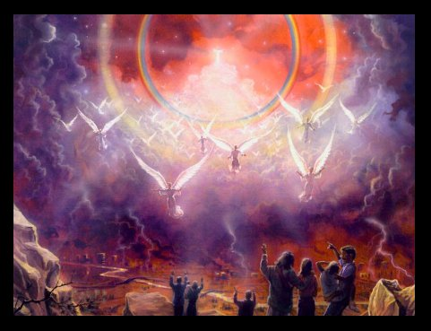
رؤيا ٢٢ : ٢٠-٢١
331
يَقُولُ الشَّاهِدُ بِهَذَا: نَعَمْ! أَنَا آتِي سَرِيعاً. آمِينَ. تَعَالَ أَيُّهَا الرَّبُّ يَسُوعُ. نِعْمَةُ رَبِّنَا يَسُوعَ الْمَسِيحِ مَعَ جَمِيعِكُمْ. آمِينَ.
Notes:
Hence, regardless of which eschatological stand we take, we should do exactly that. Be on the alert—live pure, holy and reverent lives, tell others about Jesus and tell them to do exactly the same!

Slide 54
Black
Notes:
BIBLIOGRAPHY
Aune, David E. Revelation 1-5. Word Biblical Commentary. Vol. 52. Waco, Texas:
Word Books, 1997.
Beale, G. K. The Book of Revelation: A Commentary on the Greek Text. Grand
Rapids: Eerdmans, 1999.
Benware, Paul N. Understanding End Times Prophecy: A Comprehensive Approach.
Chicago: Moody Publishers, 1995, 2006.
Eusebius. The History of the Church, trans. By G. A. Williamson. New York, Penguin,
1989.
Gentry, Kenneth L. Jr. & Thomas Ice. The Great Tribulation: Past or Future? Grand
Rapids: Kregel, 1999.
Hitchcock, Mark L. “A Critique of the Preterist view of ‘soon’ and ‘near’ in
Revelation.” Bibliotheca Sacra 163 no 652 (2006): 467-478.
_____. “A Critique of the Preterist view of the Temple in Revelation 11:1-2.”
Bibliotheca Sacra 164 no 654 (2007): 219-236.
_____. “A Critique of the Preterist view of Revelation 17:9-11 and Nero.” Bibliotheca
Sacra 164 no 656 (2007): 472-485
Johnson, Alan. “Revelation.” In Expositors Bible Commentary, Vol. 12.
Edited by Frank E. Gaebelein, 397-603. Grand Rapids: Zondervan, 1981.
Osborne, Grant R. The Hermeneutical Spiral: A Comprehensive Introduction to
Biblical Interpretation. Downers Grove: IVP, 1991.
Riddlebarger, Kim. The Man of Sin: Uncovering the Truth about Antichrist. Grand
Rapids: Baker Books, 2006.
The Holy Bible. English Standard Version. Illinois: Good News Publishers, 2001.
Thomas, Robert L. Revelation 1-7. Wycliffe Exegetical Commentary. Vol. 1. Chicago:
Moody, 1992.

Slide 55
Black

Slide 56
دراسات نقدية للعهد الجديد • BibleStudyDownloads.org
أحصل على هذا العرض التقديمي مجاناً
Notes:
NT Survey (ns)

