Slide 1

تحضير التلاميذ من قبل الملك
120-137
يخدم المسيح التلاميذ الإثنا عشر بشكل خاص ليعدهم لخدمتهم بعد رحيله
تلخيص القسم معتمد على ج. دوايت بنتيكوست، تناغم أقوال وأعمال يسوع المسيح (جراند رابيدز: زوندرفان، 1981)
د. ريك جريفيث • مؤسسة الدراسات اللاهوتية الأردنية • BibleStudyDownloads.org

Slide 2
ملخص كتاب بنتيكوست
تقديم الملك
أصالة الملك
جدل حول الملك
إعداد الإثني عشر من قبل الملك
مقاومة الملك
تحضير التلاميذ من قبل الملك
التقديم الرسمي للملك
التحضير لموت الملك
رفض الملك
قيامة الملك

Slide 3

زيادة الاستقطاب
القيامة
التحضير
لموت
تحضير
التلاميذ
إعداد
أصالة
تقديم
الجدل
مقاومة
التقديم
الرفض
Notes:
Today we discuss how Jesus prepared his men for his rejection and their future rejection too—so share with your group your own need to prepare those whom you lead to for future rejection, then pray about it together.
____________
The Life of Christ brought increasing polarization. The more Jesus showed about himself, the greater the resistance to him and his message. Also, the more intense the controversy leading to opposition, the higher priority Christ placed on preparing his men for when he would be gone. The climactic rejection when he presented himself as king of Israel at the Triumphal Entry resulted in rejection to the point of crucifixion followed by the victory of resurrection.
Introduction of the King
Authentication of the King
Controversy over the King
Instruction of the Twelve by the King
Opposition to the King
Preparation of the Disciples by the King
Official Presentation of the King
Preparation for the Death of the King
Rejection of the King
Resurrection of the King

Slide 4

فترات عظيمة في حياة المسيح
55
لأن ابن الإنسان أيضاً لم يأت ليُخدم بل ليخدم وليبذل نفسه فدية عن كثيرين (مرقس 10: 45)
الجليلي في ذروته
السامري المبكر
السامري المتأخر
اليهودي المبكر
اليهودي المتأخر
البيري المبكر
البيري المتأخر
الأحداث الإفتتاحية
الأحداث الختامية
التحضير
التأكيد
محاضرة السير عبر العهد الجديد (استخدمت بإذن)
Notes:
The Walk Thru outline of the life of Christ forms a chiasm or literary arrangement with repeating elements in the opposite order. This structure makes Confirmation parallel to Preparation, Closing Events parallel to Opening Events, etc. until the only event without parallel becomes the focus: Climatic Galilean. Such an arrangement of material was common in antiquity and is seen in both the OT (e.g., Zephaniah) and the NT (1 Thess) where the central teaching appears in the middle of each writing.
_______
LC-00-Syllabus-63
LC-01-Introduction-265
LC-05-Opposition-4

Slide 5
أ. الإنسحاب من اليهودية
120
يوحنا 10: 40-42
ينسحب المسيح من اليهودية حتى يموت صلباً في توقيت الله المعين بدلاً من الرجم مبكراً بيد الجمهور لأن كل أبواب الخدمة مغلقة في اليهودية وبذلك فهو يعلم تلاميذه كيف يخدمون بدلاً عنه
Notes:
Jesus had to die in Jerusalem at God's appointed time of Passover when the other Passover lambs were being slaughtered. To accomplish this, He withdrew from Judea as his men were also not ready for his departure.
__________
John 10:40 NLT He went beyond the Jordan River near the place where John was first baptizing and stayed there awhile. 41 And many followed him. “John didn’t perform miraculous signs,” they remarked to one another, “but everything he said about this man has come true.” 42 And many who were there believed in Jesus.

Slide 6
ب. تعليمات بخصوص دخول الملكوت
121
لوقا 13: 22-35
بما أن إسرائيل كأمة رفضت المسيح فهو يدعى أفراداً أن يقرروا بخصوصه وينعموا بالملكوت حتى يشجع هؤلاء الخائفين بسبب رفضه ويعد التلاميذ للخدمة المستقبلية
Notes:
Luke 13:22 Jesus went through the towns and villages, teaching as he went, always pressing on toward Jerusalem. 23 Someone asked him, “Lord, will only a few be saved?”
He replied,
24 “Work hard to enter the narrow door to God’s Kingdom, for many will try to enter but will fail. 25 When the master of the house has locked the door, it will be too late. You will stand outside knocking and pleading, ‘Lord, open the door for us!’ But he will reply, ‘I don’t know you or where you come from.’ 26 Then you will say, ‘But we ate and drank with you, and you taught in our streets.’ 27 And he will reply, ‘I tell you, I don’t know you or where you come from. Get away from me, all you who do evil.’
Luke 13:28 “There will be weeping and gnashing of teeth, for you will see Abraham, Isaac, Jacob, and all the prophets in the Kingdom of God, but you will be thrown out. 29 And people will come from all over the world—from east and west, north and south—to take their places in the Kingdom of God. 30 And note this: Some who seem least important now will be the greatest then, and some who are the greatest now will be least important then.”
Luke 13:31 At that time some Pharisees said to him, “Get away from here if you want to live! Herod Antipas wants to kill you!”
Luke 13:32 Jesus replied, “Go tell that fox that I will keep on casting out demons and healing people today and tomorrow; and the third day I will accomplish my purpose. 33 Yes, today, tomorrow, and the next day I must proceed on my way. For it wouldn’t do for a prophet of God to be killed except in Jerusalem!
Luke 13:34 “O Jerusalem, Jerusalem, the city that kills the prophets and stones God’s messengers! How often I have wanted to gather your children together as a hen protects her chicks beneath her wings, but you wouldn’t let me. 35 And now, look, your house is abandoned. And you will never see me again until you say, ‘Blessings on the one who comes in the name of the LORD!’”
Jesus quotes Psalm 118:26 after rejection by Israel to indicate that he would come back to a believing nation. In answer to the question how many will be saved (v. 26), Jesus said that few Jews would be saved but many Gentiles would accept him.

Slide 7
ت. تعليمات في بيت الفريسي
122
لوقا 14: 1-24
يعلم المسيح أن الفريسيين لن يدخلوا الملكوت بسبب علاقتهم الجسدية مع إبراهيم وإنما سيتم استبعادهم بينما اليهود غير المستحقين والأمم سيدخلون بالإيمان حتى يفهم الفريسيين أن التجاوب مع دعوة المسيح يضمن البركة وليس فقط مجرد الدعوة
Notes:
Jesus Heals on the Sabbath
Luke 14:1 NLT One Sabbath day Jesus went to eat dinner in the home of a leader of the Pharisees, and the people were watching him closely. ² There was a man there whose arms and legs were swollen. ³ Jesus asked the Pharisees and experts in religious law, “Is it permitted in the law to heal people on the Sabbath day, or not?” ⁴ When they refused to answer, Jesus touched the sick man and healed him and sent him away. ⁵ Then he turned to them and said, “Which of you doesn’t work on the Sabbath? If your son or your cow falls into a pit, don’t you rush to get him out?” ⁶ Again they could not answer.
Jesus Teaches about Humility
Luke 14:7 When Jesus noticed that all who had come to the dinner were trying to sit in the seats of honor near the head of the table, he gave them this advice: ⁸ “When you are invited to a wedding feast, don’t sit in the seat of honor. What if someone who is more distinguished than you has also been invited? ⁹ The host will come and say, ‘Give this person your seat.’ Then you will be embarrassed, and you will have to take whatever seat is left at the foot of the table!
Luke 14:10 “Instead, take the lowest place at the foot of the table. Then when your host sees you, he will come and say, ‘Friend, we have a better place for you!’ Then you will be honored in front of all the other guests. ¹¹ For those who exalt themselves will be humbled, and those who humble themselves will be exalted.”
Luke 14:12 Then he turned to his host. “When you put on a luncheon or a banquet,” he said, “don’t invite your friends, brothers, relatives, and rich neighbors. For they will invite you back, and that will be your only reward. ¹³ Instead, invite the poor, the crippled, the lame, and the blind. ¹⁴ Then at the resurrection of the righteous, God will reward you for inviting those who could not repay you.”
Parable of the Great Feast
Luke 14:15 Hearing this, a man sitting at the table with Jesus exclaimed, “What a blessing it will be to attend a banquet in the Kingdom of God!”
Luke 14:16 Jesus replied with this story: “A man prepared a great feast and sent out many invitations. ¹⁷ When the banquet was ready, he sent his servant to tell the guests, ‘Come, the banquet is ready.’ ¹⁸ But they all began making excuses. One said, ‘I have just bought a field and must inspect it. Please excuse me.’ ¹⁹ Another said, ‘I have just bought five pairs of oxen, and I want to try them out. Please excuse me.’ ²⁰ Another said, ‘I just got married, so I can’t come.’
Luke 14:21 “The servant returned and told his master what they had said. His master was furious and said, ‘Go quickly into the streets and alleys of the town and invite the poor, the crippled, the blind, and the lame.’ ²² After the servant had done this, he reported, ‘There is still room for more.’ ²³ So his master said, ‘Go out into the country lanes and behind the hedges and urge anyone you find to come, so that the house will be full. ²⁴ For none of those I first invited will get even the smallest taste of my banquet.’”
__________
"Throughout this section the theme of entering into the kingdom is often symbolized as taking part in a feast or banquet (13:29; 14:7-24; 15:23; 17:7-10)." —BKC

Slide 8
ث. تعليمات بخصوص التلمذة
123
لوقا 14: 25-35
يحذر المسيح بالنظر إلى رفض إسرائيل اشتراك تلاميذه في قرار إرادي برفض أي سلطة أخرى وحساب النفقة والتوحد مع المسيح حتى لا يدخل المرء حياة التلمذة ومن ثم ينشق
Notes:
The Cost of Being a Disciple
Luke 14:25 NLT A large crowd was following Jesus. He turned around and said to them, ²⁶ “If you want to be my disciple, you must, by comparison, hate everyone else—your father and mother, wife and children, brothers and sisters—yes, even your own life. Otherwise, you cannot be my disciple. ²⁷ And if you do not carry your own cross and follow me, you cannot be my disciple.
Luke 14:28 “But don’t begin until you count the cost. For who would begin construction of a building without first calculating the cost to see if there is enough money to finish it? ²⁹ Otherwise, you might complete only the foundation before running out of money, and then everyone would laugh at you. ³⁰ They would say, ‘There’s the person who started that building and couldn’t afford to finish it!’
Luke 14:31 “Or what king would go to war against another king without first sitting down with his counselors to discuss whether his army of 10,000 could defeat the 20,000 soldiers marching against him? ³² And if he can’t, he will send a delegation to discuss terms of peace while the enemy is still far away. ³³ So you cannot become my disciple without giving up everything you own.
Luke 14:34 “Salt is good for seasoning. But if it loses its flavor, how do you make it salty again? ³⁵ Flavorless salt is good neither for the soil nor for the manure pile. It is thrown away. Anyone with ears to hear should listen and understand!”

Slide 9
ج. تعليمات بخصوص فكر الله نحو الخطاة
124
لوقا 15: 1-32
بما أن الفريسيين يؤمنون أن الله يكره الخطاة ويبتعد عنهم فقد قدم يسوع ثلاثة أمثال ليوضح محبة الله للخطاة حيث يبحث عنهم ويفرح كثيراً في توبتهم
Notes:
LOST SHEEP—LOST COIN—LOST SON (Luke 15)
1—Something of value is lost
2—One who sees this value searches tirelessly to recover it
3—Once found, the owner rejoices and asks others also to rejoice
The focus is on God, whose attitude is to rejoice over the lost.

Slide 10
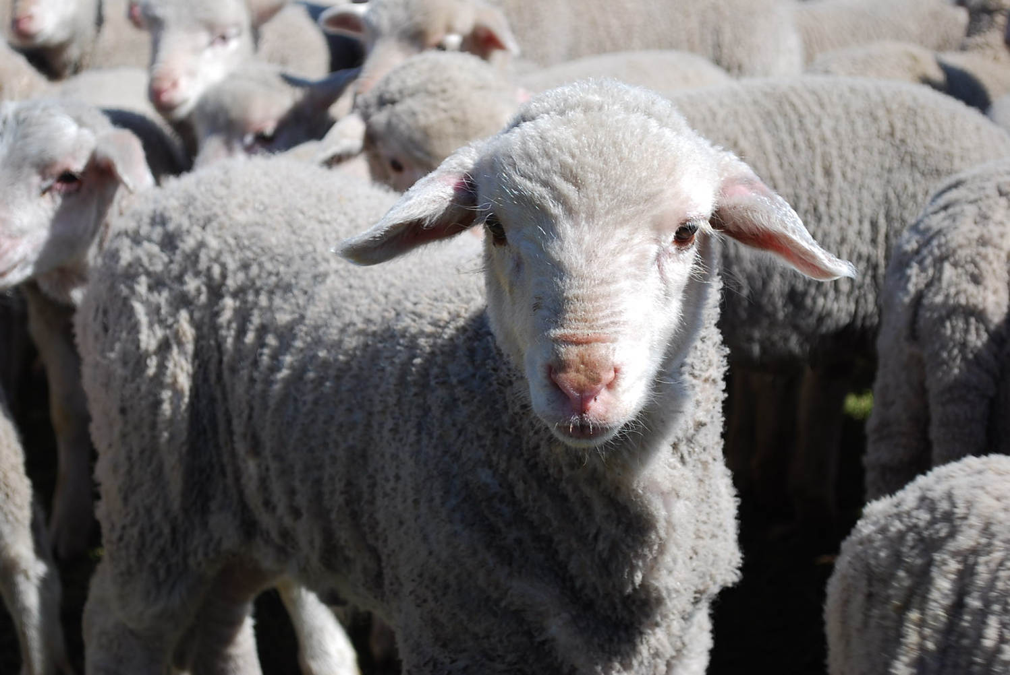
نحن خراف
Notes:
The animal that the Bible compares us to most is the sheep. Why do you think that is so?

Slide 11
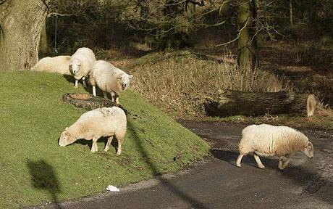
تميل الأغنام إلى الضلال
١ يوحنا
Notes:
It’s because sheep easily lose their way—like us!

Slide 12
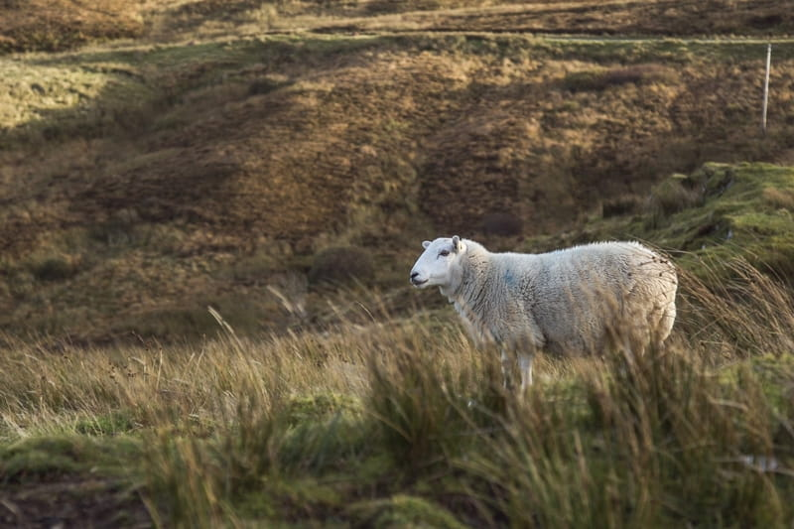
تصبح الأغنام الضائعة وحيدة
Notes:
الأغنام حيوانات علائقية، لذا فإن الابتعاد عن القطيع يجعلك وحيدًا.

Slide 13
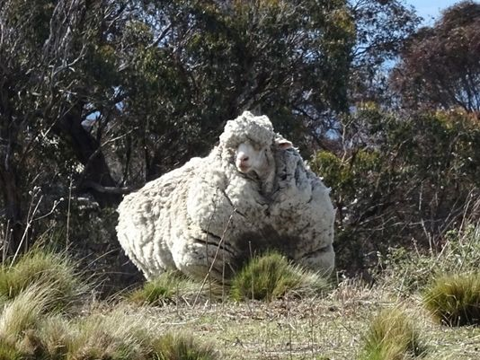
تميل الأغنام إلى العودة
Notes:
هذا أحد الخراف وأسمه كريس ضاع في أستراليا. في عام 2015 تم العثور عليه من قبل مشاة الأدغال بعد حوالي 6 سنوات من البحث. كما ترون صوفه الثقيل الذي يبلغ 90 رطلاً.

Slide 14
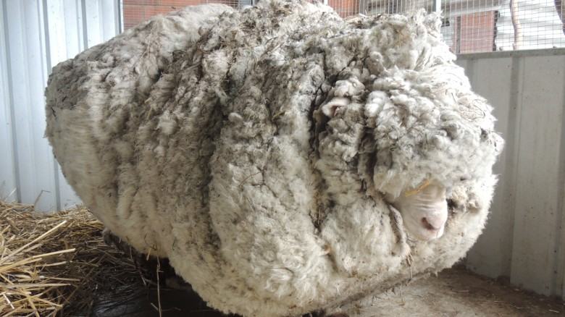
لكن الضلال له ثمن.
Notes:
إن عوائق الابتعاد تشكل عبئًا كبيرا، على الأغنان كما على الإنسان أيضًا.
مات كريس، الخروف المشهور بصوفه
بقلم إليزابيث وولف وسعيد أحمد، سي إن إن
تم التحديث في الساعة 1623 بتوقيت غربنتش، (0023 بتوقيت هونغ كونغ) 22 تشرين الأول 2019
مات الخروف كريس في موطنه Little Oak Sanctuary.
(CNN) عاس الخروف، إذا صح القول، حياة كاملة ورقيقة، محبوبًا من قبل جميع معجبيه في جميع أنحاء العالم بسب صوفه الفريد.
مات في موطنه في Little Oak Sanctuary. حيث كان يعيش منذ اعتلائه الشهرة في عام 2015.
في حين ينبغي تقدير كريس لصفاته المحبوبة العديدة – فكروا في عينيه اللطيفتين وأنفه المائل بلطف – فقد أصبح مشهورًا عالميًا بعد أن أصبح صاحب الرقم القياسي العالمي غير الرسمي في امتلاكه أكبر صوفٍ نامٍ.
تم العثور عليه خارج العاصمة الاسترالية، كانبيرا، مغطى بكمية من الصوف، ما يقرب من 90 رطلاً، حتى أنه بالكاد كان يستطيع المشي.
عندما تم العثور عليه، كان كريس يحمل على جسده ما يعادل سنوات من الصوف، مما جعل من الصعوبة عليه أن يمشي.
أعلنت Little Oak Sanctuary موت الخروف الأسطوري يوم الثلاثاء في في منشور على الفسبوك:
"نشعر بالحسرة لفقدان هذه الروح العذبة، والحكيمة، والودية،" كما جاء في المنشور.
حرصت Little Oak Sanctuary على النظر إلى كريس أكثر من مجرد عرض مبهر مع احترامه كرفيق.
"لقد كان أكثر من هذا بكثير، بل وأكثر من ذلك بكثير،" كما قال المنشور. "وسوف نتذكره على كل ما كان عليه – شخصًا، وليس شيئًا – هنا معنا، وليس من أجلنا. أرقد بسلام عزيزي كريس."
أولئك الذين يريدون إعلان الحداد على وفاة كريس أن يشاهدوا الصوف المعروض في المتحف الوطني الاسترالي.

Slide 15
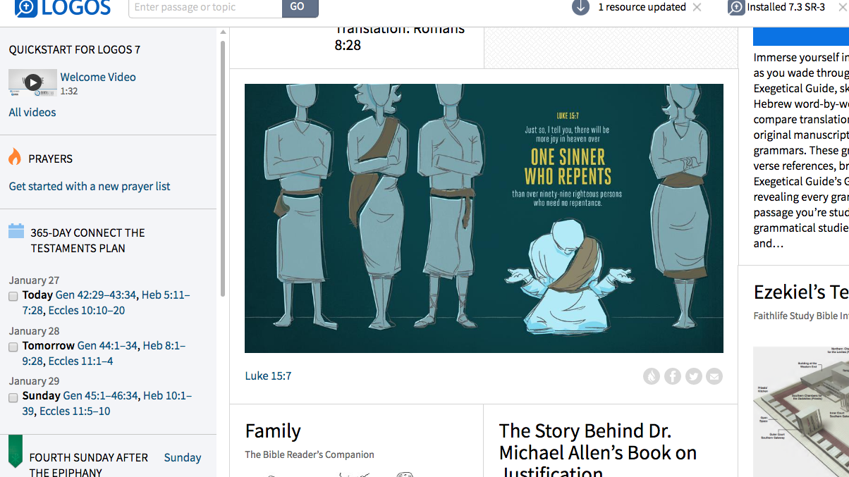
لوقا 15: 7
أقول لكم إنه هكذا
يكون فرح في السماء
بخاطئ واحد
يتوب
أكثر من 99 باراً
لا يحتاجون إلى توبة
Adapted from Logos Bible Software
Notes:
God values what people despise.

Slide 16
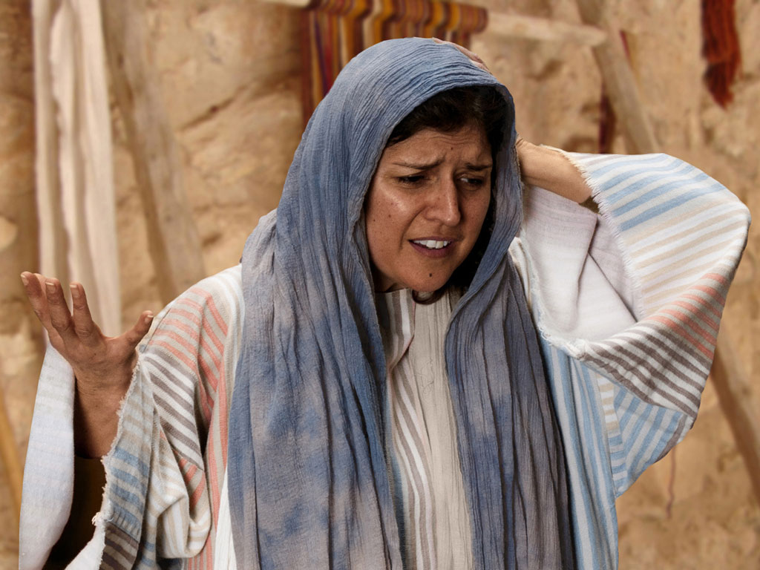

صور كتابية مجانية
مثل
الدرهم المفقود
لوقا 15: 8-10
Notes:
Luke's gospel is known for its many parables by Jesus.

Slide 17
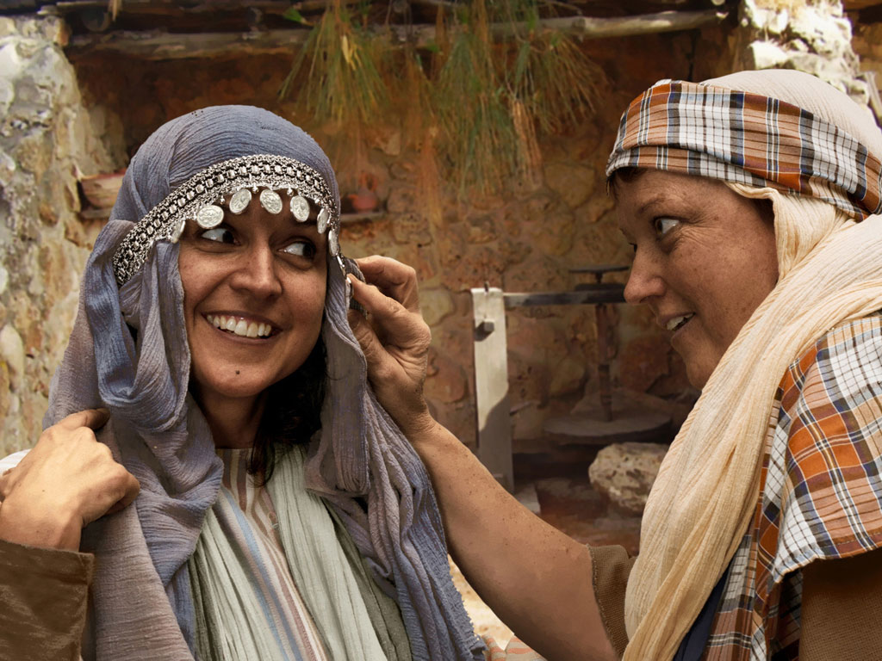
Notes:
Luke 15:8 Woman with 10 silver coins.
Most think that the silver coin (drachma) the woman lost was from the adornment of coins that women wore around her head and would have been her dowry. If so it was poor woman's dowry as a drachma was a day's salary for a peasant working for someone else. In the culture of the time, loss of a coin from a dowry could represent unfaithfulness and this would bring real shame and disgrace to her family and husband.

Slide 18
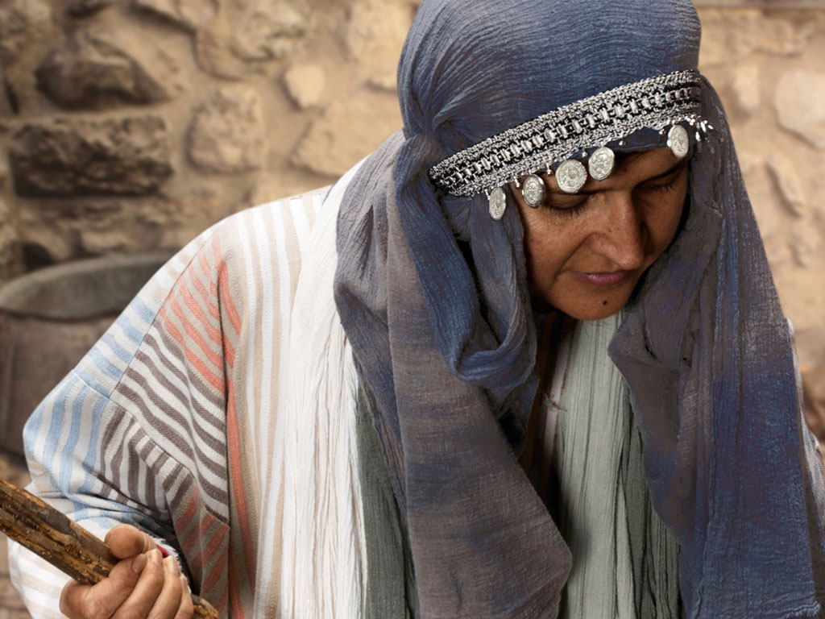
Notes:
Luke 15 v 8: Woman shown with coin missing.

Slide 19
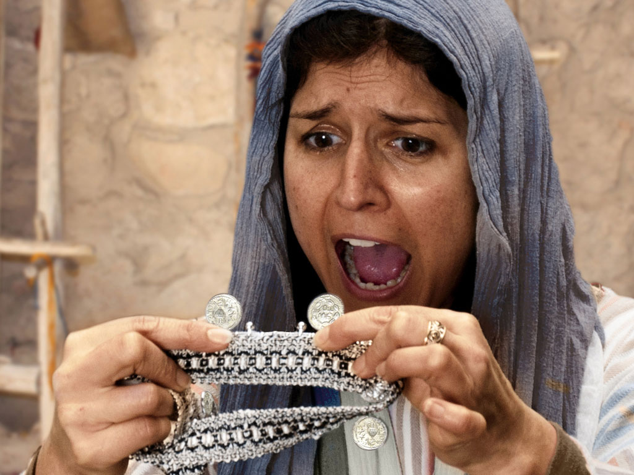
Notes:
Luke 15 v 8: Woman discovers a silver coin is missing.

Slide 20
Notes:
Luke 15 v 8: Woman wonders where she may have lost it.

Slide 21
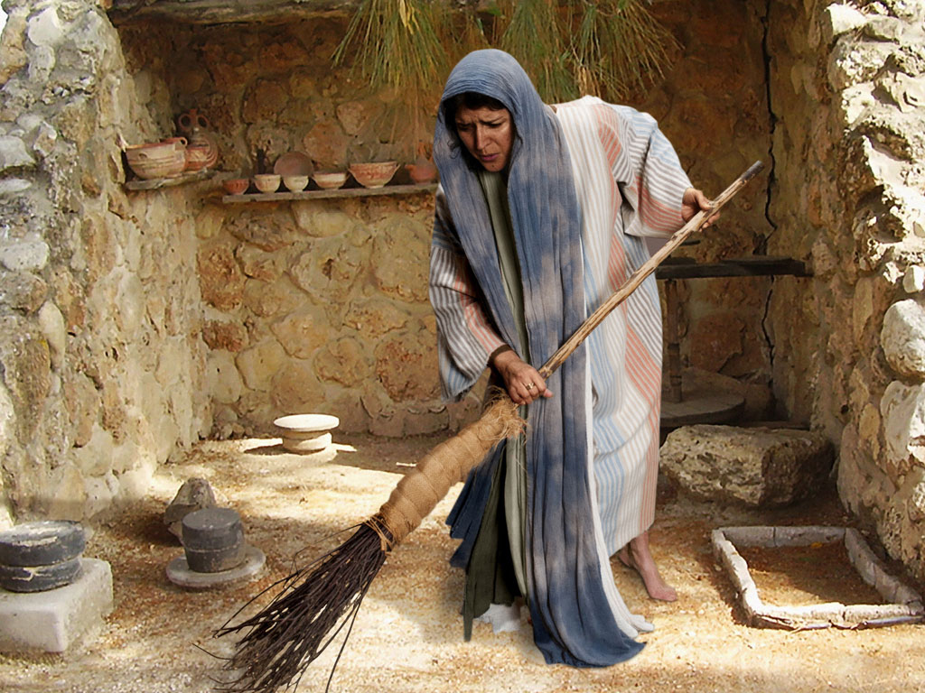
Notes:
Luke 15 v 8: Woman searches using broom.

Slide 22
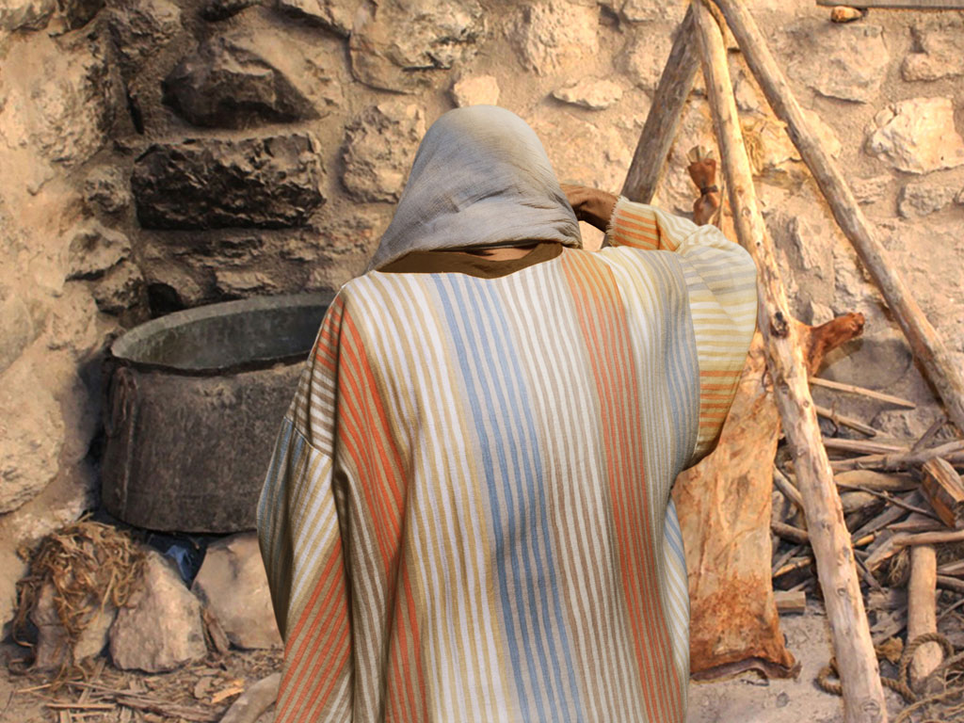
Notes:
Luke 15 v 8: Woman searches in courtyard.

Slide 23
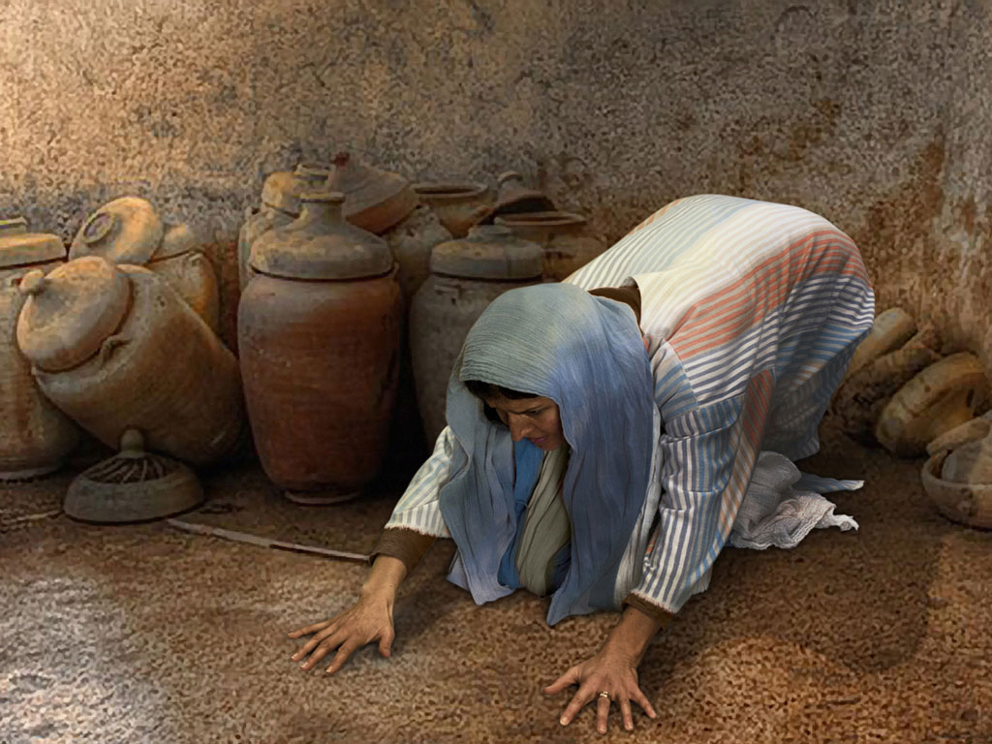
Notes:
Luke 15 v 8: Woman searches floor.

Slide 24
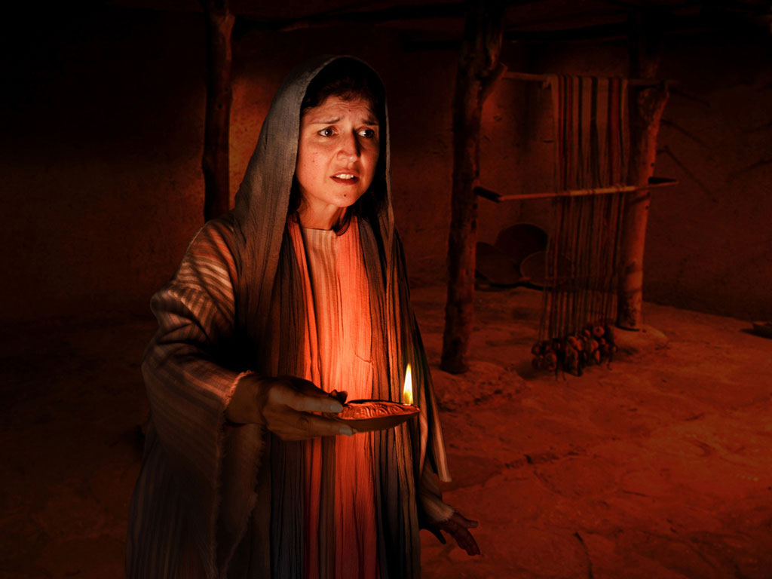
Notes:
Luke 15 v 8: Woman lights lamp and searches house. Many poor homes had very small windows and rooms were dark.

Slide 25
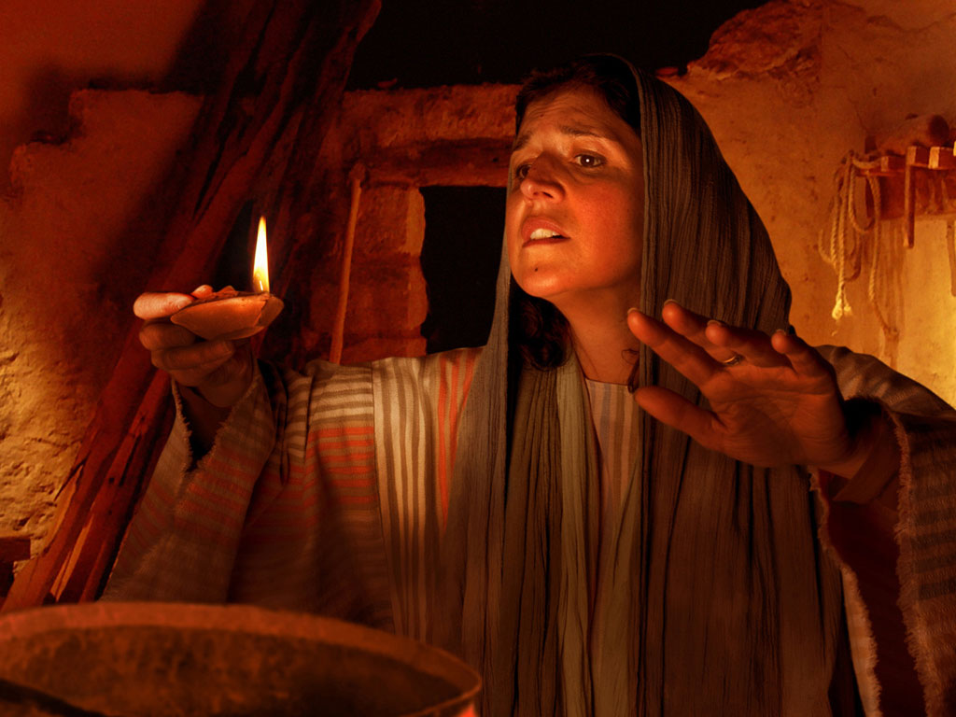
Notes:
Luke 15 v 8: Woman searches house by lamp light.

Slide 26
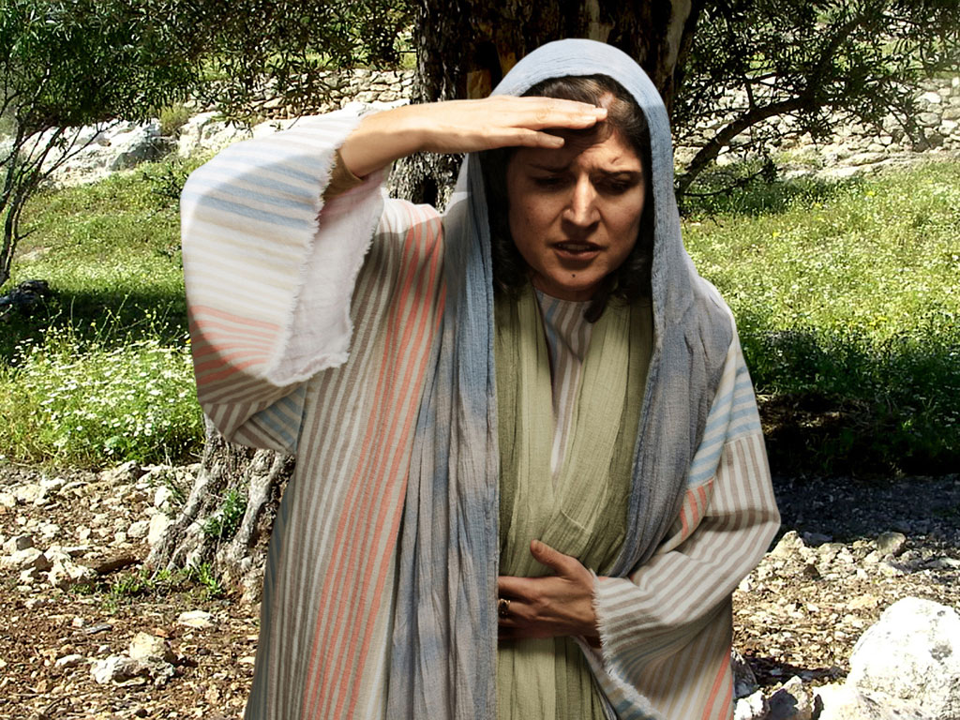
Notes:
Luke 15 v 8: Woman continues search.

Slide 27
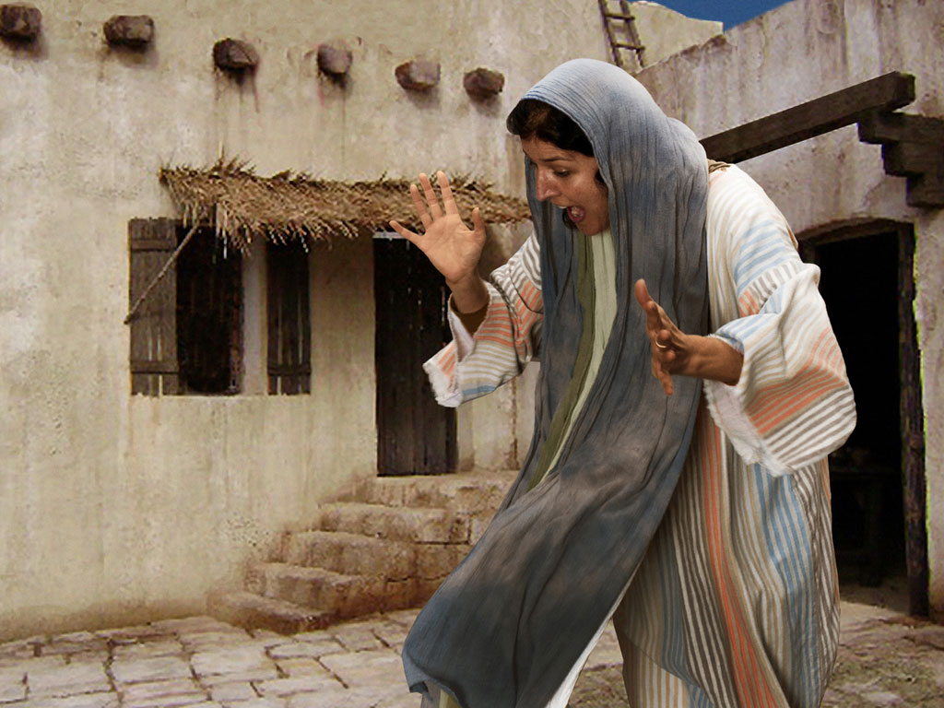
Notes:
Luke 15 v 9: Woman search is rewarded as she sees silver coin.

Slide 28
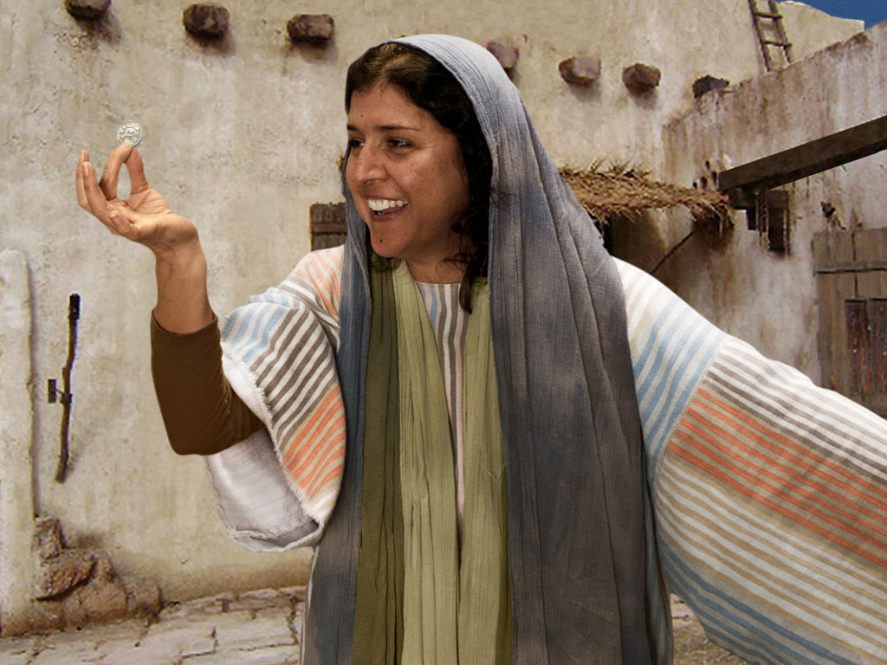
Notes:
Luke 15 v 9: Woman is full of joy as she finds coin.

Slide 29
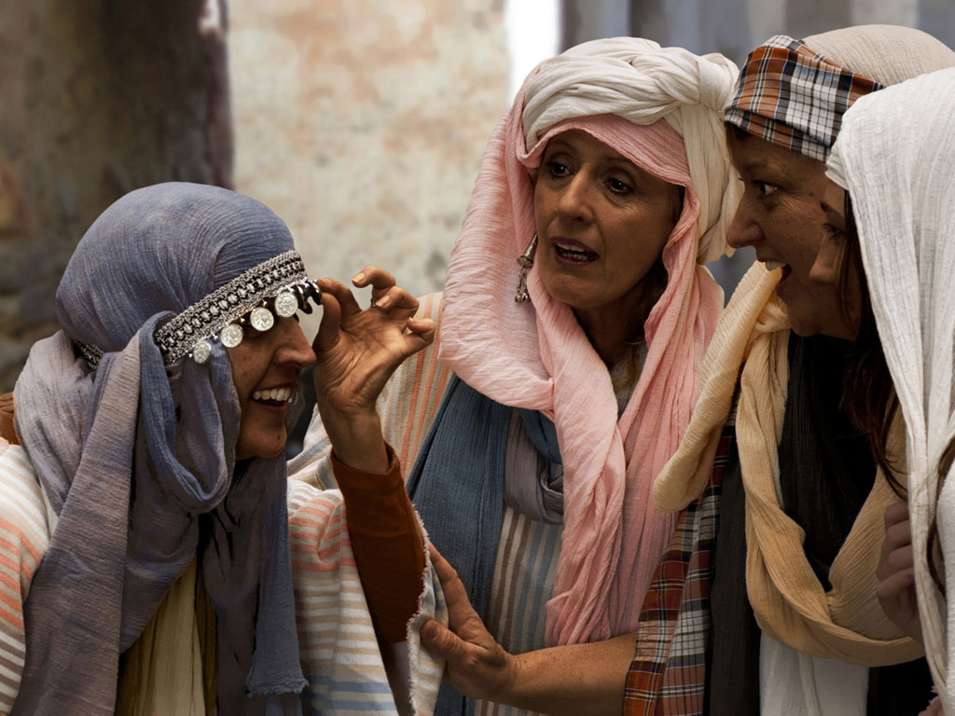
Notes:
Luke 15 v 9: Woman shares her good news with neighbours and friends.

Slide 30
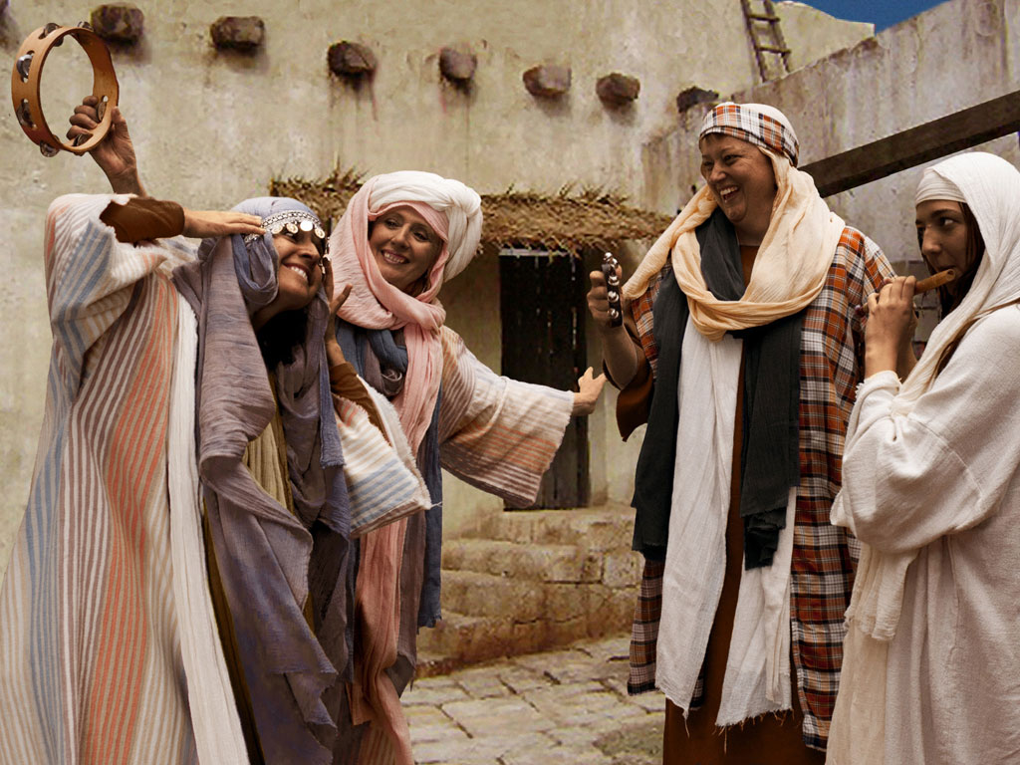
Notes:
Luke 15 v 9: Woman celebrates her good news with neighbours and friends. 'Rejoice with me; I have found my lost coin.'

Slide 31
الكلمة في صور
صور كتابية مجانية

Slide 32

FreeBibleimages would like to thank Peter Hutley and Wintershall Players for the use of their cast, costumes and facilities in creating these images.

Slide 33
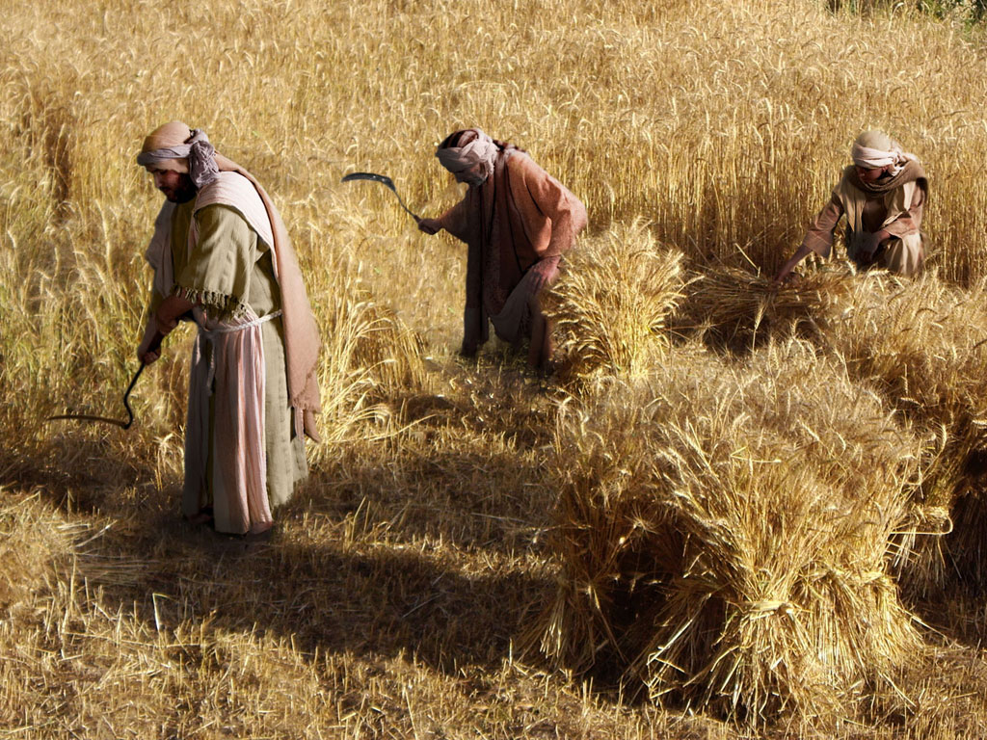
مثل
الإبنين
(الإبن الضال)
صور كتابية مجانية
لوقا 15: 11-32

Slide 34
Notes:
Sons were valued highly in ancient Jewish culture.

Slide 35
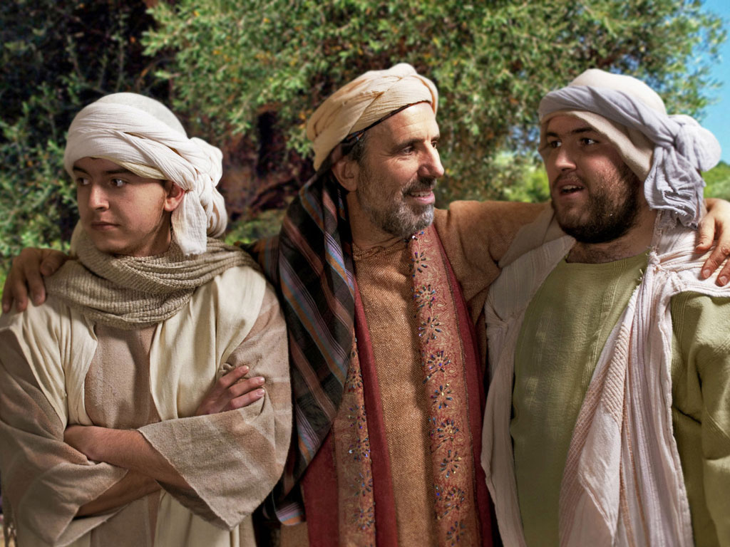
Notes:
Jesus told the parable of a man with two sons—the older son who brought him pride on the right, and the younger son who was hard to please on the left.

Slide 36
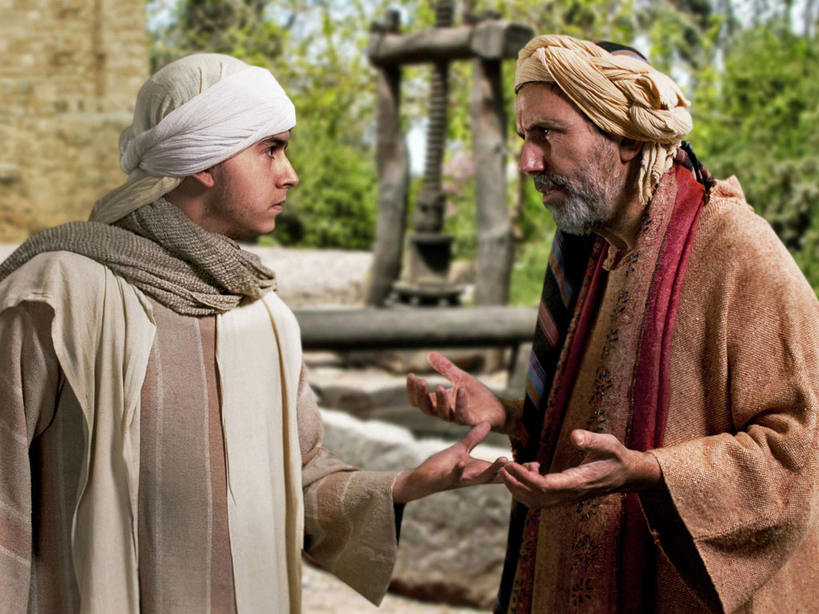
Notes:
This younger son was so ungrateful that he demanded his inheritance while his father still lived.

Slide 37
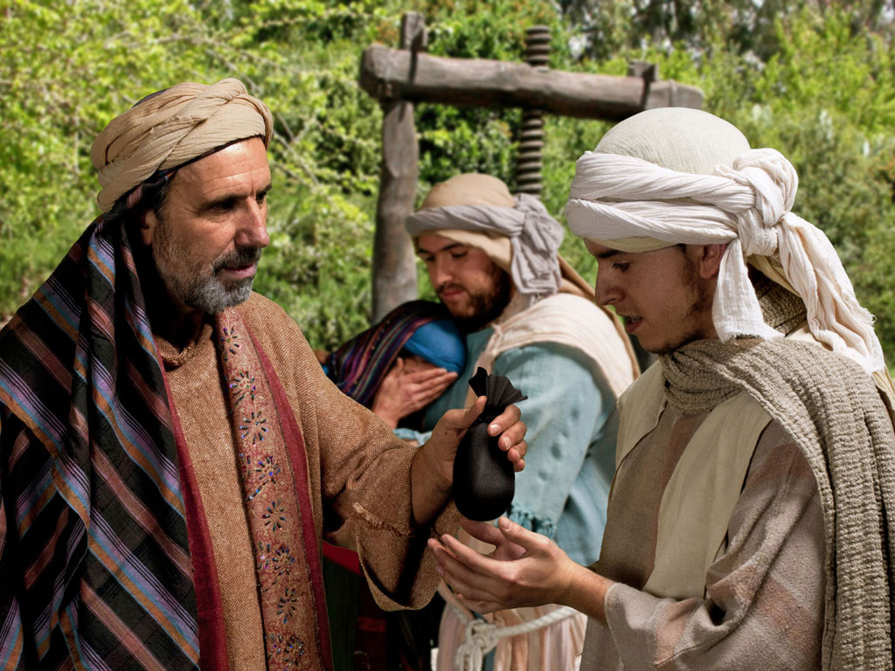
Notes:
At great cost to the father, he agreed to give his younger son one third of his wealth as the older son got the double portion of two thirds.

Slide 38
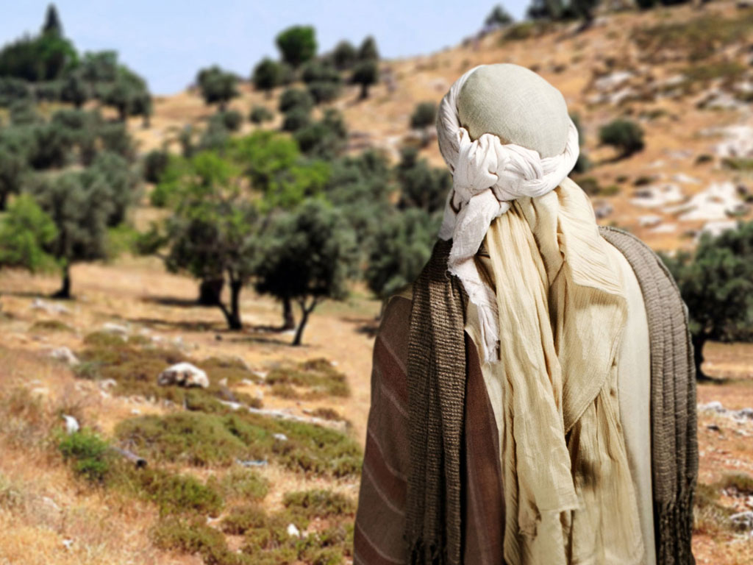
Notes:
Off the son went to pursue his dreams.

Slide 39
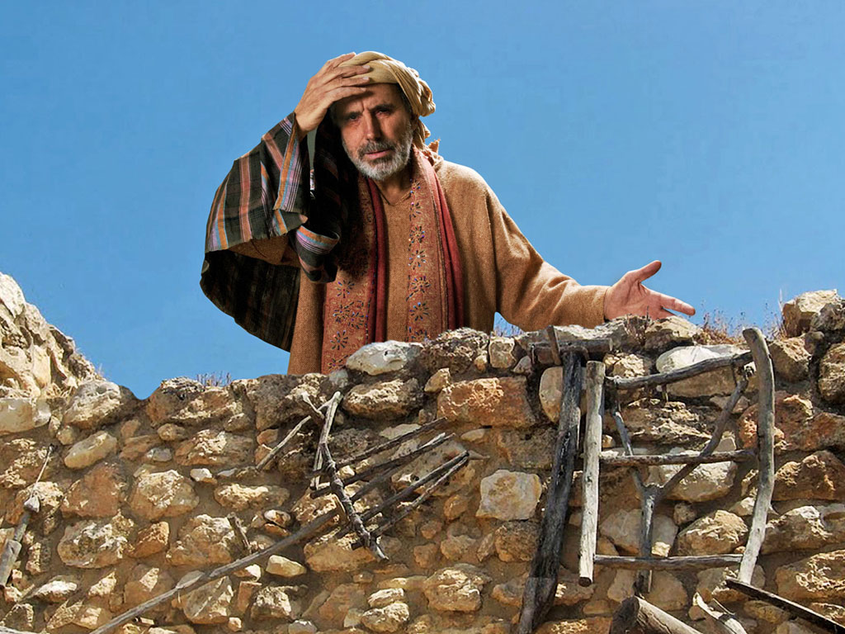
Notes:
The father mourned the loss, but he didn't prevent his son from experiencing the results of his greed. He instead longed for him to return.

Slide 40
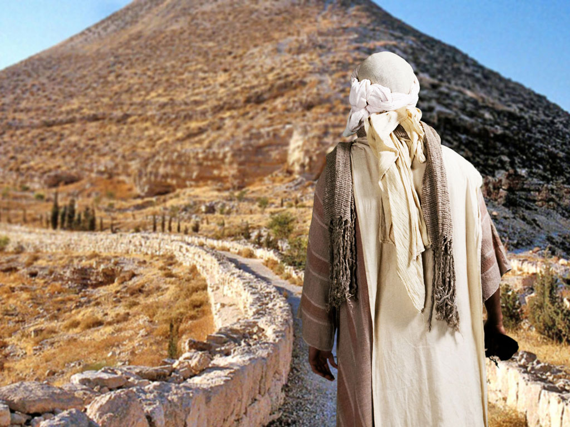
Notes:
Village life is deemed boring to those pursuing pleasure, so the younger son traveled out of the region.

Slide 41
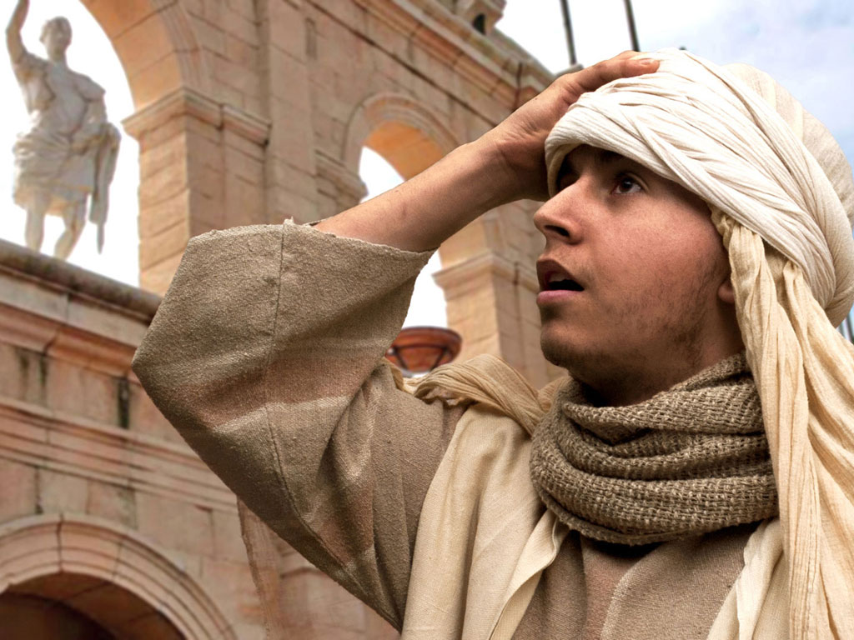
Notes:
His bad heart lured him to the city.

Slide 42
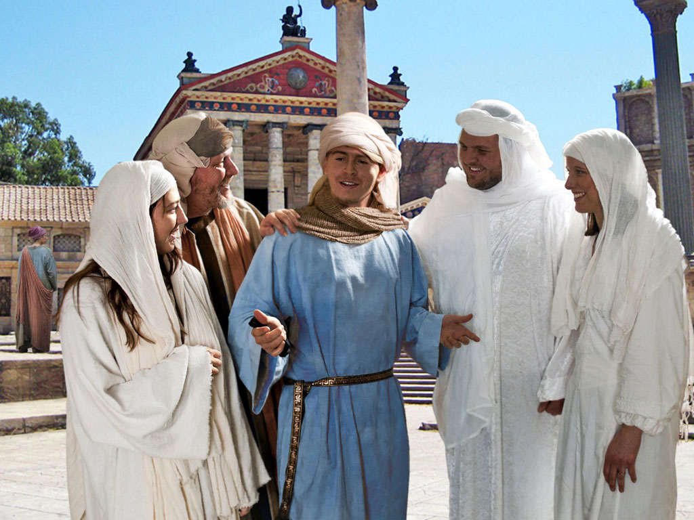
Notes:
Wealthy people typically find lots of "friends," defined as people willing to help spend the money of fools.

Slide 43
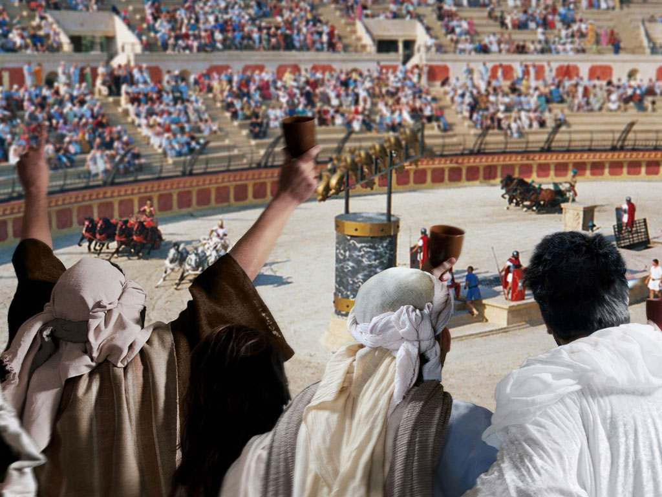
Notes:
There was no end to places to waste money then—and now.

Slide 44
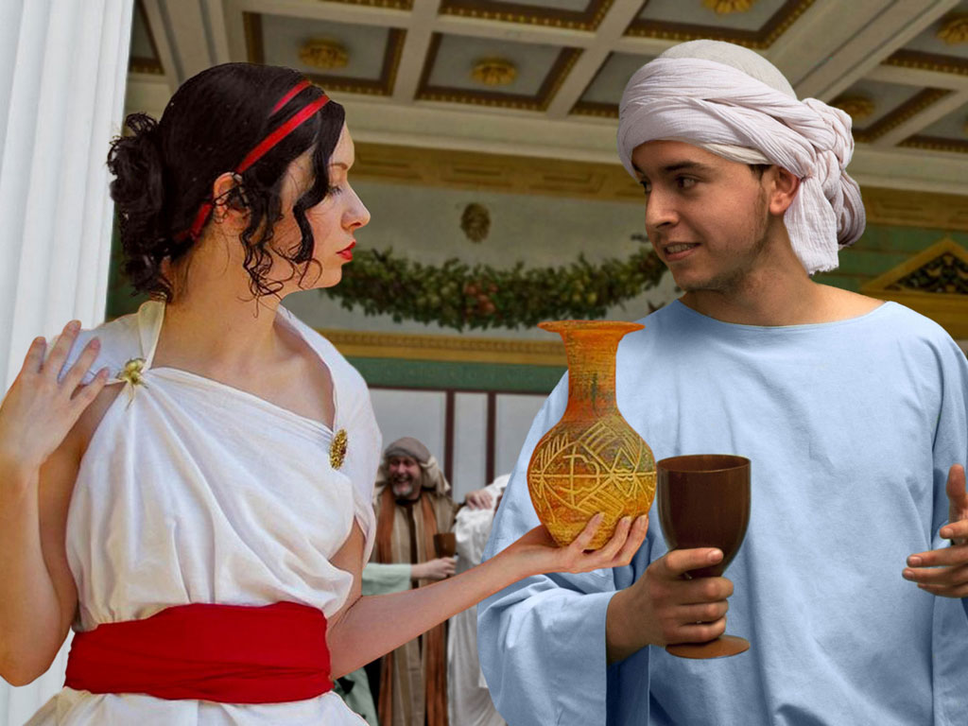
Notes:
Fools also attract gold diggers who prefer the finer things of life like an etched vase instead of a simple cup.

Slide 45
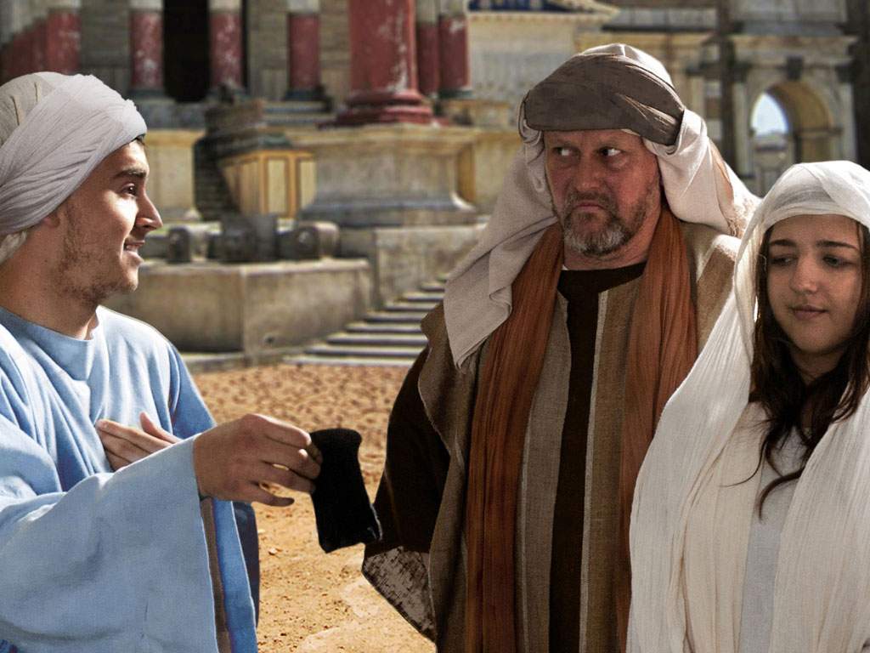
Notes:
Soon, the money ran out, and so did the friends.

Slide 46
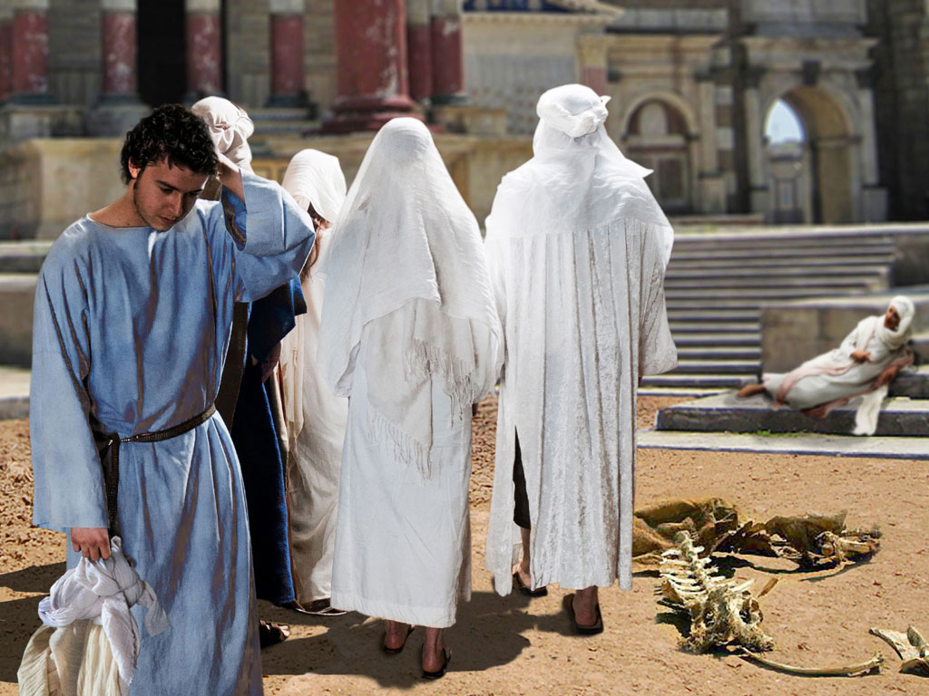
Notes:
The young son found himself without companions.

Slide 47
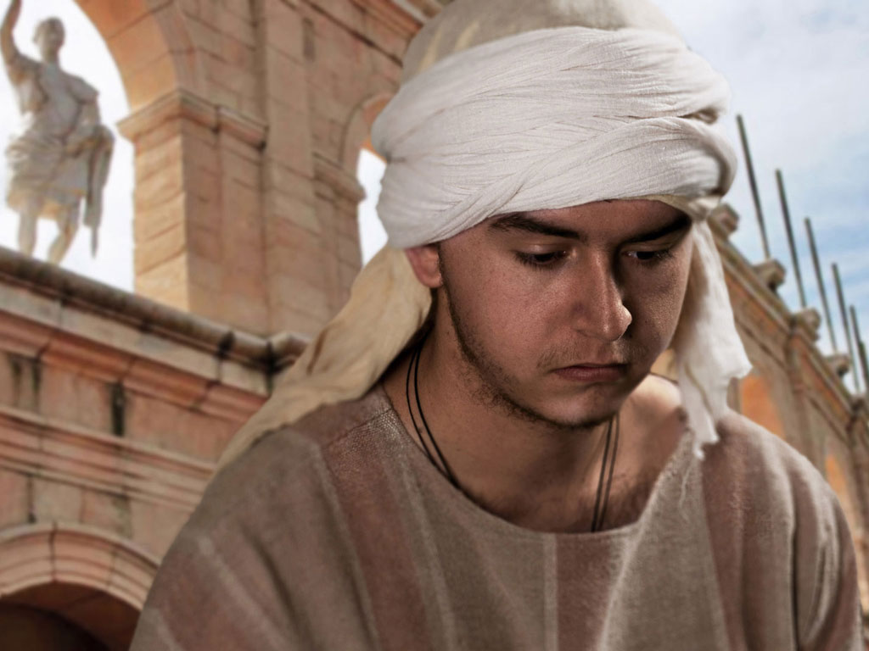
Notes:
City life without money is incredibly hard, so he had to leave the city.

Slide 48
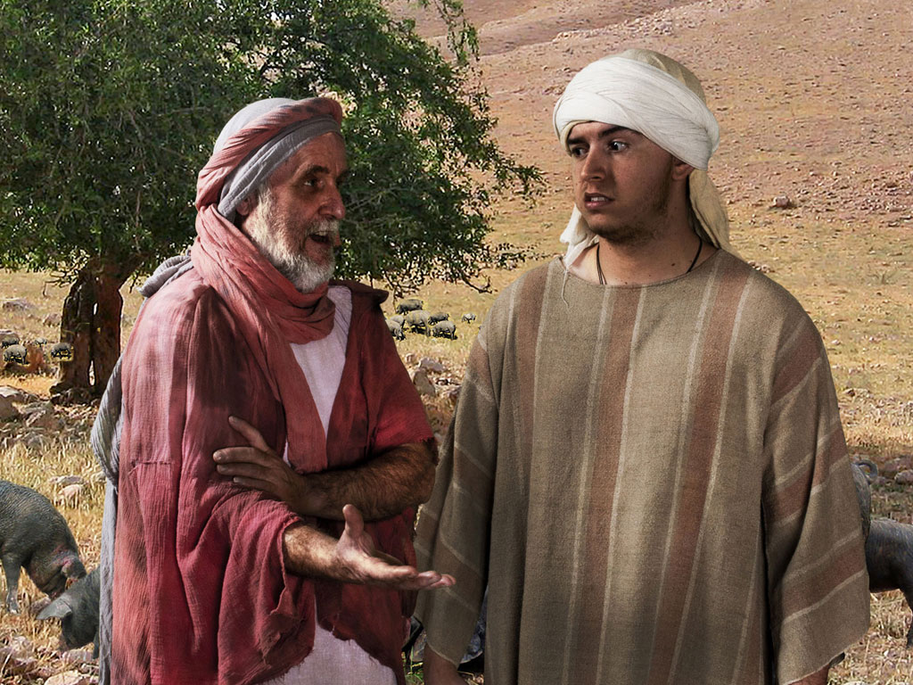
Notes:
Farmwork is good for the soul and the body. But he found work to alleviate his hunger from a man raising pigs.

Slide 49
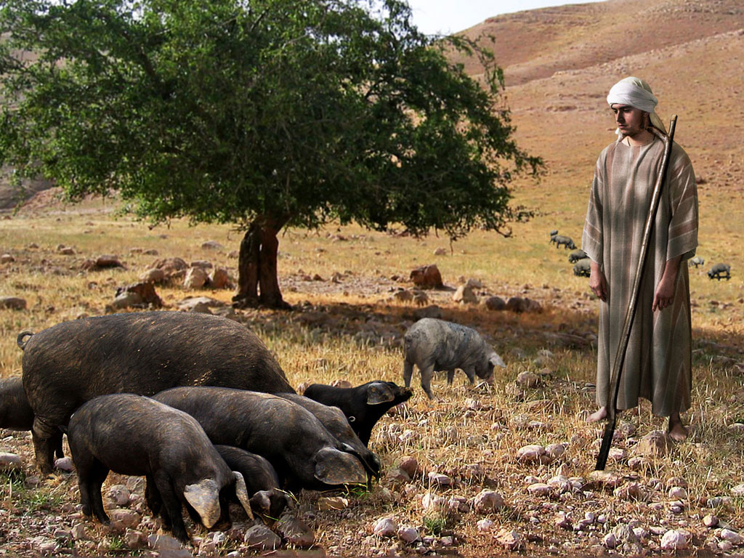
Notes:
Raising pigs is as low as a man from a wealthy family can get. Pigs were not allowed to be sacrificed, nor eaten.

Slide 50
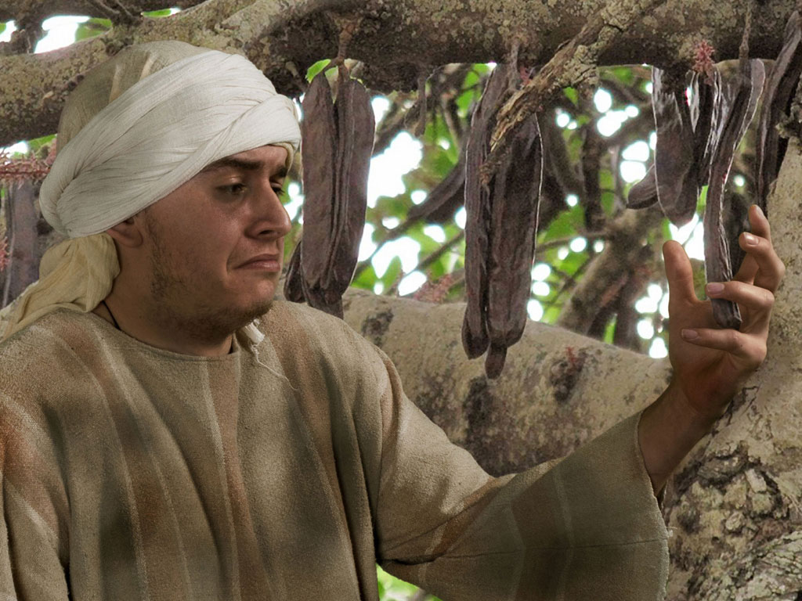
Notes:
Even the pods to feed the pigs became tempting.

Slide 51
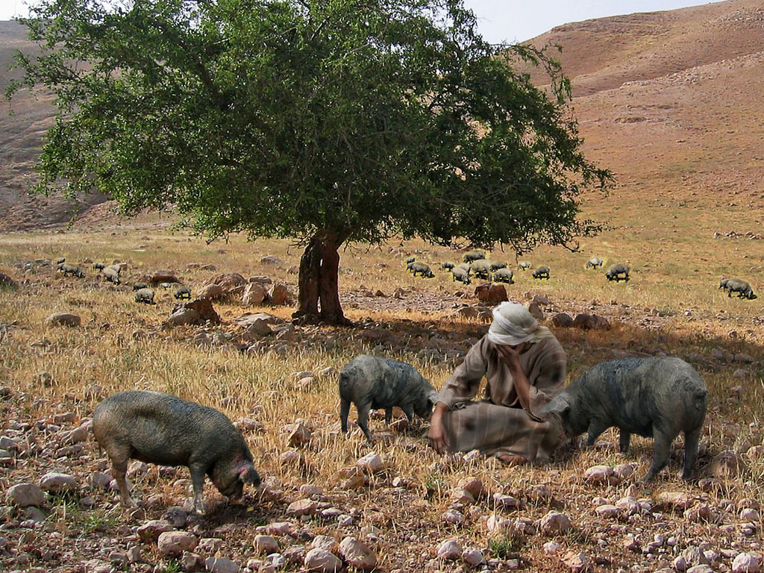
Notes:
The young finally got to his lowest point and recalled that his father's servants were in better shape than him.

Slide 52
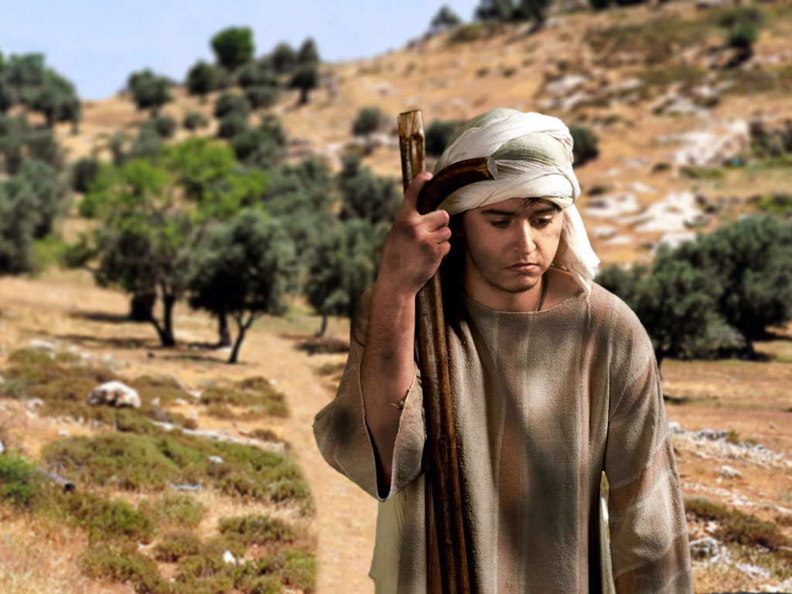
Notes:
So he returned home with a rehearsed speech of confession to his father.

Slide 53
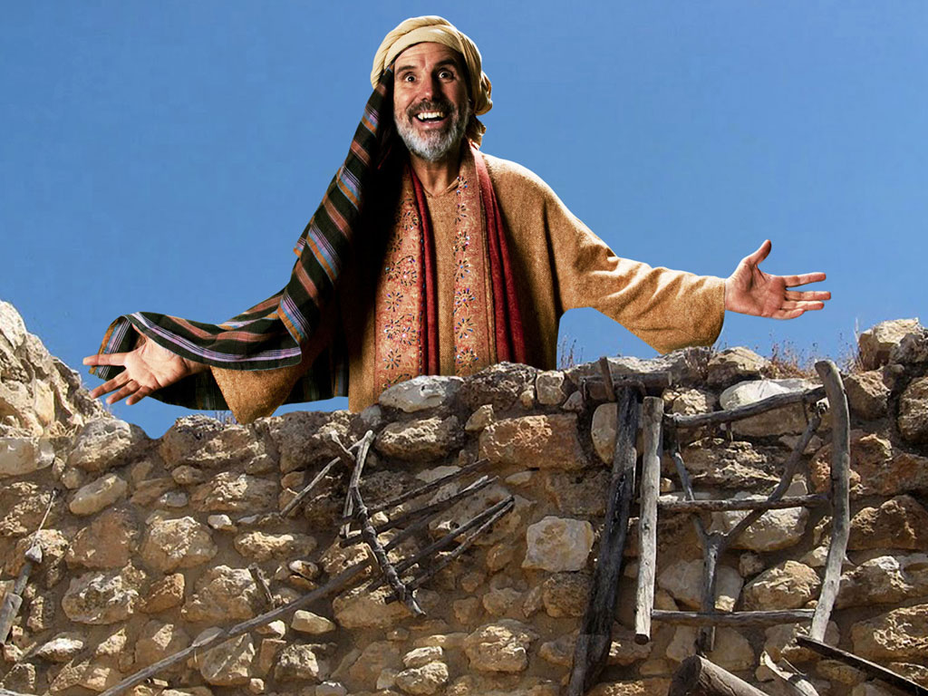
Notes:
The father saw him as soon as he came into view.

Slide 54
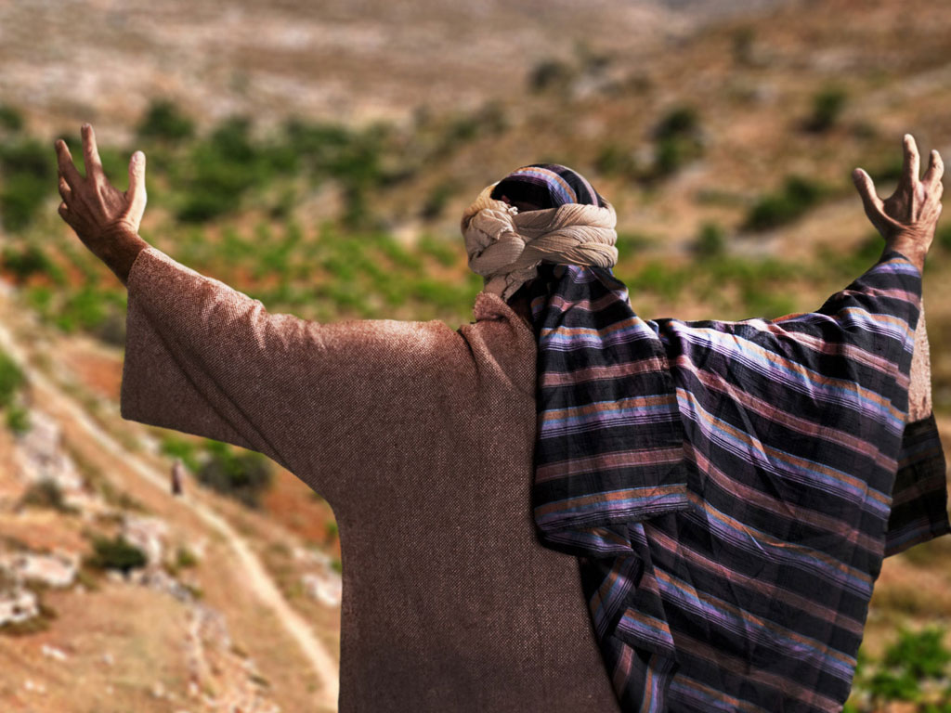
Notes:
This was because the father continued looking for him each day, praying for his return.

Slide 55
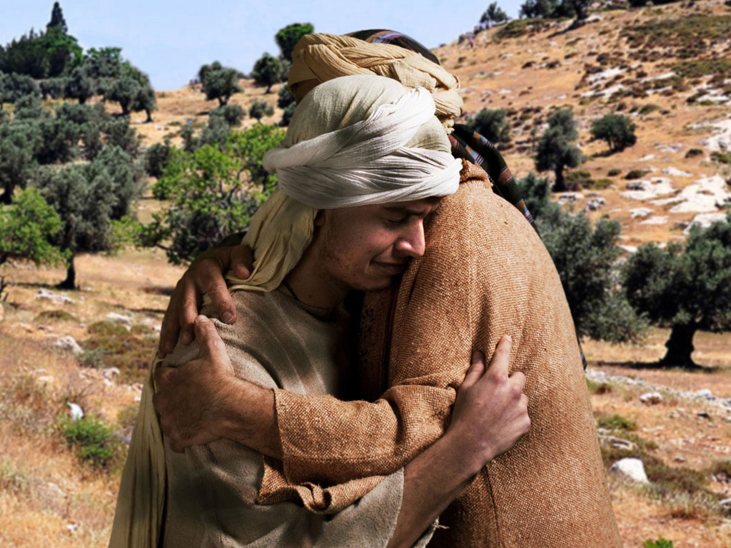
Notes:
The father ran to meet him, which fathers did not do as it appeared undignified to lift up one's robe to run.

Slide 56
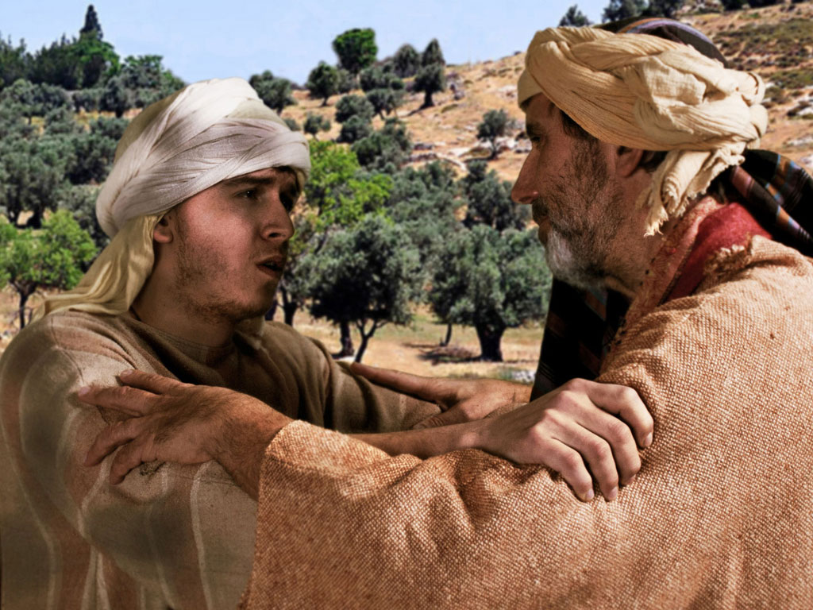
Notes:
The son began his confession but was interrupted by his father to tell his servants to bring him new clothes.

Slide 57
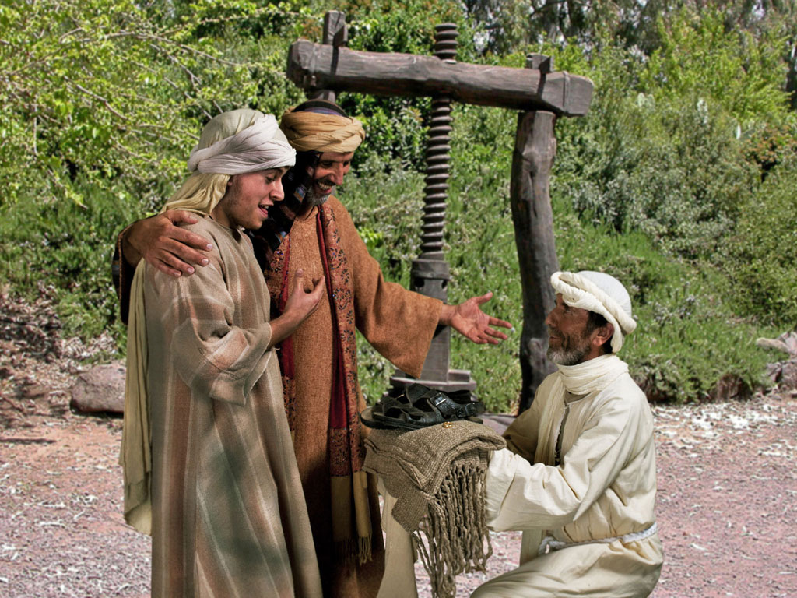
Notes:
A new robe and sandals were not earned by the son by any deed but only because of his status as a son.

Slide 58
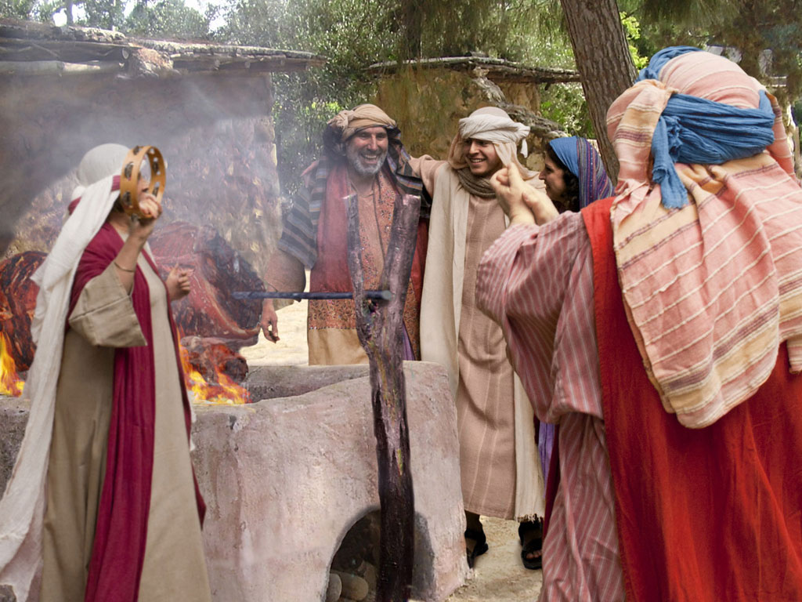
Notes:
The calf that had been saved for a celebration was roasted for a feast.

Slide 59
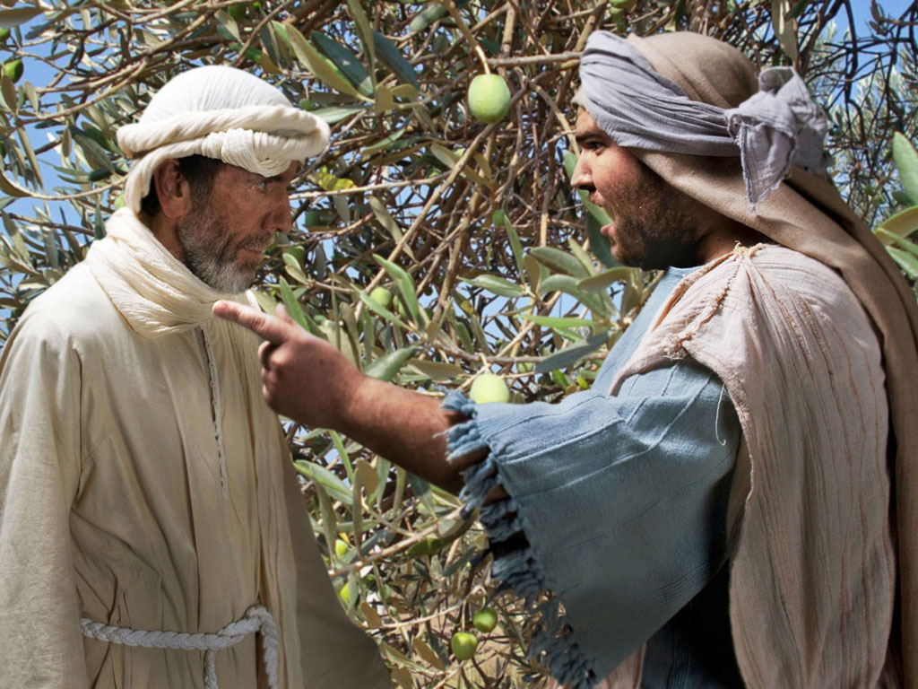
Notes:
The older son working in the fields asked a servant why he could hear a celebration. The servant told him that his brother had returned to a feast.

Slide 60
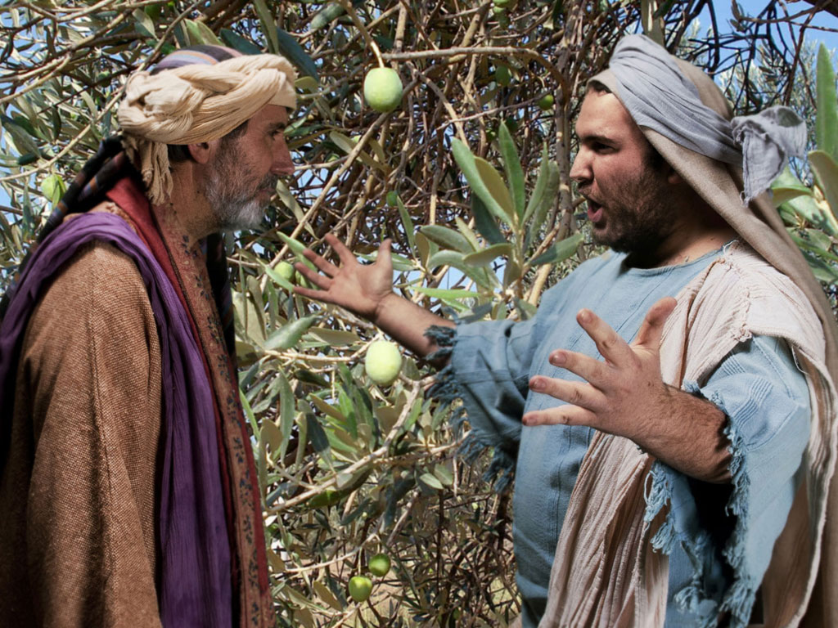
Notes:
The older son would not attend the feast, so his father went out to plead for him to return and celebrate—but to no avail.
Deuteronomy 21:18-21 says to kill a rebellious son—
Deut. 21:18 “Suppose a man has a stubborn and rebellious son who will not obey his father or mother, even though they discipline him. 19 In such a case, the father and mother must take the son to the elders as they hold court at the town gate. 20 The parents must say to the elders, ‘This son of ours is stubborn and rebellious and refuses to obey. He is a glutton and a drunkard.’ 21 Then all the men of his town must stone him to death. In this way, you will purge this evil from among you, and all Israel will hear about it and be afraid.
The father would not let this happen, so he ran to the Pharisees to protect him!

Slide 61
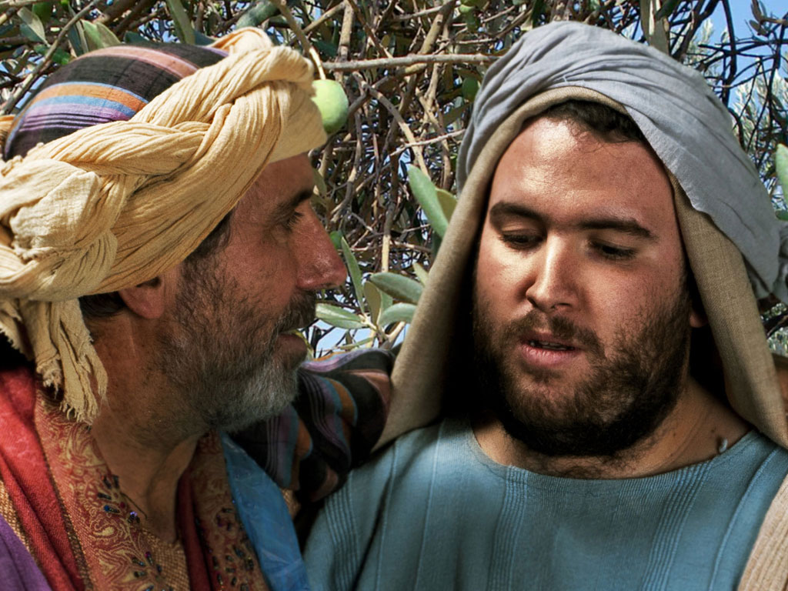
Notes:
This older, faithful son thought only of himself, declaring him as a slave of the father and one who could not celebrate with his friends. But the father reminded him that this older son owned the estate. The father said that they HAD to rejoice because his brother was alive.

Slide 62
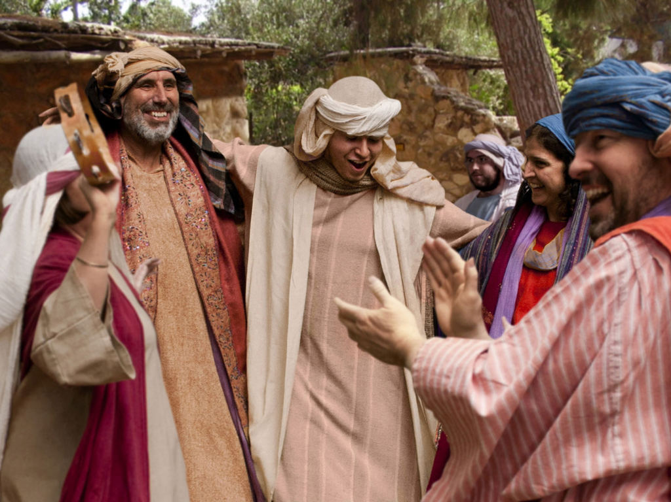
Notes:
The older son never joined the feast.
What do you think is the main point of this parable? (Small groups fro 4 minutes)
Jesus was telling the Pharisees that they were invited to the kingdom feast, but, like the older son, they refused to come.
Do not be like the older brother who thinks he deserves God's grace.
God does not keep any of us from the feast (salvation), but if we refuse to come, then he regretfully accepts our decision to prefer hell over heaven.

Slide 63
الكلمة في صور
صور كتابية مجانية

Slide 64
FreeBibleimages would like to thank Peter Hutley and Wintershall Players for the use of their cast, costumes and facilities in creating these images.

Slide 65
ح. تعليمات بخصوص الثروة
125
لوقا 16: 1-31
ينصح المسيح بخصوص استعمال الثروة المادية للأبدية بدلاً من الإستثمارات المؤقتة ليحفز التلاميذ للتخلي عن الربح المادي حتى يصيروا خدام الله وليحذرهم ضد النظرة الفريسية للثقة بالمال كأساس للضمان الأبدي

Slide 66
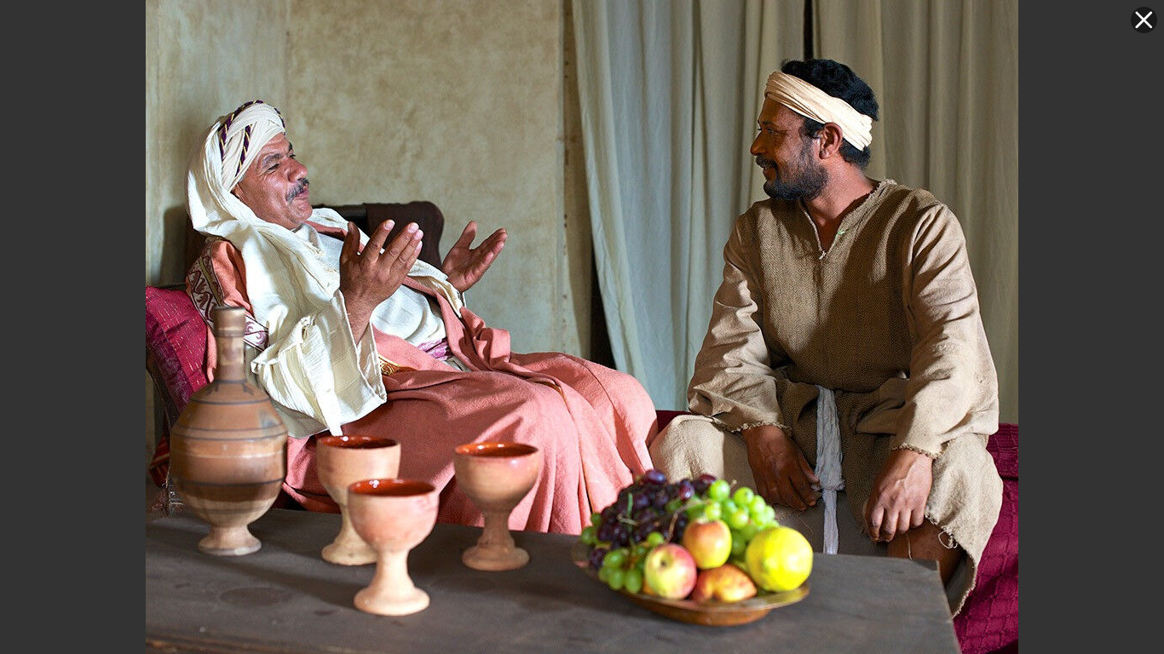

وكيل الظلم
لوقا 16: 1-13
د. ديفيد مارتن • مؤسسة الدراسات اللاهوتية الأردنية
AmmanChurch.org • BibleStudyDownloads.org

Slide 67




Notes:
Many of us collected stamps as kids.

Slide 68



لوقا 16: 1-13
الموضوع: دور التلميذ كوكيل
يعالج يسوع سوء الفهم الرئيسي:
لوقا 15: المواقف الخاطئة تجاه الناس
لوقا 16: المواقف الخاطئة تجاه المال

Slide 69
مثل عن الوكالة

Slide 70

✓ كان غنياً جداً
✓ كان مالك اراضي كبير
✓ فوض الإدارة كاملة
(أنظر تك 39: 1، 4-6)
✓ سمع تقارير سلبية
✓قام بمحاسبة الوكيل
لوقا 16: 2

Slide 71

✓كان لديه سلطة قانونية كاملة
كان من المفترض أن يستخدم الأصول لصالح السيد
✓ بدد موارد سيده
✓ رأى النهاية قادمة
✓ وضع خياراته بعين الإعتبار
لوقا 16: 1، 3-4

Slide 72


لوقا 16: 5-7
✓استدعى الوكيل جميع الدائنين
✓قام بتخفيض كل عقد بشكل كبير

Slide 73




اتفاقية
دين 100بث زيت
التوقيع
تثنية 23: 19
50
لا تقرض أخاك بربا
+ 100% فائدة
=
اقتراض 50 بث
دين 100 بث

Slide 74



Nazareth Village
اتفاقية
دين 100 كر قمح
التوقيع
80
+ 20% فائدة
=
اقتراض 80 كر
دين 100 كر

Slide 75

ألغى الوكيل الفائدة
تمت الإشادة به لكونه ذكيًا
✓ امتلك السلطة
✓ كانت سلطته قانونية بالكامل
✓ كوّن العديد من الأصدقاء في ذلك اليوم
✓ تم ضمان راحته المستقبلية
✓جعل السيد يبدو كريمًا
✓ غيّر تخطيطه/تصرفه السريع مصيره

Slide 76





قيّم وكالتك طالما أن هناك المزيد من الوقت لعمل تغييرات

Slide 77

2 كو 5: 10
سوف تترك كل هذه الأشياء خلفك
(جامعة 5: 15، 2: 19)

Slide 78



1. أدرك أنك مجرد وكيل ولست المالك لكل ما وضعه الله في يديك
(1 أخ 29: 14)
ماذا نتعلم؟

Slide 79



2. استثمر أموالك وممتلكاتك ووقتك لتعزيز الترحيب بك في السماء
(لو 16: 9؛ مت 6: 19-21).
هل سيكون هناك أحد في السماء بسببك؟
ماذا نتعلم؟

Slide 80

3. الأمانة في الوكالة تبدأ الآن بأشياء صغيرة (لو 16: 10؛ 1 كو 4: 2).
نادرا ما يزيد العطاء بشكل متناسب مع الدخل
ماذا نتعلم؟

Slide 81
4. إن إهدار أموالك وفرصك يحد من مقدار استخدام الله لك الآن ومكافأتك لاحقًا (لو 16: 11؛ 19: 17).
ماذا نتعلم؟

Slide 82

5. كن داهية وتصرف سريعًا لتعظيم كنوزك في السماء بالطريقة التي تستثمر بها مواردك في عمل الله على الأرض (في 4: 15-17).
ماذا نتعلم؟

Slide 83




الرجل الغني ولعازر
لوقا 16: 19-31
د. ديفيد مارتن • مؤسسة الدراسات اللاهوتية الأردنية
AmmanChurch.org • BibleStudyDownloads.org

Slide 84


تعليم يسوع عن المال
(لوقا 16)
وكيل الظلم
الرجل الغني/لعازر
النظر نحو المستقبل
النظر هنا والآن

Slide 85


سياق المثل
لوقا 16: 13-15
متى
19: 23-25
المسألة: هل الغنى دليل على قبول الله والفقر دليل على رفضه؟

Slide 86
الرجل الغني
✓ كان فاحش الثراء
✓ كان لباسه ملكياً
✓ كان يتناول طعامًا فاخرًا كل يوم
✓ كان يبدو متديناً
✓ كان يعيش في قصر مسور
✓كان يعرف لعازر لكنه تجاهل حاجاته
✓اسمه غير مذكور

Slide 87
لعازر
✓كان متسولاً معدماً
✓ معنى اسمه
الرجل الذي يساعده الله
✓كان عاجزًا جسديًا ومغطى بالقروح المفتوحة
✓كان يشتاق إلى فتات المائدة

Slide 88


Slide 89
لعازر
✓كان متسولاً معدماً
✓ معنى اسمه
الرجل الذي يساعده الله
✓ كان عاجزًا جسديًا ومغطى بالقروح المفتوحة
✓كان يشتاق إلى فتات المائدة
✓كانت الكلاب البرية تلحس قروحه

Slide 91

الرجل الغني
✓ مات ودفن
(في روعة وأبهة)

Slide 92


لعازر
✓مات لكنه حتى لم يدفن
Valley of Gehenna

Slide 93

الرجل الغني
الغنى لا يشير
إلى قبول الله
✓استيقظ في الجحيم/جهنم

Slide 94

لعازر
الفقر لا يشير إلى رفض الله
✓ مات وحملته الملائكة إلى حضن إبراهيم

Slide 95
الرجل الغني
✓ استيقظ في الجحيم/جهنم
✓ كان في العذاب

Slide 96
لعازر
✓ مات وحملته الملائكة إلى حضن إبراهيم (الفردوس، السماء)
✓أقام وليمة في مكان كريم (مت 8: 11)

Slide 97

الرجل الغني
✓ استيقظ في الجحيم/جهنم
✓كان في العذاب
✓ طلب الرحمة بصراخ من أبينا إبراهيم

Slide 98
لعازر
✓مات وحملته الملائكة إلى حضن إبراهيم (الفردوس، السماء)
✓ أقام وليمة في مكان كريم (مت 8: 11)
✓ كان في تعزية

Slide 99
الرجل الغني
✓ استيقظ في الجحيم/جهنم
✓كان في العذاب
✓ طلب الرحمة بصراخ من أبينا إبراهيم
✓ لقد حصل على أشياء جيدة في حياته لكن عدم توبته أدى إلى عذاب أبدي

Slide 100
لعازر
✓مات وحملته الملائكة إلى حضن إبراهيم (الفردوس، السماء)
✓ أقام وليمة في مكان كريم (مت 8: 11)
✓ كان في تعزية
✓ لقد نال أشياء سيئة في حياته لكن ثقته في الله أدت إلى الراحة الأبدية

Slide 101

☞ لم يتوقع معظمهم أبدًا أن ينتهي بهم الأمر هناك
☞ لا أحد يريد أن ينضم إليهم الأصدقاء/العائلة هناك
☞ يدرك الجميع أنه لا يوجد فرصة ثانية
☞ لن يدعي أحد أنه ذهب إلى هناك بالخطأ
ماذا نتعلم عن جهنم؟

Slide 102

لوقا 16: 31
تم تحذيرهم
✓الكتاب المقدس تحذير كافي
✓ حتى المعجزات لا تقنع القلب القاسي
يوحنا 11: 43-46، 53 (لعازر)
☞ متى 28: 11-15 (يسوع)

Slide 103
✓متى 3: 2 (يوحنا المعمدان)
✓ متى 4: 17 (يسوع)
عبرانيين 9: 27
✓ أعمال 2: 38 (بطرس)
✓ أعمال 17: 30-31 (الرسول بولس)
1) التوبة هي تغيير الفكر ...
☞ عن الخطية وعواقبها
عمن هو يسوع وعمله
2) يترتب على التوبة تغيير في السلوك
ماذا نتعلم عن التوبة / الإيمان؟

Slide 104



نقل الى الفردوس (Paradise)
8 لذلك يقول إذ صعد إلى العلاء سبى سبياً وأعطى الناس عطايا 9 وأما أنه صعد فما هو إلا أنه نزل أيضاً أولاً إلى أقسام الأرض السفلى 10 الذي نزل هو الذي صعد أيضاً فوق جميع السماوات لكي يملأ الكل
14و16
السماء
أف 4: 8-10
... اليوم تكون معي في الفردوس
اختطف هذا إلى السماء الثالثة... اختطف إلى الفردوس
لوقا 23: 43
2 كو 12: 2، 4
ش
ي
ئ
و
ل
النعيم
18 فإن المسيح أيضاً تألم مرة واحدة من أجل الخطايا البار من أجل الأثمة لكي يقربنا إلى الله مماتاً في الجسد ولكن محيى في الروح
19 الذي فيه أيضاً ذهب فكرز للأرواح التي في السجن 20 إذ عصت قديماً حين كانت أناة الله تنتظر مرة في أيام نوح إذ كان الفلك يبنى الذي فيه خلص قليلون أي ثماني أنفس بالماء
الهاوية
1بطرس 3: 18-20
الهاوية
لوقا 16: 26
رؤيا يوحنَّا 20: 14-15
جهنم
جهنا
بحيرة النار
بحيرة الألم المشتعلة
الموت الثاني
.... بيننا وبينكم هوة عظيمة قد أثبتت حتَّى إن الذين يريدون العبور من ههنا إليكم لا يقدرون ولا الذين من هناك يجتازون إلينا
وطرح الموت والهاوية في بحيرة النار هذا هو الموت الثاني وكل من لم يوجد مكتوباً في سفر الحياة طرح في بحيرة النار
Notes:
Paradise before Christ's death was part of OT Sheol, or the underworld of the dead—both saved and unsaved. But Jesus brought Paradise up to God after his resurrection. Also, Hades is different from Hell in that Hades is a temporary place of punishment now, while Hell is the future and eternal place of torment.
___________________
Common-472
ES-03-Reincarnation&SpiritsInPrison-45
OB-38-Salvation-45
OP-Eccles9:1-18—slide 28
NS-08-2Cor-268
NS-10-Ephesians-270
NS-21-1Peter-235
NS-22-Rev20-22-slide 155

Slide 105
خ. تعليمات بخصوص الغفران
126
لوقا 17: 1-6
يعلم المسيح تلاميذه أنهم يمكن لهم أن يكرهوا التعاليم الفريسية بدون كره الفريسيين أنفسهم ليؤكد أن فكر التلاميذ ضدهم لن يمنع أي شخص من المجيء إلى المسيح أو يحدد قدرتهم لمسامحة مؤمن آخر

Slide 106
د. تعليمات بخصوص الخدمة
127
لوقا 17: 7-10
ذكر المسيح تلاميذه أن المسؤولية تجاهه كخدام للسيد لا تتحقق أبداً حتى يدركوا أن الطاعة هي واجبهم الأدنى تجاه المسيح

Slide 107
ذ. إقامة لعازر
128
يوحنا 11: 1-54
اقام يسوع لعازر من الموت حتى يعلم أن القيامة والحياة موجودتان فيه فقط وليس في برنامج الله بشكل جزئي

Slide 108
1. معجزة الإسترداد
يوحنا 11: 1-44
استرد المسيح حياة لعازر ليؤكد إيمان هؤلاء الذين سبق أن آمنوا به

Slide 109

صور كتابية مجانية
يوحنا 11: 1-12: 2
يسوع يقيم لعازر

Slide 111

يسوع يقيم لعازر (يوحنا 11)
السامرة
بيرية
نهر الأردن
أورشليم
بيت عنيا
0 5 ميل
اليهودية
بحر الملح
0 8 كم
Notes:
Lazarus lived in Bethany just east of Jerusalem, but Jesus was on the other side of the Jordan River.
Jews at the time of Jesus hated the Samaritans so much that they did not travel northward from Jerusalem through Samaria to get to the north. Instead, they traveled east through Bethany on the other side of the Mount of Olives and straight across the Jordan River to bypass Samaria. Bethany was the hometown of Lazarus and his sisters, Mary and Martha.
_______
LC-06-Preparation of the Disciples-111
NS-04-John1-11-slide 467

Slide 112

Notes:
Word came to Jesus that Lazarus was sick.

Slide 113

Notes:
But Jesus kept teaching his disciples instead of going to Lazarus.

Slide 114

Notes:
He seemed to have no urgency to heal Lazarus to keep him from dying.

Slide 115

Notes:
This perplexed many who had seen Jesus heal others.

Slide 116

Notes:
John 11:4 But when Jesus heard about it he said, “Lazarus’s sickness will not end in death. No, it happened for the glory of God so that the Son of God will receive glory from this.”

Slide 117

Notes:
⁵ So although Jesus loved Martha, Mary, and Lazarus, ⁶ he stayed where he was for the next two days.

Slide 118

Notes:
Finally, he said to his disciples, “Let’s go back to Judea.”
John 11:8 But his disciples objected. “Rabbi,” they said, “only a few days ago the peopleª in Judea were trying to stone you. Are you going there again?”
John 11:9 Jesus replied, “There are twelve hours of daylight every day. During the day people can walk safely. They can see because they have the light of this world. ¹⁰ But at night there is danger of stumbling because they have no light.” ¹¹ Then he said, “Our friend Lazarus has fallen asleep, but now I will go and wake him up.”
John 11:12 The disciples said, “Lord, if he is sleeping, he will soon get better!” ¹³ They thought Jesus meant Lazarus was simply sleeping, but Jesus meant Lazarus had died.
John 11:14 So he told them plainly, “Lazarus is dead. ¹⁵ And for your sakes, I’m glad I wasn’t there, for now you will really believe. Come, let’s go see him.”

Slide 119

Notes:
John 11:16 Thomas, nicknamed the Twin, said to his fellow disciples, “Let’s go, too—and die with Jesus.”

Slide 120
يسوع يقيم لعازر (يوحنا 11)
السامرة
بيرية
نهر الأردن
أورشليم
بيت عنيا
0 5 ميل
اليهودية
بحر الملح
0 8 كم
Notes:
After he waited four days, he then headed toward Bethany.
_______
LC-06-Preparation of the Disciples-75
NS-04-John1-11-slide 476, 478

Slide 121


Slide 122
يسوع يقيم لعازر (يوحنا 11)
السامرة
بيرية
نهر الأردن
أورشليم
بيت عنيا
0 5 ميل
اليهودية
بحر الملح
0 8 كم
Notes:
After he waited four days, he then headed toward Bethany.
_______
LC-06-Preparation of the Disciples-75
NS-04-John1-11-slide 476, 478

Slide 123

Notes:
²⁰ When Martha got word that Jesus was coming, she went to meet him. But Mary stayed in the house.

Slide 124

Notes:
²¹ Martha said to Jesus, “Lord, if only you had been here, my brother would not have died.

Slide 125

Notes:
²² But even now I know that God will give you whatever you ask.”

Slide 126

Notes:
John 11:23 Jesus told her, “Your brother will rise again.”

Slide 127

Notes:
John 11:24 “Yes,” Martha said, “he will rise when everyone else rises, at the last day.”
John 11:25 Jesus told her, “I am the resurrection and the life. Anyone who believes in me will live, even after dying. ²⁶ Everyone who lives in me and believes in me will never ever die. Do you believe this, Martha?”
John 11:27 “Yes, Lord,” she told him. “I have always believed you are the Messiah, the Son of God, the one who has come into the world from God.”

Slide 128

Notes:
²⁸ Then she returned to Mary. She called Mary aside from the mourners and told her, “The Teacher is here and wants to see you.” ²⁹ So Mary immediately went to him.

Slide 129

Notes:
John 11:30 Jesus had stayed outside the village, at the place where Martha met him. ³¹ When the people who were at the house consoling Mary saw her leave so hastily, they assumed she was going to Lazarus’s grave to weep. So they followed her there. ³² When Mary arrived and saw Jesus, she fell at his feet and said, “Lord, if only you had been here, my brother would not have died.”

Slide 130

Notes:
John 11:33 When Jesus saw her weeping and saw the other people wailing with her, a deep anger welled up within him, and he was deeply troubled. ³⁴ “Where have you put him?” he asked them.
They told him, “Lord, come and see.”

Slide 131

Notes:
³⁵ Then Jesus wept. ³⁶ The people who were standing nearby said, “See how much he loved him!” ³⁷ But some said, “This man healed a blind man. Couldn’t he have kept Lazarus from dying?”

Slide 132

Notes:
John 11:38 Jesus was still angry as he arrived at the tomb, a cave with a stone rolled across its entrance. ³⁹ “Roll the stone aside,” Jesus told them.

Slide 133

Notes:
John 11:39 But Martha, the dead man’s sister, protested, “Lord, he has been dead for four days. The smell will be terrible.”

Slide 134

Notes:
John 11:40 Jesus responded, “Didn’t I tell you that you would see God’s glory if you believe?”

Slide 135

Notes:
⁴¹ So they rolled the stone aside.

Slide 136

Notes:
Then Jesus looked up to heaven and said, “Father, thank you for hearing me. ⁴² You always hear me, but I said it out loud for the sake of all these people standing here, so that they will believe you sent me.” ⁴³ Then Jesus shouted, “Lazarus, come out!”

Slide 137

Notes:
⁴⁴ And the dead man came out, his hands and feet bound in graveclothes, his face wrapped in a headcloth.

Slide 138

Notes:
Jesus told them, “Unwrap him and let him go!”

Slide 139

Notes:
The Plot to Kill Jesus
John 11:45 Many of the people who were with Mary believed in Jesus when they saw this happen.

Slide 140


Slide 141


Slide 142

Notes:
⁴⁶ But some went to the Pharisees and told them what Jesus had done.

Slide 143

Notes:
⁴⁷ Then the leading priests and Pharisees called the high council together. “What are we going to do?” they asked each other. “This man certainly performs many miraculous signs."

Slide 144

Notes:
⁴⁸ If we allow him to go on like this, soon everyone will believe in him. Then the Roman army will come and destroy both our Temple and our nation.”

Slide 145

Notes:
John 11:49 Caiaphas, who was high priest at that time,ª said, “You don’t know what you’re talking about! ⁵⁰ You don’t realize that it’s better for you that one man should die for the people than for the whole nation to be destroyed.”

Slide 146


Slide 147

Notes:
John 11:51 He did not say this on his own; as high priest at that time he was led to prophesy that Jesus would die for the entire nation. ⁵² And not only for that nation, but to bring together and unite all the children of God scattered around the world.

Slide 148

Notes:
John 11:53 So from that time on, the Jewish leaders began to plot Jesus’ death.

Slide 149

يسوع يقيم لعازر
السامرة
بيرية
أفرايم
نهر الأردن
أورشليم
بيت عنيا
اليهودية
0
ميل 5
البحر الميت
0
كم 8
Notes:
_______
LC-06-Preparation of the Disciples-102
NS-04-John1-11-slide 505

Slide 150


Slide 151


Slide 152


Slide 153

يسوع يقيم لعازر
السامرة
بيرية
أفرايم
نهر الأردن
أورشليم
بيت عنيا
اليهودية
0
ميل 5
البحر الميت
0
كم 8
Notes:
_______
LC-06-Preparation of the Disciples-106
NS-04-John1-11-slide 509

Slide 154


Slide 155


Slide 156

استخدمت بإذن رسمي
إنجيل
متى
إنجيل
مرقس
إنجيل
لوقا
إنجيل
يوحنا
نظرًا لإنتاج Lumo لمواد النشر الخاصة به ، نأسف لإبلاغك بأنه لا يمكننا ترخيص صورنا لعملاء آخرين خارج
freebibleimages.org
هذه الصور غير مرخصة لإعادة استخدامها في الفيديو أو النشر أو الوسائط الأخرى. لا يمكن إعادة توزيع الصور والملفات التي تم تنزيلها من خلال أي موقع ويب آخر غير freebibleimages.org أو استخدامها في أي سياق تؤدي فيه الرسالة المصاحبة إلى تقويض الإيمان المسيحي والإنجيل.
لا يمكن استخدام الصور إلا في العروض التقديمية التعليمية والمدونات ووسائل التواصل الاجتماعي ، وكلها يجب أن تكون مصحوبة بالإشارة إلى
www.LumoProject.com.
Picture courtesy of BBM
© All Rights Reserved.
www.bigbookmedia.com

Slide 157

يسوع، مريم ومرثا (يوحنا 11)
أحب يسوع هاتين الأختين اللتان عاشتا في بيت عنيا قرب أورشليم (11: 5)
لقد آمنتا به قبلاً (اعتباره رب 11: 3، 11: 27)
مسحته مريم لاحقاً لدفنه في عبادة (11: 2، 12: 1-8)

Slide 158

مرثا (يوحنا 11)

Slide 159

مريم (يوحنا 11)

Slide 160

مرثا ومريم (يوحنا 11)

Slide 161
اختلاف مرثا عن مريم في يوحنا 11
##
الموضوع | مرثا | مريم
السعي نحو يسوع | ذهبت على الفور لتجد يسوع (20 أ) - خاصًا كفاعل | أجلت وبقيت في البيت (20ب) ومن ثم بشكل علني (29) مع مشاعر أكبر
الكلمات إلى يسوع | لوم مع إيمان (21) | لوم مع سجود (32)
كلمات الشك | لم ترى أملاً في إقامة فورية (24، 39) | لا يوجد

Slide 162
اختلاف مرثا عن مريم في يوحنا 11
##
الموضوع | مرثا | مريم
رد يسوع | اختبر إيمانها ما إذا كان بإمكانه إقامة لعازر (23)، وادعى أنه القيامة والحياة (25)، وسألها عما إذا كانت تؤمن (26) | لم يمتحن إيمانها – بل سأل عن مكان الجسد (34) ثم بكى (35)
إعلانات الإيمان في المسيح | مرتين: يمكن للمسيح أن يشفي (21) و"أنت المسيح ... ابن الله ... من الله" (27) | لا تصريحات
نقص الإيمان | ولا يزال الشك يشكو من رائحة الجسد (39) فيما لم يلاحظ رد فعل من يواسيها | جاء كثيرون من الذين آمنوا (45) لكن بعضاً منهم خانوا يسوع وأخبروا الفريسيين (46)

Slide 163


هل كانت مريم المجدلية
هي المرأة
حاملة قارورة الطيب؟
المرأة
و
قارورة الطيب
مريم
المجدلية
والكأس
المقدسة
لا. في لوقا غير مذكور اسمها
ولكن في الأناجيل الأخرى
هي مريم من بيت عنيا
بكل وضوح
كما ورد
في
شيفرة دافنشي

Slide 164
2. صراع حول المعجزة
يوحنا 11: 45-54
معجزة استرداد لعازر أنتجت تأكيداً على إيمان التلاميذ ومؤمنين جدد عديدين ورفض أوسع للمسيح في التخطيط لموته من قبل القادة الدينيين

Slide 165
ر. تعليمات بخصوص الشكر
129
لوقا 17: 11-19
يثني المسيح على الأبرص المطهر لشكره ويدين التسعة برص المطهرين الآخرين على افتقارهم إلى المديونية ليذكر تلاميذه بمديونيتهم له ويظهر التباين مع رفض إسرائيل لبركته بالإمتنان الذي كان يجب على الأمة إظهاره
Notes:
Ten Healed of Leprosy
Luke 17:11 As Jesus continued on toward Jerusalem, he reached the border between Galilee and Samaria. ¹² As he entered a village there, ten men with leprosy stood at a distance, ¹³ crying out, “Jesus, Master, have mercy on us!”
Luke 17:14 He looked at them and said, “Go show yourselves to the priests.” And as they went, they were cleansed of their leprosy.
Luke 17:15 One of them, when he saw that he was healed, came back to Jesus, shouting, “Praise God!” ¹⁶ He fell to the ground at Jesus’ feet, thanking him for what he had done. This man was a Samaritan.
Luke 17:17 Jesus asked, “Didn’t I heal ten men? Where are the other nine? ¹⁸ Has no one returned to give glory to God except this foreigner?” ¹⁹ And Jesus said to the man, “Stand up and go. Your faith has healed you.”

Slide 166
ز. تعليمات بخصوص مجيئه
130
لوقا 17: 20-37
يعلم المسيح أنه على الرغم من وجود الملكوت والملك بينهم لكنه رُفض وسيعود ثانية بشكل فجائي لدينونة إسرائيل في مجيئه الثاني ليزيل غير المخلصين من الأرض
Notes:
NLT Luke 17:20 One day the Pharisees asked Jesus, “When will the Kingdom of God come?”
Jesus replied, “The Kingdom of God can’t be detected by visible signs.
²¹ You won’t be able to say, ‘Here it is!’ or ‘It’s over there!’ For the Kingdom of God is already among you.”
Luke 17:22 Then he said to his disciples, “The time is coming when you will long to see the day when the Son of Man returns, but you won’t see it. ²³ People will tell you, ‘Look, there is the Son of Man,’ or ‘Here he is,’ but don’t go out and follow them. ²⁴ For as the lightning flashes and lights up the sky from one end to the other, so it will be on the day when the Son of Man comes. ²⁵ But first the Son of Man must suffer terribly and be rejected by this generation.
Luke 17:26 “When the Son of Man returns, it will be like it was in Noah’s day. ²⁷ In those days, the people enjoyed banquets and parties and weddings right up to the time Noah entered his boat and the flood came and destroyed them all.
Luke 17:28 “And the world will be as it was in the days of Lot. People went about their daily business—eating and drinking, buying and selling, farming and building— ²⁹ until the morning Lot left Sodom. Then fire and burning sulfur rained down from heaven and destroyed them all. ³⁰ Yes, it will be ‘business as usual’ right up to the day when the Son of Man is revealed. ³¹ On that day a person out on the deck of a roof must not go down into the house to pack. A person out in the field must not return home. ³² Remember what happened to Lot’s wife! ³³ If you cling to your life, you will lose it, and if you let your life go, you will save it. ³⁴ That night two people will be asleep in one bed; one will be taken, the other left. ³⁵ Two women will be grinding flour together at the mill; one will be taken, the other left.”
Luke 17:37 “Where will this happen, Lord?” the disciples asked.
Jesus replied, “Just as the gathering of vultures shows there is a carcass nearby, so these signs indicate that the end is near.”

Slide 167
س. تعليمات بخصوص الصلاة
131
لوقا 18: 1-14
يعلم المسيح أن الشعب يجب أن يثابر في الصلاة لأجل الملكوت على الرغم من تأجيله وكل شخص يثق في تدبير الله للخطية فيه كحمل الله أن يقدم الصلاة المقبولة
Notes:
Parable of the Persistent Widow
Luke 18:1 One day Jesus told his disciples a story to show that they should always pray and never give up. ² “There was a judge in a certain city,” he said, “who neither feared God nor cared about people. ³ A widow of that city came to him repeatedly, saying, ‘Give me justice in this dispute with my enemy.’ ⁴ The judge ignored her for a while, but finally he said to himself, ‘I don’t fear God or care about people, ⁵ but this woman is driving me crazy. I’m going to see that she gets justice, because she is wearing me out with her constant requests!’”
Luke 18:6 Then the Lord said, “Learn a lesson from this unjust judge. ⁷ Even he rendered a just decision in the end. So don’t you think God will surely give justice to his chosen people who cry out to him day and night? Will he keep putting them off? ⁸ I tell you, he will grant justice to them quickly! But when the Son of Man returns, how many will he find on the earth who have faith?”
Parable of the Pharisee and Tax Collector
Luke 18:9 Then Jesus told this story to some who had great confidence in their own righteousness and scorned everyone else: ¹⁰ “Two men went to the Temple to pray. One was a Pharisee, and the other was a despised tax collector. ¹¹ The Pharisee stood by himself and prayed this prayer: ‘I thank you, God, that I am not like other people—cheaters, sinners, adulterers. I’m certainly not like that tax collector! ¹² I fast twice a week, and I give you a tenth of my income.’
Luke 18:13 “But the tax collector stood at a distance and dared not even lift his eyes to heaven as he prayed. Instead, he beat his chest in sorrow, saying, ‘O God, be merciful to me, for I am a sinner.’ ¹⁴ I tell you, this sinner, not the Pharisee, returned home justified before God. For those who exalt themselves will be humbled, and those who humble themselves will be exalted.”

Slide 168
ش. تعليمات بخصوص الطلاق
132
متى 19: 1-12، مرقس 10: 1-12
يعلم المسيح أن الإستثناء الوحيد لحظر الله للطلاق هو في إلغاء عقد الزواج في فترة الخطبة اليهودية، لتجنب الجدل الفريسي حول الطلاق والهروب من الفخ للإفتراء على هيرودس لزواجه من امرأة أخيه
Notes:
Discussion about Divorce and Marriage
Matt. 19:1 When Jesus had finished saying these things, he left Galilee and went down to the region of Judea east of the Jordan River. ² Large crowds followed him there, and he healed their sick.
Matt. 19:3 Some Pharisees came and tried to trap him with this question: “Should a man be allowed to divorce his wife for just any reason?”
Matt. 19:4 “Haven’t you read the Scriptures?” Jesus replied. “They record that from the beginning ‘God made them male and female.’” ⁵ And he said, “‘This explains why a man leaves his father and mother and is joined to his wife, and the two are united into one.’ ⁶ Since they are no longer two but one, let no one split apart what God has joined together.”
Matt. 19:7 “Then why did Moses say in the law that a man could give his wife a written notice of divorce and send her away?” they asked.
Matt. 19:8 Jesus replied, “Moses permitted divorce only as a concession to your hard hearts, but it was not what God had originally intended. ⁹ And I tell you this, whoever divorces his wife and marries someone else commits adultery—unless his wife has been unfaithful.”
Matt. 19:10 Jesus’ disciples then said to him, “If this is the case, it is better not to marry!”
Matt. 19:11 “Not everyone can accept this statement,” Jesus said. “Only those whom God helps. ¹² Some are born as eunuchs, some have been made eunuchs by others, and some choose not to marry for the sake of the Kingdom of Heaven. Let anyone accept this who can.”
Discussion about Divorce and Marriage
Mark 10:1 Then Jesus left Capernaum and went down to the region of Judea and into the area east of the Jordan River. Once again crowds gathered around him, and as usual he was teaching them.
Mark 10:2 Some Pharisees came and tried to trap him with this question: “Should a man be allowed to divorce his wife?”
Mark 10:3 Jesus answered them with a question: “What did Moses say in the law about divorce?”
Mark 10:4 “Well, he permitted it,” they replied. “He said a man can give his wife a written notice of divorce and send her away.”
Mark 10:5 But Jesus responded, “He wrote this commandment only as a concession to your hard hearts. ⁶ But ‘God made them male and female’ from the beginning of creation. ⁷ ‘This explains why a man leaves his father and mother and is joined to his wife, ⁸ and the two are united into one.’ Since they are no longer two but one, ⁹ let no one split apart what God has joined together.”
Mark 10:10 Later, when he was alone with his disciples in the house, they brought up the subject again. ¹¹ He told them, “Whoever divorces his wife and marries someone else commits adultery against her. ¹² And if a woman divorces her husband and marries someone else, she commits adultery.”

Slide 169
ص. تعليمات بخصوص دخول الملكوت
133
متى 19: 13-15، مرقس 10: 13-16، لوقا 18: 15-17
يبارك يسوع الأطفال ليوضح للتلاميذ أن الثقة والإيمان بالمسيح ضروريان لدخول الملكوت
Notes:
Jesus Blesses the Children
Matt. 19:13 One day some parents brought their children to Jesus so he could lay his hands on them and pray for them. But the disciples scolded the parents for bothering him.
Matt. 19:14 But Jesus said, “Let the children come to me. Don’t stop them! For the Kingdom of Heaven belongs to those who are like these children.” ¹⁵ And he placed his hands on their heads and blessed them before he left.
Jesus Blesses the Children
Mark 10:13 One day some parents brought their children to Jesus so he could touch and bless them. But the disciples scolded the parents for bothering him.
Mark 10:14 When Jesus saw what was happening, he was angry with his disciples. He said to them, “Let the children come to me. Don’t stop them! For the Kingdom of God belongs to those who are like these children. ¹⁵ I tell you the truth, anyone who doesn’t receive the Kingdom of God like a child will never enter it.” ¹⁶ Then he took the children in his arms and placed his hands on their heads and blessed them.
Jesus Blesses the Children
Luke 18:15 One day some parents brought their little children to Jesus so he could touch and bless them. But when the disciples saw this, they scolded the parents for bothering him.
Luke 18:16 Then Jesus called for the children and said to the disciples, “Let the children come to me. Don’t stop them! For the Kingdom of God belongs to those who are like these children. ¹⁷ I tell you the truth, anyone who doesn’t receive the Kingdom of God like a child will never enter it.”

Slide 170
ض. تعليمات بخصوص الحياة الأبدية
134
متى 19: 16-20، مرقس 31-17 :10، لوقا 18: 30-18
يظهر المسيح استحالة دخول الملكوت من خلال الغنى ليدحض الإيمان الفريسي أن الغنى المادي يشير إلى الرضا الإلهي والحياة الأبدية
Notes:
The Rich Man
Matt. 19:16 Someone came to Jesus with this question: “Teacher, what good deed must I do to have eternal life?”
Matt. 19:17 “Why ask me about what is good?” Jesus replied. “There is only One who is good. But to answer your question—if you want to receive eternal life, keep the commandments.”
Matt. 19:18 “Which ones?” the man asked.
And Jesus replied: “‘You must not murder. You must not commit adultery. You must not steal. You must not testify falsely.
¹⁹ Honor your father and mother. Love your neighbor as yourself.’”
Matt. 19:20 “I’ve obeyed all these commandments,” the young man replied. “What else must I do?”
Leaders Demand a Miraculous Sign
Matt. 16:1 One day the Pharisees and Sadducees came to test Jesus, demanding that he show them a miraculous sign from heaven to prove his authority.
Matt. 16:2 He replied, “You know the saying, ‘Red sky at night means fair weather tomorrow; ³ red sky in the morning means foul weather all day.’ You know how to interpret the weather signs in the sky, but you don’t know how to interpret the signs of the times! ⁴ Only an evil, adulterous generation would demand a miraculous sign, but the only sign I will give them is the sign of the prophet Jonah.” Then Jesus left them and went away.
Yeast of the Pharisees and Sadducees
Matt. 16:5 Later, after they crossed to the other side of the lake, the disciples discovered they had forgotten to bring any bread. ⁶ “Watch out!” Jesus warned them. “Beware of the yeast of the Pharisees and Sadducees.”
Matt. 16:7 At this they began to argue with each other because they hadn’t brought any bread. ⁸ Jesus knew what they were saying, so he said, “You have so little faith! Why are you arguing with each other about having no bread? ⁹ Don’t you understand even yet? Don’t you remember the 5,000 I fed with five loaves, and the baskets of leftovers you picked up? ¹⁰ Or the 4,000 I fed with seven loaves, and the large baskets of leftovers you picked up? ¹¹ Why can’t you understand that I’m not talking about bread? So again I say, ‘Beware of the yeast of the Pharisees and Sadducees.’”
Matt. 16:12 Then at last they understood that he wasn’t speaking about the yeast in bread, but about the deceptive teaching of the Pharisees and Sadducees.
Peter’s Declaration about Jesus
Matt. 16:13 When Jesus came to the region of Caesarea Philippi, he asked his disciples, “Who do people say that the Son of Man is?”
Matt. 16:14 “Well,” they replied, “some say John the Baptist, some say Elijah, and others say Jeremiah or one of the other prophets.”
Matt. 16:15 Then he asked them, “But who do you say I am?”
Matt. 16:16 Simon Peter answered, “You are the Messiah, the Son of the living God.”
Matt. 16:17 Jesus replied, “You are blessed, Simon son of John, because my Father in heaven has revealed this to you. You did not learn this from any human being. ¹⁸ Now I say to you that you are Peter (which means ‘rock’), and upon this rock I will build my church, and all the powers of hell will not conquer it. ¹⁹ And I will give you the keys of the Kingdom of Heaven. Whatever you forbid on earth will be forbidden in heaven, and whatever you permit on earth will be permitted in heaven.”
Matt. 16:20 Then he sternly warned the disciples not to tell anyone that he was the Messiah.
Jesus Predicts His Death
Matt. 16:21 From then on Jesus began to tell his disciples plainly that it was necessary for him to go to Jerusalem, and that he would suffer many terrible things at the hands of the elders, the leading priests, and the teachers of religious law. He would be killed, but on the third day he would be raised from the dead.
Matt. 16:22 But Peter took him aside and began to reprimand him for saying such things. “Heaven forbid, Lord,” he said. “This will never happen to you!”
Matt. 16:23 Jesus turned to Peter and said, “Get away from me, Satan! You are a dangerous trap to me. You are seeing things merely from a human point of view, not from God’s.”
Matt. 16:24 Then Jesus said to his disciples, “If any of you wants to be my follower, you must give up your own way, take up your cross, and follow me. ²⁵ If you try to hang on to your life, you will lose it. But if you give up your life for my sake, you will save it. ²⁶ And what do you benefit if you gain the whole world but lose your own soul? Is anything worth more than your soul? ²⁷ For the Son of Man will come with his angels in the glory of his Father and will judge all people according to their deeds. ²⁸ And I tell you the truth, some standing here right now will not die before they see the Son of Man coming in his Kingdom.”
The Rich Man
Mark 10:17 As Jesus was starting out on his way to Jerusalem, a man came running up to him, knelt down, and asked, “Good Teacher, what must I do to inherit eternal life?”
Mark 10:18 “Why do you call me good?” Jesus asked. “Only God is truly good. ¹⁹ But to answer your question, you know the commandments: ‘You must not murder. You must not commit adultery. You must not steal. You must not testify falsely. You must not cheat anyone. Honor your father and mother.’”
Mark 10:20 “Teacher,” the man replied, “I’ve obeyed all these commandments since I was young.”
Mark 10:21 Looking at the man, Jesus felt genuine love for him. “There is still one thing you haven’t done,” he told him. “Go and sell all your possessions and give the money to the poor, and you will have treasure in heaven. Then come, follow me.”
Mark 10:22 At this the man’s face fell, and he went away sad, for he had many possessions.
Mark 10:23 Jesus looked around and said to his disciples, “How hard it is for the rich to enter the Kingdom of God!” ²⁴ This amazed them. But Jesus said again, “Dear children, it is very hard to enter the Kingdom of God. ²⁵ In fact, it is easier for a camel to go through the eye of a needle than for a rich person to enter the Kingdom of God!”
Mark 10:26 The disciples were astounded. “Then who in the world can be saved?” they asked.
Mark 10:27 Jesus looked at them intently and said, “Humanly speaking, it is impossible. But not with God. Everything is possible with God.”
Mark 10:28 Then Peter began to speak up. “We’ve given up everything to follow you,” he said.
Mark 10:29 “Yes,” Jesus replied, “and I assure you that everyone who has given up house or brothers or sisters or mother or father or children or property, for my sake and for the Good News, ³⁰ will receive now in return a hundred times as many houses, brothers, sisters, mothers, children, and property—along with persecution. And in the world to come that person will have eternal life. ³¹ But many who are the greatest now will be least important then, and those who seem least important now will be the greatest then.”
The Rich Man
Luke 18:18 Once a religious leader asked Jesus this question: “Good Teacher, what should I do to inherit eternal life?”
Luke 18:19 “Why do you call me good?” Jesus asked him. “Only God is truly good. ²⁰ But to answer your question, you know the commandments: ‘You must not commit adultery. You must not murder. You must not steal. You must not testify falsely. Honor your father and mother.’”
Luke 18:21 The man replied, “I’ve obeyed all these commandments since I was young.”
Luke 18:22 When Jesus heard his answer, he said, “There is still one thing you haven’t done. Sell all your possessions and give the money to the poor, and you will have treasure in heaven. Then come, follow me.”
Luke 18:23 But when the man heard this he became very sad, for he was very rich.
Luke 18:24 When Jesus saw this, he said, “How hard it is for the rich to enter the Kingdom of God! ²⁵ In fact, it is easier for a camel to go through the eye of a needle than for a rich person to enter the Kingdom of God!”
Luke 18:26 Those who heard this said, “Then who in the world can be saved?”
Luke 18:27 He replied, “What is impossible for people is possible with God.”
Luke 18:28 Peter said, “We’ve left our homes to follow you.”
Luke 18:29 “Yes,” Jesus replied, “and I assure you that everyone who has given up house or wife or brothers or parents or children, for the sake of the Kingdom of God, ³⁰ will be repaid many times over in this life, and will have eternal life in the world to come.”

Slide 171


صور كتابية مجانية
شاب غني
يسأل يسوع
متى 19: 16-30، مرقس 10: 17-31، لوقا 18: 18-30
Notes:
"This man’s question indicated that he viewed eternal life as something to be achieved by doing good (in contrast with Mark 10:15; cf. Matt. 19:16) and also that he felt insecure about his future destiny. References to eternal life (mentioned in Mark only in 10:17, 30), “entering God’s kingdom” (vv. 23-25), and being “saved” (v. 26) all focus on the future possession of life with God, though a person enters it now by accepting God’s rule in his earthly life. John’s Gospel emphasizes the present possession of eternal life."
John D. Grassmick, Mark *(The Bible Knowledge Commentary; eds. John F. Walvoord and Roy B. Zuck; Accordance electronic ed. 2 vols.; Wheaton: Victor Books, 1983), 2:150.

Slide 172

Notes:
Mark 10:17 As Jesus was starting out on his way to Jerusalem, a man came running up to him, knelt down, and asked, “Good Teacher, what must I do to inherit eternal life?”
———————
"His question was specifically, “What must I do to inherit eternal life?” In Jewish understanding, to “inherit eternal life” was to be resurrected and accepted for entrance into the messianic kingdom of the future (cf. Dan 12:2; 2 Macc 7:9).
5 Notice Mark 10:30 in which Jesus spoke of “eternal life” in the “age to come.” So “to inherit eternal life” was an equivalent expression for entering the kingdom of God, referred to elsewhere as “inheriting the kingdom” (cf. Mt 25:34; 1 Cor 6:9, 10; 15:50; Gal 5:21). The NT is very clear that one can only do this by humbly coming to Jesus with a child-like faith in order to be born again (Mk 10:15; John 3:3; Col 1:13-14). The young man’s question in Mark 10:17, however, gives him away that he does not understand the right approach, for he asks, “What must I do?” The NT is clear that there is not anything we can “do” to merit eternal life. Receiving God’s forgiveness and eternal life do not come because of what we “do,” but only as a free gift of God’s grace."
—Paul Tanner, Following the Master (BEE World), 144

Slide 173

Notes:
Mark 10:18 “Why do you call me good?” Jesus asked. “Only God is truly good.

Slide 174

Notes:
Mark 10:19 But to answer your question, you know the commandments: ‘You must not murder. You must not commit adultery. You must not steal. You must not testify falsely. You must not cheat anyone. Honor your father and mother.’"
————————
Jesus sought to show him that he was not good after all by having him evaluate himself by the Ten Commandments.

Slide 175

Notes:
Mark 10:20 “Teacher,” the man replied, “I’ve obeyed all these commandments since I was young.”
——————————
This shows that the man was self-deluded that he was the only person in the world who was good! He should have known Isa 64:6, “all our so-called righteous acts are like a menstrual rag in your sight.”

Slide 176

Notes:
Mark 10:21 Looking at the man, Jesus felt genuine love for him.

Slide 177
Notes:
Mark 10:21 “There is still one thing you haven’t done,” he told him.

Slide 178

Notes:
Mark 10:21 “Go and sell all your possessions and give the money to the poor, and you will have treasure in heaven. Then come, follow me.”

Slide 179

Notes:
Mark 10:22 At this the man’s face fell, and he went away sad, for he had many possessions.

Slide 180

Notes:
Mark 10:23 Jesus looked around and said to his disciples, “How hard it is for the rich to enter the Kingdom of God!” ²⁴ This amazed them. But Jesus said again, “Dear children, it is very hard to enter the Kingdom of God. ²⁵ In fact, it is easier for a camel to go through the eye of a needle than for a rich person to enter the Kingdom of God!”
Mark 10:26 The disciples were astounded. “Then who in the world can be saved?” they asked.

Slide 181

Notes:
Mark 10:27 Jesus looked at them intently and said, “Humanly speaking, it is impossible. But not with God. Everything is possible with God.”
Mark 10:28 Then Peter began to speak up. “We’ve given up everything to follow you,” he said.
Mark 10:29 “Yes,” Jesus replied, “and I assure you that everyone who has given up house or brothers or sisters or mother or father or children or property, for my sake and for the Good News, ³⁰ will receive now in return a hundred times as many houses, brothers, sisters, mothers, children, and property—along with persecution. And in the world to come that person will have eternal life. ³¹ But many who are the greatest now will be least important then, and those who seem least important now will be the greatest then.”

Slide 182
Used with Permission
THE
GOSPEL
——OF—— MATTHEW
THE
GOSPEL
——OF—— MARK
THE
GOSPEL
——OF—— LUKE
THE
GOSPEL
——OF—— JOHN
Due to the Lumo Project producing its own publishing material we regret to inform you that we cannot license our photos to other clients outside of freebibleimages.org.
These images are not licensed for reuse in video, epublishing or other media. Downloaded pictures and files cannot be redistributed through any other website than freebibleimages.org or used in any context where the accompanying message is undermining of the Christian faith and gospel.
Photos can only be used on educational presentations, blogs and social media, all of which should be accompanied with reference to www.LumoProject.com.
Picture courtesy of BBM
© All Rights Reserved.
www.bigbookmedia.com

Slide 183
ط. تعليمات بخصوص موته
135
متى 20: 17-28، مرقس 10: 32-45، لوقا 18: 31-34
أعلن يسوع عن موته وقيامته القادمين لتلاميذه ليعلمهم عن أهمية أن يكونوا خداماً لا سادة
Notes:
Jesus Again Predicts His Death
Matt. 20:17 As Jesus was going up to Jerusalem, he took the twelve disciples aside privately and told them what was going to happen to him. ¹⁸ “Listen,” he said, “we’re going up to Jerusalem, where the Son of Man will be betrayed to the leading priests and the teachers of religious law. They will sentence him to die. ¹⁹ Then they will hand him over to the Romans to be mocked, flogged with a whip, and crucified. But on the third day he will be raised from the dead.”
Jesus Teaches about Serving Others
Matt. 20:20 Then the mother of James and John, the sons of Zebedee, came to Jesus with her sons. She knelt respectfully to ask a favor. ²¹ “What is your request?” he asked.
She replied, “In your Kingdom, please let my two sons sit in places of honor next to you, one on your right and the other on your left.”
Matt. 20:22 But Jesus answered by saying to them, “You don’t know what you are asking! Are you able to drink from the bitter cup of suffering I am about to drink?”
“Oh yes,” they replied, “we are able!”
Matt. 20:23 Jesus told them, “You will indeed drink from my bitter cup. But I have no right to say who will sit on my right or my left. My Father has prepared those places for the ones he has chosen.”
Matt. 20:24 When the ten other disciples heard what James and John had asked, they were indignant. ²⁵ But Jesus called them together and said, “You know that the rulers in this world lord it over their people, and officials flaunt their authority over those under them. ²⁶ But among you it will be different. Whoever wants to be a leader among you must be your servant, ²⁷ and whoever wants to be first among you must become your slave. ²⁸ For even the Son of Man came not to be served but to serve others and to give his life as a ransom for many.”
Jesus Again Predicts His Death
Mark 10:32 They were now on the way up to Jerusalem, and Jesus was walking ahead of them. The disciples were filled with awe, and the people following behind were overwhelmed with fear. Taking the twelve disciples aside, Jesus once more began to describe everything that was about to happen to him. ³³ “Listen,” he said, “we’re going up to Jerusalem, where the Son of Man will be betrayed to the leading priests and the teachers of religious law. They will sentence him to die and hand him over to the Romans. ³⁴ They will mock him, spit on him, flog him with a whip, and kill him, but after three days he will rise again.”
Jesus Teaches about Serving Others
Mark 10:35 Then James and John, the sons of Zebedee, came over and spoke to him. “Teacher,” they said, “we want you to do us a favor.”
Mark 10:36 “What is your request?” he asked.
Mark 10:37 They replied, “When you sit on your glorious throne, we want to sit in places of honor next to you, one on your right and the other on your left.”
Mark 10:38 But Jesus said to them, “You don’t know what you are asking! Are you able to drink from the bitter cup of suffering I am about to drink? Are you able to be baptized with the baptism of suffering I must be baptized with?”
Mark 10:39 “Oh yes,” they replied, “we are able!”
Then Jesus told them, “You will indeed drink from my bitter cup and be baptized with my baptism of suffering.
⁴⁰ But I have no right to say who will sit on my right or my left. God has prepared those places for the ones he has chosen.”
Mark 10:41 When the ten other disciples heard what James and John had asked, they were indignant. ⁴² So Jesus called them together and said, “You know that the rulers in this world lord it over their people, and officials flaunt their authority over those under them. ⁴³ But among you it will be different. Whoever wants to be a leader among you must be your servant, ⁴⁴ and whoever wants to be first among you must be the slave of everyone else. ⁴⁵ For even the Son of Man came not to be served but to serve others and to give his life as a ransom for many.”
Jesus Again Predicts His Death
Luke 18:31 Taking the twelve disciples aside, Jesus said, “Listen, we’re going up to Jerusalem, where all the predictions of the prophets concerning the Son of Man will come true. ³² He will be handed over to the Romans, and he will be mocked, treated shamefully, and spit upon. ³³ They will flog him with a whip and kill him, but on the third day he will rise again.”
Luke 18:34 But they didn’t understand any of this. The significance of his words was hidden from them, and they failed to grasp what he was talking about.

Slide 184
ظ. تعليمات بخصوص حاجة إسرائيل
136
متى 20: 29-34، مرقس 10: 46-52، لوقا 18: 35-43
يشفي يسوع أعميين كتوضيح عن عمى إسرائيل الروحي وقدرته على مساعدة الأمة أن ترى إن عادت إليه بالإيمان
Notes:
Jesus Heals Two Blind Men
Matt. 20:29 As Jesus and the disciples left the town of Jericho, a large crowd followed behind. ³⁰ Two blind men were sitting beside the road. When they heard that Jesus was coming that way, they began shouting, “Lord, Son of David, have mercy on us!”
Matt. 20:31 “Be quiet!” the crowd yelled at them.
But they only shouted louder, “Lord, Son of David, have mercy on us!”
Matt. 20:32 When Jesus heard them, he stopped and called, “What do you want me to do for you?”
Matt. 20:33 “Lord,” they said, “we want to see!” ³⁴ Jesus felt sorry for them and touched their eyes. Instantly they could see! Then they followed him.
Jesus Heals Blind Bartimaeus
Mark 10:46 Then they reached Jericho, and as Jesus and his disciples left town, a large crowd followed him. A blind beggar named Bartimaeus (son of Timaeus) was sitting beside the road. ⁴⁷ When Bartimaeus heard that Jesus of Nazareth was nearby, he began to shout, “Jesus, Son of David, have mercy on me!”
Mark 10:48 “Be quiet!” many of the people yelled at him.
But he only shouted louder, “Son of David, have mercy on me!”
Mark 10:49 When Jesus heard him, he stopped and said, “Tell him to come here.”
So they called the blind man. “Cheer up,” they said. “Come on, he’s calling you!”
⁵⁰ Bartimaeus threw aside his coat, jumped up, and came to Jesus.
Mark 10:51 “What do you want me to do for you?” Jesus asked.
“My Rabbi,” the blind man said, “I want to see!”
Mark 10:52 And Jesus said to him, “Go, for your faith has healed you.” Instantly the man could see, and he followed Jesus down the road.
Jesus Heals a Blind Beggar
Luke 18:35 As Jesus approached Jericho, a blind beggar was sitting beside the road. ³⁶ When he heard the noise of a crowd going past, he asked what was happening. ³⁷ They told him that Jesus the Nazarene was going by. ³⁸ So he began shouting, “Jesus, Son of David, have mercy on me!”
Luke 18:39 “Be quiet!” the people in front yelled at him.
But he only shouted louder, “Son of David, have mercy on me!”
Luke 18:40 When Jesus heard him, he stopped and ordered that the man be brought to him. As the man came near, Jesus asked him, ⁴¹ “What do you want me to do for you?”
“Lord,” he said, “I want to see!”
Luke 18:42 And Jesus said, “All right, receive your sight! Your faith has healed you.” ⁴³ Instantly the man could see, and he followed Jesus, praising God. And all who saw it praised God, too.

Slide 185
ع. تعليمات بخصوص برنامج الملكوت
137
لوقا 19: 1-28
يكرر المسيح تأجيل الملكوت لكنه أيضاً يشجع كل شخص يثق في شخصه أن دخوله للملكوت مضمون
Notes:
_____________
LC-06-Preparation of the Disciples-146
NS-03-Luke13-24—slide 74

Slide 186
1. درس في الإيمان الشخصي
لوقا 19: 1-10
يقبل المسيح زكا الفاسد التائب ليظهر أنه يريد أن يسامح أي شخص يضع إيمانه فيه ليسمح لهم الدخول إلى الملكوت بإيمان بسيط
Notes:
Jesus and Zacchaeus
Luke 19:1 Jesus entered Jericho and made his way through the town. ² There was a man there named Zacchaeus. He was the chief tax collector in the region, and he had become very rich. ³ He tried to get a look at Jesus, but he was too short to see over the crowd. ⁴ So he ran ahead and climbed a sycamore-fig tree beside the road, for Jesus was going to pass that way.
Luke 19:5 When Jesus came by, he looked up at Zacchaeus and called him by name. “Zacchaeus!” he said. “Quick, come down! I must be a guest in your home today.”
Luke 19:6 Zacchaeus quickly climbed down and took Jesus to his house in great excitement and joy. ⁷ But the people were displeased. “He has gone to be the guest of a notorious sinner,” they grumbled.
Luke 19:8 Meanwhile, Zacchaeus stood before the Lord and said, “I will give half my wealth to the poor, Lord, and if I have cheated people on their taxes, I will give them back four times as much!”
Luke 19:9 Jesus responded, “Salvation has come to this home today, for this man has shown himself to be a true son of Abraham. ¹⁰ For the Son of Man came to seek and save those who are lost.”

Slide 187
2. تعليمات بخصوص تأجيل الملكوت
لوقا 19: 11-28
يعلم المسيح التلاميذ من خلال مثل الرجل النبيل كيف تأجل الملكوت حتى عودة المسيح في مجيئه الثاني ليدين إسرائيل
Notes:
Parable of the Ten Servants
Luke 19:11 The crowd was listening to everything Jesus said. And because he was nearing Jerusalem, he told them a story to correct the impression that the Kingdom of God would begin right away. ¹² He said, “A nobleman was called away to a distant empire to be crowned king and then return. ¹³ Before he left, he called together ten of his servants and divided among them ten pounds of silver, saying, ‘Invest this for me while I am gone.’ ¹⁴ But his people hated him and sent a delegation after him to say, ‘We do not want him to be our king.’
Luke 19:15 “After he was crowned king, he returned and called in the servants to whom he had given the money. He wanted to find out what their profits were. ¹⁶ The first servant reported, ‘Master, I invested your money and made ten times the original amount!’
Luke 19:17 “‘Well done!’ the king exclaimed. ‘You are a good servant. You have been faithful with the little I entrusted to you, so you will be governor of ten cities as your reward.’
Luke 19:18 “The next servant reported, ‘Master, I invested your money and made five times the original amount.’
Luke 19:19 “‘Well done!’ the king said. ‘You will be governor over five cities.’
Luke 19:20 “But the third servant brought back only the original amount of money and said, ‘Master, I hid your money and kept it safe. ²¹ I was afraid because you are a hard man to deal with, taking what isn’t yours and harvesting crops you didn’t plant.’
Luke 19:22 “‘You wicked servant!’ the king roared. ‘Your own words condemn you. If you knew that I’m a hard man who takes what isn’t mine and harvests crops I didn’t plant, ²³ why didn’t you deposit my money in the bank? At least I could have gotten some interest on it.’
Luke 19:24 “Then, turning to the others standing nearby, the king ordered, ‘Take the money from this servant, and give it to the one who has ten pounds.’
Luke 19:25 “‘But, master,’ they said, ‘he already has ten pounds!’
Luke 19:26 “‘Yes,’ the king replied, ‘and to those who use well what they are given, even more will be given. But from those who do nothing, even what little they have will be taken away. ²⁷ And as for these enemies of mine who didn’t want me to be their king—bring them in and execute them right here in front of me.’”
Jesus’ Triumphant Entry
Luke 19:28 After telling this story, Jesus went on toward Jerusalem, walking ahead of his disciples.

Slide 188


الفترات الزمنيَّة للأنبياء
442
إشعياء:
7-8
39-40
52-53
2، 11
25: 8
السماء
الجديدة
والأرض
الجديدة
المجيء
الثاني للمسيح
ليَحْكُم
ألف عام
المجيء
الأوَّل للمسيح
لكي يتألَّم
السبي
والعودة
الزمن الذي عاش فيه النبيُّ
مقتبسٌ على نحوٍ كبيرٍ من سالم كيربان، مُخطَّطات سفر رؤيا يوحنَّا (1979م)، 49
Notes:
كثيرًا ما كان الأنبياء ينظرون إلى المستقبَل دون أن يعلموا مدى بُعْدِ الفترة الزمنيَّة التي كانت نبوَّاتهم تُشير إليها. إنَّ الأمر يشبه شخصًا يقف على قمَّة جبلٍ وينظر إلى الأُفق الممتدِّ أمام ناظرَيه فيرى ما يبدو ظاهريًّا أنَّه جَبَلٌ واحدٌ. ولكنْ إذا وقَفَ الشخص أمام هذه الجبال نفسه من الجانب (مِثْل المقطع العرْضيِّ)، فإنَّه سيرى بوضوحٍ وجود فجواتٍ كبيرةٍ تفصل بين قمم هذه الجبال، وهكذا هي النظرة التي تكون لدينا لأحداثٍ في المستقبَل بَعْد آلاف السنوات. توجد عمومًا خمس فتراتٍ زمنيَّة، بما في ذلك الفتر ة الزمنيَّة التي تشمل عصْرَ النبيِّ نفسه. وقد تنبَّأ إشعياء على وجه الخصوص عن كلِّ واحدةٍ من هذه الفترات الزمنيَّة في الأصحاحات والمقاطع الكتابيَّة المذكورة في الرسم التوضيحيِّ أعلاه.
The prophets often looked to the future but did not know how far their prophecies referred. It is like a person standing on a mountain looking into the distance and seeing what appears to be the same mountain. However, the person standing at these same mountains from the side can see significant gaps between the peaks. Such is the viewpoint that we have thousands of years later. There generally existed five time periods, including the prophet’s era. Isaiah especially prophesied of each of these periods in the chapters above.
During the ministry of Jesus, like Isaiah, his hearers understandably could not see that the kingdom would come in stages. Israel rejected Jesus and the kingdom at his first coming, thus delaying the full benefits of the kingdom by initiating only its spiritual aspects in our present Church Age. But at the return of Christ, the nation of Israel will finally believe in him (Rom 11:26-27) and reign in the millennium (Rev 5:9; 20:4-6).
____________
Common-334
BE-31-Obadiah-64
LC-06-Preparation of the Disciples-149
NS-03-Luke13-24—slide 75
OS-OT_Book_Overviews-782_pp42a_and_347a-613
OS-23-Prophets_Introduction-19
OS-23-Isaiah1-12—slide 362
OS-31-Obadiah-13

Slide 189
قَبْل الألفيَّة (Premillenialism)
473
المجيء الثاني
الظهور الثاني
=
الضيقة
المُلْك الألفيّ
عصْرُ الكنيسة
الملكوت الأبديّ
٧ سنوات
١٠٠٠ سنة
الدينونة
الدينونة
Notes:
189
تُعَلِّم مدرسة "قَبْل الألفيَّة (Premillenialism)" أنَّ يسوع سيعود قَبْل المُلْك الألفيّ. ويعني هذا أنَّه ستكون هناك على الأقلِّ دينونتان: الأُولى قَبْل فترة الألف سنةٍ هذه والثانية بعْدَها. يُعَلِّم جميع أتباع مدرسة "قَبْل الألفيَّة" بوجود فترة ضيقةٍ بالضبط قَبْل مجيء المسيح الثاني.
Premillennialism teaches that Jesus will return BEFORE the millennium. This means that there will be at least TWO judgments before and after this 1000-year period. All Premillennialists teach a Tribulation Period just before his second coming.
_________
Common-328
LC-06-Preparation of the Disciples-148
NS-03-Luke13-24—slide 76
OS-23-Isaiah1-12-slide 50

Slide 190
Black

Slide 191


حياة المسيح at BibleStudyDownloads.org
أحصل على العرض التقديمي مجاناً
Notes:
NT Survey (ns)

