Slide 1
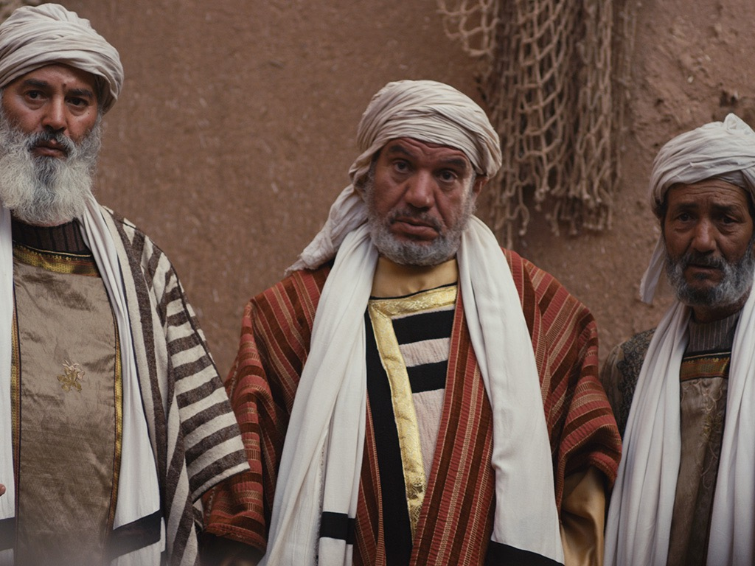
مقاومة الملك
98-119
قاوم القادة اليهود يسوع في عدة صراعات حول شخصه ومعجزاته وكانوا يتساءلون حول سلطته كالله
تلخيص القسم معتمد على ج. دوايت بنتيكوست، تنا وأقوال وأعمال يسوع المسيح (جراند رابيدز: زوندرفان، 1981)
د. ريك جريفيث • مؤسسة الدراسات اللاهوتية الأردنية • BibleStudyDownloads.org

Slide 2
ملخص كتاب بنتيكوست
تقديم الملك
أصالة الملك
جدل حول الملك
إعداد الإثني عشر من قبل الملك
مقاومة الملك
تحضير التلاميذ من قبل الملك
التقديم الرسمي للملك
التحضير لموت الملك
رفض الملك
قيامة الملك

Slide 3

زيادة الاستقطاب
القيامة
التحضير
لموت
تحضير
التلاميذ
إعداد
أصالة
تقديم
الجدل
مقاومة
التقديم
الرفض
Notes:
The Life of Christ brought increasing polarization. The more Jesus showed about himself, the greater the resistance to him and his message. Also, the more intense the controversy leading to opposition, the higher priority Christ placed on preparing his men for when he would be gone. The climactic rejection when he presented himself as king of Israel a the Triumphal Entry resulted in rejection to the point of crucifixion followed by the victory of resurrection.
Introduction of the King
Authentication of the King
Controversy over the King
Instruction of the Twelve by the King
Opposition to the King
Preparation of the Disciples by the King
Official Presentation of the King
Preparation for the Death of the King
Rejection of the King
Resurrection of the King

Slide 4
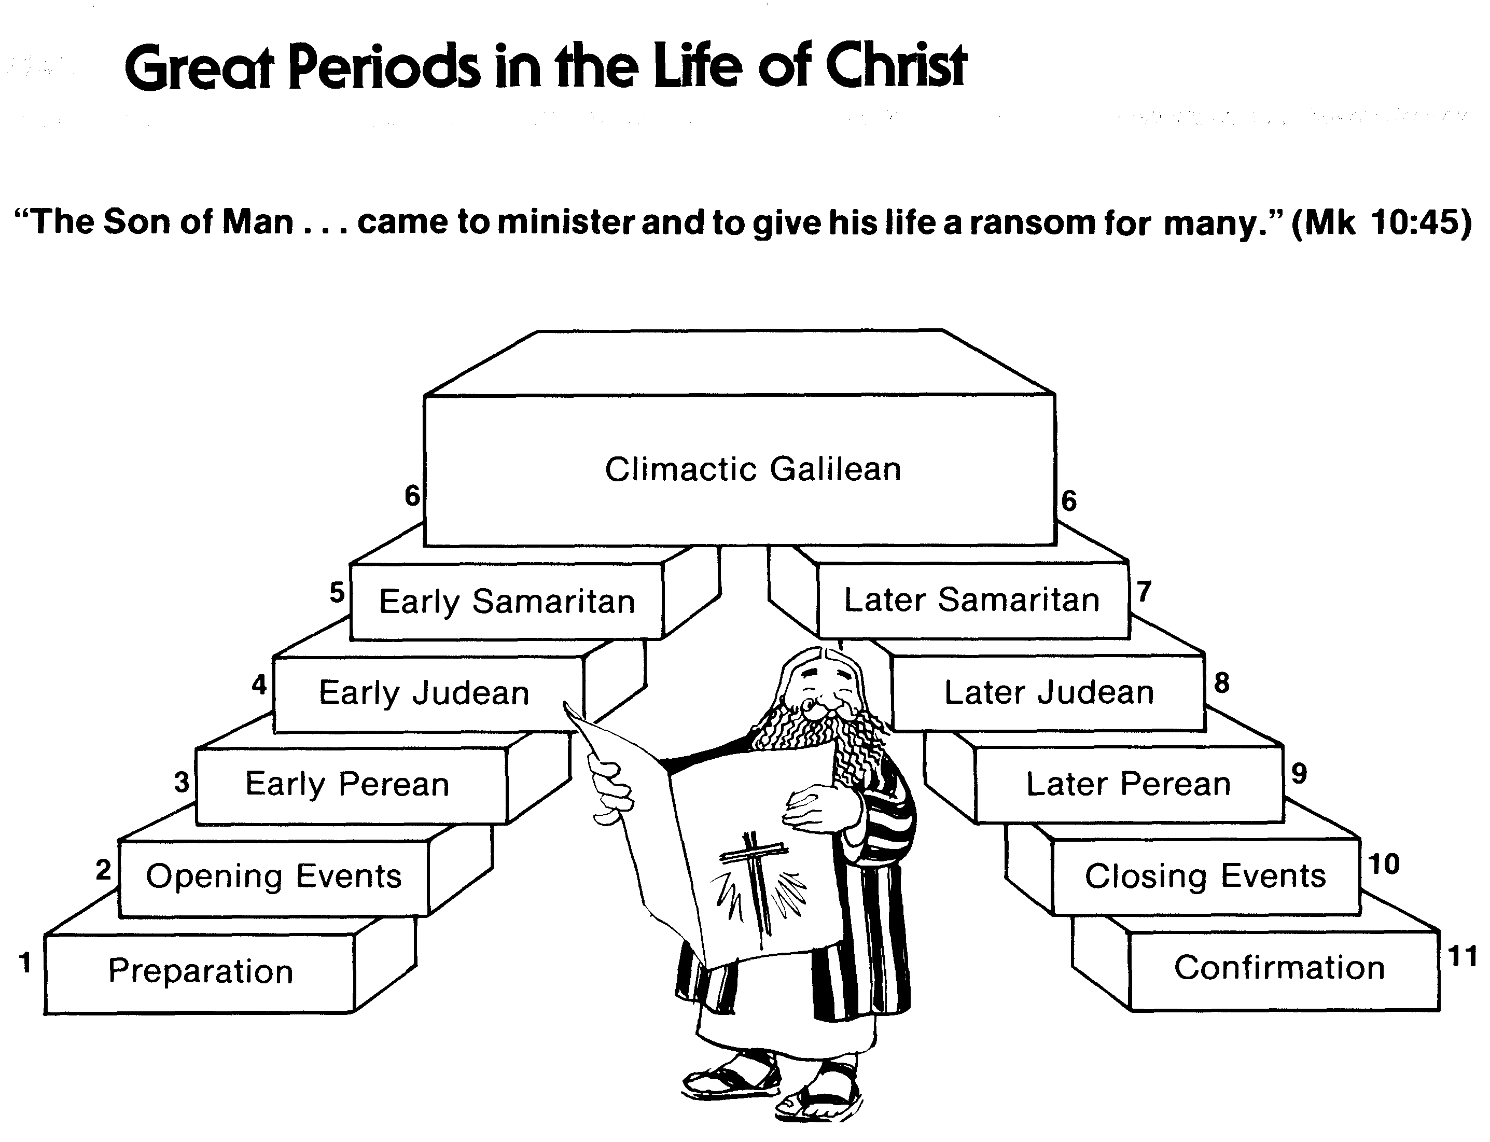
فترات عظيمة في حياة المسيح
55
لأن ابن الإنسان أيضاً لم يأت ليُخدم بل ليخدم وليبذل نفسه فدية عن كثيرين (مرقس 10: 45)
الجليلي في ذروته
السامري المتأخر
السامري المبكر
اليهودي المتأخر
اليهودي المبكر
البيري المبكر
البيري المتأخر
الأحداث الختامية
الأحداث الإفتتاحية
التأكيد
التحضير
محاضرة السير عبر العهد الجديد (استخدمت بإذن)
Notes:
The Walk Thru outline of the life of Christ forms a chiasm or literary arrangement with repeating elements in the opposite order. This structure makes Confirmation parallel to Preparation, Closing Events parallel to Opening Events, etc. until the only event without parallel becomes the focus: Climatic Galilean. Such an arrangement of material was common in ancient antiquity and is seen in both the OT (e.g., Zephaniah) and the NT (1 Thess) where the central teaching appears in the middle of each writing.
_______
LC-00-Syllabus-63
LC-01-Introduction-265
LC-05-Opposition-4

Slide 5

أ. صراع في عيد المظال
98
يوحنا 7: 11-52
يدافع يسوع عن سلطته وشخصه في عيد المظال، مما يعطي
اليهود غير المؤمنين دافعًا إضافيًا لقتله
Notes:
John 7:11 The Jewish leaders tried to find him at the festival and kept asking if anyone had seen him. ¹² There was a lot of grumbling about him among the crowds. Some argued, “He’s a good man,” but others said, “He’s nothing but a fraud who deceives the people.” ¹³ But no one had the courage to speak favorably about him in public, for they were afraid of getting in trouble with the Jewish leaders.
John 7:14 Then, midway through the festival, Jesus went up to the Temple and began to teach. ¹⁵ The peopleª were surprised when they heard him. “How does he know so much when he hasn’t been trained?” they asked.
John 7:16 So Jesus told them, “My message is not my own; it comes from God who sent me. ¹⁷ Anyone who wants to do the will of God will know whether my teaching is from God or is merely my own. ¹⁸ Those who speak for themselves want glory only for themselves, but a person who seeks to honor the one who sent him speaks truth, not lies. ¹⁹ Moses gave you the law, but none of you obeys it! In fact, you are trying to kill me.”
John 7:20 The crowd replied, “You’re demon possessed! Who’s trying to kill you?”
John 7:21 Jesus replied, “I did one miracle on the Sabbath, and you were amazed. ²² But you work on the Sabbath, too, when you obey Moses’ law of circumcision. (Actually, this tradition of circumcision began with the patriarchs, long before the law of Moses.) ²³ For if the correct time for circumcising your son falls on the Sabbath, you go ahead and do it so as not to break the law of Moses. So why should you be angry with me for healing a man on the Sabbath? ²⁴ Look beneath the surface so you can judge correctly.”
Is Jesus the Messiah?
John 7:25 Some of the people who lived in Jerusalem started to ask each other, “Isn’t this the man they are trying to kill? ²⁶ But here he is, speaking in public, and they say nothing to him. Could our leaders possibly believe that he is the Messiah? ²⁷ But how could he be? For we know where this man comes from. When the Messiah comes, he will simply appear; no one will know where he comes from.”
John 7:28 While Jesus was teaching in the Temple, he called out, “Yes, you know me, and you know where I come from. But I’m not here on my own. The one who sent me is true, and you don’t know him. ²⁹ But I know him because I come from him, and he sent me to you.” ³⁰ Then the leaders tried to arrest him; but no one laid a hand on him, because his timeª had not yet come.
John 7:31 Many among the crowds at the Temple believed in him. “After all,” they said, “would you expect the Messiah to do more miraculous signs than this man has done?”
John 7:32 When the Pharisees heard that the crowds were whispering such things, they and the leading priests sent Temple guards to arrest Jesus. ³³ But Jesus told them, “I will be with you only a little longer. Then I will return to the one who sent me. ³⁴ You will search for me but not find me. And you cannot go where I am going.”
John 7:35 The Jewish leaders were puzzled by this statement. “Where is he planning to go?” they asked. “Is he thinking of leaving the country and going to the Jews in other lands?ª Maybe he will even teach the Greeks! ³⁶ What does he mean when he says, ‘You will search for me but not find me,’ and ‘You cannot go where I am going’?”
Jesus Promises Living Water
John 7:37 On the last day, the climax of the festival, Jesus stood and shouted to the crowds, “Anyone who is thirsty may come to me! ³⁸ Anyone who believes in me may come and drink! For the Scriptures declare, ‘Rivers of living water will flow from his heart.’”ª ³⁹ (When he said “living water,” he was speaking of the Spirit, who would be given to everyone believing in him. But the Spirit had not yet been given,ª because Jesus had not yet entered into his glory.)
Division and Unbelief
John 7:40 When the crowds heard him say this, some of them declared, “Surely this man is the Prophet we’ve been expecting.”ª ⁴¹ Others said, “He is the Messiah.” Still others said, “But he can’t be! Will the Messiah come from Galilee? ⁴² For the Scriptures clearly state that the Messiah will be born of the royal line of David, in Bethlehem, the village where King David was born.”ª ⁴³ So the crowd was divided about him. ⁴⁴ Some even wanted him arrested, but no one laid a hand on him.
John 7:45 When the Temple guards returned without having arrested Jesus, the leading priests and Pharisees demanded, “Why didn’t you bring him in?”
John 7:46 “We have never heard anyone speak like this!” the guards responded.
John 7:47 “Have you been led astray, too?” the Pharisees mocked. ⁴⁸ “Is there a single one of us rulers or Pharisees who believes in him? ⁴⁹ This foolish crowd follows him, but they are ignorant of the law. God’s curse is on them!”
John 7:50 Then Nicodemus, the leader who had met with Jesus earlier, spoke up. ⁵¹ “Is it legal to convict a man before he is given a hearing?” he asked.
John 7:52 They replied, “Are you from Galilee, too? Search the Scriptures and see for yourself—no prophet ever comesª from Galilee!”

Slide 6
1. استجواب سلطة المسيح
يوحنا 7: 11-15
تتساءل حشود أورشليم كيف يمكن للمسيح أن يعلم بسلطان دون تدريب حاخامي لإعداده ليكشف عن طبيعته الحقيقية.
Notes:
John 7:11 The Jewish leaders tried to find him at the festival and kept asking if anyone had seen him. ¹² There was a lot of grumbling about him among the crowds. Some argued, “He’s a good man,” but others said, “He’s nothing but a fraud who deceives the people.” ¹³ But no one had the courage to speak favorably about him in public, for they were afraid of getting in trouble with the Jewish leaders.
John 7:14 Then, midway through the festival, Jesus went up to the Temple and began to teach. ¹⁵ The people were surprised when they heard him. “How does he know so much when he hasn’t been trained?” they asked.

Slide 7
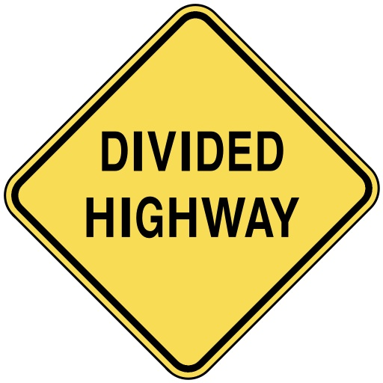
آراء منقسمة
يوحنا 7

Slide 8
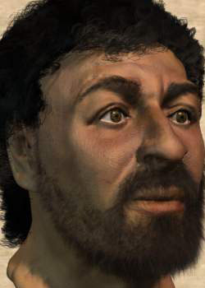
من يكون هذا؟
Notes:
This is Jesus—or at least one of the most recent depictions of him by bone specialists who studied first-century skeletons.

Slide 9
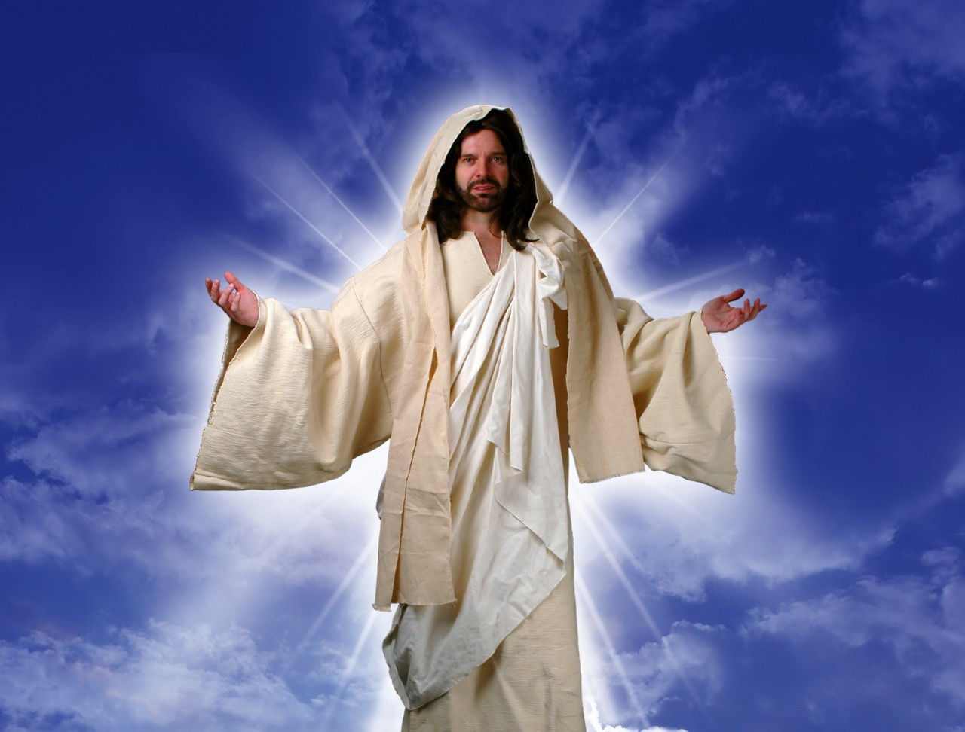
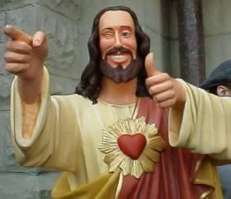
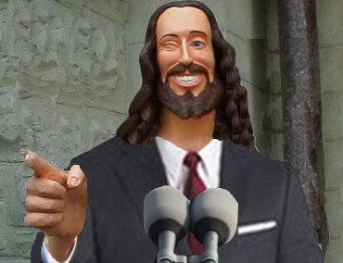
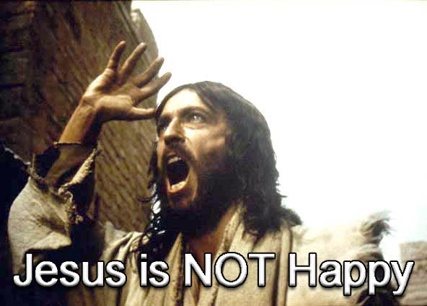
مـاذا تـعـتـقـد عـن يـسـوع؟
يسوع ليس سعيدا
Notes:
Some of us think Jesus is not very cool—so we make him out to be according to our preferences.

Slide 10
Black

Slide 11

Touched by an Angel
المسلسل التلفزيوني الشهير "لَمَسه ملاك" مليء بالروحانية ولكنه لم يذكر يسوع أبدًا
لمست من قبل ملاك
Notes:
The popular TV series "Touched by an Angel" is filled with spirituality but never mentions Jesus

Slide 12
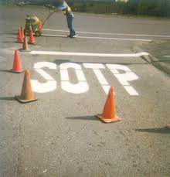
والمؤمنون يعتبرون أغبياء

Slide 13

Four Christmases
أربعة
أعياد ميلاد
Notes:
Jesus is also NEVER noted in the popular movie "أربعة أعياد ميلاد"

Slide 14
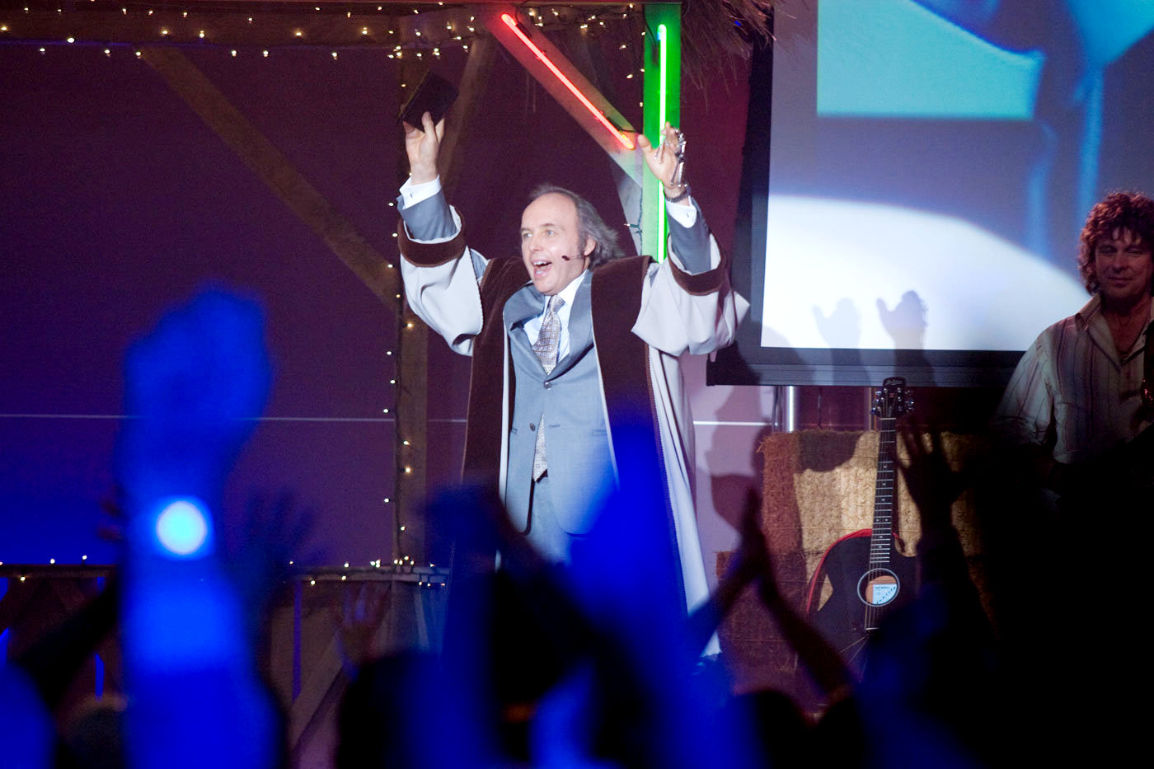
(أربعة أعياد ميلاد) القس فيل
Notes:
But Christianity is mocked with the disrespectful appearance of Pastor Phil.

Slide 15
Black

Slide 16

موضوعنا اليوم
لماذا يمتلك الناس آراء منقسمة بخصوص المسيح؟

Slide 17
شخص مثير للجدل في يوحنا 1-6
الجليليون
المؤمنون في
يوحنا 1-4
المرأة السامرية
يوحنا المعمدان
نيقوديموس
يهود الفصح
التلاميذ
خط الإيمان
غير المؤمنون
في يوحنا 5-6
قادة أورشليم
شعب الجليل
تلاميذ هجروا يسوع

Slide 18
موضوعنا اليوم
لماذا يمتلك الناس آراء منقسمة بخصوص المسيح؟
3 أسباب

Slide 19
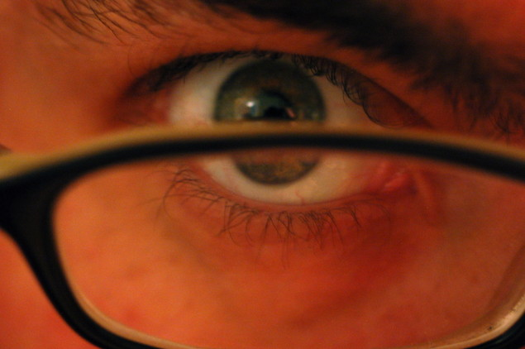
1. يتخذ كل فرد قراره الخاص بشأن المسيح (يوحنا 7: 1-13)
لماذا لدى الناس مثل هذه الآراء المنقسمة حول المسيح؟

Slide 20
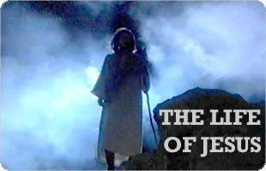
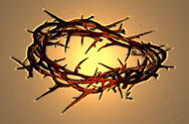
إخوة يسوع
الانتقال بين الخدمة فب الجليل وعيد المظال في أورشليم
أَنَّهُ لَيْسَ أَحَدٌ يَعْمَلُ شَيْئًا فِي الْخَفَاءِ وَهُوَ يُرِيدُ أَنْ يَكُونَ عَلاَنِيَةً. إِنْ كُنْتَ تَعْمَلُ هذِهِ الأَشْيَاءَ فَأَظْهِرْ نَفْسَكَ لِلْعَالَمِ(7: 4)
وَكَانَ عِيدُ الْيَهُودِ، عِيدُ الْمَظَالِّ، قَرِيبًا (7: 2)
إنَّ وَقْتِي لَمْ يَحْضُرْ بَعْدُ، وَأَمَّا وَقْتُكُمْ فَفِي كُلِّ حِينٍ حَاضِرٌ
لأَنَّ وَقْتِي لَمْ يُكْمَلْ بَعْدُ

Slide 21

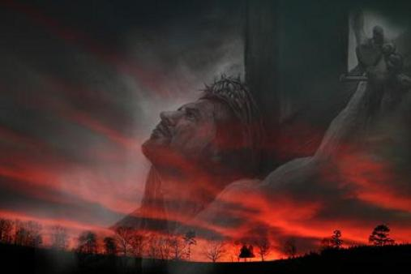
الساعة في إنجيل يوحنا
ورود كلمة ساعة في ترجمة NASB (باليونانية كلها أورا ما عدا 7: 6، 8)
2: 4 لم تأت ساعتي بعد
7: 6 إن وقتي (كيروس باليونانية) لم يحضر بعد
7: 8 لأن وقتي (كيروس باليونانية) لم يكمل بعد
7: 30 لأن ساعته لم تكن قد جاءت بعد

Slide 22
Black
Notes:
Jerusalem crowds also divided (10-13)

Slide 23
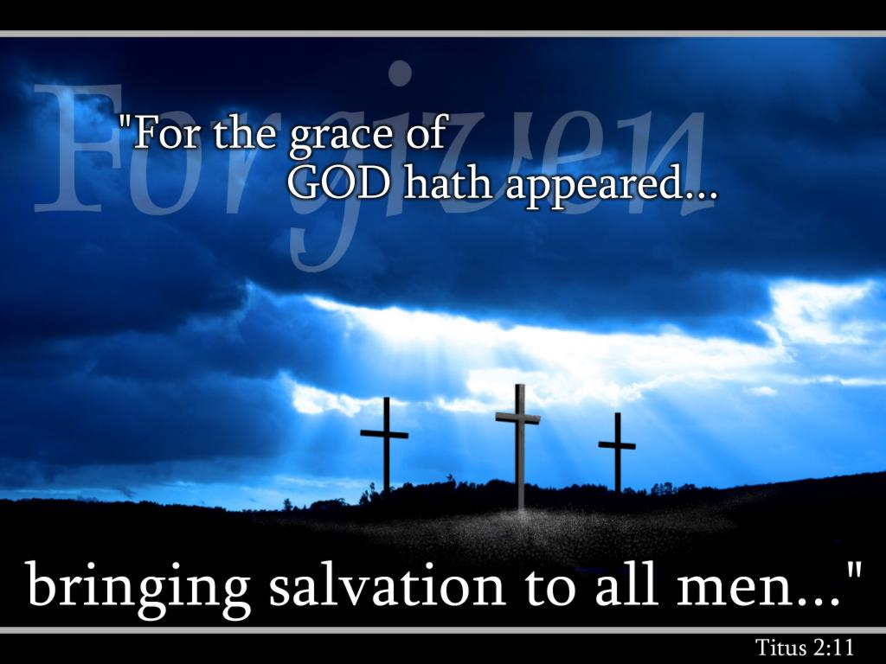
على كل واحد منّا أن يقرر من هو المسيح، وأيضاً يمنح هذا الخيار للآخرين

Slide 24
1. يتخذ كل فرد قراره الخاص بشأن المسيح (يوحنا 7: 1-13)
لماذا لدى الناس مثل هذه الآراء المنقسمة حول المسيح؟

Slide 25
2. تفسير المسيح
يوحنا 7: 16-24
يطلب المسيح من الفريسيين أن يخضعوا لتعاليمه باعتبارها
ذات سلطان كما كانت لموسى، لأن الآب (وليس الحاخامات)
هو من علمه
Notes:
John 7:11 The Jewish leaders tried to find him at the festival and kept asking if anyone had seen him. ¹² There was a lot of grumbling about him among the crowds. Some argued, “He’s a good man,” but others said, “He’s nothing but a fraud who deceives the people.” ¹³ But no one had the courage to speak favorably about him in public, for they were afraid of getting in trouble with the Jewish leaders.
John 7:14 Then, midway through the festival, Jesus went up to the Temple and began to teach. ¹⁵ The peopleª were surprised when they heard him. “How does he know so much when he hasn’t been trained?” they asked.
John 7:16 So Jesus told them, “My message is not my own; it comes from God who sent me. ¹⁷ Anyone who wants to do the will of God will know whether my teaching is from God or is merely my own. ¹⁸ Those who speak for themselves want glory only for themselves, but a person who seeks to honor the one who sent him speaks truth, not lies. ¹⁹ Moses gave you the law, but none of you obeys it! In fact, you are trying to kill me.”
John 7:20 The crowd replied, “You’re demon possessed! Who’s trying to kill you?”
John 7:21 Jesus replied, “I did one miracle on the Sabbath, and you were amazed. ²² But you work on the Sabbath, too, when you obey Moses’ law of circumcision. (Actually, this tradition of circumcision began with the patriarchs, long before the law of Moses.) ²³ For if the correct time for circumcising your son falls on the Sabbath, you go ahead and do it so as not to break the law of Moses. So why should you be angry with me for healing a man on the Sabbath? ²⁴ Look beneath the surface so you can judge correctly.”
Is Jesus the Messiah?
John 7:25 Some of the people who lived in Jerusalem started to ask each other, “Isn’t this the man they are trying to kill? ²⁶ But here he is, speaking in public, and they say nothing to him. Could our leaders possibly believe that he is the Messiah? ²⁷ But how could he be? For we know where this man comes from. When the Messiah comes, he will simply appear; no one will know where he comes from.”
John 7:28 While Jesus was teaching in the Temple, he called out, “Yes, you know me, and you know where I come from. But I’m not here on my own. The one who sent me is true, and you don’t know him. ²⁹ But I know him because I come from him, and he sent me to you.” ³⁰ Then the leaders tried to arrest him; but no one laid a hand on him, because his timeª had not yet come.
John 7:31 Many among the crowds at the Temple believed in him. “After all,” they said, “would you expect the Messiah to do more miraculous signs than this man has done?”
John 7:32 When the Pharisees heard that the crowds were whispering such things, they and the leading priests sent Temple guards to arrest Jesus. ³³ But Jesus told them, “I will be with you only a little longer. Then I will return to the one who sent me. ³⁴ You will search for me but not find me. And you cannot go where I am going.”
John 7:35 The Jewish leaders were puzzled by this statement. “Where is he planning to go?” they asked. “Is he thinking of leaving the country and going to the Jews in other lands?ª Maybe he will even teach the Greeks! ³⁶ What does he mean when he says, ‘You will search for me but not find me,’ and ‘You cannot go where I am going’?”
Jesus Promises Living Water
John 7:37 On the last day, the climax of the festival, Jesus stood and shouted to the crowds, “Anyone who is thirsty may come to me! ³⁸ Anyone who believes in me may come and drink! For the Scriptures declare, ‘Rivers of living water will flow from his heart.’”ª ³⁹ (When he said “living water,” he was speaking of the Spirit, who would be given to everyone believing in him. But the Spirit had not yet been given,ª because Jesus had not yet entered into his glory.)
Division and Unbelief
John 7:40 When the crowds heard him say this, some of them declared, “Surely this man is the Prophet we’ve been expecting.”ª ⁴¹ Others said, “He is the Messiah.” Still others said, “But he can’t be! Will the Messiah come from Galilee? ⁴² For the Scriptures clearly state that the Messiah will be born of the royal line of David, in Bethlehem, the village where King David was born.”ª ⁴³ So the crowd was divided about him. ⁴⁴ Some even wanted him arrested, but no one laid a hand on him.
John 7:45 When the Temple guards returned without having arrested Jesus, the leading priests and Pharisees demanded, “Why didn’t you bring him in?”
John 7:46 “We have never heard anyone speak like this!” the guards responded.
John 7:47 “Have you been led astray, too?” the Pharisees mocked. ⁴⁸ “Is there a single one of us rulers or Pharisees who believes in him? ⁴⁹ This foolish crowd follows him, but they are ignorant of the law. God’s curse is on them!”
John 7:50 Then Nicodemus, the leader who had met with Jesus earlier, spoke up. ⁵¹ “Is it legal to convict a man before he is given a hearing?” he asked.
John 7:52 They replied, “Are you from Galilee, too? Search the Scriptures and see for yourself—no prophet ever comesª from Galilee!”

Slide 26
3. استجواب شخص المسيح
يوحنا 7: 25-27
لا تصدق الجموع أن يسوع هو المسيح لسبب أن الفريسيين لم يقبضوا عليه ويفترضون أنه ولد في الناصرة
Notes:
Is Jesus the Messiah?
John 7:25 Some of the people who lived in Jerusalem started to ask each other, “Isn’t this the man they are trying to kill? ²⁶ But here he is, speaking in public, and they say nothing to him. Could our leaders possibly believe that he is the Messiah? ²⁷ But how could he be? For we know where this man comes from. When the Messiah comes, he will simply appear; no one will know where he comes from.”

Slide 27
4. تفسير المسيح
يوحنا 7: 28-30
يقول المسيح أن أصله سماوي (وليس الناصرة) والله أبوه (وليس يوسف) لذلك فإن هويته هي ابن الله
Notes:
John 7:28 While Jesus was teaching in the Temple, he called out, “Yes, you know me, and you know where I come from. But I’m not here on my own. The one who sent me is true, and you don’t know him. ²⁹ But I know him because I come from him, and he sent me to you.” ³⁰ Then the leaders tried to arrest him; but no one laid a hand on him, because his timeª had not yet come.

Slide 28
5. التجاوب
يوحنا 7: 31-36
الرد على المسيح هو أنه بينما يؤمن البعض، فإن القادة يلتزمون أكثر بقتله بتهمة التجديف، حتى لو حاول الهروب
Notes:
John 7:31 Many among the crowds at the Temple believed in him. “After all,” they said, “would you expect the Messiah to do more miraculous signs than this man has done?”
John 7:32 When the Pharisees heard that the crowds were whispering such things, they and the leading priests sent Temple guards to arrest Jesus. ³³ But Jesus told them, “I will be with you only a little longer. Then I will return to the one who sent me. ³⁴ You will search for me but not find me. And you cannot go where I am going.”
John 7:35 The Jewish leaders were puzzled by this statement. “Where is he planning to go?” they asked. “Is he thinking of leaving the country and going to the Jews in other lands?ª Maybe he will even teach the Greeks! ³⁶ What does he mean when he says, ‘You will search for me but not find me,’ and ‘You cannot go where I am going’?”

Slide 29
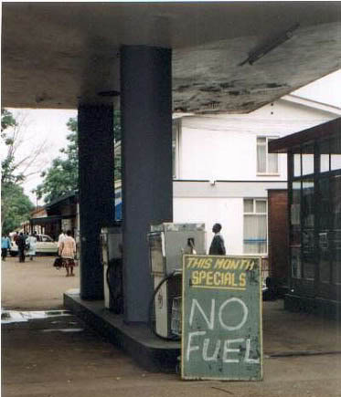

2. يرفض الناس تعاليم المسيح لأنهم يرفضون الله (يوحنا 7: 14-36)

Slide 30
Black

Slide 31
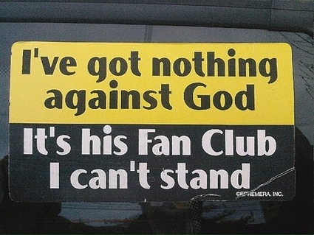
ليس لدي شيء ضد الله
إنه نادي المعجبين الخاص به الذي لا أطيقه

Slide 32
1. يتخذ كل فرد قراره الخاص بشأن المسيح (يوحنا 7: 1-13)
لماذا لدى الناس مثل هذه الآراء المنقسمة حول المسيح؟

Slide 33
2. يرفض الناس تعاليم المسيح لأنهم يرفضون الله (يوحنا 7: 14-36)

Slide 34
6. دعوة المسيح
يوحنا 7: 37-52
يُظهر استخدام يسوع لمراسم الإبريق الذهبي في العيد (= إعطاء الله الماء لإسرائيل) أنه قادر على إشباع عطشهم الروحي
Notes:
Jesus Promises Living Water
John 7:37 On the last day, the climax of the festival, Jesus stood and shouted to the crowds, “Anyone who is thirsty may come to me! ³⁸ Anyone who believes in me may come and drink! For the Scriptures declare, ‘Rivers of living water will flow from his heart.’”ª ³⁹ (When he said “living water,” he was speaking of the Spirit, who would be given to everyone believing in him. But the Spirit had not yet been given,ª because Jesus had not yet entered into his glory.)
Division and Unbelief
John 7:40 When the crowds heard him say this, some of them declared, “Surely this man is the Prophet we’ve been expecting.”ª ⁴¹ Others said, “He is the Messiah.” Still others said, “But he can’t be! Will the Messiah come from Galilee? ⁴² For the Scriptures clearly state that the Messiah will be born of the royal line of David, in Bethlehem, the village where King David was born.”ª ⁴³ So the crowd was divided about him. ⁴⁴ Some even wanted him arrested, but no one laid a hand on him.
John 7:45 When the Temple guards returned without having arrested Jesus, the leading priests and Pharisees demanded, “Why didn’t you bring him in?”
John 7:46 “We have never heard anyone speak like this!” the guards responded.
John 7:47 “Have you been led astray, too?” the Pharisees mocked. ⁴⁸ “Is there a single one of us rulers or Pharisees who believes in him? ⁴⁹ This foolish crowd follows him, but they are ignorant of the law. God’s curse is on them!”
John 7:50 Then Nicodemus, the leader who had met with Jesus earlier, spoke up. ⁵¹ “Is it legal to convict a man before he is given a hearing?” he asked.
John 7:52 They replied, “Are you from Galilee, too? Search the Scriptures and see for yourself—no prophet ever comesª from Galilee!”

Slide 35

3. ادعاء يسوع بمنح الحياة البدية دائماً يجد استجابات مختلطة (7: 37-52)
لماذا لدى الناس مثل هذه الآراء المنقسمة حول المسيح؟

Slide 36
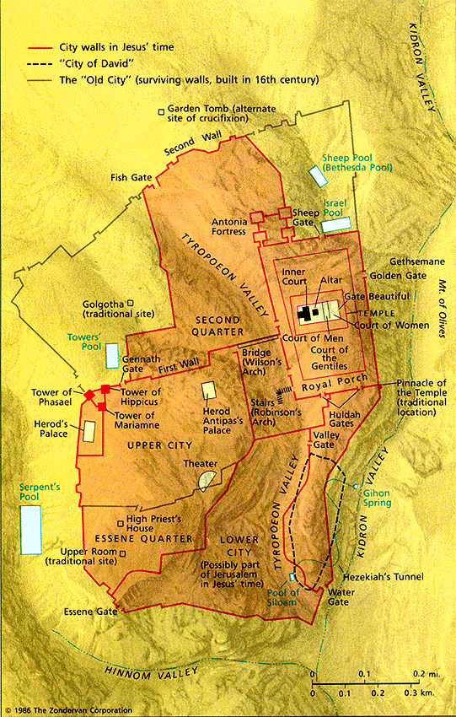
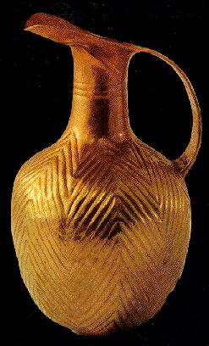
أورشليم
21
عيد المظال

Slide 37
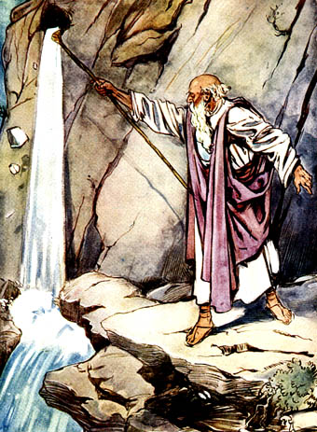
ماء من الصخرة
عدد 20: 8-11

Slide 38

إِنْ عَطِشَ أَحَدٌ فَلْيُقْبِلْ إِلَيَّ وَيَشْرَبْ. مَنْ آمَنَ بِي، كَمَا قَالَ الْكِتَابُ، تَجْرِي مِنْ بَطْنِهِ أَنْهَارُ مَاءٍ حَيٍّ (يوحنا 7: 37-38)
Notes:
When Jesus added, As the Scripture has said, He did not identify the Old Testament passage(s) He had in mind. But He may have thought of Psalm 78:15-16 and Zechariah 14:8 (cf. Ezek. 47:1-11; Rev. 22:1-2).
John F. Walvoord, Roy B. Zuck and Dallas Theological Seminary., The Bible Knowledge Commentary : An Exposition of the Scriptures (Wheaton, IL: Victor Books, 1983-c1985), 2:301.

Slide 39
Black

Slide 40


Black
Notes:
Toyota’s Secret Weapon: A Car That Drinks Water
https://www.youtube.com/watch?v=twexksm_yRA
Accessed 17 October 2025
50,355 views Jul 21, 2025
Toyota is reportedly developing a groundbreaking water-powered engine that could redefine the future of clean transportation. Unlike electric vehicles that rely on lithium batteries or hydrogen cars requiring high-pressure tanks, this engine uses real-time electrolysis to convert water into hydrogen on demand. It’s compact, eco-friendly, and astonishingly simple—requiring only distilled water to run. With near-zero emissions and no dependency on rare earth metals, this innovation could offer a more accessible and sustainable alternative to EVs. In this video, we explore how Toyota’s new engine works, why it matters, and whether it could truly disrupt the global automotive landscape. Let’s dive in.
____________
See also the video about Stanley Meyer, a Christian man who invested a water-powered car but died a mysterious death in 1998. He apprarently was poisoned after 200,000 patents! His car was also stolen from his garage soon after and never seen again.
What Happened To The Man Who Invented The Water Powered Car?
….. But Apparently Not Everyone Was A Big Fan Of It So What Actually Happened To Him?
63,415 views Premiered Sep 9, 2023 ✪
https://www.youtube.com/watch?v=egM2y8-kHd0
0:03
not need to run on oil-based fuels or
0:06
that you've been told a lie this whole
0:09
time
0:10
what if it was a big cover-up because
0:12
the people in power wanted you to keep
0:15
buying Fuel and what if watered power
0:18
cars already exist just that the people
0:22
in power wanted to keep you in the dark
0:24
about it for their own agenda
0:27
well today we'll be taking a look at the
0:30
mysterious circumstances surrounding the
0:33
death of a man who claimed to have
0:35
invented the water powered car
0:37
[Music]
0:56
rumors have always been floating around
0:59
that there is a single Elite group of
1:01
people in charge of the whole world
1:04
controlling everything from the food you
1:07
consume to the things you watch but
1:09
that's just the thing it has always been
1:12
rumors never once was there any real
1:15
proof however today's story might just
1:18
shed light on what has been going on in
1:21
the shadows well you see with the way
1:25
the economy is nowadays I don't think
1:27
I'm alone when I wish cars would just
1:29
run on the most abundant liquid on Earth
1:32
but the difference here is that this man
1:34
actually did it
1:37
born in 1940 Stanley Mayer was sort of a
1:41
prodigy and ever since a young age he
1:44
had been building and creating things to
1:47
give you context on how much of a genius
1:49
this guy is he ended up applying for 200
1:53
000 patents throughout his lifetime with
1:56
the patent office putting him on a fast
1:58
track program in 1989 that allowed him
2:01
to have priority when it came to
2:03
approval of his patents that was nine
2:07
brand new ideas every other day and well
2:10
he still somehow managed to squeeze in
2:13
time to work on the Gemini Space Program
2:16
with NASA where he developed technology
2:18
that was leaps ahead of its time and
2:22
even though the majority of his initial
2:24
work was solely funded in 1993 Stanley
2:28
won the award of best inventor and
2:30
received support from countries like
2:32
Canada Sweden and even England and it's
2:36
important to understand that countries
2:38
would have done their due diligence
2:40
before throwing money at someone in the
2:42
name of supporting them am I right
2:45
even though the majority of his patents
2:47
were accepted by the patent office today
2:49
we just want to focus on one specific
2:52
one the one that could have cost him his
2:55
life the patent of the water powered car
2:59
well you see the reason behind this
3:02
patent was that in 1975 Saudi Arabia cut
3:06
the oil supply to the United States
3:08
causing the oil prices to soar and as
3:11
the oil reserves were slowly getting
3:13
depleted it resulted in corporations
3:16
going bankrupt one after another the car
3:20
demand dropped to an all-time low
3:23
even though alternative fuel sources
3:25
were being pushed hard Stanley wanted a
3:28
foolproof solution that will eradicate
3:30
the use of oil once and for all making
3:33
it possible for the country's economy to
3:36
not be dependent on the oil supply his
3:39
solution to it was the hydrogen car
3:41
you see Stanley realized that he could
3:44
harness hydrogen by splitting atoms of
3:47
water through the process of
3:49
electrolysis into its basic forms oxygen
3:52
and hydrogen and since hydrogen was
3:54
combustible it would be used to power
3:57
the car while fresh oxygen would be
3:59
released through the exhaust essentially
4:02
powering an automobile by water
4:05
it was a miracle and after a few more
4:08
months of tinkering Stanley had a fully
4:11
running buggy that was powered by water
4:13
people flocked from all over the country
4:16
to see how this miracle could
4:18
potentially Resurrect The American
4:20
economy even showing it to Skeptics like
4:23
Professor Michael Langton the dean of
4:25
engineering at Mary College in London
4:28
who for the longest time claimed that it
4:30
wasn't possible until he saw Stanley
4:33
Meyer's creation
4:35
well it wasn't just the world that was
4:38
watching Stanley Meyer and his water
4:40
powered cars zip about using only water
4:43
other people were watching as well
4:48
through his efforts Stanley was slowly
4:51
rising up to be one of science's
4:53
upcoming stars that was until 1996. that
4:59
was the year everything seemed to have
5:01
gone wrong for Stanley
5:03
allegations started to rise up that the
5:06
hydrogen-powered car was a hoax and was
5:09
all a ploy to funnel money out of
5:11
investors leading to Meyer being slapped
5:14
with countless lawsuits Meyer was
5:17
eventually dragged to court where his
5:19
water-fueled car was examined and taken
5:22
apart by three expert Witnesses who then
5:25
went on to testify in court that there
5:27
was nothing revolutionary about the fuel
5:30
cell at all claiming that it lacked the
5:33
necessary science to actually power a
5:36
working car
5:37
quote one of the witnesses creating
5:39
hydrogen with simple electrolysis is
5:42
nothing new
5:43
being deemed as illegitimate this was
5:46
probably the biggest hit for Meyer and
5:49
when the court decided that Meyer repay
5:51
all his investors it really shut him
5:54
down
5:55
sudden lack of funding minty had to stop
5:58
all development this was a huge blow to
6:01
Meyer as he was on the verge of
6:03
bankruptcy his patents were picked off
6:06
him one by one in a final attempt to
6:09
stay afloat
6:12
person that he was Stanley never once
6:15
caved in and still continued to trudge
6:18
along in an attempt to independently
6:20
develop his water powered car now
6:23
operating from his garage things were at
6:26
an all-time low and little by little the
6:29
resources dried up
6:31
Stanley and his brother Stefan continued
6:34
to lobby for investors to fund his
6:36
research but due to the court order
6:39
nobody took up his offer
6:41
until one day when an anonymous phone
6:44
call came in at the Meyer residence with
6:47
someone on the other end saying that
6:49
they were big fans of Meyer's work and
6:52
would like to arrange a meeting to
6:53
discuss a potential investment the Meyer
6:57
Brothers immediately jumped at the
6:59
opportunity and the meeting was set
7:02
21st of March 1998 was the fateful day
7:07
Story Goes that the Meyer Brothers
7:10
arrived early at the restaurant where
7:12
they met with two Belgian investors
7:14
allegedly Stanley ordered cranberry
7:17
juice and upon toasting to the closing
7:19
of a deal Stanley grabbed his neck and
7:22
ran out of the restaurant to the car
7:24
park where he violently vomited before
7:26
yelling they poisoned me and that was it
7:30
Stanley passed away leaving behind
7:33
whatever was left of his patents as well
7:36
as his water powered car
7:39
even though Stanley's brother Stefan was
7:42
offered multiple deals to buy out the
7:45
water powered car countless times by
7:47
governments and mysterious and Anonymous
7:49
parties he turned them all down in
7:52
respect for his late brother
7:54
and two weeks after the offer was
7:57
declined Stanley Myers garage was broken
8:00
into and the water power car stolen and
8:03
was never seen again
8:06
well the official statement released by
8:09
the authorities was that Stanley Meyer
8:11
died from a cerebral aneurysm but
8:14
unofficially things did not really line
8:17
up
8:18
many including Stanley's brother came
8:20
forward saying that the symptoms that
8:23
were being shown on that day did not
8:25
line up with a brain aneurysm
8:28
furthermore it was later revealed that
8:30
the two Belgian investors that the Myers
8:33
met with became untraceable and the
8:35
identification that they went by simply
8:38
did not exist leading to speculation
8:40
that something more Sinister was going
8:43
on behind the scenes
8:45
it's easy to understand the suspicion
8:48
there were billions to be made and the
8:51
titans of Industry have always opposed
8:54
competition from the Common Man
8:57
even if it saved Humanity as we know it
9:00
they'd rather protect their own fortunes
9:03
through Shady backroom deals
9:06
and for the most part this strategy has
9:09
stood the test of time
9:11
Bloomberg analysts estimate that by 2048
9:14
over 62 percent of America's wealth will
9:18
belong to its wealthiest one percent
9:21
and that would crush the previous
9:23
all-time high of 51 percent and that
9:27
record was set in 1928 just a year
9:31
before the Great Depression
9:33
in the next 25 years America's median
9:37
annual income is estimated to rise just
9:40
0.3 percent
9:43
so if you fall somewhere in the upper
9:45
middle don't hold your breath waiting
9:48
for a life jacket
9:49
because even during periods of collapse
9:52
or stagnancy Elite members of society
9:55
protect themselves from major Fallout
9:58
they can get even richer because they
10:01
have connections in private markets we
10:03
can't even access
10:05
luckily today's sponsor Masterworks is
10:09
disrupting the elites by giving you an
10:11
unprecedented chance to potentially grow
10:14
your wealth with the oldest luxury asset
10:17
in the books it's Blue Chip Museum grade
10:20
fine art
10:22
98 of the ultra-rich allocate at least
10:25
five percent of their portfolio to Art I
10:29
know I know but that's the genius of
10:32
Masterworks now you can do it too in
10:35
just a few short years Masterworks has
10:38
delivered tens of millions in net
10:40
returns to investors like you I haven't
10:43
invested or started my collection just
10:46
yet and like any investment performance
10:49
of exited Investments is not
10:51
representative of artwork that has not
10:54
yet sold and past performance is not
10:56
indicative of future results so it's no
10:59
surprise over eight hundred thousand
11:01
people have signed up so far and since
11:04
so many of you guys are creating
11:06
accounts they're extending your chance
11:08
to skip the wait list just click the
11:11
link in the description and now back to
11:14
the video
11:16
a water-powered car is a very
11:18
fascinating story but if we take a look
11:21
at the science for a little bit the
11:23
problem with hydrogen cars and why they
11:26
are not being mass produced is due to
11:28
the fact that in conventional
11:30
electrolysis more energy is actually
11:32
required to split the atoms as compared
11:35
to the amount of energy that will be
11:37
released in the process of making this
11:39
source of energy highly inefficient
11:41
where is the initial energy going to
11:44
come from but this is all based on the
11:46
assumption that Stanley Meyer's fuel
11:49
cell was running off conventional
11:50
electrolysis and does not violate the
11:53
first and second laws of thermodynamics
11:56
but this would probably align very well
11:59
with the fact that many initial
12:00
investors of this program would be
12:02
outraged as Stanley Meyer claimed that
12:05
his car could run for miles on a gallon
12:07
of water the other alternative
12:09
explanation was that perhaps Stanley
12:12
Meyer did really have a fuel cell that
12:14
was revolutionary and there were people
12:16
out there to get him
12:18
well it is no secret that big oil is a
12:22
gigantic industry that makes a lot of
12:25
money for a lot of powerful people
12:28
just put yourselves in their shoes for a
12:31
little bit and say someone comes up with
12:33
an invention that could potentially be
12:35
the downfall of the Empire that you own
12:37
how would you feel it is no secret that
12:41
throughout the course of development
12:43
Stanley Meyer was approached by
12:45
countless people to outright buy out his
12:48
patent and his prototype now this is
12:51
probably just speculation but what if
12:53
some of these people were sent by Big
12:55
Oil Giants to buy out the idea with the
12:59
sole purpose of shelving it so that
13:01
there would be essentially no threat to
13:03
the big oil industry and eventually time
13:07
and time again after countless
13:09
rejections they discredited him and
13:11
eventually took him out of the equation
13:13
entirely
13:15
after all in Stanley Meyer's defense
13:18
there are many who witnessed Meyer's
13:20
water powered car in action driving up
13:23
and down along the streets and unless
13:26
Stanley found a way to fool the people
13:28
who came into close contact with this
13:30
car the only option we are really left
13:33
with is that Stanley Meyer's car really
13:36
did work
13:37
now the mysterious circumstances of
13:40
Stanley Meyer's death is an intriguing
13:43
story that left many questions
13:45
unanswered but with many witnesses
13:47
saying that there was in fact a real
13:50
water powered car on the streets at one
13:53
point hopefully sometime in the future
13:55
the location of it will be revealed and
13:58
we can take a look at what actually made
14:01
it run underneath the hood
14:03
but for now what actually happened to
14:06
the man who invented the water powered
14:08
car
14:09
well I'll leave that for you to decide
14:21
[Music]
Lepanto 157

Slide 41

س وج
شخص فضولي: من أين له كل هذه المعرفة؟ (14-15)
جواب يسوع: أعطاني إياها الله
شخص منزعج: أنت مسكون بالشياطين من يريد أن يقتلك؟ (20)
جواب يسوع : المراؤون هم من يهتمون بالختان أكثر من الناس

Slide 42
س وج
شخص غير عارف: "أليس هذا هو الرجل الذي يحاولون قتله؟ لكن المسيح سيظهر ببساطة ... "(25).
جواب يسوع: تعلمون من أين أنا لكنكم لا تعرفون الله.
شخص مؤمن: هل سيصنع المسيا معجزات أكثر من يسوع؟ (31)
جواب يسوع: سأكون معكم لفترة قصيرة [حوالي 6 شهور] لكنكم لن تجدوني ولا تستطيعون أن تتبعوني.

Slide 43
أي منهم أنت؟
فضولي؟
منزعج؟
غير عارف؟
مؤمن؟

Slide 44
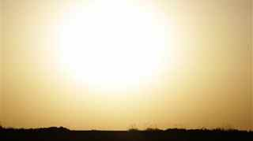
الفكرة الرئيسية
يرفض الناس المسيح
لأنهم لا يقبلون
سلطة الله
على حياتهم

Slide 45

Jesus Paid It All
دفع يسوع كل شيء
إشعياء 53: 5

Slide 46
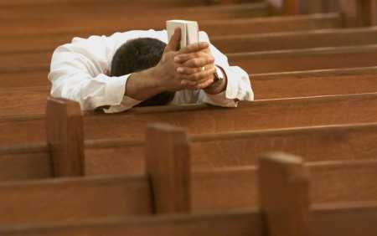
لماذا لا يؤمنون اليوم؟

Slide 47
ب. صراع حول الناموس
99
يوحنا 7: 53-8: 11
يتجنب يسوع فخ الفريسيين بعدم إدانة امرأة زانية ليحكم على
صارمة الناموس أو لقبول ازدراء الفريسيين بالناموس
Notes:
John 7:53 [[ªThen the meeting broke up, and everybody went home.
A Woman Caught in Adultery
John 8:1 Jesus returned to the Mount of Olives, ² but early the next morning he was back again at the Temple. A crowd soon gathered, and he sat down and taught them. ³ As he was speaking, the teachers of religious law and the Pharisees brought a woman who had been caught in the act of adultery. They put her in front of the crowd.
John 8:4 “Teacher,” they said to Jesus, “this woman was caught in the act of adultery. ⁵ The law of Moses says to stone her. What do you say?”
John 8:6 They were trying to trap him into saying something they could use against him, but Jesus stooped down and wrote in the dust with his finger. ⁷ They kept demanding an answer, so he stood up again and said, “All right, but let the one who has never sinned throw the first stone!” ⁸ Then he stooped down again and wrote in the dust.
John 8:9 When the accusers heard this, they slipped away one by one, beginning with the oldest, until only Jesus was left in the middle of the crowd with the woman. ¹⁰ Then Jesus stood up again and said to the woman, “Where are your accusers? Didn’t even one of them condemn you?”
John 8:11 “No, Lord,” she said.
And Jesus said, “Neither do I. Go and sin no more.”]]

Slide 48
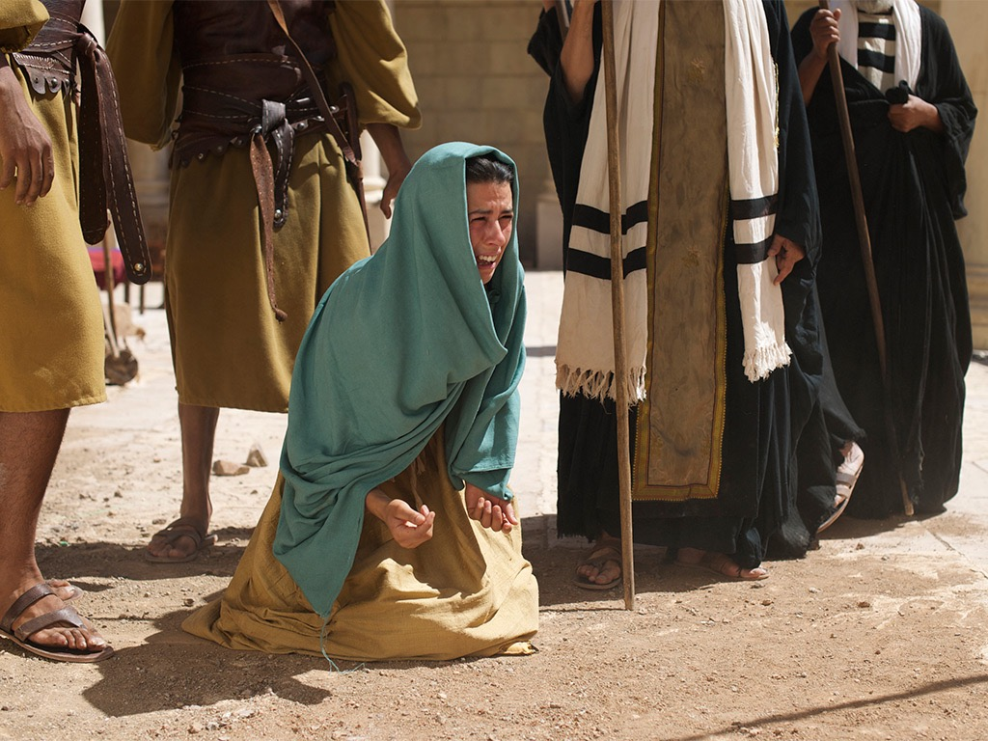

صور كتابية مجانية
يوحنا 8: 2-11
يسوع والمرأة
التي أمسكت في زنا

Slide 49
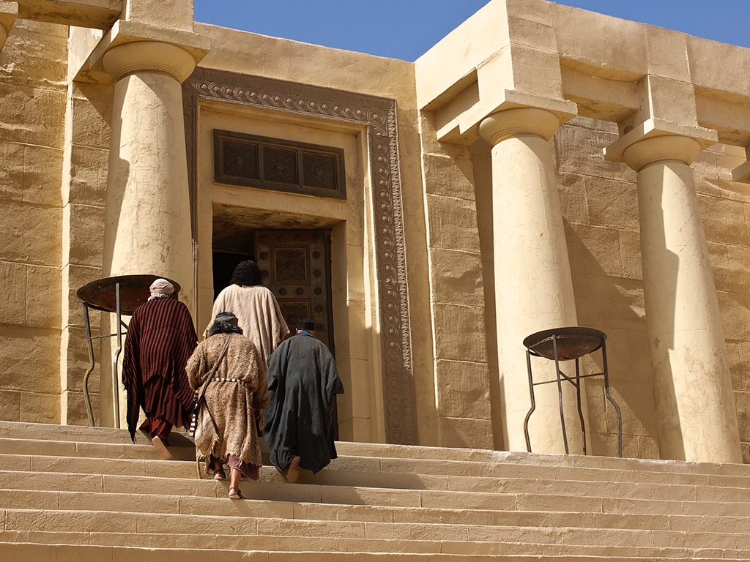

Slide 50
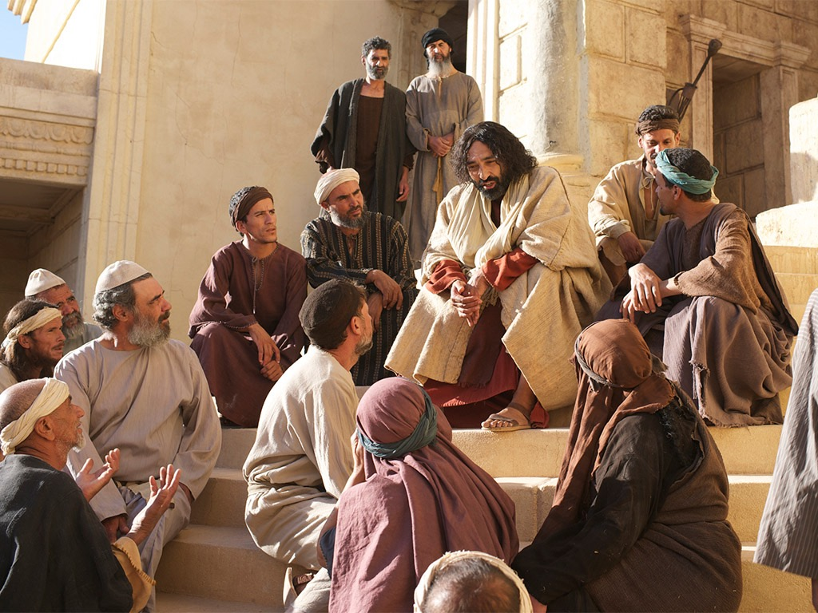

Slide 51
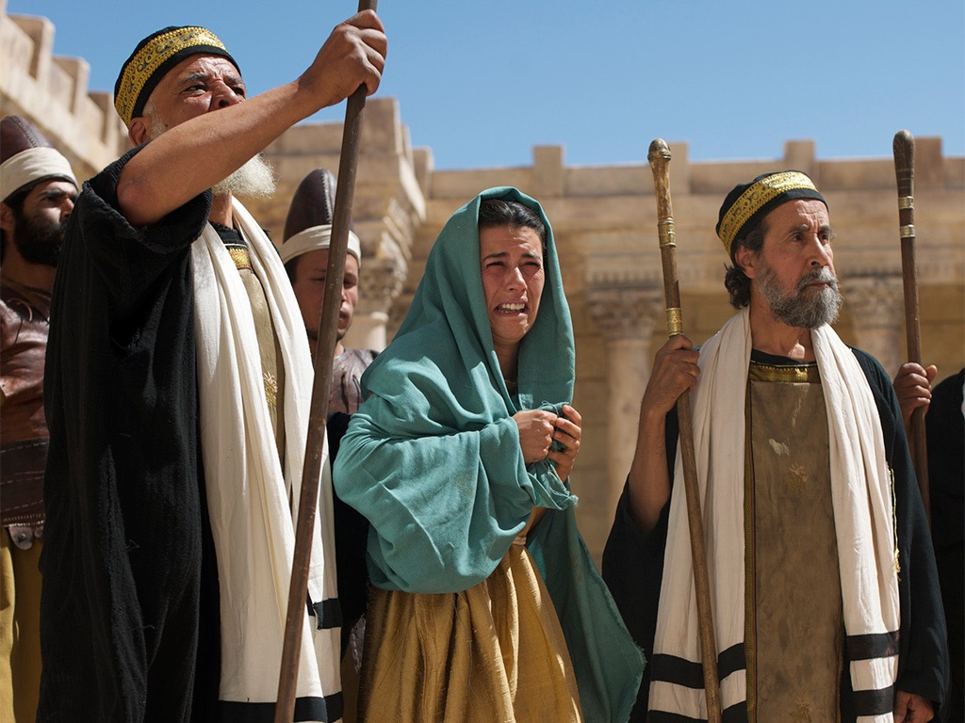

Slide 53
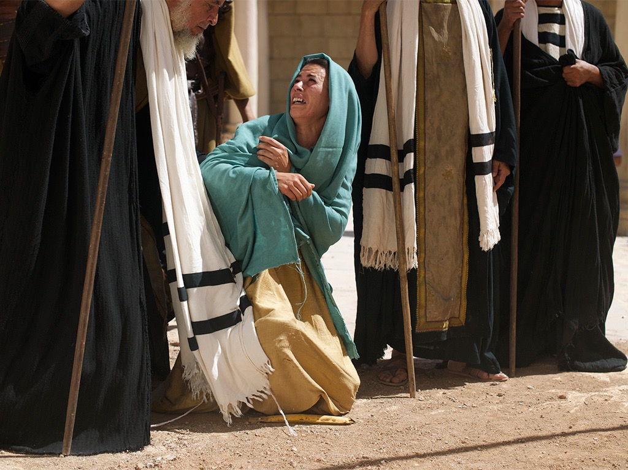

Slide 54
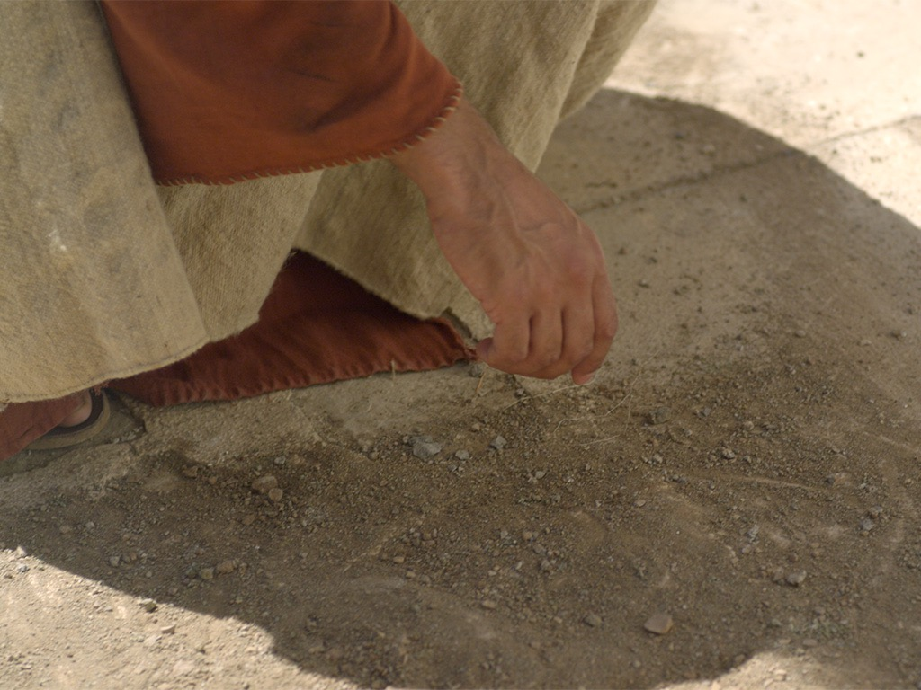

Slide 55
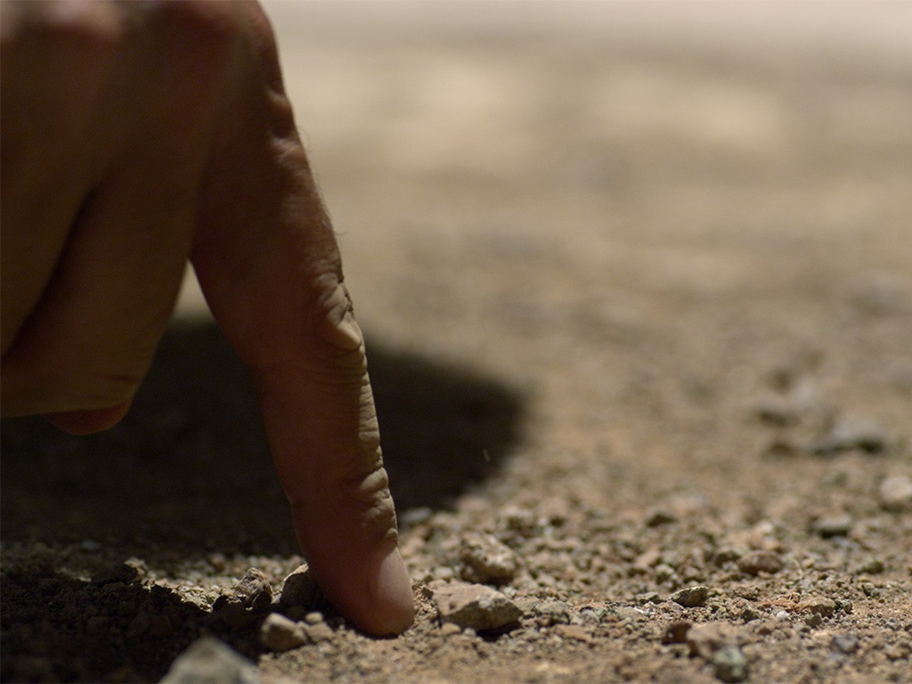

Slide 56
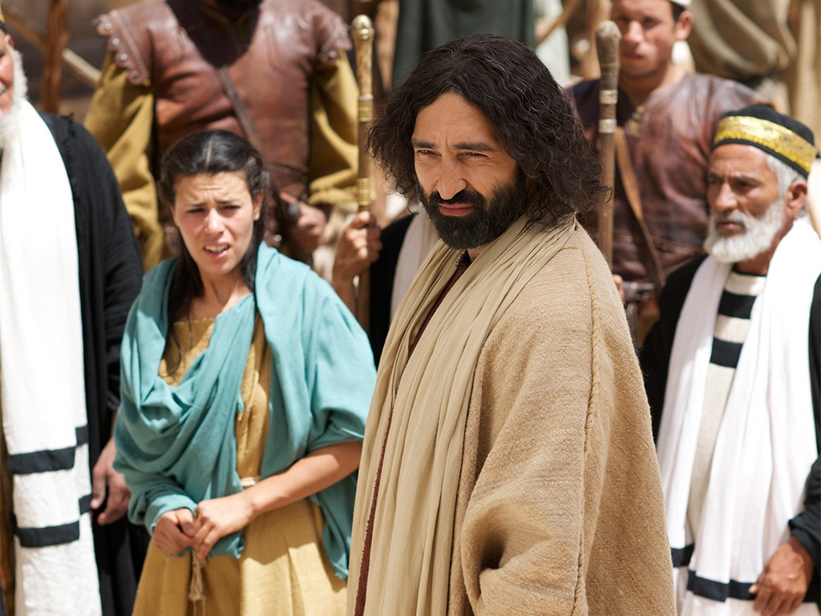

Slide 57


Slide 58
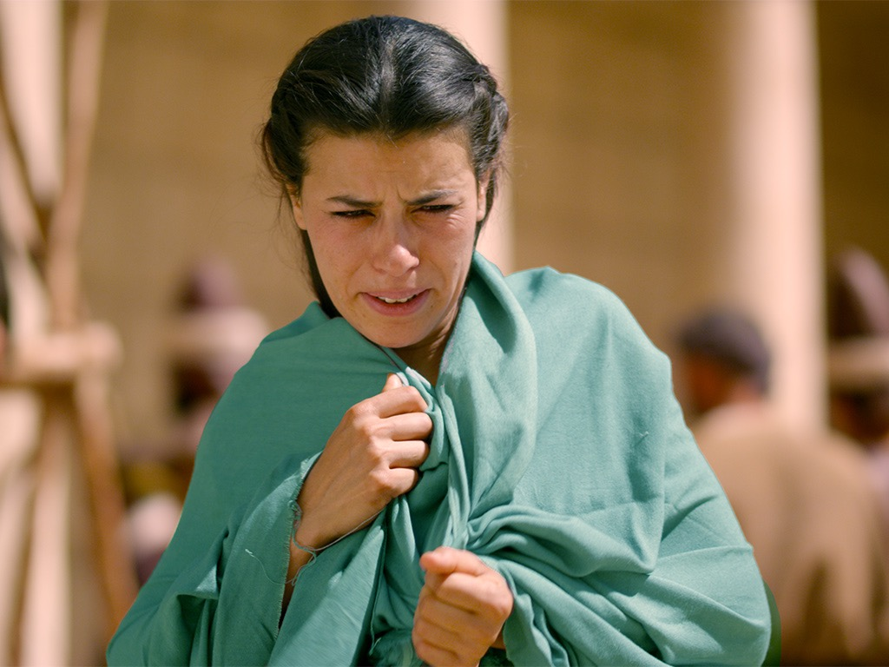

Slide 59
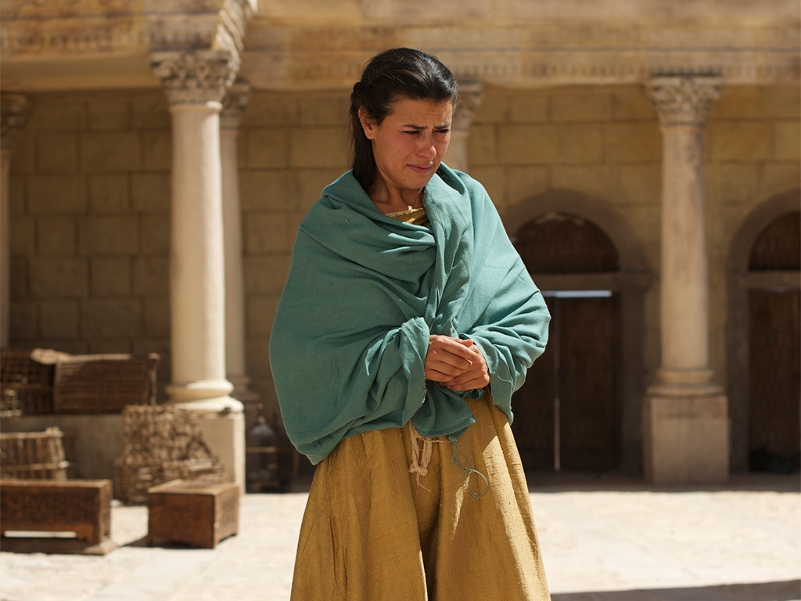

Slide 60
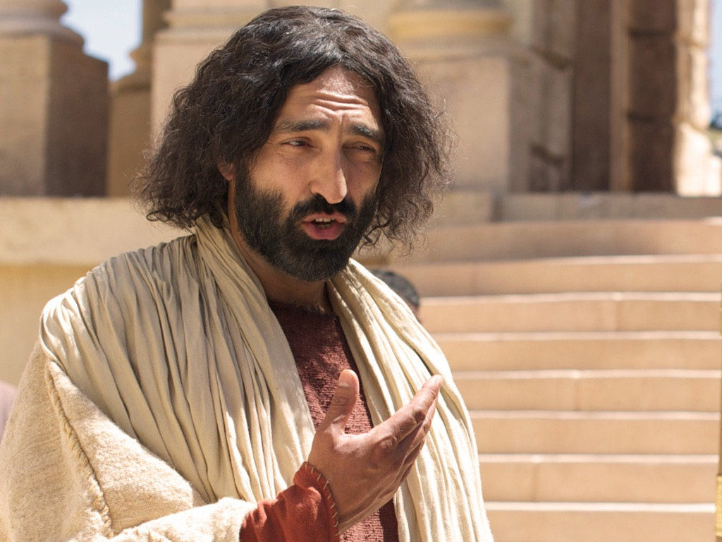

Slide 61
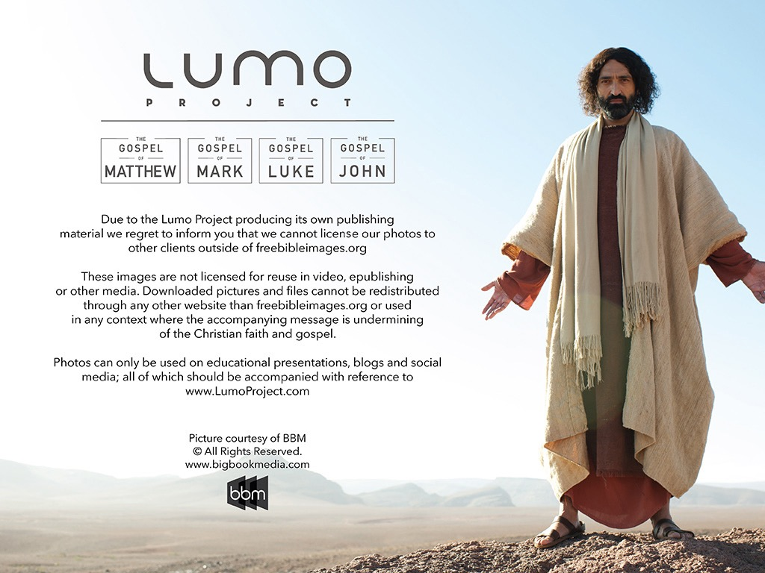
استخدمت بإذن رسمي
إنجيل
متى
إنجيل
مرقس
إنجيل
لوقا
إنجيل
يوحنا
نظرًا لإنتاج Lumo لمواد النشر الخاصة به ، نأسف لإبلاغك بأنه لا يمكننا ترخيص صورنا لعملاء آخرين خارج
freebibleimages.org
هذه الصور غير مرخصة لإعادة استخدامها في الفيديو أو النشر أو الوسائط الأخرى. لا يمكن إعادة توزيع الصور والملفات التي تم تنزيلها من خلال أي موقع ويب آخر غير freebibleimages.org أو استخدامها في أي سياق تؤدي فيه الرسالة المصاحبة إلى تقويض الإيمان المسيحي والإنجيل.
لا يمكن استخدام الصور إلا في العروض التقديمية التعليمية والمدونات ووسائل التواصل الاجتماعي ، وكلها يجب أن تكون مصحوبة بالإشارة إلى
www.LumoProject.com.
Picture courtesy of BBM © All Rights Reserved.
www.bigbookmedia.com

Slide 62

كيف يمكننا أن نظهر رأفة الله في عالم يعتقد أن المسيحية تديننا فقط؟

Slide 63
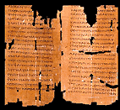
نص يوحنا 7: 53 - 8: 11
موحى به
أم لا؟

Slide 64
آراء
منقسمة
"يتفق جميع علماء النصوص تقريبًا على أن هذه الآيات لم تكن جزءًا من النص الأصلي... يختلف أسلوب ومفردات هذا المقطع عن بقية الإنجيل، ويقطع هذا الجزء التسلسل من ٧: ٥٢-٨: ١٢. ربما يكون جزءًا من التقليد الشفوي الحقيقي الذي أضافه النساخ إلى المخطوطات اليونانية اللاحقة".
إدوين أ. بلوم، معرفة الكتاب المقدس
"يبدو أن معظم العلماء يتفقون على أن المقطع هو جزء من الكتاب المقدس الموحى به [على سبيل المثال، ف. بروس]. في الواقع، يمكن بسهولة رؤية تطور الفصل بأكمله من هذا الحدث المذهل في الهيكل... سيكون الانتقال من يوحنا 7 :52 إلى 8 :12 مفاجئًا جدًا بدون قسم انتقالي.“
وارين ويرزبي، الكتاب المقدس التفسيري
Notes:
Wiersbe notes, “Is the story of the woman taken in adultery a part of Scripture? If it is, where does it belong in the Gospel record? John 7:53–8:11 is not found in some of the ancient manuscripts; where it is found, it is not always in this location in John’s Gospel. Most scholars seem to agree that the passage is a part of inspired Scripture (“a fragment of authentic Gospel material,” says Dr. F.F. Bruce) regardless of where it is placed.
“To many of us, the story fits right here! In fact, the development of the entire chapter can easily be seen to grow out of this striking event in the temple. Our Lord’s declaration on His being the Light of the world (John 8:12) certainly fits, and so do His words about true and false judgment (John 8:15–16, 26). The repeated phrase “die in your sins” (John 8:21, 24) would clearly relate to the judgment of the woman; and the fact that the chapter ends with an attempt to stone Jesus shows a perfect parallel to the opening story. The transition from John 7:52 to 8:12 would be too abrupt without a transitional section.”
Warren W. Wiersbe, The Bible Exposition Commentary (Wheaton, Ill.: Victor Books, 1996, c1989), Jn 7:37.

Slide 65
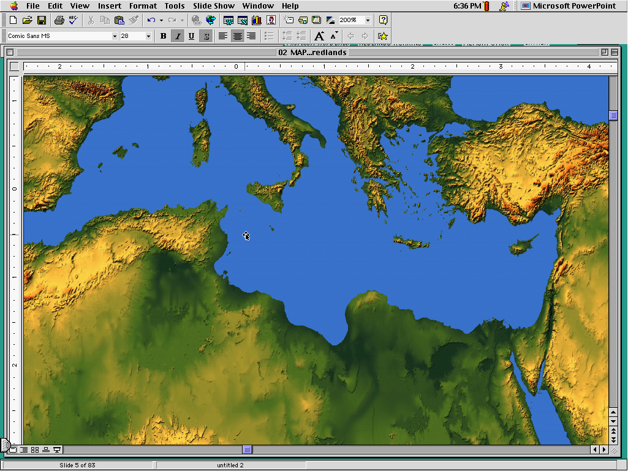
الغرب
بيزنطة
متأخر (600 م)
احتفظت بها المخطوطات
الأكثر تأخراً (1000 م) احتفظت بها المخطوطات
3 أنواع نصوص
الإسكندرية
الأبكر (200-400 م) ألغتها المخطوطات
Notes:
The NT manuscripts of the early centuries of the church were copied in three main regions: Rome gave us the Western text type (or majority text since they copied so many of them), the city of Constantinople became the capital of the Eastern Orthodox church with its Byzantine manuscripts, and a large community of Christians gathered in Alexandria, Egypt. These Alexandrian texts were the earliest, going back to about AD 200.

Slide 66
لاحظ التتابع
يسوع هو نور العالم (8: 12)
يكشف يسوع النية الشريرة للفريسيين (8: 10)
أصدر يسوع دينونة صحيحة (8: 16)
أصدر الفريسيون دينونة خاطئة (8: 15)
حاول الفريسيون رجم يسوع (8: 59)
حاول الفريسيون رجمها (8: 5)

Slide 67

أين نتجه اليوم....
التطبيقات
المقطع

Slide 68

ما هي الفكرة؟
أظهر رحمة للتائبين!
لا تدع الناس تخدعك!
كن أكثر ذكاء عندما تزني حتى لا يتم الإمساك بك!
يسوع لم يتبع الناموس حقيقة!
اغفر للناس قبل أن تتوب – هذا ما يفعله يسوع!
لا تستعجل إلقاء الحجارة!
الله ليس جاداً بشأن الخطية، بعد كل هذا!
Notes:
Show mercy to the repentant—maybe, but we don’t see her repent!
Don't let people trap you!
Be smarter when you commit adultery so you don’t get caught!
Jesus didn’t really follow the Law? Hmmm…
Forgive people before they repent—that's what Jesus does!
Don’t be too quick to throw stones?
God isn’t serious about sin after all?

Slide 69
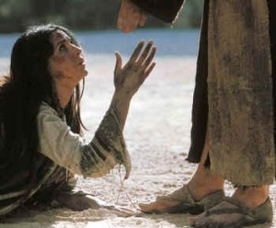
1. أظهر يسوع رأفة الناموس الحقيقي من خلال مسامحة المرأة الزانية (7: 53-8: 11)

Slide 70
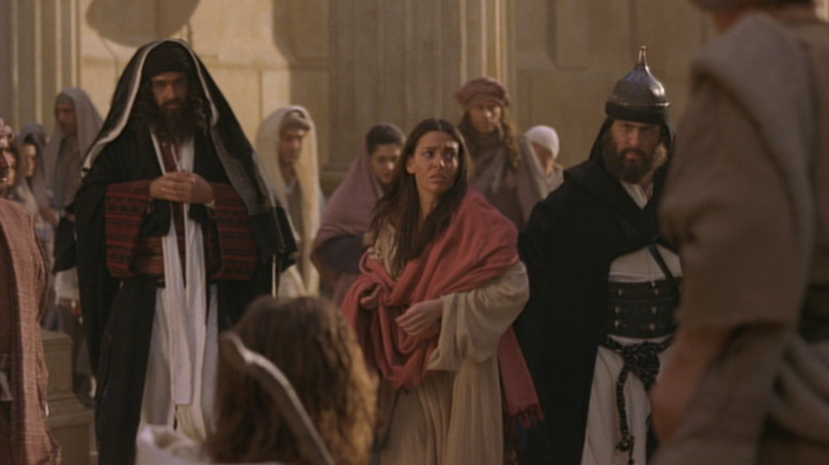
أ. أحضر الفريسيون امرأة زانية إلى يسوع ليحافظوا على قوتهم من خلال إدانة يسوع لنفسه (7: 53-8: 6أ)

Slide 71
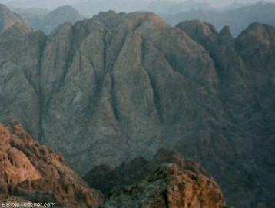
ب. كشف يسوع خطية الفريسيين من خلال اظهار رأفة الناموس الحقيقي في إدانة الخطاة وفداء التائبين (8: 6ب-11)
لماذا أعطى الله الناموس على جبل سيناء؟

Slide 72

2. أظهر رأفة الله من خلال مساعدة الناس على التوبة (الفكرة الرئيسية في يو 7: 53 – 8: 11)

Slide 73
ت. صراع حول النور
100
يوحنا 8: 20-12
الفريسيون يرفضون شهادة يسوع عن نفسه بأنه نور العالم،
لذلك قال إن المظال والآب يشهدان له
Notes:
Does anyone prefer darkness over light?
Jesus, the Light of the World
John 8:12 Jesus spoke to the people once more and said, “I am the light of the world. If you follow me, you won’t have to walk in darkness, because you will have the light that leads to life.”
John 8:13 The Pharisees replied, “You are making those claims about yourself! Such testimony is not valid.”
John 8:14 Jesus told them, “These claims are valid even though I make them about myself. For I know where I came from and where I am going, but you don’t know this about me. ¹⁵ You judge me by human standards, but I do not judge anyone. ¹⁶ And if I did, my judgment would be correct in every respect because I am not alone. The Fatherª who sent me is with me. ¹⁷ Your own law says that if two people agree about something, their witness is accepted as fact.ª ¹⁸ I am one witness, and my Father who sent me is the other.”
John 8:19 “Where is your father?” they asked.
Jesus answered, “Since you don’t know who I am, you don’t know who my Father is. If you knew me, you would also know my Father.”
²⁰ Jesus made these statements while he was teaching in the section of the Temple known as the Treasury. But he was not arrested, because his timeª had not yet come.

Slide 74

نور العالم
يوحنا 8: 12-59

Slide 75

هل يستطيع الناس أن يميزوا
بين
الظلمة
والنور؟

Slide 76
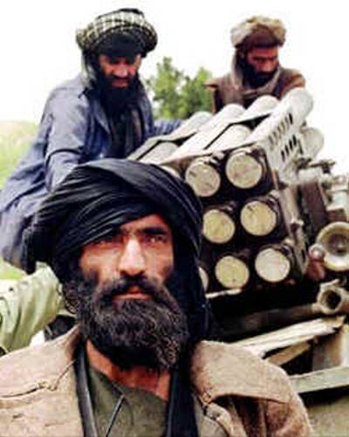
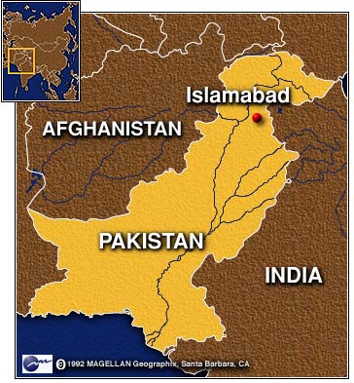
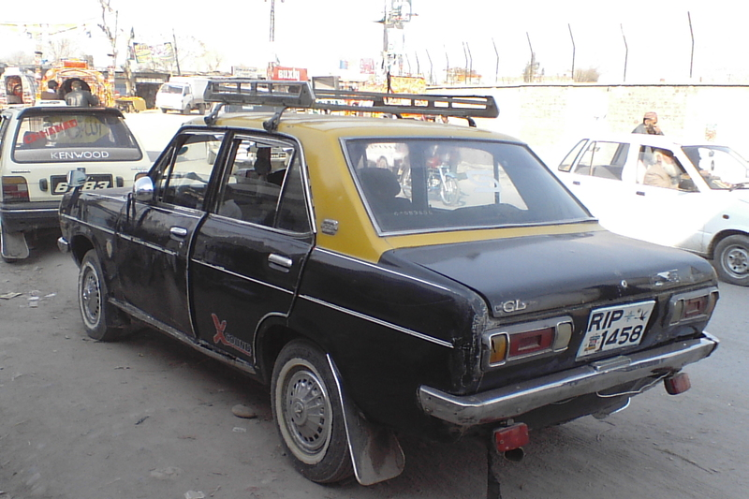
إدوين بول
28 أيلول 2010
Notes:
A Christian lawyer in Pakistan named Edwin Paul lived in the light. He gave legal counsel to a Christian taxi driver who bought a taxi for about $2000, but then the Taliban-associated lenders discovered he was a Christian, so they demanded $12,000 instead! After Edwin brought the case to the police, the lenders murdered him in his home on September 28, 2010—just three weeks ago along with his wife Ruby and their five children. His murderers obviously could not see that Edwin lived in the light—and they were in darkness.

Slide 77
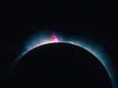
يسوع (الكلمة) كان الله (1: 1ت)
فِي الْبَدْءِ كَانَ الْكَلِمَةُ، وَالْكَلِمَةُ كَانَ عِنْدَ اللهِ،
وَكَانَ الْكَلِمَةُ اللهَ
(يوحنا 1: 1)
Notes:
Scripture is very clear that Jesus is God. Christians have always believed this key doctrine called the deity of Christ.

Slide 78
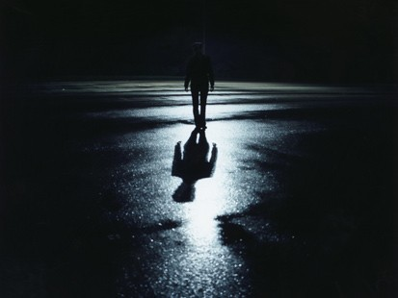
الإنتقال العظيم
وَنَقَلَنَا إِلَى مَلَكُوتِ ابْنِ مَحَبَّتِهِ،
الَّذِي أَنْقَذَنَا مِنْ سُلْطَانِ الظُّلْمَةِ،
الَّذِي لَنَا فِيهِ الْفِدَاءُ، بِدَمِهِ غُفْرَانُ الْخَطَايَا.
(كو 1: 13-14)

Slide 79

كيف يجب أن نتوقع تجاوب الناس مع ادعاء المسيح أنه الله الأبدي؟

Slide 80


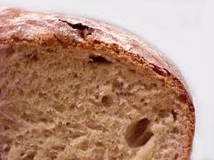
يوحنا 6-8
النور
8
الماء
7
الخبز
6

Slide 81
كيف يجب أن نتوقع تجاوب الناس مع ادعاء المسيح أنه الله الأبدي؟
3 استجابات

Slide 82
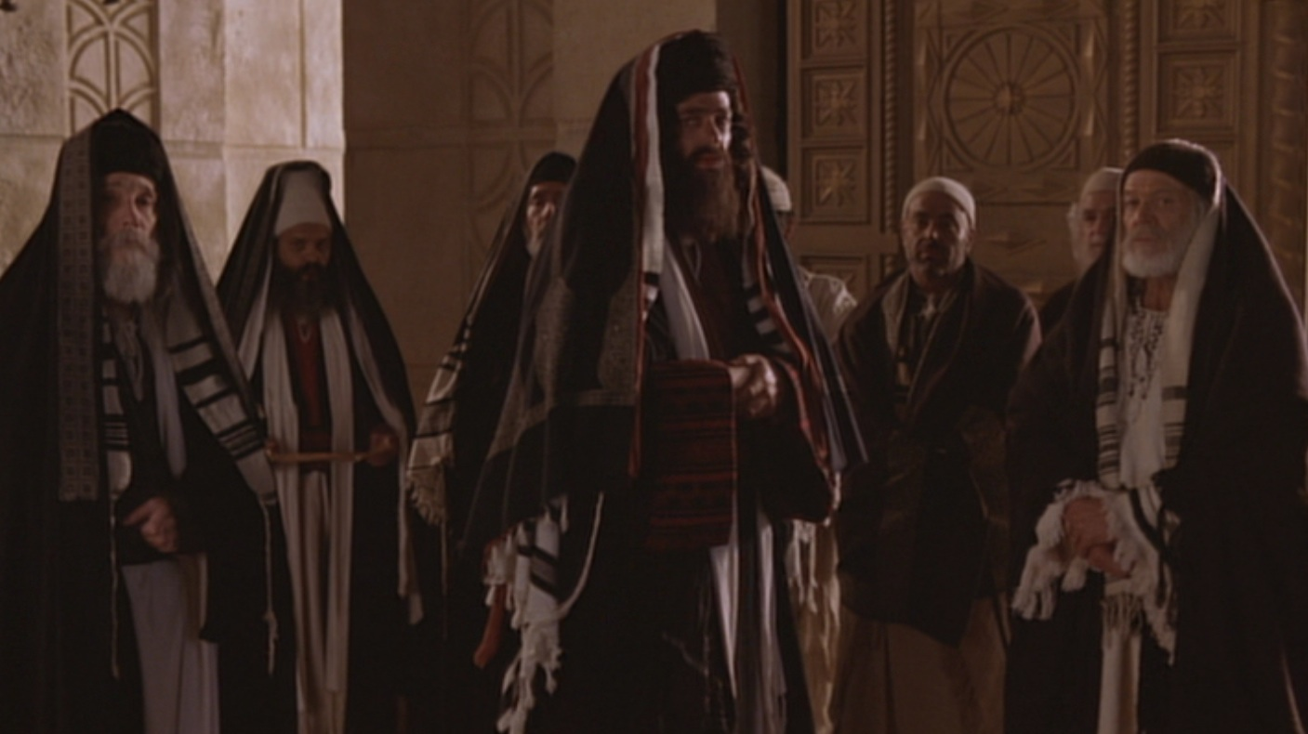
1. البعض معادون للمسيح باعتباره طريق الخلاص (يوحنا 8: 12-20)

Slide 83
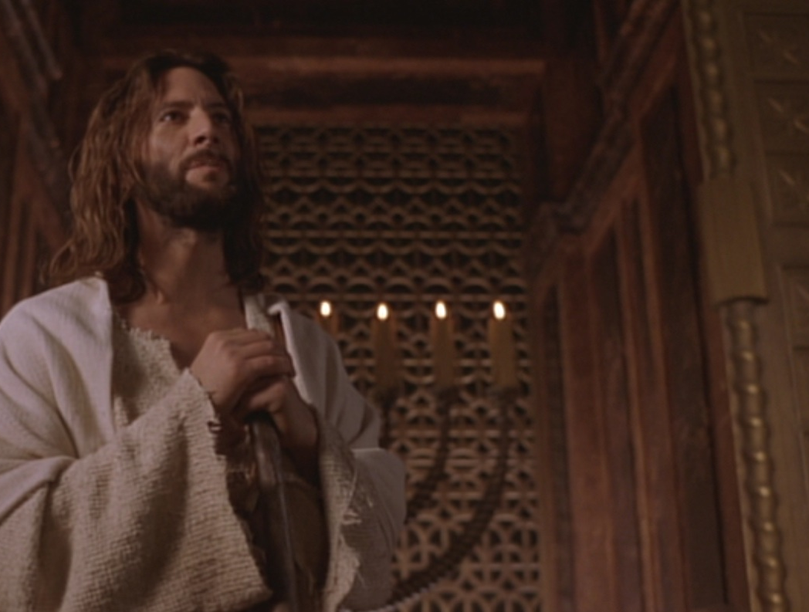
أنا هو نور العالم
يوحنا 8: 12

Slide 84
هذا الادعاء حصري، لا يمكن أن يفعله أحد إلّا الله وحده. لاحظوا أن يسوع ادعّى أنه نور العالم وليس نورًا. وعلى الرغم من أن الادعاء هو حصري إلاّ أنه شامل - أي أن الجميع يمكنهم الاستجابة له."
تشارلز سويندول، اتبّاع المسيح... رجل الله، 33

Slide 85

شاهدَين (تث 17: 6)
على فم شاهدَين أو ثلاثة شهود يُقتل الذي يَقتل،
لا يُقتل على فم شاهد واحد.

Slide 86
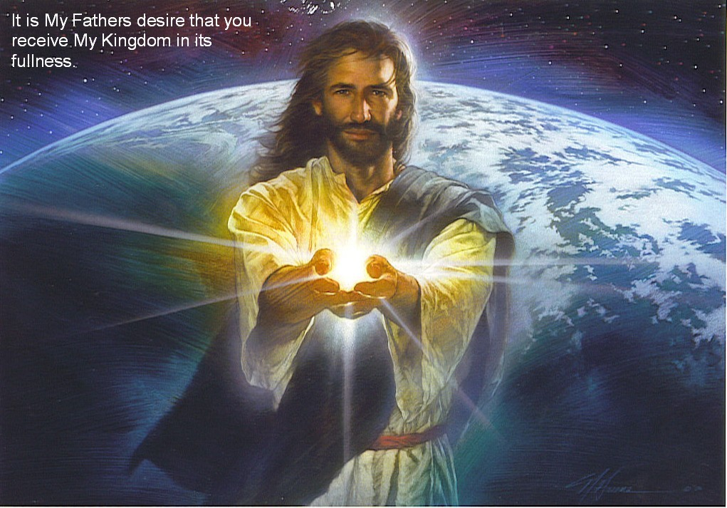
يسوع هو نور الحياة (12-20)
النور
الحياة
الظلمة
الموت
العداوة

Slide 87
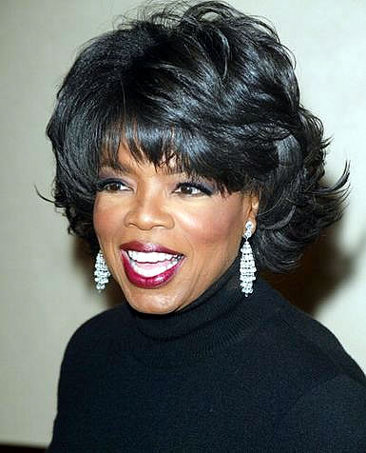
أوبرا وينفري
هل الله يهتم بقلبك ... أم يهتم بأن تسمي ابنه يسوع؟
Notes:
http://www.youtube.com/watch?v=ETeI6i5oqh4&feature=related

Slide 88
1. البعض معادون للمسيح باعتباره طريق الخلاص (يوحنا 8: 12-20)

Slide 89
ث. صراع حول شخصه
101
يوحنا 8: 21-59
يدعي يسوع أنه مسيّا وإله، ويحاول قادة اليهود قتله بالرجم
بتهمة التجديف لكن دون جدوى
Notes:
The Unbelieving People Warned
John 8:21 Later Jesus said to them again, “I am going away. You will search for me but will die in your sin. You cannot come where I am going.”
John 8:22 The peopleª asked, “Is he planning to commit suicide? What does he mean, ‘You cannot come where I am going’?”
John 8:23 Jesus continued, “You are from below; I am from above. You belong to this world; I do not. ²⁴ That is why I said that you will die in your sins; for unless you believe that I AM who I claim to be,ª you will die in your sins.”
John 8:25 “Who are you?” they demanded.
Jesus replied, “The one I have always claimed to be.ª
²⁶ I have much to say about you and much to condemn, but I won’t. For I say only what I have heard from the one who sent me, and he is completely truthful.” ²⁷ But they still didn’t understand that he was talking about his Father.
John 8:28 So Jesus said, “When you have lifted up the Son of Man on the cross, then you will understand that I AM he.ª I do nothing on my own but say only what the Father taught me. ²⁹ And the one who sent me is with me—he has not deserted me. For I always do what pleases him.” ³⁰ Then many who heard him say these things believed in him.
Jesus and Abraham
John 8:31 Jesus said to the people who believed in him, “You are truly my disciples if you remain faithful to my teachings. ³² And you will know the truth, and the truth will set you free.”
John 8:33 “But we are descendants of Abraham,” they said. “We have never been slaves to anyone. What do you mean, ‘You will be set free’?”
John 8:34 Jesus replied, “I tell you the truth, everyone who sins is a slave of sin. ³⁵ A slave is not a permanent member of the family, but a son is part of the family forever. ³⁶ So if the Son sets you free, you are truly free. ³⁷ Yes, I realize that you are descendants of Abraham. And yet some of you are trying to kill me because there’s no room in your hearts for my message. ³⁸ I am telling you what I saw when I was with my Father. But you are following the advice of your father.”
John 8:39 “Our father is Abraham!” they declared.
“No,” Jesus replied, “for if you were really the children of Abraham, you would follow his example.ª
⁴⁰ Instead, you are trying to kill me because I told you the truth, which I heard from God. Abraham never did such a thing. ⁴¹ No, you are imitating your real father.”
They replied, “We aren’t illegitimate children! God himself is our true Father.”
John 8:42 Jesus told them, “If God were your Father, you would love me, because I have come to you from God. I am not here on my own, but he sent me. ⁴³ Why can’t you understand what I am saying? It’s because you can’t even hear me! ⁴⁴ For you are the children of your father the devil, and you love to do the evil things he does. He was a murderer from the beginning. He has always hated the truth, because there is no truth in him. When he lies, it is consistent with his character; for he is a liar and the father of lies. ⁴⁵ So when I tell the truth, you just naturally don’t believe me! ⁴⁶ Which of you can truthfully accuse me of sin? And since I am telling you the truth, why don’t you believe me? ⁴⁷ Anyone who belongs to God listens gladly to the words of God. But you don’t listen because you don’t belong to God.”
John 8:48 The people retorted, “You Samaritan devil! Didn’t we say all along that you were possessed by a demon?”
John 8:49 “No,” Jesus said, “I have no demon in me. For I honor my Father—and you dishonor me. ⁵⁰ And though I have no wish to glorify myself, God is going to glorify me. He is the true judge. ⁵¹ I tell you the truth, anyone who obeys my teaching will never die!”
John 8:52 The people said, “Now we know you are possessed by a demon. Even Abraham and the prophets died, but you say, ‘Anyone who obeys my teaching will never die!’ ⁵³ Are you greater than our father Abraham? He died, and so did the prophets. Who do you think you are?”
John 8:54 Jesus answered, “If I want glory for myself, it doesn’t count. But it is my Father who will glorify me. You say, ‘He is our God,’ª ⁵⁵ but you don’t even know him. I know him. If I said otherwise, I would be as great a liar as you! But I do know him and obey him. ⁵⁶ Your father Abraham rejoiced as he looked forward to my coming. He saw it and was glad.”
John 8:57 The people said, “You aren’t even fifty years old. How can you say you have seen Abraham?ª”
John 8:58 Jesus answered, “I tell you the truth, before Abraham was even born, I AM!ª” ⁵⁹ At that point they picked up stones to throw at him. But Jesus was hidden from them and left the Temple.

Slide 90
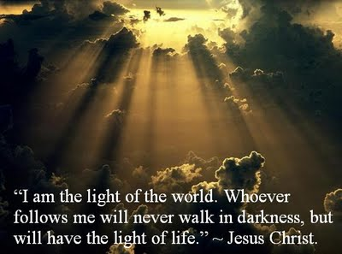
2. يؤمن كثيرون أن الآب أرسل يسوع من السماء (21-30)

Slide 91

من أنت؟
يوحنا 8: 25

Slide 92

هويتي؟ أنا الله (25-30)
فوق
حياة أبدية
أسفل
موت بالخطايا
فَقَالَ لَهُمْ: «أَنْتُمْ مِنْ أَسْفَلُ، أَمَّا أَنَا فَمِنْ فَوْقُ. أَنْتُمْ مِنْ هذَا الْعَالَمِ، أَمَّا أَنَا فَلَسْتُ مِنْ هذَا الْعَالَمِ. فَقُلْتُ لَكُمْ: إِنَّكُمْ تَمُوتُونَ فِي خَطَايَاكُمْ، لأَنَّكُمْ إِنْ لَمْ تُؤْمِنُوا أَنِّي أَنَا هُوَ تَمُوتُونَ فِي خَطَايَاكُمْ». (يوحنا 8: 23-24)

Slide 93

أناس كثيرون هناك وضعوا ثقتهم فيه (30).

Slide 94
1. البعض معادون للمسيح باعتباره طريق الخلاص (يوحنا 8: 12-20)

Slide 95
2. يؤمن الكثيرون أن الآب أرسل يسوع من السماء (يوحنا :821-30)

Slide 96

3. كل شيء معلن إما من الله أو الشيطان (يوحنا :8 31-59)

Slide 97

أ. المؤمنون بيسوع حرروا من العبودية ليصيروا من نسل إبراهيم الروحي )يوحنا :831-38)
ابن لله

Slide 98

الإيمان في إنجيل يوحنا
وَبَيْنَمَا هُوَ يَتَكَلَّمُ بِهذَا آمَنَ بِهِ كَثِيرُونَ. فَقَالَ يَسُوعُ لِلْيَهُودِ الَّذِينَ آمَنُوا بِهِ: «إِنَّكُمْ إِنْ ثَبَتُّمْ فِي كَلاَمِي فَبِالْحَقِيقَةِ تَكُونُونَ تَلاَمِيذِي، وَتَعْرِفُونَ الْحَقَّ، وَالْحَقُّ يُحَرِّرُكُمْ».
(يوحنا 8: 30-32)

Slide 99
أَجَابُوهُ: «إِنَّنَا ذُرِّيَّةُ إِبْرَاهِيمَ وَلَمْ نُسْتَعْبَدْ لأَحَدٍ قَطُّ. كَيْفَ تَقُولُ أَنْتَ: إِنَّكُمْ تَصِيرُونَ أَحْرَاراً؟»
يوحنا ٨ : ٣٣
Notes:
Who is "They"? Are they the new believers in verses 30-32, or are they the unbelievers to whom Jesus is speaking throughout the chapter?
“They” answered him. While some argue that “they” refers back to verse 30 (i.e., to those who have believed in Him), the portrayal of those addressed in 8:33-59 renders this impression highly unlikely. Jesus says that they are slaves to sin; they are murderers; they have no belief in His word (v. 37); they want to kill Jesus; their father is Satan (v. 44); they are unable to hear what Jesus has to say (v. 43); they do not believe in Christ (v. 45); and they do not belong to God (v. 47). They in turn say that Jesus is demon-possessed (v. 48), and they picked up stones to stone him (v. 48). This hardly sounds like the same group in verse 30, who, after hearing him speak, “put their faith in him” (v. 30). Charles Bing is correct, “The abrupt change of tone from verses 30-31 resumes this motif, making it unnecessary to identify the speakers; the Jews had raised objections from the start of the dialogue (v. 13, 19, 22, 25).”1240 These critics, having heard Jesus’ aside to the new Christians, respond in anger.
Bing continues, “The objection of v 33 is totally out of character with the inclination of those mentioned in verses 30–32, as is also the declaration that those opposing Christ are children of the devil (v 44).”1241 The true believers of verses 31-32 are clearly not “children of the devil.” It is therefore perplexing why Schreiner and Caneday call our interpretation “remarkable.”1242 It is not “remarkable” at all. It makes very good sense of the context and the general usage of the phrase “believe in” found in the rest of John’s gospel. 1243
"In an extensive analysis, John Niemalä has shown that in John’s Gospel there are 353 speaking verbs which introduce new speakers or reintroduce previously introduced ones. He determined that there are 78 such verbs which do not have an explicit subject word like “Jesus said” or “the Pharisees replied,” etc. In all 78 instances, the use of such verbs without a named subject (“they said,” “they replied,” etc.), these verbs always indicated the reintroduction of a speaker who had spoken earlier in the context. This proves that the “they” of v. 33 cannot refer to the believers in v. 31 who have never spoken in the preceding context and must refer to the Pharisees who have (see vv. 13, 14, 19, 22, 25, 33).1244
"Long ago Augustine argued that “those who believed in him” are true, not spurious believers, and that the “they” of verse 33 refers to Christ’s critics, not the true believers of verses 31-32.1245 As Bernard and McNeile have noted, “Those who made the answer which follows were not the Jews who ‘believed Him’ (v. 31), but the Jewish objectors, with whom throughout the rest of this chapter Jesus is engaged in controversy. He could not have charged ‘the Jews who believed Him’ with seeking His life (vv. 37, 39).”1246
____________
1240 See Charles C. Bing, "The Condition for Salvation in John's Gospel," JOTGES 9, no. 1 (Spring 1996): 36.
1241 Ibid.
1242 Schreiner and Caneday, The Race Set Before Us, 118.
1243 Does this violate the principle of the near antecedent? Should the “they” of verse 33 refer to those in verse 31 and not the Pharisees of verses 27-29? Not necessarily. The principle of the near antecedent is only suggestive and not absolute. What might be the nearest antecedent contextually might not be the nearest antecedent in the author’s mind. For example in Acts 4:11 “He” refers to Christ in v. 10, but the near antecedent is “this man” in v. 10.
1244 John Niemalä, "Free at Last! Liberty in Jesus' Footsteps (John 8:30-32),"(2013). Niemalä’s paper can be downloaded from http://www.mol316.com/pdfs/GES2013FreeAtLast.pdf.
1245 Augustine, "Tractates on John," in Nicene and Post-Nicene Fathers ed. Philip Schaff (Oak Harbor, WA: Logos Research Systems, 1997), 7:230.
1246 J. H. Bernard and A. H. McNeile, A Critical and Exegetical Commentary on the Gospel According to St. John, 2 vols. (Edinburgh: T. & T. Clark, 1928), 2:306.
Joseph C. Dillow, Final Destiny, 4th ed. (Monument, CO; Paniym Group, Inc., 2019), 359-360

Slide 100
«أجابوه هم». بينما يرى بعضهم أن «هم» تعود إلى الآية 30 (أي إلى الذين آمنوا به)، فإن تصوير المخاطَبين في 8:33–59 يجعل هذا الانطباع غير مرجّح للغاية. يقول يسوع إنهم عبيد للخطية؛ وهم قتلة؛ وليس لكلامه موضع فيهم (ع 37)؛ ويريدون قتله؛ وأبوهم هو الشيطان (ع 44)؛ ولا يستطيعون أن يسمعوا ما يقوله يسوع (ع 43)؛ ولا يؤمنون بالمسيح (ع 45)؛ ولا ينتمون إلى الله (ع 47). وهم بدورهم يقولون إن يسوع به شيطان (ع 48)، والتقطوا حجارة ليرجموه (ع 48).
جوزيف ديلو، المصير النهائي، 359
Notes:
Who is "They"? Are they the new believers in verses 30-32, or are they the unbelievers to whom Jesus is speaking throughout the chapter?
“They” answered him. While some argue that “they” refers back to verse 30 (i.e., to those who have believed in Him), the portrayal of those addressed in 8:33-59 renders this impression highly unlikely. Jesus says that they are slaves to sin; they are murderers; they have no belief in His word (v. 37); they want to kill Jesus; their father is Satan (v. 44); they are unable to hear what Jesus has to say (v. 43); they do not believe in Christ (v. 45); and they do not belong to God (v. 47). They in turn say that Jesus is demon-possessed (v. 48), and they picked up stones to stone him (v. 48). This hardly sounds like the same group in verse 30, who, after hearing him speak, “put their faith in him” (v. 30). Charles Bing is correct, “The abrupt change of tone from verses 30-31 resumes this motif, making it unnecessary to identify the speakers; the Jews had raised objections from the start of the dialogue (v. 13, 19, 22, 25).”1240 These critics, having heard Jesus’ aside to the new Christians, respond in anger.
Bing continues, “The objection of v 33 is totally out of character with the inclination of those mentioned in verses 30–32, as is also the declaration that those opposing Christ are children of the devil (v 44).”1241 The true believers of verses 31-32 are clearly not “children of the devil.” It is therefore perplexing why Schreiner and Caneday call our interpretation “remarkable.”1242 It is not “remarkable” at all. It makes very good sense of the context and the general usage of the phrase “believe in” found in the rest of John’s gospel. 1243
"In an extensive analysis, John Niemalä has shown that in John’s Gospel there are 353 speaking verbs which introduce new speakers or reintroduce previously introduced ones. He determined that there are 78 such verbs which do not have an explicit subject word like “Jesus said” or “the Pharisees replied,” etc. In all 78 instances, the use of such verbs without a named subject (“they said,” “they replied,” etc.), these verbs always indicated the reintroduction of a speaker who had spoken earlier in the context. This proves that the “they” of v. 33 cannot refer to the believers in v. 31 who have never spoken in the preceding context and must refer to the Pharisees who have (see vv. 13, 14, 19, 22, 25, 33).1244
"Long ago Augustine argued that “those who believed in him” are true, not spurious believers, and that the “they” of verse 33 refers to Christ’s critics, not the true believers of verses 31-32.1245 As Bernard and McNeile have noted, “Those who made the answer which follows were not the Jews who ‘believed Him’ (v. 31), but the Jewish objectors, with whom throughout the rest of this chapter Jesus is engaged in controversy. He could not have charged ‘the Jews who believed Him’ with seeking His life (vv. 37, 39).”1246
____________
1240 See Charles C. Bing, "The Condition for Salvation in John's Gospel," JOTGES 9, no. 1 (Spring 1996): 36.
1241 Ibid.
1242 Schreiner and Caneday, The Race Set Before Us, 118.
1243 Does this violate the principle of the near antecedent? Should the “they” of verse 33 refer to those in verse 31 and not the Pharisees of verses 27-29? Not necessarily. The principle of the near antecedent is only suggestive and not absolute. What might be the nearest antecedent contextually might not be the nearest antecedent in the author’s mind. For example in Acts 4:11 “He” refers to Christ in v. 10, but the near antecedent is “this man” in v. 10.
1244 John Niemalä, "Free at Last! Liberty in Jesus' Footsteps (John 8:30-32),"(2013). Niemalä’s paper can be downloaded from http://www.mol316.com/pdfs/GES2013FreeAtLast.pdf.
1245 Augustine, "Tractates on John," in Nicene and Post-Nicene Fathers ed. Philip Schaff (Oak Harbor, WA: Logos Research Systems, 1997), 7:230.
1246 J. H. Bernard and A. H. McNeile, A Critical and Exegetical Commentary on the Gospel According to St. John, 2 vols. (Edinburgh: T. & T. Clark, 1928), 2:306.
Joseph C. Dillow, Final Destiny, 4th ed. (Monument, CO; Paniym Group, Inc., 2019), 359-360

Slide 101
«هذا بالكاد يبدو أنه نفس الجماعة المذكورة في الآية 30، الذين، بعد أن سمعوه يتكلم، “آمنوا به” (ع 30). إن Charles Bing مُحقّ حين يقول: “إن التحول المفاجئ في النبرة من الآيتين 30–31 يستأنف هذا النمط، مما يجعل من غير الضروري تحديد المتكلمين؛ فقد كان اليهود يثيرون اعتراضات منذ بداية الحوار (ع 13، 19، 22، 25).”1240 هؤلاء النقاد، بعد أن سمعوا ملاحظة يسوع الجانبية للمسيحيين الجدد، ردّوا بغضب.»
جوزيف ديلو، المصير النهائي، 359
Notes:
Who is "They"? Are they the new believers in verses 30-32, or are they the unbelievers to whom Jesus is speaking throughout the chapter?
“They” answered him. While some argue that “they” refers back to verse 30 (i.e., to those who have believed in Him), the portrayal of those addressed in 8:33-59 renders this impression highly unlikely. Jesus says that they are slaves to sin; they are murderers; they have no belief in His word (v. 37); they want to kill Jesus; their father is Satan (v. 44); they are unable to hear what Jesus has to say (v. 43); they do not believe in Christ (v. 45); and they do not belong to God (v. 47). They in turn say that Jesus is demon-possessed (v. 48), and they picked up stones to stone him (v. 48). This hardly sounds like the same group in verse 30, who, after hearing him speak, “put their faith in him” (v. 30). Charles Bing is correct, “The abrupt change of tone from verses 30-31 resumes this motif, making it unnecessary to identify the speakers; the Jews had raised objections from the start of the dialogue (v. 13, 19, 22, 25).”1240 These critics, having heard Jesus’ aside to the new Christians, respond in anger.
Bing continues, “The objection of v 33 is totally out of character with the inclination of those mentioned in verses 30–32, as is also the declaration that those opposing Christ are children of the devil (v 44).”1241 The true believers of verses 31-32 are clearly not “children of the devil.” It is therefore perplexing why Schreiner and Caneday call our interpretation “remarkable.”1242 It is not “remarkable” at all. It makes very good sense of the context and the general usage of the phrase “believe in” found in the rest of John’s gospel. 1243
"In an extensive analysis, John Niemalä has shown that in John’s Gospel there are 353 speaking verbs which introduce new speakers or reintroduce previously introduced ones. He determined that there are 78 such verbs which do not have an explicit subject word like “Jesus said” or “the Pharisees replied,” etc. In all 78 instances, the use of such verbs without a named subject (“they said,” “they replied,” etc.), these verbs always indicated the reintroduction of a speaker who had spoken earlier in the context. This proves that the “they” of v. 33 cannot refer to the believers in v. 31 who have never spoken in the preceding context and must refer to the Pharisees who have (see vv. 13, 14, 19, 22, 25, 33).1244
"Long ago Augustine argued that “those who believed in him” are true, not spurious believers, and that the “they” of verse 33 refers to Christ’s critics, not the true believers of verses 31-32.1245 As Bernard and McNeile have noted, “Those who made the answer which follows were not the Jews who ‘believed Him’ (v. 31), but the Jewish objectors, with whom throughout the rest of this chapter Jesus is engaged in controversy. He could not have charged ‘the Jews who believed Him’ with seeking His life (vv. 37, 39).”1246
____________
1240 See Charles C. Bing, "The Condition for Salvation in John's Gospel," JOTGES 9, no. 1 (Spring 1996): 36.
1241 Ibid.
1242 Schreiner and Caneday, The Race Set Before Us, 118.
1243 Does this violate the principle of the near antecedent? Should the “they” of verse 33 refer to those in verse 31 and not the Pharisees of verses 27-29? Not necessarily. The principle of the near antecedent is only suggestive and not absolute. What might be the nearest antecedent contextually might not be the nearest antecedent in the author’s mind. For example in Acts 4:11 “He” refers to Christ in v. 10, but the near antecedent is “this man” in v. 10.
1244 John Niemalä, "Free at Last! Liberty in Jesus' Footsteps (John 8:30-32),"(2013). Niemalä’s paper can be downloaded from http://www.mol316.com/pdfs/GES2013FreeAtLast.pdf.
1245 Augustine, "Tractates on John," in Nicene and Post-Nicene Fathers ed. Philip Schaff (Oak Harbor, WA: Logos Research Systems, 1997), 7:230.
1246 J. H. Bernard and A. H. McNeile, A Critical and Exegetical Commentary on the Gospel According to St. John, 2 vols. (Edinburgh: T. & T. Clark, 1928), 2:306.
Joseph C. Dillow, Final Destiny, 4th ed. (Monument, CO; Paniym Group, Inc., 2019), 359-360

Slide 102
«ويواصل بينغ قائلاً: “إن اعتراض الآية 33 لا ينسجم إطلاقًا مع ميول المذكورين في الآيات 30–32، كما أن التصريح بأن الذين يعارضون المسيح هم أولاد إبليس (ع 44) لا ينسجم معهم أيضًا.”1241 إن المؤمنين الحقيقيين في الآيتين 31–32 ليسوا قطعًا “أولاد إبليس”. لذلك فمن المحيّر أن يصف Thomas Schreiner وArdel Caneday تفسيرنا بأنه “لافت للنظر” أو “غريب”.1242 فهو ليس “غريبًا” على الإطلاق، بل يقدّم فهمًا منطقيًا جدًا للسياق وللاستخدام العام لعبارة “يؤمن بـ” في بقية إنجيل يوحنا.»
جوزيف ديلو، المصير النهائي، 359
Notes:
Who is "They"? Are they the new believers in verses 30-32, or are they the unbelievers to whom Jesus is speaking throughout the chapter?
“They” answered him. While some argue that “they” refers back to verse 30 (i.e., to those who have believed in Him), the portrayal of those addressed in 8:33-59 renders this impression highly unlikely. Jesus says that they are slaves to sin; they are murderers; they have no belief in His word (v. 37); they want to kill Jesus; their father is Satan (v. 44); they are unable to hear what Jesus has to say (v. 43); they do not believe in Christ (v. 45); and they do not belong to God (v. 47). They in turn say that Jesus is demon-possessed (v. 48), and they picked up stones to stone him (v. 48). This hardly sounds like the same group in verse 30, who, after hearing him speak, “put their faith in him” (v. 30). Charles Bing is correct, “The abrupt change of tone from verses 30-31 resumes this motif, making it unnecessary to identify the speakers; the Jews had raised objections from the start of the dialogue (v. 13, 19, 22, 25).”1240 These critics, having heard Jesus’ aside to the new Christians, respond in anger.
Bing continues, “The objection of v 33 is totally out of character with the inclination of those mentioned in verses 30–32, as is also the declaration that those opposing Christ are children of the devil (v 44).”1241 The true believers of verses 31-32 are clearly not “children of the devil.” It is therefore perplexing why Schreiner and Caneday call our interpretation “remarkable.”1242 It is not “remarkable” at all. It makes very good sense of the context and the general usage of the phrase “believe in” found in the rest of John’s gospel. 1243
"In an extensive analysis, John Niemalä has shown that in John’s Gospel there are 353 speaking verbs which introduce new speakers or reintroduce previously introduced ones. He determined that there are 78 such verbs which do not have an explicit subject word like “Jesus said” or “the Pharisees replied,” etc. In all 78 instances, the use of such verbs without a named subject (“they said,” “they replied,” etc.), these verbs always indicated the reintroduction of a speaker who had spoken earlier in the context. This proves that the “they” of v. 33 cannot refer to the believers in v. 31 who have never spoken in the preceding context and must refer to the Pharisees who have (see vv. 13, 14, 19, 22, 25, 33).1244
"Long ago Augustine argued that “those who believed in him” are true, not spurious believers, and that the “they” of verse 33 refers to Christ’s critics, not the true believers of verses 31-32.1245 As Bernard and McNeile have noted, “Those who made the answer which follows were not the Jews who ‘believed Him’ (v. 31), but the Jewish objectors, with whom throughout the rest of this chapter Jesus is engaged in controversy. He could not have charged ‘the Jews who believed Him’ with seeking His life (vv. 37, 39).”1246
____________
1240 See Charles C. Bing, "The Condition for Salvation in John's Gospel," JOTGES 9, no. 1 (Spring 1996): 36.
1241 Ibid.
1242 Schreiner and Caneday, The Race Set Before Us, 118.
1243 Does this violate the principle of the near antecedent? Should the “they” of verse 33 refer to those in verse 31 and not the Pharisees of verses 27-29? Not necessarily. The principle of the near antecedent is only suggestive and not absolute. What might be the nearest antecedent contextually might not be the nearest antecedent in the author’s mind. For example in Acts 4:11 “He” refers to Christ in v. 10, but the near antecedent is “this man” in v. 10.
1244 John Niemalä, "Free at Last! Liberty in Jesus' Footsteps (John 8:30-32),"(2013). Niemalä’s paper can be downloaded from http://www.mol316.com/pdfs/GES2013FreeAtLast.pdf.
1245 Augustine, "Tractates on John," in Nicene and Post-Nicene Fathers ed. Philip Schaff (Oak Harbor, WA: Logos Research Systems, 1997), 7:230.
1246 J. H. Bernard and A. H. McNeile, A Critical and Exegetical Commentary on the Gospel According to St. John, 2 vols. (Edinburgh: T. & T. Clark, 1928), 2:306.
Joseph C. Dillow, Final Destiny, 4th ed. (Monument, CO; Paniym Group, Inc., 2019), 359-360

Slide 103
«في تحليل موسَّع، أظهر John Niemelä أنه في إنجيل يوحنا توجد 353 فعلَ قولٍ تُستخدم لتقديم متكلمين جدد أو لإعادة تقديم متكلمين ذُكروا سابقًا. وقد توصّل إلى أن هناك 78 فعلًا من هذا النوع لا تحتوي على فاعلٍ مُصرَّح به مثل “قال يسوع” أو “أجاب الفريسيون”، إلخ. وفي جميع هذه الحالات الـ78، فإن استخدام مثل هذه الأفعال دون ذكر فاعل بالاسم (“قالوا”، “أجابوا”، إلخ) كان يشير دائمًا إلى إعادة تقديم متكلم كان قد تكلّم سابقًا في السياق.»
جوزيف ديلو، المصير النهائي، 359
Notes:
Who is "They"? Are they the new believers in verses 30-32, or are they the unbelievers to whom Jesus is speaking throughout the chapter?
“They” answered him. While some argue that “they” refers back to verse 30 (i.e., to those who have believed in Him), the portrayal of those addressed in 8:33-59 renders this impression highly unlikely. Jesus says that they are slaves to sin; they are murderers; they have no belief in His word (v. 37); they want to kill Jesus; their father is Satan (v. 44); they are unable to hear what Jesus has to say (v. 43); they do not believe in Christ (v. 45); and they do not belong to God (v. 47). They in turn say that Jesus is demon-possessed (v. 48), and they picked up stones to stone him (v. 48). This hardly sounds like the same group in verse 30, who, after hearing him speak, “put their faith in him” (v. 30). Charles Bing is correct, “The abrupt change of tone from verses 30-31 resumes this motif, making it unnecessary to identify the speakers; the Jews had raised objections from the start of the dialogue (v. 13, 19, 22, 25).”1240 These critics, having heard Jesus’ aside to the new Christians, respond in anger.
Bing continues, “The objection of v 33 is totally out of character with the inclination of those mentioned in verses 30–32, as is also the declaration that those opposing Christ are children of the devil (v 44).”1241 The true believers of verses 31-32 are clearly not “children of the devil.” It is therefore perplexing why Schreiner and Caneday call our interpretation “remarkable.”1242 It is not “remarkable” at all. It makes very good sense of the context and the general usage of the phrase “believe in” found in the rest of John’s gospel. 1243
"In an extensive analysis, John Niemalä has shown that in John’s Gospel there are 353 speaking verbs which introduce new speakers or reintroduce previously introduced ones. He determined that there are 78 such verbs which do not have an explicit subject word like “Jesus said” or “the Pharisees replied,” etc. In all 78 instances, the use of such verbs without a named subject (“they said,” “they replied,” etc.), these verbs always indicated the reintroduction of a speaker who had spoken earlier in the context. This proves that the “they” of v. 33 cannot refer to the believers in v. 31 who have never spoken in the preceding context and must refer to the Pharisees who have (see vv. 13, 14, 19, 22, 25, 33).1244
"Long ago Augustine argued that “those who believed in him” are true, not spurious believers, and that the “they” of verse 33 refers to Christ’s critics, not the true believers of verses 31-32.1245 As Bernard and McNeile have noted, “Those who made the answer which follows were not the Jews who ‘believed Him’ (v. 31), but the Jewish objectors, with whom throughout the rest of this chapter Jesus is engaged in controversy. He could not have charged ‘the Jews who believed Him’ with seeking His life (vv. 37, 39).”1246
____________
1240 See Charles C. Bing, "The Condition for Salvation in John's Gospel," JOTGES 9, no. 1 (Spring 1996): 36.
1241 Ibid.
1242 Schreiner and Caneday, The Race Set Before Us, 118.
1243 Does this violate the principle of the near antecedent? Should the “they” of verse 33 refer to those in verse 31 and not the Pharisees of verses 27-29? Not necessarily. The principle of the near antecedent is only suggestive and not absolute. What might be the nearest antecedent contextually might not be the nearest antecedent in the author’s mind. For example in Acts 4:11 “He” refers to Christ in v. 10, but the near antecedent is “this man” in v. 10.
1244 John Niemalä, "Free at Last! Liberty in Jesus' Footsteps (John 8:30-32),"(2013). Niemalä’s paper can be downloaded from http://www.mol316.com/pdfs/GES2013FreeAtLast.pdf.
1245 Augustine, "Tractates on John," in Nicene and Post-Nicene Fathers ed. Philip Schaff (Oak Harbor, WA: Logos Research Systems, 1997), 7:230.
1246 J. H. Bernard and A. H. McNeile, A Critical and Exegetical Commentary on the Gospel According to St. John, 2 vols. (Edinburgh: T. & T. Clark, 1928), 2:306.
Joseph C. Dillow, Final Destiny, 4th ed. (Monument, CO; Paniym Group, Inc., 2019), 359-360

Slide 104
«وهذا يبرهن أن “هم” في الآية 33 لا يمكن أن تشير إلى المؤمنين في الآية 31 الذين لم يتكلموا قط في السياق السابق، بل لا بد أن تشير إلى الفريسيين الذين تكلّموا (انظر الآيات 13، 14، 19، 22، 25، 33).»
جوزيف ديلو، المصير النهائي، 359
Notes:
Who is "They"? Are they the new believers in verses 30-32, or are they the unbelievers to whom Jesus is speaking throughout the chapter?
“They” answered him. While some argue that “they” refers back to verse 30 (i.e., to those who have believed in Him), the portrayal of those addressed in 8:33-59 renders this impression highly unlikely. Jesus says that they are slaves to sin; they are murderers; they have no belief in His word (v. 37); they want to kill Jesus; their father is Satan (v. 44); they are unable to hear what Jesus has to say (v. 43); they do not believe in Christ (v. 45); and they do not belong to God (v. 47). They in turn say that Jesus is demon-possessed (v. 48), and they picked up stones to stone him (v. 48). This hardly sounds like the same group in verse 30, who, after hearing him speak, “put their faith in him” (v. 30). Charles Bing is correct, “The abrupt change of tone from verses 30-31 resumes this motif, making it unnecessary to identify the speakers; the Jews had raised objections from the start of the dialogue (v. 13, 19, 22, 25).”1240 These critics, having heard Jesus’ aside to the new Christians, respond in anger.
Bing continues, “The objection of v 33 is totally out of character with the inclination of those mentioned in verses 30–32, as is also the declaration that those opposing Christ are children of the devil (v 44).”1241 The true believers of verses 31-32 are clearly not “children of the devil.” It is therefore perplexing why Schreiner and Caneday call our interpretation “remarkable.”1242 It is not “remarkable” at all. It makes very good sense of the context and the general usage of the phrase “believe in” found in the rest of John’s gospel. 1243
"In an extensive analysis, John Niemalä has shown that in John’s Gospel there are 353 speaking verbs which introduce new speakers or reintroduce previously introduced ones. He determined that there are 78 such verbs which do not have an explicit subject word like “Jesus said” or “the Pharisees replied,” etc. In all 78 instances, the use of such verbs without a named subject (“they said,” “they replied,” etc.), these verbs always indicated the reintroduction of a speaker who had spoken earlier in the context. This proves that the “they” of v. 33 cannot refer to the believers in v. 31 who have never spoken in the preceding context and must refer to the Pharisees who have (see vv. 13, 14, 19, 22, 25, 33).1244
"Long ago Augustine argued that “those who believed in him” are true, not spurious believers, and that the “they” of verse 33 refers to Christ’s critics, not the true believers of verses 31-32.1245 As Bernard and McNeile have noted, “Those who made the answer which follows were not the Jews who ‘believed Him’ (v. 31), but the Jewish objectors, with whom throughout the rest of this chapter Jesus is engaged in controversy. He could not have charged ‘the Jews who believed Him’ with seeking His life (vv. 37, 39).”1246
____________
1240 See Charles C. Bing, "The Condition for Salvation in John's Gospel," JOTGES 9, no. 1 (Spring 1996): 36.
1241 Ibid.
1242 Schreiner and Caneday, The Race Set Before Us, 118.
1243 Does this violate the principle of the near antecedent? Should the “they” of verse 33 refer to those in verse 31 and not the Pharisees of verses 27-29? Not necessarily. The principle of the near antecedent is only suggestive and not absolute. What might be the nearest antecedent contextually might not be the nearest antecedent in the author’s mind. For example in Acts 4:11 “He” refers to Christ in v. 10, but the near antecedent is “this man” in v. 10.
1244 John Niemalä, "Free at Last! Liberty in Jesus' Footsteps (John 8:30-32),"(2013). Niemalä’s paper can be downloaded from http://www.mol316.com/pdfs/GES2013FreeAtLast.pdf.
1245 Augustine, "Tractates on John," in Nicene and Post-Nicene Fathers ed. Philip Schaff (Oak Harbor, WA: Logos Research Systems, 1997), 7:230.
1246 J. H. Bernard and A. H. McNeile, A Critical and Exegetical Commentary on the Gospel According to St. John, 2 vols. (Edinburgh: T. & T. Clark, 1928), 2:306.
Joseph C. Dillow, Final Destiny, 4th ed. (Monument, CO; Paniym Group, Inc., 2019), 359-360

Slide 105
«منذ زمن بعيد جادل Augustine of Hippo بأن “الذين آمنوا به” هم مؤمنون حقيقيون لا زائفون، وأن “هم” في الآية 33 تشير إلى منتقدي المسيح، لا إلى المؤمنين الحقيقيين في الآيتين 31–32.1245 وكما لاحظ J. H. Bernard وA. H. McNeile: “إن الذين قدّموا الجواب التالي لم يكونوا اليهود الذين «آمنوا به» (ع 31)، بل المعترضين من اليهود، الذين ينشغل يسوع معهم بالجدال طوال بقية هذا الأصحاح. ولم يكن ممكنًا أن يتهم «اليهود الذين آمنوا به» بأنهم يسعون إلى قتله (ع 37، 39).”1246»
جوزيف ديلو، المصير النهائي، 359
Notes:
Who is "They"? Are they the new believers in verses 30-32, or are they the unbelievers to whom Jesus is speaking throughout the chapter?
“They” answered him. While some argue that “they” refers back to verse 30 (i.e., to those who have believed in Him), the portrayal of those addressed in 8:33-59 renders this impression highly unlikely. Jesus says that they are slaves to sin; they are murderers; they have no belief in His word (v. 37); they want to kill Jesus; their father is Satan (v. 44); they are unable to hear what Jesus has to say (v. 43); they do not believe in Christ (v. 45); and they do not belong to God (v. 47). They in turn say that Jesus is demon-possessed (v. 48), and they picked up stones to stone him (v. 48). This hardly sounds like the same group in verse 30, who, after hearing him speak, “put their faith in him” (v. 30). Charles Bing is correct, “The abrupt change of tone from verses 30-31 resumes this motif, making it unnecessary to identify the speakers; the Jews had raised objections from the start of the dialogue (v. 13, 19, 22, 25).”1240 These critics, having heard Jesus’ aside to the new Christians, respond in anger.
Bing continues, “The objection of v 33 is totally out of character with the inclination of those mentioned in verses 30–32, as is also the declaration that those opposing Christ are children of the devil (v 44).”1241 The true believers of verses 31-32 are clearly not “children of the devil.” It is therefore perplexing why Schreiner and Caneday call our interpretation “remarkable.”1242 It is not “remarkable” at all. It makes very good sense of the context and the general usage of the phrase “believe in” found in the rest of John’s gospel. 1243
"In an extensive analysis, John Niemalä has shown that in John’s Gospel there are 353 speaking verbs which introduce new speakers or reintroduce previously introduced ones. He determined that there are 78 such verbs which do not have an explicit subject word like “Jesus said” or “the Pharisees replied,” etc. In all 78 instances, the use of such verbs without a named subject (“they said,” “they replied,” etc.), these verbs always indicated the reintroduction of a speaker who had spoken earlier in the context. This proves that the “they” of v. 33 cannot refer to the believers in v. 31 who have never spoken in the preceding context and must refer to the Pharisees who have (see vv. 13, 14, 19, 22, 25, 33).1244
"Long ago Augustine argued that “those who believed in him” are true, not spurious believers, and that the “they” of verse 33 refers to Christ’s critics, not the true believers of verses 31-32.1245 As Bernard and McNeile have noted, “Those who made the answer which follows were not the Jews who ‘believed Him’ (v. 31), but the Jewish objectors, with whom throughout the rest of this chapter Jesus is engaged in controversy. He could not have charged ‘the Jews who believed Him’ with seeking His life (vv. 37, 39).”1246
____________
1240 See Charles C. Bing, "The Condition for Salvation in John's Gospel," JOTGES 9, no. 1 (Spring 1996): 36.
1241 Ibid.
1242 Schreiner and Caneday, The Race Set Before Us, 118.
1243 Does this violate the principle of the near antecedent? Should the “they” of verse 33 refer to those in verse 31 and not the Pharisees of verses 27-29? Not necessarily. The principle of the near antecedent is only suggestive and not absolute. What might be the nearest antecedent contextually might not be the nearest antecedent in the author’s mind. For example in Acts 4:11 “He” refers to Christ in v. 10, but the near antecedent is “this man” in v. 10.
1244 John Niemalä, "Free at Last! Liberty in Jesus' Footsteps (John 8:30-32),"(2013). Niemalä’s paper can be downloaded from http://www.mol316.com/pdfs/GES2013FreeAtLast.pdf.
1245 Augustine, "Tractates on John," in Nicene and Post-Nicene Fathers ed. Philip Schaff (Oak Harbor, WA: Logos Research Systems, 1997), 7:230.
1246 J. H. Bernard and A. H. McNeile, A Critical and Exegetical Commentary on the Gospel According to St. John, 2 vols. (Edinburgh: T. & T. Clark, 1928), 2:306.
Joseph C. Dillow, Final Destiny, 4th ed. (Monument, CO; Paniym Group, Inc., 2019), 359-360

Slide 106

يوحنا 8: 34
"أَجَابَهُمْ يَسُوعُ: «الْحَقَّ الْحَقَّ أَقُولُ لَكُمْ: إِنَّ كُلَّ مَنْ يَعْمَلُ الْخَطِيَّةَ هُوَ عَبْدٌ لِلْخَطِيَّةِ."

Slide 107

رحلة الحياة

Slide 108

الحرية
حرية
Notes:
الحرية

Slide 109

الحرية (يوحنا 8: 34)
حرية
يوحنا 8: 34

Slide 110

ب. إن هؤلاء الذين يرفضون يسوع يعتبرون أن الشيطان أباً لهم حتى إلى نقطة محاولة قتل المرسل (يوحنا 8: 39-59)

Slide 111

1. هؤلاء الذين يرفضون يسوع يعتبرون أن الشيطان أباً لهم (يوحنا 8: 39-47)

Slide 112

أنتم من أب هو إبليس ذاك كان قتالاً للناس من البدء... متى تكلم بالكذب فإنه يتكلم مما له (يوحنا 8: 44).
هل تعلم كيف يمكنني معرفة متى تكذب؟ … شفتاك تتحرك

Slide 113

2. يرفض البعض الله لدرجة أنهم يحاولون قتل المرسل (يوحنا 8: 48-59)
قتل مؤمن صومالي
من أجل إيمانه

Slide 114

قبل أن يكون إبراهيم أنا كائن
يوحنا 8: 58

Slide 115

قول المسيح أنا هو ... ادعاءات في إنجيل يوحنا

Slide 116
قول المسيح أنا هو ... ادعاءات في إنجيل يوحنا
"نور العالم"
"قبل إبراهيم"
"الراعي الصالح"
"الباب"
"أنا والآب واحد"
"القيامة والحياة"
"الطريق والحق والحياة"
"الكرمة الحقيقية"

Slide 117

فرفعوا حجارة ليرجموه
يوحنا 8: 59

Slide 118

الفكرة الرئيسية
كيف نتوقع أن يتجاوب الناس مع ادعاء المسيح أنه الله الأبدي الذي يخلصنا من الخطية؟
ادعاء المسيح أنه الله يظهر أفضل وأسوأ ما فينا

Slide 119

من هو يسوع؟
1. يسوع هو نور الحياة (12-20)
2. يسوع مرسل من السماء من الله الآب (21-30)
3. يستطيع يسوع أن يجعلك ابن الله (31-38)
4. يسوع هو الله الأبدي (39-59)

Slide 120

3 تجاوبات
• البعض معادون (يوحنا 8: 12-20)
• الكثيرون يؤمنون (يوحنا 8: 21-30)
• الكل معلن إما من الله أو الشيطان (يوحنا 8: 31-59)

Slide 121

سر نحو النور

Slide 122


د. ل. مودي
Notes:
[Moody’s mistake and the Great Chicago Fire by Charles R. Swindoll, "Following Christ…The Man of God," 32]
“Dwight L. Moody, by his own admission, made a mistake on the eighth of October 1871—a mistake he determined never to repeat.
He had been preaching in the city of Chicago. That particular night drew his largest audience yet. His message was, ‘What will you do then with Jesus who is called the Christ?’
By the end of the service, he was tired. He concluded his message with a presentation of the gospel and a concluding statement: ‘Now I give you a week to think that over. And when we come together again, you will have the opportunity to respond.’
A soloist began to sing. But before the final note, the music was drowned out by clanging bells and wailing sirens screaming through the streets. The great Chicago Fire was blazing. In the ashen aftermath, hundreds were dead, and over a hundred thousand were homeless.
Without a doubt, some who heard Moody’s message had died in the fire. He reflected remorsefully that he would have given this right arm before he would ever give an audience another week to think over the message of the gospel.
If you were a victim of a fire like that, would you know with certainty whether you would spend eternity with Christ in heaven? Not hope or wish or pray that you would go there—but know?”

Slide 123
ج. صراع حول شفاء الرجل الأعمى
102
يوحنا 9: 1-41
من خلال شفاء الرجل المولود أعمى في يوم سبت يؤكد يسوع ادعاءه أنه نور للذين هم في الظلمة، وانه يجب عبادته كالله
Notes:
Jesus Heals a Man Born Blind
John 9:1 As Jesus was walking along, he saw a man who had been blind from birth. ² “Rabbi,” his disciples asked him, “why was this man born blind? Was it because of his own sins or his parents’ sins?”
John 9:3 “It was not because of his sins or his parents’ sins,” Jesus answered. “This happened so the power of God could be seen in him. ⁴ We must quickly carry out the tasks assigned us by the one who sent us. The night is coming, and then no one can work. ⁵ But while I am here in the world, I am the light of the world.”
John 9:6 Then he spit on the ground, made mud with the saliva, and spread the mud over the blind man’s eyes. ⁷ He told him, “Go wash yourself in the pool of Siloam” (Siloam means “sent”). So the man went and washed and came back seeing!
John 9:8 His neighbors and others who knew him as a blind beggar asked each other, “Isn’t this the man who used to sit and beg?” ⁹ Some said he was, and others said, “No, he just looks like him!”
But the beggar kept saying, “Yes, I am the same one!”
John 9:10 They asked, “Who healed you? What happened?”
John 9:11 He told them, “The man they call Jesus made mud and spread it over my eyes and told me, ‘Go to the pool of Siloam and wash yourself.’ So I went and washed, and now I can see!”
John 9:12 “Where is he now?” they asked.
“I don’t know,” he replied.
John 9:13 Then they took the man who had been blind to the Pharisees, ¹⁴ because it was on the Sabbath that Jesus had made the mud and healed him. ¹⁵ The Pharisees asked the man all about it. So he told them, “He put the mud over my eyes, and when I washed it away, I could see!”
John 9:16 Some of the Pharisees said, “This man Jesus is not from God, for he is working on the Sabbath.” Others said, “But how could an ordinary sinner do such miraculous signs?” So there was a deep division of opinion among them.
John 9:17 Then the Pharisees again questioned the man who had been blind and demanded, “What’s your opinion about this man who healed you?”
The man replied, “I think he must be a prophet.”
John 9:18 The Jewish leaders still refused to believe the man had been blind and could now see, so they called in his parents. ¹⁹ They asked them, “Is this your son? Was he born blind? If so, how can he now see?”
John 9:20 His parents replied, “We know this is our son and that he was born blind, ²¹ but we don’t know how he can see or who healed him. Ask him. He is old enough to speak for himself.” ²² His parents said this because they were afraid of the Jewish leaders, who had announced that anyone saying Jesus was the Messiah would be expelled from the synagogue. ²³ That’s why they said, “He is old enough. Ask him.”
John 9:24 So for the second time they called in the man who had been blind and told him, “God should get the glory for this, because we know this man Jesus is a sinner.”
John 9:25 “I don’t know whether he is a sinner,” the man replied. “But I know this: I was blind, and now I can see!”
John 9:26 “But what did he do?” they asked. “How did he heal you?”
John 9:27 “Look!” the man exclaimed. “I told you once. Didn’t you listen? Why do you want to hear it again? Do you want to become his disciples, too?”
John 9:28 Then they cursed him and said, “You are his disciple, but we are disciples of Moses! ²⁹ We know God spoke to Moses, but we don’t even know where this man comes from.”
John 9:30 “Why, that’s very strange!” the man replied. “He healed my eyes, and yet you don’t know where he comes from? ³¹ We know that God doesn’t listen to sinners, but he is ready to hear those who worship him and do his will. ³² Ever since the world began, no one has been able to open the eyes of someone born blind. ³³ If this man were not from God, he couldn’t have done it.”
John 9:34 “You were born a total sinner!” they answered. “Are you trying to teach us?” And they threw him out of the synagogue.
Spiritual Blindness
John 9:35 When Jesus heard what had happened, he found the man and asked, “Do you believe in the Son of Man?”
John 9:36 The man answered, “Who is he, sir? I want to believe in him.”
John 9:37 “You have seen him,” Jesus said, “and he is speaking to you!”
John 9:38 “Yes, Lord, I believe!” the man said. And he worshiped Jesus.
John 9:39 Then Jesus told him, “I entered this world to render judgment—to give sight to the blind and to show those who think they see that they are blind.”
John 9:40 Some Pharisees who were standing nearby heard him and asked, “Are you saying we’re blind?”
John 9:41 “If you were blind, you wouldn’t be guilty,” Jesus replied. “But you remain guilty because you claim you can see.

Slide 124


ألا يعلم العميان أنهم عميان؟ يوحنا 9

Slide 125
العمى الروحي

Slide 126



الشفاء من العمى الروحي
حياة مُرضية
مغفرة
الحياة الأبدية

Slide 127

ما الذي يجب أن نراه لمنع العمى الروحي – فينا وفي الآخرين؟

Slide 128
يوحنا 6-8
النور
8
الماء
7
الخبز
6

Slide 129
ما الذي يجب أن نراه لمنع العمى الروحي – فينا وفي الآخرين؟
3 وجهات نظر
معجزة
جدل
قرار

Slide 130

1. جعل يسوع العميان يبصرون

Slide 131

أ. شفاء يسوع لرجل أعمى أثبت أنه يعطي البصر الروحي أيضاً (9: 1-7)

Slide 132

1. ولد هذا الرجل أعمى ليُظهر أن الله منح يسوع أن يهب الحياة الأبدية (9: 1-5)

Slide 133

لماذا هذا العمى؟

Slide 134

خروج 20: 4-5
خطية
لاَ تَصْنَعْ لَكَ تِمْثَالاً مَنْحُوتًا، ... لاَ تَسْجُدْ لَهُنَّ وَلاَ تَعْبُدْهُنَّ، لأَنِّي أَنَا الرَّبَّ إِلهَكَ إِلهٌ غَيُورٌ، أَفْتَقِدُ ذُنُوبَ الآبَاءِ فِي الأَبْنَاءِ فِي الْجِيلِ الثَّالِثِ وَالرَّابعِ مِنْ مُبْغِضِيَّ
معاناة

Slide 135

2. أثبت يسوع أنه الطريق للحياة الأبدية من خلال شفاء الرجل بطريقة معجزية (9: 6-7)

Slide 136

لماذا وضع يسوع الطين على عيني الرجل؟ (9: 6)

Slide 137

شكل يسوع آدم من التراب (يو 1: 3؛ تك 2: 7)

Slide 138
طور الغسيل إيمانه

Slide 139

الرحلة إلى بركة سلوام
الهيكل
بركة سلوام

Slide 140

ب. هل تؤمن أن الله أرسل يسوع ليشفي عماك الشخصي؟

Slide 141


معجزات إنجيل يوحنا
111
معجزات فريدة في إنجيل يوحنا باللون الأصفر (6 من 9 معجزات)
الماء
إلى خمر
(2: 1-11)
شفاء
ابن
قائد المئة 4: 46-54
شفاء
المشلول
5: 1-18
إطعام
5000 6: 1-15
المشي
على الماء 6: 16-24
شفاء
الرجل الأعمى 9: 1-7
إقامة
لعازر 11: 1-45
قيامة
المسيح 20: 1-31
صيد
السمك 21: 1-3
Notes:
LC_05-Opposition-131
NS-04-John1-12-slide 143

Slide 142
1. يجعل يسوع العميان يبصرون

Slide 143

2. يغيّر يسوع حياة الناس (9: 8-34).

Slide 144


بينما رفض الفريسيون بشكل متزايد شهادته وصاروا عميان روحياً (8-34)
أ. الرجل الأعمى ربح بصيرة روحية متزايدة

Slide 145

دليل العمى الروحي
الثقة بالقوانين أكثر من عمل الله (8-16).
هذا الإنسان ليس من الله
لأنه لا يحفظ السبت (16أ)
Notes:
Read 13-16a: “¹³ Then they took the man who had been blind to the Pharisees, ¹⁴ because it was on the Sabbath that Jesus had made the mud and healed him. ¹⁵ The Pharisees asked the man all about it. So he told them, “He put the mud over my eyes, and when I washed it away, I could see!”
¹⁶ Some of the Pharisees said, “This man Jesus is not from God, for he is working on the Sabbath.”
Tyndale House Publishers., Holy Bible : New Living Translation., 2nd ed. (Wheaton, Ill.: Tyndale House Publishers, 2004), Jn 9:13-16.

Slide 146

دليل العمى الروحي
اضطهاد شهود الله (17-23).

Slide 147

دليل العمى الروحي
رفض المسيح بالرغم من وجود الدليل (24-34).

Slide 148

مُنْذُ الدَّهْرِ لَمْ يُسْمَعْ أَنَّ أَحَدًا فَتَحَ عَيْنَيْ مَوْلُودٍ أَعْمَى. لَوْ لَمْ يَكُنْ هذَا مِنَ اللهِ لَمْ يَقْدِرْ أَنْ يَفْعَلَ شَيْئًا (32-33)
لا استرداد للبصر في العهد القديم
^{لم يشفي التلاميذ العميان}
شفاء العميان كانت معجزة المسيح الأكثر انتشاراً
^{دليل كونه المسيا}

Slide 149

ب. هل البصر دليل على أن يسوع يمكن أن يساعدك لربح أو خسارة البصر الروحي؟

Slide 150

التواضع
لست متعجرفًا جدًا للإعتقاد بأنني توصلت إلى الحقيقة بشأن أي شيء، لكنني متأكد تمامًا من أن كل ما تقوله ليس خطأً فحسب، بل إنه غبي حقًا أيضًا.

Slide 151

هل نشأت الحياة على أنها صدفة؟
"لا يوجد سوى تفسيرين محتملين لكيفية نشأة الحياة: التوالد التلقائي الناتج عن التطور، أو عمل الله الخلاّق الخارق... ليس هناك احتمال آخر. لقد تم دحض نظرية التوالد التلقائي علميًا منذ 120 عامًا على يد لويس باستور وآخرين. هذا لا يترك لنا سوى احتمال واحد آخر... أن الحياة جاءت كعمل خلق خارق للطبيعة من قبل الله. لكنني لا أستطيع قبول هذه الفلسفة لأنني لا أريد أن أؤمن بالله. لذلك، اخترت أن أصدق ما أعلم أنه مستحيل علمياً، وهو التوالد التلقائي الناتج عن التطور."
دكتور جورج والد
أستاذ فخري في علم الأحياء بجامعة هارفرد الحائز على جائزة نوبل في علم الأحياء، 1971
Notes:
The same applies to hearing others testify that Jesus offers eternal life—we must act on the evidence by believing it to prevent spiritual blindness.
George Wald, “Origin, Lie and Evolution,” Scientific American 1978); cited by Joe White and Nicholas Comninellis, Darwin’s Demise (Green Forest, AR: Master Books, 2001), 46.
_________
Common Arabic-121
OS-01-Genesis1-3
LS-05-Opposition-141

Slide 152
1. جعل يسوع العميان يبصرون.

Slide 153
2. يغير يسوع حياة الناس (9: 8-34).

Slide 154


3. يستحق يسوع العبادة كونه الله (35-41)

Slide 155


أجوبة متناقضة

Slide 156

الرجل الأعمى سابقاً اعترف بيسوع أنه الله (35-38).

Slide 157

أدان يسوع الفريسيين لرفضه كالله (39-41).

Slide 158

فَقَالَ يَسُوعُ: «لِدَيْنُونَةٍ أَتَيْتُ أَنَا إِلَى هذَا الْعَالَمِ، حَتَّى يُبْصِرَ الَّذِينَ لاَ يُبْصِرُونَ وَيَعْمَى الَّذِينَ يُبْصِرُونَ». فَسَمِعَ هذَا الَّذِينَ كَانُوا مَعَهُ مِنَ الْفَرِّيسِيِّينَ، وَقَالُوا لَهُ: «أَلَعَلَّنَا نَحْنُ أَيْضًا عُمْيَانٌ؟» قَالَ لَهُمْ يَسُوعُ: «لَوْ كُنْتُمْ عُمْيَانًا لَمَا كَانَتْ لَكُمْ خَطِيَّةٌ. وَلكِنِ الآنَ تَقُولُونَ إِنَّنَا نُبْصِرُ، فَخَطِيَّتُكُمْ بَاقِيَةٌ.
يوحنا 9: 39-41

Slide 159

كيف يجب أن نستجيب عندما نرى أن يسوع هو حقًا الله نفسه؟

Slide 160
؟؟؟؟؟؟؟؟
من هو الرجل
الأعمى الحقيقي؟

Slide 161

الرجل الأعمى يرى!
من هو الرجل
الأعمى الحقيقي؟
• الله: يسوع المعبود (38).
• رجل من الله (33).
• نبي (17).
• رجل يُدعى يسوع (7).

Slide 162

الفريسيين عميان!
من هو الرجل
الأعمى الحقيقي؟
• يسوع رجل محتال (15، 18).
• يسوع كاسر السبت (16).
• الرجل الأعمى مخدوع (17).
• سيشوه الوالدين مصداقيته (19).
• التهديد بالحرمان (22).
• لعنة باسم الله (24أ).

Slide 163
الفريسيين عميان!
من هو الرجل
الأعمى الحقيقي؟
• يسوع خاطئ (24ب).
• يسوع مخادع (26).
• الرجل الأعمى مخدوع (26).
• لعنوا الرجل الأعمى (28).
• كذبوا حول أصل يسوع (29).
• حرموا الرجل الأعمى (34).

Slide 164

الفكرة الرئيسية في يوحنا 9
كيف يمكنك تجنب العمى الروحي؟
تجاوب بالإيمان لما تعرفه عن يسوع

Slide 165


هل لديك عمى ألوان؟
1. يسوع يجعل العمي يبصرون
2. يغيّر يسوع حياة الناس
3. يستحق يسوع العبادة كالله

Slide 166


هيلن كيلر (1880-1968)

Slide 167

على كل من يريد الشفاء من العمى الروحي أن يؤمن بأن يسوع هو الله

Slide 168
القصد الأول شفى يسوع الرجل الأعمى
إعلان الحق
9: 1-7

Slide 169
ألوهية المسيح
9: 1 رجل ولد أعمى
نحن عميان روحياً منذ الولادة ولهذا نحتاج إلى الولادة الثانية التي لا يستطيع إلا الله وحده أن يمنحها.
9: 2-4أ يا معلم من أخطأ ....؟ لكي تظهر أعمال الله فيه
قدرة المسيح على مداواة عمانا الروحي تظهر بأنه الله
9: 4ب-5 نهار وليل
أُرسل من الله ليعمل لكن عمله توقف خلال صلبه - قيامته

Slide 170
ألوهية المسيح
9: 6 الطين واللعاب
يؤمن إيرينايوس بأن هذا العمل ليظهر يسوع بصفته الخالق (تك 2: 7).
9: 7 سلوام تعني مرسل
كان يسوع مرسلاً من الله.
يرمز الماء للروح القدس لهذا فالرجل الأعمى مولود من الماء والروح (3: 5).

Slide 171
ما هو الحق في الأعداد 1-7؟
يسوع هو ابن الله
لأنه مرسل من الله
ليعطي الحق الروحي للعميان
كَانَ النُّورُ الْحَقِيقِيُّ الَّذِي يُنِيرُ كُلَّ إِنْسَانٍ آتِيًا إِلَى الْعَالَمِ (1: 9)
أَجَابَ يَسُوعُ وَقَالَ لَهُ: «الْحَقَّ الْحَقَّ أَقُولُ لَكَ: إِنْ كَانَ أَحَدٌ لاَ يُولَدُ مِنْ فَوْقُ لاَ يَقْدِرُ أَنْ يَرَى مَلَكُوتَ اللهِ» (3: 3)

Slide 172
القصد الأول شفى يسوع الرجل الأعمى
إعلان العمى
9: 8-34

Slide 173


من الذي كان أعمى بالحقيقة؟
الفريسيين؟ أم الرجل الأعمى؟

Slide 174
خطوات في إيمان الرجل الأعمى
الرجل الذي يدعى يسوع (11)
إنه نبي (17)
سواء كان خاطئاً أم لا أنا لا أعلم لكني أعلم شيئاً واحداً أنني كنت أعمى ولكن الآن أبصر (25)
إن لم يكن هذا الرجل من الله لما استطاع أن يفعل شيئاً (33)
تم استجواب الرجل الأعمى من قبل جيرانه (8-12)
تم استجواب الرجل الأعمى ووالديه من قبل الفريسيين (13-23)
تم استجواب الرجل من قبل الفريسيين ثانية (24-34)

Slide 175
خطوات في عدم إيمان الفريسيين
هذا الرجل ليس من الله (17)
هذا الرجل خاطئ (25)
أنتم تلاميذه أما نحن فتلاميذ موسى (29)
أنت مولود بجملتك في الخطية وأنت تعلمنا (34)

Slide 176

تباينات
الرجل الأعمى
لم ير يسوع مطلقاً قبل شفاؤه
يعرف القليل عن الناموس الموسوي
متسول
استقبل الحق الروحي
(البصر الروحي)
الفريسيين
شهدوا تعاليم ومعجزات يسوع
ادعوا معرفة كلمة الله
متدينين
رفضوا الحق الروحي
(العمى الروحي)

Slide 177
ما الذي سبب العمى؟
قَالَ أَبَوَاهُ هذَا لأَنَّهُمَا كَانَا يَخَافَانِ مِنَ الْيَهُودِ، لأَنَّ الْيَهُودَ كَانُوا قَدْ تَعَاهَدُوا أَنَّهُ إِنِ اعْتَرَفَ أَحَدٌ بِأَنَّهُ الْمَسِيحُ يُخْرَجُ مِنَ الْمَجْمَعِ (يو 9: 22)
إِنْ تَرَكْنَاهُ هكَذَا يُؤْمِنُ الْجَمِيعُ بِهِ، فَيَأْتِي الرُّومَانِيُّونَ وَيَأْخُذُونَ مَوْضِعَنَا وَأُمَّتَنَا (يو 11: 48)
السمعة، الكبرياء والثروة سببت عماهم الروحي

Slide 178
عاش الفريسيون في الظلمة
إِلَى خَاصَّتِهِ جَاءَ، وَخَاصَّتُهُ لَمْ تَقْبَلْه
يوحنا 1: 11
لأَنَّ كُلَّ مَنْ يَعْمَلُ السَّيِّآتِ يُبْغِضُ النُّورَ، وَلاَ يَأْتِي إِلَى النُّورِ
لِئَلاَّ تُوَبَّخَ أَعْمَالُهُ
يوحنا 3: 20

Slide 179
لماذا كانوا عمياناً؟
كان الفريسيون عميان روحياً لأنهم رفضوا شهادة الرجل الأعمى وألوهية المسيح

Slide 180
النتيجة
(35-41)

Slide 181
النتيجة للرجل الأعمى (35-38)
استطاع الرجل الأعمى أن يرى ملكوت الله لأنه صار مولوداً ثانية
صار المتسول الأعمى ابناً لله
عبد الرجل الأعمى ابن الله

Slide 182
النتيجة بالنسبة للفريسيين (39-41)
سوف يُدان الفريسيين ويُحاسَبوا لأنهم رفضوا يسوع كابن الله بملء إرادتهم (39أ)
انحطت قدرة الفريسيين على رؤية الحق الروحي (39ب)
استمر الفريسيون بحمل إثمهم عليهم (41ب)

Slide 183
يوحنا 3: 17-18
لأَنَّهُ لَمْ يُرْسِلِ اللهُ ابْنَهُ إِلَى الْعَالَمِ لِيَدِينَ الْعَالَمَ، بَلْ لِيَخْلُصَ بِهِ الْعَالَمُ. 18 اَلَّذِي يُؤْمِنُ بِهِ لاَ يُدَانُ، وَالَّذِي لاَ يُؤْمِنُ قَدْ دِينَ، لأَنَّهُ لَمْ يُؤْمِنْ بِاسْمِ ابْنِ اللهِ الْوَحِيدِ.

Slide 184
رسالة يوحنا
يسوع هو الحق ... لهذا
الذين يؤمنون بيسوع يجب أن يعرفوا الحق والحق سوف يحررهم
أما هؤلاء الذين يرفضون يسوع باعتباره ابن الله سوف يدانون

Slide 185
تطبيق
دعونا لا نتبع خطوات الفريسيين العميان بكبريائهم، سمعتهم وثروتهم
دعونا نتبع مثال الرجل الأعمى الذي أطاع بتواضع وصدق كلمته

Slide 186
الإنتقال العظيم
وَنَقَلَنَا إِلَى مَلَكُوتِ ابْنِ مَحَبَّتِهِ
الَّذِي أَنْقَذَنَا مِنْ سُلْطَانِ الظُّلْمَةِ،
الَّذِي لَنَا فِيهِ الْفِدَاءُ، بِدَمِهِ غُفْرَانُ الْخَطَايَا
(كو 1: 13-14)

Slide 187
ح. صراع حول الراعي
103
يوحنا 10: 1-21
إن بقية إسرائيل تتبع يسوع باعتباره الراعي الحقيقي والصالح والمطيع، لذلك يدعو الفريسيين أنهم اتباع رعاة كاذبين.
Notes:
The Good Shepherd and His Sheep
John 10:1 “I tell you the truth, anyone who sneaks over the wall of a sheepfold, rather than going through the gate, must surely be a thief and a robber! ² But the one who enters through the gate is the shepherd of the sheep. ³ The gatekeeper opens the gate for him, and the sheep recognize his voice and come to him. He calls his own sheep by name and leads them out. ⁴ After he has gathered his own flock, he walks ahead of them, and they follow him because they know his voice. ⁵ They won’t follow a stranger; they will run from him because they don’t know his voice.”
John 10:6 Those who heard Jesus use this illustration didn’t understand what he meant, ⁷ so he explained it to them: “I tell you the truth, I am the gate for the sheep. ⁸ All who came before meª were thieves and robbers. But the true sheep did not listen to them. ⁹ Yes, I am the gate. Those who come in through me will be saved.ª They will come and go freely and will find good pastures. ¹⁰ The thief’s purpose is to steal and kill and destroy. My purpose is to give them a rich and satisfying life.
John 10:11 “I am the good shepherd. The good shepherd sacrifices his life for the sheep. ¹² A hired hand will run when he sees a wolf coming. He will abandon the sheep because they don’t belong to him and he isn’t their shepherd. And so the wolf attacks them and scatters the flock. ¹³ The hired hand runs away because he’s working only for the money and doesn’t really care about the sheep.
John 10:14 “I am the good shepherd; I know my own sheep, and they know me, ¹⁵ just as my Father knows me and I know the Father. So I sacrifice my life for the sheep. ¹⁶ I have other sheep, too, that are not in this sheepfold. I must bring them also. They will listen to my voice, and there will be one flock with one shepherd.
John 10:17 “The Father loves me because I sacrifice my life so I may take it back again. ¹⁸ No one can take my life from me. I sacrifice it voluntarily. For I have the authority to lay it down when I want to and also to take it up again. For this is what my Father has commanded.”
John 10:19 When he said these things, the peopleª were again divided in their opinions about him. ²⁰ Some said, “He’s demon possessed and out of his mind. Why listen to a man like that?” ²¹ Others said, “This doesn’t sound like a man possessed by a demon! Can a demon open the eyes of the blind?”

Slide 188

لمن أو ماذا تستمع؟

Slide 189


كيف ينظر يسوع إلى الخراف؟

Slide 190

يوحنا 10 : 4 وَمَتَى أَخْرَجَ خِرَافَهُ الْخَاصَّةَ يَذْهَبُ أَمَامَهَا وَالْخِرَافُ تَتْبَعُهُ لأَنَّهَا تَعْرِفُ صَوْتَهُ.

Slide 191

يوحنا 10 : 7 فَقَالَ لَهُمْ يَسُوعُ أَيْضاً: «الْحَقَّ الْحَقَّ أَقُولُ لَكُمْ: إِنِّي أَنَا بَابُ الْخِرَافِ.

Slide 192


Slide 193
سي.إس. لويس، المسيحية المجردة، 55-56
"إنني أحاول هنا أن أمنع أي شخص من قول الشيء السخيف الذي كثيراً ما يقوله الناس عنه: ’أنا مستعد لقبول يسوع كمعلم أخلاقي عظيم، ولكنني لا أقبل ادعائه بأنه الله‘. هذا هو الشيء الوحيد الذي لا ينبغي لنا أن نقوله. إن الرجل الذي كان مجرد رجل وقال مثل هذه الأشياء التي قالها يسوع لن يكون معلماً أخلاقياً عظيماً. إما أن يكون مجنوناً ـ على نفس مستوى الرجل الذي يقول إنه بيضة مسلوقة ـ أو يكون شيطان الجحيم. عليك أن تختار. إما أن يكون هذا الرجل، ولا يزال، ابن الله: أو مجنوناً أو شيئاً أسوأ. يمكنك أن تسكته باعتباره أحمق، ويمكنك أن تبصق عليه وتقتله باعتباره شيطاناً؛ أو يمكنك أن تسقط عند قدميه وتسميه رباً وإلهاً. ولكن لا ينبغي لنا أن نأتي بأي هراء متعالي حول كونه معلماً بشرياً عظيماً. فهو لم يترك لنا هذا الأمر مفتوحاً. ولم يكن يقصد أن يفعل ذلك".

Slide 194

كذاب – مجنون - رب
قال يسوع
أنا الله
قول صحيح
قول خاطئ
إذا كان غير مخلص
إذا كان مخلص
يسوع هو الله
يسوع
يسوع
رب
كاذب
مجنون
Notes:
C.S. Lewis, a popular British theologian, wrote, "I am trying here to prevent anyone saying the really foolish thing that people often say about Him: 'I'm ready to accept Jesus as a great moral teacher, but I don't accept His claim to be God.' That is the one thing we must not say. A man who was merely a man and said the sort of things Jesus said would not be a great moral teacher. He would either be a lunatic - on the level with the man who says he is a poached egg - or else he would be the Devil of Hell. You must make your choice. Either this man was, and is, the Son of God: or else a madman or something worse. You can shut Him up for a fool, you can spit at Him and kill Him as a demon; or you can fall at His feet and call Him Lord and God. But let us not come with any patronising nonsense about His being a great human teacher. He has not left that open to us. He did not intend to." (C.S. Lewis, Mere Christianity, The MacMillan Company, 1960, pp. 40-41.)

Slide 195
خ. شهادة الإثنين والسبعون
104
لوقا 10: 1-24
يرسل المسيح تلاميذه ال72 ليخبروا الجموع أنه المسيّا الذي يقدّم الملكوت ليظهر الجدل حوله من القادة ومن الشعب.
Notes:
Jesus Sends Out His Disciples
Luke 10:1 The Lord now chose seventy-twoª other disciples and sent them ahead in pairs to all the towns and places he planned to visit. ² These were his instructions to them: “The harvest is great, but the workers are few. So pray to the Lord who is in charge of the harvest; ask him to send more workers into his fields. ³ Now go, and remember that I am sending you out as lambs among wolves. ⁴ Don’t take any money with you, nor a traveler’s bag, nor an extra pair of sandals. And don’t stop to greet anyone on the road.
Luke 10:5 “Whenever you enter someone’s home, first say, ‘May God’s peace be on this house.’ ⁶ If those who live there are peaceful, the blessing will stand; if they are not, the blessing will return to you. ⁷ Don’t move around from home to home. Stay in one place, eating and drinking what they provide. Don’t hesitate to accept hospitality, because those who work deserve their pay.
Luke 10:8 “If you enter a town and it welcomes you, eat whatever is set before you. ⁹ Heal the sick, and tell them, ‘The Kingdom of God is near you now.’ ¹⁰ But if a town refuses to welcome you, go out into its streets and say, ¹¹ ‘We wipe even the dust of your town from our feet to show that we have abandoned you to your fate. And know this—the Kingdom of God is near!’ ¹² I assure you, even wicked Sodom will be better off than such a town on judgment day.
Luke 10:13 “What sorrow awaits you, Korazin and Bethsaida! For if the miracles I did in you had been done in wicked Tyre and Sidon, their people would have repented of their sins long ago, clothing themselves in burlap and throwing ashes on their heads to show their remorse. ¹⁴ Yes, Tyre and Sidon will be better off on judgment day than you. ¹⁵ And you people of Capernaum, will you be honored in heaven? No, you will go down to the place of the dead.ª”
Luke 10:16 Then he said to the disciples, “Anyone who accepts your message is also accepting me. And anyone who rejects you is rejecting me. And anyone who rejects me is rejecting God, who sent me.”
Luke 10:17 When the seventy-two disciples returned, they joyfully reported to him, “Lord, even the demons obey us when we use your name!”
Luke 10:18 “Yes,” he told them, “I saw Satan fall from heaven like lightning! ¹⁹ Look, I have given you authority over all the power of the enemy, and you can walk among snakes and scorpions and crush them. Nothing will injure you. ²⁰ But don’t rejoice because evil spirits obey you; rejoice because your names are registered in heaven.”
Jesus’ Prayer of Thanksgiving
Luke 10:21 At that same time Jesus was filled with the joy of the Holy Spirit, and he said, “O Father, Lord of heaven and earth, thank you for hiding these things from those who think themselves wise and clever, and for revealing them to the childlike. Yes, Father, it pleased you to do it this way.
Luke 10:22 “My Father has entrusted everything to me. No one truly knows the Son except the Father, and no one truly knows the Father except the Son and those to whom the Son chooses to reveal him.”
Luke 10:23 Then when they were alone, he turned to the disciples and said, “Blessed are the eyes that see what you have seen. ²⁴ I tell you, many prophets and kings longed to see what you see, but they didn’t see it. And they longed to hear what you hear, but they didn’t hear it.”

Slide 196
د. الصراع حول السؤال عن الحياة الأبدية
105
لوقا 10: 25-37
يخبر المسيح مثل السامري الصالح للناموسي الذي يبرر نفسه لكي يساعد هذا الناموسي كل محتاج حتى ينال بركات الملكوت
Notes:
The Most Important Commandment
Luke 10:25 One day an expert in religious law stood up to test Jesus by asking him this question: “Teacher, what should I do to inherit eternal life?”
Luke 10:26 Jesus replied, “What does the law of Moses say? How do you read it?”
Luke 10:27 The man answered, “‘You must love the LORD your God with all your heart, all your soul, all your strength, and all your mind.’ And, ‘Love your neighbor as yourself.’”ª
Luke 10:28 “Right!” Jesus told him. “Do this and you will live!”
Luke 10:29 The man wanted to justify his actions, so he asked Jesus, “And who is my neighbor?”
Parable of the Good Samaritan
Luke 10:30 Jesus replied with a story: “A Jewish man was traveling from Jerusalem down to Jericho, and he was attacked by bandits. They stripped him of his clothes, beat him up, and left him half dead beside the road.
Luke 10:31 “By chance a priest came along. But when he saw the man lying there, he crossed to the other side of the road and passed him by. ³² A Temple assistantª walked over and looked at him lying there, but he also passed by on the other side.
Luke 10:33 “Then a despised Samaritan came along, and when he saw the man, he felt compassion for him. ³⁴ Going over to him, the Samaritan soothed his wounds with olive oil and wine and bandaged them. Then he put the man on his own donkey and took him to an inn, where he took care of him. ³⁵ The next day he handed the innkeeper two silver coins,ª telling him, ‘Take care of this man. If his bill runs higher than this, I’ll pay you the next time I’m here.’
Luke 10:36 “Now which of these three would you say was a neighbor to the man who was attacked by bandits?” Jesus asked.
Luke 10:37 The man replied, “The one who showed him mercy.”
Then Jesus said, “Yes, now go and do the same.”

Slide 197

السامري الصالح (لوقا 10)
99

Slide 198
تفسير أغسطينوس المجازي لمثل السامري الصالح (لوقا 15)
حقاً؟
النص التفسير
الإنسان آدم
اللصوص الأرواح الشريرة والشياطين
عروه سلبوا خلوده
ضربوه جربوه بالخطية
الكاهن واللاوي خدمة العهد القديم التي لم تفعل شيئاً لآدم
السامري الصالح المسيح
صب عليها زيتاً وخمراً يكبح الخطيئة بالأمل والحث على العمل بروح حارة
الفندق الكنيسة
صاحب الفندق الرسول بولس

Slide 199

رأفة الله
لوقا 10: 25-37
Notes:
“The phrase ‘inherit eternal life’ occurs four times in the New Testament.1180 [Matthew 19:29; Mark 10:17; Luke 10:25; 18:18 listed below] In each case, some kind of work or character quality is necessary if one is to inherit it. Therefore, it is doubtful that this has anything to do with personal salvation, which is by faith alone. We have discussed the meaning of ‘life’ in detail in our earlier discussion.1181 In the parable of the narrow way, entering life (Matthew 7:14) refers to entering into a kingdom way of living resulting in an abundant life now and greatness in the kingdom.1182 “
—Jospeh Dillow, Final Destiny, 344.
Matt. 19:29 “And everyone who has left houses or brothers or sisters or father or mother or children or farms for My name’s sake, will receive many times as much, and will inherit eternal life.
The Rich Young Ruler
Mark 10:17 As He was setting out on a journey, a man ran up to Him and knelt before Him, and asked Him, “Good Teacher, what shall I do to inherit eternal life?”
Luke 10:25 And a lawyer stood up and put Him to the test, saying, “Teacher, what shall I do to inherit eternal life?”
The Rich Young Ruler
Luke 18:18 A ruler questioned Him, saying, “Good Teacher, what shall I do to inherit eternal life?”

Slide 200
هل سيثابر كل مسيحي حقيقي بأمانة حتَّى الموت؟
274ج
نعم
لا
الإصلاحي
شركاء
الأرميني
مؤمن غير حقيقي
مؤمن سابق
مؤمن جسدي
لا يمكن حدوث الإرتداد
الإرتداد يقود إلى فقدان المكافآت
الإرتداد يقود إلى فقدان الخلاص
ضمان أبدي لكن بدون تأكيد
ضمان أبدي مع تأكيد
لا ضمان أبدي ولا تأكيد
Notes:
How do scholars see perseverance and God's discipline for the believer who turns away (Hebrews 10:26-31)? Three views are possible to answer the perseverance question.
• YES—Reformed: All persevere so apostasy cannot happen—security but no assurance.
• NO—Arminians claim they experience hell, and thus lose their salvation. This denies both security and assurance. But these readers are believers and thus already saved from hell due to the scriptural evidence for eternal security (cf. John 3:16; 10:28-29; Eph. 1:14; 1 John 5:11-13).
• NO—Partakers say they lose their rewards (Dillow, 542), guaranteeing both security and assurance. But the fire consumes "the enemies of God" in Hebrews 10:27b. It will burn up people, not burn up rewards. Therefore, it appears that a modified Partakers View is best, where apostates actually lose their physical lives while maintaining their salvation. It is a "sin unto death" (1 John 5:16).
• The first view envisions a "false believer," who is not a Christian after all.
• The third view sees the genuine apostate as a "former believer" who "used to be a Christian" until he lost his salvation.
• The best view is in the middle, understanding the person as a genuine Christian that other texts like 1 Cor 3:1 (KJV) call a "carnal" believer.
Though the Partakers View is the newest, I believe it is the most faithful to the Bible. It also has the strengths of the other views (security but the reality of apostasy, respectively) while avoiding their weaknesses (lack of assurance and denial of security, respectively), thus advocating a mediating view.
______________
Common-458
OS-04-Numbers-155
LC-05-Opposition-194
NP-Hebrews12:18-29—slide 51
NS-19-Hebrews-52
NS-20-James-115
SA-15-Inheritance-47

Slide 201

التأكيد والإرتداد
الإصلاحي
(الكالفيني)
الأرميني (الوسلي)
ثبات
القديسين
(الإرتداد
ممكن)
شركاء
الإرتداد
يقود
لفقدان
الخلاص
ضمان لكن
لا تأكيد
الضمان
الأبدي
الإرتداد
ممكن
لا ضمان
لا تأكيد
الإرتداد يؤدي إلى خسارة المكافآت
كيف نلائم ما بين التأكيد والإرتداد؟
التأكيد
Notes:
201
Believers hold one of three basic views on eternal security, perseverance, and rewards.
1 • The Reformed view upholds perseverance saying that no believer can deny the faith—if someone does, he was not really a Christian as apostasy cannot happen.
2 • The Reformed View thus believes in security but you cannot tell if the person is a true believer until he dies without denying the Lord—thus no assurance of salvation.
3 • Arminians are the opposite. They advocate that true Christians can and do turn away from Christ—and this leads to them losing eternal life!
4 • Thus there is no security in salvation for the Arminian as one must keep walking with Christ to maintain salvation, which provides no assurance that one is saved.
5 • The Partakers View seeks to draw the best from both camps.
6 • Partakers teach that true Christians do abandon the faith—so they share this in common with the Arminian camp.
7 • But Partakers also share with the Reformed View the belief in eternal security—once saved, always saved—so salvation cannot be lost.
8 • Partakers also agree with Arminians that some believers do turn away, but this apostasy is seen as depriving them of rewards rather than losing salvation.
9 • In contrast to the other views, the Partakers have genuine assurance of salvation. But they do not give assurance of reward.
Though the Partakers View is the newest, I believe it is the most faithful to the Bible. It also has the strengths of the other views while avoiding their weaknesses, thus advocating a mediating view.
______________
Common-460
LC-05-Opposition-195
NS-19-Hebrews-64
SA-15-Inheritance-36

Slide 202


الحكم المستقبليُّ للملوك الخدَّام
جودي ديلو هو المؤلِّف الرئيسيُّ للرأي "وجهة النظر: الشركاء"
المصير النهائيّ
الحكم المستقبليُّ للملوك الخدَّام
جوزيف ديلو
Notes:
• هناك حُكْمٌ مستقبَليٌّ لـِ "الملوك الخدَّام"، وهؤلاء الملوك الخدَّام هُم أنت وأنا!
• لقد جرى توضيح ميراثنا المستقبَليِّ بصورةٍ جيِّدةٍ من قِبَل جوزيف ديلو في كتابه الضخم "المصير النهائيُّ" (Final Destiny).
• ديلو هو المؤلِّف الرئيسيُّ لما يُطلِق عليه اسم (وجهة النظر: "الشركاء") Partakers View)).
يشرح هذا الرأيُ الميراثَ في العهد القديم. كان الميراث في العهد القديم على نوعين:
جميع الإسرائيليِّين الذين آمنوا بالربِّ كانوا سيحصلون على الله ليكون "ميراثًا" لهم– بمعنى أنَّهم كانوا سيَخْلُصون.
ولكن، فقط الإسرائيليُّون الذين أطاعوا الربَّ من كلِّ قلبهم كانوا سيرثون كنعان– بمعنى أنَّهم كانوا سيحصلون على المكافأة.
• There is a future reign of the Servant Kings—you and me!
• Joseph Dillow articulates our future inheritance in his massive book, Final Destiny
• Dillow is the key author of what he calls the Partakers View.
This view explains inheritance in the OT.
Inheritance in the OT was of two types:
All Israelites who believed in the LORD would have God as their inheritance, or be saved.
But only those Israelites who obeyed the LORD wholeheartedly would inherit Canaan, or be rewarded.
Dillow calls this view the Partakers View based on Hebrews 3:14 that promises believers who persevere to be partakers or sharers with Jesus in his future rule.
___________
Common-257
LC-05-Opposition-196
OS-04-Numbers-148
OS-06-Joshua-175
NP-Rev3v7-13—slide 70
NS-19-Hebrews-58, 186, 448
NS-27-Rev3—slide 157
SA-15-Inheritance-35, 173
TP-01-Our Inheritance OT Summary-35
TP-03-Our Inheritance Hebrews Warnings-56

Slide 203

الميراث اليوم

Slide 204

الميراث من المسيح

Slide 205

الميراث في العهد الجديد

Slide 206
نوعين من الميراث
فإن كنا أولاداً فإننا ورثة أيضاً
ورثة لله ووارثون مع المسيح
إن كنا نتألم معه لكي نتمجد أيضاً معه
(رو 8: 17)
= المكافأة
= الخلاص
Notes:
إنَّ كوننا "ورثة الله" و"وارثين مع المسيح" هما بركتين مختلفتين في رومية 8: 17. نحن نعرف هذا لأنَّ البركة الثانية تشتمل على شرط "إنْ"- "إنْ كنَّا نتألَّم معه".
جميع المسيحيِّين هُم "ورثة الله" بواسطة الإيمان بيسوع المسيح، وهو ما يؤدِّي إلى الخلاص. وهذا يعني أنَّهم جميعًا حصلوا على الحياة الأبديَّة وعلى مكانةٍ جديدةٍ (مركزٍ) عند الله كأبناء. يشرح بولس هذا كثيرًا في رومية 8.
ولكن ليس كلُّ المؤمنين يشتركون في آلامه، كما لاحَظَ بولس في 1كورنثوس 2: 14-3: 5، حيث يُظهِر هذا المقطع أنَّ الكثيرين جسديُّون، أيْ أنَّهم لا يسيرون مع المسيح بطريقةٍ ثابتةٍ كما هي الحال مع "الإنسان الروحيّ". " ولكنَّ هؤلاء المسيحيِّين الذين يُضحُّون من أجل المسيح سيتألَّمون أيضًا مع المسيح ثمَّ "يشتركون في مجده" بوصفهم "ورثةً مع المسيح"، وهذا يعني أنَّهم سيملكون معه على الأرض بعد عودته (1كورنثوس 6: 1-2؛ رؤيا يوحنَّا 20: 4-6).
________
Common-264
OP-04-Numbers-93
OS-04-Numbers-141
OS-37-Haggai-148
OS-06-Joshua-182
NP-02-Inheritance NT Summary-11
NS-Rom5-8-Slide149
NS-19-Hebrews-66, 193
SA-15-Inheritance-35

Slide 207

##
دخول الملكوت
الدخول بالخلاص
الدخول بالتلمذة
الخلاص
المكافأة
Entering into a Rich Experience of Life!
كل المؤمنين
المؤمنون الأمناء
مسكن الألفية
الحكم في الألفية
خشب، عشب، قش
ذهب، فضة، حجارة كريمة
يعتمد على الإيمان فقط
يعتمد على الأعمال
Notes:
"There are two kinds of inheritance - a salvation inheritance and a reward inheritance - see chapter 4. There are also several kinds of 'entering'—e.g., entering into salvation or into a way of kingdom living, a call to discipleship. E.g. Matt 5:19-20" (taught by Joseph Dillow, Final Destiny, 4th ed.) but I cannot find the exact quote.

Slide 208
##
دخول الملكوت
الدخول بالخلاص
الدخول بالتلمذة
Faith for salvation
متى 5: 19
فَمَنْ نَقَضَ إِحْدَى هَذِهِ الْوَصَايَا الصُّغْرَى وَعَلَّمَ النَّاسَ هَكَذَا يُدْعَى أَصْغَرَ فِي مَلَكُوتِ السَّمَاوَاتِ. وَأَمَّا مَنْ عَمِلَ وَعَلَّمَ فَهَذَا يُدْعَى عَظِيماً فِي مَلَكُوتِ السَّمَاوَاتِ.
Notes:
Matthew certainly believed in salvation by faith alone, but here he says that some disciples who are not very faithful will still be in the kingdom. "Jesus has made it clear in Matthew 5:19 that a life of good works is not necessary to be in the kingdom" (Joseph Dillow, Final Destiny, 4th ed., 242).
_____________
"Are Works a Condition for Entering the Kingdom?
The New Testament includes 23 references to entering the kingdom, entering into “life,” seeking “life,” or seeking the kingdom. These passages, commonly called the “entry sayings,” are usually understood to refer to entrance into personal salvation either now or in the eschatological future. However, in many of these passages, entry into the kingdom or into “life” appears to be predicated on works. If the traditional idea that “the kingdom” always refers to individual salvation and that “entrance into the kingdom” always refers to “getting saved” or going to heaven when one dies is accepted, as Bill did, then there emerges an apparent conflict with the faith-alone gospel of the New Testament.
For example to “enter the kingdom” requires a righteousness that is greater than that of the scribes and Pharisees (Matthew 5:20). Those who enter the kingdom must do so through the path of discipleship, the narrow gate (Matthew 7:13, 14). In order to enter the kingdom, one must do the “will of the Father,” that is, obey the precepts taught in the Sermon on the Mount (Matthew 7:21). To “enter into life,” which is an equivalent phrase, one must deal radically with sin, reject it, and remove it from one’s lifestyle (Matthew 18:3, 9). To enter the kingdom, one must be “converted” (Matthew 18:3, 9). Jesus tells the rich young ruler that to “enter into life” (which he equates with entering the kingdom, v. 23) one must “keep the commandments” (Matthew 19:17). Strenuous moral effort is required if one is to enter the kingdom (Mark 10:24, “how hard”).
It should be obvious to any unbiased reader that the calls to enter the kingdom are conditioned upon works" (Joseph Dillow, Final Destiny, 4th ed., 230-31).

Slide 209
##
دخول الملكوت
الدخول بالخلاص
الدخول بالتلمذة
متى 5: 20
فإني اقول لكم إنكم إن لم يزد بركم على الكتبة و الفريسين لن تدخلوا ملكوت السماوات
Notes:
Is this imputed righteousness? "The factor causing most scholars to reject this view is that Matthew himself defines what he means by “righteousness.” The word “righteousness” in Matthew’s gospel never means “imputed righteousness.” In this sermon righteousness refers to ethical kingdom behavior as will be demonstrated in the following discussion….
"The view that most closely fits the immediate context is that the greater righteousness is the ethical behavior described in the Sermon on the Mount. This behavior is achieved by daily dependence upon Christ and reflects an inner attitude that complies with the spirit of the Law. When the Law is obeyed with this spirit, it leads to a kingdom way of living and higher status in the kingdom. The Pharisees had reduced Torah to external legalisms and specific acts of obedience.
Matthew is writing to a Jewish audience, an audience steeped in the Old Testament. Therefore, a starting place to understanding righteousness is their Scripture744 which speaks of righteousness in two ways. First, and fundamentally, they knew that their faith could be counted as righteousness, as the encounter with Abraham clearly explained (Genesis 15:6). That kind of righteousness led to personal salvation. But the Old Testament also spoke of righteousness as ethical behavior, just like Matthew does" (Joseph Dillow, Final Destiny, 4th ed., 233).

Slide 210
الملكوت
##
الدخول
الميراث
متى 7: 21
ليس كل من يقول لي يا رب يا رب يدخل ملكوت السماوات بل الذي يفعل إرادة أبي الذي في السماوات
Notes:
"Entering the kingdom now involves entering into an aspect of the future kingdom available under the New Covenant, a new way of life now, a rich way of living before God by means of the Spirit" (Joseph Dillow, Final Destiny, 4th ed., 254).
______
Footnote 731: "The “entry sayings” refer to these phrases: (1) “enter the kingdom of heaven” (Matthew 5:20; 7:21; 18:3; 19:23, 24; 23:13; Mark 9:47; 10:15, 25; Luke 18:17, 24, 25; John 3:5; Acts 14:22); (2) “entering into life” (Matthew 18:8, 9; 19:17; Mark 9:43; (3) “seeking life” (Luke 17:33; Romans 2:7); (4) “seeking the kingdom” (Matthew 6:33; 13:45; Luke 12:31). These seem to be parallel and explain one another" (Dillow, 230).

Slide 211
الملكوت
##
الدخول
الميراث
متى 19: 23
فقال يسوع لتلاميذه الحق أقول لكم إنه يعسر أن يدخل غني إلى ملكوت الله
Notes:
"Jesus tells the rich young ruler that to “enter into life” (which he equates with entering the kingdom, v. 23) one must “keep the commandments” (Matthew 19:17)…
It should be obvious to any unbiased reader that the calls to enter the kingdom are conditioned upon works" (Joseph Dillow, Final Destiny, 4th ed., 231).

Slide 212
الملكوت
##
الدخول
الميراث
1 كو 6: 9
أم لستم تعلمون أن الظالمين لا يرثون ملكوت الله لا تضلوا لا زناة و لا عبدة أوثان و لا فاسقون و لا مأبونون و لا مضاجعو ذكور
Notes:
When we "do wrong" do we then not have salvation? Are we saved by faith plus not "doing wrong"? No, this verse does not show the requirements for salvation. It warns believers that sin keeps us from inheriting rewards after salvation.

Slide 213
الملكوت
##
الدخول
الميراث
1 كو 6: 10
و لا سارقون و لا طماعون و لا سكيرون و لا شتامون و لا خاطفون يرثون ملكوت الله
Notes:
Being greedy doesn't keep one from maintaining salvation. It keeps us from entering into a rich experience of life with Christ—that is, sin keeps us from fully appreciating our reward.

Slide 214


الأكاليل في العهد الجديد
لا يفنى
1 كو 9: 25
الرجاء
1 تس 2: 19
البر
2 تي 4: 8
الحياة
يع 1: 12 رؤ 2: 10
المجد
1 بط 5: 4
Notes:
Rick Griffith, Eschatology notes, 189
2. What is the nature of the heavenly rewards? What will these rewards be like?
a. Rewards of Possession
1) Five crowns (stephanos) are noted as personal possessions in heaven (cf. p. 76). These crowns are not kingly crowns (diadems) but victor’s wreaths made of vines or leaves (or even gold and silver in the form of a garland or wreath):
An incorruptible crown is for those who master their flesh (1 Cor. 9:25).
A crown of hope or joy is for those who bore fruit in others’ lives for Christ (1 Thess. 2:19). This is sometimes called the soul-winner’s crown.
A crown of life is for believers who patiently endure trials and suffering (James 1:12; Rev. 2:10).
A crown of glory rewards spiritual shepherds who feed the flock (1 Pet. 5:4).
A crown of righteousness is for one longing for Christ’s return (2 Tim. 4:8).
b. Rewards of Responsibility (cf. W. A. Criswell and Paige Patterson, Heaven, 208-14)
1) In Luke 19:11-27 (Parable of the Ten Minas) Jesus taught that before going on a journey, a nobleman gave each of his ten servants the same amount of money—one mina each. Upon returning, the master rewarded each accordingly with differing degrees of responsibility based on their faithfulness.
2) Matthew 25:14-30 (Parable of the Talents) records a similar story, except each man received a different amount of money to invest for his master (the one who buried his master’s money depicts an unsaved man, v. 30). This parable also depicts varying degrees of reward: “His master replied, ‘Well done, good and faithful servant! You have been faithful with a few things; I will put you in charge of many things. Come and share your master’s happiness’” (v. 21).
2) We too often view ownership as sinful, though this is not scriptural.
a) As joint-heirs with Christ (Rom. 8:17; Heb. 1:2), we own what He owns! This is joint-ownership in a communal sense but “to deny private property inevitably ends in denying privacy” (Gilmore, 302) much like the mystical idea of blending into the “Total One.” Ownership in heaven will not include the sinful possessiveness of earth.
b) We have a heavenly inheritance which is “imperishable and undefiled, and will not fade away, reserved in heaven for you” (1 Pet. 1:4 NASB).
3. However, a recent article argues against levels of reward (Craig L. Blomberg, “Degrees of Reward in the Kingdom of Heaven?” Journal of the Evangelical Theological Society 35 [June 1992]: 159-72). He provides some interesting thoughts:
a. The vineyard worker parable teaches that each worker received the same pay no matter how long he worked (Matt. 20:1-16). This teaches that all believers are rewarded equally since all receive pay by grace. The ending, “the last shall be first, and the first, last” (v. 16), means that all positions in heaven are interchangeable.
Response: Do they indeed receive pay by grace? In each case the pay was for work, not faith. The main point that “the last shall be first, and the first, last” (v. 16) may better indicate that God’s system of ranking people in heaven differs from that which man uses on earth.
b. Scholars do not agree on the form these differing heavenly rewards will take. Suggestions include capacity for service, added responsibilities, degree of bliss, possessions, and an enriched relationship with God.
Response: Our ignorance of the type of reward does not deny its existence (see preceding discussion for more details on types of reward).
c. If heaven is perfection, how can there be varying degrees of perfection?
Response: This may seem inappropriate from our vantage point since we are not God, but he has made many perfect things which differ in quality even in our present world. For example, plants are perfectly made yet less durable than jewels.
d. Blomberg considers passages generally used to teach rewards not convincing.
1) The crown passages speak of the reward of eternal life itself, not something in addition to it (1 Cor. 9:25; 1 Thess. 2:19; 2 Tim. 4:8; Jas. 1:12; 1 Pet. 5:4). [But this does not seem to be the normal reading of each passage.]
2) The texts about those who are the “least” or “greatest” relate only to the “present aspects of the kingdom” (Matt. 5:19; 11:11; 18:4; Mark 9:34-35; Luke 9:48). [No, for people here are compared with the least of the people there.]
3) The quality of each man’s works and their rewards (1 Cor. 3:11-15) relates to degree of shame or satisfaction at the judgment (cf. 1 John 2:28), not the lasting results of it which persist for all time in an everlasting hierarchy. [Even this is not correct, since verse 14 declares that “if what he has built survives, he will receive his reward.” It is true that the nature of the reward is not stated, so the belief that it is merely momentary satisfaction may be true or false—no one knows. However, 2 Corinthians 5:10 does indicate that each will be judged for his deeds and “will receive what is due him.”]
Other arguments of Blomberg should be considered. This article is worth reading. Perhaps we need to re-evaluate long-held views in this area.

Slide 215
ذ. مثال عن الشركة
106
لوقا 10: 38-42
يمدح المسيح شركة مريم أكثر من خدمة مرثا ليظهر أن الانشغال
مع المسيح أكثر أهمية من الإنشغال للمسيح
Notes:
Jesus Visits Martha and Mary
Luke 10:38 As Jesus and the disciples continued on their way to Jerusalem, they came to a certain village where a woman named Martha welcomed him into her home. ³⁹ Her sister, Mary, sat at the Lord’s feet, listening to what he taught. ⁴⁰ But Martha was distracted by the big dinner she was preparing. She came to Jesus and said, “Lord, doesn’t it seem unfair to you that my sister just sits here while I do all the work? Tell her to come and help me.”
Luke 10:41 But the Lord said to her, “My dear Martha, you are worried and upset over all these details! ⁴² There is only one thing worth being concerned about. Mary has discovered it, and it will not be taken away from her.”

Slide 216
ر. تعليمات عن الصلاة
107
لوقا 11: 1-13
يعلم يسوع المثابرة في الصلاة إلى الله الذي وحده قادر على تلبية احتياجاتنا ويحثنا على الصلاة من أجل الروح القدس.
Notes:
Teaching about Prayer
Luke 11:1 Once Jesus was in a certain place praying. As he finished, one of his disciples came to him and said, “Lord, teach us to pray, just as John taught his disciples.”
Luke 11:2 Jesus said, “This is how you should pray:
“Father, may your name be kept holy.
May your Kingdom come soon.
³ Give us each day the food we need,
⁴ and forgive us our sins,
as we forgive those who sin against us.
And don’t let us yield to temptation.”
Luke 11:5 Then, teaching them more about prayer, he used this story: “Suppose you went to a friend’s house at midnight, wanting to borrow three loaves of bread. You say to him, ⁶ ‘A friend of mine has just arrived for a visit, and I have nothing for him to eat.’ ⁷ And suppose he calls out from his bedroom, ‘Don’t bother me. The door is locked for the night, and my family and I are all in bed. I can’t help you.’ ⁸ But I tell you this—though he won’t do it for friendship’s sake, if you keep knocking long enough, he will get up and give you whatever you need because of your shameless persistence.
Luke 11:9 “And so I tell you, keep on asking, and you will receive what you ask for. Keep on seeking, and you will find. Keep on knocking, and the door will be opened to you. ¹⁰ For everyone who asks, receives. Everyone who seeks, finds. And to everyone who knocks, the door will be opened.
Luke 11:11 “You fathers—if your children ask for a fish, do you give them a snake instead? ¹² Or if they ask for an egg, do you give them a scorpion? Of course not! ¹³ So if you sinful people know how to give good gifts to your children, how much more will your heavenly Father give the Holy Spirit to those who ask him.”

Slide 217


Free Bible images
لوقا 10: 38-42
مارثا تشكو من أختها مريم

Slide 218

Notes:
When Jesus and His disciples came to a village a woman named Martha invited them to her home to eat. She had a sister called Mary, who sat listening to Jesus.

Slide 219

Notes:
Martha was very busy and under pressure to get food prepared and ready for her guests.

Slide 220

Notes:
Her sister Mary was not helping but listening intently to what Jesus was teaching.

Slide 221
Notes:
An exasperated Martha finally blurted out, ‘Lord, don’t you care that my sister has left me to do the work by myself? Tell her to help me!’

Slide 222

Notes:
‘Martha, dear friend, you are so upset over all these details,’ Jesus replied.

Slide 223

Notes:
‘There is really only one thing worth being concerned about.

Slide 224

Notes:
‘Mary has discovered it—and I won’t take it away from her!’

Slide 225
استخدمت بإذن رسمي
إنجيل
متى
إنجيل
مرقس
إنجيل
لوقا
إنجيل
يوحنا
نظرًا لإنتاج Lumo لمواد النشر الخاصة به ، نأسف لإبلاغك بأنه لا يمكننا ترخيص صورنا لعملاء آخرين خارج
freebibleimages.org
هذه الصور غير مرخصة لإعادة استخدامها في الفيديو أو النشر أو الوسائط الأخرى. لا يمكن إعادة توزيع الصور والملفات التي تم تنزيلها من خلال أي موقع ويب آخر غير freebibleimages.org أو استخدامها في أي سياق تؤدي فيه الرسالة المصاحبة إلى تقويض الإيمان المسيحي والإنجيل.
لا يمكن استخدام الصور إلا في العروض التقديمية التعليمية والمدونات ووسائل التواصل الاجتماعي ، وكلها يجب أن تكون مصحوبة بالإشارة إلى
www.LumoProject.com.
Picture courtesy of BBM © All Rights Reserved.
www.bigbookmedia.com

Slide 226
ز. صراع حول شفاء الرجل الأخرس
108
لوقا 11: 14-36
بعد اتهامه بطرد الأرواح الشريرة بقوة الشيطان، يقول يسوع أن الله سيدين عدم إيمان إسرائيل، لذا فإن الأمر أسوأ مما كان عليه قبل خدمة يوحنا.
Notes:
Jesus and the Prince of Demons
Luke 11:14 One day Jesus cast out a demon from a man who couldn’t speak, and when the demon was gone, the man began to speak. The crowds were amazed, ¹⁵ but some of them said, “No wonder he can cast out demons. He gets his power from Satan,ª the prince of demons.” ¹⁶ Others, trying to test Jesus, demanded that he show them a miraculous sign from heaven to prove his authority.
Luke 11:17 He knew their thoughts, so he said, “Any kingdom divided by civil war is doomed. A family splintered by feuding will fall apart. ¹⁸ You say I am empowered by Satan. But if Satan is divided and fighting against himself, how can his kingdom survive? ¹⁹ And if I am empowered by Satan, what about your own exorcists? They cast out demons, too, so they will condemn you for what you have said. ²⁰ But if I am casting out demons by the power of God,ª then the Kingdom of God has arrived among you. ²¹ For when a strong man is fully armed and guards his palace, his possessions are safe— ²² until someone even stronger attacks and overpowers him, strips him of his weapons, and carries off his belongings.
Luke 11:23 “Anyone who isn’t with me opposes me, and anyone who isn’t working with me is actually working against me.
Luke 11:24 “When an evilª spirit leaves a person, it goes into the desert, searching for rest. But when it finds none, it says, ‘I will return to the person I came from.’ ²⁵ So it returns and finds that its former home is all swept and in order. ²⁶ Then the spirit finds seven other spirits more evil than itself, and they all enter the person and live there. And so that person is worse off than before.”
Luke 11:27 As he was speaking, a woman in the crowd called out, “God bless your mother—the womb from which you came, and the breasts that nursed you!”
Luke 11:28 Jesus replied, “But even more blessed are all who hear the word of God and put it into practice.”
The Sign of Jonah
Luke 11:29 As the crowd pressed in on Jesus, he said, “This evil generation keeps asking me to show them a miraculous sign. But the only sign I will give them is the sign of Jonah. ³⁰ What happened to him was a sign to the people of Nineveh that God had sent him. What happens to the Son of Manª will be a sign to these people that he was sent by God.
Luke 11:31 “The queen of Shebaª will stand up against this generation on judgment day and condemn it, for she came from a distant land to hear the wisdom of Solomon. Now someone greater than Solomon is here—but you refuse to listen. ³² The people of Nineveh will also stand up against this generation on judgment day and condemn it, for they repented of their sins at the preaching of Jonah. Now someone greater than Jonah is here—but you refuse to repent.
Receiving the Light
Luke 11:33 “No one lights a lamp and then hides it or puts it under a basket.ª Instead, a lamp is placed on a stand, where its light can be seen by all who enter the house.
Luke 11:34 “Your eye is like a lamp that provides light for your body. When your eye is healthy, your whole body is filled with light. But when it is unhealthy, your body is filled with darkness. ³⁵ Make sure that the light you think you have is not actually darkness. ³⁶ If you are filled with light, with no dark corners, then your whole life will be radiant, as though a floodlight were filling you with light.”

Slide 227


صور كتابية مجانية
متى 9: 32-34، لوقا 11: 14-23
يسوع يشفي رجلاً أخرس

Slide 228

Notes:
Luke 11:14 One day Jesus cast out a demon from a man who couldn’t speak…

Slide 229
Notes:
…and when the demon was gone…

Slide 230


Slide 231

Notes:
…the man began to speak.

Slide 232

Notes:
The crowds were amazed…

Slide 233

Notes:
¹⁵ but some of them said, “No wonder he can cast out demons. He gets his power from Satan,ª the prince of demons.”

Slide 234

Notes:
¹⁶ Others, trying to test Jesus, demanded that he show them a miraculous sign from heaven to prove his authority.

Slide 235

Notes:
Luke 11:17 He knew their thoughts, so he said, “Any kingdom divided by civil war is doomed. A family splintered by feuding will fall apart.

Slide 236

Notes:
¹⁸ You say I am empowered by Satan. But if Satan is divided and fighting against himself, how can his kingdom survive? ¹⁹ And if I am empowered by Satan, what about your own exorcists? They cast out demons, too, so they will condemn you for what you have said.

Slide 237
Notes:
²⁰ But if I am casting out demons by the power of God,ª then the Kingdom of God has arrived among you. ²¹ For when a strong man is fully armed and guards his palace, his possessions are safe— ²² until someone even stronger attacks and overpowers him, strips him of his weapons, and carries off his belongings.

Slide 238

Notes:
Luke 11:23 “Anyone who isn’t with me opposes me, and anyone who isn’t working with me is actually working against me."

Slide 239
استخدمت بإذن رسمي
إنجيل
متى
إنجيل
مرقس
إنجيل
لوقا
إنجيل
يوحنا
نظرًا لإنتاج Lumo لمواد النشر الخاصة به ، نأسف لإبلاغك بأنه لا يمكننا ترخيص صورنا لعملاء آخرين خارج
freebibleimages.org
هذه الصور غير مرخصة لإعادة استخدامها في الفيديو أو النشر أو الوسائط الأخرى. لا يمكن إعادة توزيع الصور والملفات التي تم تنزيلها من خلال أي موقع ويب آخر غير freebibleimages.org أو استخدامها في أي سياق تؤدي فيه الرسالة المصاحبة إلى تقويض الإيمان المسيحي والإنجيل.
لا يمكن استخدام الصور إلا في العروض التقديمية التعليمية والمدونات ووسائل التواصل الاجتماعي ، وكلها يجب أن تكون مصحوبة بالإشارة إلى
www.LumoProject.com.
Picture courtesy of BBM © All Rights Reserved.
www.bigbookmedia.com

Slide 240
س. صراع حول الطقوس الفريسية
109
لوقا 11: 37-54
يقول المسيح أن تقاليد الفريسيين انحرفت عن القصد الحقيقي للناموس، لذلك لا يمكنه أن يتصالح مع الفريسيين
Notes:
Jesus Criticizes the Religious Leaders
Luke 11:37 As Jesus was speaking, one of the Pharisees invited him home for a meal. So he went in and took his place at the table.ª ³⁸ His host was amazed to see that he sat down to eat without first performing the hand-washing ceremony required by Jewish custom. ³⁹ Then the Lord said to him, “You Pharisees are so careful to clean the outside of the cup and the dish, but inside you are filthy—full of greed and wickedness! ⁴⁰ Fools! Didn’t God make the inside as well as the outside? ⁴¹ So clean the inside by giving gifts to the poor, and you will be clean all over.
Luke 11:42 “What sorrow awaits you Pharisees! For you are careful to tithe even the tiniest income from your herb gardens,ª but you ignore justice and the love of God. You should tithe, yes, but do not neglect the more important things.
Luke 11:43 “What sorrow awaits you Pharisees! For you love to sit in the seats of honor in the synagogues and receive respectful greetings as you walk in the marketplaces. ⁴⁴ Yes, what sorrow awaits you! For you are like hidden graves in a field. People walk over them without knowing the corruption they are stepping on.”
Luke 11:45 “Teacher,” said an expert in religious law, “you have insulted us, too, in what you just said.”
Luke 11:46 “Yes,” said Jesus, “what sorrow also awaits you experts in religious law! For you crush people with unbearable religious demands, and you never lift a finger to ease the burden. ⁴⁷ What sorrow awaits you! For you build monuments for the prophets your own ancestors killed long ago. ⁴⁸ But in fact, you stand as witnesses who agree with what your ancestors did. They killed the prophets, and you join in their crime by building the monuments! ⁴⁹ This is what God in his wisdom said about you:ª ‘I will send prophets and apostles to them, but they will kill some and persecute the others.’
Luke 11:50 “As a result, this generation will be held responsible for the murder of all God’s prophets from the creation of the world— ⁵¹ from the murder of Abel to the murder of Zechariah, who was killed between the altar and the sanctuary. Yes, it will certainly be charged against this generation.
Luke 11:52 “What sorrow awaits you experts in religious law! For you remove the key to knowledge from the people. You don’t enter the Kingdom yourselves, and you prevent others from entering.”
Luke 11:53 As Jesus was leaving, the teachers of religious law and the Pharisees became hostile and tried to provoke him with many questions. ⁵⁴ They wanted to trap him into saying something they could use against him.

Slide 241
ش. تعليمات حول التلاميذ
118-110
لوقا ١٢-١٣
يعلّم المسيح المؤمنين بين الجموع عن الممارسات الفريسية
وبرنامج الله في ظل رفض إسرائيل

Slide 242
1. الرياء
110
لوقا 12: 1-12
ينبغي للحشود أن تنفصل عن الفريسيين المنافقين لتأمين
مصيرهم الأبدي من خلال وضع إيمانهم فيه
Notes:
NLT Luke 12:1 Meanwhile, the crowds grew until thousands were milling about and stepping on each other. Jesus turned first to his disciples and warned them, “Beware of the yeast of the Pharisees—their hypocrisy. ² The time is coming when everything that is covered up will be revealed, and all that is secret will be made known to all. ³ Whatever you have said in the dark will be heard in the light, and what you have whispered behind closed doors will be shouted from the housetops for all to hear!
Luke 12:4 “Dear friends, don’t be afraid of those who want to kill your body; they cannot do any more to you after that. ⁵ But I’ll tell you whom to fear. Fear God, who has the power to kill you and then throw you into hell.ª Yes, he’s the one to fear.
Luke 12:6 “What is the price of five sparrows—two copper coinsª? Yet God does not forget a single one of them. ⁷ And the very hairs on your head are all numbered. So don’t be afraid; you are more valuable to God than a whole flock of sparrows.
Luke 12:8 “I tell you the truth, everyone who acknowledges me publicly here on earth, the Son of Manª will also acknowledge in the presence of God’s angels. ⁹ But anyone who denies me here on earth will be denied before God’s angels. ¹⁰ Anyone who speaks against the Son of Man can be forgiven, but anyone who blasphemes the Holy Spirit will not be forgiven.
Luke 12:11 “And when you are brought to trial in the synagogues and before rulers and authorities, don’t worry about how to defend yourself or what to say, ¹² for the Holy Spirit will teach you at that time what needs to be said.”

Slide 243

لوقا 12:2
فليس مكتوم لن يستعلن
ولا خفي لن يعرف
لوقا ١٢ : ٢

Slide 244
2. الشهوة
111
لوقا 12: 13-34
إن الفريسيين الذين يعتمدون على الثروات كدليل على قبولهم
أمام الله نشأوا من الجشع، لذلك يجب على التلاميذ أن يثقوا
في يسوع وحده
Notes:
Parable of the Rich Fool
NLT Luke 12:13 Then someone called from the crowd, “Teacher, please tell my brother to divide our father’s estate with me.”
Luke 12:14 Jesus replied, “Friend, who made me a judge over you to decide such things as that?” ¹⁵ Then he said, “Beware! Guard against every kind of greed. Life is not measured by how much you own.”
Luke 12:16 Then he told them a story: “A rich man had a fertile farm that produced fine crops. ¹⁷ He said to himself, ‘What should I do? I don’t have room for all my crops.’ ¹⁸ Then he said, ‘I know! I’ll tear down my barns and build bigger ones. Then I’ll have room enough to store all my wheat and other goods. ¹⁹ And I’ll sit back and say to myself, “My friend, you have enough stored away for years to come. Now take it easy! Eat, drink, and be merry!”’
Luke 12:20 “But God said to him, ‘You fool! You will die this very night. Then who will get everything you worked for?’
Luke 12:21 “Yes, a person is a fool to store up earthly wealth but not have a rich relationship with God.”
Teaching about Money and Possessions
Luke 12:22 Then, turning to his disciples, Jesus said, “That is why I tell you not to worry about everyday life—whether you have enough food to eat or enough clothes to wear. ²³ For life is more than food, and your body more than clothing. ²⁴ Look at the ravens. They don’t plant or harvest or store food in barns, for God feeds them. And you are far more valuable to him than any birds! ²⁵ Can all your worries add a single moment to your life? ²⁶ And if worry can’t accomplish a little thing like that, what’s the use of worrying over bigger things?
Luke 12:27 “Look at the lilies and how they grow. They don’t work or make their clothing, yet Solomon in all his glory was not dressed as beautifully as they are. ²⁸ And if God cares so wonderfully for flowers that are here today and thrown into the fire tomorrow, he will certainly care for you. Why do you have so little faith?
Luke 12:29 “And don’t be concerned about what to eat and what to drink. Don’t worry about such things. ³⁰ These things dominate the thoughts of unbelievers all over the world, but your Father already knows your needs. ³¹ Seek the Kingdom of God above all else, and he will give you everything you need.
Luke 12:32 “So don’t be afraid, little flock. For it gives your Father great happiness to give you the Kingdom.
Luke 12:33 “Sell your possessions and give to those in need. This will store up treasure for you in heaven! And the purses of heaven never get old or develop holes. Your treasure will be safe; no thief can steal it and no moth can destroy it. ³⁴ Wherever your treasure is, there the desires of your heart will also be.

Slide 245


Free Bible images
مثل الغني الغبي
لوقا 12: 13-21

Slide 246

Notes:
Jesus was teaching a large crowd of many thousands. Someone in the crowd said to Him, ‘Teacher, tell my brother to divide our inheritance with me.’

Slide 247

Notes:
Jesus replied, ‘Who, appointed me a judge or an arbiter between you? Watch out! Be on your guard against all kinds of greed. Life is not defined by what you have, even when you have a lot.

Slide 248

Notes:
Jesus then told this parable. ‘The farm of a certain rich man produced a terrific crop.

Slide 249

Notes:
‘He thought to himself, “What shall I do? I have nowhere to store my crops.”

Slide 250

Notes:
‘Then he said, “This is what I’ll do. I will tear down my barns and build bigger ones to store my surplus grain.

Slide 251

Notes:
‘“And I’ll say to myself, ‘You have plenty of grain laid up for many years.

Slide 252
Notes:
“Take life easy; eat, drink and be merry.”

Slide 253

Notes:
‘But God said to him, “You fool!

Slide 254

Notes:
‘“This very night your life will be demanded from you. Then who will get what you have prepared for yourself?”

Slide 255

Notes:
‘This is how it will be with whoever stores up possessions for themselves but is not rich towards God.’

Slide 256
استخدمت بإذن رسمي
إنجيل
متى
إنجيل
مرقس
إنجيل
لوقا
إنجيل
يوحنا
نظرًا لإنتاج Lumo لمواد النشر الخاصة به ، نأسف لإبلاغك بأنه لا يمكننا ترخيص صورنا لعملاء آخرين خارج
freebibleimages.org
هذه الصور غير مرخصة لإعادة استخدامها في الفيديو أو النشر أو الوسائط الأخرى. لا يمكن إعادة توزيع الصور والملفات التي تم تنزيلها من خلال أي موقع ويب آخر غير freebibleimages.org أو استخدامها في أي سياق تؤدي فيه الرسالة المصاحبة إلى تقويض الإيمان المسيحي والإنجيل.
لا يمكن استخدام الصور إلا في العروض التقديمية التعليمية والمدونات ووسائل التواصل الاجتماعي ، وكلها يجب أن تكون مصحوبة بالإشارة إلى
www.LumoProject.com.
Picture courtesy of BBM © All Rights Reserved.
www.bigbookmedia.com

Slide 257

دروس من الغني الغبي
Notes:
Luke 12:21 “Yes, a person is a fool to store up earthly wealth but not have a rich relationship with God.”

Slide 258
3. اليقظة
112
لوقا 12: 35-41
إن تأخير الملكوت يجب أن يحفز التلاميذ على الاستعداد لعودته
لإقامة الملكوت
Notes:
Be Ready for the Lord’s Coming
Luke 12:35 “Be dressed for service and keep your lamps burning, ³⁶ as though you were waiting for your master to return from the wedding feast. Then you will be ready to open the door and let him in the moment he arrives and knocks. ³⁷ The servants who are ready and waiting for his return will be rewarded. I tell you the truth, he himself will seat them, put on an apron, and serve them as they sit and eat! ³⁸ He may come in the middle of the night or just before dawn.ª But whenever he comes, he will reward the servants who are ready.
Luke 12:39 “Understand this: If a homeowner knew exactly when a burglar was coming, he would not permit his house to be broken into. ⁴⁰ You also must be ready all the time, for the Son of Man will come when least expected.”
Luke 12:41 Peter asked, “Lord, is that illustration just for us or for everyone?”

Slide 259

لوقا 12: 35-38
«لِتَكُنْ أَحْقَاؤُكُمْ مُمَنْطَقَةً وَسُرُجُكُمْ مُوقَدَةً،
وَأَنْتُمْ مِثْلُ أُنَاسٍ يَنْتَظِرُونَ سَيِّدَهُمْ مَتَى يَرْجعُ مِنَ الْعُرْسِ، حَتَّى إِذَا جَاءَ وَقَرَعَ يَفْتَحُونَ لَهُ لِلْوَقْتِ.
طُوبَى لأُولَئِكَ الْعَبِيدِ الَّذِينَ إِذَا جَاءَ سَيِّدُهُمْ يَجِدُهُمْ سَاهِرِينَ. اَلْحَقَّ أَقُولُ لَكُمْ: إِنَّهُ يَتَمَنْطَقُ وَيُتْكِئُهُمْ وَيَتَقَدَّمُ وَيَخْدُمُهُمْ.
وَإِنْ أَتَى فِي الْهَزِيعِ الثَّانِي أَوْ أَتَى فِي الْهَزِيعِ الثَّالِثِ وَوَجَدَهُمْ هكَذَا، فَطُوبَى لأُولَئِكَ الْعَبِيدِ.
(لوقا 12: 35-38)

Slide 260
4. الأمانة
113
لوقا 12: 42-48
وعلى من هم يقظين أن يكونوا أمناء أيضًا، لأن ذلك سيحدد
درجات الثواب والعقاب.
Notes:
NLT Luke 12:42 And the Lord replied, “A faithful, sensible servant is one to whom the master can give the responsibility of managing his other household servants and feeding them. ⁴³ If the master returns and finds that the servant has done a good job, there will be a reward. ⁴⁴ I tell you the truth, the master will put that servant in charge of all he owns. ⁴⁵ But what if the servant thinks, ‘My master won’t be back for a while,’ and he begins beating the other servants, partying, and getting drunk? ⁴⁶ The master will return unannounced and unexpected, and he will cut the servant in pieces and banish him with the unfaithful.
Luke 12:47 “And a servant who knows what the master wants, but isn’t prepared and doesn’t carry out those instructions, will be severely punished. ⁴⁸ But someone who does not know, and then does something wrong, will be punished only lightly. When someone has been given much, much will be required in return; and when someone has been entrusted with much, even more will be required.

Slide 261
5. تأثير مجيئه
114
لوقا 12: 49-53
عند عودة يسوع، إن الدينونة ستقسّم الناس حول شخص المسيح، لذلك يجب على الناس رفض الفريسيين من أجل يسوع
Notes:
NLT Luke 12:49 “I have come to set the world on fire, and I wish it were already burning! ⁵⁰ I have a terrible baptism of suffering ahead of me, and I am under a heavy burden until it is accomplished. ⁵¹ Do you think I have come to bring peace to the earth? No, I have come to divide people against each other! ⁵² From now on families will be split apart, three in favor of me, and two against—or two in favor and three against.
Luke 12:53 ‘Father will be divided against son
and son against father;
mother against daughter
and daughter against mother;
and mother-in-law against daughter-in-law
and daughter-in-law against mother-in-law.’”

Slide 262
6. علامات الأزمنة
115
لوقا 12: 54-59
يستطيع الناس تمييز الطقس ولكنهم لا يستطيعون تمييز
العلامات التي تثبت صحة يسوع، لذلك يجب عليهم السعي إلى المصالحة مع القاضي
Notes:
Luke 12:54 Then Jesus turned to the crowd and said, “When you see clouds beginning to form in the west, you say, ‘Here comes a shower.’ And you are right. ⁵⁵ When the south wind blows, you say, ‘Today will be a scorcher.’ And it is. ⁵⁶ You fools! You know how to interpret the weather signs of the earth and sky, but you don’t know how to interpret the present times.
Luke 12:57 “Why can’t you decide for yourselves what is right? ⁵⁸ When you are on the way to court with your accuser, try to settle the matter before you get there. Otherwise, your accuser may drag you before the judge, who will hand you over to an officer, who will throw you into prison. ⁵⁹ And if that happens, you won’t be free again until you have paid the very last penny.ª”

Slide 263
7. الإهتمام بالتوبة
116
لوقا 13: 1-9
الاعتقاد بأن المأساة تصيب الخطاة فقط هو اعتقاد خاطئ، لذلك
فإن الله سيدين هذا الجيل بأكمله ما لم يتوبوا.
Notes:
A Call to Repentance
Luke 13:1 About this time Jesus was informed that Pilate had murdered some people from Galilee as they were offering sacrifices at the Temple. ² “Do you think those Galileans were worse sinners than all the other people from Galilee?” Jesus asked. “Is that why they suffered? ³ Not at all! And you will perish, too, unless you repent of your sins and turn to God. ⁴ And what about the eighteen people who died when the tower in Siloam fell on them? Were they the worst sinners in Jerusalem? ⁵ No, and I tell you again that unless you repent, you will perish, too.”
Parable of the Barren Fig Tree
Luke 13:6 Then Jesus told this story: “A man planted a fig tree in his garden and came again and again to see if there was any fruit on it, but he was always disappointed. ⁷ Finally, he said to his gardener, ‘I’ve waited three years, and there hasn’t been a single fig! Cut it down. It’s just taking up space in the garden.’
Luke 13:8 “The gardener answered, ‘Sir, give it one more chance. Leave it another year, and I’ll give it special attention and plenty of fertilizer. ⁹ If we get figs next year, fine. If not, then you can cut it down.’”

Slide 264
8. الإهتمام بحاجة إسرائيل
117
لوقا 13: 10-17
المسيح يشفي امرأة منحنية يوم السبت ليُظهِر أن إسرائيل
بحاجة إليه كمسيّا وليُظهِر بركاته إذا وثقت به الأمة
Notes:
NLT Luke 13:10 One Sabbath day as Jesus was teaching in a synagogue, ¹¹ he saw a woman who had been crippled by an evil spirit. She had been bent double for eighteen years and was unable to stand up straight. ¹² When Jesus saw her, he called her over and said, “Dear woman, you are healed of your sickness!” ¹³ Then he touched her, and instantly she could stand straight. How she praised God!
Luke 13:14 But the leader in charge of the synagogue was indignant that Jesus had healed her on the Sabbath day. “There are six days of the week for working,” he said to the crowd. “Come on those days to be healed, not on the Sabbath.”
Luke 13:15 But the Lord replied, “You hypocrites! Each of you works on the Sabbath day! Don’t you untie your ox or your donkey from its stall on the Sabbath and lead it out for water? ¹⁶ This dear woman, a daughter of Abraham, has been held in bondage by Satan for eighteen years. Isn’t it right that she be released, even on the Sabbath?”
Luke 13:17 This shamed his enemies, but all the people rejoiced at the wonderful things he did.

Slide 265
9. بخصوص برنامج الملكوت
118
لوقا 13: 18-21
على الرغم من عدم الإيمان، علّم يسوع في بداية الملكوت أنه
رغم صغره، لكنه سوف ينمو بهدوء، وبشكل شامل، ولا رجعة
عن شكله الجديد الكبير.
Notes:
Parable of the Mustard Seed
Luke 13:18 Then Jesus said, “What is the Kingdom of God like? How can I illustrate it? ¹⁹ It is like a tiny mustard seed that a man planted in a garden; it grows and becomes a tree, and the birds make nests in its branches.”
Parable of the Yeast
Luke 13:20 He also asked, “What else is the Kingdom of God like? ²¹ It is like the yeast a woman used in making bread. Even though she put only a little yeast in three measures of flour, it permeated every part of the dough.”

Slide 266
ص. صراع حول عيد التجديد
119
يوحنا 10: 22-39
يُظهِر يسوع أن اليهود يرفضونه باعتباره مسيّا الله على الرغم
من أقواله وأعماله، وليس بسبب نقص الأدلة
Notes:
Jesus shows that the Jews reject him as Messiah of God, despite his words and works—not for lack of evidence.
Jesus Claims to Be the Son of God
John 10:22 It was now winter, and Jesus was in Jerusalem at the time of Hanukkah, the Festival of Dedication. ²³ He was in the Temple, walking through the section known as Solomon’s Colonnade. ²⁴ The people surrounded him and asked, “How long are you going to keep us in suspense? If you are the Messiah, tell us plainly.”
John 10:25 Jesus replied, “I have already told you, and you don’t believe me. The proof is the work I do in my Father’s name. ²⁶ But you don’t believe me because you are not my sheep. ²⁷ My sheep listen to my voice; I know them, and they follow me. ²⁸ I give them eternal life, and they will never perish. No one can snatch them away from me, ²⁹ for my Father has given them to me, and he is more powerful than anyone else.ª No one can snatch them from the Father’s hand. ³⁰ The Father and I are one.”
John 10:31 Once again the people picked up stones to kill him. ³² Jesus said, “At my Father’s direction I have done many good works. For which one are you going to stone me?”
John 10:33 They replied, “We’re stoning you not for any good work, but for blasphemy! You, a mere man, claim to be God.”
John 10:34 Jesus replied, “It is written in your own Scripturesª that God said to certain leaders of the people, ‘I say, you are gods!’^{b} ³⁵ And you know that the Scriptures cannot be altered. So if those people who received God’s message were called ‘gods,’ ³⁶ why do you call it blasphemy when I say, ‘I am the Son of God’? After all, the Father set me apart and sent me into the world. ³⁷ Don’t believe me unless I carry out my Father’s work. ³⁸ But if I do his work, believe in the evidence of the miraculous works I have done, even if you don’t believe me. Then you will know and understand that the Father is in me, and I am in the Father.”
John 10:39 Once again they tried to arrest him, but he got away and left them.

Slide 267



أنطيوخس الرابع أبيفانس
65
دانيال ١١ : ٢٩-٣٠
وَفِي الْمِيعَادِ يَعُودُ وَيَدْخُلُ الْجَنُوبَ وَلَكِنْ لاَ يَكُونُ الآخِرُ كَالأَوَّلِ. فَتَأْتِي عَلَيْهِ سُفُنٌ مِنْ كِتِّيمَ فَيَيْئَسُ وَيَرْجِعُ وَيَغْتَاظُ عَلَى الْعَهْدِ الْمُقَدَّسِ وَيَعْمَلُ وَيَرْجِعُ وَيَصْغَى إِلَى الَّذِينَ تَرَكُوا الْعَهْدَ الْمُقَدَّسَ.
Beitzel, 1st edition, 166

Slide 268


الثورة المكابية المبكرة 167- 164 ق.م
66
يهوذا يهزم أبولونيوس
يهوذا يداهم السوريين
متاثياس وأولاده يفرون إلى التلال
متاثياس يقتل اليهودي والمسؤول
يهوذا يهزم سيرون

Slide 269




الحانوكاه (عيد النور) يحيي ذكرى انتصار يهوذا المكابي على السلوقيين عام 164 قبل الميلاد
184
منارة من 7 فروع
(منتظم)
منارة من
9 فروع
(الحانوكاه)

Slide 270
Black

Slide 271


حياة المسيح at BibleStudyDownloads.org
أحصل على العرض التقديمي مجاناً
Notes:
NT Survey (ns)

