Slide 1
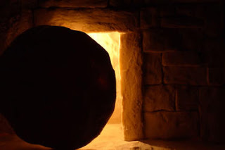
التسلسل الزمني للمسيح
د. ريك جريفيث• مؤسسة الدراسات اللاهوتية الأردنية• BibleStudyDownloads.org

Slide 2

ومع ذلك يجب علينا أيضًا النظر في هذا العمل النهائي

Slide 3
تاريخ ميلاد المسيح
65
تاريخ الميلاد: ما بين كانون أول 5 ق.م / كانون الثاني 4 ق.م
ولد يسوع بين هذين التاريخين
إحصاء
كيرينيوس
(لوقا 2: 1-5)
موت هيرودس الكبير (متى 2: 1؛ لوقا 1: 5)
6 ق.م
29 آذار – 11 نيسان
4 ق.م
هارولد و. هوهنر، النواحي الزمنية لحياة المسيح (زوندرفان، 1977)، 114
Notes:
_________
NS-00-NT Introduction-62
NS-01-Matt1-14-slide
NS-03-Luke1-12-slide 161

Slide 4
تاريخ بداية خدمة المسيح
56
بدء الخدمة: حوالي خريف 29 م
على الأغلب أن يسوع بدأ خدمته بين هذين التاريخين:
السنة الخامسة عشرة من حكم طيباريوس * (لوقا 3: 1-3)
19 آب 28 م
31 كانون أول 29 م
* محسوب إما من التقويم اليولياني أو من سنة طيباريوس الملكية
هارولد و. هوهنر، النواحي الزمنية لحياة المسيح (زوندرفان، 1977)، 114
Notes:
_________
NS-00-NT Introduction-63
NS-01-Matt1-14-slide
NS-03-Luke1-12-slide 193

Slide 5

مدة خدمة المسيح
56
خريف 29 م – 3 نيسان 33 م (3.5 سنة)
ذكر يوحنا وحده ثلاثة أعياد فصح
لهذا فإن خدمة يسوع كانت 2.5 سنة على الأقل
بدء خدمة يسوع
الفصح الأول 7 نيسان 30 م
الفصح الثاني
الفصح الثالث 25 نيسان 32 م
الفصح الرابع 3 نيسان 33 م
خريف 29 م
يو 2: 13 و23
غير مذكور في يوحنا
مر 2: 23-28
لو 6: 1-5
مت 12: 1-8
يو 6: 4
يو 11: 55 - 12: 1
هارولد و. هوهنر، النواحي الزمنية لحياة المسيح (زوندرفان، 1977)، 114
Notes:
Christ's 3½ year ministry spanned four Passovers. However, the Synoptics mention only one Passover (#2 on this timeline), which could give the impression of only a year-old ministry. John fills in the details, though, by showing three other Passovers not mentioned by Matthew, Mark, or Luke.
_________
NS-00-NT Introduction-64
NS-01-Matt1-14-slide
NS-03-Luke1-12-slide 194

Slide 6
التسلسل الزمني ليسوع و الأعمال
38أ
4 ق.م
1 ق.م
1 م
14
29
30
33
35
ولادة
يسوع
–سنة–
تتويج
طيباريوس
السنة 15
لطيباريوس
– يوحنا
و يسوع
موت
يسوع
إيمان
بولس
في السنة الخامسة عشرة لطيباريوس... كرز يوحنا. (يو 3: 1)
32-33 سنة
و لما ابتدأ يسوع خدمته كان له نحو ثلاثين سنة (لو 3: 23)
Notes:
_________
NS-00-NT Introduction-66
NS-01-Matt1-14-slide
NS-03-Luke1-12-slide 165, 195

Slide 7
عمر يسوع عندما بدأ خدمته
38أ
و لما ابتدأ يسوع خدمته كان له نحو ثلاثين سنة (لو 3: 23)
سنة
3 سنوات
28-29 سنة
4 3 2 1 1 2 3 4 5 6 7 8 …………………………………….……………….…………………… 26 27 28 29
ق.م م
3 + 1 + 28 = 32 سنة (غير شامل 29 م)
3 + 1 + 29 = 33 سنة (شامل 29 م)
مقتبس من ميشيل آنج (طالب مسح العهد الجديد، كلية سنغافورة للكتاب المقدس، 2006)
Notes:
_________
NS-00-NT Introduction-66
NS-01-Matt1-14-slide
NS-03-Luke1-12-slide 196

Slide 8

عطلة نهاية أسبوع نبويَّة
م ع ج 39
يوم الخميس
جمعة
السبت
الأحد
الجليل
الانفصال
الفداء
القيامة
يهودا
الفداء
الانفصال
القيامة
العشاء الأخير
صلب
القيامة
2 أبريل 33
3 أبريل 33
5 أبريل 33
"وَلَكِنِ الآنَ قَدْ قَامَ الْمَسِيحُ مِنَ الأَمْوَاتِ وَصَارَ بَاكُورَةَ الرَّاقِدِينَ." ١ كورنثوس ١٥ : ٢٠
المسيح هو الوحيد الذي قام على الإطلاق، ولكن على هذا النحو، فهو أيضًا الأول من بين الكثيرين الذين سينضمون إلى جسد مُقام.
Notes:
Leviticus 23 gives the order of Israel's three key feasts: • Passover, • Unleavened Bread, and • Firstfruits.
• But how could Jesus have the Passover on Thursday night but then die at 3 PM the next day on Friday when the Passover lambs were being slaughtered? And why did the Jewish leaders want the bodies off the cross quickly as Passover was approaching when Jesus had already celebrated Passover the night before?
• The answer is that Galilean Jews celebrated Passover the day before • Judean Jews. Since his disciples were Galileans, Jesus naturally celebrated on their timetable.
• The Feast of Unleavened Bread always began the day after Passover (Lev 23:5-6).
• Then Firstfruits followed sometime later on the first Sabbath after the first crops began to ripen (Lev 23:11). It indicated that millions of additional sheaves would follow until the entire harvest came in at Pentecost. In AD 33, these three celebrations occurred one after another on three consecutive days!
The significance is astonishing. • Christ predicted his death at the Last Supper Thursday night. • Then Jesus died on the Judean Passover • so that believers can live a life without yeast (Unleavened Bread), • which immediately followed with his resurrection on Firstfruits as he is the first and only human ever to obtain a glorified body as an installment for millions more to follow (1 Cor 15:20)!
We know these dates to be • 2 April 33 for the Thursday night Passover, • 3 April 33 was the day of his crucifixion, and • Jesus rose from the dead on the Feast of Firstfruits on 5 April 33.
————————————
OB-25-Feasts-35
OS-03-Leviticus-303
OS-26-Ezek40-48-Slide73
LC-00-NT Chronology-43
LC-00-Chronology of Christ-8
LC-09-Rejection-243
NB-11-Feasts-35
NS-00-NTS Chronology-slide 40
NS-00-Chronology of Christ-8
NS-01-Matt15-28-slide 313
NS-02-Mark9-16-slide 274
NS-03-Luke13-24-slide 290
NS-04-John12-21-slide 294
Another view by Mark Moore:
"§ 143 Preparation for the Passover Meal (Mt 26:17–19; Mk 14:12–16; Lk 22:7–13)
The Synoptics indicate that Jesus ate the actual Passover meal on Nisan 14 before he was crucified on Nisan 15 (roughly equivalent to our April). Some, however, have interpreted John 18:28 and 19:14 to say that Jesus died at the very time the Passover lambs were being slain on Nisan 14. If that is true then we have an obvious contradiction between John and the Synoptics.
Though some are always eager to charge the Evangelists with theological editing or outright error, a better solution seems to be the suggestion that two separate calendars were followed. For example, Jaubert argues that Jesus followed the Essene solar calendar,²¹ or that the Passover sacrifices and meals were spread over two days because of the flood of visitors to Jerusalem.²² This would put the Passover on Thursday for the disciples but on Friday for the Sadducees. Hoehner argues that there was a difference in how the Galileans and Judeans reckoned their days (from sunrise or sunset).²³ Hence Jesus and the other Galileans ate the Passover a day before the Judeans did. Others have suggested that the discrepancy stemmed from an argument between the Pharisees and Sadducees. However, none of these arguments based on a calendar have strong documentary support.
There is a third solution that is better still and much simpler. Jesus and his disciples celebrated the actual Passover. John knew that. After all, he was familiar with synoptic chronology. In fact, John 13 also describes the Passover Jesus celebrated. (1) It was in Jerusalem rather than Bethany, which had been their haunt the entire week. (2) They are pictured as reclining at the table at night, which is indicative of a festival meal. And (3) when the disciples saw Judas exit urgently they believed he was going out to get last minute supplies for the Passover meal or to give alms to the poor. These are indications of a Passover meal. Consequently, what John calls the Passover (18:28), is actually the chagigah (Num 28:18–19), which opened the Feast of Unleavened Bread. Was John confused about what it was actually called? No. In John’s day, there was little distinction between the Passover (Nisan 14) and the Feast of Unleavened Bread (Nisan 15–21). Both terms were used interchangeably (Mt 26:17; Mk 14:1, 12; Lk 2:41; 22:1; Josephus, Ant 2.317; JW 5.98). So it was perfectly acceptable for John to identify this special meal as the Passover. Besides, every other time John uses the term “Passover” he refers to the entire feast, not the single meal (Jn 2:13, 23; 6:4; 11:55; 12:1; 13:1). Therefore, we suggest that Jesus and the disciples ate the actual Passover meal, celebrated on Nisan 14. Furthermore, the Jews of John 18:12 refused to enter Pilate’s praetorium so they would not be disqualified from the rest of the seven day Feast of Unleavened Bread, not the actual Passover meal.²⁴
²¹ Annie Jaubert, The Date of the Last Supper (New York: Alba House, 1965). One great weakness of her view is that her evidence for the Essene solar calendar comes from a third century document.
²² Cf. Maurice Casey, “The Date of the Passover Sacrifices and Mark 14:12,” TB 48/2 (1997): 245–247.
²³ H.W. Hoehner, Chronological Aspects of the Life of Christ (Grand Rapids: Zondervan, 1977).
Ant Antiquities of the Jews
JW Jewish Wars
²⁴ Cf. Carson, pp. 528–532; and B. Smith, “The Chronology of the Last Supper,” WTJ 53 (1991): 29–45. F. Chenderlin, “Distributed Observance of the Passover: A Preliminary Test of the Hypothesis,” Biblica 57 (1976): 1–24, adds a couple of additional keen points. First, there were probably too many Passover participants to have all the lambs killed and eaten in a single day. Hence, he argues for a “distributed observance” in which the Passover would be celebrated on successive days. Second, if that were the case, the Jewish leaders may have preferred to eat the Passover on the holy high Sabbath during Passover week rather than strictly on Nisan 14."
— Mark E. Moore, The Chronological Life of Christ (Joplin, MO: College Press Publishing Company, 2011), 557–558.
————————————
Common-435
OB-25-Feasts-35
OS-03-Leviticus-303
OS-26-Ezek40-43-Slide105
LC-00-Chronology of Christ-8
LC-08-Preparation-98
LC-09-Rejection-227
LC-10-Resurrection-35
NB-11-Feasts-35
NC-10-Reliability of Acts-13
NS-00-NTS Chronology-slide 40
NS-00-Chronology of Christ-8
NS-01-Matt15-28-slide 315
NS-02-Mark9-16-slide 262
NS-03-Luke13-24-slide 292
NS-04-John12-21-slide 390

Slide 9
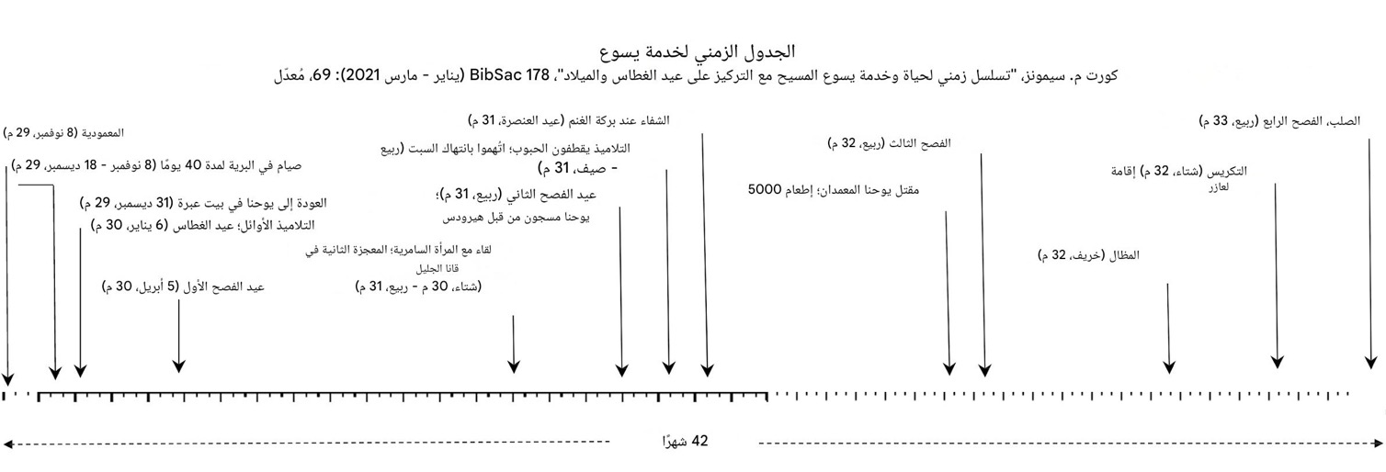
الجدول الزمني لخدمة يسوع
Notes:
Kurt M. Simmons published a recent (2021) scholarly study of the chronology of Jesus. He argues for the 25 Dec 5 BC birth and 3 April AD 33 death.
_________
LC-00-Chronology of Christ-8
LC-09-Rejection-255

Slide 10
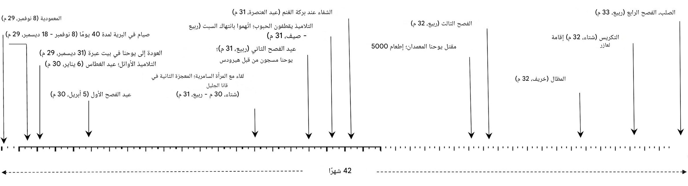
الجدول الزمني لخدمة يسوع
Notes:
Kurt M. Simmons published a recent (2021) scholarly study of the chronology of Jesus. He argues for the 25 Dec 5 BC birth and 3 April AD 33 death.
_________
LC-00-Chronology of Christ-9
LC-09-Rejection-256

Slide 11
الجدول الزمني لخدمة يسوع
Notes:
Kurt M. Simmons published a recent (2021) scholarly study of the chronology of Jesus. He argues for the 25 Dec 5 BC birth and 3 April AD 33 death.
_________
LC-00-Chronology of Christ-10
LC-09-Rejection-257

Slide 12


مسح العهد الجديد • BibleStudyDownloads.org
أحصل علي هذا العرض مجانا!
Notes:
NT Survey (ns) Arabic

Slide 13
Black

