Slide 1
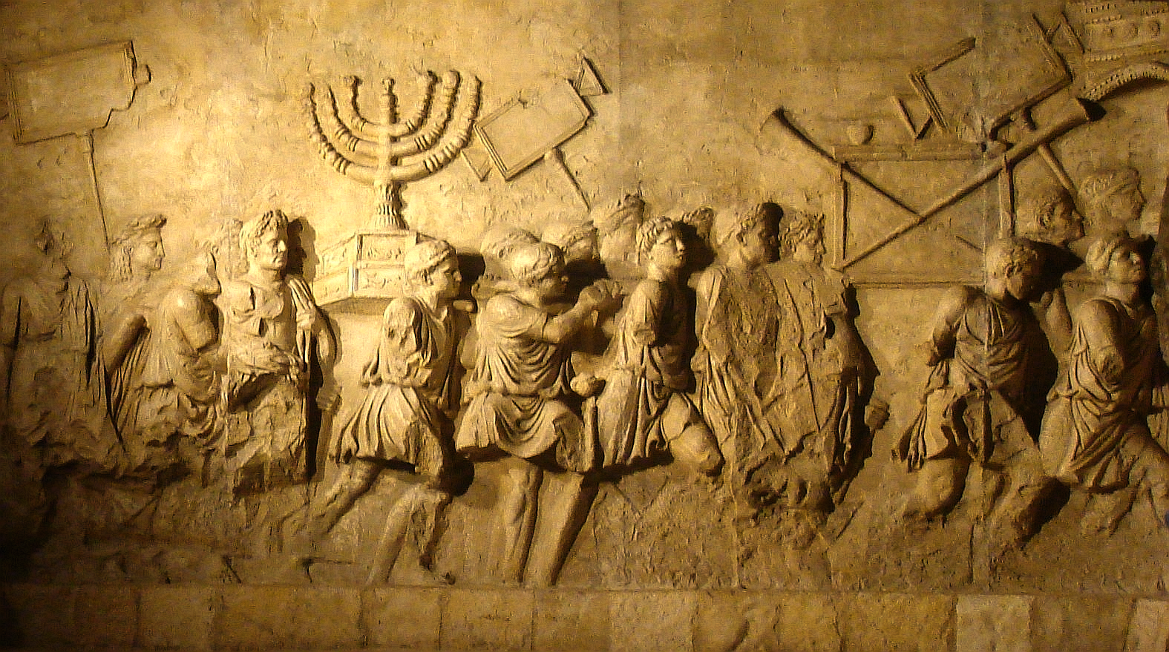
كيف عاملت الأمم إسرائيل؟
كراهية اليهود عبر القرون
د. ريك جريفيث• مؤسسة الدراسات اللاهوتية الأردنية• BibleStudyDownloads.org

Slide 2
ما هي معاداة السامية؟

Slide 3
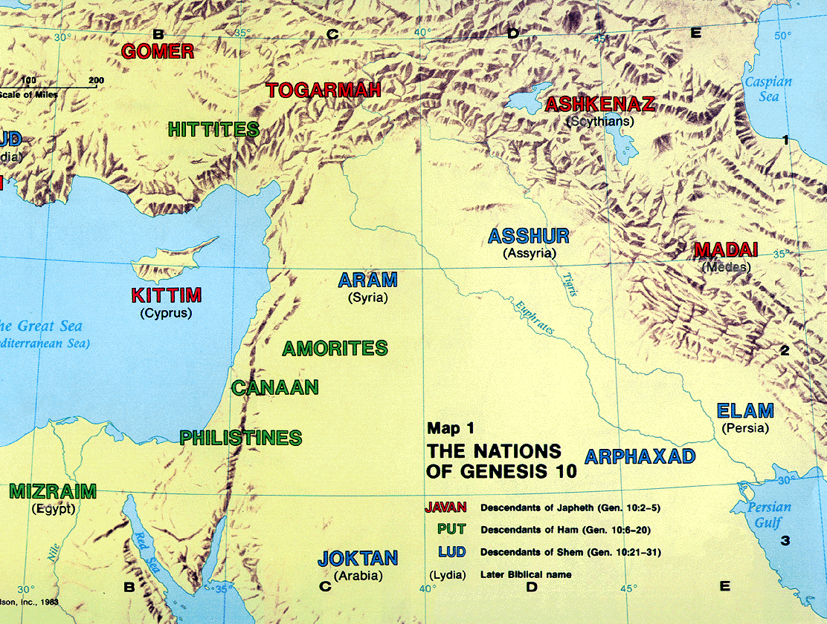
قائمة الأمم
92
أخبار الأيام الأول 1: 4-27
نوح
سينو
يافث
حام
سام
سين
القوقازيون
الكنعانيون
الساميون
سيناء
الأوروبيون
والهنود الشرقيون
الأفارقة
والآسيويون
اليهود
والعرب
تكوين ١٠
Notes:
Noah’s three sons became three divisions of humanity in three major areas.
Asians stem from Canaanites in the city of Sin—not those who migrated south to the Sinai but those who migrated east to China. Here is why we have these terms of Sinai and East Asians called Sino.
_____________
ES-29-How the Nations Treat Israel-4
BG-03-Table of Nations-3
OS-01-Gen4-20-slide 150
OS-13-1Chron-74

Slide 4
كيف تعامل العالم مع اليهود؟

Slide 5
كيف تعامل العالم مع اليهود؟
المصريون
الفلسطيون
الآشوريون
البابليون
الفرس
اليونانيون
الرومان
الكاثوليك
المسلمون
الصليبيون
الإسبان
اللوثريون
الألمان
الأوروبيون
العرب
الأمم المتحدة
الجيران
الفلسطينيون
الكنديون
اليسار الأمريكي
العالم

Slide 6
المصريون
مضطهدو اليهود ...

Slide 7
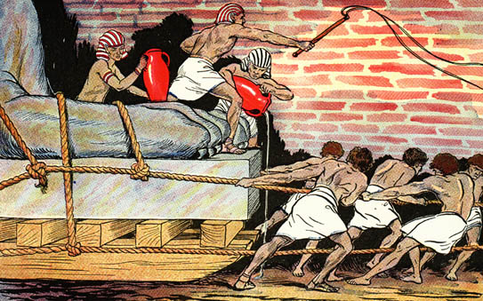
اضطهد المصريون بني إسرائيل بلا رحمة

Slide 8
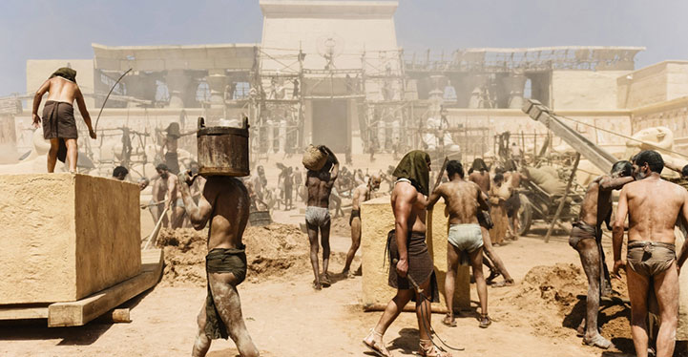
أشعياء 9 : 4 لأن نير ثقله وعصا كتفه و

Slide 9
الفلسطيون
مضطهدو اليهود ...

Slide 10
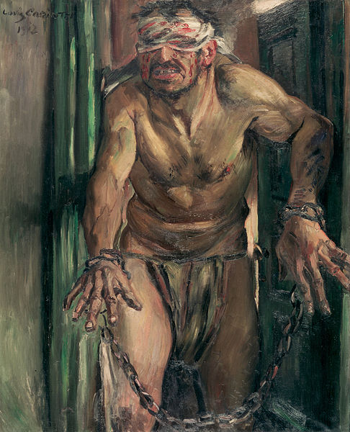
قص شعر شمشون

Slide 11
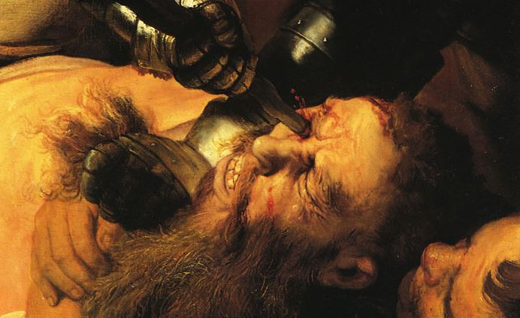
فقأ عيني شمشون

Slide 12
الآشوريون
مضطهدو اليهود ...

Slide 13
التهديد الأشوري
454
التوسع الأشوري
نينوى
البحر المتوسط
آرام
إسرائيل
يهوذا
إشعياء 7
خليج فارس
مصر
Notes:
13
The Assyrian Empire—like most empires—developed in stages. Theirs was a westward expansion that conquered many areas, some of which are noted in Isaiah 7 such as Israel and Syria. A total of 12 nations allied to fight Assyria, but Isaiah 13-23 lists their alliance as a futile attempt since God destined the Assyrians to destroy them all.
Nineveh repented 100 years earlier than Nahum under Jonah but then went back to its sin.
Assyrians invaded Israel 60 years earlier than Nahum during Isaiah's day and scattered the people.
Then they destroyed 46 towns of Judah—all but Jerusalem in 701 BC!
———————
Common-370
BG-03-Table of Nations & OT Peoples-37
ES-29-Antisemitism-14
OS-23-Isaiah1-12-slide 113
OS-34-Nahum-38

Slide 14
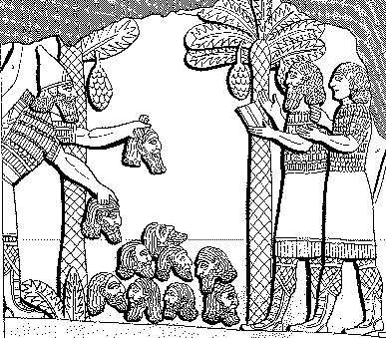
Assyrian Brutality
الوحشية
614
الأشورية
ترتب هرم من الرؤوس أمام مدينته. احترق شبابهم وبناتهم في النيران.
شلمنصر ، 859-824 ق.م = 80 سنة قبل يونان ، في لوكينبيل السجلات القديمة لآشور وبابل ، 1: 213

Slide 15
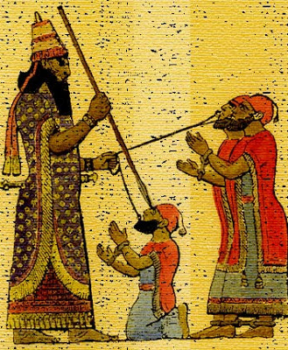
معاملة الملوك الأسرى
614
قد يحتوي حكم الإعدام في آشور على الكثير من التعذيب كالسلخ أو اقتلاع اللسان الكاذب أو الحرق أو
لقد اخترقت ذقنه بخنجر يدي الحاد. من خلال فكه ... مررت بحبل، ووضعت عليه سلسلة كلب وجعلته يحتل مأوى
أشور بانيبال، 669-626 ق.م = 100 سنة بعد يونان في لوكينبيل، السجلات القديمة لأشور وبابل،
2: 319

Slide 16
التطورات الآشورية
ونقل ملك أشور جماعات من بابل وكوث وعبا وحماة وسفروايم وأسكنهم في مدن السامرة عوضاً عن بني إسرائيل. فاستولى الآشوريون على السامرة ومدن إسرائيل الأخرى
(2 ملوك 17: 24).
وأخيراً في السنة التاسعة من حكم الملك هوشع سقطت السامرة وتم سبي شعب إسرائيل إلى أشور. واستوطنوا في مستعمرات في حلح وعلى ضفاف نهر الخابور في جوزان وبين مدن الميديين.
(2 ملوك 17: 6).
48
سقوط السامرة
صعود السامريين
تظهر الأرقام المكتوبة بخط اليد عدد السنوات التي سبقت يونان عام 760 قبل الميلاد
بيتزل، أطلس مودي لأراضي الكتاب المقدس، الطبعة الأولى، ١٣٩
Notes:
• غزت أشور في كل الاتجاهات، وبشكل خاص باتجاه الغرب، بم في ذلك إسرائيل عندما سقطت السامرة عام 722 ق. م. تم ترحيل معظم الناس إلى بلدان أخرى، وبقي عدد قليل منهم.
• جلب الآشوريون شعوبًا أخرى مهزومة إلى حدود أراضي إسرائيل، وأدى التزاوج بين تلك القلة المتبقية الشعوب الوثنية لظهور أعراق مختلطة نصفها من اليهود والنصف الآخر من الأمم. أطلق عليهم اسم العاصمة السابقة ثم أطلق عليهم اسم السامريين. كان اليهود ذوي الدم الكامل يحتقرونهم.
______________
Common-415
OS-12-2 Kings-250
OS-14-2 Chron-316
OS-23-Isaiah13-23—slide 71
OS-24-Jeremiah-242
OS-32-Jonah-39
NB-05 Politics 2 Ptolemies to 63 BC (Pompey)-4

Slide 17
البابليون
مضطهدو اليهود ...

Slide 18
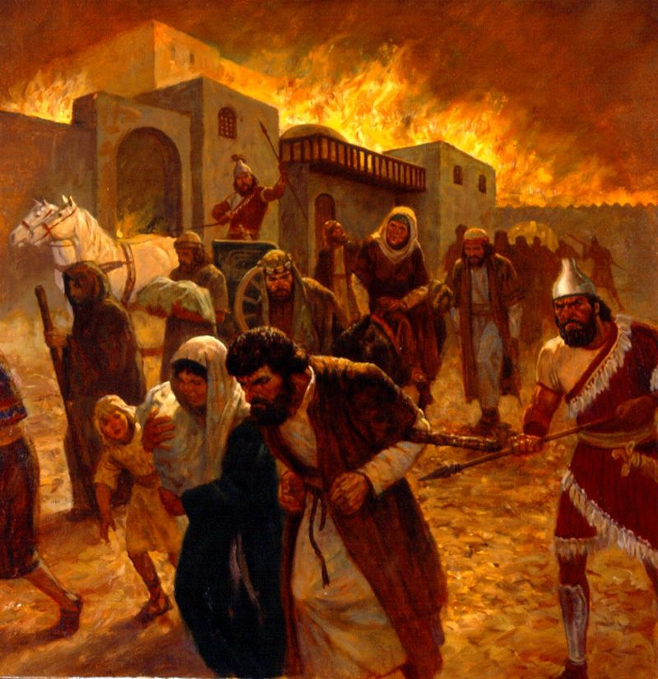
مقدمة
Notes:
Babylonians drove Jews outside their land for 70 years.
__________
ES-29-Antisemitism-18
OS-26-Ezek1-3-slide 144
OS-27-Daniel-188

Slide 19
ترحيلات وتطورات السبي
641
الترحيلات
التطورات
الإنفصال
المجمع
لا وثنية
على الرغم من وجود المجمع، لكن اليهود يريدون استرداد هيكل أورشليم
عاد المسبيون بقيادة زربابل إلى أرض يهوذا بعد مرسوم الإمبراطور الفارسي كورش في 539 ق.م، بدأ المسبيون العائدون بإعادة بناء الهيكل من خلال وضع أساساته بحسب (عزرا 5: 16)
بيتزيل, أطلس مودي للأراضي الكتابيَّة, الطبعة الأولى, 145
Notes:
• Babylonians deported those left in Jerusalem to Babylon (cf. Dan 1).
• Jews in Babylon resulted in the term"Judaism,” with three key developments:
• They resisted intermarriage with the pagan peoples.
• They established local places of teaching (but no sacrifices) called synagogues (=“together marketplace”)
• Despite living in the most idolatrous city ever, they were cured of idol worship!
• Babylonians deported those left in Jerusalem to Babylon (cf. Dan 1).
• Jews in Babylon resulted in the term"Judaism,” with three key developments:
• They resisted intermarriage with the pagan peoples.
• They established local places of teaching (but no sacrifices) called synagogues (=“together marketplace”)
• Despite living in the most idolatrous city ever, they were cured of idol worship!
But the people and temple exiles were not permanent. God promised to restore them because the exiles would last only 70 years, and the time and opportunity to return had come to return home. Remember centuries earlier when Israel entered Canaan and had 600,000 soldiers? Now, only 50,000 men of Judah had trusted the LORD to bring them back to Israel.
In some sense, you can’t blame them for not many of them wanting to return. They had separated from idolatry, developed the synagogue, and been cured of idolatry. Besides these, they were making good money in Babylon—so who would want to return to a ruined country? No money, no homes, no friends—just enemies occupying their country now. But they still came, and they trusted God’s leading. They eagerly rebuilt the temple foundation and altar in 536 BC.
______________
Common-416
BE-35-Haggai-10
OS-12-2 Kings-241
OS-14-2 Chron-317
OS-25-Jeremiah-237
NB-05 Politics 2 Ptolemies to 63 BC (Pompey)-5

Slide 20
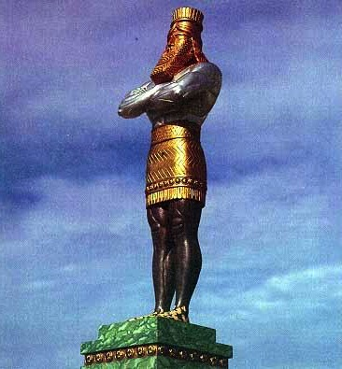
صورة دانيال 2
ذهب
بابل
فضة
فارس
نحاس
اليونان
حديد
روما
حديد و خزف
ضد المسيح
حجر
المملكة
Notes:
While Babylon was depicted by gold, even Babylon would fall to Christ’s kingdom!

Slide 21
الفرس
مضطهدو اليهود ...

Slide 22
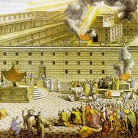
The Postexilic Era
560
^{فترة ما بعد السبي}
العمل في الهيكل
الأنبياء
حجي
زكريا
ملاخي
605
586
539
536
520
516
483-473
444-425
72 سنة
آخرون
زربابل
أستير
عزرا
نحميا
ملوك فارس
كورش
داريوس
أحشويروش
أرتحشستا
Notes:
The Post-Exilic Era was actually three separate periods: (1) Temple rebuilding led by Zerubbabel, Haggai, and Zechariah in two parts under Cyrus and Darius,
(2) The saving of the nation from destruction by Esther about 30 years later under Xerxes, and
(3) The restoration of Jerusalem’s walls and gates by Nehemiah another 70 years after that under Artaxerxes.
_________
Common-321
BE-37-Haggai-15
BE-39-Malachi-21
OS-12-Kings & Prophets Charts-24
OS-15-Ezra-36
OS-16-Nehemiah-94, 156
OS-17-Esther-16, 75
OS-27-Daniel-340
OS-37-Haggai-43
OS-38-Zechariah-46, 121
OS-39-Malachi-13, 56

Slide 23
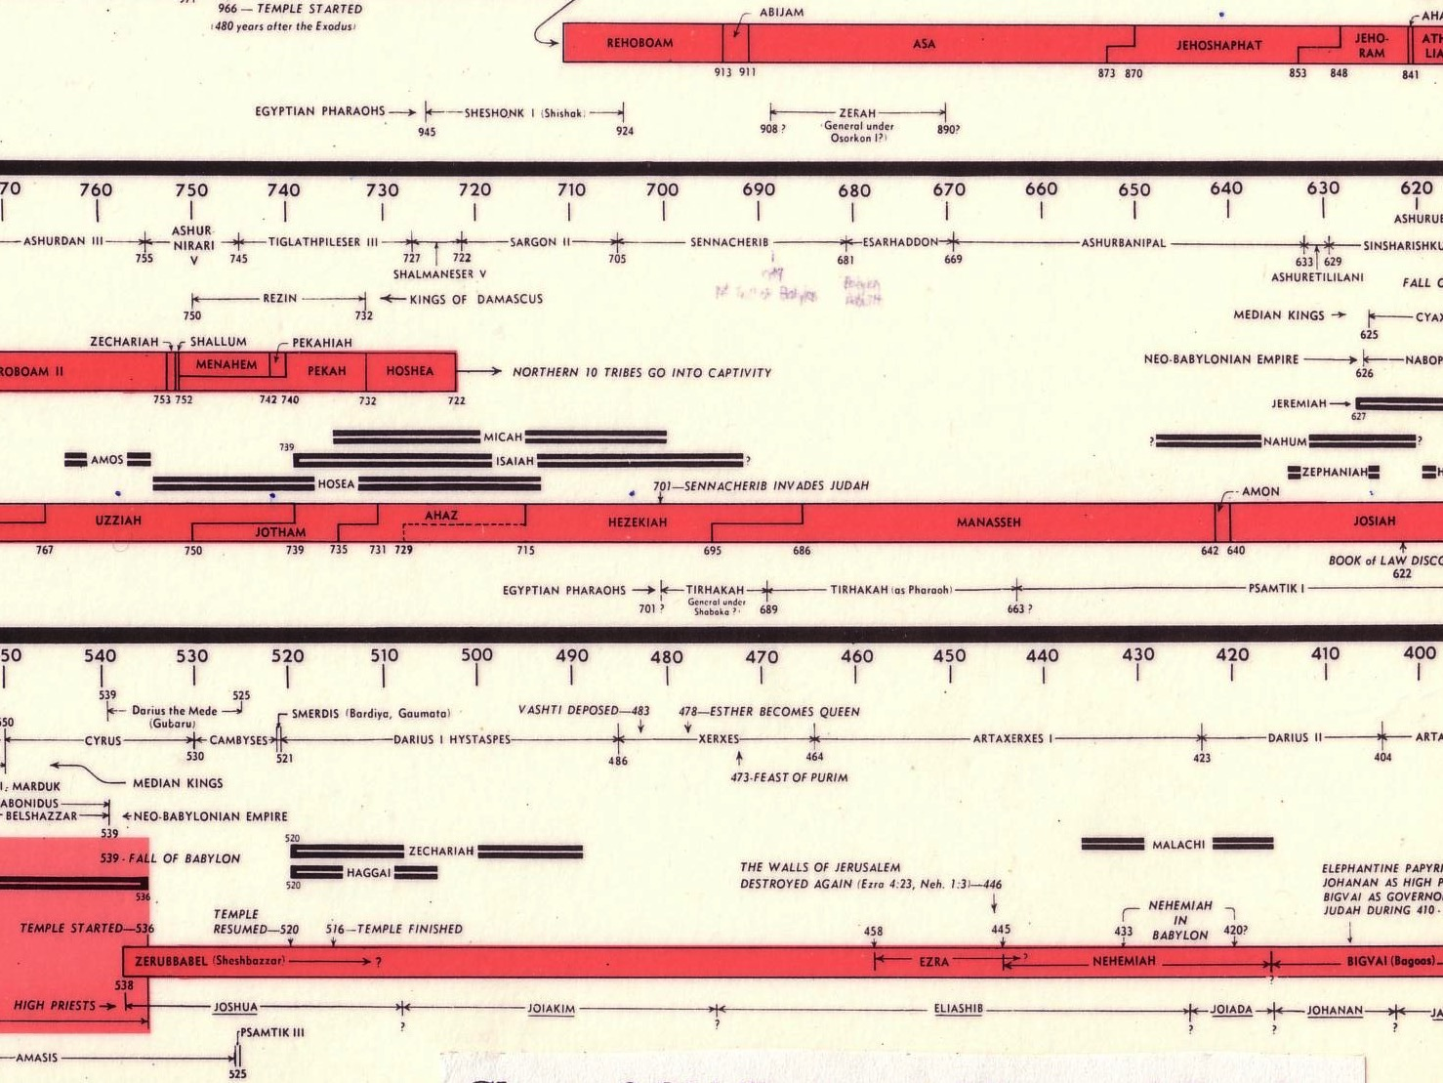
الجدول الزمني للمقاومة (عزرا 4 ؛ أستير 1 ؛ نحميا 13)
232 342
زربابل تحت قيادة كورش
536-520 ق.م
أستير تحت قيادة أحشويروش
486 ق.م
عزرا تحت قيادة أرتحشستا
±460 ق.م
نحميا تحت قيادة داريوس (داخلي) ±430 ق.م
قائمة ملوك وأنبياء العهد القديم
John C. Whitcomb, 4th ed. (Winona Lake, IN: BMH Books, 1968), 2
Notes:
"﻿The terminology in the biblical copies of letters to and from the Persian court is directly comparable with what we find in the external, firsthand documents. Inferiors call themselves the “servant(s)” of superiors and kings; the idiom for issuing decrees (sam t’e’em) is the same; the body of the typical Official Aramaic letter begins with the phrase “Peace (sh-l-m) and much well-being I send you,” which is what is presupposed in Ezra 4:17 (lit. “Peace, etc.”), where the formula is abbreviated for brevity’s sake.39 And so on, we may also say, on this topic. The form or stage of language of Aramaic used in Ezra and Daniel is precisely that used in the Neo-Babylonian and Persian period (sixth to fourth centuries), and is currently termed Official Aramaic. In the Old Testament the sole difference is that the spelling has been consistently modernized, to bring it into line with the Aramaic otherwise in popular use among the Jews by the third century.”
K. A. Kitchen, On the Reliability of the Old Testament. Grand Rapids, MI: Eerdmans, Kindle Edition. Loc 1892 of 14432.
________
Common English-168
OS-37-Ezra-87
OS-38-Nehemiah-407
OS-39-Esther-54

Slide 24
هامان الأجاجي (أستير 3: 1-2)
Notes:
"Some time later King Xerxes promoted Haman son of Hammedatha the Agagite over all the other nobles, making him the most powerful official in the empire. ² All the king’s officials would bow down before Haman to show him respect whenever he passed by, for so the king had commanded. But Mordecai refused to bow down or show him respect" (3:1-2 NLT).
"Because Haman was an Agagite, some have supposed that he was descended from Agag, king of the Amalekites (1 Sam. 15:8). However, it seems unlikely that a high-ranking Persian official would be related to a west Semite who lived 600 years earlier. Archeologists have uncovered an inscription which indicates that Agag was also the name of a province in the Persian Empire. This probably explains why Haman was called an Agagite" (John A. Martin, "Esther," Bible Knowledge Commentary, 1:705).

Slide 25
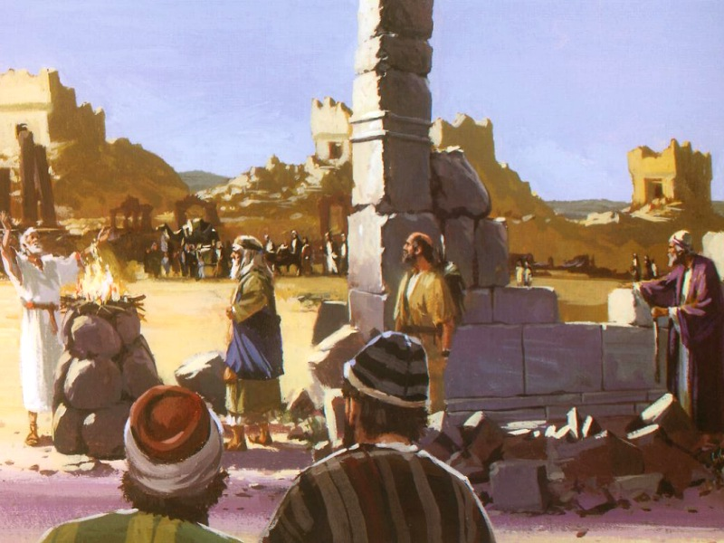
مقاومة عمل الله (4: 1-2)

Slide 26
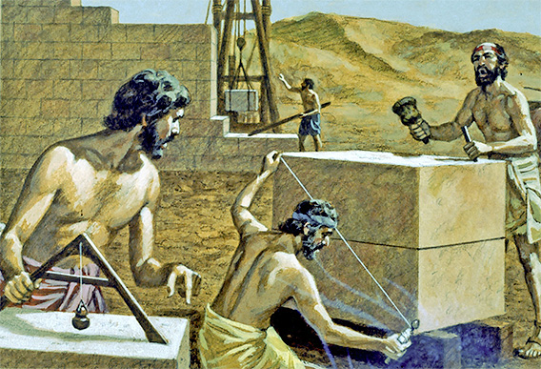
مقاومة عمل الله دائماً

Slide 27
اليونانيون
مضطهدو اليهود ...

Slide 28
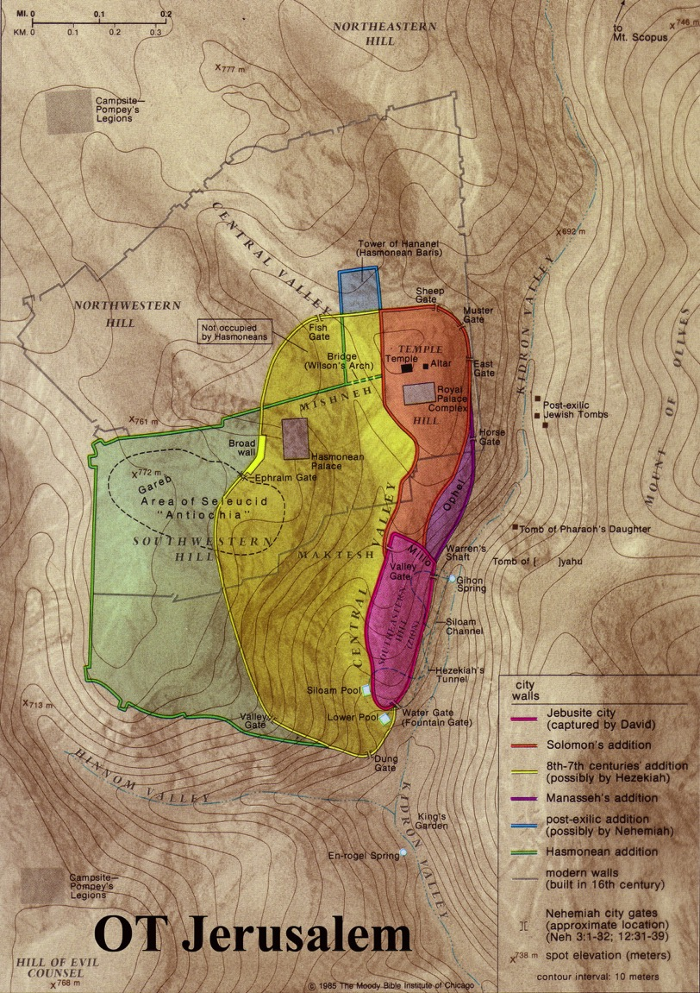
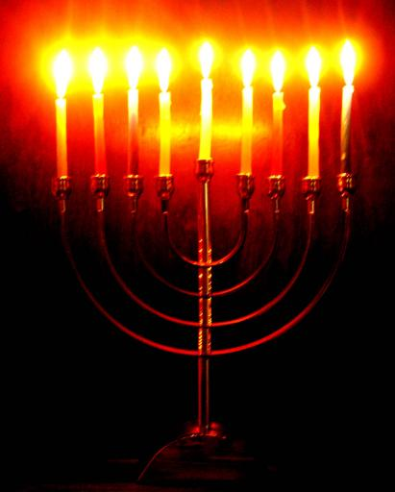
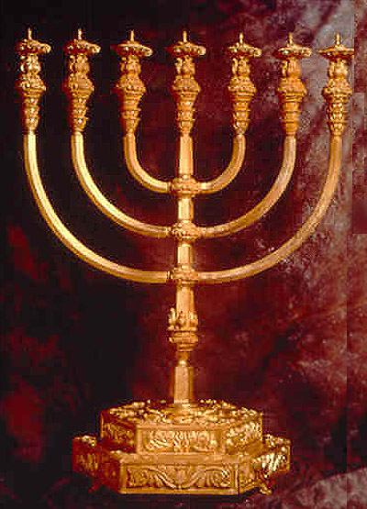
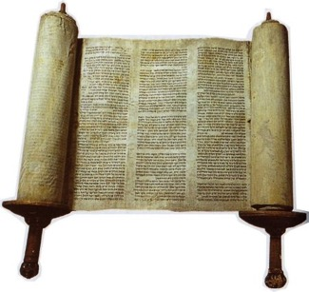
هلينة أورشليم (دانيال 11: 31-35)
65
كانون أول 167 – كانون أول 164
الحانوكاه
المنارة
عيد الأنوار (التجديد)
Notes:
Greek rule over Israel came to a height when Antiochus IV vented his anger at being defeated by Rome upon the Jews of Jerusalem.
• Jews had long held the Law sacred, but...
• Antiochus IV prohibited the law in Jerusalem itself!
• He also forced Jewish priests to offer a pig on the altar of the Jerusalem temple in 167 BC
This fulfilled Dan. 11:31 — “His army will take over the Temple fortress, pollute the sanctuary, put a stop to the daily sacrifices, and set up the sacrilegious object that causes desecration. 32 He will flatter and win over those who have violated the covenant. But the people who know their God will be strong and will resist him.
Dan. 11:33 “Wise leaders will give instruction to many, but these teachers will die by fire and sword, or they will be jailed and robbed. 34 During these persecutions, little help will arrive, and many who join them will not be sincere. 35 And some of the wise will fall victim to persecution. In this way, they will be refined and cleansed and made pure until the time of the end, for the appointed time is still to come.” (NLT).
• The revolt against took three years (167-164 BC).
• In the final battle to reclaim the temple, the lampstands in the temple had enough oil for only one day but miraculously lasted EIGHT days! Jews commemorate this in the annual Hanukkah celebration of eight days each December.
• Rather than light the normal 7-branched menorah, they light with the 8-branched Hanukkiah lampstand. This is also called the Feast of Lights, Feast of Dedication, or Feast of Rededication. Jesus declared himself as the Light of the World during this festival in John 8.
_______________
ES-29-Antisemitism-28
NB-05-Politics2 Ptolemies to 63 BC (Pompei)-23
OS-27-Daniel-496, 506

Slide 29
الرومان
مضطهدو اليهود ...

Slide 30
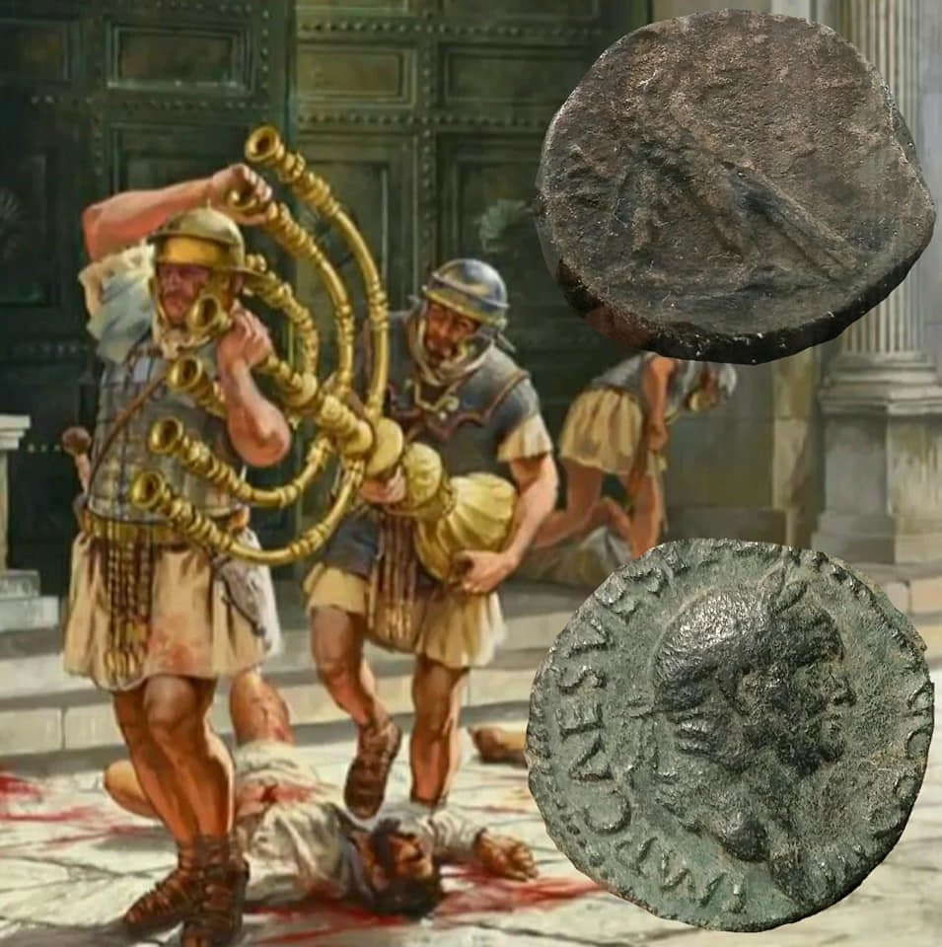
دمر الرومان الهيكل اليهودي في 70م وجعلوا أورشليم وثنية في 132م
حتى أن روما أعادت تسمية إسرائيل باسم فلسطين على اسم الفلسطينيين الذين جاءوا من بحر إيجة سعياً لمحو أي مطالبة يهودية بالمدينة

Slide 31
الكاثوليك
مضطهدو اليهود ...

Slide 32
لاهوت وممارسة الكاثوليك
قالوا أن الكنيسة هي إسرائيل الجديدة
استبدلوا إسرائيل
احترقروا اليهود
ظلموا
اليهود

Slide 33
المسلمون
مضطهدو اليهود ...

Slide 34
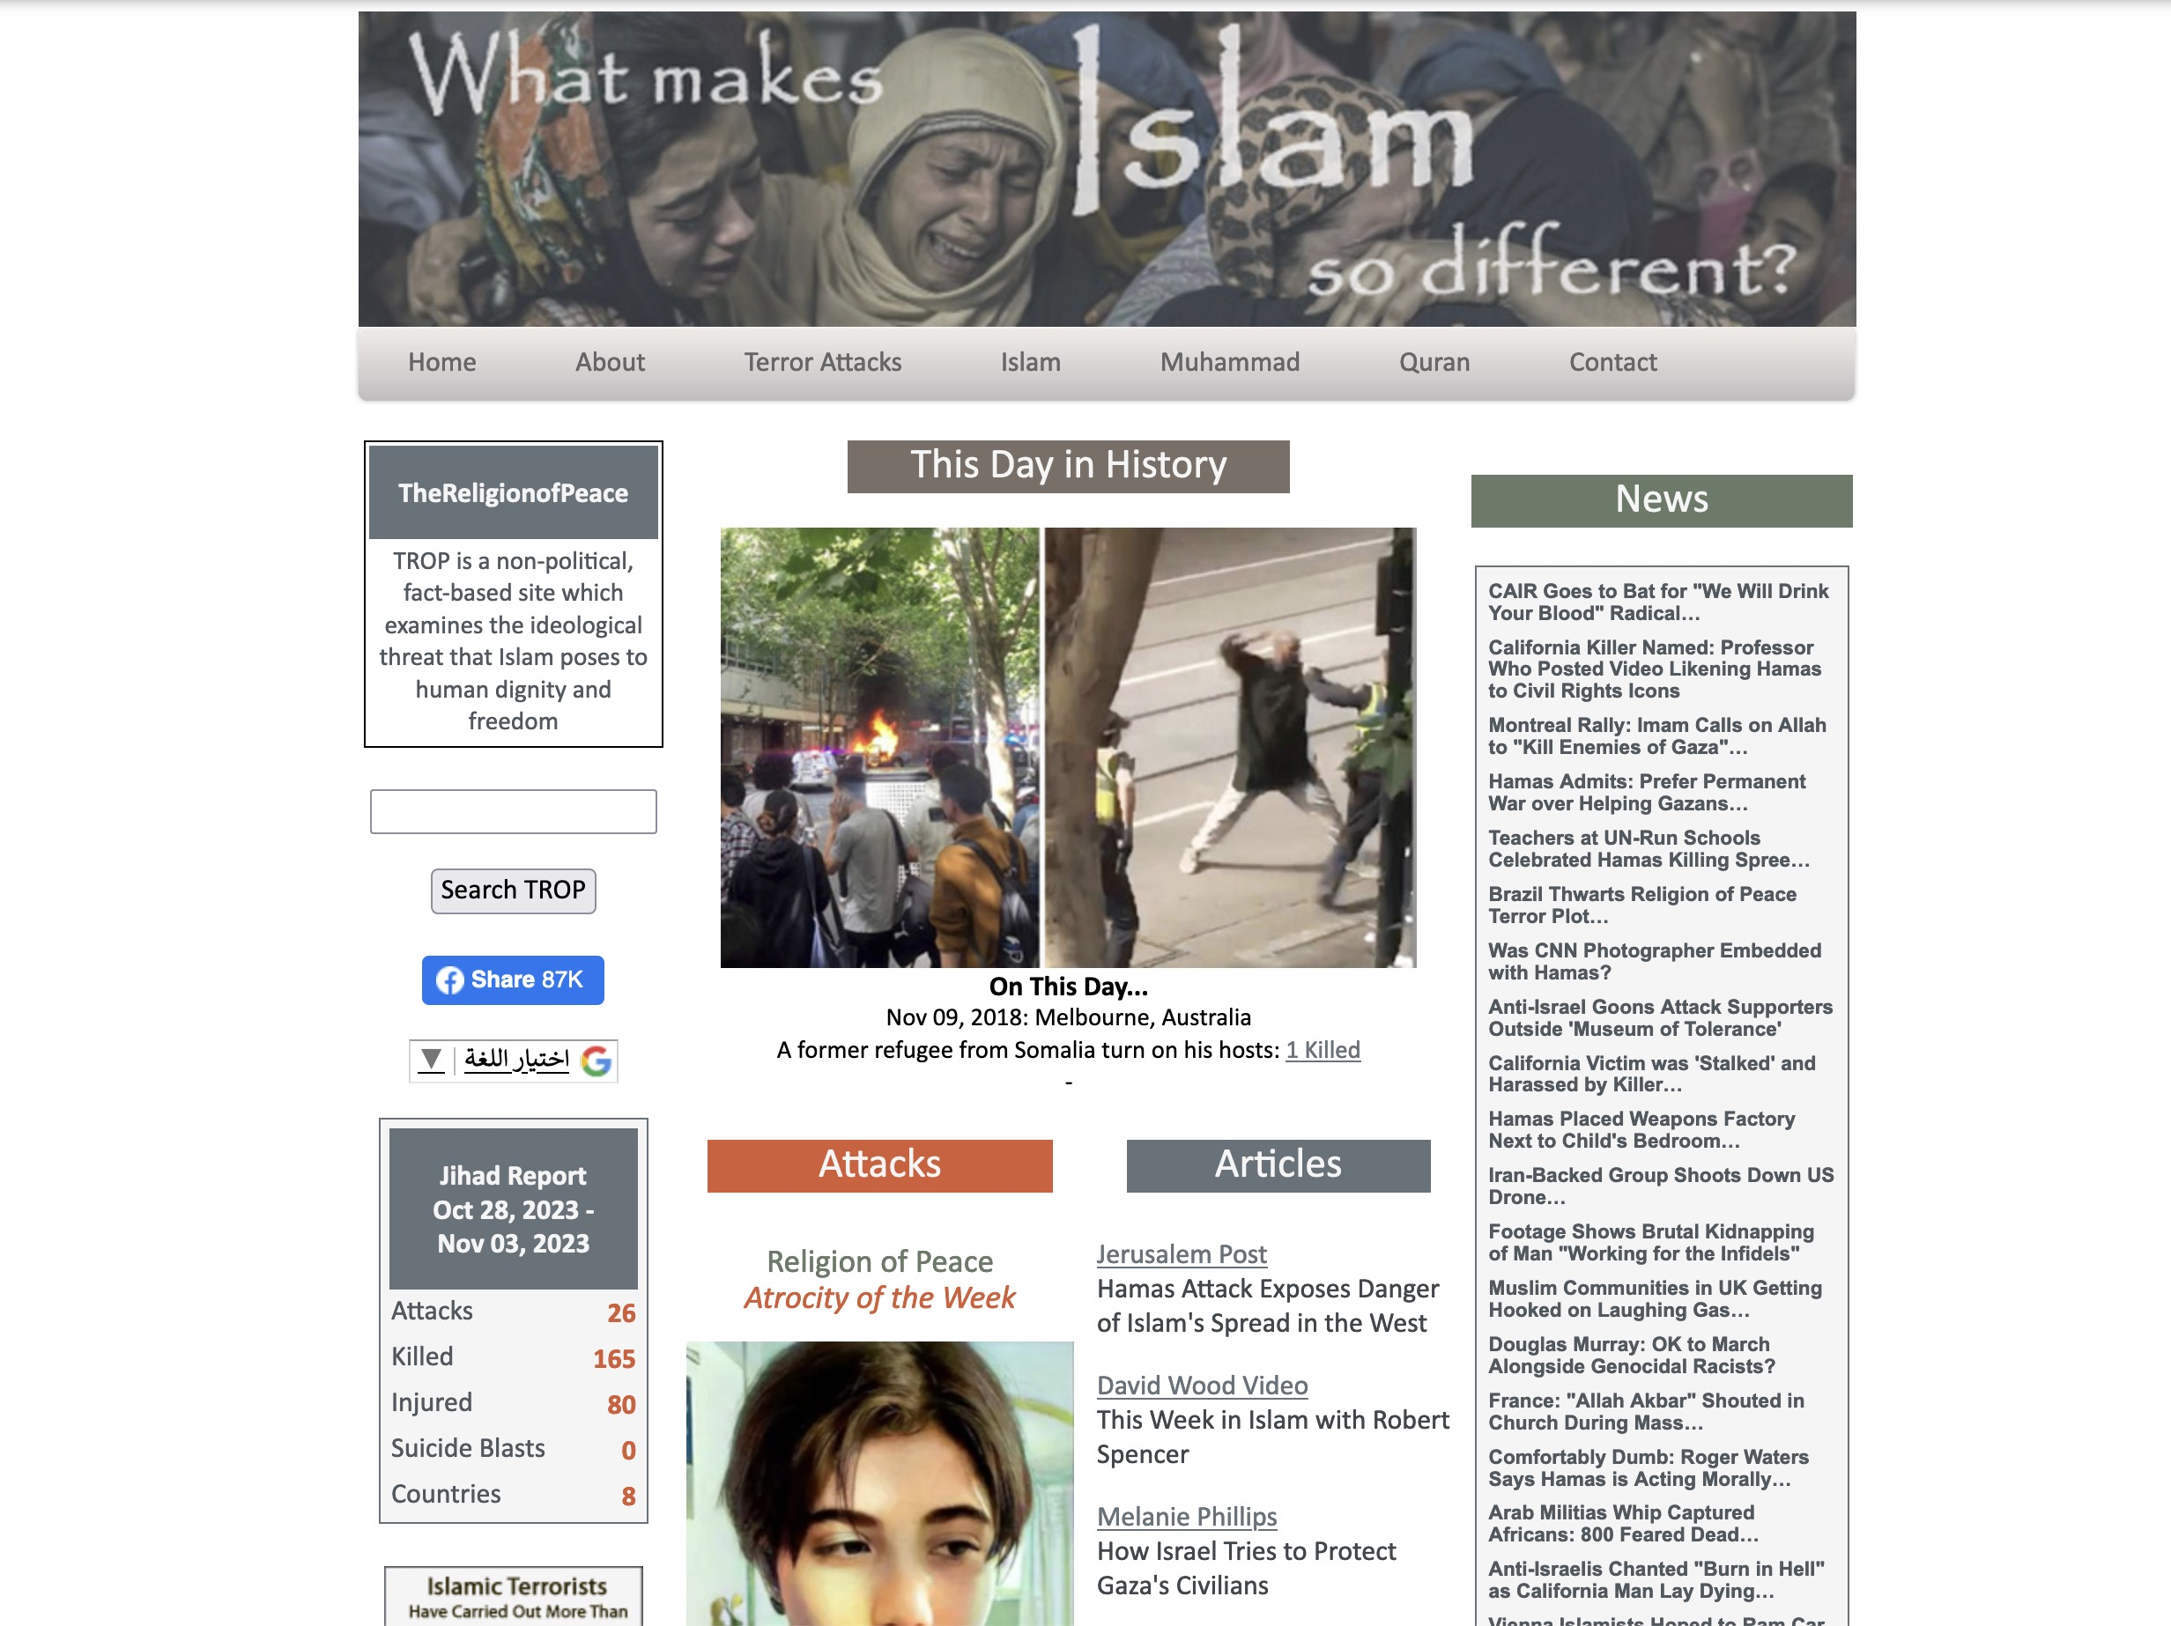
thereligionofpeace.com
9 تشرين ثاني 2023
تحديثات يومية للإرهاب الإسلامي ضد
اليهود والمسيحيين وغيرهم.

Slide 35
الصليبيون
مضطهدو اليهود ...

Slide 36
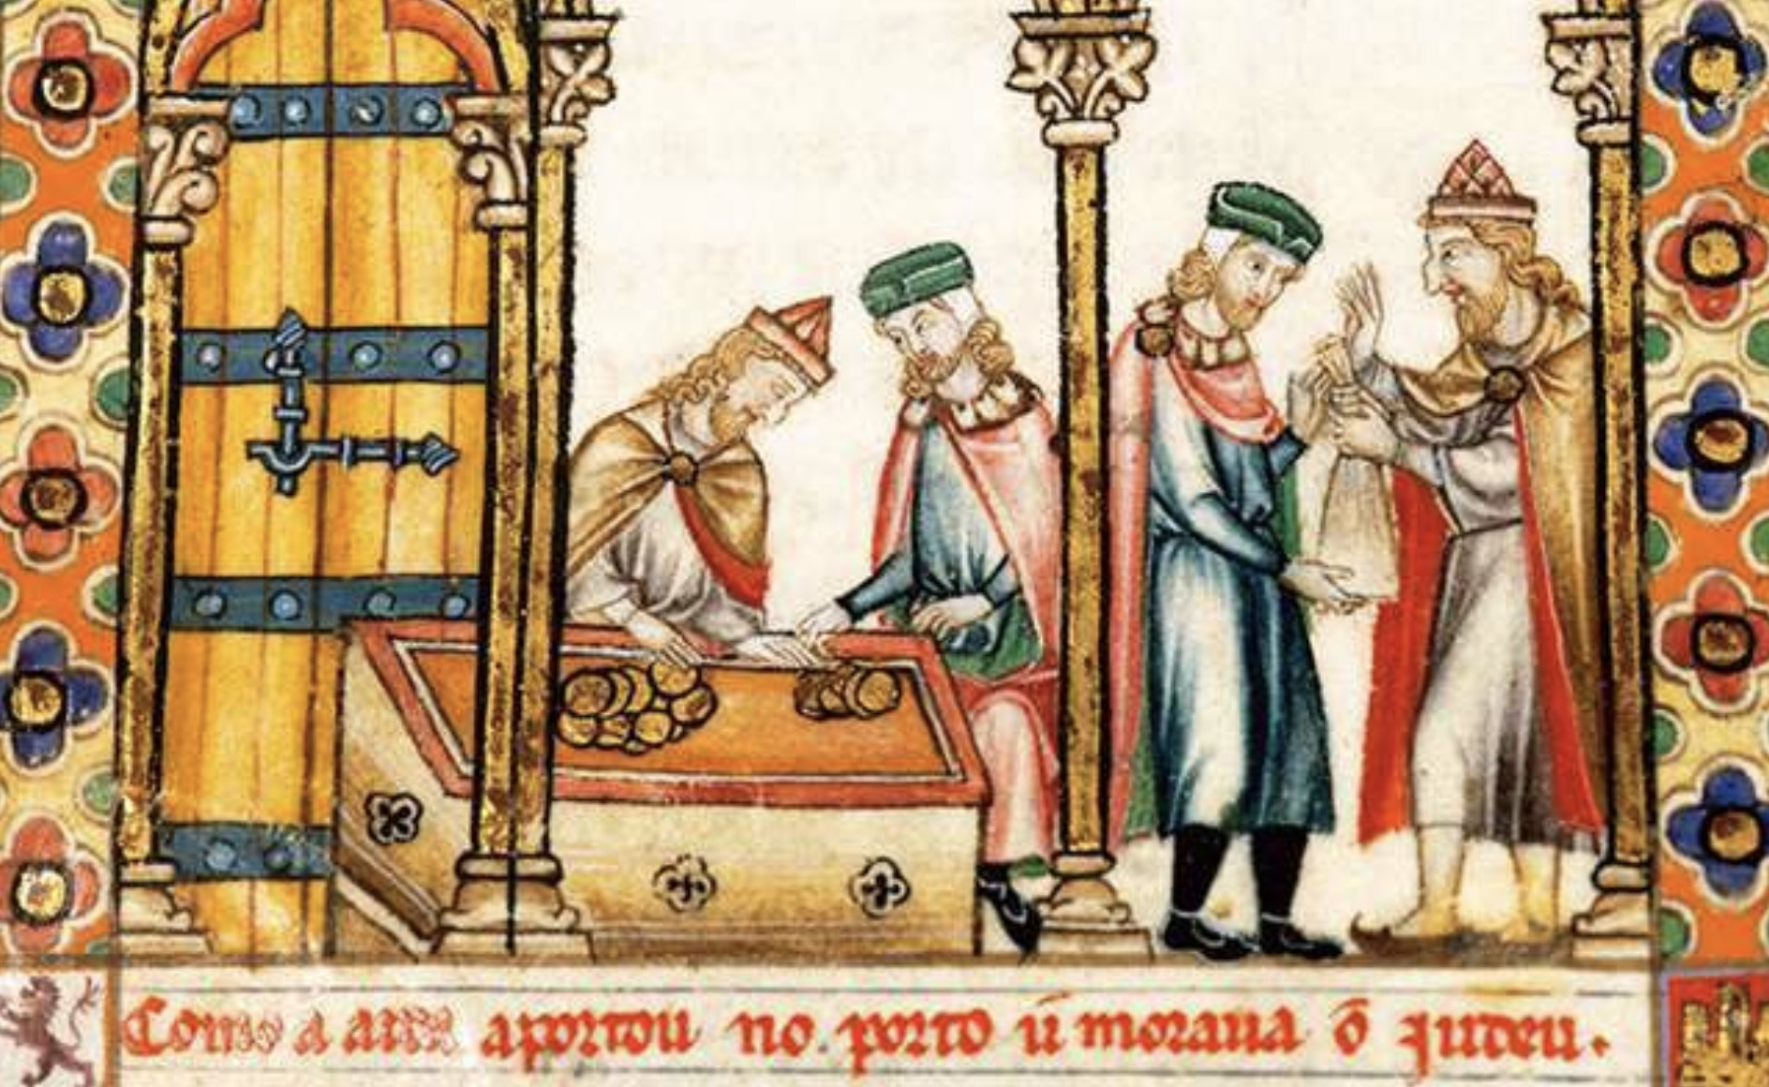
تم إحضار اليهود من فرنسا ليقرضوا الأموال بهدف بناء قلاع إنجلترا
Notes:
https://www.english-heritage.org.uk/visit/places/cliffords-tower-york/history-and-stories/massacre-of-the-jews/
The Massacre at Clifford’s Tower
England’s Jewish Population
After the Norman Conquest of 1066, a number of Jews came to England from Rouen in France. The early Norman kings needed to borrow money to build castles and secure their kingdom, but money-lending was forbidden to Christians. It was, however, permitted to Jews. These French-speaking Jews were protected by the Crown, and in time established communities in most of the principal cities of England. In the later 12th century, members of the Jewish community in Lincoln settled in York. However, there was growing hostility towards the Jewish population in England. This was in part due to public disagreements in theology between Jewish scholars and Christian churchmen. In the mid-12th century several vicious stories were spread accusing Jews of murdering Christian children. Such slanders, now known as the ‘Blood Libel’, strengthened anti-Semitic sentiment in England.
___________
An anti-Semitic portrayal of Jewish money-lenders from a 13th-century manuscript. William I brought Jewish merchants to England in the 11th century as they were able to lend money to the Crown, whereas Christians were forbidden to do so © Getty Images/Universal Images Group/Hulton Fine Art

Slide 37
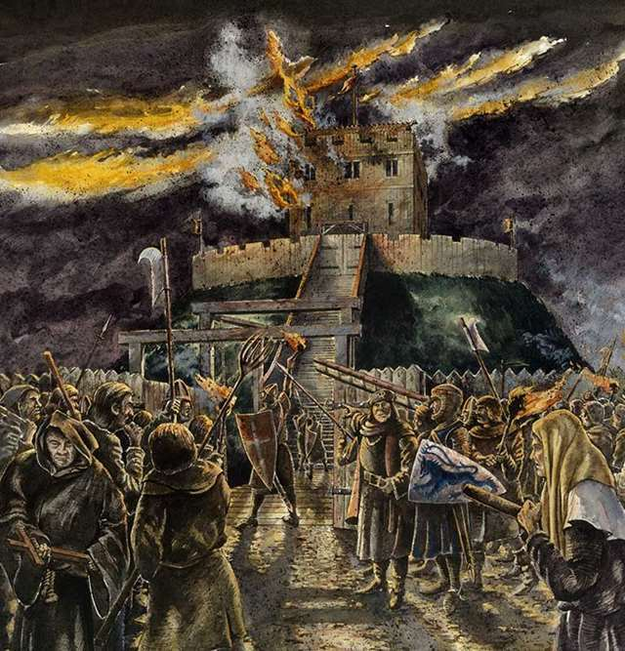
تم إحراق اليهود في برج كليفورد، إنجلترا
Notes:
https://www.english-heritage.org.uk/visit/places/cliffords-tower-york/history-and-stories/massacre-of-the-jews/
The Massacre at Clifford’s Tower
One of the worst anti-Semitic massacres of the Middle Ages took place in York in 1190. The city’s entire Jewish community was trapped by an angry mob inside the tower of York Castle. Many members of the community chose to commit suicide rather than be murdered or forcibly baptised by the attackers.

Slide 38
الإسبان
مضطهدو اليهود ...

Slide 39
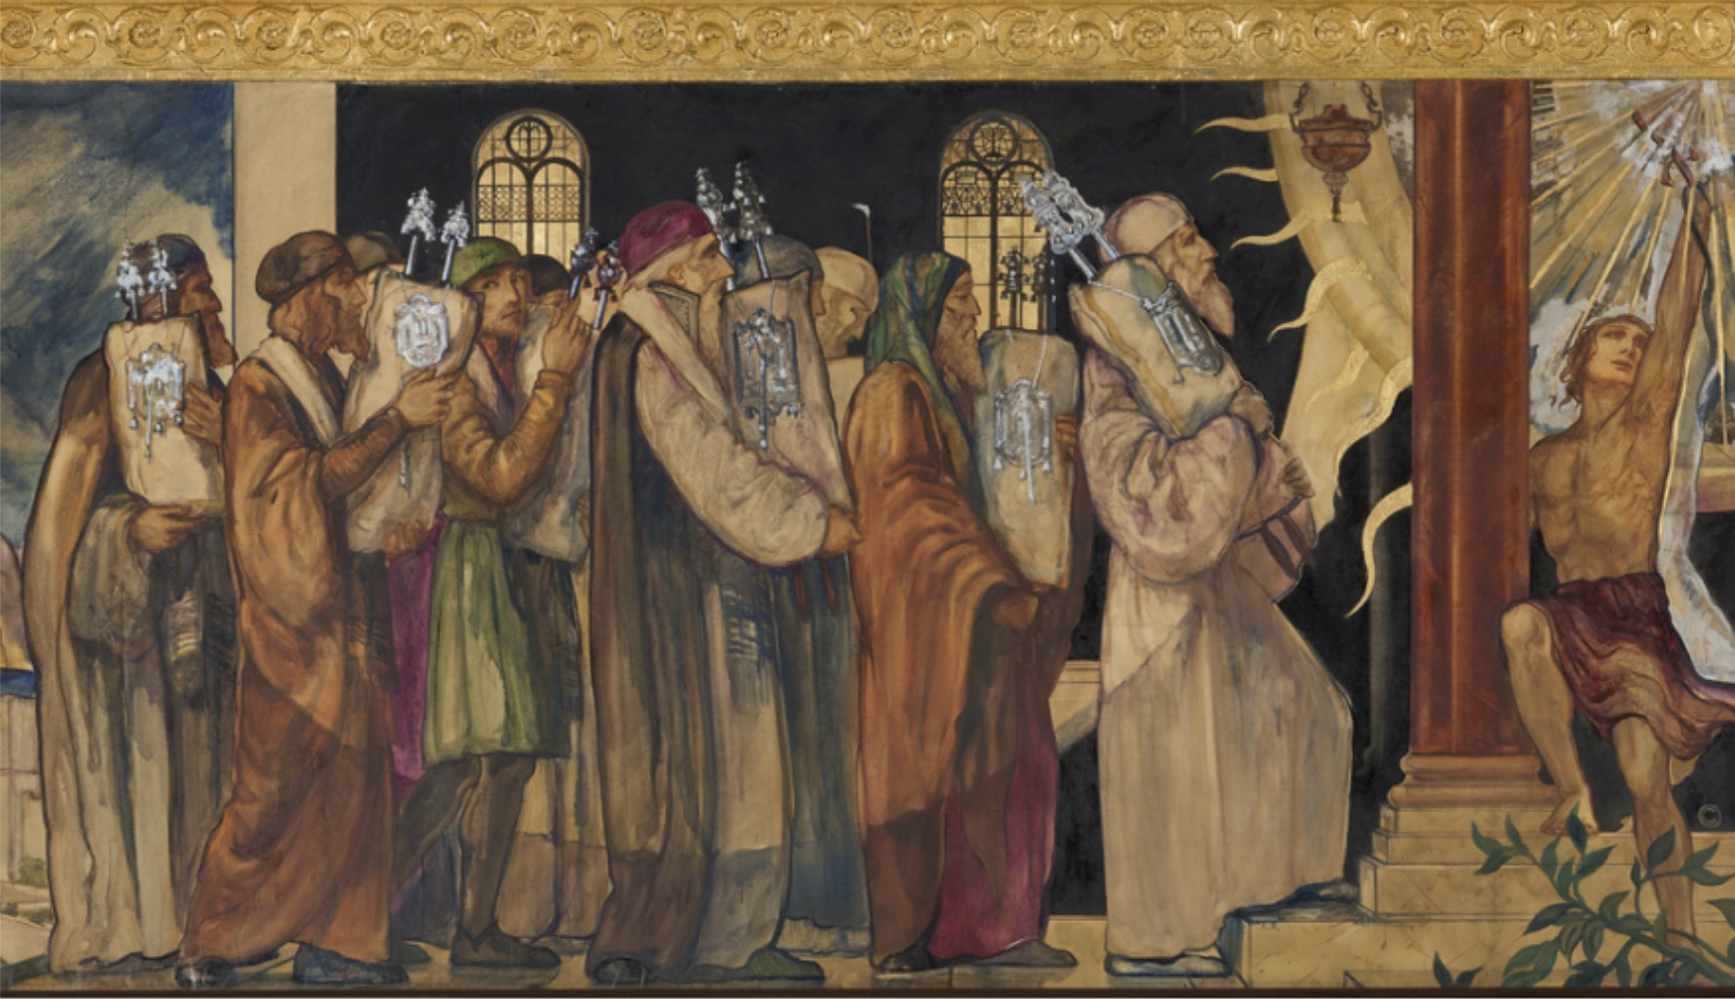
طردت إسبانيا كل اليهود
جدارية تصور حركة مخطوطات التوراة بعد الطرد من إسبانيا، من معبد ويلشاير بوليفارد في لوس أنجلوس.
Notes:
Image from:
What the Jews of the Iberian Peninsula can teach us about political power & minority status
https://jewishstudies.washington.edu/jewish-history-and-thought/political-power-minority-status-jews-iberian-peninsula/
___________
See also:
Historians say Inquisition wasn't that bad
Sophie Arie in Rome
Wed 16 Jun 2004 02.00 BST
https://www.theguardian.com/world/2004/jun/16/artsandhumanities.internationaleducationnews
Estimates of the number killed by the Spanish Inquisition, which Sixtus IV authorised in a papal bull in 1478, have ranged from 30,000 to 300,000. Some historians are convinced that millions died.
Full article:
For centuries people were burned at the stake, stretched to death or otherwise tortured for failing to be Roman Catholic. But, if research released by the Vatican is right, the Inquisition was not as bad as one might think.
According to the documents from Vatican archives relating to the trials of Jews, Muslims, Cathars, witches, scientists and other non-Catholics in Europe between the 13th and the 19th centuries, the number actually killed or tortured into confession during the Inquisition was far fewer than previously thought.
Estimates of the number killed by the Spanish Inquisition, which Sixtus IV authorised in a papal bull in 1478, have ranged from 30,000 to 300,000. Some historians are convinced that millions died.
But according to Professor Agostino Borromeo, a historian of Catholicism at the Sapienza University in Rome and curator of the 783-page volume released yesterday, only 1% of the 125,000 people tried by church tribunals as suspected heretics in Spain were executed.
Other experts told journalists at the Vatican yesterday that many of the thousands of executions conventionally attributed to the church were in fact carried out by non-church tribunals.
What the church initiated as a strictly regulated process, in which torture was allowed for only 15 minutes and in the presence of a doctor, got out of hand when other bodies were involved.
The church does not deny its responsibility for atrocities committed by Catholics in its name. In 2000 the Pope publicly apologised for the unnecessary "violence" used.
But he is not keen to be made to repent for sins the Vatican can prove it did not commit.
"Before seeking pardon, it is necessary to have a precise knowledge of the facts," he wrote in a letter released yesterday, in which he expressed his "strong appreciation" of the research.
"The image of the Inquisition represents almost the symbol ... of scandal," he wrote.
Cardinal Georges Cottier, a Vatican theologian, said: "You can't ask pardon for deeds which aren't there."
European and North American historians have been searching the archives since a Vatican conference on the Inquisition in 1998.
Their findings support the recent theories of some independent historians that the Spanish Inquisition has been exaggerated into a kind of legend.
European school histories are filled with images of torture used to force heretics to confess in Spain, France, Italy and Portugal.
Pope Gregory IX instituted the papal inquisition in 1231 for the apprehension and trial of heretics, initially the Cathars.
Inquisitors sought out those with hidden heretic beliefs as well as anyone reading banned books or teaching non-Catholic beliefs.
In 1633 the Italian scientist Galileo Galilei was imprisoned for expounding the Copernican theory that the Sun is the centre of the universe and the Earth rotates around it.
The theory was formally declared a heresy. Galileo died under house arrest.

Slide 40
اللوثريون
مضطهدو اليهود ...

Slide 41
لوثر لأتباعه
نصيحتي إذن هي أن نعامل اليهود بلطف وأن نعلمهم الكتب المقدسة حتى يأتوا إلينا... يجب أن نرحب بهم في وسطنا ونسمح لهم بالعمل والتجارة بيننا، ثم ستتاح لهم الفرصة ليشهدوا الحياة المسيحية والعقيدة المسيحية، ولكن هل ينبغي أن يظل بعضهم عنيداً فماذا في ذلك؟ ليس كل واحد منا مسيحياً صالحاً.

Slide 42
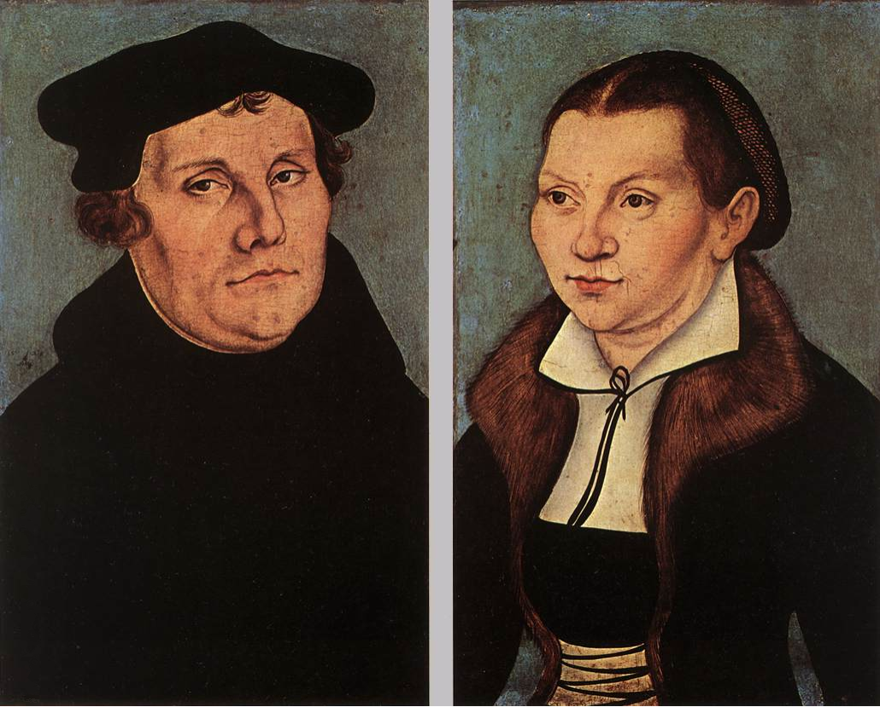
بعد أن رفض اليهود الإنجيل
أضرموا النار في مجامعهم وكل ما لا يحترق فليغطى أو يفرش بالتراب حتى لا يتمكن أحد من رؤية جمرة أو حجر منه... كذلك يجب أن تهدم منازلهم وتدمر... يجب أن يوضعوا تحت سقف واحد أو في إسطبل مثل الغجر لكي يدركوا أنهم ليسوا أسياداً في أرضنا كما يفتخرون، بل أسرى بائسين إذ يتذمرون منا أمام الله بلا انقطاع وبنحيب مرير.

Slide 43
الألمان
مضطهدو اليهود ...

Slide 44
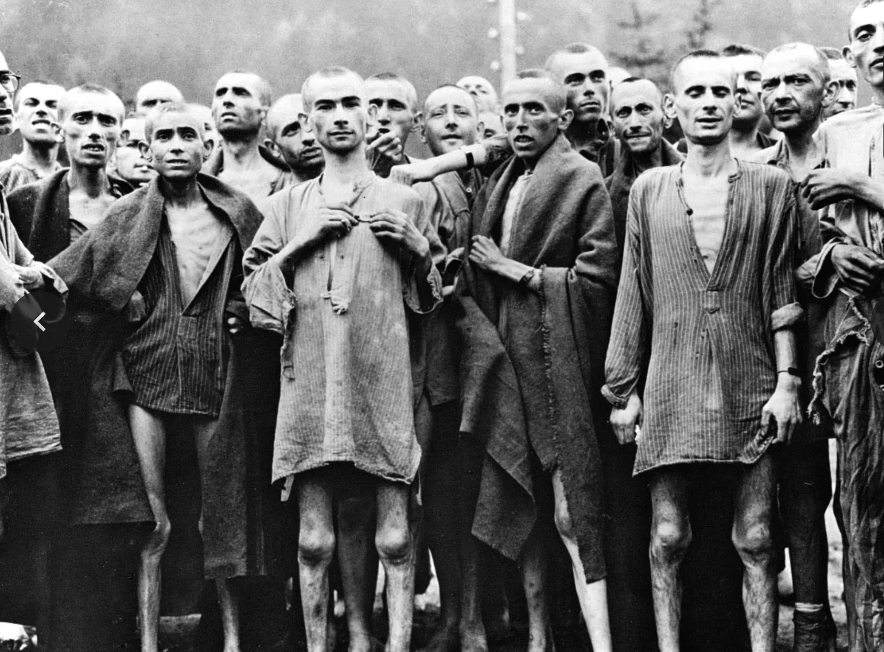
السجناء اليهود المحررون في معسكر الإعتقال النازي في إيبينسي، النمسا
Notes:
https://www.britannica.com/event/Holocaust/Artistic-responses-to-the-Holocaust

Slide 45
شجع هتلر اليهود للعودة إلى ديارهم
Notes:
The very opposite happened to what Hitler tried to do. He sought to kill the Jews and pushed them out of his land.

Slide 46
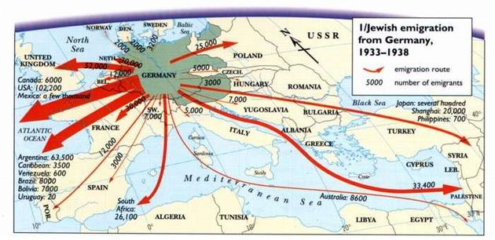
شجع هتلر اليهود للعودة إلى ديارهم
Jewish emigration from Germany 1933-1938
Route
Number
Notes:
Hitler sought to eradicate the Jews, but God sought to eradicate Hitler. He committed suicide in 1945 and three years later the Jews established their homeland in Israel! God told Abraham, "I will bless those who bless you and curse those who curse you" (Gen 12:3). Hitler's attempt to curse the Jews led to him being cursed.

Slide 47
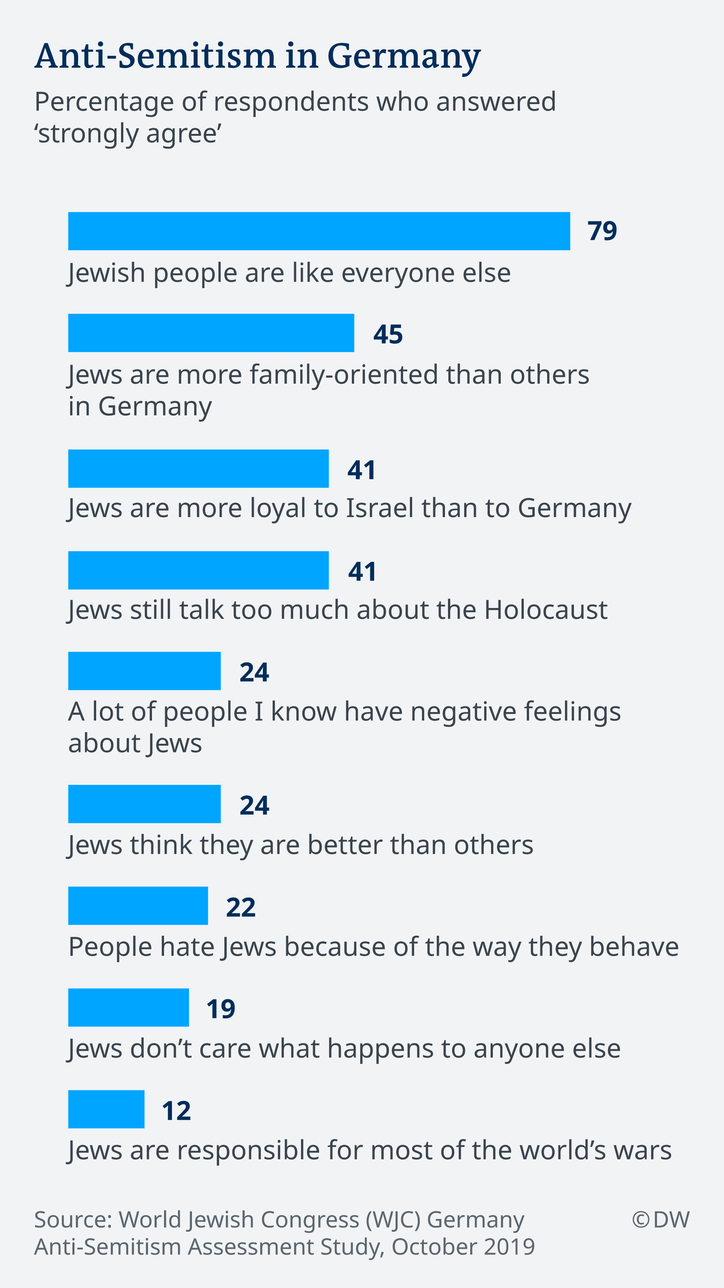
ؤيع الألمان يقولون أن اليهود يعتقدون أنهم أفضل من غيرهم (2019)
معاداة السامية في ألمانيا
نسبة المستجيبين الذين أجابوا بـ أوافق بشدة
الشعب اليهودي مثل أي شخص آخر
اليهود أكثر توجهاً نحو الأسرة من غيرهم في ألمانيا
اليهود أكثر ولاء لإسرائيل من ألمانيا
لا يزال اليهود يتاحدثون كثيراً عن الهولوكوست
الكثيرون ممن أعرلفهم يمتلكون شعوراً سلبياً تجاه اليهود
يعتقد اليهود أنهم أعظم من الا×رين
يكره الناس اليهود بسبب الطريقة التي يتصرفون بها
لا يهتم اليهود بما يحدث للآخرين
اليهود مسؤولون عن معظم حروب العالم
https://www.dw.com/en/one-in-four-germans-hold-anti-semitic-beliefs-study-finds/a-50958589
المصدر: المؤتمر اليهودي العالمي (( WJC) دراسة تقييم معاداة السامية في ألمانيا، أكتوبر 2019.
Notes:
Study: One in four Germans harbor anti-Semitic thoughts
Rebecca Staudenmaier
October 24, 2019
https://www.dw.com/en/one-in-four-germans-hold-anti-semitic-beliefs-study-finds/a-50958589
More than a quarter of Germans surveyed said they agreed with anti-Semitic statements, including that Jews have "too much power over the economy." Over 40% said they thought Jews "talk about the Holocaust too much."
Anti-Semitism is gaining a stronger foothold in German society, the Süddeutsche Zeitung newspaper reported on Wednesday, citing a new study from the World Jewish Congress (WJC).
Out of the 1,300 Germans who took part in the representative survey, 27% agreed with a range of anti-Semitic statements and stereotypes about Jewish people.
Some 41% said they agreed with the statement that "Jews talk about the Holocaust too much." The same portion said they believed "Jews are more loyal to Israel than to Germany."
Over 20% of respondents said they agreed that Jewish people have "too much power" over the economy, international financial markets and the media. Another 22% agreed that "people hate Jews due to the way they behave."
"These are cliches, stereotypes, envy but there is also some truth to it. Jews are successful. What's the problem with that?" Cologne Rabbi Yechiel Brukner told DW. "Why are Germans not envious that, as a percentage of the population, Jews have many more Nobel Prize winners? Why doesn't that bother anyone? What does it always concern the aspect of 'money'? Judaism places an emphasis on intellectual intelligence and that has meant that Jews are often very successful. They also work hard, but why does someone not like them for that?
"Think about this: There are still living Holocaust survivors and Germans already dare to entertain anti-Semitic thoughts — and even to take action based on them. That's incredible," Brukner added.
The survey was carried out two months ago, prior to the anti-Semitic attack targeting a synagogue in the eastern German city of Halle.
Hostility towards Jews growing among 'elites'
Anti-Semitism is also growing among the wealthy and well-educated, according to the study.
The WJC found that 18% of "elites" — respondents with at least one university degree who make at least €100,000 ($111,300) per year — agreed with anti-Semitic sentiments.
Within that group, over a quarter said they believed Jewish people have "too much power over world politics" and the economy.
Read more: German groups combating far-right extremism face uncertain future

Slide 48
الأوروبيون
مضطهدو اليهود ...

Slide 49
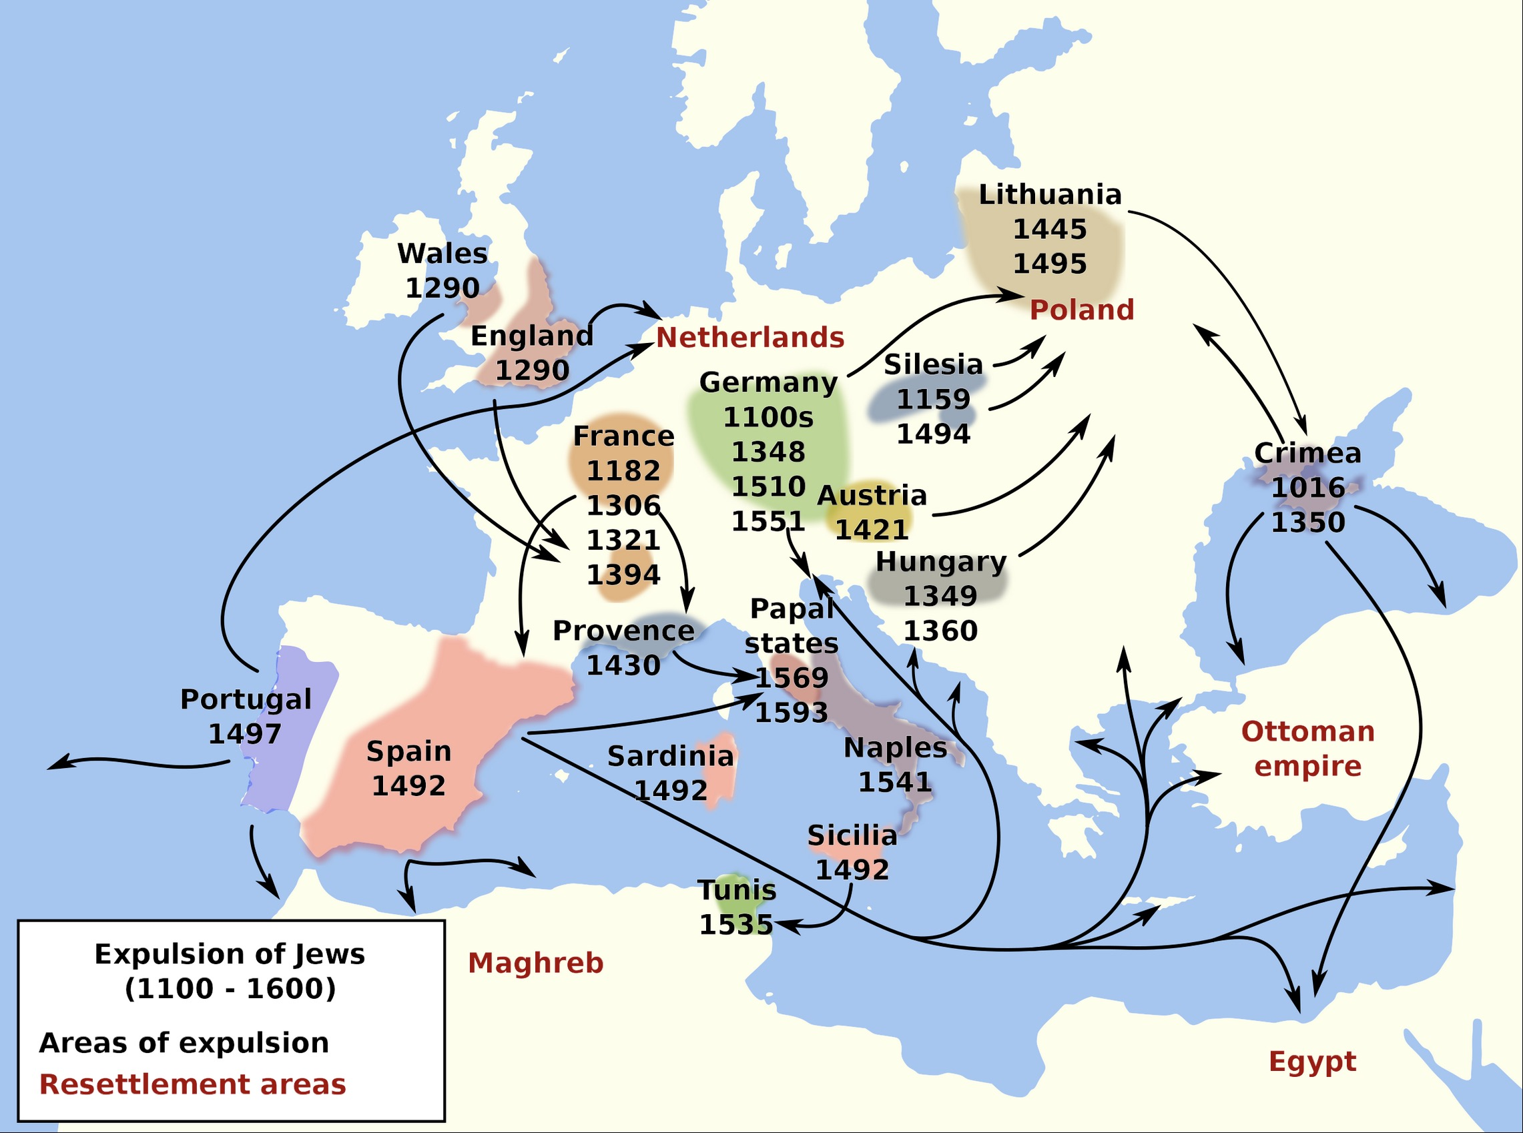
طرد اليهود من أوروبا (1100-1600)
https://en.wikipedia.org/wiki/Antisemitism#/media/File:Expulsion_judios-en.svg

Slide 50
منطقة الشرق الأوسط
مضطهدو اليهود ...

Slide 51
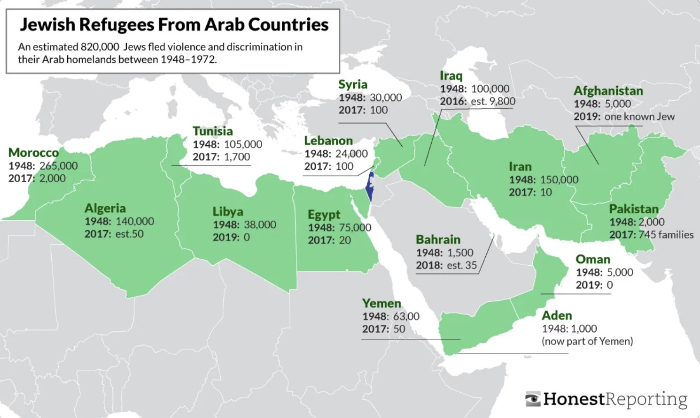
اللاجئون اليهود من الدول الإسلامية (1948-2019)
https://www.reddit.com/r/MapPorn/comments/wzfk94/jewish_refugees_from_muslim_countries/?rdt=37455

Slide 52
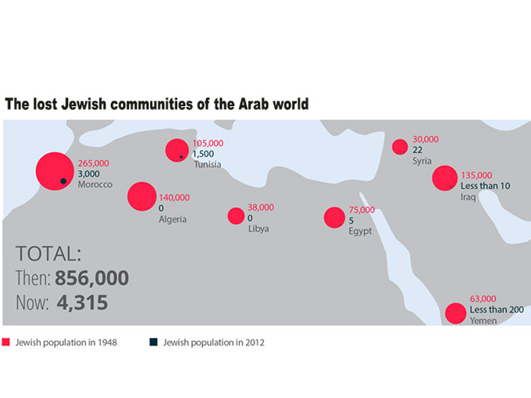
طرد اليهود من الأراضي العربية وإيران (1948-2021)
https://www.gov.il/en/departments/news/jewish-refugees-expelled-from-arab-lands-and-from-iran-30-november-2021
Notes:
Jewish refugees expelled from Arab lands and from Iran
Subject Foreign Policy
Secondary topic Behind the Headlines
Publish Date 30.11.2021
This Memorial Day commemorates the tragedy of people who were forced to flee their homes, part from their host cultures and leave the countries where they had lived for centuries, solely because of their Jewish identity.
On November 30th, Israel and the Jewish world remember the fate of more than 850,000 Jews who were expelled and forced out of Arab lands and Iran in the 20th century. This Memorial Day commemorates the tragedy of people who were forced to flee their homes, part from their host cultures and leave the countries where they had lived for centuries, solely because of their Jewish identity.
Thousands of Jews were forced to leave behind their properties, businesses and possessions. Jews in Iraq, Libya, Yemen and more, were compelled to leave behind their heritage, ancestors, and legacies. Many even suffered from violence, brutality and persecution.
The expulsion of countless Jewish communities from Arab countries and Iran dramatically changed the demographic composition of the Middle East and North Africa. The stories of these Jews and their communities are an integral part of modern Jewish history. Their expulsion profoundly affected the Jewish nation as a whole. It is incumbent that these stories are told.
Upon arrival to Israel, these Jewish immigrants who were forced to leave their homes overcame personal and communal tragedy and not only persevered, but thrived; many rose to important positions in the national government and in the public and private sectors. They have made an invaluable contribution to the fabric of Israeli society, and their vibrant cultures are an integral part of the colorful mosaic of the Jewish people in the Land of Israel. It is time for the world to hear their story.

Slide 53
الأمم المتحدة
مضطهدو اليهود ...

Slide 54
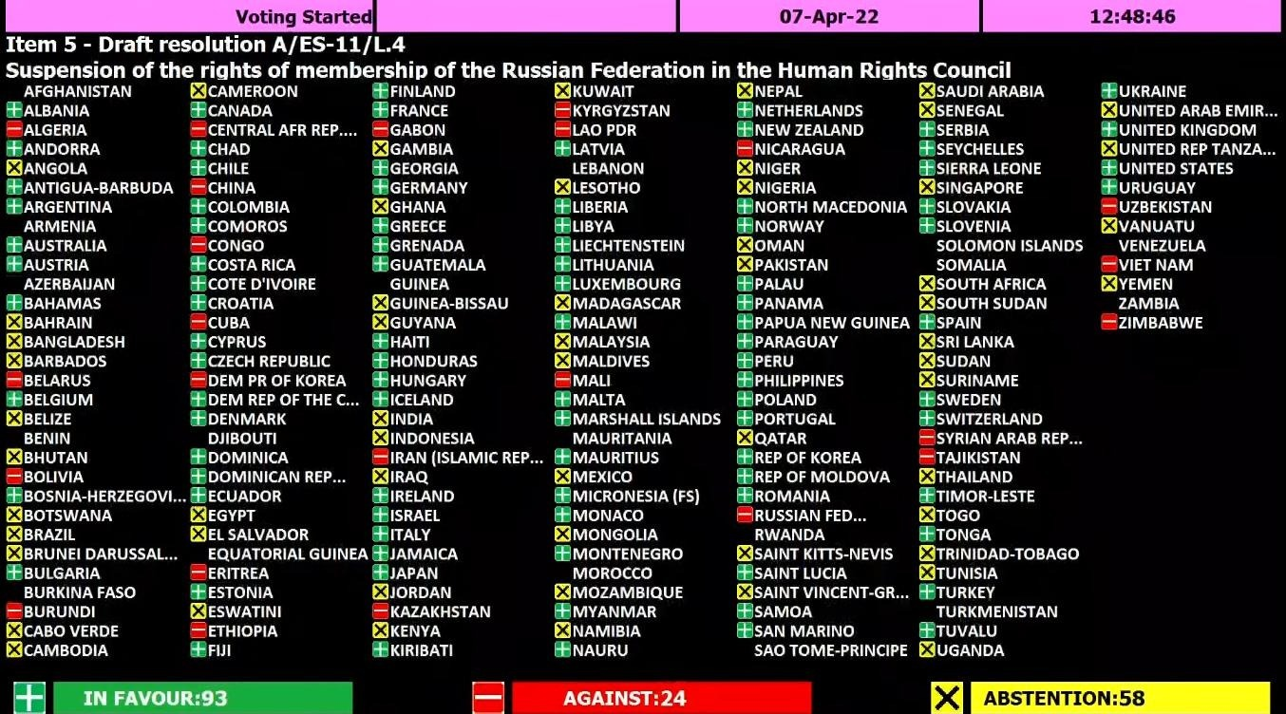
تصويت الأمم المتحدة لإسرائيل بحسب الأمة (1947)
https://ishr.ch/wp-content/uploads/2022/04/Russia_vote_UNGA.jpeg

Slide 55
امتحان الخريطة للصف السادس (منهج جمعية مراقبة حقوق الإنسان التابعة للأمم المتحدة، 2021)
Notes:
Notice how the word "Israel" does not even appear on this UN Map test.
____________
ES-29-How the Nations Treat Israel-56
OS-29-Joel-125

Slide 56
الكنديون
مضطهدو اليهود ...

Slide 57
معاداة السامية في تورنتو (2022)
من الجرائم التي تم الإبلاغ عنها في تورنتو في 2021 استهدفت المجتمع اليهودي الذي يشكل أقل من 4% من التعداد السكاني
استهدفت 14 من أصل 32 جريمة كراهية متعددة التحيز تم الإبلاغ عنها يهوداً متنوعين (7 منها تستهدف اليهود السود) في عام 2021 في تورنتو
الفئة المستهدفة للعام السادس
على التوالي
https://www.toronto.ca/community-people/get-involved/community/toronto-for-all/confronting-antisemitism/
Notes:
Confronting Antisemitism
https://www.toronto.ca/community-people/get-involved/community/toronto-for-all/confronting-antisemitism/
The Confronting Antisemitism educational campaign was completed in 2022.
Antisemitism has been the most reported hate crime in Toronto for more than five years in a row, according to the Toronto Police Service Hate Crime Unit. What’s more, antisemitism is experienced daily by Jewish Torontonians.
This Toronto for All campaign brings attention to antisemitism in Toronto and calls on Torontonians to take action to confront it and eliminate it.

Slide 58
اليسار الأمريكي
مضطهدو اليهود ...

Slide 59
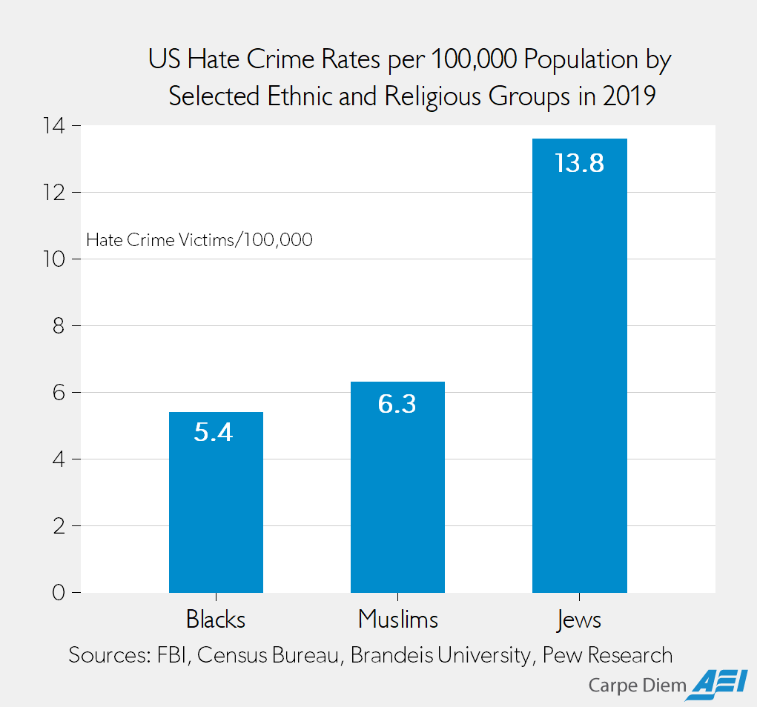
جرائم الكراهية في الولايات المتحدة لكل 100000 شخص تجاه مجموعات عرقية أو دينية في 2019
السود
المسلمون
اليهود
https://www.aei.org/carpe-diem/based-on-2019-fbi-data-jews-were-2-6x-more-likely-than-blacks-and-2-2x-more-likely-than-muslims-to-be-victims-of-hate-crimes/
Notes:
Based on 2019 FBI Data, Jews Were 2.6X More Likely Than Blacks and 2.2X More Likely Than Muslims to Be Victims of Hate Crimes
By Mark J. Perry
July 06, 2021
Members of which of these groups were most likely to be a victim of a hate crime in 2019: Muslims, Blacks, or Jews? Based on media coverage, you would probably say Muslims or Blacks. According to a Google news search for the term “hate crimes” along with the name of each of those three groups, there are 291,000 results for “hate crimes” + black, 89,600 results for “hate crimes” + Muslim, and only 67,000 results for “hate crimes” + Jew. Based on news reports, you might think that blacks were much more likely than Jews to be the victim of a hate crime and that Muslims were somewhat more likely to be hate crime victims compared to Jews.
Hate crime data released last November by the FBI for 2019 reveal that there were 2,391 black/African-American victims of hate crimes, 1,032 Jewish victims, and 227 Muslim victims. Adjusting for the population of each group in 2019 (43.98 million blacks, 7.5 million Jews, and 3.61 million Muslims) the hate crime victimization rates per 100,000 population of each group were 13.8 for Jews, 6.3 for Muslims, and 5.4 for blacks (see chart above). Therefore, adjusted for population by group, American Jews were 2.6 times more likely than blacks to be a victim of a hate crime in 2019, and 2.2 times more likely than a Muslim to be a hate crime victim.
The FBI data for 2019 on anti-religion hate crimes also reveal that of the 1,715 victims of anti-religious hate crimes in the US, 1,032 were Jews (60.2% of the total) and 227 victims were Muslims (13.2% of the total). Obviously, since more than half (60.2%) of the anti-religious hate crimes in 2019 were against Jews, there were more anti-religious hate crimes against Jews (1,032) than incidents of hate crimes against all other religious groups combined (683). The FBI data also show that there were more Jewish hate crime victims in 2019 (1,032) than the number of gay men (863) and lesbians (143) who were victims of hate crimes.
Without any adjustments for population, there 4.5 times more Jewish hate crime victims (1,032) in 2019 than Muslim victims (227). And yet there are 33.7% more media reports on hate crimes against Muslims than news reports on hate crimes against Jews.
Question: Based on hate crime victimization rates and the fact that Jews are so disproportionately targeted in hate crimes compared to blacks and Muslims, is it fair to say that hate crimes against Jews are routinely under-reported by the media relative to the reporting of hate crimes against blacks and Muslims?
https://www.aei.org/carpe-diem/based-on-2019-fbi-data-jews-were-2-6x-more-likely-than-blacks-and-2-2x-more-likely-than-muslims-to-be-victims-of-hate-crimes/
Accessed 8 Nov 2023

Slide 60
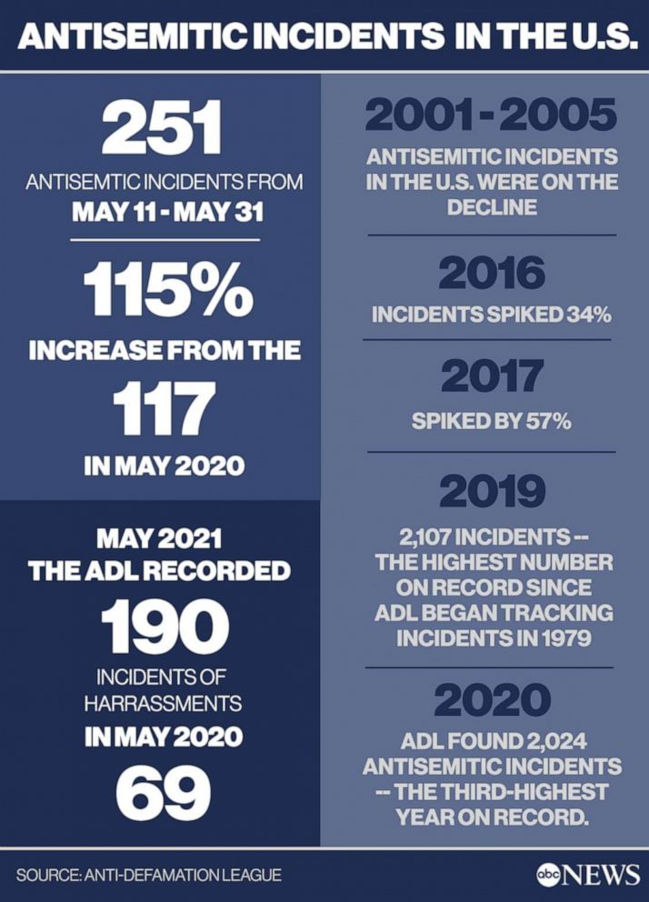
معاداة السامية في الولايات المتحدة الأمريكية (2001-2020)
https://abcnews.go.com/US/antisemitism-surged-us-gaza-conflict-part-multi-year/story?id=78092408
Notes:
Antisemitism surged across US during Gaza conflict, part of multi-year rise: Advocates
Antisemitic incidents more than doubled during the Hamas conflict.
ByEmily Shapiro
June 10, 2021, 1:00 PM
https://abcnews.go.com/US/antisemitism-surged-us-gaza-conflict-part-multi-year/story?id=78092408
Joseph Borgen, a 29-year-old accountant in New York City, was on his way to a protest after work when he was jumped near Times Square.
"Out of the corner of my eye I saw someone chasing me, with their fist raised back, looking to punch me in the face. Before I could even react … I was surrounded by a whole group," Borgen told ABC News.
The attackers punched, kicked, pepper-sprayed him and beat him with crutches, the New York Police Department said, leaving him with a concussion and bruising.
"I grabbed my head and neck and my face area and just held onto those areas as tight as I could," Borgen said of the May 20 attack. "I was getting constantly kicked, punched and hit all over my body. But I was just holding onto my face and head, holding on for dear life, hoping I would survive."

Slide 61
معاداة السامية في الولايات المتحدة الأمريكية (7-25 تشرين أول 2023)
إن الحوادث المعادية للسامية في الولايات المتحدة ارتفعت بنحو 400% منذ بدء الحرب بين إسرائيل وحماس

Slide 62
معاداة السامية في كليات الولايات المتحدة (تشرين ثاني 2023)
معاداة السامية تذهب إلى المدارس
https://wng.org/podcasts/antisemitism-goes-to-school-1699312731
Notes:
Anti-Semitism goes to school: Jewish university students in New York are troubled by incidents of anti-Semitism and doxing
World Magazine
Date 11/07/2023
Hosted By Mary Muncy
https://wng.org/podcasts/antisemitism-goes-to-school-1699312731
A Star of David necklace and a blue ribbon worn during a discussion on antisemitism on college campuses. Associated Press/Photo by Julia Nikhinson
MARY REICHARD, HOST: It’s Tuesday, the 7th of November, 2023. This is WORLD Radio. Thanks for joining us and good morning. I’m Mary Reichard.
NICK EICHER, HOST: And I’m Nick Eicher. First up on The World and Everything in It: rising anti-semitism in higher education.
On Saturday, tens of thousands of people in Washington D.C. protested in support of Palestinians with a chant that means the elimination of the state of Israel.
CROWD CHANTING: From the river to the sea, Palestine will be free.
REICHARD: Meanwhile, university administrators are being pulled into unwinnable situations. Pro-Palestinian professors and students demand the right to protest Israel’s war to root out Hamas in Gaza …while Jewish alumni and donors threaten to pull their funding if schools continue to tolerate antisemitism.
EICHER: At Columbia University, school officials have created task forces to respond to allegations of antisemitism on campus and doxing of students. Doxing is the practice of publishing private or identifying information about specific people with the intent to intimidate.
REICHARD: WORLD Radio Reporter Mary Muncy visited the Ivy League school in New York City to see what’s happening.
BARNARD FRESHMAN: I don't wear my Star of David around my neck anymore because I'm scared someone will attack me.
MARY MUNCY, REPORTER: This Jewish freshman is standing in Columbia University’s courtyard… at a vigil for people kidnapped by Hamas. For security reasons, she and other students at the vigil didn’t give me their names.
BARNARD FRESHMAN: I don't walk around Columbia's campus without being with someone else, or being on the phone with someone.
She keeps thinking about a Jewish student attacked on her campus last month. That student was placing posters of people kidnapped by Hamas when another student yelled and hit the student with a stick. Police arrested the student on charges of assault and harassment… and classified the incident as a hate crime.
But this freshman decided to show her support at the Columbia vigil.
She and about 20 other students stand around a display of roses representing the 242 people Hamas has kidnapped in the war.
Nearby, a Jewish upperclassman says she is here for more than a vigil.
BARNARD SENIOR: I guess I'm here just just for some, some support just to be around people who can sort of understand what I'm going through.
SOUND: [Protest]
About three weeks ago, students gathered in the courtyard and held Columbia’s first large pro-Palestinian demonstration. Columbia closed the campus to outsiders during the event for safety concerns. That’s really unusual. People from outside the school had been joining protests, and they have joined several other protests on campus since then.
Two weeks later, a group of more than 100 professors at Columbia signed a statement supporting the students’ right to express their views.
I contacted the pro-Palestinian groups on Columbia’s campus and more than 15 professors who signed the statement. None agreed to speak with me.
But Jewish students from campuses across the country did want to talk.
PNINA: My name is Pnina. I'm a freshman at Tulane.
SOFFER: I'm a junior at the George Washington University...
DAVID FRISCH: My name is David Frisch. I'm in my first year at Harvard Law School.
These students watched with alarm as pro-Palestinian student organizations started releasing statements.
At Harvard, 36 separate student groups signed a statement blaming Israel for the terrorist attacks of October 7. Almost all of them have since removed themselves from that list.
Other campuses have seen violence related to the unrest—everything from protests that turn violent, to students harassed individually. Cornell even canceled classes on Friday due to death threats against Jewish students.
Meanwhile, the conservative media group Accuracy in Media has been revealing the identities of pro-Palestinian students at Harvard and Columbia, a practice called doxxing.
WCVB: The names and faces of Harvard students are displayed under the title “Harvard’s leading antisemites.”
WCVB: This billboard truck was here on Mass Ave just outside campus for about two and a half hours.
NEWSNATION: This has gotten insane, and these are students.
But those are just the loud things, the ones that grab media attention, and that journalists have open access to.
While the Jewish vigil was taking place in the courtyard at Columbia last week, some law students were attending informational sessions on the conflict hosted by the group Columbia Law Students for Palestine.
The event organizers refused to let me attend, and declined to share recordings of the events with me. That said, one of the event speakers was Peter Beinart. Here he is in an interview with MSNBC from October 10th.
BEINART: If Palestinians don’t have basic rights, new Palestinians organizations will grow up, and they may do terrible things too because brutalized people do brutal things sometimes.
A few days later, Beinart wrote in a New York Times column that the Oct. 7 murder of 1,700 civilians, including women and children, was a natural reaction to not being able to peacefully protest and resist Israeli oppression.
At George Washington University, Jewish student Sabrina Soffer says a few days after the war began, The Elliot School of International Affairs put together a panel on the conflict with five or six people.
SOFFER: So students are coming in here looking at five different people thinking that this is a balanced panel. But none of them supported Israel.
Soffer went to the panel and said the speakers used what she called catchy, intellectual language like what students would hear in class.
SOFFER: This is, I think, actually the most subtle and dangerous and almost, I would call it insidious, way of-of molding the minds of young people.
But this isn’t just an intellectual issue.
SOUND: [VIGIL]
Every Jewish student I talked to knew someone in Israel, and many of them are scared to wear outward signs of their faith in public.
The question of how administrations will respond is still largely unanswered. so for now, this Columbia upperclassman says she’ll keep going as always:
BARNARD SENIOR: We're all just people who are just trying to get through our days and like, keep up with school and with work.
She’s grieving her friends who died in the first attacks and hoping conversations about Hamas’s actions change for the better.
BARNARD SENIOR: I don't want to have to be fighting for like, to try and convince people that their death isn't justified.
Reporting for WORLD, I’m Mary Muncy at Columbia University in New York.
——————————
WORLD Radio transcripts are created on a rush deadline. This text may not be in its final form and may be updated or revised in the future. Accuracy and availability may vary. The authoritative record of WORLD Radio programming is the audio record.

Slide 63
الدول المجاورة
مضطهدو اليهود ...

Slide 64
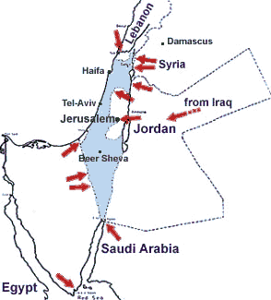
كدَّس جيران إسرائيل الكثيرون الجيوش على كل جانب (1967)
Notes:
https://www.jewishvirtuallibrary.org/map-of-the-overview-of-the-six-day-war-1967
Six-Day War Maps: Overview of the War
(1967)

Slide 65
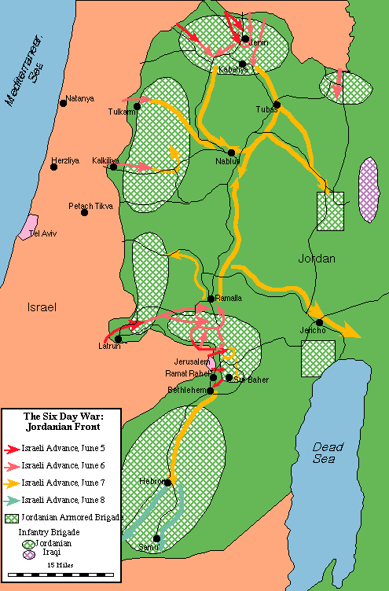
قام اليهود بهجوم استباقي ضد الجيوش الأردنية المهددة على حدود إسرائيل (1967)
Notes:
https://www.jewishvirtuallibrary.org/map-of-the-the-jordanian-front-june-1967

Slide 66
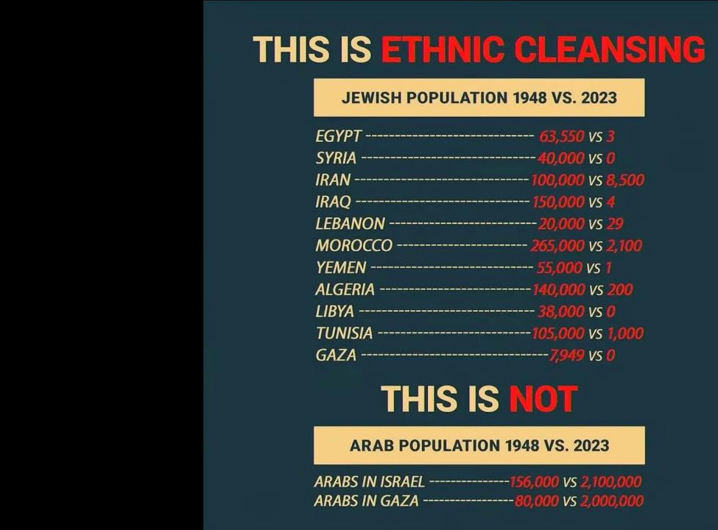
لن تشهد الألفية بعد الآن تطهيراً عرقياً لليهود.
هذا تطهير عرقي
السكان اليهود 1948 مقابل 2023
مصر
سوريا
إيران
العراق
لبنان
المغرب
اليمن
الجزائر
ليبيا
تونس
غزه
هذا ليس كذلك
السكان العرب 1948 مقابل 2023
العرب في إسرائيل
العرب في غزة
Notes:
Ethnic cleansing?
Let's look at the numbers and ask again - who's
ethnically cleansing whom?
Sources:
*
"The Jews of the Middle East and North Africa
in Modern Times". Michael Menachem Laskier.
*
'Jewish Refugees from Arab Countries". https://
www.jewishvirtuallibrary.org/jewish-refugees-
from-arab-countries
* "The Forgotten Refugees: the causes of the
post-1948 Jewish Exodus from Arab Countries".
Philip Mendes.
* "The Jews 01 Arab Lands: A History and Source
Book". Norman A. Stillman.
* "Census
Israel Central Bureau of Statistics".
https://www.cbs.gov.il/he/mediarelease/DocLib/
2023/133/11_23_133e.pdf less
____________
ES-29-How Nations Treat Israel-70
OS-23-Isaiah49-59—slide 77

Slide 67
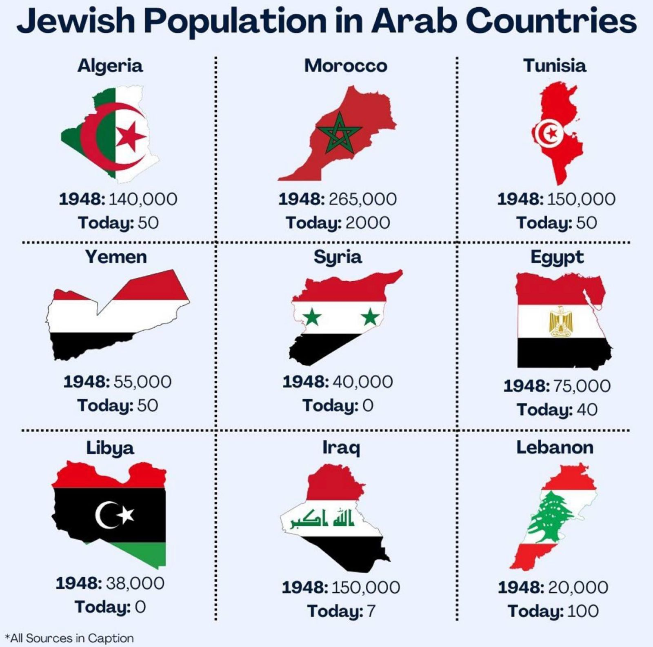
السكان اليهود في البلاد العربية (1948 مقابل 2018)
Notes:
"The Jews of the Middle East and North Africa
in Modern Times". Michael Menachem Laskier
'Jewish Refugees from Arab Countries". https://
www.jewishvirtuallibrary.org/jewish-refugees-
from-arab-countries

Slide 68
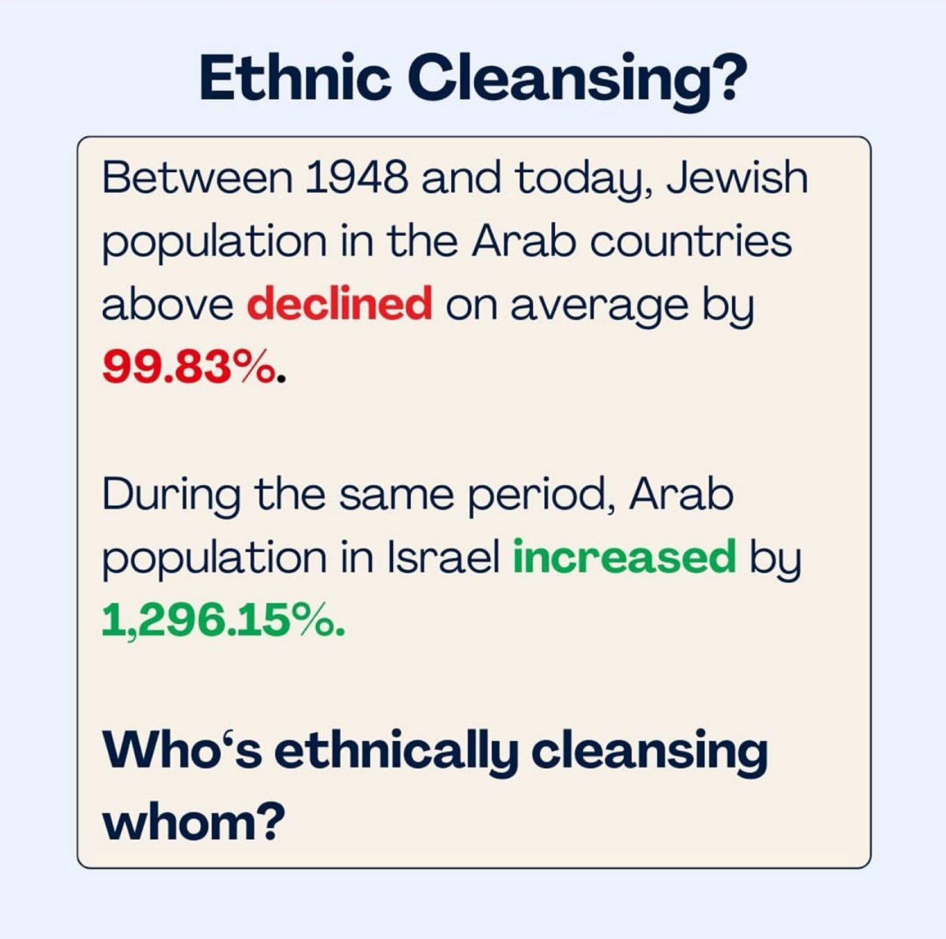
Ethnic Cleansing
التطهير العرقي؟
ما بين 1948 و2018 انخفض عدد السكان اليهود في البلاد العربية في الشريحة السابقة بنسبة 83ر99%
خلال نفس الفترة ارتفع عدد السكان العرب في إسرائيل بنسبة 15ر1296%
من الذي يقوم بالتطهير العرقي تجاه الآخر؟
Notes:
* "The Forgotten Refugees: the causes of the
post-1948 Jewish Exodus from Arab Countries".
Philip Mendes.

Slide 69
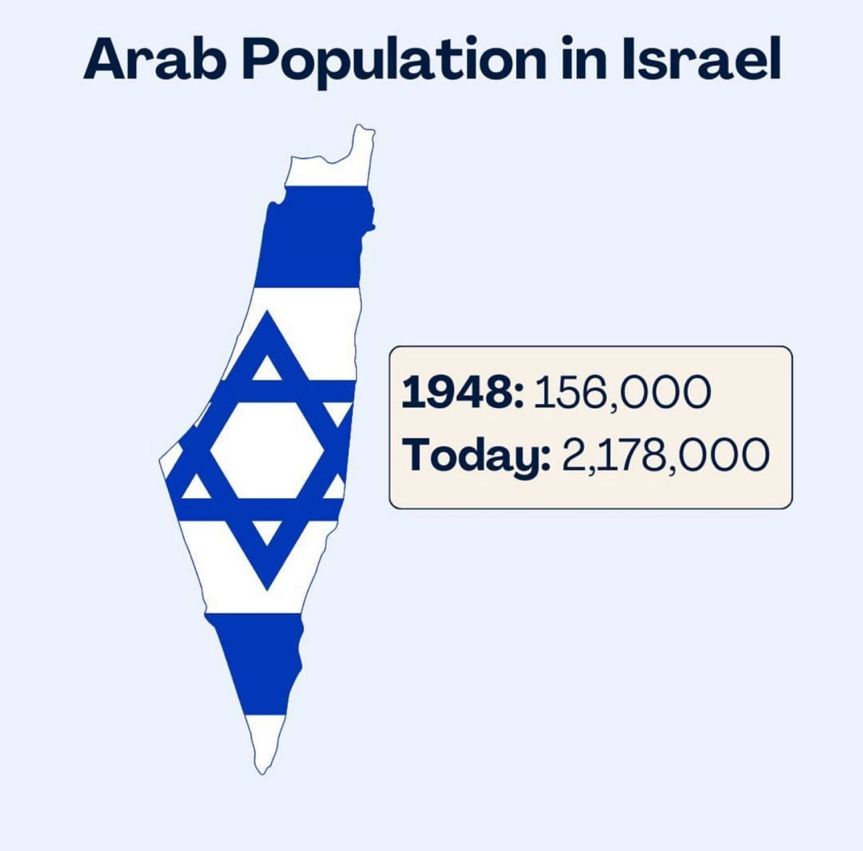
تعداد العرب في إسرائيل
Notes:
* "Census
Israel Central Bureau of Statistics".
https://www.cbs.gov.il/he/mediarelease/DocLib/
2023/133/11_23_133e.pdf

Slide 70
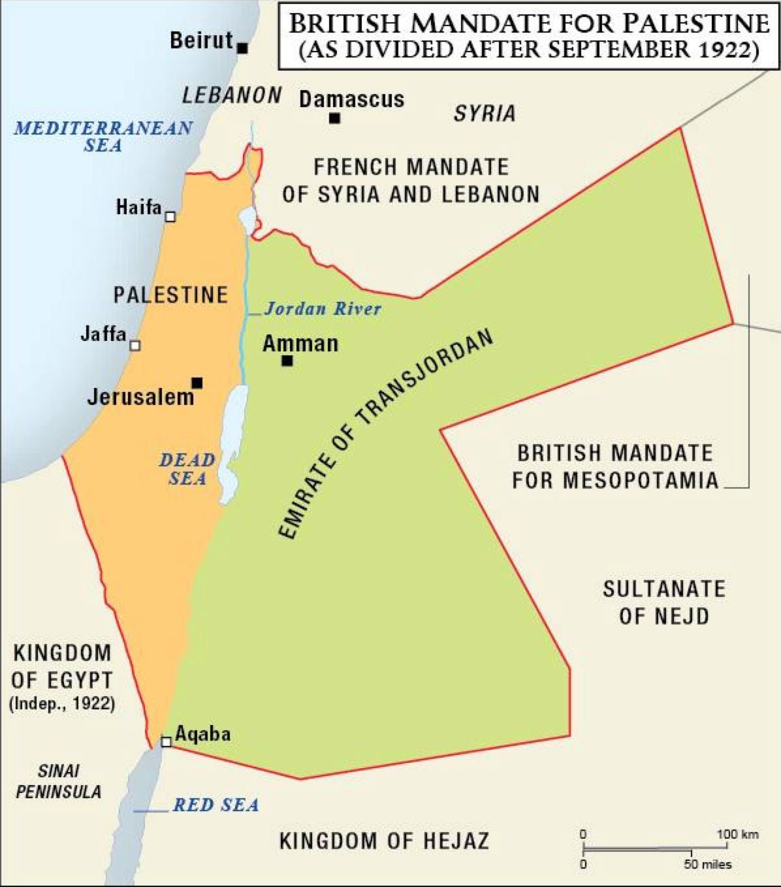
Ethnic Cleansing
الإنتداب البريطاني على فلسطين
(كما تم تقسيمها بعد سبتمبر 1922)
Notes:
* "The Jews 01 Arab Lands: A History and Source Book". Norman A. Stillman

Slide 71
العالم
مضطهدو اليهود ...

Slide 72
الحرب العالمية على اليهود

Slide 73
الإعتراف بإسرائيل (حزيران 1981)
https://www.reddit.com/media?url=https%3A%2F%2Fi.redd.it%2F2g65d04x0v291.jpg

Slide 74
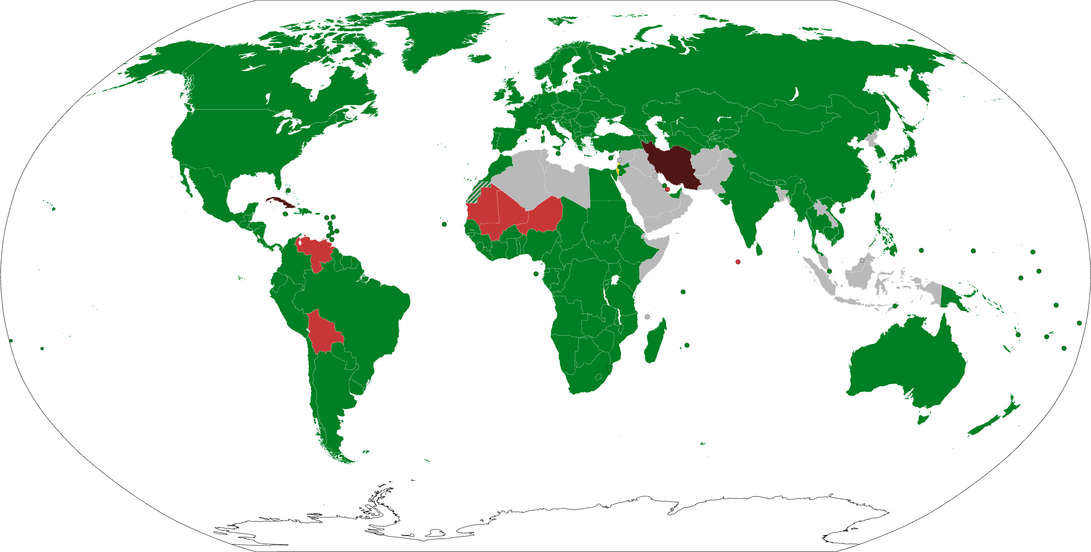
165 دولة اعترفت بإسرائيل
يعتبر هذا 85% من 193 دولة الأعضاء في الأمم المتحدة
دولة إسرائيل الدول التي اعترفت بإسرائيل الدول التي سحبت اعترافها بإسرائيل الدول التي علقت/قطعت العلاقات الثنائية مع إسرائيل الدول التي لم تعترف بإسرائيل نهائياً
https://en.wikipedia.org/wiki/International_recognition_of_Israel (accessed 13 Nov 2023)
Notes:
The State of Israel was formally established by the Israeli Declaration of Independence on 14 May 1948, and was admitted to the United Nations (UN) as a full member state on 11 May 1949.^{[1][2]} As of December 2020, it has received diplomatic recognition from 165 (or 85%) of the 193 total UN member states, and also maintains bilateral ties with all of the Permanent Five. 28^{[a]} member states have either never recognized Israel or have withdrawn their recognition; others have severed diplomatic relations without explicitly withdrawing their recognition. Additionally, many non-recognizing countries have challenged Israel's existence—predominantly those in the Muslim world—due to significant animosity stemming from the Israeli–Palestinian conflict and the Arab–Israeli conflict.^{[3]}
Also from Summary Chart at https://en.wikipedia.org/wiki/International_recognition_of_Israel:
IRAN (purple): Established relations in 1950 but voted against UN Partition Plan and voted against admission of Israel to membership of UN. Iranian government refrained from recognizing Israel de jure despite de facto recognition.^{[107]} Relations severed on 18 February 1979.^{[108]} Does not accept Israeli passports,^{[22]} and the holders of Iranian passports are "not entitled to travel to the occupied Palestine"
WESTERN HEMISPHERE (north to south in red):
Cuba recognized Israel in 1949 but severed relations in September 1973,^{[78]} and the most recent government does not recognize it.
Venezuela recognized Israel on 27 June 1948^{[85]} but severed relations in January 2009.
Bolivia recognized Israel in 1949 but severed relations in January 2009,^{[58]} restored them in November 2019.^{[59]} and severed again during the 2023 Gaza–Israel War.
NORTH-WESTERN SUB-SAHARA AFRICA (west to east in red):
Mauritania: 28 October 1999 established diplomatic relations but suspended on 6 March 2009,^{[131]} and severed on 21 March 2010^{[132]}
Mali: Diplomatic relations severed on 5 January 1973
Niger: Relations severed on 4 January 1973
MENA (Middle East/North Africa in green):
Egypt began relations in 1979 and Signatory to the Khartoum Resolution.^{[33]} Later became the first Arab state to recognize Israel, with the Egypt–Israel peace treaty.
Jordan gave recognition in 1994 and Signatory to the Khartoum Resolution.^{[33]} Recognized Israel in the Israel–Jordan peace treaty.
United Arab Emirates: On 15 September 2020, an agreement was signed to normalize relations.
State of Palestine recognized Israel in 1993 as signatory to the Khartoum Resolution.^{[33]} Recognized Israel as part of the Oslo I Accord.
MENA (Middle East/North Africa in gray):
All other Arab nations do not recognize the legitimacy of the State of Israel.
OTHER MUSLIM NATIONS (in gray as they do not recognize Israel):
Bangladesh does not accept Israeli passports, and Bangladeshi passports are not valid for travel to Israel
Malaysia does not admit Israeli passport holders without written permission from the government. Malaysian passports not valid for travel to Israel without permission from the government.
Maldives started relations in 1965 but diplomatic relations were suspended in 1974.^{[124]} Cooperation agreements began in 2009 did not develop into full diplomatic relations^{[125][126][127]} and were terminated in 2014.^{[128]}
Indonesia: Israelis can only travel to Indonesia with an invitation from the Department of Immigration of Indonesia. Can only enter Indonesia through airports in Denpasar, Jakarta and Surabaya.
NORTH KOREA (gray) and Israel held talks in 1993, but the talks were halted under pressure from the United States.^{[147]} See Israel-North Korea relations for more details.

Slide 75
الإعتراف بدولة فلسطين في 2017
https://www.aljazeera.com/wp-content/uploads/2017/02/8e739a3d3734465d88c4731cd2d30aaf_6.jpeg

Slide 76
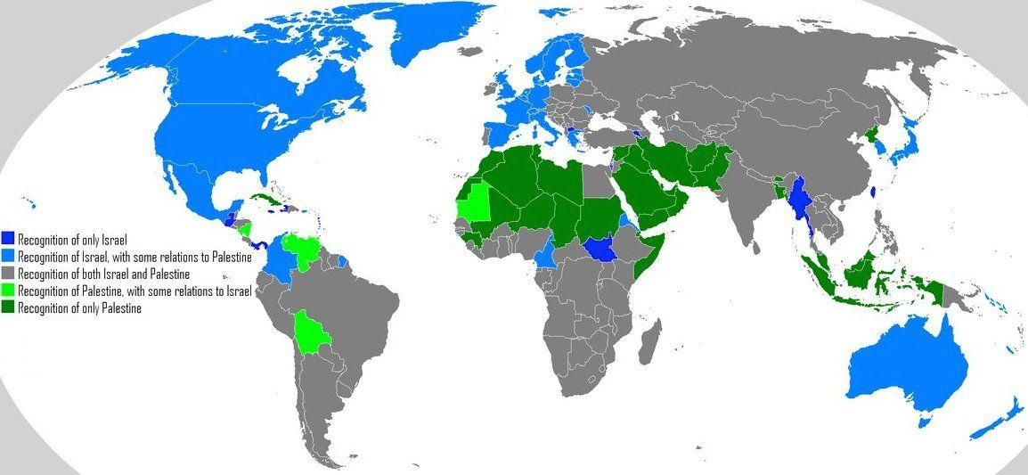
الإعتراف بإسرائيل وفلسطين (2023)
https://i.pinimg.com/originals/62/f0/57/62f05714dd327425947b776b9399375f.jpg
Notes:
This map combines both of the previous two maps to show widespread opposition to Israel in MEAN and other countries.
In Central and North America, only Guatemala, Panama, and Puerto Rico recognize only Israel (dark blue above) while
Nicaragua, Venezuela, and Bolivia side with Palestine with some relations to Israel (light green).
The other most pro-Israel nations that only recognize Israel remain South Sudan, Myanmar, and Taiwan, plus two small countries on opposite sides of Turkey (dark blue)

Slide 77
مُلك الأرض
مضطهدو اليهود ...

Slide 78
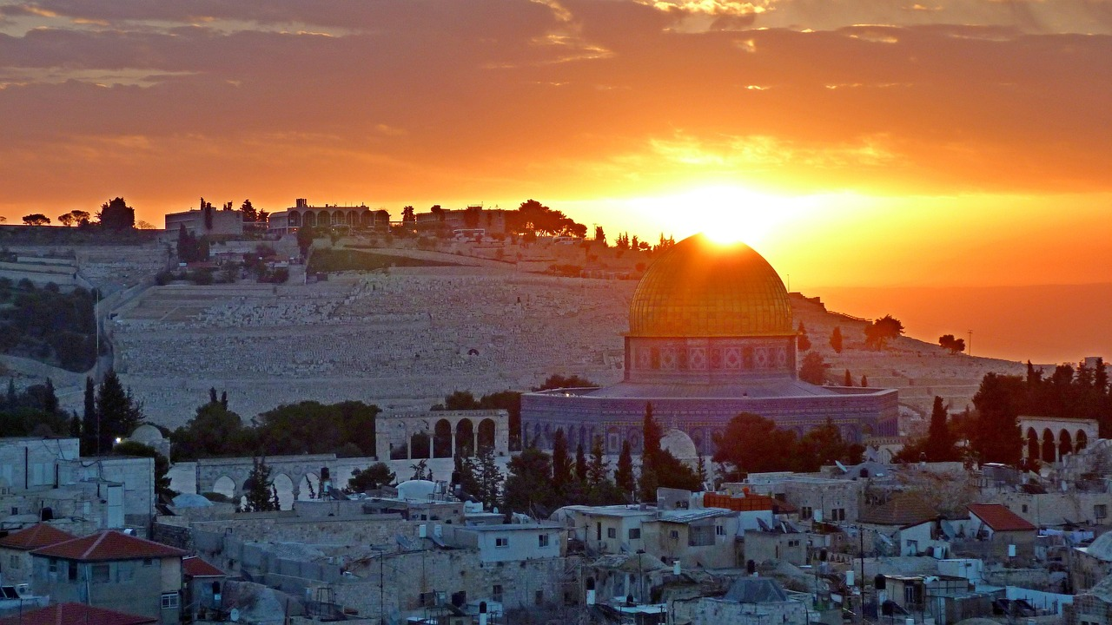
أرض مَن هذه؟

Slide 79
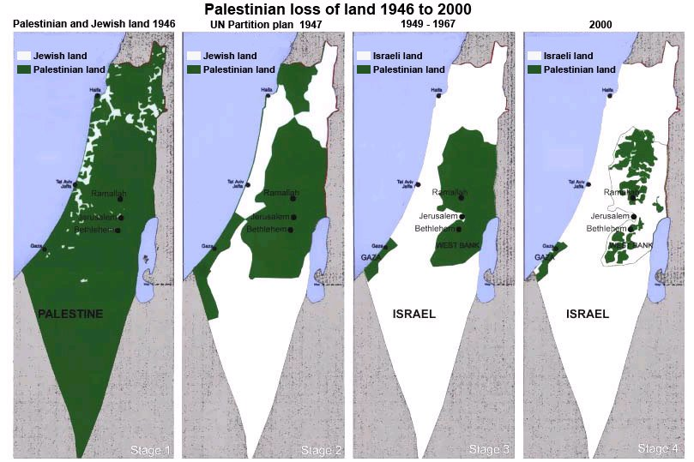
انخفاض التواجُد العربيّ على مراحل (١٩٤٧ إلى الآن)
http://tema1tema.blogspot.com/2011/05/stop-israeli-war-crimes-yells-woman-at.html
Notes:
The popular depiction of the so-called loss of Palestinian land has many problems.

Slide 80
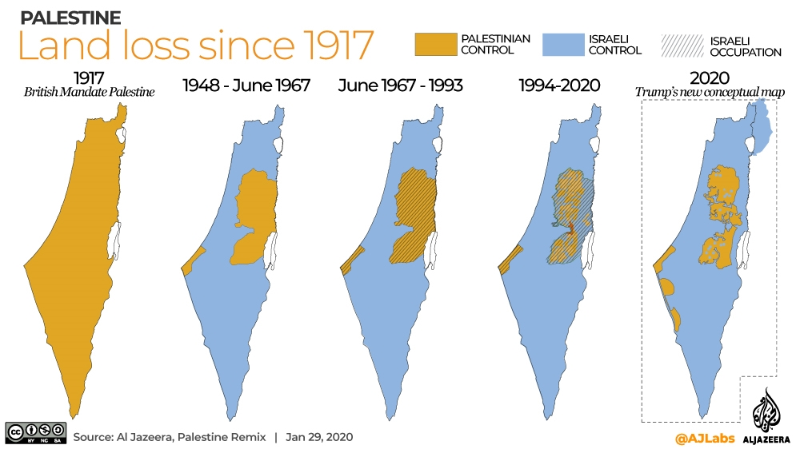
مطالبة أخرى بالخريطة
https://www.aljazeera.com/news/2020/1/29/what-does-trumps-plan-propose-for-palestinian-territories
Notes:
Here is an Arab response to President Trump's land proposal in 2020 as reported in the official Arab newspaper, Al-Jazeera…
What does Trump’s plan propose for Palestinian territories?
Israeli annexation of parts of occupied West Bank envisioned in US president’s deal.
29 Jan 2020
With Israeli Prime Minister Benjamin Netanyahu standing by his side, US President Donald Trump on Tuesday unveiled his long-delayed Middle East plan, claiming that it would lay the foundations for a “realistic two-state solution” in the long-running Israeli-Palestinian conflict.
Palestinian leaders had rejected the plan even before its release and were absent during its unveiling. Following the announcement at the White House, Palestinians denounced the proposal as utterly biased in favour of Israel and insisted that “Jerusalem is not for sale”.
Trump called his plan an “historic opportunity” for Palestinians to achieve an independent state of their own by doubling the territory currently under their control. But under the proposal, the United States said Jerusalem would remain the “undivided capital” of Israel and it would recognise Israeli sovereignty over parts of the occupied West Bank. The Palestinians want both occupied East Jerusalem and the West Bank to be part of a future state.
As many Palestinians used social media to express anger and, at times, mock the proposal, others warned that it would lead to “apartheid” within a single state.
Here are some of the key points included in Trump’s proposal:
Borders
According to the plan, Israel would annex “the vast majority” of illegal Israeli settlements in the West Bank which would be connected to the rest of Israel with their own access roads and a transportation system.
Ninety-seven percent of Israelis living in the West Bank would be incorporated into Israeli territory.
The Jordan Valley would also be under Israeli sovereignty, giving Israel a permanent eastern border along the Jordan River.
The Gaza Strip would be connected to the West Bank with a high-speed transportation link, crossing over or under Israel.
The plan also lays out the possibility that Israel’s current borders could be redrawn.
The so-called “Triangle Communities” consisting of 10 Palestinian towns in Israel: Kafr Qara, Ar’ara, Baha al-Gharbiyye, Umm al Fahm, Qalansawe, Tayibe, Kafr Qasim, Tira, Kafr Bara and Jaljulia could possibly be transferred to the State of Palestine.
According to Edo Konrad, editor-in-chief of Israeli news website 972 Magazine, 257,000 Palestinian citizens of Israel could find themselves outside the borders of Israel.
Jerusalem
Jerusalem would be the capital of Israel and “Al Quds (or another name selected by the State of Palestine)” should be internationally recognised for the State of Palestine, according to Trump’s plan.
The separation barrier would serve as a border between the two capitals.
The Palestinian state would not include any part of Jerusalem inside the current separation barrier which includes the holy Al-Aqsa Mosque located in the Old City and areas where most East Jerusalemites live.
The capital of Palestine will be in East Jerusalem, located in areas which Israel previously cut off with its separation barrier including Kafr Aqab, the eastern part of Shuafat and Abu Dis.
Demilitarised state
The plan calls for the demilitarisation of all of Palestine and the disarmament of Palestinian factions in Gaza such as Hamas and the Islamic Jihad.
Security
Israel would control security at all international crossings into Palestine.
It would also continue to carry out surveillance of Palestinians within their own territory. Israel would rely on blimps, drones and similar aerial equipment “to reduce the Israeli security footprint” within the State of Palestine.
Refugees
There would be no right of return of any Palestinian refugees or their descendants into Israel. According to the plan: “Their Arab brothers have the moral responsibility to integrate them into their countries as the Jews were integrated into the State of Israel.”
Upon the signing of an agreement as proposed under Trump’s Middle East plan, Palestinian refugee status would cease to exist and the United Nations‘s agency for Palestinian refugees would be terminated.
Prerequisites for a Palestinian State
Israel and the US would review the Palestinian school curriculum as a prerequisite for the creation of a Palestinian state.
“The Palestinians shall have ended all programs, including school curricula and textbooks, that serve to incite or promote hatred or antagonism towards its neighbours, or which compensate or incentivize criminal or violent activity,” the plan said.
Source: Al Jazeera
____________
See also:
Palestine’s Legal and Legitimate Bid to Statehood and UN Membership
Commentary by Shereen Dbouk – 18 August 2011
https://arabsthink.com/2011/08/18/palestine%E2%80%99s-legal-and-legitimate-bid-to-statehood-and-un-membership/

Slide 81
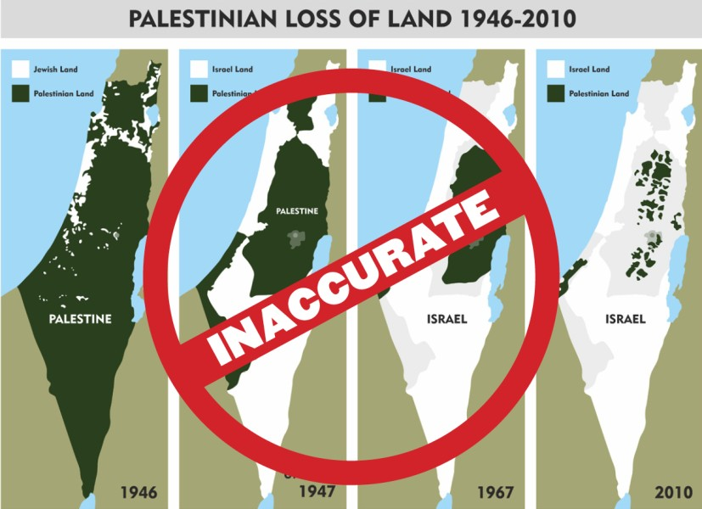
استعادت إسرائيل الحدود القديمة على مراحل (1946-2000)
https://www.linkedin.com/pulse/palestinian-loss-land-myth-4-maps-adir-duchan-ההוא-/
Notes:
This map depiction is rebutted at:
Palestinian Loss of Land: The Myth of the 4 Maps
Adir Duchan (🤓 ההוא מהזה)
Senior Software Engineer at Roundforest ⭐ | I make code, videos & cookies 🍪🎬
https://www.linkedin.com/pulse/palestinian-loss-land-myth-4-maps-adir-duchan-ההוא-/
October 17, 2023
Ladies and gentlemen, what we're about to unravel here is nothing short of a masterclass in visual deception.
These four maps, often brandished as a testament to Palestinian loss of land, may have dazzled you, but we're about to break them down, one fallacy at a time.
Warning
The points here are not meant to argue that Palestinians do not deserve self determination nor that they have no real history or connection to the land. They have and they do. I do not accept claims that they are made up people, unrelated to the land, they are here they were here and they will stay here.
However. One doesn't get to twist history in pursuit of self determination.
Terminology
Before we start, a quick word about terminology: "Palestinian," as applied to the Arab population in this region, was a term coined by Yasser Arafat in 1964, a quick narrative hack to create a connection between the Arabs living there to the area.
There's never been a Palestinian state, nor Palestinian lands. Instead, this territory was part of the British Mandate for Palestine, a geographical region that the British administered post-Ottoman Empire collapse after the First World War.
Wait so where did the name "Palestine" come from?
Though the definite origins of the word “Palestine” have been debated for years and are still not known for sure, the name is believed to be derived from the Egyptian and Hebrew word "peleshet", which appears in the Bible no fewer than 250 times. Roughly translated to mean "rolling", "migratory", "invade", the term was used to describe the inhabitants of the land to the northeast of Egypt – the Philistines.
The Philistines were an Aegean people – more closely related to the Greeks and with no connection ethnically, linguistically, or historically with Arabia – who conquered the Mediterranean coastal plain that is now Israel.
Before the 60's the 'new-age-palestinians' were simply known as 'Arabs.' In the 1947 UN Partition Plan, you won't find the term 'Palestinians.' It's the 'Jewish population' and the 'Arab population.'
So who are the indigenous people to the land?
TBH? I don't know, depends on the exact point in time you put the needle on. The entire world passed through here at some point, from crusaders to muslim conquerors.
A more pragmatic answer to the new age that does not include Bible testimonies, is that the "Native" people, are a mix of Jews (Tzabar), Arabs and Christians who lived in the area during Ottoman rule and early British mandate.
Bearing this in mind, let's deep dive to the maps.
_______________
Also see another response at:
“Disappearing Palestine” – the Maps that Lie
Jul 7, 2020 | Judy Maynard
https://aijac.org.au/fresh-air/disappearing-palestine-the-maps-that-lie/

Slide 82
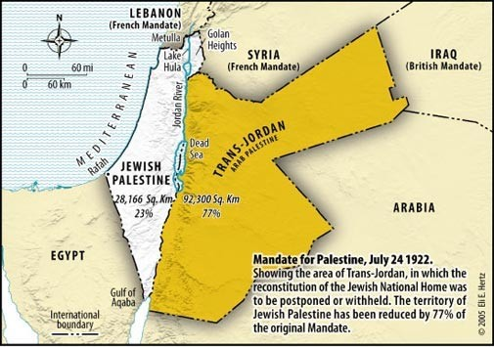
رد يهودي
تاريخ مزور
تاريخ حقيقي
Notes:
Map 1: "Palestine" in 1946
The first map showcases "Palestine" in 1946... The vast green expanses on this map supposedly represent a million Arabs living there, while the white spots are home to half a million Jewish inhabitants.
• But here's the twist: it conveniently omits the portion of the Mandate that was handed to the local Arab population in 1923, creating what we now know as Jordan. Jordan, today a Muslim Arab state with a population boasting 70% Arab Palestinian descendants. By not showing the entirety of the British Mandate, they present it as a quarter of its actual size, masquerading it as "Palestinian land."
From:
https://www.linkedin.com/pulse/palestinian-loss-land-myth-4-maps-adir-duchan-ההוא-/
Palestinian Loss of Land: The Myth of the 4 Maps
Adir Duchan (🤓 ההוא מהזה)
Senior Software Engineer at Roundforest ⭐ | I make code, videos & cookies 🍪🎬
October 17, 2023

Slide 83
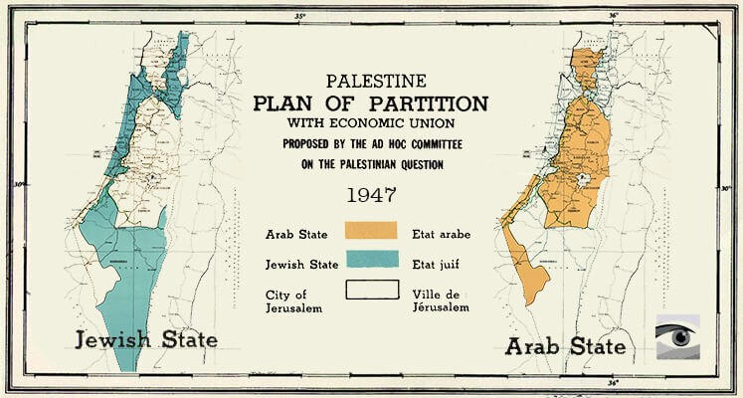
رد يهودي
تاريخ مزور
تاريخ حقيقي
Notes:
Map 2: UN Partition Plan
Now, onto the second act, featuring the UN Partition Plan, which supposedly drew the lines for Jewish and Palestinian lands. Sounds straightforward, right? Reality is bit more nuanced -- the Partition Plan indeed called for a Jewish state and one for the 'local Arab population.' But the Arabs shrugged it off, rejecting the existence of a Jewish state. As a result, that second state for the local Arab population (following Jordan which is 70% Palestinian) never saw the light of day.
• Instead, in 1948, seven Arab countries swiftly launched an attack on Israel, trying to erase it from the map.
From:
https://www.linkedin.com/pulse/palestinian-loss-land-myth-4-maps-adir-duchan-ההוא-/
Palestinian Loss of Land: The Myth of the 4 Maps
Adir Duchan (🤓 ההוא מהזה)
Senior Software Engineer at Roundforest ⭐ | I make code, videos & cookies 🍪🎬
October 17, 2023

Slide 84
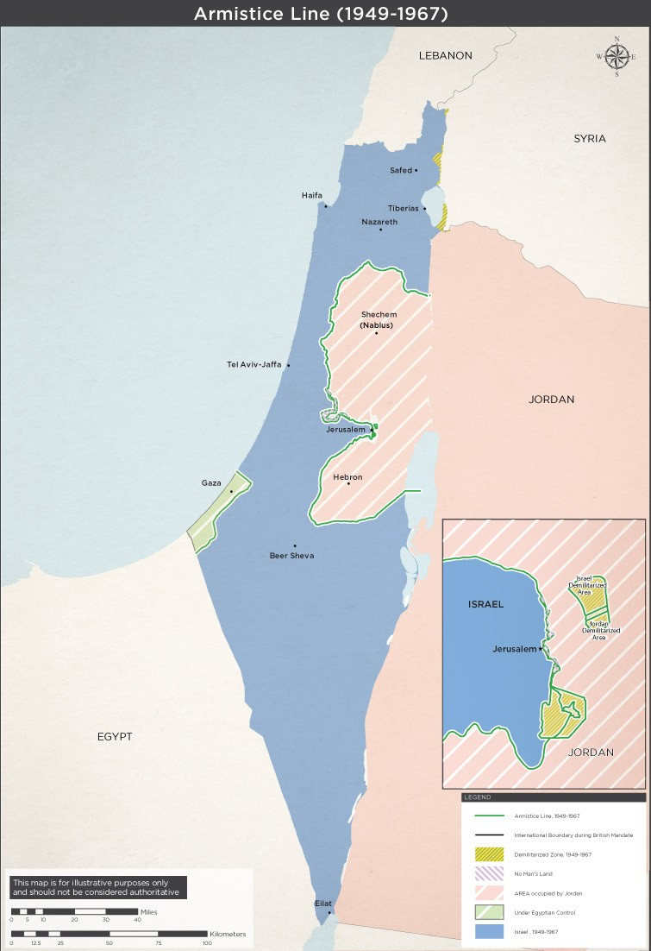
رد يهودي ...
تاريخ مزور
تاريخ حقيقي
Notes:
Map 3: The '67 Borders
Now, the third map, often mislabeled as the '67 borders. But hold onto your seats; these are neither borders nor a '67 creation.
• These are 1949 armistice lines that simply tell us who controlled what when the fighting stopped. The map portrays Gaza and the West Bank as Palestinian land, yet this is another falsehood. The West Bank was occupied by Jordan from 1948-1967, and it was ethnically cleansed of Jews. Gaza, on the other hand, was in the iron grip of Egypt from 1949 to 1967. Even today, Egypt clings to parts of the Strip from Rafah to the south. Attempting to paint all this green shading as Palestinian land is, in no uncertain terms, a categorical falsehood.
From:
https://www.linkedin.com/pulse/palestinian-loss-land-myth-4-maps-adir-duchan-ההוא-/
Palestinian Loss of Land: The Myth of the 4 Maps
Adir Duchan (🤓 ההוא מהזה)
Senior Software Engineer at Roundforest ⭐ | I make code, videos & cookies 🍪🎬
October 17, 2023

Slide 85
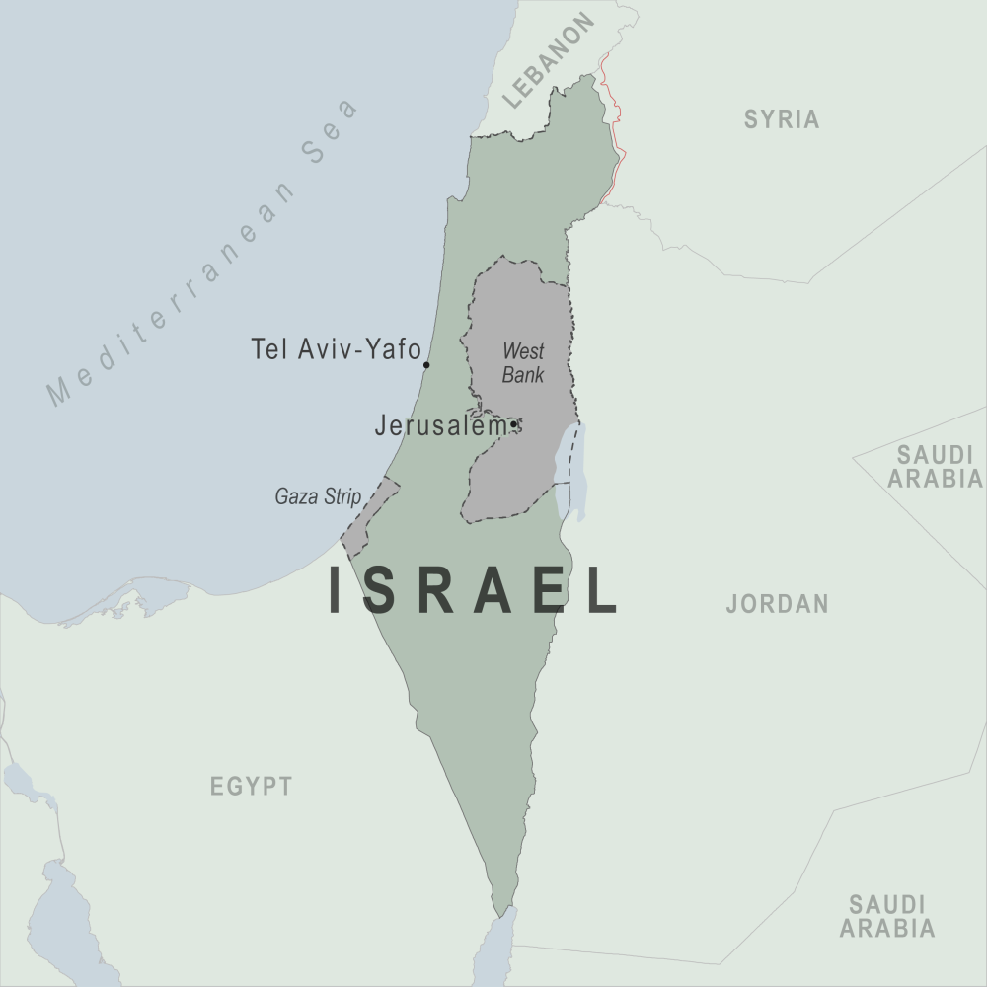
رد يهودي ...
تاريخ مزور
تاريخ حقيقي
Notes:
Map 4: Present-Day "Palestinian Land"
And now, the grand finale, the fourth map suggests it's what remains of a once-mighty territory. But hold your frowns; this isn't "what's left." It's all the land Palestinians have ever controlled. The prior maps are areas PROPOSED to the Arabs to live alongside Israel, to all of which, they refused, and decided to rage yet another war in hopes to conquer the entire land, eventually losing more land.
But wait, there's more! What about the green depiction of 1 million Arabs in 1946 on the first map? Where are they in the last map? The illusionists behind these maps want you to believe they were ethnically cleansed.
• In reality, today, these numbers have swelled from 100k to nearly 7 million, Israelis are really bad at ethnic cleansing huh? The Israeli Arab population grew from 50k to 2 million, citizens living across Israel equally, judges, doctors, engineers, some even serving in the Israeli military, completely assimilated. Yet, there's no green shading outside the West Bank and Gaza - another blatant falsehood.
From:
https://www.linkedin.com/pulse/palestinian-loss-land-myth-4-maps-adir-duchan-ההוא-/
Palestinian Loss of Land: The Myth of the 4 Maps
Adir Duchan (🤓 ההוא מהזה)
Senior Software Engineer at Roundforest ⭐ | I make code, videos & cookies 🍪🎬
October 17, 2023

Slide 86
رد يهودي ..
تاريخ حقيقي
Notes:
The Jewish Loss of Land - A different perspective
Israel's history is replete with conflicts initiated by its neighbors, all seeking its destruction. These hostilities date back to 1948 and continued through 1956, 1967, and 1973. As a result of these conflicts, Israel expanded its territories.
While critics often highlight Israel's territorial gains, it is important to recognize Israel's consistent efforts to pursue peace, including significant territorial withdrawals.
Oslo Accords - Israel ceded control of green areas within the West Bank to the PLO in hopes of achieving lasting peace. Unfortunately, this deal soured as suicide bombings targeting Israeli civilians, funded and endorsed by the PLO, persisted. This example is just one facet of a broader narrative regarding Israel's efforts for peace, a narrative that encompasses the withdrawal from Gaza, the return of the Sinai Peninsula to Egypt, and the pullout from Lebanon.
Withdrawal from the Gaza Strip - In 2005, Israel unilaterally disengaged from Gaza, uprooting settlements and relinquishing control. The aim was to establish conditions for a peaceful coexistence between Israelis and Palestinians. However, the subsequent rise of Hamas and the continued violence in the region illustrate the complexities of such initiatives.
Return of the entire Sinai Peninsula to Egypt - The Sinai had been occupied by Israel since the Six-Day War in 1967. The 1979 Egypt-Israel Peace Treaty marked a historic turning point when Israel, in exchange for peace, returned the Sinai to Egyptian sovereignty. This remains one of the most substantial territorial concessions in the quest for regional stability.
Lebanon withdrawal - in May 2000 Israel left Lebanon ending an 18-year occupation in an attempt to disentangle from the Lebanese quagmire and promote peace along its northern border.
Now let's play a quick game, zoom out, and put things in perspective. Can you find Waldo? The red dot is Israel.
Closing Remarks
The idea of "Palestinian Land Loss" must be scrutinized.
Rather than accepting one-sided narratives, we should acknowledge the complexity of the land's historical context.
To achieve a more balanced understanding of these maps, it is essential to consider Israel's history in its entirety. This broader perspective includes the wars initiated by neighboring countries, the pursuit of peace through territorial withdrawals
Misrepresentations like these maps are inaccurate, and can perpetuate conflicts and hinder progress toward reconciliation, the misinformation they propagate encourage the continues Palestinian rejectionism and violence, which have always left the Palestinians with less than they had before.
These misconceptions have permeated various platforms, affecting not only public opinion but also respected journalism and academia. A simple Google image search would show you the amount of footprint this map has on the internet, and it's time to dispel these inaccuracies.
Please share this exposé and contribute to a more nuanced understanding of the complexities surrounding Israel's land changes.
Sincerly, Adir.
From:
https://www.linkedin.com/pulse/palestinian-loss-land-myth-4-maps-adir-duchan-ההוא-/
Palestinian Loss of Land: The Myth of the 4 Maps
Adir Duchan (🤓 ההוא מהזה)
Senior Software Engineer at Roundforest ⭐ | I make code, videos & cookies 🍪🎬
October 17, 2023

Slide 87
التاريخ الحقيقي بواسطة شاني مور
Notes:
The Mendacious Maps of Palestinian “Loss”
The Tower Issue 22
January 2015
Shany Mor
Writer based in Paris; former director for foreign policy, Israeli National Security Council
click for full bio >>
https://www.thetower.org/article/the-mendacious-maps-of-palestinian-loss/
Anti-Israel activists often use doctored maps to show Israel’s supposed malfeasance over the past century. Such claims are made by people who, in the best case, have no knowledge of the facts, and in the worst case, have no moral compass.
You can’t walk very far on an American or European university campus these days without encountering some version of the “Palestinian Land Loss” maps. This series of four—occasionally five—maps purports to show how rapacious Zionists have steadily encroached upon Palestinian land. Postcards of it can be purchased for distribution, and it has featured in paid advertisements on the sides of buses in Vancouver as well as train stations in New York. Anti-Israel bloggers Andrew Sullivan and Juan Cole have both posted versions of it, and it occasionally creeps into supposedly reputable media sources, like Al Jazeera English.
Indeed, it recently appeared as a “Chart of the Day” in the UK’s respected magazine New Statesman. Beneath it was a tiny line of text listing its sources as the UN Office for the Coordination of Humanitarian Affairs and a CIA atlas from 1973. Given that the maps included information far more recent than 1973, the source struck me as slightly dubious. I contacted the staff writer who created the feature and asked him about it. He was very reluctant to admit that he had lifted it from anti-Israel propaganda sources, so he directed me to the 1973 CIA atlas. Unfortunately, nothing like the series appears in the CIA World Factbook and nothing like it could have appeared in an atlas published decades before several of the events it claims to portray. The writer then apologized for not being able to track down his sources any further and explained that he no longer works at New Statesman. He has moved on to The Guardian, and given that particular publication’s attitude toward Israel, he should have no trouble fitting in.
There is a reason why those who make use of these maps avoid examining their provenance or proving their accuracy: The maps are egregiously, almost childishly dishonest. But they have become so ubiquitous that it is worth taking the time to examine them, and what their dishonesty can teach us about the Palestinian cause and its supporters.
In whatever form they take, the “Land Loss” maps show very little variation. The standard version looks something like this:
Sometimes, a fifth map is added, this one dated 1920, showing the entirety of what was once British Mandatory Palestine in a single solid color, labeled “Palestinian.” This accomplishes the seemingly impossible and makes the series of maps even more dishonest than before.
Whether made up of four or five maps, the message of the series is clear: The Jews of Palestine have been assiduously gobbling up more and more “Palestinian land,” spreading like some sort of fungal infection that eventually devours its host.
There are some outright lies in these maps, to be sure. But the most egregious falsehoods transcend mere lies. They emerge from a more general and quite deliberate refusal to differentiate between private property and sovereign land, as well as a total erasure of any political context.
This final point is especially crucial. It goes to the question of whether the Palestinians actually “lost” this land and the context of that alleged “loss.” We could quite easily, for example, make a panel of maps showing German “land loss” in the first half of the 20th century. It would be geographically accurate but, without the political context, it would tell a completely misleading story amounting to a flat-out lie. And that is precisely what these maps are: A lie.
Taking each map in turn, it is easy to demonstrate that the first one is by far the most dishonest of the lot. As far as I have been able to determine, it is based on a map of Jewish National Fund (JNF) land purchases dating roughly from the 1920s. The JNF was founded to purchase land for Jewish residents and immigrants in then-Palestine, and was partly funded through charity boxes that were once found in almost every Jewish school and organization in the West. Ironically, this map often adorned those ubiquitous boxes.
These maps have become so ubiquitous that it is worth taking the time to examine them, and what their dishonesty can teach us about the Palestinians and their supporters.
The dishonesty of using an out-of-date map for pre-1948 Jewish land purchases is actually relatively minor. So is not omitting the political context: After 1939, Jews were forbidden from making any further land purchases by British authorities, a measure taken as a sop to Arab terrorism. Even the deceptive use of JNF land and only JNF land as a proxy for the entire Palestinian Jewish presence is but a trifle compared to the epic lie represented by this map: It deliberately conflates private property with political control.
They are not at all the same thing. The simple fact is that none of pre-1948 Palestine was under the political authority of Arabs or Jews. It was ruled by the British Mandatory government, established by the League of Nations for the express purpose of creating a “Jewish National Home.” It was also—contrary to the claims of innumerable pro-Palestinian activists—the first time a discrete political entity called “Palestine” existed in modern history. And this entity was established in order to fulfill a goal that was essentially Zionist in nature.
But this lie is compounded by another that is even more epic in scope: Labeling every single patch of land not owned by the JNF as Arab or Palestinian. This was quite simply not the case. We have incomplete data on land ownership in modern Palestine, and even less on Arab property than Jewish property, partly due to the very complicated nature of property law in Ottoman times. But anyone’s map of private property in Mandatory Palestine from this period would be mostly empty—half the country is, after all, desert. It would show small patches of private Jewish land—as this map does—alongside small patches of private Arab land, as this map shamelessly does not.
The next map is labeled 1947. This is inaccurate, as any other date would be, because the map does not represent the situation on the ground in 1947 or at any other time. Instead, it represents the partition plan adopted by the United Nations General Assembly in 1947 as UN Resolution 181. It called for two independent states to be formed after the end of the British Mandate, one Jewish and one Arab.
Needless to say, the resolution was never implemented. It was rejected by a Palestinian Arab leadership that just two years before had still been allied with Nazi Germany. The day after its passage, Arab rioting began against Jewish businesses, followed by deadly Arab attacks against Jewish civilians. Events quickly escalated into all-out war, with Arabs laying siege to major Jewish population centers—cutting off all supplies, including food and water. In some places, the siege worked, but for the most part, it was resisted successfully.
The maps emerge from a more general and quite deliberate refusal to differentiate between private property and sovereign land, as well as a total erasure of any political context.
At this point, with partition rejected by the Arabs and no help from the international community in sight, the Jews declared independence and formed what would become the Israel Defense Forces. The Arab states promptly launched a full-scale invasion, whose aims—depending on which Arab leader you choose to quote—ranged from expulsion to outright genocide. And the Arabs lost. At war’s end in 1949, the situation looked roughly like the third map in the series—the first of the lot that even comes close to describing the political reality on the ground.
I say “close” because it too is remarkably dishonest. It is only because one’s standards of dishonesty have been stretched so far by its predecessors that it almost seems true. But, alas, it is not. The map is dated 1967. What it shows are the so-called “armistice lines,” i.e., the borders where the Israeli and Arab armies stopped fighting in 1949. These lines held more or less until 1967. As far as Israel’s borders are concerned, then, the map accurately presents the situation over those 19 years.
But what lies on the other side of the line, in the territories that are today called the West Bank and the Gaza Strip, is again presented in radically dishonest fashion. These lands were not—not before, during, or after 1967—“Palestinian” in the sense of being controlled by a Palestinian Arab political entity. Both territories were occupied by invading Arab armies when the armistice was declared in 1949, the Gaza Strip by Egypt and the West Bank by Jordan. The latter was soon annexed, while the former remained under Egyptian military administration. This status quo lasted until 1967, when both were captured by Israel.
In the 1967 Six Day War, which was marked by Arab rhetoric that was sometimes even more genocidal than 1948, Israel also took the Golan Heights from Syria and the Sinai Peninsula from Egypt, more than trebling the amount of land under its control. Israel has since withdrawn from more than 90 percent of the land it occupied—mostly in the Sinai withdrawal that led to peace with Egypt. Unsurprisingly, there are no heartfelt “Israeli Land Loss” maps representing this.
The first three maps, then, confuse ethnic and national categories (Jewish and Israeli, Arab and Palestinian), property and sovereignty, and the Palestinian national movement with Arab states that ruled over occupied territory for a generation. They are a masterpiece of shameless deception.
Shameless deception is the only thing that remains consistent in this series.
As we move to the fourth map, shameless deception is the only thing that remains consistent. This map, usually labeled either 2005 or “present,” purports to show the distribution of political control following the Oslo process and the Israeli withdrawal from Gaza. The patches of Palestinian land in the West Bank are areas handed over to the Palestinian Authority in the 1990s, mostly under the 1995 Oslo II agreement. Expanding upon the autonomy put in place after previous agreements in the Oslo process since 1993, this agreement created a complex patchwork of administrative and security zones, splitting the West Bank into areas of exclusive Palestinian control, joint control, and Israeli control. It was meant as a five-year interim arrangement, after which a final status agreement would be negotiated.
Final status talks did indeed take place. But no agreement was reached. As in 1947, the principal reason was Palestinian rejectionism. This time, the Palestinian leadership rejected a state on over 90 percent of the West Bank and 100 percent of the Gaza Strip. They then broke their pledge not to return to the “armed struggle” and embarked on a campaign of suicide bombings and other terrorist atrocities that were not only morally indefensible but lost them the trappings of sovereignty they had gained over the previous decade.
After tamping down the worst of the violence, Israel decided to leave the areas of the Gaza Strip it had not evacuated a decade before. The withdrawal took place in 2005. Two years later, the Islamist group Hamas took over the Strip in a violent coup d’etat. Since then, there have been two Palestinian governments—the Hamas regime in Gaza and the Fatah-led regime in the West Bank.
Both of these regimes are marked with the same color on this fourth map, thus failing to acknowledge the split between the two regimes, though it is the first map in the series to correctly label areas under Palestinian Arab political control. Nonetheless, it does not distinguish between the sovereign territory of the State of Israel—or, in the case of East Jerusalem, territory that Israel claims as sovereign without international recognition—and territories in the West Bank that, according to agreements endorsed by both sides, are under Israeli control until a final status agreement.
Taken together, what we have is not four maps in a chronological series, but four different categories of territorial control presented with varying degrees of inaccuracy. Those categories are private property (“1946”), political control (“1967” and “2005”), and international partition plans (“1947”). They are presented in a fashion that is either tendentiously inaccurate (“2005”), essentially mendacious (“1947” and “1967”), or radically untrue (“1946”).
An honest approach would look very different. It would take each of these categories and depict how they developed over time. For example, basing ourselves on the most blatantly deceitful map, 1946, we might want to show the chronological development of private property distribution. But we’d first have to adjust the original series’ 1946 map by labeling only Arab property as Arab, rather than simply filling in the entire country with the desired color. It would be a lot of data to collect, and then we’d then have to repeat the effort for other years appropriate to the discussion: Perhaps 1950, after Israel and Jordan both instituted Absentee Property Laws; 1993, just before Palestinian self-rule began; or 2005, just after the disengagement from Gaza and the northern West Bank. The maps would have to be consistent as well, showing Arab property inside Israel as well as Jewish property in the West Bank and Gaza. I don’t know if anyone has bothered to collect all this data, and I’m not sure what it would show in any case. What argument would it advance? That Jews and Arabs should be forbidden to buy land from each other?
On the other hand, the categories of political control and international partition plans are quite easy to map out over time. Since the concern of those publicizing the maps above is Palestinian control of land, we can illustrate this with a more honest series of maps showing areas of political control, using the same years as the original—adding one for clarity.
As seen above, 1946 has exactly zero land under Palestinian Arab control—not autonomous, not sovereign, not anything—as it was all under British authority. We could go further back in time, to the Ottoman era, for example, and the map wouldn’t change in the slightest. 1947 sees no changes to the map, as Palestine was still under British control. Before the war in June 1967, control is divided between three states, and none of them is Palestinian. The 2005 map would be exactly as it is presented in the original series, showing the very first lands ever be ruled by Palestinian Arabs qua Palestinian Arabs. To clarify this a bit more, I have added a map from 1995, showing the withdrawals undertaken during the first two years of the Oslo process, just up to but not including the 1997 Hebron Protocol.
In fact, if we zoomed in a bit more, we would see how the peace process of the 1990s resulted in the first time a Palestinian Arab regime ruled over any piece of land. This occurred in 1994 with the establishment of the Palestinian Authority in Gaza and Jericho. That control steadily expanded over more and more land during the years leading up to the failed final status talks. Much of it was then lost during the second intifada, but eventually regained as violence died down, and the Gaza disengagement even expanded it slightly. All of these Palestinian land gains have taken place in the last 20 years and every square meter of it came not from Turkey or Britain or Jordan or Egypt, but from Israel alone; and nearly all of it through peace negotiations.
It is true that this is a smaller amount of land than that controlled by Israel—which is nonetheless an extremely small country by global standards. More importantly, however, it is small compared to what could have been ruled by a Palestinian state had the Palestinians not rejected partition and peace in 1947 and again in 2000. That is, had the Palestinians been motivated by the interests of their own people rather than the wish to destroy another people.
One could very easily create a theoretical series of maps that would begin in 1947 and show the distribution of political control, not as it existed, but as it could have existed. In contrast to the previous series charting political control over the years, this series would map out the international proposals to partition the country. It would begin with the Peel Commission’s 1937 partition plan, through the United Nations Special Committee on Palestine (UNSCOP) partition resolution, and end with the Clinton Parameters of 2000—which were very close to the rejected offers made by Israeli Prime Ministers Ehud Barak earlier that same year at Camp David and Ehud Olmert eight years later. But these international efforts to partition the land would be incomplete without a word or two about each side’s reaction to the proposal… (continued on the next slide)

Slide 88
التاريخ الحقيقي بواسطة شاني مور
Notes:
The Mendacious Maps of Palestinian “Loss”
The Tower Issue 22
January 2015
Shany Mor
Writer based in Paris; former director for foreign policy, Israeli National Security Council
click for full bio >>
https://www.thetower.org/article/the-mendacious-maps-of-palestinian-loss/
(continued from the previous slide)…Here too there is a continuing trend of losses for the Palestinian side. Not loss of land, but loss of potential. Each successive rejection left the Palestinians with less and less to bargain with. Surely, there is a lesson in this. But it seems that, if the Palestinians are ever to learn it, it will not be with the help of their Western supporters.
We could also make a set of maps that would present a story of Jewish “land loss.” It would begin with the first iteration of the British Mandate, before Transjordan was split off and Jewish land purchases and immigration banned. We are forever being reminded that the Palestinians have supposedly conceded 77 percent of their historic claims already, implicitly saying that all of Israel proper somehow belongs to them. But territorial maximalists on the Israeli side are not wrong when they use the same standards to claim that they have given up 73 percent of what was promised to them, including Transjordan. It is the business of pro-Palestinian activists to privilege one of these claims over the other; but in fact, both are equally wrong: The idea that the Israeli “concession” of Transjordan entitles Israel to 100 percent of the West Bank is as absurd as the Palestinians’ claim that their “concession” of Haifa entitles them to the same.
A series of actual Israeli withdrawals, however, could fill a rather long series of maps. It would include the 1957 withdrawal from Sinai, the Disengagement of Forces agreements in 1974 and 1975, the staged withdrawals stemming from the Israeli-Egyptian peace treaty in 1979 and 1982, the withdrawal from most of Lebanon in 1985, the staged withdrawals undertaken according to the Oslo Accords from 1994 to 1997, the unilateral withdrawal from southern Lebanon in 2000, and the complete withdrawal from Gaza in 2005. These maps, unlike those used by pro-Palestinian activists, have the benefit of being accurate, but I am not sure the case for “Israeli Land Loss” would convince anyone but the most partisan and ignorant of Israel’s supporters.
Perhaps the best way to illustrate the bankruptcy of the “Palestinian Land Loss” myth is to compare it to a similar situation elsewhere.
An equally absurd set of maps could be drawn up of the Indian subcontinent before and after the end of British rule. It could start with a 1946 map of the entire subcontinent, labeling any private property owned by Hindus as “Indian” and the rest as “Pakistani.” Hindus, after all, are 80 percent of India’s population today, just as Jews are 80 percent of Israel’s. It is absurd to consider anything not privately owned by Hindus under British rule as “Pakistani” when the state of Pakistan did not yet exist, but that is roughly the same as labeling anything not privately owned by Jews under the Mandate as “Palestinian.”
We could then put up a partition map from 1947, with West and East Pakistan next to a much larger India; as well as a post-partition map—perhaps from 1955—showing the land losses along the Radcliffe Line. Finally, we could draw a map from 1971 with East Pakistan shorn off into Bangladesh. A fervently dishonest person might call this series “Pakistani Land Loss,” but it would be such an obvious piece of fiction that no one could possibly take it seriously.
And no thinking person can take “Palestinian Land Loss” seriously. It is just as absurd and just as much a fiction. But it is also, in its own way, extremely destructive. Because these maps and the lies they propagate only encourage Palestinian rejectionism and violence; and as illustrated above, these have always left the Palestinians with less than they had before.

Slide 89
خسارة الفلسطينيين للأرض عبر الوقت
لكن لماذا بدأت في 1917؟
https://www.uccpin.org/land-loss-timeline
Notes:
This map has a bit more detail but bringing the maps back to 1917 and adding in the 1967 borders after the 6-Day War.

Slide 90
أخذت الأردن الأرض من البريطانيين (1949) والتي بالتالي أخذتها من الأتراك العثمانيين (1918)
لماذا بدأت في 1888؟
https://www.reddit.com/r/telaviv/comments/1762f8y/1888_2023_evolution_of_israel_palestine_borders/

Slide 91
أخذ الأتراك العثمانيون الأرض من المسلمين (1517)
لماذا بدأت في 1517؟
https://www.worldatlas.com/articles/why-did-the-ottoman-empire-fall.html

Slide 92
حروب العصور الوسطى
معارك الفتح الإسلامي
الحروب الصليبية
Notes:
There is much talk of the injustices of the Crusades against the Muslims. The reality is that there were far fewer battles to retake the Holy Land than there were in the preceding centuries by the Muslim forces.
https://www.facebook.com/DSouzaDinesh/photos/why-the-crusades-the-muslims-conquered-the-christian-near-east-parts-of-italy-an/1059025257457462/?paipv=0&eav=AfaEuJ5Ynlv9I8J6ZfgdaQVZTCwF0UBipvTCKp3Mh5r56YrWWb9nN_IaM6fmA1uetCY&_rdr

Slide 93
أخذ المسلمون الأرض من المسيحيين (640م)
لماذا بدأت في 640؟
https://theconversation.com/did-the-crusades-lead-to-islamic-state-54478
Notes:
Did the Crusades lead to Islamic State?
Published: February 22, 2016 7.05pm GMT
https://theconversation.com/did-the-crusades-lead-to-islamic-state-54478
How do we account for forces and events that paved the way for the emergence of Islamic State? Our series on the jihadist group’s origins tries to address this question by looking at the interplay of historical and social forces that led to its advent.
Today, professor of religious studies Carole Cusack considers the Crusades: can we really understand anything about Islamic State by looking at its rise as the latest incarnation of a centuries-old struggle between Islam and Christianity?
In 1996, late US political scientist Samuel P. Huntington published the book The Clash of Civilizations and the Remaking of World Order. Following the collapse of communism in 1989, he argued, conflicts would increasingly involve religion.
Islam, which Huntington claimed had been the opponent of Christianity since the seventh century, would increasingly feature in geopolitical conflict.
So, it wasn’t particularly shocking when, after the September 11 attacks on the World Trade Centre and the Pentagon, the then-US president, George W. Bush, used the term “crusade” to describe the American military response.
Framing the subsequent “war on terror” as a crusade acted as a red flag to journalists and political commentators, who could treat the events as simply the most recent stoush in a centuries-old conflict.
The actual Crusades (1096-1487) themselves evoke a romantic image of medieval knights, chivalry, romance and religious high-mindedness. But representing them as wars between Christians and Muslims is a gross oversimplification and a misreading of history.
Early Islamic conquests
That there were wars between Muslims and Christians is certainly true. After the death of Abu Bakr (573-634), the Prophet Muhammad’s father-in-law and first caliph, the second Caliph Umar (583-644) sent the Islamic armies in three divisions to conquer and spread the religion of Islam.
Whole regions that were Christian fell to Islam. The Holy Land, which comprised modern-day Palestinian territories, Israel, Lebanon, Syria and Jordan, for instance, was defeated. And Egypt was conquered without even a battle in 640.
The ancient and vast Persian Empire, officially Zoroastrian in religion, had been conquered by 642. Weakened by war with the Christian Byzantine Empire, Persia was no match for the Muslim forces.
Muslim armies marched across north Africa and crossed the Straits of Gibraltar into modern Spain, eventually securing a large territory in the Iberian Peninsula, which was known as Al-Andalus (also known as Muslim Spain or Islamic Iberia).
They also marched across the Pyrenees and into France in 732, the centenary of Muhammad’s death. But they were decisively defeated at the Battle of Poitiers (also known as Battle of Tours and, by Arab sources, as Battle of the Palace of the Martyrs) by the Frankish general, Charles Martel (686-741), grandfather of the great Emperor Charlemagne.
This was seen as a Christian victory and, after Poitiers, there were no further attacks on Western Europe. The Crusades came much later.
The causes of the Crusades
The proximate causes of the First Crusade (1096-1099) include the defeat of the Byzantine Emperor Alexius Comnenus (1056-1118), who was crowned in 1081 and ruled until his death. His armies met the Muslim Seljuk Turks at the Battle of Manzikert in 1071 and were defeated.
This placed the city of Constantinople at risk of conquest. So, the emperor requested that the West send knights to assist him – and he was prepared to pay.
Pope Urban II (1044-1099) preached the Crusade at the Council of Clermont in 1095. He argued that the Turks and Arabs attacked Christian territories and had “killed and captured many, and have destroyed the churches and devastated the empire”.
He also promised his audience:
All who die by the way, whether by land or by sea, or in battle against the pagans, shall have immediate remission of sins. This I grant them through the power of God with which I am invested.
This was recorded by a monk called Fulcher of Chartres, who wrote a chronicle of the First Crusade.
The four leaders of the First Crusade. Alphonse-Marie-Adolphe de Neuville via Wikimedia Commons Thousands answered the pope’s call and the First Crusade conquered Jerusalem in 1099. But the Crusaders’ presence in the Middle East was short-lived and the port city of Ruad, the last Christian possession, was lost in 1302/3.
Many later conflicts that were called Crusades were not actions against Muslim armies at all. The Fourth Crusade (1202-1204), for instance, was a Venetian Catholic army, which besieged Constantinople. Catholic Christians attacked Orthodox Christians, then looted the city, taking its treasures back to Venice.
Islam was not a factor in the Albigensian Crusade of 1209-1229, either. In that instance, Pope Innocent III (1160/1-1216) used the language of war against the infidel (literally “unfaithful”, meaning those without true religion) against heretics in the south of France. So, “right-thinking” Christians killed “deviant” Christians.
The end of the Middle Ages
It wasn’t all intermittent fighting. There were also periods of peace and productive relationships between Christian and Muslim rulers in the Middle Ages.
For instance, Charlemagne (742-814) (also know as Charles the Great or Charles I), who united most of Western Europe during the early part of the Middle Ages, sent gifts to Harun al-Rashid (763-809), the Caliph of Baghdad. In return, he received diplomatic presents such as a chess set, an elaborate clepsydra (water clock) and an elephant.
In Spain, the culture from the early eighth century to the late 15th was known as “la Convicencia” (the co-existence), as Jews, Christians and Muslims lived in relative peace (though the level of harmony has been exaggerated). And there was an exchange of ideas in fields including mathematics, medicine and philosophy.
The Christian kingdoms of the north gradually reconquered Al-Andalus. And, in 1492, King Ferdinand (1452-1516) and Queen Isabella (1451-1504) reclaimed Granada and expelled the Jews and Muslims from Spain, or forced them to convert to Christianity.
A clumsy view
Clearly, to speak of an “us versus them” mentality, or to frame current geopolitical conflicts as “crusades” of Christians against Muslims, or vice versa, is to misunderstand – and misuse – history.
Not all blood and guts: the Caliph of Baghdad Harun al-Rashid receives a delegation from Charlemagne. Julius Köckert via Wikimedia Commons Modern Westerners would find medieval Crusader knights as unappealing as they do Islamic State.
And it’s impossible to miss the fact that the immediate entry into heaven Pope Urban promised to Christian soldiers who died in battle against the infidel Muslims is conceptually identical to the martyrdom ideology of contemporary jihadists.
Reality is more complex – and more interesting – than the simple continuation of a historical struggle against the same enemy. Muslims conquered Christian territories, yes, but Christians engaged in reconquest.
There were forced conversions to both Islam and Christianity, and – very importantly – actual governments and monarchs were involved. It’s a simplistic thing to say that “Islamic State is neither Islamic nor a state”, but there’s an element of truth in it.
The most important reason we should resist the lure of the crusade tag to any fight against jihadists is that groups like Islamic State want the West to think like that.
It justified the Paris bomb attacks of November 2015 as attacks against “the Crusader nation of France”. Osama bin Laden used the same reasoning after the September 11 attacks.
By adopting the role of Crusaders, Western nations play into Islamic State’s hands. It’s how these jihadists want the West to understand itself – as implacably opposed to Islam. But it’s not, and it never has been.
This is the sixth article in our series on the historical roots of Islamic State. Download our special report collating the whole the series.

Slide 94
أخذ المسيحيون البيزنطيون الأرض بعد اهتداء الإمبراطور الروماني قسطنطين (313م)
The Cardo (Jerusalem Main Street) in the Byzantine Era
لماذا بدأت في 313م؟
https://www.worldhistory.org/article/1166/pilgrimage-in-the-byzantine-empire/
Notes:
Pilgrimage in the Byzantine Empire
World History Encyclopedia
by Mark Cartwright published on 08 January 2018
https://www.worldhistory.org/article/1166/pilgrimage-in-the-byzantine-empire/
The Holy Land
Pilgrimage developed in the Byzantine period to such an extent that whole itineraries were made which spanned across the eastern part of the empire. The Holy Land was, of course, the most important and popular destination for pilgrims. Jerusalem was considered by Christians to be the centre of the world. The earliest surviving account of a Christian pilgrimage to Jerusalem is by a pilgrim from Bordeaux who recorded his travels in 333 CE. The city really took off as a destination for pilgrims following Constantine I's 4th-century CE sacred building programme there. The emperor set up lavish shrines at the Holy Sepulchre on Golgotha, where Christ was crucified and then entombed, the Mount of Olives, where the Ascension took place, and the nativity cave in Bethlehem.
Other sites of interest in Jerusalem included the site of the Resurrection, Gethsemane, where Christ prayed on the eve of his death, the church of Holy Wisdom, where Christ was condemned, the birthplace of Saint Mary and her tomb, the cave of the Last Supper, and the tombs of Simeon and James. By the 4th century CE alone there were some 34 sites to be visited in the city and its environs, and these only grew over the centuries with more and more churches, especially, being built. Besides Bethlehem, other sites outside the city included the tomb of Lazarus in Bethany. There were also relics to be seen such as the very jugs which Jesus had used to turn water into wine at Cana and the notebook he had used as a child in Nazareth.

Slide 95
احتل الرومان الأرض من الهشمونيين (63 ق.م)
لماذا بدأت في 63 ق.م؟
https://medium.com/@ancient.rome/how-did-the-romans-take-over-judea-335e4b858947
Notes:
How did the Romans take over Judea?
Medium
SPQR | Ancient Rome and the Ancient World
Apr 13 (no year given, but accessed in 2023)
Judea is a small but terribly uncomfortable country. It had been a bone in Rome’s throat for over two hundred years, and much blood was spilled on both sides in the process of its conquest.
In 63 B.C., the Romans invaded Palestine for the first time. At that time, the kingdom of Hasmonean controlled this territory. The kingdom was in turmoil. Two brothers, two pretenders to the throne, Hyrcanus II and Aristobulus II, could not divide the throne. In order to provide international aid to the brotherly nation, the general Gnaeus Pompey went to Jerusalem with his troops. The kingdom went to Hyrcanus, but he ceased to be king after that. The Romans gave him the title of ethnarch, “national leader,” in modern parlance. His state retained its self-government but lost its independence. Antipater, a Roman protégé, became the de facto ruler.
See also the site where the above picture was taken:
Little Known Fact: The Romans were Invited to Invade Judea
Ward Sanford
Original: May 2, 2021
Updated: Oct 12, 2022
https://www.cryforjerusalem.com/post/romans-invited-judea
Wait—Seriously? Did the Jews invite the Romans to invade their country? Well—yes—sort of. The Jewish nation did not. But its rulers did. And that led to General Pompey besieging Jerusalem in 63 BCE. What were they thinking?
It all started four years earlier when the Queen of Judea, Salome Alexandra, died. She was the wife of former ruler Alexander Jannaeus, who was part of the Hasmonean Dynasty that had ruled Judea since the Maccabees had expelled the Greeks. Salome and Alexander had had two sons: Hyrcanus II and Aristobulus II, each the namesake of a former Hasmonean ruler. Hyrcanus was the elder and inherited the throne upon his mother’s death. But Aristobulus was superior to his older brother in power and magnanimity and could not resist trying to claim the throne for himself. Thus, the country descended into civil war. Aristobulus quickly overpowered Hyrcanus and captured Jerusalem. He allowed his brother Hyrcanus to live in peace once he had renounced the kingship and high priesthood. But Hyrcanus grew suspicious that Aristobulus was going to have him killed eventually, so he took refuge with the Nabateans in their capital at Petra in present day Jordan. There Hyrcanus eventually convinced the Nabatean king to send an army of 50,000 toward Jerusalem to restore his kingship.
Meanwhile Rome had been expanding its empire. General Pompey had been making advancements east into Asia, including the assimilation of the Greek Seleucid kingdom. The Seleucids had originally ruled over a great eastern territory that had been conquered by the Alexander the Great. By this time, however, it had been diminished to the area of modern-day Syria. With Judea on the verge of civil war again, both Aristobulus and Hyrcanus sent gifts to General Pompey in Damascus, requesting he send military troops to aide them in establishing their sole kingship of Judea while expelling their brother. Rome saw the weaker of the two brothers, Hyrcanus, as a more subservient ruler under future Roman authority, and so backed him against Aristobulus. The result was Pompey besieging Jerusalem and the removal of Aristobulus, a seeming victory for Hyrcanus. But Hyrcanus was only given the high priesthood and not the kingship. Instead, the governing administration was given to a powerful Roman ally in the Jewish court, Antipater the Idumean. Antipater was a convert to Judaism from the Edomites (descendants of Esau). He was also the father of Herod the Great, who succeeded him as founder of the new Herodian dynasty. The die now had been cast. In seeking Roman intervention for their short-term ambition of making themselves the ruler of Judea, the brothers had invited in the Roman military, who had no intention of handing the ruling authority back over to the Jews. They had put their own self-interest above that of their nation.
Cry For Jerusalem is a series of historical fiction books covering the seven years leading up to the burning of Herod’s Temple and the Siege of Jerusalem in 70 CE.

Slide 96
انتصر الهشمونيون على اليونان (164 ق.م)
69
لماذا بدأت في 164 ق.م؟
?
?
بيتزل، أطلس مودي لأراضي الكتاب المقدس، الطبعة الأولى، 155

Slide 97
سيطر اليونانيون على إسرائيل (331-164 ق.م)
60
لماذا بدأت في 331 ق.م؟
الإسكندر
الصراع على السيادة
تطورات الإمبراطورية الهيلينية

Slide 98
احتل الفرس الأرض من البابليين (539 ق.م)
57, 59
لماذا بدأت 539 ق.م؟
الهيكل
الشعب
الأسوار
باري بيتزل، أطلس مودي لأراضي الكتاب المقدس، الطبعة الأولى، 150
Notes:
Babylon had three major deportations, but Persia did the opposite with three major returns to the land.
______________
OS-12-2 Kings-242
OS-14-2 Chron-318
NB-05 Politics 2 Ptolemies to 63 BC (Pompey)-6

Slide 99
التهديد البابلي
التوسع البابلي
البحر الأبيض المتوسط
سوريا
بابل
إسرائيل
يهوذا
586 ق.م
خليج فارس
مصر
Notes:
The Babylonians had conquered the world north of Judah—and then in 586 BC, they destroyed Jerusalem, which is addressed in Jeremiah and Lamentations.
Daniel served the very confident superpower, Babylon, that had conquered its way across the Ancient Near East.
———————
Common-323
BG-03-Table of Nations & OT Peoples-53
OS-25-Lamentations-116
BE-27-Daniel-5
OS-27-Daniel-159

Slide 100
التوسع الآشوري
607
لماذا بدأت في 722 ق.م؟
باري بيتزل، أطلس مودي لأراضي الكتاب المقدس، الطبعة الأولى، 139

Slide 101
احتلت إسرائيل الأرض من الكنعانيين (1405 ق.م.) وامتلكتها 800 سنة (حتى 586 ق.م.)
تعتمد مطالبة إسرائيل بأرضها على:
1. الحرب
2. الله هو من أعطى الأرض لليهود
3. الإتفاق الدولي
4. الإقامة طويلة المدى
لكن لماذا نبدأ بسنة 1405 ق.م؟
https://jewishjournal.com/commentary/opinion/364623/israels-claims-to-its-land/
Notes:
Israel’s Claims to Its Land
There are four grounds that nations use in their self-understanding of why they rightfully occupy their land. I will give some examples from around the world, and then I will apply it to Israel.
Rabbi Elliot N. Dorff
November 1, 2023
yorkfoto/Getty Images
In these weeks when Jews all over the world are worried about the future existence of the State of Israel, let alone its safety and flourishing, and when some claim that Israel is a colonial power that is usurping the right of Palestinians to their land, the philosopher in me wants to zoom out to ask this question: How does any nation have a right to its land?
I am going to suggest that there are four grounds that nations use in their self-understanding of why they rightfully occupy their land, grounds that other nations recognize as well in respecting each nation’s sovereignty over its land. For each of these grounds, I will give some examples from around the world, and then I will apply it to Israel. Interestingly, in some form all four of these grounds are illustrated in the stories in Genesis we are reading in the synagogue at this time of year.
War
The American Revolution and the revolutions of South American countries against their Spanish and Portuguese rulers are some examples of how nations establish sovereignty over their land. This is mirrored in Genesis 14, in which Abram has to wage war to defend his hold on the land. Interestingly, in doing so he redeems Lot from captivity, an especially poignant part of the story for the current Israel-Gaza conflict.
Israel has unfortunately had a surfeit of experience of having to establish or reenforce its claim to its land through war, from its War of Independence in 1948 to the current conflict.
God gave the Jews this land
This gift to Abram and his descendants, Isaac and Jacob, is first announced in Genesis 12 and repeated many times thereafter. In similar fashion, the Japanese believe that the gods granted them the land that they occupy.
This is a powerful justification for Jews to live on the Land of Israel for religious Jews and for many Christians, especially Evangelical Christians. When I first began formulating this essay, I thought that Muslims would disagree, based on the Koran. I Googled “the Land of Israel in the Koran,” however, and found a talk by Sheikh Dr Muhammad Al-Hussaini in London, in which he points to Sura 5:20-21:
“Give heed, O believers! For Moses said to his people: O my people! Remember with reverence the grace of God upon you when He appointed prophets among you and made you sovereign over yourselves. Moreover, He gave to you what He has not given to anyone else. O my people! Enter the Holy Land that God has decreed for you to enter, and do not turn away from this battle in retreat, for then you shall turn back from the faith itself as losers of an everlasting Paradise.”
Sheikh Al-Hussaini then asserts “that the traditional commentators from the eighth and ninth century onwards have uniformly interpreted the Koran to say explicitly that Eretz Yisrael has been given by God to the Jewish people as a perpetual covenant. There is no Islamic counterclaim to the Land anywhere in the traditional corpus of commentary” (https://www.thejc.com/judaism/all/what-the-koran-says-about-the-land-of-israel-1.8278). Mohammed many times urges his followers to fight for Mecca (Makka in many translations), but never for Jerusalem or Israel. The only way in which Hamas and other Muslims can justify taking it away from Jews is to claim that they are evil sinners who must be punished, but for the Koran and its official interpreters, God gave the Land of Israel to the Jews.
International agreement
This is how Canada gained its independence — through the Constitution Acts from 1867 to 1982 — and it is how many nations gained independence after World War II, when colonial powers handed over sovereignty to the local communities in India, Pakistan, and many countries in Africa. In the same way, the British abandoned their rule of Israel and its neighbors in 1948, turning it over to what, according to the United Nations resolution of November 1947, was supposed to be two independent Jewish and Arab states between the Mediterranean the Jordan River. In at least somewhat similar ways, the Torah records in Genesis 13 the division of the land between Abram and Lot to settle the conflict between their shepherds and, in Genesis 21:22ff, the agreement between Abraham and Abimelech to settle the conflict of their clans over their wells of water.
Long-time Residence
This is the self-understanding of the Japanese, Chinese, Russians, and many African tribes as to why they rightfully occupy their land: It has been theirs from ancient ancestors to now. This is the claim that especially secular Israeli Jews use, and so it is no accident that they (and some religious Jews too) are keenly interested in archaeology to prove the claim of the ancient Israelites on the Land of Israel, and it is also the reason that the biblical stories of the conquest of the land in the Torah and in the books of the Former Prophets are taught in secular Israeli high schools. It is also the motivation of the claim that even though Jews did not rule that land for many centuries, there were always Jews living there, and Jews prayed three times daily for their return to the land of their ancestors.
In sum, the claim of Jews to the Land of Israel is grounded in all four of these factors. That said, as Americans, Central and South Americans, Australians, and New Zealanders must deal morally with the claims of those native to those lands before the current majority arrived there, and for cogent humanitarian, political, security, economic, and other pragmatic reasons, contemporary Israelis must find a way to negotiate peace with the Muslims who lived there before the modern Jewish return to the land and their descendants, as difficult as it has been to find a partner for peace among successive Palestinian representatives. We all hope and pray that there be peace there, and may it be soon.
Rabbi Elliot Dorff, Ph.D. is the Rector and Distinguished Service Professor of Philosophy at American Jewish University.

Slide 102
أرض من؟
نظرة كتابية

Slide 103
ما هي البداية الحقيقية لارتباط إسرائيل بالأرض؟

Slide 104
أعطى الله الأرض لإبراهيم ونسله (2000 ق.م)

Slide 105
كره الرومان اليهود وأعادوا تسمية الأرض باسم فلسطين في عام 132م على اسم المنطقة الفِلِسْطِيَّة لمحو أي صلة يهودية.

Slide 106
٧
العناصر الثلاثة الأساسية
تكوين ١٢
١ وقال الرب لأبرام: اذهب من أرضك ومن عشيرتك
ومن بيت أبيك إلى الأرض التي أريك.
٢ فأجعلك أمة عظيمة وأباركك وأعظم اسمك وتكون بركة
إبراهيم
٣ وأبارك مباركيك ولاعنك ألعنه وتتبارك فيك جميع قبائل الأرض
الدعوة
أرض. نسل. بركة
Handbook pg. 19-24
14
٣
Notes:
في تكوين الأصحاح ١٢، تُقدِّم الأعدادُ ١-٣ وعْدَ الله لإبراهيم المكوَّن من ثلاثة أجزاء. ها هو الوعد:
//// وقالَ الرَّبُّ لأبرامَ: «اذهَبْ مِنْ أرضِكَ ومِنْ عَشيرَتِكَ ومِنْ بَيتِ أبيكَ إلَى الأرضِ الّتي أُريكَ.
//// فأجعَلكَ أُمَّةً عظيمَةً وأُبارِكَكَ وأُعَظِّمَ اسمَكَ، وتَكونَ بَرَكَةً.
//// وأُبارِكُ مُبارِكيكَ، ولاعِنَكَ ألعَنُهُ. وتَتَبارَكُ فيكَ جميعُ قَبائلِ الأرضِ».
_______________
Common-162
OS-01-Gen4-20-slide 214
OS-10-2Samuel-91

Slide 107
حدود الأرض الموعودة لإبراهيم
سوريا
لبنان
إسرائيل
الأردن
تكوين ١٥: ١٨
في ذلك اليوم قطع الرب مع أبرام ميثاقاً قائلاً: لنسلك أعطي هذه الأرض من نهر مصر إلى النهر الكبير نهر الفرات
India
مصر
Notes:
امتدَّت أرض الله الموعودة نحو الشمال من وادي مصر الصغير جنوبًا في سيناء إلى نهر الفرات الكبير في أقصى الشمال – أي أنَّها قطعة أرضٍ ذات مساحةٍ كبيرةٍ جدًّا! عندما نضع هذه الحدود على الأرض في عصرنا الحاضر، نستطيع أن نرى الصراع الذي يتعيَّن على دولة إسرائيل الحديثة أن تخوضه للمطالبة بأراضٍ من مصر، ولبنان، وسوريا وحتَّى من الأردن على الجانب الآخر من نهر الأردن.
"إن الوعد بالأرض لإبراهيم وآباء شعب إسرائيل مشهودٌ له على نطاقٍ واسعٍ في العهد القديم (تكوين 12: 1؛ 15: 18-21؛ 17: 8؛ 26: 3؛ 28: 4، 13؛ 35: 12؛ 48: 6). الأصحاح 16، الأصحاحان 21-22؛ خروج 3: 8، 17؛ 6: 8؛ 13: 5؛ 23: 23، 28-33؛ 33: 1-3؛ 34: 11؛ سِقْر العدد 34: 29؛ تثنية 1: 7-8. 3: 21؛ 7: 16، 19؛ 9: 1-3؛ 11: 23-25؛ 31: 3-8؛ يشوع 1: 2-5)". مارك إف. رووكر "سِفْر يشوع" ضمن المنشور "العالم وكلمة الله: مقدِّمة إلى العهد القديم"، الصفحات 284-285:
Mark F. Rooker,"The Book of Joshua,” in The World and the Word: An Introduction to the Old Testament (Nashville, TN: B&H Academic, 2011), 284–285.
God’s promised land stretched northward from the small wadi of Egypt south in the Sinai to the large Euphrates River in the far north—a HUGE piece of real estate! When today’s boundaries are placed over this land we can see the struggle modern Israel has to claim land from Egypt, Lebanon, Syria, and possibly even Jordan on the other side of the Jordan River.
"The promise of the land to Abraham and the patriarchs of Israel is widely attested (Gen 12:1; 15:18–21; 17:8; 26:3; 28:4, 13; 35:12; 48:6, 16, 21–22; Exod 3:8, 17; 6:8; 13:5; 23:23, 28–33; 33:1–3; 34:11; Num 34:29; Deut 1:7–8; 3:21; 7:16, 19; 9:1–3; 11:23–25; 31:3–8; Josh 1:2–5)."
Mark F. Rooker,"The Book of Joshua,” in The World and the Word: An Introduction to the Old Testament (Nashville, TN: B&H Academic, 2011), 284–285.
_____________
Common-160
BE-31-Obadiah-83
BG-13-Present & Future-6
OS-01-Gen4-20 (Gen 12)-221
OS-04-Numbers-235
OS-06-Joshua-21
OS-17-Esther-16
OS-31-Obadiah-159

Slide 108
الأرض الأبدية لنسل إبراهيم
تكوين 17: 7-8
وأقيم عهدي بيني وبينك وبين نسلك من بعدك في أجيالهم عهداً أبدياً لأكون إلهاً لك ولنسلك من بعدك وأعطي لك ولنسلك من بعدك أرض غربتك كل أرض كنعان ملكاً أبدياً وأكون إلههم
إسرائيل
Notes:
God’s promised land stretched northward from the small wadi of Egypt south in the Sinai to the large Euphrates River in the far north—a HUGE piece of real estate! When today’s boundaries are placed over this land we can see the struggle modern Israel has to claim land from Egypt, Lebanon, Syria and possibly even Jordan on the other side of the Jordan River.
_________
ES-29-Antisemitism-104
OS-01-Gen4-20-slide 310

Slide 109
تثنية ٧ : ٧-٨ 7 ليس من كونكم أكثر من سائر الشعوب التصق الرب بكم واختاركم، لأنكم أقل من سائر الشعوب. 8 بل من محبة الرب إياكم، وحفظه القسم الذي أقسم لآبائكم، أخرجكم الرب بيد شديدة وفداكم من بيت العبودية من يد فرعون ملك مصر.

Slide 110
تثنية 30: 1- 4
44
7
1 ومتى أتت عليك كل هذه الأمور البركة واللعنة، اللتان جعلتهما
قدامك فإن رددت في قلبك بين جميع الأمم الذين طردك الرب إلهك
إليهم، 2 ورجعت إلى الرب إلهك، وسمعت لصوته حسب كل ما أنا
أوصيك به اليوم، أنت وبنوك، بكل قلبك وبكل نفسك، 3 يرد الرب
إلهك سبيك ويرحمك، ويعود فيجمعك من جميع الشعوب
الذين بددك إليهم الرب إلهك.
27
Notes:
Chapter 30 says that Israel will be dispersed but then Israel will return to the LORD, so he will restore them from the nations and bring them back to the Land.

Slide 111
يقول القرآن أن الله أعطى الأرض لإسرائيل
{وَإِذْ قَالَ مُوسَى لِقَوْمِهِ يَاقَوْمِ اذْكُرُوا نِعْمَةَ اللَّهِ عَلَيْكُمْ إِذْ جَعَلَ فِيكُمْ أَنْبِيَاءَ وَجَعَلَكُمْ مُلُوكًا وَآتَاكُمْ مَا لَمْ يُؤْتِ أَحَدًا مِنَ الْعَالَمِينَ ، يَا قَوْمِ ادْخُلُوا الْأَرْضَ الْمُقَدَّسَةَ الَّتِي كَتَبَ اللَّهُ لَكُمْ وَلَا تَرْتَدُّوا عَلَى أَدْبَارِكُمْ فَتَنْقَلِبُوا خَاسِرِينَ
(السورة 5: 20-21)
Notes:
Israel’s Claims to Its Land
There are four grounds that nations use in their self-understanding of why they rightfully occupy their land. I will give some examples from around the world, and then I will apply it to Israel.
Rabbi Elliot N. Dorff
November 1, 2023
This is a powerful justification for Jews to live on the Land of Israel for religious Jews and for many Christians, especially Evangelical Christians. When I first began formulating this essay, I thought that Muslims would disagree, based on the Koran. I Googled “the Land of Israel in the Koran,” however, and found a talk by Sheikh Dr Muhammad Al-Hussaini in London, in which he points to Sura 5:20-21:
“Give heed, O believers! For Moses said to his people: O my people! Remember with reverence the grace of God upon you when He appointed prophets among you and made you sovereign over yourselves. Moreover, He gave to you what He has not given to anyone else. O my people! Enter the Holy Land that God has decreed for you to enter, and do not turn away from this battle in retreat, for then you shall turn back from the faith itself as losers of an everlasting Paradise.”
Sheikh Al-Hussaini then asserts “that the traditional commentators from the eighth and ninth century onwards have uniformly interpreted the Koran to say explicitly that Eretz Yisrael [the land of Israel] has been given by God to the Jewish people as a perpetual covenant. There is no Islamic counterclaim to the Land anywhere in the traditional corpus of commentary” (https://www.thejc.com/judaism/all/what-the-koran-says-about-the-land-of-israel-1.8278). Mohammed many times urges his followers to fight for Mecca (Makka in many translations), but never for Jerusalem or Israel. The only way in which Hamas and other Muslims can justify taking it away from Jews is to claim that they are evil sinners who must be punished, but for the Koran and its official interpreters, God gave the Land of Israel to the Jews.

Slide 112
يقول القرآن أن الله أعطى الأرض لإسرائيل
ستجد بوضوح شديد أن المفسرين التقليديين من القرنين الثامن والتاسع فصاعداً قد فسروا القرآن بشكل موحد ليقول صراحةً أن أرض إسرائيل قد أعطاها الله للشعب اليهودي كعهد أبدي. لا يوجد أي ادعاء إسلامي مضاد للأرض في أي مكان في مجموعة التفسيرات التقليدية.
الشيخ الدكتور محمد الحسيني
Notes:
What the Koran says about the land of Israel
Islamic scripture actually recognises the Jewish link to Israel, says a British imam
BY The JC
March 19, 2009 11:55
https://www.thejc.com/judaism/all/what-the-koran-says-about-the-land-of-israel-1.8278
According to the Hamas charter, Palestine is an Islamic endowment “for all generations of Muslims until the Day of Resurrection” which no one may renounce. The Arab-Israeli conflict is seen as not just a political dispute but an implacably religious one.
But there are Muslim scholars who will tell you that this claim has no basis in the Koran: not only that, but the foundation text of Islam, in fact, recognises the special link between the Jewish people and the Land of Israel. “You will find very clearly,” says Sheikh Dr Muhammad Al-Husseini, “that the traditional commentators from the eighth and ninth century onwards have uniformly interpreted the Koran to say explicitly that Eretz Yisrael has been given by God to the Jewish people as a perpetual covenant. There is no Islamic counterclaim to the Land anywhere in the traditional corpus of commentary.”
Dr Al-Husseini is a British imam who teaches a course on the Koran as part of interfaith studies at the Leo Baeck College, the Progressive rabbinic college in Finchley, north London. One of the texts he has taught is the following verse in the Koran (5:21), “O my people! Enter the Holy Land which God has decreed for you, and turn back on your heels otherwise you will be overturned as losers.”
He examines this passage through the eyes of one classic commentator of the Koran, Muhammad ibn Jarir al-Tabari (838-923), who says the remark is “a narrative from God… concerning the saying of Moses… to his community from among the children of Israel and his order to them according to the order of God to him, ordering them to enter the holy land.”
Al-Tabari, Dr Al-Husseni says, is “our Rashi”, the founder of tafsir, “the science of exegesis” — the Arabic word is similar to pesher, Hebrew for interpretation. “One of the key rules of Islamic exegesis by which Islamic scholarship is bound is that the authority to interpret lies in the hands of the Prophet and of the Prophets’ Companions alone,” he says, “Nobody can go to the text and just freely interpret the text for their own purposes. This is really important… because if the Prophet, or one of his Companions, has given an interpretation, then we are bound by it.”
Just as you find in the Talmud that one rabbi quotes a saying in the name of one of his teachers, so al-Tabari will cite the interpretations of earlier, oral commentators in a chain going back to one of the Prophet Muhammad’s Companions, the ultimate source of authority for that interpretation.
The Muslim commentators may differ over exactly where “the Holy Land” is — one says the area around Mount Sinai, another the Levant. But what is significant, Dr Al-Husseini, is that “they are pointing to the same area — it is not Egypt, Saudi or Iraq.”
The Arabic for “the holy land”, al-ard al-muqaddasa, is close to the Hebrew, eretz kodesh and refers to this piece of land rather than other sites sacred to Muslims. “During the life of the Prophet, there was an enormous territorial ambition to get Makka back from the Makkans,” he says. “There was no territorial ambition to claim Jerusalem, Palestine.
“What happens during his lifetime is what God wants to happen for the Muslim community. His prophecy and his objective was the reclamation of the Islamic holy site which is Makka. If God had decreed that His Prophet should have Jerusalem, then it would have been something that he would have been preoccupied with during his lifetime and he conquered the whole of the Arabian peninsula.
“It was never the case during the early period of Islam…that there was any kind of sacerdotal attachment to Jerusalem as a territorial claim. Jerusalem is holy but Mount Sinai is more holy. Sinai is mentioned far more often, and Jerusalem isn’t actually mentioned by name.” (Jerusalem is alluded to in the phrase “the further mosque”).
Al-Tabari’s commentary also notes that the word “decreed” — kataba in Arabic, related to katav, “written”, in Hebrew — has the connotations of “ordered”: in other words, settling the land was regarded as a mitzvah for the children of Israel. Al-Tabari also observes that the decree is confirmed in al-lawh al-mahfuz, the eternally preserved tablet” — a reference to the Islamic idea that in heaven exists a sacred blueprint from which the Muslim, Christian and Jewish scriptures emanate, hence the covenant with the Jewish people over Israel is everlasting.
Dr Al-Husseini— who stresses his support for a two-state solution to the Israeli-Palestinian conflict — points out that other contemporary Muslim scholars draw attention to this tradition, such as Professor Khaleel Mohammed in San Diego (see: www-rohan.sdsu.edu/~khaleel/) and Sheikh Abdul Hadi Palazzi in Rome (http://jmm.aaa.net.au/articles/1002.htm).
But he also observes that many Muslims are unfamiliar with al-Tabari’s work because it is mostly untranslated and accessible only to an educated elite who understand Arabic. By contrast, the teachings of 20th-century radicals linked to political groups such as the Muslim Brotherhood are often widely available in English. Since the militants cannot contradict the Koranic precedent for Jewish attachment to the Land of Israel, they adopt another tactic, Dr Al-Husseini says: they argue that Jews are a wicked people who “must be punished” — hence the spread of antisemitism within the Muslim world. “But no fundamentalist, no matter how hard they try,” he says, “can overrule the existing tradition to say there is, in fact, an Islamic counterclaim to Eretz Yisrael.”
Studying Islam in a Jewish setting
Leo Baeck College, the Progressive rabbinic academy, has long been at the forefront of dialogue between Jews and members of other religions. Interfaith dialogue forms part of its rabbinic training.
Last autumn it launched a weekly, 10-part introduction to the classical study of the Koran, open not only to serving and trainee rabbis but also to Jewish community leaders. It is taught by Shiekh Dr Muhammad Al-Husseini, a Cairo-trained British imam who grew up in Hertfordshire with many Jewish schoolfriends — “I’ve been to more Jewish than Muslim weddings!” he said.
Committed to challenging antisemitism within the Muslim community, he is keen to demonstrate “the common DNA that exists between Judaism and Islam”.
His course is part of a larger Leo Baeck project, Scriptures in Dialogue, to encourage the comparative academic study of Jewish, Muslim and Christian texts. You can download his lecture and other resources from www. scripturesindialogue.org

Slide 113
العهد الجديد
إر 31: 31-34
³¹ ها أيام تأتي يقول الرب وأقطع مع بيت إسرائيل ومع بيت يهوذا عهداً جديداً 32 ليس كالعهد الذي قطعته مع آبائهم يوم أمسكتهم بيدهم لأخرجهم من أرض مصر حين نقضوا عهدي فرفضتهم يقول الرب 33 بل هذا هو العهد الذي أقطعه مع بيت إسرائيل بعد تلك الأيام يقول الرب
Notes:
Jeremiah anticipates a time when the divided nation is once again united (31:33) and also believes in the Lord (31:34). This has not happened since Jeremiah's time. The people did return to the land in 538 BC, but they certainly did not"all know me" (31:33) nor did they receive forgiveness as a nation when they rejected Messiah Jesus. While some new covenant elements are being fulfilled now since the cup of the Lord's supper celebrates forgiveness for those who believe (Luke 22:20-22), the ultimate fulfillment of this promise awaits Israel's trust in Jesus in the future at his return.
__________
Common-386
BE-24-Jeremiah-60
FU-05-Biblical Covenants-29
OS-24-Jeremiah-166
NS-08-2 Corinthians-81
NS-19-Hebrews-335

Slide 114
العهد الجديد
إر 31: 31-34
33ب أجعل شريعتي في داخلهم وأكتبها على قلوبهم وأكون لهم إلهاً وهم يكونون لي شعباً 34 ولا يعلمون بعد كل واحد صاحبه وكل واحد أخاه قائلين اعرفوا الرب لأنهم كلهم سيعرفونني من صغيرهم إلى كبيرهم يقول الرب لأني أصفح عن إثمهم ولا أذكر خطيتهم بعد
Notes:
Verse 34 looks forward to a time when everyone in Israel is saved (all know me) and forgiven. Zechariah repeatedly promises this to happen in a single day!
Zech. 3:9 Now look at the jewel I have set before Jeshua, a single stone with seven facets. I will engrave an inscription on it, says the LORD of Heaven’s Armies, and I will remove the sins of this land in a single day.
Zech. 12:6 "On that day I will make the clans of Judah like a flame that sets a woodpile ablaze or like a burning torch among sheaves of grain. They will burn up all the neighboring nations right and left, while the people living in Jerusalem remain secure.
Zech. 12:11 The sorrow and mourning in Jerusalem on that day will be like the great mourning for Hadad-Rimmon in the valley of Megiddo.
Zech. 14:4 On that day his feet will stand on the Mount of Olives, east of Jerusalem. And the Mount of Olives will split apart, making a wide valley running from east to west. Half the mountain will move toward the north and half toward the south.
Zech. 14:6 On that day the sources of light will no longer shine, ⁷ yet there will be continuous day! Only the LORD knows how this could happen. There will be no normal day and night, for at evening time it will still be light.
__________
Common-387
BE-24-Jeremiah-61
FU-05-Biblical Covenants-30
OS-24-Jeremiah-167
NS-08-2 Corinthians-82
NS-19-Hebrews-33

Slide 115
كيف نتخلص من اليهود؟
٣٥ هكذا قال الرب
الجاعل الشمس للإضاءة نهاراً
وفرائض القمر والنجوم للإضاءة ليلاً
الزاجر البحر حين تعج أمواجه
رب الجنود اسمه
٣٦ إن كانت هذه الفرائض
تزول من أمامي يقول الرب
فإن نسل إسرائيل أيضاً
يكف من أن يكون أمة
أمامي كل الأيام
٣٧ هكذا قال الرب
إن كانت السماوات تقاس من فوق
وتفحص أساسات الأرض من أسفل
فإني أنا أيضاً أرفض كل نسل إسرائيل
من أجل كل ما عملوا يقول الرب
(إر ٣١: ٣٥-٣٧)
Notes:
A pastor once announced to his congregation, • "Next week I will speak on the topic of 'How to Get Rid of the Jews.'" The news spread throughout the small town to the extent that on the next Sunday, after the doors had closed and just before a packed service began, the doors opened again and into the church walked the city's chief rabbi, followed by two of his lawyers! They walked down the center aisle all the way to the front, then took seats in the very front row.
The service continued with songs, prayers, offering and finally the pastor stood at the pulpit. "I am thrilled to see so many at church today, including our distinguished rabbi and his friends. My topic today is 'How to Get Rid of the Jews.' The text is from Jeremiah, chapter 31. Please turn in your Bibles to Jeremiah 31, verse 35.'" [Animate slide and read vv. 35-37]
At this point, the rabbi smiled, the pastor winked, the congregation sighed in relief, and the lawyers realized that their job was over.
God was clear to Jeremiah that his covenant with the Jews is an eternal covenant, not dependent on them. He promised a New Covenant that assures that at some future point the nation will again trust in him by believing in Messiah, after which God will forgive their sins.
A pastor once announced to his congregation, • "Next week I will speak on the topic of 'How to Get Rid of the Jews.'" The news spread throughout the small town to the extent that on the next Sunday, after the doors had closed and just before a packed service began, the doors opened again and into the church walked the city's chief rabbi, followed by two of his lawyers! They walked down the center aisle all the way to the front, then took seats in the very front row.
The service continued with songs, prayers, offering and finally the pastor stood at the pulpit. "I am thrilled to see so many at church today, including our distinguished rabbi and his friends. My topic today is 'How to Get Rid of the Jews.' The text is from Jeremiah, chapter 31. Please turn in your Bibles to Jeremiah 31, verse 35.'" [Animate slide and read vv. 35-37]
At this point, the rabbi smiled, the pastor winked, the congregation sighed in relief, and the lawyers realized that their job was over.
God was clear to Jeremiah that his covenant with the Jews is an eternal covenant, not dependent on them. He promised a New Covenant that assures that at some future point the nation will again trust in him by believing in Messiah, after which God will forgive their sins.
That God will never abandon Israel is also taught elsewhere:
Jer. 33:23 The LORD gave another message to Jeremiah. He said, ²⁴ “Have you noticed what people are saying?—‘The LORD chose Judah and Israel and then abandoned them!’ They are sneering and saying that Israel is not worthy to be counted as a nation. ²⁵ But this is what the LORD says: I would no more reject my people than I would change my laws that govern night and day, earth and sky. ²⁶ I will never abandon the descendants of Jacob or David, my servant, or change the plan that David’s descendants will rule the descendants of Abraham, Isaac, and Jacob. Instead, I will restore them to their land and have mercy on them.”
Lev. 26:40 “But at last my people will confess their sins and the sins of their ancestors for betraying me and being hostile toward me. ⁴¹ When I have turned their hostility back on them and brought them to the land of their enemies, then at last their stubborn hearts will be humbled, and they will pay for their sins. ⁴² Then I will remember my covenant with Jacob and my covenant with Isaac and my covenant with Abraham, and I will remember the land. ⁴³ For the land must be abandoned to enjoy its years of Sabbath rest as it lies deserted. At last the people will pay for their sins, for they have continually rejected my regulations and despised my decrees.
Lev. 26:44 “But despite all this, I will not utterly reject or despise them while they are in exile in the land of their enemies. I will not cancel my covenant with them by wiping them out, for I am the LORD their God. ⁴⁵ For their sakes I will remember my ancient covenant with their ancestors, whom I brought out of the land of Egypt in the sight of all the nations, that I might be their God. I am the LORD.”
See also The Restoration of Israel PPT file at https://biblestudydownloads.org/resource/future/
____________
Common-383
ES-25-Shared Land Theology-31
OS-24-Jeremiah-49, 162

Slide 116
سؤال رائع ) أعمال ١ : ٦(
أما هم المجتمعون فسألوه: يا رب هل في هذا الوقت ترد الملك إلى إسرائيل؟
Notes:
We should witness to everyone until Israel is restored (1:6-8).

Slide 117
يا رب هل في هذا الوقت ترد الملك إلى إسرائيل؟
أعمال ١ : ٦
Notes:
Why do the disciples ask about a kingdom restored to Israel (6)?
They knew from many OT texts that Messiah would rule over Israel—and they knew that Jesus was that Messiah—so they reasoned that the now resurrected Jesus would restore that kingdom.
One scholar notes, “In the disciples’ minds the outpouring of the Holy Spirit and the coming of the promised kingdom were closely associated. And well they should be, because the Old Testament frequently joined the two (cf. Isa. 32:15–20; 44:3–5; Ezek. 39:28–29; Joel 2:28–3:1; Zech. 12:8–10). When Christ told the disciples of the soon-coming Spirit baptism, they immediately concluded that the restoration of Israel’s kingdom was near in time.”
_______
Stanley D. Toussaint, “Acts,” in The Bible Knowledge Commentary: An Exposition of the Scriptures, ed. J. F. Walvoord and R. B. Zuck, vol. 2 (Wheaton, IL: Victor Books, 1985), 354.

Slide 118
إجابة رائعة ) اعمال ١ : ٧(
فقال لهم:
ليس لكم أن تعرفوا الأزمنة والأوقات التي جعلها الآب في سلطانه
Notes:
How does Jesus correct their understanding of Israel’s restoration (7)?
Does Jesus say that they had the wrong idea about the kingdom?
Does Jesus say, “Oh, you stiff-necked and dull disciples? When are you going to see that my kingdom is not a political one. It’s spiritual only!”
But he doesn’t say that it is only spiritual. He affirms their understanding of what the kingdom is. He just corrects the timing of that kingdom. It wasn’t going to happen then but only when the Father determines. They just needed to wait.
But in verse 8 he tells them what to do until the kingdom for Israel arrives: WITNESS!

Slide 119
أعمال ٨:١
أقصى الأرض
لكنكم ستنالون قوة متى حل الروح القدس عليكم وتكونون لي شهوداً في أورشليم وفي كل اليهودية والسامرة وإلى أقصى الأرض
السامرة
أورشليم
اليهودية
Notes:
What is the significance of the threefold regions (8)?
Geographically, they go from the near to the far.
By size, it begins with a city, goes to regions and then beyond regions.
Culturally, they begin with the familiar and stretch to the unfamiliar.
Chronologically, it begins in AD 33 and finishes in AD 62—as well as to today.
__________
NS-05-Acts1-2-slides 63, 204

Slide 120
مملكة سياسية حرفية
فقال لهم يسوع: الحق أقول لكم: إنكم أنتم الذين تبعتموني في التجديد، متى جلس ابن الإنسان على كرسي مجده، تجلسون أنتم أيضاً على اثني عشر كرسياً تدينون أسباط إسرائيل الإثني عشر. (متى ١٩: ٢٨)
Notes:
سيحكمها المسيح حيث سيكون لإسرائيل مكانة بارزة على العالم بأسره الذي سيتبع الرب. ________ Common-426
NS-01-Matt1-14-الشريحة 113 NS-01-Matt15-28-الشريحة 85 NS-05-Acts1-2-الشريحة 191

Slide 121
الجدول الزمنيُّ للملكوت والعهود
22 و379
9ج
تعليم الملكوت
المسيح يحكم على الكلِّ مع القدِّيسين
أفسس 1: 9 – 10
رؤيا يوحنَّا 20: 1 – 6
رؤيا يوحنَّا 22: 5ب
آدم يحكم مع الله تكوين 1: 26، 28؛ تكوين 2: 19
الشيطان يحكم بصفة إله هذا العالم تكوين 3: 15؛ 2 كور 4: 4
عهود الله مع إبراهيم لإعادة تأسيس حُكْم الإنسان بواسطة إسرائيل بصفتها "مملكة كهنة"
تكوين 12: 1 – 3
خروج 19: 6
فشَلُ إسرائيل في الشهادة للأمم بصفتها مملكة كهنة يؤدِّي إلى إدانتها بواسطة السبي تحت حُكْمٍ أجنبيّ
رفضَتْ إسرائيل عرْضَ المسيَّا بشأن الملكوت
متَّى 12: 41 – 42
متَّى 23: 37 – 39
وسَّع يسوع ملكوته ليصبح ملكوتًا سرِّيًّا يشمل الكنيسة
متَّى 13
سيُخضِع يسوع أعداء إسرائيل، والأمَّة ستؤمن به
رومية 11: 26 – 27
سقوط الإنسان
تكوين 3
العهد النُّوحيُّ (مع نوح)
تكوين 6: 18؛ 9: 8 – 17
إسرائيل
الكنيسة
الملك الألفيّ
المسيَّانيّ
الملكوت الأبديّ
عهد الأرض
(التركيز على الأمَّة)
"الإنسان الجديد" (أفسس 2: 15)
الأرض
تكوين 15: 18 (قارِنْ مع تثنية 30: 1 – 10) يعطي الوعد بالآتي:
. الأرض من وادي مصر إلى نهر الفرات (إشعياء 27: 12)
. امتلاكٌ أبديٌّ للأرض (تكوين 17: 8) بعد السبي واسترداد الأمَّة (العودة من السبي)
. بركة العالم أجمع بواسطة الأرض (إشعياء 14: 1-2)
جرت إدانة اسرائيل لرفضها المسيَّا بالتشتُّت من الأرض فترة 19 قرنًا (70م – 1948م ) لكنَّها الآن استُرِدَّتْ جزئيًّا (حز 37: 1 – 7)
تجديدٌ كاملٌ
(حز 37: 8-28)
أورشليم عاصمة العالم
(إشعياء 2: 1-5)
أورشليم الجديدة
(رؤيا يوحنَّا 21 – 22)
العهد الداوديّ
المسيح يحكم العالم
(إشعياء 11)
مع القدّيسين
(رؤيا يوحنَّا 5: 10؛ 20: 4-6)
2 صموئيل 7: 12 – 16 يعطي الوعد بالآتي:
. أبناء/نسلٌ ("بيتٌ" لا يزول)
. مملكةٌ (سلالةٌ حاكمةٌ سياسيًّا)
. عرشٌ (حقُّ الحُكْم بواسطة أحفاد السلالة)
. الهيكل (ابن داود، سليمان، سيبنيه)
المسيح هو رأسٌ لكنيسته، والتي هي هيكلٌ روحيٌّ
(أفسس 2: 19 – 22؛ 2كورنثوس 6 : 16)
يُسلِّم المسيح المُلْك لله الآب
(1كورنثوس 15: 24)
تكوين 12: 1 - 3
العهد الإبراهيميّ
النسل
العهد الجديد
إر 31: 31 – 34 يعطي الوعد بالآتي:
. الغفران
. سكنى الروح القدس
. قلبٌ جديدٌ وفكرٌ جديدٌ وطبيعةٌ جديدةٌ
. توحيد (لمُّ الشمل) إسرائيل ويهوذا
. لا داعي للكرازة
حلَّت العناصر الثلاثة الأولى من العهد الجديد محلَّ العهد الموسويّ
( لوقا 22: 20؛ 2كورنثوس 3: 6)
العناصر الخمسة كاملةً تُتَمَّم في استردادٍ للأُمَّة
(زكريَّا 8)
كلُّ الأشياء تصير جديدة!
(رؤيا يوحنَّا 21: 5)
البركة
العهد الموسويّ
جرى إلغاء الناموس وتتميمه واستبداله على الصليب (رومية 7: 1-6؛ 1كور 9: 19-21؛ عبرانيِّين 8: 13)
مؤقَّتٌ (غلاطيَّة 3: 19) ومشروطٌ (تثنية 28) ليعلن الخطيَّة (رومية 7: 7) وليضبط إسرائيل (غلاطيَّة 3: 23 – 25)
الطبعة السابعة
30 نوفمبر/تشرين الثاني 2023
يُركِّز الكتاب المقدَّس على موضوع ثنائيَّة "الملكوت–العهد". دور إسرائيل من زمن إبراهيم نراه يتوسَّع بعْدَ المسيح ليشمل الكنيسة (الاستمراريَّة)، لكنَّ الكنيسة لا تحلُّ أبدًا محلَّ الأمَّة فهي ليست "إسرائيل الجديدة" (عدم الاستمراريَّة). ستتمتَّع إسرائيل من جديدٍ بالأهمِّيَّة والصدارة على مستوى العالم بعْدَ أن تضع ثقتها بالمسيح في مجيئه الثاني.
Notes:
يجمع هذا المخطَّط المعقَّد ما بين موضوعَي "الملكوت" و"العهود". يُقدِّم اللهُ للبشريَّة عبْرَ العصور السلطانَ للاشتراك معه في حُكْمِ ملكوته (انظرْ إلى النصِّ باللون الأبيض في أعلى السلايد- تحت العنوان). لكنَّ الجزء الأساسيَّ من السلايد يُبيِّن ظهورَ وعود "العهد الإبراهيميِّ" للعيان في "عهد الأرض"، وفي وعود "العهد الداوديّ"، ووعود "العهد الجديد"- التي جرى تحقيقها جزئيًّا في الوقت الحاضر، ولكنَّها ستُتَمَّم كلِّيًّا في الملكوت المسيانيّ. سيحدث هذا في زمن "المُلْك الألفيّ"، وسيحدث على نحوٍ أوضح بعد ذلك في "الحالة الأبديَّة".
• يُظهِر هذا الرسم البيانيُّ أيضًا أنَّ العهد الجديد قد حلَّ محلَّ العهد القديم (الموسويّ).
يتَّفق الجميع على أنَّ تحقيقًا جزئيًّا للعهد المُعطَى لإبراهيم موجودٌ الآن للكنيسة في الروح القدس الساكن فيها وغفران الخطايا (إرميا 31: 31-34)- وأنَّ الإتمام النهائيَّ سيكون في "الحالة الأبديَّة".
يتعلَّق مجال الخلاف الرئيسيِّ بشأن الفترة الزمنيَّة الممتدَّة من الوقت الحاضر إلى وقت بدء الحالة الأبديَّة. هل ستكون هناك أمورٌ تتحقَّق حرفيًّا مِثْل أرضٍ وعرشٍ وبَرَكةٍ على مستوى العالم لإسرائيل القوميَّة (العِرْقيَّة) قبْلَ بدء الملكوت الأبديّ؟ يُظهِر هذا المخطَّط البيانيُّ المقاطعَ الكتابيَّة التي تعطي بصورةٍ مدوِّيةٍ إجابةَ "نعم" عن هذا السؤال، وذلك في تتميمٍ جزئيٍّ في الوقت الحاضر وتتميمٍ كلِّيٍّ في المستقبل. وسنحصل على إجابة "نعم" تلك إذا قرأنا المقاطع الكتابيَّة المذكورة بالمعنى اللغويِّ الطبيعيِّ للكلمات المستخدَمة في تلك المقاطع. لكنَّ الملكوت المسيانيَّ سيكون على مرحلتين- الأولى في المُلْك الألفيِّ الذي سيدوم 1000 سنة. ثمَّ بعد ذلك تأتي المرحلة الثانية- "الحالة الأبديَّة"- في أورشليم الجديدة بعد تدمير السماوات الحاليَّة والأرض الحاليَّة (رؤيا يوحنَّا 21-22). يا له من مستقبلٍ رائعٍ ينتظر أولئك الذين يثقون بيسوع!
This complicated chart combines the two themes of Kingdom and Covenants. God's kingdom rule extends to humanity across the ages at the top. But the major part shows the unfolding of the Abrahamic Covenant in its Land Covenant, Davidic Covenant, and New Covenant promises—partially fulfilled in the present, but fully completed in the Messianic Kingdom. This will happen in the Millennial Age and especially in the Eternal State.
• This chart also shows that the Old (Mosaic) Covenant was replaced by the New Covenant.
All agree that a partial fulfillment of the covenant to Abraham exists now to the Church in the indwelling Holy Spirit and forgiveness of sins (Jer 31:31-34)—and the ultimate fulfillment will be in the eternal state.
The main area of disagreement relates to the time period from now to eternity. Will there be a literal land, throne, and worldwide blessing to national (ethnic) Israel before the eternal kingdom? This chart shows verses giving a resounding YES to that question in a present partial fulfillment and a future full fulfillment in the normal sense of language in the verses cited. But the messianic kingdom will be in two stages—first in a millennial fulfillment to last 1000 years, but then, after that, the eternal stage in the new Jerusalem after the destruction of our present heavens and earth (Rev 21–22). What an amazing future remains for those who trust Jesus!
____________
Common-151
BG-13-Present & Future Geog-74
BS-14-OT_Literature-55
BT-01-OT Biblical Theology-25
CH-02-Nature-103-p34a
LC-01-Intro-40
OC-10-Chronology-42
OS-00-Intro & Biblical Theology-40 & 103
OS-02-Exodus-267-p22
OS-05-Deut-279, 300
OS-10-2Sam-96-p22
OS-12-Kings & Prophets Charts-25
OS-13-1 Chron-46
OS-23-Isaiah-97-p337
OS-24-Jeremiah-174-p337
OS-23-Isaiah-97-p337
OS-28-Hosea-49
OS-31-Obadiah-175
05-Acts1-2-slide 45
NS-09-Gal-148-p9g
NS-19-Hebrews-342-p9g
NS-27-Rev20-22-slide 189
SA-08-Mosaic Law-19-p38a

Slide 122
إسرائيل دائماً تعني نسل يعقوب العرقي (9: 1-5)
155ف
لأن ليس جميع الذين من إسرائيل هم إسرائيليون
(9: 6)
إسرائيل ترتبط بالأمم المؤمنين
= ليس كل اليهود يؤمنون

Slide 123
وهكذا سيخلص جميع إسرائيل (رومية ١١ : ٢٥-٢٧)
155w
25 فإني لست أريد أيها الإخوة أن تجهلوا هذا السر لئلا تكونوا عند أنفسكم حكماء: أن القساوة قد حصلت جزئياً لإسرائيل إلى أن يدخل ملؤ الأمم 26 وهكذا سيخلص جميع إسرائيل كما هو مكتوب:
سيخرج من صهيون المنقذ ويرد الفجور عن يعقوب.
27 وهذا هو العهد من قبلي لهم متى نزعت خطاياهم.
Notes:
NS-06-Rom9-13-slide 50
NS-22-Rev13-19-slide 53

Slide 124
لماذا يجب أن يكون الخلاص بالإيمان وحده ؟
يقدم بولس
٣ أسباب
Notes:
What reasons can we give that simple trust in Christ alone puts us in a right relationship with God?

Slide 125
١. دعا يسوع بولس ليعلم الخلاص بالإيمان (غل ١-٢)
Notes:
[Jesus himself appointed Paul to proclaim justification by faith as his defining doctrinal truth.]
[Personal: Paul defends his apostolic call to counter Judaizer teaching that Paul invented justification by faith.]

Slide 126
٢. الخلاص كان دائماً بالإيمان (غل ٣-٤)
مركزية الصليب
قبل الميلاد
الإيمان ينظر إلى الأمام نحو صليب يسوع المسيح
بعد الميلاد
الإيمان ينظر إلى الخلف نحو صليب يسوع المسيح
Notes:
[Whether Old Testament or new, we have always been put in a right relationship with God by simple trust.]
[Practical: Paul applies salvation by faith in Spirit-led living by exhorting balance and others-orientation.]

Slide 127
3. الخلاص بالإيمان وحده يغيرنا داخلياً (غل ٥-٦)
Notes:
[Whether Old Testament or new, we have always been put in a right relationship with God by simple trust.]
[Practical: Paul applies salvation by faith in Spirit-led living by exhorting balance and others-orientation.]

Slide 128
الفكرة الرئيسية في غلاطية
الخلاص بالإيمان يحررنا من الناموس ليعطينا حرية في المسيح

Slide 129
غلاطية ٣ : ١٣-١٤
13 المسيح افتدانا من لعنة الناموس إذ صار لعنة لأجلنا
لأنه مكتوب ملعون كل من علق على خشبة
14 لتصير بركة إبراهيم للأمم في المسيح يسوع لننال
بالإيمان موعد الروح

Slide 130
غلاطية 3: 26-27
06/08/13
26 لأنكم جميعاً أبناء الله بالإيمان بالمسيح يسوع 27 لأن كلكم الذين اعتمدتم بالمسيح قد لبستم المسيح

Slide 131
غلاطية ٣ : ٢٨
ليس يهودي ولا يوناني ليس عبد ولا حر ليس ذكر وأنثى لأنكم جميعاً واحد في المسيح يسوع

Slide 132
غلاطية ٣ : ٢٩
فإن كنتم للمسيح فأنتم إذاً نسل إبراهيم وحسب الموعد ورثة

Slide 133
غلاطية ٤ : ١ وإنما أقول: ما دام الوراث قاصراً لا يفرق شيئاً عن العبد مع كونه صاحب الجميع

Slide 134
غلاطية ٤ : ٢-٣ بل هو تحت أوصياء ووكلاء إلى الوقت المؤجل من أبيه 3 هكذا نحن أيضاً لما كنا قاصرين كنا مستعبدين تحت أركان العالم
Notes:
“4:3. Paul applied the illustration in order to show the contrast between the believers’ former position and what they now enjoyed. Formerly, in their state of spiritual immaturity (when we were children, nh/pioi), they were like slaves. The scope of that slavery was described as being under the basic principles (stoicei√a, “elements”) of the world. Though often interpreted as a reference to the Mosaic Law, this view does not fit the غلاطية, most of whom were Gentile pagans before conversion and were never under the Law. It seems better to understand the “basic principles” to refer to the elementary stages of religious experience, whether of Jews under the Law or Gentiles in bondage to heathen religions (cf. “weak and miserable principles” in v. 9, and “basic principles of this world” in Col. 2:20) Thus all were enslaved until Christ emancipated them” (Donald K. Campbell, “Galatians,” in The Bible Knowledge Commentary, 2:601).

Slide 135
الطفل | البالغ
تحت وصي (الناموس) | يتمتع بعلاقة الأب مع ابنه (مفدي)
الحالة : مثل عبد غير مدرك لحقوق البنوية | الحالة : ابن وارث وحاصل على كل حقوق البنوية
تحت عبودية : سلطة خارجية للناموس | حر : سلطة داخلية لروح الله
غير ناضج : مدرسة أساسية في الناموس مع تحفيز خارجي | ناضج : مدرسة أساسية للروح مع تحفيز داخلي
173ج
الدين الطقسي مقابل الدين الحقيقي
(غل 4: 1-7)
بول أ. بومرفيل
غلاطية ورومية
(بروكسل : 1976)، 95
Notes:
A son’s privileges over a slave’s shows a believer's faith over the Law (4:1-11).

Slide 136
تباينات العهد في غلاطية 4: 21-31
174أ
العهد | الناموس (24-25) | الإبراهيمي (28ب، 3: 16-18)
الإبن | إسماعيل (غير مسمى بشكل واضح) | إسحق (28)
الأم | هاجر (24-25) | سارة (غير مسماة بشكل واضح)
الحرية | عبد (22أ، 24ب، 31أ) | حر (22ب، 26أ، 31أ)
الولادة | طبيعية (23أ) | بالوعد (23ب)
الجبل | سيناء في العربية (24) | الجلجثة (ضمني)
أورشليم | الأرضية الحالية (25ب) | الأم السماوية المستقبلية (26)
الأتباع | أبناء لكن ليس تحت الوعد (ضمني) | أبناء الوعد (28ب)
الإضطهاد | مضطهِد (29أ) | مضطهَد (29ب)
المعلمون | المهودون | بولس والمبشرين الحقيقيين
الخلاص بواسطة | الأعمال | الإيمان بالمسيح
النتيجة | غير مخلص | مخلص
Notes:
Isaac (=Abrahamic Covenant)—not Ishmael (=Mosaic Covenant)—shows faith (4:21-31).

Slide 137
اليهود شعب مكروه

Slide 138
People
Muslim Middle East
Notes:
https://i.pinimg.com/originals/dd/c4/ed/ddc4ed300ae94e7dc6d764fd43b66de1.jpg

Slide 139
لماذا كان اليهود مكروهين عبر التاريخ؟

Slide 140
The Battle
هل هناك
معركة بين
الجيوش البشرية؟

Slide 141
عدونا الحقيقي
11 البسوا سلاح الله الكامل لكي تقدروا أن تثبتوا ضد مكايد إبليس.
12 فإن مصارعتنا ليست مع دم ولحم بل مع الرؤساء مع السلاطين، مع ولاة العالم على ظلمة هذا الدهر، مع أجناد الشر الروحية في السماويات.
— أفسس 6: 11-12 —

Slide 142
الشيطان: • يكره ما يحبه الله • يحب ما يكرهه الله
أقيمت جلسة صلاة مشتركة عام 2016 في غوش عتصيون، بعد هجوم الحرق المتعمد في دوما
(مصدر الصورة: مارك إسرائيل سيليم/ذا جيروزاليم بوست)
https://www.jpost.com/israel-news/for-jewish-agency-israeli-arabs-an-increasing-priority-445642
Notes:
God loves all people, so Satan hates all people for whom Christ died.
Picture from:
For Jewish Agency, Israeli Arabs an increasing priority
Branded as the Agency's “Global Tikkun Olam initiative,” project Ten sends Jewish youth to work in vulnerable communities around the world and in Israel.
By SAM SOKOL FEBRUARY 21, 2016 20:51 Updated: FEBRUARY 22, 2016 02:09
https://www.jpost.com/israel-news/for-jewish-agency-israeli-arabs-an-increasing-priority-445642
The Jewish Agency is seriously interested in increasing its involvement in the Israeli-Arab community and in working with Druse and Beduin, the agency’s board of governors was told during the opening of their triennial gathering in Tel Aviv on Sunday.As recently as five years ago, the agency did not employ any Druse or Arabs, while today there are 75 on the payroll and around NIS 10 million is allocated to programs among the non-Jewish minority groups in Israel, agency representatives said.“As a Zionist I believe that this is important for the future of our democracy,” agency chairman Natan Sharansky announced, addressing board members during a session on the subject.

Slide 143
ما هو مستقبل معاداة السامية؟

Slide 144
يوئيل 2: 28-29 في العهد الجديد (أعمال 2)
579
بل هذا ما قيل بيوئيل النبي (أعمال 2: 16)
Notes:
In the day of the LORD, God will send the indwelling of the Spirit upon all Jews and celestial signs [when the Jewish nation repents at the return of Christ] (Joel 2:28-32).

Slide 145
يوئيل 2: 28-29
579
28 ويكون بعد ذلك أني أسكب روحي على كل بشر فيتنبأ بنوكم وبناتكم ويحلم شيوخكم أحلاماً ويرى شبابكم رؤى
29 وعلى العبيد أيضاً وعلى الإماء أسكب روحي في تلك الأيام

Slide 146
يوئيل 2: 30-31
وأعطي عجائب في السماء والأرض دماً وناراً وأعمدة دخان تتحول الشمس إلى ظلمة والقمر إلى دم قبل أن يجيء يوم الرب العظيم المخوف
579
Notes:
God notes these phenomena in the skies which were NOT at Pentecost in Acts 2. This clues us in that only the first part of the prophecy was fulfilled then in the outpouring of the Spirit. The rest will be fulfilled when Christ returns and the “terrible day of the LORD arrives.”

Slide 147
يوئيل 2: 32
ويكون أن كل من يدعو باسم الرب ينجو لأنه في جبل صهيون وفي أورشليم تكون نجاة كما قال الرب وبين الباقين من يدعوه الرب
579

Slide 148
يوئيل ٣ : ١-٢ 1 لأنه هوذا في تلك الأيام وفي ذلك الوقت عندما أرد سبي يهوذا وأورشليم 2 أجمع كل الأمم وأنزلهم إلى ...

Slide 149
يوئيل ٣ : ٢ وادي يهوشافاط وأحاكمهم هناك على شعبي وميراثي إسرائيل الذين بددوهم بين الأمم وقسموا أرضي
حيفا
تل أبيب
فلسطين
إسرائيل
أورشليم
فلسطين
مصر
صحراء النقب
الأردن
Notes:
This verse teaches that, at the return of Christ when the prosperity of Israel is restored and the nations judged (يوئيل 3:1-2a), Gentile armies will be judged for three crimes:
Harming Israel
Scattering Jews among the nations, and
Dividing Israel into various parts.
The 2020 peace accords between Israel and Bahrain and between Israel and UAE were accomplished on the condition that Israel keep the land divided among Israel and the Palestinians.

Slide 150
استرداد يهوذا
هأنذا أنهضهم من الموضع
الذي بعتموهم إليه
وأرد عملكم على رؤوسكم
وأبيع بنيكم وبناتكم
بيد بني يهوذا
ليبيعوهم للسبائيين لأمة بعيدة لأن الرب قد تكلم (يوئيل 3: 7-8)
219
اليونانيين
صيدون
صور
يهوذا
العربية

Slide 151
طوبى للأمم (أشعياء 56: 3-5)
3 فلا يتكلم ابن الغريب الذي اقترن بالرب قائلاً: إفرازاً أفرزني الرب من شعبه. ولا يقل الخصي: ها أنا شجرة يابسة 4 لأنه هكذا قال الرب للخصيان الذين يحفظون سبوتي ويختارون ما يسرني ويتمسكون بعهدي: 5 إني أعطيهم في بيتي وفي أسواري نصباً واسماً أفضل من البنين والبنات. أعطيهم اسماً أبدياً لا ينقطع.

Slide 152
الأمم ينضمون إلى عبادة السبت مع إسرائيل في الألفية (إشعياء 56: 6-8)
6 وأبناء الغريب الذين يقترنون بالرب ليخدموه وليحبوا اسم الرب ليكونوا له عبيداً، كل الذين يحفظون السبت لئلا ينجسوه ويتمسكون بعهدي 7آتي بهم إلى جبل قدسي وأفرحهم في بيت صلاتي، وتكون محرقاتهم وذبائحهم مقبولة على مذبحي، لأن بيتي بيت الصلاة يدعى لكل الشعوب. 8 يقول السيد الرب جامع منفيي إسرائيل: أجمع بعد إليه إلى مجموعيه.

Slide 153
مشاركة الأرض بين اليهود و الأمم
21 فتقتسمون هذه الأرض لكم لأسباط إسرائيل ويكون أنكم تقسمونها بالقرعة لكم وللغرباء المتغربين في وسطكم الذين يلدون بنين في وسطكم فيكونون لكم كالوطنيين من بني إسرائيل يقاسمونكم الميراث في وسط أسباط إسرائيل ويكون أنه في السبط الذي فيه يتغرب غريب هناك تعطونه ميراثه يقول السيد الرب (حز 47: 21-23)
Notes:
This is millennial and not today. No one argues for distributing the land to the twelve tribes today, but they only say that the land should be shared with Gentiles today.
_____________
OS-23-Isaiah49-59—slide 79
OS-26-Ezek44-48—slide 80

Slide 154
هل ستصل حدود إسرائيل الألفية كل الطريق شرقاً حتى نهر الفرات؟

Slide 155
ماذا نفعل بخصوص التعليم حول معاداة السامية؟

Slide 156
هناك جنس واحد فقط
ـــــ الجنس البشري

Slide 157
يقبل الله كل الأعراق علينا أن نفعل مثله

Slide 158
صلوا من أجل الشرق الأوسط

Slide 159
Black

Slide 160
الرابط للعرض التقديميِّ "علم الأخرويَّات (الإسخاتولوجيا)" متاحٌ على الموقع الإلكترونيّ: BibleStudyDownloads.org
أحصل على هذا العرض التقديمي مجاناً
Notes:
ES Eschatology (Future) in Arabic
______________
Common-20

