Slide 1
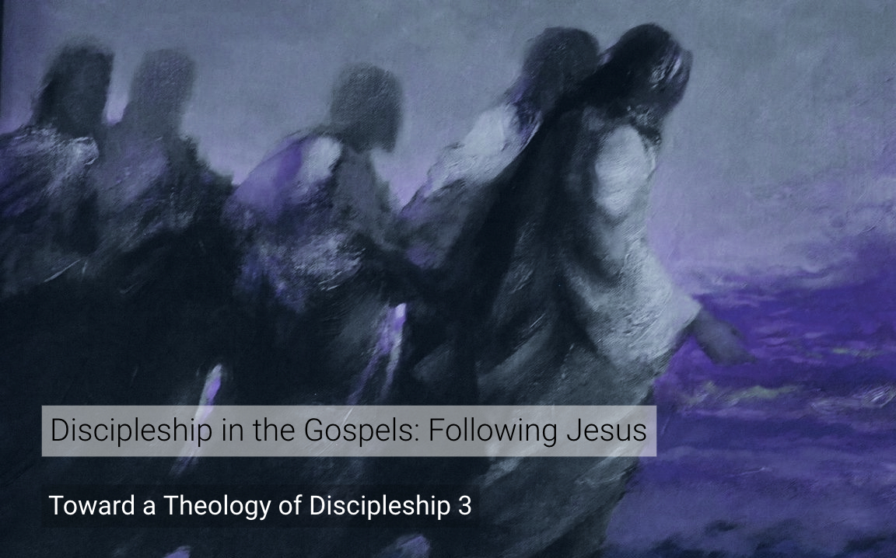
التلمذة
في الأناجيل
مسح
لعشرة أقوال ليسوع عن التلمذة
الهيئة الانجلية الثقافية-الاردن د. ريك غريفثBibleStudyDownloads.org

Slide 2
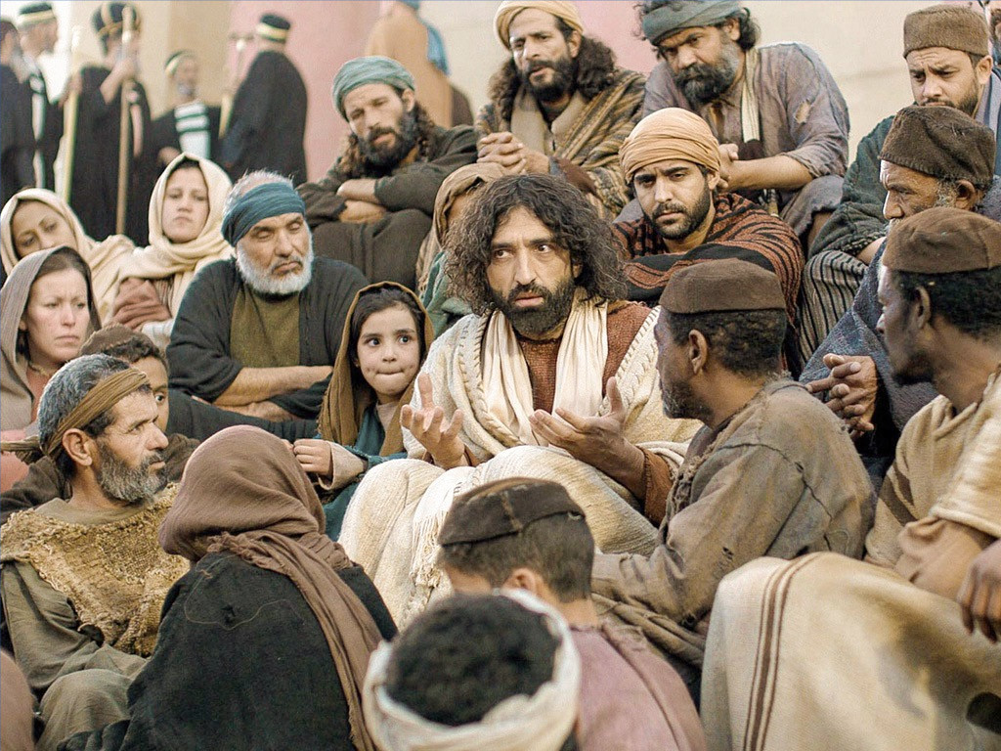
ء
نحن مشوَّشون
بخصوص التَّلمذة
Notes:
Ask the average Christian what a disciple is, and you'll get a tremendously varied response today. We have many misconceptions regarding biblical discipleship.

Slide 3

مَن هو التلميذ؟
Notes:
What is a disciple?
I once heard someone say that a disciple is something like an icicle! Well, they sound alike!

Slide 4
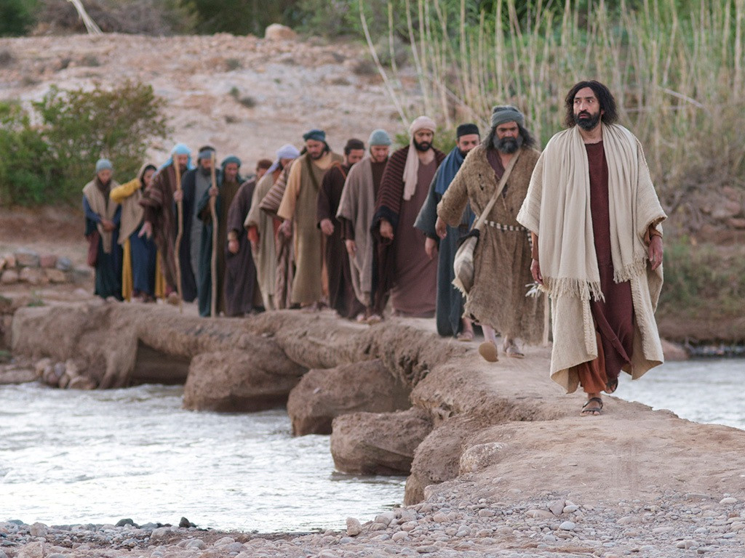
التلميذ هو تابِع
Notes:
Some argue that "disciple" means "follower," so anyone who follows Christ, regardless of the level of commitment, is considered a disciple.
Some think that every Christian is a disciple, but others disagree.

Slide 5
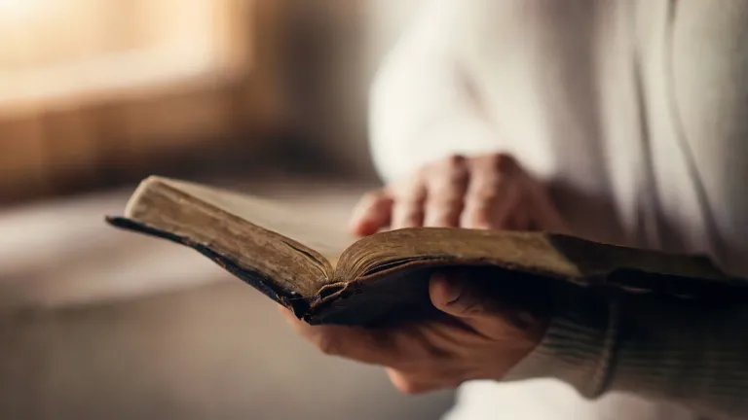
لنُعرِّف "التلميذ" كتابياً.
Notes:
What do you think? How can you determine if someone is a disciple? More importantly, are you a disciple?
The reason we are confused about biblical discipleship is that we rarely consult the primary source in the Scriptures, especially in the Gospels.

Slide 6
مَن هو التلميذ؟
لنستكشف المرَّات العشرة التي يستخدم فيها يسوع كلمة "تلميذ"
تحت ثلاث سمات
Notes:
We have ten statements by Christ recorded in the gospels about being and making disciples.
These are the only 10 times Jesus used the word "disciple" to describe the characteristics of those who follow Him as disciples. It may surprise you that there are only ten declarations, but each one is potent and full of force.
• Preview: Today, we'll examine these statements under three categories to understand the true nature of a disciple, followed by a strategy for implementing them in our lives. So we'll discern three primary characteristics of a disciple and how to obtain them.
Subject: Let's explore these three traits of a disciple to answer the question, "What is a disciple?" First of all…

Slide 7
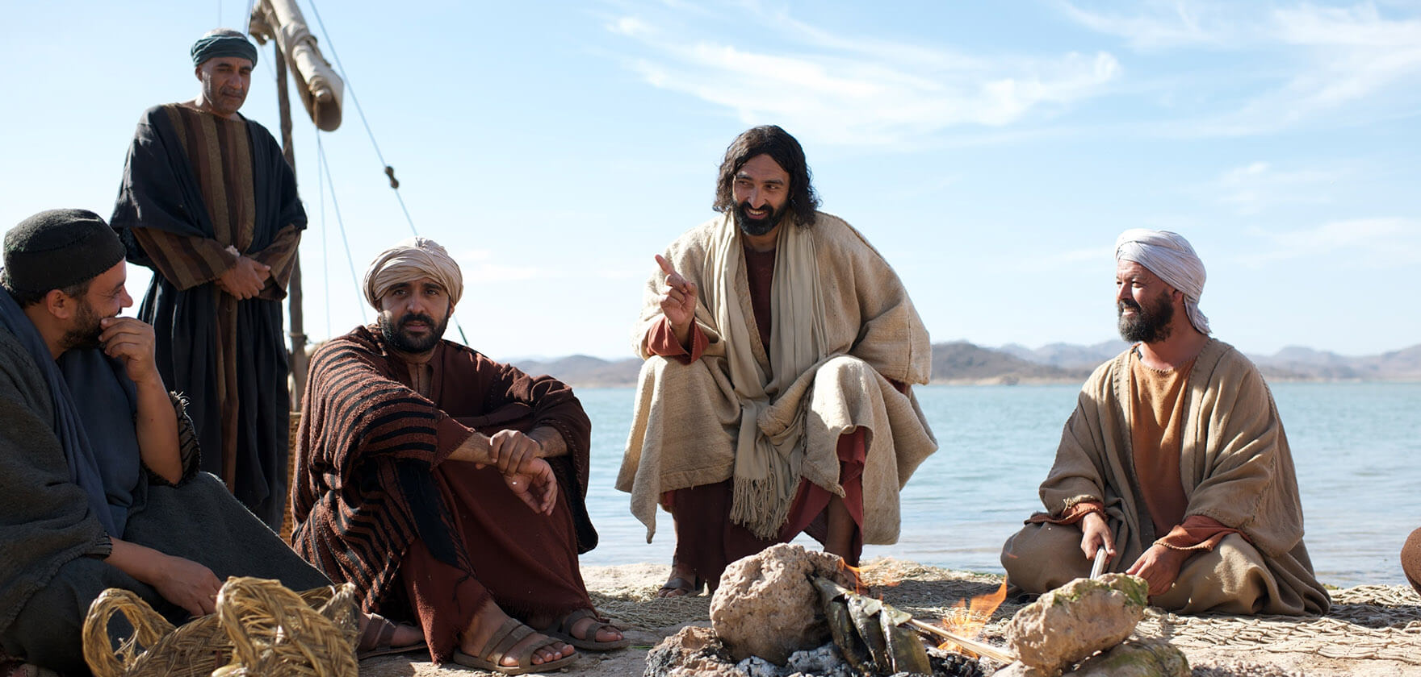
أولا: التلميذ ملتزم تماماً للمسيح.
Notes:
[A disciple shows complete allegiance to Jesus with Him first in their life.]

Slide 8
أ. التلميذ يتخلى عن عائلته ليتبع المسيح
(لوقا 14: 26 أ).
Notes:
[A disciple shows complete allegiance to Jesus with Him first in their life.]

Slide 9
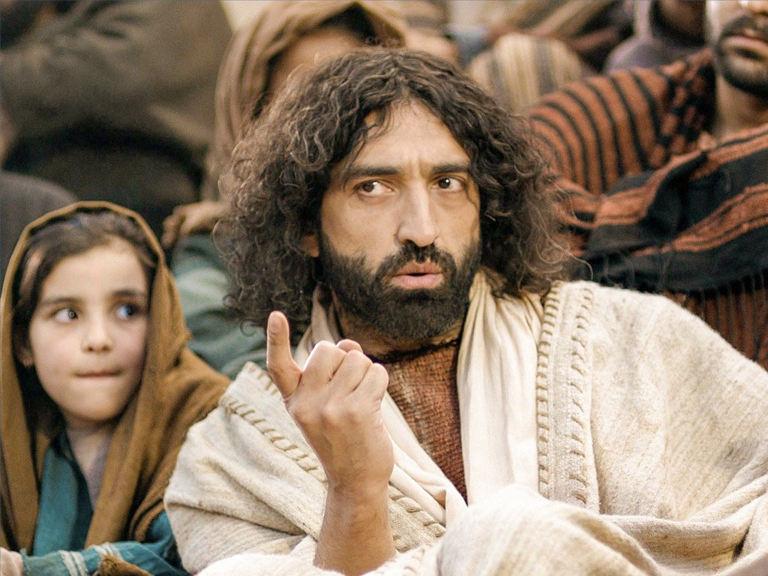
تخلَّ عن عائلتك (لوقا 14: 25- 26أ)
"^{وَكَانَ} جُمُوعٌ كَثِيرَةٌ سَائِرِينَ مَعَهُ فَالْتَفَتَ وَقَالَ لَهُمْ: ٢٦إنْ كَانَ أَحَدٌ يَأْتِي إِلَيَّ وَلاَ يُبْغِضُ أَبَاهُ وَأُمَّهُ وَامْرَأَتَهُ وَأَوْلاَدَهُ وَإِخْوَتَهُ وَأَخَوَاتِهِ..."
Notes:
Apparently, Jesus never read “How to Win Friends and Influence People.” We are commanded elsewhere to love and care for our families, but Christ came right out and demanded that we love Him more than the members of our own family.
After living overseas for years, I still had relatives who told me I should move back to America. Once, two emails from my brother and dad arrived within a month, telling me to follow my family instead of Jesus.
(Yet Jesus said that a disciple renounces his family. What else does he renounce?)

Slide 10
ب. التلميذ يتخلى عن حياته الخاصة
ليتبع المسيح
(لوقا 14: 26 ب–27).
Notes:
[A disciple shows complete allegiance to Jesus with Him first in their life.]

Slide 11
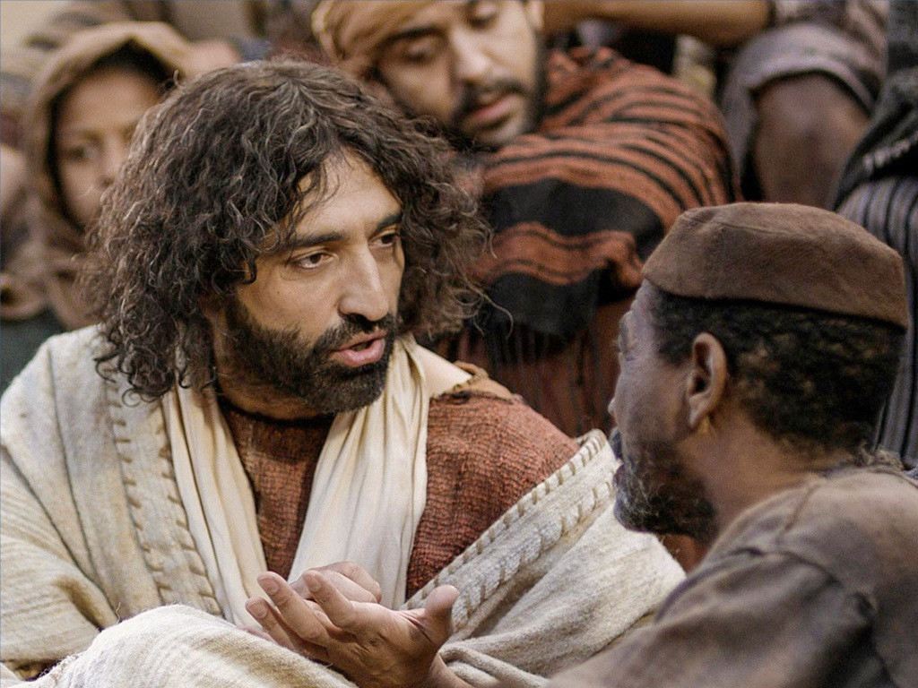
تخلَّ عن حياتك الخاصة (لوقا 14: 26ب-27)
"... يبغض ...حَتَّى نَفْسَهُ أَيْضاً فَلاَ يَقْدِرُ أَنْ يَكُونَ لِي تِلْمِيذاً. ^{٢٧} وَمَنْ لاَ يَحْمِلُ صَلِيبَهُ وَيَأْتِي وَرَائِي فَلاَ يَقْدِرُ أَنْ يَكُونَ لِي تِلْمِيذاً"
Notes:
What does it mean to hate your own life to the point of carrying your own cross? It means to be so concerned that Christ's desires for your life be fulfilled that you hardly even think about your desires! How long has it been since you heard someone say, “I hate doing what I want to do!”?
We live in a day of self-fulfillment: "looking out for number one," "you deserve a break today," "go ahead, you're worth it!" Christ demands a radical commitment to Himself as our number one priority.
(Not only does a true disciple demonstrate commitment to Christ by renouncing his family and his own life, but just a few verses later in verse 33, you’ll see that…)

Slide 12
ج. التلميذ يتخلى عن ممتلكاته ليتبع المسيح (لوقا 14: 33)
Notes:
[A disciple shows complete allegiance to Jesus with Him first in their life.]

Slide 13
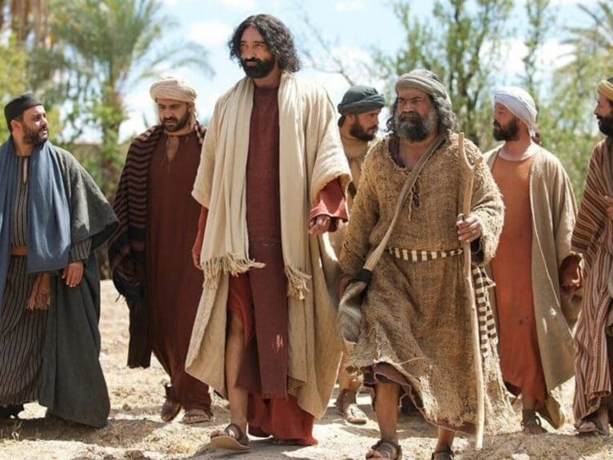
تخلَّ عن ممتلكاتك (لوقا 14: 33)
"فَكَذَلِكَ كُلُّ وَاحِدٍ مِنْكُمْ لاَ يَتْرُكُ جَمِيعَ أَمْوَالِهِ لاَ يَقْدِرُ أَنْ يَكُونَ لِي تِلْمِيذاً."
Notes:
Does this mean that we must sell all our possessions and give the money to the poor? Christ demanded this of some, but not the majority. Here's the difference between giving away all our possessions and giving them up.
The real question is, "Do you possess things or do things possess you?" A true disciple does not own any possessions of his own. Jesus Christ owns every possession we have, and we are only stewards of them.

Slide 14
د. التلميذ يتخلى عن سمعته ليتبع المسيح (متى 10: 24-25)
Notes:
[A disciple shows complete allegiance to Jesus with Him first in their life.]

Slide 15
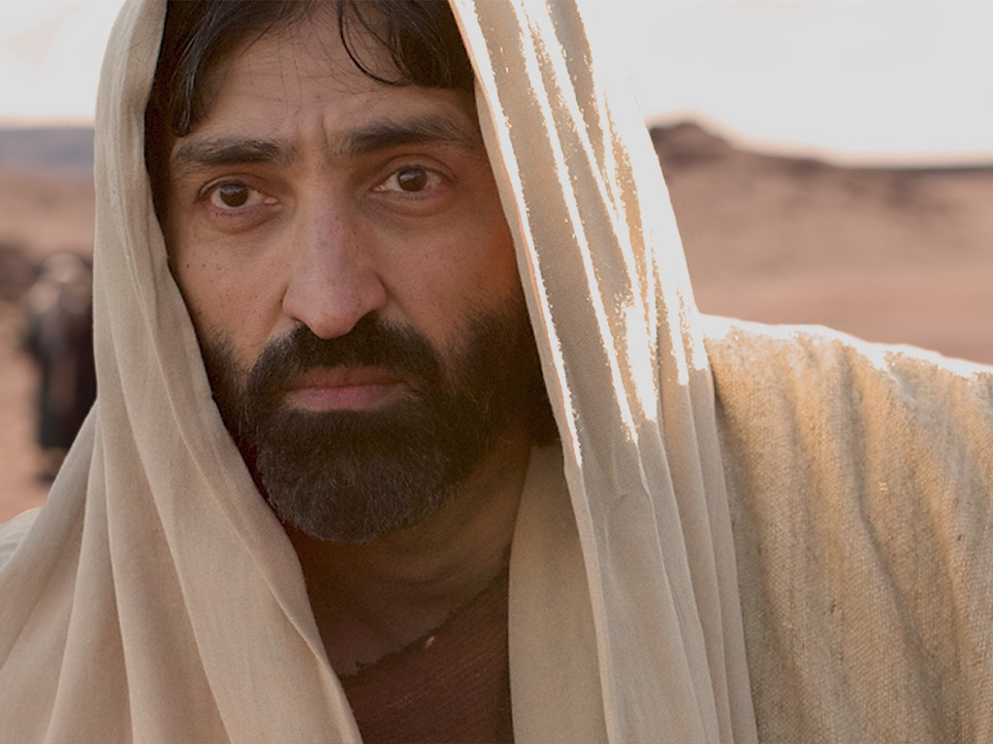
تخلَّ عن سمعتك (متى 10: 24-25)
"لَيْسَ التِّلْمِيذُ أَفْضَلَ مِنَ الْمُعَلِّمِ، وَلاَ الْعَبْدُ أَفْضَلَ مِنْ سَيِّدِهِ. ^{٢٥} يَكْفِي التِّلْمِيذَ أَنْ يَكُونَ كَمُعَلِّمِهِ، وَالْعَبْدَ كَسَيِّدِهِ. إِنْ كَانُوا قَدْ لَقَّبُوا رَبَّ الْبَيْتِ بَعْلَزَبُولَ، فَكَمْ بِالْحَرِيِّ أَهْلَ بَيْتِهِ!"
Notes:
What does this difficult statement convey? The Pharisees accused Jesus of being controlled by Satan, or Beelzebub. Our Lord warned His followers here that if the world thought that of Jesus, they would not consider His followers highly either, since "a disciple is not above his teacher." A genuine disciple is willing to be demeaned like this because his chief concern is to please God, not men.

Slide 16
أولاً: التلميذ ملتزم تماماً للمسيح.
Notes:
[A disciple shows complete allegiance to Jesus with Him first in their life.]
(These four things, which disciples must renounce, mean a disciple demonstrates commitment.
—over family
—over self
—over possessions
—over reputation
There's yet a second primary characteristic of the faithful follower of Christ…)

Slide 17
ثانياً: التلميذ يطيع المسيح.
Notes:
[True discipleship involves following Christ in the specifics.]
How do we obey to prove our loyalty to Christ as followers? We'll look at passages 5-7 for the answer.

Slide 18
أ. التلميذ يطيع من خلال الثبات في كلمة الله (يوحنا 8: 31)
Notes:
The guiding force in his life is the Bible.

Slide 19
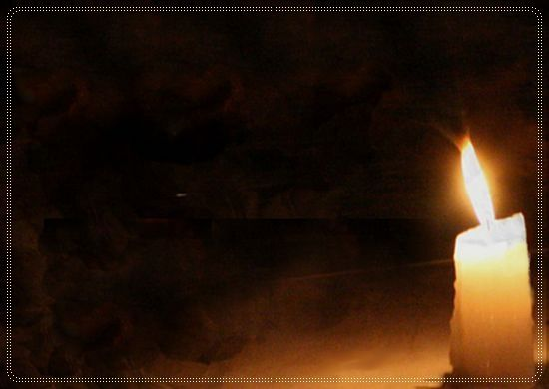
التلميذ يطيع المسيح
"وَبَيْنَمَا هُوَ يَتَكَلَّمُ بِهَذَا آمَنَ بِهِ كَثِيرُونَ.
^{٣١} فَقَالَ يَسُوعُ لِلْيَهُودِ الَّذِينَ آمَنُوا بِهِ: «إِنَّكُمْ إِنْ ثَبَتُّمْ فِي كَلاَمِي فَبِالْحَقِيقَةِ تَكُونُونَ تَلاَمِيذِي. ٣٢ وَتَعْرِفُونَ الْحَقَّ، وَالْحَقُّ يُحَرِّرُكُمْ"
(يوحنا 8: 30- 31)
Notes:
What is the real authority in your life? When faced with a difficult decision, when people tell us one thing but the Bible says something else, what does it take to get you to go against the Word?
While I was in seminary, my wife's Christian boss fired her. Another brother in Christ recommended that we get a good lawyer and take him to court. Such counsel is totally contrary to 1 Corinthians 6. A faithful follower of Jesus remains in God's Word -- knows it, believes it, and obeys it.

Slide 20
ب. التلميذ يطيع من خلال
محبة المسيحيين الآخرين
(يوحنا 13: 34- 35)
Notes:
A faithful follower shows selfless commitment to other believers.

Slide 21

التلميذ يحب المؤمنين
"وَصِيَّةً جَدِيدَةً أَنَا أُعْطِيكُمْ: أَنْ تُحِبُّوا بَعْضُكُمْ بَعْضاً. كَمَا أَحْبَبْتُكُمْ أَنَا تُحِبُّونَ أَنْتُمْ أَيْضاً بَعْضُكُمْ بَعْضاً. ^{٣٥} بِهَذَا يَعْرِفُ الْجَمِيعُ أَنَّكُمْ تلاَمِيذِي: إِنْ كَانَ لَكُمْ حُبٌّ بَعْضاً لِبَعْض"
(يوحنا 13: 34-35)
Notes:
Shocking as it may seem, oftentimes there is more love shown at the local bar than there is in the church. We're mistaken if we think people go to the bar only to get drunk. Often, there's a genuine sense of fellowship at a bar where people can take their masks off, share problems, hurts, and concerns, and get counsel, while at the church, one finds backbiting, division, self-centeredness, and hypocrisy .
Christ said that true disciples love other believers so much that the world marvels at their love for one another.

Slide 22
ج. التلميذ يطيع من خلال إظهار الرحمة للعاجزين (متى 10: 42)
Notes:
Genuine believers obey by meeting the needs of the humble.

Slide 23

التلميذ يُظهر الرحمة (متى 10: 42)
"وَمَنْ سَقَى أَحَدَ هَؤُلاَءِ الصِّغَارِ كَأْسَ مَاءٍ بَارِدٍ فَقَطْ بِاسْمِ تِلْمِيذٍ، فَالْحَقَّ أَقُولُ لَكُمْ إِنَّهُ لاَ يَضِيعُ أَجْرُهُ."
Notes:
"Little ones" can also be translated as "humble folk" in this context. Hence, the idea is that genuine believers obey by meeting the needs of the humble, whether that be giving cold water, their time, their abilities, or whatever.

Slide 24
أولاً: التلميذ ملتزم تماماً للمسيح.
Notes:
[A disciple shows complete allegiance to Jesus with Him first in their life.]

Slide 25
ثانياً: التلميذ يطيع المسيح.
Notes:
[True discipleship involves following Christ in the specifics.]
What is the third and final trait of a disciple?

Slide 26
ثالثاً: التلميذ يُتلمِذ.
Notes:
[A disciple develops other followers of Jesus.]

Slide 27
أ. التلميذ يصنع تلاميذ
(متى 28: 19-20)
Notes:
If you don't make disciples, then you aren't a disciple!

Slide 28

التلميذ يصنع تلاميذ (متى 28: 19-20)
"فَتَقَدَّمَ يَسُوعُ وَكَلَّمَهُمْ قَائِلاً: دُفِعَ إِلَيَّ كُلُّ سُلْطَانٍ فِي السَّمَاءِ وَعَلَى الأَرْضِ. ١٩فَاذْهَبُوا وَتَلْمِذُوا جَمِيعَ الأُمَمِ وَعَمِّدُوهُمْ بِاسْمِ الآبِ وَالابْنِ وَالرُّوحِ الْقُدُسِ. ٢٠ وعلموهم أن يحفظوا جميع ما أوصيتكم به. وها أنا معكم كل الأيام إلى انقضاء الدهر"

Slide 29
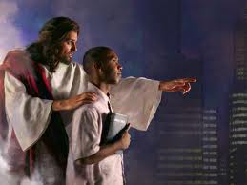

المأمورية العظمى
متى 20-18 :28
فَٱذْهَبُوا وَتَلْمِذُوا جَمِيعَ ٱلْأُمَمِ وَعَمِّدُوهُمْ بِٱسْمِ ٱلْآبِ وَٱلِٱبْنِ وَٱلرُّوحِ ٱلْقُدُسِ. ^{٢٠} وَعَلِّمُوهُمْ أَنْ يَحْفَظُوا جَمِيعَ مَا أَوْصَيْتُكُمْ بِهِ. وَهَا أَنَا مَعَكُمْ كُلَّ ٱلْأَيَّامِ إِلَى ٱنْقِضَاءِ ٱلدَّهْرِ». آمِينَ.
Notes:
المسيح لديه كل السلطان لكنه يمد بعضا منه إلينا كأشخاص تحت سلطانه. قد يبدو أن هناك أربع وصايا هنا ، لكن "تلمذة" هي الوصية الوحيدة هنا. يحدث هذا من خلال طاعة المشاركين الثلاثة: الذهاب والمعمودية والتعليم.

Slide 30
ب. التلميذ يأتي بآخرين إلى المسيح
(يوحنا 15: 8).
Notes:
A true follower of Jesus makes other true followers.

Slide 31
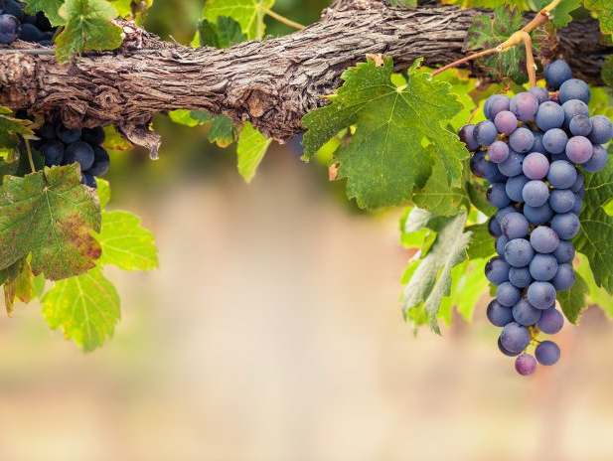
أنا الكرمة
وأنتم الأغصان
١٥
الَّذِي يَثْبُتُ فِيَّ وَأَنَا فِيهِ هذَا يَأْتِي بِثَمَرٍ كَثِيرٍ، لأَنَّكُمْ بِدُونِي لاَ تَقْدِرُونَ أَنْ تَفْعَلُوا شَيْئًا.
(يوحنا 15: 5)

Slide 32
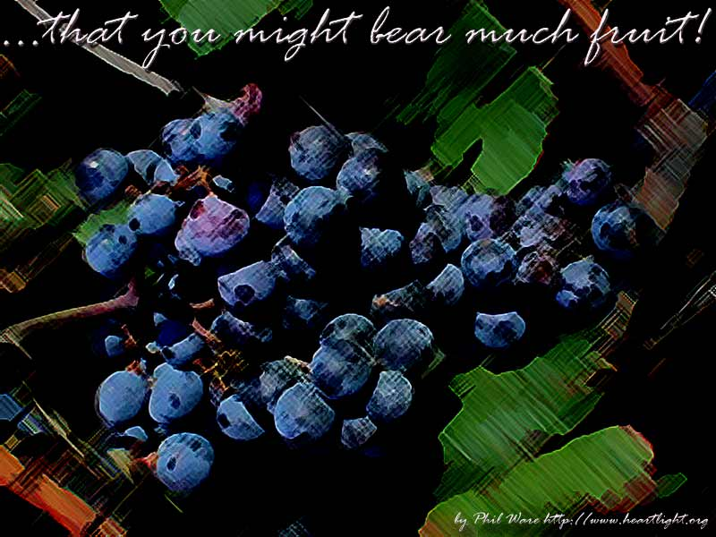
ما هو "الثَّمر"؟
ما هو "الثمر"؟

Slide 33
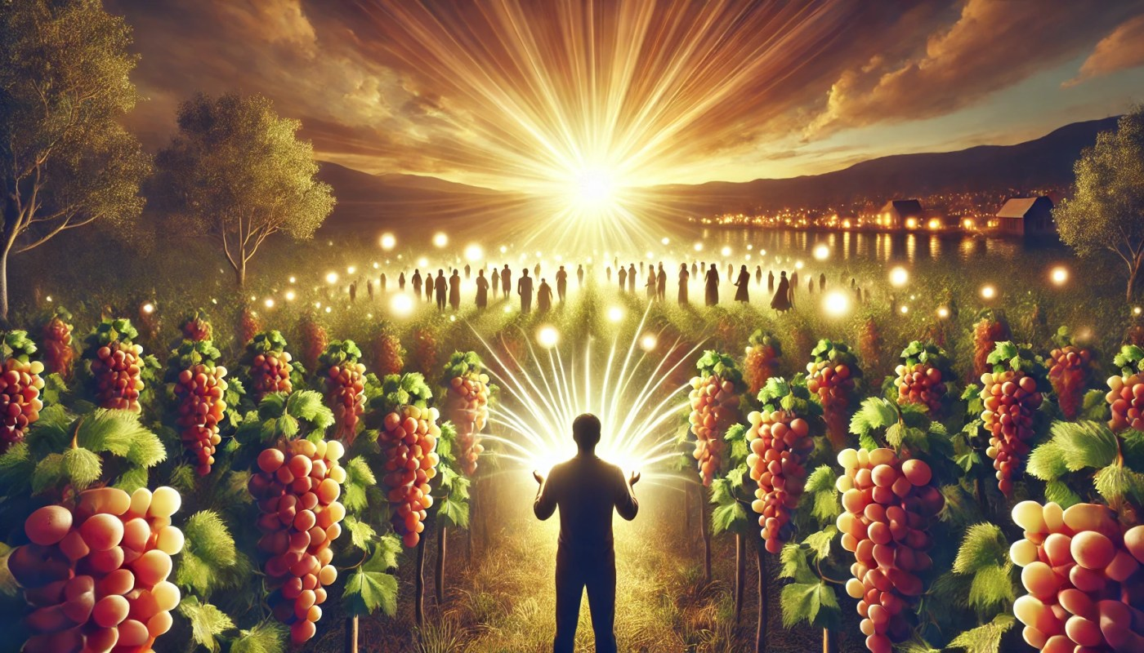
التلميذ يأتي بآخرين إلى المسيح
(يوحنا 15: 8)
"بِهذَا يَتَمَجَّدُ أَبِي: أَنْ تَأْتُوا بِثَمَرٍ كَثِيرٍ فَتَكُونُونَ تَلاَمِيذِي."
Notes:
The fruit is the reproductive part of the plant that contains the seeds, so Jesus is saying that we prove ourselves as His followers when we reproduce, or bring others into the family of God.

Slide 34
ج. التلميذ يعلّم الآخرين
(متى 13: 52).
Notes:
True followers instruct people in God's Word.

Slide 35
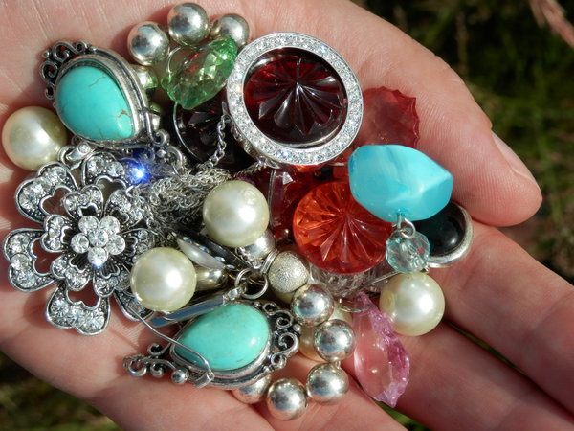
التلميذ يعلّم الآخرين
(متى 13: 52).
"مِنْ أَجْلِ ذلِكَ كُلُّ كَاتِبٍ مُتَعَلِّمٍ فِي مَلَكُوتِ السَّمَاوَاتِ يُشْبِهُ رَجُلاً رَبَّ بَيْتٍ يُخْرِجُ مِنْ كَنْزِهِ جُدُدًا وَعُتَقَاء. "
Notes:
This verse teaches that disciples know about heavenly things and then share this knowledge with others, teaching what they have previously known, as well as the new truths they have recently discovered. If you're not passing on what you've learned to someone else, then you're not fulfilling God's requirements of a disciple.

Slide 36
من هو التلميذ؟
Notes:
Here is the question we have sought to answer today.

Slide 37
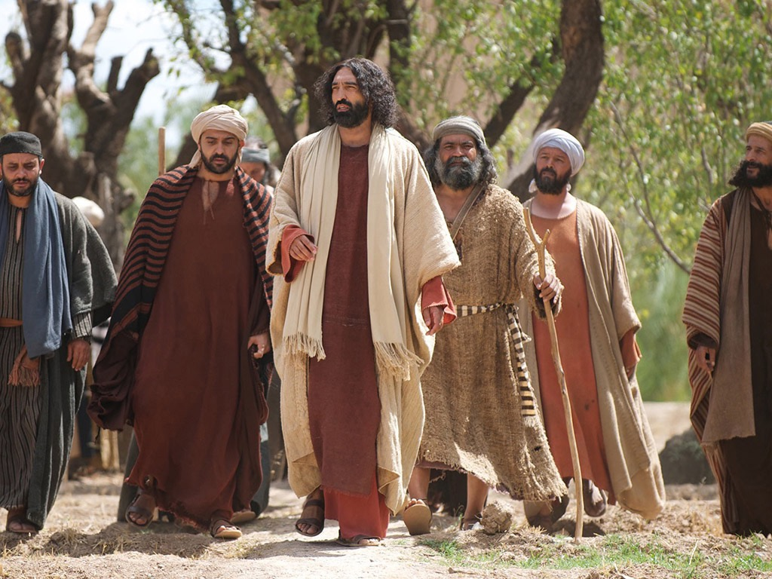
الفكرة الرئيسية
التلميذ يُظهر الالتزام والطاعة وصنع التلاميذ
Notes:
A genuine follower of Jesus puts Jesus first, obeys Him, and multiplies.

Slide 38
أولاً: التلميذ ملتزم تماماً للمسيح.
Notes:
[A disciple shows complete allegiance to Jesus with Him first in their life.]

Slide 39
ثانياً: التلميذ يطيع المسيح.
Notes:
[True discipleship involves following Christ in the specifics.]

Slide 40
ثالثاً: التلميذ يُتلمِذ.
Notes:
[A disciple develops other followers of Jesus.]

Slide 41

ماذا عنك؟
كيف يمكنك أن تمتلك هذه الصفات كتلميذ ليسوع؟
•انضم إلى مجموعة صغيرة
•التزم بتلمذة شخص ما
Notes:
• First, join a small group to hold you accountable each week in your commitment and obedience to Christ. This is what Jesus did with the Twelve. He spent time with them, they shared their lives, and they ministered to and with one another. We're no different today. There's nothing like setting individual goals in a small group and having the group hold you accountable in specific areas of commitment and obedience.
• Also, commit to discipling at least one other individual to multiply yourself. Be involved in his or her life regularly to pray together, to dig into the Scriptures, and to impart skills such as how to have a quiet time and how to witness. Remember that a true disciple is involved in disciplemaking! A person who's not involved in fulfilling the Great Commission is fooling himself if he thinks he's a disciple.
Let's not fool ourselves that we’re disciples just because we're Christians. There's a vast difference between the two that the world needs to see. Let's let them see it in us.

Slide 43


احصل على هذا العرض التقديمي مجاناً!
رابط التلمذة في BibleStudyDownloads.org
Notes:
Discipleship (di)

