Slide 1
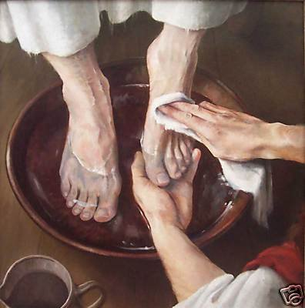
كُن خدومًا
متى
مؤسسة الدراسات اللاهوتية الأردنية. د. ريك جريفيث
CICFamily.com • BibleStudyDownloads.org

Slide 2
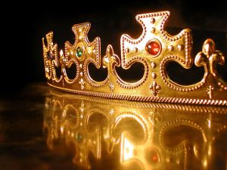
في مجموعتك الصغيرة ...
يقدم المؤلف يسوع كملك لإسرائيل. هل تعتقد أن المسيحيين اليوم يجدون وقتًا صعبًا للتفكير في المسيح كملك؟
لماذا ولما لا؟
متى
Notes:
Many of us come from democracies where we elect leaders and then proceed to tear them down afterward. This anti-authority view too often can be applied to Jesus himself. Jesus is not up for election. He is the King of kings and Lord of lords. We should embrace this reality no matter what type of earthly government we have over us.
________
OS-10-Davidic Covenant-03
NS-01-Matt1-14-slides 13, 60

Slide 3
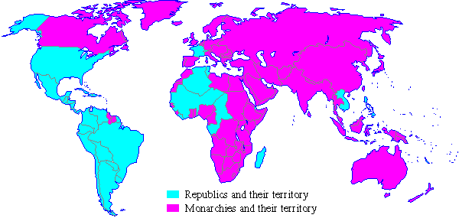
الحكومات الملكية في 1900
الجمهوريات وأراضيها
الممالك وأراضيها
Notes:
A quick look at the world map a century ago shows that most of the world was ruled by kings in 1900.
________
Common-495
OS-09-1 Samuel-93
OS-10-Davidic Covenant-04
NS-01-Matt1-14-slide 61

Slide 4
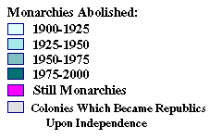
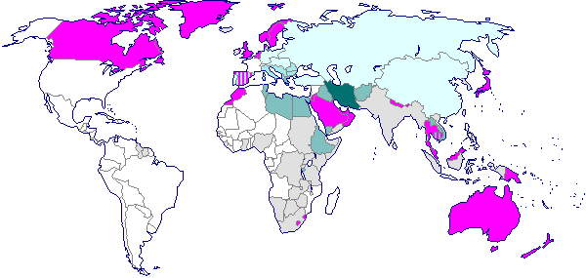
الحكومات الملكية عام 2000
الملكيات الملغاة
1900-1925
1925-1950
1950-1975
1975-2000
لا تزال ملكية
مستعمرات أصبحت جمهوريات بعد الإستقلال
Notes:
However, a century later, few monarchies are left. Even Britain, Japan, Canada, Australia and perhaps Scandinavian countries are not monarchies in the practical sense.
________
Common-496
OS-09-1 Sam-94
OS-10-Davidic Covenant-05
NS-01-Matt1-14-slide 62

Slide 5
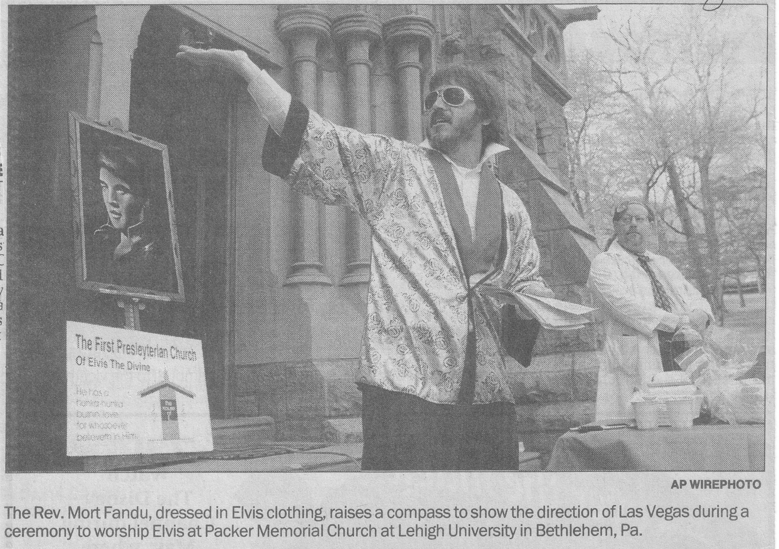
الكنيسة المشيخية الأولى لإلفيس الإلهي
القس مورت فاندو ، الذي يرتدي ملابس إلفيس ، يرفع بوصلة لإظهار اتجاه لاس فيغاس خلال حفل لعبادة إلفيس في كنيسة باكر التذكارية في جامعة ليهاي في بيت لحم. ابي.
Notes:
One wonders if this is a joke but it certainly is a blasphemy against Jesus to claim that Elvis is a god.
________
OS-10-Davidic Covenant-07
NS-01-Matt1-14-slide 64

Slide 6

دعونا ندرس
الكلمة المقدسة
الكتاب المقدس :
سفراً سفراً
متى
Notes:
This preaching series looks at each book in the Bible in a single sermon—66 messages that each cover an overview of an entire book.
I have taught through the Bible 37 times but never preached through it. Therefore, as I just finished 12 messages on the Minor Prophets, so now I will preach the other 54 books in the coming year until we learn all 66 books.
I encourage you to read through the Bible during this series, one book at a time.

Slide 7
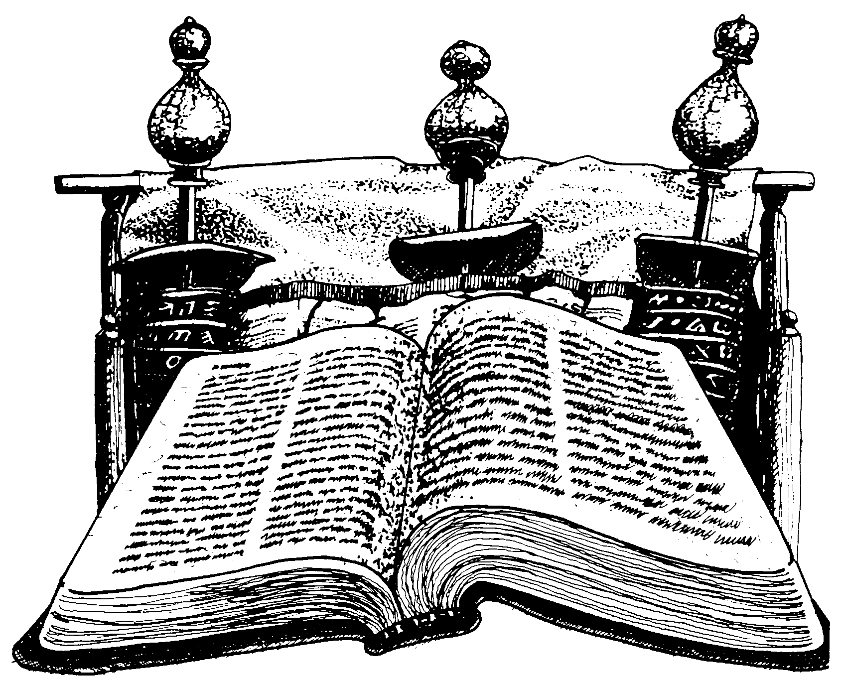
التسلسل الزمني للعهد الجديد
Notes:
NS-00-NT Introduction-9
NS-02-Mark1-8-slide 23

Slide 8
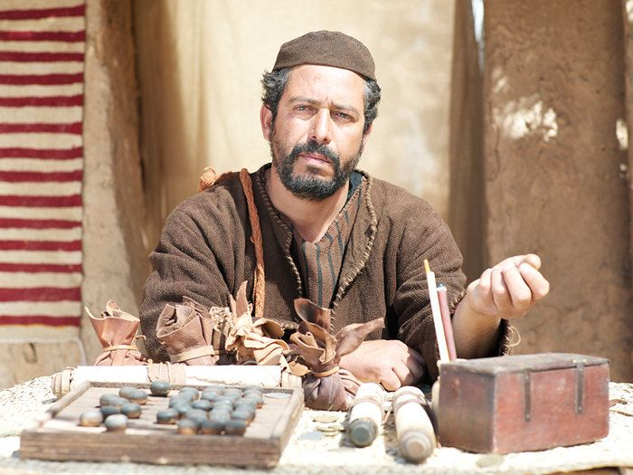
من كان متى؟
جامع الضرائب
Notes:
8

Slide 9


متى أعتقد أنها كتبت
52
1
متى
2
مرقس
إلى اليهود
إلى الرومان
الأربعينات
64-68 م
كملك
كخادم
ما قاله
ما فعله
3
لوقا
4
يوحنا
إلى اليونانيين
إلى الكنيسة
57-59 م
69 م
بعد الإزائية
الله / الإنسان
الله
ما شعر به
ما قصده
27
4
Notes:
Now…what about the dates of the writing of these crucial documents? And here we are left to our best scholarly guesses. There will ALWAYS be argument here. But some of the best guesses, based on decades of academic research and study are these – in suggested order…
//// MATTHEW…composed sometime during the A.D. 40s…
//// LUKE is suggested as next, between the years A.D. 57 and 59 A.D…
//// Mark…in the next decade…between 64 and 68…
//// and finally…John's Gospel…around A.D. 69….but certainly after the Synoptics were set down. Again, you will always find disagreement on these dates. However, these dates are from the research of well-known Christian scholars and teachers.
_________
BE-40-Matthew-9
NS-00-NT Introduction-31
NS-02-Mark1-8-slide 38

Slide 10
نظرة عامة على العهد الجديد
38
124
39-41
إلى أقصى الأرض (أع 1: 8)
أع 9 13 14 15 16 18 21 27 28
ربيع 53-
ايار 57
3
أسيا
شباط 60 – آذار 62
1
روما
نيسان 48-
أيلول 49
1
غلاطية
نيسان 50-
أيلول 52
2
بحر إيجة
ربيع 62 -
خريف 67
4
إسبانيا
خريف 67 – ربيع 68
2
روما
صيف 35-37
دمشق
أنطاكية
أيار 57
آب 59
المحاكمات
خريف 49
المجمع
ربيع 68
توسع
الكنيسة
35 48 49 50 52 53 57 60 62 67 68 95
مت
الأناجيل والأعمال
1 2 3 4
الرحلات
روما
السجون
Notes:
_________
NS-00-NT Introduction-44
NS-02-Mark1-8-slide 39
NS-03-Luke1-12-slide 35, 65

Slide 11


متى يدعي أن يسوع قد استوفى جميع المتطلبات ليكون ملك إسرائيل

Slide 12
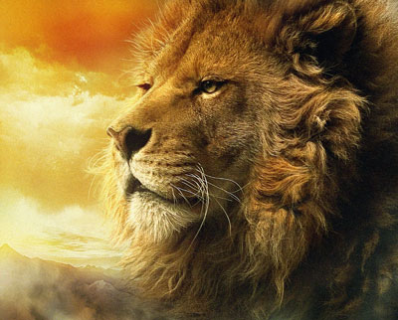
متى : المسيح كملك
منذ بركة يعقوب في تكوين 49: 9-10 ، يصور الأسد ملكًا ...
يهوذا جرو أسد من فريسة صعدت يا ابني جثا وربض كأسد وكلبوة من ينهضه لا يزول قضيب من يهوذا ومشترع من بين رجليه حتى يأتي شيلون وله يكون خضوع شعوب

Slide 13
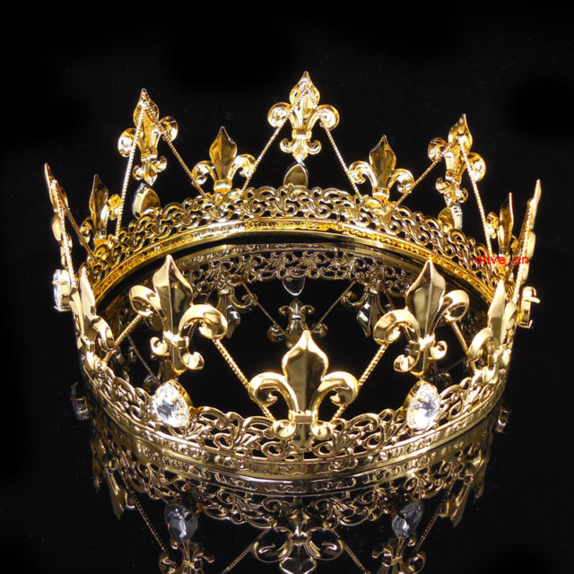
كيف تتجاوب مع الملك؟

Slide 14
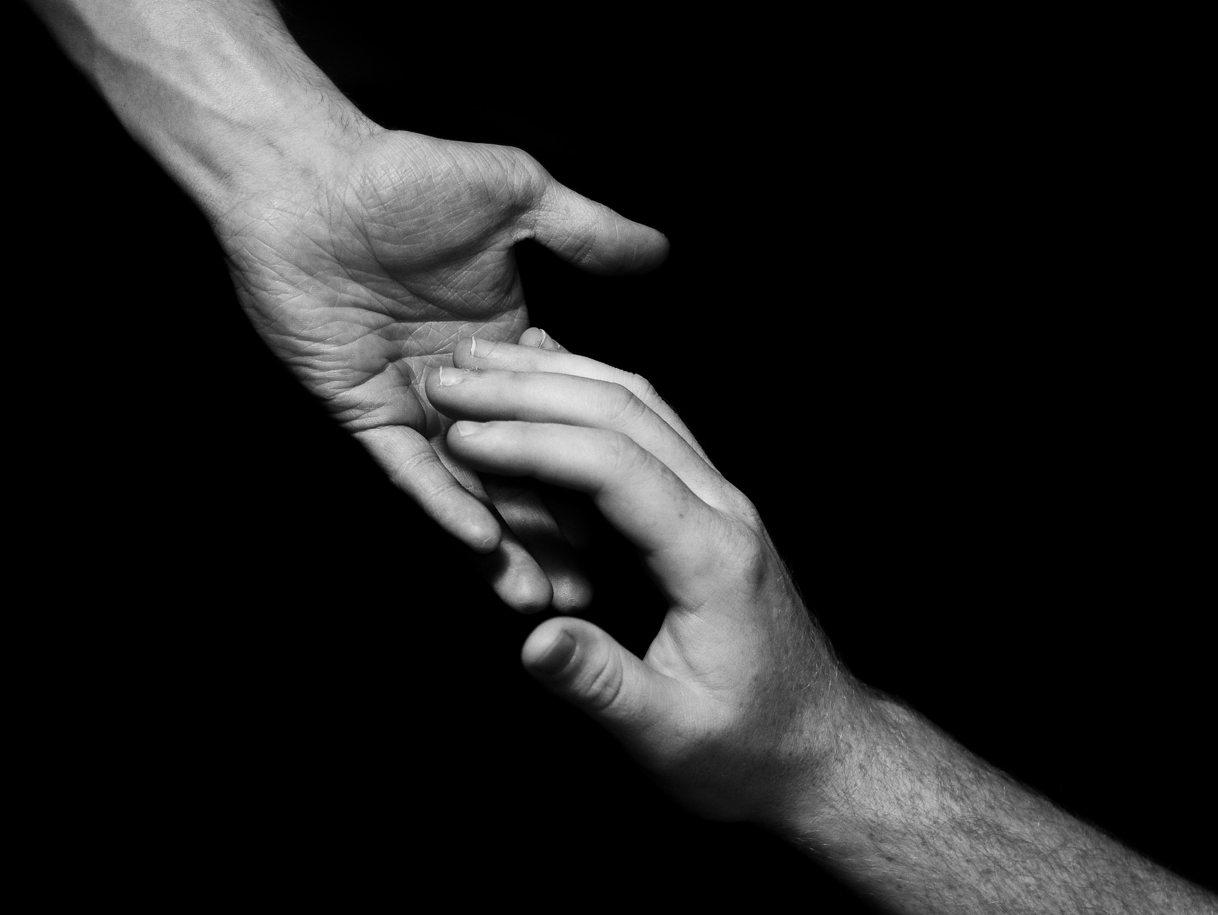
كُن خدومًا
Notes:
The natural response is to serve him.

Slide 15
لماذا تخدم يسوع؟
متى

Slide 16
الفكرة الرئيسية لـمتى
الرب
يسوع
المسيح
Notes:
أخدم يسوع في حياتك كمخلص، وإله وملك! هذه هي الرسالة والتطبيق الأساسي في كل إنجيل متى

Slide 17
أسماء مدهشة
الرب
يسوع هو أعلى حاكم
في العالم (1-10).
يسوع
المسيح
متى
Notes:
هنا المخطط الأساسي لإنجيل متى، مصممًا حول الأسماء الثلاثة للرب يسوع المسيح.

Slide 18
Slides on
متى 1

Slide 19
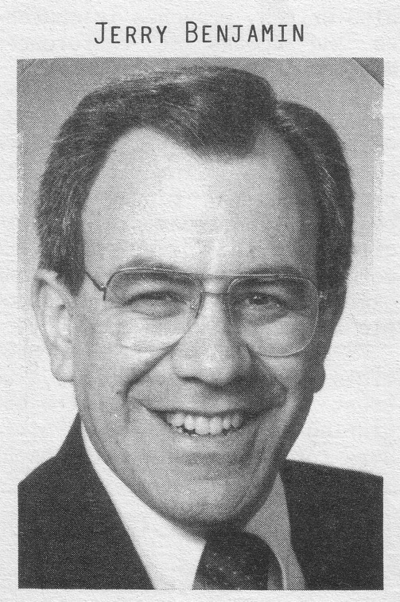
طريقة مملة للبدء بكتاب ؟
¹كِتَابُ مِيلاَدِ يَسُوعَ الْمَسِيحِ ابْنِ دَاوُدَ ابْنِ إِبْراهِيمَ: ²إِبْراهِيمُ وَلَدَ إِسْحاقَ. وَإِسْحاقُ وَلَدَ يَعْقُوبَ. وَيَعْقُوبُ وَلَدَ يَهُوذَا وَإِخْوَتَهُ. ³وَيَهُوذَا وَلَدَ فَارِصَ وَزَارَحَ مِنْ ثَامَارَ. وَفَارِصُ وَلَدَ حَصْرُونَ. وَحَصْرُونُ وَلَدَ أَرَامَ. ⁴وَأَرَامُ وَلَدَ عَمِّينَادَابَ. وَعَمِّينَادَابُ وَلَدَ نَحْشُونَ. وَنَحْشُونُ وَلَدَ سَلْمُونَ. ⁵وَسَلْمُونُ وَلَدَ بُوعَزَ مِنْ رَاحَابَ. وَبُوعَزُ وَلَدَ عُوبِيدَ مِنْ رَاعُوثَ. وَعُوبِيدُ وَلَدَ يَسَّى. ⁶وَيَسَّى وَلَدَ دَاوُدَ الْمَلِكَ. وَدَاوُدُ الْمَلِكُ وَلَدَ سُلَيْمَانَ مِنَ الَّتِي لأُورِيَّا. ⁷وَسُلَيْمَانُ وَلَدَ رَحَبْعَامَ. وَرَحَبْعَامُ وَلَدَ أَبِيَّا. وَأَبِيَّا وَلَدَ آسَا. ⁸وَآسَا وَلَدَ يَهُوشَافَاطَ. وَيَهُوشَافَاطُ وَلَدَ يُورَامَ. وَيُورَامُ وَلَدَ عُزِّيَّا. ⁹وَعُزِّيَّا وَلَدَ يُوثَامَ. وَيُوثَامُ وَلَدَ أَحَازَ. وَأَحَازُ وَلَدَ حِزْقِيَّا. ¹⁰وَحِزْقِيَّا وَلَدَ مَنَسَّى. وَمَنَسَّى وَلَدَ آمُونَ. وَآمُونُ وَلَدَ يُوشِيَّا. ¹¹وَيُوشِيَّا وَلَدَ يَكُنْيَا وَإِخْوَتَهُ عِنْدَ سَبْيِ بَابِلَ. ¹²وَبَعْدَ سَبْيِ بَابِلَ يَكُنْيَا وَلَدَ شَأَلْتِئِيلَ. وَشَأَلْتِئِيلُ وَلَدَ زَرُبَّابِلَ. ¹³وَزَرُبَّابِلُ وَلَدَ أَبِيهُودَ. وَأَبِيهُودُ وَلَدَ أَلِيَاقِيمَ. وَأَلِيَاقِيمُ وَلَدَ عَازُورَ. ¹⁴وَعَازُورُ وَلَدَ صَادُوقَ. وَصَادُوقُ وَلَدَ أَخِيمَ. وَأَخِيمُ وَلَدَ أَلِيُودَ. ¹⁵وَأَلِيُودُ وَلَدَ أَلِيعَازَرَ. وَأَلِيعَازَرُ وَلَدَ مَتَّانَ. وَمَتَّانُ وَلَدَ يَعْقُوبَ. ¹⁶وَيَعْقُوبُ وَلَدَ يُوسُفَ رَجُلَ مَرْيَمَ الَّتِي وُلِدَ مِنْهَا يَسُوعُ الَّذِي يُدْعَى الْمَسِيحَ
إرميا بنيامين
يذكر جيري: لقد أذهلتني الآية الأولى . قالت أن يسوع كان من أقرباء أجدادي .
Notes:
Most of us, if we are honest, find that the first few verses of the NT are boring. They may be good for getting us to sleep if we have insomnia, but they aren't generally appreciate as literature [read 1:1-3 with a yawn].
While I was a student at Dallas Seminary, I had the privilege of meeting Jeremiah Benjamin—a true Jewish name if you ever heard one! Jerry was from such a strictly orthodox Jewish family that the New Testament was forbidden in his home. However, a Christian student once gave him a NT and challenged him to read it. So he snuck into his room, climbed into bed, pulled the sheets over him and took out his flashlight.
[Animation] "The first verse stunned me," Jerry later recalled. "It said that Jesus was related to my forefathers."
My experience with Jerry helped me to see that Matthew's beginning didn't interest me because I am a Gentile who wasn't looking for Israel's king. I didn't even know what questions to ask or what to look for. But Matthew was written for the Jewish heart and mind. Therefore, he starts off with a bang: Jesus was actually a direct descendant of King David and therefore fulfilled the lineage necessary to be Israel's king!

Slide 20
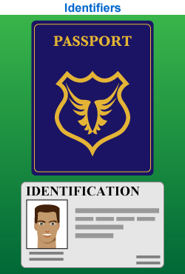
أثبت أن
يسوع ملك
Notes:
"Persons traveling by plane to another country must identify themselves. Picture identification, like a driver's license and a passport, are usually required. These identifiers are carefully examined to ensure that all the passengers are safe from harm. A man who identifies himself as the Messiah also needs the correct identification. For instance, He must be descended from the line of David, be born in the right city, be born at the right time, and be able to perform amazing works" (Rick Griffith, "Advanced Studies in the NT," Lesson 1, Topic 3, internetseminary.org accessed 17 Jan 2016).

Slide 21
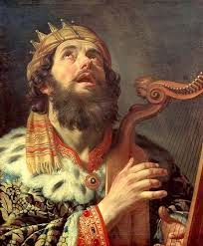
داود قبل ابراهيم
متى ١ : ١
كِتَابُ مِيلاَدِ يَسُوعَ الْمَسِيحِ ابْنِ دَاوُدَ
ابْنِ إِبْراهِيمَ.

Slide 22
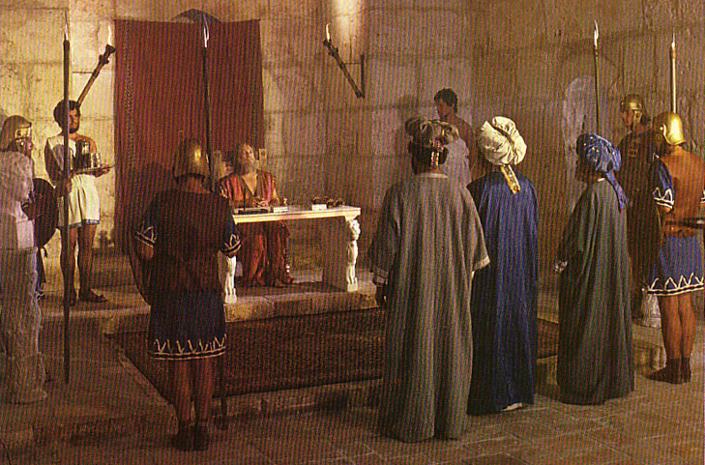
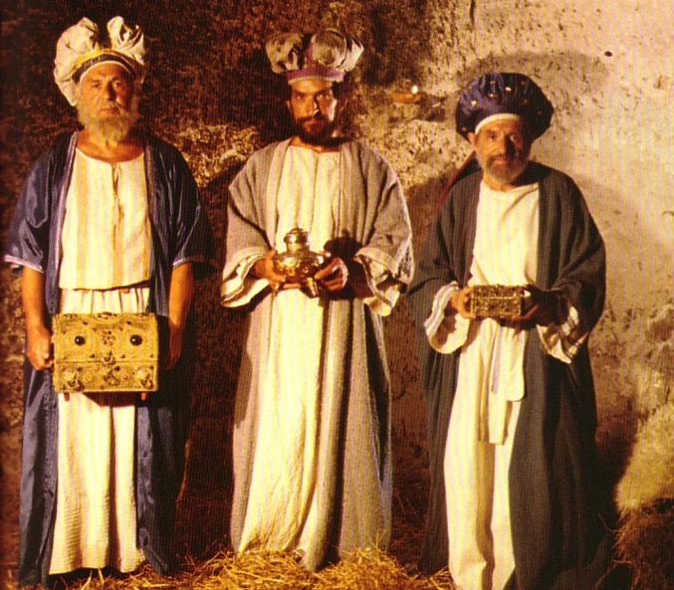
ما طبيعة الملكوت الذي تصوره كل من أشعياء ومتى؟
461ب
سياسي
مادي
عاطفي
فكري
روحي
Notes:
What did the magi mean when they asked for the location of the newborn "king of the Jews"?
Were they looking for the ruler of a spiritual kingdom?
Did King Herod feel threatened by the beginning of a spiritual kingdom in nearby Bethlehem?
What would the people have thought when they heard the word "kingdom"?
One key problem in our understanding is that we ask whether "kingdom" is spiritual or literal. This is a false dichotomy as if it cannot be both. In fact, no one can enter the literal kingdom apart from a spiritual rebirth.
The prophet who wrote most about the kingdom was undoubtedly Isaiah, the "prince of the prophets." His book is first in the prophets and also the longest. So what Isaiah say about this kingdom? This will help us understand what Jews of the first century thought, for Isaiah impacted their view tremendously.
So, our assumption here is that Matthew's use of the kingdom is the same as Isaiah's. One should assume that they are the same unless otherwise noted. Isaiah saw this kingdom of Messiah as a
• political,
• earthly entity (physical), but it also has
• emotional and
• intellectual aspects and is available only to those who qualify spiritually by placing their faith in the Messiah.
The following is copied from pages 461b-d in the OT Survey Isaiah notes. It took Dr Rick Griffith three days of reading Isaiah to compile this list of more than 100 verses in Isaiah (these were glorious days ☺).
See PPT for many of these verses below in The Restoration of Israel PPT presentation #26 in English at https://biblestudydownloads.org/resource/future/ and in Arabic at https://biblestudydownloads.org/resource/%d8%b9%d9%84%d9%85-%d8%a7%d9%84%d8%a3%d8%ae%d8%b1%d9%88%d9%8a%d8%a7%d8%aa/.
The Kingdom in Isaiah
Christians often talk about Jesus as king. It is especially discussed about Him being born king at Christmas. But this raises two important questions:
1. What kind of kingdom does Jesus bring as king? Many (esp. amillennialists) say that this is only a spiritual kingdom with no earthly or physical aspects, but others (esp. premillennialists) note many dimensions of the kingdom: spiritual, physical, political, etc.
2. What kind of kingdom did both John (Matt. 3:2) and Jesus (Matt. 4:17) mean when they preached, "Repent, for the kingdom of heaven is near"? Like the OT prophets, they said that Jews needed to turn from sin to enter the kingdom (Deut. 30:1-2). Had the nation repented, then this fulfillment would have occurred (Deut. 30:3-10). One should assume that this kingdom was the same kingdom that the OT prophets preached. Otherwise, Jesus and John would have misled the people.
Since Israel rejected this kingdom, Christ will not rule over it until the nation believes (see verses below in the “Spiritual” section). So after Israel finally believes in the future and Christ returns to establish his kingdom on earth (Rev. 19), what will this new period look like? Revelation 20:1-6 reveals the length of this era as 1000 years when saints will rule (cf. Rev. 5:10) and Satan will be bound from deceiving the nations (cf. Rev. 20:1-3). However, Isaiah gives the best total picture of what the kingdom will be like with more information than any other book in Scripture. This is the correct background one should know to understand Matthew’s concept of the kingdom.
I. Political
A. Jerusalem
1. Capital of the earth (2:2b)
2. A safe refuge for people (14:32; 25:4; 26:1-4; 32:18; 33:20-24; 35:9; 60:18; 62:8-9; 66:12)
3. City of glory without unbelievers (33:24b; 35:8-10; 52:1-3, 6)
4. Accessible (11:15-16; 33:21; 35:8; 60:15)
B. Israel’s Political Blessings
1. Enemies judged by Messiah (2:12-21; 24:21-23; 29:20-21; 45:14; 61:2; 66:24)
2. Exalted above the Gentiles (2:3; 14:1-2; 18:7; 49:22-23; 60:5, 14-17; 61:5-9; 62:1-4)
3. Serves as a nation of witnesses for God (44:8, 21)
C. Messiah’s Rule
1. His Second Advent precedes the kingdom (60:2; 61:11)
2. Extent of his rule
a. Rules on David’s throne as Davidic covenant fulfilled (4:2; 9:6-7; 16:5a)
b. Rules as King over the world (9:6-7; 11:3-5; 16:5; 24:21-23; 40:10)
c. Rules as King from Jerusalem (2:3; 24:23b; 33:17-22)
3. Nature of his rule
a. Rules gloriously (4:2; 24:23; 35:2; 40:5; 60:1, 2)
b. Rules wisely (11:2)
c. Rules meekly (42:3)
d. Rules righteously (32:1)
e. Rules nations with justice (9:7; 11:5; 16:5b; 32:1; 42:1, 4)
f. Rule unquestioned (11:4; 25:1-5; 29:17-21; 30:30-33; 42:13; 49:24-26; 66:14-19)
g. Rule in kingdom merges with eternal state (9:7; 33:20)
D. Other Rulers
1. Elders or rulers serve with Messiah in Jerusalem (24:23b; 32:1)
2. Judges serving as counselors (1:26)
3. Positions of responsibility given as rewards (40:10)
E. Worldwide peace rather than war (2:4; 9:4-7; 32:17-18; 55:12; 54:13; 60:18)
II. Physical
A. Earth and heavens renewed (65:17; 66:22)
1. Sun and moon
a. Light from both diminished in the Tribulation (13:10)
b. Sun still rises (41:25; 45:6; 59:19)
c. Moonshine equals the sun, which itself is seven times brighter (30:26)
d. Yet the sun and moon less intense and not harmful (24:23a; 49:10)
e. Both sun and moon finally eradicated in the eternal state (60:19-20)
2. Land of Israel
a. Borders enlarged (26:15; 33:17; 54:2-3; 61:7)
b. Land rebuilt after destruction (32:16-18; 49:8, 19; 61:4-5)
c. Much rainfall and water in the desert (30:23-25; 35:1-2, 6-7; 41:17-18; 49:10b)
d. Broad rivers flowing from the temple (33:20-21)
e. Animals blessed with much food (30:23)
f. Crops abundant (27:6; 35:1-2, 6-7) with the Genesis 3:17-19; Romans 8:19-22 curse on the earth removed (11:6-9; 35:9; 65:25)
g. Verdant trees replace thorn bushes and briers (55:13)
h. Mountain trees in previous desert wastelands (41:19)
i. Beautiful and prosperous from many nations‘ wealth (60:5; 61:6; 62:3; 66:10-12)
j. Glorified (60:1-9)
3. Jerusalem
a. Topographical changes with temple mount at city’s high point (2:2)
b. Cloud of smoke and pillar of fire protects Jerusalem (4:5-6)
c. Temple mount holy (11:9; 27:13; 56:7; 57:13; 65:25; 66:20)
B. Humans living in unique circumstances
1. Some Israelites living in glorified bodies after tribulation (26:19-20)
2. Babies still born to those in mortal bodies (44:3; 61:9; 65:20, 23)
3. Longevity of life where immaturity is rare but death is still existent (65:20)
4. Food for people plentiful (30:23; 62:8-9; 65:21-22)
5. Protection from harm with wild animals tamed (11:6-9; 35:9; 41:8-14; 65:25)
6. Work existent but always protective (62:8-9; 65:21-23)
7. Blind, deaf, lame, and mute all healed (29:17-19; 35:5-6)
8. Illness in Jerusalem eradicated (33:24; 65:23)
9. Death eventually destroyed in Jerusalem (25:7)
III. Emotional
A. Strength replaces fear (35:3-4; 41:10, 13-14)
B. Joy and gladness replace weeping, sorrow and sighing (9:1-4; 12:3, 6; 25:8-9; 30:29; 35:10; 42:10-11; 45:25; 52:8-9; 55:12; 60:15; 61:3, 7; 65:18-19; 66:10-11, 14)
C. Israel’s sentiment
1. The name “Israel” replaced with the new names Hephzibah (Heb. “my delight is in her”) and Beulah (Heb. “married”; 62:2)
2. Israel no longer feeling shame (25:8; 29:22)
3. Israel the praise of the earth (43:4; 62:7, 10) due to unique “marriage” to the LORD (54:1, 4-7; 62:5 NIV margin)
4. Israel singing (14:7; 30:29; 42:10-11; 52:9)
IV. Intellectual
A. Knowledge fills the earth based on the fear of the Lord (2:3; 11:9; 33:6)
B. Knowledge of God’s work seen in mountain trees flourishing in the desert (41:19)
C People taught by the Lord himself (49:10; 54:13)
D. Teachers succeed in providing direction (30:20-21)
E. People listen, understand, and articulate God’s values (32:3-4)
IV. Spiritual
A. Satan bound (14:15)
B. Gentiles (Church)
1. Converted (16:5; 18:7; 49:6; 55:5; 60:3)
2. Disciplined for sin (19:19-22)
C. Jerusalem
1. Righteousness and holiness in the city (1:26-27; 4:3-4; 11:4-5; 35:8-9; 42:1-4; 52:1; 60:21; 61:3b) and desert (32:16)
2. Justice in the city (29:18-24; 65:21-23) and desert (32:16)
D. Israel’s spiritual restoration
1. Israel cleansed by God’s judgment before the kingdom (1:25; 4:2-4; 29:1-4; 30:26b; 31:6-7)
2. Israel reunited and regathered to the land (11:10-13, 15-16; 43:1, 5; 49:6; 61:4; 65:8-9)
3. Israel victorious over enemies (2:12-21; 11:14; 24:21-23; 41:11-14; 45:14; 61:2; 66:14b)
4. Israel free from oppression (14:3-6; 42:6-7; 49:8-9)
5. Israel believing in Messiah (10:20-22; 25:8-9; 26:1-2; 27:9, 12-13; 29:23; 40:9; 45:17, 25; 52:3, 6-7, 9-11; 54:7-10; 62:12)
6. Israel forgiven, redeemed and righteous (1:25-27; 2:3; 4:3-4; 33:24; 44:22-24; 45:25; 48:17; 63:16)
7. Israel blessed and rewarded by Christ (19:25; 40:10; 62:11; 61:8)
8. Israel comforted by Christ (12:1-2; 40:1-2, 11; 49:12; 51:3; 65:18-19; 66:11-13)
9. Israel filled/empowered by Holy Spirit as never before (32:15; 44:3; 59:21)
10. Israel’s covenants fulfilled (42:6; 49:8; 54:10; 61:8)
a. Abrahamic (19:25; 41:8-10)
b. Davidic (9:7; 11:1-2; 55:3)
c. Land (11:11-16; 65:9)
d. New (32:15; 44:3; 49:6; 59:21; 66:22)
E. Millennial worship
1. Israel worshipping the true God (12:1-6; 25:9–26:19; 56:7)
2. Jerusalem as capital of nations’ (Gentile) worship (2:2-4; 11:12; 27:13; 30:29; 44:22-24)
3. Whole earth knows God–at least initially (11:9b)
4. Temple worship (56:5)
5. Priests and Levites serving the Lord (61:6; 66:21)
6. Animal sacrifices (56:7; 66:20-23)
7. Monthly New Moon celebrations (66:23)
8. Reinstitution of the Sabbath (56:4; 66:23)
F. Millennium absorbed into eternity
1. Kingdom age ends though salvation does not (51:6, 8)
2. Prosperity forever as a sign of God’s blessing (55:13)
3. Temple eunuchs blessed forever (56:5)
4. Both sun and moon finally eradicated in the eternal state (60:19-20)
5. Divine covenant continues on to be fulfilled in eternity (55:3; 61:8)
Concluding Applications
Since we will rule the world, we better start showing discernment now (1 Cor. 6:1-3)
Since this world must last 1000 more years (Rev. 20:1-6), we should take good care of it.
Work for Christ now before the 1000-year Sabbath comes with its restful service (Heb. 4:9-11).
Unless there is a clear change in the definition, shouldn't we assume that Matthew understood the kingdom in the same manner as Isaiah? This "prince of the prophets" wrote more about the kingdom than any prophet 700 years earlier.
________
OS-10-Davidic Covenant-08
OS-23-Isaiah1-12—slide 335
OS-23-Isaiah60-66—slide 59
NS-01-Matt1-14-slide 89

Slide 23
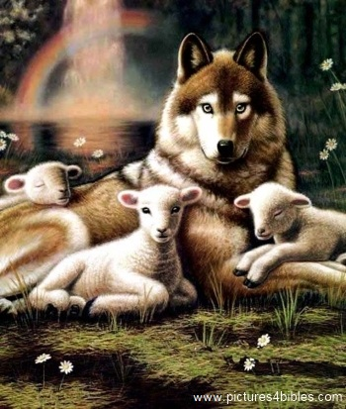
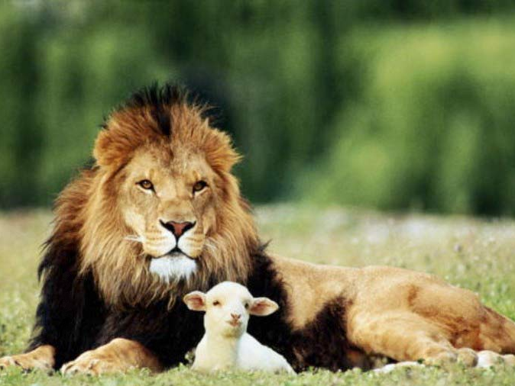
أشعياء 11: 6-9
473أ
‏فَيَسْكُنُ ٱلذِّئْبُ مَعَ ٱلْخَرُوفِ، وَيَرْبُضُ ٱلنَّمِرُ مَعَ ٱلْجَدْيِ، وَٱلْعِجْلُ وَٱلشِّبْلُ وَٱلْمُسَمَّنُ مَعًا، وَصَبِيٌّ صَغِيرٌ يَسُوقُهَا.
Notes:
23

Slide 24
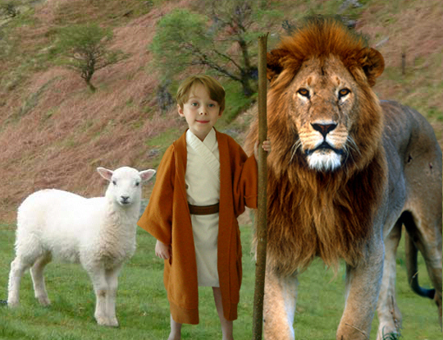
أشعياء 11: 6-9
473أ
‏فَيَسْكُنُ ٱلذِّئْبُ مَعَ ٱلْخَرُوفِ، وَيَرْبُضُ ٱلنَّمِرُ مَعَ ٱلْجَدْيِ، وَٱلْعِجْلُ وَٱلشِّبْلُ وَٱلْمُسَمَّنُ مَعًا، وَصَبِيٌّ صَغِيرٌ يَسُوقُهَا.
Notes:
24

Slide 25
متى
67
المسيا والسلطان على الكنيسة
دليل أولي
على أن يسوع
هو المسيا
الرفض والفترة
بين المجيئين
الدليل النهائي
على أن يسوع
هو المسيا
الاصحاحات 1-10
الاصحاحات 11-27
الاصحاح 28
تقديم الملك
رفض الملك
إعادة تقديم الملك
يعلم الجماهير
يعلم التلاميذ
موضعي
زمني

Slide 26
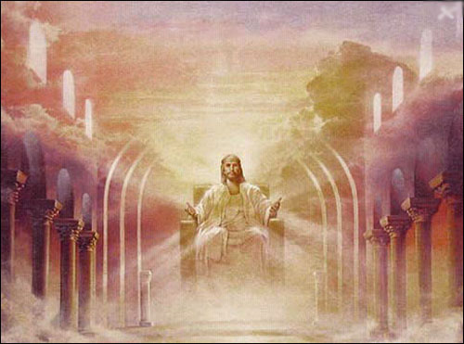
مملكة حرفية وسياسية
فَقَالَ لَهُمْ يَسُوعُ: ٱلْحَقَّ أَقُولُ لَكُمْ: إِنَّكُمْ أَنْتُمُ ٱلَّذِينَ تَبِعْتُمُونِي، فِي ٱلتَّجْدِيدِ، مَتَى جَلَسَ ٱبْنُ ٱلْإِنْسَانِ عَلَى كُرْسِيِّ مَجْدِهِ، تَجْلِسُونَ أَنْتُمْ أَيْضًا عَلَى ٱثْنَيْ عَشَرَ كُرْسِيًّا تَدِينُونَ أَسْبَاطَ إِسْرَائِيلَ ٱلِٱثْنَيْ عَشَرَ. متى ١٩: ٢٨
Notes:
سيحكمها المسيح حيث سيكون لإسرائيل مكانة بارزة على العالم بأسره الذي سيتبع الرب.
________
NS-01-Matt1-14-slide 113
NS-01-Matt15-28-slide 85
NS-05-Acts1-2-slide 191

Slide 27
البيان الموجز
25
67
هذا الكتاب:
(1) يثبت أن يسوع هو المسيا لليهود من غير المؤمنين لكي يؤمنوا به،
و
(2) أن المملكة الموعودة لإسرائيل قد تأخرت لسبب رفض إسرائيل للمسيح كملك للمؤمنين من اليهود ليروا سلطان ملكوته الحالي مقامًا في الكنيسة.
متى

Slide 28
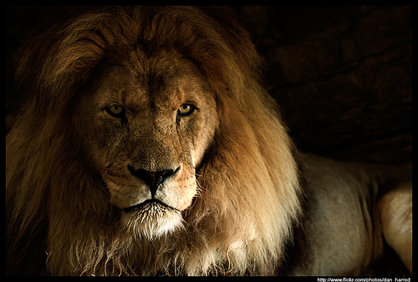
الملكوت في متى 1
218ب
سقوط المملكة
تأسيس
المملكة
الأبدية
إبراهيم
سليمان
شألتئيل
إسحق
رحبعام
زربابل
يعقوب
ابيا
ابيهود
يهوذا
آسا
ألياقيم
فارص
يهوشافاط
عازور
فجميع الأجيال من إبراهيم إلى داود أربعة عشر جيلاً و من داود إلى سبي بابل أربعة عشر جيلاً و من سبي بابل إلى المسيح أربعة عشر جيلاً
حصرون
يهورام
صادوق
رام
عزيا
أخيم
عميناداب
يوثام
أليود
نحشون
آحاز
اليعازر
سلمون
حزقيا
متان
بوعز
منسى
يعقوب
عوبيد
آمون
يوسف
مريم
قيام
المملكة
يسى
يوشيا
داود الملك
يكنيا (السبي)
يسوع المسيح
Notes:
Matthew’s genealogy omits three kings between Jehoram and Uzziah (=Azariah), giving 14 generations in each period of the rise, fall, and preservation of the kingdom until Jesus.
The Bible has several genealogies of the Davidic line:
Perez to David (Ruth 4:18-22)
David (1000 BC) to the sons of Elionai around 400 BC (1 Chron 3:9-17)
Abraham to Jesus (Matt 1:1-17)
Adam to Jesus (Luke 3:23-38)
One difficulty concerns the son of Jehoiachin/Jeconiah/Coniah in the Davidic line. Was his son Shealtiel (Matt 1:12) or should we follow the line of Jehoiachin with his other son Pedaiah (1 Chron 3:17) or his son Rhesa (Luke 3:27), the latter not even listed among the seven sons of Jehoiachin in 1 Chron 3:17?
“2. DESCENDANTS OF SOLOMON (3:10-24)
3:10-24. This list of Solomon’s descendants is in effect a list of Judah’s kings from Solomon through Zedekiah (vv. 10-16) and their exilic and postexilic continuation (vv. 17-24). Athaliah, the queen who ruled between Ahaziah and Joash, is not mentioned (v. 11). That is because she was only a political usurper and was not in the true dynastic succession (cf. 2 Kings 11). Of the sons of Josiah, Johanan (1 Chron. 3:15) is otherwise unknown. He cannot be Jehoahaz (2 Kings 23:31) because Jehoahaz was [Vol. 1, p. 595] younger than Jehoiakim (cf. 2 Kings 23:36). This means that Shallum (1 Chron. 3:15) is identical to Jehoahaz who, though the next-to-youngest son of Josiah, preceded his brothers on the throne (cf. Jer. 22:11-12).
The remainder of the succession followed by the chronicler is Jeconiah (Heb.; cf. NIV marg. of 1 Chron. 3:16; also known as Jehoiachin; cf. v. 17 and 2 Kings 24:8, and Coniah, Jer. 22:24, marg.). Then came Pedaiah (1 Chron. 3:18), Zerubbabel (v. 19), Hananiah (v. 19), Shecaniah (v. 21), Shemaiah (v. 22), Elioenai (v. 23), and Hodaviah (v. 24).
Three difficulties here must be addressed. First, Zerubbabel (v. 19) is elsewhere called the son of Shealtiel, not the son of Pedaiah (Ezra 3:2, 8; 5:2; Neh. 12:1; Hag. 1:12, 14; 2:2, 23; Matt. 1:12; Luke 3:27). Since Shealtiel and Pedaiah were brothers (1 Chron. 3:17-18) the best solution seems to be that Shealtiel died early on and his role of dynastic succession was assumed by his younger brother Pedaiah. The second problem concerns Luke’s account of the genealogy in which he identifies Shealtiel as the son of Neri, whose descent is not from Solomon but from David’s son Nathan (Luke 3:27-31). The answer may lie in the possibility that since Jeconiah had no male heir to sit on the throne (cf. Jer. 22:30), a daughter of Jeconiah married Neri, son of Melki (Luke 3:27-28; not the Melki of Luke 3:24), of the line of Nathan. Legally Shealtiel, as grandson of Jeconiah, would continue the Davidic dynasty through Solomon, a viewpoint espoused by Matthew (Matt. 1:6-12).
The third conflict appears in Zerubbabel’s line. The chronicler lists Zerubbabel’s seven sons and one daughter (1 Chron. 3:19b-20). But none of them is mentioned in the genealogies of either Matthew or Luke. Matthew, who traces Jesus’ descent from David through Solomon, wrote that the son of Zerubbabel was Abiud (Matt. 1:13). Luke, viewing it through Nathan, said Rhesa was that son (Luke 3:27). It is entirely possible, of course, that the Shealtiel and Zerubbabel of Luke are not the same as those of 1 Chronicles and that Luke preserves a genealogy of Mary straight from David through Nathan, a line of succession that has no other connection with the chronicler’s genealogy (cf. comments on Luke 3:27). This would preclude the suggested solution to the second problem previously mentioned (and would, in fact, eliminate the problem altogether). This still leaves the variance between 1 Chronicles 3:19b-20 and Matthew 1:13. One may conjecture that Abiud is another name for one of the seven sons of Zerubbabel listed in Chronicles or that his name is missing from that list to begin with. That such a thing is possible may be seen in 1 Chronicles 3:22 where the historian wrote that Shemaiah had six sons but listed only five names” (Eugene Merrill, “1 Chronicles,” in The Bible Knowledge Commentary [Wheaton, IL: Victor, 1985], 1:594-95).
______
Common-284
OS-10-2Sam-100
OS-13-1Chron-81
NS-01-Matt1-14—slide 161

Slide 29
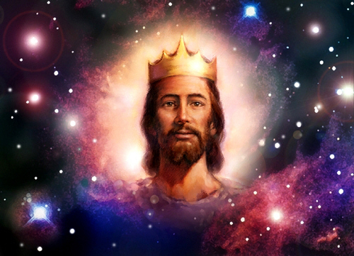
يقول متى أن يسوع ملك

Slide 30
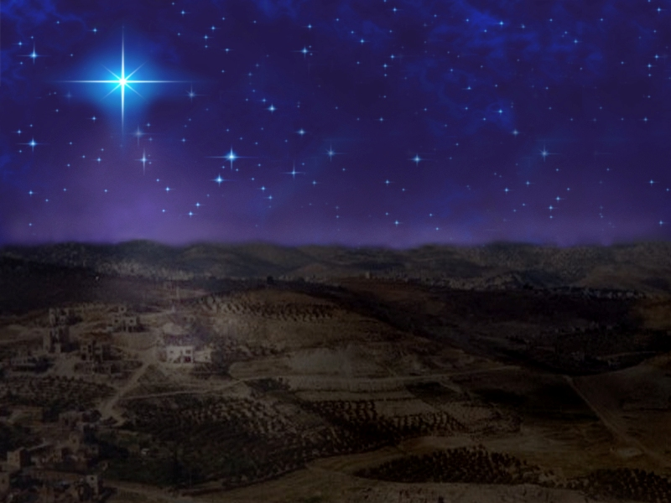
بيت لحم
وَأَنْتِ يَا بَيْتَ لَحْمٍ أَرْضَ يَهُوذَا لَسْتِ الصُّغْرَى بَيْنَ رُؤَسَاءِ يَهُوذَا لأَنْ مِنْكِ يَخْرُجُ مُدَبِّرٌ يَرْعَى شَعْبِي إِسْرَائِيلَ».
متى ٢ : ٦ —— ميخا ٥ : ٢
Notes:
The Jewish leaders were sought out for their advice (2:4).
These leaders knew that Christ would be born in Bethlehem (2:5-6).
The leaders paraphrased Micah 5:2 that gives the exact city where the Messiah would be born—in Bethlehem, which was also called "Ephrath" (cf. Gen 35:19).

Slide 31
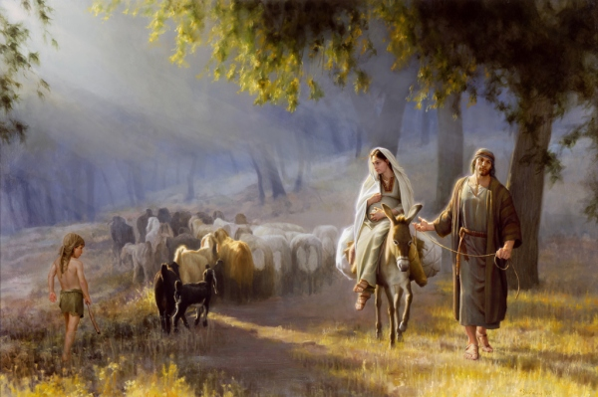
الرحلة إلى بيت لحم

Slide 32
Slides on
متى 2

Slide 33
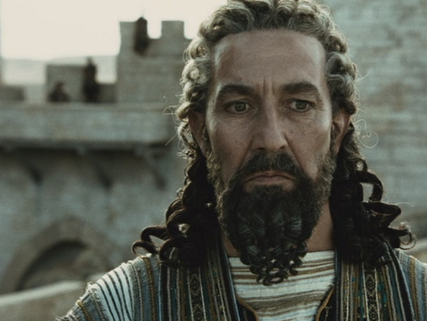
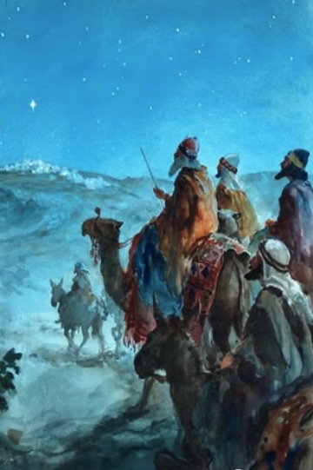
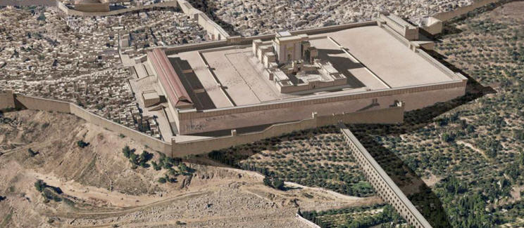
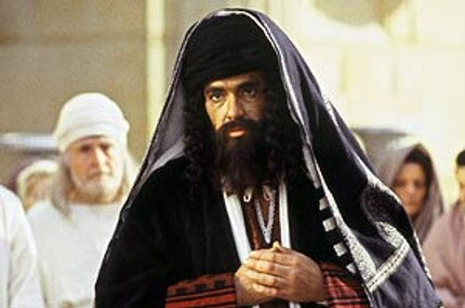
ردود الفعل على يسوع
الأمم الذين يسعون
هيرودس عارض
أورشليم مضطربة
تجاهل القادة

Slide 34
Slides on
متى 3

Slide 35
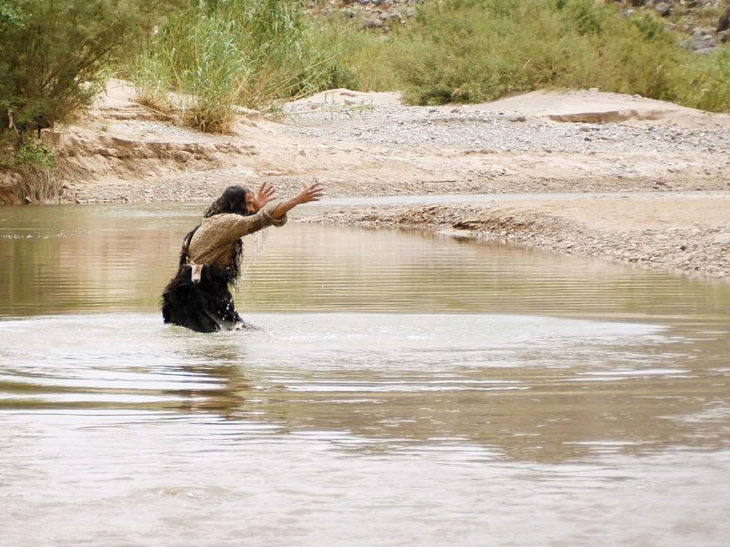

يوحنَّا المعمدان
متَّى 3: 1-16
مرقس 1: 1-11
لوقا 3: 1-22
يوحنَّا 1: 1-34
صور كتابية مجانية
Notes:
يُمثِّل الأصحاح 40 من إشعياء معلومات الخلفيَّة الرئيسيَّة المتاحة عن يوحنَّا المعمدان. يُعزِّي اللهُ شعبَه رغم أنَّه يُخبِرهم بالسبي الآتي عليهم- وهو يفعل هذا بتقديم وعدٍ عن صوت صارخٍ في البرَّيَّة، وليس في الهيكل.

Slide 36
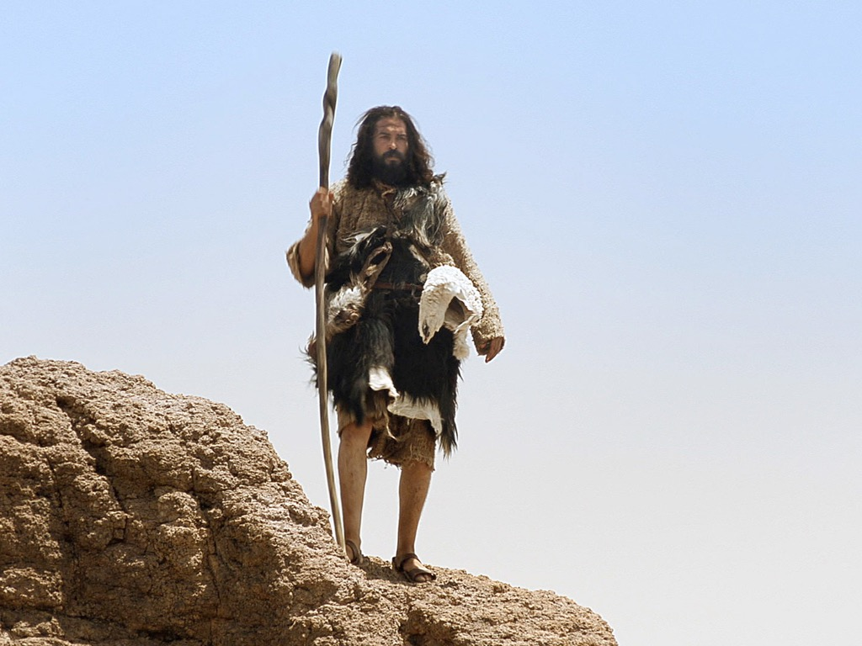
Notes:
John serves as the wilderness voice of God. Although born into the priestly line of Aaron through his father Zechariah, John is a non-conformist who grows up in the desert rather than around the temple rituals. He doesn't perform any sacrifices. Nor does not wear linen like the temple priests. Instead, he likely lived in a desert community such as the Essenes rather than be raised by Zechariah and Elizabeth—and wore camel's hair clothes!

Slide 37
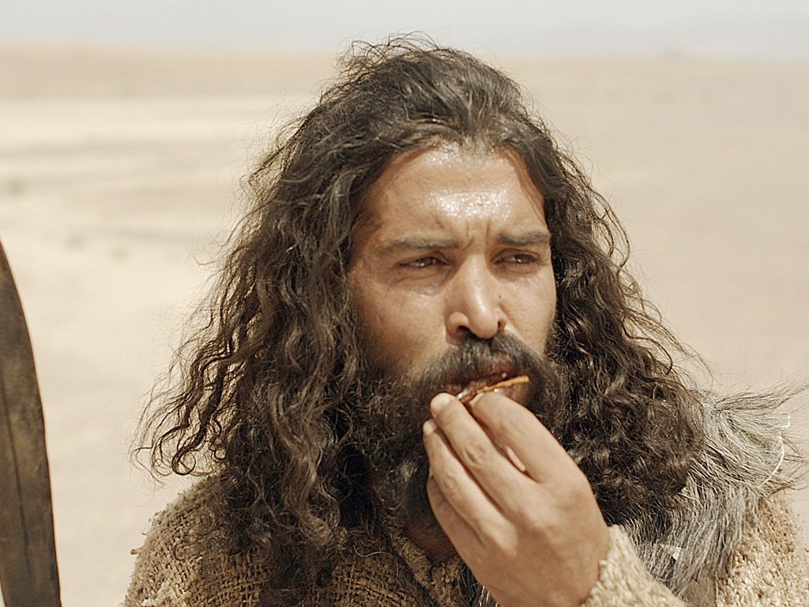
Notes:
He did not eat the meat of sacrificial animals like his fellow priests, even though he was entitled to it. He preferred insects instead, reminding us that God often uses the non-conformance individuals!

Slide 38
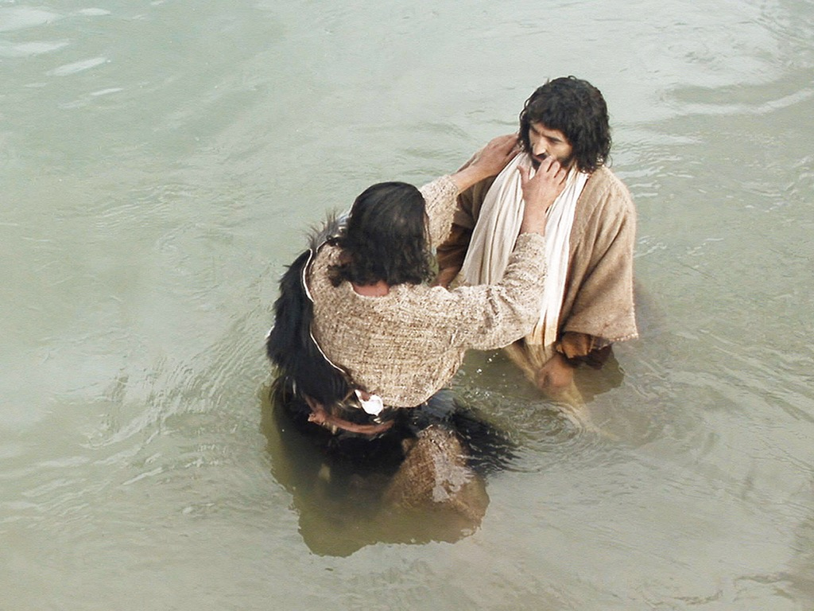

Slide 39
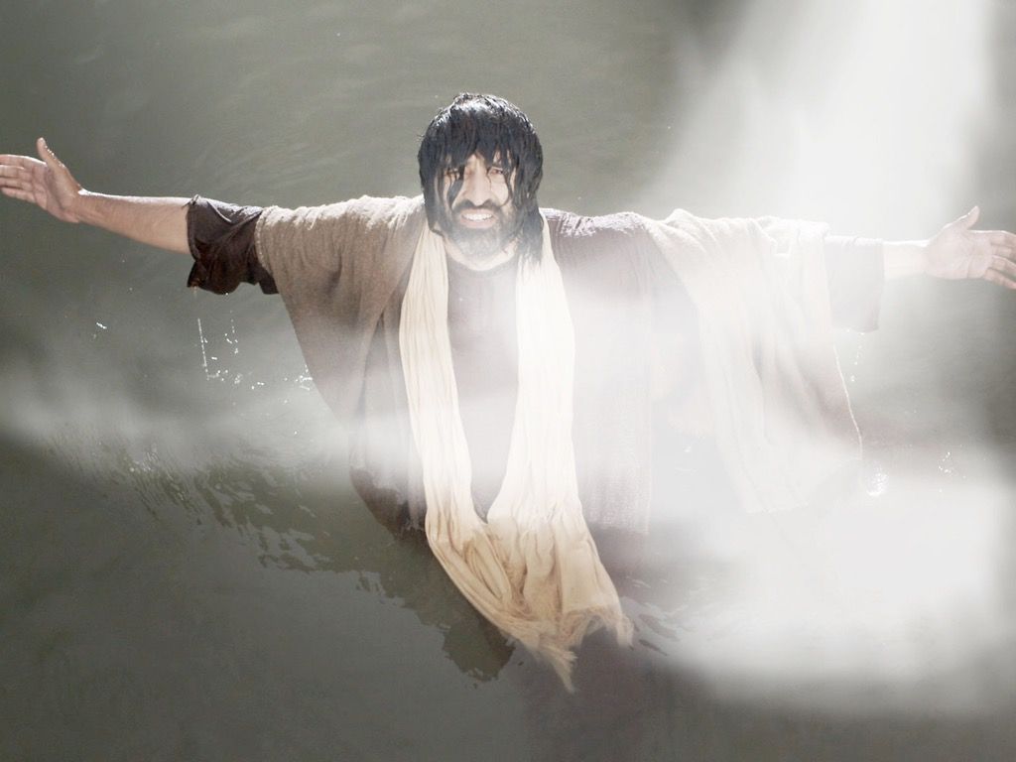

Slide 40
الكلمة في صور
صور كتابية مجانية

Slide 41
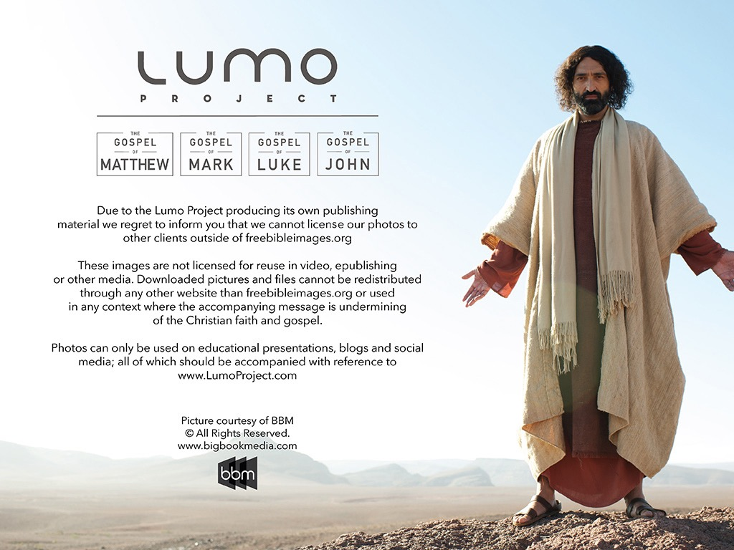
استخدمت بإذن رسمي
إنجيل
متى
إنجيل
مرقس
إنجيل
لوقا
إنجيل
يوحنا
نظرًا لإنتاج Lumo لمواد النشر الخاصة به ، نأسف لإبلاغك بأنه لا يمكننا ترخيص صورنا لعملاء آخرين خارج
freebibleimages.org
هذه الصور غير مرخصة لإعادة استخدامها في الفيديو أو النشر أو الوسائط الأخرى. لا يمكن إعادة توزيع الصور والملفات التي تم تنزيلها من خلال أي موقع ويب آخر غير freebibleimages.org أو استخدامها في أي سياق تؤدي فيه الرسالة المصاحبة إلى تقويض الإيمان المسيحي والإنجيل.
لا يمكن استخدام الصور إلا في العروض التقديمية التعليمية والمدونات ووسائل التواصل الاجتماعي ، وكلها يجب أن تكون مصحوبة بالإشارة إلى
www.LumoProject.com.
Picture courtesy of BBM
© All Rights Reserved.
www.bigbookmedia.com

Slide 42
Slides on
متى 5

Slide 43

الموعظة على الجبل
(مت 5-7)
Notes:
You may have noticed that my series is called "The Best Sermon Ever." Maybe you thought I had totally lost any sense of humility—but actually, I was referring to Christ's message in Matthew 5–7, which is called "The Sermon on the Mount."

Slide 44
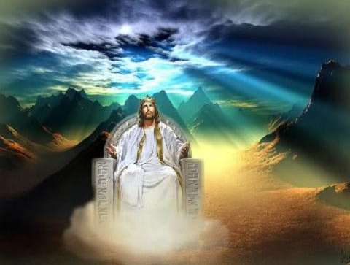
عندما يكون يسوع ملكاً ....
(متى 5-7)
كيف ستبدو حياتك لو كان المسيح بالحقيقة سيداً عليها ؟
Notes:
All of these things support the main teaching of the Sermon that shows what life looks like when Jesus is King of our lives.

Slide 45
العودة إلى الأساسيات (مت 5: 21-48)
سمعتم
أنه
قيل
6 أمور :
أما
أنا
فأقول
لكم
القتل
الزنا
الطلاق
القسم
الإنتقام
الأعداء
قصد الله الصحيح
تعليم الفريسيين
الطهارة الخارجية لا تدخلنا الملكوت (20)
Notes:
هنا نرى كيف "رفض يسوع تقاليد الفريسيين (الآيات 21-48) ... قال يسوع ست مرات: "لقد سمعتم أنه قيل. ... ولكني أقول لكم" (5: 21-22، 27-28، 31-32، 33-34، 38-39، 43-44). توضح هذه الكلمات أن يسوع كان يقدم (أ) ما كان يقوله الفريسيون ومعلمي الناموس للشعب، وعلى النقيض من ذلك، (ب) ما هي نية الله الحقيقية للناموس. وقد أوضح هذا قوله (آية 20) بأن البر الفريسي لا يكفي للدخول إلى الملكوت الآتي" (باربييري، BKC، 2: 30).

Slide 46
Slides on
متى 6

Slide 47
هيكل متوازي (متى 6
الصدقة (1-4)
الصلاة
(5-15)
الصوم
(16-18)
المراؤون (2)
المراؤون (5)
المراؤون (16)
عرض علني (1-2)
عرض علني (5)
عرض علني (16)
مكافأة بشرية (2)
مكافأة بشرية (5)
مكافأة بشرية (16)
الخفاء (4)
الخفاء (6)
الخفاء (18)
الآب يرى (4)
الآب يرى (6، 8)
الاب يرى (18)
Notes:
Barbieri notes, "In all three examples of Pharisaic 'righteousness'—almsgiving (vv. 1-4), praying (vv. 5-15), and fasting (vv. 16-18)—Jesus spoke of hypocrites (vv. 2, 5, 16), public ostentation (vv. 1-2, 5, 16), receiving their reward in full when their actions are done before men (vv. 2, 5, 16), acting in secret (vv. 4, 6, 18), and being rewarded by the Father, who sees or 'knows,' when one's actions are done secretly (vv. 4, 6, 8, 18)" (Barbieri, BKC, 2:33).

Slide 48
8-10
73
المخطط التفصيلي
(1: 1-4: 11) 1. إعلان مجيء المسيح وموافقاته كمسيا وملكا شرعيا لإسرائيل.
2. تكشف مبادئ خدمة المسيح وعظته المبكرة على الجبل أن لديه الخدمة النبوية المتوقعة من المسيا (4: 12-7: 29)
3. يظهر المسيح القوة والسلطان المتوقعين من المسيا لإظهار قدرته على جلب الملكوت إذا قبله إسرائيل.(8-10)

Slide 49
Slides on
متى 8

Slide 50
قوة وسلطة المسيا في
متى 8-10
75
المعجزات والتلمذة
(8: 1-9: 34)
ولما صار المساء قدموا إليه مجانين كثيرين فأخرج الأرواح بكلمة وجميع المرضى شفاهم لكي يتم ما قيل بأشعياء النبي القائل هو أخذ أسقامنا وحمل أمراضنا
(مت 8: 16-17، أش 53: 4)

Slide 51
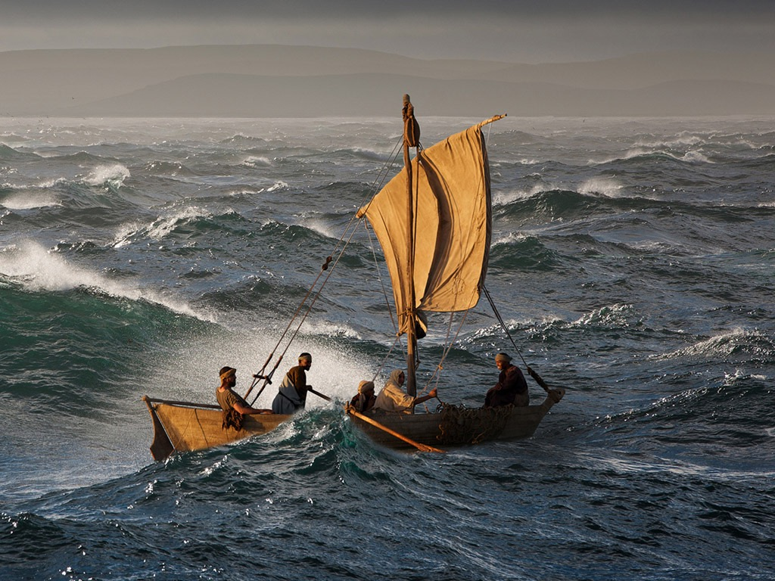

Slide 52
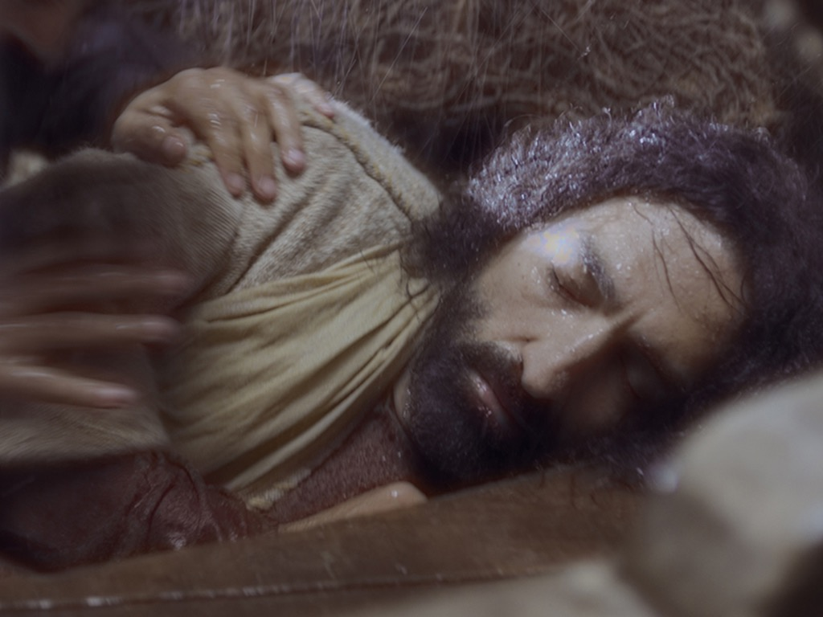

Slide 53
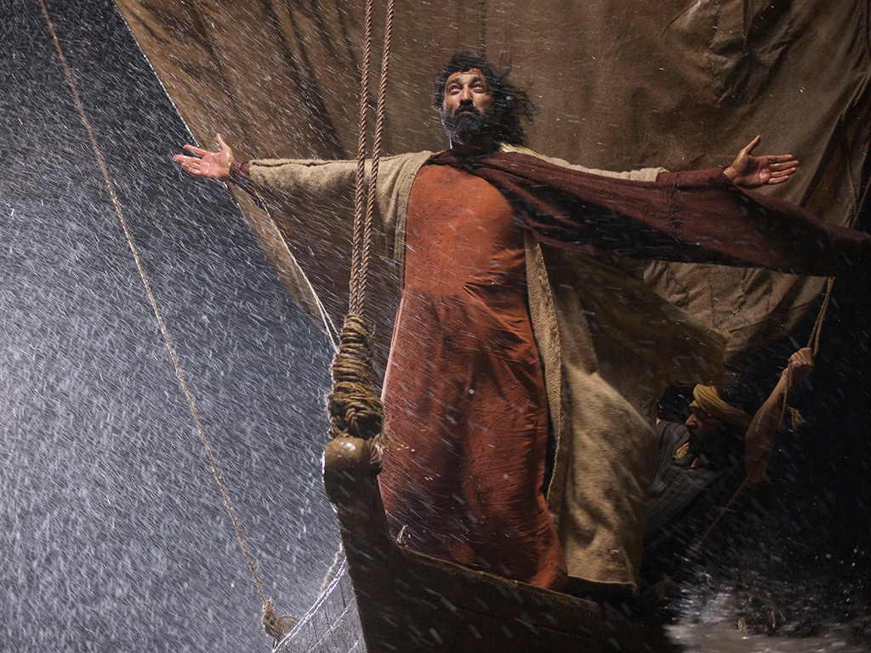

Slide 54
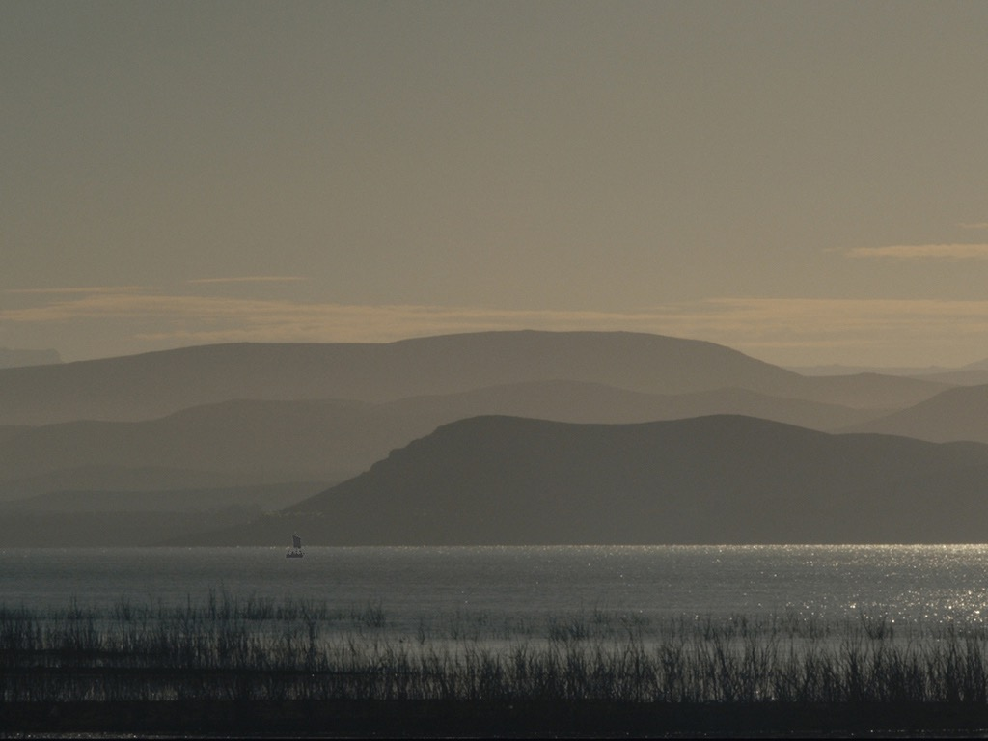

Slide 55
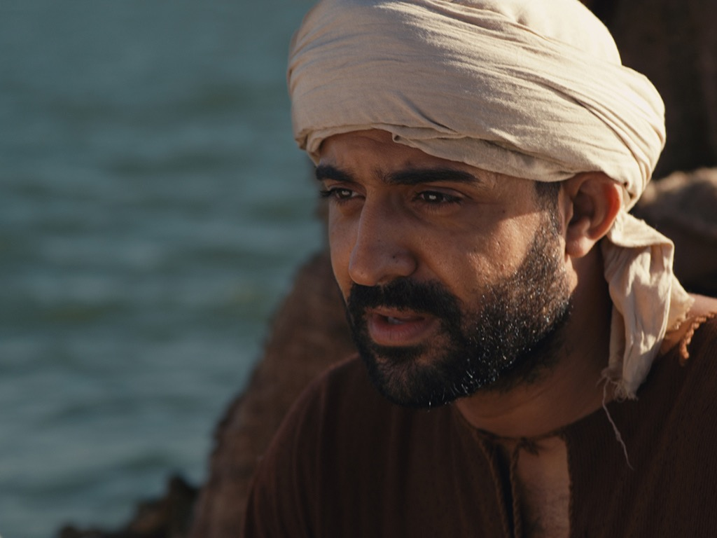

Slide 56
Slides on
متى 9

Slide 57
قوة وسلطة المسيا في
متى 8-10
75
المعجزات والتلمذة
(8: 1-9: 34)
تفويض السلطة للتلاميذ
(9: 35-10: 42)
ولما صار المساء قدموا إليه مجانين كثيرين فأخرج الأرواح بكلمة وجميع المرضى شفاهم لكي يتم ما قيل بأشعياء النبي القائل هو أخذ أسقامنا وحمل أمراضنا
(مت 8: 16-17، أش 53: 4)
ثم دعا تلاميذه الإثني عشر وأعطاهم سلطاناً على أرواح نجسة حتى يخرجوها ويشفوا كل مرض وكل ضعف
(مت 10: 1)

Slide 58
Slides on
متى 10

Slide 59
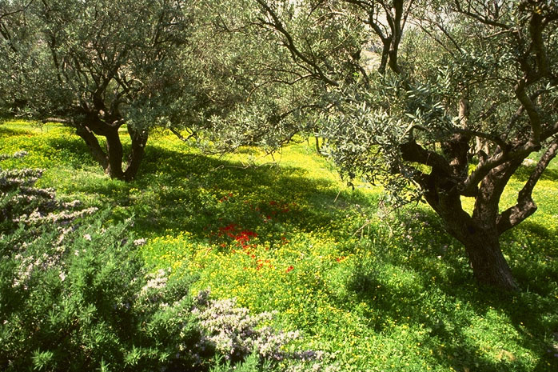
متى ١٠ : ٥-٧
هَؤُلاَءِ الاِثْنَا عَشَرَ أَرْسَلَهُمْ يَسُوعُ وَأَوْصَاهُمْ قَائِلاً: «إِلَى طَرِيقِ أُمَمٍ لاَ تَمْضُوا وَإِلَى مَدِينَةٍ لِلسَّامِرِيِّينَ لاَ تَدْخُلُوا. ٦ بَلِ اذْهَبُوا بِالْحَرِيِّ إِلَى خِرَافِ بَيْتِ إِسْرَائِيلَ الضَّالَّةِ. ٧ وَفِيمَا أَنْتُمْ ذَاهِبُونَ اكْرِزُوا قَائِلِينَ: إِنَّهُ قَدِ اقْتَرَبَ مَلَكُوتُ السَّمَاوَاتِ.
يسوع
حياة
الصليب
الكنيسة
الإنجيل
أعمال
الرسائل
الرؤيا
65
Notes:
What was Jesus saying to us? In متى's fourth chapter, we are told that "Jesus began to preach and say: 'Repent, for the kingdom of heaven is at hand…Jesus was going throughout all Galilee, teaching in their synagogues and proclaiming the gospel of the Kingdom…'"
What is that Kingdom? What did he mean?

Slide 60
لماذا تخدم يسوع؟
متى

Slide 61
أسماء مدهشة
يسوع هو أعلى حاكم
في العالم (1-10).
المسيح
متى
Notes:
هنا المخطط الأساسي لإنجيل متى، مصممًا حول الأسماء الثلاثة للرب يسوع المسيح.

Slide 62
أسماء مدهشة
يسوع هو أعلى سلطة
في الكنيسة (11-27).
الرب
المسيح
متى
Notes:
هنا المخطط الأساسي لإنجيل متى، مصممًا حول الأسماء الثلاثة للرب يسوع المسيح.

Slide 63
Slides on
متى 11

Slide 64
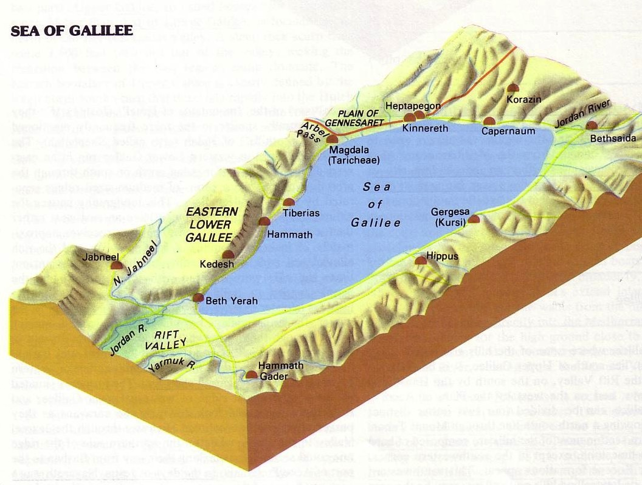
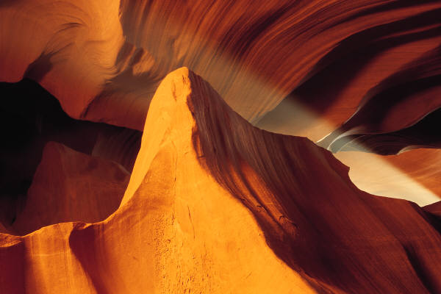
منطقة المدن الثلاث
172
النقطة ح
حينئذ ابتدأ يوبخ المدن التي صنعت فيها أكثر قواته لأنها لم تتب
ويل لك يا كورزين ويل لك يا بيت صيدا لأنه لو صنعت في صور وصيداء القوات المصنوعة فيكما لتابتا قديماً في المسوح والرماد ولكن أقول لكم إن صور وصيداء تكون لهما حالة أكثر احتمالاً يوم الدين مما لكما
وأنت يا كفرناحوم المرتفعة إلى السماء ستهبطين إلى الهاوية لأنه لو صنعت في سدوم القوات المصنوعة فيك لبقيت إلى اليوم ولكن أقول لكم إن أرض سدوم تكون لها حالة أكثر احتمالاً يوم الدين مما لك
متى 11: 20-24

Slide 65
Slides on
متى 12

Slide 66
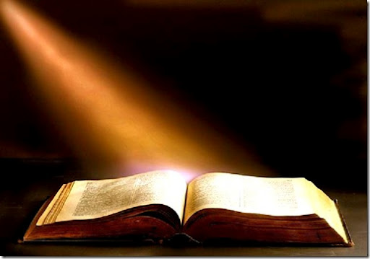
سياق النص
xiv
شفى المسيح أعمى/أبكم (متى 12: 22)
زعمت الحشود: "إنه المسيح!"
قال الفريسيون: "إنه شيطاني!"
أعطى يسوع ردا ثلاثيا (12: 25-29)

Slide 67
Slides on
متى 13

Slide 68
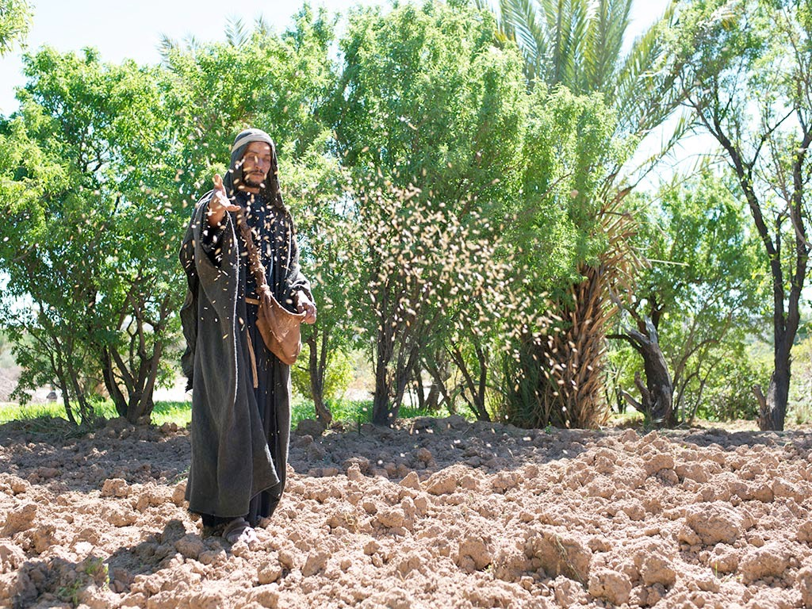
صور
كتابية
مجانية
متَّى 13: 1-23؛ مرقس 4: 1-20؛ لوقا 8: 1-15
مَثَل الزارع

Slide 69
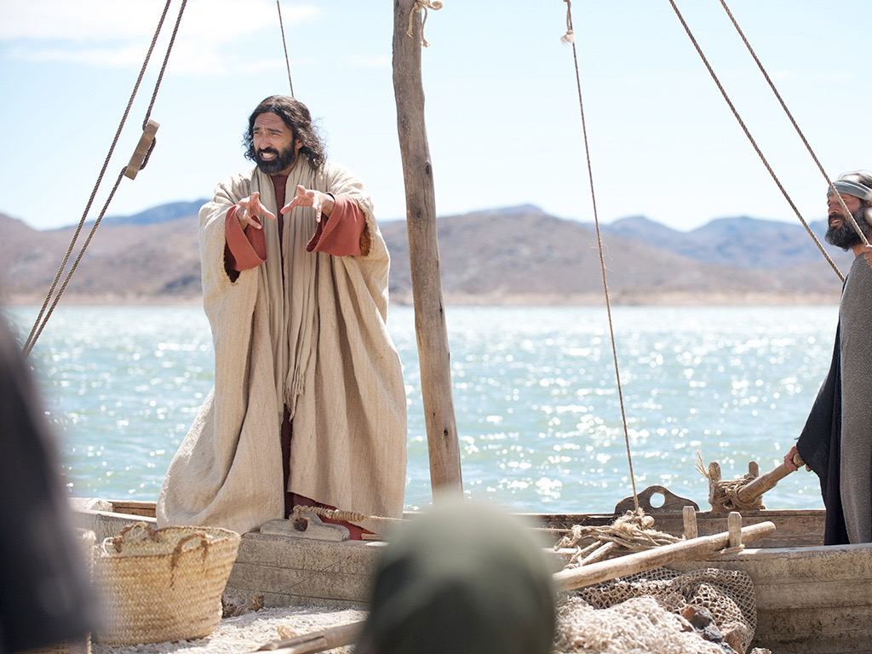

Slide 71
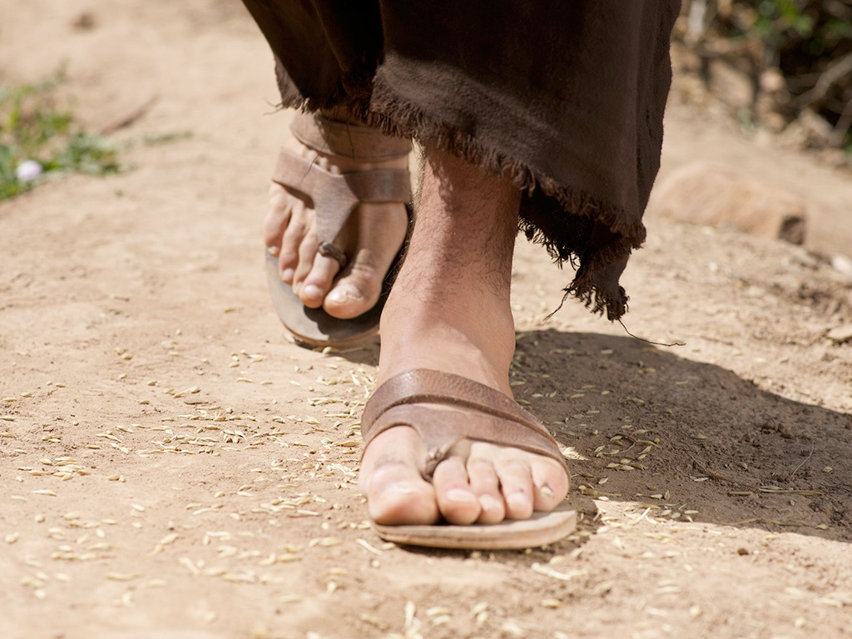

Slide 72
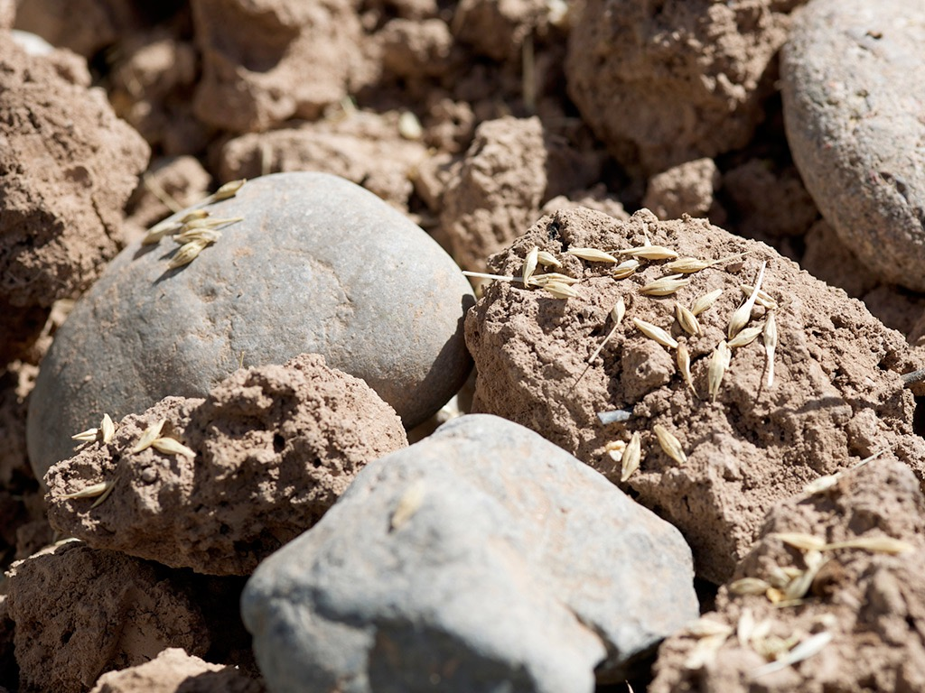

Slide 73
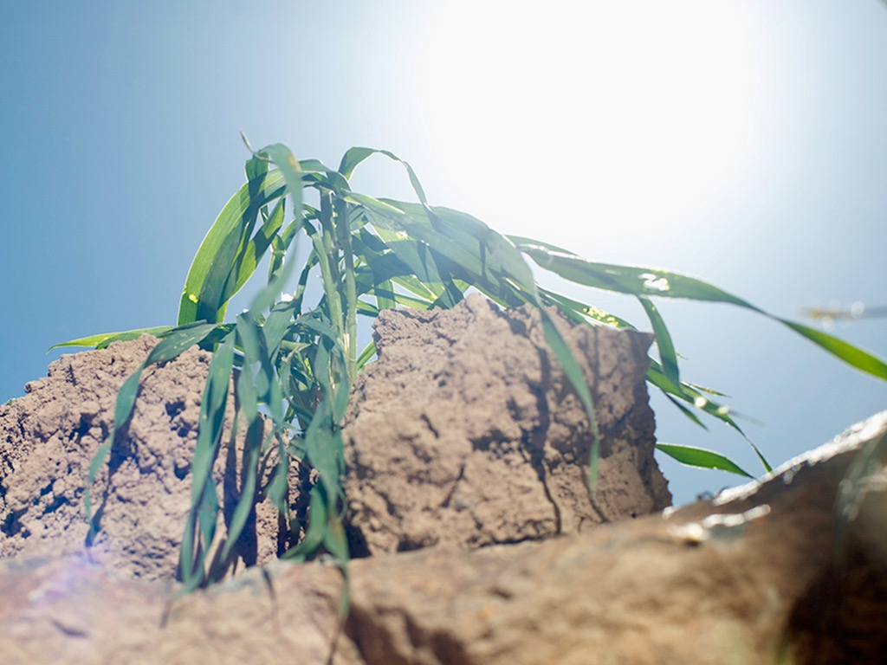

Slide 74
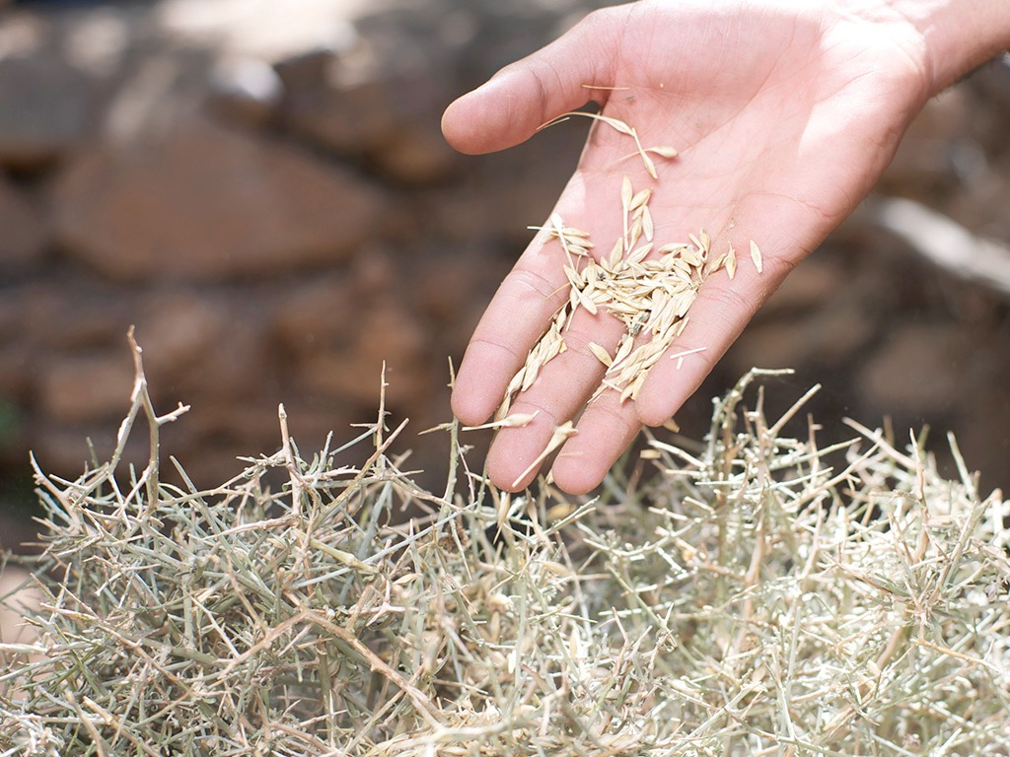

Slide 75


Slide 76


Slide 77


Slide 78
اختطاف ما قبل الضيقة
209
361
المجيء الثاني
الإختطاف
الضيقة
الألفية
عصر الكنيسة
المملكة الأبدية
7 سنوات
1000 سنة
الدينونة

Slide 79
Slides on
متى 14

Slide 80


Slide 81


Slide 82


Slide 83


Slide 84


Slide 85
Slides on
متى 18

Slide 86
متى 18: 15-20
«وَإِنْ أَخْطَأَ إِلَيْكَ أَخُوكَ فَٱذْهَبْ وَعَاتِبْهُ بَيْنَكَ وَبَيْنَهُ وَحْدَكُمَا. إِنْ سَمِعَ مِنْكَ فَقَدْ رَبِحْتَ أَخَاكَ. ^{١٦} وَإِنْ لَمْ يَسْمَعْ، فَخُذْ مَعَكَ أَيْضًا وَاحِدًا أَوِ ٱثْنَيْنِ، لِكَيْ تَقُومَ كُلُّ كَلِمَةٍ عَلَى فَمِ شَاهِدَيْنِ أَوْ ثَلَاثَةٍ. ^{١٧} وَإِنْ لَمْ يَسْمَعْ مِنْهُمْ فَقُلْ لِلْكَنِيسَةِ. وَإِنْ لَمْ يَسْمَعْ مِنَ ٱلْكَنِيسَةِ فَلْيَكُنْ عِنْدَكَ كَٱلْوَثَنِيِّ وَٱلْعَشَّارِ.
^{١٨} اَلْحَقَّ أَقُولُ لَكُمْ: كُلُّ مَا تَرْبِطُونَهُ عَلَى ٱلْأَرْضِ يَكُونُ مَرْبُوطًا فِي ٱلسَّمَاءِ، وَكُلُّ مَا تَحُلُّونَهُ عَلَى ٱلْأَرْضِ يَكُونُ مَحْلُولًا فِي ٱلسَّمَاءِ. ^{١٩} وَأَقُولُ لَكُمْ أَيْضًا: إِنِ ٱتَّفَقَ ٱثْنَانِ مِنْكُمْ عَلَى ٱلْأَرْضِ فِي أَيِّ شَيْءٍ يَطْلُبَانِهِ فَإِنَّهُ يَكُونُ لَهُمَا مِنْ قِبَلِ أَبِي ٱلَّذِي فِي ٱلسَّمَاوَاتِ، ^{٢٠} لِأَنَّهُ حَيْثُمَا ٱجْتَمَعَ ٱثْنَانِ أَوْ ثَلَاثَةٌ بِٱسْمِي فَهُنَاكَ أَكُونُ فِي وَسْطِهِمْ».
كيفية الاسترداد
15-17
لماذا الاسترداد
18-20
Notes:
في متى 18: 15-20 يقدم يسوع خطة الله للتأديب الكنسي الذي يتسم بالمحبّة. دعونا نقرأها معا [اقرأ 15-20.] يحتوي هذا النص على تعاليم رئيسية حول استعادة المسيحيين الذين في الخطية.
• الآيات 15-17 تعطي كيفية استعادتهم و...
• الآيات 18-20 تعطي لماذا استردادهم.
دعونا أولا نرى كيفية استعادة العلاقات. طريقة الله لاستعادة المؤمنين الذين يقترفون خطية هي ...
__________________
BS-18-Exegetical Idea1-slide 15
BS-19-Exegetical Idea2-slide 32
BS-26-Applications-10 focuses only on verses 15-17
NS-01-Matt15-28-slide 54
PR-08-Exegetical Idea1-slide15
PR-09-Exegetical Idea2-slide 32
PR-16-Applications-12 focuses only on verses 15-17

Slide 87

الفكرة الرئيسية:
يجب أن نستعيد بشكل صحيح الأعضاء الذين يخطئون لأننا نتصرف نيابة عن الله
Notes:
عندما تضل الخراف ، نعيدها كأيدي محبة لنعمة الله.

Slide 88
Slides on
متى 21

Slide 89


Slide 90

وَالصَّيَارِفَ جُلُوساً.
يوحنا ٢ : ١٤ب

Slide 91

وَالْبَقَرَ وَكَبَّ دَرَاهِمَ الصَّيَارِفِ
يوحنا ٢ : ١٥ت

Slide 92

وَقَالَ لِبَاعَةِ الْحَمَامِ:
يوحنا ٢ : ١٦ا

Slide 93

«ارْفَعُوا هَذِهِ مِنْ هَهُنَا. لاَ تَجْعَلُوا بَيْتَ أَبِي بَيْتَ تِجَارَةٍ».
يوحنا ٢ : ١٦ت

Slide 94

فَسَأَلَهُ الْيَهُودُ: «أَيَّةَ آيَةٍ تُرِينَا حَتَّى تَفْعَلَ هَذَا؟»
يوحنا ٢ : ١٨

Slide 95
Slides on
متى 24

Slide 96

التلاميذ : يا له من هيكل مذهل (24: 1)
يسوع : إنه لا يترك ههنا حجر على حجر لا ينقض (24: 2)
التلاميذ : متى؟ ما هي العلامة (24: 3)

Slide 97

عظة جبل الزيتون (متى 24-25)
78
مقتبس من مارك ل. بيلي، ملاحظات صفية في كلية دالاس اللاهوتية، 1986
المجيء الثاني (27-31)
علامات في السماء (29-30)
مجيء ابن الإنسان (27، 30)
مائدة الطيور (28)
خلاص المختارين (31)
رجسة الخراب (15-20)
أنبياء ومسحاء كذبة
(23-26)
بداية آلام المخاض
(4-8)
الضيقة العظيمة
(9-14، 21-22)
دينونة
الأمم
الخراف
الجداء
التوازي مع رؤيا
12: 7-12
13: 14
12: 8-17
8: 1-19: 10
(متى 25: 31-46)
6: 1-8: 5
19: 11-21

Slide 98
Slides on
متى 25

Slide 99


أليس الخراف والجداء متشابهين؟

Slide 100

دينونة الأمم
31 ومتى جاء ابن الإنسان في مجده وجميع الملائكة القديسين معه
فحينئذ يجلس على كرسي مجده 32 ويجتمع أمامه جميع الشعوب
فيميز بعضهم من بعض كما يميز الراعي الخراف من الجداء
(متى 25: 31-32)

Slide 101

دينونة الأمم الحية
31 ومتى جاء ابن الإنسان في مجده وجميع الملائكة القديسين معه فحينئذ يجلس على كرسي مجده
32 ويجتمع أمامه جميع الشعوب فيميز بعضهم من بعض كما يميز الراعي الخراف من الجداء
33 فيقيم الخراف عن يمينه والجداء عن اليسار
34 ثم يقول الملك للذين عن يمينه تعالوا يا مباركي أبي رثوا الملكوت المعد لكم منذ تأسيس العالم
(متى 25: 31-34)

Slide 102
Slides on
متى 26

Slide 103


Slide 104


Slide 105


Slide 106


Slide 107


Slide 108


Slide 109


Slide 110


Slide 111


Slide 112


Slide 113


Slide 114


Slide 115


Slide 116


Slide 117


Slide 118


Slide 119


Slide 120


Slide 121


Slide 122


Slide 123


Slide 124


Slide 125


Slide 126
لماذا تخدم يسوع؟?
متى

Slide 127
أسماء مدهشة
يسوع هو أعلى حاكم
في العالم (1-10).
المسيح
متى
Notes:
هنا المخطط الأساسي لإنجيل متى، مصممًا حول الأسماء الثلاثة للرب يسوع المسيح.

Slide 128
أسماء مدهشة
يسوع هو أعلى سلطة
في الكنيسة (11-27).
الرب
المسيح
متى
Notes:
هنا المخطط الأساسي لإنجيل متى، مصممًا حول الأسماء الثلاثة للرب يسوع المسيح.

Slide 129
أسماء مدهشة
الرب
يسوع
المسيح
قدّم يسوع الخلاص من خلال
انتصاره على الموت (28).
متى
Notes:
هنا المخطط الأساسي لإنجيل متى، مصممًا حول الأسماء الثلاثة للرب يسوع المسيح.

Slide 130
Slides on
متى 28

Slide 131


Slide 132


Slide 133


Slide 134


Slide 135


Slide 136


Slide 137


حراس مرتشون (28: 12)

Slide 138


المأمورية العظمى
متى 20-18 :28
فَٱذْهَبُوا وَتَلْمِذُوا جَمِيعَ ٱلْأُمَمِ وَعَمِّدُوهُمْ بِٱسْمِ ٱلْآبِ وَٱلِٱبْنِ وَٱلرُّوحِ ٱلْقُدُسِ. ^{٢٠} وَعَلِّمُوهُمْ أَنْ يَحْفَظُوا جَمِيعَ مَا أَوْصَيْتُكُمْ بِهِ. وَهَا أَنَا مَعَكُمْ كُلَّ ٱلْأَيَّامِ إِلَى ٱنْقِضَاءِ ٱلدَّهْرِ». آمِينَ.
Notes:
المسيح لديه كل السلطان لكنه يمد بعضا منه إلينا كأشخاص تحت سلطانه. قد يبدو أن هناك أربع وصايا هنا ، لكن "تلمذة" هي الوصية الوحيدة هنا. يحدث هذا من خلال طاعة المشاركين الثلاثة: الذهاب والمعمودية والتعليم.

Slide 139
المأمورية العظمى
صنع تلاميذ
تعليم
التعميد
ذهاب
التقديس
تعريف
خلاص
التعليم
التمثل
الكرازة
النضج
الربط
الإيمان
قم ببنائهم
احتفظ بهم
ابحث عنهم
مقتبس من الدكتور غاري ماكنتوش ، شبكة نمو الكنيسة 2014
Notes:
تؤكد معظم الكنائس على العمود الثالث وتفكر فقط في التعليم على أنه تلمذة. ومع ذلك ، فإنه يشمل الذهاب والتعميد والتعليم.
ضع قائمة بالخدمات في كنيستك تحت العمود المناسب لها. إذا لم يكن من الممكن إدراجها تحت واحدة من هذه ، فقم بإزالة تلك الوزارة.
أي من الأعمدة الثلاثة هو الأضعف في كنيستك؟ ما الذي يمكنك فعله لتقوية هذه المنطقة الضعيفة؟

Slide 140
الفكرة الرئيسية لـمتى
الرب
يسوع
المسيح
Notes:
أخدم يسوع في حياتك كمخلص، وإله وملك! هذه هي الرسالة والتطبيق الأساسي في كل إنجيل متى

Slide 141
لماذا تخدم يسوع؟?
متى

Slide 142
الفكرة الرئيسية لـمتى
خدمة الرب يسوع المسيح
الله
الرب
الملك
يسوع
المسيح
المخلص
Notes:
أخدم يسوع في حياتك كمخلص، وإله وملك! هذه هي الرسالة والتطبيق الأساسي في كل إنجيل متى

Slide 143
أسماء مدهشة
يسوع هو أعلى حاكم
في العالم (1-10).
المسيح
متى
Notes:
هنا المخطط الأساسي لإنجيل متى، مصممًا حول الأسماء الثلاثة للرب يسوع المسيح.

Slide 144
أسماء مدهشة
يسوع هو أعلى سلطة
في الكنيسة (11-27).
الرب
المسيح
متى
Notes:
هنا المخطط الأساسي لإنجيل متى، مصممًا حول الأسماء الثلاثة للرب يسوع المسيح.

Slide 145
أسماء مدهشة
الرب
يسوع
المسيح
قدّم يسوع الخلاص من خلال
انتصاره على الموت (28).
متى
Notes:
هنا المخطط الأساسي لإنجيل متى، مصممًا حول الأسماء الثلاثة للرب يسوع المسيح.

Slide 146
الفكرة الرئيسية لـمتى
خدمة الرب يسوع المسيح
الرب
يسوع
المسيح
Notes:
أخدم يسوع في حياتك كمخلص، وإله وملك! هذه هي الرسالة والتطبيق الأساسي في كل إنجيل متى

Slide 147


هل تثق بالملك الآن؟
قبل أن نصلي يا رب ليأت ملكوتك
علينا أن نكون قادرين على أن نصلي
ليرحل ملكوتنا

Slide 148
Black

Slide 149


تفسير الكتاب المقدس • BibleStudyDownloads.org
احصل علي هذا العرض مجانا!
Notes:
BE Bible Exposition in Arabic

