Slide 1
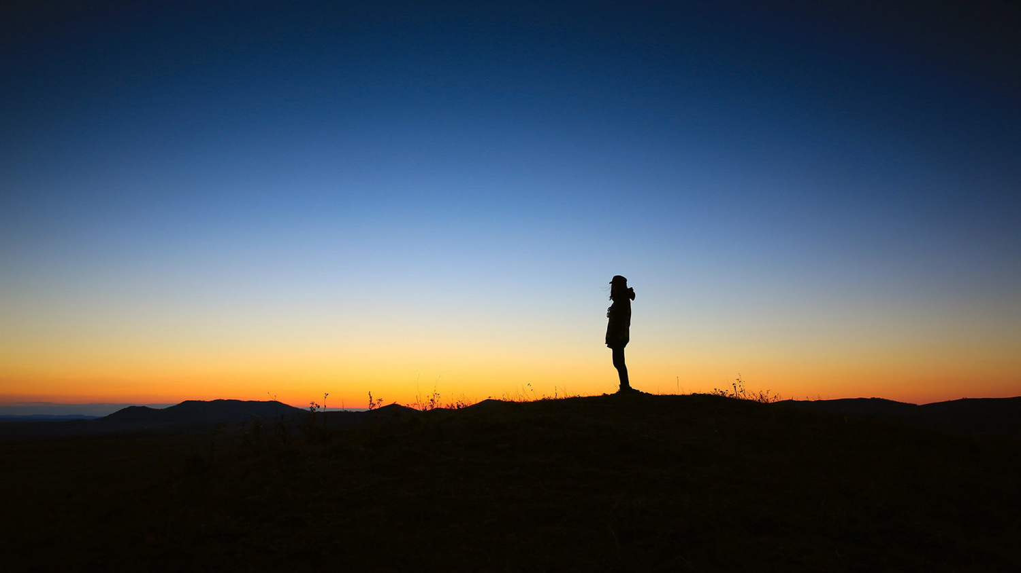
كن مهتماً
سفر يونان
د. ريك جريفيث, مؤسسة الدراسات اللاهوتية الأردنية
BibleStudyDownloads.org

Slide 2

فرصة
ضائعة
Notes:
In June 1991 a car in Singapore's East Coast area hit a 70-year-old Chinese man. The owner of the car was relieved to find a doctor at his clinic just a short distance away. When the doctor was begged to try to save the man's life, he replied that he was too busy, didn't have the right equipment, and needed the victim's approval or his family's approval before he would treat him. The doctor never tried to see the old man, who died five hours later.

Slide 3
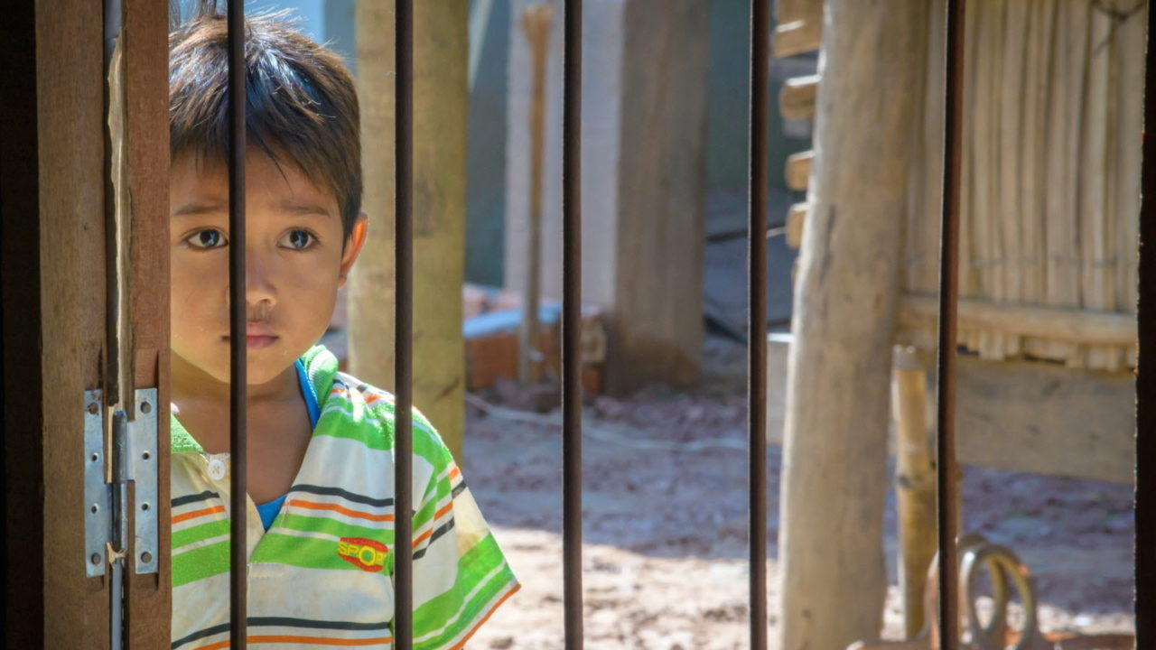
هل تهتم بالناس ؟
Notes:
I was shocked to read the account in the newspaper. How could anyone be so unfeeling—especially someone who has given himself to the "people's profession"? Would you have helped him? Do you care for people?

Slide 4
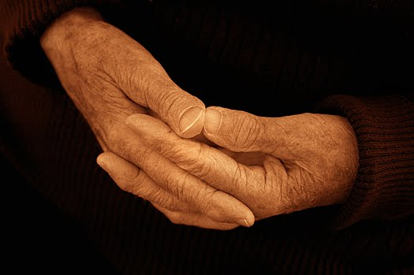
كيف يريدنا الله أن نتجاوب مع الأشخاص غير المتجاوبين ؟
Notes:
How does God want us to respond to unresponsive people? Such an incident is all too common. In fact, today we will take a look at a biblical character with this same unfeeling attitude. As we do so, I believe that God will challenge us with four principles on our own need to show compassion for other people.

Slide 5
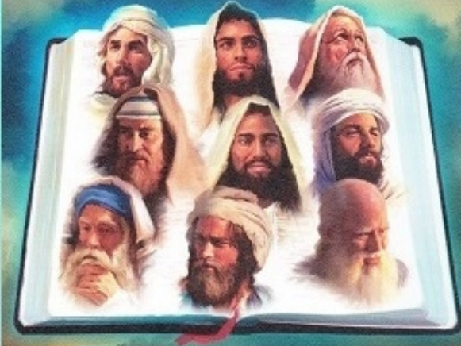
الإثنا عشر
الشجاعة لمواجهة الثقافة
— سلسلة وعظ الأنبياء الصغار —
Notes:
Today we continue with part 2 of our series on the Minor Prophets that I'm calling simply "The Twelve."

Slide 6
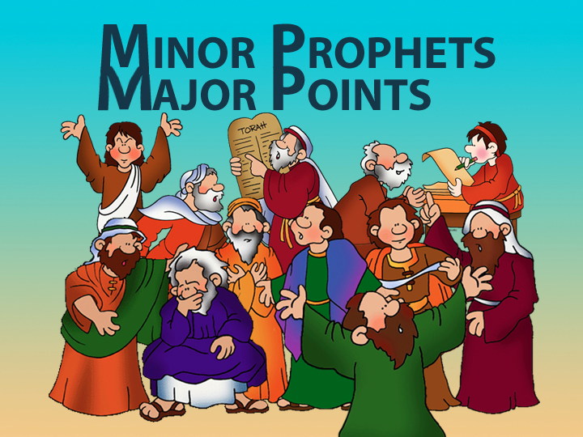
Minor Prophets—Major Points

Slide 7

Title Slide
يونان

Slide 8
Unique Elements in Jonah
600
عناصر فريدة في سفر يونان
    1. يتكلم يونان بشكل كامل من خلال اختبار نبي – و ليس من خلال كلماته .
    2. يونان هو النبي الوحيد في الكتاب المقدس الذي حاول أن يهرب من الله .
    3. يونان هو السفر الكتابي الوحيد عن تجاوب إسرائيل مع الشعوب الوثنية .
    4. تاريخية سفر يونان أنكرت من قبل علماء كثيرين .

Slide 9
اذهب، لا، إذا تأديب
يونان 1
يغير الله الأحداث ليظهر شفقته على الناس
Notes:
The Lord shows His care for people by events that get our attention.

Slide 10
يونان 1، اذهب
604
1. يأمر الله شعبه بإخبار الأشرار كم يكره خطيتهم (1-2)
Notes:
God commissioned Jonah to share His righteousness to Nineveh (1:1-2).

Slide 11
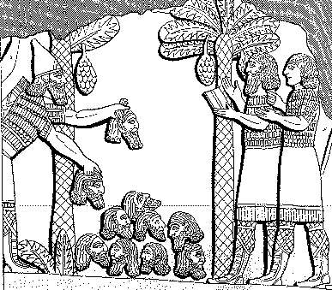
Assyrian Brutality
الوحشية
614
الأشورية
هرم من الرؤوس ترتبت أمام مدينته. احترق شبابهم وبناتهم في النيران.
شلمنصر ، 859-824 ق.م = 80 سنة قبل يونان ، في لوكينبيل السجلات القديمة لآشور وبابل ، 1: 213

Slide 12
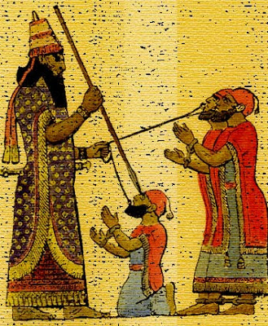
معاملة الملوك الأسرى
614
قد يحتوي حكم الإعدام في آشور على الكثير من التعذيب كالسلخ أو اقتلاع اللسان الكاذب أو الحرق أو
لقد اخترقت ذقنه بخنجر يدي الحاد. من خلال فكه ... مررت بحبل ، ووضعت عليه سلسلة كلب وجعلته يحتل مأوى
أشور بانيبال، 669-626 ق.م = 100 سنة بعد يونان في لوكينبيل، السجلات القديمة لأشور و بابل،
2: 319

Slide 13
غرور آسرحدون (660 ق.م)
614
"أنا قوي ، أنا كلي القوة ، أنا بطل ، أنا عملاق ، أنا جبار ، يشرفني ، أنا متكبر ، أنا بلا مساواة بين جميع الملوك ، المختار من أشور ونابو ومردوخ! "
لوكينبيل، السجلات القديمة لأشور و بابل، 2: 226

Slide 14
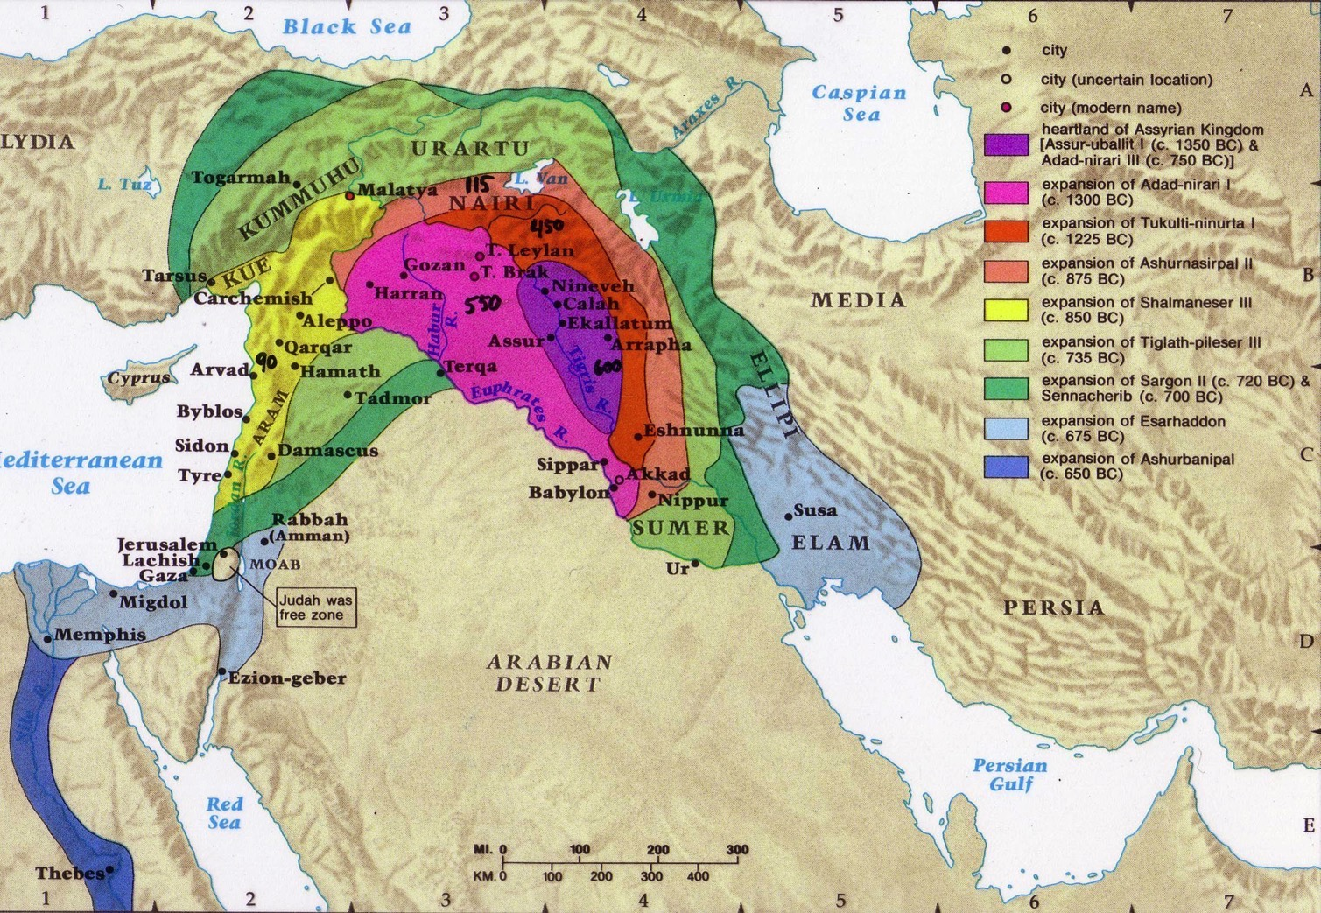
التوسع الآشوري
607

Slide 15
الإطار : القوة الآشورية
443
قوية 883-783
قوية 745-626
ضعيفة 790-745
900
850
800
750
700
650
600
550
500
يونان

Slide 16
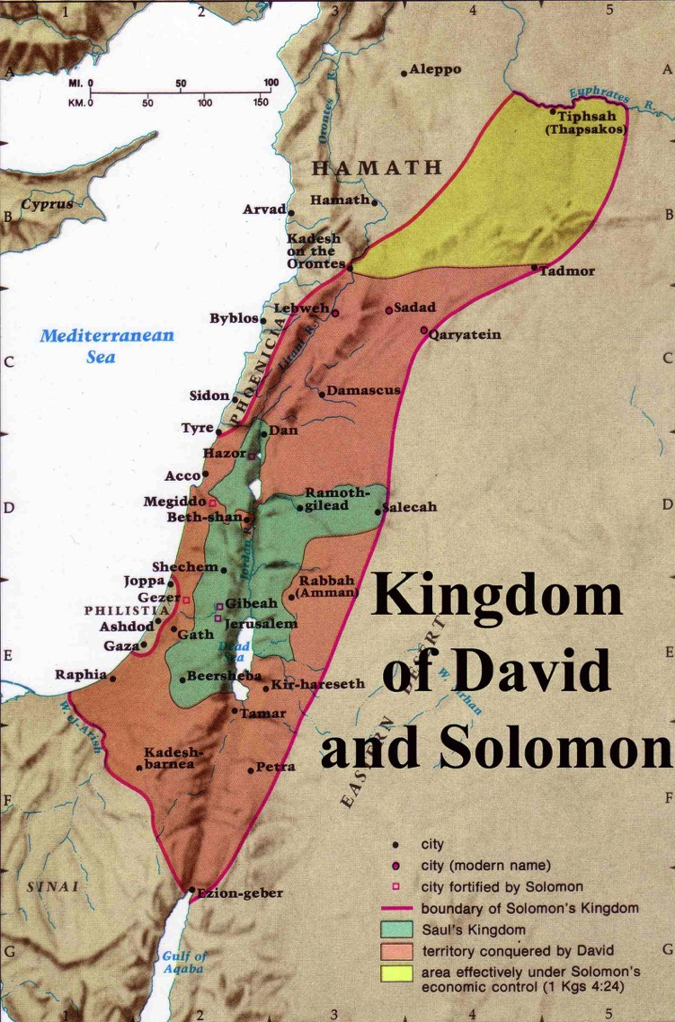
التوسع
تحت حكم
يربعام 2
446
يربعام 2
هو رد تخم إسرائيل من مدخل حماة إلى بحر العربة حسب كلام الرب إله إسرائيل الذي تكلم به عن يد عبده يونان بن أمتاي النبي الذي من جت حافر
(2 مل 14: 25(
* بالعبرية بحر العربة
يربعام 1 (930 ق.م)
مملكة شاول
مملكة داود
Notes:
The boundaries under Jeroboam II went even farther than David and Solomon, who only had tribute sent from Hamath.
____________
BE-30-Amos-14
BE-32-Jonah-16
OS-30-Amos-55
OS-32-Jonah-40

Slide 17

الله يحبك و يقدم خطة رائعة لحياتك?
Notes:
Not exactly Law #1: God loves you and has a wonderful plan for your life

Slide 18
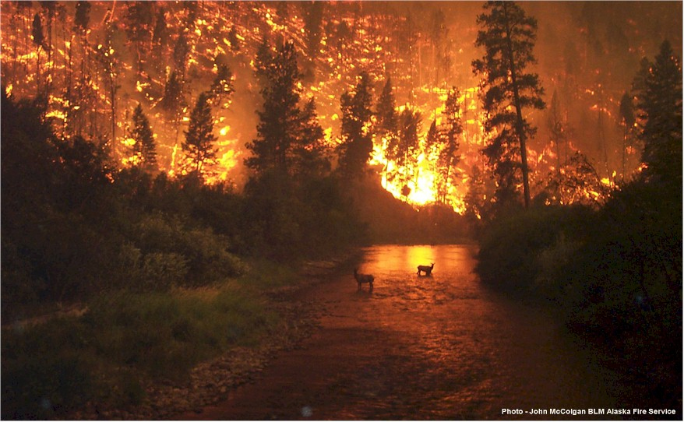
يا لها من رسالة ...
رسالة يونان ....
نينوى شريرة و الله غاضب
من الأفضل أن ترجعوا و إلا ستحرقون

Slide 19
يونان 1 : اذهب، لا
1. يأمر الله شعبه بإخبار الأشرار كم يكره خطيتهم
(1-2)
2. شعب الله أحياناً لا يريدون إخبار الأشرار أنهم أشرار (3)

Slide 20

أين سيذهب يونان ؟
ترشيش
نينوى
جت حافر
يافا

Slide 21
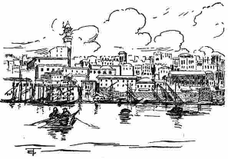
كانت يافا ميناء بحري هام
كان النزول إلى يافا هو السبيل للخروج من إسرائيل بالسفن - على عكس بطرس بعد 800 عام

Slide 22
يونان 1: اذهب، لا، إذاً تأديب
1. يأمر الله شعبه بإخبار الأشرار كم يكره خطيتهم (1-2)
2. شعب الله أحياناً لا يريدون إخبار الأشرار أنهم أشرار (3)
3. رفض الكرازة يأتي بالعواقب (4-16)

Slide 23
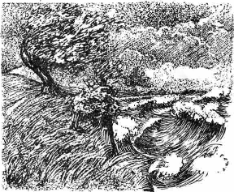
Raging Sea
Notes:
⁴ But the Lord hurled a powerful wind over the sea, causing a violent storm that threatened to break the ship apart. NLT

Slide 24
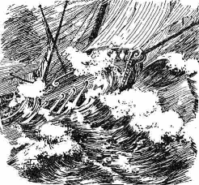
Ship Threatened to Break
Notes:
The Hebrew reads that the ship itself threatened to break up!

Slide 25
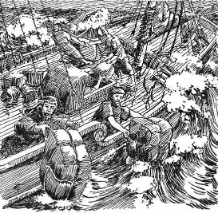
Cargo Overboard
Notes:
⁵ Fearing for their lives, the desperate sailors shouted to their gods for help and threw the cargo overboard to lighten the ship. NTL
The Bible in Pictures, drawn in 1922 but free to copy at www.creationism.org/books/

Slide 26
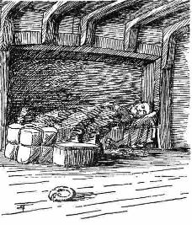
Jonah Sleeping
Notes:
But all this time Jonah was sound asleep down in the hold. ⁶ So the captain went down after him. "How can you sleep at a time like this?" he shouted. "Get up and pray to your god! Maybe he will pay attention to us and spare our lives."
NLT, Jon 1:5-6.
The Bible in Pictures, drawn in 1922 but free to copy at www.creationism.org/books/

Slide 27

Black
7 و قال بعضهم لبعض هلم نلقي قرعاً لنعرف بسبب من هذه البلية فألقوا قرعاً فوقعت القرعة على يونان
⁸ فقالوا له أخبرنا بسبب من هذه المصيبة علينا ؟ ما هو عملك ؟ و من أين أتيت ؟ ما هي أرضك ؟ و من أي شعب أنت ؟
9 فقال لهم أنا عبراني و أنا خائف من الرب إله السماء الذي صنع البحر و البر (1: 7-9)

Slide 28
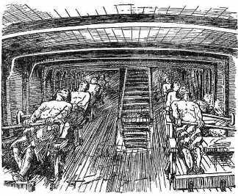
Sailors Rowing
Notes:
¹³ Instead, the sailors rowed even harder to get the ship to the land. But the stormy sea was too violent for them, and they couldn't make it (1:13 NLT).
The Bible in Pictures, drawn in 1922 but free to copy at www.creationism.org/books/

Slide 29
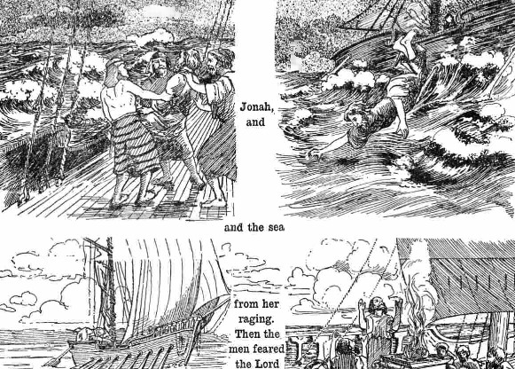
Jonah Overboard
Notes:
¹⁴ Then they cried out to the Lord, Jonah's God. "O Lord," they pleaded, "don't make us die for this man's sin. And don't hold us responsible for his death. O Lord, you have sent this storm upon him for your own good reasons."
¹⁵ Then the sailors picked Jonah up and threw him into the raging sea, and the storm stopped at once! ¹⁶ The sailors were awestruck by the Lord's great power, and they offered him a sacrifice and vowed to serve him (Jon 1:14-16 NLT).

Slide 30
كثيرا ما استخدم الله غزوات شعبه لتحويل الغزاة!
فترات التوسع المسيحي
الفترة 1
الفترة 2
الفترة 3
الفترة 4
الفترة 5
رومية
البربر
القراصنة
المسلمون
أقاصي الأرض
0
400
800
1200
1600
2000
رالف وينتر، الحركة المسيحية العالمية
Notes:
God has used invasions by pagan peoples to bring them the gospel. The Romans received the gospel from the early church, but kept it to themselves, so in the fifth century God had the barbarians to the north invade Rome. The result? Roman slaves shared Christ and won the barbarians to Christ! Four hundred years later the same thing happened. The barbarians, then Christian, refused to reach out to the Vikings to the north, and the Vikings invaded Europe and became Christians in the process! So who has invaded your life for God to use you?! Perhaps some international students?

Slide 31
الفكرة الرئيسية في يونان 1
رفض الكرازة
ياتي بالعواقب
لا يزال الله يستخدم
وسائل عديدة اليوم
ليرينا جديته بخصوص الكرازة

Slide 32
The Ten Million Dollar Question
سؤال العشرة مليون دولار
كيف يجب أن نتجاوب
مع صلاح الله
بالرغم من خطايانا ؟

Slide 33
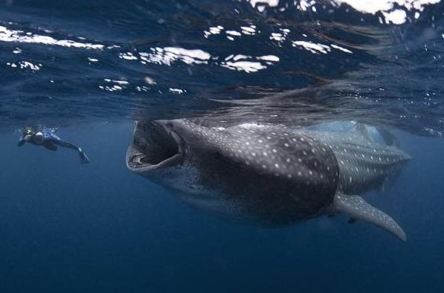
يونان 2
أشكر الله لشفقته عليك
بالرغم من خطيتك
Notes:
33
Your response to God's mercy on you as a sinful creature should be gratefulness.

Slide 34
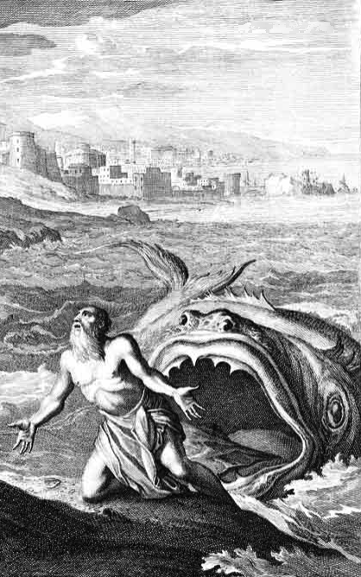
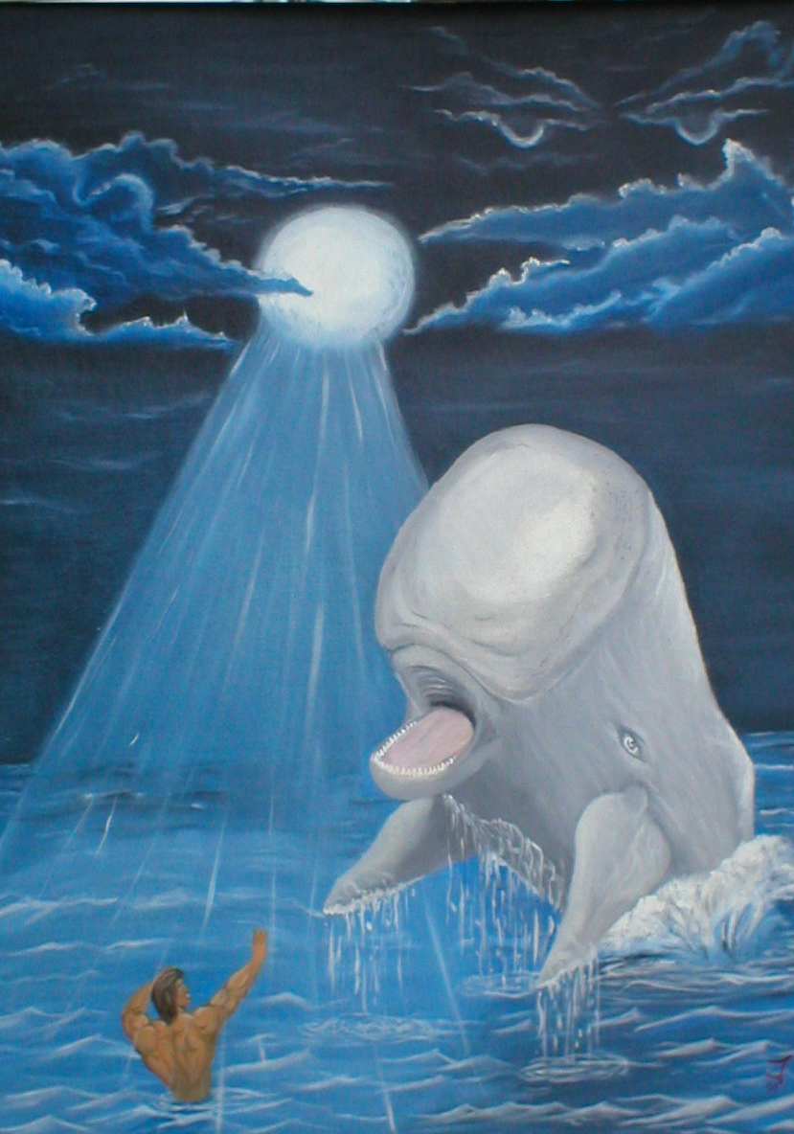
سمكة عظيمة ؟
سمك القرش ؟
الكتاب المقدس
حوتاً عظيماً
Notes:
34

Slide 35
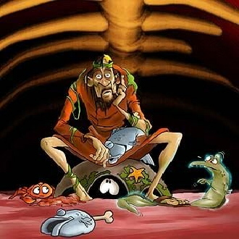
داخل الحوت
Notes:
35
What would he eat? I hope he liked sea food!
Could he really breathe in there? Wouldn't the oxygen run out?
No, provided an eco-system!

Slide 36
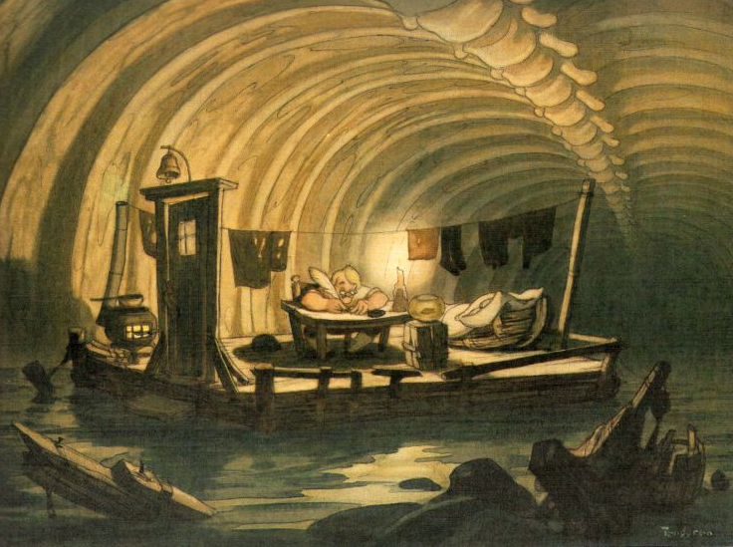
داخل الحوت
Notes:
36
Some think that Jonah had a writing ministry because of the things written in chapter 2. But I tend to think that these were written down later!
I'm not sure that he had a desk and lamp inside the fish.
Actually, the next slide is the best picture that I have seen that shows what it look like inside the fish…

Slide 37
Black
Notes:
37
Yeah, this is what it look like inside the fish.
But sometimes in the dark we see the light!
This is what happened to Jonah where the light finally turned on in his thinking.
We have this recorded in chapter 2.

Slide 38
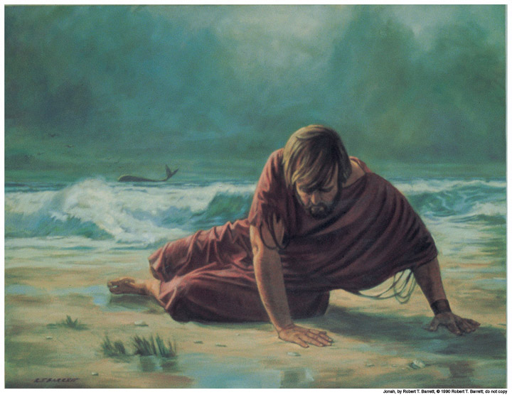
شكر يونان الله لإنقاذه من الغرق
(1: 17-2: 10)
ألن تفعل ؟

Slide 39
الدينونة ؟
الإنقاذ ؟
Notes:
39
Was the fish God's judgment on Jonah? Not at all!
It was the means of deliverance!

Slide 40
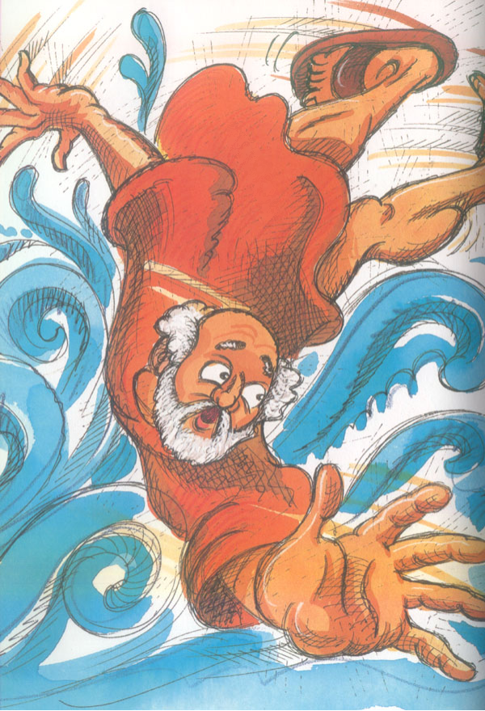
مزمور
شكر
الصلاة (1-2)
الرثاء (3-7)
النذر (8-9)
يونان 2
Notes:
40
Jonah 2 sounds much like a psalm in the book of Psalms. That is because it has the typical Hebrew structure of a thanksgiving psalm.

Slide 41
مزمور
شكر
الصلاة (1-2)
دعوت من
ضيقي الرب
فاستجابني
يونان 2
Notes:
41

Slide 42
مزمور
شكر
مزمور (1-2)
الرثاء (3-7)
لأنك طرحتني
(2: 3، 1: 4و5و12و15)
يونان 2
Notes:
42

Slide 43
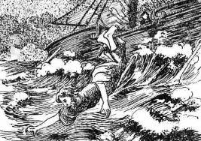
"النزول"
في يونان
فنزل إلى يافا
(1: 3أ)
نزل إلى جوف السفينة
(1: 5)
نزلت إلى أسافل الجبال
(2: 6)

Slide 44
مزمور
شكر
الصلاة (1-2)
الرثاء (3-7)
النذر (8-9)
يونان 2
Notes:
44

Slide 45

نذر يونان
أما أنا فبصوت الحمد أذبح لك و أوفي بما نذرته للرب الخلاص
(2: 9)

Slide 46

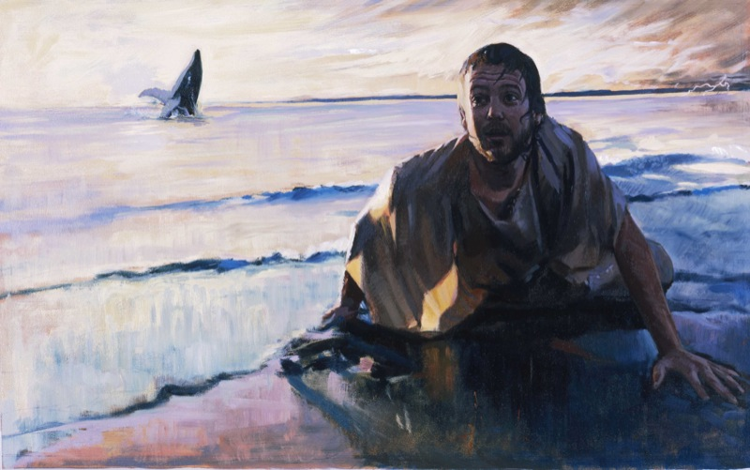
النتيجة : تقيأ الحوت يونان
DRESSING
THE
STAGE
MS
SG
ER
"THE LAND"
DS
PG
RS
Handbook pg. 15-16
25
Notes:
46

Slide 47
The Ten Million Dollar Question
سؤال العشرة مليون دولار
كيف يجب أن نتجاوب
مع صلاح الله
بالرغم من خطيتنا ؟

Slide 48
يجب أن نشكر الله أه يحفظنا بالرغم من عصياننا

Slide 49
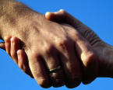
تمييز بعض المصطلحات الأساسية
النعمة : الله يعطينا ما لا نستحق
الرحمة : الله لا يعطينا ما نستحقه
العدل : الله يعطينا ما نستحقه
Notes:
49
So what have I learned? Everything I am, have, and do—it's all because of God's grace. Who would have ever thought that this shy boy—from a broken home whose parents and those they have married have endured 12 divorces—who would ever thought that this guy would be privileged to serve Him at SBC and beyond?

Slide 50

The Big Idea
الفكرة الكبيرة في يونان 2
اشكر الله
لأن رحمته
تلقي بظلالها
على عدله

Slide 51
اذهب أنت، قف
يونان 3
شارك رسالة الله
لأن الناس يستجيبون
Notes:
51

Slide 52
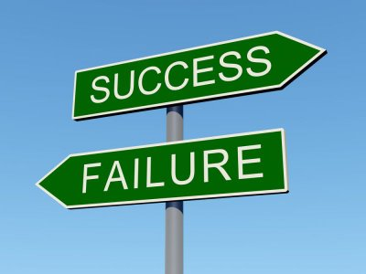
Success - Failure
النجاح
الفشل
Notes:
52
Susan's 10th HS reunion had one student retire at age 28
Christopher Lee's HS reunion in HK passed out business cards—"vice president...CEO…Prime Minister" then "SBC prof" so they paid for his lunch
Dad's 25th HS reunion—man voted most likely to succeed could not come as the warden would not let him out of prison!

Slide 53
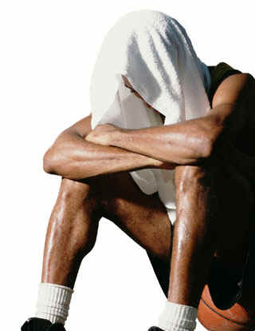
هل تخاف
ا
ل
ف
ش
ل
؟
Notes:
53
One western journalist referred to Singapore as a "city of fear"—fear of breaking the law, fear of not making the grade, fear of not having enough money, etc.
Years ago Lee Kuan Yew noted that Singaporeans are not risk-takers in business.

Slide 54
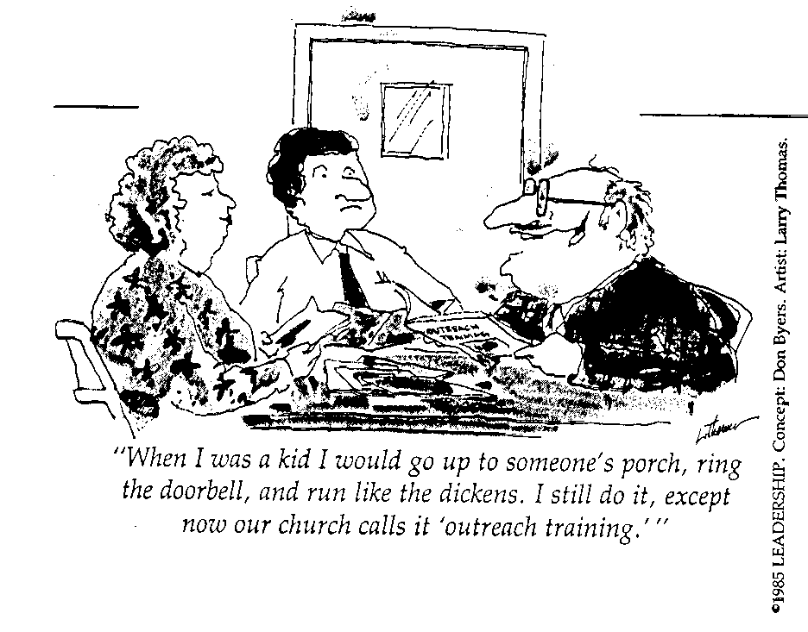
الكثيرون يخشون الكرازة
"عندما كنت طفلاً ، كنت أصعد إلى شرفة أحد الأشخاص ، وأقرع جرس الباب ، وأركض مثل الدواجن. ما زلت أفعل ذلك ، باستثناء الآن تسميه كنيستنا" تدريب الوصول ".

Slide 55
كيف ينظر الله إلى الفشل – خصوصاً في الكرازة ؟
Notes:
What does the Lord think of us when we ignore his promptings to witness?
How does he respond when we are unfaithful in bringing his message?
55

Slide 56

فشل يونان في الذهاب أولاً
Notes:
If anyone knows about failure, it's Jonah !
56

Slide 57
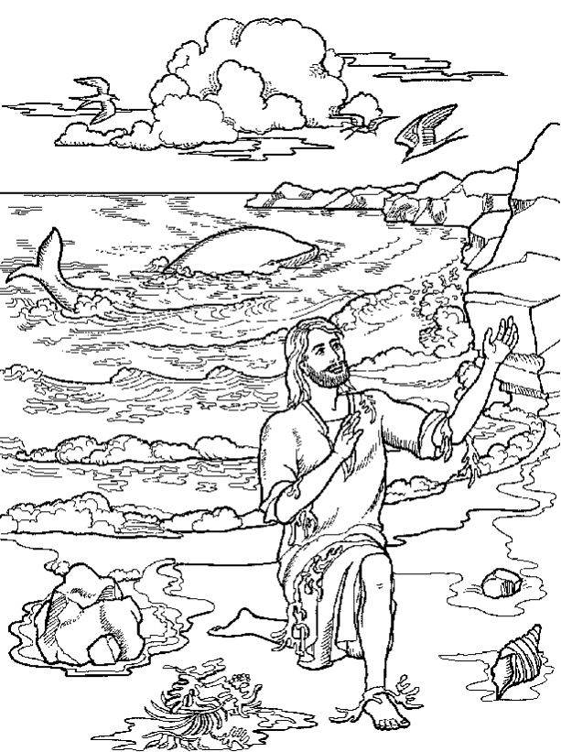
يونان 3 : اذهب
1. اذهب : الله إله الفرصة الثانية للمرسلين غير الأمناء (1-2)
Notes:
57
In his grace he doesn't beat us over the head when we fail to witness—he often gives us more opportunities
Then the Lord spoke to Jonah a second time: ² "Get up and go to the great city of Nineveh, and deliver the message I have given you." (3:1-2 NLT)

Slide 58
"لا يمكنك العثور على مكان واحد في الكتاب المقدس حيث تم إرسال رجل للقيام بعمل فشل فيه"
د. ل. مودي

Slide 59
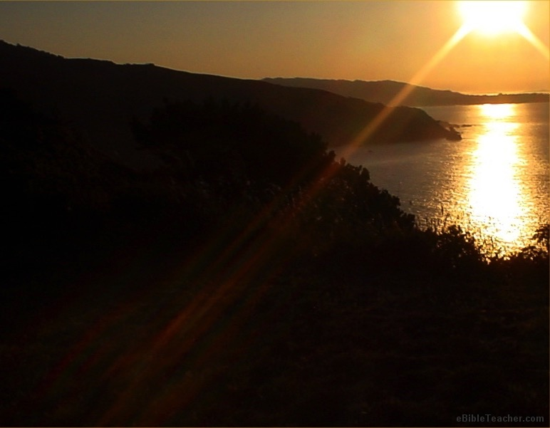
إله الفرصة الثانية
إبراهيم
موسى
داود
بولس
يوحنا مرقس

Slide 60
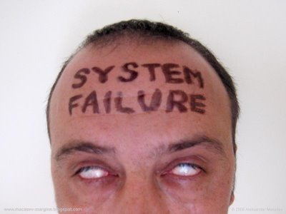
الفشل حدث – و ليس شخص
Notes:
60

Slide 61
يونان 3 : اذهب
1. اذهب : الله إله الفرصة الثانية للمرسلين غير الأمناء (1-2)
2. شعب الله خاصة يجب أن يعلنوا رسالته لهؤلاء الذين لم يسمعوها أبداً (3-4)
Notes:
61

Slide 62



مدينة
نينوى
602
رحوبوت عير
حجم سنغافورة
نينوى الحقيقية
مدينة
نينوى
العظيمة
رصن
كالح
تكوين 10: 11-12
0
كيلومتر
20
Notes:
"This time Jonah obeyed the Lord's command and went to Nineveh, a city so large that it took three days to see it all" (3:3 NLT).
There's a problem here regarding the three-day's journey (cf. OTS, 602). Nineveh's inner wall was less than eight miles, so the diameter of the city was only two miles—hardly a three-day journey. One day's journey in the open was usually 15-20 miles (Hannah, BKC, 1:1463).
But this isn't really a problem in either of two ways:
"The great city of Nineveh" (1:2; 3:2; cf. 4:11) almost surely included three other towns in the vicinity as well. Four cities (Nineveh, Rehoboth Ir, Calah, and Resen) are mentioned in Genesis 10:11-12 as "the great city" and they still exist today with different names (Kouyunjik, Khorsbad, Nimroud, and Karamles). This can be observed on the following map by Austin Henry Layard, Nineveh and Its Remains, 2:40.
If we superimpose a map of Singapore over it, we can see that walking through Nineveh would be like walking in Singapore from the far north in Yishun to Harbourfront in the south. That could take 3 days easily!
62

Slide 63
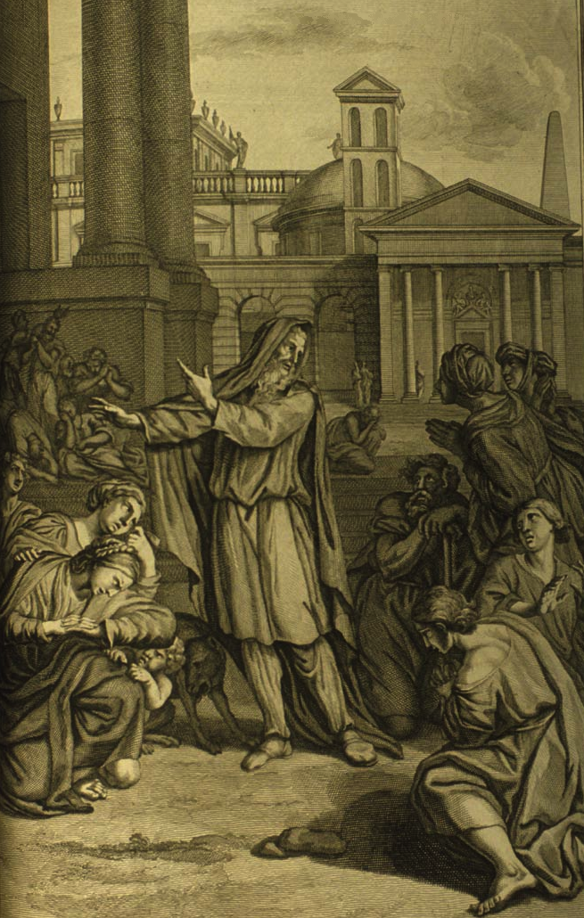

بعد أربعين يوماً تنقلب نينوى
(رسالة عبرية من
خمس كلمات)
`tk,Ph.n< hwEßn>ynI)w> ~Ayë ~y[iäBr>a; dA[
Notes:
63
http://www.mythfolklore.net/lahaye/150/LaHaye1728Figures150JonahIII4JonahEntersNiniveh.jpg

Slide 64
يونان 3 : اذهب
1. اذهب : الله إله الفرصة الثانية للمرسلين غير الأمناء (1-2)
2. شعب الله خاصة يجب أن يعلنوا رسالته لهؤلاء الذين لم يسمعوها أبداً (3-4)
3. نتائج المشاركة عن الله غالباً إيجابية بطريقة مدهشة
Notes:
64
⁵ The people of Nineveh believed God's message, and from the greatest to the least, they declared a fast and put on burlap to show their sorrow.
⁶ When the king of Nineveh heard what Jonah was saying, he stepped down from his throne and took off his royal robes. He dressed himself in burlap and sat on a heap of ashes. ⁷ Then the king and his nobles sent this decree throughout the city:
"No one, not even the animals from your herds and flocks, may eat or drink anything at all. ⁸ People and animals alike must wear garments of mourning, and everyone must pray earnestly to God. They must turn from their evil ways and stop all their violence. ⁹ Who can tell? Perhaps even yet God will change his mind and hold back his fierce anger from destroying us."
¹⁰ When God saw what they had done and how they had put a stop to their evil ways, he changed his mind and did not carry out the destruction he had threatened (3:5-10 NLT)

Slide 65
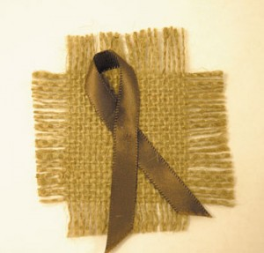
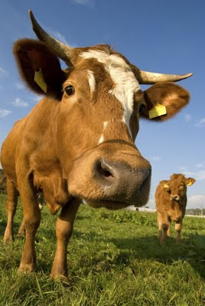

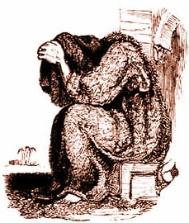
ماذا فعلت ؟
يونان 3: 5-10
Notes:
65
⁵ The people of Nineveh believed God's message, and from the greatest to the least, they declared a fast and put on burlap to show their sorrow.
⁶ When the king of Nineveh heard what Jonah was saying, he stepped down from his throne and took off his royal robes. He dressed himself in burlap and sat on a heap of ashes. ⁷ Then the king and his nobles sent this decree throughout the city:
"No one, not even the animals from your herds and flocks, may eat or drink anything at all. ⁸ People and animals alike must wear garments of mourning, and everyone must pray earnestly to God. They must turn from their evil ways and stop all their violence. ⁹ Who can tell? Perhaps even yet God will change his mind and hold back his fierce anger from destroying us."
¹⁰ When God saw what they had done and how they had put a stop to their evil ways, he changed his mind and did not carry out the destruction he had threatened (3:5-10 NLT)

Slide 66
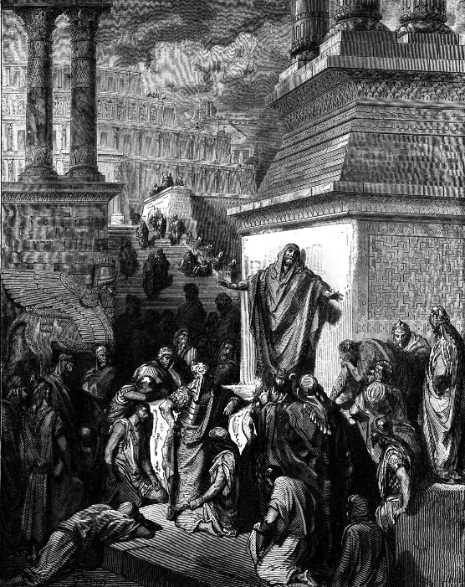
يونان في
بلاد العجائب
"ويا لها من نتيجة رائعة أعقبت وعظه! لم يتمكن أعظم الأنبياء في إسرائيل من تحقيق أي شيء كهذا ... نحن في بلاد العجائب! بالتأكيد هذا ليس سجلًا لأحداث تاريخية فعلية ولم يُقصد به ذلك على الإطلاق. إنه كذلك إثم ضد المؤلف أن يتعامل مع ما قصده من الشعر على أنه نثر حرفي ".
(يوليوس أ. بيور، تعليق تفسيري نقدي
لسفر يونان، 3-4)
Notes:
66
http://www.mythfolklore.net/lahaye/150/LaHaye1728Figures150JonahIII4JonahEntersNiniveh.jpg

Slide 67
التحضير للتوبة
605
أحداث أدت لتوبة نينوى في 758 ق.م :
787 بدأت العبادة التوحيدية لنبو
765 ضربة في كل آشور
763 تمرد في مدينة آشور
763 كسوف الشمس
762 تمرد في مدينة آشور
761 تمرد في مدينة عرفة
760 تمرد في مدينة عرفة
759 ضربة أخرى
758 سلام في الأرض (التوبة بقيادة يونان ؟)
Notes:
67

Slide 68
الناس أكثر تجاوباً
مما تعتقد
الفكرة الرئيسية في
يونان 3
Notes:
Tom Roxas led the murderer of his brother Nino to Christ.
Ralph Neighbor's Singapore survey of why people aren't Christians led him to weep at his desk as 85% said, "No one has ever explained to me the issues involved."
"If you don't show, you'll never know."
"Most of us are so full of tact that we never make contact" —George Sweeting, MBI

Slide 69
Book Chart
يونان
رحمه وتعاطف الله على الامم
عصيان المهمة التفويضية |  |  |  | اطاعة المهمة التفويضية
اصحاحات ١-٢ |  |  |  | اصحاحات ٣-٤
الله يرحم يونان |  |  |  | الله يرحم نينوى
البحر العظيم |  |  |  | المدينه العظيمة
التكليف ١: ١-٢ | عدم الطاعه ١: ٣ |  | النتائج ١: ٤ – ٢: ١٠ | اعاده التكليف ٣: ١ | الطاعه ٣: ٣-٤ |  | النتائج ٣: ٤ - ٤: ١٠
" أذهب!" | "لا!" |  | "So Row!" "Lo!" | "أذهب!" | "حسنا!" |  | "Whoa!" "Oh No!"
يونان ينحرف الاصحاح ١ ( يريد ان الموت) |  | يونان يصلي الاصحاح ٢ ( يريد ان يعيش) |  | يونان يعظ الاصحاح ٣ ( يريد ان يعيش) |  | يونان يغتاظ الاصحاح ٤ (يريد ان يموت )
حوالي ٧٦٠ قبل الميلاد
599

Slide 70
أوه، لا
يونان 4
أظهر شفقة أعظم على الناس لا الأشياء
Notes:
70

Slide 71
تشدد يونان في الأمور
ونسي الناس (4: 1-9).

Slide 72
أ. اهتمام الله كان بخصوص نينوى لكن خلاصها جعل يونان غاضباً (4: 1-4)
603
الآية المفتاحية
و صلى إلى الرب و قال آه يا رب أليس هذا كلامي إذ كنت بعد في أرضي لذلك بادرت إلى الهرب إلى ترشيش لأني علمت أنك إله رؤوف و رحيم بطيء الغضب و كثير الرحمة و نادم على الشر (4: 2)
Notes:
72
Jonah's theology about God is correct—and I think 4:2 is the key verse of the book.
Most of us fear failure, but Jonah feared success! He feared that the Ninevites might repent—and they did!
But why was he angry? He wanted the people judged!

Slide 73
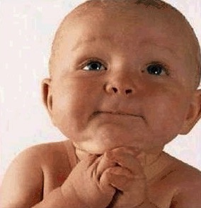
عزيزي الله، أرجوك
امنحني الحكمة لأتفهم مديري
امنحني المحبة لأسامحه
امنحني الصبر لأتفهم تصرفاته
لكن يا إلهي الأعز لا تمنحني القوة
لأنك إذا منحتني القوة
سأحطم رأسه
Notes:
Jonah was powerless too.

Slide 74

هدسون
تايلور
Notes:
74
Like God, Hudson Taylor was a man who had compassion on lost people too [adapted from Hudson Taylor, A Retrospect, 85-87, in Evangelism notes, 18]:
Among the passengers on board the boat was one intelligent man, who in the course of his travels had been a good deal abroad, and had even visited England, where he went by the name of Peter. As might be expected he had heard something of the Gospel, but had never experienced its saving power. On the previous evening I had drawn him into earnest conversation about his soul's salvation. The man listened with attention, and was even moved to tears, but still no definite result was apparent. I was pleased, therefore, when he asked … to accompany me, and to hear me preach.
I went into the cabin of the boat to prepare tracts and books for distribution on landing with my Chinese friend, when suddenly I was startled by a splash and cry from without. I sprang on deck and took in the situation at a glance. Peter was gone! The other men were all there, on board, looking helplessly at the spot where he had disappeared, but making no effort to save him. A strong wind was carrying the junk rapidly forward in spite of a steady current in the opposite direction, and the low-lying shrub less shore afforded no landmark to indicate how far we had left the drowning man behind.
I instantly let down the sail and leapt overboard in the hope of finding him. Unsuccessful, I looked around in agonizing suspense, and saw close to me a fishing-boat with a peculiar drag-net furnished with hooks, which I knew would bring him up.
"Come!" I cried, as hope revived in my heart. "Come and drag over this spot directly; a man is drowning just here!"
"Veh bin" (It is not convenient), was the unfeeling answer.
"Don't talk of convenience!" I cried in an agony; "a man is drowning I tell you!"
"We are busy fishing," they responded, "and cannot come."
"Never mind your fishing," I said, "I will give you more money than many a day's fishing will bring; only come—come at once!"
"How much money will you give us?"
"We cannot stay to discuss that now! Come, or it will be too late. I will give you five dollars."
"We won't do it for that," replied the men. "Give us twenty dollars, and we will drag."
"I do not possess so much; do come quickly, and I will give you all I have!"
"How much may that be?"
"I don't know exactly, about fourteen dollars."
At last, but even then slowly enough, the boat was paddled over, and the net let down. Less than a minute sufficed to bring up the body of the missing man. The fisherman were clamorous and indignant because their exorbitant demand was delayed while efforts at resuscitation were being made. But all was in vain—life was extinct.
To myself this incident was profoundly sad and full of significance, suggesting a far more mournful reality. Were not those fishermen actually guilty of this poor Chinaman's death, in that they had the means of saving him at hand, if they would have but used them? Assuredly they were guilty. And yet, let us pause [before] we pronounce judgment against them lest a greater than Nathan answer, "Thou art the man." Is it so hard-hearted, so wicked a thing to neglect to save the body? [Isn't he much worse who leaves the soul to perish, and like Cain says], "Am I my brother's keeper?"
The Lord Jesus commands, commands me, commands you, my brother, and you, my sister. "Go," says He, "go ye into all the world, and preach the Gospel to every creature." Shall we say to Him, "No, it is not convenient"? shall we tell Him that we are busy fishing and cannot go? that we have bought a piece of ground and cannot go? that we have purchased five yoke of oxen, or married, or are engaged in other and more interesting pursuits, and cannot go? [Before] long "we must all appear before the judgment seat of Christ; that every one may receive the things done in his body." Let us remember, let us pray for, let us labour for the unevangelised Chinese; or we shall sin against our own souls.

Slide 75

عبوس
يونان
اهتم يونان بالنباتات، و لهذا فإن دمارها جعله غاضباً (4: 5-9)
Notes:
I wonder how long he planned on staying there—forty days like in 3:4?

Slide 76
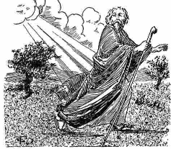
ذهب
يونان
شرقي
المدينة
Notes:
76
You would think he would go west back to Israel, right?

Slide 77
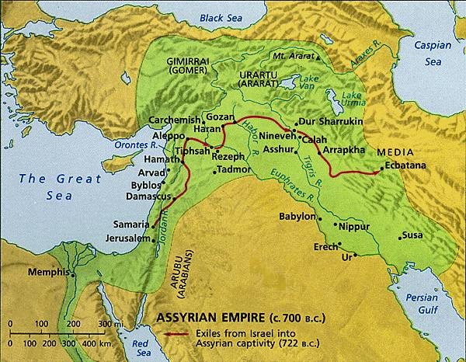
لماذا جلس يونان شرقي المدينة ؟
607
ربما كان يعتقد أن دينونة الله ستأتي من أورشليم في الغرب وأنه لا يريد أن يكون في الطريق!
Notes:
77

Slide 78
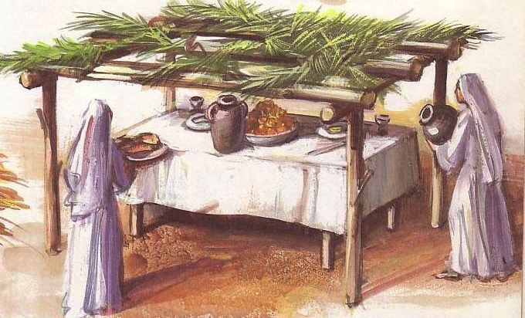
عيد المظال (السقائف)
Notes:
He knew how to make shelters since he did this once a year for the Feast of Booths when Israelites lived for a whole week in a small shelter outside their homes

Slide 79
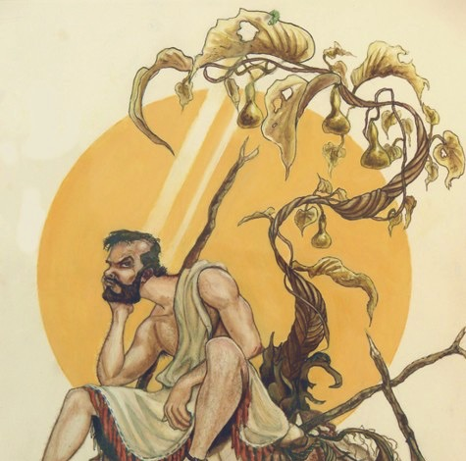
مهاجمة
و احتراق
Notes:
Some think this is a castor oil plant that grows 8 feet in five months.
But this is a miraculous one that grew in but a few minutes or hours.
79

Slide 80
التلاعب
بالكلمات
الله ...
612
• أعد حوتاً (1: 17)
• أعد نبتة (4: 6)
• أعد دودة (4: 7)
• أعد ريحاً (4: 8)
Notes:
There's a word play in Jonah with the word "appoint"…
80

Slide 81
مهاجمة و
احتراق
• الدودة هاجمت النبتة (4: 7)
• الشمس هاجمت رأس يونان (4: 8)
Notes:
There's another word play here because it literally says,
"The worm attacked the plant and the sun attacked Jonah."
What a turn of events…
81

Slide 82
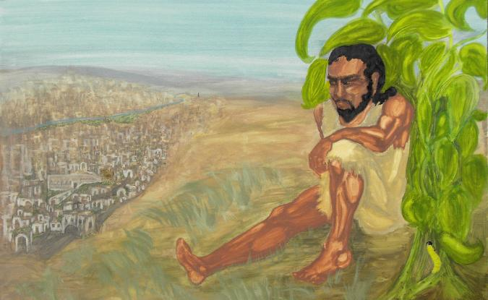
يا له من تحول في الأحداث
الإصحاح 1 : رسالة يونان
نينوى شريرة و الله غاضب
من الأفضل أن ترجعوا و إلا ستحرقون
الإصحاح 4 : معاناة يونان
الله سعيد و يونان غاضب
نينوى رجعت و يونان احترق

Slide 83
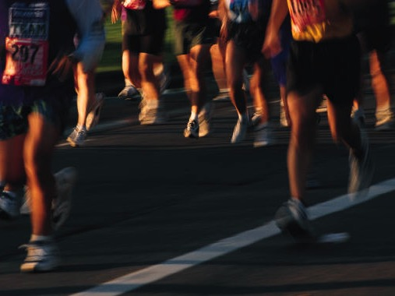

ضع الناس فوق الأشياء (4: 10-11)
Notes:
We should be "people people" rather than "things people."
Read verses 10-11
83

Slide 84

الأشياء ؟ أم الأشخاص ؟
Notes:
A. We, like Jonah, are often more concerned about things than people (4:10).
Actually, we don't try to be concerned for earthly things—we just try to be concerned for everything all at once. Reminds me of the old TV show where a man put a plate on a stick and begun to spin it. He got it going and then did the same with a second plate. On and on until he had about five plates. Of course, plate #1 began to wobble, so he went back to it to give it another spin. As each plate was about to fall, he'd spin it more. Eventually he had 10 plates spinning on sticks!
This reminds me of my life. Once I get a few things "spinning" well, others begin to wobble and I have to give them attention. It takes a great deal of energy to keep all the plates spinning at the same time!

Slide 85

4:10 NLT
الأشياء ؟ أم الأشخاص ؟
فقال الرب : أنت شفقت على اليقطينة التي لم تتعب فيها و لا ربيتها التي بنت ليلة كانت و بنت ليلة هلكت (4: 10)
Notes:
Jonah was not spinning plates here, though.
He was actually enjoying the blessings of God's goodness. The Lord pointed out that he didn't plant or care for this plant.
I guess we also can get used to God's goodness and resent it when he takes something away—as if we deserved this blessing.
In the meantime, we are crazy about improving everything—almost.
Must we have a car—or a better car?
Renovating the kitchen tile in their house seems to really matter to people now!
A farmer advertised, "Farmer seeks wife—with tractor. When applying, please send picture…of tractor" (PRIORITIES marriage).
During a professional golf tournament, a branch fell at the green, killing a spectator below. A reporter interviewed the pro afterwards, who commented, "At that point, all of a sudden, making a 3-foot putt didn't really matter anymore" (PRIORITIES death rearranges)
85

Slide 86
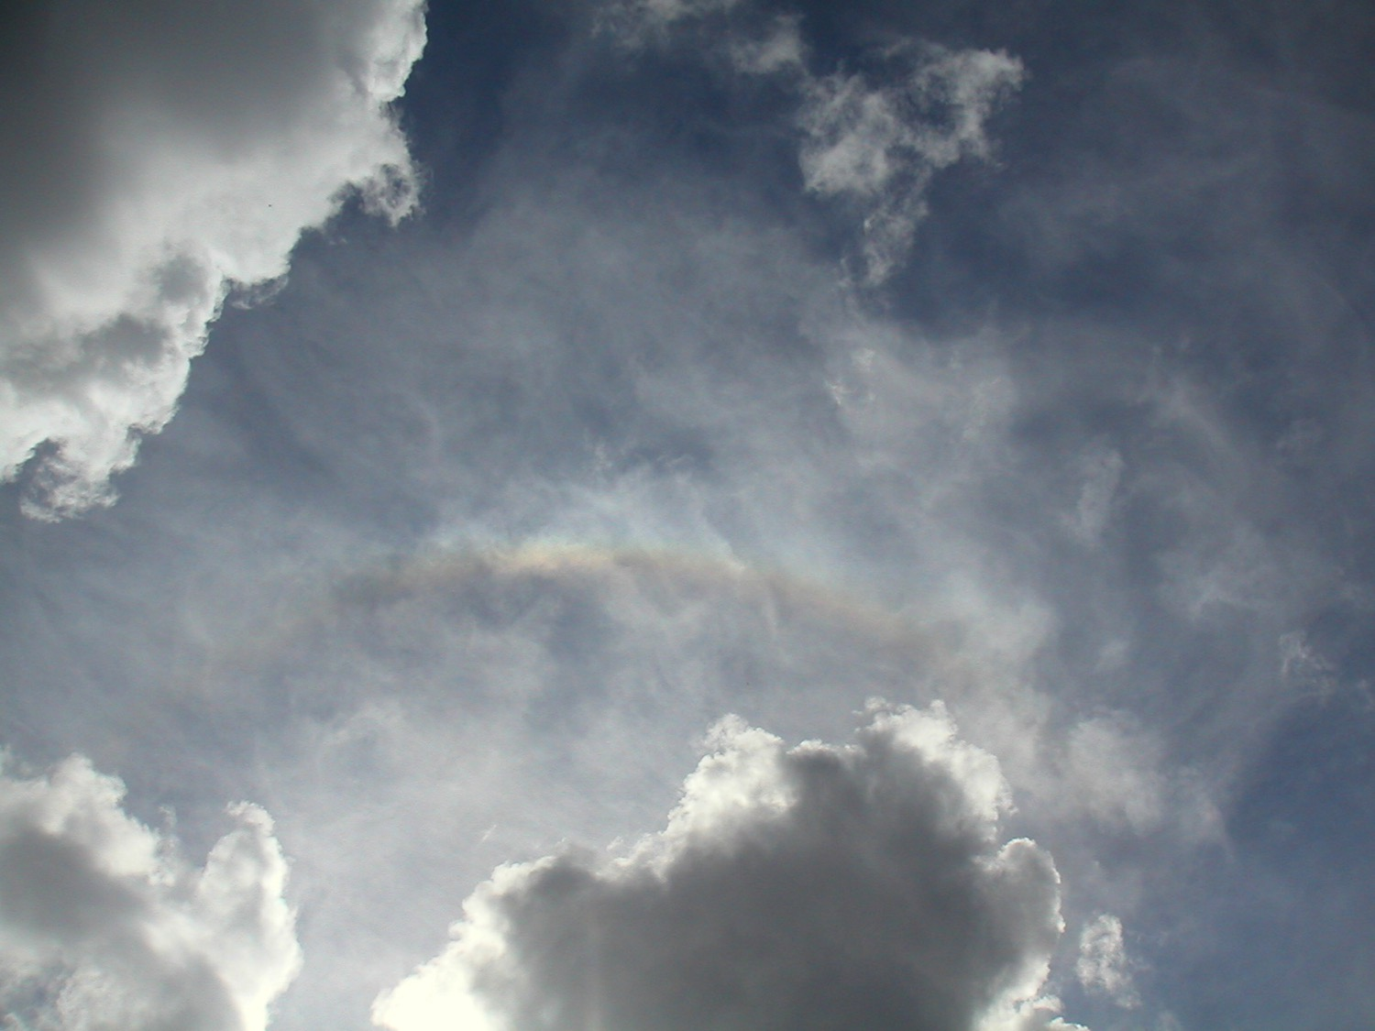
ثلاثة أمور فقط هي أبدية :
1. الله
2. كلمة الله
3. الناس
فأين تستثمر حياتك ؟

Slide 87

أفلا أشفق أنا على نينوى المدينة العظيمة التي يوجد فيها أكثر من اثنتي عشرة ربوة من الناس
يونان
الله
دينونة 120000
أنت أشفقت على اليقطينة
خلاص 120000
برابرة
سذج
من يهتم بحيواناتهم ؟
أنا أهتم
و بهائم كثيرة ؟
Notes:
87
B. We need to be like God, who is always more concerned about people than things (4:11).

Slide 88
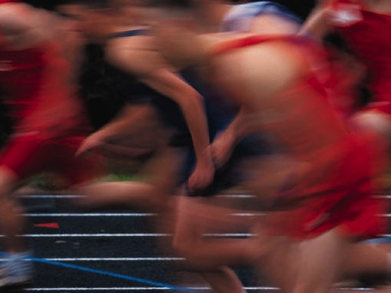
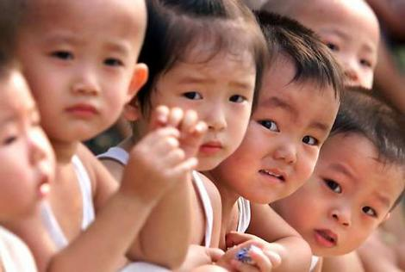
كيف يمكنك أن تمتلك شفقة الله على الناس ؟
وقتك
مالك
نظرتك
أذنك
إذا لم تشارك، فأنت لا تهتم
Notes:
Your time—keep an open door for conversation. Are you available when someone wants to talk? Or do the numerous tasks get in the way? While preparing this message, a neighbor of mine came over six nights in a row to talk about difficulties he's having with his son. So many times I wanted to say, "Hey, I can't afford this much time with you. I have to go prepare a message on giving people priority!"
Your money—is it invested in things or people? Do you give God your first fruits or your leftovers after you spend money on yourself?
Your view—how do you see people? We often see people's attractiveness, social status, or race. But I encourage you to see people not for what they are now, but what they will become after death—see that person as radiant, happy, eternally blessed in a place beyond imagination, or see the person as despondent, wretched, eternally suffering among flames. Take every chance to share the gospel.
Your ear—To see if you are compassionate, ask the person closest to you, "Am I a person of compassion?" Ask him or her right now if he or she is right next to you. Look for a nod and then the other person can ask the same question of you. If you're afraid to ask the question, you already know the answer.
88

Slide 89
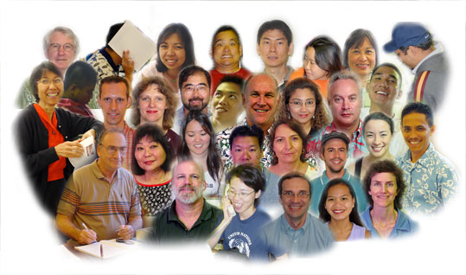
نقطة يونان :
599
اجعل الناس الأولوية الأولى في حياتك
التجاوب مع قلب الله يعني التشبه بقلبه نحو الضالين
Notes:
People are God's first concern—so people should be our first concern.
Imitate God's compassion for people by considering people more important than things.
Do you need to let some plates break?

Slide 90
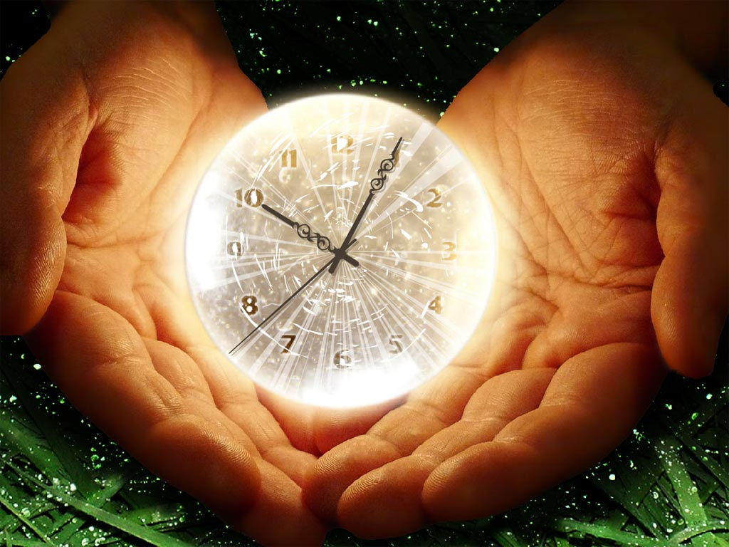
أسئلة للتفكير
599
ما هو التوازي الذي تراه بين حياتك و يونان ؟
ما الذي يجعل المؤمنين و خصوصاً القدامى منهم يفقدون شفقتهم على الضالين ؟
ما هي الممارسات التي وجدتها مساعدة لك لتحافظ على شفقتك نحو غير المؤمنين ؟
Notes:
90

Slide 91
Black
Notes:
91
Let's bow in prayer. But before we pray, honestly consider two questions:
Do others know you as compassionate—a "people person"? Why or why not?
2. What concern in your life hinders your concern for people? Studies? Perfectionism? A hobby which gobbles all your time? Not being able to say "no" to non-people-oriented tasks?
"Father, thank you for setting the example in your compassion on us. But help us to follow well in this area. May our comfort of persons be more important than our personal comforts. Show us how temporal things of this world really are—and how eternal people are—those for whom your Son died. In His precious name, Amen."

Slide 92


عظات العهد القديم at BibleStudyDownloads.org
أحصل على العرض التقديمي و النص مجاناً

