Slide 1
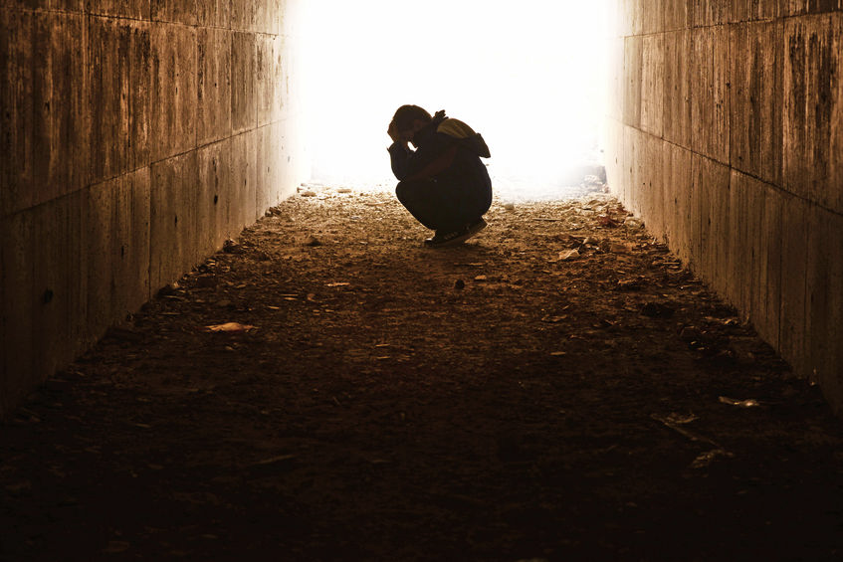
كُنْ متعزيا
كونوا مُتعزين
كُنْ مُتعزين
إرميا-كونوا مُتعزين
إرميا
د. ريك جريفيث . كنيسة ملتقى الطرق الدولية سنغافورة
BibleStudyDownloads.org
Notes:
Dr. Rick Griffith • Crossroads International Church Singapore
CICFamily.com • BibleStudyDownloads.org

Slide 2
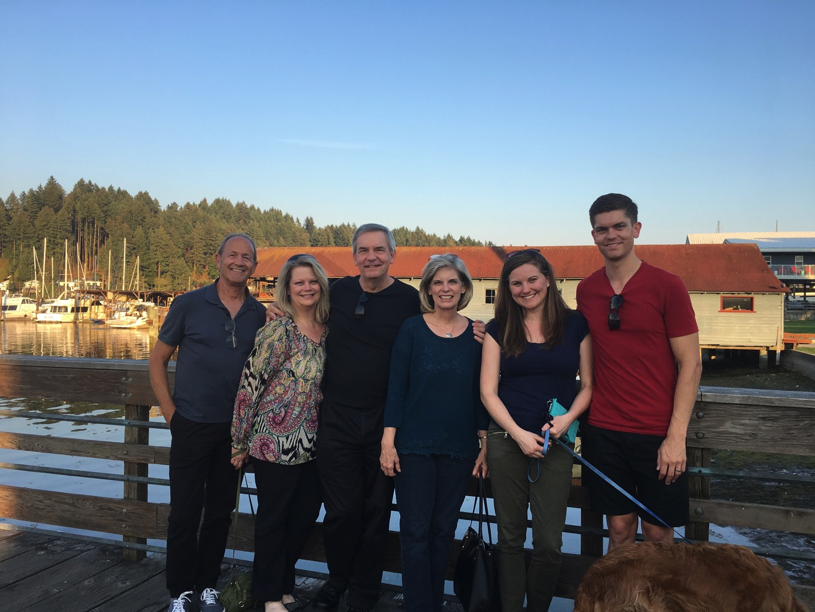
سفر 3 أيام، زيارة 4 أيام
Notes:
It is wonderful to be with you all again after taking a week off to be with my family in the USA. This is a first for us—three days of flying to have four and half days with my family—but when a $4000 trip costs only $100 now since our son is a pilot, we had little excuse not to go!

Slide 3
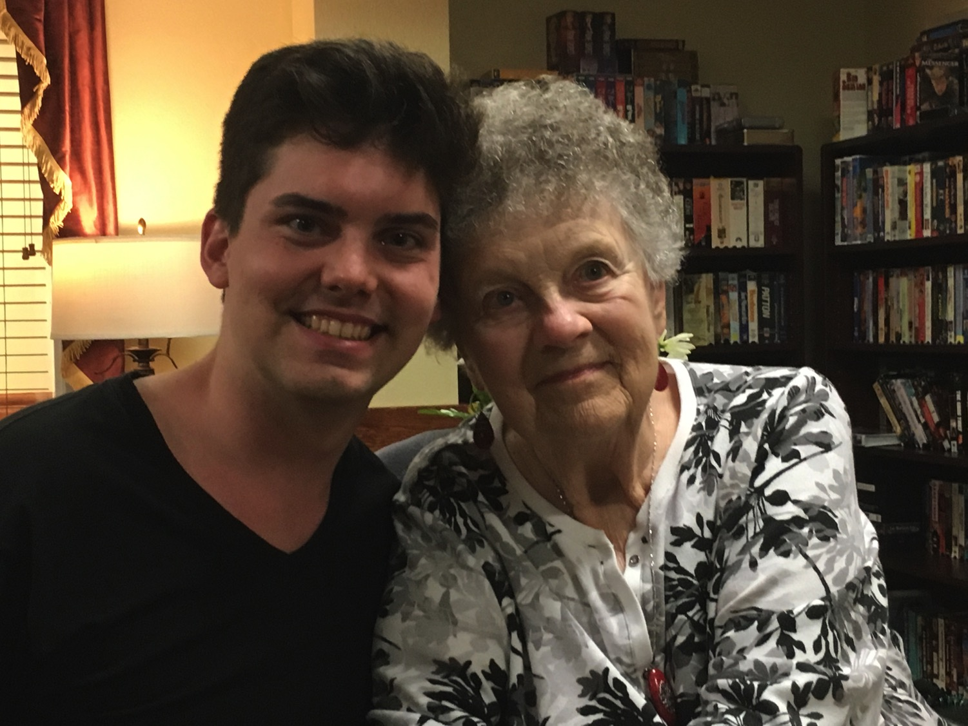
We all need to be comforted
Notes:
We had special times with our youngest son John and Susan's mother.

Slide 4
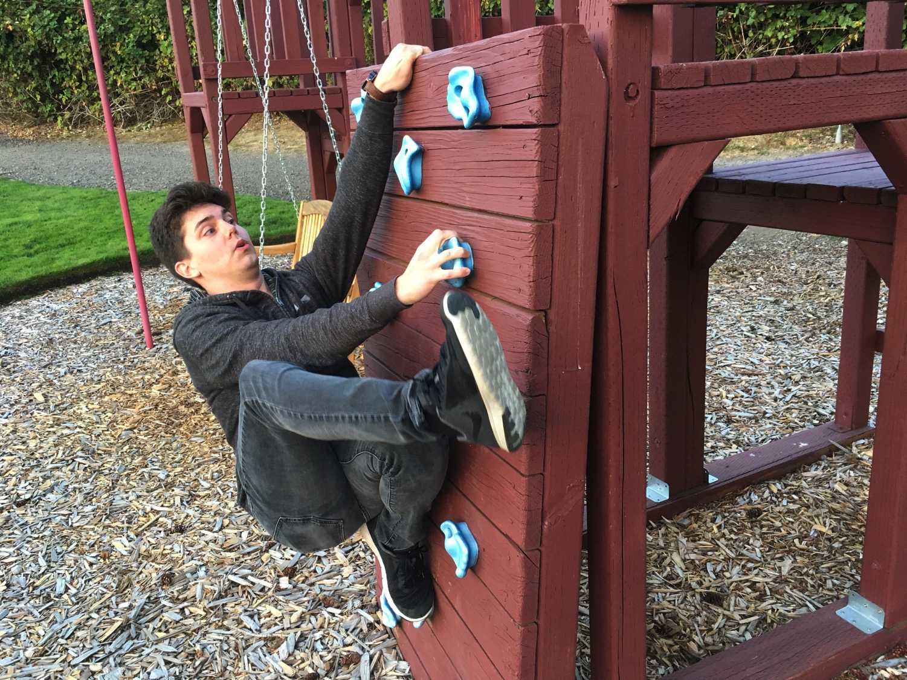
3-day travel, 4-day visit
Notes:
John even showed off his climbing skills.

Slide 5
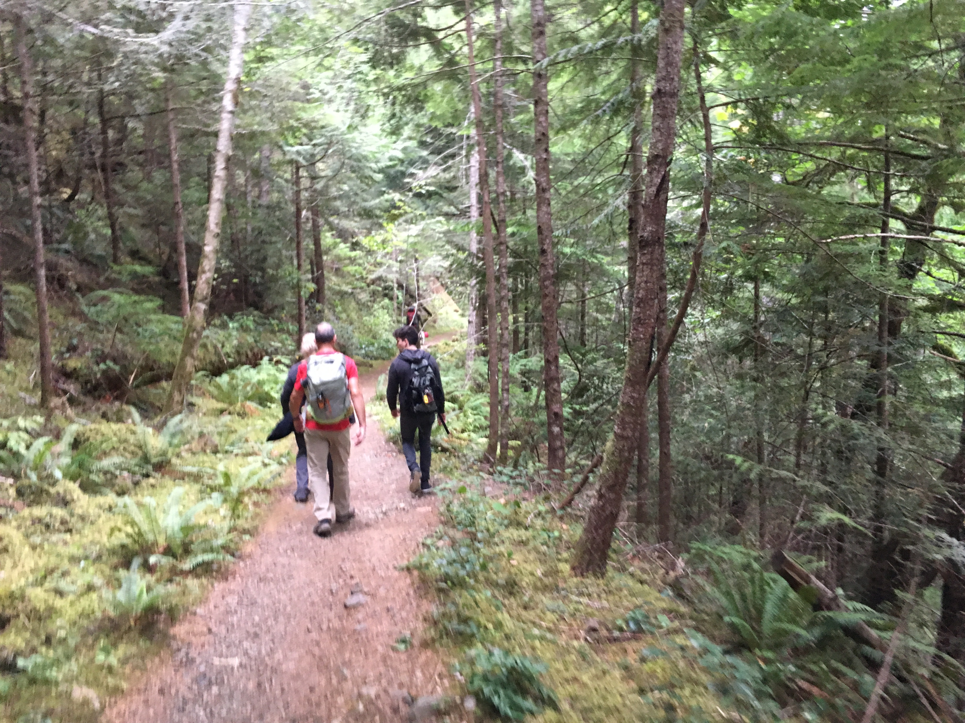
3-day travel, 4-day visit
Notes:
We got in some hiking…

Slide 6
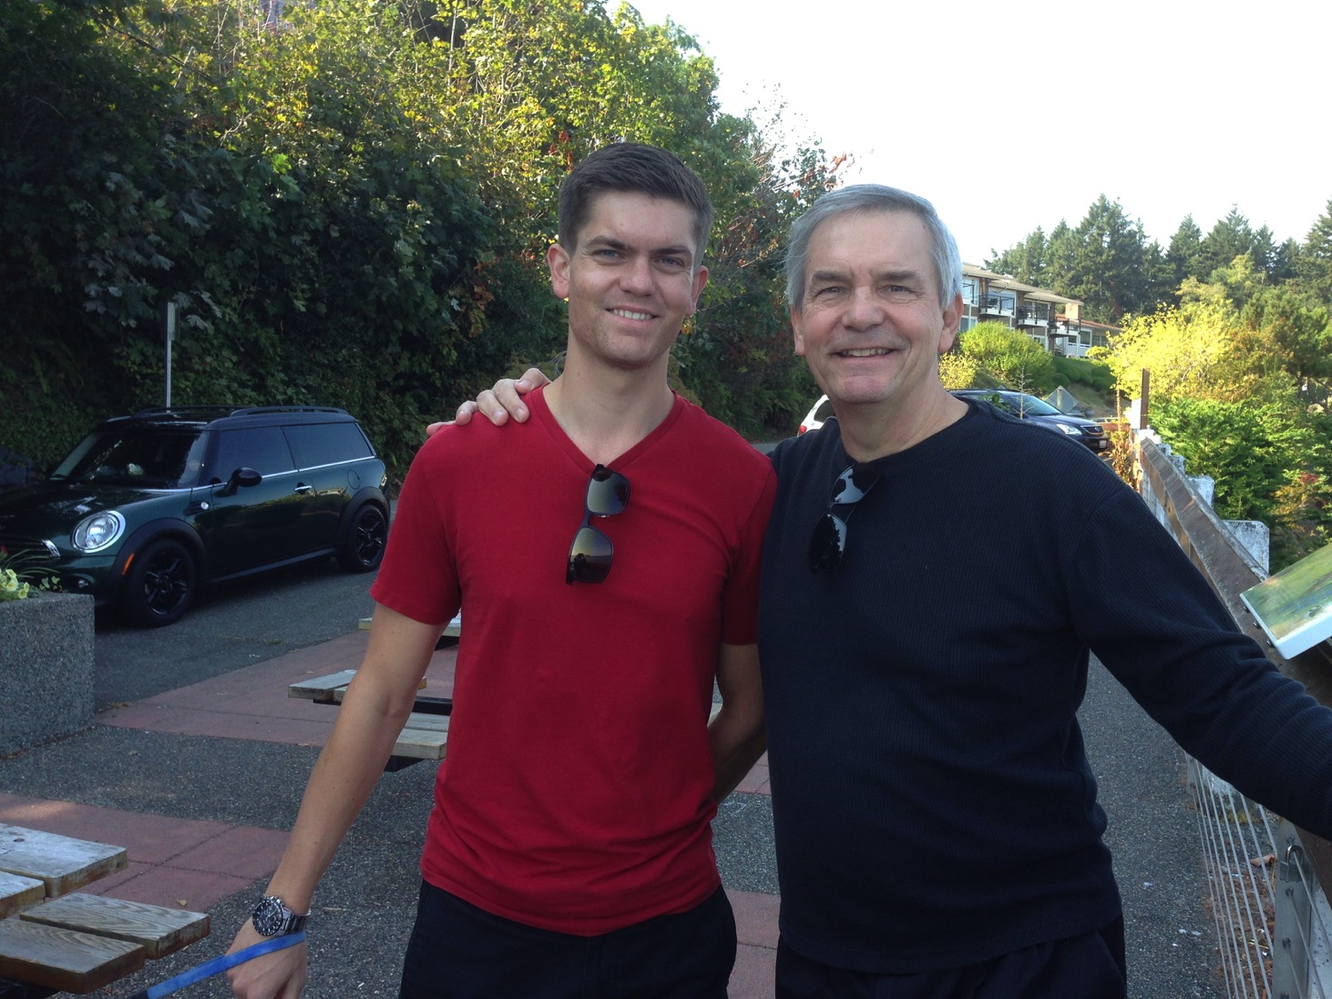
We all need to be comforted
Notes:
This was due to our United pilot son, Stephen.

Slide 7
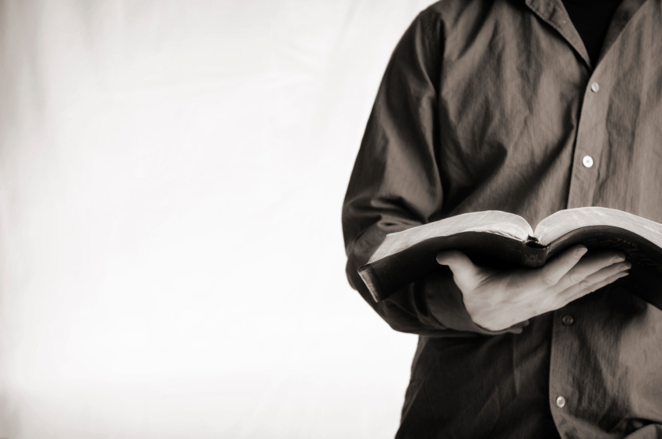
دعونا ندرس
الكلمة المقدسة
الكتاب المقدس :
سفراً سفراً
إرميا
Notes:
This preaching series looks at each book in the Bible in a single sermon—66 messages that each cover an overview of an entire book.
I have taught through the Bible 37 times but never preached through it. Therefore, as I just finished 12 messages on the Minor Prophets, so now I will preach the other 54 books in the coming year until we learn all 66 books.
I encourage you to read through the Bible during this series, one book at a time.

Slide 8
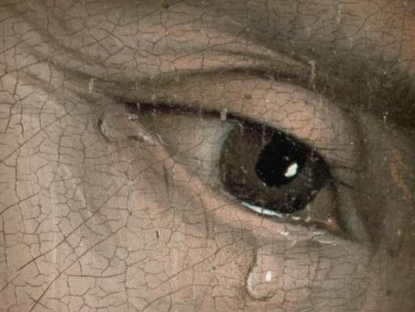
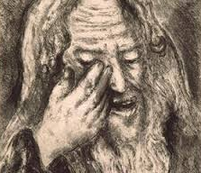
”النبي الباكي"
Notes:
إرميا was the only prophet to live through the 586 BC fall of Jerusalem. God called him to show God’s compassion even in Judah’s darkest hours. إرميا is known as "The Weeping Prophet." I suspect you would weep also if you saw your country ravaged and destroyed before your very eyes and you were powerless to stop it. It actually makes sense that God would call one like him who experienced such loss to be one who teaches us the need to be comforted.

Slide 9
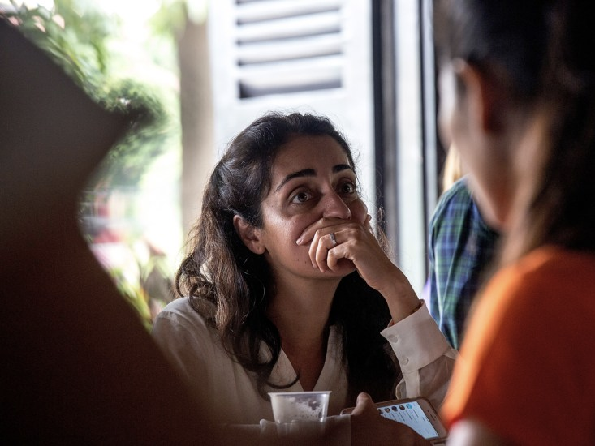
كلنا نحتاج أن نتعزى
Notes:
That’s because we all need to be comforted at various times of our lives. This is true for women, of course, but not only for women.

Slide 10
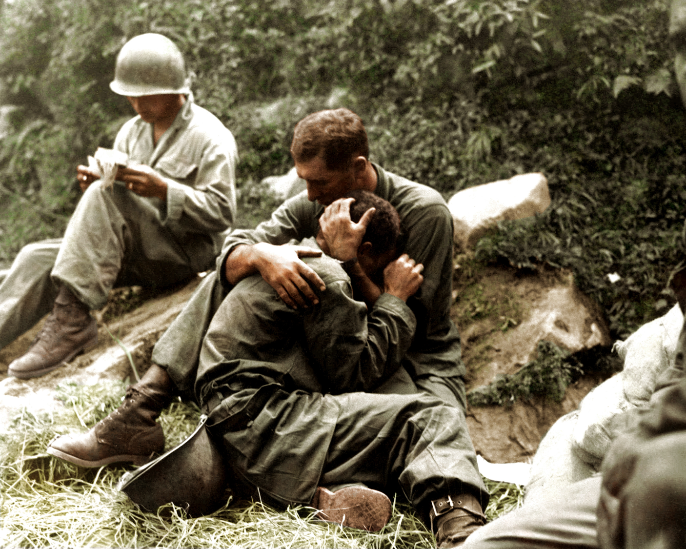
كلنا نحتاج أن نتعزى
Notes:
Men also need comfort many times.

Slide 11
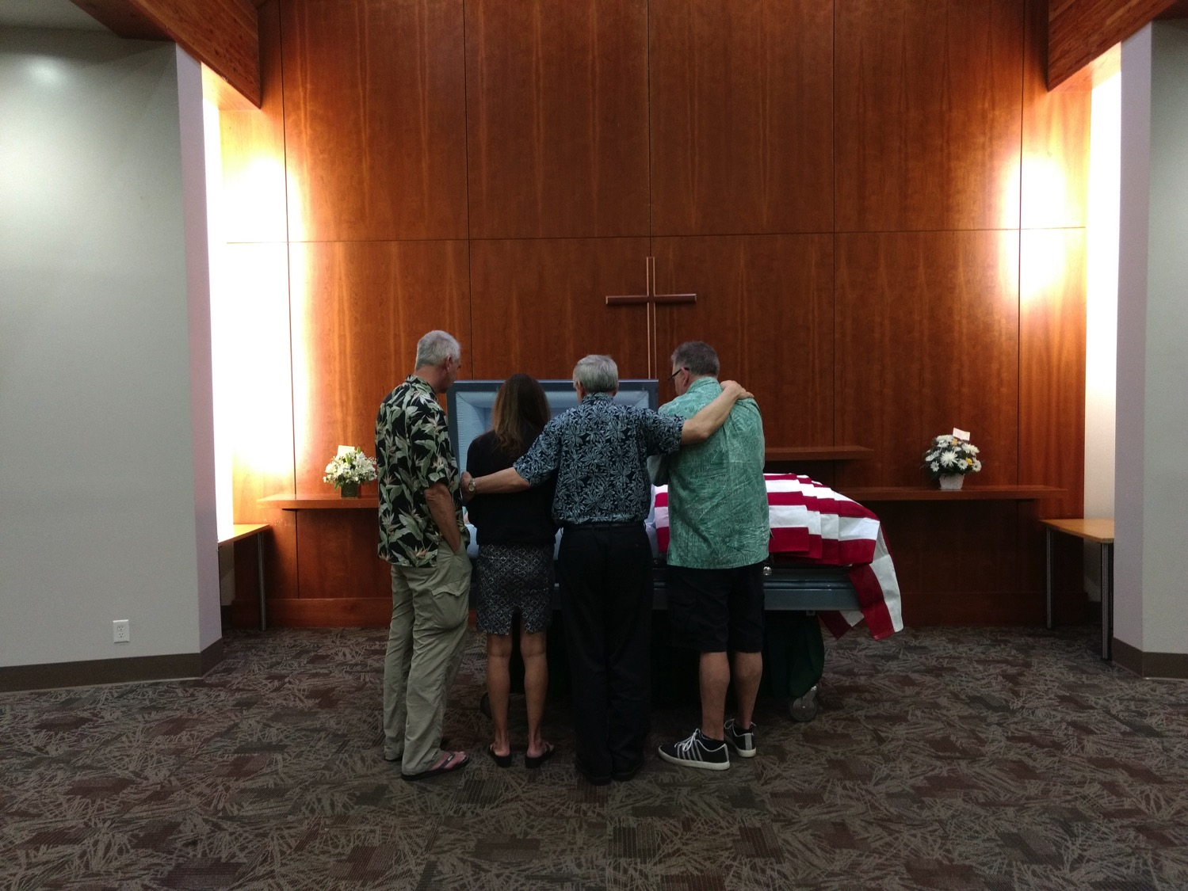
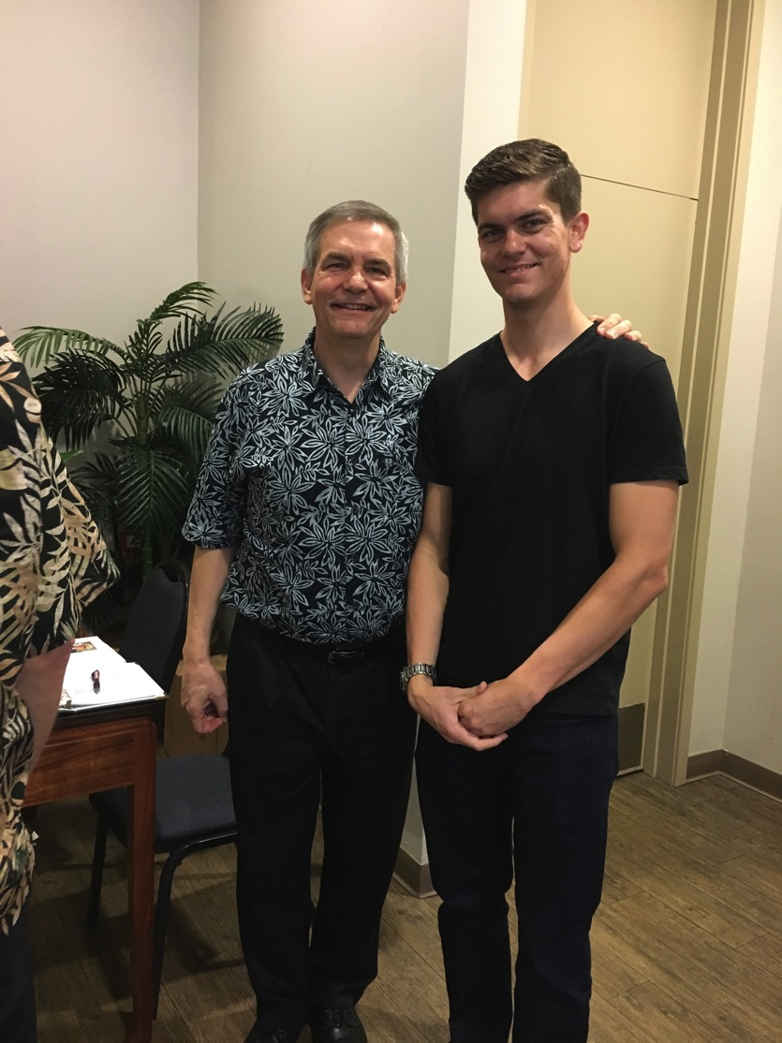
We all need to be comforted
Notes:
As one who often gives comfort, I found myself as one needing to be on the receiving end in January. It was challenging to be both the son and the officiating minister at my father’s memorial service,
• but God granted comfort from this same son, Stephen, who made the effort to fly to be there as a support.

Slide 12
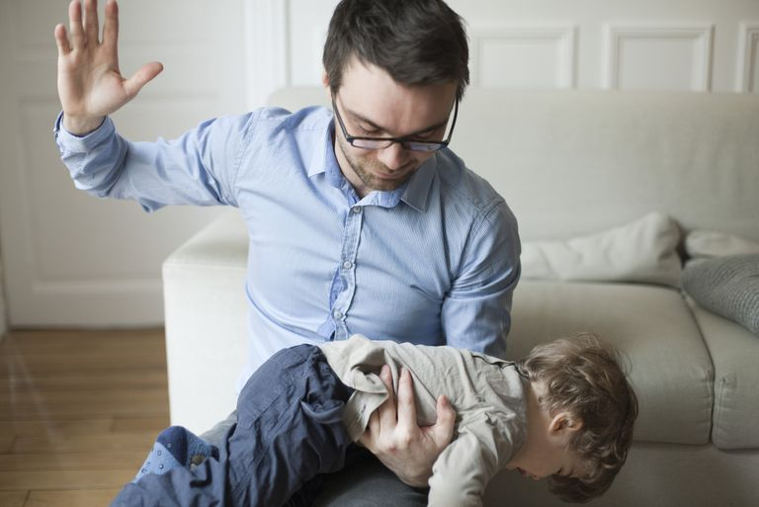
توازن التأديب مع التعزية
Notes:
Of course, we all know that life is not only about comfort. One of the signs of growing up is to realize that we must balance discipline with comfort.
Discipline shows us when we are off track and need to realign.

Slide 13
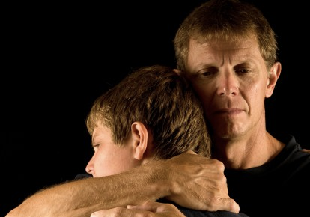
توازن التأديب مع التعزية
Notes:
But comfort helps us feel appreciated and loved.

Slide 14
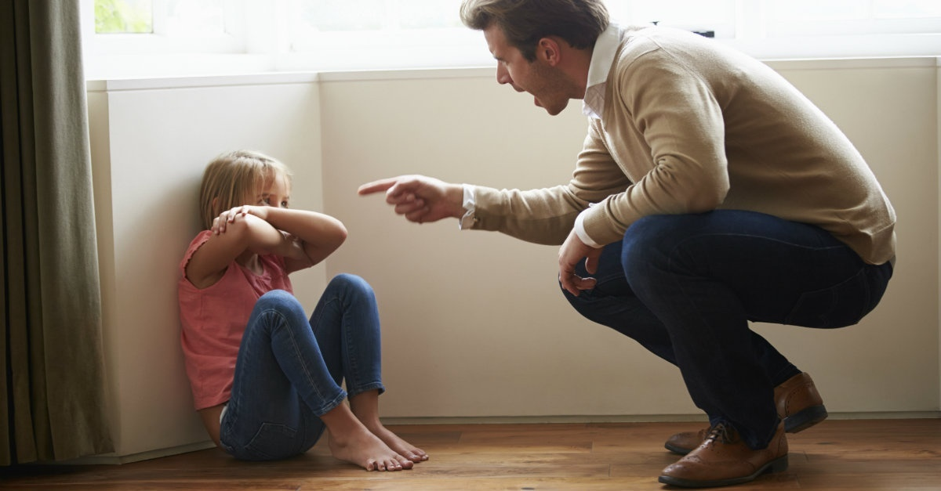
التأديب
Notes:
What images or memories come to your mind when you hear the word "discipline"?
When you were growing up, were you disciplined in a balanced way?
Did you receive mostly harsh discipline?
Or did your parents give you no discipline at all?
Or did you experience a good balance where standards (the principle of the thing) were matched with support? Did you receive comfort along with the discipline?

Slide 15
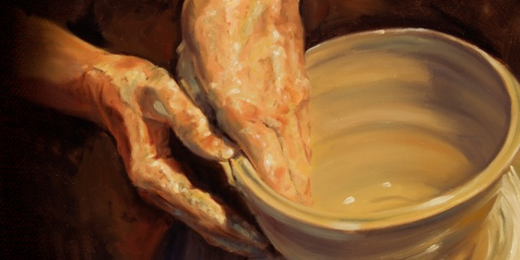
كيف يعزي الله (يُريح) حتى أولئك الذين يؤدبهم؟
Notes:
In what ways can we see God's compassion even when he has to punish sin?

Slide 16
أبناء يوشيا و الأنبياء
232
342
دانيال
605
حزقيال
سقطت المدينة
يهوآحاز
يوشيا
يهوياقيم
يهوياكين
صدقيا
609
597
586
(3 شهور)
(11 سنة)
(3 شهور)
(11 سنة)
إرميا
627
موجز ملوك الدمى
Notes:
BE-24-Jeremiah-16
OS-12-2Kings-220
OS-14-2Chron-283
OS-24-Jeremiah-58, 82
OS-27-Daniel-87

Slide 17
الكلمة المفتاحية
474
343
المحتوم
إرميا
Notes:
بحلول الوقت الذي نصل فيه إلى إرميا ، يعلن الله أن السبي سيأتي بالتأكيد. لا مفر من هذا.

Slide 18
الفكرة الرئيسية
474
السبي المستحق
والإسترداد غير المستحق
إرميا
Notes:
إرميا’s theme is that captivity is deserved but also the restoration is undeserved and will also happen.

Slide 19
الآية المفتاحية
474
لِأَنَّ الرَّبَّ إِلَهَنَا قَدْ أَصْمَتَنَا… وَأَسْقَانَا مَاءَ الْعَلْقَمِ لِأَنَّنَا قَدْ أَخْطَأْنَا إِلَى الرَّبِّ إرميا 14:8
إرميا
Notes:
Judgment was because of Judah’s sin, as the key verse indicates in 8:14.

Slide 20
كُنْ مُتعزين
كونوا مُتعزين
كُنْ مُتعزين
إرميا-كونوا مُتعزين
إرميا
د. ريك جريفيث . كنيسة ملتقى الطرق الدولية سنغافورة
BibleStudyDownloads.org
Notes:
Dr. Rick Griffith • Crossroads International Church Singapore
CICFamily.com • BibleStudyDownloads.org

Slide 21
كيف يعزي الله (يُريح) حتى أولئك الذين يؤدبهم؟
Notes:
In what ways can we see God's compassion even when he has to punish sin?

Slide 22
1- الله يدعو الرسل الصادقين معنا
(إرميا 1)
كيف يُعّزى الله حتي أولئك الذين يؤدبهم؟
Notes:
The LORD assures that he has a representative who tells us both his discipline and restoration.

Slide 23
Slides on
إرميا 1

Slide 24
كدة الخدمات النبوية
أشعياء
65 سنة
هوشع
45 سنة
إرميا
+ 40 سنة
ميخا
25 سنة
Notes:
إرميا reveals himself as author and reveals that his ministry lasted over four decades from Josiah's thirteenth year (627 BC) to the exile (1:1-3; 586 BC).

Slide 25
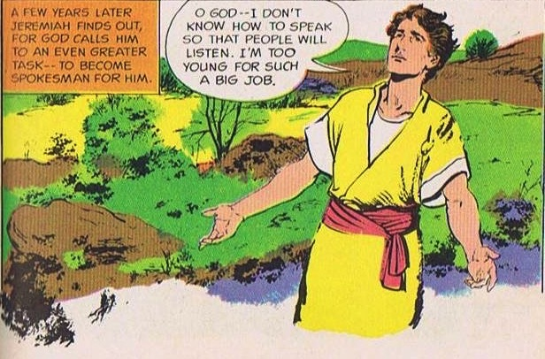
الله يدعو و يرسل إرميا
حكم و إصلاحات الملك يوشيا لم تنتهي
الله يدعو شاباً
إر 1: 4-9
Source: The Picture Bible (Chariot Books, David C Cook, 1978)
Notes:
When God called and commissioned him to be a prophet إرميا was a young man, maybe a teenager, in the thirteenth year of King Josiah's reign. But he protests that he is too young for such a big job.

Slide 26

تأكيد الله لإرميا
قبلما صورتك في البطن
عرفتك و قبلما خرجت من الرحم
قدستك
جعلتك نبياً للشعوب
لا تقل إني ولد لأنك إلى كل من أرسلك إليه تذهب و تتكلم بكل ما آمرك به
لا تخف من وجوههم لأني أنا معك لأنقذك يقول الرب
و مد الرب يده و لمس فمي و قال الرب لي ها قد جعلت كلامي في فمك
إر 1: 5، 7-9
Notes:
God assured إرميا – He knew, set apart, appointed him. And said he would put His words into His mouth. The Lord reached out His hand and touched his mouth. He is to stand up against nations and kingdoms, uproot and tear them down. He is to build up and plant others.
إرميا’s success was not determined by the size of his “church”!
In fact, like Isaiah, Ezekiel, and, frankly, all the prophets, his success was in saying and doing what God commanded to a stubborn and rebellious people who were bent on their own way all their days until the Babylonians stormed the gates of their capital—and remained stubborn and rebellious even afterwards.

Slide 27
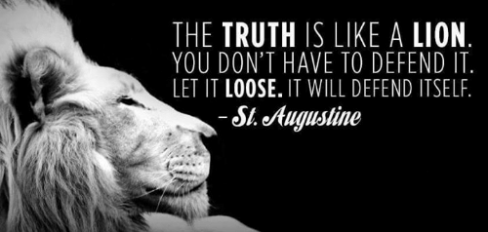
هل يحاول الله أن يعزيك
من خلال رسله الأمناء ؟
Notes:
I will be honest with you—my main goal is to be honest with you!
That honest truth includes both the things we like to hear and those things that we do not like.
• St. Augustine said, “The truth is like a lion. You don’t have to defend it. Let it loose. It will defend itself.”
My prayer is that those of us who need comfort will find it here today. God is, after, the “God of all comfort” (2 Cor). That is the “building up” aspect of pastoral ministry. I have come to build you up.
But God has also called me to “tear down.” That means that God’s primary goal in your life is not to make you comfortable. It is to make you like his son Jesus. That will take some tearing down of patterns that hinder Christlikeness in us.

Slide 28
كيف يعزي الله (يُريح) حتى أولئك الذين يؤدبهم؟
Notes:
In what ways can we see God's compassion even when he has to punish sin?

Slide 29
1- الله يدعو الرسل الصادقين معنا (إرميا 1)
كيف يُعّزي الله حتي أولئك الذين يؤدبهم؟
Notes:
The LORD assures that he has a representative who tells us both his discipline and restoration.

Slide 30
2- الله لديه تأديب محدود ولكن بركة غير محدودة ( إر 2-25)
كيف يُعّزي الله حتي أولئك الذين يؤدبهم؟
Notes:
The LORD's punishment is always less than his rewards.

Slide 31
Slides on
إرميا 2
Notes:
God comforted Judah throughout Jerusalem's fall that the 70-year exile would result in a new covenant (Jer 2–45).
God indicts the nation for its sinful treatment of God seen in its ingratitude, idolatry, immorality, and irrationality (Jer 2; see esp. 2:10-11).

Slide 32


علاقة يهوذا مع الله
عروس شابة
غير أمينة ... محبون كثيرون
أحدهم يدعى بعل
إر 2-4
Notes:
So, إرميا prophesies before the fall of Jerusalem. He proclaims God has just reasons for judging the nation – its punishment is deserved! God reminds them of the days He blessed them. But they have been idolatrous and spiritually rebellious.
• Judah is like an unfaithful wife who defiled herself with her lovers, to follow Baal and many other gods. He likens Israel and Judah to two sisters. Judah did not learn anything from Israel's judgment! Judgment will come from Babylon, so repent!

Slide 33
Slides on
إرميا 6
Notes:
God calls the nation to repent from spiritual adultery to motivate the people to escape the impending judgment of the Babylonians (Jer 3–6).

Slide 34
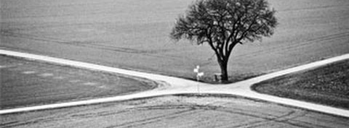
إرميا ٦ : ١٦
هَكَذَا قَالَ الرَّبُّ: [قِفُوا عَلَى الطُّرُقِ وَانْظُرُوا وَاسْأَلُوا عَنِ السُّبُلِ الْقَدِيمَةِ: أَيْنَ هُوَ الطَّرِيقُ الصَّالِحُ؟ وَسِيرُوا فِيهِ فَتَجِدُوا رَاحَةً لِنُفُوسِكُمْ. وَلَكِنَّهُمْ قَالُوا: لاَ نَسِيرُ فِيهِ!
Notes:
This verse reminds us of some of our key priorities based on this theme verse for Crossroads International Church:
1. We must look out for people in need going through various crossroads in their lives.
2. We must prioritize that which is proven and not be pursuing every new fad that comes down the road.
3. We must instead pursue the Word of God, making the Bible central to all we do—and obey it.
4. We must be a place of rest for people in the very stressed out country of Singapore.

Slide 35
Slides on
إرميا 7
Notes:
إرميا's temple address aims to convince the people to turn from their false reliance on the temple and idolatry to avoid impending judgment (Jer 7–10).

Slide 36
عبادة عامة بلا قيمة
يثقون في كلمات فارغة
و لن يدمر الله الهيكل
طلب الله من إرميا أن...
يتوقف عن الصلاة ليهوذا
شرهم صار عظيماً
قدموا أولادهم محرقات
إر 7-8
Notes:
إرميا preaches at the temple as people came by to worship. He warns them they are trusting in the empty words to save them, thinking God will not allow the temple to be destroyed. They think God will bless Judah no matter how they lived just because of the Davidic covenant. God instructs إرميا to stop praying for the people. Their evil had become unthinkable and were even sacrificing their children to pagan gods.

Slide 37
Slides on
إرميا 11

Slide 38
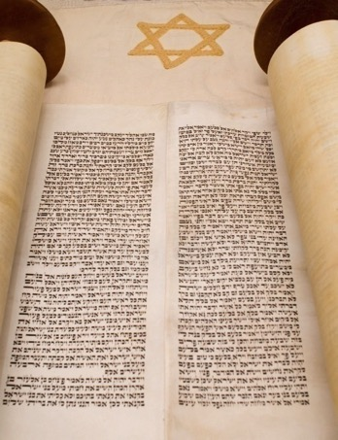

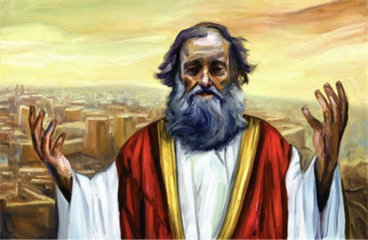
العهد، المؤامرات و التذمرات
رجال من عناثوث
يتآمرون لقتله
يعظ إرميا
بالعهد المكسور
إرميا يشكو لله
الله يشجعه
إر 11-12
Notes:
إرميا preaches the covenant sermon to proclaim that Judah has violated God's covenant through its idolatry. What is their response? The men of Anathoth, إرميا's own home town, plot against his life because they do not like what they hear. إرميا struggles from their mocking and persecution. He complains to God about the prosperity of the wicked but God encourages him and warns him to continue. God says, Worse events are coming, but the destruction will bring Judah to repent.

Slide 39
Slides on
إرميا 24

Slide 40
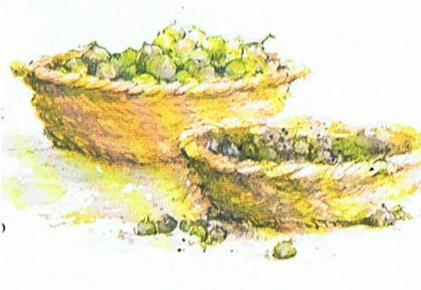
لا توبة في أورشليم بعد نبوخدنصر
تصوير الناس من خلال التين في الهيكل
التين الجيد
– مسبيي بابل الذين بدأوا بالتوبة
– سيعتني الله بهم و يرجعهم
التين الفاسد
– الملك صدقيا و حاشيته و كل شعب أورشليم
– لا يزال يتآمر و يحارب ضد بابل
– ليس جيداً للحفظ
Picture Source: The Children's Bible in 365 stories, Lion Publishing, 1985
إر 24
Notes:
God uses another object lesson of two baskets of figs in front of the temple. The good figs are those in Babylon whom God will protect, bless and one day restore. The bad figs symbolizes Zedekiah and those who remained in Jerusalem who still refused to submit to Babylon rule. This faithless group will die by sword, famine and disease.

Slide 41
Slides on
إرميا 25

Slide 42
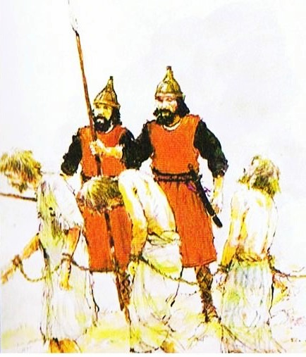
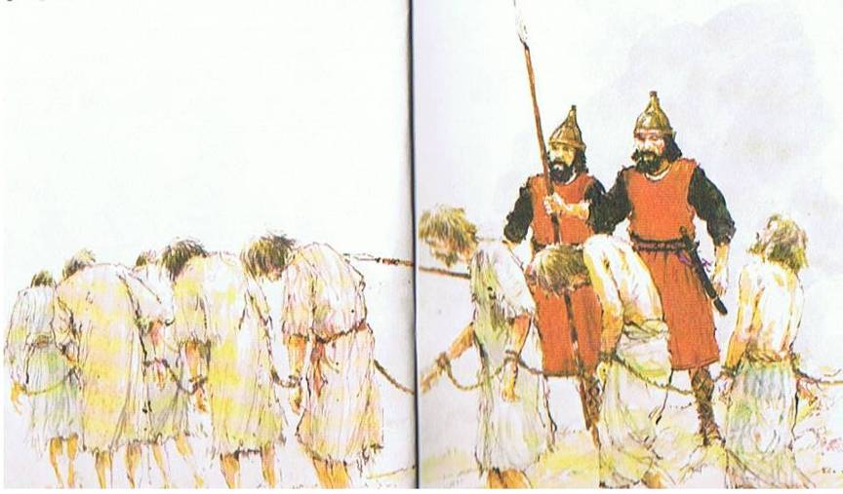
مجيء نبوخدنصر (597 ق.م)
نبوة السبي
70 سنة
يأخذ المسبيين والملك يهوياكين بعيدا.
وضع صدقيا على العرش يعطي فرصة أخرى ليهوذا للخضوع لبابل.
Picture Source: The Children's Bible in 365 stories, Lion Publishing, 1985
إر 24-25
Notes:
Now 8 years after إرميا's prophecy about Nebuchadnezzar, Nebuchadnezzar came and took King Jehoiachin away with many other exiles. He placed his uncle, Zedekiah (Josiah's other son) in charge and gave Judah one more chance to submit to Babylon's rule.
• Here God revealed to إرميا the 70 years captivity.

Slide 43

Two 70-Year Exiles
560
سبيين لمدة 70 سنة
سبي الشعب
605
586
539
536
516
سبي الهيكل
و تصير كل هذه الأرض خراباً و دهشاً و تخدم هذه الشعوب ملك بابل سبعين سنة و يكون عند تمام السبعين سنة أني أعاقب ملك بابل و تلك الأمة يقول الرب على إثمهم و أرض الكلدانيين و أجعلها خرباً أبدية
(إر 25 : 11 – 12)
Notes:
Jeremiah does not tell us the exact years that begin and end the 70-year exile.
But we can actually determine this in two ways—either the exile of the people beginning with Daniel’s deportation (605) to the people fully returning in 536, or the exile of the temple from its destruction in 586 to its rebuilding in 516.
_____________________
OS-00-OT Book Overviews-294
OS-12-Kings & Prophets Charts-26
OS-12-2Kings-287
OS-14-2Chron-287
OS-15-Ezra-14
OS-24-Jeremiah-53, 139
OS-27-Daniel-94, 284, 340
OS-35-Haggai-32

Slide 44
ترحيلات نبوخدنصر الستة إلى بابل
492
الحجم | التاريخ | ملك يهوذا | عدد المسبيين | الأسرى الرئيسيين | النتائج/الملاحظات
1. صغيرة | 605 ق.م | يهوياقيم | قليل (دا 1 : 3) | دانيال ، 3 أصدقاء ونبلاء وملوك | فرض الجزية مصر قوية
2 متوسطة | 598 ق.م | يهوياقيم | 3023 (إر 52 : 28) |  | ترحيلات صغيرة
3. كبرى | 597 ق.م | يهوياكين | 10000 (2 مل 24 : 14) | يهوياكين حزقيال مردخاي | نبوخد نصر يرحل الكثيرين و يثبت صدقيا
4. صغيرة | 587 ق.م | صدقيا | 832 (إر 52 : 29) |  | قبل الدمار
5. كبرى | 586 ق.م | صدقيا | 10400 (2 مل 25 : 11) | صدقيا | تدمير أورشليم و الهيكل
6. صغرى | 582 ق.م |  | 745 (إر 52 : 30) |  | 4 سنوات بعد دمار أورشليم
Notes:
Nebuchadnezzar invaded Judah with 6 deportations to Babylon. The 597 BC deportation was the third of the six and the first of 2 major deportations, with about 10,000 people deported each time.
______
BE-24-Jeremiah-44
OS-24-Jeremiah-53, 140

Slide 45
Slides on
إرميا 27
Notes:
Jerusalem’s leaders reject إرميا and lead to captivity as unavoidable (Jer 26–29).

Slide 46
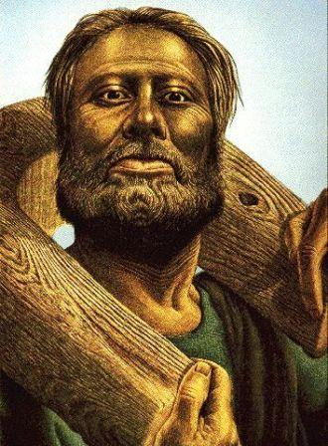
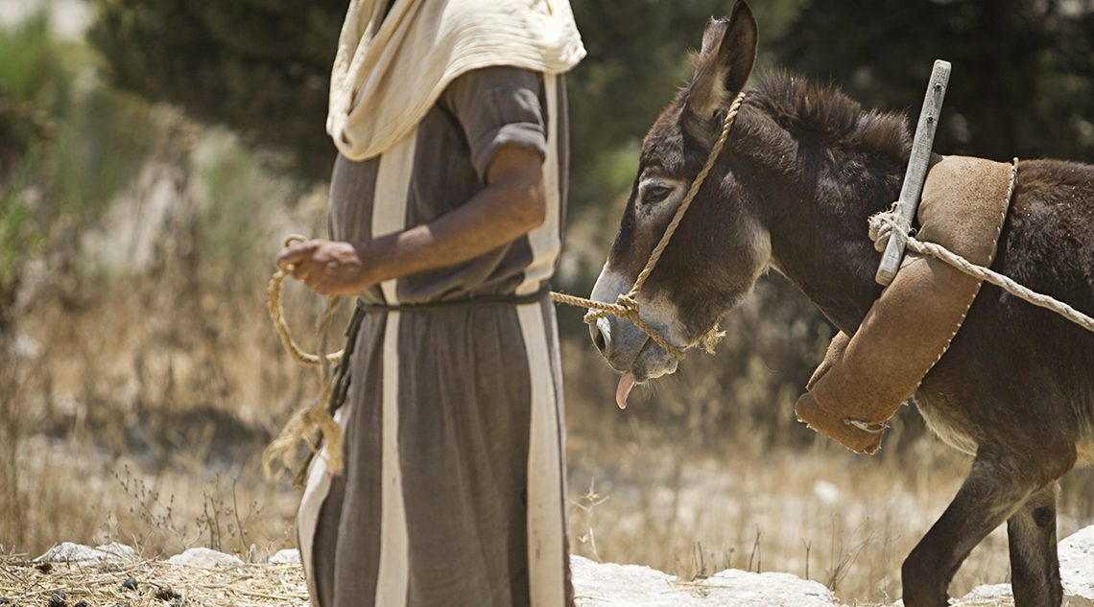
قاوم قادة أورشليم
حكم بابل
يلبس إرميا نيراً
ليمثل مستقبل
خضوع يهوذا
لبابل
إر 27-28
Notes:
At the beginning of Zedekiah's reign, there is talk of revolt against Babylon. As animals wore a yoke to inndicate their submissions, • so God instructs إرميا to wear a yoke to symbolize Judah's future submission to Babylon. God will place all nations under Nebuchadnezzar's yoke; any nation that resisted would perish. He urges the king not to listen to the false prophets.

Slide 47
Slides on
إرميا 28
Notes:
The false prophets continued to predict peace for the rebellious people in chapter 28.

Slide 48
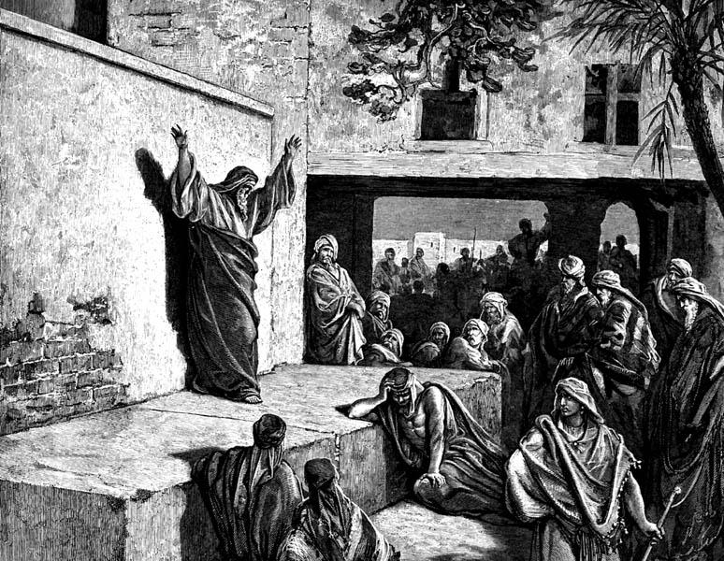
إرميا (إر25: 11-12) مقابل حننيا (إر28: 2-3)
خاطئ
صحيح
"ستعودون بعد سنتين"
"ستبقون 70 عاما"
توفي بعد شهرين
(إر28 : 17)
عاش 23 سنة أكثر
(51 : 64)

Slide 49
Slides on
إرميا 29

Slide 50

كيف يختلف الأنبياء؟
186أ-ب
الكتابيين
الوثنيين
غير مرغوب فيها
عرافة
دعوة إلهية
أنبياء من ذاتهم
في أي مكان
مكان العبادة
كلام علم (الكشف الفوري)
تنجيم

Slide 51
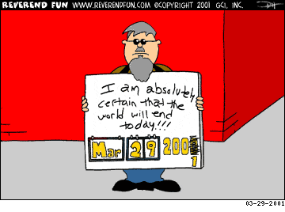
النبوءات الكاذبة تتغير
أنا متأكد تماما أن العالم سينتهي اليوم!!!

Slide 52
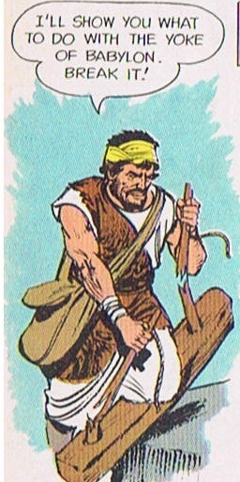
مقاومة الأنبياء الكذبة
كسر النبي الكاذب حننيا نير إرميا ليصور كسر الله لقوة بابل و ادعى أن السبي سينتهي خلال سنتين و مات بعد شهرين
وعظ النبي الكاذب شمعيا ضد إرميا
إر 28-29
Notes:
إرميا faces serious opposition from false prophets. Hananiah seizes إرميا's yoke and breaks it, claiming God would break Babylon's power and the captivity is not 70 years, but only 2 years. Well, he pays for his lies with his own life. He dies 2 months later. After him, Shemaiah the false prophet also opposes إرميا.

Slide 53
Slides on
إرميا 30
Notes:
Israel’s future restoration with a new covenant (The Book of Comfort) should encourage the remnant that God has not forgotten his promises (Jer 30–33).

Slide 54
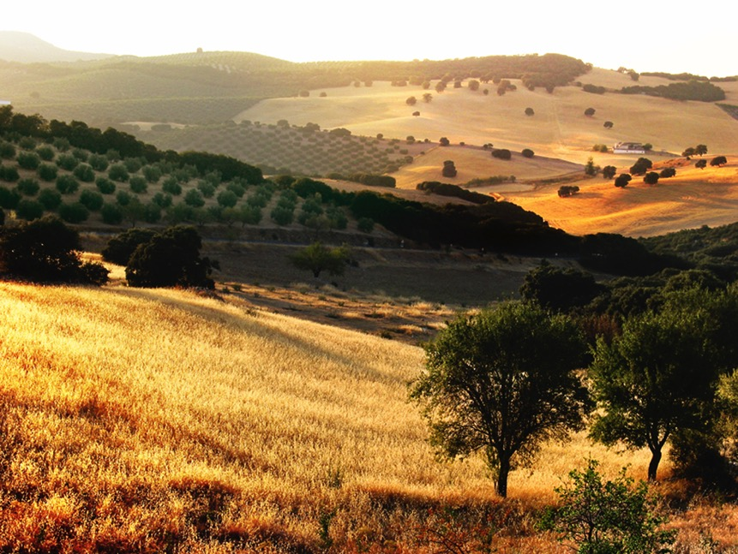
سفر التعزية و العهد الجديد
إر 30-33
اشترى إرميا حقلاً
(إر 32) كعلامة رجاء
لم يطرد الله شعبه جانباً
مستقبل مجيد سوف يتبع دينونتهم
سوف يعودون إلى الأرض
Notes:
Scholars refer to إرميا 30–33 as the Book of Comfort or Book of Consolation. إرميا's prophecies contained strong words against God's sinful people. But God has not cast aside His people nor forgotten His covenant. He promises a glorious future would follow their judgment and they will return to the land. The Lord instructs إرميا to buy a field in Jerusalem from his cousin, Hanamel, as a sign of hope. The land will once again have value and God's people will return to claim it again.

Slide 55
Slides on
إرميا 31
Notes:
Israel and Judah will be reunited in the land with a new heart under a new covenant [after Messiah’s second coming] (Jer 30–31).

Slide 56
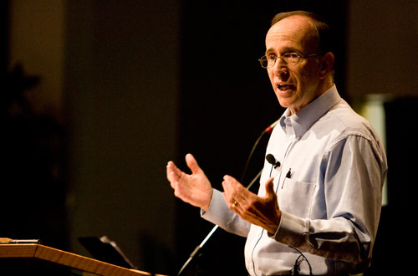
كيف نتخلص من اليهود ؟
35 هكذا قال الرب
الجاعل الشمس للإضاءة نهاراً
و فرائض القمر و النجوم للإضاءة ليلاً
الزاجر البحر حين تعج أمواجه
رب الجنود اسمه
³⁶ إن كانت هذه الفرائض
تزول من أمامي يقول الرب
فإن نسل إسرائيل أيضاً
يكف من أن يكون أمة
أمامي كل الأيام
37 هكذا قال الرب
إن كانت السماوات تقاس من فوق
و تفحص أساسات الأرض من أسفل
فإني أنا أيضاً أرفض كل نسل إسرائيل
من أجل كل ما عملوا يقول الرب
(إر 31: 35-37)
Notes:
A pastor once announced to his congregation, • "Next week I will speak on the topic of 'How to Get Rid of the Jews.'" The news spread throughout the small town to the extent that on the next Sunday, after the doors had closed and just before a packed service began, the doors opened again and into the church walked the city's chief rabbi, followed by two of his lawyers! They walked down the center aisle all the way to the front, then took seats in the very front row.
The service continued with songs, prayers, offering and finally the pastor stood at the pulpit. "I am thrilled to see so many at church today, including our distinguished rabbi and his friends. My topic today is 'How to Get Rid of the Jews.' The text is from Jeremiah, chapter 31. Please turn in your Bibles to Jeremiah 31, verse 35.'" [Animate slide and read vv. 35-37]
At this point, the rabbi smiled, the pastor winked, the congregation sighed in relief, and the lawyers realized that their job was over.
God was clear to Jeremiah that his covenant with the Jews is an eternal covenant, not dependent on them. He promised a New Covenant that assures that at some future point the nation will again trust in him by believing in Messiah, after which God will forgive their sins.

Slide 57
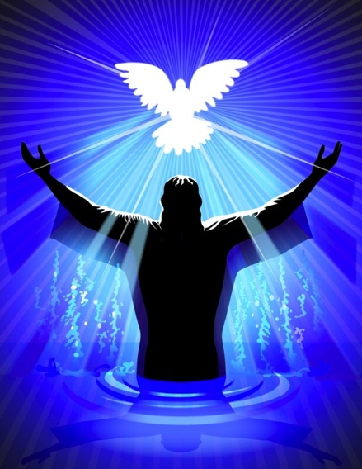
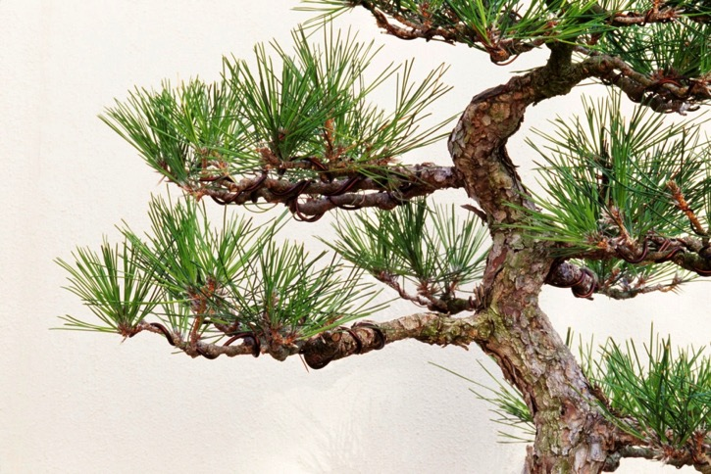
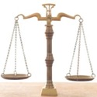
العهد الجديد و غصن داود
غصن داود – ملك و كاهن
جديد – إر 33
العهد الجديد – الناموس مكتوب على قلوبنا و ارواحنا ليقودنا – إر 31
Notes:
These wonderful chapters contain the New Covenant where God will forgive Judah's sins, God's laws will be written on their hearts and His Spirit will guide them. إرميا also prophesies restoration of Judah under the new King from the Branch of David's line and promises to bless the priesthood.

Slide 58
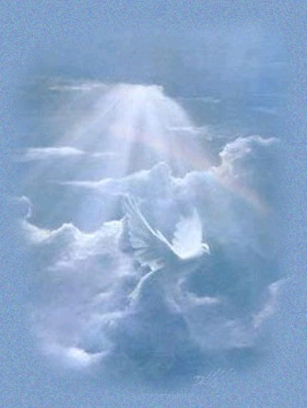
العهد الجديد
(إرميا 31: 31-34)
IN BRIEF
Notes:
These verses are the key verses on the New Covenant in the whole Bible.
__________
BE-24-Jeremiah-58
FU-05-Biblical Covenants-27
OS-24-Jeremiah-162
NS-08-2 Corinthians-79
NS-19-Hebrews-333

Slide 59
أربعة عهود كتابية غير مشروطة
476
الإبراهيمي
تك 12: 1-3
البركة
الأرض
النسل
الأرض
تث 30: 1-10
الداوودي
2 صم 7 : 12-16
الجديد
إر 31: 31-34
العهد الجديد هو تضخيم الله غير المشروط لوعد البركة في العهد الإبراهيمي حيث ستختبر يهوذا وإسرائيل الفداء القومي والروحي.
Notes:
Three covenants amplify the Abrahamic covenant. The new covenant was one of them.
(cf. Deut. 30:1-10) promises:
Land from Wadi of Egypt to Euphrates River (Isa. 27:12)
Eternal possession of land (Gen. 17:8) after exile/restoration
Whole world blessed via the land (Isa. 14:1-2)
2 Samuel 7:12-16 promises perpetual:
Sons ("house" never wiped out)
Kingdom (political dynasty)
Throne (right to rule by descendants)
Temple (son to build it)
Jeremiah 31:31-34 promises:
Forgiveness
Indwelling Spirit
New heart, nature, mind
Reunification of Israel and Judah
No need for evangelism
__________
BE-24-Jeremiah-59
FU-05-Biblical Covenants-28
OS-24-Jeremiah-163
NS-08-2 Corinthians-80
NS-19-Hebrews-334

Slide 60

العهد الجديد
إر 31: 31-34
³¹ ها أيام تأتي يقول الرب و أقطع مع بيت إسرائيل و مع بيت يهوذا عهداً جديداً 32 ليس كالعهد الذي قطعته مع آبائهم يوم أمسكتهم بيدهم لأخرجهم من أرض مصر حين نقضوا عهدي فرفضتهم يقول الرب 33 بل هذا هو العهد الذي أقطعه مع بيت إسرائيل بعد تلك الأيام يقول الرب
Notes:
Note that Jeremiah looks forward to a time when the divided nation is once again united (31:33) and also believes in the Lord (31:34). This has not happened since Jeremiah's time. The people did return to the land in 538 BC, but they certainly did not "all know me" (31:33) nor did they receive forgiveness as a nation when they rejected Messiah Jesus. While some new covenant elements are being fulfilled now since the cup of the Lord's supper celebrates forgiveness for those who believe (Luke 22:20-22), the ultimate fulfillment of this promise awaits Israel's trust in Jesus in the future at his return.
__________
BE-24-Jeremiah-60
FU-05-Biblical Covenants-29
OS-24-Jeremiah-164
NS-08-2 Corinthians-81
NS-19-Hebrews-335

Slide 61
العهد الجديد
إر 31: 31-34
33ب أجعل شريعتي في داخلهم و أكتبها على قلوبهم و أكون لهم إلهاً و هم يكونون لي شعباً 34 و لا يعلمون بعد كل واحد صاحبه و كل واحد أخاه قائلين اعرفوا الرب لأنهم كلهم سيعرفونني من صغيرهم إلى كبيرهم يقول الرب لأني أصفح عن إثمهم و لا أذكر خطيتهم بعد
Notes:
Verse 34 looks forward to a time when everyone in Israel is saved (all know me) and forgiven. Zechariah repeatedy promises this to happen in a single day!
Zech. 3:9 Now look at the jewel I have set before Jeshua, a single stone with seven facets. I will engrave an inscription on it, says the LORD of Heaven’s Armies, and I will remove the sins of this land in a single day.
Zech. 12:6 “On that day I will make the clans of Judah like a flame that sets a woodpile ablaze or like a burning torch among sheaves of grain. They will burn up all the neighboring nations right and left, while the people living in Jerusalem remain secure.
Zech. 12:11 The sorrow and mourning in Jerusalem on that day will be like the great mourning for Hadad-rimmon in the valley of Megiddo.
Zech. 14:4 On that day his feet will stand on the Mount of Olives, east of Jerusalem. And the Mount of Olives will split apart, making a wide valley running from east to west. Half the mountain will move toward the north and half toward the south.
Zech. 14:6 On that day the sources of light will no longer shine,ª ⁷ yet there will be continuous day! Only the LORD knows how this could happen. There will be no normal day and night, for at evening time it will still be light.
__________
BE-24-Jeremiah-61
FU-05-Biblical Covenants-30
OS-24-Jeremiah-165
NS-08-2 Corinthians-82
NS-19-Hebrews-33

Slide 62
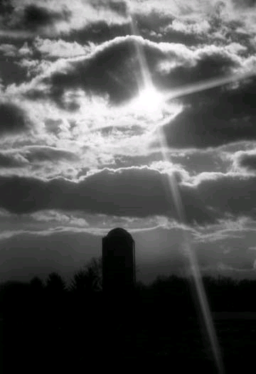
الأحكام
477
تمّت
سكنى الروح القدس
(إر 31: 33 مع حز 36: 27)
طبيعة، قلب و فكر جديد
(إر 31: 33، أش 59: 21)
غفران الخطايا
(إر 31: 34ب(
لم تتم بعد
كل شخص سيعرف الرب
(إر 31: 34أ)
ستتحد إسرائيل و يهوذا ثانية
(إر 31: 31)
Notes:
There are debates about how far or when or to whom the covenant refers. This is because Jeremiah 31 declares the covenant is for Israel and Judah but in the New Testament, it is declared for the church (Luke 22:20; 1 Cor 11:25; 2 Cor.3:6; Heb 8:8;9:15).
So questions arise. Is there a new covenant? Is it especially for the church? Or is it only for Israel? Or were there two covenants? Or are these promises built upon each other?
__________
BE-24-Jeremiah-62
FU-05-Biblical Covenants-33
OS-24-Jeremiah-170
NS-08-2 Corinthians-83
NS-19-Hebrews-338

Slide 63
خط سير الملكوت و العهود
22 و 379
9ج
تعليم الملكوت
آدم يحكم مع الله تك 1: 26, 28 تك 2: 19
الشيطان يحكم كاله هذا العالم تك 3: 15 2 كو 4: 4
عهود الله مع إبراهيم لإعادة تأسيس حكم الإنسان من خلال إسرائيل كمملكة كهنة
تك 12 : 1 – 3
خر 19 : 6
فشل إسرائيل في الشهادة للأمم كمملكة كهنة أدين من خلال السبي تحت حكم أجنبي
رفضت إسرائيل عرض المسيا بخصوص الملكوت
مت 12 : 41 – 42
مت 23 : 37 – 39
وسع يسوع ملكوته بشكل غامض للكنيسة
مت 13
أخاف يسوع أعداء اسرائيل و الأمة آمنت
رو 11 : 26 – 27
المسيح يحكم على كل شيء مع القديسين
أف 1 : 9 – 10
رؤ 20 : 1 – 6
رؤ 22 : 5ب
سقوط الإنسان
تك 3
العهد النوحي
تك 6 : 18, 9 : 8 – 17
عهد الأرض
إسرائيل
الكنيسة
الألفية الملكوت
(التركيز على الأمة)
الإنسان الجديد (أف 2: 15)
المسيانية الأبدي
الأرض
تك 15 : 18 ( قارن مع تث 30 : 1 – 10 ) يعد :
. الأرض من وادي مصر إلى نهر الفرات (أش 27 : 12)
. امتلاك أبدي للأرض (تك 17 : 8) بعد السبي و التجديد
. بركة العالم أجمع من خلال الأرض (أش 14 : 1-2)
أدينت اسرائيل لرفضها المسيا بالتشتت من الأرض لتسعة عشر قرناً ( 70م – 1948م ) لكنها الآن استردت جزئياً ( حز 37 : 1 – 7 )
تجديد كامل
(حز 37 : 8-28)
أورشليم عاصمة العالم
(أش 2 : 1-5)
أورشليم الجديدة
(رؤ 21 – 22)
العهد الداوودي
المسيح هو رأس كنيسته التي هي هيكل روحي
( أف 2 : 19 – 22, 2 كو 6 : 16)
المسيح يحكم على العالم
(أش 11)
مع القديسين
(رؤ 5 : 10, 20 : 4-6)
يسلم المسيح الملكوت إلى الآب
(1كو 15 : 24)
العهد الإبراهيمي
2 صم 7 : 12 يعد بالإزدهار الدائم :
. أبناء (بيت لا يزول)
. مملكة (سلالة حاكمة سياسياً)
. عرش (حق الحكم من خلال النسل)
. الهيكل (الإبن سيبنيه)
تك 12 : 1 - 3
النسل
العهد الجديد
كل الأشياء تصير جديدة
(رؤ 21 : 5)
العناصر الخمسة كاملة تتم في تجديد وطني
(زك 8)
إر 31 : 31 – 34 يعد :
. الغفران
. سكنى الروح
. قلب و فكر و طبيعة جديدة
. لم شمل إسرائيل و يهوذا
. لا داعي للكرازة
تم استبدال العهد الموسوي بالعناصر الثلاثة الأولى من العهد الجديد
( لو 22 : 20, 2 كو 3 : 6 )
البركة
العهد الموسوي
إلغاء و تتميم و استبدال الناموس على الصليب
(رو 7: 1-6, 1كو 9: 19-21, عب 8: 13)
الطبعة السادسة
15 حزيران 2012
مؤقت (غل 3 : 19 ) و مشروط ( تث 28 ) ليعلن الخطية ( رو 7 : 7 ) و ينظم إسرائيل
( غل 3 : 23 – 25 )
الكتاب المقدس يحتوي على تركيز مزدوج على الملكوت – العهد, يتوسع دور إسرائيل من إبراهيم إلى المسيح ليشمل الكنيسة (الإستمرارية) مع أن الكنيسة لن تحل محل الأمة كإسرائيل الجديدة (عدم الإستمرارية) سوف تستمتع إسرائيل ثانية بحكم العالم بعد الإيمان بالمسيح في مجيئه الثاني
Notes:
All agree that a partial fulfillment of the covenant to Abraham exists now to the Church in the indwelling Holy Spirit and forgiveness of sins (Jer 31:31-34)—and the ultimate fulfillment will be in the eternal state.
The main area of disagreement relates to the time period from now to eternity. Will there be a literal land, throne, and worldwide blessing to national (ethnic) Israel before the eternal kingdom? This chart shows verses giving a resounding YES to that question in a present partial fulfillment and a future full fulfillment in the normal sense of language in the verses cited. But the messianic kingdom will be in two stages—first in a millennial fulfillment to last 1000 years, but then, after that, the eternal stage in the new Jerusalem after the destruction of our present heavens and earth (Rev 21–22). What an amazing future remains for those who trust Jesus!
____________
Common English-7
CH-02-Nature-103-p34a
OS-00-Intro & Biblical Theology-25 & 90
OS-02-Exodus-267-p22
OS-05-Deut-248-p22
OS-10-2Sam-96-p22
OS-23-Isaiah-97-p337
OS-24-Jeremiah-174-p337
NS-09-Gal-143-p9g
NS-19-Hebrews-342-p9g
SA-08-Mosaic Law-19-p38a

Slide 64

هل تركز على تعزية الله غير المحدودة أو تأديبه المحدود ؟
Notes:
You might ask, “Well which should I focus on? God has both, right?”
Yes, he does. Whatever your concern today, he offers you his unlimited comfort in this Book of Comfort. He cannot care for you more than he does right now!
But he also offers you his limited discipline. He will hold you accountable for how you live—not for salvation, since that is by faith in our Lord Jesus Christ—but accountable for your actions that lead to reward in the coming kingdom. Like the farmer who prunes his plant for greater yield later, he may be trimming you down in discipline for your glorious future.

Slide 65
كيف يعزي الله (يُريح) حتى أولئك الذين يؤدبهم؟
Notes:
In what ways can we see God's compassion even when he has to punish sin?

Slide 66
1- الله يدعو الرسل الصادقين معنا (إرميا1)
كيف يُعّزى الله حتي أولئك الذين يؤدبهم؟
Notes:
The LORD assures that he has a representative who tells us both his discipline and restoration.

Slide 67
2- الله لديه تأديب محدود ولكن بركة غير محدودة ( إر2-25)
كيف يُعّزى الله حتي أولئك الذين يؤدبهم؟
Notes:
The LORD's punishment is always less than his rewards.

Slide 68
3- الله يطبق نفس المعيار على جميع الناس
إر46-51
كيف يعّزى الله حتي أولئك الذين يؤدبهم؟
Notes:
He will judge unbelievers as well as his own people.

Slide 69
Slides on
إرميا 46

Slide 70

الدينونة على تحالف الأمم الإثني عشر (أش 13-23)
457
بابل
فلسطين
مؤاب
دمشق (سوريا)
إسرائيل
الحبشة
مصر
بابل على البحر
أدوم
العربية
أورشليم (يهوذا)
طرسوس
أشور
فينيقية
سوريا
إسرائيل
بابل
يهوذا
فلسطين
مؤاب
بابل على البحر
مصر
أدوم
الحبشة
العربية
Notes:
The temptation for Ahab in Isaiah's time was to trust in a coalition of other nations to fight Assyria—yet God told them to trust him instead. Why? All these nations would fall to Assyria since God had appointed it. The Assyrians later destroyed the northern nation of Israel during Isaiah’s lifetime—as well as 46 cities of Judah.
In such a time of calamity, whom would Judah trust?
So, for 11 chapters, God tells Judah not to trust in…
13:1–14:27 Babylon
14:28-32 Philistia
15–16 Moab
17 Damascus/Israel
18 Ethiopia
19–20 Egypt
21:1-10 Babylon by the Sea
21:11-12 Edom
21:13-17 Arabia
22 Jerusalem
23 Tyre

Slide 71
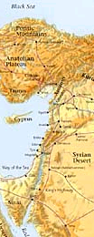
الأمم المتنبأ ضدها (46-51)
485
1. مصر (46: 1-27) – يتم هزيمتها من قبل بابل
2. فلسطين (47: 1-6) – يتم اجتياحها من قبل مصر
3. مؤاب (48: 1-47) – يتم استعمارها من قبل بابل
4. عمون (49: 1-6) – يتم تدميرها و إعادة تأسيسها في الألفية
5. أدوم (49: 7-22) – تصير مثل سدوم و عمورة
6. دمشق (49: 23-27) – يتم تدميرها في يوم واحد
7. قيدار و حاصور (49: 28-35) – يتم تدميرها من قبل نبوخدنصر
8. عيلام (49: 34-39) – يتم اجتياحها من قبل نبوخدنصر و يعاد تأسيسها خلال الألفية
9. بابل (50: 1-51: 64) – دمار الإمبراطورية النهائي
Notes:
God held accountable more than just the people of Judah alone. Jeremiah also addresses prophecies to the other non-Israelite cities during his time around 600 BC.
_________
BE-24-Jeremiah-71
OS-23-Isa13-23-slide 2
OS-24-Jeremiah-44, 229

Slide 72
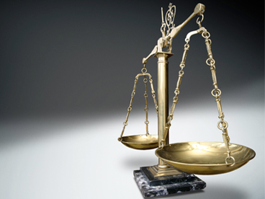
هل تدرك
أن الله
كان عادلاً معك ؟
Notes:
None of these nations received the same level of revelation that Israel got, but they still were responsible based on the moral law that God has put into the heart of every person. They should not have persecuted Israel.
Likewise, God has been and will be fair to you. Now “fair” doesn’t mean that every one of us has had the same experiences in life. It only means that the way God has dealt with you is just—as he dealt fairly with these nations who refused him.

Slide 73
Slides on
إرميا 52
Notes:
God balanced Jerusalem’s fall with Jehoiachin’s elevation so the exiles would see that they also would be elevated in a return to the land (Jer 52).

Slide 74
4- الله يوازن بين العدالة والرحمة (أر25)
كيف يُعّزى الله حتي أولئك الذين يؤدبهم؟
Notes:
He judges but also restores.

Slide 75
نهاية سيئة ليهوذا
256
1
يوشيا
640-609
(31 سنة)
ملك صالح باللون الأبيض
ملوك أشرار باللون الأصفر
3
5
2
يوحنان
(لم يحكم)
يهوياقيم ألياقيم
609-597
(11 سنة)
صدقيا
متنيا
597-586
(11 سنة)
يهوآحاز
شلوم
609
(3 شهور)
4
يهوياكين
يكنيا / كنيا
597
(3 شهور)
بابل
سبي
Notes:
OS-12-2Kings-214
OS-14-2Chron-282
OS-24-Jeremiah-36, 234

Slide 76
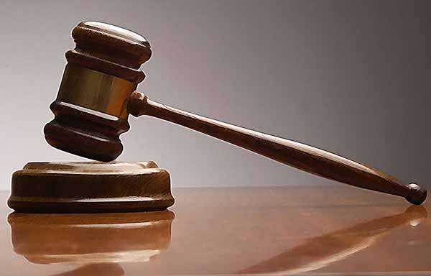
هل تركز
على تأديب الله
بدلاً من رحمته
في حياتك ؟
Notes:
Few, if any, of us has had our country totally destroyed, though this still happens today in places like Iraq, Syria, Lebanon, and even closer to home like Jakarta in 1998 when a fourth of the city was destroyed. Yet even in these situations, God has shown his mercy. Many have trusted Christ by being expulse from their country.
But on a more personal level, do you think more of God’s judgment or his grace in your own life? Do you realize have much he has blessed you? The old song tells us to “count your many blessings, count them one by one.” Do you?

Slide 77
كيف يعزي الله (يُريح) حتى أولئك الذين يؤدبهم؟
Notes:
In what ways can we see God's compassion even when he has to punish sin?

Slide 78
الفكرة الرئيسية في إرميا
يعمل الله في حدوده الخاصة لذلك
سنخضع لتأديبه
Notes:
Be encouraged that the LORD restrains his own punishing our sin for us to return to him.

Slide 79
1- الله يدعو الرسل الصادقين معنا (إرميا1)
كيف يُعّزى الله حتي أولئك الذين يؤدبهم؟
Notes:
The LORD assures that he has a representative who tells us both his discipline and restoration.

Slide 80
2- الله لديه تأديب محدود ولكن بركة غير محدودة ( إر2-25)
كيف يُعّزى الله حتي أولئك الذين يؤدبهم؟
Notes:
The LORD's punishment is always less than his rewards.

Slide 81
3- الله يطبق نفس المعيار على جميع الناس
إر46-51
كيف يعّزى الله حتي أولئك الذين يؤدبهم؟
Notes:
He will judge unbelievers as well as his own people.

Slide 82
4- الله يوازن بين العدالة والرحمة (أر25)
كيف يُعّزى الله حتي أولئك الذين يؤدبهم؟
Notes:
He judges but also restores.

Slide 83

التطبيقات
Notes:
Where does إرميا show up in our lives today?

Slide 84
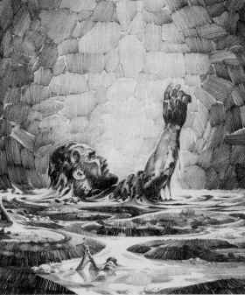
التطبيق الأول
هل أنت
مثل إرميا ؟
حياة النبي إرميا توضح كم هي مكلفة خدمة الرب

Slide 85

خدمة إرميا الصعبة و المضحية
خدم أكثر من 40 سنة
ذكر خطايا الشعب ليظهر عدل الله
وعظ عن قبول تأديب الله من خلال الخضوع للسبي البابلي 70 سنة
أمر بالإمتناع عن الزواج (16: 2)
اضطهد من عائلته و شعب مدينته و العالم الديني
وضع في السجن (37: 5)
أجبر على الذهاب إلى مصر حيث أكمل خدمته ضد الخطية (43: 1-7)
Notes:
• He remained faithful over the long haul—are you?
• He did not shy away or reinterpret God’s difficult words to those who needed to see he was fair (just) to them for their sins
• His message was so out-of-the-ordinary that he even told his people to give up during war
• Singleness may not have been his preference, but he submitted to God’s will here
• His family rejected him, as did his hometown people. - Therefore thus says the LORD concerning the men of Anathoth, who seek your life, and say, "Do not prophesy in the name of the LORD, or you will die by our hand"
• He was thrown into prison after being accused of being in league with the enemy by Zedekiah
• He was forced to go to Egypt. How would you feel if you were forced to do something against your own will?
After the fall, facing the prospect of real trouble from Babylon, the people sought إرميا's advice.
إرميا told God wanted them to stay in the land but they rejected his counsel.
A large group still fled to Egypt, taking إرميا and Baruch.
Even in Egypt, إرميا continued to prophesy that God would use Babylon to judge Egypt.

Slide 86
تأكيد الله لإرميا
قبلما صورتك في البطن
عرفتك و قبلما خرجت من الرحم
قدستك
جعلتك نبياً للشعوب
لا تقل إني ولد لأنك إلى كل من أرسلك إليه تذهب و تتكلم بكل ما آمرك به
لا تخف من وجوههم لأني أنا معك لأنقذك يقول الرب
و مد الرب يده و لمس فمي و قال الرب لي ها قد جعلت كلامي في فمك
إر 1: 5، 7-9
Notes:
God assured إرميا – He knew, set apart, appointed him. And said he would put His words into His mouth. The Lord reached out His hand and touched his mouth. He is to stand up against nations and kingdoms, uproot and tear them down. He is to build up and plant others.
إرميا’s success was not determined by the size of his “church”!
In fact, like Isaiah, Ezekiel, and, frankly, all the prophets, his success was in saying and doing what God commanded to a stubborn and rebellious people who were bent on their own way all their days until the Babylonians stormed the gates of their capital—and remained stubborn and rebellious even afterwards.

Slide 87
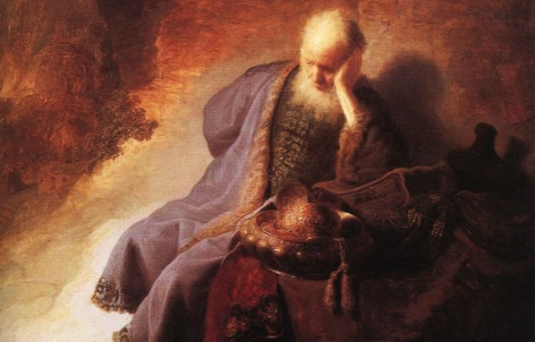
هل أنت مثل إرميا ؟
  كيف تقنعك خدمة إرميا المكلفة لما تحتاج أن تفعله لتكون أكثر أمانة و طاعة لله ؟
  هل تتساءل حول دعوتك ؟ هل أنت مستاء من المهمة التي أعطاك إياها الله لتفعلها ؟

Slide 88
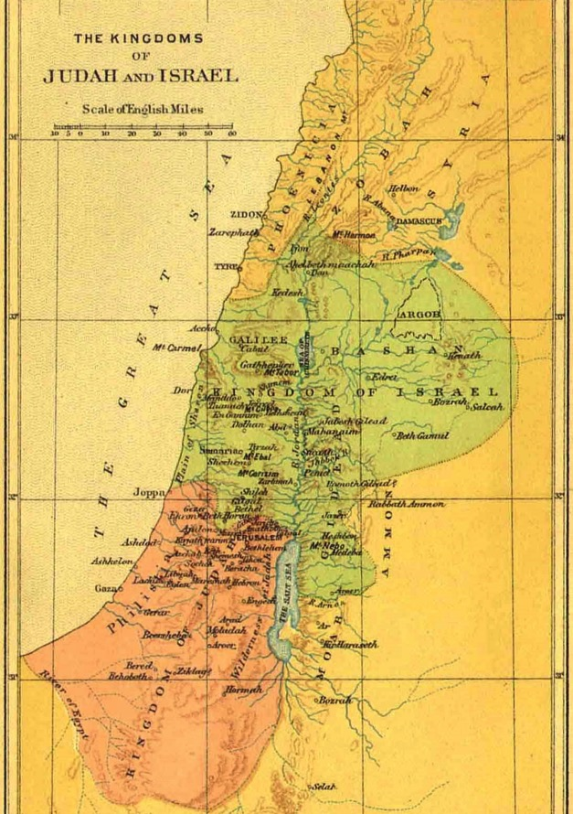
التطبيق الثاني
هل أنت مثل يهوذا ؟
إذا اخترنا الاستمرار في الخطيئة ، فسنصل في النهاية إلى النقطة التي يصبح فيها تأديب الله أمرًا لا مفر منه.

Slide 89
خطية يهوذا
بل اللقلق في السماوات
يعرف ميعاده
و اليمامة و السنونة المزقزقة
حفظتا وقت مجيئهما
تلاحظ الحيوانات
قوانين الله
بعكس شعب الله
يتصرف الشعب
و كأنهم لم يسمعوا
هذه القوانين أبداً
إر 8: 7
Notes:
Judah’s sin focused on “I” priorities: ingratitude, idolatry, immorality, irrationality

Slide 90
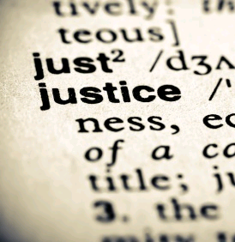
أدت خطيئة يهوذا في النهاية إلى تأديب الله
  1. أدين قادة و ملوك يهوذا و تم معاقبتهم . إرميا 22
2. صبر اليهود 70 سنة في السبي البابلي . إرميا 25: 11
  3. أدان الله الأمم التي اضطهدت يهوذا أيضاً . إرميا 46-51
Notes:
Jehoahaz will be judged through his death in exile (22:10-12).
Jehoiakim will be judged through a terrible death without burial (22:13-23).
Jehoiachin will be judged by not having any of his immediate descendants sit upon the throne (22:24-30)

Slide 91
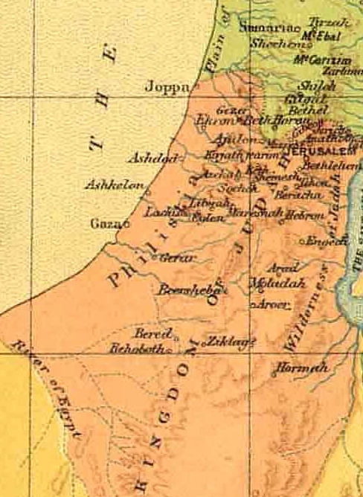
هل أنت مثل يهوذا ؟
  في أي أمر في حياتك تستمر في الخطية أو ترفض التوبة ؟
  هل تقبل تأديب الله العادل ؟

Slide 92
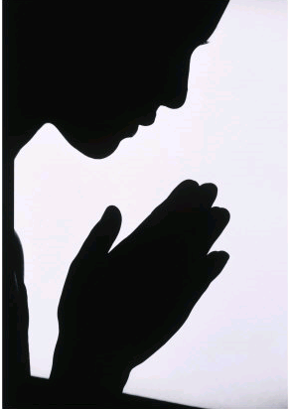
التطبيق الثالث
هل أنت مثل
البقية التقية ؟
هناك رجاء بعد التأديب لأن عدل الله متوازن
بين الرحمة و الأمانة

Slide 93
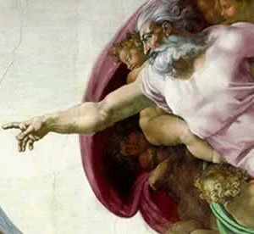
طبيعة الدينونة في إرميا
1. ضد كل من يهوذا و الشعوب الوثنية
2. تعلن عدل، سيادة، أمانة و رحمة الله
3. متوازنة بين الرجاء في العهد الجديد و الإسترداد

Slide 94
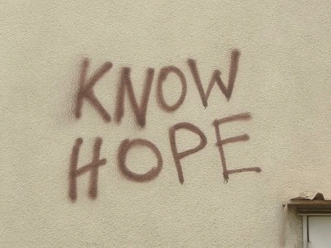
هل أنت جزء من البقية التقية؟
لا رجاء ؟
  هل تضع رجاءك في إلهك الأمين والرحيم؟
  هل تتطلع إلى يوم الرب والإسترداد الكامل الذي يعد به؟
أم؟
معرفة / الرجاء

Slide 95
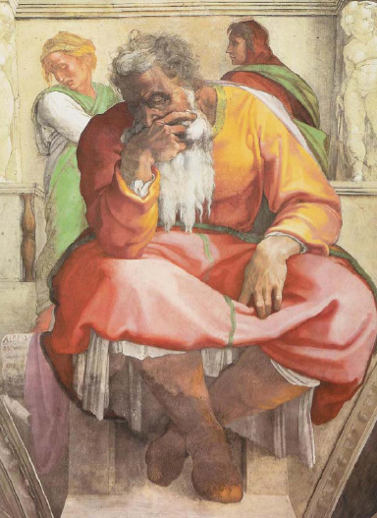
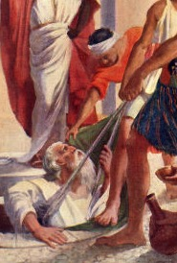
كيف يجب أن تعيش ؟

Slide 96
Black

Slide 97


مسح العهد القديم • BibleStudyDownloads.org
احصل علي هذا العرض مجانا!
Notes:
OP Arabic

