Slide 1
كن مُحباً
نشيــــد الأنشــــــاد
مؤسسة الدراسات اللاهوتية الأردنية. د. ريك جريفيث
• BibleStudyDownloads.org

Slide 2
الزواج معرض للهجوم

Slide 3
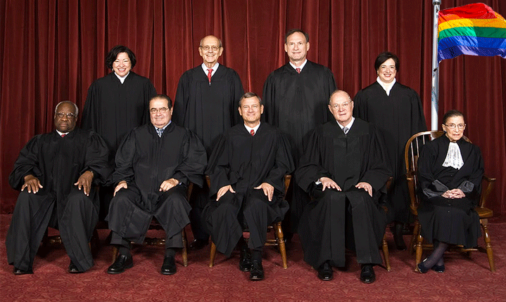
إعادة تعريف الزواج في المحكمة العليا 26 حزيران 2015

Slide 4
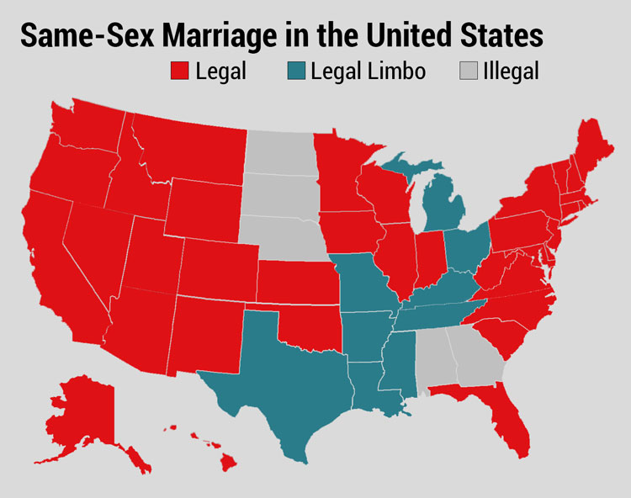
قبل القرار
زواج مثليي الجنس في الولايات المتحدة
قانوني
مأزق قانوني
غير قانوني
Notes:
Before the decision, the states were divided on the issue of same-sex marriage.

Slide 5
بعد القرار
Notes:
The Supreme Court overturned all states that prohibited homosexual marriage, making the entire USA redefine this thousands-of-years-old institution.

Slide 6
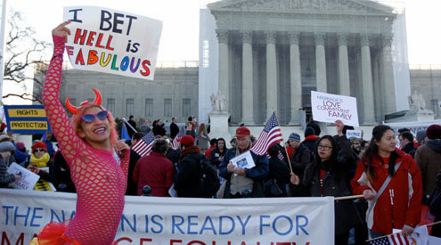
إعادة تعريف الزواج في المحكمة العليا 26 حزيران 2015

Slide 7
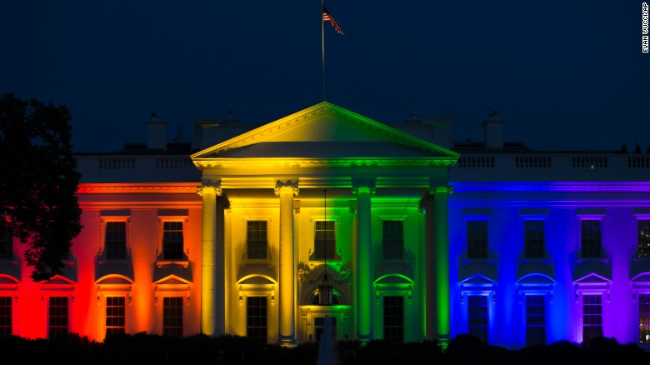
إعادة تعريف الزواج في المحكمة العليا 26 حزيران 2015
Notes:
President Obama even ordered the White House lit in the homosexual rainbows in celebration.

Slide 8
أين ستنتهي ؟
Notes:
Legalizing of polygamy is a natural future fear.
Now we are told there are 70 different sexes. This will not strengthen marriage!

Slide 9
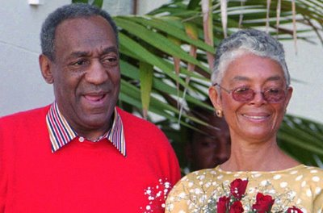
بيل كوسبي
Notes:
Bill Cosby’s sexual failures and the #MeToo movement have highlighted how women have become abused.

Slide 10
بيل هايبلز
Notes:
Many of us here have been blessed by the ministry of Bill Hybels, who has been married since 1974.
____
Bill Hybels is Living Happily With Wife Lynne Hybels and Children; Know about his Married Life and Children
May 18, 2018 First published on:May 18, 2018

Slide 11
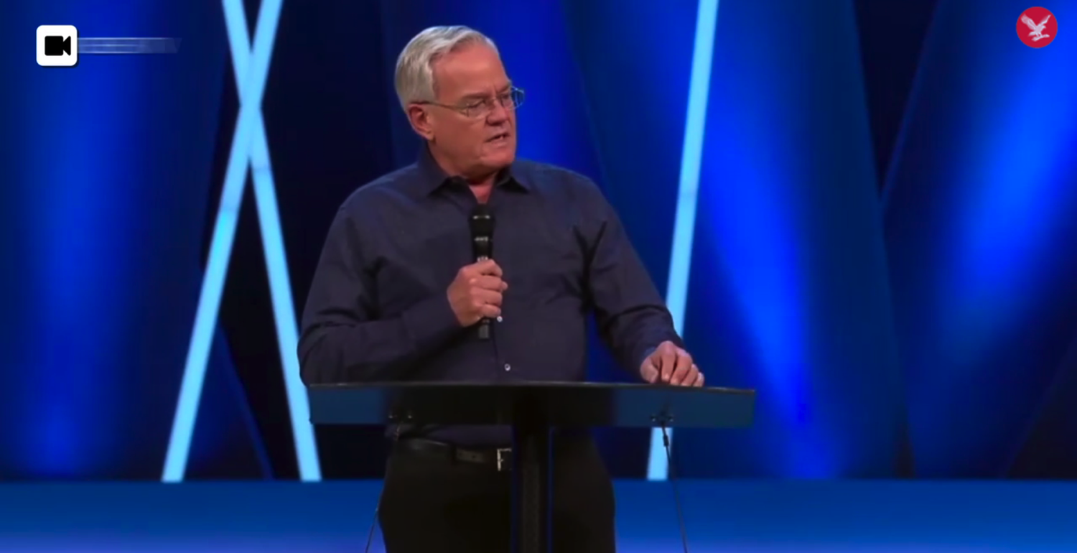
بيل هايبلز
بات بارانوفسكي
Notes:
But in April 2018 Hybels resigned from Willow Creek over sexual allegations.
______
He’s a Superstar Pastor. She Worked for Him and Says He Groped Her Repeatedly: Bill Hybels built an iconic evangelical church outside Chicago. A former assistant says that in the 1980s, he sexually harassed her.
By Laurie Goodstein
Aug. 5, 2018
https://www.nytimes.com/2018/08/05/us/bill-hybels-willow-creek-pat-baranowski.html
Pat Baranowski was the executive assistant to the Rev. Bill Hybels at the Willow Creek Community Church in South Barrington, Ill., one of the largest megachurches in the country.CreditAlyssa Schukar for The New York Times
SOUTH BARRINGTON, Ill. — After the pain of watching her marriage fall apart, Pat Baranowski felt that God was suddenly showering her with blessings.
She had a new job at her Chicago-area megachurch, led by a dynamic young pastor named the Rev. Bill Hybels, who in the 1980s was becoming one of the most influential evangelical leaders in the country.
The pay at Willow Creek Community Church was much lower than at her old job, but Ms. Baranowski, then 32, admired Mr. Hybels and the church’s mission so much that it seemed worth it. She felt even more blessed when in 1985 Mr. Hybels and his wife invited her to move into their home, where she shared family dinners and vacations.
Once, while Mr. Hybels’s wife, Lynne, and their children were away, the pastor took Ms. Baranowski out for dinner. When they got home, Mr. Hybels offered her a back rub in front of the fireplace and told her to lie face down.
Stunned, she remembered feeling unable to say no to her boss and pastor as he straddled her, unhooked her bra and touched her near her breasts. She remembered feeling his hands shake.
That first back rub in 1986 led to multiple occasions over nearly two years in which he fondled her breasts and rubbed against her. The incidents later escalated to one occasion of oral sex. Ms. Baranowski said she was mortified and determined to stay silent.
[Read about the resignation of Willow Creek Church’s lead pastor and board of elders.]
“I really did not want to hurt the church,” said Ms. Baranowski, who is now 65, speaking publicly for the first time. “I felt like if this was exposed, this fantastic place would blow up, and I loved the church. I loved the people there. I loved the family. I didn’t want to hurt anybody. And I was ashamed.”
Mr. Hybels denied her allegations about her time working and living with him. “I never had an inappropriate physical or emotional relationship with her before that time, during that time or after that time,” he said in an email.
Since the #MeToo movement emerged last year, evangelical churches have been grappling with allegations of sexual abuse by their pastors. A wave of accusations has begun to hit evangelical institutions, bringing down figures like the Rev. Andy Savage, at Highpoint Church in Memphis, and the Rev. Harry L. Thomas, the founder of the Creation Festival, a Christian music event.
Ms. Baranowski is not the first to accuse Mr. Hybels of wrongdoing, though her charges are more serious than what has been reported before.
In March, The Chicago Tribune and Christianity Today reported that Mr. Hybels had been accused by several other women, including co-workers and a congregant, of inappropriate behavior that dated back decades. The allegations included lingering hugs, invitations to hotel rooms, comments about looks and an unwanted kiss.
The accusations did not immediately result in consequences for Mr. Hybels. At a churchwide meeting where Mr. Hybels denied the allegations, he received a standing ovation from the congregation.
The church’s elders conducted their own investigation of the allegations when they first surfaced four years ago and commissioned a second inquiry by an outside lawyer, completed in 2017. Both investigations cleared Mr. Hybels, though the church’s two lead pastors have since issued public apologies, saying that they believe the women.
In April, Mr. Hybels announced to the congregation he would accelerate his planned retirement by six months and step aside immediately for the good of the church. He continued to deny the allegations, but acknowledged, “I too often placed myself in situations that would have been far wiser to avoid.” The congregation let out a disappointed groan. Some shouted “No!”
On Sunday, one of the church’s two top pastors severed his ties with Willow Creek. After services, the Rev. Steve Carter announced that he was resigning immediately in response to Ms. Baranowski’s “horrifying” allegations about Mr. Hybels.
Mr. Carter said he had a “fundamental difference” with the church’s elders over how they had handled the allegations against Mr. Hybels, and had been planning to resign for some time.
Mr. Carter did not appear as scheduled at Sunday services at the church’s main campus, and the congregation at the second service was told that he was so sick that he was vomiting backstage.
No mention was made of Mr. Hybels or the allegations against him at either service at the main campus.
In many evangelical churches, a magnetic pastor like Mr. Hybels is the superstar on whom everything else rests, making accusations of harassment particularly difficult to confront. Such a pastor is seen as a conduit to Christ, giving sermons so mesmerizing that congregants rush to buy tapes of them after services.
In the evangelical world, Mr. Hybels is considered a giant, revered as a leadership guru who discovered the formula for bringing to church people who were skeptical of Christianity. His books and speeches have crossed over into the business world.
Mr. Hybels built a church independent of any denomination. In such churches, there is no larger hierarchy to set policies and keep the pastor accountable. Boards of elders are usually volunteers recommended, and often approved, by the pastor.
But the most significant reason sexual harassment can go unchecked is that victims do not want to hurt the mission of their churches.
“So many victims within the evangelical world stay silent because they feel, if they step forward, they’ll damage this man’s ministry, and God won’t be able to accomplish the things he’s doing through this man,” said Boz Tchividjian, a former sex crimes prosecutor who leads GRACE, an organization that works with victims of abuse in Christian institutions.
“Those leaders feel almost invincible,” said Mr. Tchividjian, a grandson of Billy Graham who has consulted with some former staff members accusing Mr. Hybels of wrongdoing. “They don’t feel like the rules apply to them, because they’re doing great things for Jesus, even though their behavior doesn’t reflect Jesus at all.”
A Sign
In 1984, Ms. Baranowski was walking to her car in the vast parking lot of Willow Creek one night after services. She had just been praying about whether to apply for a job at the church she saw posted.
Suddenly a car screeched to a stop beside her, and the driver rolled down his window. It was the church’s pastor.
“Could I drive you to your car or something?” offered Mr. Hybels, who was then 33. Her car was nearby, but she accepted the ride.
It seemed like a sign from God.
Mr. Hybels later also described the meeting as a miracle: He had been driving out of the parking lot when God urged him to go back and find the woman he drove by.
“That night I had no idea how offering help to a person who probably didn’t need it would affect my life and ministry,” he wrote in one of his first books.
Soon after, she left her position as a computer systems manager. She found great purpose in working for a church that was adding more than 1,000 new members a year. She served as Mr. Hybels’s gatekeeper, fielding calls from pastors across the country eager to tap him for advice.
“It was a wonderful time,” she said. “I thought maybe God was just being good to me, and I think he was. But I couldn’t understand: Why did he select me? Because I didn’t think that highly of myself.”
Ms. Baranowski kept handwritten notes she received from Mr. Hybels. In one, Mr. Hybels praised her work and said, “I am praying that your new small group” at church “will be a source of much happiness and strength in your life.” Then he added, “P.S. Plus, you are a knockout!”
Mr. Hybels was regarded as a maverick in the evangelical world for giving women leadership positions.
Nancy Beach, who joined the staff soon after Ms. Baranowski, said the work was exhilarating.
“We were at the center of this grand adventure,” said Ms. Beach, the first woman appointed by Mr. Hybels to be a “teaching pastor,” meaning she could preach at services.
Ms. Beach recalled that Mr. Hybels was an exacting boss who got angry if the sound system was fuzzy or if a Christmas drama wasn’t performed smoothly. And he didn’t tolerate personal misconduct. After one staff member had an affair and another was discovered with pornography, she said, “They had to speak publicly to everyone affected. They lost their jobs.”
Ms. Beach is among the women who have recently come forward in articles accusing Mr. Hybels of harassment. She said that on a work trip to Spain in 1999, he invited her to his hotel room and gave her a long hug that made her feel uncomfortable.
She didn’t speak up until recently, when she heard there were other women with similar experiences.
“That’s what makes some of this so confusing, because he has been a champion for women,” said Ms. Beach, who has since left Willow but still preaches widely.
‘Humiliated, Guilty and Ashamed’
In the late 1980s, crusading against pornography was a top priority for evangelicals. Mr. Hybels told Ms. Baranowski that he had been told to educate himself on the issue by James Dobson, founder of the ministry Focus on the Family, who had been appointed by President Ronald Reagan to an anti-pornography commission.
Calling it research, Mr. Hybels once instructed Ms. Baranowski to go out and rent several pornographic videos, she said, to her great embarrassment. He insisted on watching them with her, she said, while he was dressed in a bathrobe.
One night, she said, Mr. Hybels felt too sick to go to a church event, so he sent his wife in his stead to introduce the guest speaker, a famous evangelist from India. He asked Ms. Baranowski to bring him something to eat, and fondled her again, she said.
Ms. Baranowski said that during the years of harassment, Mr. Hybels never kissed her, and they never had intercourse. She was particularly ashamed about the oral sex. She grew increasingly wracked by guilt and tried to talk with him. One day in his office, she told him that it was unfair to his wife, that it was sin, and that she felt humiliated.
That night she recorded in her journal what he had said in response: “It’s not a big deal. Why can’t you just get over it? You didn’t tell anyone, did you?”
His attitude toward her slowly began to change, she said. She moved out of the house after two years. In the office, he began to suggest she was incompetent and unstable. He berated her work in front of others. She grew depressed and poured out her feelings to God, filling 20 spiral-bound journals.
On May 11, 1989, she wrote, “I feel like an abused wife.”
She feared that she would be forced to stand in front of the congregation and confess, like the other employees who were fired. She was relocated to work in a converted coat closet.
Mr. Hybels finally sketched out an exit plan for her on a piece of note paper, which she kept. She resigned from Willow after more than eight years.
Mr. Hybels said in an email last week that Ms. Baranowski had “wanted a bigger challenge than being my assistant” and changed jobs “on good terms.”
She saw a counselor, who said in an interview that she remembered only that Ms. Baranowski was “humiliated, guilty and ashamed” because of her relationship with Mr. Hybels. The counselor, who spoke with Ms. Baranowski’s permission, requested anonymity because she did not want to be part of the controversy.
She recalled of Ms. Baranowski, “She felt she had lost her connection to God.”
Since leaving the church, Ms. Baranowski said she has struggled to keep a job, lost her condominium, moved from state to state, and had migraines and panic attacks.
“I carried Bill’s responsibility, for things he should have been responsible for,” she said.
Ms. Baranowski told only one friend, the Rev. Don Cousins, about one month after she left the Willow staff. She begged him to stay silent, and he did, until now.
The entanglement with Mr. Hybels “altered the trajectory of her life,” said Mr. Cousins, a well-known evangelical leader who worked at Willow for 17 years.
“She had been a very high-performing person, committed, high-caliber, responsible,” said Mr. Cousins, now a pastor in Orlando, Fla. “And the church was her life.”
Mr. Hybels went on to expand Willow to eight sites with 25,000 worshipers. He published more than 50 books, many on ethics, like “Who Are You When No One’s Looking.”
He was a spiritual adviser to President Bill Clinton and stuck with him through his impeachment. He drew speakers like Colin Powell, Bono and Sheryl Sandberg to his annual Global Leadership Summit, which has continued and will be held later this week.
When news of the other allegations against Mr. Hybels broke, Mr. Cousins encouraged Ms. Baranowski to get in touch with Ms. Beach. The two women had a tearful reunion. Both wish they had confronted Mr. Hybels at the time so they could have spared other women from harassment.
Ms. Beach remembers traveling to 27 countries representing Willow Creek and hearing pastors say hundreds of times that they owed their churches’ success to Mr. Hybels.
“How could he have done all this good,” she asked, “when there were such dark things happening behind the scenes?”
Mitch Smith contributed reporting.
A version of this article appears in print on Aug. 6, 2018, on Page A1 of the New York edition with the headline: ‘I Loved the Church’: An Accuser and Her Pastor. Order Reprints | Today’s Paper | Subscribe
____
See also Willow Creek Members React to Bill Hybels' Resignation as Accuser Stands by Story
By Leonardo Blair , Christian Post Reporter | Apr 11, 2018 12:56 PM
https://www.christianpost.com/news/willow-creek-members-react-to-bill-hybels-resignation-as-accuser-stands-by-story-222796/

Slide 12
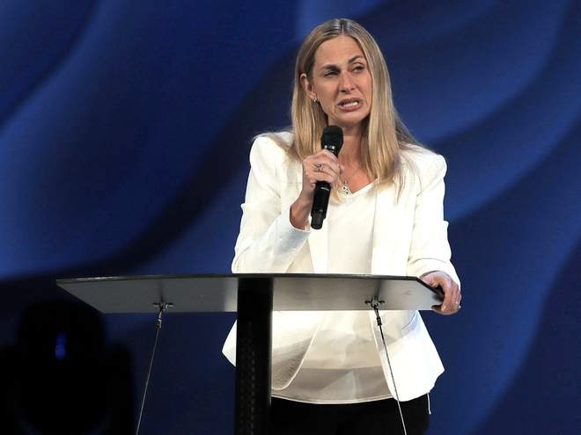
Bill Hybels
Notes:
The latest 10 August 2018 report now is: "The lead pastor of one of the largest evangelical churches in the US has said she is stepping down along with the entire Board of Elders after a string of sexual harassment allegations against its founder, Bill Hybels.
Heather Larson said the Willow Creek Community Church needed new leadership.
"To all of the women who have come forward, the church should always follow in Jesus’ footsteps to help the wounded find healing, and we are sorry we added to your pain,” she said in an announcement on the Chicago-area church’s website.
It has eight locations dotted around the Illinois city.
“That was not our intention, and we regret that it has taken us this long to acknowledge that. While we will probably never know with certainty everything that’s true about each of your stories, we have no reason not to believe you. We are sorry that our initial statements were so insensitive, defensive, and reflexively protective of Bill. We exhort Bill to acknowledge his sin and publicly apologise.”
Mr Hybels former assistant, Pat Baranowski, alleged to The New York Times that he repeatedly demanded oral sex and groped her while she worked for him the 1980s. After leaving her job, she struggled for 25 years with depression, becoming unemployed and homeless.
A number of other women have also accused Mr Hybels of sexual misconduct.
Although he denies the allegation, Mr Hybels resigned from the church in April.
The announcement from the Board of Elders came as the Willow Creek Association ahead of the megachurch's 23rd annual Global Leadership Summit.
Heather Larson, lead pastor at the Willow Creek Commnity Church, says the church needs new leadership in the wake of sexual harassment allegations against Bill Hybels (Steve Lundy/Daily Herald via AP)
Several speakers have backed out and over 100 churches cancelled plans to broadcast the event, after the allegations against Mr Hybels surfaced.
At least five participants, including Oscar winner Denzel Washington, also cancelled their scheduled appearances at the event, according to The Chicago Tribune.
Previous guests to appear at the summit over its 26-year history include U2 frontman Bono, Bill Clinton and Tony Blair.
Mr Hybels will not appear at the event, which he has previously hosted."
Willow Creek: Megachurch's lead pastor and board of elders resign in wake of sexual harassment allegations against founder Bill Hybels: 10 August 2018
https://www.independent.co.uk/news/world/americas/willow-creek-church-bill-hybels-sexual-harassment-pastor-elders-resign-chicago-a8484071.html accessed 11 Aug 2018

Slide 13
أشعياء 5 : 20
ويل للقائلين للشر خيراً و للخير شراً الجاعلين الظلام نوراً و النور ظلاماً الجاعلين المر حلواً و الحلو مراً

Slide 14
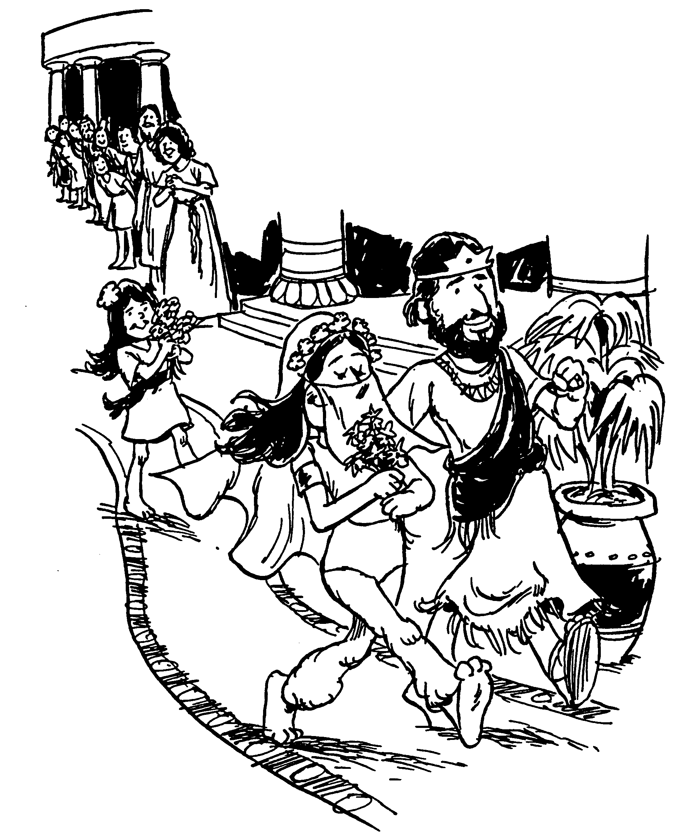
نشيد الأنشاد
حوار الحب الزوجي
Notes:
Marriage is the most intimate relationship in existence.
We should not be surprised to see a book in the Bible devoted to marriage.
In fact, we should be surprised if the Bible did not address this building block of every civilization!

Slide 15
Keys
الحـــــــب
425
الكلمة المفتاحية
الآية المفتاحية
أَنَا لِحَبِيبِي، وَإِلَيَّ اشْتِيَاقُه ( نش ٧ : ١٠ )
Notes:
The purity and simplicity of this book may indicate it was the first of Solomon’s three inspired writings.
Solomon later had 700 wives and 300 concubines.
It seems reasonable that he wrote this book before his viewpoint deteriorated.

Slide 16
كن مُحباً
نشيــــد الأنشــــــاد
مؤسسة الدراسات اللاهوتية الأردنية . د/ ريك جريفيث
• BibleStudyDownloads.org

Slide 17
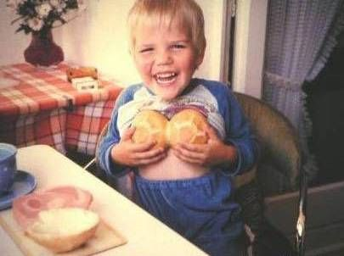
من الطبيعي أن نشعر بالفضول حيال الحياة الجنسية منذ أقدم العصور
ومع ذلك ، لم تسمح اليهودية التقليدية للرجال بقراءة نشيد الأنشاد حتى سن الثلاثين

Slide 18
نشــيد الأنشـــاد
٤٢٥
٢٥
حوار الحــب الــزوجــي
الخطوبة ما قبل الزواج
النمو في الزواج
١:١ - ٥: ١
٥: ٢ - ٨: ١٤
بداية الحب
إتساع الحب
حب أناني
حَبِيبِي لِي وَأَنَا لَهُ ( ٢: ١٦ أ )
حب غير أناني
أَنَا لِحَبِيبِي وَحَبِيبِي لِي ( ٣: ١٦ أ )
أعزب
مـتـــزوج
حب طفولي
حب غير مختبر
حب مختبر وصحيح
أسترجاع الحب
تودد ١:١ – ٣: ٥
زواج
٣: ٦ – ٥: ١
نمو
٥: ٢- ٨: ٤
أسترجاع
٨: ٥ - ١٤
شوق
١: ١- ١١
تكثيف
١: ١٢ – ٣: ٥
مسيرة
٣: ٦- ١١
إكتمال
٤: ١ – ٥: ١
صراعات
٥: ٢ – ٦: ١٣
تسبيح وأستجابة
٧:١- ٨: ٤
قوة الحب
٨: ٥- ٧
عذرية الحب
٨: ٨- ١٤
هما الاثنان في الكرم
بداية شهر العسل
نهاية شهر العسل
هما الاثنان في الكرم
إنفصال
٥: ٢- ١٦
تزين
٦: ١-١٣

Slide 19
كيف يمكن أن يصبح الحب الزوجي كل ما صممه الله؟
نشيــــد الأنشــــــاد
Notes:
What can you do now to have the fantastic marriage that God desires if he has marriage in his plan for you?

Slide 20
١- انتظر الجنس حتى الزواج ( ١: ١ - ٥: ١ )
نشيــــد الأنشــــــاد
Notes:
Be loving to God's person for you by preserving yourself now.
Solomon and the Shulammite begin their love relationship in courtship and marriage as an example of the need for premarital sexual restraint (1:1–5:1).

Slide 21
Slides on نشيد الأنشاد 1

Slide 22
الفرضية
430
حوار الحب الزوجي
1: 1-5: 1 المغازلة للزفاف
5: 2-8: 14 النمو في الزواج

Slide 23
نشيد الانشاد ١ : ١ نَشِيدُ الأَنَاشِيدِ الَّذِي لِسُلَيْمَانَ

Slide 24
العروس : لِيُقَبِّلْنِي بِقُبْلاَتِ فَمِهِ لأَنَّ حُبَّكَ أَطْيَبُ مِنَ الْخَمْرِ. لِرَائِحَةِ أَدْهَانِكَ الطَّيِّبَةِ. اسْمُكَ دُهْنٌ مُهْرَاقٌ لِذَلِكَ أَحَبَّتْكَ الْعَذَارَى. نشيد الأنشاد ١ : ٢-٣
Notes:
Solomon and the Shulammite express longing, insecurity, and praise as a prelude to the content of the entire poem (1:2-11).

Slide 25
العروس : اُجْذُبْنِي وَرَاءَكَ فَنَجْرِيَ. أَدْخَلَنِي الْمَلِكُ إِلَى حِجَالِهِ. نَبْتَهِجُ وَنَفْرَحُ بِكَ. نَذْكُرُ حُبَّكَ أَكْثَرَ مِنَ الْخَمْرِ. بِالْحَقِّ يُحِبُّونَكَ.
نشيد الأنشاد ١ : ٤

Slide 26
The beloved’s “friends” (see NIV marg.), elsewhere referred to as the “daughters of Jerusalem” (v. 5; 3:10; 5:8, 16) and “daughters of Zion” (3:11)
الأصدقاء و بنات أورشليم) (1: 5، 3: 10، 5: 8، 16)
بنات صهيون (3: 11)
الأصدقاء :
نَبْتَهِجُ وَنَفْرَحُ بِكَ. نَذْكُرُ حُبَّكَ أَكْثَرَ مِنَ الْخَمْرِ. بِالْحَقِّ يُحِبُّونَكَ.
نشيد الأنشاد ١ : ٤
Notes:
The female inhabitants of Jerusalem are probably depicted in 1:4b as "The chorus is a literary device in the Song whereby the beloved and her lover express their emotions and thoughts more fully. By praising Solomon (you is masc. sing.) in Song of Songs 1:4 the “daughters” seemed to be agreeing with one another that the couple had an ideal romance. The last line in verse 4 may be the words of the beloved (see NIV marg.) or, perhaps better, the words of the friends" (Jack S. Deere, "Song of Songs," In The Bible Knowledge Commentary, 1:1014).

Slide 27
العروس : أَنَا سَوْدَاءُ وَجَمِيلَةٌ يَا بَنَاتِ أُورُشَلِيمَ كَخِيَامِ قِيدَارَ كَشُقَقِ سُلَيْمَانَ. لاَ تَنْظُرْنَ إِلَيَّ لِكَوْنِي سَوْدَاءَ لأَنَّ الشَّمْسَ قَدْ لَوَّحَتْنِي. بَنُو أُمِّي غَضِبُوا عَلَيَّ. جَعَلُونِي نَاطُورَةَ الْكُرُومِ. أَمَّا كَرْمِي فَلَمْ أَنْطُرْهُ. نشيد الأنشاد ١ : ٥-٦

Slide 28
الراعي
Notes:
The woman at times calls him a king (1:4) and other times a shepherd (1:7)—so which is it? Both?

Slide 29
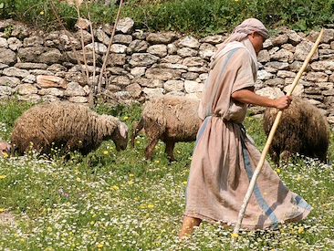
العروس : أَخْبِرْنِي يَا مَنْ تُحِبُّهُ نَفْسِي أَيْنَ تَرْعَى أَيْنَ تُرْبِضُ عِنْدَ الظَّهِيرَةِ. لِمَاذَا أَنَا أَكُونُ كَمُقَنَّعَةٍ عِنْدَ قُطْعَانِ أَصْحَابِكَ؟ نشيد الأنشاد ١ : ٧

Slide 30
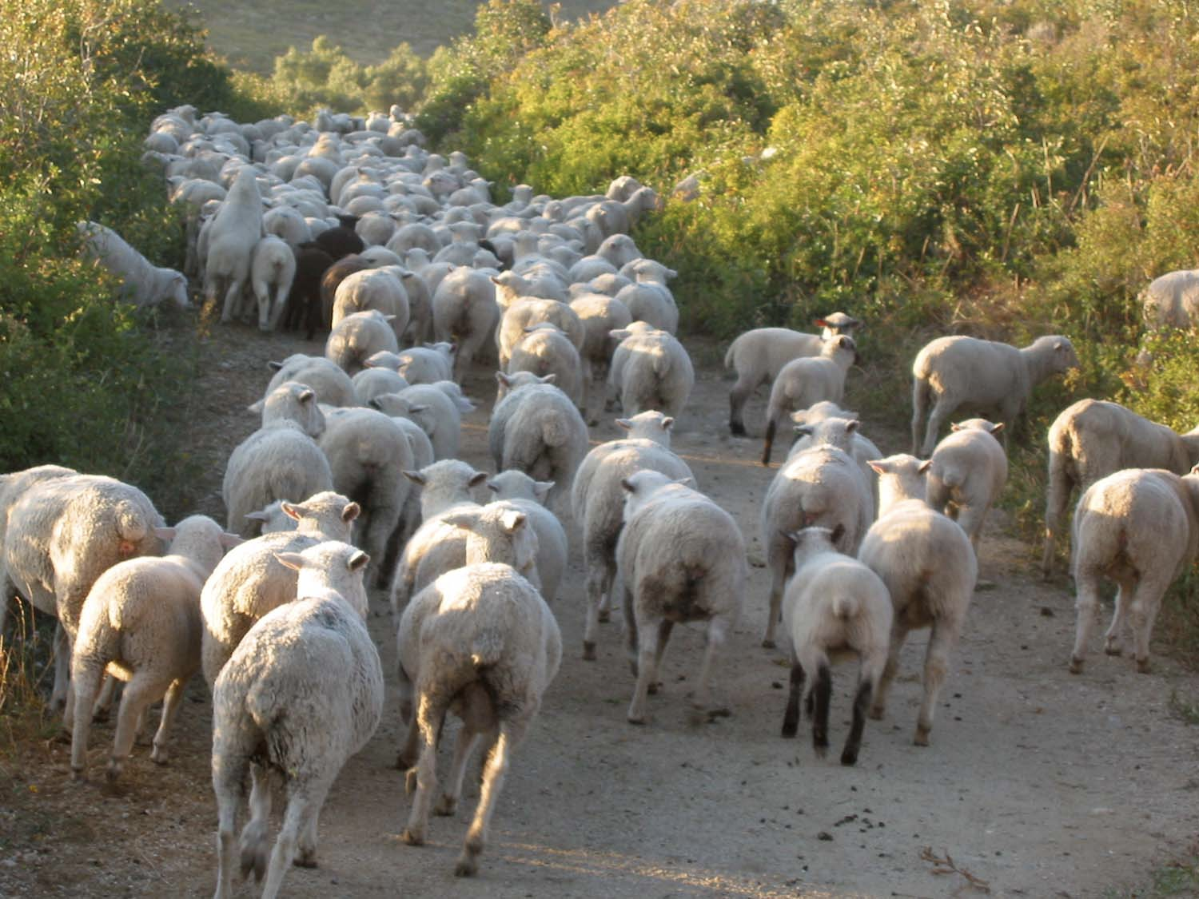
الأصدقاء : إِنْ لَمْ تَعْرِفِي أَيَّتُهَا الْجَمِيلَةُ بَيْنَ النِّسَاءِ فَاخْرُجِي عَلَى آثَارِ الْغَنَمِ وَارْعَيْ جِدَاءَكِ عِنْدَ مَسَاكِنِ الرُّعَاةِ. نشيد الأنشاد ١ : ٨

Slide 31
لَقَدْ شَبَّهْتُكِ يَا حَبِيبَتِي بِفَرَسٍ فِي مَرْكَبَاتِ فِرْعَوْنَ. مَا أَجْمَلَ خَدَّيْكِ بِسُمُوطٍ وَعُنُقَكِ بِقَلاَئِدَ! نَصْنَعُ لَكِ سَلاَسِلَ مِنْ ذَهَبٍ مَعَ جُمَانٍ مِنْ فِضَّةٍ. نشيد الأنشاد ١ : ٩-١١

Slide 32
العروس : مَا دَامَ الْمَلِكُ فِي مَجْلِسِهِ أَفَاحَ نَارِدِينِي رَائِحَتَهُ. صُرَّةُ الْمُرِّ حَبِيبِي لِي. بَيْنَ ثَدْيَيَّ يَبِيتُ. طَاقَةُ فَاغِيَةٍ حَبِيبِي لِي فِي كُرُومِ عَيْنِ جَدْيٍ. نشيد الأنشاد ١ : ١٢-١٤
Notes:
The courtship between lover and beloved intensifies but they remain patient until their wedding day (1:12–3:5).

Slide 33
٥ أَنَا سَوْدَاءُ وَجَمِيلَةٌ يَا بَنَاتِ أُورُشَلِيمَ كَخِيَامِ قِيدَارَ كَشُقَقِ سُلَيْمَانَ. نشيد الانشاد ١ : ٥

Slide 34
حرفي أم رمزي؟
النساء
هَا أَنْتَ جَمِيلٌ يَا حَبِيبِي وَحُلْوٌ وَسَرِيرُنَا أَخْضَرُ. جَوَائِزُ بَيْتِنَا أَرْزٌ وَرَوَافِدُنَا سَرْوٌ.
نشيد الأنشاد ١ : ١٦-١٧
Notes:
"The beams of cedars and the rafters made of firs probably do not refer to a literal building but figuratively to the pastoral setting in which they first met. This is also suggested by the verdant (green) bed (couch). The field where they fell in love and sat talking was green" (Jack S. Deere, "Song of Songs," In The Bible Knowledge Commentary, 1:1014).

Slide 35
رمزي
النساء
هَا أَنْتَ جَمِيلٌ يَا حَبِيبِي وَحُلْوٌ وَسَرِيرُنَا أَخْضَرُ.
جَوَائِزُ بَيْتِنَا أَرْزٌ وَرَوَافِدُنَا سَرْوٌ.
نشيد الأنشاد ١ : ١٦-١٧
Notes:
"The beams of cedars and the rafters made of firs probably do not refer to a literal building but figuratively to the pastoral setting in which they first met. This is also suggested by the verdant (green) bed (couch). The field where they fell in love and sat talking was green" (Jack S. Deere, "Song of Songs," In The Bible Knowledge Commentary, 1:1014).

Slide 36
Slides on نشيد الأنشاد 2

Slide 37
أين يجب أن أنام ؟
نشيد الانشاد ٢ : ٦
شِمَالُهُ تَحْتَ رَأْسِي وَيَمِينُهُ تُعَانِقُنِي.
Notes:
On my marriage night, my Beloved Susan and I approached our bed for the first time and I was at a loss which side of the bed I should sleep. However, I recalled Song 2:6…
• I figured the only way for me to get my left arm under her head was to lay on the left side of the bed. So, in an effort to sleep biblically, I have slept on that side since 1983. (It also helps being right handed to embrace her with my stronger arm.)

Slide 38
انتظر (نش 2: 7)
نشيد الأنشاد ٢ : ٧
أُحَلِّفُكُنَّ يَا بَنَاتِ أُورُشَلِيمَ بِالظِّبَاءِ وَبِأَيَائِلِ الْحُقُولِ أَلاَّ تُيَقِّظْنَ وَلاَ تُنَبِّهْنَ الْحَبِيبَ حَتَّى يَشَاءَ!
Notes:
The النساء feels blessed to have waited for God's best for her. She also wants other women to see the benefits of waiting for sex until marriage.

Slide 39
والآن ماذا ؟
٤٢٥
ممارسة ضبط النفس الجنسي قبل الزواج حتى يمكن الإستمتاع بالزواج على أكمل وجه (أي السماح للحب بالإزدهار في وقته الخاص).
ألا تيقظن و لا تنبهن الحبيب حتى يشاء
نش ٢: ٧

Slide 40
Slides on نشيد الأنشاد 3
Notes:
The Shulammite dreams of losing her love but finds him and again warns the young virgins against premature sexual arousal (3:1-5).

Slide 41
والآن ماذا ؟
٤٢٥
ممارسة ضبط النفس الجنسي قبل الزواج حتى يمكن الإستمتاع بالزواج على أكمل وجه (أي السماح للحب بالإزدهار في وقته الخاص).
ألا تيقظن ولا تنبهن الحبيب حتى يشاء
نش ٢: ٧
ألا تيقظن ولا تنبهن الحبيب حتى يشاء
نش ٣ :٥

Slide 42
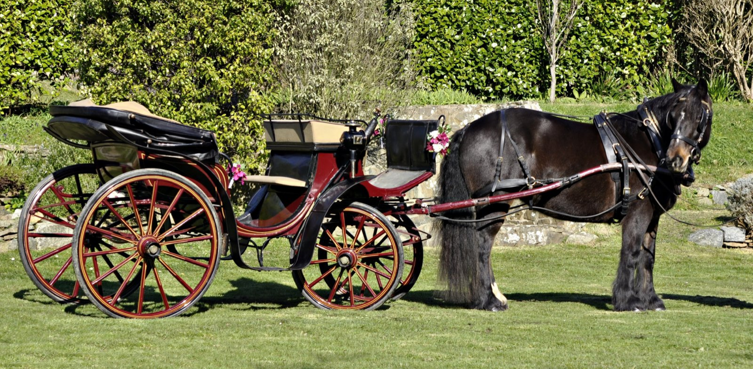
زفاف سليمان
نشيد الأنشاد ٣ : ٦-٧
مَنْ هَذِهِ الطَّالِعَةُ مِنَ الْبَرِّيَّةِ كَأَعْمِدَةٍ مِنْ دُخَانٍ مُعَطَّرَةً بِالْمُرِّ وَاللُّبَانِ وَبِكُلِّ أَذِرَّةِ التَّاجِرِ؟ هُوَذَا تَخْتُ سُلَيْمَانَ حَوْلَهُ سِتُّونَ جَبَّاراً مِنْ جَبَابِرَةِ إِسْرَائِيلَ.
Notes:
How? Solomon arrives for their wedding with the great pomp of a royal wedding procession (3:6-11).

Slide 43
كُلُّهُمْ قَابِضُونَ سُيُوفاً وَمُتَعَلِّمُونَ الْحَرْبَ.
ككُلُّ رَجُلٍ سَيْفُهُ عَلَى فَخْذِهِ مِنْ هَوْلِ اللَّيْلِ.
نشيد الأنشاد ٣ : ٨

Slide 44
نشيد الأنشاد ٣ : ٩-١٠ اَلْمَلِكُ سُلَيْمَانُ عَمِلَ لِنَفْسِهِ تَخْتاً مِنْ خَشَبِ لُبْنَانَ. عَمِلَ أَعْمِدَتَهُ فِضَّةً وَرَوَافِدَهُ ذَهَباً وَمَقْعَدَهُ أُرْجُواناً وَوَسَطَهُ مَرْصُوفاً مَحَبَّةً مِنْ بَنَاتِ أُورُشَلِيمَ.

Slide 45
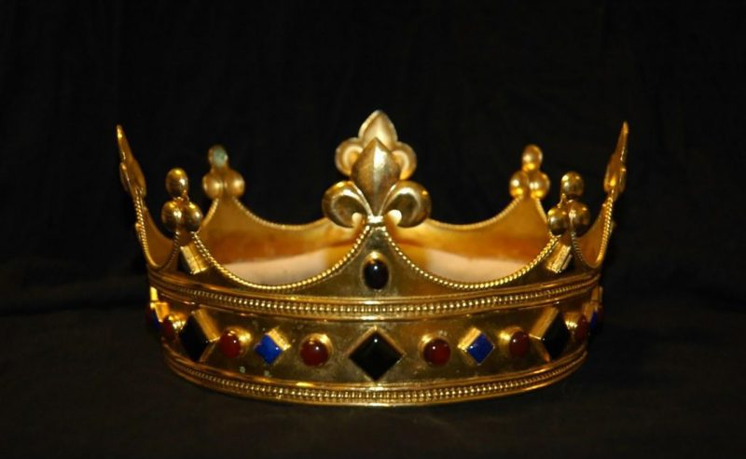
العروس : اُخْرُجْنَ يَا بَنَاتِ صِهْيَوْنَ وَانْظُرْنَ الْمَلِكَ سُلَيْمَانَ بِالتَّاجِ الَّذِي تَوَّجَتْهُ بِهِ أُمُّهُ فِي يَوْمِ عُرْسِهِ وَفِي يَوْمِ فَرَحِ قَلْبِهِ. نشيد الأنشاد ٣ : ١١

Slide 46
Slides on نشيد الأنشاد 4
Notes:
The groom praises his bride on their wedding night and they consummate their marriage (4:1–5:1). (Note: “bride” appears six times and only in this section.)

Slide 47
ماذا يعني أخذ النشيد حرفياً ؟
هَا أَنْتِ جَمِيلَةٌ يَا حَبِيبَتِي هَا أَنْتِ جَمِيلَةٌ! عَيْنَاكِ حَمَامَتَانِ مِنْ تَحْتِ نَقَابِكِ. شَعْرُكِ كَقَطِيعِ مِعْزٍ رَابِضٍ عَلَى جَبَلِ جِلْعَادَ. أَسْنَانُكِ كَقَطِيعِ الْجَزَائِزِ الصَّادِرَةِ مِنَ الْغَسْلِ اللَّوَاتِي كُلُّ وَاحِدَةٍ مُتْئِمٌ وَلَيْسَ فِيهِنَّ عَقِيمٌ. شَفَتَاكِ كَسِلْكَةٍ مِنَ الْقِرْمِزِ. وَفَمُكِ حُلْوٌ. خَدُّكِ كَفِلْقَةِ رُمَّانَةٍ تَحْتَ نَقَابِكِ. عُنُقُكِ كَبُرْجِ دَاوُدَ الْمَبْنِيِّ لِلأَسْلِحَةِ. أَلْفُ مِجَنٍّ عُلِّقَ عَلَيْهِ كُلُّهَا أَتْرَاسُ الْجَبَابِرَةِ. ثَدْيَاكِ كَخِشْفَتَيْ ظَبْيَةٍ تَوْأَمَيْنِ يَرْعَيَانِ بَيْنَ السَّوْسَنِ.
نشيد الأنشاد ٤ : ١-٥
Notes:
Solomon praises his bride's body, love, and purity (4:1-15).
—Solomon praises his bride's body and gives her security (4:1-7).
—Solomon praises his bride's love and calls her away from her home country (4:8-11; cf. Ps. 45:10-11).
—Solomon praises his bride's purity (4:12-15).

Slide 48
نشيد الأنشاد ٤ : ١٦
اِسْتَيْقِظِي يَا رِيحَ الشَّمَالِ وَتَعَالَيْ يَا رِيحَ الْجَنُوبِ! هَبِّي عَلَى جَنَّتِي فَتَقْطُرَ أَطْيَابُهَا. لِيَأْتِ حَبِيبِي إِلَى جَنَّتِهِ وَيَأْكُلْ ثَمَرَهُ النَّفِيسَ.
Notes:
The Shulammite encourages her husband to consummate their marriage and he accepts her invitation (4:16–5:1).
The Shulammite invites Solomon to sexual union with her with the imagery of a garden (4:16).

Slide 49
Slides on نشيد الأنشاد 5

Slide 50
نشيد الأنشاد ٥ : ١
قَدْ دَخَلْتُ جَنَّتِي يَا أُخْتِي الْعَرُوسُ. قَطَفْتُ مُرِّي مَعَ طِيبِي. أَكَلْتُ شَهْدِي مَعَ عَسَلِي.
العروس :
شَرِبْتُ خَمْرِي مَعَ لَبَنِي. كُلُوا أَيُّهَا الأَصْحَابُ. اشْرَبُوا وَاسْكَرُوا أَيُّهَا الأَحِبَّاءُ.
Notes:
"The NIV margin attributes the last part of the verse, Eat, O friends, and drink; drink your fill, O lovers, to the “friends” of the couple. However, it is unlikely that friends, wedding guests, or any other persons would have been present in the bedroom at the consummation of the couple’s marriage. A more plausible suggestion is that the speaker was God Himself. Only their Creator would have been a “guest” on that occasion. Since their love was from Him it was fitting that He approve it. He invited them to enjoy sexual love in marriage as if it were a banquet (“eat ... and drink”). This clearly indicates God’s approval of marriage, which He designed in the Garden of Eden (cf. Gen. 2:24)" (Deere, BKC, 1:1020).

Slide 51
شَرِبْتُ خَمْرِي مَعَ لَبَنِي. كُلُوا أَيُّهَا الأَصْحَابُ. اشْرَبُوا وَاسْكَرُوا أَيُّهَا الأَحِبَّاءُ.
نشيد الانشاد ٥ : ١
الله
Notes:
"The NIV margin attributes the last part of the verse, Eat, O friends, and drink; drink your fill, O lovers, to the “friends” of the couple. However, it is unlikely that friends, wedding guests, or any other persons would have been present in the bedroom at the consummation of the couple’s marriage. A more plausible suggestion is that the speaker was God Himself. Only their Creator would have been a “guest” on that occasion. Since their love was from Him it was fitting that He approve it. He invited them to enjoy sexual love in marriage as if it were a banquet (“eat ... and drink”). This clearly indicates God’s approval of marriage, which He designed in the Garden of Eden (cf. Gen. 2:24)" (Deere, BKC, 1:1020).

Slide 52
كيف يمكن أن يصبح الحب الزوجي كل ما صممه الله؟
نشيــــد الأنشــــــاد
Notes:
What can you do now to have the fantastic marriage that God desires if he has marriage in his plan for you?

Slide 53
١- انتظر الجنس حتى الزواج ( ١: ١ - ٥: ١ )
نشيــــد الأنشــــــاد
Notes:
Be loving to God's person for you by preserving yourself now.
Solomon and the Shulammite begin their love relationship in courtship and marriage as an example of the need for premarital sexual restraint (1:1–5:1).

Slide 54
٢- اعمل من أجل زواج جيد ( ٥: ٢ – ٨: ١٤ )
نشيــــد الأنشــــــاد
Notes:
No relationship is built without sweat and tears.
The love of the couple matures through various events until it is very strong to show the effort needed to grow in marital love (5:2–8:14).

Slide 55
العروس : أَنَا نَائِمَةٌ وَقَلْبِي مُسْتَيْقِظٌ. صَوْتُ حَبِيبِي قَارِعاً: «اِفْتَحِي لِي يَا أُخْتِي يَا حَبِيبَتِي يَا حَمَامَتِي يَا كَامِلَتِي لأَنَّ رَأْسِي امْتَلَأَ مِنَ الطَّلِّ وَقُصَصِي مِنْ نَدَى اللَّيْلِ». نشيد الأنشاد ٥ : ٢
Notes:
1. The Problem: The Wife’s Indifference and the Husband’s Absence (5:2-8)
5:2. In a dream (I slept but my heart was awake; cf. another recorded dream, 3:1-4) the wife was approached by her husband, who said Open to me (cf. 5:6). The fact that the lover no longer addressed her as “my bride” indicates there is a time lapse between verse 1 (the wedding night) and verse 2. The couple should no longer be regarded as newlyweds. But he did address her by other affectionate terms: my sister (see comments on 4:9), my darling (cf. 1:9, 15; 2:2, 10, 13; 4:1, 7; 6:4), my dove, and my flawless one (cf. 4:7). This is the first record of his using all these terms of endearment. His head and hair were covered with dew, as he had been outside. Dew in Israel was often heavy.
—Deere, BKC, 1:1020

Slide 56
نشيدالأنشاد ٥ : ٣ قَدْ خَلَعْتُ ثَوْبِي فَكَيْفَ أَلْبِسُهُ؟ قَدْ غَسَلْتُ رِجْلَيَّ فَكَيْفَ أُوَسِّخُهُمَا؟
Notes:
She is indifferent to him at first.

Slide 57
نشيد الأنشاد ٥ : ٤-٥ حَبِيبِي مَدَّ يَدَهُ مِنَ الْكُوَّةِ فَأَنَّتْ عَلَيْهِ أَحْشَائِي. ٥ قُمْتُ لأَفْتَحَ لِحَبِيبِي وَيَدَايَ تَقْطُرَانِ مُرّاً وَأَصَابِعِي مُرٌّ قَاطِرٌ عَلَى مَقْبَضِ الْقُفْلِ.
Notes:
But after he kept pursuing her, she then changed her mind about him.

Slide 58
نشيد الأنشاد ٥ : ٥-٦ قُمْتُ لأَفْتَحَ لِحَبِيبِي وَيَدَايَ تَقْطُرَانِ مُرّاً وَأَصَابِعِي مُرٌّ قَاطِرٌ عَلَى مَقْبَضِ الْقُفْلِ. ٦ فَتَحْتُ لِحَبِيبِي لَكِنَّ حَبِيبِي تَحَوَّلَ وَعَبَرَ. نَفْسِي خَرَجَتْ عِنْدَمَا أَدْبَرَ. طَلَبْتُهُ فَمَا وَجَدْتُهُ. دَعَوْتُهُ فَمَا أَجَابَنِي.

Slide 59
نشيد الأنشاد ٥ : ٨ أُحَلِّفُكُنَّ يَا بَنَاتِ أُورُشَلِيمَ إِنْ وَجَدْتُنَّ حَبِيبِي أَنْ تُخْبِرْنَهُ بِأَنِّي مَرِيضَةٌ حُبّاً.

Slide 60
نشيد الأنشاد ٥ : ١٦
حَلْقُهُ حَلاَوَةٌ وَكُلُّهُ مُشْتَهَيَاتٌ. هَذَا حَبِيبِي وَهَذَا خَلِيلِي يَا بَنَاتِ أُورُشَلِيمَ.
Notes:
The Shulammite regrets rejecting her husband as she ponders his admirable qualities (5:9-16).

Slide 61
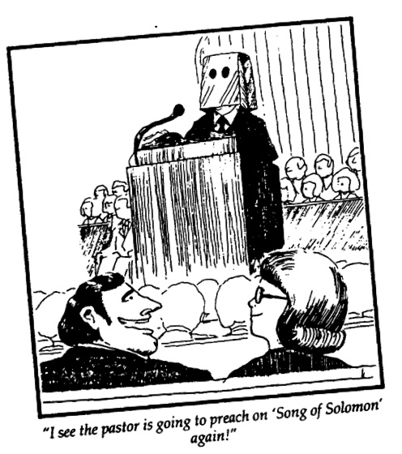
هل أنت محرج ؟
428
أرى أن الراعي سوف يعظ من نشيد الأنشاد ثانية

Slide 62
Slides on نشيد الأنشاد 6
Notes:
She pursues her husband for reconciliation (6:1-3).

Slide 63
العريس :
أَنْتِ جَمِيلَةٌ يَا حَبِيبَتِي كَتِرْصَةَ حَسَنَةٌ كَأُورُشَلِيمَ مُرْهِبَةٌ كَجَيْشٍ بِأَلْوِيَةٍ.
نشيد الأنشاد ٦ : ٤
Notes:
Solomon responds to her request and praises her (6:4-13).

Slide 64
Slides on نشيد الأنشاد 7
Notes:
Solomon praises the Shulammite for her beauty and ability to fulfill him sexually (7:1-9a).

Slide 65
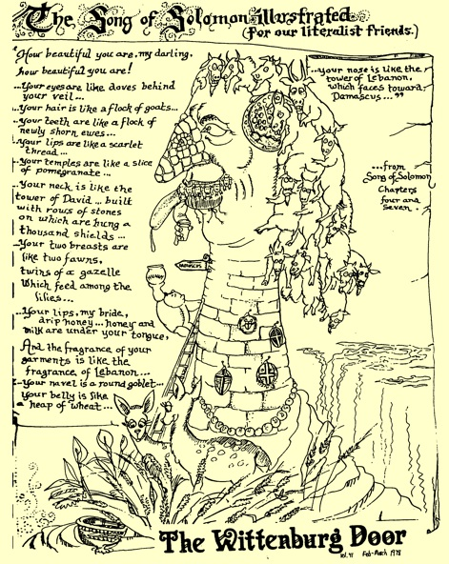
توضيح نشيد سليمان (7: 5-7)
436

Slide 66
أَنَا لِحَبِيبِي، وَإِلَيَّ اشْتِيَاقُه ( نش ٧ : ١٠ )
Notes:
She responds to his request but also requests a countryside stroll and deeper intimacy in their marriage (7:9b–8:4).

Slide 67
Slides on نشيد الأنشاد 8
Notes:
The Shulammite praises love's strength and their love story is reviewed in flashback form (8:5-14).

Slide 68
نشيد الأنشاد ٨ : ٦-٧ اِجْعَلْنِي كَخَاتِمٍ عَلَى قَلْبِكَ كَخَاتِمٍ عَلَى سَاعِدِكَ. لأَنَّ الْمَحَبَّةَ قَوِيَّةٌ كَالْمَوْتِ. الْغَيْرَةُ قَاسِيَةٌ كَالْهَاوِيَةِ. لَهِيبُهَا لَهِيبُ نَارِ لَظَى الرَّبِّ. ٧ مِيَاهٌ كَثِيرَةٌ لاَ تَسْتَطِيعُ أَنْ تُطْفِئَ الْمَحَبَّةَ وَالسُّيُولُ لاَ تَغْمُرُهَا. إِنْ أَعْطَى الإِنْسَانُ كُلَّ ثَرْوَةِ بَيْتِهِ بَدَلَ الْمَحَبَّةِ تُحْتَقَرُ احْتِقَاراً.
Notes:
The beloved exults in the awesome strength of genuine love by declaring that it is as universal and irresistible as death (8:5-7).

Slide 69
النساء ٨ لَنَا أُخْتٌ صَغِيرَةٌ لَيْسَ لَهَا ثَدْيَانِ. فَمَاذَا نَصْنَعُ لِأُخْتِنَا فِي يَوْمٍ تُخْطَبُ؟ ٩ إِنْ تَكُنْ سُوراً فَنَبْنِي عَلَيْهَا بُرْجَ فِضَّةٍ. وَإِنْ تَكُنْ بَاباً فَنَحْصُرُهَا بِأَلْوَاحِ أَرْزٍ. نشيد الأنشاد ٨ : ٨-٩
Notes:
The brothers of the Shulammite protected her from losing her virginity while she was young (8:8-9).

Slide 70
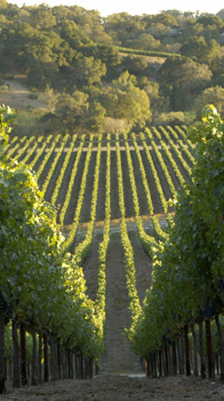
١١ كَانَ لِسُلَيْمَانَ كَرْمٌ فِي بَعْلَ هَامُونَ. دَفَعَ الْكَرْمَ إِلَى نَوَاطِيرَ كُلُّ وَاحِدٍ يُؤَدِّي عَنْ ثَمَرِهِ أَلْفاً مِنَ الْفِضَّةِ. ١٢ كَرْمِي الَّذِي لِي هُوَ أَمَامِي. الأَلْفُ لَكَ يَا سُلَيْمَانُ وَمِئَتَانِ لِنَوَاطِيرِ الثَّمَرِ. نشيد الأنشاد ٨ : ١١-١٢
Notes:
The love story of Solomon and the Shulammite is reviewed in flashback form (8:8-14).

Slide 71
البيــان المـوجــز
425
تشير قصة حب سليمان وزوجته شولميث إلى الحب الزوجي القوي كمثال على الحاجة إلى ضبط النفس الجنسي قبل الزواج والجهد المطلوب للنمو في الحب الزوجي.

Slide 72
كيف يمكن أن يصبح الحب الزوجي كل ما صممه الله؟
نشيــــد الأنشــــــاد
Notes:
What can you do now to have the fantastic marriage that God desires if he has marriage in his plan for you?

Slide 73
١- انتظر الجنس حتى الزواج ( ١: ١ - ٥: ١ )
نشيــــد الأنشــــــاد
Notes:
Be loving to God's person for you by preserving yourself now.
Solomon and the Shulammite begin their love relationship in courtship and marriage as an example of the need for premarital sexual restraint (1:1–5:1).

Slide 74
٢- اعمل من أجل زواج جيد ( ٥: ٢ – ٨: ١٤ )
نشيــــد الأنشــــــاد
Notes:
No relationship is built without sweat and tears.
The love of the couple matures through various events until it is very strong to show the effort needed to grow in marital love (5:2–8:14).

Slide 75
نشيــــد الأنشــــــاد
أحبب وأنتظر واعمل ..
Notes:
Restatement

Slide 76
نحتاج أن نساعد الزيجات التي تجتاز المشاكل

Slide 77
والآن ماذا ؟
٤٢٥
ممارسة ضبط النفس الجنسي قبل الزواج حتى يمكن الإستمتاع بالزواج على أكمل وجه (أي السماح للحب بالإزدهار في وقته الخاص).
ألا تيقظن ولا تنبهن الحبيب حتى يشاء
نش ٢: ٧
ألا تيقظن ولا تنبهن الحبيب حتى يشاء
نش ٣ :٥
ألا تيقظن ولا تنبهن الحبيب حتى يشاء
نش ٨: ٤

Slide 78
عذارى حتى الزواج
كيف يشعر الرجال و النساء الذين ينتظرون بخصوص اختيارهم ؟
Notes:
This website is not only for Christians, though they are the majority. It has 5,331 members, of whom 35% are men and 65% women.

Slide 79
معدل الزنى في الولايات المتحدة
100%
المصدر : أمريكا اليوم
95%
1%
0%
1900
2002
Notes:
Most Americans have had premarital sex, study finds
Updated 12/19/2006 9:29 PM ET
usatoday30.usatoday.com/news/health/2006-12-19-premarital-sex_x.htm
Accessed 29 Feb 2016 (ten years later)

Slide 80
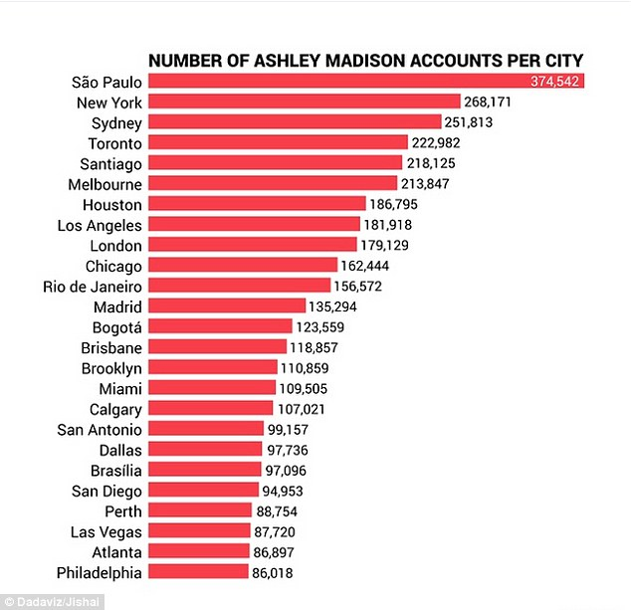
عدد الحسابات لكل مدينة
أكثر من 20800000 عضو مجهول إلى موقع على شبكة الإنترنت لتسهيل الزنا

Slide 81
أمثال ٦ : ٣٢-٣٣ أَمَّا الزَّانِي بِامْرَأَةٍ فَعَدِيمُ الْعَقْلِ. الْمُهْلِكُ نَفْسَهُ هُوَ يَفْعَلُهُ. ٣٣ ضَرْباً وَخِزْياً يَجِدُ وَعَارُهُ لاَ يُمْحَى.

Slide 82
والآن ماذا ؟
٤٢٥
مارس ضبط النفس الجنسي قبل الزواج حتى يمكن الإستمتاع بالزواج على أكمل وجه (أي السماح للحب أن يزدهر في وقته
توقع الزواج الجيد ثم اعمل فيه.
امدح كل من الفضائل الجسدية وغير الجسدية لزوجتك.

Slide 83
Black

Slide 84
مسح العهد القديم • BibleStudyDownloads.org
احصل علي هذا العرض مجانا!
Notes:
OP Arabic OT Preaching

