Slide 1

كن حكيماً
الأمثال
د. ريك جريفيث • مؤسسة الدراسات اللاهوتية الأردنية
CICFamily.com • BibleStudyDownloads.org

Slide 2

ما الذي
يثير
شغف
الناس ؟
Notes:
Money—so Singapore has the highest percentage of millionaires worldwide (16.5%)
Education—few feel you could be overeducated
Power—many are not happy with their job
Sex—few people remain with one person for life
Fun—the last experience didn’t satisfy, so try another
Travel—never before have so many traveled
Food—some travel across the country for a certain stall
Sports—depression if their team loses, elation if it wins

Slide 3

هل تريد أن تكون حكيماً
Notes:
But have you ever met someone who said he or she was passionate about gaining wisdom? Are you passionate about pursuing wisdom?
God gave Solomon one wish (since God is not a genie who gives three wishes!).
Solomon had the wisdom to want wisdom (1 Kings 3).
How much do you want wisdom?
But even if you desire to be wise, it still won’t just happen, so…

Slide 4

كيف يمكنك أن تكون حكيماً ؟
Notes:
What is the way for you to gain true wisdom? Not knowledge, but discernment in life—the question we'll address today is HOW this type of prudence is gained. Such sense will not keep trouble from finding you, but it will keep you from finding trouble.

Slide 5

دعونا ندرس
النص الكتابي
الكتاب المقدس
سفراً سفراً
Notes:
We are in a study through the whole Bible right now, book by book. The goal is to give us a basic understanding of each book of the Bible.

Slide 6
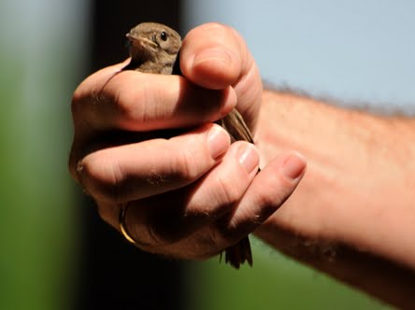
أمثال
الأيام الحالية
عصفور في اليد
أفضل من اثنين في العش
Notes:
Today we study the book of Proverbs. This may seem strange to be studying short, pithy sayings, but actually, you and I encounter proverbs all the time. Can you think of the proverb associated with this picture?
• Yes, a bird in the hand is worth two in the bush.
This proverb isn't just talking about birds. It means we should be satisfied with the blessing that we have rather than long for those we will never have. You may like the two birds over in a bush, but try going after them and they will fly away. It's better to be satisfied with the chicken you have to eat today than chase after two Peking ducks that you'll never catch.

Slide 7
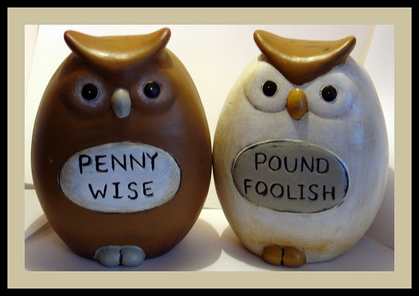
أمثال
الأيام الحالية
حكيم بفلس و لكن أحمق بجنيه
Notes:
Don't spend one British pound to save one penny. Wisdom is allowing yourself to waste something small to preserve something big. That's why we all pay money for insurance.

Slide 8

أمثال
الأيام الحالية
لا تضيعها و لا تريدها
Notes:
If you don't spend friviously, then you won't have financial woes in the future.

Slide 9
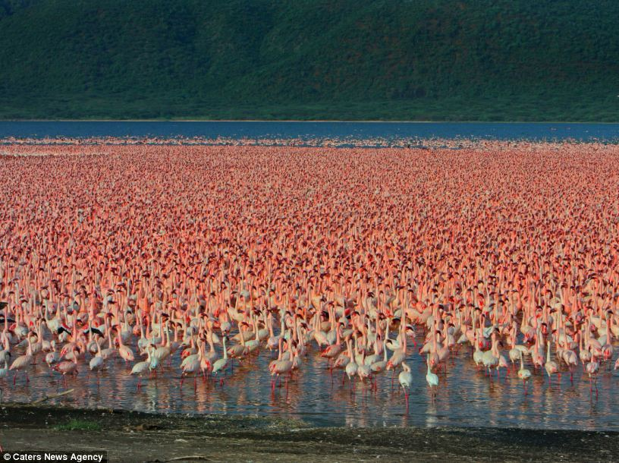
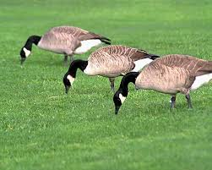
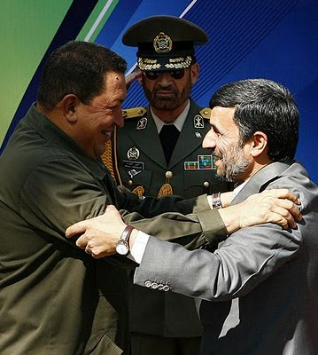
أمثال
الأيام الحالية
الطيور على أشكالها تقع
شافيز و أحمدي نجاد
Notes:
People like to be with people who are like them.
We typically do not seek out others who differ from us in values and priorities.

Slide 10

فقط افعلها
Notes:
Stop procrastinating.
Don’t think about things or plan ahead—hmmm, do you think Nike follows their own slogan? Not on your life!

Slide 11

الوقت من ذهب
Notes:
What you do with every minute of the day is your best investment.

Slide 12
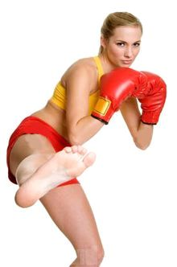

جلطات مختلفة
لأشخاص مختلفين
Notes:
Use varying strategies depending on whom you are relating to.
"The earliest use of DIFFERENT STROKES FOR DIFFERENT FOLKS that I could find was from 1966 (see quote below) by boxer and world heavyweight champion Muhammad Ali (Cassius Marcellus Clay, Jr.). Rhythm and soul singer Syl Johnson (father of Syleena) released the single titled 'DIFFERENT STROKES' in 1967 with the line also appearing in the song. But its appearance in Sly and the Family Stone's 1968 big hit single Everyday People is probably what put the phrase on the map. Additional exposure of the expression was burned into our collective psyches with the television comedy Diff'rent Strokes [1978-86] (an often used abbreviated form of the expression, but without the apostrophe) about a millionaire white widower who adopts two Black boys (one of which was that cute little guy Gary Coleman), and which was subsequently shown in the U.K where, so I've read, when the expression is used, the word folks may sometimes be replaced by blokes.
<1966 [quoting boxer Cassius Clay]" I got DIFFERENT STROKES FOR DIFFERENT FOLKS."—Great Bend Daily Tribune (Kansas), 11 November, page 6>
<1969 "The Adult has something to work on: what must I do to gain their STROKES, or their approval?"—I'm OK, You're OK by T. A. Harris, iii. page 45>
<1973 "The popular saying around the P[almer]D[rug]A[buse]P[rogram] is 'DIFFERENT STROKES FOR DIFFERENT FOLKS,' and that's the basis of the program."—Houston Chronicle Magazine, 14 October, page 4/1>
<1978 "He started off dishing out some nice STROKES. With an admiring smile he told me how smart I was, how honest, so absolutely reliable."—Fools Die by Mario Puzzo, xi. page 122>
<1981 "Let's face it, everybody needs their STROKES and that would be very ego-satisfying."—TV Picture Life, March, page 12/3>
<1986 "The whole point, says John Poindexter, [[President]] Reagan's national security adviser, is DIFFERENT STROKES FOR DIFFERENT FOLKS. 'We need different policies toward Communist dictatorships . . . , . . . for non-democratic regimes that are slowly evolving toward democracy, and different policies for non-democratic regimes in which there is no viable democratic center . . .'"—in New York (magazine), "How Reagan Does It" by Michael Kramer>
<1999 "There are a hundred times as many people addicted to alcohol, antidepressants and nicotine as there are to heroin or Charlie [cocaine]. DIFFERENT STROKES FOR DIFFERENT FOLKS, right?"—Spanish Highs by Wayne Anthony, page 65>
<2003 "If one motto sums up the [[weight loss]] industry, it could be 'DIFFERENT STROKES FOR DIFFERENT FOLKS.' At No. 1, with revenues this year expected to reach $1 billion, is 40-year-old Weight Watchers, with its program of weekly meetings and group support. Next comes Slim-Fast, the maker of bar and shake replacement meals. . . ."— U.S. News & World Report, 16 July>
<2008 "Suddenly [[Professor Wolfgang]] Mieder [[renowned expert on proverbs at the University of Vermont]] reminds me that he hasn't yet told me his favorite proverb. Can he really have a favorite? . . . But Mieder is a decisive man. 'DIFFERENT STROKES FOR DIFFERENT FOLKS is my favorite proverb,' he says. . . . 'I would argue it had to grow on American ground, because it doesn't tell you what to do. It says, "Accept the differences in people." . . . 'I think it's a truly liberating proverb.'"—Christian Science Monitor, 6 March>" (accessed 20 Aug 2014) http://www.wordwizard.com/phpbb3/viewtopic.php?f=7&t=20582

Slide 13
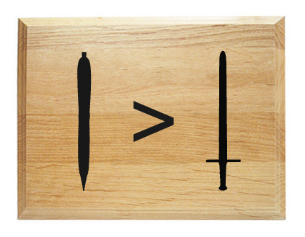
القلم أقوى من السيف
Notes:
Books impact us more than armies.

Slide 14
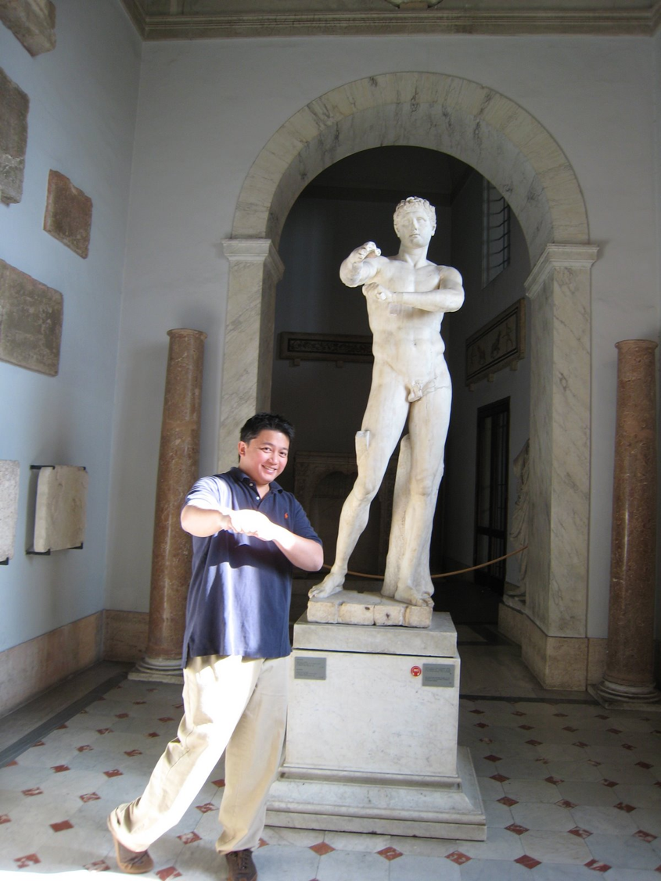
روما
عندما تكون
في روما تصرف كالرومان
Notes:
Fit in when you are in a different environment.
Don’t try to stick out.

Slide 15

صرير العجلة تحصل على الشحوم
الشحوم
Notes:
The person who makes the most noise generally gets the most attention to his or her concerns.

Slide 16

حيث لا رجل يوجد جزيرة
Notes:
No person operates in isolation.
We all need other people.

Slide 17
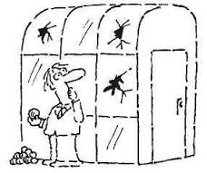
الناس الذين بيوتهم
من زجاج
لا يرمون الحجارة
Notes:
Don’t be so critical that you destroy your own reputation or that of your family.

Slide 18
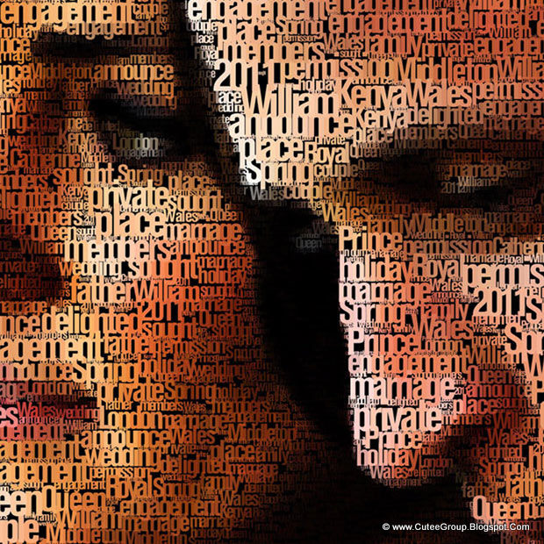
الصورة خير من ألف كلمة
Notes:
Visuals sum up reality more than many descriptions.

Slide 19

لا يوجد ما يساوي طعاماً مجانياً
Notes:
Somebody pays for every benefit that you have.
You may not be paying for something, but someone else did.

Slide 20
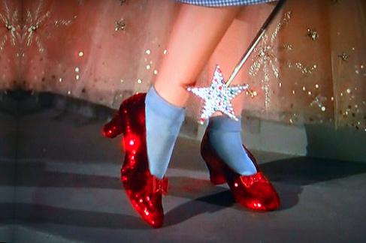
لا يوجد مكان كالمنزل
Notes:
We all want the security and familiarity of a place where we belong—typical where we grew up and where our family resides.

Slide 21
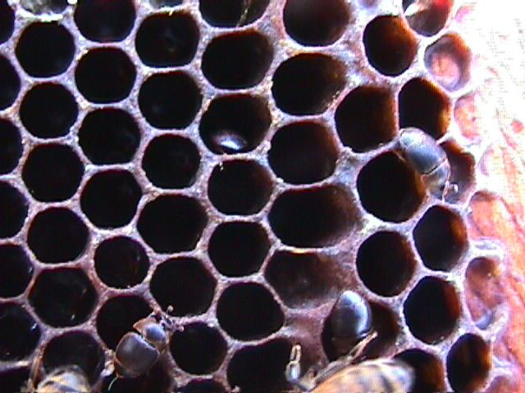
الحكمة جيدة لك
يا ابني كل عسلاً لأنه طيب و قطر العسل حلو في حنكك كذلك معرفة الحكمة لنفسك
(أم 24 : 13-14أ)
Notes:
We have a natural desire for good food, so we should have the same desire for wisdom.

Slide 22


الكلمة المفتاحية في سفر الأمثال
394
اعرف
الحكمة
اليوم
Notes:
The Chinese character for wisdom implies that we know what is appropriate for that day.

Slide 23

العنوان و التاريخ
الأمثال – قيمة و سبيل الحكمة
سليمان |  |  | الرجال الحكماء (مجهول) | سليمان | رجال حكماء (أجور، لموئيل، مجهولين)
1: 1-22: 16 |  |  | 22: 17-24: 34 | 25-29 | 30-31
13 قول 375 مثل شطرين |  |  | 36 قول | حوالي 100 مثل من شطرين | 3 أقوال
 |  |  | اجتماعي و متفرقات | اجتماعي و متفرقات
مقدمة | مبادئ الحكمة |  |  |  | خاتمة
950-700 ق.م
394
التناقضات
و التقوى
10: 1-22: 16
اجتماعي و الطبيعة
30
الزودة التقية
31: 10-31
الأهداف
1: 1-7
قيمة الحكمة
1: 8-9: 18
الحكم
31: 1-9

Slide 24
عنوان السفر
395
كلمة مثل تعني : يشبه أو يقارن مع
المثل هو عبارة تصنع مقارنة أو تصف اختباراً عاماً
العنوان اللاتيني: المثل هو "الكلمة التي تعني" العديد من الكلمات (أي مجتمعة في قول قصير واحد).

Slide 25

مواضيع
في
الأمثال

Slide 26
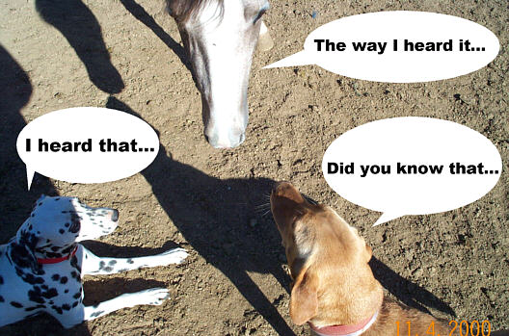
الكلمات و الخطاب
401
الطريقة التي
سمعته بها
الساعي بالوشاية يفشي السر
و الأمين الروح يكتم الأمر
(أمثال 11: 13)
سمعت أن
هل تعلم أن

Slide 27

المال

Slide 28
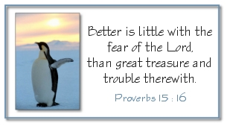
التقوى على الذهب
القليل مع مخافة الرب
خير من
كنز عظيم مع هم
(أمثال 15: 16)

Slide 29


النجاح الحقيقي
النجاح
في عيني
الله

Slide 30
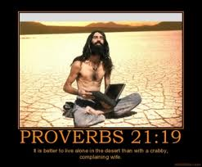
أمثال 21: 19
السكنى في أرض برية
خير من امرأة مخاصمة حردة

Slide 31
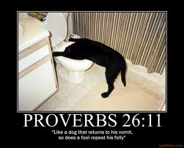
أمثال 26: 11
كما يعود الكلب إلى قيئه
هكذا الجاهل يعيد حماقته

Slide 32
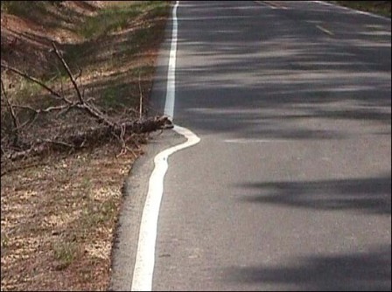
الإجتهاد
و
الكسل
نفس الكسلان تشتهي
و لا شيء لها
و نفس المجتهدين تسمن
(أمثال 13: 4)

Slide 33
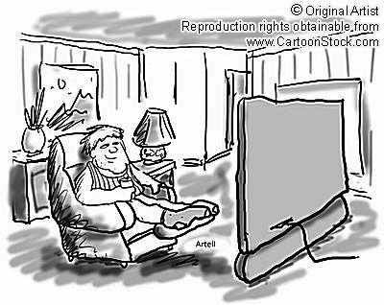
American, idle
أمريكي، عاطل

Slide 34
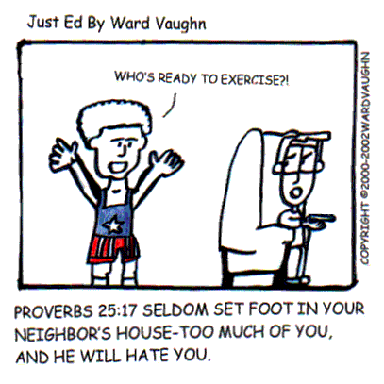
العلاقات
من منكم مستعد للتمرين ؟
أمثال 25: 17
(لا تدخل دار صاحبك كثيراً لئلا يمل منك و يكرهك)

Slide 35
كيف يمكنك أن تكون حكيماً ؟
الأمثال يقدم 3 طرق
Notes:
What is the way for you to gain true wisdom? Not knowledge, but discernment in life—the question we'll address today is HOW this type of prudence is gained. Such sense will not keep trouble from finding you, but it will keep you from finding trouble.

Slide 36

1. تعلم الإنضباط و مخافة الرب (1: 1-7)
كيف تكون حكيماً
Notes:
A wise person is never a lazy person, but rather one who diligently seeks God

Slide 37
أمثال 1

Slide 38

الأمثال تعطي الحكمة، الإنضباط و البصيرة (1: 1-2)
1 أمثال سليمان بن داود ملك إسرائيل
2 لمعرفة حكمة و أدب لإدراك أقوال الفهم
لماذا ندرس الأمثال ؟
Notes:
Wisdom is practical because it helps us to continue to learn from others who are wiser than we are (1:2b).

Slide 39
الأمثال تقودنا لعمل ما هو صحيح (1: 3)
3 لقبول تأديب المعرفة و العدل و الحق و الإستقامة
لماذا ندرس الأمثال ؟
Notes:
Wisdom is ethical because it shows us the difference between right and wrong (1:5).

Slide 40
الأمثال تعطي بصيرة خلال الحياة (1: 4-6)
4 لتعطي الجهال ذكاء و الشاب معرفة و تدبراً
5 يسمعها الحكيم فيزداد علماً و الفهيم يكتسب تدبيراً
6 لفهم المثل و اللغز أقوال الحكماء و غوامضهم
لماذا ندرس الأمثال ؟

Slide 41
الأمثال تعلمنا مخافة الرب (1: 7)
7 مخافة الرب رأس المعرفة
أما الجاهلون فيحتقرون الحكمة و الأدب
لماذا ندرس الأمثال ؟
Notes:
In 1 John 4:18, we see that, “There is no fear in love. But perfect love drives out fear, because fear has to do with punishment. The one who fears is not made perfect in love,” so does the NT contradict the OT?
Actually, this NT verse speaks of fear of people, not fear of God.
We should fear what might have to do to us to get us back on the right path when we stray from him!
Only a fool despises the things that benefit his life.

Slide 42
1. تعلم الإنضباط و مخافة الرب (1: 1-7)
كيف تكون حكيماً
Notes:
A wise person is never a lazy person, but rather one who diligently seeks God

Slide 43

2. قدّر الحكمة التي تقود إلى حياة مزدهرة (1: 8-9: 18)
كيف تكون حكيماً
Notes:
A wise person really wants wisdom and then experiences wisdom’s benefits.

Slide 44
الحكمة
تعطي الكرامة لحماية الشباب من عار الغباوة (1: 8-9)
Notes:
Text

Slide 45
الحكمة
تحمي الشباب من
الكارثة (1: 10-33)
Notes:
Text

Slide 46
أمثال 2

Slide 47
الحكمة
تساعد في الحفاظ على
السلوك الأخلاقي (أم 2)
Notes:
Text

Slide 48
العنوان و التاريخ
الأمثال – قيمة و سبيل الحكمة
سليمان |  |  | الرجال الحكماء (مجهول) | سليمان | رجال حكماء (أجور، لموئيل، مجهولين)
1: 1-22: 16 |  |  | 22: 17-24: 34 | 25-29 | 30-31
13 قول 375 مثل شطرين |  |  | 36 قول | حوالي 100 مثل من شطرين | 3 أقوال
 |  |  | اجتماعي و متفرقات | اجتماعي و متفرقات
مقدمة | مبادئ الحكمة |  |  |  | خاتمة
950-700 ق.م
394
التناقضات
و التقوى
10: 1-22: 16
اجتماعي و الطبيعة
30
الزودة التقية
31: 10-31
الأهداف
1: 1-7
قيمة الحكمة
1: 8-9: 18
الحكم
31: 1-9

Slide 49
أمثال 3

Slide 50
الحكمة
تساعدنا على الإرتباط مع الله و الناس
(أم 3)
Notes:
Text

Slide 51

الآية المفتاحية
394
توكل على الرب
بكل قلبك
امثال 3: 5-6)

Slide 52

الآية المفتاحية
394
و على فهمك لا تعتمد
أمثال 3: 5-6

Slide 53

الاية المفتاحية
في كل
طرقك اعرفه
394
أمثال 3: 5-6

Slide 54

الآية المفتاحية
وهو
يقوم
سبلك
394
أمثال 3: 5-6

Slide 55
أمثال 4

Slide 56
الحكمة
توفر حياة كريمة
(4: 1-9)
Notes:
Text

Slide 57
الحكمة
تحفظ الشباب من المشاكل
(4: 10-19)
Notes:
Text

Slide 58
الحكمة
تنتج شباب أصحاء
(4: 20-27)
Notes:
Text

Slide 59
أمثال 5

Slide 60
الحكمة
تساعد في تجنب الخطية الجنسية
(أم 5)
Notes:
Text

Slide 61

1 يا ابني أصغ إلى حكمتي أمل أذنك إلى فهمي
2 لحفظ التدابير و لتحفظ شفتاك معرفة

Slide 62

لأن شفتي
المرأة الأجنبية تقطران عسلاً
و حنكها أنعم
من الزيت
(5: 3)
Notes:
(5:3) Immoral people's advances are genuinely enticing in touch and sound.

Slide 63

سجل
في برنامج
عهد العيون

Slide 64

Covenant Eyes

Slide 65
أمثال 6

Slide 66
الحكمة
تحفظ من الفقر
(6: 1-11)
Notes:
Text

Slide 67
الحكمة
تحفظ من الخلاف
(6: 12-19)
Notes:
Text

Slide 68
الحكمة
تحفظ الشباب من
الفجور الجنسي
(6: 20-7: 27)
Notes:
Text

Slide 69
أمثال 8

Slide 70
الحكمة
لها فضائل ومكافآت ثمينة
واستخدمت في الخلق
(أمثال 8)
Notes:
Text

Slide 71
أمثال 9

Slide 72
الحكمة
لها قيمة مقارنة بادعاءات الحماقة
(أمثال 9)
Notes:
Text

Slide 73
1. تعلم الإنضباط و مخافة الرب (1: 1-7)
كيف تكون حكيماً
Notes:
A wise person is never a lazy person, but rather one who diligently seeks God

Slide 74
2. قدّر الحكمة التي تقود إلى حياة مزدهرة (1: 8-9: 18)
كيف تكون حكيماً
Notes:
A wise person really wants wisdom and then experiences wisdom’s benefits.

Slide 75

3. انتبه لنصائح الحكماء بخصوص العلاقات
(أم 10-31)
كيف تكون حكيماً
Notes:
A wise person isn’t a loner but relies on others to relate better with people.

Slide 76
أمثال 10

Slide 77

حوالي 375 مثل من شطرين لسليمان تعلم الفوائد العملية للحكمة فوق الشر في الحياة اليومية
(10: 1-22: 16)
Notes:
Follow these many short sayings and you will be truly wise!

Slide 78
أمثال 11

Slide 79
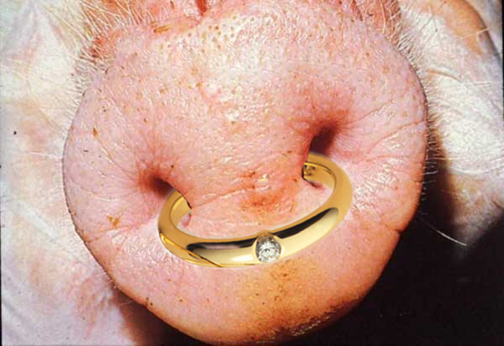

وصفي جداً
خزامة ذهب في فنطيسة خنزيرة المرأة الجميلة العديمة العقل
(أم 11: 22)

Slide 80
أمثال 22

Slide 81

الحكمة
تحذر أقوال الحكماء الأكثر طولاً عن أهمية الحكمة العملية في العديد من المجالات
(22: 17-24: 34)
Notes:
Text

Slide 82
أمثال 25

Slide 83

الحكمة
المجموعة الأخيرة من أمثال سليمان التي كتبها كتبة حزقيا بعد 250 عامًا ترشد العلاقات الاجتماعية والأنشطة المختلفة (أمثال 25-29).
Notes:
Text

Slide 84
أمثال 30

Slide 85

الحكمة
أقوال أجور لإيثيئيل و أكال تظهر بصيرة بخصوص الطبيعة و العلاقات الإجتماعية
(أم 30)
Notes:
Text

Slide 86

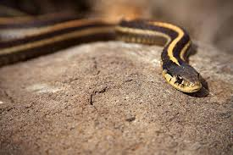
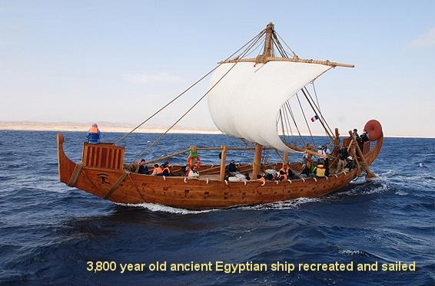

أمثال 30: 18-20
ثلاثة عجيبة فوقي و أربعة لا أعرفها
طريق نسر في السماوات
طريق حية على صخر
طريق سفينة في قلب البحر
طريق رجل بفتاة

Slide 87
أمثال 31

Slide 88

الحكمة
تعد والدة لموئيل المجهولة ابنها للملك
من خلال نصحه بتجنب تجاوزات النساء والخمر وحماية حقوق المحرومين (31: 1-9).
Notes:
Text

Slide 89
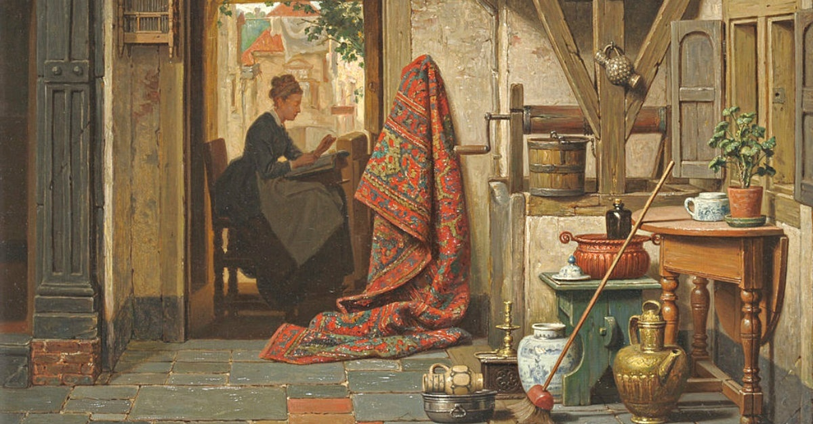
الحكمة
تحث قصيدة أفقية ومجهولة الإسم لزوجة نبيلة الشابات على التقوى والمثابرة وتحث الأزواج الصغار على مدح هذه الصفات في زوجاتهم (31: 10-31).
Notes:
Text

Slide 90
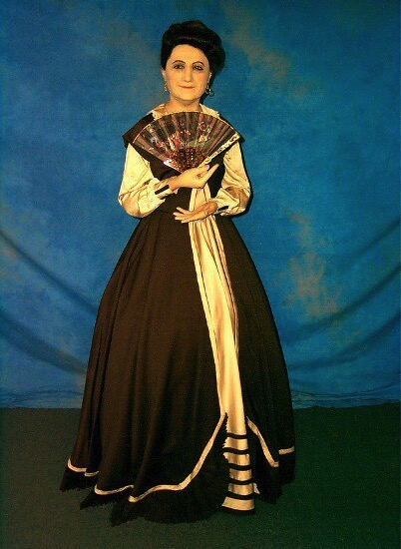
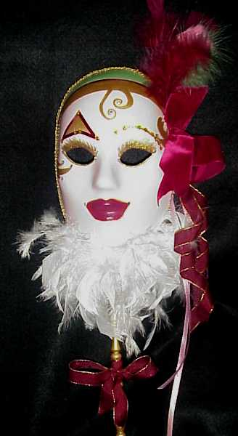
امرأتين
الحكمة
و الجهل

Slide 91

المرأة
الحكيمة

Slide 92
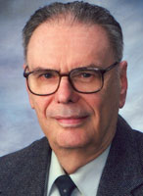
كل مجتمع يمتلك امرأة مثالية
نموذج المرأة في الأبوية القبلية هو فرس حضنة ؛ في مذهب المتعة الطبيعية ، هي الأرنب أو اللعب ؛ في الأيديولوجية النسوية ، هي المرأة المهنية المكتفية ذاتيًا ؛ في الرومانسية ، هي الأميرة الخرافية أو العذراء المنتظرة ليتم خلاصها ؛ في الإيمان الكتابي ، هي شريكة في الخدمة.
اللاهوتي دونالد بلوسيك
(1928-2010)

Slide 93

امرأة فاضلة من يجدها لأن ثمنها يفوق اللآلئ
(أم 31: 10)

Slide 94

Proverbs 31
تقوم باكراً لتهتم بعائلتها
و تقوم إذ الليل بعد و تعطي أكلاً لأهل بيتها و فريضة لفتياتها
(أم 31: 15)

Slide 95

Proverbs 31
تضحك على مستقبلها
العز و البهاء لباسها و تضحك على الزمن الآتي
(أم 31: 25)
Notes:
Chrystal Evans Hurst
https://www.proverbs31.org/speakers

Slide 96



تعتبر أفضل عارضة أزياء

Slide 97

توقفي عن مقارنة نفسك بامرأة أمثال 31
http://924jeremiah.wordpress.com/2014/03/21/stop-comparing-yourself-to-the-proverbs-31-woman/ advises…
تعرف على من اخترع امرأة الأمثال 31 ولماذا لا تتوافق هذه القائمة من الصفات "المثالية" مع أولويات الله بالنسبة لك.
Notes:
For all you women who are trying to please God but feel utterly despaired every time someone whips out Proverbs 31: take heart! God is not comparing you to this fictitious female, nor should you be interpreting this passage as His personal calling on your life. To put this passage in perspective, you need to put the whole book of Proverbs in perspective. A proverb is simply a saying. The Holy Spirit will make it clear to you when a particular proverb has any value for you in a given moment. But let's be clear about the kind of effect the Holy Spirit's Voice has on us. When He speaks to your heart, you don't end up feeling beat down, discouraged, and hopelessly flawed. So as you're reading through Proverbs 31, if it feels like someone is shoveling wet cement onto your back and you're feeling more and more burdened with every word you read, then you're not hearing from the Holy Spirit. You're hearing from that nasty old deceiver Satan, or one of his many sordid friends.
Demons are the ones who want you to go through life feeling like a flop because you don't live up to someone's fantasy woman. And fantasy is what we're dealing with in Proverbs 31, because the woman described there has magically escaped the burden of carnal flesh. Not only is this woman utterly selfless, she's also in perfect health, she's got bundles of energy, she's super social, she's physically strong, and she clearly has more than 24 hours in a day. And as this charming lady is busy making everything from scratch and running a charity house for the poor out of her home, she's also super wealthy (since she and her children only wear the best of threads), plus she's politically powerful. Her husband is one of the leaders in the land (v23), which puts her hobnobbing in higher society. And to top it all off, this lady who weaves her own fabric and sews everything she owns from scratch also gets by on only a few hours of sleep. We're told she works late into the night and is up before the sun feeding the servant girls. She never wastes her time (v27), and she gives her husband everything he needs. So of course her family praises her and everyone thinks this lady is fabulous. And by the time she's done making wardrobes from scratch, planting vineyards, cooking meals and running a booth at the local marketplace, we wonder what those servant girls do besides get up before dawn to eat their pre-made breakfast.
So how do we put things in perspective here? Well, for one thing, let's remember how credit is assigned to people in the Old Testament. For example, we're told that King Solomon built God's Temple, per the instructions of his father King David. But while Solomon gets all the glory for creating that massive structure, what did he really contribute besides a long prayer on dedication day? In real life King Solomon didn't lift a single stone—he just told other people to go and build the Temple while he went off and parked in a nice shaded room with lots of goodies and soft sofas. When all the laborers were done sweating and slaving under the hot sun, their accomplishments were recorded as Solomon's accomplishments. This is how it works when you're the king or the head of a household. In Proverbs 31, the woman being described is running a rich household. That means she'd have a bunch of servants who she'd get to boss around all day. Would a woman in her position really be trimming wool off the sheep and weaving it into thread? No, because such tasks are beneath her. What we really have being described in Proverbs 31 is a good delegator—someone who is definitely busy, but she's also telling everyone else what to do all day and then taking the glory for both their work and hers. Well, no wonder she gets so much done.
Look up rich people in the Bible and you'll find they are credited for all sorts of things that they didn't do. In a culture where women got the credit for the babies their slave girls birthed, we have to read records of accomplishments with caution.
So who wrote Proverbs 31, anyway? It's a man named King Lemuel who is sharing things his mother drilled into his brain. In verse 1 we're told: "These are the words of King Lemuel, the message his mother taught him." Lemuel's mom then starts off by telling her son to stay away from liquor because kings don't rule well when they're drunk. Then she tells him to look out for the needs of the poor. This is certainly sound advice. Interestingly in verse 3, Mom doesn't sound very keen on women in general, for she tells her son:
"Don't waste your strength on women, or your time on those who ruin kings."
The way poetry works in the Bible, these two phrases are meant to be descriptions of the same people: Mom is defining women as "those who ruin kings." Now we all know that rich men become targets for Delilah type vipers. Mom sounds pretty protective, and she has good reason to be. There's a reason kings have harems—once a guy gets some rank, his hormones have a way of taking him over and pretty soon he cares more about sex than he does about his kingdom and God. This is what happened with King Solomon and his 1,000 recorded lovers (plus who knows how many unrecorded flings). Solomon has had a lot more airtime in the book of Proverbs. We only hear about Lemuel here at the end, when Mom pipes up to tell her son "no wine and no women." Rather harsh. One wonders if Mom is ruling out all women or just the shady ones. It's interesting that she doesn't use any extra adjectives to pinpoint what percentage of her own gender she disapproves of. The way her words are written, it sounds like Mom's pretty much anti-female. Perhaps she's been burned in the past by seeing evil women corrupt those she cares about and she's not going to let that happen to her Lemuel.
Now it's not very realistic to think Lemuel isn't going to get married, so after Mom tells him to stay away from women in general, she then supplies a long, detailed definition of an acceptable wife. Because Lemuel is crediting Mom for everything he's saying in this passage, we have to assume that this perfect wife is something she's come up with—and this would make sense because the passage has a very female tone to it. Women are the nurturing gender and we hear the nurturing instinct coming through in a comment about the woman being concerned for her family's warmth in the winter months (v21), plus we hear an awful lot about clothes and cooking. The Proverbs 31 perspective is very much that of a homemaker and not at all that of a busy king. Clearly Lemuel's mom is a fan of the textile industry for we hear all about fabric in this passage—weaving it, sewing it, and selling it. We hear about raw material: wool and flax. We hear about the quality of the finished product: fine linen. And we hear about colors: scarlet and purple. With such a strong focus on fabric, it's quite possible that Lemuel's inherited wealth came from the clothing business. So what we find in Proverbs 31 is not a description of God's ideal woman, but of one king's mother's ideal vision for the kind of woman she wants her son to marry. What mother doesn't hope for the stars when it comes to marrying off her pride and joy? And with Mom's hostility towards women in general so openly expressed, it's no wonder that she's demanding the best of the best for her son. She wants Lemuel to find a woman who will satisfy his every need, make him a bunch of money, and be a total workaholic. With her daughter-in-law working hard day in and day out, she certainly wouldn't be much competition for Lemuel's attention. When we realize who is really supplying the words of this passage, it's interesting to wonder about all the ulterior motives that went into painting a picture of an "ideal" woman—a woman who clearly doesn't exist. Obviously Mom isn't in any rush for grandchildren. And clearly she isn't going to be an easy sell to anyone Lemuel tries to bring home for dinner.
"An excellent wife, who can find?" (v10)
Indeed, and as we read through Mom's list of impossible requirements, we wonder if she ever wants Lemuel to get a wife. It's really Mom's character that's coming through in this passage more than anything else. Whoever Lemuel's mother was, she clearly felt that lollygagging about was a major sin. She sounds like a very driven woman—obsessed with productivity and very concerned with social reputation. What does God tell us about these themes elsewhere in the Bible? Well, when Martha complained that her sister Mary was slacking with the household chores, Jesus took the side of the slacker. Productivity is all fine and well, but God tell us not to store up our treasures here on earth, or to spend our lives focused on accumulating wealth.
As for all people thinking well of us—this is another dream that both Yahweh and Jesus shoot down. As Christians, we don't want to be agitating others just to do it. But God's truth is a divisive thing, and His influence is often greeted with great hostility. Jesus said He didn't come to bring peace to the world, but to cause division and strife (Lk 12:51). The more we mature in the faith, the more division we will cause as well. Lukewarm Christians are generally tolerated by the world, but fully devoted ones are met with opposition in both the world and the Church. Who was it that really pushed for Jesus to be crucified? It was the religious leaders, not the lay people. It was the ancient Jewish equivalent of our modern pastors, theologians and elders. The more like Christ we are, the more we can expect the same hostile treatment He received. So while Lemuel's mom dreams of a daughter-in-law who is both righteous in character and super popular, in real life, these two

Slide 98

أمثال 31
هل هذا الكلام للنساء فقط ؟
ليس حقاً . إنها تعطي مثالاً عما تبدو عليه الحكمة في المرأة
الرجال يحتاجون نفس الصفات
Notes:
But the qualities here are traits that every believer should seek.

Slide 99
كيف يمكنك أن تكون حكيماً ؟
الأمثال تعطي 3 طرق
Notes:
Restatement

Slide 100

الفكرة الرئيسية في الأمثال
اتق الله من خلال الإصغاء لأمثاله عن قيمة و سبيل الحكمة
Notes:
Restatement

Slide 101
1. تعلم الإنضباط و مخافة الرب (1: 1-7)
كيف تكون حكيماً
Notes:
Restatement

Slide 102
2. قدّر الحكمة التي تقود إلى حياة مزدهرة (1: 8-9: 18)
كيف تكون حكيماً
Notes:
Restatement

Slide 103
3. انتبه لنصائح الحكماء بخصوص العلاقات
(أم 10-31)
كيف تكون حكيماً
Notes:
A wise person isn’t a loner but relies on others to relate better with people.

Slide 104
التطبيقات
394
علّم الشباب و (الأطفال) سفر الأمثال
احفظ الأمثال لعيش الحياة الحكيمة
اقرأ إصحاحاً واحداً من الأمثال كل يوم في الشهر (31 يوم 31 إصحاح)

Slide 105
Black

Slide 106


وعظ العهد القديم at BibleStudyDownloads.org
أحصل على العرض التقديمي و النص مجاناً

