Slide 1
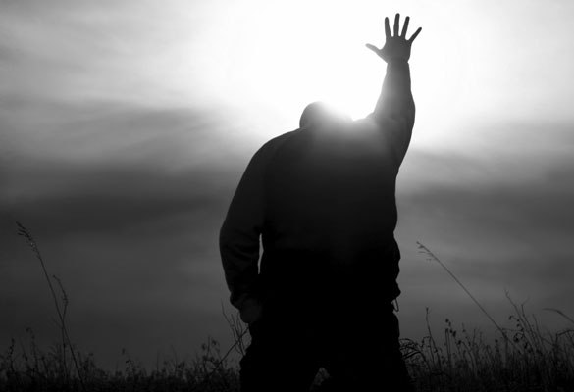
كن ملتزماً
أستير
د. ريك جريفيث • مؤسسة الدراسات اللاهوتية الأردنية
CICFamily.com • BibleStudyDownloads.org

Slide 2
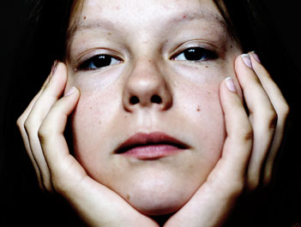
عادة ما تعاني الكنيسة من نقص خطير في الإلتزام
لماذا يحدث هذا ؟
Notes:
Why do you think? Tell your neighbor next to you.

Slide 3
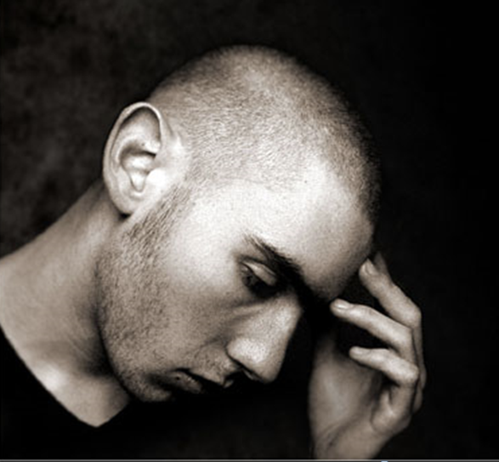
ما هو
مقدار التزامك
نحو عمل الله ؟
Notes:
If you were accused of being devoted to Jesus, would there be enough evidence to convict you in a court of law?

Slide 4
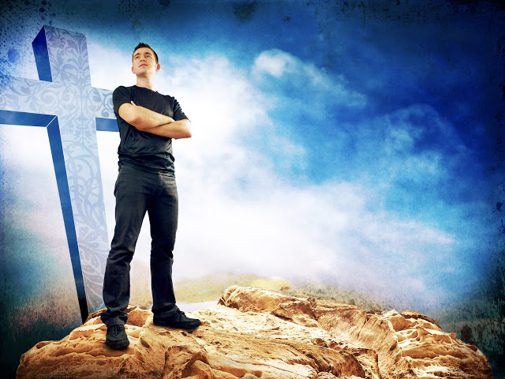
لماذا يجب
أن تكون ملتزماً
نحو الله ؟
Notes:
What reasons can you give to be dedicated, loyal and devoted to the Lord?

Slide 5
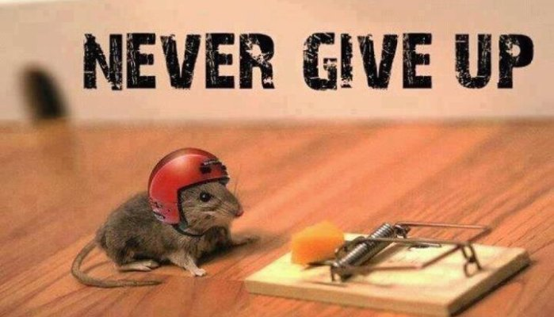
خلفية سفر أستير
لا تستسلم أبداً
Notes:
Today in the book of Esther we will see that apathy can be cured.

Slide 6


The Postexilic Era
295
296
560
فترة ما بعد السبي
عمل الهيكل
الأنبياء
حجي
زكريا
ملاخي
605
586
539
536
520
516
483-473
444-425
آخرون
زربابل
أستير
عزرا
نحميا
ملوك الفرس
كورش
داريوس
أحشويروش
أرتحشستا
Notes:
The temple was rebuilt some 50 years before Esther—and Nehemiah would live some 50 years afterwards.

Slide 7
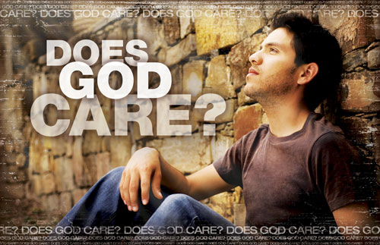
هل يهتم الله بمن تخلفوا عن الركب ؟
معظم اليهود لم يرجعوا مطلقاً إلى أرض إسرائيل حتى في فترة ما بعد السبي
Notes:
Why didn’t they return? What would happen to them? How would God shake them out of their lethargy?

Slide 8

The Persian Empire
خارطة الإمبراطورية الفارسية
317
باري ج. بيتزل، أطلس مودي لأراضي الكتاب المقدس، 150-51
شوشن
الإمبراطورية الفارسية في القرن الخامس قبل الميلاد امتدت من الهند و الحبشة (أس 1: 1)
حدود الإمبراطورية التي أسسها كورش الثاني ووسعها داريوس الأول امتدت من اليونان إلى الهند
Notes:
The Jews needed to renew their commitment to God based on his commitment to them over the ages. Yet they also needed to see God working in their lives right then as they lived outside the land of Israel.
Cyrus ruled over an absolutely ENORMOUS kingdom that eventually stretched from Greece in the west and India in the east. From his capital at Susa he had control over 127 provinces! God moved his heart to initiate a return to the land not only for the Jews but for other conquered peoples—as long as they would pray for the welfare of the king and his sons.

Slide 9
الإرتباط مع عزرا
289
استرداد الهيكل و الشعب
الهيكل
سفر أستير (فجوة 58 سنة)
الشعب
زربابل
عزرا
عزرا 1-6
عزرا 7-10
50000 عائد
5000 عائد
النجاة
النهضة
العمل
العبادة
538-516 ق.م (22 سنة)
458-457 ق.م (سنة واحدة)
مقاومة خارجية : السامريون
مقاومة داخلية : الزواج المتبادل
العودة 1-2
إعادة البناء 3-6
العودة 7-8
الإسترداد 9-10
المرسوم 1
العائدون 2
البدء 3
المقاومة 4: 1-6: 12
الإنتهاء 6: 13-22
المؤهلات و الأحكام 7
العائدون و الحماية 8
الزواج المتبادل و الرثاء
9
تتميم
الطلاق
10

Slide 10

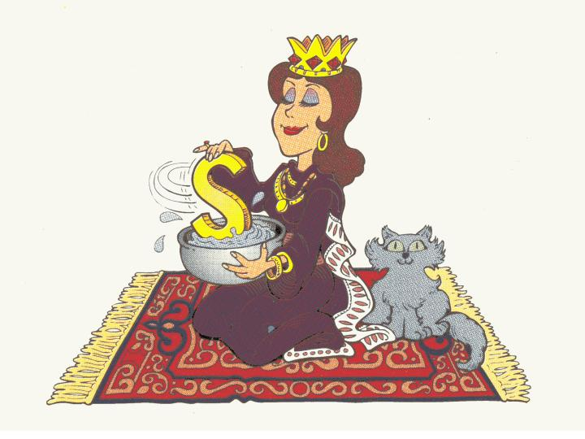
أستير : ملكة فارس
رحلة عبر الكتاب©1989

Slide 11
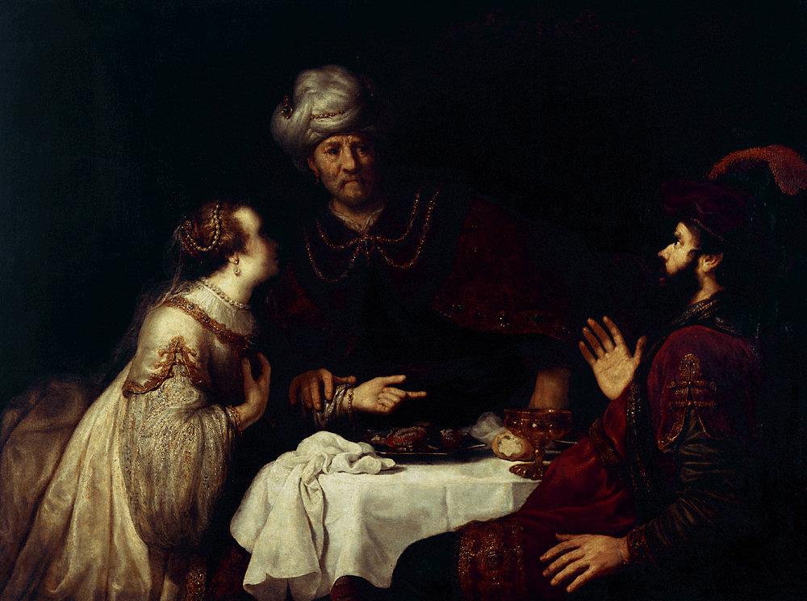
جدول سفر أستير
308
إحباط مؤامرة الإبادة
تخطيط المؤامرة
احباط المؤامرة
الإصحاحات 1-4
الإصحاحات 5-10
التهديد
الإنتصار
إعداد العناية الإلهية
تتميم العناية الإلهية
الإضطهاد
الحفظ
خطر جسيم
انتصار عظيم
احتفالات أحشويروش
احتفالات أستير و الفوريم
تعظيم أستير
1: 1-2: 18
مؤامرة هامان
2: 19-4: 17
سيادة مردخاي على هامان
5: 1-8: 2
سيادة اليهود على الأعداء
8: 3-9: 32
سيادة مردخاي على فارس
10
فارس
10 سنوات (483-473 ق.م)

Slide 12
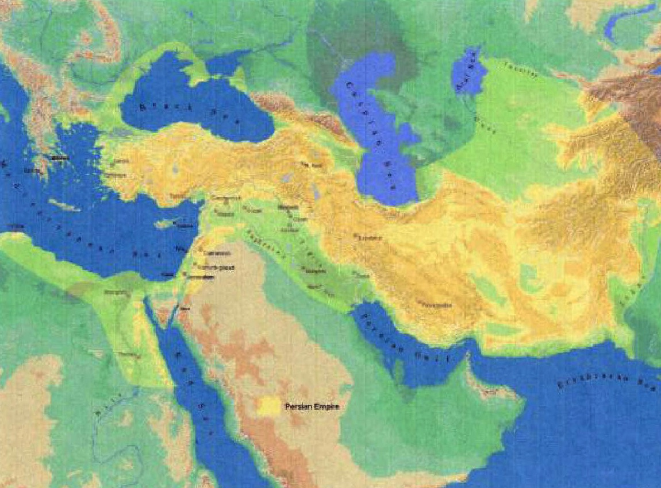
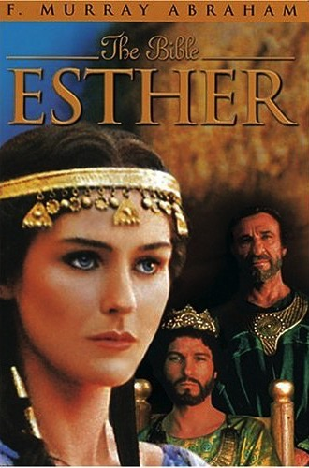
الكلمة المفتاحية
308
العناية الإلهية

Slide 13
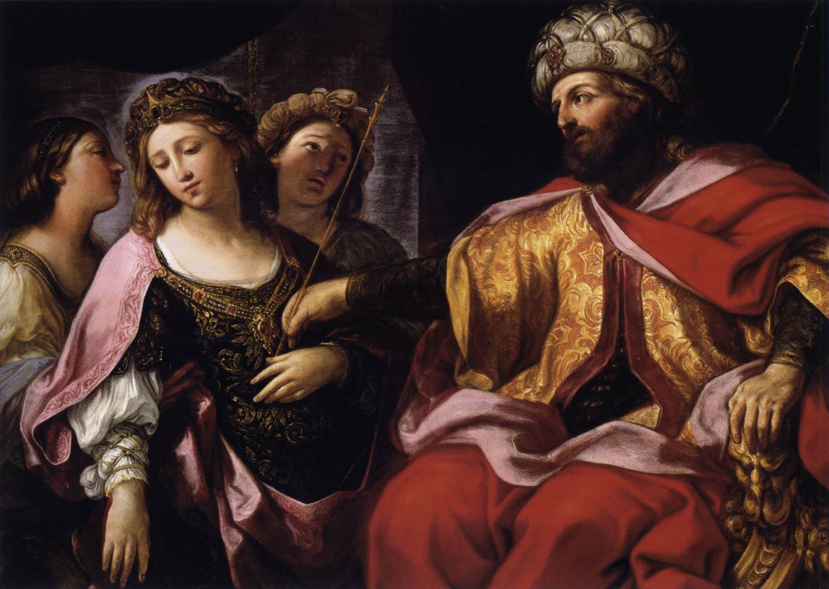
الآية المفتاحية
308
(مردخاي إلى أستير)
لأنك إن سكت سكوتاً في هذا الوقت يكون الفرج و النجاة لليهود من مكان آخر و أما أنت و بيت أبيك فتبيدون و من يعلم إن كنت لوقت مثل هذا وصلت إلى الملك
(أستير 4: 14)

Slide 14
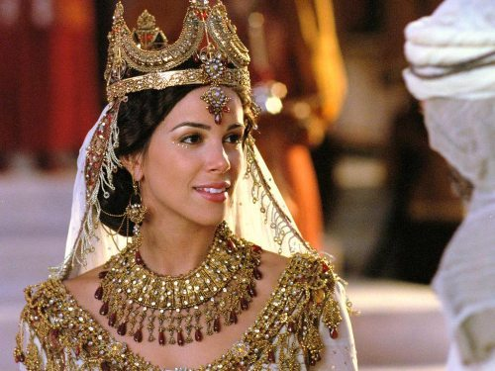
لوقت
مثل
هذا

Slide 15
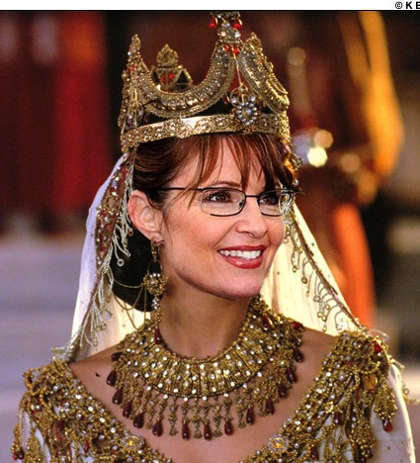
لوقت
مثل
هذا

Slide 16
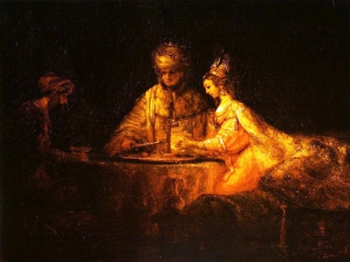
البيان الموجز
308
إبادة الأمة اليهودية التي خططها هامان عادت على رأسه من خلال العناية الإلهية عبر مردخاي و أستير لتشجيع إسرائيل ما بعد السبي على التزام الله المستمر نحو العهد الإبراهيمي

Slide 17
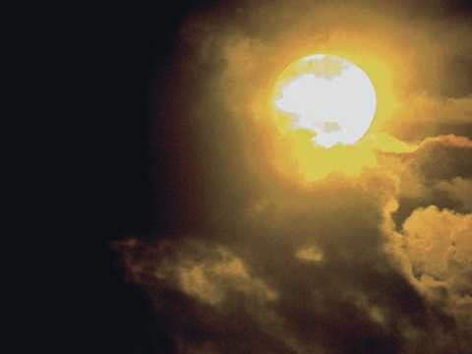
التركيب
311
إحباط مؤامرة الإبادة
1-4 تخطيط المؤامرة - تهديد
5-10 فشل المؤامرة - انتصار

Slide 18
لماذا يجب
أن تكون ملتزماً
نحو الله ؟
سببين
Notes:
What reasons can you give to be dedicated, loyal and devoted to the Lord?

Slide 19
عمل الله يواجه تهديدات
(أستير 1-4)
لماذا الإلتزام نحو الله ؟
Notes:
Satan is always trying to push down whatever the Lord does.
God commands our wholehearted devotion as we face many obstacles while God fulfills his plan.

Slide 20
أستير 1
Notes:
Threat: God strategically placed Mordecai and Esther to thwart Haman's plot to exterminate the Jews to fulfill the Abrahamic Covenant (Esther 1–4).

Slide 21
The Persian Empire
خارطة الإمبراطورية الفارسية
317
باري ج. بيتزل، أطلس مودي لأراضي الكتاب المقدس، 150-51
شوشن
الإمبراطورية الفارسية في القرن الخامس قبل الميلاد امتدت من الهند و الحبشة (أس 1: 1)
حدود الإمبراطورية التي أسسها كورش الثاني ووسعها داريوس الأول امتدت من اليونان إلى الهند
Notes:
The Jews needed to renew their commitment to God based on his commitment to them over the ages. Yet they also needed to see God working in their lives right then as they lived outside the land of Israel.
Cyrus ruled over an absolutely ENORMOUS kingdom that eventually stretched from Greece in the west and India in the east. From his capital at Susa he had control over 127 provinces! God moved his heart to initiate a return to the land not only for the Jews but for other conquered peoples—as long as they would pray for the welfare of the king and his sons.

Slide 22
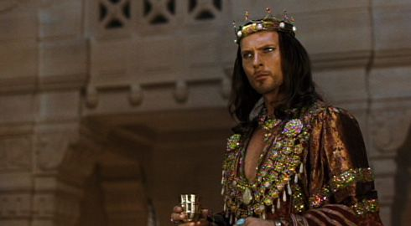
أمر الملك أحشويروش غير المنطقي
للملكة وشتي
Notes:
The account begins with a very frustrated King Xerxes, or Ahasuerus.

Slide 23
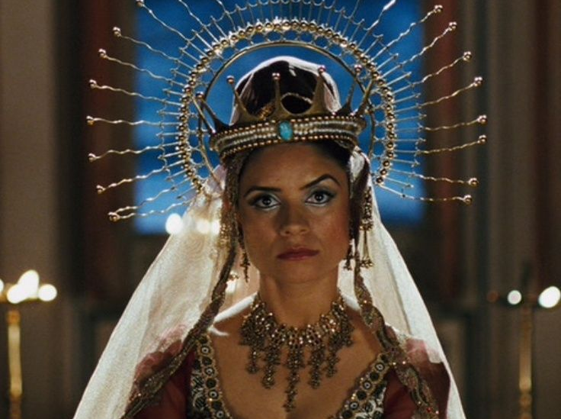
إنزعاج وشتي
Notes:
Xerxes (Heb. Ahasuerus in the book) divorced his disobedient Queen Vashti, unaware of God’s plan for Esther to replace Vashti to preserve the Jews (Esther 1; 483 BC; 1:3).

Slide 24
صعود أستير
  الإرتباك 1-2
وشتي
483
479
صعود مردخاي
ولائم
Notes:
God actually uses the confusion of the first two chapters to bring about his plan. Sound familiar?

Slide 25
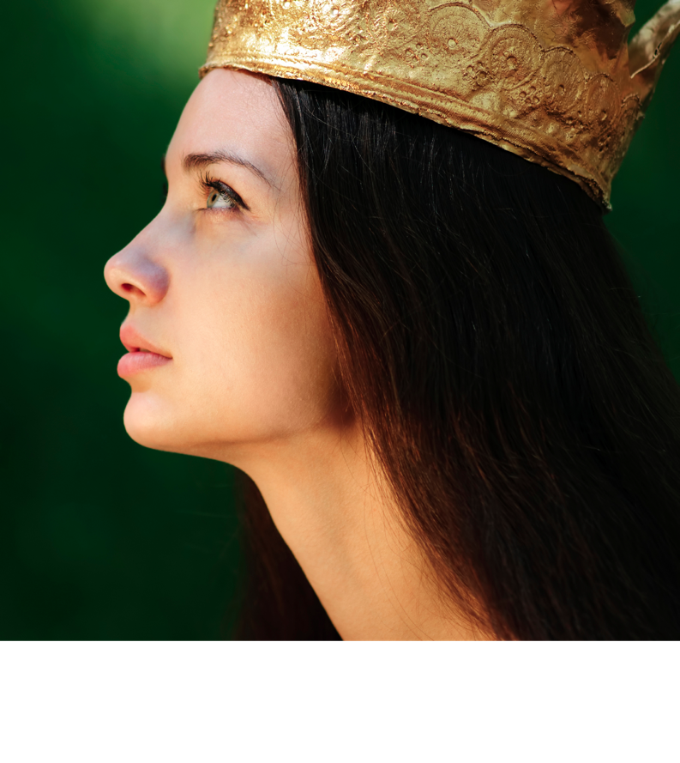
الموجز
311-312
1. (الإصحاحات 1-4) مؤامرة هامان لإبادة الشعب اليهودي أصبحت معروفة لمردخاي و أستير، اللذان خطط الله لوضعهما لينذرا إسرائيل أن الإنفصال عن الله قد يؤدي إلى فنائهم كأمة
Notes:
Haman’s plot to kill the Jews came just after Mordecai foiled a plot to murder the king to show God protecting Jews via Esther to uphold the Abrahamic Covenant (2:19–4:17).

Slide 26
أستير 2
Notes:
Xerxes married Esther to replace Vashti after a divinely designed beauty contest where God controlled Xerxes' taste in women to avert a disaster for the Jews (2:1-18; 479 BC).

Slide 27
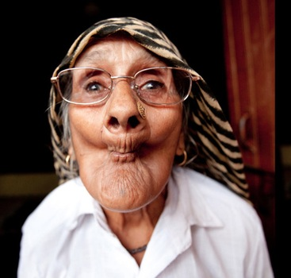
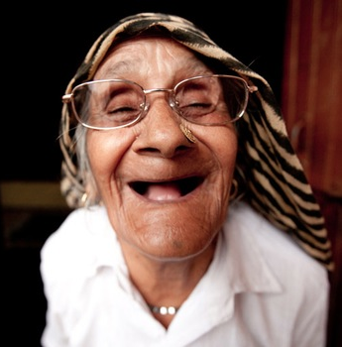
مسابقة الجمال
Notes:
Actually God uses a beauty contest for his plan.
• So all the beauties are gathered.
• And they were happy about that!

Slide 28
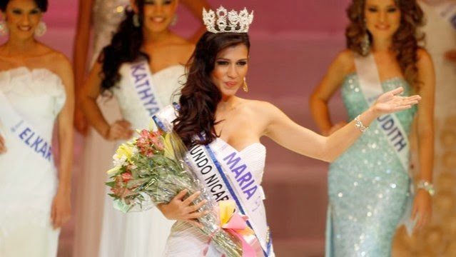
مسابقة الجمال
Notes:
OK, maybe they looked better than that…

Slide 29
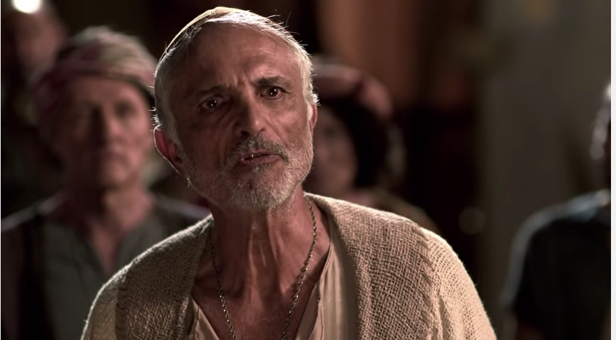
مردخاي اليهودي
(أستير 2: 5)
Notes:
"At that time there was a Jewish man in the fortress of Susa whose name was Mordecai son of Jair. He was from the tribe of Benjamin and was a descendant of Kish and Shimei. ⁶ His family had been among those who, with King Jehoiachin of Judah, had been exiled from Jerusalem to Babylon by King Nebuchadnezzar" (2:5-6 NLT).

Slide 30
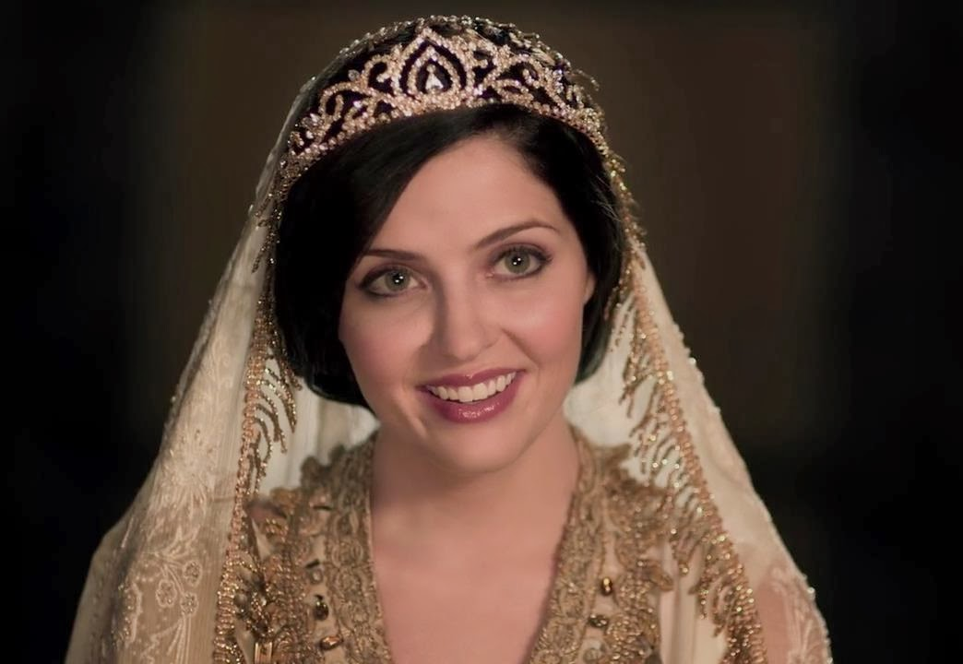
أستير الشابة ابنة عم مردخاي
(2: 7)
Notes:
"This man had a very beautiful and lovely young cousin, Hadassah, who was also called Esther. When her father and mother died, Mordecai adopted her into his family and raised her as his own daughter" (2:7 NLT).

Slide 31
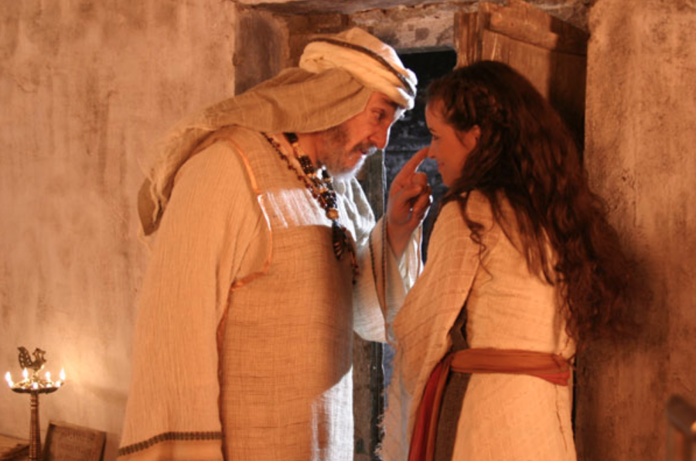
مردخاي يرشد أستير
Notes:
"Esther had not told anyone of her nationality and family background, because Mordecai had directed her not to do so" (2:10 NLT).

Slide 32
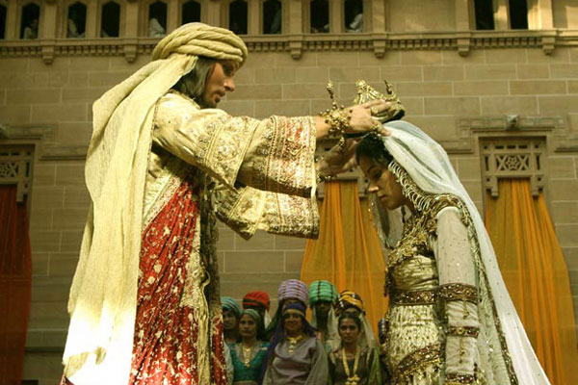
هل تصرفت أستير بشرف ؟
Notes:
"Esther kept her Jewish nationality a secret (cf. v. 20), not telling Hegai, her maids, or anyone else because Mordecai had told her not to. From this and other statements in the book it is clear the author was making the point that God protected and used Esther and Mordecai in spite of the fact that they were not living according to the Law commanded by God to the people of Israel. By Law Esther was not to marry a pagan (Deut. 7:1-4) or have sexual relations with a man who was not her husband (Ex. 20:14), and yet this was the purpose of her being included in the harem. Esther could be contrasted with Daniel who refused to eat the things from the king’s table (Dan. 1:5) because the food would include items considered unclean by the Jewish Law. Apparently Esther had no qualms about the food she ate (Es. 2:9). She certainly did not set herself apart as Daniel had done" (John A. Martin, "Esther," in The Bible Knowledge Commentary, 1:704).

Slide 33
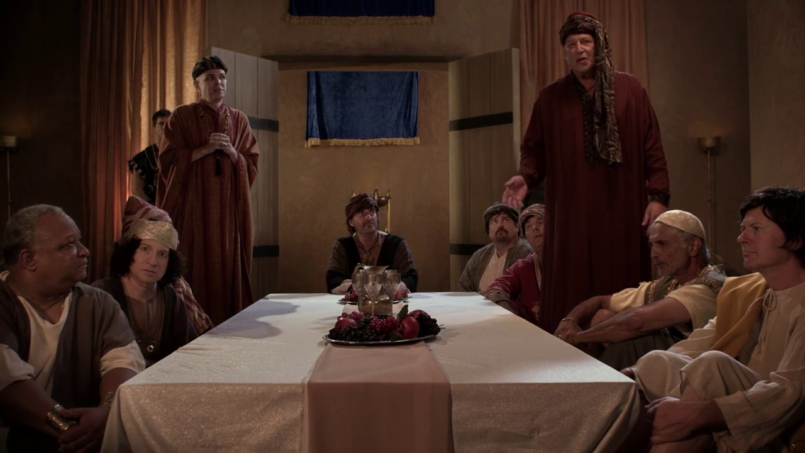
كل رجال الملك
Notes:
Haman’s plot to kill the Jews came just after Mordecai foiled a plot to murder the king to show God protecting Jews via Esther to uphold the Abrahamic Covenant (2:19–4:17).

Slide 34
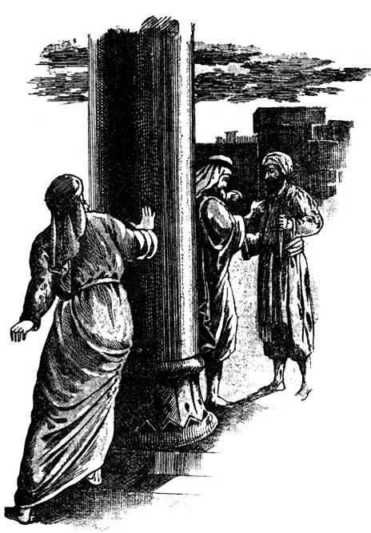
التنصت
أستير
  الإرتباك 1-2
وشتي
483
479
صعود مردخاي
الولائم
Notes:
God informed Mordecai of a secret assassination plot that saved Xerxes' life as God’s design to later exalt Mordecai to benefit his people (2:19-23).

Slide 35
أستير 3
Notes:
Haman’s anger at Mordecai refusing to honor him convinced Xerxes to kill all Jews from Egypt to India eleven months later for God protect them instead (Esther 3).

Slide 36
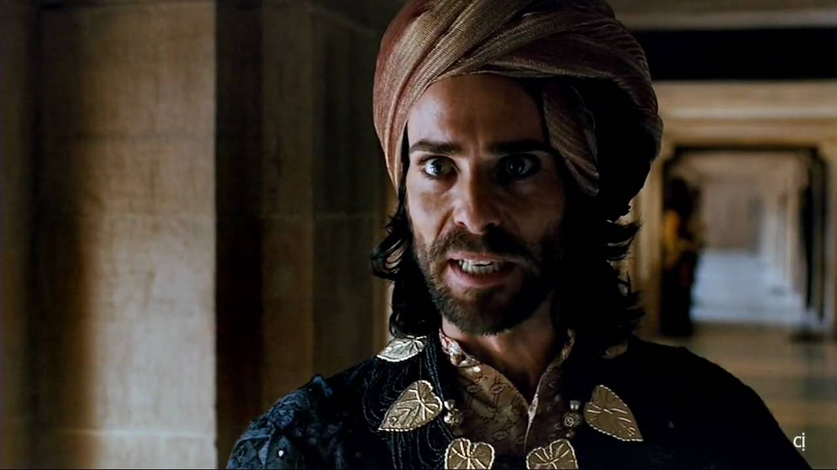
هامان الأجاجي
(أستير 3: 1-2)
Notes:
"Some time later King Xerxes promoted Haman son of Hammedatha the Agagite over all the other nobles, making him the most powerful official in the empire. ² All the king’s officials would bow down before Haman to show him respect whenever he passed by, for so the king had commanded. But Mordecai refused to bow down or show him respect" (3:1-2 NLT).
"Because Haman was an Agagite, some have supposed that he was descended from Agag, king of the Amalekites (1 Sam. 15:8). However, it seems unlikely that a high-ranking Persian official would be related to a west Semite who lived 600 years earlier. Archeologists have uncovered an inscription which indicates that Agag was also the name of a province in the Persian Empire. This probably explains why Haman was called an Agagite" (John A. Martin, "Esther," Bible Knowledge Commentary, 1:705).

Slide 37
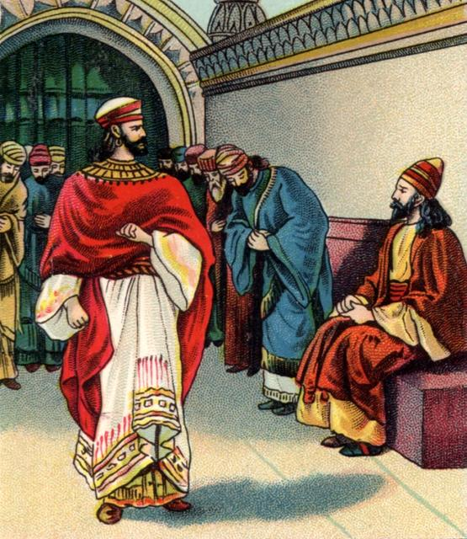
عدم الإحترام (3: 1-2(
أستير
خطر جسيم
  المؤامرة 3-4
  الإرتباك 1-2
صعود و سقوط هامان
وشتي
483
479
صعود مردخاي
الولائم
الصوم
Notes:
Haman was so stuck on himself that when Mordecai refused to stand in his presence, Haman decided to kill not only him, but ALL Jews throughout the 127 provinces of the empire! Talk a chip on his shoulder!

Slide 38
أستير 4
Notes:
Mordecai convinced Esther to risk her life for the Jews by showing that God crowned her for this role even if she failed since he would still uphold the Abrahamic Covenant (Esther 4).

Slide 39
الآية المفتاحية
308
(مردخاي إلى أستير)
لأنك إن سكت سكوتاً في هذا الوقت يكون الفرج و النجاة لليهود من مكان آخر و أما أنت و بيت أبيك فتبيدون و من يعلم إن كنت لوقت مثل هذا وصلت إلى الملك
(أستير 4: 14)

Slide 40
لماذا يجب
أن تكون ملتزماً
نحو الله ؟
Notes:
What reasons can you give to be dedicated, loyal and devoted to the Lord?

Slide 41
عمل الله يواجه التهديدات (أستير 1-4)
لماذا الإلتزام نحو الله ؟
Notes:
Satan is always trying to push down whatever the Lord does.
God commands our wholehearted devotion as we face many obstacles while God fulfills his plan.

Slide 42
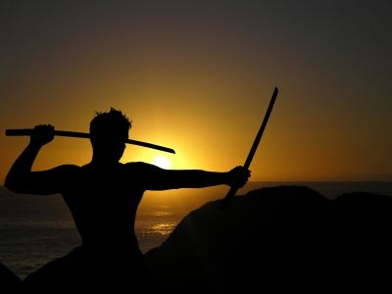
نحن آمنون في علاقتنا مع الله – لكن هذا لا يعني أنه لن يكون هناك هجومات

Slide 43
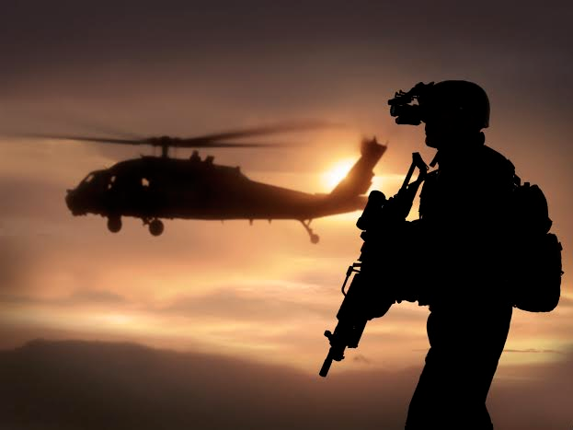
نحن في حالة حرب
Notes:
We are at war. The sad reality is that many of us do not realize it—so we are not committed to God as a result.

Slide 44

تقاطع طرق
Notes:
Each of us is at a crossroads—thus our church is Crossroads International Church.
Like the Jews in the story of Esther, right now we are attacked at home, at work, and a number of other arenas.
We are challenges whether we will take God’s road at the crossroads. Too often our problem is not that we don’t know which road is God’s road. Our issue is having the courage and commitment to do it.
Why should we be committed to God?

Slide 45
عمل الله يواجه التهديدات (أستير 1-4)
لماذا الإلتزام نحو الله ؟
عمل الله سوف ينتصر (أستير 5-10)
Notes:
Satan is always trying to push down whatever the Lord does.
But the Lord will eventually be the victor.
It’s easier to be committed to God’s plan when we know that it will ultimately succeed.

Slide 46
الموجز
311-312
1. (الإصحاحات 1-4) مؤامرة هامان لإبادة الشعب اليهودي أصبحت معروفة لمردخاي و أستير، اللذان خطط الله لوضعهما لينذرا إسرائيل أن الإنفصال عن الله قد يؤدي غلى فنائهم كأمة
2. (الإصحاحات 5-10) مؤامرة هامان للإبادة تعود على رأسه من خلال العناية الإلهية العاملة في مردخاي و أستير لتشجيع إسرائيل ما بعد السبي على التزام الله المستمر نحو العهد الإبراهيمي
Notes:
Triumph: God reverted Haman's massacre plot on his own head via Mordecai and Esther to fulfill the Abrahamic Covenant (Esther 5–10).

Slide 47
أستير 5
Notes:
Mordecai overcame Haman as proof of God's faithfulness when we fear him (5:1–8:2).

Slide 48
الشجاعة 5-7
أستير
خطر جسيم
  المؤامرة 3-4
  الإرتباك 1-2
  الشجاعة 5-7
صعود و سقوط هامان
وشتي
483
479
صعود مردخاي
الولائم
الولائم
الصوم
Notes:
True, God is for us—but that doesn't mean it doesn't take courage on our part!

Slide 49
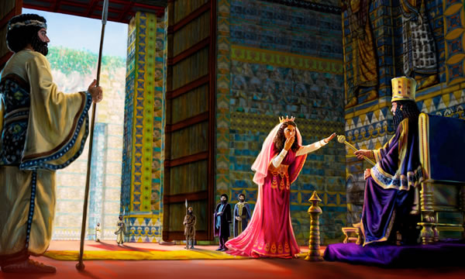
خاطرت أستير بحياتها لأجل اليهود (5: 2)
Notes:
Esther had not been summonded by the king for over a month, and to come into his presence without an invitation was actually risking her very life.

Slide 50
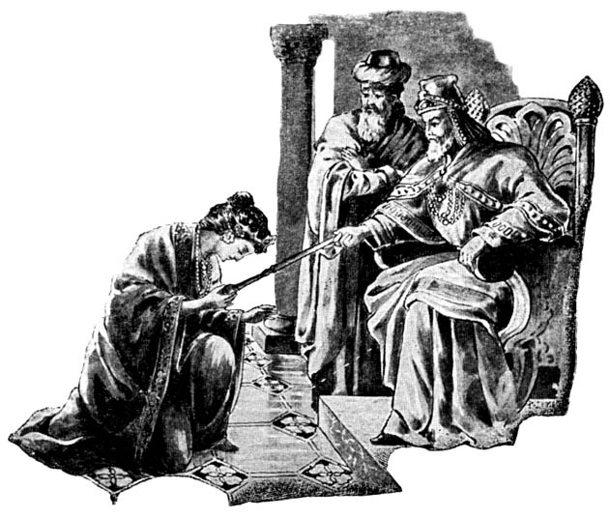
أستير 5: 1-8
Notes:
I think it is telling here that a woman is set as an example of courage. Too often it is the ladies who model courage before us men, even though God's plan is for the men to be the spiritual leaders.

Slide 51
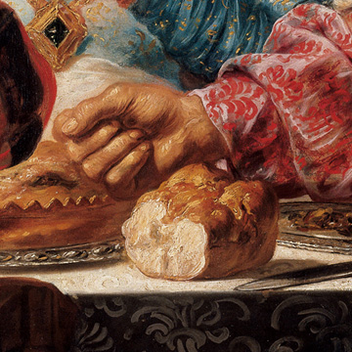
دعت أستير هامان و الملك للطعام (5: 4)
Notes:
The king enthusiastically and curiously accepted Esther's boldness, yet Esther only invited him to a banquet to put him in the proper mood to grant her request (5:1-8).

Slide 52
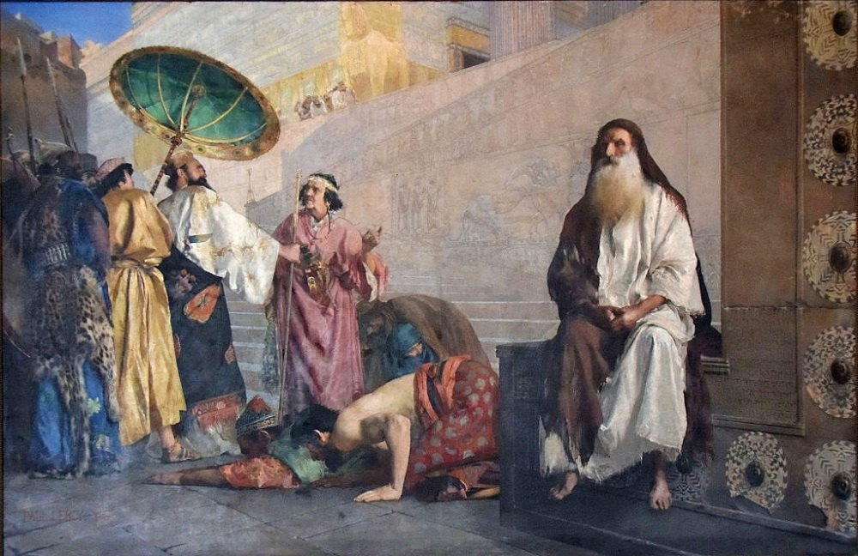
أستير 5: 9-14
Notes:
Yet, when Haman leaves after the meal, Mordecai refused to stand for Haman which motivated Haman to impale Mordecai.
So Haman arrogantly plotted to murder Mordecai on a 75-foot gallows as God's provision for his own death to protect the Jews (5:9-14).

Slide 53

عمود حاد ...
ارتفاعه 75 قدماً
(5:14 NLT)
مشنقة بنيت ...
بطول 75 قدماً
(5:14 NIV, NAU)
Notes:
"Haman’s wife, Zeresh, and all his friends were no better than he was. They suggested that Haman have a gallows built that would be 75 feet high and that he have Mordecai hanged on it before the banquet so he would have nothing bothering him when he went to the feast. The gallows probably was an impaling stake, a common method of execution in the ancient world (cf. comments on 2:23). The purpose in suggesting such a tall stake was so it would be a lesson to all who saw it. The person on the stake would be visible from all directions, since he would be higher than all the trees. This spectacle would solemnly emphasize that Haman was in control (cf. 3:1) and that no one should try to stand in his way.
Haman undoubtedly felt that with Mordecai gone there would be no organized opposition from the Jewish camp. He would be freed from his enemy forever. Here the tension in the Haman-Mordecai conflict reached its peak. From this point on it was relieved little by little through circumstances that had already been set in motion. As the events unfold, the reader is reminded of seemingly insignificant or forgotten events that the skillful narrator had previously mentioned but had not highlighted. God was sovereignly at work behind even such a hateful act as building a gallows (cf. Acts 2:23; 4:27-28)" (John A. Martin, "Esther," Bible Knowledge Commentary, 1:708).

Slide 54
أستير 6
Notes:
Haman honored Mordecai and returned home humiliated (Esther 6).

Slide 55
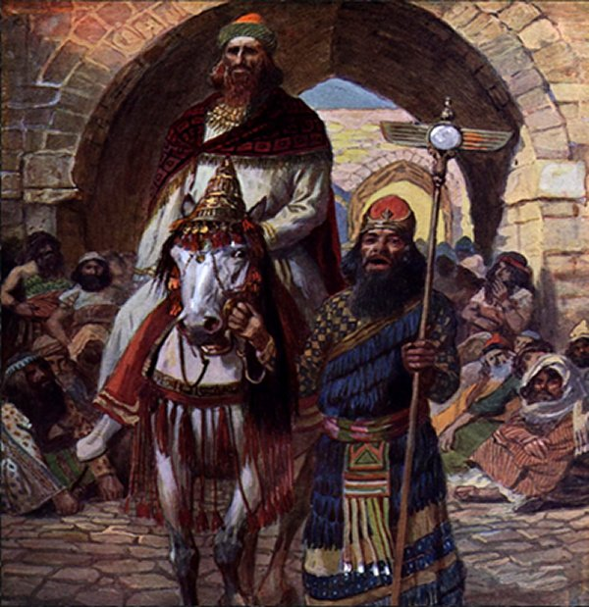
أستير 6
Notes:
I can just hear Haman pronounce under his voice, "This is what the king does for the one he wants to honor" and then Morcedai says, "Hey, say it a little louder!"

Slide 56
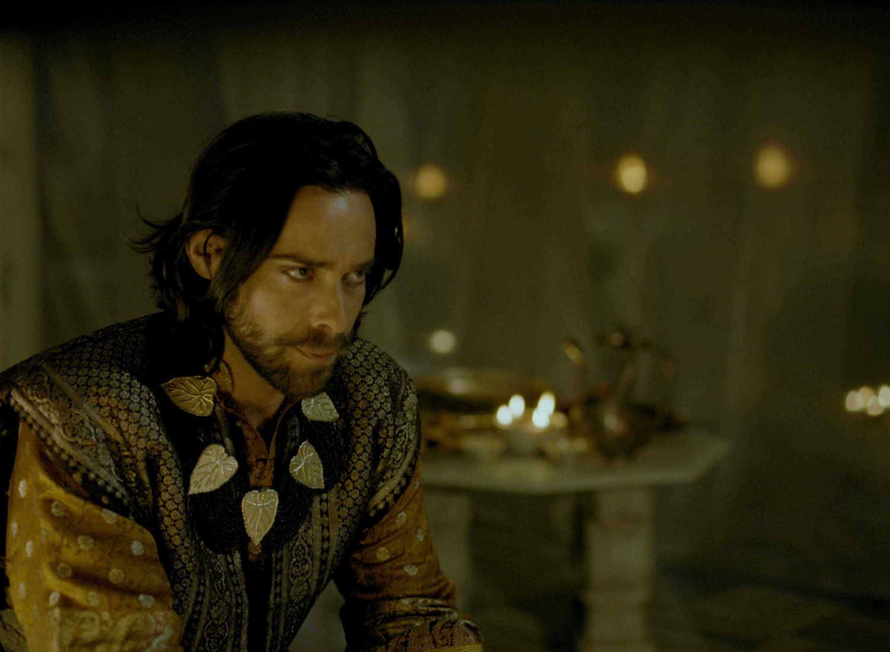
و رجع مردخاي إلى باب الملك و أما هامان فأسرع إلى بيته نائحاً و مغطى الرأس (6: 12)

Slide 57
أستير 7
Notes:
Haman died on the gallows prepared for Mordecai as evidence that God protects those who fear him and punishes those who oppose him and his people (Esther 7).

Slide 58

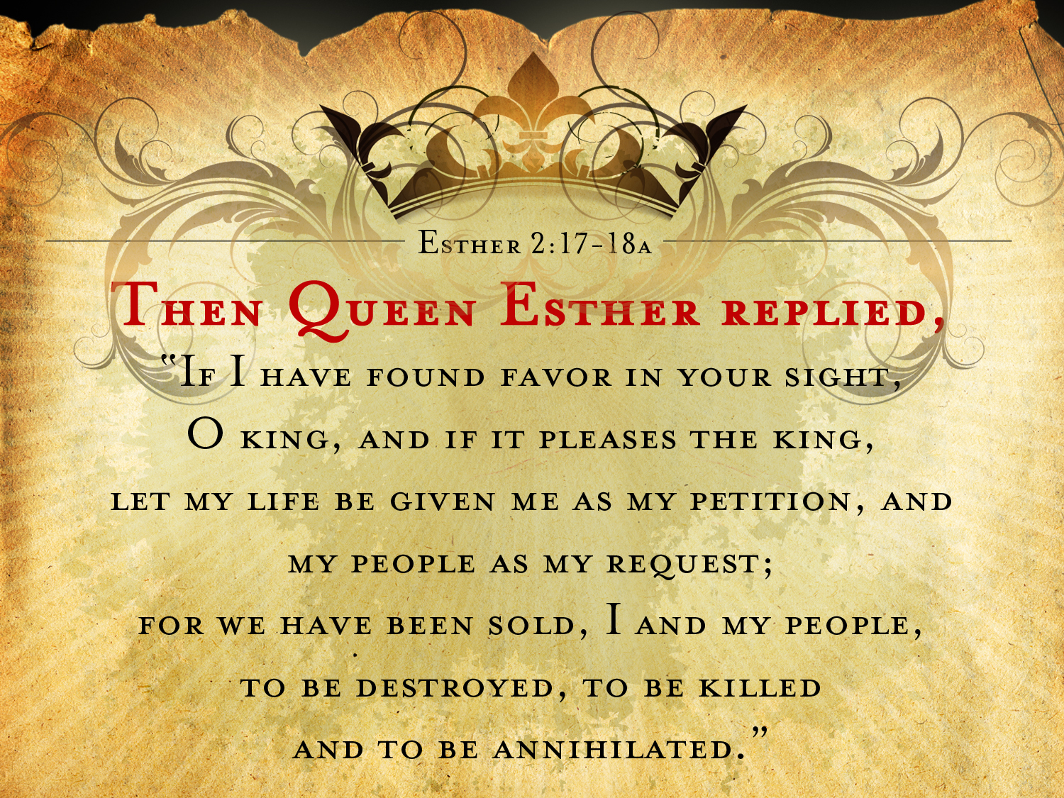
أستير 7: 3-4أ
فأجابت أستير الملكة و قالت
إن كنت قد وجدت نعمة في عينيك أيها الملك و إذا حسن عند الملك فلتعط لي نفسي بسؤلي و شعبي بطلبتي لأننا قد بعنا أنا و شعبي للهلاك و القتل و الإبادة

Slide 59
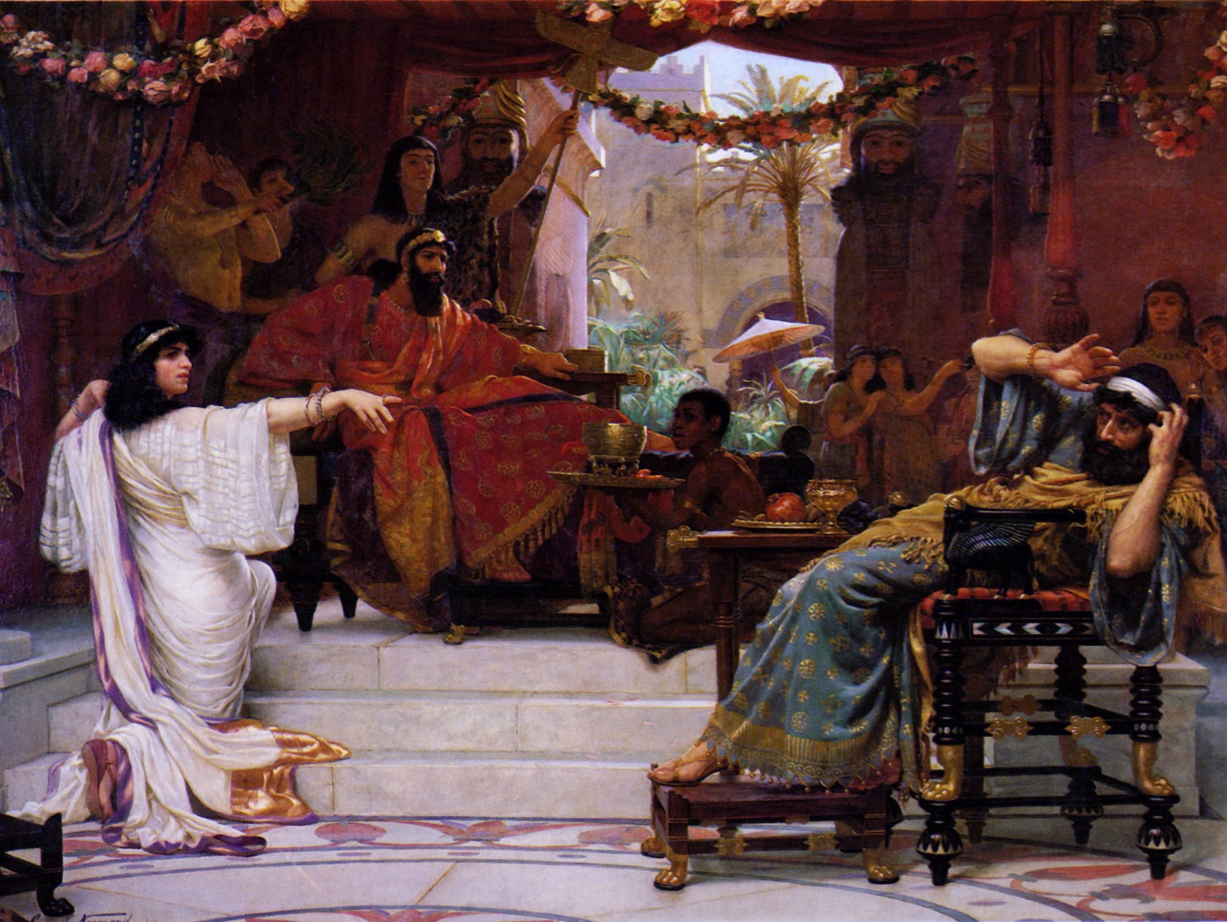
هو رجل خصم و عدو هذا هامان الرديء
(7: 6)

Slide 60
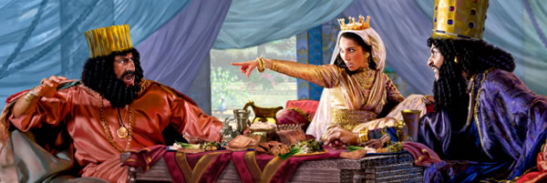
هذا هامان الرديء (7: 6)

Slide 61
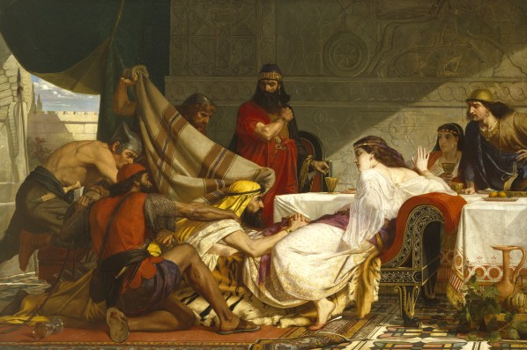
أستير 7: 8
Notes:
"In despair he fell on the couch where Queen Esther was reclining, just as the king was returning from the palace garden. The king exclaimed, “Will he even assault the queen right here in the palace, before my very eyes?” And as soon as the king spoke, his attendants covered Haman’s face, signaling his doom" (7:8 NLT).

Slide 62
عمود حاد ...
ارتفاعه 75 قدماً
(5:14 NLT)
مشنقة بنيت ...
بطول 75 قدماً
(5:14 NIV, NAU)
Notes:
"Haman’s wife, Zeresh, and all his friends were no better than he was. They suggested that Haman have a gallows built that would be 75 feet high and that he have Mordecai hanged on it before the banquet so he would have nothing bothering him when he went to the feast. The gallows probably was an impaling stake, a common method of execution in the ancient world (cf. comments on 2:23). The purpose in suggesting such a tall stake was so it would be a lesson to all who saw it. The person on the stake would be visible from all directions, since he would be higher than all the trees. This spectacle would solemnly emphasize that Haman was in control (cf. 3:1) and that no one should try to stand in his way.
Haman undoubtedly felt that with Mordecai gone there would be no organized opposition from the Jewish camp. He would be freed from his enemy forever. Here the tension in the Haman-Mordecai conflict reached its peak. From this point on it was relieved little by little through circumstances that had already been set in motion. As the events unfold, the reader is reminded of seemingly insignificant or forgotten events that the skillful narrator had previously mentioned but had not highlighted. God was sovereignly at work behind even such a hateful act as building a gallows (cf. Acts 2:23; 4:27-28)" (John A. Martin, "Esther," Bible Knowledge Commentary, 1:708).

Slide 63
أستير 8
Notes:
Mordecai was elevated to Haman's position and appointed over Haman's estate to show that those who plot evil will only prosper the righteous (8:1-2).

Slide 64
يوم الإنتصار
أستير
خطر جسيم
انتصار عظيم
  المؤامرة 3-4
  الدفاع 8
  الإرتباك 1-2
  الشجاعة 5-7
صعود و سقوط هامان
حماية اليهود
وشتي
483
479
صعود مردخاي
473
الولائم
الإحتفال
الولائم
الصوم

Slide 65
أستير 9
Notes:
Israel triumphed over its enemies and began to annually celebrate the Feast of Purim as evidence of God's faithfulness to the Abrahamic Covenant (8:3–9:32).

Slide 66
يوم الدفاع
أستير
خطر جسيم
انتصار عظيم
  المؤامرة 3-4
  الدفاع 8
  الإرتباك 1-2
  الشجاعة 5-7
  الإنتصار 9-10
صعود و سقوط هامان
حماية اليهود
وشتي
483
479
صعود مردخاي
473
الولائم
الإحتفال
الولائم
الصوم

Slide 67
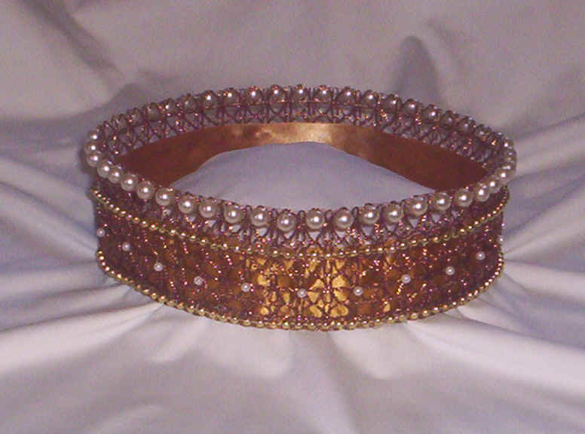
الفوريم
عيد الفوريم هو عطلة صغيرة في التقويم اليهودي بناء على ما ورد في سفر أستير، يسبق هذه العطلة صوم أستير إحياء لذكرى فترة التجمع و الصوم قبل الإنقاذ .
في عيد الفوريم و بحسب ممارسات التلمود يتم قراءة الميغيلاه (سفر أستير) في المجمع و يتم توزيع الصدقات و تبادل هدايا الطعام كما يتم تناول وجبة احتفالية .
الفوريم، قاموس هاربر للكتاب المقدس
Notes:
Xerxes allowed Esther and Mordecai’s counter-decree for Jews to defend themselves and God caused many Gentiles to become proselytes (8:3-17).

Slide 68
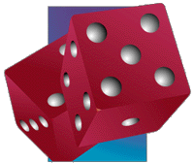
أمثال 16: 33
    القرعة تلقى في الحضن
    و من الرب كل حكمها
Notes:
The Jews slaughtered at least 75,810 enemies in two days with help from royal officials to show God's faithfulness to the Abrahamic Covenant (9:1-16; Feb-Mar 473 BC).
Mordecai and Esther authorized the Feast of Purim (plural for pur, the lot thrown by Haman) to annually celebrate God’s victory over the enemies of the Jews (9:17-32).

Slide 69
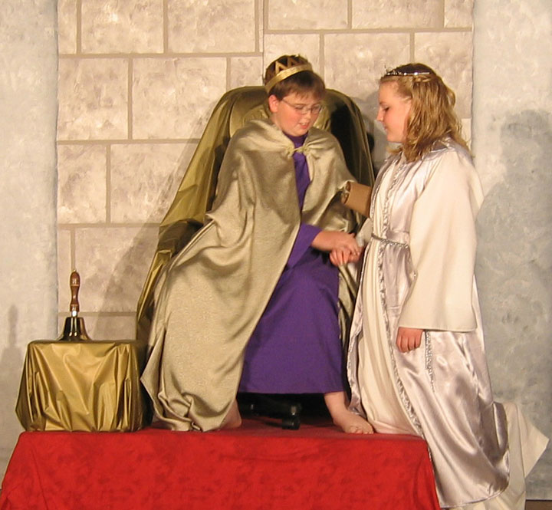
تستمر القصة في المسرحيات اليهودية كل عام
Notes:
Purim is celebrated annually by Jews where boys play the part of Mordecai and girls Esther.

Slide 70
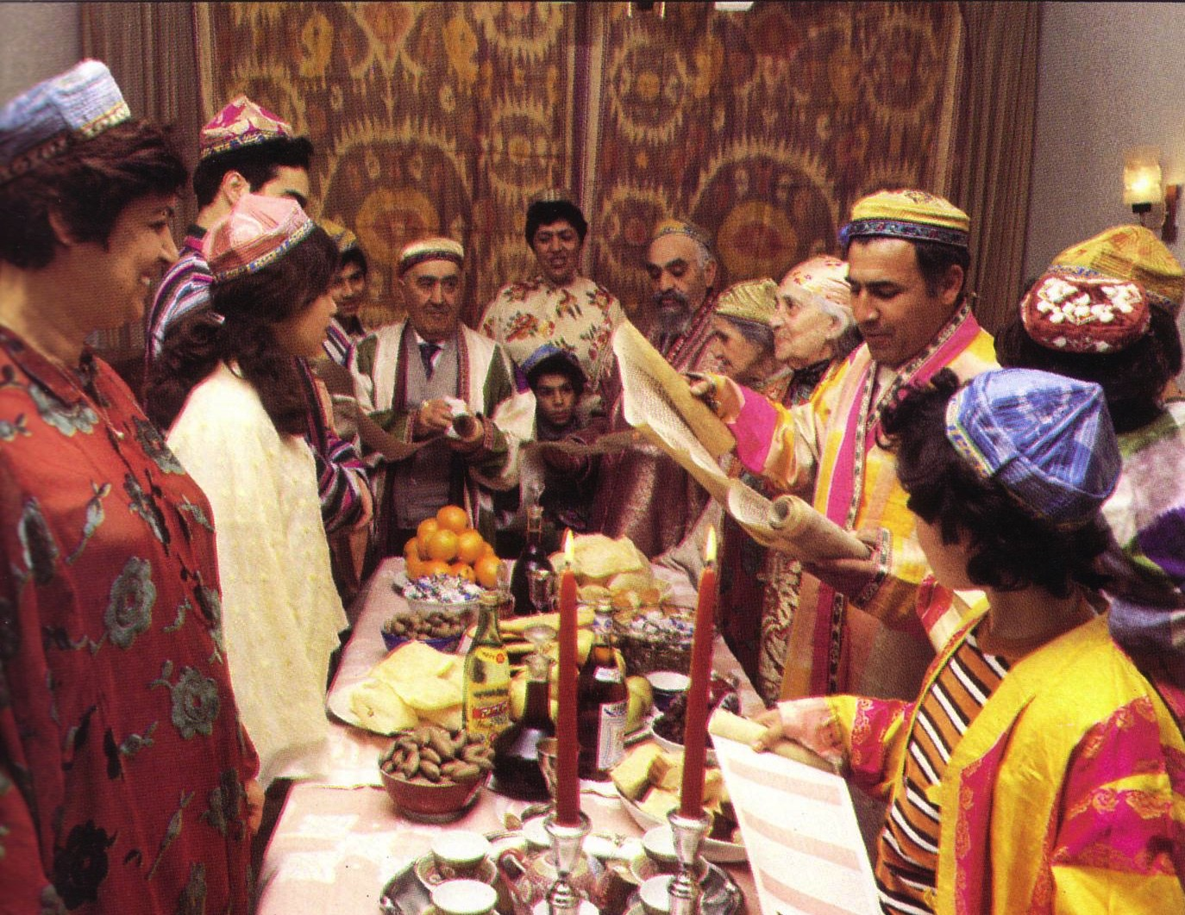
عيد الفوريم : الكثير من الإنتصار
Notes:
It is a festive time!

Slide 71
أستير 10
Notes:
The LORD exalted Mordecai to second only to Xerxes due to his selfless concern for the Jews, which shows God's blessing on those who seek the welfare of others (Esther 10).

Slide 72
نحن آمنون في علاقتنا مع الله – لكن هذا لا يعني أنه لن يكون هناك هجومات

Slide 73
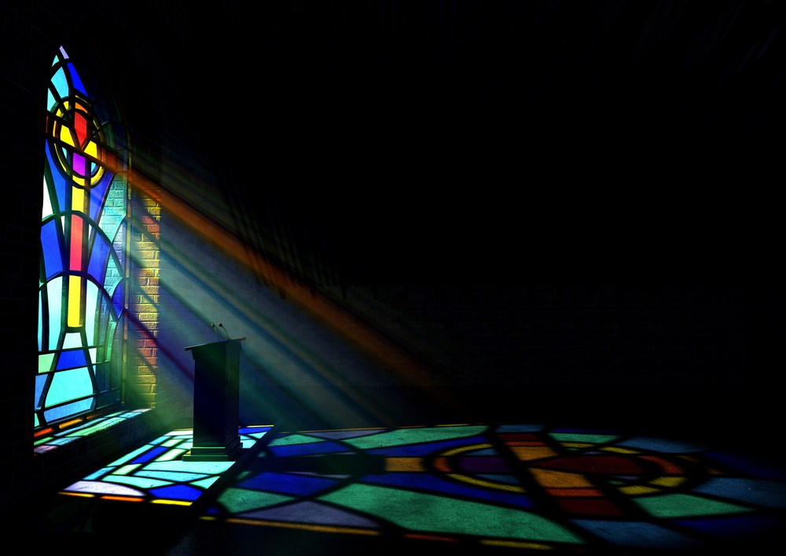
لدينا أيضاً انتصار مستقبلي
لأن خطة الله لن يتم إحباطها

Slide 74
الآية المفتاحية
308
(مردخاي إلى أستير)
لأنك إن سكت سكوتاً في هذا الوقت يكون الفرج و النجاة لليهود من مكان آخر و أما أنت و بيت ابيك فتبيدون و من يعلم إن كنت لوقت مثل هذا وصلت إلى الملك ؟
(أستير 4: 14).
Notes:
The key verse reminds us that, even if we have poor judgment and are not committed to God’s plan, “relief for the Jews will arise from another place” (Esther 4:14).

Slide 75
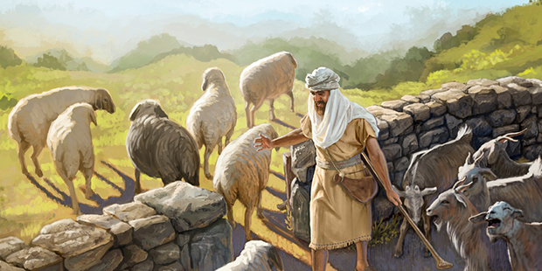
لا يمكنك أن تحبط خطة الله السيادية
لكن يمكنك أن تكون جزء منها
Notes:
It is the same with us! You cannot thwart God’s sovereign plan! He is the king and will accomplish it with or without you. The real question is whether you will have that blessing to be reigning with him.

Slide 76
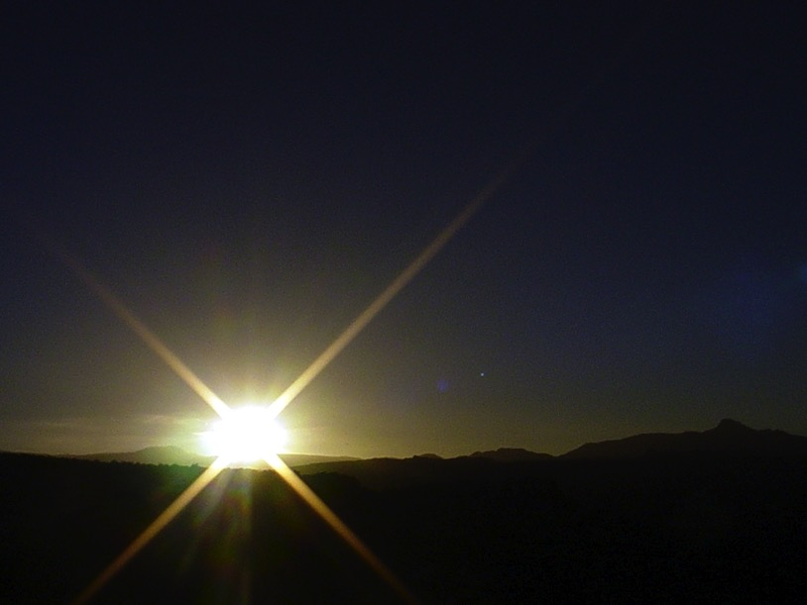


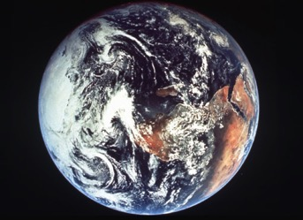
تناغم الكتاب المقدس
446
أنماط متكررة بترتيب عكسي
فداء المسيح
حكم المسيح
فقدان
حكم الإنسان في السقوط
استرداد
حكم
الإنسان
في
الألفية
الخليقة
الخليقة الجديدة
Notes:
Creation in Genesis 1–2 is repeated In the Restored, New Creation in Rev 21–22
Man was created to rule over the fish, birds, and land animals (Gen. 1:28) but he gave over his rule over to the god of this world, Satan (2 Cor. 4:4)
However, this rule is restored during the 1000-year reign of the saints (Rev. 20:4-6)
But Christ is the central Person of history: both as Lamb (Redeemer) and as Lion (Ruler of all creation in the line of David)

Slide 77

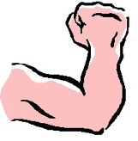
رسم بياني رؤيا 20: 4-6
424
4ب فعاشوا
و ملكوا
مع المسيح
ألف سنة
⁴أ و رأيت عروشاً فجلسوا عليها و أعطوا حكماً و رأيت نفوس الذين قتلوا من أجل شهادة يسوع و من أجل كلمة الله و الذين لم يسجدوا للوحش و لا لصورته و لم يقبلوا السمة على جباههم و على أيديهم
1000 سنة
5ب هذه هي القيامة الأولى 6أ مبارك و مقدس من له نصيب في القيامة الأولى هؤلاء ليس للموت الثاني سلطان عليهم
6ب بل سيكونون كهنة لله و المسيح و سيملكون معه ألف سنة
5أ و أما بقية الأموات فلم تعش حتى تتم الألف سنة
Notes:
Believers will reign with Christ for 1000 years!

Slide 78
لماذا يجب
أن تكون ملتزماً
نحو الله ؟
Notes:
What reasons can you give to be dedicated, loyal and devoted to the Lord?

Slide 79
عمل الله يواجه التهديدات (أستير 1-4)
لماذا الإلتزام نحو الله ؟
عمل الله سوف ينتصر
(أستير 5-10)
الفكرة الرئيسية
برغم تهديدات الشيطان
فإن الله سوف ينتصر
Notes:
Satan is always trying to push down whatever the Lord does.
But the Lord will eventually be the victor.
It’s easier to be committed to God’s plan when we know that it will ultimately succeed.

Slide 80


ما العمل ؟
308
استخدم موقعك
المعد لك
بعناية إلهية
لمساعدة شعب الله
Notes:
Where are you feeling crushed as if on the losing team? Plans at work, home, your future, your whatever…
You are not on the losing team! Be committed to God because you are actually on the winning side!
• Use your providentially placed position to help God's people. How? What advantages do you have that others do not? Language? Relationships? Money?

Slide 81

قبر أستير
في إيران اليوم
Notes:
Just as one can visit Esther’s tomb in Iran today, who knows but that your courage could long be remembered in God’s service.

Slide 82
Black

Slide 83


وعظ العهد القديم at BibleStudyDownloads.org
أحصل على العرض التقديمي و المخطوطة مجاناً

