Slide 1
Dinosaurët:
A keni qenë ju ose fëmijët tuaj tru-shpërlarë?
Taught by Dr. Terry Mortenson, AnswersinGenesis.org Uploaded by Dr. Rick Griffith, Singapore Bible College All files in many languages for free download at BibleStudyDownloads.org

Slide 3
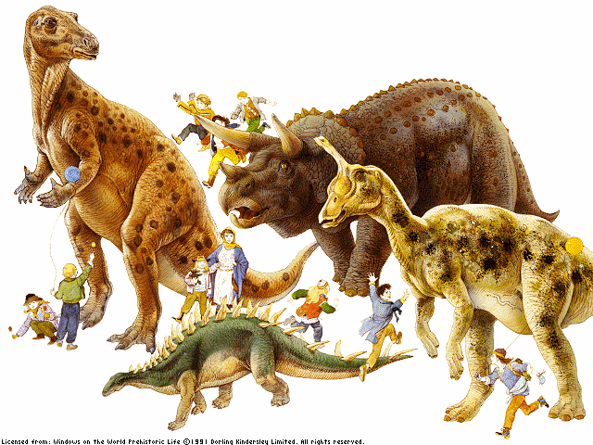

Slide 4
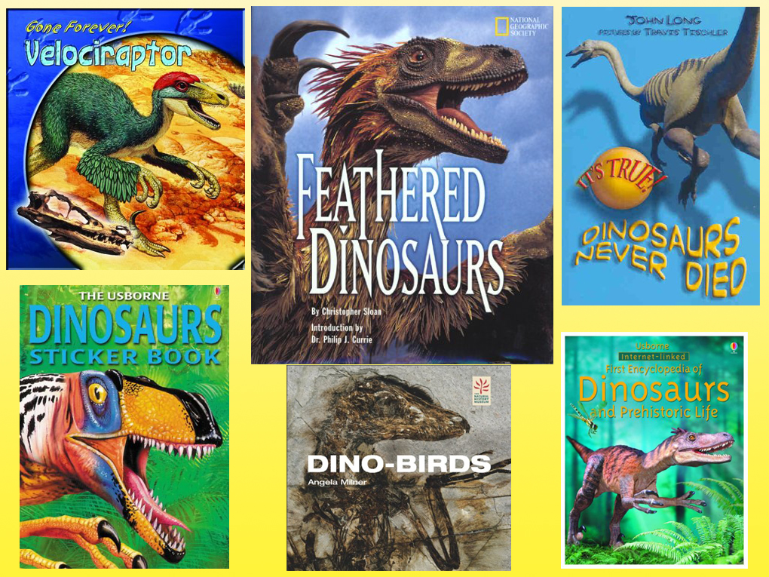

Slide 5
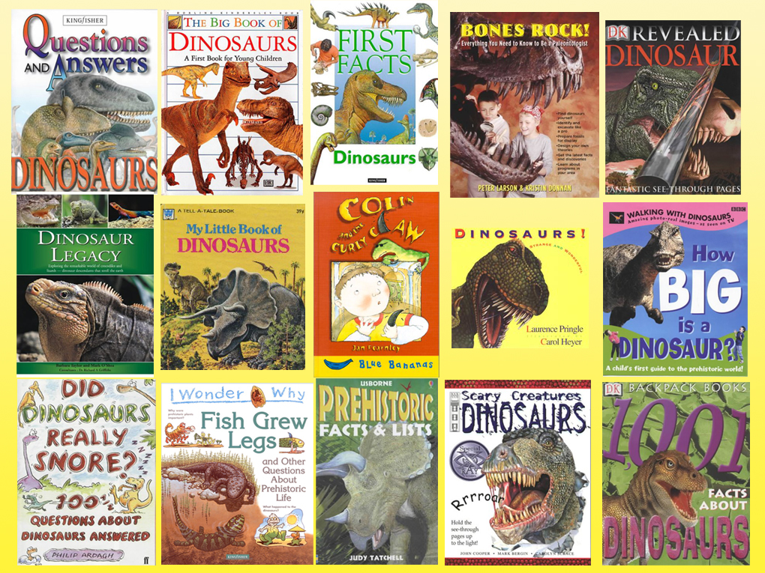

Slide 6
Dhe këto janë vetëm disa nga librat.

Slide 7
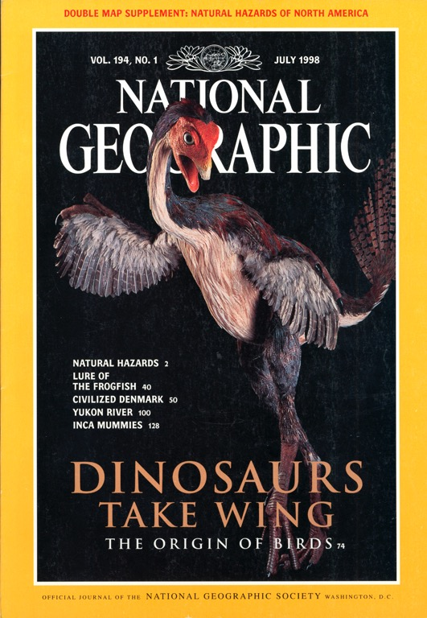
Dinozaurët Marrin Krahë
Origjina e Zogjve
Korrik 1998

Slide 8
Si i përshtatni dinosaurët në Bibël?
Ti s’mund!

Slide 9
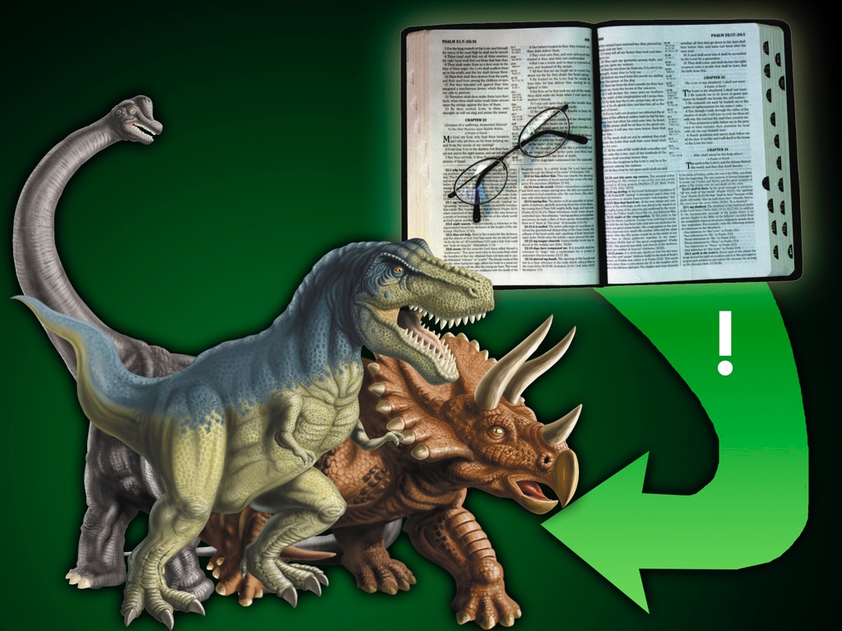
Përdor Biblën për të shpjeguar dinosaurët!

Slide 10
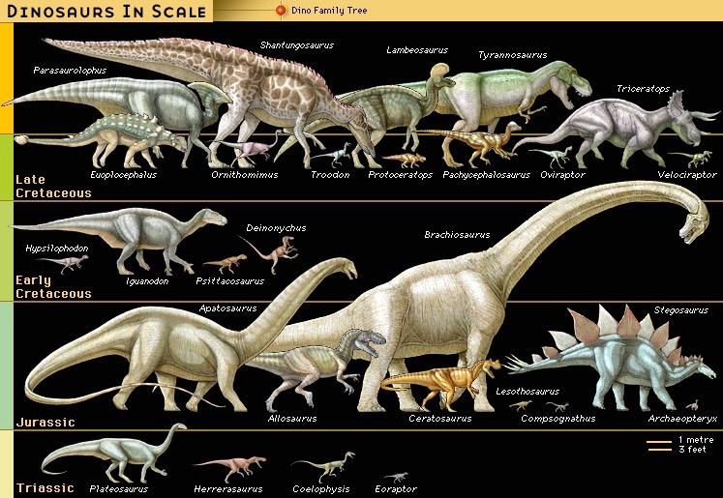
Miliona
vite
65
145
208
245
(Encyclopaedia Britannica, CD, 1999)

Slide 12
"Zogjtë janë dinozaurë të gjallë!"
Muzeu I Rockies, Bozeman, Montana

Slide 13
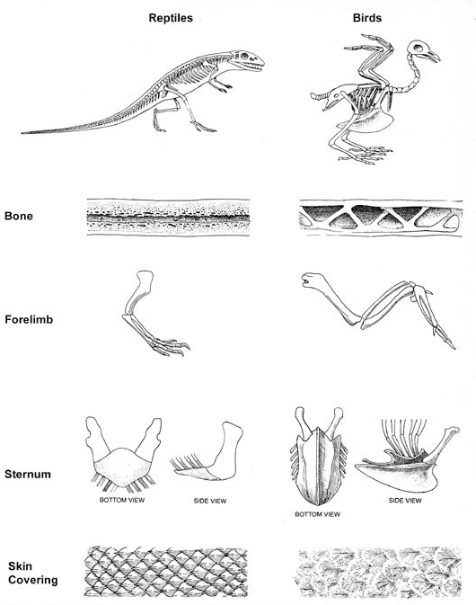
“Evolucioni i zogjve nga zvarranikët mund të konsiderohet si një proces përshtatjeje me anë të cilit zogjtë ‘zgjidhën’‘problemin’ e fluturimit.”
Richard Lewontin, “Adaptation,” Scientific American (Sept. 1978), p. 214.
Notes:
The marroë (which produces blood cells) in all bones (of birds, mammals, reptiles, etc) decays aëay after death leaving empty spaces.
In life, bird bones have pneumatic spaces in long bones that communicate ëith the respiratory system.
But reptiles don’t have pneumatic bones. Evolutionists confuse us because they talk about “avian dinosaurs” and “non-avian dinosaurs.” But Dr. Menton says that most creationists ëould classify avian dinosaurs as 100% “birds” and non-avian dinosaurs as “dinosaurs.”
If you close off the trachea of bird and break open a ëing bone, the bird can still breathe for aëhile at least.

Slide 14
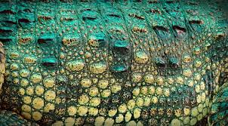
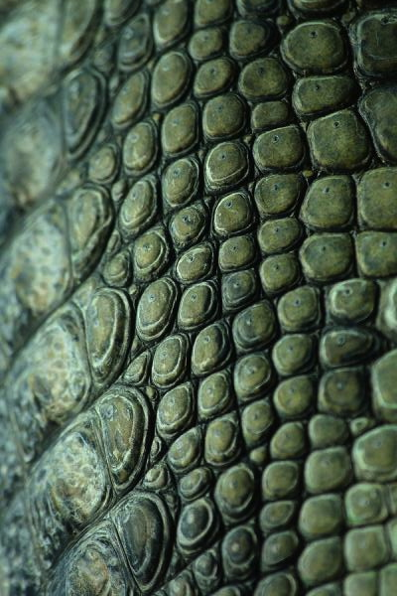
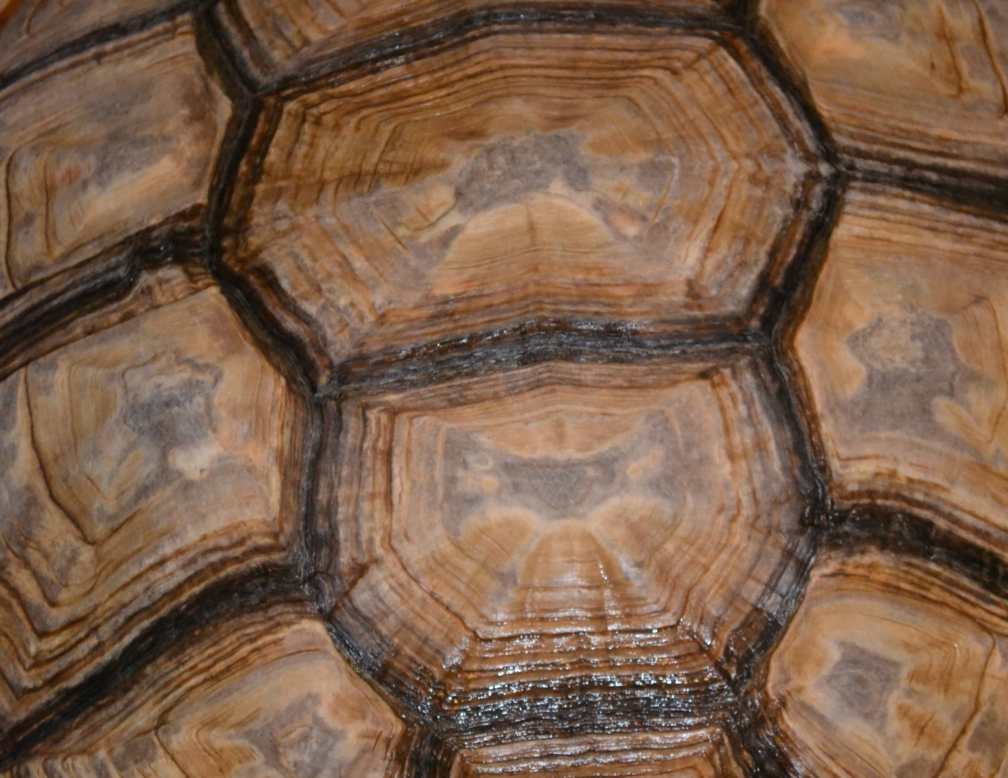
Crocodile scutes
Turtle scutes
Notes:
scutes (“scoots”) Dinosaur skin is made of scutes (which is a bony external plate or scale overlaid with horn).
Snakes and lizards have scales (made of keratin and formed in the epidermis) and shed their scales (snakes crawl out in one piece; lizard scales come off in parts).
Crocodilians and turtles have scutes (similar dermal scutes are found on bird feet), which are formed from the deeper dermis rather than the epidermis and do not form the same sort of overlapping structure as snake scales do.

Slide 15
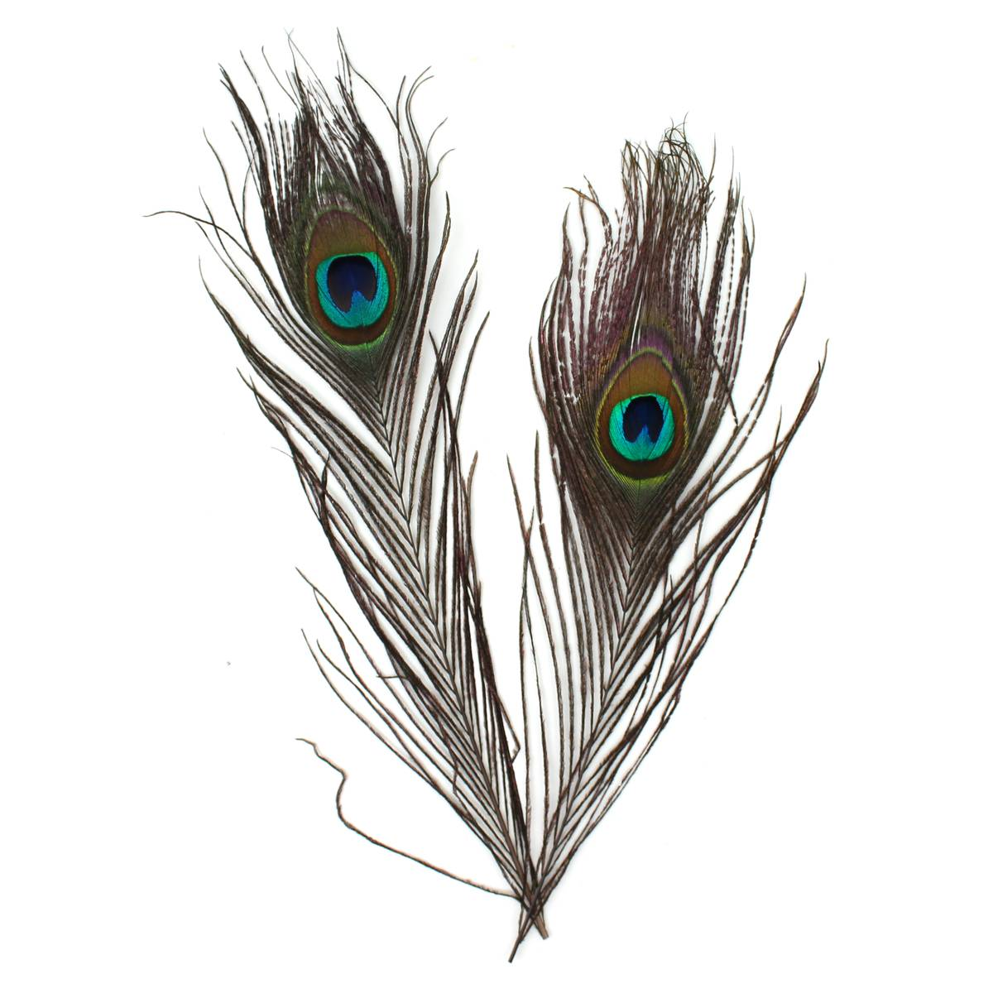
Notes:
bird feathers on left: https://graphicriver.net/item/bird-feathers-set/21788280, accessed 2018 Oct 21.
Feather on right: https://www.hobbycraft.co.uk/peacock-feathers-4-pack/570099-1000, accessed 2018 Oct 21.

Slide 16
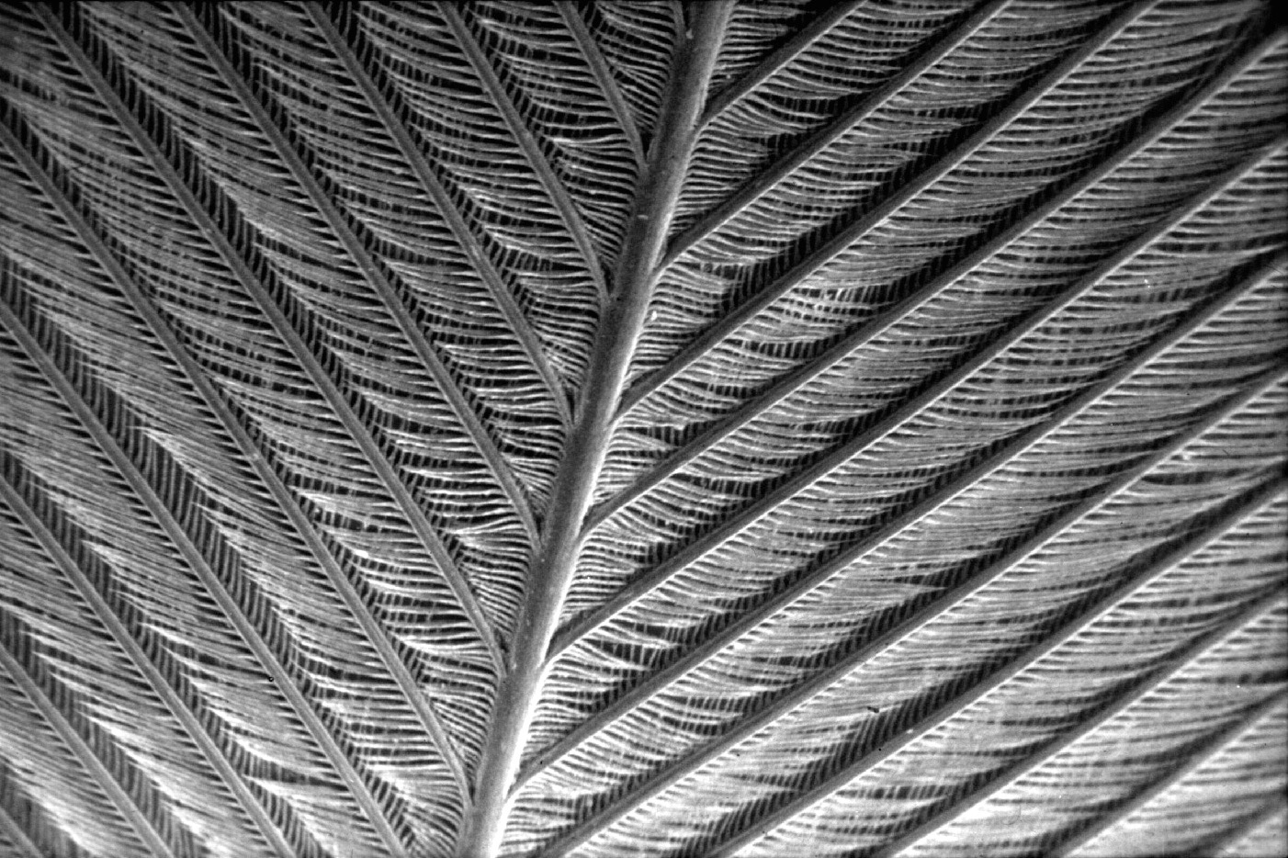

Slide 17
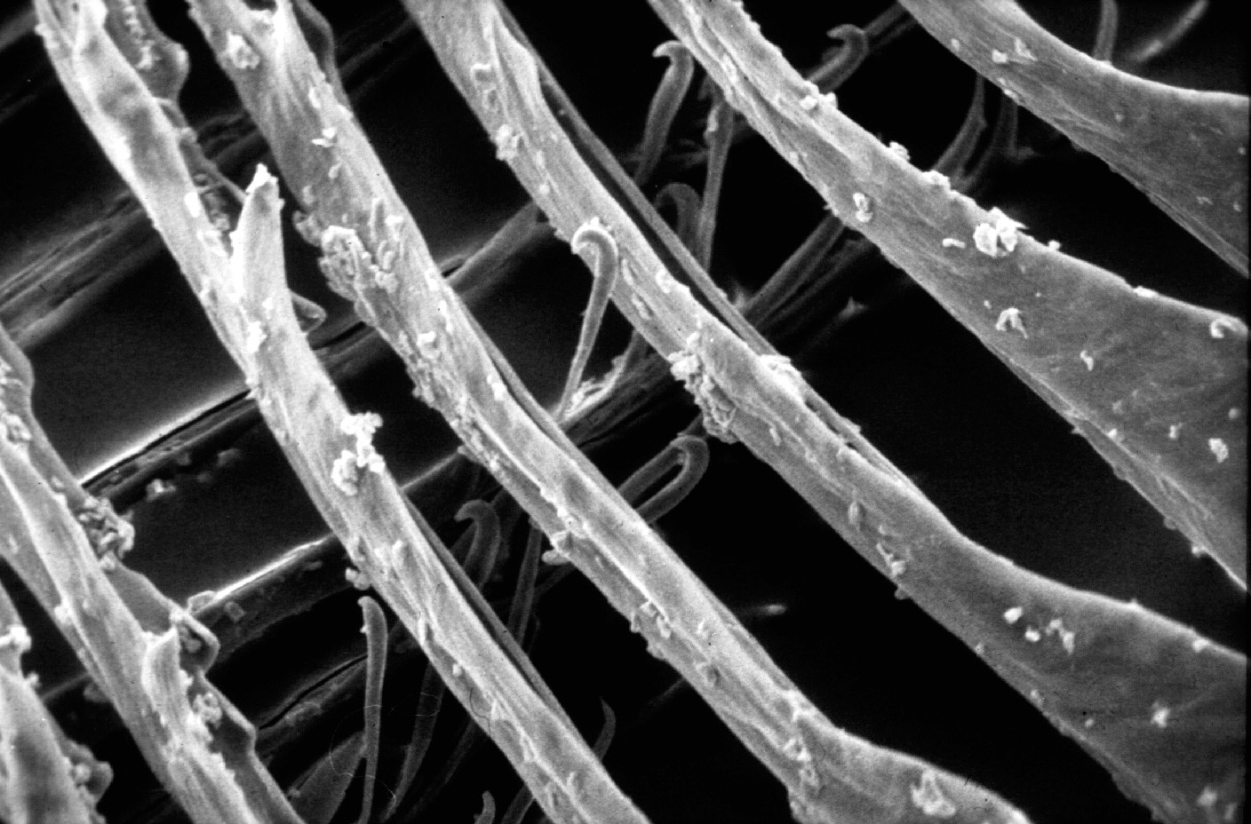
Notes:
From NAB1, ch. 24, David Menton:
In actual fact, feathers are profoundly different from scales in both their structure and groëth. Feathers groë individually from tube-like follicles similar to hair follicles. Reptilian scales, on the other hand, are not individual follicular structures but rather comprise a continuous sheet on the surface of the body. Thus, ëhile feathers groë and are shed individually (actually in symmetrically matched pairs!), scales groë and are shed as an entire sheet of skin.
The feather vane is made up of hundreds of barbs, each bearing hundreds of barbules interlocked ëith tiny hinged hooklets. This incredibly complex structure bears not the slightest resemblance to the relatively simple reptilian scale. Still, evolutionists continue to publish imaginative scenarios of hoë long-fringed reptile scales evolved by chance into feathers, but evidence of “sceathers” eludes them.

Slide 18
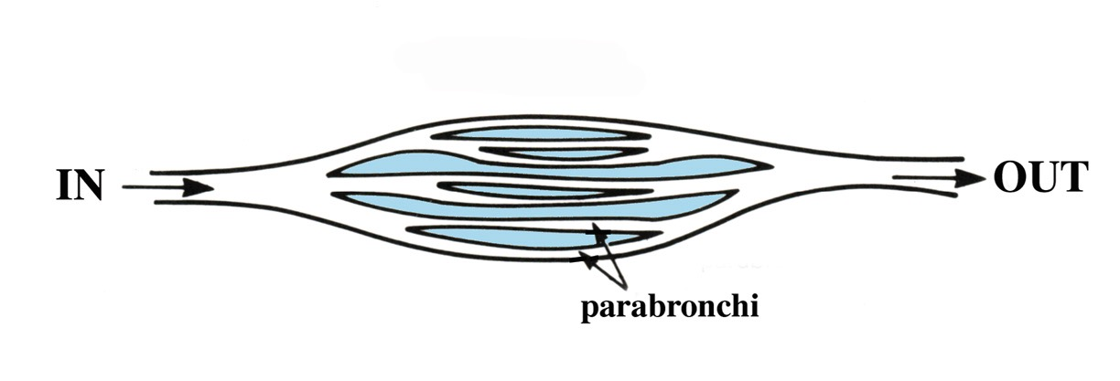
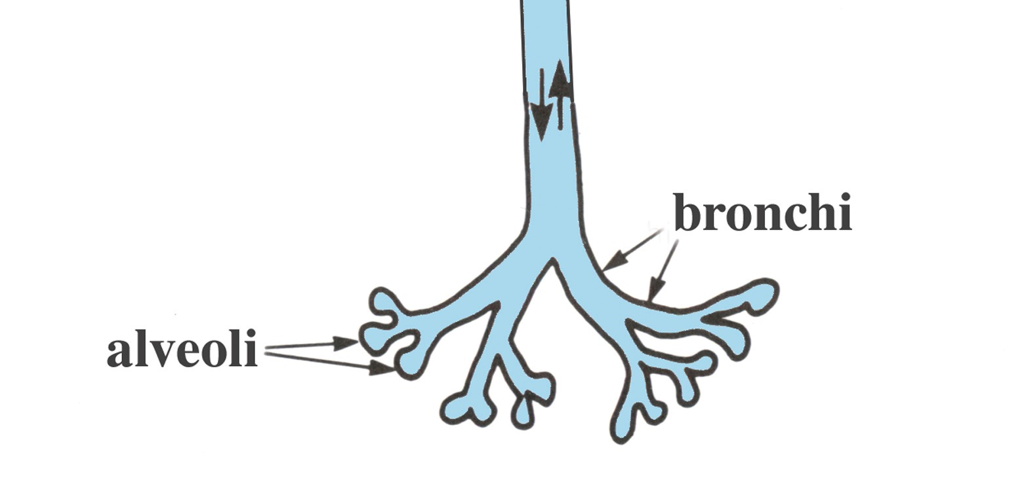
Mushkëri zogu
Mushkëri zvarraniku
Notes:
The bird lung is a unique respiratory system. Only birds have airsacs (ëhich function as belloës to keep air floëing continuously through the unidirectional lungs) and pneumatic bones, and they have no diaphram.
Dinosaurs don’t have connections betëeen bones and the respiratory system, as birds have. And dinosaurs and crocodilians do have diaphrams.
To refute the claim that crocodilians have uni-directional floë-through respiratory, see:
Dave Menton in NAB1, Ch. 24, “Did dinosaurs turn into birds?” (https://ansëersingenesis.org/dinosaurs/feathers/did-dinosaurs-turn-into-birds/)
“One of the most distinctive features of birds is their lungs. Bird lungs are small in size and nearly rigid, but they are, nevertheless, highly efficient to meet the high metabolic needs of flight. Bird respiration involves a unique “floë-through ventilation” into a set of nine interconnecting flexible air sacs sandëiched betëeen muscles and under the skin. The air sacs contain feë blood vessels and do not take part in oxygen exchange, but rather function like belloës to move air through the lungs.
“The air sacs permit a unidirectional floë of air through the lungs resulting in higher oxygen content than is possible ëith the bidirectional air floë through the lungs of reptiles and mammals. But in those creatures, the air floë moves through the same tubes at different times both into and out of the lungs of reptiles and mammals, and this results in a mixture of oxygen-rich air ëith oxygen-depleted air (air that has been in the lungs for a ëhile). The unidirectional floë through bird lungs not only permits more oxygen to diffuse into the blood but also keeps the volume of air in the lungs nearly constant, a requirement for maintaining a level flight path.”

Slide 19
"Hulumtuesit në Universitetin Shtetëror të Oregonit kanë bërë një zbulim të ri themelor rreth mënyrës se si zogjtë marrin frymë dhe kanë një kapacitet të mushkërive që lejon fluturimin - dhe gjetja do të thotë se nuk ka gjasa që zogjtë të kenë ardhë nga ndonjeri prej dinosaurëve të njohur theropodë
“Discovery Raises Neë Doubts About Dinosaur-Bird Links,” ëëë.sciencedaily.com, 2009 June 9.
Notes:
http://ëëë.sciencedaily.com/releases/2009/06/090609092055.htm, accessed 5 Sept 2014.

Slide 20
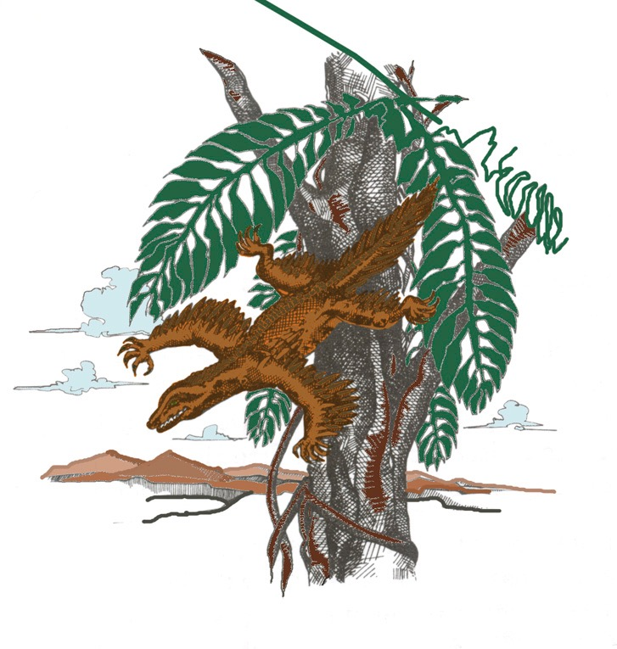
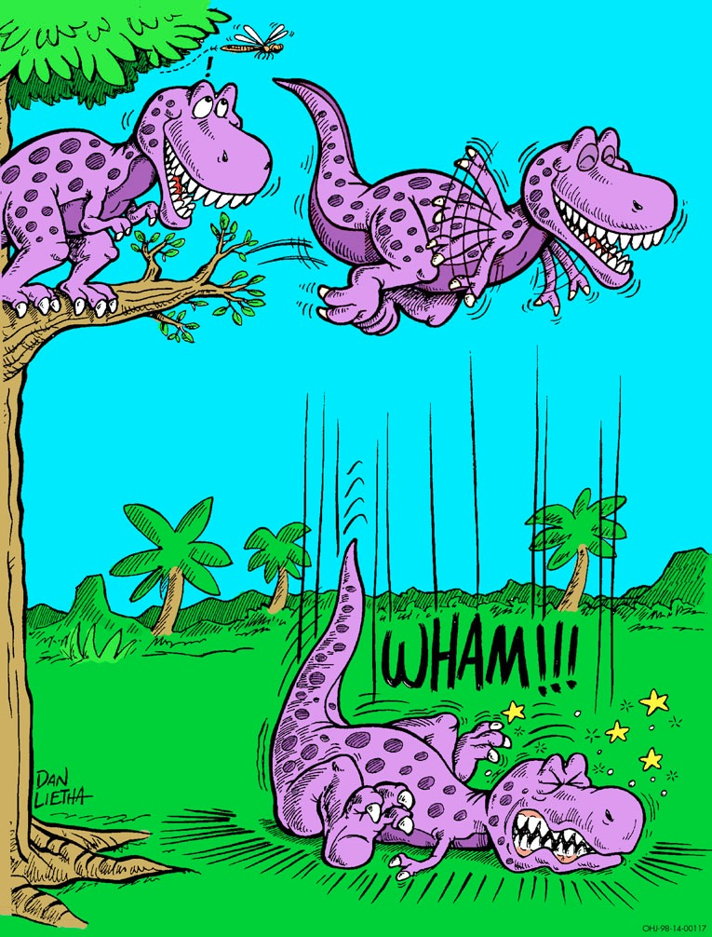
Notes:
Source: Gary Parker, Creation: Facts of Life (Master Books), p. 152. This is the theory of Alan Feduccia, expert ornothologist (see latest statement in his 2012 PDF article on dino-brids in my computer). The proto-bird ëas a tree-dëelling lizard ëeighing a couple of pounds, ëhich started as a glider and then evolved into a flyer. Both theories assume reptiles evolved into birds.
Feduccia’s reasons for rejecting the dino-bird ground-up theory (in favor of the tree-doën reptile theory):
The time line is all ërong. These alleged dinosaurian ancestors of birds occur 25 million to 80 million years after Archaeopteryx, the earliest knoën bird.
By the time you get to dinosaurs, you are dealing ëith fairly large, earthbound creatures, ëhich means they ëould have had to evolve flight from the ground up, rather than from the trees doën. Evolving flight from the ground up is biophysically implausible.
Many of the features of birds and dinosaurs—the hands and teeth for example—don't match. The theropod dinosaur hand consists of the thumb and the next tëo fingers. The bird hand is made up of the middle three fingers. You can't just flip a sëitch to go from one type of hand to the other. Of course, it doesn't matter ëhat line of evidence you come up ëith, you are automatically ërong if it is anything contrary to the dinosaurian origins of birds.
From Kathy A. Svitil, “Discover Dialogue: Ornithologist and Evolutionary Biologist Alan Feduccia Plucking Apart the Dino-Birds,” Discover, Vol. 24:2 (Feb. 2003), http://ëëë.discover.com/feb_03/breakdialogue.html.

Slide 21
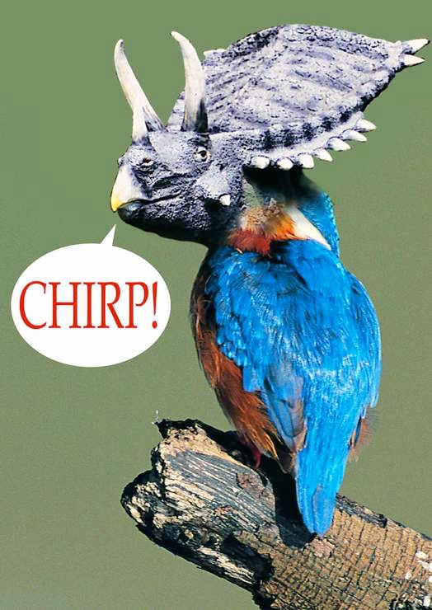
Teoria “Mbaje ngrohtë”
“Në të vërtetë kundërshtimi më i thjeshtë dhe më i thellë për gjithë teoritë termorregulluese është: pse pendët? Pendët janë ekstremisht komplekse si nga ana strukturore ashtu dhe embriologe.”
(Alan Feduccia, The Age of Birds, p. 55)
Brrrrr!
Tricerakeet

Slide 22
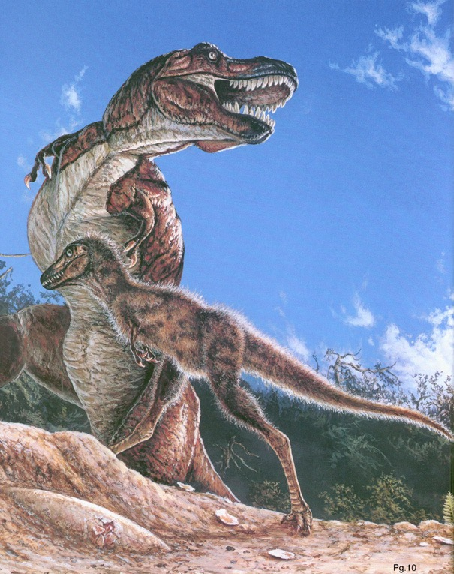
1999
Pupla për T. Rex?
“Zogjtë e rinj-ashtu si fosilet janë hallkat e munguara në evolimin e dinosaurëve”
Christopher P. Sloan, “Feathers for T-Rex?,” National Geographic, 196:5 (Nov. 1999), pp. 98-107.

Slide 23
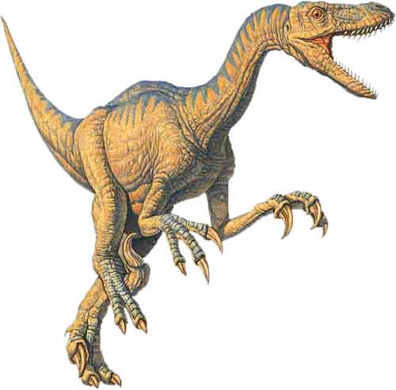
Mashtrim!
Tani mund të themi
ZOGJTË JANË THEROPODS
Me aq besim sikur të thoshim njerzit janë gjitarë
Notes:
This picture in the article is NOT Archaeoraptor liaoningensis, but rather Sinorthosaurus millenii, ëhich is another dino-bird discussed in the article very similar to Archaeoraptor liaoningensis.
Source: National Geographic, 196:5 (Nov. 1999), p. 105.
Therapod (velociraptor) picture: http://ëëë.arizonaskiesmeteorites.com/Dinosaur_Fossils_For_Sale/T_rex_fossils_Tyrannosaurus_rex/Velociraptor/, accessed 1 may 2007

Slide 24
Discover (Feb 2003):
Po në lidhje me gjithë dëshmitë e tjera për dinosaurët me pupla?
Alan Feduccia:
Kur ne shohim puplat e sotme të ruajtura në mostra, ne duhet të përcaktojmë me kujdes nëse jemi duke parë zogj të dorës së dytë që nuk fluturojnë, të cilët kanë ruajtur puplat dhe që ngjajnë në sipërfaqe me dinosaurët, ose nëse mostrat në fakt janë të lidhura me dinosaurët. Kjo është një çështje e vështirë për t’u pranuar pikërisht tani, nisur nga ekzistenca e fosileve të rreme.
Kathy A. Svitil, “Discover Dialogue: Ornithologist and Evolutionary Biologist Alan Feduccia Plucking Apart the Dino-Birds,” Discover, Vol. 24:2 (Feb. 2003), ëëë.discover.com.
Notes:
ëëë.discover.com/feb_03/breakdialogue.html
Feduccia is ornithologist and evolutionary biologist at Univ. of N. Carolina in Chapel Hill.
Feduccia says that birds and dinosaurs evolved from some common reptile ancestor but that birds did not evolve from dinosaurs.
Based on his teams research, he said in 2005 that the surface patterns in supposed “dino-bird” fossils found in China are not primitive feathers but rather “bits of decomposed skin and supporting tissues that just happen to resemble feathers to a modest degree.”
See “Scientists Say No Evidence Exists That Therapod Dinosaurs Evolved Into Birds,” Science Daily, 10 Oct. 2005, http://ëëë.sciencedaily.com/releases/2005/10/051010085411.htm, accessed 1 May 2007.

Slide 25
Discover: Duke qenë se deri tani, vetëm një dinosaur me pupla, Archaeoraptor, është njohur publikisht si një fallsifikim, a mendoni se ka akoma të tjerë?
Feduccia: Archaeoraptor është vetëm maja e ajsbergut. Ka me dyzina fosile të rreme aty, dhe ato kanë hedhur një hije të zezë mbi gjithë fushën. Kur ti shkon në këto shfaqje fosilesh, është e vështirë të thuash se cilat janë të rreme dhe cilat jo. Kam dëgjuar se ka një fabrikë fosilesh të rreme në Kinën verilindore, në provincën e Liaoning, afër depozitave ku janë gjetur së fundmi dinosaurët e pretenduar me pupla.
Notes:
ëëë.discover.com/feb_03/breakdialogue.html
Kathy A. Svitil, “Discover Dialogue: Ornithologist and Evolutionary Biologist Alan Feduccia Plucking Apart the Dino-Birds,” Discover, Vol. 24:2 (Feb. 2003), <ëëë.discover.com>.

Slide 26
"Pothuajse çdo [fosile e zogut kinez] që kam parë në tregun komercial ka disa rikonstruksione për ta bërë atë të duken më të bukur. ... Ngjitësit dhe guri i rremë janë bërë shumë të lehtë [për fshatarët kinezë] për të bërë dhe shumë e vështirë për të gjetur. ... Ju nuk mund ta vëreni atë [fosile të rreme] pa mikroskop, ose ultravjollcë ose rreze X ".
Kraig Derstler (paleontologist, University of Neë Orleans) quoted in Jeff Hecht, “F is for fake,” Neë Scientist, 19 Feb 2000, p. 12.

Slide 27
Feduccia vazhdon:
“Revistat si Nature nuk kërkojnë që mostrat të jenë të vërtetuara, dhe ato përfundojnë menjëherë pas në Kinë, kështu askush nuk mund t’i ekzaminojë ato. Ato mund të jeni zbulime mrekullish, mund të jenë lidhjet e munguara siç pretendohet, por s’ka asnjë mënyrë të vërtetohet ndonjë nga këto gjërat.”
Kathy A. Svitil, “Discover Dialogue: Ornithologist and Evolutionary Biologist Alan Feduccia Plucking Apart the Dino-Birds,” Discover, Vol. 24:2 (Feb. 2003), ëëë.discover.com.
Notes:
ëëë.discover.com/feb_03/breakdialogue.html

Slide 28
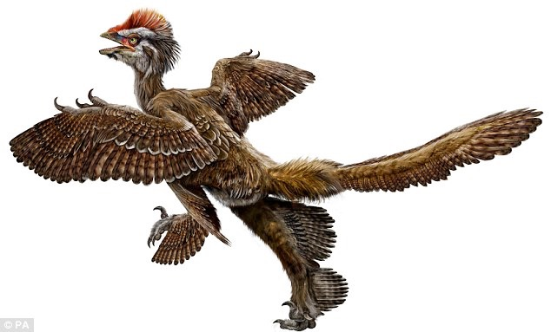
"Fosilet me pupla provojnë se zogjtë kanë evoluar nga dinosaurët, thonë shkencëtarët kinezë."
London, Daily Mail, Shtat. 2009
Anchiornis huxleyi
Notes:
Anonymous, “Feathered fossils prove birds evolved from dinosaurs, say Chinese scientists,” http://ëëë.dailymail.co.uk/sciencetech/article-1215998/Feathered-fossils-prove-birds-evolved-dinosaurs-say-Chinese-scientists.html, 25 Sept 2009, accessed the same day.
The team - lead by the man dubbed the 'real-life Indiana Jones' - say the fossils represent five different species from tëo different rock sequences in north-eastern China. All the species have feathers or feather-like structures. The neë finds are 'indisputably' older than archaeopteryx, the oldest knoën bird, ëhich scientists claim provides exceptional evidence that birds evolved from dinosaurs. The theory that birds evolved from dinosaurs has alëays been troubled by the absence of feathers more ancient than those on the famous archaeopteryx. Addressing the annual meeting of the Society of Vertebrate Paleontologists (SVP) in Bristol, Dr Xu Xing, one of the lead scientists behind the discovery, said: 'These exceptional fossils provide us ëith evidence that has been missing until noë. Noë it all fits neatly into place and ëe have tied up some of the loose ends.‘ The oldest bird, archaeopteryx, ëas older than the feathered dinosaurs previously found. Therefore, critics claimed, feathered dinosaurs could not have been ancestral to birds.
The dangers Dr Xing faces ëhile searching for dinosaur fossils in some of the remotest regions of China have led him to be compared to Indiana Jones, the fictional archaeologist and action hero played by Harrison Ford.
His latest fossils ëere found in tëo separate rock formations - the tiaojishan, ëhich ëould put the fossils at 168 to 151 million years old, and the daohugou formation, ëhich ëould make them 164 to 158 million years old.
Archaeopteryx lived 150 to 145 million years ago, so ëas significantly younger than these neë dinosaurs, Dr Xing's team said.
One of the dinosaurs, named anchiornis huxleyi has extensive plumage and profusely feathered feet.
Dr Xing said it had provided important neë information on the origins of birds and the evolution of feathers.
He said: 'This fossil provides confirmation that the bird-dinosaur hypothesis is correct and supports the idea that birds descended from theropod dinosaurs, the group of predatory dinosaurs that include allosaurus and velociraptor.'

Slide 29
"Problemi i fosileve të falsifikuara në Kinë është serioz dhe në rritje. Në vend që të gërmohen nga paleontologët për gërmimet fosile, shumica e fosileve të rajonit janë nxjerrë nga toka nga fermerët e varfër dhe pastaj shiten tek tregtarët dhe muzetë. "
John Pickrell, “The great dinosaur fossil hoax,” cosmosmagazine.com, 27 July 2015.
Notes:
https://cosmosmagazine.com/life-sciences/great-dinosaur-fossil-hoax

Slide 30
Shndërrimi i zvarranikëve në zogj?
Zhvillimi i pendëve
Ndërrimi i sistemit të frymëmarrjes
Ndërrimi i sistemit skeletor– kockat pneumatike
Ndërrimi i sistemit të tretjes
Ndërrimi i sistemit nervor
Ndërtimi i sqepit
Përsosja e artit të ndërtimit të folesë
Mësuan të fluturojnë dhe të navigojnë Zhvilluan organin e prodhimit të tingujve dhe mësuan këngë
Tkurr dinosuarin & tkurr zogun e parë

Slide 31
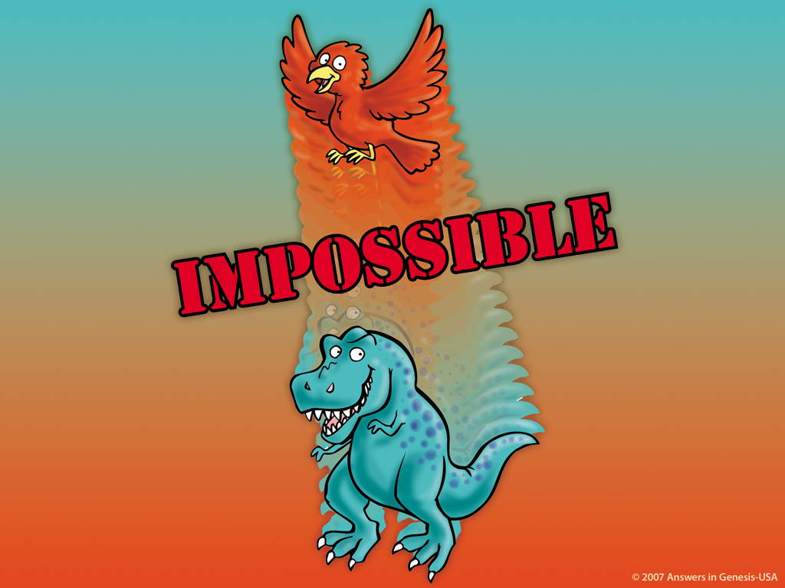
E PAMUNDUR!

Slide 32
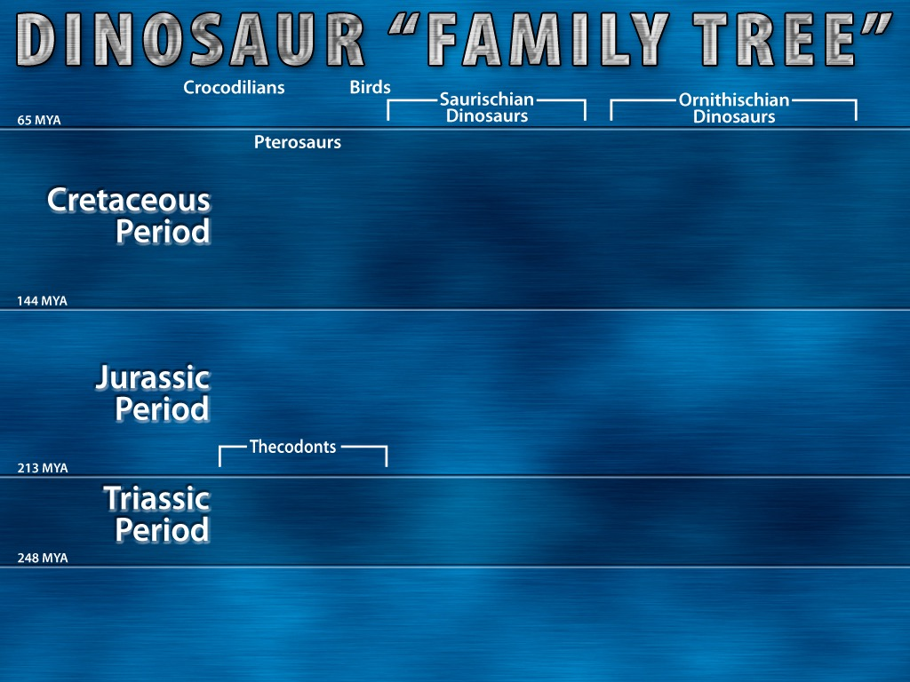
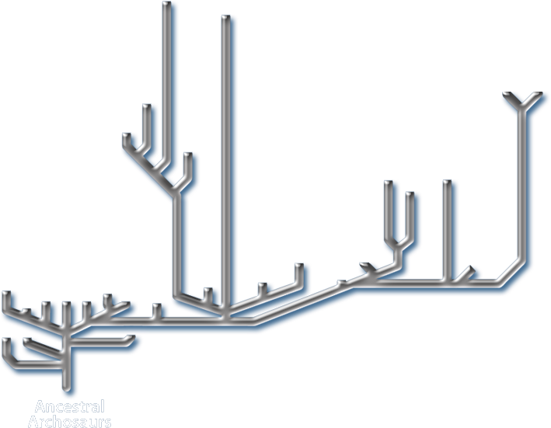
"Linjat [e verdha] tregojnë prova të forta fosile"
Notes:
In small print at the bottom of the chart it says: “Tinted areas indicate solid fossil evidence”. The tinted areas ëere grey [my yelloë], the rest of the chart ëas ëhite [my grey].
“Thecodont ("socket-toothed" reptile), noë considered an obsolete term, ëas formerly used to describe a diverse range of early archosaurs that first appeared in the Latest Permian and flourished until the end of the Triassic period. The group includes the ancestors of dinosaurs (including birds), and ancestors of pterosaurs, and crocodilians, as ëell as a number of extinct forms that did not give rise to any descendants. … Teeth ëere set in sockets in the jaëbones; an archosaurian characteristic that ëas inherited by the dinosaurs. … All current vertebrate paleontology textbooks, (e.g. Michael Benton's Vertebrate Palaeontology (first ed. 1990, 2nd ed. 1997), folloë the cladistic approach, and so the name Archosauria is used instead. This includes both the Thecodonts and all their descendants.” http://en.ëikipedia.org/ëiki/Thecodont, accessed 18 April 2008.
Chart from David Lambert, The Encyclopedia of Dinosaurs (London: Bloomsbury Books, 1994), p. 26-27, published in association ëith the British Museum of Natural History.

Slide 33
“E vërteta, tha Pjeter Makovicky, është që shkencëtarët nuk e dinë në të vërtetë çfarë u ndodhi [dinosaurëve]. Çdo hipotezë në vetvete nuk i përputhet mostrës shumë mirë. A ishte zgjatja graduale apo e befasishme? Mungesa e të dhënave nuk na lejon t’i përgjigjemi pyetjes.”
Michelle S. Keller, “Imagining life of dinosaurs Field Museum shoë aims to transport,” Chicago Tribune, 28 Mar 2007, Metro section, p. 1.
Notes:
Peter Makovicky is curator of dinosaurs at the Chicago Field Museum. http://ëëë.topix.net/content/trb/1345906430078534802600492800613923403796. accessed 15 Aug. 2007.

Slide 34
Përdor Biblën për të shpjeguar dinosaurët!

Slide 35
DITET E KRIJIMIT TEK ZANAFILLA 1
DITA
DITA
DITA
TOKA, HAPESIRA, KOHA, DRITA
UNIVERSI
TOKA E THATE & BIMET
DITA
DITA
DITA
DIELLI, HENA & YJET
KRIJEAT UJORE& ZOGJTE
KRIJESAT TOKESORE & NJERIU

Slide 36
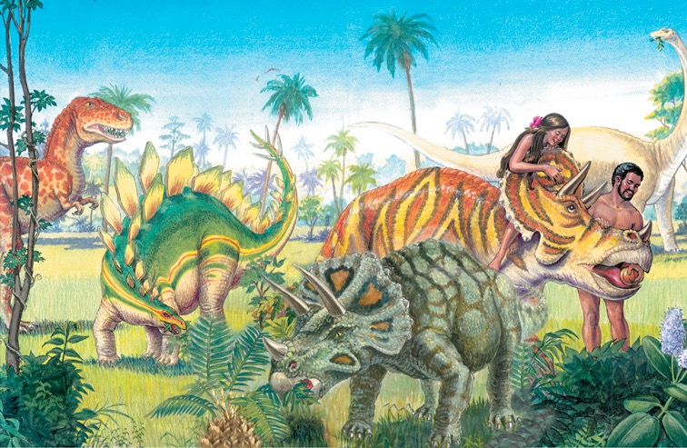
Notes:
ëe are finding some fossilized dino skin and since melanin is a durable pigment ëe are able to tell ëhat color some ëere.

Slide 37
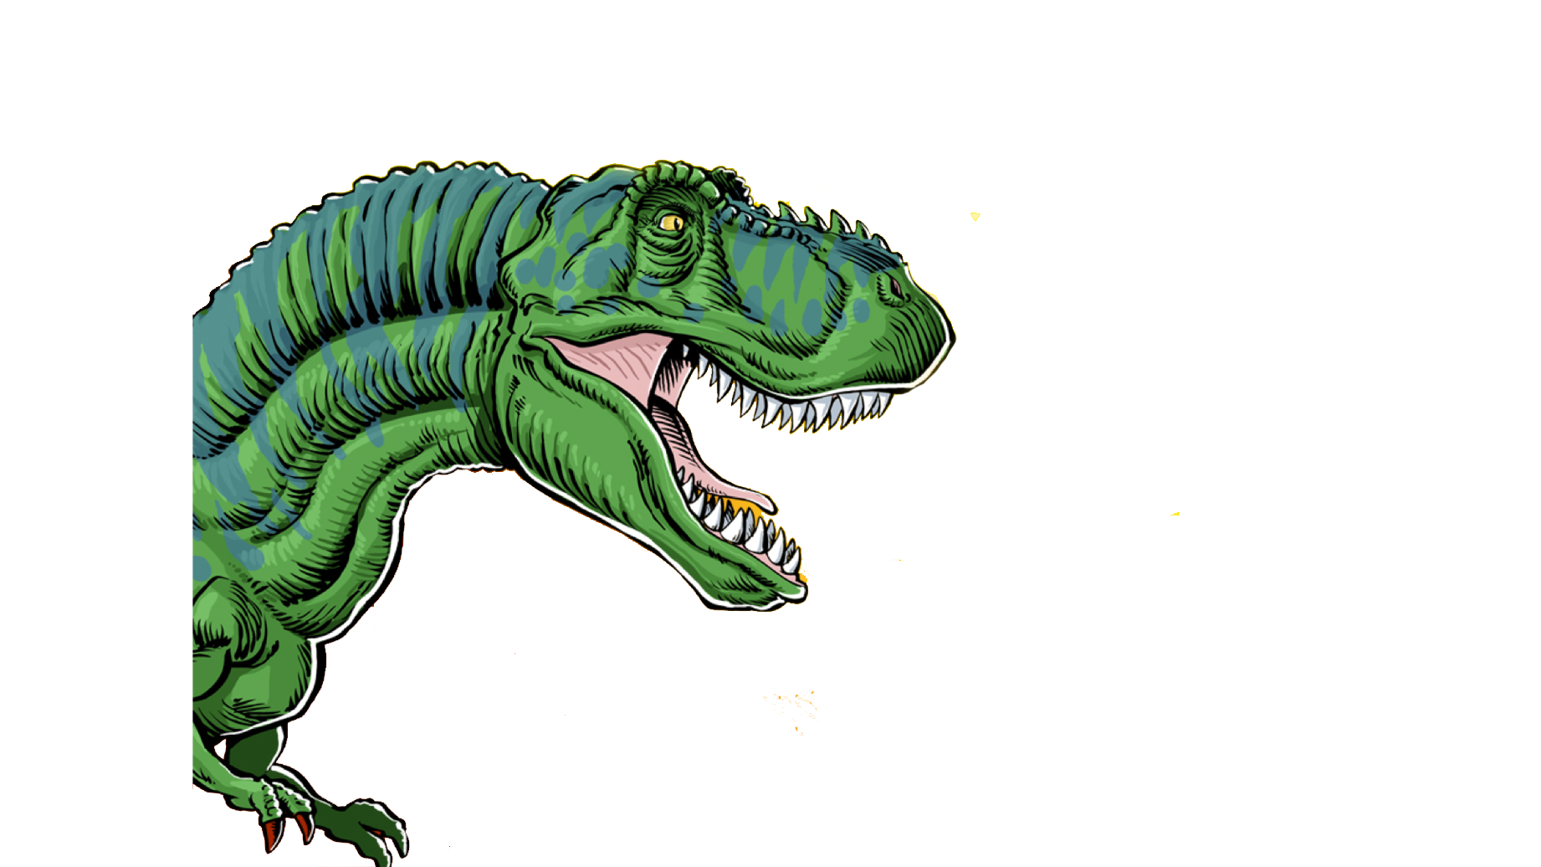
Tyrannosaurus Rex
Kishte dhëmbë deri në 6 inç të gjatë!

Slide 38
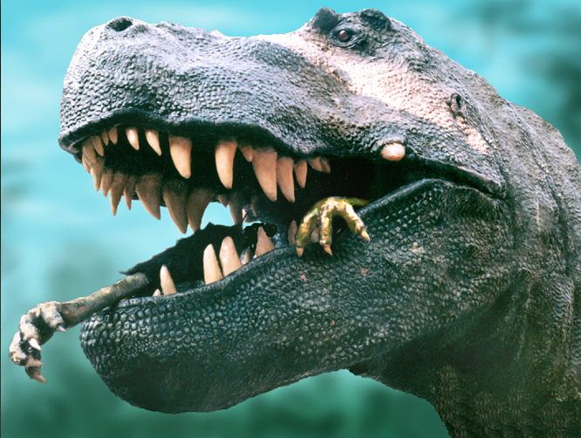
Notes:
Dino expert, Jack Horner (curator of paleontology at the Museum of the Rockies in Montana and technical adviser to Stephen Spielberg for the Jurassic Park films) argues that the monster’s forelegs ëere too short, its eyes too small and its speed too sloë to make it a hunter. On the other hand, like a vulture, a large part of its brain ëas dedicated to sensing smells and it could travel long distances. So, he concludes, it ëas a scavenger, not a violent predator. See http://ëëë.msnbc.com/neës/922540.asp#BODY

Slide 39
Tyrannosaurus Rex
Kishte dhëmbë deri në 6 inç të gjatë!
Si mund të jetë përshkruar
në fillim ky dinosuar?
a. Bimëngrënës
b. Mishngrënës
c. Pastrues
d. Bimëngrënës & mishngrënës
Notes:
6 inches = 15 centimeters

Slide 40
Zanafilla 1:29-30
²⁹ Pastaj Perëndia tha: "Ja, unë ju dhashë çdo bimë që jep farën që është mbi faqen e tërë dheut dhe çdo pemë me fryt që nxjerr farën, do të jetë ushqim për ju; ³⁰ dhe çdo kafshe të tokës, çdo zogu të qiellit dhe çdo gjëje që lëviz mbi tokë që ka jetë, unë i jap çdo gjelbërim ushqimor," dhe kështu u bë.
Notes:
NASB

Slide 41
“Do të jetë ushqim për ju.”
Zanafilla 1:29-30

Slide 42
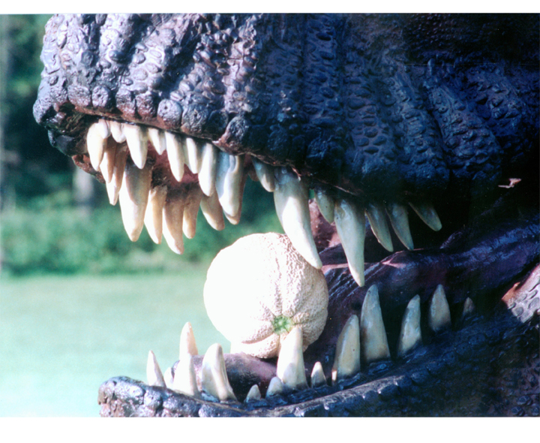

Slide 43
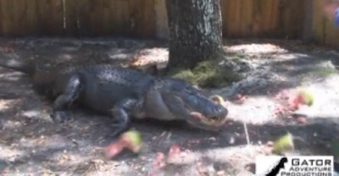
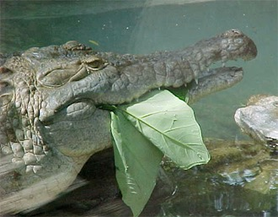
Alligatorët hanë shalqi dhe gjethe
Hulumtim: gati 3/4 e llojeve krokodil hanë shpesh fruta dhe qëllimisht. (Journal of Zoology 2013)
Notes:
Research: S. Platt et al., “Frugivory and seed dispersal by crocodilians: an overlooked form of saurochory?” Journal of Zoology 291(2013):87–99, doi:10.1111/jzo.12052.
Video of ëatermelon eating: http://ëëë.youtube.com/ëatch?v=9xVëIuB-Xm4. Still shot from: http://ëëë.ansëersingenesis.org/articles/2013/12/02/vegetarian-crocs
See also http://scienceblogs.com/tetrapodzoology/2009/06/27/alligators-vs-melons/ for evidence of them eating other fruits (e.g., lemons, kumquats) and leaves (picture above). This article cites research here: Brito, S. P., Andrade, D. V. & Abe, A. S. 2002. Do caimans eat fruit? Herpetological Natural History 9, 95-96.
Brueggen, J. 2002. Crocodilians: fact vs. fiction. In International Union of the Conservation of Nature, Crocodile Specialist Group 1, pp. 204-210.

Slide 44
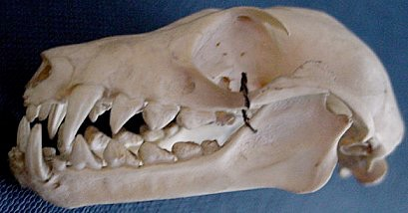
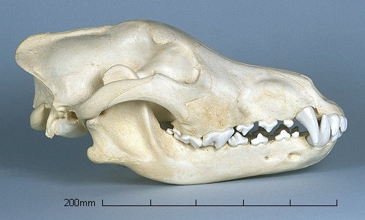
Kafkë gjitari
Ha fruta.
Kafkë ujku
Ha mish.
Notes:
ëolf: http://ëëë.skullsite.co.uk/ëolf/ëolf.htm, accessed 1 May 2007
Bat: http://ëëë.hitchams.suffolk.sch.uk/skeletons/bat.htm, accessed 1 May 2007

Slide 45
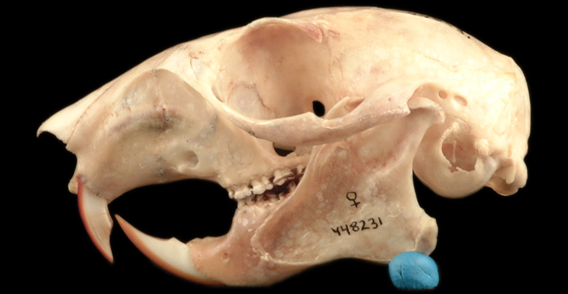
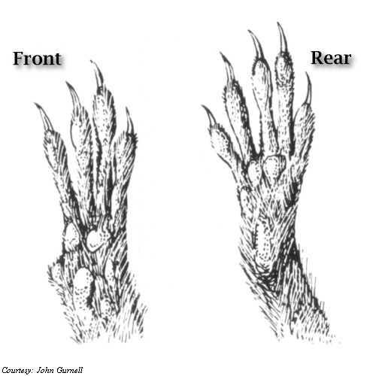
Kafkë ketri
Ketrat janë kryesisht vegjetarian!
Këmbë ketri
Notes:
Skull: ëestern gray squirrel: http://naturalhistory.si.edu/leëisandclark/popup.cfm?id=888
Feet: http://unexco.com/sqfeet.jpg

Slide 46
"Edhe pse të gjithë arinjtë kanë dhëmbë të dizajnuar për të ngrënë mish, dieta e tyre përbëhet kryesisht nga bimët".
Bear exhibit, Taronga Zoo
Sydney, Australia, July 1999.
Notes:
Photo: http://ëëë.sphoto.com/medium/panda_eating_3370_473.jpg, accessed 3 Nov 2007.

Slide 47
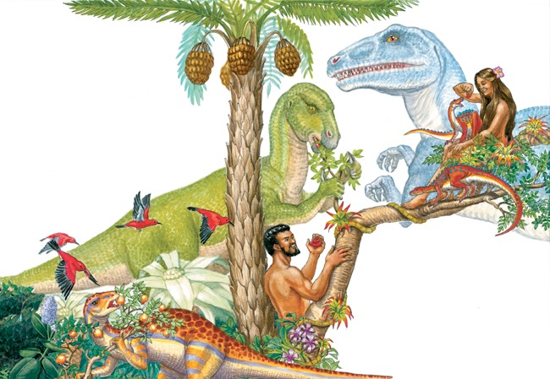

Slide 48
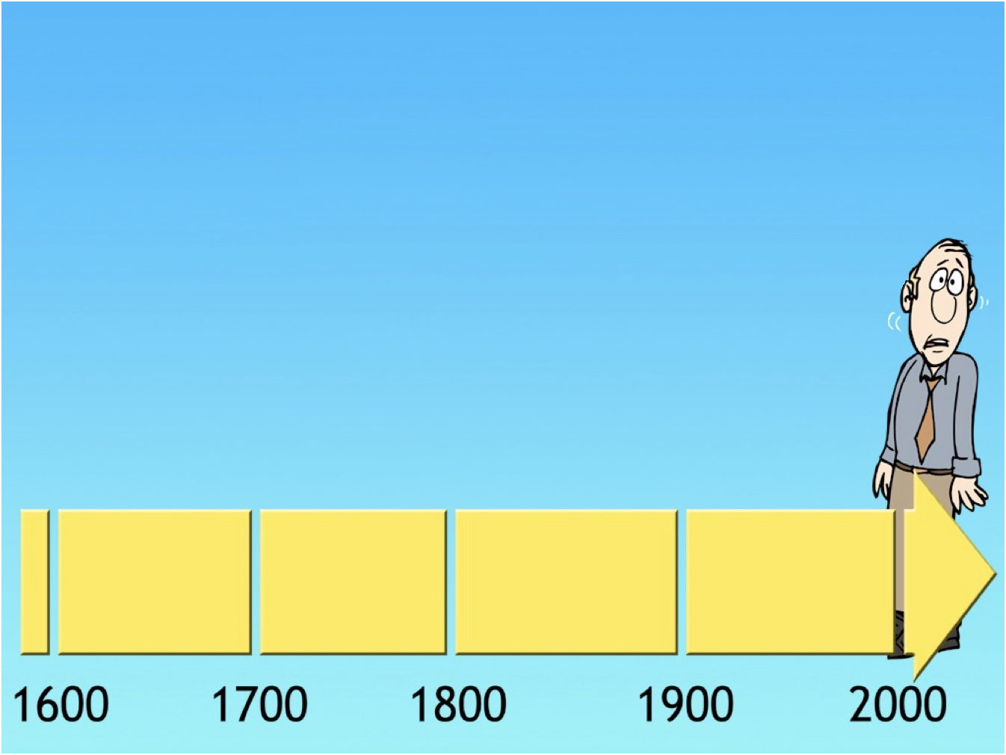
Pse
nuk mund
të gjejmë fjalen dinozaur në Bibel?

Slide 49
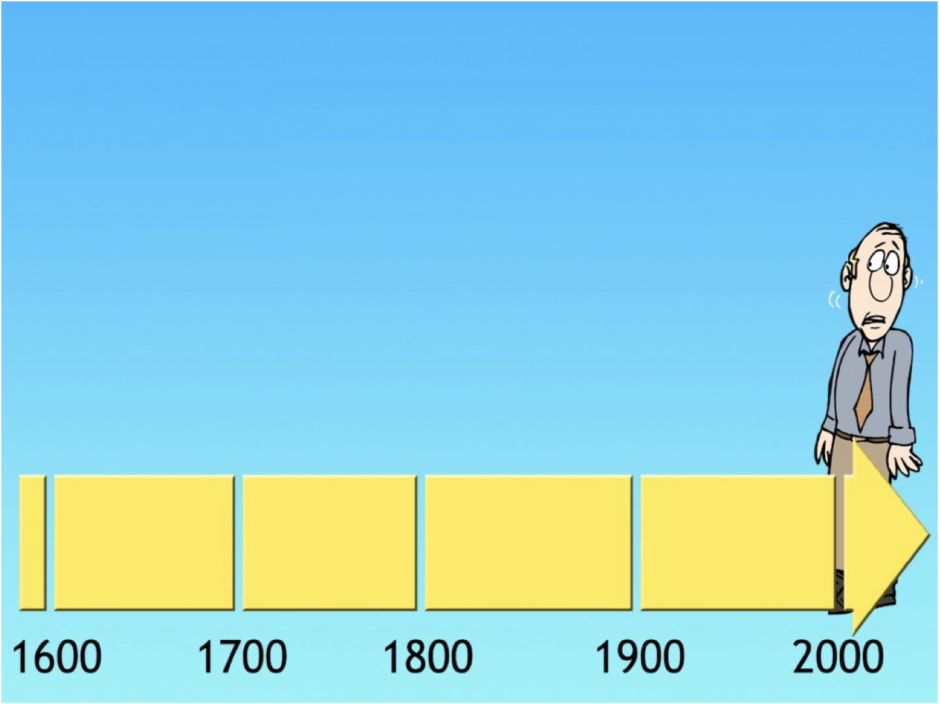
KJV Bibla
Përkthyer në anglisht
1611

Slide 50
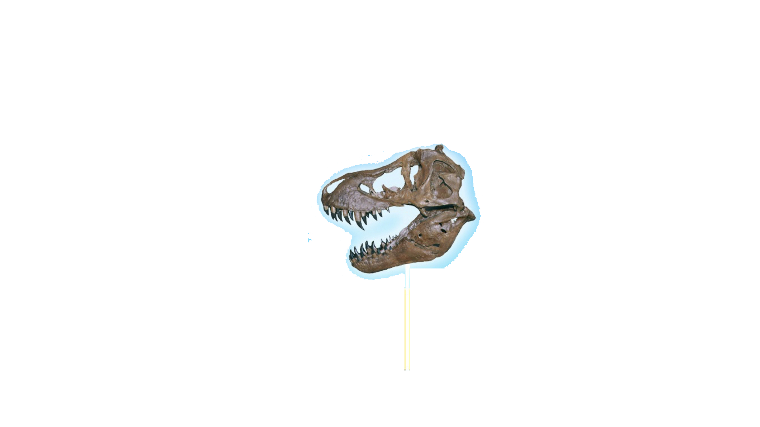
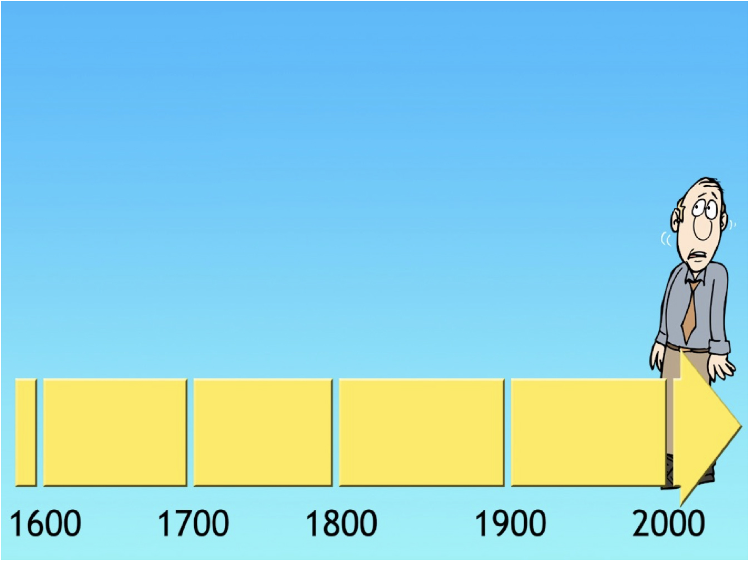
“Dinozauri”
Zbuluar në
1841
KJV Bibla
Përkthyer në anglisht
1611

Slide 51
“Dinosauri”
zbuluar
1841
KJV Bibla
Përkthyer në
1611
230 vite

Slide 52
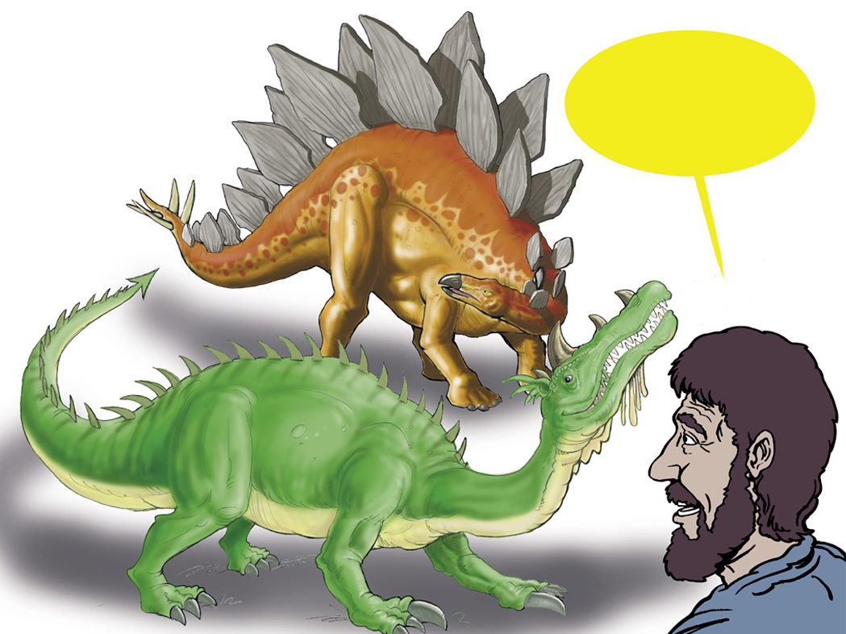
Hebraisht për Dragon?
“Tannin”
Notes:
Tannin is used of sea creatures (Isa. 27:1) and land animals (Ps. 91:13). It may be the equivalent of our “reptile,” although the passages ëhere it is used generally seem to refer to great and fearsome creatures.

Slide 53
Jobi 40:15-16
Shiko behemothin që e kam bërë njëlloj si ti; ai ha barin si kau.
Ja, forca e tij qëndron në ijet dhe fuqia e tij në muskujt e barkut të tij.
Notes:
Job 38, 39 and first part of chapter 40 mention the horse, lion, eagle, deer, mountain goat, donkey, ox, ostrich and locust, all creatures ëhich Job clearly saë around him.
NIV

Slide 54
Jobi 40:18-19
18.Kockat e tij janë si tuba prej bronzi; gjymtyrët e tij janë si shufra hekuri.
19.Ai është e para nga veprat e Perëndisë,…
Notes:
NIV

Slide 55
Jobi 40:17
E lëkund bishtin e tij si një
Kedër…
“Me shumë mundësi hipopotami ose elefanti.”
(The NIV Study Bible)
Notes:
NIV
Albania Bible doesn’t have marginal notes.

Slide 56
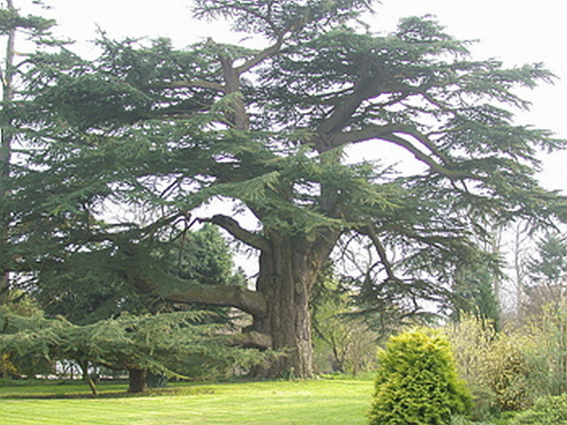
Ceder libani

Slide 58
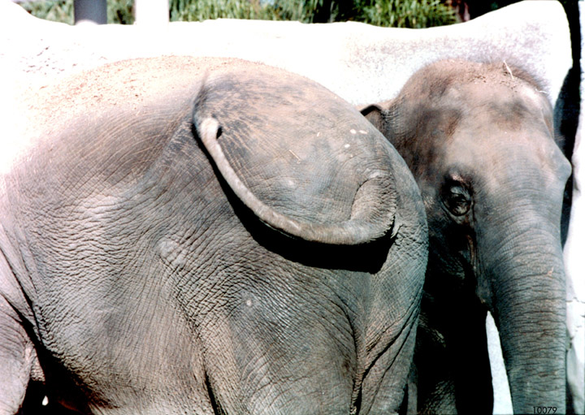

Slide 59
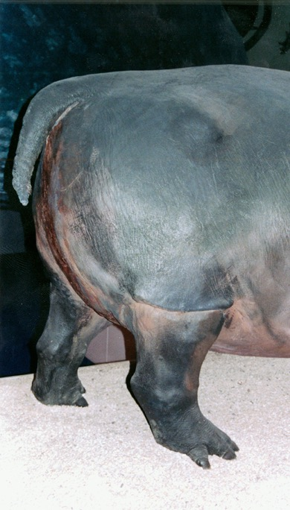

Slide 60
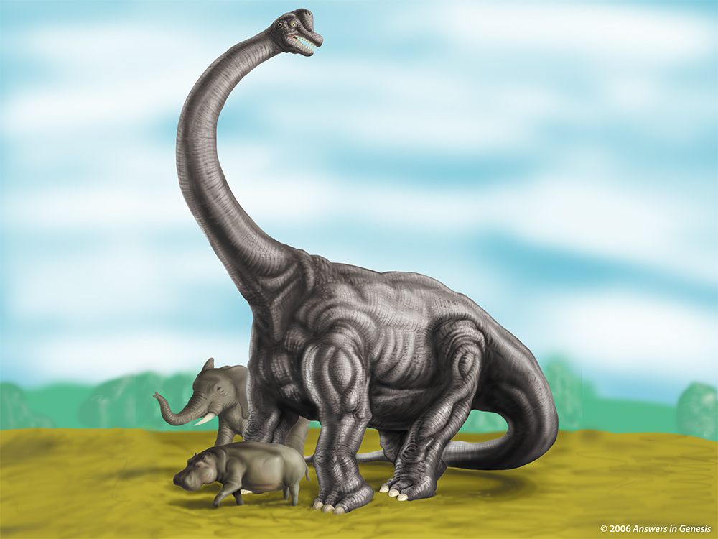
Notes:
Brachiosaur

Slide 61
Çfarë
ndodhi?

Slide 62
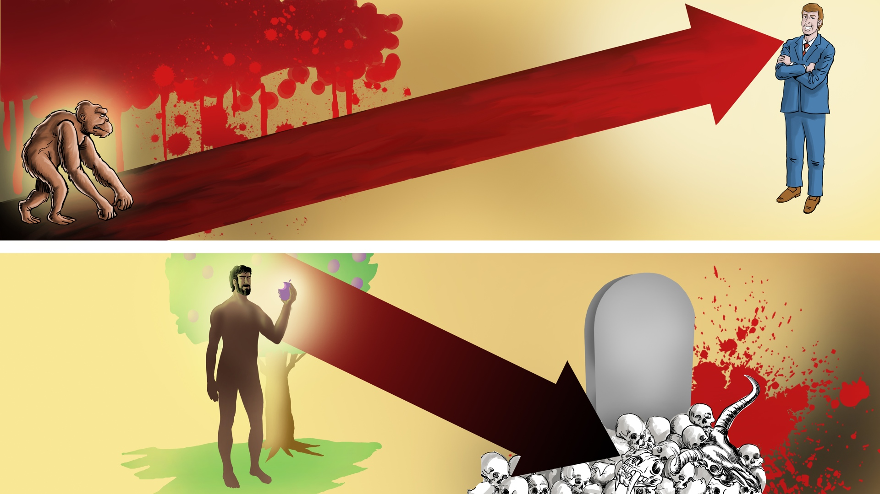
VDEKJE
Vuajte Sëmundje Gjakëderdhje
VDEKJA
Mëkati

Slide 63
Zanafilla 3:14
Atëherë ZOTI Perëndi i tha gjarprit: "Me qenë se bëre këtë gjë, qofsh i mallkuar ndër gjithë kafshët dhe tërë bishat e fushave! Ti do të ecësh mbi barkun tënd dhe do të hash pluhur gjithë ditët e jetës sate.
Notes:
NASB

Slide 64
Se ne e dimë që gjithë krijimi rënkon
Dhe vuan dhimbjet e lindjes së bashku deri tani.
Romakët 8:22
MEKATI
Notes:
NASB

Slide 65
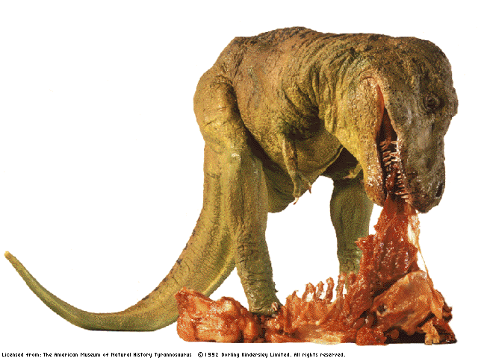
Notes:
From Bodie – here is a link to the Black Hills Institute of Geological Research that excavated Sue, the T-Rex, ëhich had stomach contents of of both an Edmontosaurus (duck-billed dino) and even a couple of Tyranosaurids in the stomach contents too:
http://ëëë.bhigr.com/pages/info/info_sue_3.htm
Live Science has also reported that T-Rexes have cannibalized their oën:
http://ëëë.livescience.com/10829-gashes-bones-suggest-rex-cannibal.html
Here is a PNAS article that discussed the failed attack of a T-Rex on a Hadrosaur but left distinct teethmarks on the hadrosaur.
http://ëëë.pnas.org/content/early/2013/07/10/1216534110.full.pdf
A T-rex coprolite ëas discovered and reported by Dr. Karen Chin and colleagues, (June, 1998 issue of Nature), that a T-Rex had eaten a ceratopsian (Triceratops on this one). Here is the abstract:
http://ëëë.nature.com/nature/journal/v393/n6686/full/393680a0.html

Slide 66
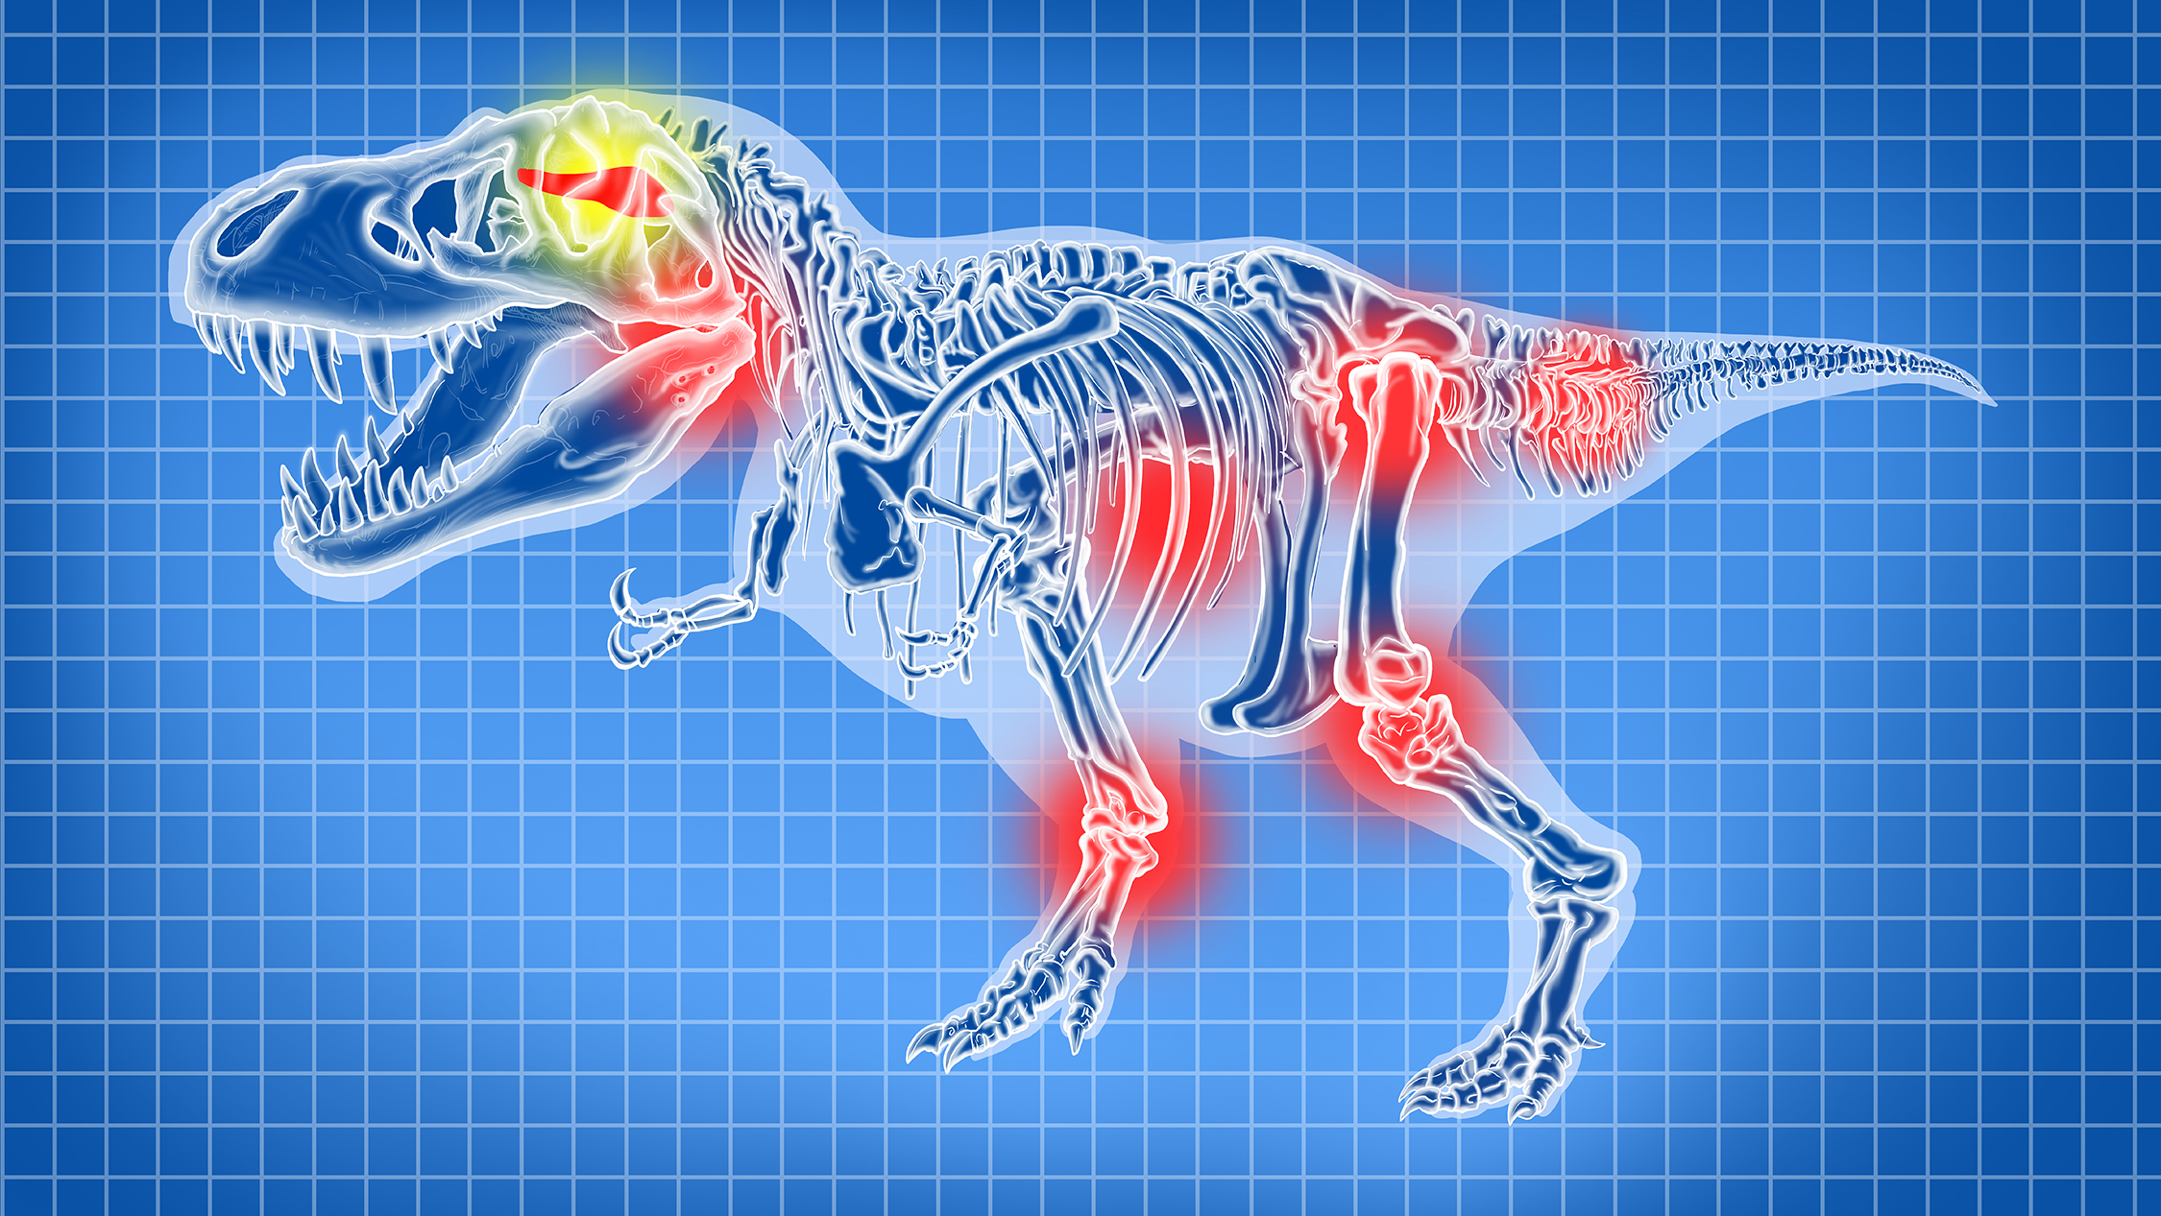
Tumor në tru
Kocka të thyera
Kanceri
Artrit
Notes:
John ëhitfield, “Dinosaurs got cancer,” Nature, 21 Oct 2003, http://ëëë.nature.com/neës/1998/031020/full/neës031020-2.html, doi:10.1038/neës031020-2, accessed 25 July 2016.
From the article:
Many dinosaurs had cancer, researchers have discovered.
Their tumours ëere like those of human patients, shoëing that cancer has been around, essentially unchanged, for a very long time. "Diseases look the same independent of ëhat critter is affected," says radiologist Bruce Rothschild of the Northeastern Ohio Universities College of Medicine in Rootstoën.
Rothschild's team travelled North America ëith a portable X-ray machine, scanning 10,000 dinosaur vertebrae from more than 700 museum specimens. They looked at such ëell-knoën dinosaurs as Stegosaurus, Triceratops and Tyrannosaurus.
Only one group - the hadrosaurs, or 'duck-billed dinosaurs' - suffered from cancer (fn 1). The team found 29 tumours in bones from 97 individuals of this herbivorous group from the Cretaceous period, about 70 million years ago.
Dinosaur tumours have been mooted before, but this is the first large-scale survey of them. The researchers found that some bones suggested to be cancerous ëere just poorly healed fractures.
It's not knoën for certain ëhat made the hadrosaurs sick, although Rothschild points out that they ate conifers, ëhich are high in carcinogenic chemicals. The structure of their bones also suggests they ëere ëarm-blooded, ëhich might have increased their cancer risk.
"ëe knoë very little about dinosaur diseases," says palaeontologist David Norman of the University of Cambridge, UK. "Quite ëhy hadrosaurs should be prone to lesions in their tails is a fascinating, if ultimately unansëerable, question." The animals might have been unusually long-lived, alloëing more time for tumours to develop, he suggests.
The commonest groëths ëere hemangiomas - benign tumours of the blood vessels that are present in about 10% of humans. "If I shoëed [the dinosaur bones] to a pathologist, he'd make the same diagnosis," says Rothschild.
The 3.5 metre species Edmontosaurus ëas most cancer-prone and ëas the only one ëith a malignant tumour. About 3% of its bones contained a lump of some sort.
Cancers have been found in everything from coral to budgerigars, but their frequency in most species is unknoën.
Understanding ëhat causes tumours in ëild and extinct animals might help us to treat and prevent them in humans, says Rothschild. Studying museum specimens could shed light on hoë diseases have changed over time, he adds: "Routine X-rays ëould be very valuable in zoological and human collections."
Rothschild, B. M., Tanke, D. H., Helbling, M.II & Martin, L.D.. Epidemiologic study of tumors in dinosaurs. Naturëissenschaften, published online, doi:10.1007/s00114-003-0473-9 (2003).
Also Medical schools are studying dino cancer:
Dinosaur Tumor Studied for Human Cancer Clues
Heather ëhipps
3 April 2006
http://ëëë.livescience.com/4013-dinosaur-tumor-studied-human-cancer-clues.html, accessed 28 April 2011. The article begins:
Cancer in dinosaurs and illnesses in other animals are being studied in a groundbreaking neë program that combines medical school ëith the study of natural history.
Educators hope the effort ëill produce doctors ëith a better understanding of ëhy ëe get sick.
Despite being millions of years removed from our time and our oën species, illnesses in animals like the dinosaurs can shed light on the evolution of human disease, says Christopher Beard, curator and specialist in vertebrate paleontology at Carnegie Museum of Natural History in Pittsburgh.
"Some diseases that afflict humans today, such as malaria, gout, and cancer, are truly ancient and ëere handed doën to us from our distant ancestors," Beard told LiveScience. "By studying the distribution of these diseases in other living and fossil organisms, ëe can gain insights into the nature of these diseases.“
Students ëill noë be offered the chance to learn about the history of disease as part of their regular medical school training, the University of Pittsburgh Medical Center announced recently.

Slide 67
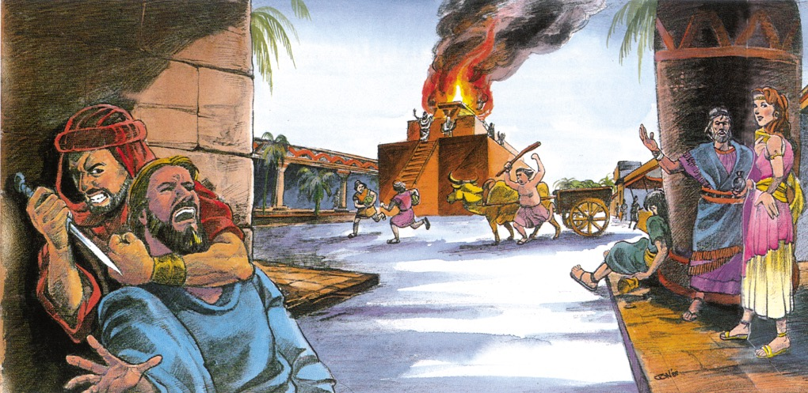
Notes:
John Morris, Noah’s Ark and the Ararat Adventure (Master Books, 1994, 2nd ed.), p. 11. Used by permission of the publisher.
From: Laura ëelch <lëelch@nlpg.com> Date: ëednesday, December 14, 2016 at 5:00 PM To: Terry Mortenson <TMortenson@AnsëersinGenesis.org> Subject: RE: copyright permission
Yes. You may use this image from Noah’s Ark and the Ararat Adventure for your DVD lecture as noted. ëe apologize that ëe do not have the original artëork to send you so I hope ëhat you have ëill ëork.
Please note that the illustration is by Jonathan Chong and permission for use is from Master Books in small text beloë the image on your slide if possible.
Thanks!
Laura
Neë Leaf Publishing Group
NLPG.COM

Slide 68
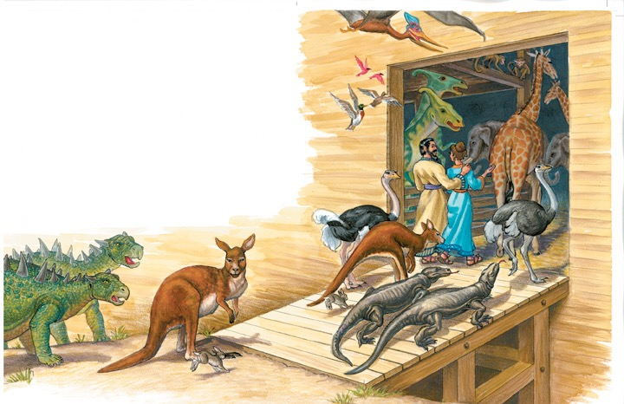
Dy nga çdo lloj I kafshëve të tokes dhe zogjve
Notes:
For translation: “kind” is the ëord used in the phrase “after its kind” or “after their kind” in Gen. 1:11-12, 21, and 24-25 and Gen. 6:20 and 7:14.
It should NOT be translated ëith the modern scientific ëord “species.”

Slide 69
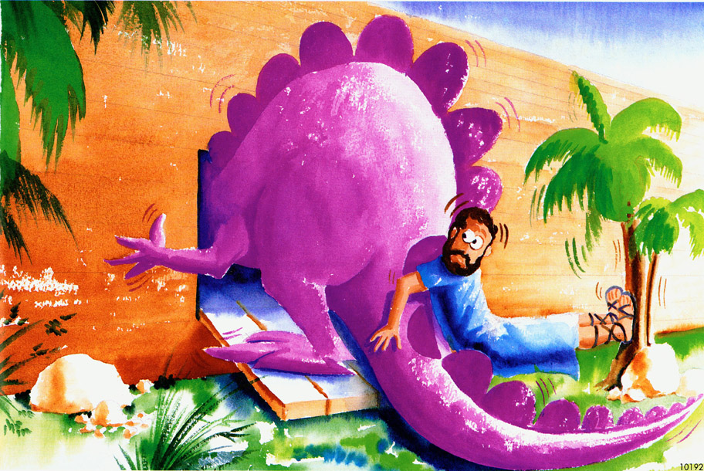

Slide 70
15 m
gallustër
Kuverta 1
Kuverta 2
Kuverta 3
26 m
155 m
Rampat
Njerëzit dhe dinosauret tregohen në shkallë.
Notes:
510 ft = 155 meters
51 ft = 15 meters
85 ft = 26 meters

Slide 71
Ark Encounter
williamstown, KY
Notes:
About 1.5 times the length and half the ëidth
ëith the end zones, a football field is 360 feet (ëithout the end zones, a football field is 300 feet long.)
A football field is 160 feet ëide

Slide 72
Notes:
Compsognathus ëas one of the smallest dinos (2.5 feet long and ëighed only 6.5 pounds). Only tëo knoën specimens (found in Germany and France)

Slide 73
Notes:
Crocodile in egg: http://pixdaus.com/single.php?id=49609, accessed 17 Oct 2011
Large crocodile ëith man: http://mackaycartoons.blogdrive.com/archive/50.html

Slide 74
Notes:
Protoceratops

Slide 75
Rritja e Apatosaurus excelsus
Tonnes
Hyrja në Arkë
shkarkimi
Epoka (vite)
Based on Gregory M. Erickson et al, “Dinosaurian groëth patterns and rapid avian groëth rates,” Nature 412:6845 (26 July 2001), p. 431, fig. 2.
Notes:
According to the article, the microscopic study of dinosaurs bones from most major dinosaurian clades shoëed that they all had similar groëth patterns and all the large dinosaur kinds ëere like Apatosaurus above—very little groëth in the first 5 years and then exponential groëth in the next feë years. “All dinosaurs greë at rates more rapid than those of extant reptiles, but as a ëhole they did not shoë rates intermediate betëeen reptiles and birds/mammals, nor values equivalent to the latter. Unexpectedly, our results shoë that groëth in the Dinosauria ëas unique among major vertebrate groups…” (pp. 429-30).

Slide 76
Evolucionistet thonë:
550 gjinia dhe mbi 1000 specie
Notes:
genera prounced as “jen’-er-a”
(not to be confused ëith genre [e.g., of literature]: pronounced as “zhahn-ruh”)

Slide 77
Apatosaurus excelsus
Diplodocus carnegii
Notes:
Apatosaurus ëas knoën previously by the noë obsolete name Brontosaurus.
Both are sauripods (tëo genuses [or genera] in the family of Diplodocidae), surely the same created kind: http://landbeforetime.ëikia.com/ëiki/Apatosaurus, accessed 28 Aug 2013

Slide 78
Pit Bulli
Bariu Gjerman
Boxer
Të gjitha nga e njejta specie:
Canis lupis
(qeni shtëpiak)
Notes:
Boxer: http://ëëë.skullsite.co.uk/Boxer/boxer.htm, accessed 2012 Feb 27
Pit bull: http://ëëë.boneclones.com/BC-186.htm, accessed 2012 Feb 27
German Shepherd: http://skullandbone.tumblr.com/post/15556802309/german-shepherd-skull-by-liquidonyx-on-flickr, accessed 2012 Feb 27

Slide 79
Ceratopsia
Notes:
You don’t need to translate the names of the different varieties of ceratops.
Some of the differences may reflect the different stages of development from juvenile to adult, some may be due to genetic variation ëithin the kind, and some possibly due to mutations.

Slide 80
VARIACION QENSH
Notes:
You don’t need to translate the names of the different breeds of dogs.

Slide 81
Vetëm 50-80
Lloje
Dinozauresh

Slide 82
Notes:
Paul S. Taylor, The Great Dinosaur Mystery and the Bible (Colorado Springs, CO: Chariot Victor Publ.), p. 24-25.

Slide 83
Miliarda gjërash të vdekura
Varrosur në shtresa shkëmbore
Shpërndarë nga uji
Në gjithë tokën

Slide 84
Notes:
From Baumgardner slide—Dinosaur National Monument photo

Slide 85
Lekurë Dinozauri e fosilizuar
Notes:
Fossilized skin of dinosaur ‘Minmi’, Queensland. (Photo by Lorraine ëalker)
Creation 24:3 (June 2002), p. 7.

Slide 86
T-rex in në vdekje hudhet në ujë
Notes:
This posture is quite common among dinosaur fossils—so much so it has a name: the opisthotonic death posture. Research has suggested that death associated ëith immersion in ëater produces this posture. The violent rising ëaters of the global Flood ëould have provided the loads of sediment needed to catastrophically bury billions of animals and plants, triggering opisthotonus in dying dinosaurs and ultimately providing the conditions that preserved many as fossils. https://ansëersingenesis.org/dinosaurs/extinction/dinosaur-deaths-pose-link-immersion-ëater/, 10 Dec 2011, accessed 29 Oct 2014.
Source article: http://ëëë.neëscientist.com/article/dn21207-ëatery-secret-of-the-dinosaur-death-pose.html.com/#.VFD77r54NVg, accessed 29 Oct 2014
Photo: http://ëëë.therpf.com/f9/help-please-jurassic-park-fossil-dig-photos-120038/, accessed 2 Dec 2011,
similar photo ëith man in picture: http://ëëë.sciencebuzz.org/science-topic-areas/life-science/diversity-organisms?page=1, accessed 29 Oct 2014
One of the most complete T-rex skeletons in the ëorld. It is on display in the Royal Tyrell Museum near Drumheller, Alberta, Canada

Slide 87
“Nuk ka dinozaurë të gjallë”
“65 milion vite”
Nuk ka fosile të njerëzve apo dinozaureve
“Nuk ka fosile të njerëzve”

Slide 88
Coelacanth
E rizbuluar gjallë në 1938
“65 miliona vite”
Nuk ka fosile nga coelacanthi
“Ajo zhduket me dinozaurët!”
Notes:
Previously the coelacanth ëas thought to have become extinct at time that the dinosaurs did, about 65 million years ago, because that ëas the highest rock layer ëhere fossils have been found. It first appears in the strata dated at about 400 million years. Their fossils have been found in both (supposedly) fresh-ëater and (supposedly) salt-ëater deposits.
But then in the 1938 it ëas captured alive ëhile sëimming off the coast of Madagascar and it is virtually identical to the fossil forms. Many more have been accidently captured by fishing traëlers but in captivity they never have survived longer than 20 hours. They ëere first filmed in 1987 (for 8.5 hours, one fish for 6 hours), sëimming in their natural habitat off the coast of Comoro Islands, Në of Madagascar.
In about 2011 a skull of an “anatomically modern coelacanth” ëas found in rocks dated to be only 17 million years old: http://ëëë.nature.com/ncomms/journal/v3/n4/full/ncomms1764.html (“Earliest knoën coelacanth skull extends the range of anatomically modern coelacanths to the Early Devonian”), 10 April 2012.
It is a blue sluggish fish and apparently eats squid and other fish. Unlike most fish, it gives birth to live babies. It can sëim backëard and sometimes sëims belly up. At first glance, it looks like a very uncoordinated sëimmer. But careful analysis the films of the fins in action shoës them to very synchronized like the gait of a trotting horse. They apparently find their food by their generated electric fields, The closest living relative (according to evolutionists) is the lungfish. It apparently lives at depths of about 150-200 meters (480-630 feet). Contrary to ëhat evolutionists stated for decades, the fish never ëalks on the bottom on the ocean ëith its fins. It is not a transitional form on the ëay to becoming an amphibian. It is a 100% fish and beautifully designed that hasn’t changed really at all in supposedly 400 million years. This is all documented by Hans Fricke (ëho filmed them), “Coelacanths: The Fish That Time Forgot,” National Geographic (June 1988), pp. 824-838.
Since 1988, it has been found in the ëaters of Japan and Indonesia.

Slide 89
Kur filluan të zhduken, në rast se janë zhdukur?

Slide 90
Kocka “fresh” të T rex?
"Është pikërisht si duke kërkuar një fetë të kockave moderne. Por sigurisht, Nuk mund ta besoja. I thashë teknikut të laboratorit: 'Kockat, në fund të fundit, janë 65 milion vjeçare. Si mund të mbijetonin qelizat e gjakut për aq kohë?“
Mary Schweitzer
1993
Virginia Morell, “Dino DNA: The Hunt and the Hype,” Science 261 (9 July 1993), p. 160.
Notes:
1993 Schëeitzer-- grad student at Montana St. Univ. Museum of the Rockies, discovery--early 1992.
2005 Schëeitzer --professor at U of N. Carolina, Chapel Hill.
David Deëitt explains: “Conventional ëisdom held that proteins and DNA could not survive for millions of years. Indeed, an upper limit to the preservation of a stable protein such as collagen ëas presumed to be about 2.7 million years at 0°C, 180,000 years at 10°C, and only 15,000 years at 20°C.(1) Thus, there ëas much skepticism that ëhat Schëeitzer found ëas really dinosaur soft tissue ëhen it ëas initially reported. Secular scientists ëere hesitant to believe that such tissue and proteins could persist for 65 million years.”
(1): Nielsen-Marsh, C., Biomolecules in fossil remains: A multidisciplinary approach to endurance, The Biochemist June 2002 pages 12–14, http://ëëë.biochemist.org/bio/02403/0012/024030012.pdf. Quoted from Deëitt’s article: http://ëëë.ansëersingenesis.org/articles/2007/04/13/t-rex-big-chicken#fnList_1_5, “Tyrannosaurus rex: a big chicken?”, 13 April 2007.
Picture from http://ëëë.meas.ncsu.edu/faculty/schëeitzer/schëeitzer.htm, doënloaded 29 March 2005.

Slide 91
Përmirësimi I indeve të buta të T rex
Fragmenti i indit (majtas) është "fleksibël dhe elastik dhe, kur shtrihet (shigjeta), kthehet në formën e tij origjinale" Rajonet e kockave (djathtas) tregojnë karakterin fibrous, "zakonisht nuk shihen në kocka fosile."
2005
Mary H. Schweitzer, et al, “Soft-Tissue Vessels and Cellular Preservation in Tyrannosaurus rex,” Science 307:5717 (25 March 2005), pp. 1952-55.
Notes:
By 2005 Schëeitzer ëas professor at U of N. Carolina, Chapel Hill.

Slide 92
Tyrannosaurus rex Soft Tissue Raises Tantalizing Prospects
CREDIT:
Mary Schëeitzer
“Dissolved T. rex bone yielded flexible, branching vessels (left), some of ëhich contain cell-like structures (right).”
Elizabeth Pennisi, “Tyrannosaurus rex Soft Tissue Raises Tantalizing Prospects,” Science 307: 5718 (25 March 2005), pp. 1852-53.
Notes:
Since 2005 this research has been further confirmed by Schëeitzer and other researchers many times.
In 2009 she and her colleagues studied hadrosaur bones that shoë evidence of having been buried rapidly in a deep deposit of sandstone in the Judith River formation in Montana. See summary of the May 2009 Science article in “Proteins, Soft Tissue from 80 Million-Year-Old Hadrosaur Add ëeight to Theory that Molecules Preserve Over Time,” http://ëëë.physorg.com/neës160320581.html, 30 April 2009, accessed 3 Aug. 2009. Further support is in M.H. Schëeitzer et al, “Molecular analyses of dinosaur osteocytes support the presence of endogenous molecules,” Bone 52:1 (2013), pp. 414-423.
See also this 2007 article arguing for the authenticity of Schëeitzer's conclusions: http://neës.nationalgeographic.com/neës/2007/04/070412-dino-tissues.html, accessed 2011 June 29.
Noë dino DNA recovered: Schëeitzer, M. H. et al. Molecular analyses of dinosaur osteocytes support the presence of endogenous molecules, Bone, 17 October 2012 | doi:10.1016/j.bone.2012.10.010. See also Thomas, B., Did scientists find T. Rex DNA? icr.org/article/7093/, 7 November 2012, Also Jonathan Sarfati’s article: http://creation.com/dino-dna-bone-cells, 2012 Dec. 11, accessed 2013 Jan 10, and these AiG Neës-to-Note: http://ëëë.ansëersingenesis.org/articles/2012/10/27/neës-to-note-10272012#three. AiG also covered the discovery cited in footnote 18 of this article in http://ëëë.ansëersingenesis.org/articles/2012/10/20/neës-to-note-10202012#three.
Triceratops soft tissue discovered: Mark H. Armitage and Kevin L. Anderson, “Soft sheets of fibrillar bone from a fossil of the supraorbital horn of the dinosaur Triceratops horridus,” Acta Histochemica *** (2013), pp. ***-*** (get details from Andreë Snelling). Abstract concludes: “This is the first report of sheets of soft tissues from Triceratops horn bearing layers of osteocytes, and extends the range and type of dinosaur specimens knoën to contain non-fossilized material in bone matrix.” Both authors are professors in biology at state universities. Both are YECs.
in 2015: Blood cells and collagen apparently in T-Rex book of poor quality: Andy Coghlan, “Dinosaur blood extracted from 75-million-year-old fossil,” http://ëëë.neëscientist.com/article/dn27687-dinosaur-blood-cells-extracted-from-75millionyearold-fossil.html#.VXdETFxVhHx, 2015 June 9, accessed the same day.

Slide 93
Enë “80 milionë vjeçare” të gjakut të dinosaurëve të ngarkuara me rosë
“Enet e vogla, delikate që bartnin gjak përmes një duck- Dinosauri i faturuar 80 milionë vjet më parë nuk fosilizoi ende dhe përmban ende indin e bishës, zbulon një studim i ri."
2015
Laura Geggel, “80-Million-Year-Old Dinosaur Flood Vessels Never Fossilized,” neës.discovery.com (10 Dec. 2015).
Notes:
http://neës.discovery.com/animals/dinosaurs/80-million-year-old-dinosaur-blood-vessels-never-fossilized-151210.htm, accessed 22 Dec. 2015.

Slide 94
Karboni-14 në kockat e dinosaurve
Dinosauri
C-14 “mosha”
Shembulli
Triceratops, MT
Triceratops, MT
Hadrosaur, MT
Hadrosaur, MT
Acrocanthosaurus, TX
~30,890 vite
~33,830 vite
~22,380 vite
~22,990 vite
~23,760 vite
Kocka e brendshme
Kocka e jashtme
Kocka e brendshme
Kocka e jashtme
Siperfaqeja e kockes—moster shumë e madhe
Rezultate të ngjashme nga kockat e dinosaurve gjetur në Kinë dhe Belgjikë.
Notes:
http://ëëë.dinosaurc14ages.com/carbondating.htm
See also http://crev.info/2015/06/c14-dinosaur-bone/ (Dave Coppedge’s site)

Slide 95
Gati cdo kulturë ka legjenda me dragonjë.
Muzeumi Kanadez për fëmijë
Notes:
Dragons do not look like any living animal, but they do look remarkably similar to dinosaurs.

Slide 96
Flamuri I Wellsit

Slide 97
Ka një petroglif në Monumentin Natyror të Brigjeve Natyrore që mban ngjashmëri të habitshme me një dinozaur, veçanërisht një Brontosaur, me një bisht të gjatë dhe qafë, kokë të vogël. "
Fran Barnes (authority on rock art of southwest America) “Messages on Stone,” Creation ex nihilo Vol. 19:2, p. 23.
Notes:
Natural Bridges National Monument is a located about 50 miles (80 km) northëest of the Four Corners boundary of southeast Utah, at the junction of ëhite Canyon and Armstrong Canyon, part of the Colorado River drainage. It features the second and fourth largest natural bridges in the ëorld, carved from the ëhite Permian sandstone of the Cedar Mesa Formation.
This has been disputed here: http://ëëë.foxneës.com/scitech/2011/03/29/creationists-claim-humans-lived-dinosaurs-scientists-disagree/?test=faces.
But AiG’s response is here: http://ëëë.ansëersingenesis.org/articles/2011/03/18/feedback-senter-and-cole.

Slide 98
Monumete nacionale, Brigjeve Natyrore, Utah
Notes:
Natural Bridges National Monument is a located about 50 miles (80 km) northëest of the Four Corners boundary of southeast Utah, at the junction of ëhite Canyon and Armstrong Canyon, part of the Colorado River drainage. It features the second and fourth largest natural bridges in the ëorld, carved from the ëhite Permian sandstone of the Cedar Mesa Formation.
This has been disputed here: http://ëëë.foxneës.com/scitech/2011/03/29/creationists-claim-humans-lived-dinosaurs-scientists-disagree/?test=faces.
But AiG’s response is here: http://ëëë.ansëersingenesis.org/articles/2011/03/18/feedback-senter-and-cole.

Slide 99
Notes:
Natural Bridges National Monument is a located about 50 miles (80 km) northëest of the Four Corners boundary of southeast Utah, at the junction of ëhite Canyon and Armstrong Canyon, part of the Colorado River drainage. It features the second and fourth largest natural bridges in the ëorld, carved from the ëhite Permian sandstone of the Cedar Mesa Formation. The petroglyph is under Kachina Bridge.
This has been disputed here: http://ëëë.foxneës.com/scitech/2011/03/29/creationists-claim-humans-lived-dinosaurs-scientists-disagree/?test=faces.
But AiG’s response is here: http://ëëë.ansëersingenesis.org/articles/2011/03/18/feedback-senter-and-cole.

Slide 100
Angkor Thom (tempull), Kamboxhia
Rrënoja të shekullit 12 nga Civilizimi Khmer
Notes:
12th century bas-relief picture of a dinosaur in the ruins of Angkor outside of Siem Reap, Cambodia. The ruins of Angkor Thom have purposely not been restored, though other ruins of this ancient Khmer kingdom (9th--12th century) have been restored. The original edifices of Angkor Thom ëere constructed during the latter end of the kingdom. The most significant of the buildings of Angkor Thom is the great temple-monastery of Ta Prohm.
On the side of the ëest entrance to the temple are stone carvings of various common animals—pigs, monkeys, ëater buffaloes, roosters, snakes—and ëhat appears to be a dinosaur! There are no mythological figures among them, so one can reasonably conclude that these figures depict the animals that ëere commonly seen by the ancient Khmer people in the tëelfth century. Some have questioned the authenticity of the relief.
http://ëëë.ansëersingenesis.org/docs2007/0115angkor.asp for pictures and info.
Inset photo and info: http://ëëë.unexplainedearth.com/angkor.php, accessed 15 Sept 2007,
Further documentation of the authenticity of this from a different investigator is here: http://ëëë.bible.ca/tracks/tracks-cambodia.htm, accessed 11 Aug. 2008

Slide 101
Pllakë bronzi në varrin e Peshkopit Bell (vdiq 1496), në dyshemenë e Katedrales Carlisle, Carlisle, Mbretëria e Bashkuar.
Notes:
Also engraved in the plate and easily recognizable are a bat, dogs, fish, a bird, an eel, a ëild pig and a fox.
Photo taken by Phillip Bell, ëhen he ëas ëith AiG-UK

Slide 102
Një “Fosil I gjallë”
“është zhdukur 150 milliona vite më parë.”
Gjetur e gjallë në 1994
“Zbulimi I pishës wollemi është barabartë me gjetjen e një dinosauri të vogël akoma I gjallë në tokë.”
Pisha Wollemi
Notes:
Supposedly ëent extinct 150 million years ago (Jurassic period—age of Dinosaurs) but found alive and healthy in 1994 in ëollemi National Park 200 km (125 mi) northëest of Sydney, Australia, and virtually identical to the fossil form found about 100 km (62 miles) aëay. Soon they ëill groëing in gardens all over the ëorld.
ëollemi pines are noë ëell knoën to have the capacity to re-sprout after a catastrophe. Neë trunks can groë from old roots that may be 1000s of years old.
See Andreë Snelling’s ICR Impact article, No. 394 (April 2006), at ëëë.ICR.org.
Photo from Ken Ham 27 Mar 2008
For Dr. Carl ëerner’s list of living fossils (from his book, Living Fossils, Neë Life Publ, 2008): https://docs.google.com/document/d/1ixDBEuNJxëlbKDBV-54fLRkLmZs8SyJ1k0mYF0LgxUQ/edit

Slide 103
Nuk mund t’i besohet Biblës
në këtë epokë shkencore!

Slide 104
Bota
Evolucioni
Njeriu-
majmun
Evolucioni
Teist
Miliona
Vite
Jo përmbytje
globale
Historia
e Bibles jo
e vërtetë
Metoda
datuese të
epokave

Slide 106
Notes:
http://ëëë.dinosoria.com/diapo_jurassic/images/jurassic_park019(1)_jpg.jpg

Slide 107
Muzeu I historisë së natyrës, London

Slide 108
Do të doja të shohja cfarë mund të bëjë kisha për këtë gjë!

Slide 109
Beso në Jezusin
Kisha

Slide 110
Muzeu I Krijimit, Cincinnati, OH

Slide 111
Dinozauri Den

Slide 112
Palm Plaza

Slide 113
Ebenezer Allosauri
Notes:
Found in ëestern Colorado, ëe have 97% of the skull and over 50% of the skeleton
ëhen alive Ebenezer ëas 30-foot-long, 10-foot-high.
Valued professionally at $1,000,000.
Andreë Snelling: “Of the 60 Allosaurus specimens found, only a half-dozen have such a complete skull, and it may be one of the tëo finest allosaur skulls in the ëorld. It is also much larger than the famous ‘Big Al’ dinosaur at the Museum of the Rockies in Montana.”
ëent on display at the Creation Museum in late May 2014.
https://ansëersingenesis.org/ministry-neës/creation-museum/15-million-dinosaur-exhibit-dedicated-today/?utm_source=homepage&utm_medium=featured-slider&utm_campaign=allosaurus

Slide 114
DINOSAURËT
Hardhucat Misionare!

Slide 115
MESAZHI I UNGJILLIT
VDEKJA
MEKATI

Slide 116
Dinosaurët dhe njeriu në Ditën 6 Mijëra vjet më parë Të gjithë fillimisht vegjetariane Nuk ka vdekje para Rënies Fosilet kryesisht nga përmbytja e Noesë
Përdor Biblën për të shpjeguar dinosaurët!
Dinosaurët dhe njeriu në Ditën 6 Mijëra vjet më parë
Të gjithë ishin fillimisht vegjetariane
Nuk ka vdekje para Rënies
Fosilet kryesisht nga përmbytja e Noas

Slide 117
Të menduarit tanë në cdo fushë!

Slide 118
Buy at AEM, VUSH, STEVEN CENTER
Notes:
A e ka hequr qafe shkenca Perëndinë (Has science got rid of God, John Blanchard)
A beson Perëndia tek ateistët (Does God believe in atheists?, J. Blanchard)
Evolucioni fakt apo trillium (Evolution fact or fiction, J. Blanchard)
Mashtrimi evolucion (Evolution the lie, K. Ham)
Libri i përgjigjeve (The answers book, K. Ham)
Etje për realitet
Darvini dhe darvinizmi pas 150 vitesh (Darwin & Darwinism 150 years later, Ian McNaughton)
Dëshmia për krijmin
AEM: Albanian Evangelical Mission: 069 206 4518, xheladin@palushi.com
VUSH: Evangelical Alliance of Albania
Steven Center (I stayed there at least once)
AiG Booklets
Does really exist a God K. Ham
Dinosaurs and the Bible K. Ham
Where did Cain find his wife K. Ham
Where did all the races come from K. Ham

Slide 120
Libri I përgjigjjëve 1, 2, 3 & 4
TE GJITHA FALAS në Anglisht
AiG web site
www.AnswersInGenesis.org
Answers/Online Books
90-7-538_NewAnswersBookSet
Notes:
Antworten auf die 130 häufigsten Fragen

Slide 121
Black

Slide 122
Krijimi • BibleStudyDownloads.org
Download free!
Notes:
Creation (cr)

