Slide 1
Revelation
Ang Walang Katulad na Kristo
Kristolohiya: Ang Persona at Gawa ni Hesus
Ang Ministeryo ng Pagsulat ni Hesus
Dr. Rick Griffith • Crossroads International Church Singapore • cicfamily.com • BibleStudyDownloads.org
Notes:
Slide 173

Slide 2
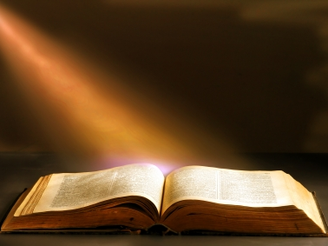
Pahayag 1

Slide 3
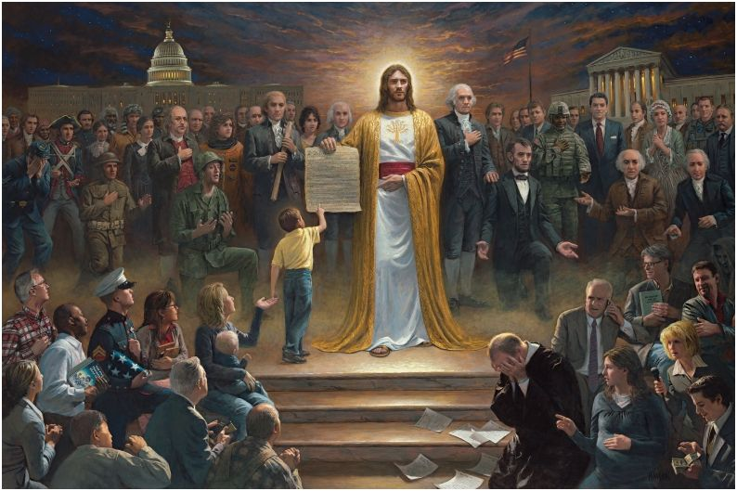
Isang Bansa sa Ilalim ng Diyos
Ni Jon McNaughton (2012)
http://jonmcnaughton.com/content/ZoomDetailPages/OneNationUnderGod.html
Notes:
http://jonmcnaughton.com/content/ZoomDetailPages/OneNationUnderGod.html
Interview with the Artist: http://jonmcnaughton.com/content/ZoomDetailPages/OneNationInterview.html

Slide 4
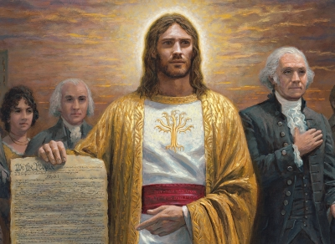
Hesukristo, ang Pinaka-pinag-uusapang Tao
http://jonmcnaughton.com/content/ZoomDetailPages/OneNationUnderGod.html
Notes:
http://jonmcnaughton.com/content/ZoomDetailPages/OneNationUnderGod.html
Interview with the Artist: http://jonmcnaughton.com/content/ZoomDetailPages/OneNationInterview.html

Slide 5
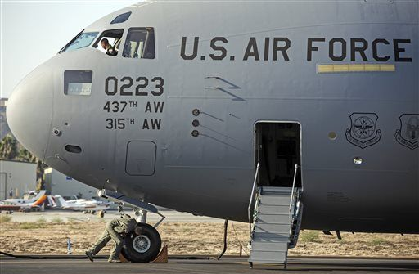
Ang “Diyos" Ngayon ay Opsyonal sa Panunumpa ng US Air Force
Ang Buong Panunumpa: “Hindi kami magsisinungaling, magnanakaw o mandaraya ni pahihintulutan ang gumagawa nito. Bukod dito, pinagtitibay kong tuparin ang aking tungkulin at mamuhay ng marangal, kaya tulungan ako ng Diyos."
Notes:
(Newser 25 Oct 2013) – An oath of honor uttered by Air Force cadets might be a little less godly from here on out. The service says cadets now have the option to skip the last phrase, "So help me God," reports the Air Force Times. The move comes in response to a group pushing for separation of church and state in the military, but it might not be enough to ward off a lawsuit. The Military Religious Freedom Foundation wanted the phrase cut entirely—the Air Force chose to keep it, but make it optional.
The full oath: "We will not lie, steal or cheat nor tolerate among us anyone who does. Furthermore, I resolve to do my duty and live honorably, so help me God." The founder of the MRFF calls it unconstitutional, though he wouldn't object if cadets continued to say the phrase even if it were stripped from the official oath. "They can swear so help me God, so help me Allah, so help me Spider-Man. But when you have it there, that is a noxious violation of separation of church and state."

Slide 6
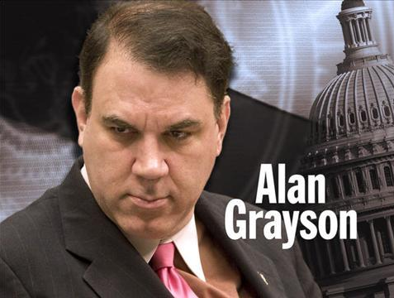
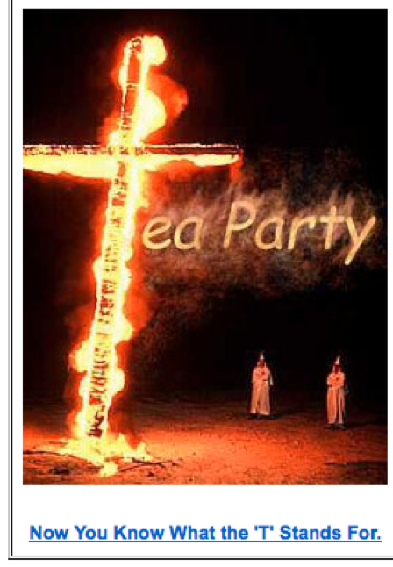
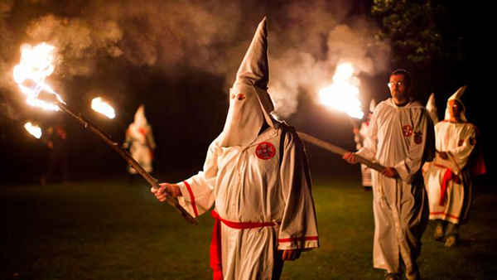
Paglubog sa mga bagong pagkababa …

Slide 7
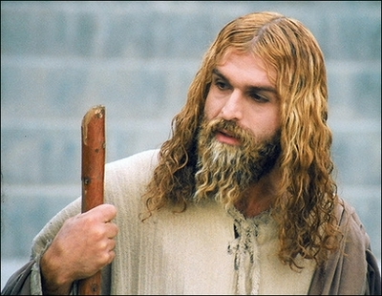
Isang Muslim na artista bilang Hesukristo sa Iran (29 April 2008)
Sino ako?
Notes:
http://latimesblogs.latimes.com/babylonbeyond/2008/04/iran-an-iranian.html
IRAN: A Muslim actor as Jesus Christ
Comments (19)
(13)
(0)
April 29, 2008 | 3:00 am
He is an Iranian Muslim who looks so much like a Hollywood or Renaissance image of Jesus Christ that the faithful sometimes make the sign of the cross when they see him.
Ahmad Soleimani-Nia has been playing Jesus for seven years, keeping his hair long and lightly dyed, his beard knotty and vibrant.
He is the star of "Jesus, the Spirit of God," a new film from Iran that depicts the man Christians believe to be the messiah and son of God as a tormented Judean prophet heralding the coming of Muhammad, the founder of the Muslim faith. Nia's Jesus is at once serene, devout, driven and passionate.
In real life, if there is a real life after a spiritual and artistic odyssey that is still not over, Nia lives in Tehran. He was once a soldier in the Iranian army and then a welder for — the irony is interesting in this Jesus story — his nation's Atomic Energy Agency, which the Bush administration accuses of pursuing nuclear weapons.
That may unsettle some American neo-cons, but perhaps not as much as the film itself, which suggests that Jesus wasn't crucified and never rose from the dead.
Check out the rest of the story in today's Los Angeles Times.
— Jeffrey Fleishman in Tehran
Photo: Ahmad Soleimani-Nia as Jesus. Credit: minbar.tatar.ru/rus/Messiah.htm

Slide 8
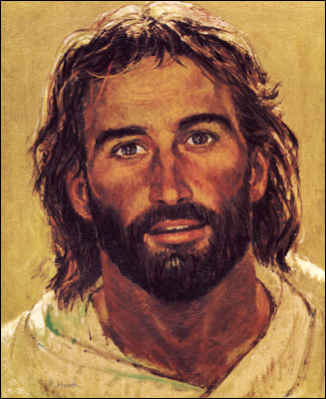
Si Hesus ay nauukol noong 1980s

Slide 9
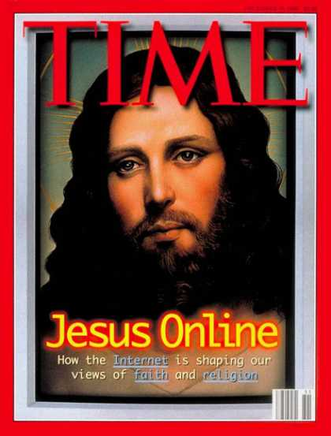
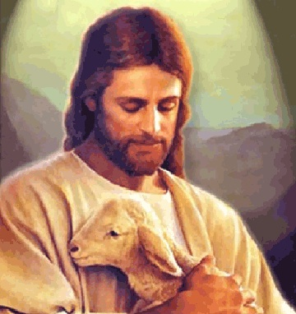
Ngunit si Hesus ay naging mahina

Slide 10
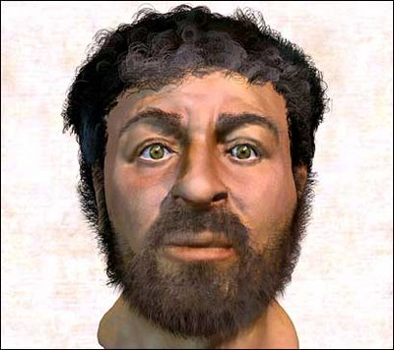
Si Hesus ay naging taong-kweba
Pagkatapos ay sinubukan ng iskultor
Notes:
This depiction of Christ was determined by collecting samples of first-century Jewish facial bone structures to provide a composite "average" man for that time.

Slide 11
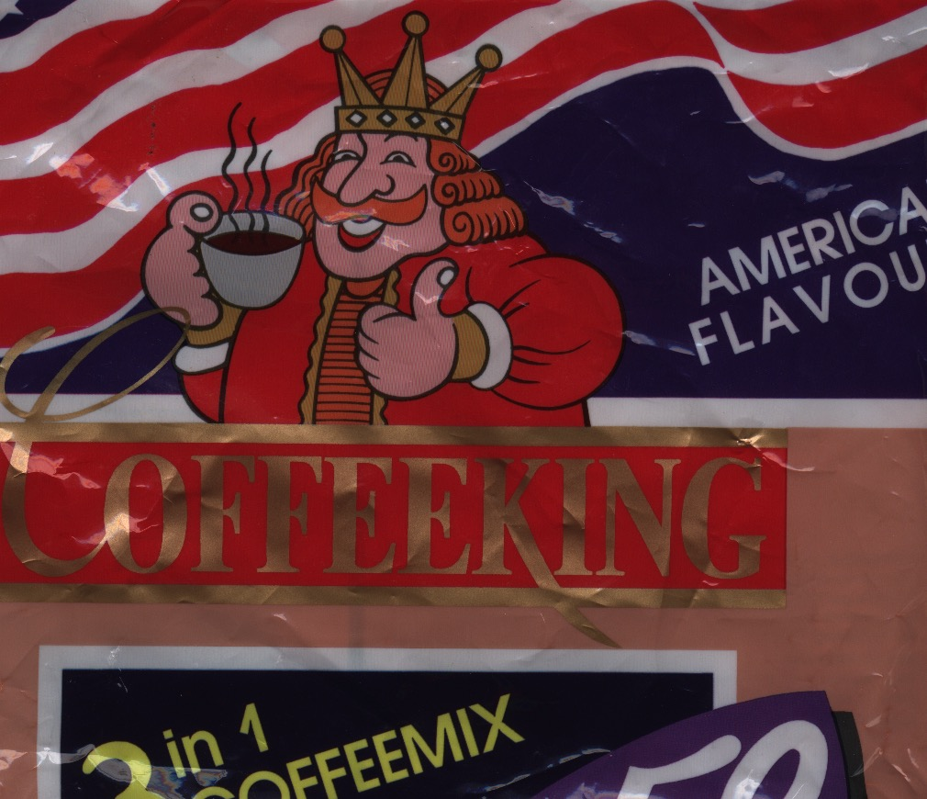
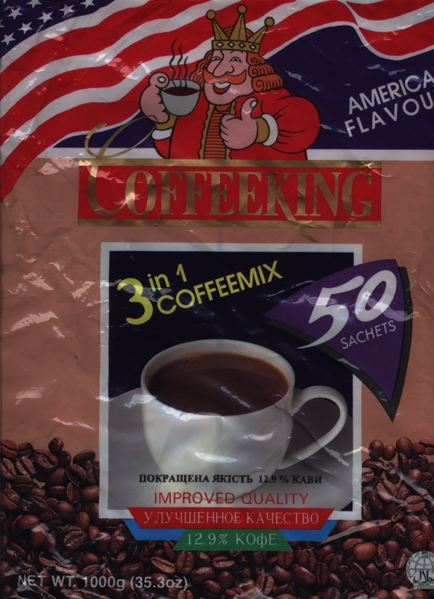
Sino ang Tunay na Hari?
Ang Tagumpay ni Kristo
Notes:
My favourite instant coffee is the "American Flavour" Coffee King brand. Interestingly, each packet shows a king drinking coffee. Since America was established in rebellion to the King of England and the USA has never had a king, one wonders who this king is on the package! Nevertheless, it does raise the issue of who really rules the world. The book of Revelation is quite clear on this question as it removes all doubt in showing that Christ is the Ultimate Victor and Sovereign over all creation.

Slide 12
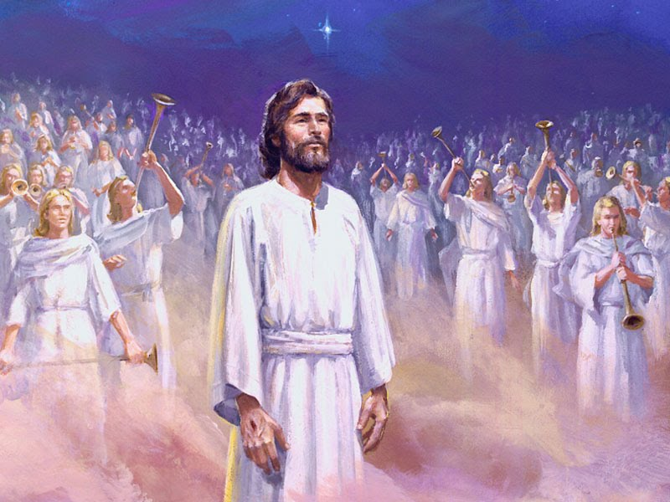
Bakit kailangan nating malaman na pinamumunuan ni Hesus ang mundo?
318
Ang Tagumpay ni Kristo

Slide 13
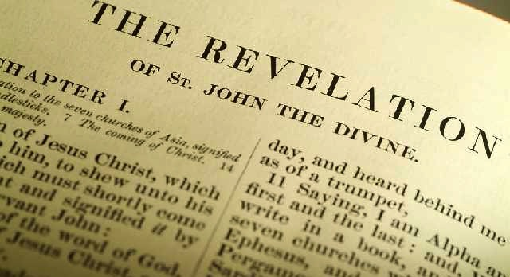
Ano ang Titulo?
319
Ang Aklat ng mga Pahayag?
Ang Aklat ng Pahayag

Slide 14
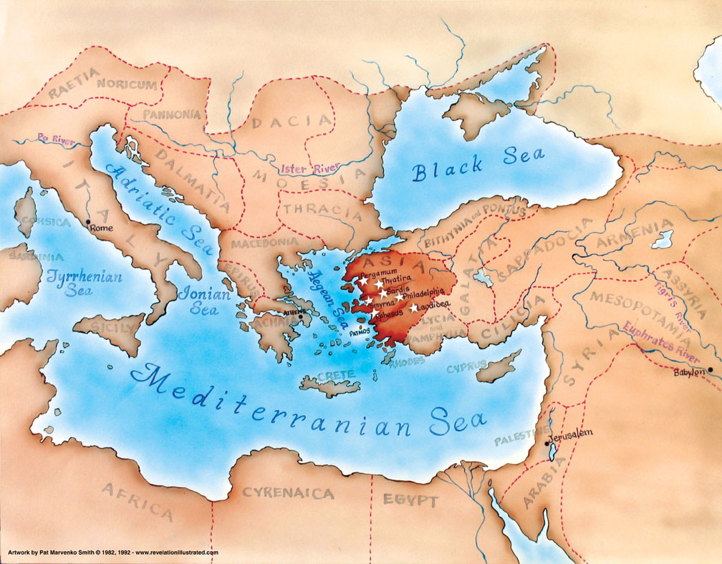
Asya sa Emperyong Romano
321

Slide 15
Ano ang nakita ni Juan sa paligid niya?
Title Page 321
Mga Iglesiya sa Asya
Roma
2. Panlabas na Pag-uusig mula sa Roma (1:9; 2:9-10; 3:10)
1. Mga Panloob na Tungalian sa mga iglesiya (2:4, 14-15, 21-24; 3:1, 15-17)

Slide 16
318
Bakit kailangan nating malaman na pinamumunuan ni Hesus ang mundo?
Bakit babasahin ang Pahayag?
Bakit sasamba kay Hesus?
Bakit dapat makita nang malinaw si Hesus?

Slide 17
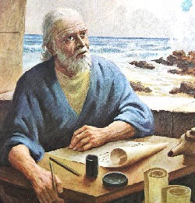
I. Ang pagbabasa at pagsunod sa Pahayag ng pagka-soberano ni Kristo ay nagdudulot ng pagpapala (1:1-3).
343

Slide 18
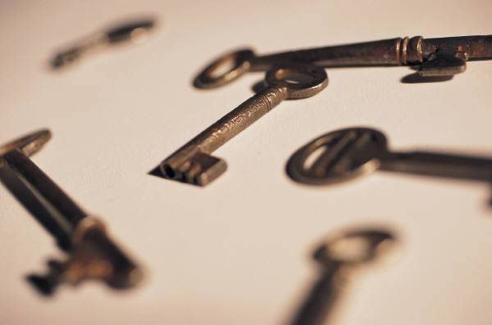
Ang pagka-soberano ni Kristo sa mga panghinaharap na pangyayari na ipinabatid kay Juan ay ipinapakita ang kinasihang propesiya (1:1-2)
322
Points H & I
Diyos
"Ang pahayag ni Hesukristo, na ibinigay sa kanya ng Diyos upang ipakita sa kanyang mga lingkod kung ano ang malapit nang maganap. Ipinaalam ito ni Hesukristo sa pamamagitan ng pagsugo ng kanyang anghel sa lingkod niyang si Juan, na nagpatotoo sa salita ng Diyos at sa ipinahayag ni Hesukristo, at maging sa mga bagay na nakita niya." (1:1-2 FSV).
Hesus
Anghel
Juan
Mambabasa (mga lingkod)
Notes:
"How did the Lord convey the contents of this book to His servant? According to Revelation 1:1–2, the Father gave the revelation to the Son, and the Son shared it with the apostle, using "His angel" as intermediary. Sometimes Christ Himself conveyed information to John (Rev. 1:10ff); sometimes it was an elder (Rev. 7:13); and often it was an angel (Rev. 17:1; 19:9–10). Sometimes a "voice from heaven" told John what to say and do (Rev. 10:4). The book came from God to John, no matter what the various means of communication were; and it was all inspired by the Spirit" (Wiersbe, Be Ready, Bible Exposition Commentary).

Slide 19
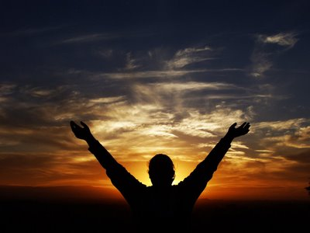
Mga Katangian
322
Ito lamang ang aklat sa Bibliya na may pangako ng isang natatanging pagbabala sa babasa nito (1:3).
"Pinagpala ang bumabasa ng mga salita ng propesiyang ito sa mga tao, at ang mga nakikinig at tumutupad ng mga bagay na nakasulat dito, sapagkat malapit na ang takdang panahon." (1:3 FSV)

Slide 20
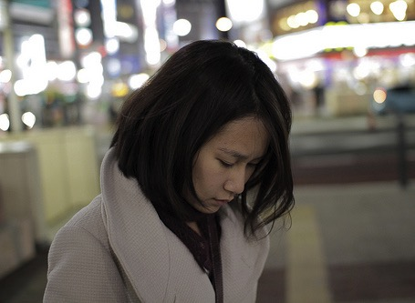
Tayo ay kadalasang tumutungo…

Slide 21
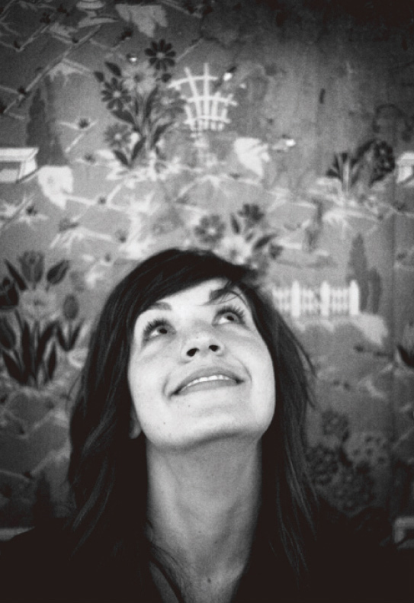
…kaya bakit ka titingala at bakit sasamba kay Hesus sa panahon ng pakikibaka?

Slide 22
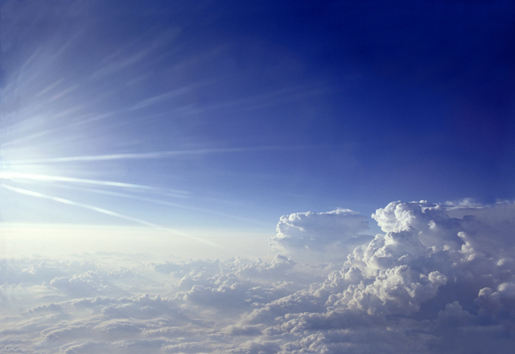
II. Dapat nating sambahin ang Trinidad na Diyos dahil si Kristo ay malapit nang dumating (1:4-8).

Slide 23
"Sumainyo nawa ang biyaya at kapayapaan mula sa kanya na siyang kasalukuyan, nakaraan at siyang darating"
Ama
Pah. 1:4-6
ay
ay hindi
ay hindi
DIYOS
ay
ay
Anak
Espiritu
“at mula kay Hesukristo…"
"…mula sa pitong espiritu na nasa harapan ng kanyang trono"
ay hindi
H. Wayne House, Charts of Christian Theology and Doctrine, 45

Slide 24
Katubusan kay Kristo (1:5b-6)
"ang tapat na saksi, ang pangunahin sa mga binuhay mula sa kamatayan, at pinuno ng mga hari sa lupa. Doon sa umiibig at nagpalaya sa atin mula sa ating mga kasalanan sa pamamagitan ng kanyang dugo, 6 at ginawa tayong isang kaharian, mga pari para sa kanyang Diyos at Ama, sa kanya ang kaluwalhatian at kapangyarihan magpakailanman. Amen."

Slide 25
"Tingnan ninyo! Dumarating siyang nasa mga ulap; makikita siya ng bawat mata, maging ng mga sumaksak sa kanya, at tatangis dahil sa kanya ang lahat ng lipi sa daigdig. Mangyari nawa. Amen."
Pah. 1:7 FSV
cf. Zac. 12:10

Slide 26
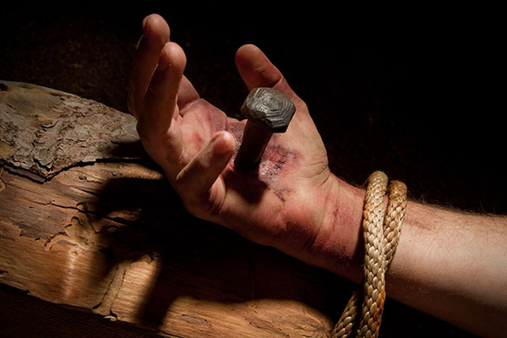
Ang Pagsisisi ng Israel
"At aking bubuhusan ang sangbahayan ni David, at ang mga mananahan sa Herusalem, ng espiritu ng biyaya at ng daing; at sila'y magsisitingin sa akin na kanilang pinalagpasan: at kanilang tatangisan siya, na gaya ng pagtangis sa bugtong na anak, at magiging kapanglawan sa kaniya, na parang kapanglawan sa kaniyang panganay." (Zac. 12:10 TAB).

Slide 27
"Tingnan ninyo! Dumarating siyang nasa mga ulap; makikita siya ng bawat mata, maging ng mga sumaksak sa kanya, at tatangis dahil sa kanya ang lahat ng lipi sa daigdig. Mangyari nawa. Amen."
Pah. 1:7 FSV
cf. Zac. 12:10

Slide 28
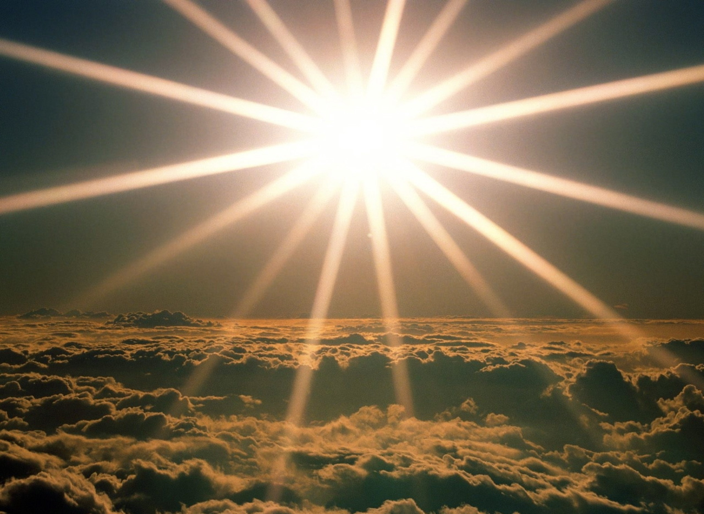
"Ako ang Alpha at ang Omega,” ang sabi ng Panginoong Diyos, “na siyang kasalukuyan, nakaraan at siyang darating, ang Makapangyarihan sa lahat." (1:8 FSV).
iii

Slide 29
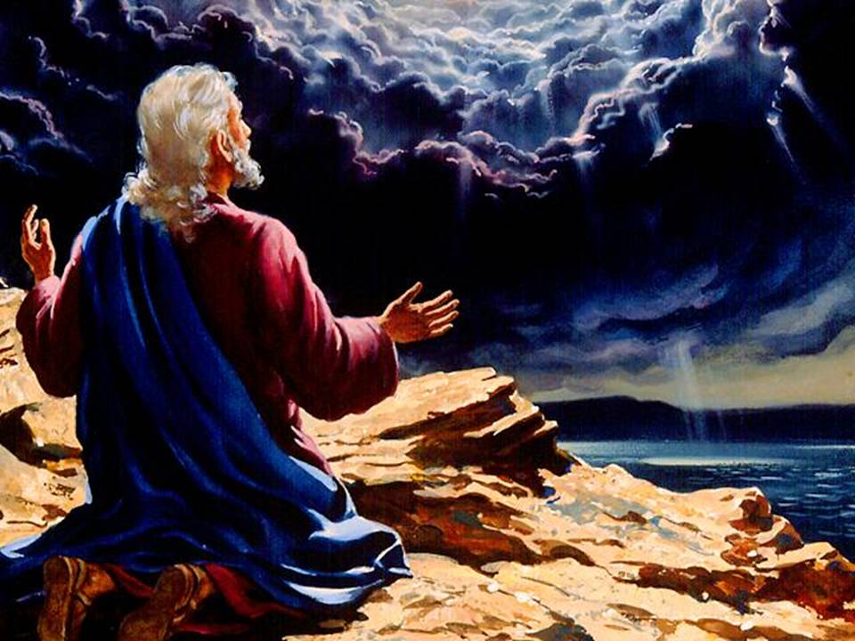
Bakit dapat makita nang maliwanag si Hesus?
343
Notes:
"Tradition says that it was Domitian who sent John to the Isle of Patmos, a Roman penal colony off the coast of Asia Minor. This being the location of John's exile, perhaps it is not surprising that the word sea is found twenty-six times in his book" (Warren Wiersbe, Bible Exposition Commentary)

Slide 30
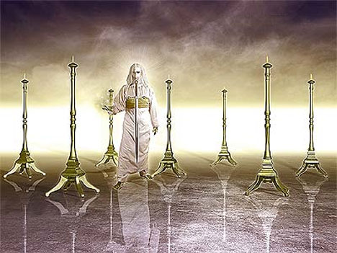
III. Ang makitang naluwalhati si Kristo ay nagpapakitang kaya Niyang lutasin ang iyong mga problema (1:9-20).
343

Slide 31
Dalawahang Konteksto ng Aklat
Panloob na Kompromiso
321
Panlabas na Pag-uusig
Patmos
"Akong si Juan, ang inyong kapatid na kabahagi ninyo sa pag-uusig, sa kaharian at sa pagtitiis para kay Hesus, ay nasa pulo na tinatawag na Patmos alang-alang sa salita ng Diyos at pagpapatotoo ni Hesus." (Rev. 1:9 FSV)
Notes:
Two factors will help us understand the historical situation in AD 95 with these churches scattered throughout the Empire:
External persecution against the churches is noted in 1:9 [click] that began in Rome and spread by imperial edict
Internal compromise within most churches is rebuked in chapters 2-3: division, false teaching, sinful living, self-centered luxurious lifestyles, etc.
What evidence of internal compromise and eternal persecution do you see in your own experience today? How can you relate?

Slide 32
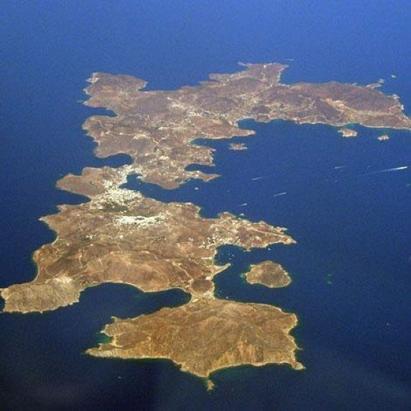
Ang Pulo ng Patmos
Notes:
"The small island of Patmos is about 7.5 miles (12 km) long from north to south and at its widest is 6 miles (10 km) from east to west. It is the northernmost island of the Dodecanese. With an area of 13 square miles (35 sq. km) and a circumference of 25 miles (37 km), the volcanic island presents a largely rocky and treeless landscape" (http://www.bibleplaces.com/patmos.htm).

Slide 33
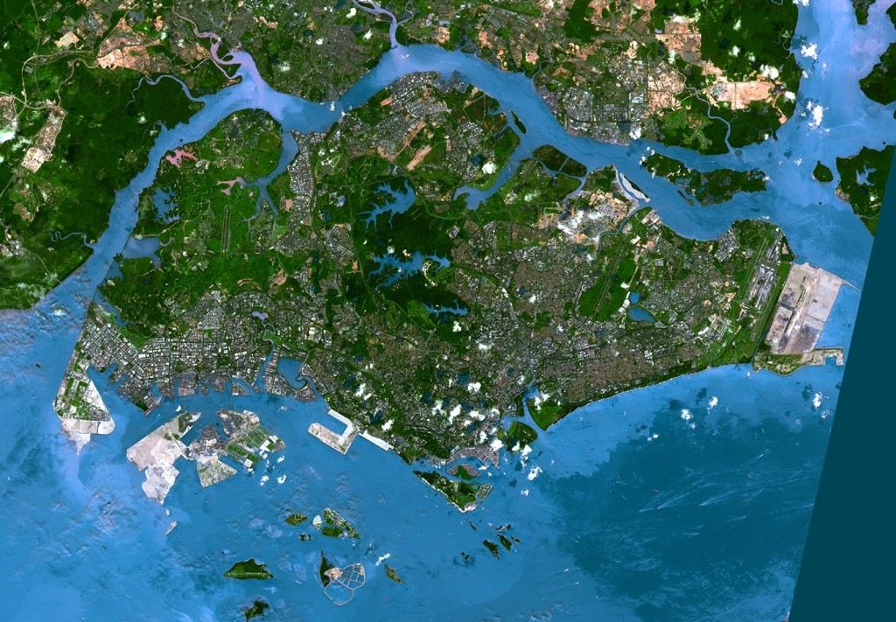
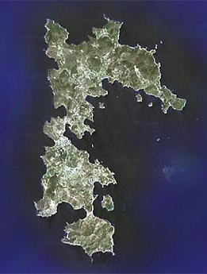
Paghahambing ng Singapore sa Patmos mula sa Satellite
Patmos

Slide 34
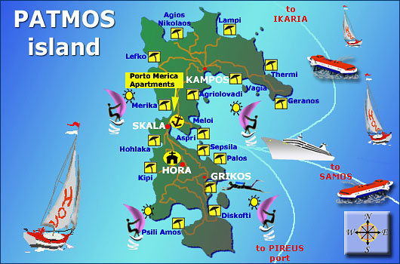
Pangturistang Pulo ng Patmos

Slide 35
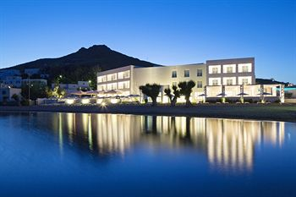
Mga Marangyang Hotel sa Patmos

Slide 36
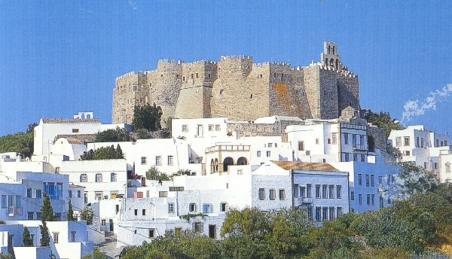
Monasteryo ng San Juan sa Patmos
Notes:
"The most imposing building on the island is the Monastery of St. John the Theologian. Constructed by Christodoulos in 1088, the monastery is located in the town of Chora overlooking the harbor. With walls 50 feet (15 m) high, it was built like a fortress because of the threat from pirates. The monastery was built on top of the remains of a 4th century AD church and an earlier temple of Artemis. An inscription that mentions the temple of Artemis is displayed in the monastery's museum" (http://www.bibleplaces.com/patmos.htm).

Slide 37
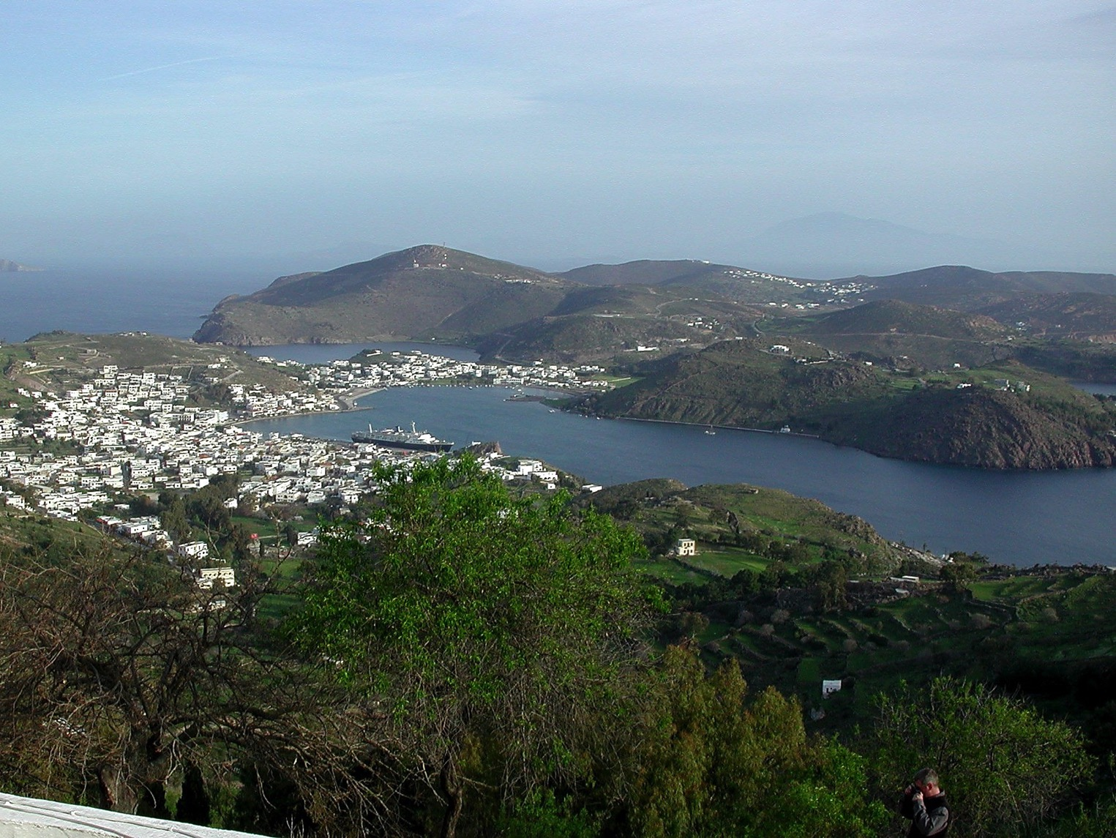
Tanawin ni Juan mula sa Taas

Slide 38
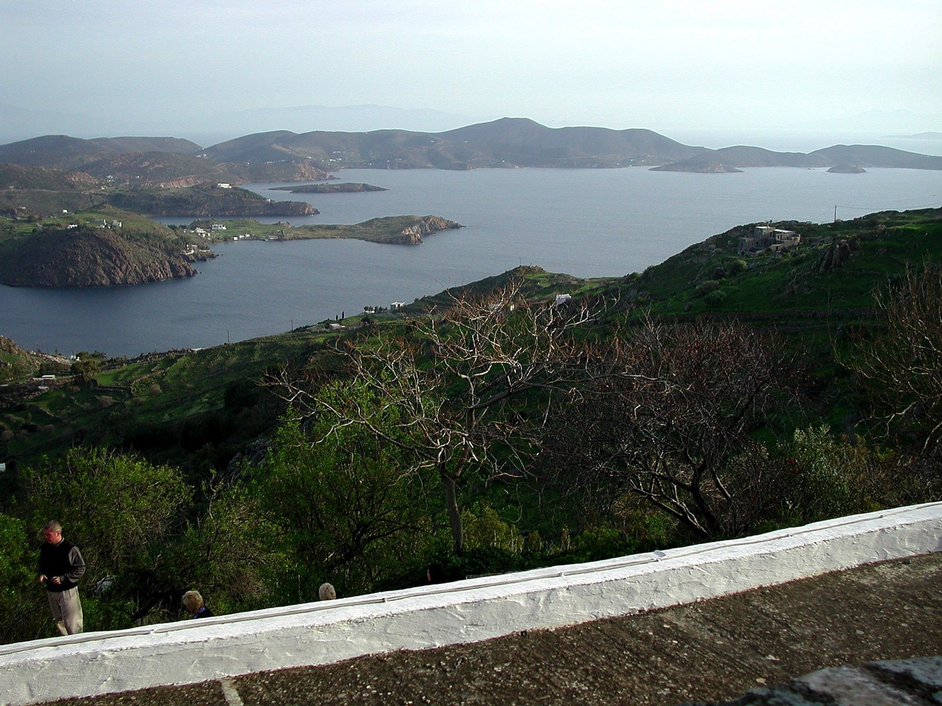
Tanawin ni Juan mula sa Taas

Slide 39
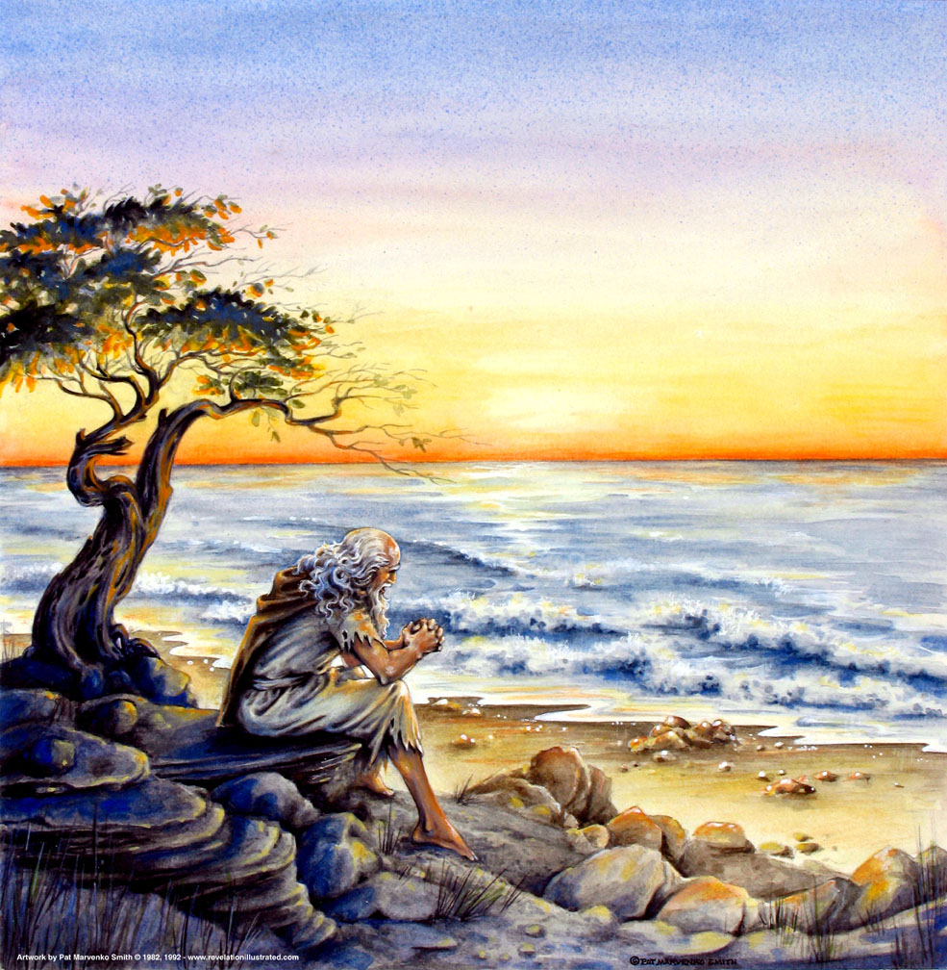
"…Sa araw ng Panginoon…" (1:10)
319
Linggo?
Ang “Araw ng PANGINOON"?

Slide 40
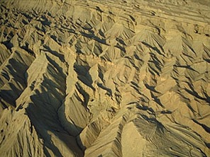
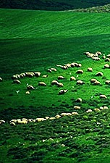
Ang Araw ng PANGINOON
OT Survey 638-639
Paghatol
+
Pagpapala
Pighati
Milenyo
Pah. 6–19
Pah. 20
7 taon
1000 taon

Slide 41
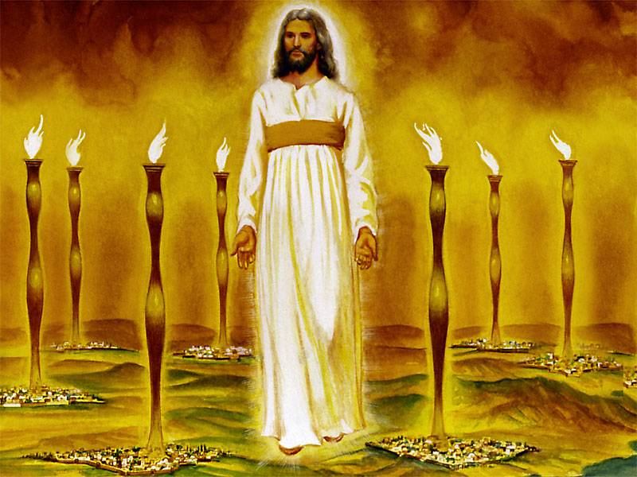
Ang pangitain ni Juan ng naluwalhating Kristo ay nagpapatunay na kaya Niyang tugunan ang mga panloob at panlabas na suliranin ng Iglesiya (1:12-16)
343
Notes:
"Christ's garments are those of a Judge-King, One with honor and authority. The white hair symbolizes His eternality, "the Ancient of Days" (Dan. 7:9, 13, 22). His eyes see all (Rev. 19:12; Heb. 4:12), enabling Him to judge righteously. His feet of burning brass also suggest judgment, since the brazen altar was the place where the fire consumed the sin offering. The Lord had come to judge the churches, and He would also judge the evil world system.
The "sound of many waters" (Rev. 1:15) makes me think of Niagara Falls! Perhaps two ideas are suggested here: (1) Christ gathers together all the "streams of revelation" and is the Father's "last Word" to man (Heb. 1:1–3); (2) He speaks with power and authority and must be heard. The sword from His mouth certainly represents the living Word of God (Heb. 4:12; Eph. 6:17). He fights His enemies by using His Word (Rev. 2:16; 19:19–21)" (Wiersbe).

Slide 42
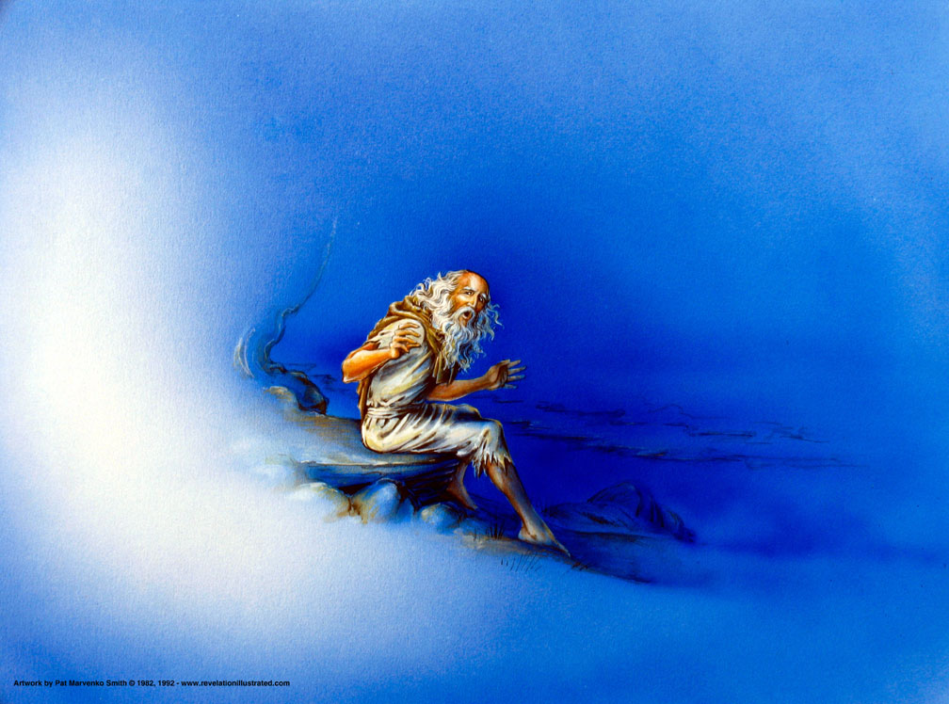
"Sa araw ng Panginoon, ako ay nasa Espiritu, at narinig ko sa aking likuran ang isang malakas na tinig na parang sa trumpeta" (1:10 FSV).

Slide 43
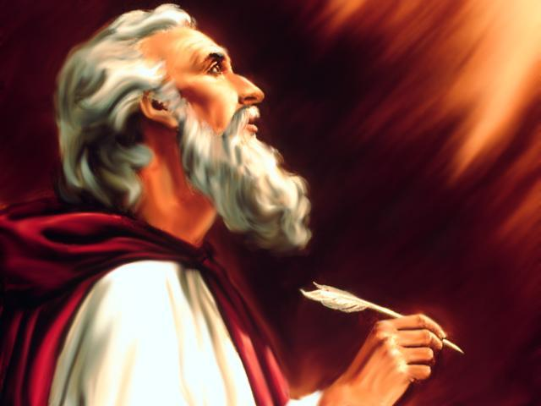
“Nakita ko…" (1:12)
1:12
1:17
4:1
5:1
5:2
5:6
5:11
6:1
6:2
6:5
6:8
6:9
6:12
7:1
7:2
7:9
8:2
8:13
9:1
9:17
10:1
10:5
13:1
13:2
13:11
14:1
14:6
14:14
15:1
15:2
15:5
16:13
17:3
17:6
18:1
19:11
19:17
19:19
20:1
20:4
20:11
20:12
21:1
21:2
21:22
p. 322 Point B
Ang anyo ng pandiwang ito ay ginamit ng 45 na beses sa Pahayag!
ei=don

Slide 44
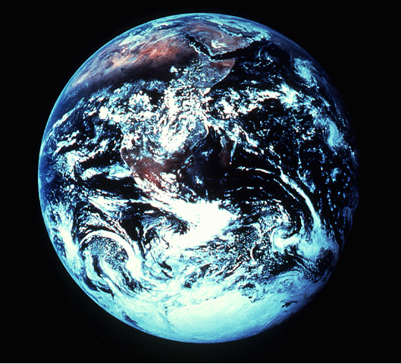
NGAYON…UPANG MABUO ANG LARAWAN…
343
Pahayag 1:12-18 (FSV) ¹²Lumingon ako para tingnan kung kaninong tinig ang nangusap sa akin. Sa aking paglingon nakakita ako ng pitong gintong ilawan,
MATEO
MARCOS
¹³at sa gitna ng mga ilawang ito, nakita ko ang isang gaya ng Anak ng Tao na nakasuot ng mahabang damit at sa kanyang dibdib ay may bumabalot na gintong bigkis.
ANG PAHAYAG NI HESUKRISTO KAY APOSTOL JUAN
¹⁴Ang kanyang ulo at buhok ay puti tulad ng balahibo ng tupa, kasimputi ng niebe; ang kanyang mga mata'y tulad ng ningas ng apoy,
¹⁵ang kanyang mga paa'y tulad ng tansong pina-kintab na parang dinalisay sa pugon, at ang kanyang tinig ay tulad ng ingay ng rumaragasang tubig.
¹⁶Ang kanang kamay niya'y may hawak na pitong bituin, at mula sa kanyang bibig, lumabas ang isang matalas na tabak na dalawa ang talim, at ang mukha niya'y tulad ng araw na matinding sumisikat.
¹⁷Nang makita ko siya, bumulagta akong parang patay sa kanyang paanan. Ipinatong niya ang kanyang kamay sa akin at sinabi, “Huwag kang matakot; Ako ang una at ang huli,
LUCAS
JUAN
¹⁸at ang nabubuhay! Ako'y namatay, ngunit tingnan mo, ako ay buhay magpakailanpaman. Hawak ko ang mga susi ng kamatayan at ng Hades."
28
9
Notes:
Now…to complete the portraits given to us by
MATTHEW…MARK…LUKE…and JOHN.
//// For this, we need to get out into space and look at this unfortunate planet. Man has made a mess of it, you will probably agree. This view of earth helps us more clearly understand the final view of Christ given to us in the New Testament.
//// Now travel to the last book of the New Testament…The Revelation of Jesus Christ to John the Apostle. There, we see Jesus Christ in His risen, ascended glory, as he will appear when He returns at the end of History to reclaim all that is His.
//// In his first chapter of The Revelation, John writes this:
I turned around to see the voice that was speaking to me. And when I turned I saw seven golden lamp stands…
//// and among the lamp stands was someone "like a son of man," dressed in a robe reaching down to his feet and with a golden sash around his chest.
//// His head and hair were white like wool, as white as snow, and his eyes were like blazing fire.
//// His feet were like bronze glowing in a furnace, and his voice was like the sound of rushing waters.
//// In his right hand he held seven starts, and out of his mouth came a sharp double-edged sword. His face was like the sun shining in all its brilliance.
//// When I saw him, I fell at his feet as though dead. Then he placed his right hand on me and said: "Do not be afraid. I am the First and the Last.
//// I am the Living one; I was dead, and behold I am alive forever and ever! And I hold the keys the death and Hades.

Slide 45
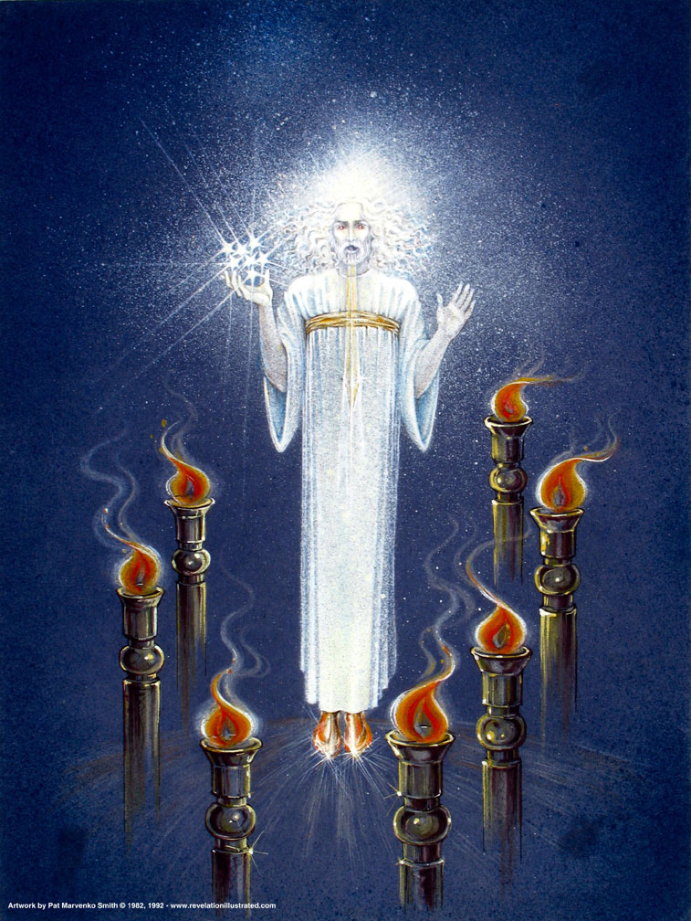
Si Kristo sa Gitna ng Ilawan (1:12-16)
Notes:
"Christ's garments are those of a Judge-King, One with honor and authority. The white hair symbolizes His eternality, "the Ancient of Days" (Dan. 7:9, 13, 22). His eyes see all (Rev. 19:12; Heb. 4:12), enabling Him to judge righteously. His feet of burning brass also suggest judgment, since the brazen altar was the place where the fire consumed the sin offering. The Lord had come to judge the churches, and He would also judge the evil world system" (Wiersbe).

Slide 46
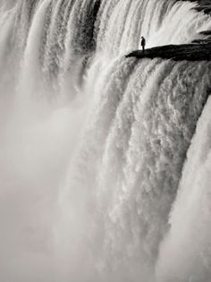
"…ingay ng rumara-gasang tubig" (1:15)
Notes:
"The "sound of many waters" (Rev. 1:15) makes me think of Niagara Falls! Perhaps two ideas are suggested here: (1) Christ gathers together all the "streams of revelation" and is the Father's "last Word" to man (Heb. 1:1–3); (2) He speaks with power and authority and must be heard." (Wiersbe).

Slide 47
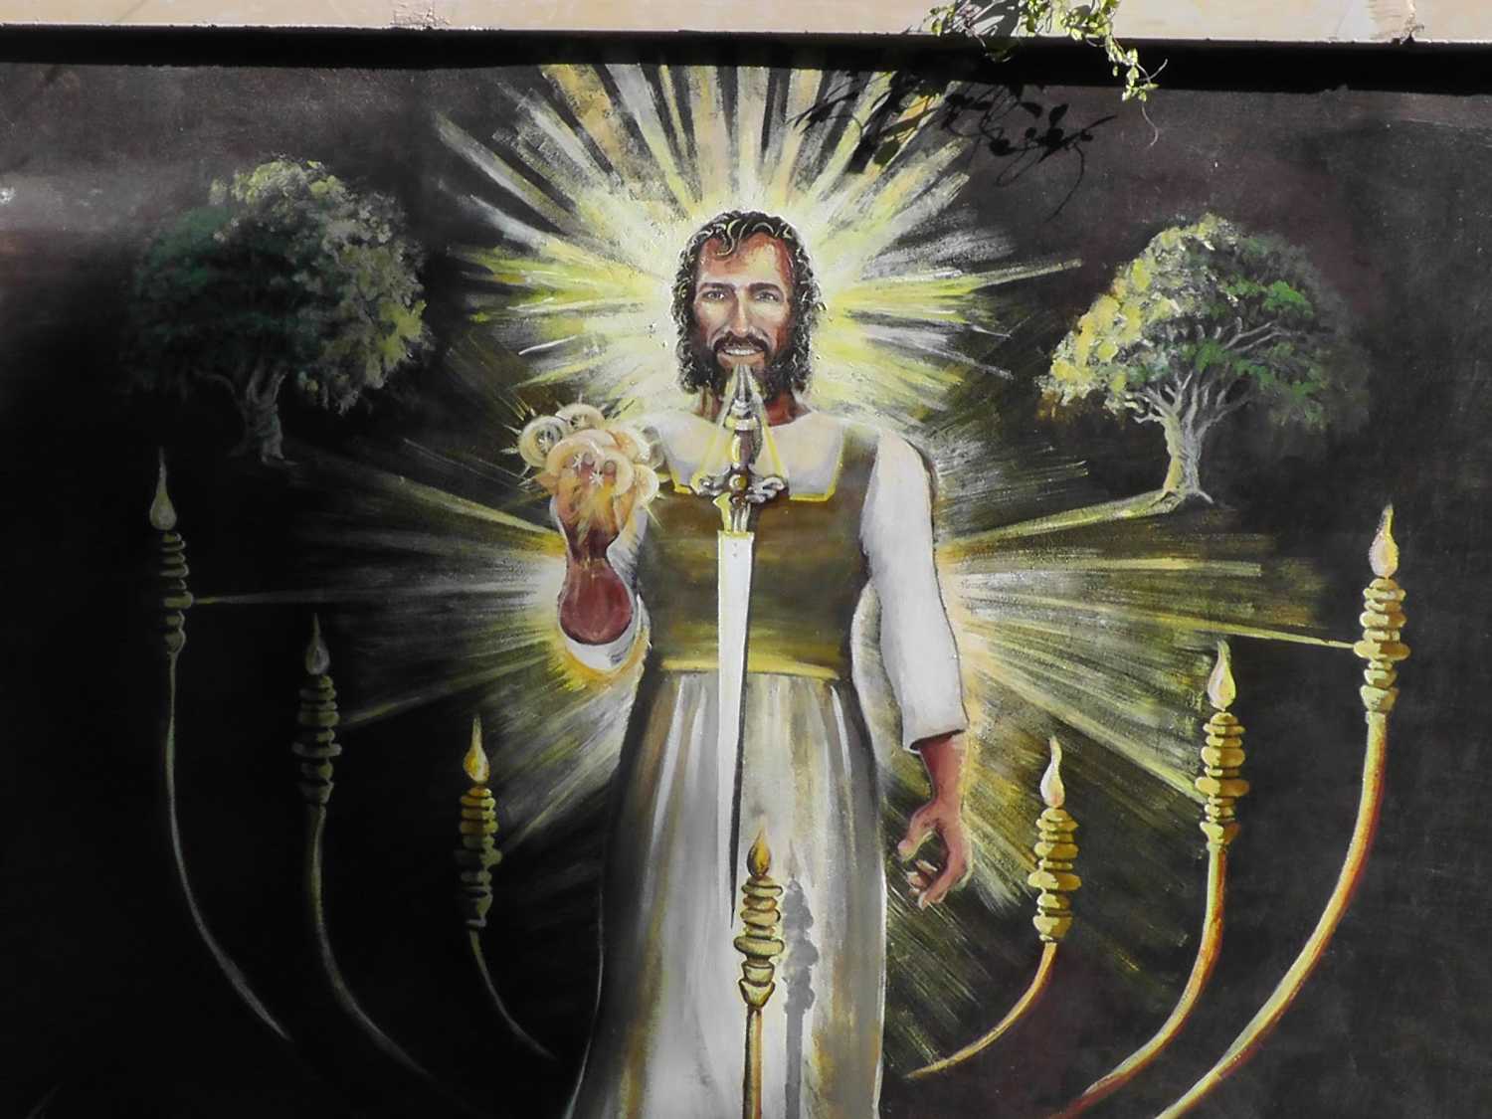
"…tabak mula sa kanyang bibig" (1:16)
Notes:
"The sword from His mouth certainly represents the living Word of God (Heb. 4:12; Eph. 6:17). He fights His enemies by using His Word (Rev. 2:16; 19:19–21)" (Wiersbe).

Slide 48
Pagkakatulad sa OT kay Hesus sa Pah. 1:12-16
343
Pah. 1:12-16 | Ezek. 1:24-28 | Dan. 10:5-6 | Dan. 7:9-10 | Dan. 7:13-14
anak ng tao | tulad sa isang tao | Isang tao |  | anak ng tao
mahabang damit |  | Mahabang damit na lino
gintong bigkis |  | gintong bigkis
puting buhok |  |  | puting buhok
mata'y tulad ng apoy | apoy | mata‘y gaya ng apoy | apoy
paa'y tulad ng tanso | metal na nagbabaga | pinakintab na tanso
tinig ng ruma-ragasang tubig | ugong ng dagliang tubig | tinig ng isang karamihan
mga bituin sa kamay
mukha na tulad ng araw | ningning | like lightning
Hango kay Vern Poythress sa www.frame-poythress.org

Slide 49
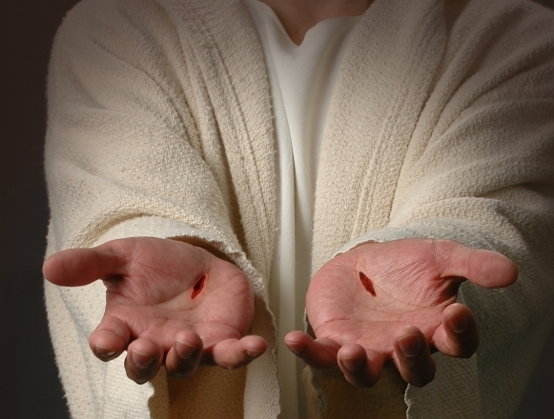
"Nang makita ko siya, bumulagta akong parang patay sa kanyang paanan. Ipinatong niya ang kanyang kamay sa akin at sinabi, “Huwag kang matakot; Ako ang una at ang huli, at ang nabubuhay! Ako'y namatay, ngunit tingnan mo, ako ay buhay magpakailanpaman. Hawak ko ang mga susi ng kamatayan at ng Hades." (1:17-18 FSV)
343

Slide 50
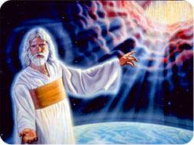
338
Sundan ang kinasihang balangkas ng Pahayag
Pahayag 1:19 "Kaya isulat mo ang nakita mo, kung ano ang kasalukuyan, at kung ano ang mangyayari pagkatapos nito." (FSV).
nakita
kasalukuyan
mangyayari

Slide 51
Pahayag
Pagkasoberano ni Kristo sa Darating na Tagumpay
Pagka-soberano sa Kanyang Persona |  |  | Pagka-soberano sa mga Iglesiya | Pagka-soberano sa mga Pangyayari Sa Huling-araw
Kabanata 1 |  |  | Kabanata 2–3 | Kabanata 4–22
“ang nakita mo” (1:19a) |  |  | “ano ang kasalukuyan" (1:19b) | “ano ang mangyayari" (1:19c)
Nakalipas |  |  | Kasalukuyan | Hinaharap
Naihayag na Kristo |  |  | Naihayag na mga Iglesiya | Naihayag ang Kalubusan
Diyos sa Mundo |  |  | Mga Kinatawan ng Diyos sa Mundo | Impyerno sa Mundo patungo sa Langit sa Mundo
Ang Hukom |  |  | Ang mga Pagtatalaga | Ang mga Kahatulan at mga Gantimpala
Paksa 1:1-3 | Pagsamba sa Trinidad 1:4-8 | Naluwal-hating Kristo 1:9-20 | Pitong Iglesiay ng Asia: Efeso Smirna Pergamo Tiatira Sardis Filadelfia Laodicea | Kapigha-tian 4:1–19:10 | Pangala-wang Pagdating 19:11-21 | Sanlibong Taon 20 | Walang-hanggang Kalagayan 21:1–22:5 | Pagwawakas Mangyayari Agad 22:6-21
AD 95
318, 324 M

Slide 52
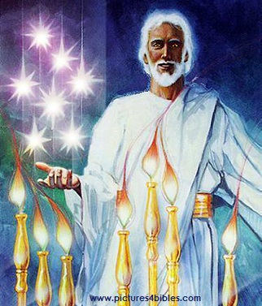
Ano ang 7 butuin & 7 ilawan (1:20 FSV)?
"Tungkol naman sa hiwaga ng pitong bituin na nakita mo sa aking kanang kamay, at ang pitong gintong ilawan: ang pitong bituin ay ang mga anghel ng pitong iglesya, at ang pitong ilawan ay ang pitong iglesya."

Slide 53
Ang paghahayag ng pagka-soberano ni Hesukristo ay nagpapatotoo sa pitong iglesiya sa Asya na si Kristo ay lulupig sa kanilang panloob na kompromiso at panlabas na tunggalian
Title Page 321
Mga Iglesiya sa Asya
Roma
2. Panlabas na Pag-uusig mula sa Roma (1:9; 2:9-10; 3:10)
1. Panloob na Tunggalian sa mga Iglesiya (2:4, 14-15, 21-24; 3:1, 15-17)

Slide 54
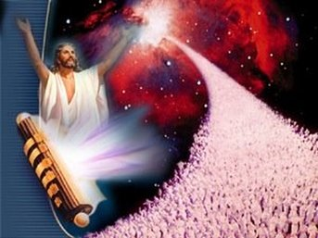
Si Hesus ang namumuno sa mundo! Kaya kaya Niyang tugunan ang iyong maliit na problema.
Ang Mahalagang Kaisipan

Slide 55
Bakit kailangan nating malaman sa si Hesus ang namumuno sa mundo?
318
Bakit babasahin ang Pahayag?
Upang pagpalain ka!
Bakit sasamba kay Hesus?
Siya ay magbabalik!
Bakit dapat makita nang malinaw si Hesus?
Lulutasin Niya ang iyong problema!

Slide 56
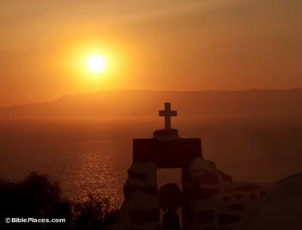
Ano ang iyong pananaw kay Hesus?

Slide 57
Pagbubuod ng Buong Aklat
343
Inihayag ng Diyos sa pamamagitan ni Juan ang pagka-soberano ni Hesukristo sa Kanyang pangwakas na tagumpay sa hinaharap upang bigyang-pag-asa ang mananampalataya na magtiyaga sa kabila ng panloob na kompromiso at panlabas na tunggalian

Slide 58
Tagumpay si Hesus!
Serye sa Pahayag

Slide 59
Black

Slide 60
Pangangaral sa Bagong Tipan • BibleStudyDownloads.org
Kunin ang presentation na walang-bayad!
Notes:
NP (New Testament Preaching)

