Slide 1
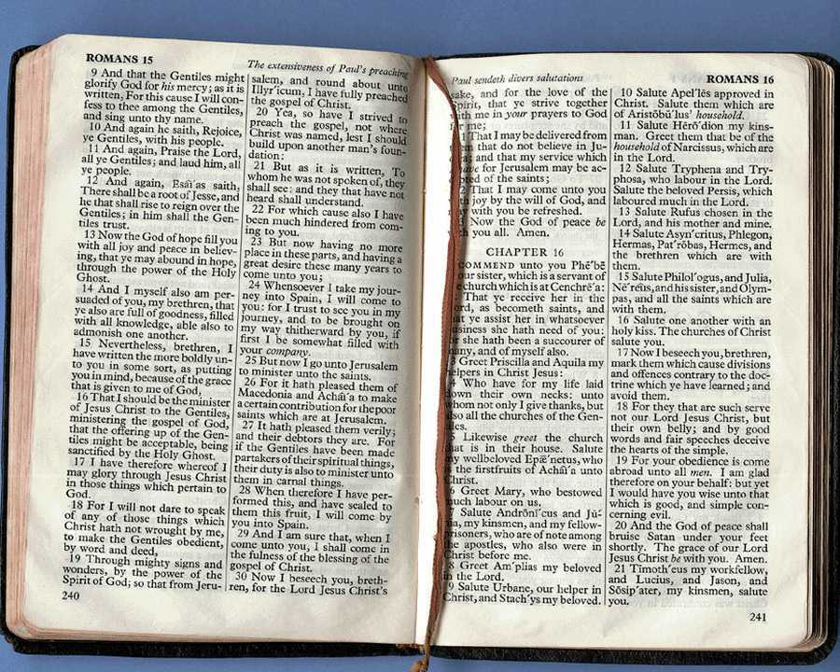
me;dpa vjpu; Ntjhfk jPu;f;fjuprdq;fs;
186
me;dpa
A+j
fpwp];jt
Dr. Rick Griffith • Singapore Bible College • BibleStudyDownloads.org

Slide 2
jPu;f;fjuprdk;
me;dpa kw;Wk; Ntjhfk jPu;f;fjuprdq;fSf;F ,ilNa ePu; mtjhdpf;Fk; NtWghL ahJ?

Slide 3
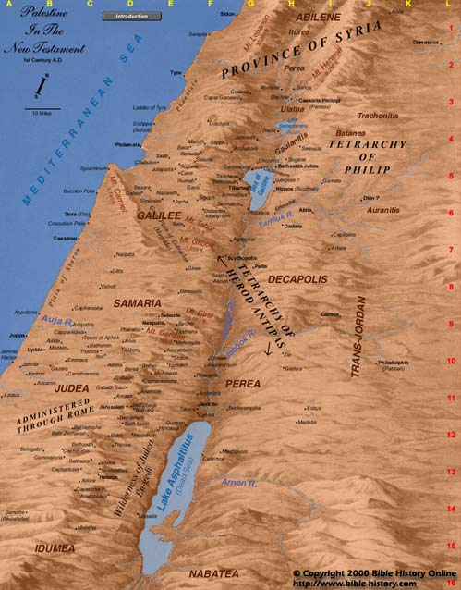
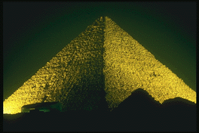
flw; ghij
Muhd;
,];uhNay;
Ramoth-Gilead
nkfpNjh
A+jh
Egypt

Slide 4
1 ,uh[hf;fs; 22
muNka mr;RWj;jy;
nkhrgj;Njkpah
ngUq;
fly;
Muhd;
ngdhjhj;
,q;F fhzg;gLk; cz;ikahd> ngha;ahd jPu;f;fjuprdq;fSf;F ,ilNa cs;s Kuz;ghL ahJ?
Mfhg;
,];uhNay;
A+jh
NahNrghj;
ghurPf Flh
vfpg;J

Slide 5
“M fu;j;jhNt ck;Kila rpj;jj;jpd; gb vd;id gad;gLj;jp ckJ Mnyhridapd; gb vd;id elj;Jk;!”

Slide 6
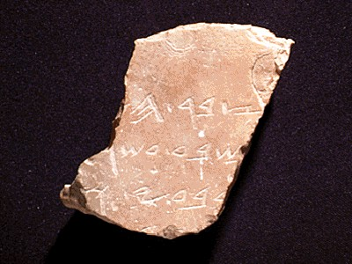
tpsf;fk;
186
vgpNuak;: negp NjtDila tha;.
“Ngr;rhsu;> jPu;f;fjuprp”
fpNuf;fk;: g;Nuhgl]; “Njtd; njwpag;gLj;j tpUk;Gtij mwptpj;J NjtDf;fhf NgRgtu;.”

Slide 7
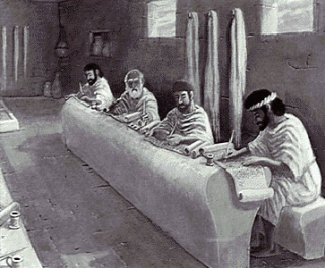
cz;ikahd jPu;f;fjuprdj;jpd; mtrpak; vd;d?
186
jdJ thu;ijapy; njspit typAWj;Jjy; NjtDila ,ay;G
Nghyp jPu;f;fjuprpfs; J}f;fpyplg;gl;ldu; cghfkk; 18:21-22).

Slide 8
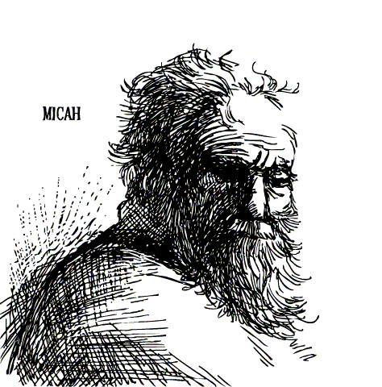
jPu;f;fjuprpia Fwpj;j jPu;f;fjuprdk; NkhNrapdhy; nfhLf;fg;gl;lJ. (cghfkk; 18:15)
“cd; Njtdhfpa fu;j;ju; vd;idg; Nghy xU jPu;f;fjuprpia cdf;fhf cd; eLNt cd; rNfhjuupypUe;J vOk;gg; gz;Zthu;; mtUf;Fr; nrtpnfhLg;gPu;fshf.”

Slide 9
cz;ik jPu;f;fjuprpapd; guPl;ir (cghfkk;18:18-20)
100 tpfpj cz;ik fzpg;G
fu;j;jiu Muhjpj;jy;

Slide 10
cz;ikahd jPu;f;fjuprdj;jpd; mtrpak; vd;d?
186
jdJ thu;ijapy; njspit typAWj;Jjy; NjtDila ,ay;G
Nghyp jPu;f;fjuprpfs; J}f;fpyplg;gl;ldu; cghfkk; 18:21-22).
mNdfu; ,d;W NjtDila thu;ij> jPu;f;fjuprdk; vd;W nrhy;tjdhy;> ehk; epjhdpj;J mwpa Ntz;baJ mtrpak;.
NjUjy; NjtDila thu;j;ijia mwptjD}lhf tUk; (2 jPNkh 3:16-17).

Slide 11
Vd; Njt thu;j;ij mj;jud Kf;fpak;?
Ntjthf;fpaq;fnsy;yhk; NjtMtpapdhy; mUsg;gl;bUf;fpwJ; NjtDila kD\d; NjwpdtdhfTk;> ve;j ew;fpupiaAQ; nra;aj; jFjpAs;stdhfTk; ,Uf;Fk;gbahf> mitfs; cgNjrj;Jf;Fk;> fbe;Jnfhs;SjYf;Fk; rPu;jpUj;jYf;Fk;> ePjpiag; gbg;gpf;FjYf;Fk; gpuNah[dKs;sitfshapUf;fpwJ.
2 jPNkh 3:16-17

Slide 12
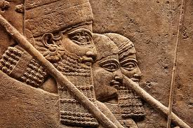
,];Nuyu;fs; khj;jpuk; jPu;f;fjuprdq;fis nfhz;bUe;jhu;fsh?
186g
(mfhbad; jPu;f;fjuprdk;)
“xU jsgjp vOk;Gthd; mtd; 13 tUlq;fs; MSthd;. Mfhj;Jf;F tpNuhjkhf Vyhk; gilnaLg;ghd;> Mfhj;jpd; nry;tq;fs; nfhs;isaplg;gLk;.
xU jiytd; vOthd; mtd; ehl;f;fs; nfhQ;rkha; ,Uf;Fk;. Mts; Mskhl;lhd;.”
ANET, 608 (Arnold/Beyer, 208)
Notes:
James Pritchard, Ancient Near Eastern Texts Relating to the Old Testament (Princeton, NJ: Univ. Press, 1969), 608; cited in Arnold/Beyer, Encountering the OT, 345. Mari material also from Arnold/Beyer, 345.

Slide 13
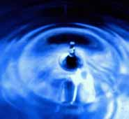
,];Nuyu; khj;jpuk; jPu;f;fjuprpfis nfhz;bUe;jhu;fsh?
186g
(mfhbad; jPu;f;fjuprdk;)
ghgpNyhdpa Xkhd; vOj;Jf;fs;
ypfhNdhd;kd;rp (jz;zPupy; ,lg;gl;l vz;iz Jspfis mtjhdpj;jy;)
ehd; jz;zPupy; vz;izj; Jspia ,Lk; nghOJ mJ jhdhf gpupe;jhy; Nehahsp kwpj;JtpLthu;: Nghu; re;ju;g;gj;jpy;. gil ehL jpUk;ghJ.
(Arnold/Beyer, 218)
Notes:
James Pritchard, Ancient Near Eastern Texts Relating to the Old Testament (Princeton, NJ: Univ. Press, 1969), 608; cited in Arnold/Beyer, Encountering the OT, 345. Mari material also from Arnold/Beyer, 345.

Slide 14
,];Nuyu; khj;jpuk; jPu;f;fjuprpfis nfhz;bUe;jhu;fsh?
186g
(mfhbad; jPu;f;fjuprdk;)
ghgpNyhdpa Xkhd; vOj;Jf;fs;
ypfhNdhd;kd;rp (jz;zPupy; ,lg;gl;l vz;iz Jspfis mtjhdpj;jy;)
ypghNdhkd;rp (fyrj;jpy; ,Ue;J ntspNaWk; Gifia mtjhdpj;jy;)
Mypt;Nuhkd;rp (jz;zPupy; rpjug;gl;l khit mtjhdpj;jy;)
vf;];b];gprp (gypaplg;gl;l tpyq;Ffsps; clw;$Wfis mtjhdpj;jy;)
“KO <uYk; rpijtile;jpUe;jhy; Mfhj; Nguopit re;jpf;f NeupLk;.”
(Arnold/Beyer, 218)
Notes:
James Pritchard, Ancient Near Eastern Texts Relating to the Old Testament (Princeton, NJ: Univ. Press, 1969), 608; cited in Arnold/Beyer, Encountering the OT, 345. Mari material also from Arnold/Beyer, 345.

Slide 15
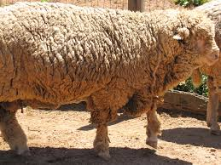
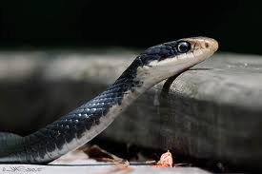
,];Nuyu; khj;jpuk; jPu;f;fjuprpfis nfhz;bUe;jhu;fsh?
186g
(mfhbad; jPu;f;fjuprdk;)
ghgpNyhdpa Xkhd; vOj;Jf;fs;
ML jd; fhiy fbj;jhy;> vjpupapd; jhf;Fjy; epiyahdjhf ,Uf;Fk;.
xU kdpjdpd; tykpUe;J ,lJ ghk;G flf;Fnkahdhy;> mtDf;F ew;ngau; fpilf;Fk;.
xU kdpjdpd; tykpUe;J ,lJ ghk;G flf;Fnkahdhy;> mtDf;F nfl;l ngau; fpilf;Fk;.
(Arnold/Beyer, 219)
Notes:
James Pritchard, Ancient Near Eastern Texts Relating to the Old Testament (Princeton, NJ: Univ. Press, 1969), 608; cited in Arnold/Beyer, Encountering the OT, 345. Mari material also from Arnold/Beyer, 345.

Slide 16
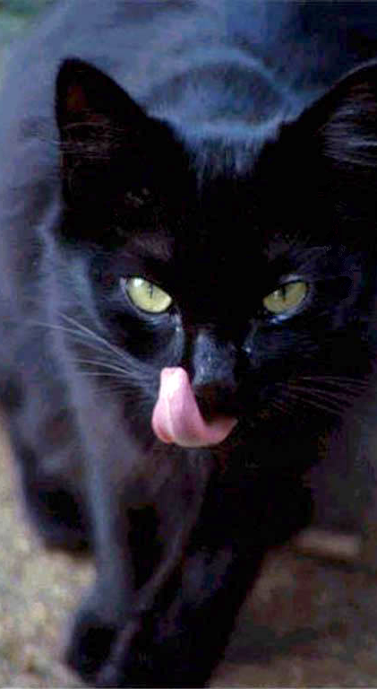
ghgpNyhdpa Xkhd; vOj;Jf;fs;
186g
xU kD\Dila tPl;by; fUg;G G+id njd;gl;lhy;> me;j epyk; ey;y mjp\;lj;ij fhZk;.
xU kD\Dila tPl;by; nts;is G+id njd;gl;lhy;> me;j epyk; f\;lj;ij fhZk;.
(Arnold/Beyer, 219)
Notes:
James Pritchard, Ancient Near Eastern Texts Relating to the Old Testament (Princeton, NJ: Univ. Press, 1969), 608; cited in Arnold/Beyer, Encountering the OT, 345. Mari material also from Arnold/Beyer, 345.

Slide 17
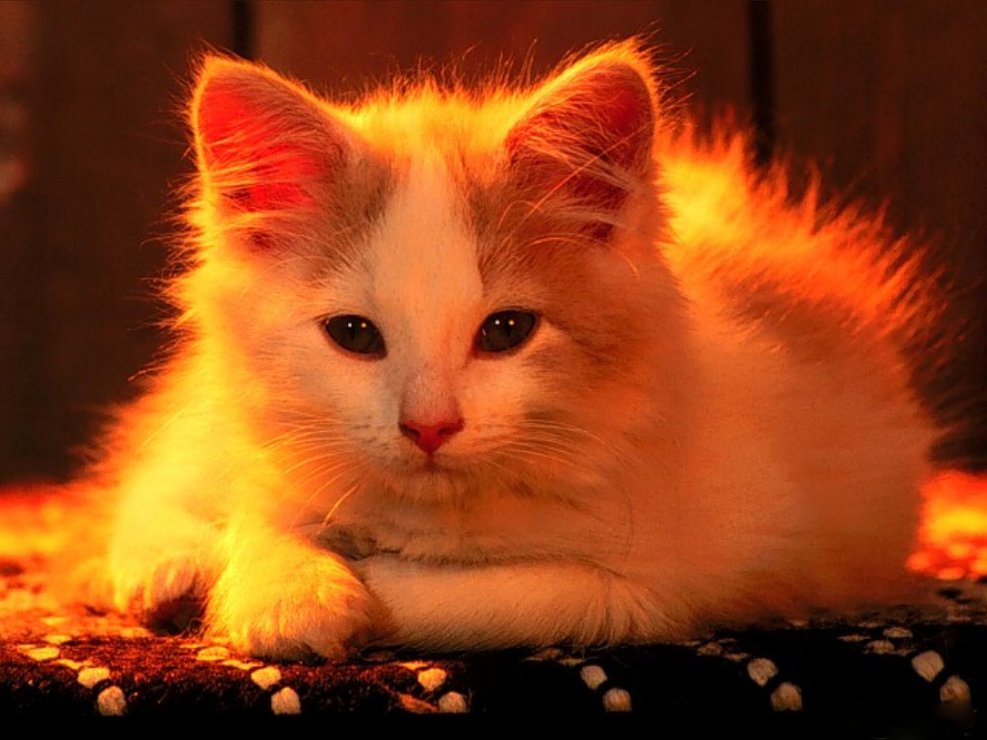
ghgpNyhdpa Xkhd; vOj;Jf;fs;
186g
xU kD\Dila tPl;by; kQ;ry; G+id njd;gl;lhy;> me;j epyk; xU tUl mjp\;lj;ij fhZk;.
xU kD\Dila tPl;by; rpfg;G G+id njd;gl;lhy;> me;j epyk; nrypf;Fk;.
(Arnold/Beyer, 219)
Notes:
James Pritchard, Ancient Near Eastern Texts Relating to the Old Testament (Princeton, NJ: Univ. Press, 1969), 608; cited in Arnold/Beyer, Encountering the OT, 345. Mari material also from Arnold/Beyer, 345.

Slide 18
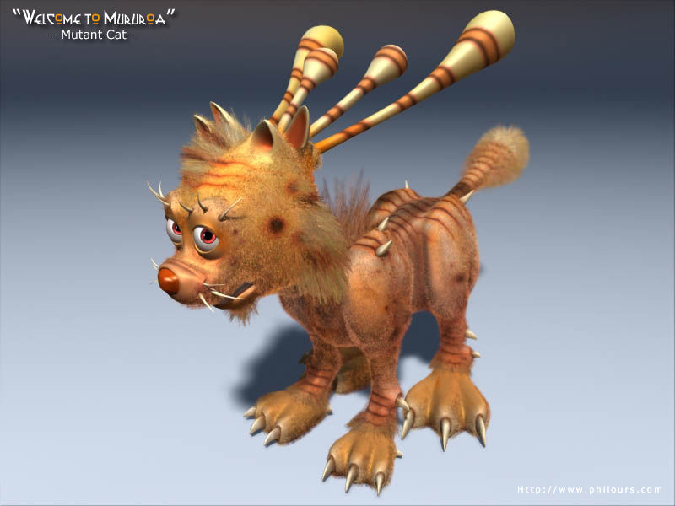
ghgpNyhdpa Xkhd; vOj;Jf;fs;
186g
xU kD\Dila tPl;by; gytu;z G+id njd;gl;lhy;> me;j epyk; nrypg;ig fhzhJ.
(Arnold/Beyer, 219)
Notes:
James Pritchard, Ancient Near Eastern Texts Relating to the Old Testament (Princeton, NJ: Univ. Press, 1969), 608; cited in Arnold/Beyer, Encountering the OT, 345. Mari material also from Arnold/Beyer, 345.

Slide 19
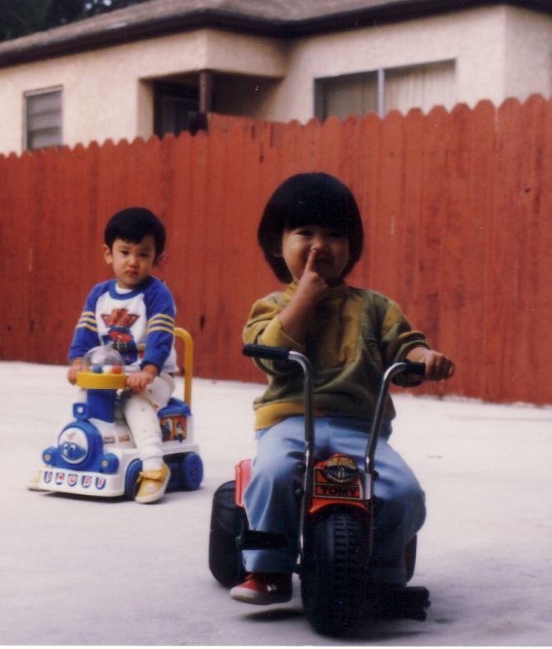
ghgpNyhdpa Xkhd; vOj;Jf;fs;
186g
xUtd; jd;Dil %f;fpy; tpuypl;L mOf;ffw;wpdjy;> mtd; vjpupfs; mtDf;F mbgzptu;.
(Arnold/Beyer, 219)
Notes:
James Pritchard, Ancient Near Eastern Texts Relating to the Old Testament (Princeton, NJ: Univ. Press, 1969), 608; cited in Arnold/Beyer, Encountering the OT, 345. Mari material also from Arnold/Beyer, 345.

Slide 20
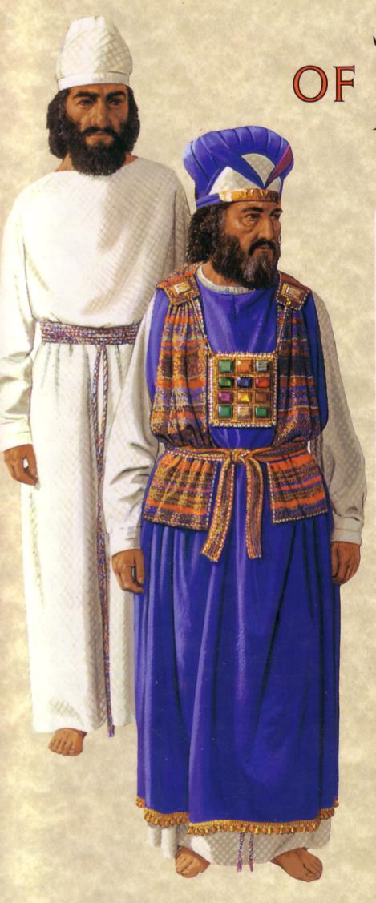
Cupk; kw;Wk; Jk;kPk; vd;gtw;iw Fwpj;J?
me;dpa gFjpfspy; ,J vt;thW NtWgLk;?
Fwpf;Nfhs;
Njtdhy; epakpf;fg;gly;
ahj;jpuhfkk; 28

Slide 21
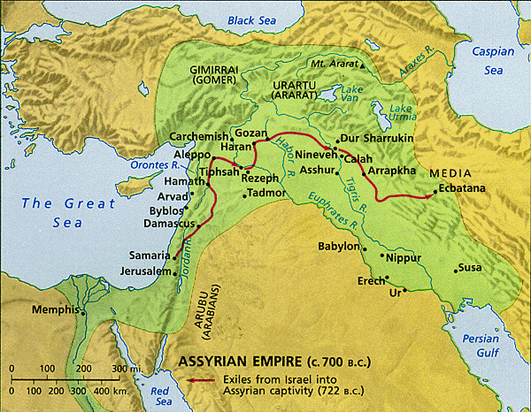
,];Nuyu; khj;jpuk; jPu;f;fjuprpfis nfhz;bUe;jhu;fsh?
186g
(mfhbad; jPu;f;fjuprdk;)
ghgpNyhdpa Xkhd; vOj;Jf;fs;
khup jPu;f;fjuprd vOj;Jf;fs;
(fpK 1800-1760 )
kd;dd; rpk;up ypk;; ,l;F khup ,t;thW $wpdhd;:
gazj;ij Fwpj;j rig
Kul;lhl;lj;ij Fwpj;j vr;rupf;if
vjpupfspd; Nky; ntw;wp thf;Fjj;jq;fs;
nja;tPf topghL Fwpj;j cl;rhfgLj;jy;
Mari
Notes:
James Pritchard, Ancient Near Eastern Texts Relating to the Old Testament (Princeton, NJ: Univ. Press, 1969), 608; cited in Arnold/Beyer, Encountering the OT, 345. Mari material also from Arnold/Beyer, 345.

Slide 22
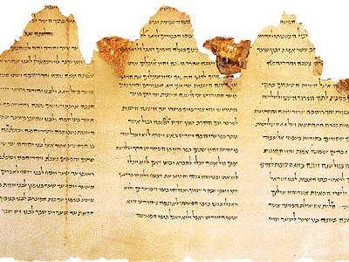
cz;ikahd> Nghypahd jPu;f;fjuprdq;fspd; nghJ ,ay;G
186
miog;G
milahsk;
$W
ghzp

Slide 23
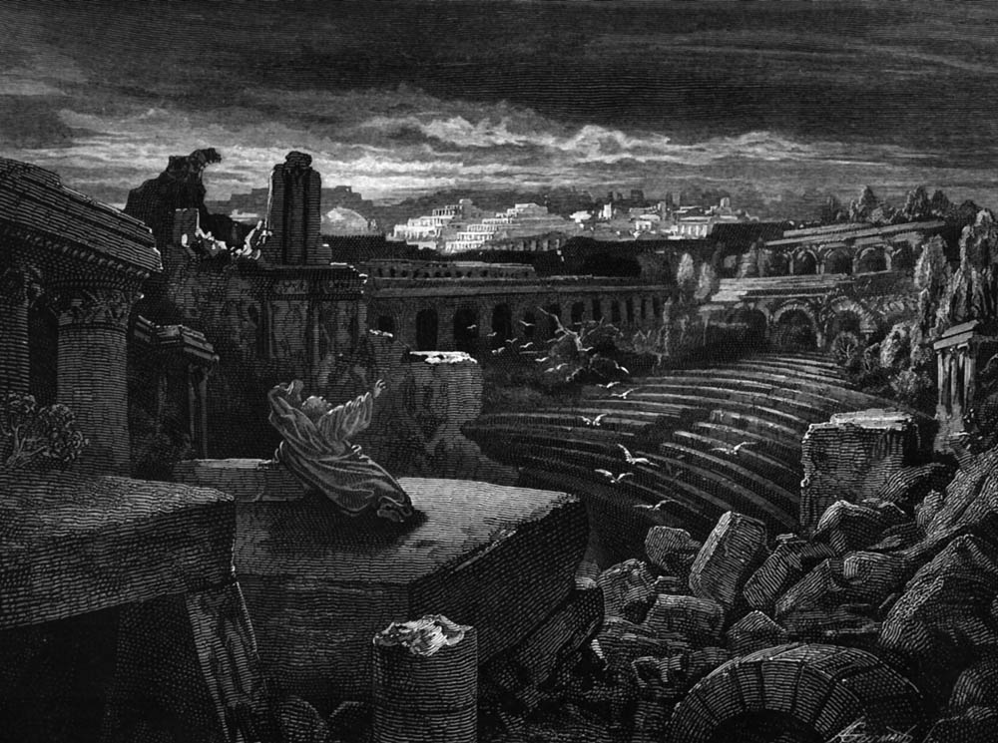
$Wfspd; nghJ ,ay;G
,];uNaypy; ,Ue;J neNghit nfhz;LtUk; gbahf nrNkh\; vdf;F nrhd;dhd;. Ehd; tpbaw; fhiy njhlq;fp gfy; tiu rz;ilapl;L ngUe;njhifahdtw;iw vLj;Jf;nfhz;Nld;. 7000 Ngu; nfhz;l Mz;> ngz;fs;.
King Mesha Stele, lines 11-12
(830 BC “victory over Omri” in 2 Kings 3)
—Arnold/Beyer, 162; cf. ANET (1969), 320-21

Slide 24
ePu; rpe;jpf;f $ba etPz %lek;gpf;iffs; vit?

Slide 25
Njt [dk; Njt jpl;lj;ij mwptJ vg;gb?
cyf Mnyhridfs; mNdfkhf ftu;r;rpahditahf ,Uf;Fk;
MfNy Njtd; ,J Njt thu;j;ijah vd;gij mwpa ,];NuYf;F gy topfis fhz;gpj;jhu;.

Slide 26
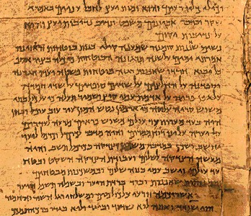
jPu;f;fu; vg;gb NtWgLfpd;wdu;?
186a-b
Ntjhfk
me;dpa
jhdha; Kd;tUjy;
fzpj;jy;
nja;tPf miog;G
jhdhf Nfhwy;
vy;yh ,lq;fspYk;
kuG rhu; ,lq;fs;
Kd; gpd; nrhy;Yjy;
Kd; nrhy;Yjy;

Slide 27
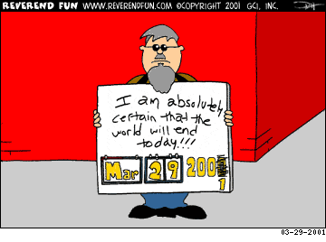
Nghyp jPu;f;fjuprdq;fs; khWk;!
cyfk; ,d;W mopag;NghfpwJ vd;gij ehd; cWjpahf $WfpNwd; !!!

Slide 28
jPu;f;fu; vg;gb NtWgLfpd;wdu;?
186b
Ntjhfk
me;dpa
nja;tPf ,ay;G
xOf;fkpd;ik
mNdfkhf Mz;fs;
mNdfkhf ngz;fs;
Vtg;gLjy;
nrhe;j fUj;J
nrhe;j ghzp
nghy;yhj Mtp

Slide 29
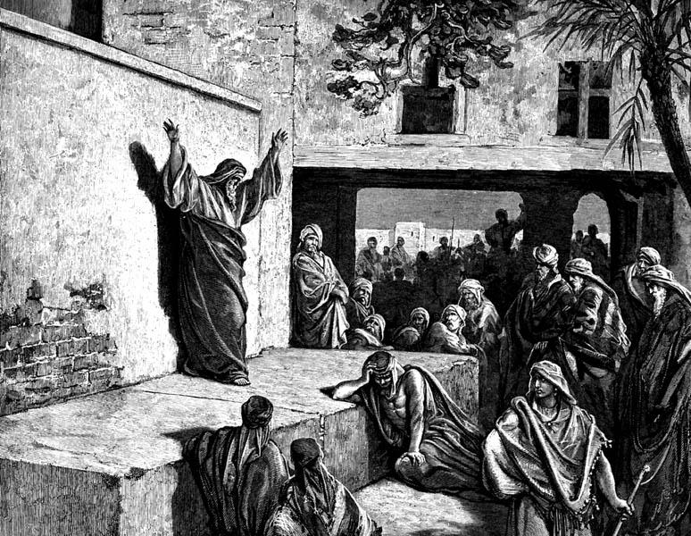
vNukpah (25:11-12) vjpu; mddpah (28:2-3)
cz;ik
ngha;
“70 tUlk; ,Ug;gPu;fs;”
“2 tUlj;jpy; jpUk;GtPu;fs;!”
23 Mz;Lfs; tho;e;jhu; (51:64)
2 khjj;jpy; kupj;jhd; (28:17)

Slide 30
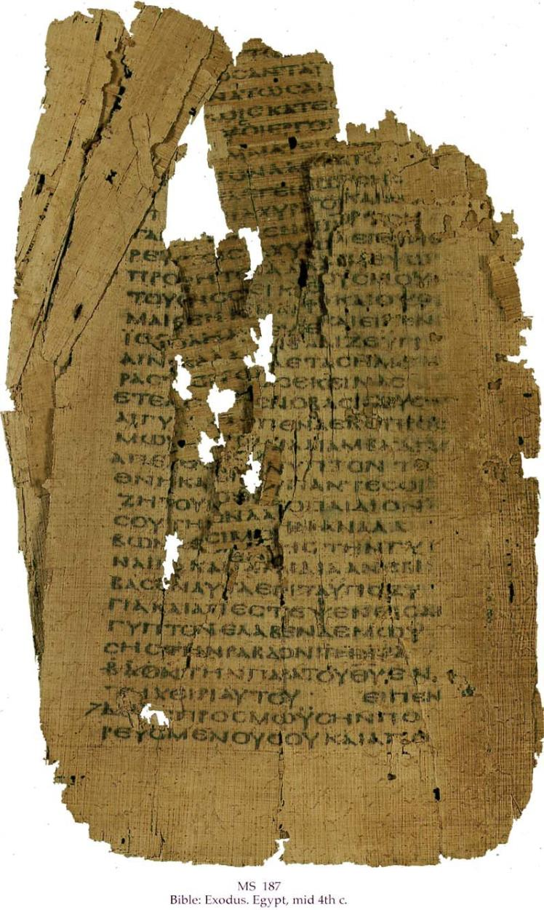
jPu;f;fu; vg;gb NtWgLfpd;wdu;?
186c-d
Ntjhfk
me;dpa
nja;ltPf Nehf;fk;
rk;ghj;jpa Nehf;F
Neub nra;jp
jpUl;L nra;jp
100 tpfpj cz;ik
rpf;fy;fs;
Jd;GWj;jg;gly;
cau;j;jg;gly;

Slide 31
Ntjhfk kw;Wk; me;dpa jPu;f;fjuprdq;fspy; fhzg;gLk; Kuz;ghLfs;
186b-d
rpe;jpf;f
,t; ,uz;L Kiwfspy; Kf;fpakhdjhf fUJk; NtWghL ahJ?
Vd;?

Slide 32
jPu;f;fjuprdk; vd;why; vd;d?
“Ntjj;jpYs;s ve;jj; jPu;f;fjuprdKk; RaNjhw;wkhd nghUisAilajhapuhnjd;W ePq;fs; Ke;jp mwpaNtz;baJ. jPu;f;fjuprdkhdJ xUfhyj;jpYk; kD\Uila rpj;jj;jpdhNy cz;lhftpy;iy; NjtDila gupRj;j kD\u;fs; gupRj;j MtpapdhNy Vtg;gl;Lg; Ngrpdhu;fs;.”
2 NgJU 1:20-21

Slide 33
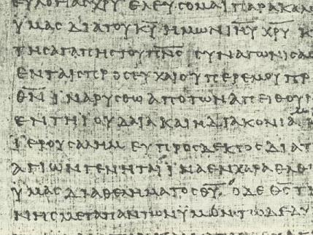
fye;Jiwahly; FO 1
186e
jPu;f;fd; vd;W jd;id $wp ,tw;iw nra;gtiu rig vd;d nra;a Ntz;Lk;?
ngha;ahdtw;iw mDkhdpj;jy;
xOf;fuPjpahd ghtk;
tpRthrpfis gpioahf topelj;jy;

Slide 34
fye;Jiwahly; FO 2
186e
jpBu; vd rpe;jidf;F Njtd; nfhz;LtUtjh jPu;f;fjuprdk;? (nta;d; F&lk;)
jPu;f;fjuprdj;jpy; tYf;fs; ,Uf;fyhkh?
Vd;? my;yJ Vd; ,Uf;f $lhJ?

Slide 35
fye;Jiwahly; FO 3
186e
F&lk;> vy;yh tpRthrpfSk; Ntj Mjhuj;Jld; jPu;f;fjuprdk; ciuf;fyhk; vd;fpwhu; vd epidf;fpd;wPuh? (1 nfhup 12:29 vjpu; 14:1)?
ckJ gjpiy jhq;Ff

Slide 36
fye;Jiwahly; FO 4
186e
jdJ jPu;f;fjuprdk; Vtg;gl;lJ vdpDk; trdj;Jf;F epfuhd mjpfhuk; nfhz;ljy;y vd;Dk; egUf;F ckJ gjpy;?
ntt;NtW kl;lj;jpyhd Vtjy; cs;sNjh!?

Slide 37
jPu;f;fjuprdj;jpw;F nta;d; F&lk; mtu;fspd; tpsf;fk;
jpBu; vd rpe;jidf;F Njtd; nfhz;LtUtij nrhy;tNj jPu;f;fjuprdk;.
“,d;Dk; Vd; fpwp];jtu;fshy; jPu;f;fjuprdk; nrhy;y Kbfpd;wJ?”
Christianity Today (16 Sept 1988), 29

Slide 38
jPu;f;fjuprd fz;Ndhl;lj;jpf; RUf;fk;
186f
F&lk; fz;Ndhl;lk;
Ntjhfk fz;Ndhl;lk;
jPu;fjuprdk; vd;gJ (cz;ikNah ngha;Nah) Mtpapy; Vtg;gLtij cld; mwptpj;jy;
Njtdhy; cs; Cjg;gl;L Vtg;gLtNj jPu;f;fjuprdk;
,t; tpsf;fkhdJ 1988 ,y; nta;d; F&lk; ,dhy; mwpKfg;gLj;jg;gl;lJ
,t; tpsf;fkhdJ 20 E}w;whz;Lfshf rig gpd;gw;Wk; tps;f;fkhFk;
g.V jPu;f;fjuprpfs; G.V mg;Ngh]]jyUf;F rkkhdtu;fs;.
g.V jPu;f;fjuprpfs; G.V jPu;f;fjuprpfSf;F rkkhdtu;fs;.
g.V ,ypUe;J G.V ,w;F jPu;f;fjuprdj;jpd; tpsf;fj;ij Njtd; khw;wpdhu;
,U Vw;ghl;bYk; jPu;f;fjuprdj;jpw;fhd mu;j;jj;ij khwpypahf itj;jpUfpwhu;
rpy jPu;f;fjuprdq;fis Njtd; tOf;fYld; nfhLj;jhu;
vy;yh jPu;f;fjuprdq;fisAk; Njtd; tOtpy;yhky;; nfhLj;jhu;.(2 NgJ 1:20-21)
ve;e tpRthrpAk; jPu;fjuprdk; ciuf;fyhk;
jPu;f;fjuprd tuk; cilatu; kl;LNk (1 nfhup 12:29)
,U tifahd jPu;f;fjuprdq;fs; G.V ,y; cz;L (jtwpiof;Fk;> jtwpiof;fhj)
G.V ,y; xNu tifahd jPu;f;fjuprdk; (jtwpiof;fhj)
jtwpiof;Fk; jPu;f;fjuprdk; $l Vtg;glyhk;
jtwpiof;Fk; jPu;f;fjuprdk; Nghyp jPu;f;fjuprdk;. (cgh 13:1-5; 18:14-20)
Njtd; rpy re;ju;g;gq;fspy; ngha; nrhy;thu;
mtu; cz;ikia kl;Lk; NgRk; ngha;Aiuahj Njtd;. (vgpNu 6:18)
Notes:
Wayne A. Grudem, “Why Christians Can Still Prophesy: Scripture Encourages Us to Seek this Gift yet Today,” Christianity Today [September 16, 1988] 29; cf. Grudem's 1988 book, The Gift of Prophecy.

Slide 39
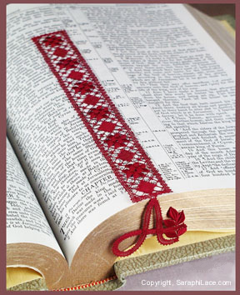
Njt thu;j;ijia cau;thdjhf gw;wpf;nfhs;Nthk;!
vkJ md;whl n[g jpahdq;fspy;
vkJ FLk;gj;jpy;
vkJ Ntiyfspy;
vkJ Ntj ghlq;fspy; (,jidAk; Nru;j;J)

Slide 40
Black

Slide 41
jPu;f;fjuprd fz;Ndhl;lj;jpf; RUf;fk;
186f
F&lk; fz;Ndhl;lk;
Ntjhfk fz;Ndhl;lk;
jPu;fjuprdk; vd;gJ (cz;ikNah ngha;Nah) Mtpapy; Vtg;gLtij cld; mwptpj;jy;
Njtdhy; cs; Cjg;gl;L Vtg;gLtNj jPu;f;fjuprdk;
,t; tpsf;fkhdJ 1988 ,y; nta;d; F&lk; ,dhy; mwpKfg;gLj;jg;gl;lJ
,t; tpsf;fkhdJ 20 E}w;whz;Lfshf rig gpd;gw;Wk; tps;f;fkhFk;
g.V jPu;f;fjuprpfs; G.V mg;Ngh]]jyUf;F rkkhdtu;fs;.
g.V jPu;f;fjuprpfs; G.V jPu;f;fjuprpfSf;F rkkhdtu;fs;.
g.V ,ypUe;J G.V ,w;F jPu;f;fjuprdj;jpd; tpsf;fj;ij Njtd; khw;wpdhu;
,U Vw;ghl;bYk; jPu;f;fjuprdj;jpw;fhd mu;j;jj;ij khwpypahf itj;jpUfpwhu;
rpy jPu;f;fjuprdq;fis Njtd; tOf;fYld; nfhLj;jhu;
vy;yh jPu;f;fjuprdq;fisAk; Njtd; tOtpy;yhky;; nfhLj;jhu;.(2 NgJ 1:20-21)
ve;e tpRthrpAk; jPu;fjuprdk; ciuf;fyhk;
jPu;f;fjuprd tuk; cilatu; kl;LNk (1 nfhup 12:29)
,U tifahd jPu;f;fjuprdq;fs; G.V ,y; cz;L (jtwpiof;Fk;> jtwpiof;fhj)
G.V ,y; xNu tifahd jPu;f;fjuprdk; (jtwpiof;fhj)
jtwpiof;Fk; jPu;f;fjuprdk; $l Vtg;glyhk;
jtwpiof;Fk; jPu;f;fjuprdk; Nghyp jPu;f;fjuprdk;. (cgh 13:1-5; 18:14-20)
Njtd; rpy re;ju;g;gq;fspy; ngha; nrhy;thu;
mtu; cz;ikia kl;Lk; NgRk; ngha;Aiuahj Njtd;. (vgpNu 6:18)
Notes:
Wayne A. Grudem, “Why Christians Can Still Prophesy: Scripture Encourages Us to Seek this Gift yet Today,” Christianity Today [September 16, 1988] 29; cf. Grudem's 1988 book, The Gift of Prophecy.

Slide 42
me;dpa ghi\ vjpu; jPu;f;fjuprdk;
161m
NtWghL | me;dpa ghi\ | jPu;f;fjuprdk;
Ngr;rhsUila fl;Lg;ghL | juk; jho;e;j (14:5a) | juk; cau;e;j (14:1)
kw;iwa tuq;fSldhd njhlu;G | filrp Kf;fpakhd tuk; (12:28) | ,uz;lhtJ kpf Kf;fpa tuk; (12:28)
gad;gLj;jg;gl;l nkhop | me;dpa nkhop (14:10) | tl;lhu nkhop (14:19)
mDkhd tuk; | mu;j;j tpsf;fk; nra;jy; (12:30; 14:27-28) | gFj;jupjy; (12:10; 14:29)
Ngr;rhsUf;F Ngrg;gLk; nkhopia Fwpj;j mwpT | njwpahjJ : “MtpapNy ,ufrpaq;fis NgRthd;.. fUj;J gadw;wjhFk;.” (14:2b, 14) | njwpe;jJ : “MtpapNy Ngrthd;. fUj;Js;sjha; ,Uf;Fk;” (14:15, 19)
ngWkjp (mu;jjtpsf;fk; ,d;wp) | Mgj;jhdJ: kf;fshy; tpsq;fpf;nfhs;s KbahJ> njsptw;wJ (14:16-17> 23> 28) | rpwg;ghdJ: kf;fs; tpsq;fpf;nfhs;tu;> njspthdJ (14:5b> 24-25)
njspT (mu;jjtpsf;fk; ,d;wp) | jdf;Fkl;LkhdJ (14:4a; cf. 10:24; 12:7> 11) | KO rigf;FkhdJ (14:4b)

Slide 43
me;dpa ghi\ vjpu; jPu;f;fjuprdk;
161m
NtWghL | me;dpa ghi\ | jPu;f;fjuprdk;
Ngrg;gLk; jpir | Njtd; (14:2) | kdpjd; (14:3)
kw;wTUf;fhd gyd; | ntspghL> mwpT> jPu;f;fjuprdk;> mwpTiu (14:6) | gyg;gLj;jy;> cl;rhfg;gLj;jy;> Mwjy;gLj;jy; (14:3b)
Njhlu;ghly; Kiw | NgRjy; (14:6) n[gk; (14:14) Jjpj;jy; (14:16) ghLjy;? (14:15b) | Vjpu;fhyj;ij Kd;dhf mwptpj;jy; “Kd;Dk; gpd;Dk;” cz;ik Nfhl;g;ghLfis mwptpj;jy; (14:19)
Nehf;fk; | tpRthrpfs; my;yhj A+ju;fSf;F milahsk; (14:21-22a) | tpRthrpfSf;fhd nra;jp (14:22b)
tiuaiw | ,uz;L my;yJ %d;W me;dpaghi\ nra;jpfs; ,Uf;f Ntz;Lk; (14:27a) Kiwg;gb mwptpj;jy; (14:27b) nkhopngu;f;fg;gl Ntz;Lk; (14:27c-28) | ,uz;L my;yJ %d;W jPu;f;fjuprd nra;jpfs; ,Uf;f Ntz;Lk; (14:29a) Kiwg;gb mwptpj;jy; (14:30-31) mwptpf;fg;gl;lij rPu;j;J}f;fg;ghu;f;f Ntz;Lk; (14:29b, 32)
Gj;jpkjp | Vjpu;kiw : me;dpaghi\ Ngr jilg;gz;z Ntz;lhk; (14:39b) | Neu;kiw : jPu;f;fjuprdk; nrhy;y ehLq;fs; (14:39a)
,ilepWj;Jgtu; | jhdhf : Xa;e;JNghFk; (13:8b) | jhd; my;yhj NtW xUtuhy;: eLepiyahdJ (13:8a)

Slide 44
cgNjrq;fs; vjpu; jPu;f;fjuprdq;fs;
161h
NtWghL | cgNjrq;fs; | jPu;f;fjuprdq;fs;
ngWkjp | juk; jho;e;j : cgNjrk; me;jpNahf;fpa rigapd; jiyikj;Jt fl;likg;gpy; jPu;f;fjuprdj;Jf;F mLj;jjhf tupirg;gLj;jg;gl;lJ (mg;Ngh 13:1) | juk; cau;e;jJ : jPu;f;fjuprdkhdJ mu;j;jtpsf;fg;glhj NjtDila thu;j;ijia nrhy;Yk; ePz;l g.V tuyhw;iw nfhz;Ls;sJ (2 NgJU 1:20-21) cgNjrfu;fs; mu;j;jtpsf;fk; nra;a Ntz;Lk;
kw;iwa tuq;fSldhd njhlu;G | filrp Kf;fpakhd tuk; : jPu;f;fjuprdj;Jf;F mLj;jjhf tupirg;gLj;jg;gl;lJ (1 nfhup 12:28) | ,uz;lhtJ kpf Kf;fpa tuk;> mg;Ngh];jyj;Jtj;jpdhy; kl;LNk <Lnra;a KbAk;.
mjpfhuk; | jPu;f;fjuprdj;ij tpl Fiwe;j mjpfhuKs;sJ. cgNjrfu; fl;lfakhf Ntjhfkj;ij mu;f;ftpsf;fk; nra;a Ntz;Lk; | Njtdhy; mUsg;gl;ljhf> mu;j;jtpsf;fk; nra;ag;glhjjhf cgNjrj;ij tpl mjpf mjpfhuKs;sJ. (2 NgJU 1:20-21)
cz;ikf;fhd Mjhuk; | NjtDila thu;j;ij (nfhNyh 3:16) | NjtDila Mtp (2 NgJU 1:21)
tUk; fhupaj;ij Fwpj;j ,ay;G | Vw;fdNt ntspg;gLj;jg;gl;l mz;ikapd; mUsg;glhj mu;j;jtpsf;fk; (mg;Ngh 15:35; 11:12> 26; Nuhku; 2:21; 15:4; vgpNuau; 5:12) | Vjpu;fhyj;ij Kd;dhf mwptpj;jy;> Kd;Dk; gpd;Dk; “cz;ik Nfhl;g;ghLfis mwptpj;jy;” ntspghl;bD}lhf ngWjy; (1 nfhup 14:19> 26> 29-30; vNgrpau; 3:5)

Slide 45
cgNjrq;fs; vjpu; jPu;f;fjuprdq;fs;
161h
NtWghL | cgNjrq;fs; | jPu;f;fjuprdq;fs;
ghzp | Kiwg;gLj;jg;gl;lit | jpBu; ntspghL (mg;Ngh 11:28; 21:4> 10-11)
tiuaiw | rigapy; cgNjrpj;jYf;fhd tiuaiw ,y;iy | xU Muhjidapy; ,uz;L my;yJ %d;W jPu;f;fjuprd nra;jpfs; (14:29a), Kiwg;gb mwptpj;jy; (14:30-31), mwptpf;fg;gl;lij rPu;j;J}f;fg;ghu;f;f Ntz;Lk; (14:29b, 32)
jiyikj;Jt jFjp | Kjpu;r;rpahdtu;fSila Njit (1 jPNkh 3:2; 5:17; jPj;J 1:9) rig tuyhw;wpy; njhlu;rprpahf cz;ikia fw;Wf;nfhz;L te;jJ | cau;jukhdJ vd;gjdhy; Kjpu;r;rpaile;jtu;fSila Njit ,y;iy: fNdhd; epiwT ngw;wikahy; ntspghLfs; njhlu Ntz;ba mtrpak; ,y;iy (ntsp 22:18-19)
rigf;fhd mbj;jsk; | ,y;iy. mbg;gilahdJ mu;j;jtpsf;fg;gl Ntz;bajy;y. Njtdhy; Ngrg;gl;L vOjg;gl;L> mg;Ngh];jyUf;F> jPu;f;fu;fSf;F tsq;fg;gl;ljhFk; | mg;Ngh];jyu;fis mbj;jskhf nfhz;lJ (vNgrp 2:20) njhlug;gl Ntz;baJ my;y> vy;yhtw;wpw;Fk; Nghlg;gl;l mbj;jsk; NghJkhdJ. (cjh: ,d;W mg;Ngh];jyu;fs; ,y;iy)
epWj;jk; | G.V ,jid epWj;jptpl;ljhf vt;tpj jftYk; ,y;iy my;yJ ,t;thNu nra;a Ntz;Lk; vd;Wk; ,y;iy. | NtW xUtupdhy; ,t;tukhdJ epWj;;jg;gLk;. nrayw;w Fuy;; (1 nfhup 13:8a; cf. Mtpf;Fupa tuq;fs;> Fwpg;G 29)

Slide 46
Black

Slide 47
பழைய ஏற்பாடு பின்னனிகள்BibleStudyDownloads.org
இந்த விளக்கக்காட்சியை இலவசமாகப் பெறுங்கள்!
Notes:
Bible Study (bs)

