Slide 1

THE BIBLE... BASICALLY
jpUkiwapd;…
mbg;gil
Designed by Dr. John Fryman, Texas, USA • BibleBasically.org
Taught by Dr. Rick Griffith, Singapore Bible College
All files in many languages for free download at BibleStudyDownloads.org

Slide 2
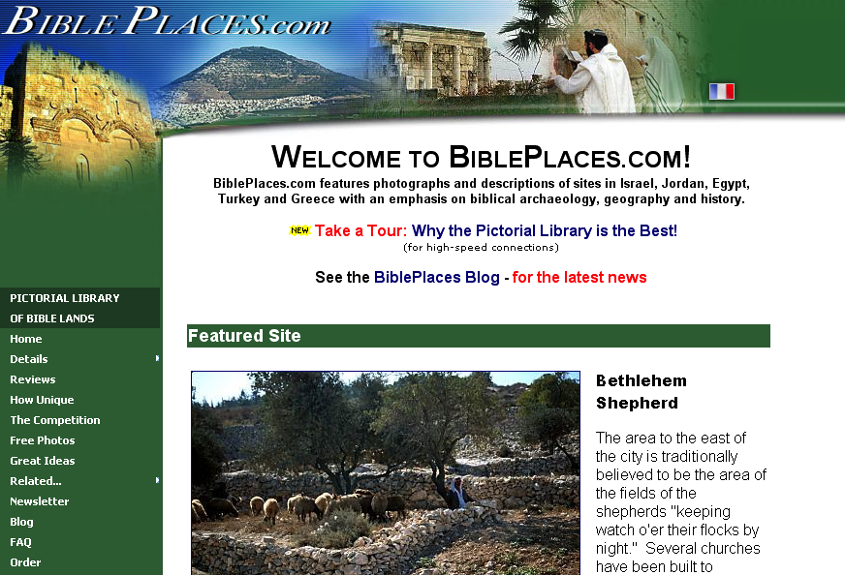
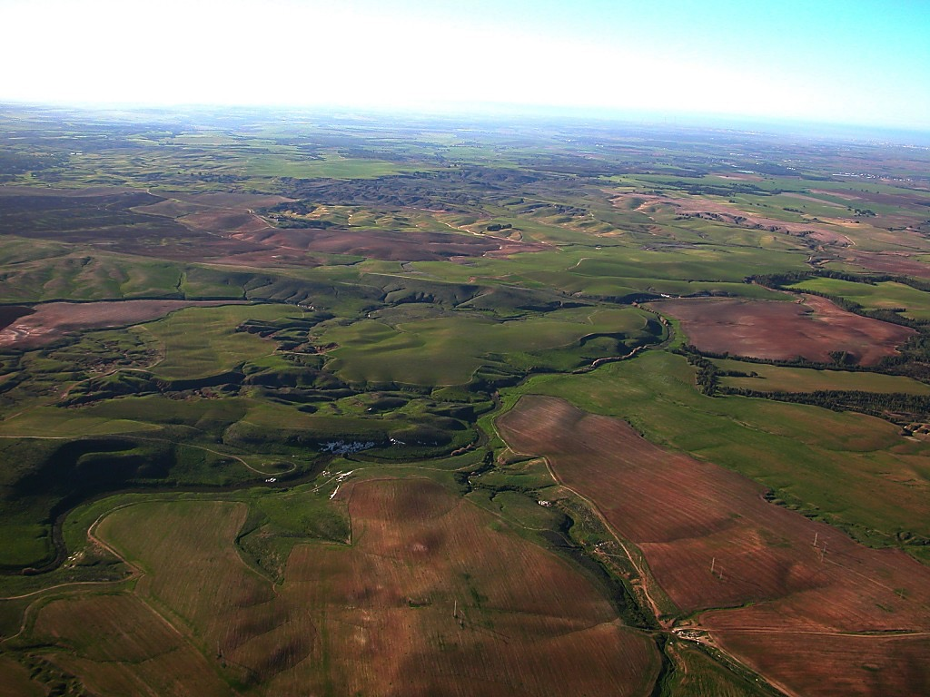
Evtakm niltfti[f Oviy Nalf niAlymf
tiBmAryi[f.... `FpfpAdyilf p<Akpdgfkqi[f vRvaAy upeyakikfk taraqmak `{mti ekaDtft Evtakm niltfti[f Oviy Nalf niAlytti[f vFvAmpfpaqrf Edadf Epal[f `vrfkQkfK, 'gfkqf Uziymf kdAmpfpdfFRkfkibT.
tipipiAy py[pDtfTEvarf, BiblePlaces.com `kpfpkfktfAt ulavv<mf, `tiLlfl ~yirmf k]kfka[ p<Akpdgfkqi[f vRvaAy: kibisftftv viCvacmf Evrfeka]fd priCtft niltftiliRnfT, 'yfk[f, emFtftiEr[iy[f ntipfpDAk vAryiLmf, priEcatikfk EkdfDkfekaqfqpDkibifrfkqf. ~ciriyrfkQkfKmf pdkfkadfcfci tyaripfpaqrfkQkfKmf opfpilfla uyrfnft erecaLx[f Fjitftlf EpadfEdakibapfpikf vRvaAy vzgfKkibt. Ulavrv<mf. Edadf `vrkQkfK n[fbi!

Slide 3



cmfpvipfpT vRmaB
tiBmAryi[f.... `FpfpAd
®
pakmf _nfT
Evtakm `sftiparmf
9.65.05a.
©2006 TBBMI
02
Notes:
SEGMENT TITLE: BIBLICAL BEDROCK (A)
In THE QUICK CHRONOLOGY we found THE WHAT of what happened in the great Biblical panorama. Now it’s time to discover THE WHY of those world-shaping events.

Slide 4

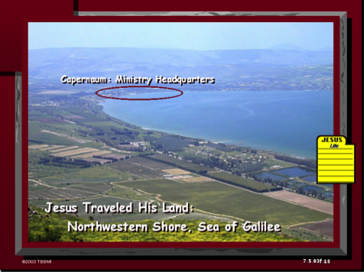
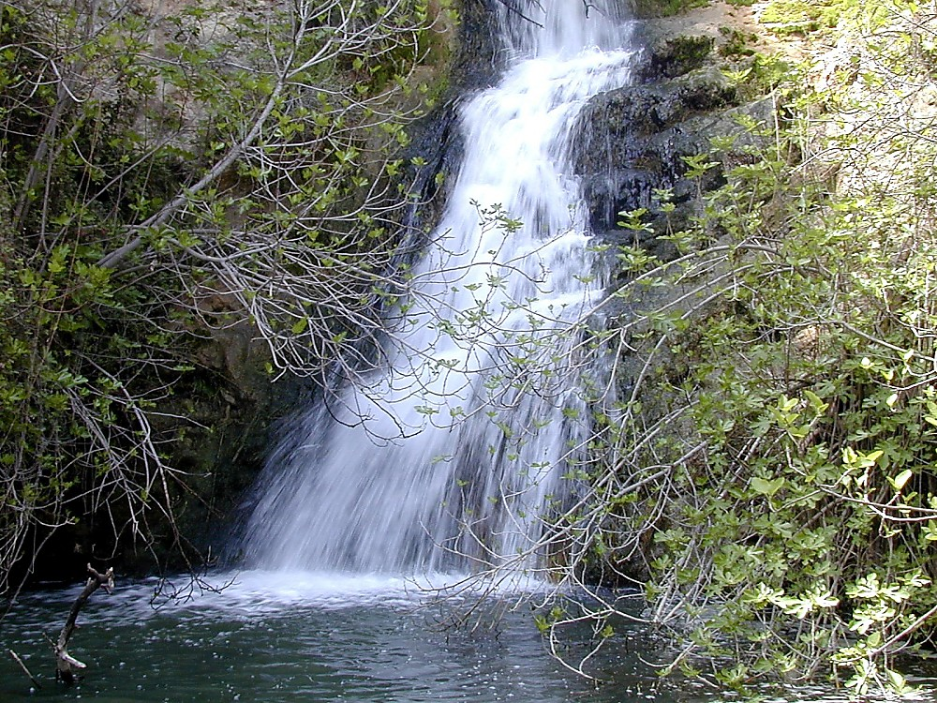
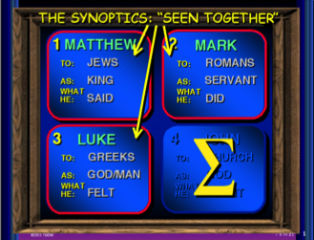
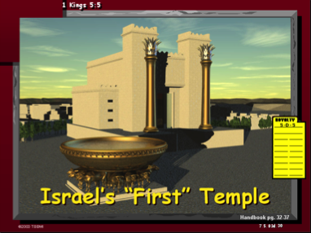
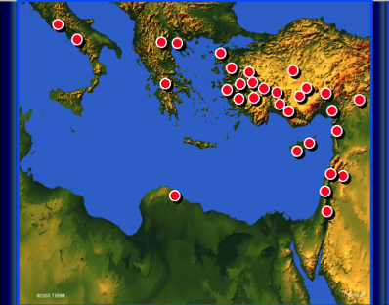
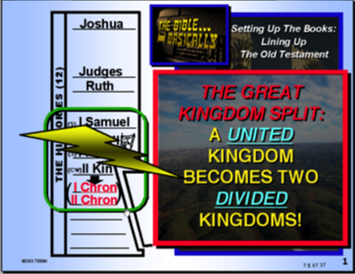
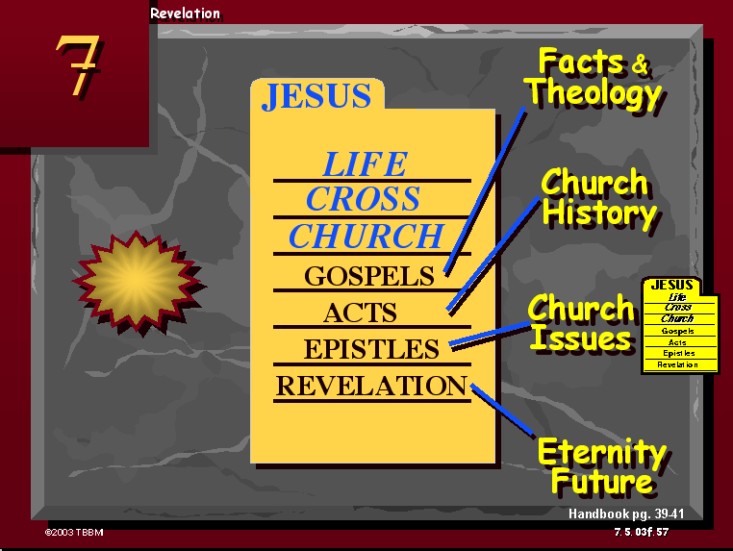
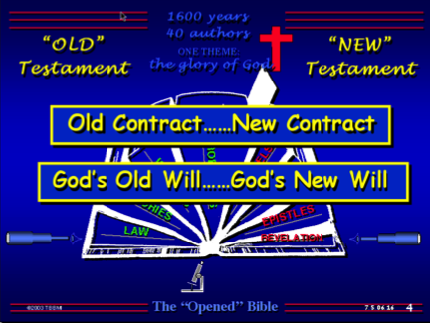
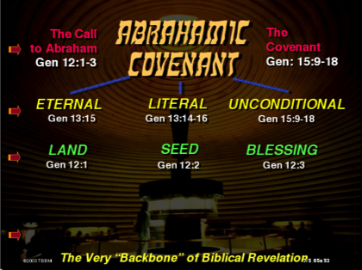
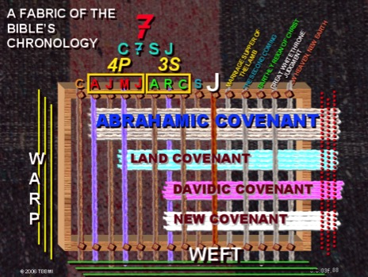
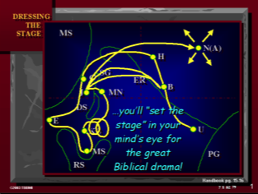
03
©2006 TBBMI
9.65.05a.
Notes:
In everything we’ve encountered so far in THE BIBLE...BASICALLY, we have covered enormous epochs of time, a storyline of incredible dimension, presented to us in a collection of books that are unparalleled in divine authorship, human impact, and spiritual instruction.
So the question is this: what holds all this together? Are there concepts or basic ideas that run straight through the progress of each event and the presentation of each new revelation in God's unfolding program for Man?
_____________
Note to Translators: Slides 3A.10 and 5A.04 are identical and preview slides that should be translated in the other presentations. Note that each graphic listed below shows where to find it in the other presentations. Only the “Help” graphic in the upper left corner and the blue OT map in the lower right corner are translated by the time you start to translate presentation 3A, so take a screenshot of these slides at 01.19 (Presentation 01, slide 19) and 02.79 and substitute the English ones here. For example, the HELP! Graphic is at Animation > Picture 13 > Effect Options > In From Screen Center > Timing > After Previous. Put the translated version of this graphic over it and then delete the English version.
Later, once all the presentations are translated, screen shots of these various slides should be added here.
Here is where to find the 11 graphics:
Picture 8 Map with Red Dots at 08.49
Picture 3 Sea of Galilee at 3F.15
Picture 5 Jesus file Folder at 3F.57
Picture 7 The Synoptics Blue Quadrants at 08.21
Picture 2 Solomon’s Temple at 3D.30.
Picture 14 Blue OT Map at 02.79.
Picture 9 Light Blue OT Historical Books Structure at 07.37
Picture 10 Open Bible Blue OT & NT at 06.16
Picture 11 Abrahamic Covenant Eternal—Literal—Unconditional at 5B.13.
Picture 13 HELP! at 01.19
Picture 18 Fabric of the Bible’s Chronology with Covenants & Jeremiah 31 at 3F.83 and 08.83

Slide 5
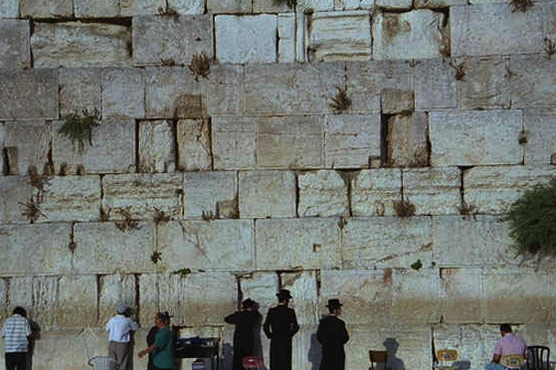
Evtakm
`sftiparmf
~rmfpmaKmf
;dmf
9.65.05a.
1
©2006 TBBMI
04
Notes:
The answer is, yes. The ideas ARE there. And we call them, our BIBLICAL BEDROCK...because in that deepest stratum of biblical meaning, revelation and understanding...
//// ….that's where it all begins.

Slide 6



enyfypfpDvtbfK NaAl EkabfpTpfEpalf kbfpA[ ecyfy<gfkaff...
Evtakmtfti[f kdnft kal uRvmff
pad utvi #08
9.65.05a.
© 2006 TBBMI
05
Notes:
Remember that imaginary loom we built and threaded in the JESUS FILE? On Study Help #8 we called it "The Fabric of the Bible's Chronology.

Slide 7

Evtakmtfti[f kdnft kal uRvmff
7
4m
3c
ra
<;
p
Eya
Ema
Eya
`
`
~
`
p
oZgfKpDtftkfPFy
ptfT
varftfAtkqf !
9.65.05a.
1
© 2006 TBBMI
06
Notes:
7
We prepared the loom with ten threads representing the C7SJ ideas…
//// …followed by those ten organizing words of THE BIBLE FILE.

Slide 8
Evtakmtfti[f kdnft kal uRvmff
7
4m
3c
ra
<;
p
Eya
Ema
Eya
`
`
~
`
pAdpfp<
p
~pirkamf
EyaEcpfp<
EmaEc
EyaCva
`rajkmf
`rcrfkqf
`FAm
`Amti
;EyC
9.65.05a.
1
© 2006 TBBMI
06
Notes:
8
We prepared the loom with ten threads representing the C7SJ ideas…
//// …followed by those ten organizing words of THE BIBLE FILE.

Slide 9
Evtakmtfti[f kdnft kal uRvmff
7
4m
3c
ra
<;
p
Eya
Ema
Eya
`
`
~
`
pAdpfp<
p
~pirkamf
kAdci kalmf
EyaEcpfp<
EmaEc
EyaCva
`rajkmf
`rcrfkqf
`FAm
`Amti
;EyC
9.65.05a.
1
© 2006 TBBMI
06
Notes:
9
We prepared the loom with ten threads representing the C7SJ ideas…
//// …followed by those ten organizing words of THE BIBLE FILE.

Slide 10
Evtakmtfti[f kdnft kal uRvmff
7
Ev. Cigf. Niyayrnftirfpfp<
4m
3c
kiBsftfTvi[f `rcaQAk
~dfDkfKdfFya[vri[f tiRviRnfT
;r]fdamf vRAk
p<tiy va[mf, p>mi
ra
<;
p
Eya
Ema
Eya
`
`
~
`
pAdpfp<
p
~pirkamf
kAdci kalmf
EyaEcpfp<
EmaEc
EyaCva
`rajkmf
`rcrfkqf
`FAm
`Amti
;EyC
9.65.05a.
1
© 2006 TBBMI
06
Notes:
10
We prepared the loom with ten threads representing the C7SJ ideas…
//// …followed by those ten organizing words of THE BIBLE FILE.

Slide 11
Evtakmtfti[f kdnft kal uRvmff
7
Ev. Cigf. Niyayrnftirfpfp<
3c
~dfDkfKdfFya[vri[f tiRviRnfT
4m
kiBsftfTvi[f `rcaQAk
;r]fdamf vRAk
p<tiy va[mf, p>mi
ra
`
`
<;
p
Eya
Ema
Eya
~
`
~pirkami[f ud]fpFkfAk
nil ud]fpFkfAk
taviti[f ud]fpFkfAk
p<tiy ud]fpFkfAk
9.65.05a..
5
© 2006 TBBMI
10
Notes:
Now…bring back to mind those strong bands of the covenants that we wove into that fabric of the Bible's chronology...Those covenants…unconditional promises from God…we believe are continuing to run at this very time. Those strong bands of the Old Testament promises are, in order,
//// THE ABRAHAMIC COVENANT...Genesis 12 and 15…
//// THE LAND COVENANT...Deuteronomy 30
//// THE DAVIDIC COVENANT…2 Samuel 7…and
//// the great NEW COVENANT…Jeremiah 31.
Taken together, all these grand events bring to a
//// close earth’s history and the climax of all those glorious promises – and their complete fulfillment – made from God to old Abraham so long ago.

Slide 12
Evtakm evqipaDkqi[f “MTekZmfp<“
nipnftA[ybfb Etv
f ud]fpFkfAkyi[f tidfdmf
11
Notes:
SO...to further explore all this...let's get into THE BACKBONE OF BIBLICAL REVELATION...GOD'S UNCONDITIONAL COVENANTAL PROGRAM.

Slide 13
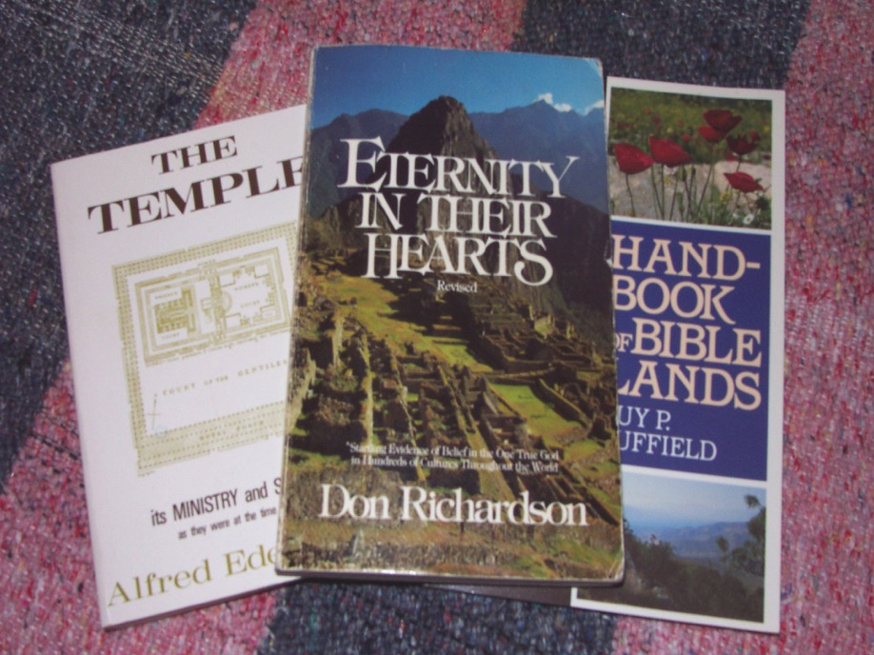
Evtakm evqipaDkqi[f MTekZmfp< nipnftA[ybfb Etv ud[fpFkfAkyi[f tidfdmf
da[f ricfcrfdfs[f, ;drf[idfF ;[f tiyrf ~rfdf.
12
Notes:
Here's another good quote to think about...it's by Christian author Don Richardson, a writer of wide and long experience on the mission field...a missionary who is also an expert linguist. Don Richardson wrote...in his book ETERNITY IN THEIR HEARTS…

Slide 14
Evtakm evqipaDkqi[f MTekZmfp< nipnftA[ybfb Etv ud[fpFkfAkyi[f tidfdmf
~pirkami[f ud]fpFkfAk... Evtakm MTekZmfpayfyiRkfkibT – piritftiEyk evqipadfF[f t]fDvdmf. t]fDvdtfAt otfTkfekaqfqat 'nfft EpatA[y<mf cil MTekZmfpilflatAt tvirfkfk MFyaT.
criyak ecalflEv]fDma[alf--MTekZmfpilflaAm. ;t[alf kibsftftvrfkqf tgfkQAdy j[tftibfK matftirmf `lflamlf ulktftiLlfl lfla j[tftibfKmf tagfkqf epbfb ~cirfvattfAt vzgfk Ukfkmbfbvrfkqak ;Rpfparfkqf. (pkfkmf 163)
da[f ricfcrfdfs[f, ;drf[idfF ;[f tiyrf ~rfdf.
13
2
Notes:
“The Abrahamic Covenant...is the very backbone of the Bible – the spinal column of special revelation. Teaching which does not acknowledge that spinal column will inevitably have a certain spinelessness about it.
//// It will – quite literally – lack backbone. And it will tend to leave Christians less motivated than they would otherwise be to …
//// …pass on the blessing they have received, not merely to their own kind of people, but to all people on earth.”

Slide 15
Evtakm evqipaDkqi[f MTekZmfp< nipnftA[ybfb Etv ud[fpFkfAkyi[f tidfdmf
“pavmf”f - '[fkib varftfAt KbitfT
'piery, kiErkfk emaziyilf:
Tvra[ ndtfAt
papcf ecylf
`kfkirmgfkqff
plvI[gfkqf
mIBtlffkqff
tIAmkqf...
pad utvi #10
14
8
Notes:
Now let's put some parts of a Biblical puzzle together. There will be several pieces to work with. Begin with Study Help #10.
//// Starting with some ideas about that common little English word, SIN.
//// In both the Hebrew of the Old Testament and the Greek of the New...both words which, in English, are translated SIN ... actually have much wider meanings…such as…
//// MISBEHAVIOR...
//// INIQUITY...
//// TRANSGRESSION...
//// WICKEDNESS...
//// TRESPASS...
//// and EVIL...
Each of those words in their original languages means all these different kinds of negative behavior. As you can see, the word SIN is really an ineffective single word when we consider all the wider ORIGINAL meanings for which the only English word in translation is: SIN.

Slide 16
Ntjhfk ntspg;ghbd; “KJnfYk;G” :
flTspd; epge;jidapy;yh epfo;
~[alf!…oREvAl nIgfkqf cinftipfpT '[f[ev[fbalf…
“ghtk;” vd;w thh;j;ij ...
vgpNuah; fpNuf;F nkhopfsps;:
…`nft `Adyalmf 'gfEk ka]lamf?
“Fwp jg;GtJ.”
15
2

Slide 17
Evtakm evqipaDkqi[f MTekZmfp< nipnftA[ybfb Etv ud[fpFkfAkyi[f tidfdmf
“pavmf”f - '[fkib varftfAt KbitfT
'piery, kiErkfk emaziyilf: “Kbi tvBtlf”
p>r]ma[ `rtfttftibfK… EvttibfK EnrFyak eclflv<mf !
“~Akyalf prElaktftiliRkfkib ugfkqf pita p<>r] cbfK]rayiRkfkibTEpal nIgfkQmf p<>r] cbfK]rayiRkfk kdvIrfkqf.” mtf 5 : 48
16
1
Notes:
Well…for that plumb line of perfection…we go straight to Scripture. And there we discover God's own mark or expectation for perfect human behavior.
//// Jesus Himself said, “Be perfect, therefore, as your heavenly Father is perfect.” [Matthew 5:48]

Slide 18
Etv]i[f mktfTv namgfkqf!
ABBA…ADVOCATE…ALMIGHTY…ALPHA…AMEN…ANCIENT OF DAYS…
ANOINTED ONE…APOSTLE AND HIGH PRIEST…ARM OF THE LORD…
AUTHOR OF LIFE…AUTHOR OF OUR FAITH…BEGINNING AND THE END…
BLESSED AND ONLY RULER…BRANCH…BREAD OF LIFE…BREAD OF GOD… BRIDE GROOM…BRIGHT MORNING STAR…CHIEF SHEPHERD…CHOSEN ONE…CHRIST…CHRIST OF GOD…CHRIST THE LORD…CHRIST THE SON OF THE LIVING GOD… COMFORTER…COMMANDER…CONSOLATION OF ISRAEL…CONSUMING FIRE…CORNER STONE…COUNSELOR… CREATOR…DELIVERER…. DESIRED OF ALL NATIONS… DOOR…EL SHADDAI…ETERNAL GOD… EVERLASTING FATHER…EXACT REPRESENTATION OF HIS BEING… FAITHFUL AND TRUE…FAITHFUL WITNESS…FATHER… FIRSTBORN OVER ALL CREATION….FIRST FRUITS… FOUNDATION…FRIEND OF TAX COLLECTORS AND SINNERS…GENTLE WHISPER…GIFT OF GOD…GLORY OF THE LORD…GOD…GOD ALMIGHTY…GOD OVER ALL…GOD WHO SEES ME…GOOD SHEPHERD…GREAT HIGH PRIEST…GREAT SHEPHERD… GUIDE…HEAD OF THE BODY…HEAD OF THE CHURCH…HEIR OF ALL THINGS…HIGH PRIEST FOREVER…HOLY ONE…HOLY ONE OF ISRAEL…HOLY SPIRIT…HOPE …HORN OF SALVATION…I AM…IMAGE OF GOD…IMAGE OF HIS PERSON…IMMANUEL…JEHOVAH…JESUS…JESUS CHRIST OUR LORD…JUDGE…KING…KING ETERNAL…KING OF KINGS…KING OF THE AGES…LAMB OF GOD…LAST ADAM…LAW GIVER…LEADER… LIFE…LIGHT OF THE WORLD…LIKE AN EAGLE…LILY OF THE VALLEY…LION OF THE TRIBE OF JUDAH…LIVING STONE…LIVING WATER…LORD…LORD GOD ALMIGHTY…LORD JESUS CHRIST…LORD OF ALL…LORD OF GLORY…LORD OF LORDS…LORD OUR RIGHTEOUSNESS…LOVE…MAN OF SORROWS…MASTER… MEDIATOR…MERCIFUL GOD…NAZARENE…OFFSPRING OF DAVID…OMEGA…ONLY BEGOTTEN SON…OUR PASSOVER LAMB… OUR PEACE…POTTER…POWER OF GOD…PRINCE OF PEACE… PROPHET…PURIFIER…RABBONI [TEACHER]…RADIANCE OF GOD’S GLORY…REDEEMER…REFINER’S FIRE…RESURRECTION AND THE LIFE…RIGHTEOUS ONE…ROCK…ROOT OF DAVID…ROSE OF SHARON…RULER OF GOD’S CREATION…RULER OF THE KINGS OF THE EARTH…RULER OVER ISRAEL…SAVIOR…SCEPTER OUT OF ISRAEL…SEED…SERVANT…SHEPHERD AND OVERSEER OF YOUR SOULS…SHIELD…SON OF DAVID…SON OF GOD…STAR OUT OF JACOB…STONE…SON OF RIGHTEOUSNESS… TEACHER…TRUE LIGHT…TRUTH…VINE…WISDOM OF GOD…WONDERFUL COUNSELOR…WORD…WORD OF GOD.
;EyC
krftftrakiy kiBsftfT
krftftrakiy kiBsftfT
pad utvi #11
Mary Foxwell Loeks, The Glorious Names of God
KbiAy - tvrvidfEdama ;lfAlya?
17
8
Notes:
With Study Help # 11…how exactly would you ever know the dimensions of “perfection?” For that…just look at the names of God right there in the Bible…names, terms and phrases that He uses in reference to Himself. That list gives us a good idea of the quality of the behavior and spiritual behavior expected of us. And, of course, among those dozens of the biblical names for God…are these…
//// ….ALMIGHTY…
//// ….COMFORTER…
//// ….FAITHFUL AND TRUE…
//// ….LAMB OF GOD…
//// ….RIGHTEOUS ONE…
//// ….TRUTH…
//// ….AND THAT NAME ABOVE ALL NAMES……CHRIST THE LORD…JESUS Himself!
These are some of the dimensions of expectation…to which none of us can compare. Then the question remains…
//// DO WE…OR DO WE NOT…MISS THE MARK? THAT’S why we need a Savior…Jesus Christ the Lord.

Slide 19
Evtakm evqipaDkqi[f MTekZmfp< nipnftA[ybfb Etv ud[fpFkfAkyi[f tidfdmf
“pavmf”f - '[fkib varftfAt KbitfT….
`nft tidfdma[ `qAvkfK yarf `qkfk MFy<mf?
pv<lf mikcf cibpfpak Eramrf 3 : 23lf
etaKtfT vznfKkibarff
18
1
Notes:
Another question then: WHO can measure up to such criteria? How do we live life on this planet and NOT miss that mark?
//// We have an answer to that. Paul summed it up clearly in Romans.

Slide 20
'lflaRmf pavwfecyfT,
Etv mkiAmybfbvrfkqaki....
19
Notes:
"FOR ALL HAVE SINNED AND FALL SHORT OF THE GLORY OF GOD." AGAIN…ALL HAVE SINNED!

Slide 21
Evtakm evqipaDkqi[f MTekZmfp< nipnftA[ybfb Etv ud[fpFkfAkyi[f tidfdmf
pAzy
p<tiy
"bfpaD
"bfpaD
opfpnftmf
opfpnftmf
ud]fpFkfAk
ud]fpFkfAk
WILL
citftmf
WILL
ud]fpFkfAk
pad utvi #12
opfpnftmf
"bfpaD
20
19
Notes:
Now comes another puzzle piece...Study Help #12…this one is a matter of some interchangeable words. Beginning with
//// WILL.....then
//// CONTRACT...followed by
//// TESTAMENT...and finally
//// COVENANT.
Each of these terms has a legal idea behind its meaning.
In fact,
//// CONTRACT and TESTAMENT are interchangeable...as are
//// TESTAMENT and WILL...then
//// WILL and CONTRACT...and finally...each one...
//// CONTRACT,
//// TESTAMENT and
//// WILL…is an interchangeable term with
//// COVENANT.
So there is an enormous amount of contractual and legal nuance brought together in these four terms. In other words, according to the dictionary, we could call the parts of our Bible...God’s OLD
//// ….WILL…
//// ….COVENANT...or
//// ….CONTRACT…
In the same way…we could refer to God’s New
//// ….WILL
//// ….COVENANT or
//// ….CONTRACT
Interchangeable terms that give enormous insight into the depth and breadth of God’s legal arrangements with his Creation. With all these possibilities…it was the decision of earlier translators to use the older inclusive term TESTAMENT…giving us
//// OLD TESTAMENT and
//// NEW TESTAMENT.
Then...with the idea of Biblical covenants and contracts in mind...think about this…

Slide 22
Evtakm evqipaDkqi[f MTekZmfp< nipnftA[ybfb Etv ud[fpFkfAkyi[f tidfdmf
pzgfkal
ud]fpFkfAkkQmf
opfpnftgfkQmf.
21
Notes:
…the social or financial situations in those ancient times where covenants and contracts were a prominent part of civil discourse. As an example of ancient covenants, this situation…

Slide 23
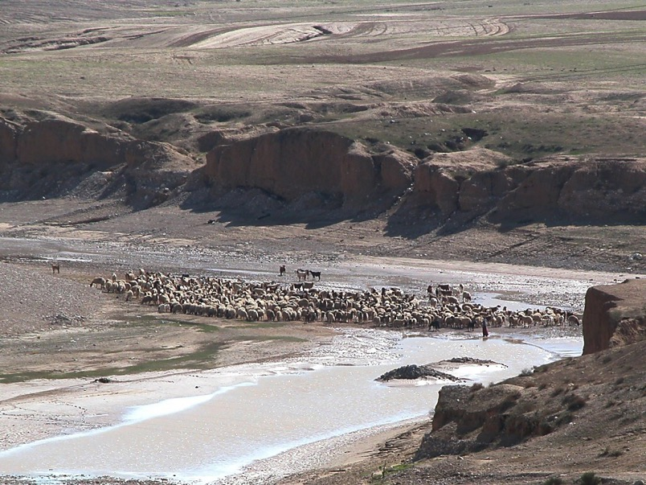
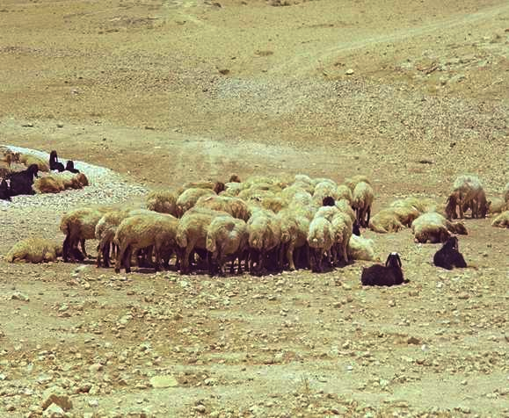
Evtakm evqipaDkqi[f MTekZmfp<: nipnftA[ybfb Etv ud[fpFkfAkyi[f tidfdmf
pzgfkal ud]fpFkfAkkqff
pad utvi #13
22
1
Notes:
…with Study Help 13 in hand…suppose you own a herd of sheep…but you need additional land on which to graze that herd.
//// On the other hand, your friend owns a very large range of land and is quite willing to make some of it available to fill your needs.
How do you make that arrangement?
In Biblical times…in one of four ways...such as…

Slide 24
sfra 10:19; EckfkiEylf 17:18
Evtakm evqipaDkqi[f MTekZmfp<: nipnftA[ybfb Etv ud[fpFkfAkyi[f tidfdmf
pzgfkal ud]fpFkfAkkqff
• Akkqf
23
Notes:
The ancient HAND COVENANT…simply shaking hands…a basic gesture of understanding between people -- coming right on down to our own time.

Slide 25
Rtf 4:8
Evtakm evqipaDkqi[f MTekZmfp<: nipnftA[ybfb Etv ud[fpFkfAkyi[f tidfdmf
pzgfkal ud]fpFkfAkkqff
• Akkqf
• ecBpfp<
24
Notes:
With slightly more symbolic permanence…though temporary…the SHOE COVENANT. As a symbol of the agreement, each party exchanges a sandal, which will be retained by each...just as long as the agreement is in effect. To cancel it all, we simply give back each other's sandal, and the agreement is concluded. Things return to their original condition.

Slide 26
Elvi 2:13; [f 18:19; 2 naqa 13:5
Evtakm evqipaDkqi[f MTekZmfp< : nipnftA[ybfb Etv ud[fpFkfAkyi[f tidfdmf
pzgfkal ud]fpFkfAkkqff
• Akkqf
• ecBpfp<
• upfp<
• ;rtftmf
25
2
Notes:
Then…the SALT COVENANT…still another form of contract, this one requiring yet more commitment than the shoe covenant, though not by much. Each party to the agreement exchanged an amount of precious salt from a side condiment pouch many people carried. The idea here being that once the agreement was ended…the return of all the salt would be very difficult although, in theory, possible. And also, salt was used in ancient times as a way of ratifying an agreement. Sometimes the pouches were just exchanged between the parties. So, this contract could be nullified with some ease.
//// But now, we come to the most important and far-reaching ancient covenant or contract agreement of them all. This one we call a BLOOD COVENANT.
The Blood Covenant worked like this:
//// each of the parties to an agreement selects an animal, or animals, depending upon one’s personal wealth.

Slide 27

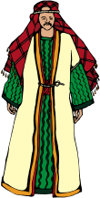





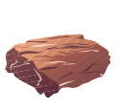



~tiyakmmf 15
Evtakm evqipaDkqi[f MTekZmfp<: nipnftA[ybfb Etv ud[fpFkfAkyi[f tidfdmf
[Etv[f] kIEz ;bgfki ~pirkaEmaD( ~pirkami[f ud]fpFkfAk) cmfpirtay opfpnftmf ecyftarf(T]fFtftarf). ~A]yiDmfpF(ud]fpFkfAkAy uBtipDtft) tmfmiLmf epriyvrf oRvRmilflatpFyi[aEl, “tmTEpriEl taE[ ~A]yidfdarf”( 'pieryrf 6:13). ;T oRtrpfpa[ ud]fpFkfAkyakyiRkfkibT. ~Akyalf `vfvakfKttftmf nicfcyma[T.
Walvoord/Zuck, The Bible Knowledge Commentary
;rtft ud]fpFkfAkyilf:
‘AkeyZtftidfd’ oR caraaf mbikfKmff vAr, `vfv<d[fpFkfAk py{qfqtayiRkfkibT!
pzgfkal ud]fpFkfAkkqff
X
• ;rtftmf
26
3
Notes:
The animals are slaughtered and the carcasses spread about on the ground with a passage between them,
//// …and then side-by-side, the parties walk together between the animal pieces. Significant? Yes…because blood has been spilled in behalf of the arrangement.
//// That BLOOD COVENANT then is utterly binding until the death of one of the parties! In other words, there is no abrogating a blood covenant. Why this emphasis? Here’s a glimpse of that climactic scene in Genesis between Abraham and God:
//// “[God] came down and made…or literally CUT…a formal treaty with Abraham (the Abrahamic Covenant.) Since God could “swear” (confirm a covenant) by none greater, ‘He swore by Himself’ (Heb. 6:13). In other words this was a unilateral covenant. So its promises are absolutely sure.

Slide 28

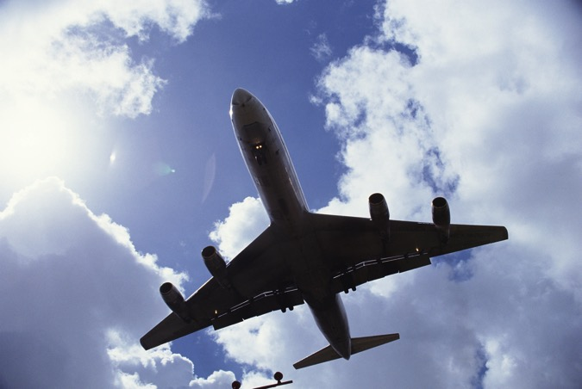

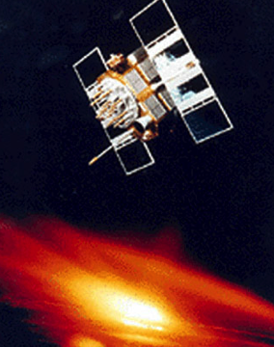
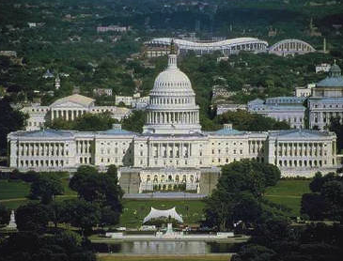

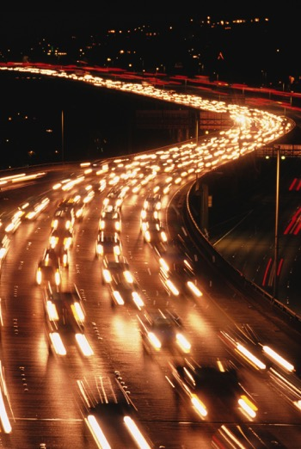
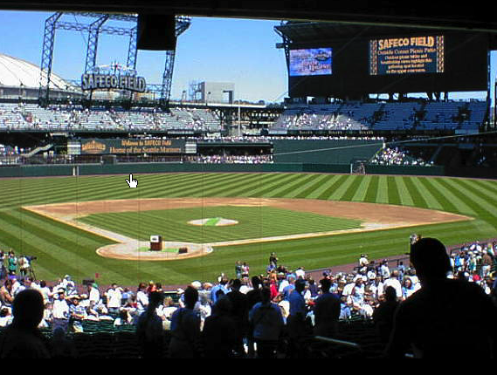
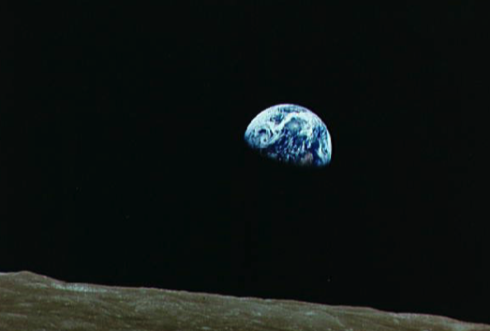
;AvkAqeylflamf o[fbak niAlniBtfTvT '[f[?
27
1
Notes:
Now the last puzzle piece...
Here is a series of sights and events that are common to life in the United States at this time in the world’s history.
….And the majesty of the U.S. capitol building in Washington D.C.
With all of these varied aspects of our contemporary life...
//// ….there is a question here: is there one common concept that holds all this together? Is there an underlying idea or fundamental principle that brings all this – in this instance, the United States of America – together in what we could call –– in this case –– nationhood?

Slide 29
`emrikfkavi[f `rciylf cac[mf `emrikrfkqi[f vazfkfAkyi[f Mkfkiy MTekZmfp<
28
Notes:
We could suggest that the U.S. Constitution be considered as the very BACKBONE of American life. It is a legal document...not a divine instrument, of course. However, through the centuries that single written document has held the United States and its way of life together…through war and through peace...the good times and the very bad…a document of common understanding among all American people.

Slide 30
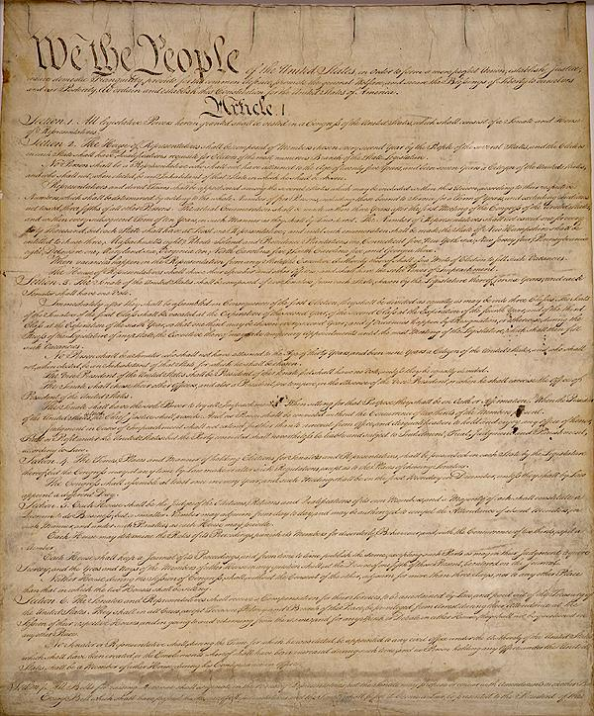
M[it{kfKmf `v[f `rcagfktibfKmf p<rinfT[rfv<qfq cdfdp>rfvma[ ptftirmf!
`emrikfkavi[f `rciylf cac[mf `emrikrfkqi[f vazfkfAkyi[f Mkfkiy MTekZmfp<
29
1
Notes:
//// A LEGAL DOCUMENT OF UNDERSTANDING BETWEEN MEN AND THEIR GOVERNMENTS.

Slide 31
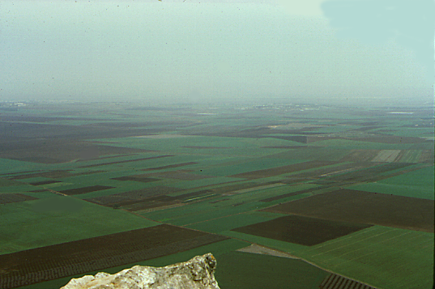
`Azpfp<
kaEtxf prfE[ya
c-t-ca
CviExgfkqf
40
cI[ayf
niBpgfkqf
'riEka
nilmf pgfkiDtlf
430
yatftirakmmf
cAp
70 ~]fDkqf
;sfrEvlf
tIrfkfktricikqf
ya-"
`pfEpasftlrfkqf
`FAmkqf
niyayatiptikqf
y>ta
350
ni-vi-~
I - I
12 Ekatftirmf
evqipDtfti[ viEcxmf
t-o-ni
ec-'sf-en
5 pircgfkgfkqf
3 pirya]gfkqf...
9.65.05a.
© 2006 TBBMI
30
Notes:
Now think about all of these Biblical concepts, these ideas, the people, the events...all of them major parts of THE BIBLE…BASICALLY and THE QUICK CHRONOLOGY … the Bible's time and story lines we have moved through earlier…[DISSOLVING DIRECTLY INTO…]

Slide 32
`Azpfp<
kaEtxf prfE[ya
c-t-ca
CviExgfkqf
40
mbfBmf...
niBpgfkqf
cI[ayf
'riEka
nilmf pgfkiDtlf
krftftrakiy ;Eyc kiBsftfTvi[f Uziymf
430
yatftirakmmf
cAp
70 ~]fDkqf
;sfrEvlf
tIrfkfktricikqf
ya-"
`pfEpasftlrfkqf
`FAmkqf
niyayatiptikqf
y>ta
350
ni-vi-~
I - I
12 Ekatftirmf
evqipDtfti[ viEcxmf
t-o-ni
ec-'sf-en
5 pircgfkgfkqf
3 pirya]gfkqf...
9.65.05a.
© 2006 TBBMI
30
Notes:
32
Now think about all of these Biblical concepts, these ideas, the people, the events...all of them major parts of THE BIBLE…BASICALLY and THE QUICK CHRONOLOGY … the Bible's time and story lines we have moved through earlier…[DISSOLVING DIRECTLY INTO…]

Slide 33
`Azpfp<
kaEtxf prfE[ya
c-t-ca
CviExgfkqf
40
mbfBmf...
niBpgfkqf
cI[ayf
'riEka
nilmf pgfkiDtlf
krftftrakiy ;Eyc kiBsftfTvi[f Uziymf
430
yatftirakmmf
cAp
70 ~]fDkqf
;sfrEvlf
tIrfkfktricikqf
ya-"
`pfEpasftlrfkqf
`FAmkqf
niyayatiptikqf
y>ta
350
ni-vi-~
'lfla cmfpvgfkQkiAdyilff etadrfp< u]fda?
I - I
12 Ekatftirmf
evqipDtfti[ viEcxmf
t-o-ni
ec-'sf-en
5 pircgfkgfkqf
3 pirya]gfkqf...
9.65.05a.
© 2006 TBBMI
30
Notes:
33
Now think about all of these Biblical concepts, these ideas, the people, the events...all of them major parts of THE BIBLE…BASICALLY and THE QUICK CHRONOLOGY … the Bible's time and story lines we have moved through earlier…[DISSOLVING DIRECTLY INTO…]

Slide 34
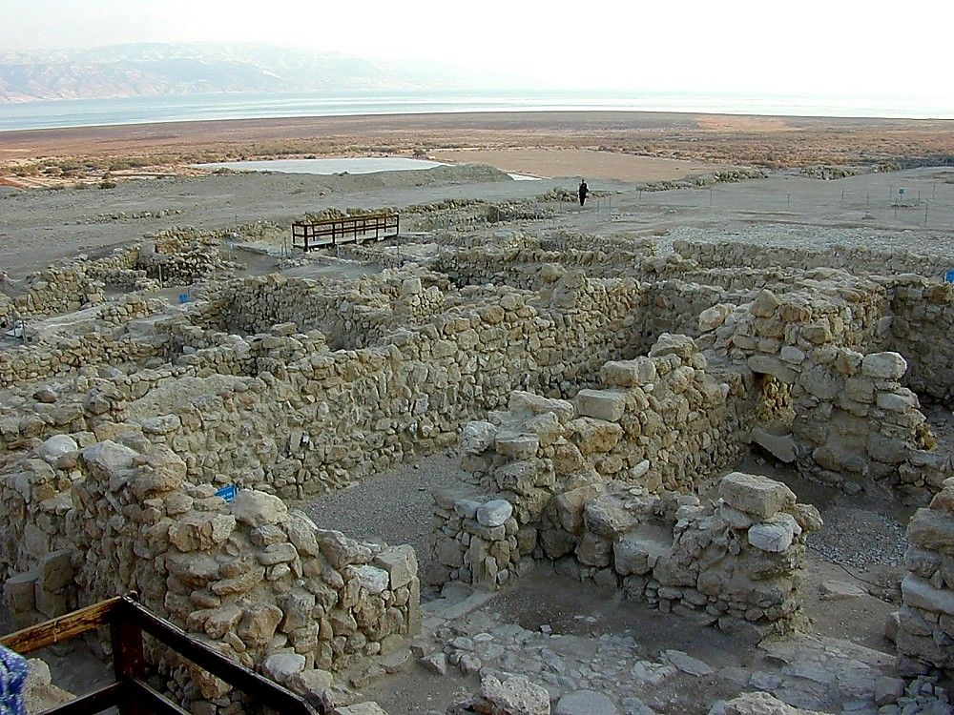
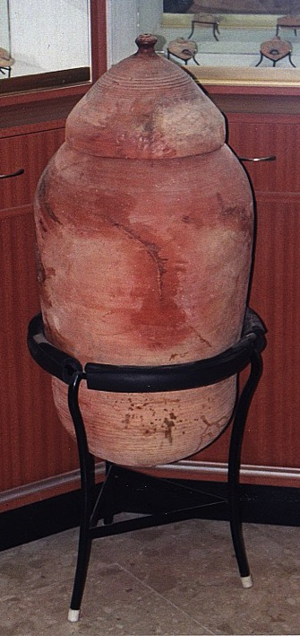
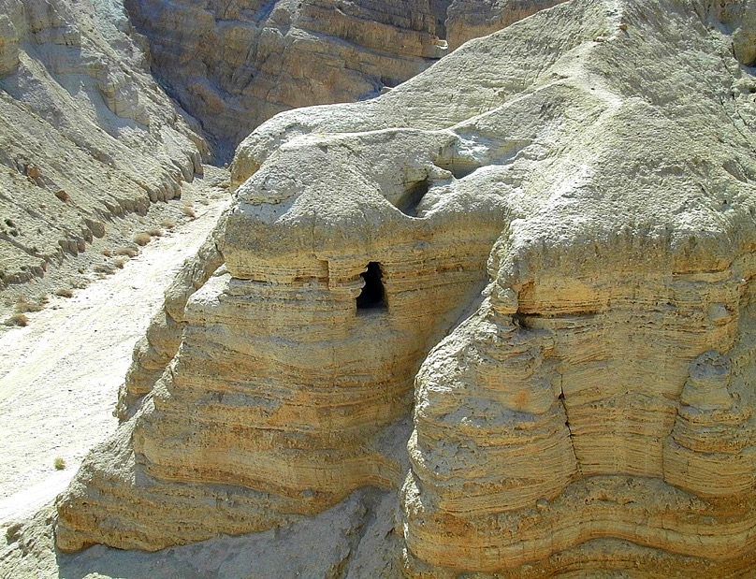
upfp< kdlf kakit CRqfkqf olitfTAvtftlf
pzgfkal ciAtnft Kmfra[f, upfp< kdElarmayf vaznft 'ec[iyrf cMtaymf
33
2
Notes:
But first…let’s make a framework in which to talk about all this. These are the ancient ruins of Qumran, a community of Essenes – a sect of extremely pious Jews – who lived apart on the shores of the Dead Sea not far from Jerusalem. Some scholars believe that John the Baptist was a member of this community.
//// The Essenes were known to have hand-copied the ancient Jewish scriptures. As Palestine was collapsing under the Romans, the Essenes spirited their precious copies of the Scriptures out of the community…hiding them across a dry streambed in a group of caves…
//// …preserving them in ceramic jars like this. And they stayed right there –– in the caves –– undisturbed until 1947 when they were discovered by a shepherd boy searching for his wandering sheep.

Slide 35

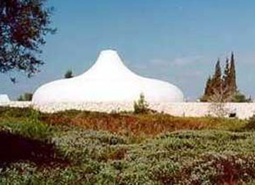
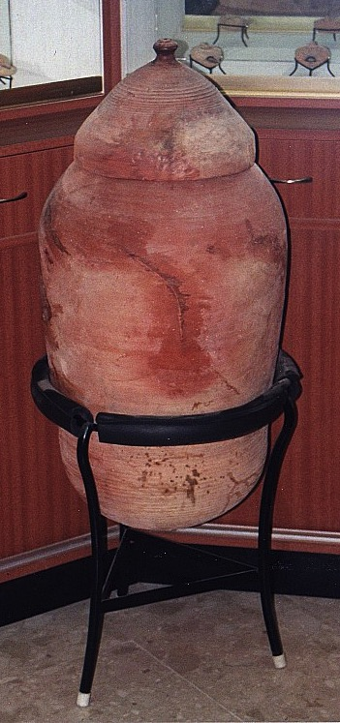
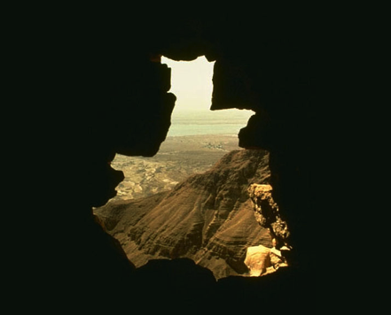
p<tftktfti[f p<]f]iy sftlmf, ;sfrEvlf Etciy `Rgfkadfcfciykmf, 'RcElmf.
9.65.05a.
2
©2006 TBBMI
34
Notes:
Today, some of those ancient scrolls are preserved and displayed to the public in Jerusalem’s…
//// …famed Shrine of the Book at Israel’s National Museum.
//// So…from the caves…to the museum and to scroll researchers around the world…an enormous treasure of Essene writings has survived….held by many to be the most significant archeological discovery of the Twentieth Century.

Slide 36
p<tftktfti[f p<]f]iy sftlmf, ;sfrEvlf Etciy `Rgfkadfcfciykmf, 'RcElmf.
p<tftktfti[f p<]f]iy sftltfti[f udfp<bmf
9.65.05a.
©2006 TBBMI
35
Notes:
Then…with this background inside Jerusalem’s Shrine of the Book, let’s explore the place of the Biblical legal understandings and promises between God and man…just as they have come down to us IN WRITING and preserved in the pages of Scripture in your own Bible.

Slide 37
~pirkami[f
ud]fpFkfAk
pad utvi #14
9.65.05a.
1
©2006 TBBMI
36
Notes:
The arrows on the side of the screen will guide us through Study Help #14…
//// ….as we develop…first… THE ABRAHAMIC COVENANT.

Slide 38
~pirkami[f ud]fpFkfAk
Evtakm evqipaDkqi[f “MTekZmfp<” :
nipnftA[ybfb Etv ud[fpFkfAkyi[f tidfdmf ;gfEk ~rmfpmakibT.
9.65.05a.
©2006 TBBMI
37
Notes:
This is Richardson’s “VERY BACKBONE OF BIBLICAL REVELATION.” GOD’S UNCONDITIONAL COVENANTAL PROGRAM BEGINS RIGHT HERE!
That great ABRAHAMIC COVENANT....God's unconditional covenantal program of the ages was announced in two parts..

Slide 39
~pirkaAm `Aztftlf ~ti 12:1-3
~pirkami[f ud]fpFkfAk
ud]fpFkfAk ~ti 15:9-18
Evtakm evqipaDkqi[f “MTekZmfp<” :
nipnftA[ybfb Etv ud[fpFkfAkyi[f tidfdmf ;gfEk ~rmfpmakibT.
9.65.05a.
2
©2006 TBBMI
38
Notes:
Guided on the Study Help by the arrows to the left…
The Abrahamic Promises originate in two different locations in Genesis...
//// First…Abraham received his famous CALL –– with its three promises –– in Genesis 12:1-3. Remember the time frame: about 2000 B.C.
//// Later on in Genesis 15:9-18, the actual Covenant is presented …in the form of a BLOOD COVENANT…as we described earlier…. followed by God –– in effect –– signing the actual COVENANT or contract between Himself and Abraham.
So then…what ARE the features of that ancient promise.

Slide 40
~tiyakmmf 12: 1-3
~pirkami[f vakfKttftmf
¹ krftftrf ~pirkaAm Enakfki: nI u[f EtctfAty<mf,
u[f ;[tfAty<mf, u[f tkpfp{Ady vIdfAdy<mf
vidfDpf p<bpfpdfD, na[f u[kfKkf ka]fpikfKmf
EtctfTkfKpf Epa.
nilmf
2 na[f u[fA[ epriy jatiyakfki u[fA[
~cirfvtitfT, u[f EpArpf
epRAmpDtfTEv[f, nI ~cirfvatmayf ;Rpfpayf.
vitfT
~pirkamf
³ u[fA[ ~cIrfvtikfkibvvrfkAq ~cIrfvtipfEp[f.
u[fA[ cpikfkibvA[cf cpipfEp[f p>miyiLlfl
vmfcgfkEqlflamf u[kfKqf
~cIrfvtikfkppDmf '[fbarf.
The CALL
ni - vi - ~
I - I
J - E
12
~cirfvatmf
39
8
Notes:
Read along with this Covenant between God and Abraham as we touched on it much earlier...remember from Genesis 12: 1-3?
//// ….the L-S-B on the ABRAHAM File Folder. The verses read…
//// ¹ “ The Lord had said to Abram,
“Leave your country, your people and your father’s household, and go to the land I will show you.
//// THIS IS THE PROMISE OF A LAND FOR THE ABRAHAM’S DESCENDANTS.
//// ²“I will make you into a great nation
and I will bless you;
I will make your name great,
and you will be a blessing.
//// THIS IS THE PROMISE OF A SEED, OR GREAT LINE OF DESCENDANTS, TO COME FROM HIM.
//// ³ I will bless those who bless you,
and whoever curses you I will curse;
and all peoples on earth
will be blessed through you.”
//// THIS IS THE BLESSING, THAT PART OF THE PROMISE THAT EXTENDS FAR BEYOND ABRAHAM’S LINE…OUT TO EVERY PERSON ON EARTH FROM THEN UNTIL THIS VERY DAY!
//// The significant points of that promise are these... L…S…B… presenting to Abraham
A LAND...A SEED......AND A BLESSING!

Slide 41
~pirkaAm `Aztftlf ~ti 12:1-3
~pirkami[f ud]fpFkfAk
ud]fpFkfAk ~ti 15:9-18
nilmf
vitfT
~cirfvatmf
~ti 12:1
~ti 12:2
~ti 12:3
Evtakm evqipaDkqi[f “MTekZmfp<”
9.65.05a.
2
©2006 TBBMI
40
Notes:
So…in outline…The LAND provision is stated in Genesis 12:1...
//// The SEED aspect laid out in Genesis 12:2...
//// And that amazing BLESSING provision in Genesis 12:3.

Slide 42
~tiyakmmf 12: 1-3
~pirkami[f vakfKttftmf
¹ krftftrf ~pirkaAm Enakfki: nI u[f EtctfAty<mf,
u[f ;[tfAty<mf, u[f tkpfp{Ady vIdfAdy<mf
vidfDpf p<bpfpdfD, na[f u[kfKkf ka]fpikfKmf
EtctfTkfKpf Epa.
;vfvarftfAtkAqmI]fDmf oR MAb kv]ikfkv<mf…
2 na[f u[fA[ epriy jatiyakfki u[fA[
~cirfvtitfT, u[f EpArpf
epRAmpDtfTEv[f, nI ~cirfvatmayf ;Rpfpayf.
³ u[fA[ ~cIrfvtikfkibvvrfkAq ~cIrfvtipfEp[f.
u[fA[ cpikfkibvA[cf cpipfEp[f p>miyiLlfl
vmfcgfkEqlflamf u[kfKqf
~cIrfvtikfkppDmf '[fbarff.
39
8
Notes:
42
Now take another quick look at those astonishing verses one more time. Two questions arise...

Slide 43
~tiyakmmf 12: 1-3
~pirkami[f vakfKttftmf
¹ krftftrf ~pirkaAm Enakfki: nI u[f EtctfAty<mf,
u[f ;[tfAty<mf, u[f tkpfp{Ady vIdfAdy<mf
vidfDpf p<bpfpdfD, na[f u[kfKkf ka]fpikfKmf
EtctfTkfKpf Epa.
;vfvarftfAtkAq EmEladfdma[ `rftfttftilf p<rinftkfekaqfqlama?
2 na[f u[fA[ epriy jatiyakfki u[fA[
~cirfvtitfT, u[f EpArpf
epRAmpDtfTEv[f, nI ~cirfvatmayf ;Rpfpayf.
³ u[fA[ ~cIrfvtikfkibvvrfkAq ~cIrfvtipfEp[f.
u[fA[ cpikfkibvA[cf cpipfEp[f p>miyiLlfl
vmfcgfkEqlflamf u[kfKqf
~cIrfvtikfkppDmf '[fbarf.
39
8
Notes:
43
FIRST… do we take them at their absolute face value…exactly what they say or mean?

Slide 44
~tiyakmmf 12: 1-3
~pirkami[f vakfKttftmf
¹ krftftrf ~pirkaAm Enakfki: nI u[f EtctfAty<mf,
u[f ;[tfAty<mf, u[f tkpfp{Ady vIdfAdy<mf
vidfDpf p<bpfpdfD, na[f u[kfKkf ka]fpikfKmf
EtctfTkfKpf Epa.
2 na[f u[fA[ epriy jatiyakfki u[fA[
~cirfvtitfT, u[f EpArpf
epRAmpDtfTEv[f, nI ~cirfvatmayf ;Rpfpayf.
³ u[fA[ ~cIrfvtikfkibvvrfkAq ~cIrfvtipfEp[f.
u[fA[ cpikfkibvA[cf cpipfEp[f p>miyiLlfl
vmfcgfkEqlflamf u[kfKqf
~cIrfvtikfkppDmf '[fbarf.
39
8
Notes:
44
We are told plainly enough…God is promising Abraham and his descendants A LAND OF THEIR OWN…A GREAT NATION OF INDIVIDUALS…AND, THROUGH HIM, AN EVENTUAL BLESSING TO ALL FAMILIES OF THE EARTH!

Slide 45
¹ krftftrf ~pirkaAm Enakfki: nI u[f EtctfAty<mf,
u[f ;[tfAty<mf, u[f tkpfp{Ady vIdfAdy<mf
vidfDpf p<bpfpdfD, na[f u[kfKkf ka]fpikfKmf
EtctfTkfKpf Epa.
~tiyakmmf 12: 1-3
~pirkami[f vakfKttftmf
~pirkamf kaltftibfEpalf ;pfEpaTmf ;vfvarftfAtkqf eclfLpFyakibta?
2 na[f u[fA[ epriy jatiyakfki u[fA[
~cirfvtitfT, u[f EpArpf
epRAmpDtfTEv[f, nI ~cirfvatmayf ;Rpfpayf.
`pfpF ;lfAl '[fbalf, Evtakm ptiv<kqilf EvEb 'nft pakmf eclfLpF ;lfAl '[fB ecalfEvamf?
³ u[fA[ ~cIrfvtikfkibvvrfkAq ~cIrfvtipfEp[f.
u[fA[ cpikfkibvA[cf cpipfEp[f p>miyiLlfl
vmfcgfkEqlflamf u[kfKqf
~cIrfvtikfkppDmf '[fbarf.
39
8
Notes:
45
Are these words as valid today as they were in Abraham's time
…some 4,000 years ago when first revealed to the patriarch?
Of course, that's for you to answer…from your heart and from your intellect! Our response to that question has deep implications for our faith in the infallibility of God's Word…because…
//// Otherwise…IF NOT…what other parts of the biblical record would you put aside as no longer valid…or adjust to your more comfortable preferences?

Slide 46
~tiyakmmf 12: 1-3
~pirkami[f vakfKttftmf
¹ krftftrf ~pirkaAm Enakfki: nI u[f EtctfAty<mf,
u[f ;[tfAty<mf, u[f tkpfp{Ady vIdfAdy<mf
vidfDpf p<bpfpdfD, na[f u[kfKkf ka]fpikfKmf
EtctfTkfKpf Epa.
~mf!
`pfpFya[alf,
EvEb [f[ ;gfEk kibiAykqiliRkfkibT?
2 na[f u[fA[ epriy jatiyakfki u[fA[
~cirfvtitfT, u[f EpArpf
epRAmpDtfTEv[f, nI ~cirfvatmayf ;Rpfpayf.
³ u[fA[ ~cIrfvtikfkibvvrfkAq ~cIrfvtipfEp[f.
u[fA[ cpikfkibvA[cf cpipfEp[f p>miyiLlfl
vmfcgfkEqlflamf u[kfKqf
~cIrfvtikfkppDmf '[fbarf.
39
8
Notes:
46
A second question then follows: is there anything else at work here? Indeed…
//// Emphatically YES!

Slide 47
~pirkaAm `Aztftlf ~ti 12:1-3
~pirkami[f ud]fpFkfAk
ud]fpFkfAk ~ti 15:9-18
nitftiymf
~ti 13:15
nilmf
vitfT
~cirfvatmf
~ti 12:1
~ti 12:2
~ti 12:3
Evtakm evqipaDkqi[f “MTekZmfp<”
9.65.05a.
2
©2006 TBBMI
40
Notes:
47
The scholars, the linguists and the teachers tell us that these words are ETERNAL in their application...an example is Genesis 13:15. Are these words in effect even as you read them here?

Slide 48
nitftiymf...~tiyakmmf 13:15
¹⁵ nI parfkfkib ;nft p>mi MZvaty<mf na[f u[kfKmf u[f cnfttikfKmf '[fAbkfKmf ;BkfKmfpF ekaDtfT…
47
1
Notes:
God said..."All the land that you see I will give to you and your offspring FOREVER."
…Not a year...or a thousand years...but FOREVER…an unmistakable meaning in the Hebrew original.

Slide 49
~pirkaAm `Aztftlf ~ti 12:1-3
~pirkami[f ud]fpFkfAk
ud]fpFkfAk ~ti 15:9-18
nitftiymf
EmEladfdmf
~ti 13:15
~ti 13:14-16
nilmf
vitfT
~cirfvatmf
~ti 12:1
~ti 12:2
~ti 12:3
Evtakm evqipaDkqi[f “MTekZmfp<”
9.65.05a.
2
©2006 TBBMI
40
Notes:
49
Following ETERNAL…then…the covenant promises are LITERAL. They mean exactly what they say.

Slide 50
EmEladfdma[....~tiyakmmf 13:14-17
14 ElatfT ~piraAmvidfDpf pirinft pi[fp<, krftftrf ~piraAm Enakffki: u[f k]fkAAq "ebDtfT, nI ;Bkfkib ;dtftiliRnfT vdkfEky<mf, etbfEky<mf, kizkfEky<mf, EmbfEky<mf Enakfkipfparf.
49
Notes:
Look at the larger context of that FOREVER verse…Genesis 13: 14-17.
"The LORD said to Abram after Lot has parted from him, "lift up your eyes from where you are and look north and south, east and west.”

Slide 51
EmEladfdma[.... ~tiyakmmf 13:14-17
14 nI parfkfkib ;nftpf p>mi MZvAty<mf na[f u[kfKmf u[f cnfttikfKmf '[fAbkfKmf ;RkfKmfpF ekaDtfT..
50
Notes:
All the land that you see I will give to you and your offspring forever.

Slide 52
EmEladfdma[.... ~tiyakmmf 13 :14-17
16 u[f cnfttiAy p>miyi[f TAqpf Epalpf epRkpfp]f}Ev[f; oRv[f p>miyi[f T\Aq '[f[kfPDma[alf, u[f cnfttiy<mf '[f[pfpDmf.
51
Notes:
I will make your offspring like the dust of the earth, so that if anyone could count the dust, then your offspring could be counted.

Slide 53
EmEladfdma[...~tiyakmmf 13 :14-17
nI 'ZnfT Etctfti[f nIqMmf `klMmf
'mfmdfEda, `mfmdfDmf ndnfT tiri;
u[kfK `Attf tREv[f '[fbarf.
52
1
Notes:
Go, walk through the length and breadth of the land, for
I AM GIVING IT TO YOU.

Slide 54
~pirkaAm `Aztftlf ~ti 12:1-3
~pirkami[f ud]fpFkfAk
ud]fpFkfAk ~ti 15:9-18
nitftiymf
EmEladfdmf
nipnftA[ybfbT
~ti 13:15
~ti 13:14-16
~ti 15:9-18
nilmf
vitfT
~cirfvatmf
~ti 12:1
~ti 12:2
~ti 12:3
Evtakm evqipaDkqi[f “MTekZmfp<”
9.65.05a.
2
©2006 TBBMI
40
Notes:
54
Underlying every word of this additional information on the contract is the fact that God is giving the land – making the promises -- to Abraham and his descendants with no strings attached. In other words...it is an UNCONDITIONAL COVENANT arrangement. What does that imply… UNCONDITIONAL?

Slide 55
;r]fD `vciyma[ Vtftirmf…
nipnftA[y<bfb opfpnftmf...
“nI `AvkAq ecyftalf…
…;AvkAl na[f ecyfEv[f.”
nipnftA[ybfb opfpnftmf...
“;AdEnrtftilf nI niAbEvbfbi[aLmf ;lflaviDLmf,
na[f ;AvkAly<mf `AvkAqy<mf
niAbEvbfBEv[f.”
54
5
Notes:
Think of these two crucial formulas:
//// A CONDITIONAL agreement would be...
//// "I will do THIS...if you will do THAT."
It’s an agreement requiring mutual action on both sides of a bargain or agreement.
//// However, for an UNCONDITIONAL agreement to be arranged,
the formula must be…
//// "I will do this or that NO MATTER WHAT YOU MIGHT DO in the meantime."
It’s an agreement between two parties with one side of the agreement carrying out its end of the deal with absolutely nothing required – no action whatever -- on the part of the other.
//// THAT was and is the very heart and soul of the Abrahamic Covenant, Contract, Testament, or...in this case, God’s Will.

Slide 56
nipnftA[ybfb...
~tiyakmmf 15:9-18*
17 YVriy[f `sftmitfTkf, kariRqf u]fda[pi[fp<, ;Eta, p<Akkib YVAqy<mf, `nfttf T]fdgfkqi[f nDEv kdnfT Epakib `kfki[ijHvaAly<mf Eta[fbi[..
*;T ;rtft ud]fpFkfAkyi[f kadffci
55
2
Notes:
Now…for an event closer look…we’ll read Genesis 15: 9-18:
//// It’s the scene of that blood covenant agreement between God and Abraham. Here are two verses at the climax of the scene of signing the blood covenant –- a recognized legal contract in the culture of that day:
//// “When the sun had set and darkness had fallen, a smoking firepot with a blazing torch appeared and passed between the pieces.

Slide 57
nipnftA[ybfb...
~tiyakmmf 15:9-18(b)*
17 `nfnaqiEl krftftrf ~piraEmaEd ud]fpFkfAkp[f]i, 'kipfti[f ntiTvkfki Y_piratfT nti '[f{mf epriy ntimdfDMqfqTmf… “;nft EtctfAt u[f cnfttikfK ekaDtfEt[f '[fbarf”
56
Notes:
“On that day the Lord made a covenant with Abram and said, "To your descendants I give this land, from the river of Egypt to the great river, the Euphrates."

Slide 58
M[fEpal, ~pirkami[f ud]fpFkfAk oRtrpfp< ;rtft ud]fpFkfAkyayiRnftT - tmfMAdy n[fp[akiy ~pirkami[f M[f[idfD, Etv{mf taMmf ecyft vakfKttft opfpnftmf carfp<AdytayiRnft[.
'pieryrf 6
13 ~pirkaMkfKtf Etv[f vakfKttftmfp]f]i[EpaT, ~A]yiDmfpF tmfmiLmf epriyvrf oRvRmilflatpFyi[aEl tmTEpriEl taE[ ~A]yiddarf...
9.65.05a.
2
©2006 TBBMI
57
Notes:
We defined it earlier…THE ABRAHAMIC COVENANT then was a unilateral blood-covenant-based contractual promise between God and himself toward his friend, Abraham.
//// Over in the New Testament this is made clear…Hebrews 6: 13 tells us….
//// “When God made his promise to Abraham, since there was no one greater for him to swear by, he swore by himself…”

Slide 59
^{~Akyalf…}
`ti{Ady kal kdfdtftilf, `vfvakfKttftmf nitftiyma[Tmf, `rftfttftilf EmEladfdma[Tmf, niAbEvRvtilf nipnftA[ybfbTmayiRkfki[fb[.
9.65.05a.
4
©2006 TBBMI
58
Notes:
So then...regarding these arrangements that God made with Abraham...
//// The promises are
//// ETERNAL in their duration...
//// LITERAL in the meaning...
//// and UNCONDITIONAL in their fulfillment.

Slide 60
MFvak…
`AmpfAp MZAmecyfy<mf klf!
`v[f(~piramf) krftftAr viCvacitfta[f, `At `vrf(Etv[f) `v{kfK nItiyak ']f]i[arf.
~tiyakmmf 15:6
59
3
Notes:
Finally…a capstone to all that is revealed. It’s there for us in a sentence of startling simplicity…at Genesis 15:6…we mentioned it in the ABRAHAM FILE FOLDER…
//// ABRAM BELIEVED THE LORD AND HE...[GOD]...CREDITED TO HIM AS RIGHTEOUSNESS.
Which gives us the powerful lesson: simple unquestioning belief in God's direction and provision is the proper definition for
//// righteousness in His sight. And it's presented to us clearly in words that we can easily understand...which makes
//// Genesis 15:6 one of the Old Testament’s anchor points of basic evangelical
theology.

Slide 61

EmaEcEvaDkfPd Etv[f ecyft pirtftiEyk "bfpaD
I
II
III
IV
V
VI
VII
VIII
IX
X
pAzy "bfpadfFliRnfT yatftirakm p<tftkmf:
“EmaEcyi[f ud]fpFkfAk”
;nft "bfpaD
'pfpF uqfqT?
9.65.05a.
3
©2006 TBBMI
60
Notes:
Now we must journey onto a side road for just a moment.
//// There is another covenant in the Old Testament that you may have thought about already. We must consider it briefly.
//// However, its circumstances and its elements are very different from those in the Abrahamic promises. . IT’S GOD’S SPECIAL ARRANGEMENT WITH MOSES! This covenant is placed in the book of Exodus in the Old Testament…
//// and is called THE MOSAIC COVENANT. However…THE MOSAIC is NOT a part of that Abrahamic contract. What about THIS arrangement?

Slide 62
EmaEcEvaDkfPd Etv[f ecyft pirtftiEyk "bfpaD
I
II
III
IV
V
VI
VII
VIII
IX
X
pad utvi #15
pAzy "bfpadfFliRnfT yatftirakm p<tftkmf:
“EmaEcyi[f ud]fpFkfAk”
;nft "bfpaD
'pfpF uqfqT?
9.65.05a.
3
©2006 TBBMI
60
Notes:
In our next session we will work through THE MOSAIC COVENANT with Study Help #15.

Slide 63
62
©2006 TBBMI
9.65.05a.

Slide 64


jpUkiwapd;…mbg;gil • BibleStudyDownloads.org
,g;ghlf;Fwpg;Gfis ,ytrkhf ngw;Wf;nfhs;s
Notes:
The Bible…Basically (bb)

