Slide 1

THE BIBLE... BASICALLY
jpUkiwapd;…
mbg;gil
Designed by Dr. John Fryman, Texas, USA • BibleBasically.org
Taught by Dr. Rick Griffith, Singapore Bible College
All files in many languages for free download at BibleStudyDownloads.org

Slide 2
md;dsthd jpfjp:
Mgpufhk; - NahNrg;G 2000 B.C.
vy;yh jpfjpfSk; 500 tUl fhyg;gFjpf;Fs; cs;slf;fg;gl;Ls;sJ.
Ghl ifRhy; gf;fk. 19-24
01
1

Slide 3
Mjpah. 37:2 - Mjpah. 50:26
7
“XH
epahahjpgjp
epahae;j_hf;f Ntz;lk;”
gilg;G
ABRAHAM
Mgpufhk;
ABRAHAM
NahNrg;G
ABRAHAM
NkNr
NaRth
Gul;rpfuk;
uh[h_fk;
rpiwapWg;G
4 kf;fspy;
Kjy; gFjpapy;
cs;stHfs;
mikjp
,NaR
Ghl ifRhy; gf;fk. 19-24
02

Slide 4
Mjpah. 15:18
,lj;ij
tiujy;
kf
6
ep(m)
M
Fertile Crescent
ff
fh
[e
B
J
Nek
Muk;gkhFk; epiy...
cf
V
C
fhg
kf
ght
nrf
Ghl ifRhy; gf;fk. 19-24
03
1

Slide 5
Mjpah. 15:18
,lj;ij
tiujy;
10 ,lq;fs;
kf
6
4
Ep(m)
M
ff
fypNyahf; fly;
fh
[e
<uhf;
<uhd;
Fitj;
rTjp mNugpah
r_hpah
,];uNty;
JUf;fp
vfpg;J
gh
fhdhd;
J
Nek
cf
eapy; ejp
cg;Gf; fly;
V
Vfpg;J
fhg
C
r_k
r{dha;g; gpuNjrk;..
ght
nrf
Ghl ifRhy; gf;fk. 19-24
04
14

Slide 6
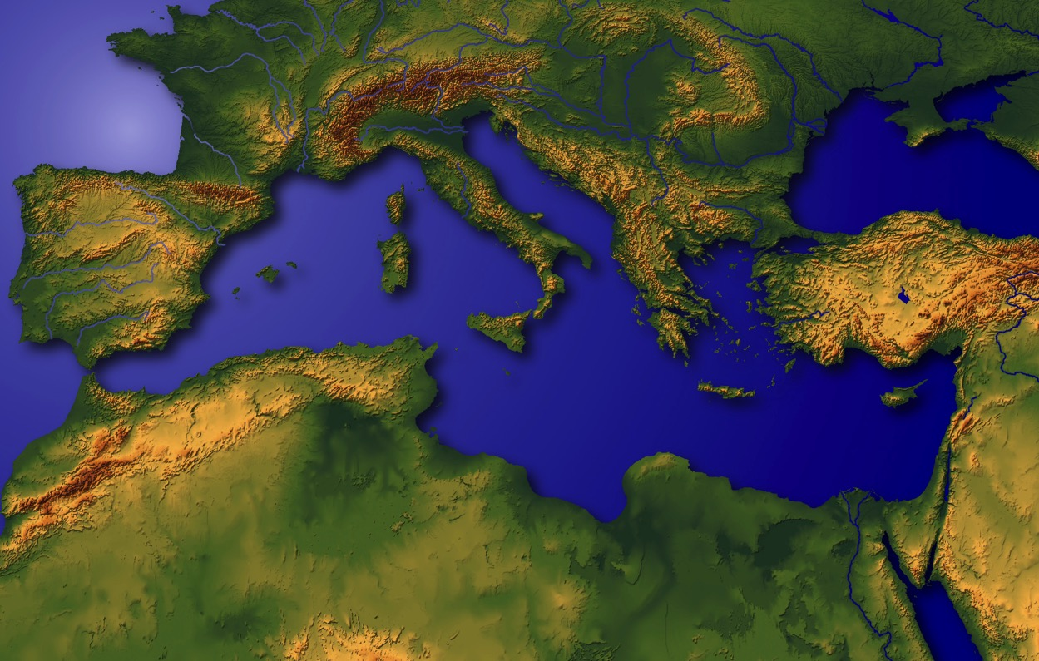
“,t; cyfj;jpd; ikak;”
Ghl ifRhy; gf;fk. 19-24
05

Slide 7
Mjpah. 11:28
,lj;ij
tiujy;
kf
Ep(m)
M
ff
C
[e
gh
v
Nek
cf
V
fhg
C
fy;NjahtpYy;y CH: nknrNghj;Njkpahtpd; Mjp fyhr;rhu ikakhf fhzg;gl;lJ;Mgpufhkpd; nre;j ,lk;
r{k
ght
nrf
Ghl ifRhy; gf;fk. 19-24
06
1

Slide 8
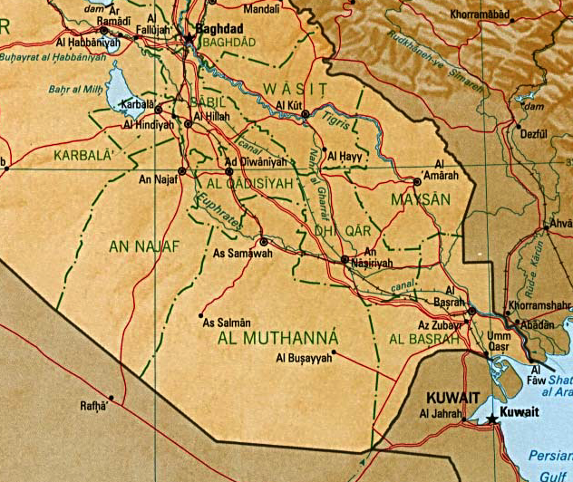
7
ghgpNyhd;
UR
Qgfj;jpy; itj;Jf;nfhs;sTk;! <uhf;fpy; eilngw;w tisFlh Aj;jj;ij
Ghl ifRhy; gf;fk. 19-24
07
6

Slide 9
7
The Mesopotamian Basin
SUMERIAN INVENTIONS…
WRITING AND THE WHEEL
BEGINNINGS…
LAW
MEDICINE
ASTRONOMY
ARCHITECTURE
EARLIEST URBAN CENTERS
Handbook pg. 19-24
07a
4
Notes:
Here in this Middle Eastern land – bordering the Persian Gulf --
were some of the earliest beginnings of mankind's discovery of an intellectual life.
//// In this triangular shaped valley,
//// called the Mesopotamian Basin,
//// the ancient Sumerians presented us the gifts of writing and the wheel. And here we see
//// the beginnings of basic concepts of civilization…of law…of medicine… of astronomy and architecture.
//// Archaeologists have also found evidence of some of the very earliest urban centers…
the communities and the cities that, through time, have led directly to the civilization and cultures we know today.

Slide 10
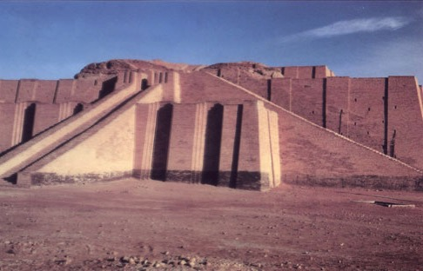
Mjp. 10:10; 11:28, 31
fy;NjaUila CH vdg;gl;l ,lj;jpYy;y “r{f;Fuhj;” ,J ,d;W <uhf;fpy; fhzg;gLfpd;wJ
Ghl ifRhy; gf;fk. 19-24
08

Slide 11
Mjpah. 11:31
Mgpufhkpd; FLk;gk;:
• NjuhF (jfg;gd;)
•Mgpufhk; (Mgpuhk;)
• rhuhs; (mtUila kidtp, rhuha;)
• Nyhj; (Mgpufhkpd; kUkfd;)
Ghl ifRhy; gf;fk. 19-24
09
5

Slide 12

7
Mgpufhk;
ABRAHAM
ca. 2000 B.C.
Kjy;
4 kf;fs;:
Mgpufhk;
AJMJ
Mjpahfkk; 12 ypUe;J
Ghl ifRhy; gf;fk. 19-24
10
3

Slide 13
Mjp. 12: 1-3
7
Mgpufhk;
ABRAHAM
ca. 2000 B.C.
miog;G
Kjy;
4 kf;fs;:
Mgpufhk;
Miog;G
AJMJ
Mjpahfkk; 12 ypUe;J
Ghl ifRhy; gf;fk. 19-24
11

Slide 14
Mjp. 12: 1-3
7
Mgpufhk;
ABRAHAM
ca. 2000 B.C.
miog;G
AC
AJMJ
Mjp. 12:1-3
Mgpufhk;
Miog;G L
MgpufhKf;F flTspd; epge;jidapy;yhj thf;Fj;jj;jk;!
Ghl ifRhy; gf;fk. 19-24
12

Slide 15
7
Mgpufhk;
ABRAHAM
ca. 2000 B.C.
Miog;G
AC
L - S - B
AJMJ
Mjp. 12:1-3
XH ,lk;
XH tpj;j
Mgpufhk;
Miog;G
L - S - B
XH MrPHthjk;
epge;jidaw;w thf;Fjj;jk; gpw;ghL XH rl;lh_jpahd cld;gbf;ifahdJ!
Ghl ifRhy; gf;fk. 19-24
13

Slide 16
7
Mjpahfkk; 12
fHj;jH Mgpuhik Nehf;fp,
“e_ cd; Njrj;ijAk;, cd; ,dj;ijAk;, cd; jfg;gDila tPl;ilAk; tpl;Lg; Gwg;gl;L,ehd; cdf;F fhz;gpf;Fk; Njrj;Jf;F Ngh.
1
“ehd; cd;idg; nghpa [hjpahf;fp,
cd;id MrPHtjpj;J, cd; Ngiug; ngUikg;gLj;JNtd;; eP MrPHthjkha; ,Ug;gha;.
2
Mgpufhk;
Miog;G
cd;id MrPHtjpf;fpwtHfis MrPHtjpg;Ngd;, cd;idr; rgpf;fpwtidr; rgpg;Ngd;;
G+kpapYy;y tk;rq;fnsy;yhk; cdf;Fs; MrPHtjpf;fg;gLk; vd;whH.”
L - S - B
3
Ghl ifRhy; gf;fk. 19-24
14
3

Slide 17
7
Mjpahfkk; 12
fHj;jH Mgpuhik Nehf;fp,
“e_ cd; Njrj;ijAk;, cd; ,dj;ijAk;, cd; jfg;gDila tPl;ilAk; tpl;Lg; Gwg;gl;L,ehd; cdf;F fhz;gpf;Fk; Njrj;Jf;F Ngh.
1
XH ,lk;
“ehd; cd;idg; nghpa [hjpahf;fp,
cd;id MrPHtjpj;J, cd; Ngiug; ngUikg;gLj;JNtd;; eP MrPHthjkha; ,Ug;gha;.
2
Mgpufhk;
XH tpj;j
Miog;G
cd;id MrPHtjpf;fpwtHfis MrPHtjpg;Ngd;, cd;idr; rgpf;fpwtidr; rgpg;Ngd;;
G+kpapYy;y tk;rq;fnsy;yhk; cdf;Fs; MrPHtjpf;fg;gLk; vd;whH.”
L - S - B
3
XH MrPHthjk;
Ghl ifRhy; gf;fk. 19-24
15
3

Slide 18

MgpufhKldhd cld;gbf;if
(“miog;G”)
Mjpahfkk; 12: 1-3
Mgpufhk;
,lk;
Tpj;J
MrPHthjk;
Miog;G
L - S - B
12:1
12:2
12:3
“L-S-B”
. 19-24
16
3

Slide 19
MgpufhKldhd cld;gbf;if
(“miog;G”)
Mjpahfkk; 12: 1-3
%d;W tpjkhd Fzhjpraq;fs;!
Mgpufhk;
,lk;
tpj;J
MrPHthjk;
Miog;G
L - S - B
• tha;%ykhd
• epj;jpakhd
• epge;jidaw;w
17
3

Slide 20
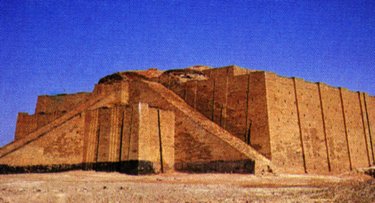
Mjp. 12:4
,lj;ij
tiujy;
mtHfs; tpRthrj;jpy;
nrd;whHfs;!
kf
Ep(m)
M
ff
fh
R
gh
v
Nek
Mgpufhk;
cf
Miog;G
V
fhg
C
rPk
ght
nrf
Ghl ifRhy; gf;fk. 19-24
18
2

Slide 21
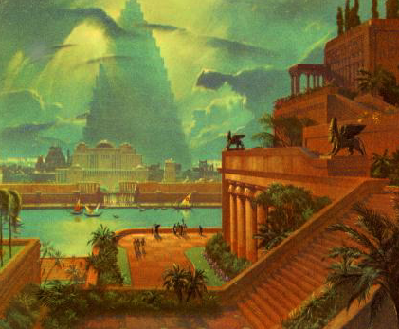
Mjp. 11:31
,lj;ij
tiujy;
kf
Ep(m)
M
ff
C
[e
gh
v
Nek
Mgpufhk;
cf
Miog;G
V
fhg
C
gpugy;akhd ghgpNyhd; efuk;
rPk
ght
nrf
Ghl ifRhy; gf;fk. 19-24
19

Slide 22
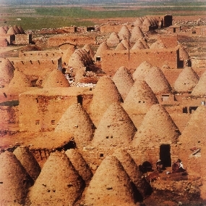
Mjp. 11:31-32
,lj;ij
tiujy;
kf
Ep(m)
M
jfg;gd;,
taJ nrd;w NjuhF, mtH Muhdpy; khpj;jhH.
ff
fh
[e
gh
v
Nek
Mgpufhk;
cf
Miog;G
V
fhg
C
,d;iwa Muhd; efuk; (JUf;fp) - “Bee-Hive”
rPk
ght
nrf
Ghl ifRhy; gf;fk. 19-24
20
1

Slide 23
Mjpah. 12:5
,lj;ij
tiujy;
kf
Ep(m)
M
ff
fh
[e
gh
v
MN
Mgpufhk;
cf
Miog;G
V
fhg
C
rPk
ght
nrf
Ghl ifRhy; gf;fk. 19-24
21

Slide 24

7
Mgpufhk; ,lj;ij milAk; nghOj…
mtd; 75 taJs;stdhapUe;jhd;
mtUila kidtp rhuhs; 65 taJs;stshf ,Ue;jhs;.
mj;Jld; ,d;Dk;… gps;is fpilf;Fk; vd thf;ffpf;fg;gl;lJ!
Mgpufhk;
Miog;G
L - S - B
Ghl ifRhy; gf;fk. 19-24
22
4

Slide 25
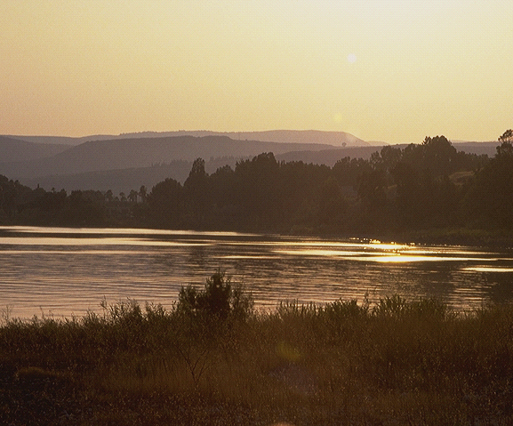
Mjpah. 15:6
7
Mgpufhk; flTspd; thf;Fj;jj;ij tpRthrpj;jhd;: XH ,lk;, XH tpj;J, mj;Jld; XH MrPHthjk;!
_{,,lk;}
_{Tpj;J,}
_{MrPHthjk;}
Mjpahfkk; 15:6!
mtd; fHj;jiu tpRthrpj;jhd, mij mtH mtDf;F ePjpahf vz;zpdhH!
XH rhjhuz tpRthrk;!
Mgpufhk;
Miog;G
L - S - B
Ghl ifRhy; gf;fk. 19-24
23
3

Slide 26
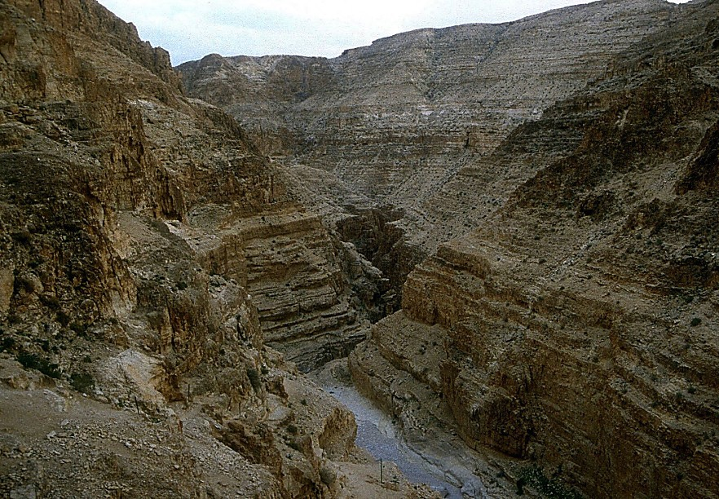

Mjpah. 16:1-4
7
Mgpufhk; flTis tpRthrpj;jy;!
MdhYk;: MfgpufhKk; rhuhSk; nghWikia ,oe;jdH.
“Mfhiu kidtpahf;fpdhd;!” rhuhspd; gzptpilf;fhhp)
Mgpufhk;
Miog;
L - S - B
Ghl ifRhy; gf;fk. 19-24
24
3

Slide 27
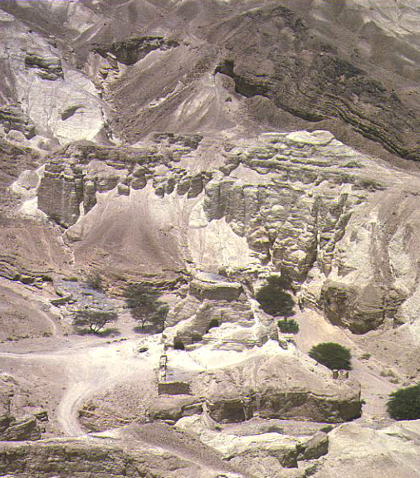
Mjpah. 16:11-12; 17:20-21
7
MfhUf;$lha; XH kfDf;$lhf Mgpufhk; jfg;gd; MdhH.
mtUila ngaH: ,];kNty;.
(,];kNty; thf;fspf;fg;gl;l Fkhud; my;y.)
Mgpufhk;
Miog;G
L - S - B
Ghl ifRhy; gf;fk. 19-24
25
3

Slide 28
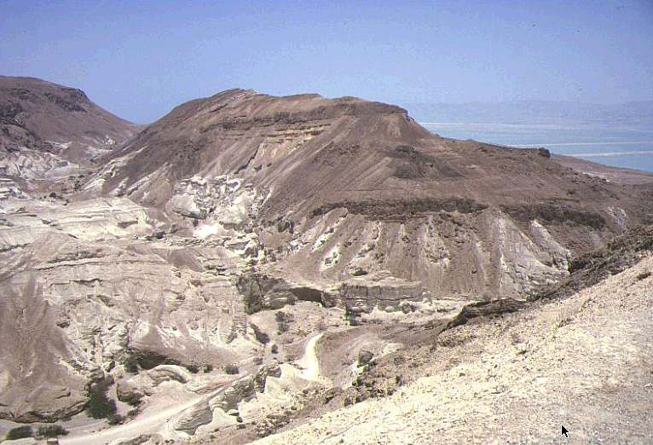
Mjpah. 17:19
7
,g;nghOJ MgpufhKf; taJ 85 rhuhSf;F 75 taJ.
,d;Dk; 15 tUlq;fspd; gpd;G…
rhuhSf;$lhf MgpufhKf;F XH kfd; gpwe;jhH.
ngaH: “<rhf;F”
Mgpufhk;
Miog;G
L - S - B
Ghl ifRhy; gf;fk. 19-24
26
4

Slide 29
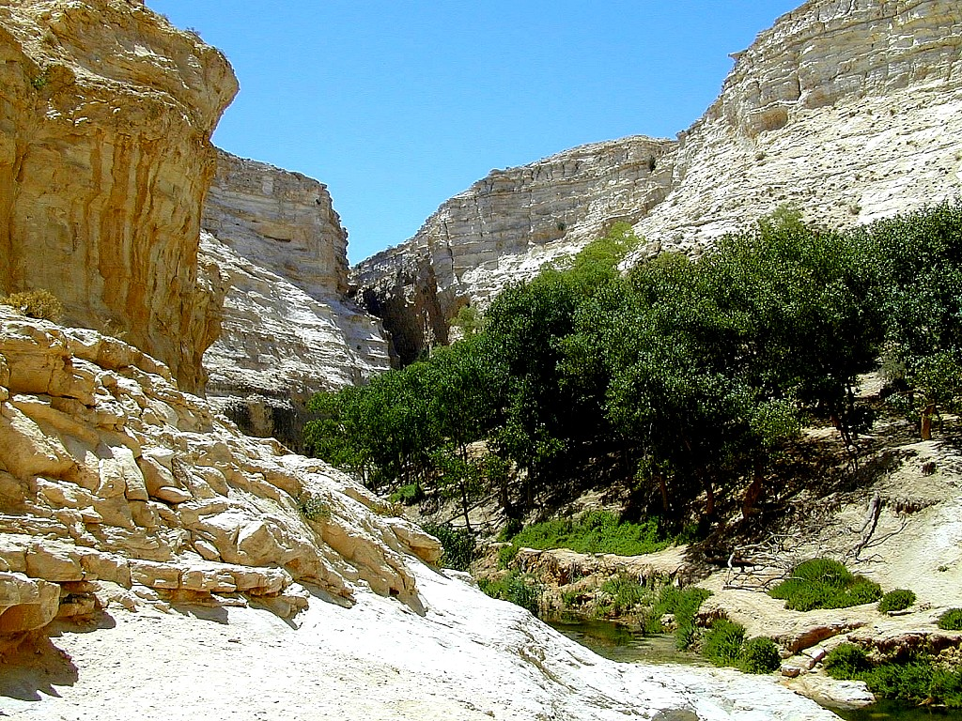
Mjpah. 17:21
7
ePz;l fhykh vjpHghHf;fg;gl;ltH <rhf;F…
flTs; MgpufhKf;F nfhLj;j thf;Fj;jj;jk; ,tDf;$lhf fle;J nry;Yk;…
Mgpufhk;
Miog;G
L - S - B
<rhf;F…
Clhf FLk;g tuyhW!
Ghl ifRhy; gf;fk. 19-24
27
2

Slide 30
Mjpah. 17
7
Mgpufhk;
ABRAHAM
ca. 2000 B.C.
miog;G
AC
L - S - B
AJMJ
I - I
Mjp. 12:1-3
Mgpufhk;
Miog;
L - S - B
I - I
,];kNty; & <rhf;F
Ghl ifRhy; gf;fk. 19-24
28

Slide 31
7
Mgpufhk;
ABRAHAM
ca. 2000 B.C.
The CALL
AC
L - S - B
AJMJ
I - I
Mjp. 12:1-3
Mgpufhk;
Miog;
L - S - B
I - I
mNugpa kf;fs;
,tDf;$lhf ,];kNty;
A+j kf;fs;
,tDf;$lhf <rhf;F
Ghl ifRhy; gf;fk. 19-24
29
2

Slide 32
7
Mgpufhk;
ABRAHAM
ca. 2000 B.C.
The CALL
AC
L - S - B
AJMJ
I - I
Mjp. 12:1-3
Mgpufhk;
Miog;
L - S - B
I - I
mNugpa kf;fs;
,tDf;$lhf ,];kNty;
A+j kf;fs;
,tDf;$lhf <rhf;F
Ghl ifRhy; gf;fk. 19-24
30

Slide 33
Mjpah. 22:2; 2 ehsh. 3:1
7
ve;j kfd;?
“mg;nghOJ mtH: cd; Gj;jpuDk; cd; VfRjDk; cd; NerFkhudhfpa <rhf;if eP ,g;nghOJ mioj;Jf;nfhz;L, Nkhhpah Njhrj;Jf;Fg; Ngha;, mq;Nf ehd; cdf;Ff; Fwp;f;Fk; kiyfs; xd;wpd;Nky; mtidj; jfdgypahfg; gypapL vd;whH.” Mjpahfkk; 22:2
Mgpufhk;
Miog;
Fwpg;G : "VgpNua vOj;Jf;fspy;, “ahiu md;G nra;jhH”, vd;w thHj;ijahy; “<hf;F” mwpag;gl;lhd;: mjd; Kf;fpaj;Jtj;ij vLj;J fhz;gpg;gjw;F: “cq;fs; Fkhud;, cq;fs; xNu Fkhud;, vtiu md;G nra;jPHfNsh -- <rhf;F.” <rhf;F xUtNu “thf;Fj;jj;jk; gz;zg;gl;l FkhudhthH”
L - S - B
I - I
2 Chr 3:12ehsh.3:1 vOj;jhsd; ,g; gFjpia kiyapYy;y Njthyaj;Jld; xg;gpLfpd;whH [,d;iwf;F fw;ghiwapYy;y FifAld; xg;gpLfpd;whH].
Ghl ifRhy; gf;fk. 19-24
31
3

Slide 34
Mjpah. 17:20-21
7
ve;j kfd;?
“,];kNtYf;fhfTk; eP nra;j tpz;zg;gj;ijf; Nfl;Nld; ehd; mtid MrPHtjpj;J, mtid kpfTk; mjpfkhfg; gYfTk; ngUfTk; gz;ZNtd;; mtd; gd;dpuz;L gpuGf;fisg; ngWthd;; mtidg; nghpa [hjpahf;FNtd; . tUfpw tU\j;jpy; Fwpj;jfhyj;jpNy rhuhs; cdf;Fg; ngwg;Ngfpw <rhf;NfNl ehd; vd; cld;gbf;ifia Vw;gLj;JNtd; vd;whH.”
Mjp. 17:20-21
Mgpufhk;
Miog;
L - S - B
I - I
<rhf;NfNl ehd; vd;
cld;gbf;ifia Vw;gLj;JNtd;
Ghl ifRhy; gf;fk. 19-24
32
2

Slide 35
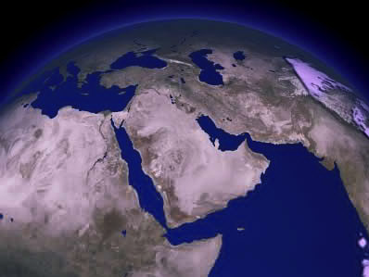
7
,d;iwa nfhilia xg;gpl;Lg;ghHf;fTk;…
<rhf;F
Mgpufhk;
Miog;
L - S - B
I - I
,];kNty;
,g; nghpa tpj;jpahrj;jpw;fhd fhuzk; vd;d?
Ghl ifRhy; gf;fk. 19-24
33
3

Slide 36
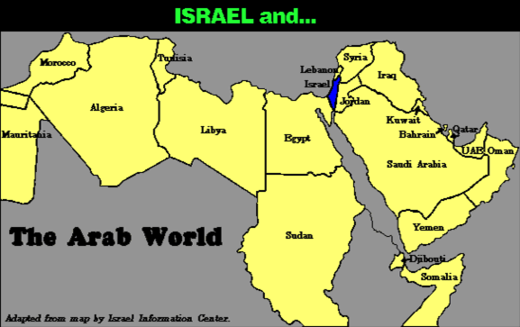
7
G+Nyhftiuglj;Jld; xg;gpl;Lg;ghHf;fTk;…
Mgpufhk;
Miog;
L - S - B
I - I
Ghl ifRhy; gf;fk. 19-24
34

Slide 37
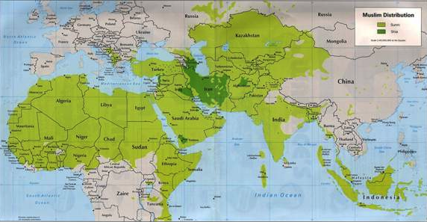
7
G+Nyhftiuglj;Jld; xg;gpl;Lg;ghHf;fTk;…
Mgpufhk;
Miog;
L - S - B
I - I
KfkJld; <rhf;F!
Ghl ifRhy; gf;fk. 19-24
35

Slide 38
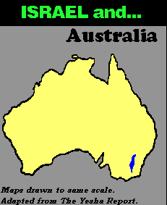
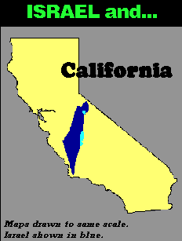
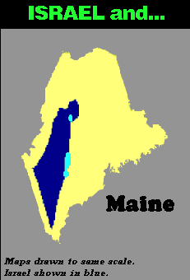
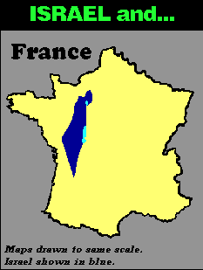
7
G+Nyhftiuglj;Jld; xg;gpl;Lg;ghHf;fTk;…
Mgpufhk;
Miog;
L - S - B
I - I
Ghl ifRhy; gf;fk. 19-24
36
3

Slide 39
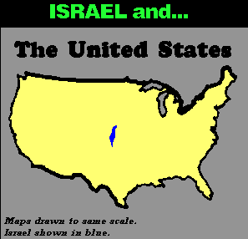
7
mnkhpf;fhTld;
Mgpufhk;
Miog;
L - S - B
I - I
,J ePjpahdjhf fhzg;gLfpd;wjh?
Ghl ifRhy; gf;fk. 19-24
37

Slide 40
7
“…,];uNtyiu tpl ,];kNtyUf;F mjpf ,lKk; mjpf nrj;Jf;fSk; nfhLf;fg;gl;lJ. mtHfSila fle;jfhy tuyhw;iw ghHf;Fk; nghOJ cz;ikahFk;, ,d;iwf;F fhzg;gLk; vz;iz tsj;ij khj;jpuk; rpj;jpf;fhky; mtHfSf;F Md;kPf kPl;igg; ngWtjw;F re;jHg;gk; nfhLf;fg;gl;Ls;sJ
Mgpufhk;
Miog;
L - S - B
I - I
Hal Lindsey, “The Everlasting Hatred: The Roots of Jihad,” 2002, Pg 65
Ghl ifRhy; gf;fk. 19-24
38

Slide 41
7
“…,];uNtyiu tpl ,];kNtyUf;F mjpf ,lKk; mjpf nrj;Jf;fSk; nfhLf;fg;gl;lJ. mtHfSila fle;jfhy tuyhw;iw ghHf;Fk; nghOJ cz;ikahFk;, ,d;iwf;F fhzg;gLk; vz;iz tsj;ij khj;jpuk; rpj;jpf;fhky; mtHfSf;F Md;kPf kPl;igg; ngWtjw;F re;jHg;gk; nfhLf;fg;gl;Ls;sJ
Mdhy; flTSila cld;gbf;ifahdJ, mtUila Md;kPf Nehf;fj;Jld; njhlHGilaJ, ,J <rhf;Ff;Fk; mtDila re;jjpf;Fk; khj;jpuNk. rhPu MrPHthjq;fs; flTSila Md;kPf miog;G mtuhy; miof;fg;gl;l re;jjpapypUe;J tUk; ,e;j thf;Fj;jj;jk; <rhf;Ff;$lhf tUk;.”
Mgpufhk;
Miog;
L - S - B
I - I
Hal Lindsey, “The Everlasting Hatred: The Roots of Jihad,” 2002, Pg 65
Ghl ifRhy; gf;fk. 19-24
39

Slide 42
7
Nygdhd;
<rhf;fpd; re;jjp
kj;jpajiuf; fly;
SYRIA
fypNyahf; fly;
<uhf;
Ma;gh
Nazareth
Eld;dpah
NahHjhd;
Njy; My;tp-ahgh
mk;khd;
vUrNyk;
Vhpf;Nfh
Gaza
Hebron
cg;Gf; fly;
Mgpufhk;
ghHrpgh
Miog;
ISRAEL
L - S - B
I - I
L,];kNyypd; re;jjp
Vfpg;J
rTjp mNugpah
,yl;
My; MFghth
MFghth tisFlh
ISHMAEL & ISAAC IN TODAY’S ISRAEL
,d;iwa ,];uNtypy; ,];kNtYk; <rhf;Fk;
Ghl ifRhy; gf;fk. 19-24
40
2

Slide 43
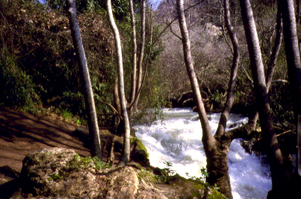
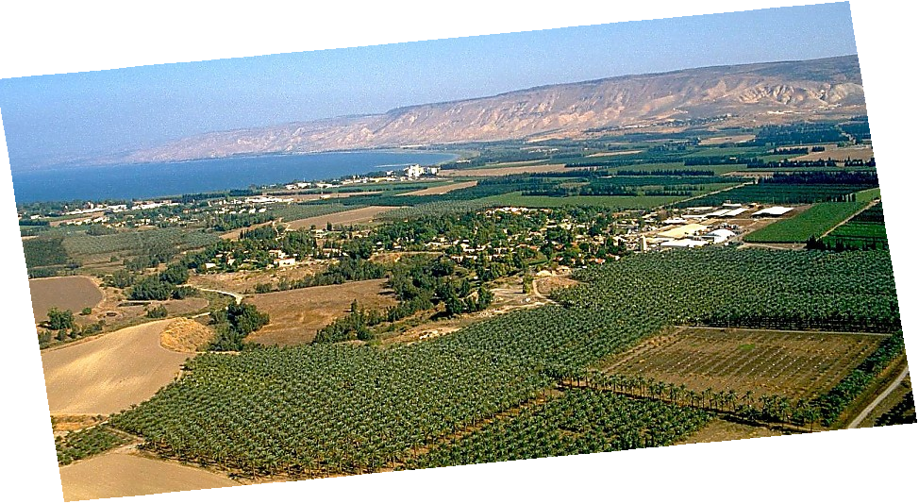
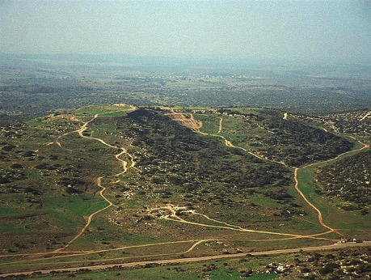
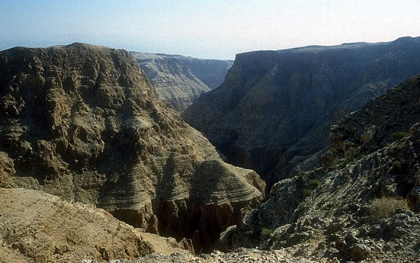
Mjpah. 13:10-11; Josh. 17:16
MgpufhKf;F nfhLf;fg;gl;l thf;Fj;jj;jpd; XH gFjp,,,
Mgpufhk;
Miog;
L - S - B
kpf mofhd fhdhd; Njrk;… mtUf;F nfhLf;fg;gl;l Njrk;!
Ghl ifRhy; gf;fk. 19-24
41

Slide 44
Ahj;. 2:24
7
Mgpufhk;
ABRAHAM
ca. 2000 B.C.
miog;G
AC
L - S - B
AJMJ
I - I
Mjp. 12: 1-3
J - E
12
Mgpufhk;
Miog;
L - S - B
I - I
J - E
12
ahf;NfhG thf;ffpf;fg;gl;l Fkhud; MthH!
thf;fspf;fg;gl;l re;jjpapy; tUgtH!
Ghl ifRhy; gf;fk. 19-24
42
7

Slide 45
Mjpah. 35:23-26; Mjpah. 34:1
7
Mgpufhk;
ABRAHAM
ca. 2000 B.C.
miog;G
AC
L - S - B
AJMJ
I - I
Mjp. 12: 1-3
J - E
12
12
10
Mgpufhk;
1
Miog;
L - S - B
I - I
6
8
J - E
5
12
4
13
7
11
3
9
2
Ghl ifRhy; gf;fk. 19-24
43

Slide 46
Mjpah. 35:24
7
Mgpufhk;
ABRAHAM
ca. 2000 B.C.
miog;G
AC
L - S - B
AJMJ
I - I
Mjp. 12: 1-3
J - E
12
12
10
Mgpufhk;
1
Miog;
L - S - B
I - I
6
8
J - E
5
12
4
7
11
3
9
2
Ghl ifRhy; gf;fk. 19-24
44

Slide 47
Mjpah. 35:24
7
Mgpufhk;
ABRAHAM
ca. 2000 B.C.
miog;G
AC
L - S - B
AJMJ
I - I
Mjp. 12: 1-3
J - E
12
Mgpufhk;
Miog;
L - S - B
I - I
J - E
12
NahNrg;G!
11
Ghl ifRhy; gf;fk. 19-24
45

Slide 48
Mjpah. 1-35
7
Gilg;G
Gul;rPfuk;
1tJ Mz; & bgz;n
1tJghtk;
C
1tJ RtpN\k;
1tJ FLk;gk;
Yh[hPfk;
(1000 B.C.)
1tJ nghiy
Nts;sKk; thstpy;Yk;
NfhGy
(2000 B.C.)
Mgpufhk;
(2000 B.C.)
3 rKfq;fs;
C 7 S J
Miog;G
AC
L - S - B
I - I
J - E
12
rpiwapWg;G
7 = 4 + 3
NahNrg;G
Mgpufhk;
Miog;
4 kf;fs;
L - S - B
I - I
NkhNr
(1500 B.C.)
(500 B.C.)
J - E
S
S
mikjp
12
,NaR
J
NaRth
46
2

Slide 49
7
AJMJ
ehd;F kf;fspy; ,uz;lhtJ gFjpapdH
,tHfs;:
?
47

Slide 50
7
AJMJ
ehd;F kf;fspy; ,uz;lhtJ gFjpapdH
,tHfs;:
“NahNrg;G”
48

Slide 51
7
md;dsthd jpfjp:
Mgpufhk; - NahNrg;G 2000 B.C.
49

Slide 52
Mjpah. 37:2 - Mjpah. 50:26
7
gilg;G
“XH
epahahjpgjp
epahae;j_hf;f Ntz;lk;”
ABRAHAM
Mgpufhk;
ABRAHAM
NahNrg;G
ABRAHAM
NkNr
NaRth
Gul;rpfuk;
uh[h_fk;
rpiwapWg;G
mikjp
,NaR
Ghl ifRhy; gf;fk. 24-25
50

Slide 53
7
NahNrg;G
ABRAHAM
ehd;F kf;fspy; ,uz;lhtJ gFjpapdH
,tHfs;:
NahNrg;G
AJMJ
Ghl ifRhy; gf;fk. 24-25
51

Slide 54
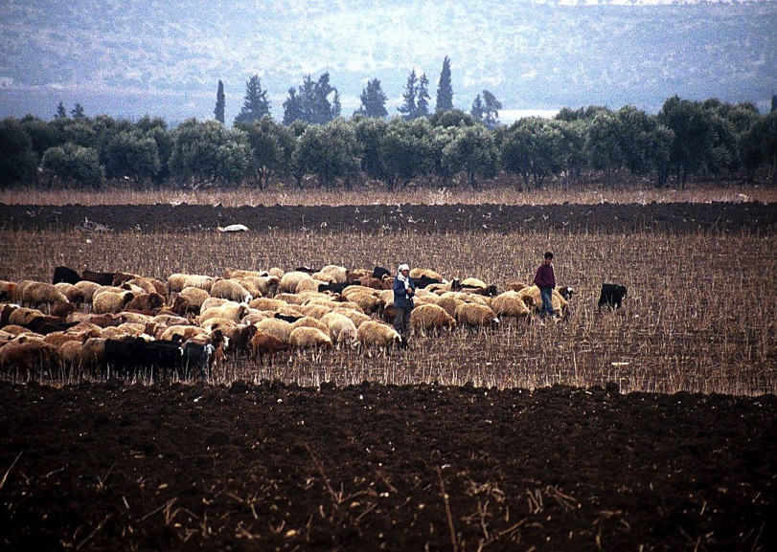
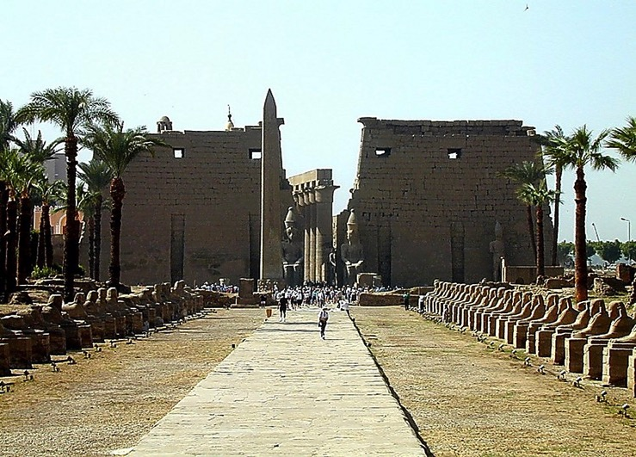
Mjpa. 37-41
Vfpg;jpYy;y ghfhlh]; Yf;rhH Myak;
NahNrg;G
,];uNty; Nlhjhdpy; ke;ijfis Nka;f;Fk; ,lk;
Ghl ifRhy; gf;fk. 24-25
52
1

Slide 55
Mjpa. 37-41
NahNrg;G
Ghl ifRhy; gf;fk. 24-25
53

Slide 56
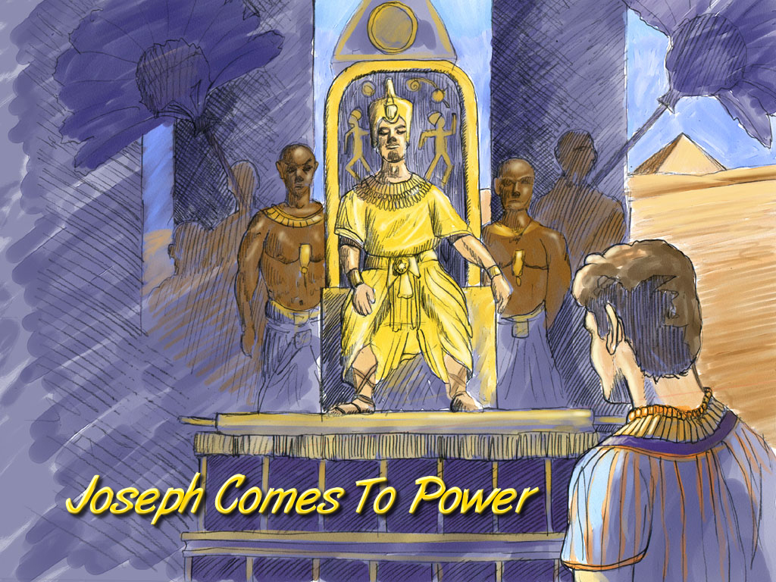
Mjpah. 41:41-44
JOSEPH
Joseph Comes To Power
Ghl ifRhy; gf;fk. 24-25
54

Slide 57
Mjpah. 42:2
,lj;ij
tiujy;
kf
ep(m)
gQ;rk;!
M
ff
fh
[e
gh
v
Nek
NahNrg;G
cf
V
fhg
CH
ghpG+uzk;!
rPk
ght
nrf
Ghl ifRhy; gf;fk. 24-25
55
1

Slide 58
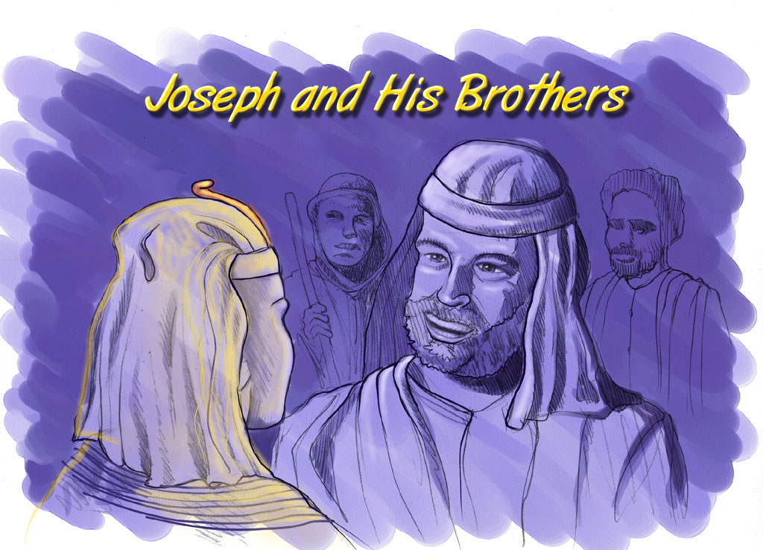
Mjpah. 37-41
NahNrg;G
Joseph and His Brothers
Ghl ifRhy; gf;fk. 24-25
56

Slide 59
Mjpah. 46: 3-7
,lj;ij
tiujy;
kf
ep(m)
M
fh
[e
THE FAMILY FOLLOWS…
THE FAMILY WILL BECOME A NATION !
gh
v
ff
NahNrg;G
cf
V
fhg
CH
rPk
ght
nrf
Ghl ifRhy; gf;fk. 24-25
57

Slide 60
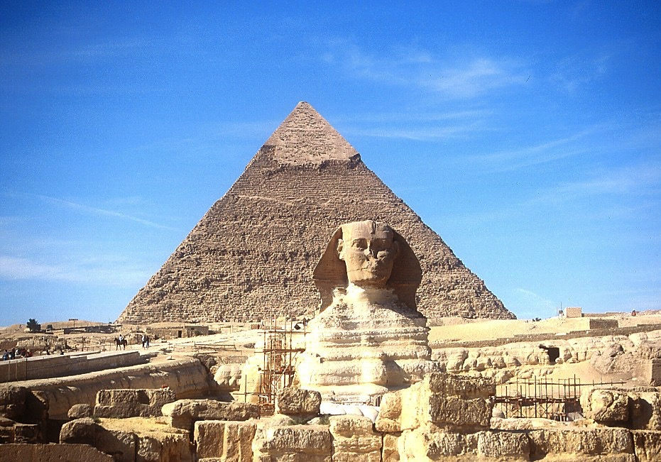
7
NahNrg;G
ty;yikahd gpukpl;Lk; ];j;uPapd; KfKk;
Ghl ifRhy; gf;fk. 24-25
58

Slide 61
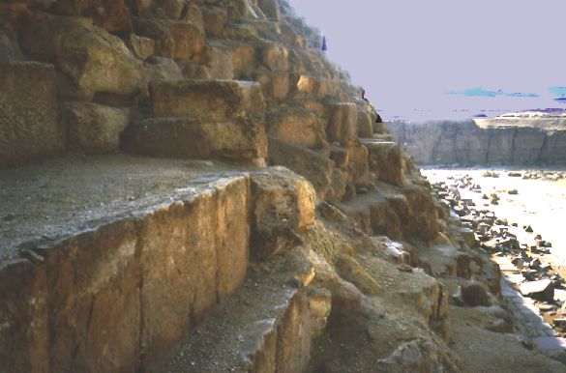
7
NahNrg;G
Ruq;f ntl;Lf;fSk;ty;yikahd gpukpl;Lk;
Ghl ifRhy; gf;fk. 24-25
59

Slide 62
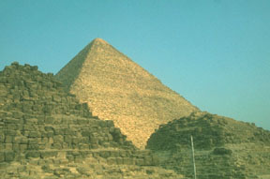
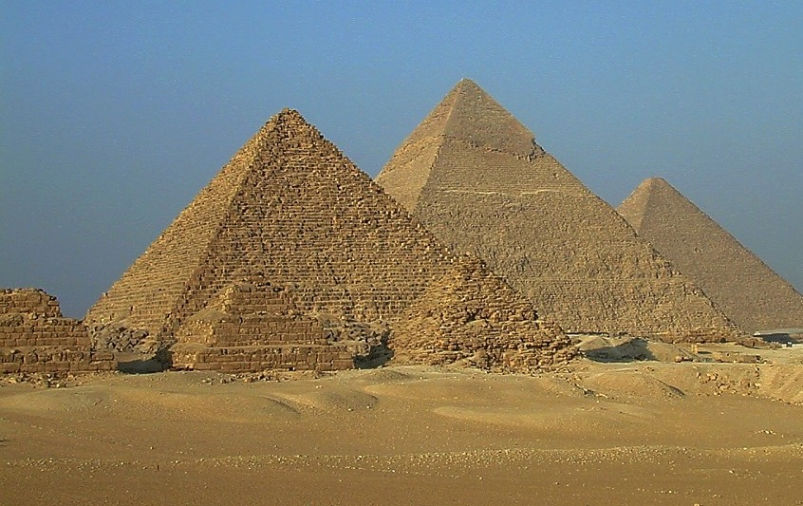
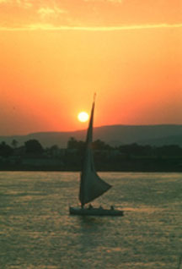
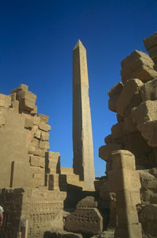
7
,];uNtyH fz;lhHfs;…
NahNrg;G
…,];uNtyhpd; gz;ilf;fhy mjpraq;fs;.
Ghl ifRhy; gf;fk. 24-25
60

Slide 63
Ahj;. 12:40-41;fyhj;l. 3:17
7
NahNrg;G
ABRAHAM
Mbikj;jdk;
ehd;F kf;fspy; ,uz;lhtJ gFjpapdH
,tHfs;:
AJMJ

Slide 64
Mjpah. 1:1 – ahj;. 1:6
7
Gilg;G
Gul;rPfuk;
1tJ Mz; & bgz;n
1st Sin
C
1tJ RtpN\k;
1tJ FLk;gk;
Yh[hPfk;
(1000 B.C.)
1tJ nghiy
Nts;sKk; thstpy;Yk
NfhGyk;
(2000 B.C.)
Mgpufh
(2000 B.C.)
3 rKfq;fs;
C 7 S J
Miog;G
AC
L - S - B
I - I
J - E
12
p
rpiwapWg;G
7 = 4 + 3
NahNrg;G
NahNrg;G
mbikj;jdk;
mbikj;jdk;
430
430
4 kf;fs;
NkhNr
(1500 B.C.)
(500 B.C.)
S
S
mikjp
,NaR
J
NahRth
Ghl ifRhy; gf;fk. 24-25
62

Slide 65
7
AJMJ
ehd;F kf;fspy; %d;whtJ gFjpapdH
,tHfs;:
?
63

Slide 66
7
AJMJ
ehd;F kf;fspy; %d;whtJ gFjpapdH
,tHfs;:
“NkhNr”
64

Slide 67
65
©2004 TBBMI
8.0.03b.

Slide 68


jpUkiwapd;…mbg;gil • BibleStudyDownloads.org
,g;ghlf;Fwpg;Gfis ,ytrkhf ngw;Wf;nfhs;s
Notes:
The Bible…Basically (bb)

