Slide 1
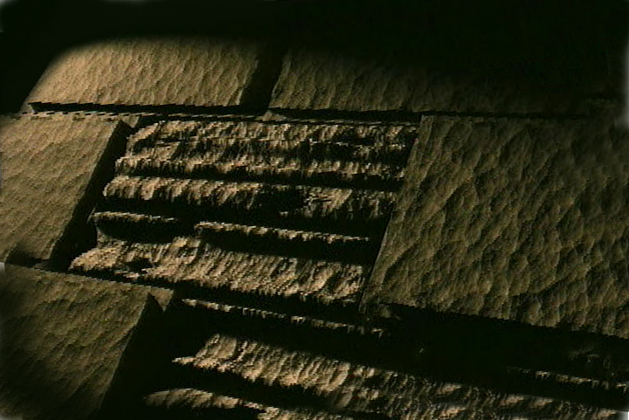
THE BIBLE... BASICALLY
jpUkiwapd;… mbg;gil
Designed by Dr. John Fryman, Texas, USA • BibleBasically.org Taught by Dr. Rick Griffith, Singapore Bible College All files in many languages for free download at BibleStudyDownloads.org

Slide 2
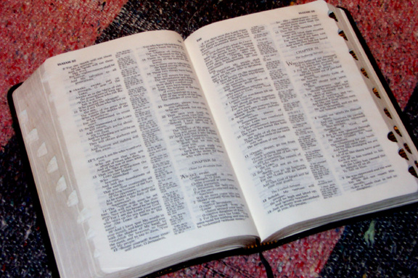
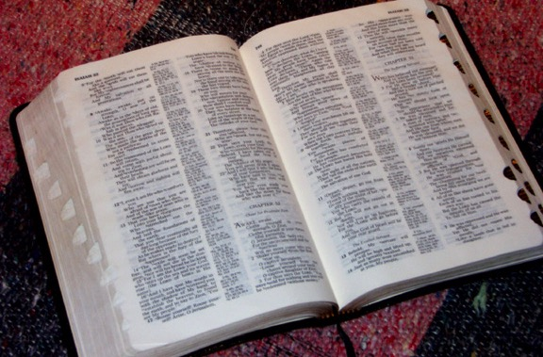
(,q;F ele;jij ftdpg;Nghk;)
jpUkiwapd;…
mbg;gil
®
gFjp %d;W
“tpiuthd fhyml;ltizf;fhd”
XH mwpKfk;:
02
©2004 TBBMI
8.0.03a.

Slide 3
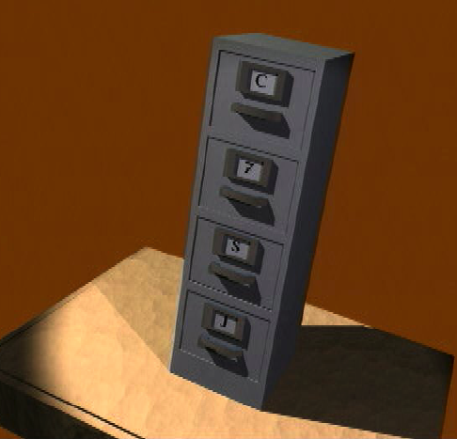
7
-
C
7
S
J
03
1

Slide 4
7
cq;fs; Qgfj;jpw;F...
C 7 S J
=
4 3
04
1

Slide 5
7
cq;fs; Qgfj;jpw;F...
C 7 S J
C 4 3 S J
05

Slide 6
7
cq;fs; Qgfj;jpw;F...
C 7 S J
C 4 3 S J
gilg;G
4 kf;fs;
3 r%fq;fs;
mikjp
,NaR
06

Slide 7
7
gilg;G
Mgpufhk;
NahNrg;G
NkhNr
NahRth
Gul;rpfuk;
uh[h{fk;
rpiwapUg;G
mikjp
,NaR
07

Slide 8
,lj;ij
Tiujy;
10 ,lq;fs;
kf
gilg;G
6 4
Mgpufhk;
ep(m)
NahNrg;G
M
NkhNr
,lg; gFjpfs;
ff
fh
NahRth
Gul;rpfuk;
Nek
gh
v
uh[h{fk;
“jpUkiwr;
rk;gtq;fs;d;
nraw;ghl;L
epfo;Tfs;!”
ck
rpiwapUg;G
mikjp
C
V
fhg
,NaR
nrf
kf
ght
08

Slide 9
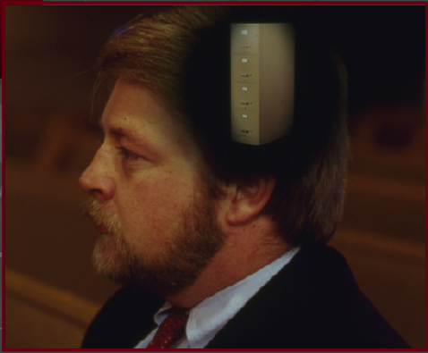
7
gilg;G
ABRAHAM
Mgpufhk;
ABRAHAM
NahNrg;G
ABRAHAM
NkhNr
NahRth
Gul;rpfuk;
uh[h{fk;
rpiwapUg;G
mikjp
,NaR
•ehk; mwpTG+Htkhd XH tiuglj;ij jahhpf;fpd;Nwhk;!
•ehk; vy;yh tpguq;fisAk; fw;ftpy;iy...
•XH Koikahd glj;ij ftd;g;Nghk;.
•jpUkiwapd; nghJthd tpsf;fk;.
09
4

Slide 10
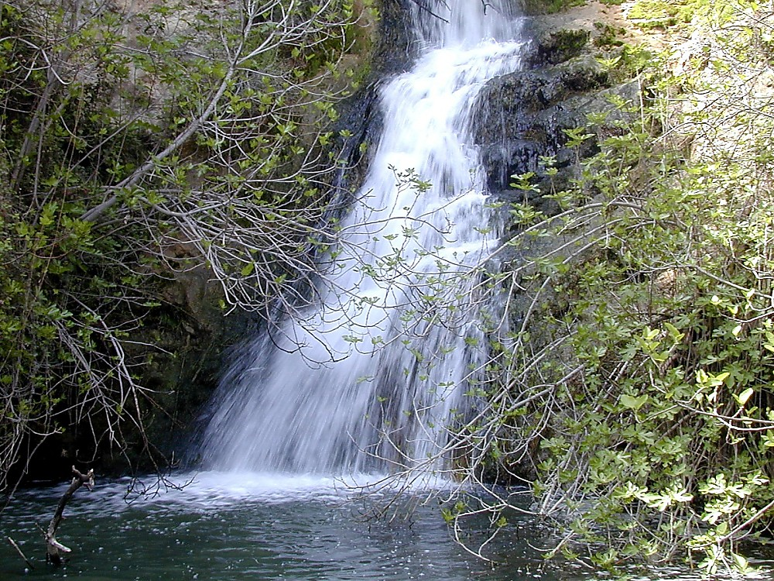
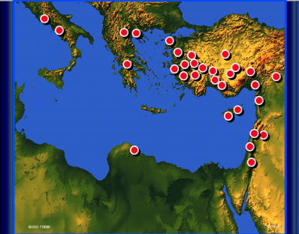
10

Slide 11
gilg;G
ABRAHAM
Mgpufhk;
ABRAHAM
NahNrg;G
ABRAHAM
NkhNr
NahRth
Gul;rpfuk;
uh[h{fk;
rpiwapUg;G
mikjp
,NaR
10

Slide 12
7
gilg;G
ABRAHAM
Mgpufhk;
ABRAHAM
NahNrg;G
ABRAHAM
NkhNr
NahRth
Gul;rpfuk;
uh[h{fk;
rpiwapUg;G
mikjp
,NaR
12

Slide 13
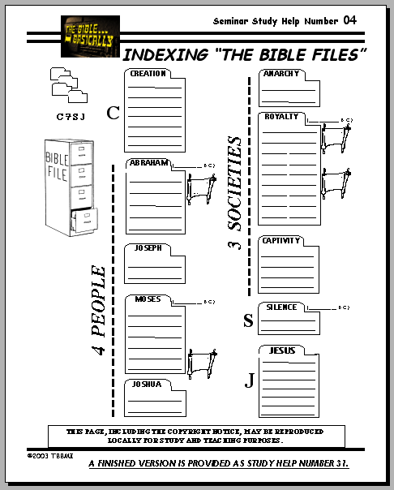
Mjp. 1-11
7
gilg;G
ABRAHAM
Mgpufhk;
gilg;G
ABRAHAM
NahNrg;G
ABRAHAM
NkhNr
NahRth
Gul;rpfuk;
uh[h{fk;
rpiwapUg;G
mikjp
,NaR
ghl cjtp #04
13
1

Slide 14
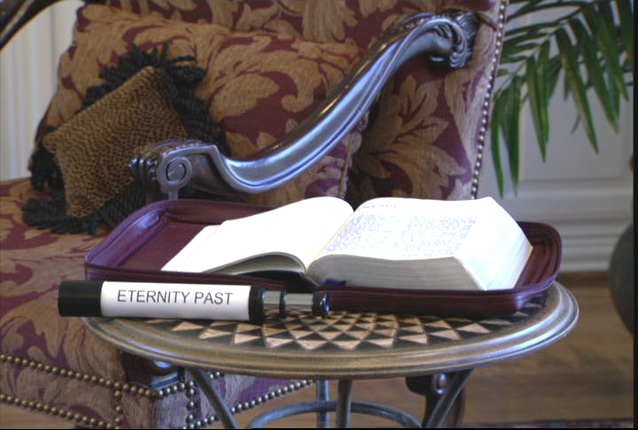
7
Mjp. 1-11:fle;jfhy epj;jpaj;Jtk;
Ghl ifRhy; gf;fk;. 17-19
14
1

Slide 15
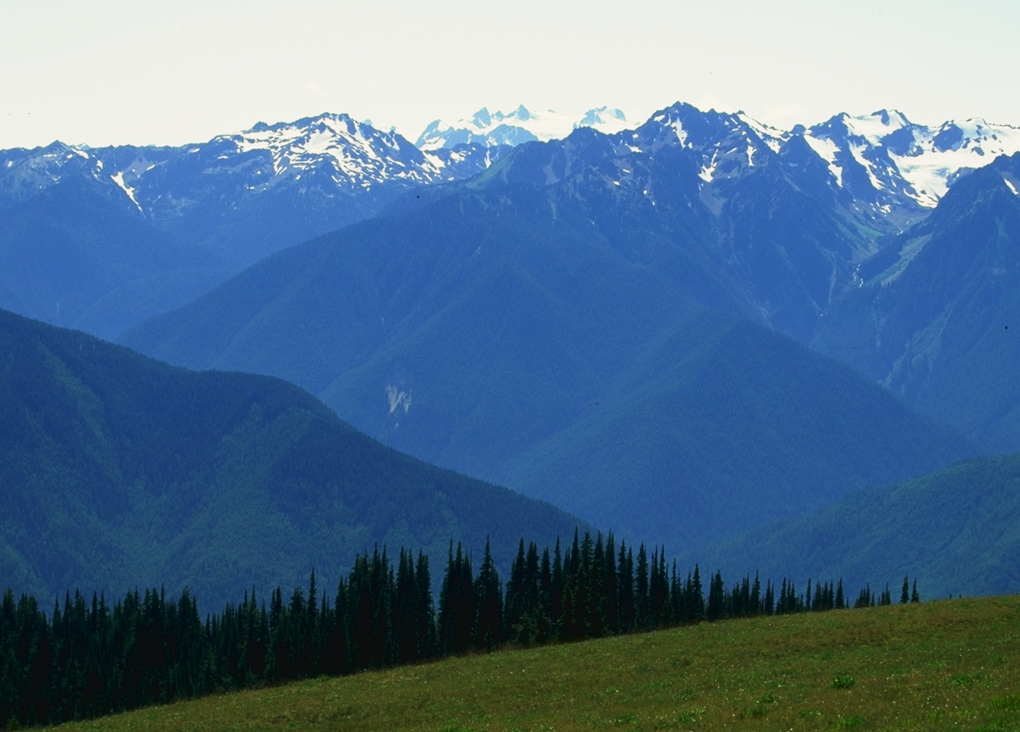
fle;jfhy epj;jpaj;ijg;gw;wpa XH “njhiyj; njhlH ghHit...
Ghl ifRhy; gf;fk;.. 17-19
15

Slide 16
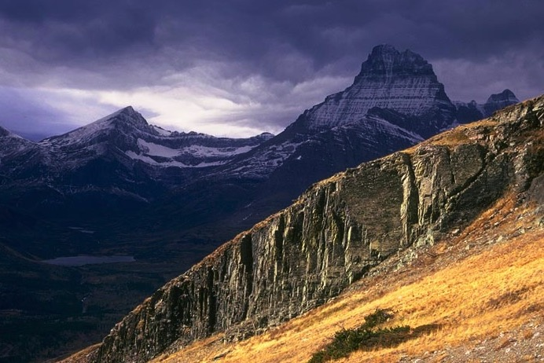
fle;jfhy epj;jpaj;ijg;gw;wpa XH “njhiyj; njhlH ghHit...
Ghl ifRhy; gf;fk;.. 17-19
16
1

Slide 17
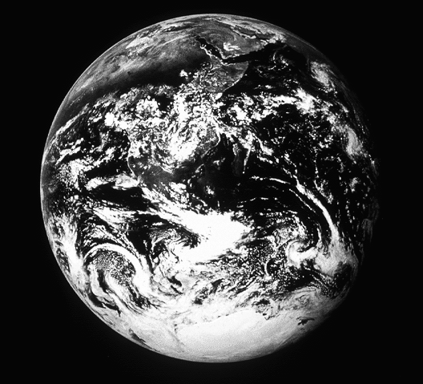
Mjp. 1:1
“MjpapNy...”
,NaRTk; ,f; fhyj;ijf; Fwpj;Jg; NgrpdhH…
17
1
©2004 TBBMI
8.0.03a.

Slide 18
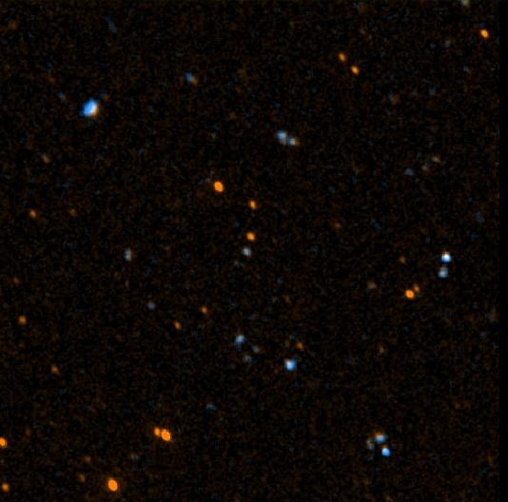
Nahthd; 17:5
“gpjhNt, cyf;k; cz;lhfpwjw;F Kd;Nd ck;kplj;jpy; vdf;F cz;lhapUe;j kfpikapdhNy ,g;nghOJ e{H vd;id ck;kplj;jpNy kfpikg;gLj;Jk;.”
18
©2004 TBBMI
8.0.03a.

Slide 19
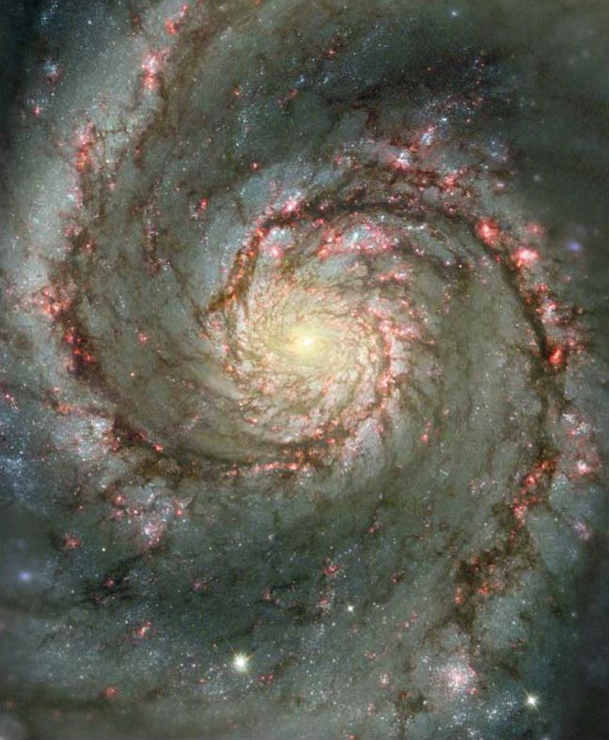
Nahthd; 17:5
“gpjhNt, cyf;k; cz;lhfpwjw;F Kd;Nd ck;kplj;jpy; vdf;F cz;lhapUe;j kfpikapdhNy ,g;nghOJ e{H vd;id ck;kplj;jpNy kfpikg;gLj;Jk;.”
19
©2004 TBBMI
8.0.03a.

Slide 20
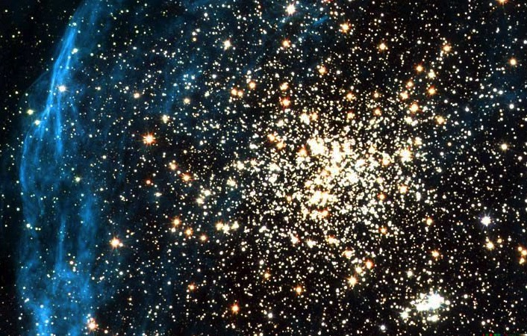
Nahthd; 17:5
“gpjhNt, cyf;k; cz;lhfpwjw;F Kd;Nd ck;kplj;jpy; vdf;F cz;lhapUe;j kfpikapdhNy ,g;nghOJ e{H vd;id ck;kplj;jpNy kfpikg;gLj;Jk;.”
20
©2004 TBBMI
8.0.03a.

Slide 21
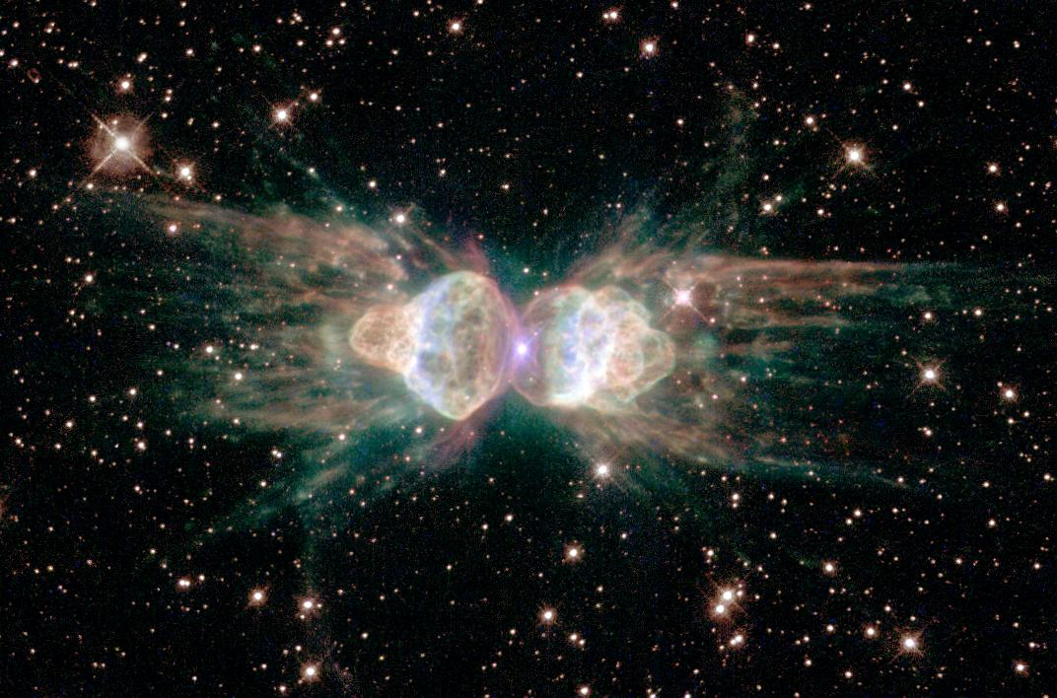
Nahthd; 17:5
“gpjhNt, cyf;k; cz;lhfpwjw;F Kd;Nd ck;kplj;jpy; vdf;F cz;lhapUe;j kfpikapdhNy ,g;nghOJ e{H vd;id ck;kplj;jpNy kfpikg;gLj;Jk;.”
21
©2004 TBBMI
8.0.03a.

Slide 22
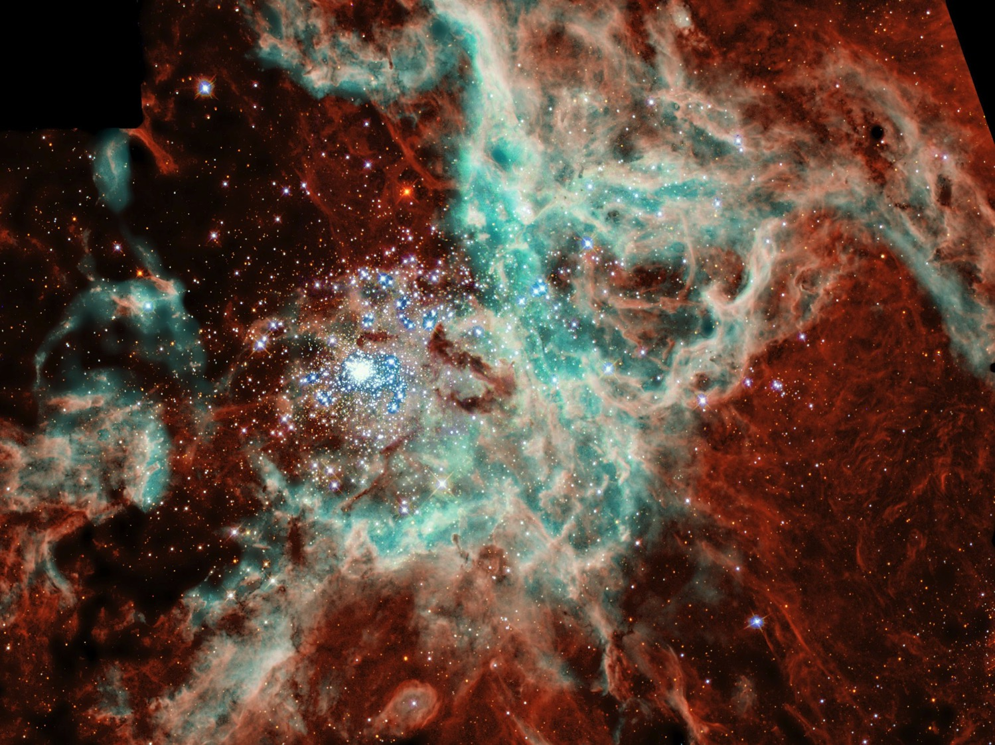
Nahthd; 17:5
“gpjhNt, cyf;k; cz;lhfpwjw;F Kd;Nd ck;kplj;jpy; vdf;F cz;lhapUe;j kfpikapdhNy ,g;nghOJ e{H vd;id ck;kplj;jpNy kfpikg;gLj;Jk;.”
22
©2004 TBBMI
8.0.03a.

Slide 23
NahG 38:4-18
Aehk; vkJ Ra NjitfisAk; vk;ikg;gw;wp rpe;j;f;fpwtHfshf ,Uf;f Ntz;Lkh…
CREATION
“,t; cyfj;ij cUthf;Fk; nghOJ e_q;fs; vq;Nf ,Ue;j{Hfs;?”
23
1
©2004 TBBMI
8.0.03a.

Slide 24
Mjp. 1-11
Mjp. 3:15:…”mtH cd; jiyia eRf;FthH, e_ mtH Fjpf;fhiy eRf;Ftha;.”
“fd;dpapDlhf tUfpwtH rhj;jhdpd; jiyia eRf;FthH; rhj;jhid fpwp];j ntw;wp nfhs;thH vd;w thf;FWjp epiwNtwpaJ ..,e;j ntw;wpia vy;yh tpRthrpfSk; gfpHe;J nfhs;tH”
(NuhkH 16:20).
Gilg;G
All time pre-Abraham
CREATION
1Mt Mz;&ngz;
(Perfection)
1Mt ghtk;
(Miss the Mark)
gilg;G
ABRAHAM
1Mt RtpNr\k;
(Redeemer)
7 tplaq;fs;
1Mt FLk;gk;
(Contention)
1Mt nfhiy
(Abject Sin)
nts;sk;/thdtpy;
(Pgm #1: Noah)
NfhGuk;
(Pgm #2: Babel)
Handbook pg. 42-45
24
10

Slide 25
A
rhuhk;rk;:gilg;igf; Fwpj;j NfhitahdJ flTs; kdpjidg; gilj;jijAk; t{o;r;rpiaA $Wfpd;wJ. flTSila epj;jpa jpl;lkhdJ ghtj;jpypUe;J tpLgl;l flTSld; neUq;fpa cwit itj;Jf;nfhs;tjw;fhf. “mtUila tUifia cs;slf;fpajhf jpUkiw rk;gtk; fhzg;gLtJld, RtpNr\k; ,jw;F Kf;fpakhdjhFk;.” N[hd; ty;T+l;
Ghl ifRhy; gf;fk;.. 17-19
25
©2004 TBBMI
8.0.03a.

Slide 26
Mjp. 1-11
7
Gilg;G
Gul;rpfuk;
1Mt Mz;&ngz
1Mt ghtk
C
1Mt RtpNr\k;
1Mt FLk;gk;
uh[h{fk;
(1000 B.C.)
1Mt nfhiy
nts;sk;/thdtpy
NfhGuk;
Mgpufhk;
(2000 B.C.)
3 r%fq;fs;
C 7 S J
rpiwapUg;G
7 = 4 + 3
NahNrg;G
4 kf;fs;
NkhNr
(1500 B.C.)
(500 B.C.)
S
S
mikjp
,NaR
J
NahRth
Ghl ifRhy; gf;fk;.. 17-19
26

Slide 27
©2004 TBBMI
8.0.03a.
27

Slide 28
jpUkiwapd;…mbg;gil • BibleStudyDownloads.org
Get this presentation for free!
Notes:
The Bible…Basically (bb)

