Slide 1

THE BIBLE... BASICALLY
jpUkiwapd;…
mbg;gil
Designed by Dr. John Fryman, Texas, USA • BibleBasically.org
Taught by Dr. Rick Griffith, Singapore Bible College
All files in many languages for free download at BibleStudyDownloads.org
Notes:
Download the Tamil script for each slide on the accompanying Word documents at BibleStudyDownloads.org

Slide 2
cq;fs;
ftdj;jpw;F…
ghl Ntisapy; cq;fs; ifalf;njhiyNgrp cl;gl midj;J njhiyj;njhlh;G rhjdq;fisAk; %B itf;fTk;. tFg;gpy; cs;s khztHfs; cq;fSf;F ed;wp $WthHfs; !
8.0.01.
01.
1

Slide 3
©
The Bible…Basically Ministries Int'l
Committee of Reference
Dr. John Hannah
Distinguished Professor of Historical Theology
Research Professor, Historical Theology
Dallas Theological Seminary
Dallas, Texas
Dr. Rick Griffith
Doctor of Ministry Director
Assoc. Professor in Biblical Studies
Singapore Bible College
Republic of Singapore
Dr. Mark Bailey
President
Dallas Theological Seminary
Dallas, Texas
John Maisel • Kurt Nelson
President • Exec. Vice President
East/West Ministries
Dallas, Texas
Dr. William R. Bright
Late Founder
Campus Crusade for Christ
Orlando, Florida
Vasily Dimitrievski
Director for Russia
Global Missions Fellowship (e3)
Penza, Russia
Rev. Douglas Valenzuela
Senior Pastor, Conservative Baptist Missions
Chiesa Battista Evangelica di Casoria
Naples, Italy
Dr. Ted Kitchens
Senior Pastor
Christ Chapel Bible Church
Ft. Worth, Texas
Karyn Granger
Director of Bible Studies
Southwest Christian Schools
Ft. Worth, Texas
Dr. Kenneth Horton
Senior Pastor
McKinney Memorial Bible Church
Ft. Worth, Texas
03
©2006 TBBMI
9.65.01.
Notes:
This seminar has been approved by many respectable leaders in the western world.

Slide 4


Ntjhfkj;jpd; Njrk; - Xtpa E}yfk;
rNfhjuh; Njhl; nghyDf;F [Todd Bolen] vq;fs; Copak; kpfTk; flikg;gl;Ls;sJ. fhuzk; mtNu Ntjhfkj;jpd; Njrq;fis Xtpa E}yfkhf rpU\;bj;jhh;. ekf;F “Ntjhfkk; Muk;gk;” vDk; ifg;Gj;jfj;jpy; ,lk; ngw;Ws;s Xtpaq;fis KOkdNjhL mh;gzpj;jhh; “Ntjhfkk; Muk;gk®”. ifg;Gj;jfj;ij cgNahfpg;gth;fs; ,izaj;jpy; “BiblePlaces.com” vDk; ,izajsj;jpy; Mapuj;Jf;Nkw;gl;l Xtpaq;fis fhzyhk;. mitfs; ghpRj;j Njrk;, Vfhd;, Nky; rKj;jpuk;, njd; INuhg;gh mjhtJ fpU];jth;fspd; tpRthrk; tpsq;fpa ,lk;. “BiblePlaces.com” Mrphpah;fSf;Fk; jahhpg;ghsUf;Fk; rk mstpshd mjpEl;g Xtpaj;jpw;fhd Gifg;gl tsq;fis toq;FfpwJ.
,izajsj;ij tyk; thUq;fs;.
ed;wp, (Njhl);

Slide 5
jpUkiwapd;…
mbg;gil
A Presentation of The Bible…Basically Ministries International Inc. Fort Worth, Texas
www.biblebasically.com
8.0.01.
©2004 TBBMI
04

Slide 6
The Bible…Basically Project was conceived, developed
and produced by John E. Fryman, Ph.D.
Copyright © 2006 The Bible…Basically Ministries Intl. Inc., Ft. Worth, Texas
All rights reserved. This work is protected under the copyright laws of the United States of America. No part or section may be reproduced in any form without permission in writing from the author or copyright owner, except in the case of brief quotations embodied in critical articles or reviews.
Those sections for which permission is specifically provided in the text may be reproduced locally as student need requires.
The ministry is indebted to Dr. Todd Bolen, The Master's College, Jerusalem, Israel, and Pictorial Library of Bible Lands (BiblePlaces.com) for permission
to use extensive photo resources throughout this production. Photography of Kadesh-Barnea is used with permission of Dr. Leen Ritmeyer, Hawthornedene, Australia. Should the copyrighted material of others be noted without our knowledge or proper attribution, the ministry requests an immediate notice. The specified content attribution will be properly adjusted. Every effort was used to avoid unauthorized use of text and graphics.
Teachers, media operators and/or other facilitators may not alter any PowerPoint slide, animation effect, or order of presentation in any way, in any language edition, or in any computerized application from any image storage facility, transmission, digital or Internet technique except by permission of the producers.
Produced in the United States of America. International Rights Reserved.
06
©2006 TBBMI
9.65.01.
Notes:
At biblestudydownloads.org you can download all of the PPT for this seminar so you can teach it to your own people. However, as this copyright page notes, we ask you not to change any of the content.

Slide 7



(Nehf;fk;:jpUkiwia rpwe;j Kiwapy; ifahStjw;F!)
jpUkiwapd;…
mbg;gil
®
gFjp xd;W
“jpUkiwf; Nfhitia”
jpwe;J nfhs;Sjy;
©2004 TBBMI
8.0.01.
05

Slide 8
XH Kf;fpa rpe;ijAld; ,e;j khngUk; jpl;lj;ij mwpKfk; nra;Nthk; !
,tw;wpw;fhd Mjhuk; vd;d…
?
xt;nthU fpwp];jt Nfhl;ghL
xt;nthU fpwp];jt ek;gpf;if Kiw
xt;nthU jpUkiwapd; mbg;gilapyhd Gj;jfq;fs;:
xt;nthU fy;Yhpapd; Gj;jfrhiy
xt;nthU nghJthd Gj;jfrhiy
xt;nthU jdpg;gl;l Gj;jfrhiy
xt;nthU rHtfyhrhiyapd; Gj;jfrhiy
cyfj;jpYs;s xt;nthU ehl;bYk;
mNdfkhf xt;nthU nkhopapYk;
mj;Jld;
jpUkiwapd; mbg;gil rpe;jidfshtd
,g; G+kpapYs;s tpRthrpf;Fk; mtpRthrpf;Fk;
8.0.01.
15
©2004 TBBMI
06
Notes:
Our lonely planet floats in space while men on its surface struggle – sometimes in vain – to understand it! They ask the questions for which Christians have the valid answers. But too many of the questioners either will not listen…or else have never heard. Believers know very well that the answers have been given between the covers of God's Word…His Bible.
//// So with that fact in mind…let's launch this seminar with one massive thought!
//// What is the source of
//// every Christian doctrine,
//// Every Christian belief system,
//// In every Biblically based book in
//// Every seminary library,
//// Every public library,
//// Every personal library,
//// Every University library,
//// In every country in the world,
//// In almost every language,
//// And…besides all that…
//// The source of every biblically based thought of
//// every believer and nonbeliever across our planet?
//// (DIZ QUESTION MARK)

Slide 9
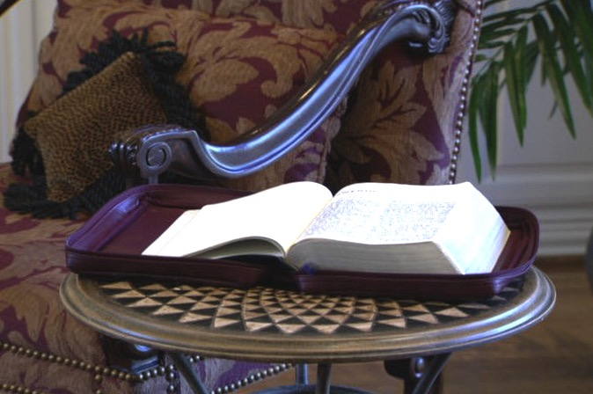
vkJ tpRthrj;jpd; mbg;gil Mtzk;
ghl ifEhy; gf;fk;. 6
07
2

Slide 10

mtUila Gj;jfj;jpy; “jpUkiw vjidg;gw;wpaJ!”
fyhepjp. Vd;hPl;lh khH]; vOJfpd;whH…
ghl ifEhy; gf;fk;. 6
08

Slide 11
gy kf;fSila jpUkiw mwpthdJ: XH khiyapy; fhzg;gLk; Kj;Jf;fisg; Nghd;wJ. Mdhy; thrpf;Fk; gyUila rpe;ijapy;…
ghl ifEhy; gf;fk;. 6
09

Slide 12

…Kj;J khiy mWe;Js;sJ… jpUkiwapy; $wg;gl;Ls;s rk;gtq;fs; xOq;fw;witahfTk; Fok;gpa epiyapy; fhzg;gLfpd;wJ!
ghl ifEhy; gf;fk;. 6
10

Slide 13
ghl ifEhy; gf;fk;. 6
11

Slide 14
jpUkiwapd; Mok;
mtw;wpd; nghUs; tpsf;fk;
ghpRj;j Mtpapd;
Mokhd topelj;Jjy;
12
2

Slide 15
?
?
?
MgpufhKf;Fk; ,];uNtyUf;Fkhd flTSila kPl;gpd; jpl;lk;
Mz;ltuhfpa ,NaR fpwp];Jtpd; gpurd;dk;
jpUr;rigapd; gpwg;G
?
?
?
?
?
?
13
5

Slide 16





  ,q;Nf nfhLf;fg;gl;Ls;s
  jpUkiwfisg;
  ghHf;fTk; !
14

Slide 17
,q;F jhd; gpur;rid Muk;gpf;fpd;wJ!
mjpfk; Fok;gpa njhd;whf fhzg;gLfpd;wJ!
• Mapuf;fdf;fhd tpguq;fs;
• Ehw;Wf;F Nkw;gl;l kf;fs;
• 750,000 thHj;ijfs;
• 1,200 mjpfhuq;fs;
• 31,000 thHj;ijfs;
• vz;zKbahj tiffSk;
nkhopg;ngaHg;Gf;fSk;
15
7

Slide 18
ahH vjid nra;jdH?
ahH vjidf; $wpdH?
Gj;jfq;fs;
Vd;?
kf;fs;
jpfjpfs;
ahUf;F vjDld; njhlHGfs; fhzg;gl;ld?
16
7

Slide 19
cjtp!
ahH vjid nra;jdH?
ahH vjid $wpdH?
Gj;jfq;fs;
Vd;?
kf;fs;
jpfjpfs;
ahUf;F vjDld; njhlHGfs; fhzg;gl;ld?
17

Slide 20
cjtp!
vd;dhy; ,tw;iw
ngw;Wf;nfhs;s
KbahJ!!!
MfNt ehd;
NjtCopad;
nra;Ak;gb
tpl;LtpLfpd;Nwd; !
18

Slide 21
nghWg;Gs;stH
ahH?
19

Slide 22
,jdhy;
vd;d?
20

Slide 23
“vkJ tpRthrk; cz;ikapdhy; fl;bnaOg;gg;glhtpl;lhy;, mJ vkJ Cfk;, %lek;gpf;if, epidj;jy; Nghd;wjhf fhzg;gLk;.”
iky;]; ];ld;Nghl; (Miles Stanford)
Md;kPf tsHr;rpapd; nfhs;iffs;
cz;ik
Cfk;
%lek;gpf;if
;epidj;jy;
21
4

Slide 24
fw;wypd; Kf;fpa jd;ik…
“ehk; mwpe;jij tpl NtW xd;iwAk; tpRthrpf;fkhl;Nlhk;,
vkJ ek;gpf;iffSf;F Nkyhf ehk; thokhl;Nlhk;.”
Albert Mohler, President
The Southern Baptist Seminary Louisville, KY
22

Slide 25
So…here we go!
(And don't miss a single session. Each builds toward the next!)
25
1
Notes:
Which brings us to the study that lies ahead. We are about to embark on a Biblical voyage named: THE BIBLE…BASICALLY. It's a quick tour through ALL of Scripture, leaving you well equipped to THINK BIBLICALLY and to help others acquire that same skill!
You will have a new set of mental tools that can reshape your view of God's Word and his message for your life and the lives of others around you…both believers and those still searching for life's answers!
//// So here we go…and try to attend every session or class because each new idea steadily builds on those that have gone before!

Slide 26
jpUkiwapd;… mbg;gil
®
ehk; rpe;jpf;Fk; Kiw!
24
Notes:
CHANGED FROM THE ORIGINALS (TQC)

Slide 27
jpUkiwapd;…mbg;gil
®
Ntjhfkj;ij
mwpT hPjpahf
ePq;fs; fw;Wf;nfhs;tPHfs;!
25
Notes:
CHANGED FROM THE ORIGINALS (TQC)

Slide 28
jpUkiwapd;…mbg;gil
®
XH Kf;fpakhd tplak;: ,q;F kw;wtHfSgf;F fw;Wf;nfhLg;gjw;fhd rpy tplaq;fs;!
C 7 S J
rhl;rp nfhLg;gjw;fhd xH re;jHg;gk;!!!
26
1
Notes:
CHANGED FROM THE ORIGINALS (TQC)

Slide 29
jpUkiwapd;…
mbg;gil
®
jpUiwf; Nfhitia”
jpwe;J nfhs;Sjy;
27
Notes:
CHANGED FROM THE ORIGINALS (TQC)

Slide 30
jpUkiwapd;
…mbg;gil
30
Notes:
I'd like to introduce you to our friend, Mike. Mike is about to go into church. He's entering the building with a "Bible File" of information already in his head...well…somewhat!

Slide 31
jpUkiwapd;
…mbg;gil
BIBLE
FILE
31
Notes:
There he is…walking up the sidewalk right into church with his mental Bible File...

Slide 32
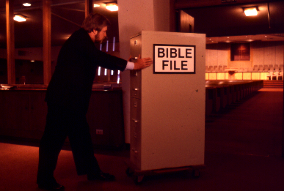
BIBLE
FILE
jpUkiwapd;
…mbg;gil
BIBLE FILE
32
31
Notes:
... And Mike goes straight into the building, pushing that File Cabinet in his head right into the sanctuary or worship center.

Slide 33
jpUkiwapd;
…mbg;gil
Votre
Dossier
de la
Bible
33
Notes:
Mike sits himself down ready for the preacher or the teacher to begin. And Mike is getting ready to open his biblical file cabinet…

Slide 34
34
Notes:
…up there in his head! …….Well, there he sits... his Bible file all primed to plug into whatever the pastor or teacher is about to say.

Slide 35
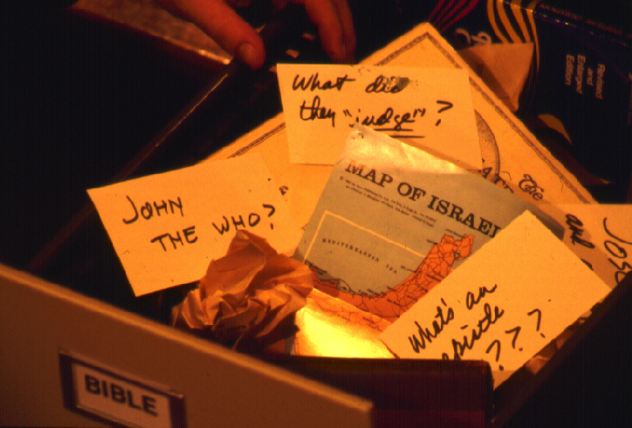
?
MfNt… ,e;j tpguq;fid vq;F xOq;FgLj;j Muk;gpf;fyhk;… mj;Jld;MIStpguq;fisAk; vq;F Muk;gpf;fyhk;?
?
?
?
33
5

Slide 36
vd;dplk; ve;j KOikahd rpe;jidAk; ,y;iy!
vq;F ehd; Muk;gpf;
fyhk;?
34

Slide 37
7
ghl ifEhy; gf;fk;. 8-14
35

Slide 38
7
7
ghl ifEhy; gf;fk;. 8-14
36
1

Slide 39
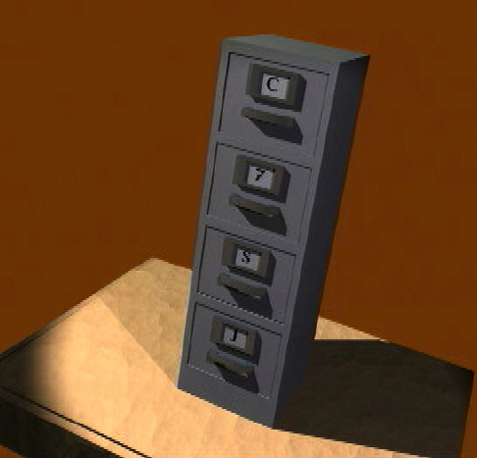
7
cq;fSila jpUkiwf; Nfhit
ghl ifEhy; gf;fk;. 8-14
37

Slide 40
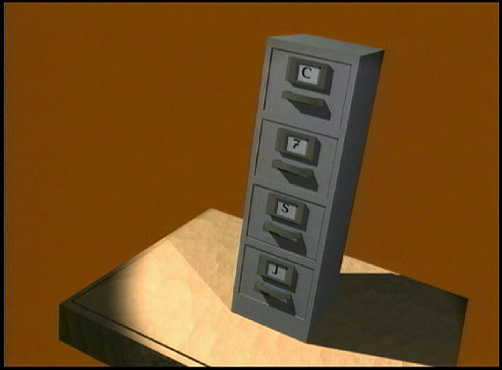
7
File Cabinet Movie w/ narration
38

Slide 41
7
1
2
3
4
5
6
7
8
9
10
ghl ifEhy; gf;fk;. 8-14
39

Slide 42
“cq;fs; jpUkiwf; Nfhitia” jpwe;Jnfhs;Sjy;
7
7
7
7
7
7
C S J
C S J
C S J
C S J
ghl ifEhy; gf;fk;. 8-14
40
4

Slide 43
“cq;fs; jpUkiwf; Nfhitia” jpwe;Jnfhs;Sjy;
7
7
= 4+3
ghl ifEhy; gf;fk;. 8-14
41
2

Slide 44
7
“cq;fs; jpUiiwf; Nfhitia”
jpwe;Jnfhs;Sjy;
C 4 3 S J
C 4 3 S J
ghl ifEhy; gf;fk;. 8-14
42
1

Slide 45
5 Kf;fpa thHj;ijfs; my;yJ thf;fpaq;fs;:
7
C = gilg;G
4 = kf;fs;
3 = r%fq;fs;
S = mikjp
J = ,NaR
ghl ifEhy; gf;fk;. 8-14
43
5

Slide 46
5 Kf;fpa thHj;ijfs; my;yJ thf;fpaq;fs;:
7
C = gilg;G
4 = kf;fs;
3 = r%fq;fs;
S = mikjp
J = ,NaR
ghl ifEhy; gf;fk;. 8-14
44
6

Slide 47
5 Kf;fpa thHj;ijfs; my;yJ thf;fpaq;fs;:
7
C = gilg;G
4 = kf;fs;
3 = r%fq;fs;
S = mikjp
J = ,NaR
ghl ifEhy; gf;fk;. 8-14
45

Slide 48
gpd;tUk; 4 kf;fs:;
7
A Mgpufhk;
J NahNrg;G
M NkhNr
J NaRth
ghl ifEhy; gf;fk;. 8-14
46
5

Slide 49
7
A
epahajpgjp
fl;lhak;
epahae;jP
Hj;jy;!
ghl ifEhy; gf;fk;. 8-14
47

Slide 50
gpd;tUk; 4 kf;fs;:
7
J NahNrg;G
A Mgpufhk;
A
M NkhNr
Jepahahjpgjp
J NahRth
Mfl;lhak;
Jepahae;jPHj;jy;
ghl ifEhy; gf;fk;. 8-14
48
8

Slide 51
7
C gilg;G
A Mgpufhk;
J NahNrg;G
M NkhNr
J NahRth
ghl ifEhy; gf;fk;. 8-14
49
5

Slide 52
5 Kf;fpa thHj;ijfs; my;yJ thf;fpaq;fs;:
7
C = gilg;G
4 = kf;fs;
3 = r%fq;fs;
S = mikjp
J = ,NaR
ghl ifEhy; gf;fk;. 8-14
50

Slide 53
7
A R C
ghl ifEhy; gf;fk;. 8-14
51
2

Slide 54
gpd;tUk; 3 r%fq;fs;:
7
A Gul;rpfuk;
R uh[hPfk;
C rpiwapWg;G
ghl ifEhy; gf;fk;. 8-14
52
6

Slide 55
gilg;G
Mgpufhk;
NahNrg;G
NkhNr
NahRth
A Gul;rpfuk;
R uh[hPfk;
C rpiwapWg;G
7
ghl ifEhy; gf;fk;. 8-14
53

Slide 56
7
7
kPl;Lg;ghHj;jy;...
C 7 S J
C 4 3 S J
ghl ifEhy; gf;fk;. 8-14
54
3

Slide 57
C gilg;G
4 kf;fs;
3 r%fq;fs;
S mikjp
J ,NaR
7
ghl ifEhy; gf;fk;. 8-14
55

Slide 58
7
C gilg;G
A Mgpufhk;
J NahNrg;G
M NkhNr
J NaRth
A Gul;rpfu
R uh[hPfk;
C rpiwapWg;G
S mikjp
J ,NaR
ghl ifEhy; gf;fk;. 8-14
56
2

Slide 59
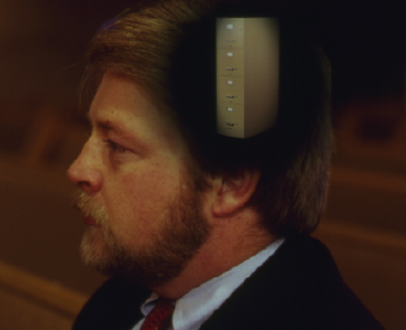
cq;fs; Gjpa “jpUkiwf; Nfhit”
rpU\;bg;G
rpU\;bg;G
mgpufhk;
Mgpufhk;
NahNrg;G
NkhNr
NaRth
NahNrg;G
muh[fk;
uh[hPfk;
NkhNr
rpiwapWg;G
NaRth
nksdk;
,NaR
muh[fk;
uh[hPfk;
rpiwapWg;G
nksdk;
,NaR
ghl ifEhy; gf;fk;. 8-14
57
11

Slide 60
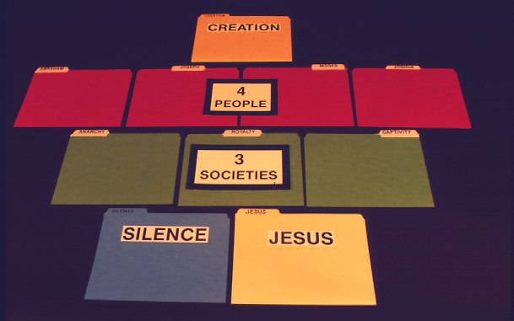
7
rpU\;bg;G
Manuel pg. 8-14
60

Slide 61
7
rpU\;bg;G
4 kf;fs
Manuel pg. 8-14
61

Slide 62
7
rpU\;bg;G
4 kf;fs
3
r%fq;fs;
Manuel pg. 8-14
62

Slide 63
7
rpU\;bg;G
4 kf;fs
3
r%fq;fs;
mikjp
,NaR
Manuel pg. 8-14
63

Slide 64

7
cyfk; KOikahf khw;wkile;Js;sJ!
ghl ifEhy; gf;fk;. 8-14
62

Slide 65




7
rpU\;bg;G
mgpufhk;
NahNrg;G
NkhNr
NaRth
muh[fk;
uh[hPfk;
rpiwapWg;G
nksdk;
,NaR
63

Slide 66

jpUkiwapd;
…mbg;gil
66
Notes:
Imagine this as the main screen of your own computer monitor – with a data folder you created named, naturally, Bible File. Double click on that imaginary folder….

Slide 67

C
rpU\;bg;G
Mgpufhk;
Gul;rpfu
nksdk;
,NaR
NahNrg;G
uh[hPfk
NkhNr
rpiwapWg;G
NaRth
67
10
Notes:
…and you would get this...the ten sub-files, all as folders, named, in
order…and say them along with me…
//// CREATION
//// ABRAHAM
//// JOSEPH
//// MOSES
//// JOSHUA
//// ANARCHY
//// ROYALTY
//// CAPTIVITY
//// SILENCE
//// JESUS.

Slide 68
C
{
}
rpU\;bg;G
Mgpufhk;
Gul;rpfu
nksdk;
,NaR
4 kf;fs
NahNrg;G
uh[hPfk
3
r%fq;fs;
NkhNr
rpiwapWg;G
NaRth
68
Notes:
And, with some computer graphics, you might even add the basic building plan over those folders. The now a familiar mental tool... C 7 S J And its 4 PEOPLE and 3 SOCIETIES.

Slide 69
cq;fs; jpUkiwf; Nfhit
rpU\;bg;G
mgpufhk;
NahNrg;G
gbg;G
NkhNr
NaRth
muh[fk;
Ghpe;J nfhs;Sjy;
uh[hPfk;
rpiwapWg;G
nksdk;
,NaR
Kuz;ghby;yhj
67
4

Slide 70

,g;nghOJ jpUkiwapd;… mbg;gil cq;fs; rpe;ijapy; fhzg;gLfpd;wJ…
• “jpUkiwf; Nfhit” vd;w rpe;jid
• “jpUkiwf; Nfhit”…C 7 S J jpwg;gjw;fhd Kf;fpa jpwg;G
1. vd;d ele;jJ!
gjpyspg;gjw;
fhd %d;W Nfs;tpfs;
2. Vd; mJ ele;jJ!
3.jpUkiwf;Fk; mjd; nghUslf;fj;jpw;Fk; Mjpf;fk; nrYj;jpa fhuzpfs;
68
4

Slide 71
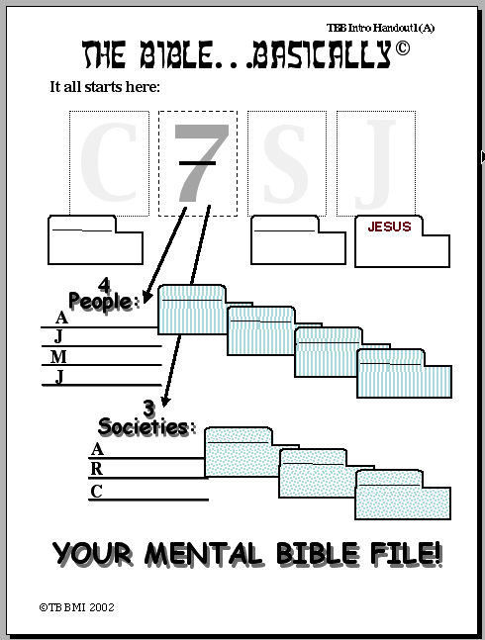
jpUkiwapd;…mbg;gil
It all starts here:
C
7
S
J
rpU\;bg;G
nksdk;
,NaR
4 kf;fs:
{
Mgpufhk
A
Mgpufhk
NahNrg;G
J
NahNrg;G
NkhNr
NkhNr
M
NaRth
NaRth
J
{
3 r%fq;fs;:
ghl cjtp #01
A
Gul;rpfu
Gul;rpfu
R
uh[hPfk
uh[hPfk
rpiwapWg;G
rpiwapWg;G
C
cq;fs; jpUkiwf; Nfhit
©2006 TBBMI
9.65.01.
20
71
Notes:
Now look at Study Help Number One in the student handbook. That sheet will help you to embed in your thinking how to keep these tools on the front of your mind…while also learning how to teach others.
//// Beginning with a large C…
//// for CREATION then…
//// the Number 7…the dashed line is already there…7 standing for the four people and then the three societies. So…first…the FOUR
PEOPLE…
//// who are ABRAHAM…
//// then added to his File Folder…
//// JOSEPH…
//// onto the JOSEPH folder
//// MOSES…
//// his Folder…and finally…
//// JOSHUA…
//// finishing out the FOUR GREAT PEOPLE and their file Folders in the Bible File. Then on to the THREE SOCIETIES…
//// beginning with ANARCHY…
//// and its folder…
//// ROYALTY…
//// and the folder…
//// finishing with CAPTIVITY…
//// and its folder.
Now we'll finish it out…
//// S for
//// SILENCE…and
//// the culmination of all our thinking…J for JESUS.

Slide 72
jpUkiwapd;…mbg;gil
Now…try your hand at opening your mental Bible File,
either by yourself or by drilling or quizzing someone else.
jpwg;gjw;fhd Kf;fpa jpwg;G “cq;fs; jpUkiwf; Nfhit ”
C 7 S J
The letter "C" stands for:
rpU\;bg;G
7 = 4+3 breaks out into:
4 kf;fs & 3 r%fq;fs
The FOUR PEOPLE are:
Mgpufhk
NahNrg;G
NkhNr
NaRth
ghl cjtp #02
The THREE SOCIETIES are:
Gul;rpfu
uh[hPfk
rpiwapWg;G
rpU\;bg;G
Mgpufhk
The letter "S" stands for:
nksdk;
JESUS
NahNrg;G
The letter "J" stands for:
,NaR
...
NkhNr
Therefore, the ten words… and your ten file folder labels… are:
NaRth
Gul;rpfu
uh[hPfk
rpiwapWg;G
cq;fs; jpUkiwf; Nfhit!
nksdk;
,NaR
©2006 TBBMI
9.65.01.
9
72
Notes:
And here is STUDY HELP NUMBER 2….this is the one you can use for your own review-- or to hold in your hand while you teach THE BIBLE FILE idea to others.
//// First the key to open the file:
//// C 7 S J…
//// The letter C stands for CREATION.
//// 7 equals 4 plus 3…for the four people and the three societies.
//// FOUR PEOPLE…ABRAHAM, JOSEPH, MOSES, JOSHUA.
//// THREE SOCIETIES…ANARCHY, ROYALTY, CAPTIVITY.
//// The letter S standing for SILENCE
//// The letter J representing JESUS.
//// FINALLY the TEN WORDS. And there are your ten file folders in your new Bible File. Repeat them one last time:
CREATION, ABRAHAM, JOSEPH, MOSES, JOSHUA, ANARCHY, ROYALTY, CAPTIVITY, SILENCE, and JESUS.

Slide 73
7
71

Slide 74
jpUkiwapd;…mbg;gil
®
jpwg;gjw;fhd Kf;fpa jpwg;G
“cq;fs; jpUkiwf; Nfhit ”
72

Slide 75
,g;nghOJ ,jid mDgtpJs;sPHfs; vkJ gazk; ,jid Nehf;fpaJ…
•“jpUkiwf; Nfhit”vd;w rpe;jid
•“jpUkiwf; Nfhit”…C 7 S J jpwg;gjw;fhd Kf;fpa jpwg;G
•A jpUkiwapd; Kf;fpa epfo;Tfisf; Fwpg;gpLk; tiuglk;
•jpUkiw “rk;gtq;fspd;” : “tpiuthd fhyml;ltiz”
•MgpufhKf;$lhf tUk; m];jpghukhdJ Mz;ltuhfpa ,NaR fpwp];Jtpd; Copaj;jpw;F Neubahf topelj;Jtij jpUkiwapy; fhzyhk;
•jpUkiwapd; fl;llf;fiy “mjd; rk;gtj;jpy;” jq;fpAs;sJ
•gioa, Gjpa Vw;ghLfspd; Gj;jfq;fSk; jiyg;Gf;fSk;
 
73
7

Slide 76
jpUkiwapd;…
mbg;gil
A Presentation of The Bible…Basically Ministries International Inc. Fort Worth, Texas
www.biblebasically.com
8.0.01.
©2004 TBBMI
74

Slide 77


jpUkiwapd;…mbg;gil • BibleStudyDownloads.org
,g;ghlf;Fwpg;Gfis ,ytrkhf ngw;Wf;nfhs;s
Notes:
The Bible…Basically (bb)

Slide 78
8.0.01.
©2004 TBBMI
75

