Slide 1
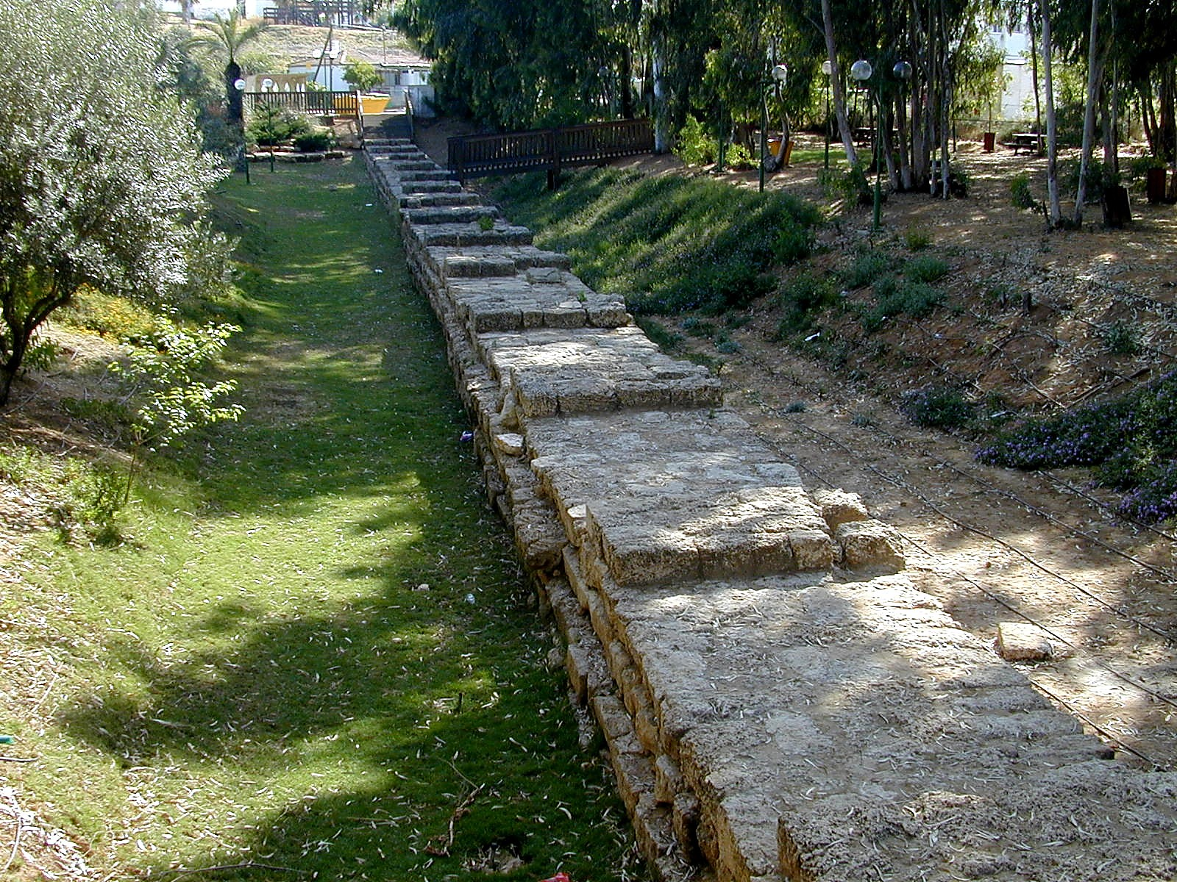
Nawui angayung pangsang khangasak
Dr. Rick Griffith
Singapore Bible College
Dr. Rick Griffith • Singapore Bible College • Crossroads International Church Singapore • cicfamily.com • BibleStudyDownloads.org

Slide 2

“Haokaphok-khareli"
Gen. 1:1

Slide 3
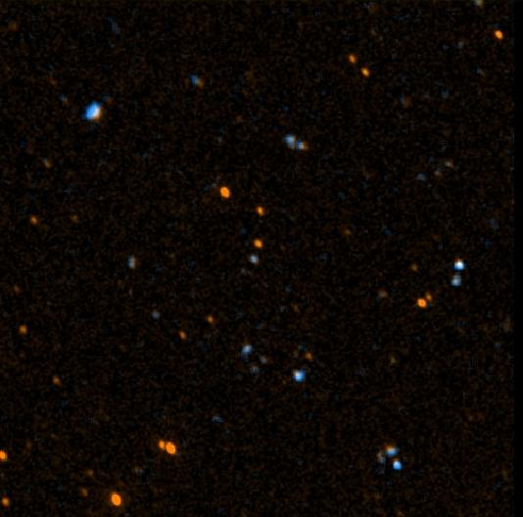


Haokaphokwui aming
Hebrew:
tyvarb
bereshith
Haophokhareli
Greek:
ge,nesij
Haokaphok
Leikaphok, apong, kaphara
©2003 TBBMI
7.5.03a.
17

Slide 4

Haokaphokwui pongli Khangahan
“Haokaphok"
Ithum kachiwui eina ra
Khiwuivang okathuili makapha leihao?
Kachihan leila?
©2003 TBBMI
7.5.03a.
18

Slide 5
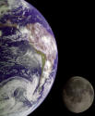
Haokaphokwui pongli khangarui khararchan
Memphite Theology
Enuma Elish
Atrahasis Epic
Gilgamesh Epic
Okathui kasem
Okathui kasem
Okathui kasem Kala tarakaphong
Tara kaphong

Slide 6
Black
Notes:
Sumerians said that the high god raped the air goddess, resulting in the moon god.
Babylonians taught that king of the created gods (Marduk) murdered his mother (Tiamat) and cut her into two halves that became the land and sea (cf. Gen. 1:6-8).
So the world started from a son murdering his mother!

Slide 7
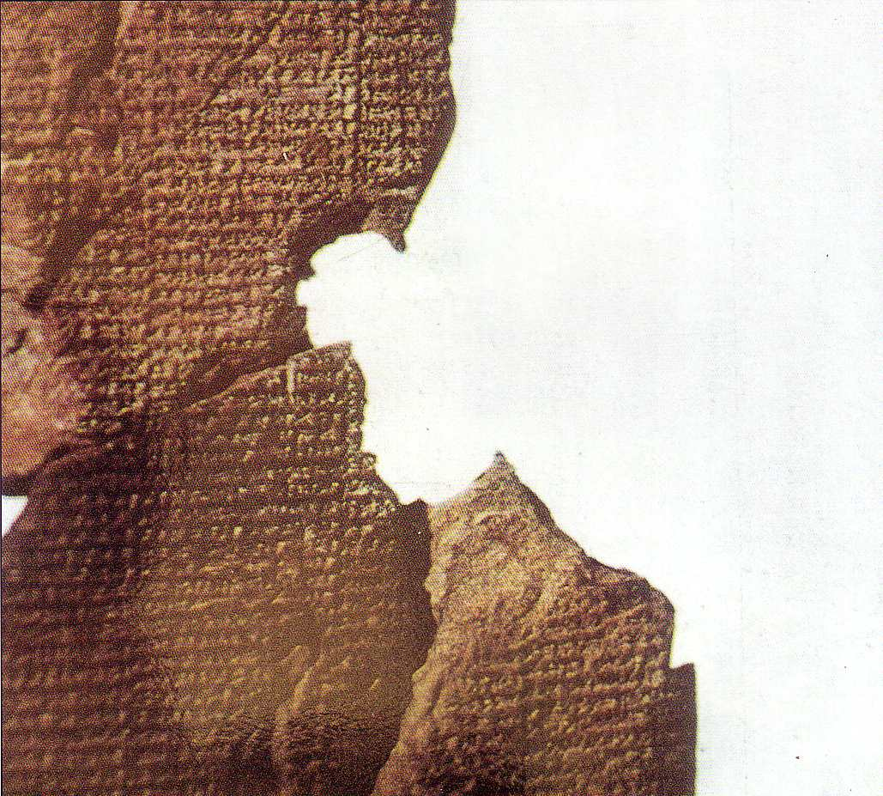
Atrahasis Epic
"Kaphara kameo chili mangla kapai ana semachiranu, kala michina kameonao phararanua… mikumo semlu chithakha ana chora pharara… Chieina Nintu na ngaleichi manatlu thakha kameo kala mikumo chi ngalei chili mathalakeina manathaora kala kameowui asa eina mangla leiranu”
(Arnold/Beyer, 24)
Akkadian 1650 BC
Pangsem kala tara kaphongwui khararchan
Mikumo kasemhi varewui ot chili yangngachon khavaina
Mikumohi ngaleiwui eina sakhui

Slide 8
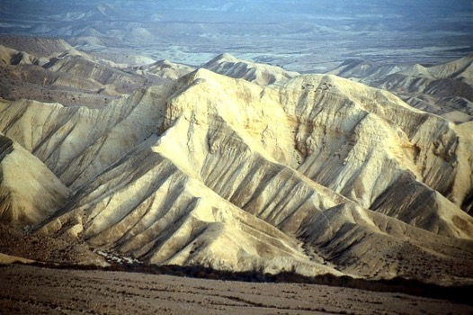
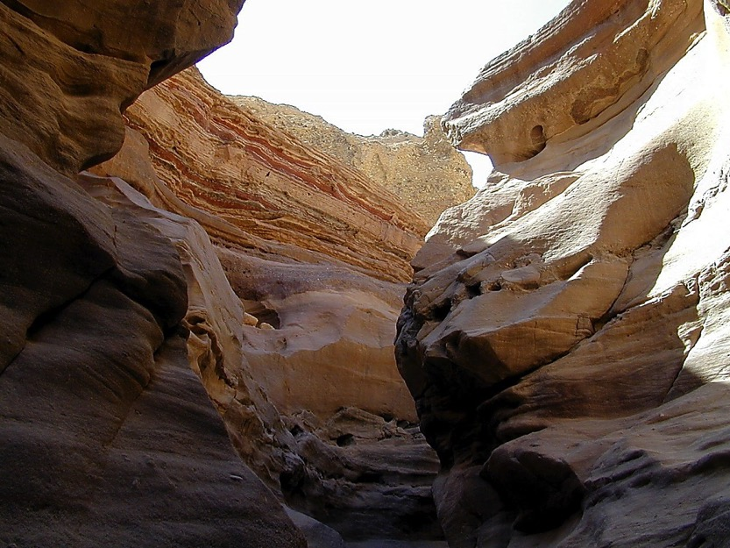
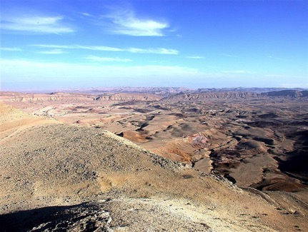
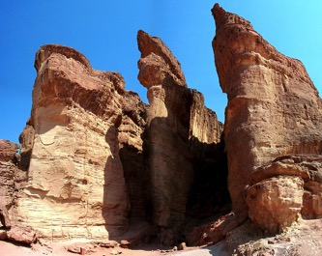
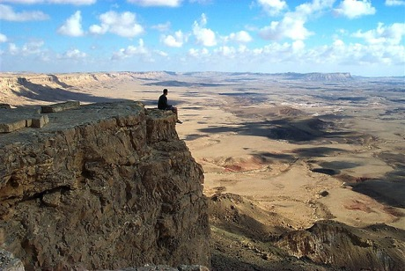
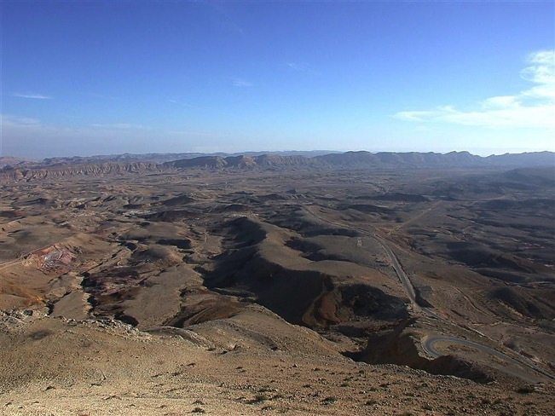
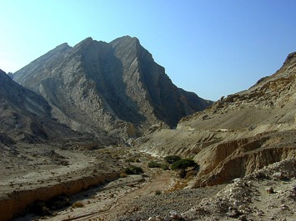
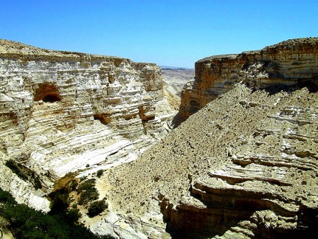

40 YEARS? OUT HERE?
Mishan. 32:13
DRESSING
THE
STAGE
Nava Chili zingkum hangmati leiya kachila?
MOSES
Exodus
Sinai
M - C - C
Kadesh Barnea
40
40
Handbook pg. 26-29
23

Slide 9

Jericho
Kathi ngayi
JORDAN KONG
ARUIHON WUI JERICHO
JOSHUA
Jericho/Ai
ACHALAKHAWUI JERICHO
Jericho wui eina Zingsho shong Jordan Kanda
ngashankhava
Handbook pg. 26-29
42

Slide 10
Black

Slide 11
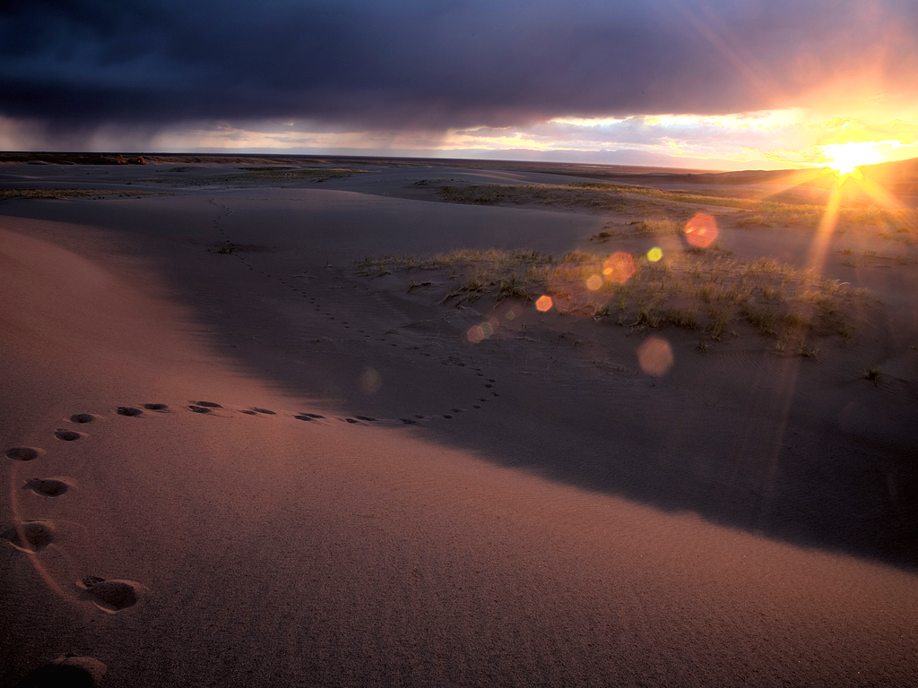
Ithum kali vaukikaji?
Haokaphok 1
Ngahangaka
Changkhay-ang

Slide 12
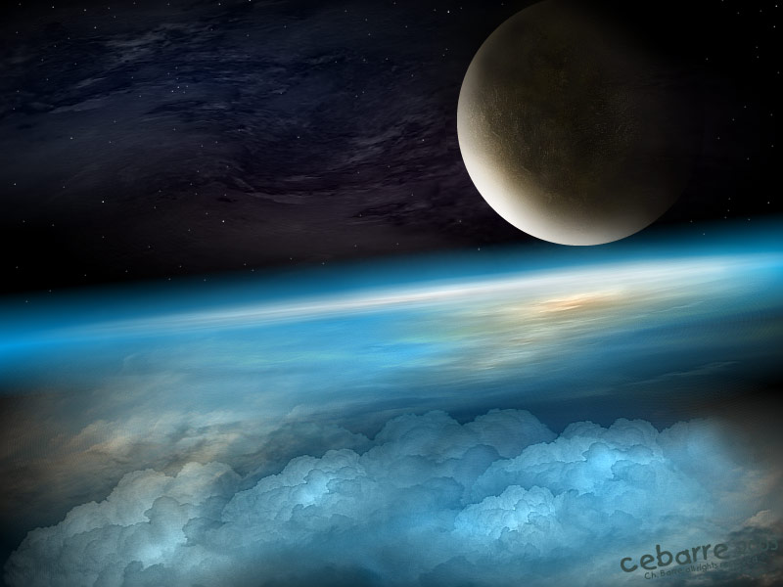
I. Ithumwui Vare hi saikora kasa Awunga mikumona semkakhui ningchukli Ngateihang kahaiyana
(Haokaphok 1).

Slide 13

Kazing ngalei kasemwui zimikshobing
_{x}
33
Amei-ama maleikashawui eina- semkaka
Amei-ama maleikashawui eina- chipemkasang
Khamadithang: Zimik, Kazang kala sira ngatei khangasak
Kharethang: Kahor
Kakhanethang: Tara eina khamasai ngatei khangasak
Kaphangathang: Khai eina sayurvayur
Kakathumathang: Ngalei eina shamadru ngatei khangasak
Katharukthang: sayur eina mekamo
Haokaphok1:3-31

Slide 14
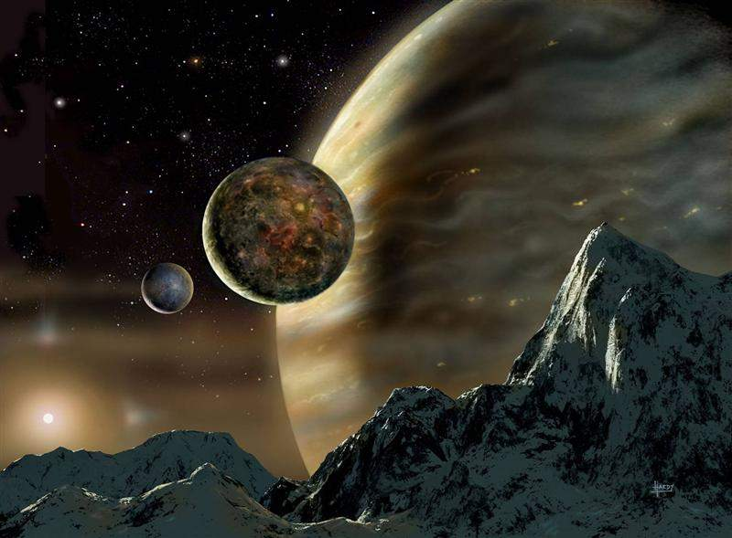
Zimiksho tharuk thangwui lungli Kazing ngaleili kasem

Slide 15
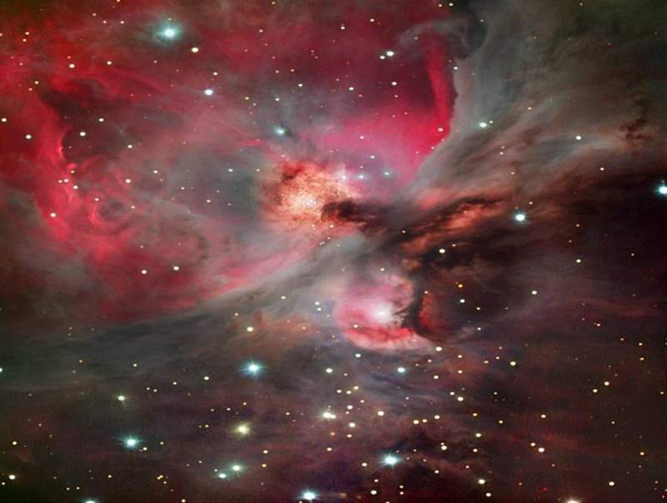
Day 1
Khare thang…Day 1
Haophok khareli Varena kazing ronadakhalei ngaleili sai (1).

Slide 16
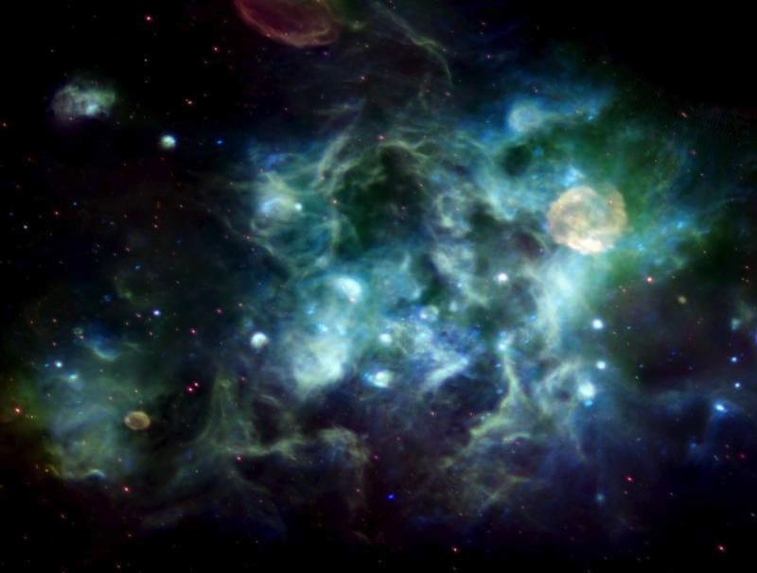
Formless & Void
Khare thang
Okathui hi amei-ama maleisamana, Kala Kathuka chiwui ari-arap tangmangting eina leisai; kala Varewui Mangla china taratungli zatung-zatva sai (2).

Slide 17
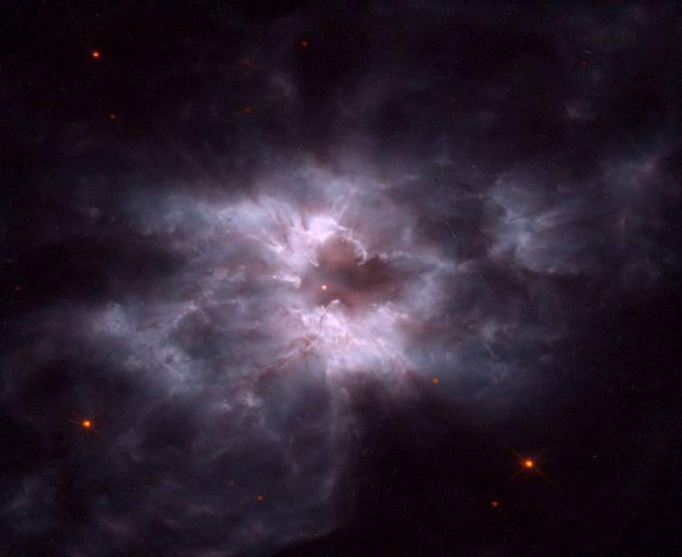
Light
Khare thang
Kala Varena hanga, "Kahor leiranu"; chieina kahor leihaowa. Kala Varena kahor chi tangkhamangwui eina ngatei ngasaka (3-4).

Slide 18
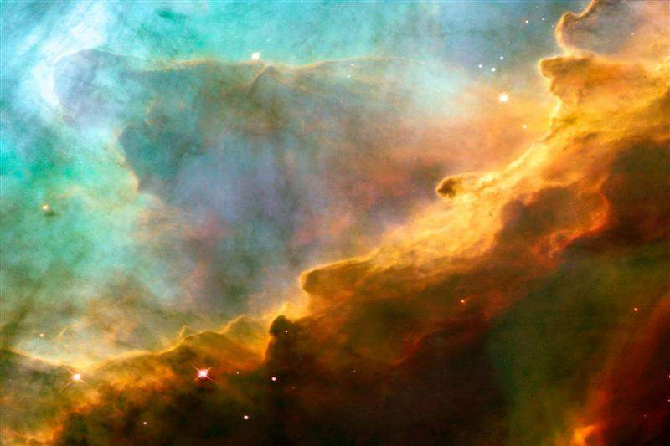
First Day
Khare thang
Varena kahor chili Ngashun kala tangkhamang chili Ngaya da hoi. Chithang ngazin eina ngathor chi kharethangna (5).

Slide 19
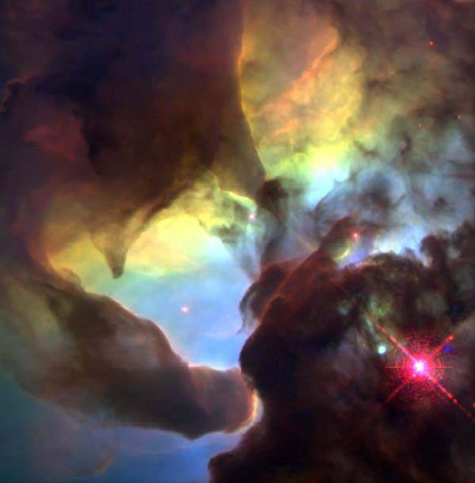
Day 2
Kakhane thang
Kala Varena hanga, "Tara ngachaiwui eina khamasai shokranu,kala china tara akhawui eina tara akhali ngatei ngasakranu" (6).

Slide 20
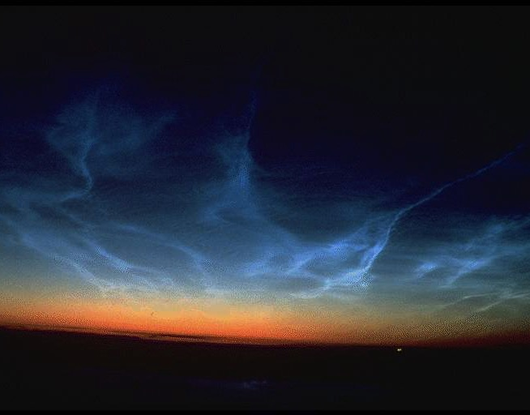
Expanse
Kakhane thang
Kala Varena khamasaiwui azingli khalei tara eina khamasaiwui atungli khalei tara chi ngatei ngasaka. Kala chi takam eina shoka (7).

Slide 21

Sky
Kakhane thang
Varena khamasai chili Kazingram hoi (8a).

Slide 22
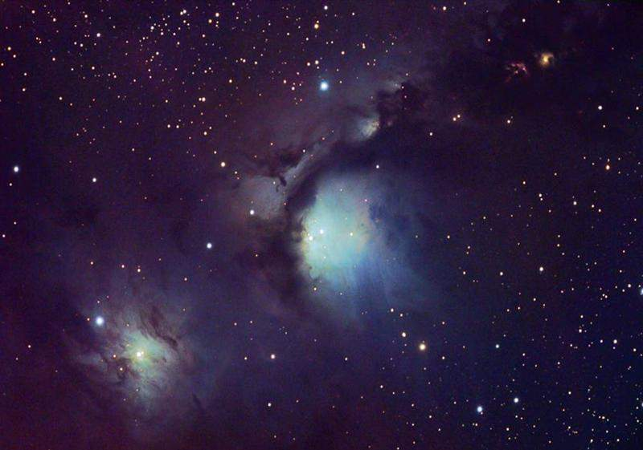
Second Day
Kakhanethang
Chithang ngazin eina ngathor chi kakhanethangna (8b).

Slide 23
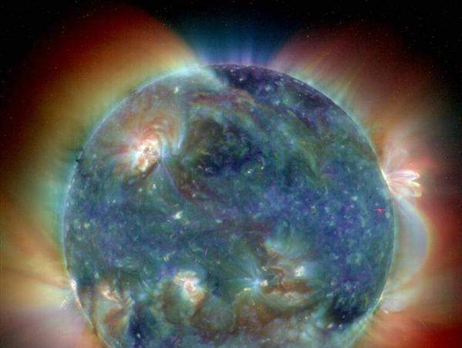
Day 3
Kakathumathang
Kala Varena hanga, "Kazingli khalei tara chi apam akhali kazipkha sahaida ngalei katheng leiranu." Kala chi takam eina shoka (9).

Slide 24
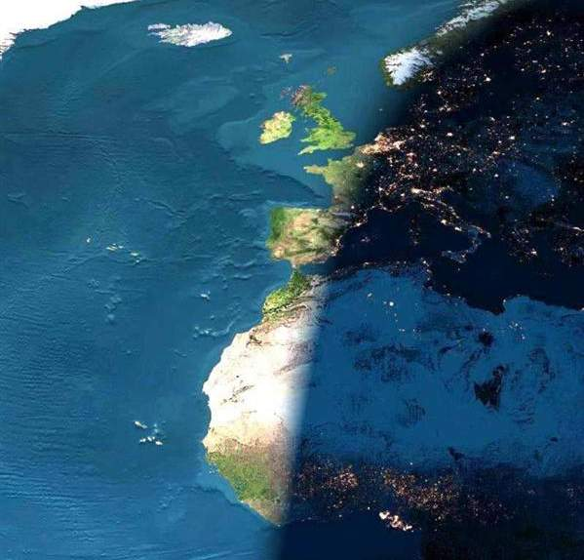
Land & Seas
Kakathumathang
Kathrng chili Varena Ngalei hoi, kala tara kazipkha sakahai chili Shamadru hoi. Kala chi phahaira da Varena thei (10).

Slide 25
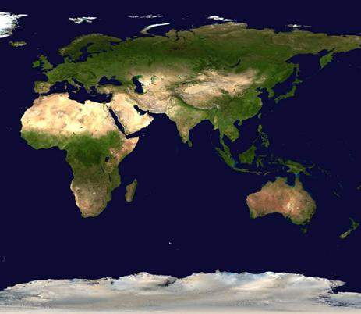
Vegetation
Kakathumathang
Kala Varena, "Ngaleina akhar Kharda thingna-raha, atha kazang arongyurbing kala atheirong yurna kachichawui ayur athishurda atha kazanga athei athei matheiranu" da hanga. Kala chi takam eina shoka. Ngaleili thingna-raha kachungkha shoka, arong ayur ngateida atha zangsera kala thingrongbingna athei matheida ayur ayurwui athishurda atha zangsera. Kala chi Varena phahaira da thei (11-12).

Slide 26
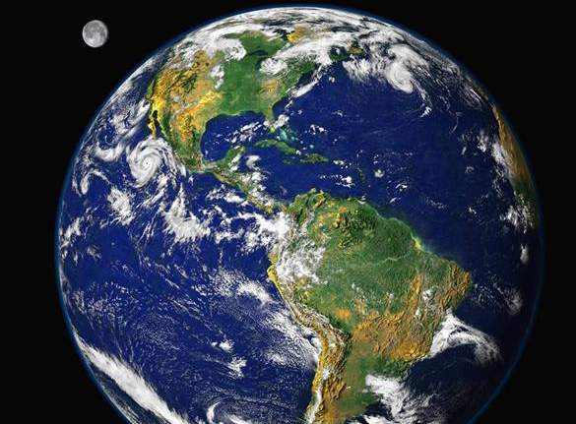
Third Day
Kakathumathang
Chithang ngazin eina ngathor chi kakathumathangna (13).

Slide 27
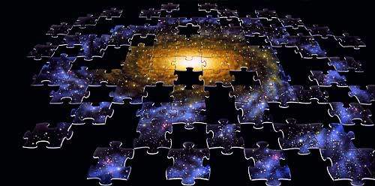
Day 4
Khamatithang
Varena hanga, "Ngashun eina ngaya ngatei khavai kazingwui khamasaili kahirbing leiranu, kala china atam, zimiksho kala zingkum theikhui khavai saranu (14);

Slide 28
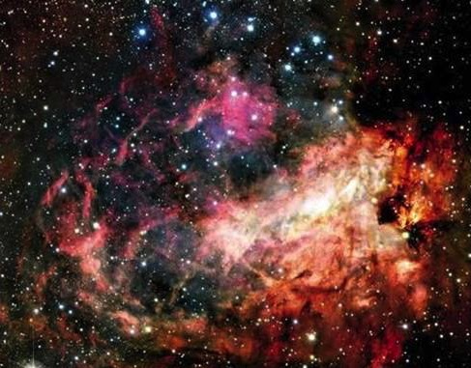
Sun & Moon
Khamatithang
Kala okathuili horkhavai kazingramwui khamasaili kahor leiranu." Kala chi takam eina shoka(15).

Slide 29
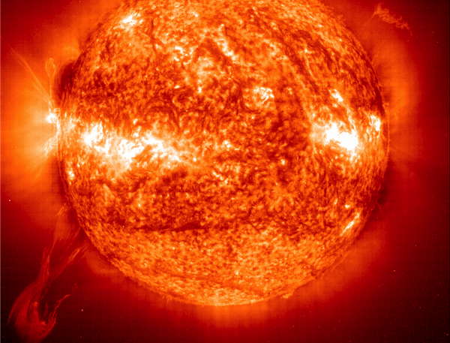
Sun
Khamatithang
Varena kahor kahakva khani sai, hakkhamei kahor china ngashun mungkhavai (16a)…

Slide 30
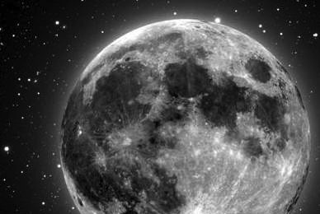
Moon
Khamatithang
Ateokhamei kahor china ngaya mungkhavai (16b)…

Slide 31
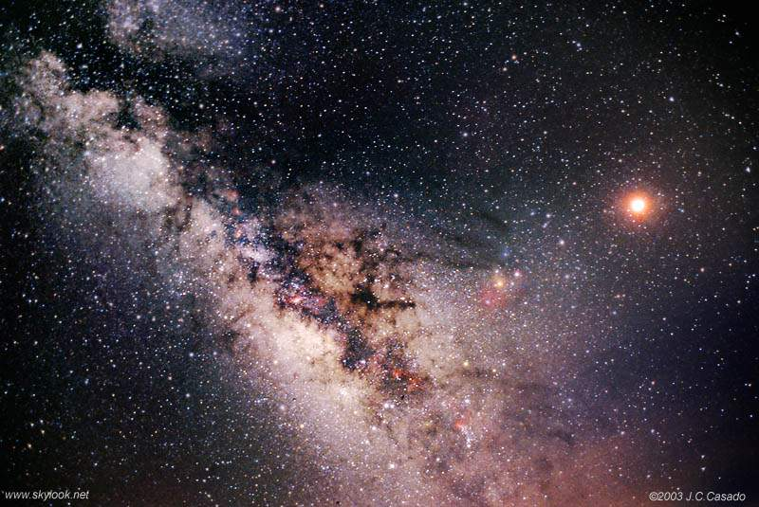
Stars
Khamatethang
Kala ana sira kachungkhala sakhui. (16c).

Slide 32
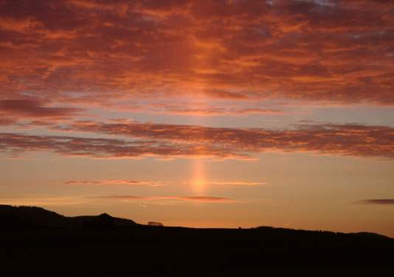
Fourth Day
Khamatethang
Kala okathuili horkhavai saikora chi kazingramwui khamasaili Varena haimi, china ngashun eina ngaya mungkhavai, kala kahor eina tangkhamang ngatei ngasak khavaina. Kala chi Varena phahairada thei. Chithang ngazin eina ngathor chi khamatethangna (17-19).

Slide 33
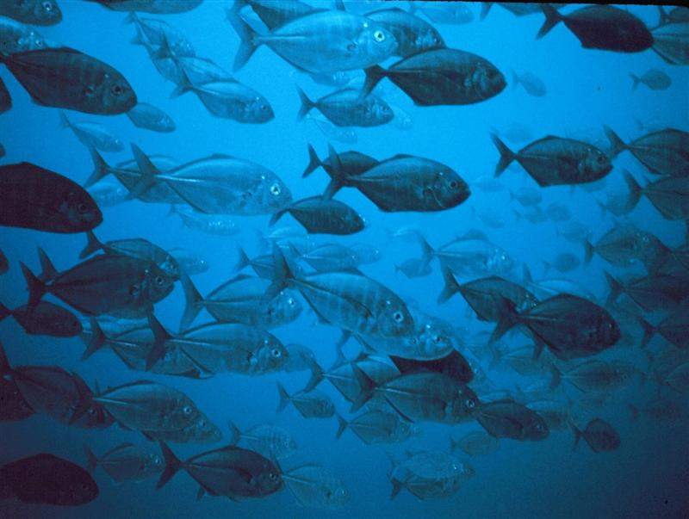
Day 5
Kaphangathang
Kala Varena hanga, "Tarawui eina manglakapai kachungkha shokranu…” (20a)

Slide 34
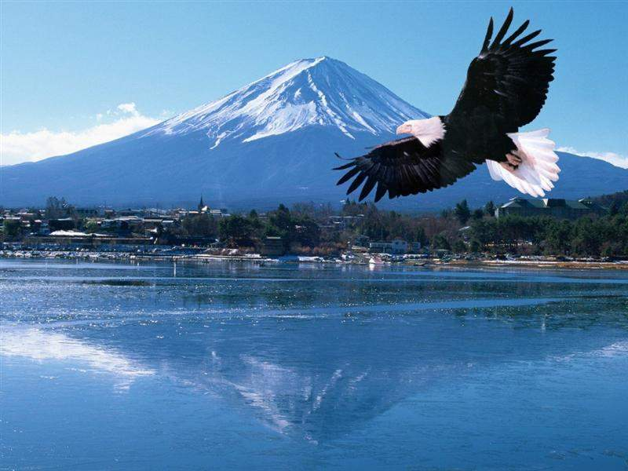
Birds
Kaphangathang
kala okathuili vanaobingna kazingramwui khamasaili yongzatranu” (20b).

Slide 35
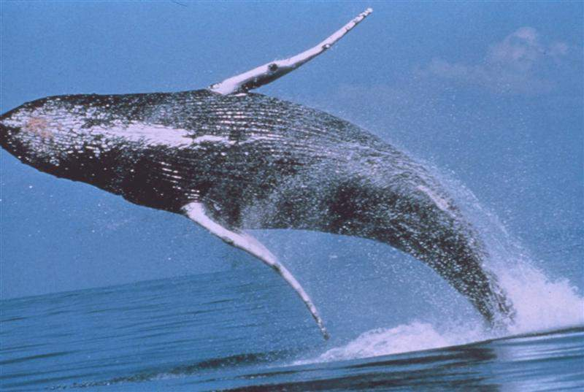
Whales
Kaphangathang
Chithada sada Varena shamadrulungli hakkhamaha sayur kala taralungli ngarikkazata kharingyur kachiva (21a)…

Slide 36
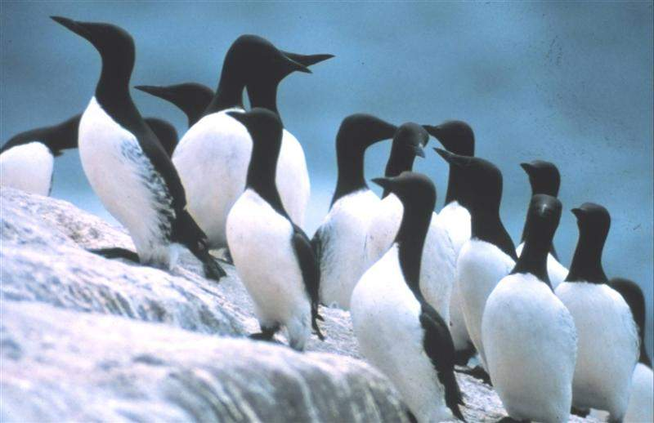
Penguins
Kaphangathang
kala angachang kaka vanaoyur kachivasakhui. Kala chi Varena phahaira da thei(21b).

Slide 37
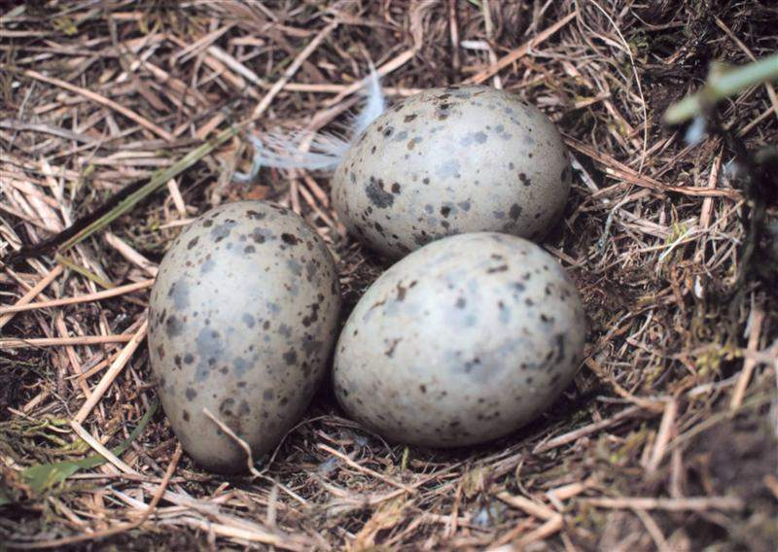
Multiply
Kaphangathang
Kala Varena athumli somida hanga,"Athei matheilu kala mataisanglu kala shamadruwui taralungli chipemlu, kala okathuili vanao mayasangranu” (22).

Slide 38
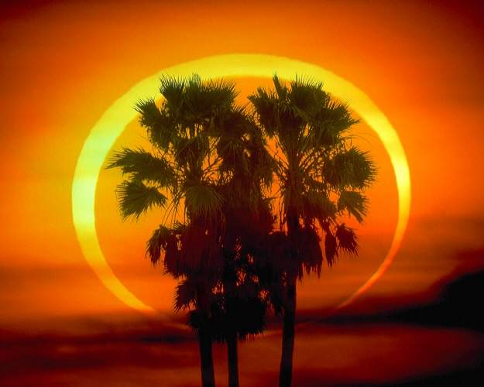
Fifth Day
Kaphangathang
Chithang ngazin eina ngathor chi kaphanga thangna (23).

Slide 39
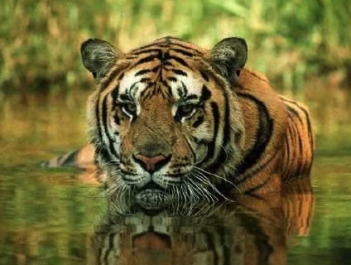
Animals
Katharukathang
Varena hanga, "Ngalriwui eina manglakapaiyur kachiva: shakei, ngarikazata yur, kala sayur shokranu." kala chi takam eina shoka. Kala Varena sayur ayayava, shakei ayur ngateida kala ngaleili ngarikazata ayur ngateida shokngasaka. Kala chi Varena phahaira da thei (24-25).

Slide 40

Man
Katharukathang
Chiwui thili Varena hanga," Ithumwui sakrin khuida ithumli ngaraikacha mi sakhuisa; kala shamadruli khalei khaihyur, kazingli yongkazata vanao, shakei kala okathuiwui ngaleitungli ngarikazata saikorawuitungli athumna mungranu.” (26).

Slide 41
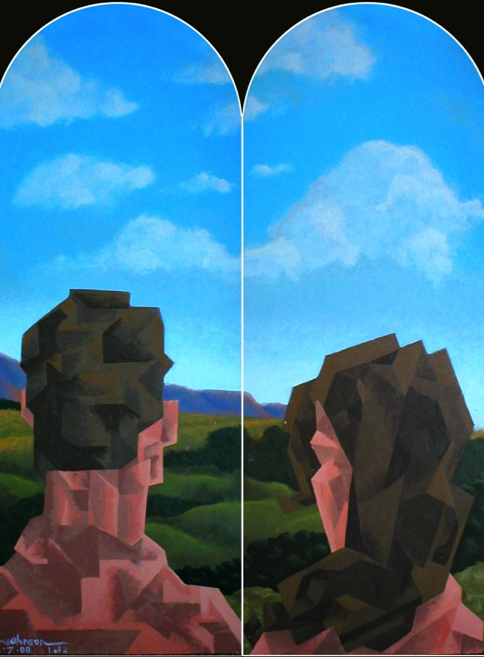
Woman
Katharukathang
Chithada Varena awui sakrin khuida mi sakhui,
Varewui sakrin khuida mayarnao sakhui;
Mayarnao eina shanao chi sakhui (27).

Slide 42
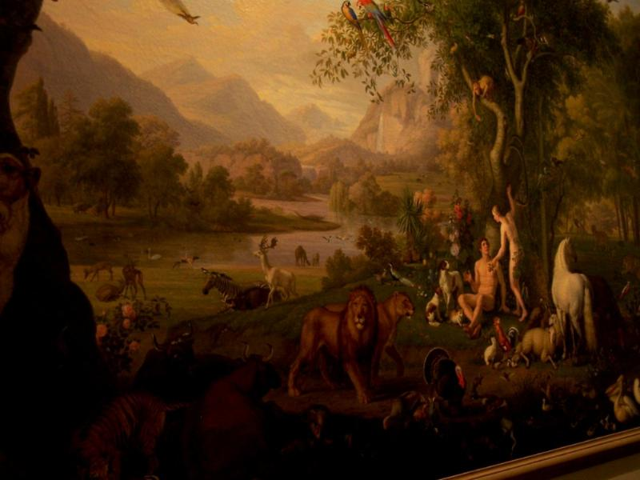
Mandate
Kala Varena anili somida hanga, "Athei matheilu kala mayasanglu, okathui chipemlu kala khamunga salu;
shamadruwui khaih, kazingwui vanao
kala ngaleitungli ngawokazat manglakapai kachivawuitungli munglu” (28).

Slide 43
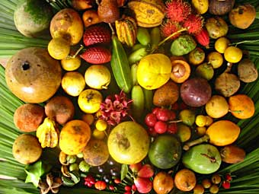
Food
Varena hanga, "Yanglu, okathui apam huptali khalei atha kapanga akhar katonga, kala atheili atha kazanga atheirong kachiva ina khamina; naniwui vang kashakaza ngasara” (29)

Slide 44
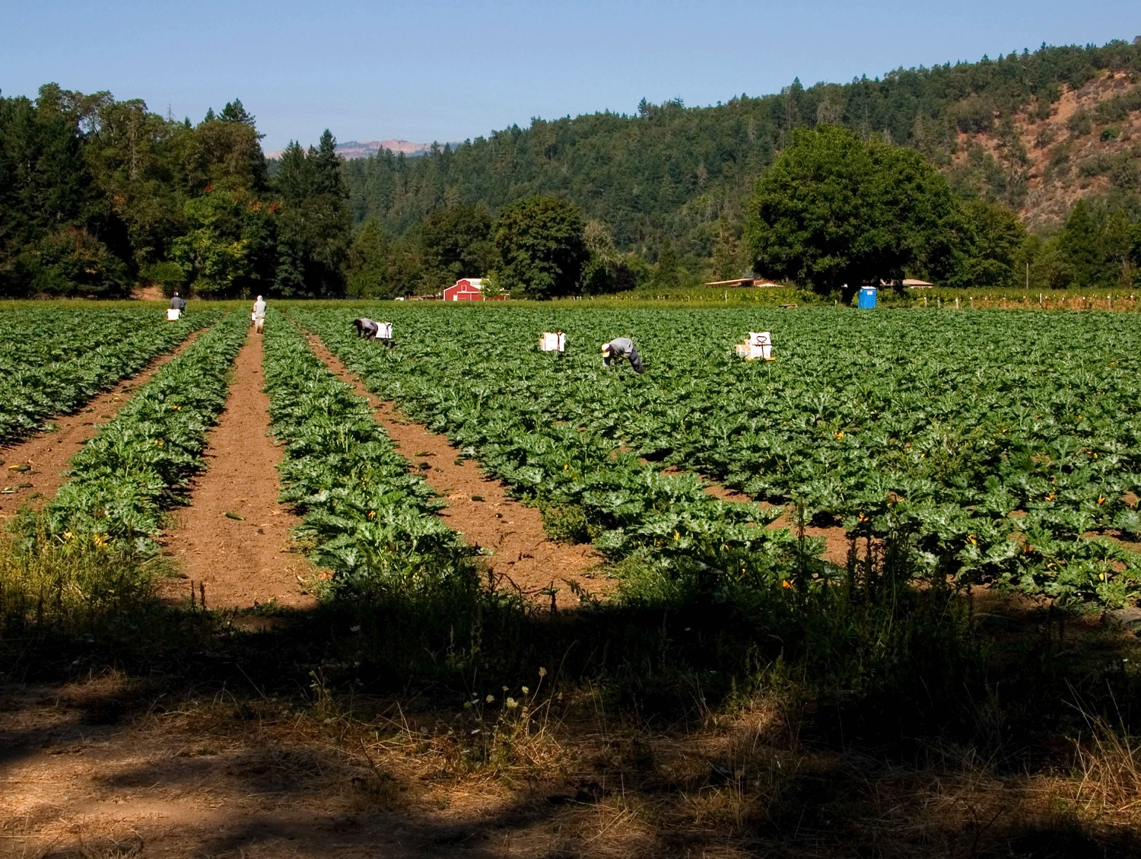
Food
Kala okathuili khalei sayur saikora, kazingwui vanaoyur saikora kala ngaleitungli ngarikazata, kala khaksuida kharingayur kachivali, khamateka thingna-raha kachiva kashakaza sakhavai mihaira". Kala chi takam eina shoka (30).

Slide 45
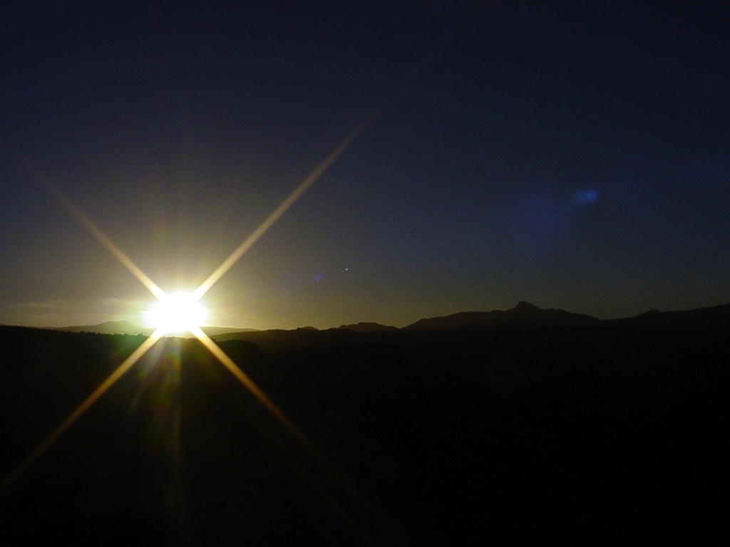
Sixth Day
Katharukathang
Kala Varena sakahai saikora chi yanglaka phalakhaira da ana thei.
Chithang ngazin eina ngathor chi katharuka thangna (31).

Slide 46
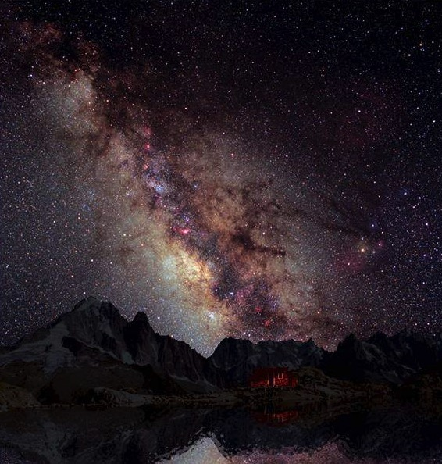
Summary
Kashinethang
Chithada sada kazingram eina okathui kala chiwui alungli khalei aning-anga saikora sakuphaowa (2:1)

Slide 47
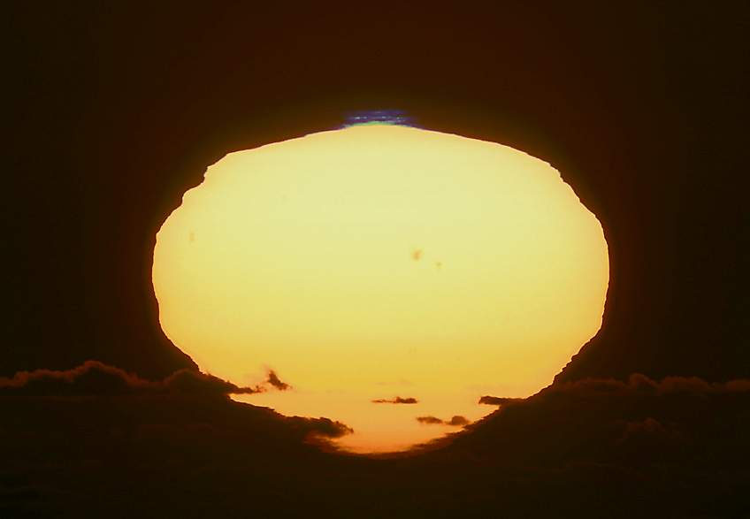
Day 7
Kashinethang
Kala kashinethang Varena ana sada khalei saikaora kupsanghaowa, kala kashinethang chi ngasamkhui (2:2).

Slide 48
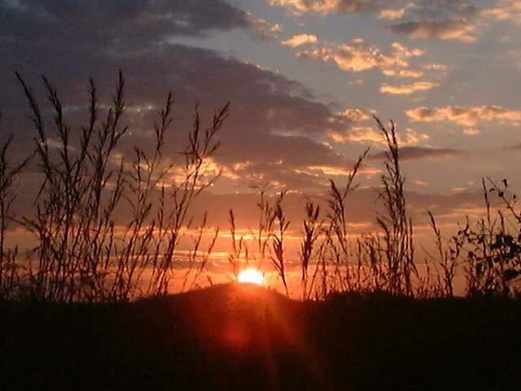
Sabbath
Kashinethang
Chieina Varena kashinethang chi somida tharngasaka, kaja Varena sakahai saikora kuphaida chithang ngasamkhui (2:3).

Slide 49
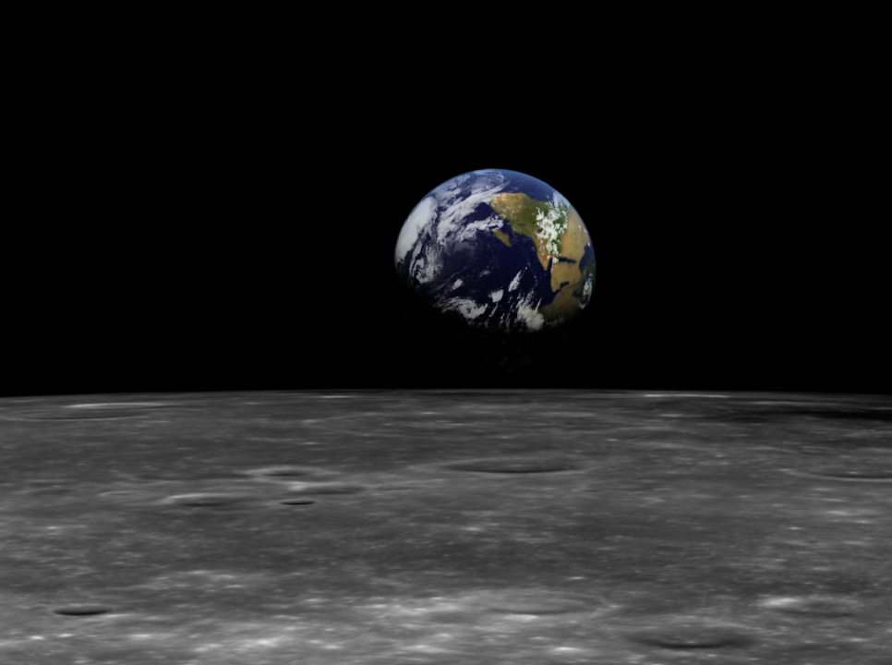
Haokaphok 1 li Varehi Awunga/Akhavana
Khipanakha makasema Vare (1:1)
Tuimang eina shokkhanasak (1:4)
Tacham eina kasem
Zimik kala kachang kasa akhava (1:16)
Mikumoli ana mungkhavai pangshap khami (1:26)

Slide 50
_{x}
Kazing ngalei kasemwui zimikshobing
33
Amei-ama maleikashawui eina- semkaka
Amei-ama maleikashawui eina- chipemkasang
Khamadithang: Zimik, Kazang kala sira ngatei khangasak
Kharethang: Kahor
Kakhanethang: Tara eina khamasai ngatei khangasak
Kaphangathang: Khai eina sayurvayur
Kakathumathang: Ngalei eina shamadru ngatei khangasak
Katharukthang: sayur eina mekamo
Haokaphok1:3-31

Slide 51
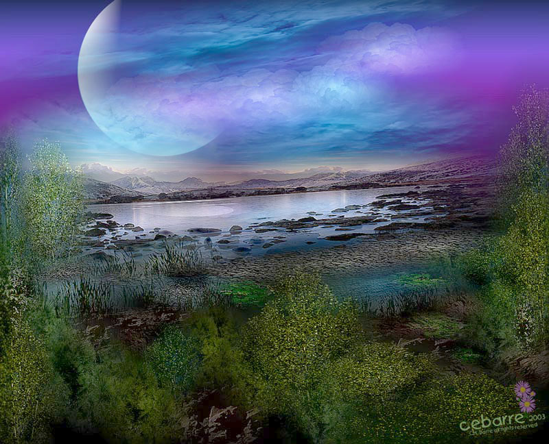
II. Apuk-apakva kasem kala Varwui pangshap chili aja rashungda khangasam maleila kaphayat

Slide 52
Okathui kasemwui maramli katam
Thangkhali pung
24
Zimiksho Akha= pung 24
Zimiksho akha hi zingkumwui tuina
Zimiksho Akha = Mashankharar zingkum
Lairik kakapiwui athusurda
Zimiksho 7 = Amaha(symbolic)
Khamatai ya Kashem
Khare pangsem| Angatak |Kakhane pangsem
1:1 1:2-2:3
Khani - kakhai
Pangsem | Gap | pangsem
1:1-2:3 2:4-25
Haokaphok 1

Slide 53
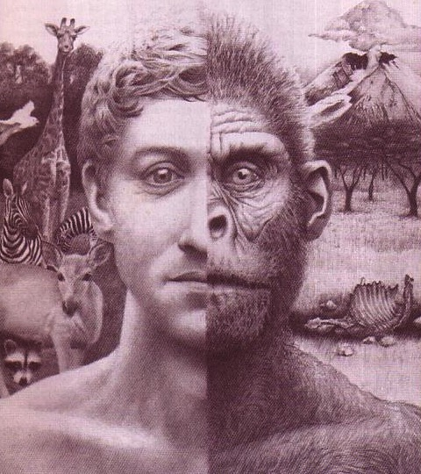

Kashem or Mathang mathangda Sada ngachei khara(Evolution)?
Ava Kharer

Slide 54

Varena dinosaurs li katharuka-thang sai

Slide 55



Evolutionhi miwui phapkada kala mekeina theikhakhui
Mangli shitsanghaoda pailak eina tokhui shapei.
Mathang mathang sada khangachaiwui khararchan

Slide 56

Expelled Movie Clip
Khuishok kahai
Theithang khamei mamya mana

Slide 57
Black

Slide 58

III. Varehi kasakhava kala Awung maningmana da kaphayatbing chili ithum Varehi kasa-akhava kala awungana kachihi nganingtitda ngashung phalungra.

Slide 59

The 24-Hour View
WHEW!!...Ina pung 24 atamhi kahor kala tangkhamang ngachei ngasaklaka okathuihi kasemna.
What are you going to do now?
Na aruiva
Khisa ura?
Ajuva hina
Sapsa
haosai

Slide 60

Khiwui vang pung magatamati hao?
70b
Kachat mavaila kasem
“Prohowui tui eina kazingram sakhui kala awui khaksui eina chili khalei ashangva sakhui " (Ps. 33:6)
“Hili ithum wui ningphaning hilakada maleimanai, kala khangui khamasung, maningakha mathang mathang eiina ungsungkha ngashak”
– John Whitcomb, Hakapoka Okathui, 24

Slide 61
Khiwui vang pung magatamati hao?
70b
Kachat mavaila kasem (Ps. 33:6)
“Ngazin eina ngathor”

Slide 62

Dan. 8:26 mangna (Haokaphok 1 maningla) “Ngazin & Ngathor”
–– khangacha zimikshona da tamiya
“Hangkahai ngathor eina ngazinwui khamaha hi khamashungna”

Slide 63
Khiwui vang pung magata mati hao?
Kachat mavailakla kasem (Ps. 33:6)
“Ngazin eina Ngathor”
Numerical adjective (“kare…”)
Hebrew li "zimiksho"(yom) is preceded by a numericial adjective, “Zimiksho” is always literal!

Slide 64

Mishan 7:12
"Kharethang chigatrikapki kaje chi Judah shangwui Amminadabwui naomayara Nahshonna…"

Slide 65
Khiwui vang pung magata mati hao?
Kachatmavaila kasem (Ps. 33:6)
“ngazin eina ngathor”
Numerical adjective (“kare…”)
Ot kasa kala khangasam wui asakavat

Slide 66

Ithum hapta akha li zimiksho shini na kachihi Haokaphok akha wui eina samkaphangna.

Slide 67
Khiwui vang pung magata mati hao?
Kachat maleila kasem (LAA. 33:6)
“ngazin eina ngathor”
Numerical adjective (“akha…”)
Otsak eina khangasamwui asakavat
Zimik eina kachang khamatethang wui thili semma.

Slide 68

Nawui shitkasangwui angayung chi kazingngalei kasem chili ngashunglu!

Slide 69

Psalm 11:3 KJV 00422
LAA11:3
Angayung sashiman kahai tharan khangaronga china khi sa?

Slide 70

House 1 00418

Slide 71

House 2 00419
Notes:
Chamsada gari kachungkhana shim kuimareida masajala kuinam kahai chitharan

Slide 72

House 3 00420
Notes:
Garibing china makahatlakla shim chiwui angayung sashimankahai tharan shimchi longluihaora.

Slide 73


Blocks-Genesis Doctrine & Doctrines 00405
Kakhane-khara
Khare khara
Khanaowa Adam
Khonkashi
Khamung
Tamkhami
(Doctrine)
Ot kasa
Hapta akhali
Zimiksho shine
Haokaphok
Haokaphok

Slide 74

Blocks-God's Word & Man's Opinion 00403
Mirinwui kakhalat
Nao khuikata
Kakashungathak
Khamathang
Wui otsak
Shimpan
Ngaraikachayur phasa
khangaso
Ain
Mashunmakhui
Makathei
Pangsem
Vare tui
Ayur akhana eina
Khaon
Mikumowui
kaphaning

Slide 75
Q335-Sagan 00434
Evolutionwui khangathuma chiya atam kala kathihina. Atam china ngaironda ngacheilaga shiman khangasak, kala kathi china khangatei kadhar kachikatha akawui vang apam masangasaka.
© 2003 Answers in Genesis

Slide 76

Evolution: Death-Man 00413
Ayurakhawui eina
Khangatei yur khaon
Mikumo rakashok
Kathi
Asheekata
Kachotkachang
kazatkashi

Slide 77

Creation: Actions-Death 00412
Vare pangsem
Mikumowui otsak
KATHI

Slide 78

Reinterpretations 00363
Khalat khalui
Zimiksho Zingkum
Tara kaphong
Haokapok

Slide 79
Black

Slide 80

Ajawui khamataiya ningchuk
I. Ithumwui Varehi saikorakasa Awung mikumona semkakhui ningchukli ngateihang kahaiyana Gen. 1
II. Kazingngalei kasem kala Verehi awungana kachi mangasamlakla aja rashungda phayatching dalei.
III. Ithum Varehi kazingngalei kasa kala awungana kachihi nganingtit phalungra.

Slide 81

Khamataiya tuira
Ithumna aja kathada vare makazanga aworwui tamkachithei chili ngashungra?
Varehi Kasema akhava kala Awungana kachihi kaphayat!

Slide 82

Balloons Kachot kachang—evol vs creat
Mayernao eina Mayarnao
Sakkaza
Kachot Kachang
Nao khuikata
LAA 11:3
Hilaka kachi mashun
Makhui makhalei
Euthanasia
Vereshi
Mekumobing
Mathang mathangda
Sada ngachei khara (Evolution)
Kashem
Notes:
82
The humanistic philosophies all are undermining the very foundation of what Christians believe by focusing their attacks at creation.
Meanwhile, Christians accept their evolutionary theory and then focus our attacks at the results of humanism instead of attacking the foundation in evolution.
Some Christians shoot their own foundation and others are asleep or shooting other Christians.

Slide 83

Balloons Kachot kachang —Mekumo eina Varewui Tui
Tuitak
Mayernao eina Mayarnao
Sakkaza
ISAIAH 58:12
Khuishok kahai
Vereshi
Mekumobing
Mikumowui tui
Varewui Tui
Notes:
83

Slide 84

AiG Web Address 00439
Vakhayang
Haokaphok li ngahan ka khami

Slide 85


Kachama tuingashitli munlak eina ngaheo khayang-BibleStudyDownloads.org
Hiwuili zangda kha lei lairik binghi khalem eina samphang baira!
Notes:
OT Preaching (op)

Slide 86
Expelled Movie Clip
Khuishok kahai
Theithang khamei mamya mana
YouTube: escapingplatoscave

Slide 87

The Lord of Creation can also take care of you!
Ningkhan hili Samphanga

Slide 88
Black

