Slide 1
HAIRAPKAHAI TARIK KHAMI:
ABRAHAM-JOSEPH 2000 B.C.
MOSES-JOSHUA 1500 B.C.
01
Notes:
Atam Angarit: Khangachei khara: Zingkum Shaphanga (500yrs) zatrahaira thuikhahai zingkum thingkha shaphanga Jesu mara ranglaga (1500 B.C) wui thotringchanli khanganai hi. Phaning ungsa: atam bing chi nganingzaser dalei.

Slide 2
7
Sho. 2:10
OKATHUI KASEM
ABRAHAM
ABRAHAM
“Aja
Jesu
Mirin Jesu”
ABRAHAM
JOSEPH
ABRAHAM
MOSES
JOSHUA
ROTKHAMARAT
WUNGNAO
NARKAHAI
VARI KAHAI
JESU
Ngasoda kazat lairik pg.26-29
02
Notes:
Phaning ung khavai khotlai… BITCHAR KASA CHIYA SAPHALUNGRA… kachiwui tuizali ‘M’ da khalei chi, Moses wui mingpho na. Ara hina Moses wui leirik nai- kazip kahai lairik chi , Verewui Kadhara tui li kathei eina ngasoda Verewui Kadhara tui wui eina zat da lei.

Slide 3

7
Sho. 8:1
IWUI MIBINGLI CHIHO HAOLU!
MOSES
ca. 1500 B.C.
“MI 4 ”
chiwui eina
KAKATHUMA
chi:
AJMJ
MOSES
40
Ngasoda kazat lairik pg.26-29
03
1
Notes:
Moses wui lairik kazip kahai kakathuma lairik hina chithei midalei hakmaha lakkhahai mi mati wui kharar chan ngarum sang haora. Jibing chiya; Moses na pangshap pokhuilaka phasawui eina kachithei. Zingkum shakha kanthui khahai Israelite wui khangashik, latui latui da, Pharaoh li …
//// “I WUI MIBINGLI CHIHO MIHAOLU” da kapo. Naolak eina Moses na Egypt li khaorei chiho sang milaga kachot kachang kaphung eina naolak eina Pharoah na Israelites li chiho kashok Egypt wui eina.

Slide 4
7
Sho. 12:31
MOSES
ca. 1500 B.C.
SHONGZA!
EXODUS
“MI 4 ”
chiwui eina
KAKATHUMA
chi:
AJMJ
MOSES
Shongza
40
Ngasoda kazat lairik pg.26-29
04
1
Notes:
//// And that’s the first item on the Moses file folder.
Tangkhul: Moses wui chizakhami wui azingli athisurda, Israel wui rao kala shimkhur asang eina Egypt wui eina zat thui khavai khamaya. Kathem thangkhamei kala oja ngarabing wui hangkhami athishurda, (two million) sakha Egypt wui eina kankashok na.
//// Ara chili hoya kachiya, mathalak eina kathei asangva Moses wui hongkathui na.

Slide 5
Sho. 12:31; 19:2
HAOPHOK
KHAVAI
KHANGARAN
MY
N(A)
H
GN
C
EK
B
J
NK
MOSES
MN
Shongza
SHONGZA!
E
KB
U
40
SK
PG
RS
Ngasoda kazat lairik pg.26-29
05
Notes:
Chiwui pherang na, achala kha wui ramkazat leiret (Map) khayun; ara ato wui eina aze kala ngasan wui apam Mount Sinai kaho amatakli khalei li va kayia.

Slide 6
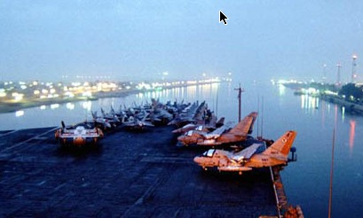
Sho. 13:18
HAOPHOK
KHAVAI
KHANGARAN
MY
N(A)
H
GN
C
EK
B
J
ARUIHONWUI SUEZ CANAL
NK
MOSES
MN
Shongza
E
RED SEA KACHI NGAYI:
“YAM SUPH”
KB
U
40
SK
PG
RS
Ngasoda kazat lairik pg.26-29
06
2
Notes:
Israelites nao bingli; Moses na thanda kathaada Red Sea hi ngasan ho hao?
//// Kathem thangkhamei bing na hosa kala shitkasang eina mashungda hanga, Yampai kaho wui ngayi chi Egypt eina Sinai Peninsula tarawui tungli khangakai thari chi naolak eina katha ngayi da ho haowa.
//// Suez Canal okathui apam katonga li leih lon kapai ngalei chi aja wui Suez Canal kachi apam hi lapai.
Chiwui apam li, Egypt wui Pharaoh na nampu eina yungkazat tamkazatwui vang; Moses li Vare na khamaya mida katheng eina makan ngasak laka, kakan eina ngasoda Egypt bingli tarali nagaphum ngashakhaoa.

Slide 7
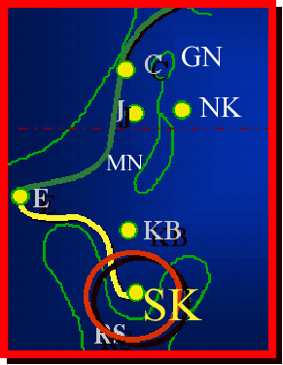
7
Sho. 19
MOSES
ca. 1500 B.C.
SHONGZA
SINAI
AJMJ
MOSES
Shongza
Sinai
40
Ngasoda kazat lairik pg.26-29
07
1
Notes:
Moses lakha vak ngayi kan kahai laga yaonaobingli yavak wui eina sinai ta khavai ngareithui kahai…
//// Naolak eina alung meithui kachi Sinai Peninsula Rabbit’s Ear wui ngachaili khalei Mount Sinai li vakashung.

Slide 8
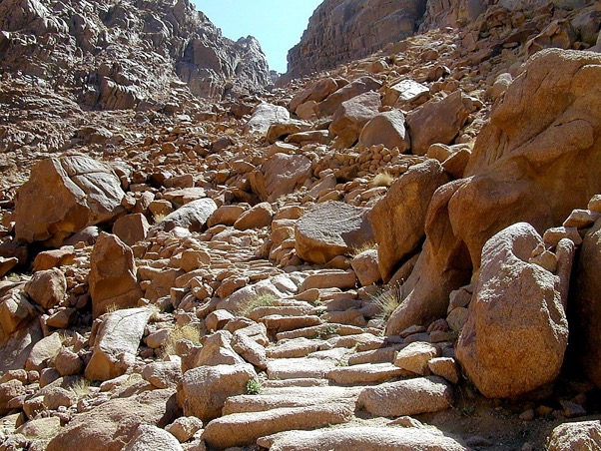
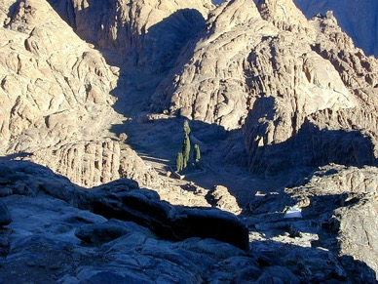

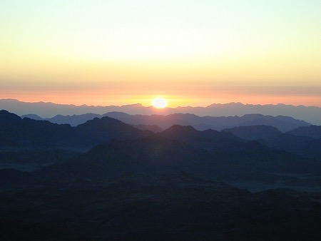
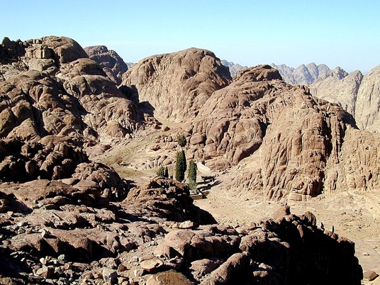

Sho. 19:2
MOSES
Shongza
Sinai
40
Sinai Kaphung:
Varena Mosesli ain khami pam china
Ngasoda kazat lairik pg.26-29
08
Notes:
Arui ho wui monastery wui St. Catherine ngashan wui apam kaho Mt. Sinai wui ngalem chili kadhara apam phakzat bingna toilak eina Egypt miyur wui zimik kashok kaphung aton chili khanga shana. Theilui chiya; mathalak eina maring kapha kala nigma khanga nung chi! Hili Vare na Moses li matui khami athisurda phongkhami aian, kala Torah kachi Hebrew li khuira khami.

Slide 9
7
Sho. 20 eina thuilaga 31 eina tangda
MOSES
ca. 1500 B.C.
SHONGZA
SINAI
AJMJ
A - Y - P
MOSES
Shongza
Sinai
A - Y - P
40
ACHAM-ARAM
YARUI AIN
PHANIT-PHANAO
Ngasoda kazat lairik pg.26-29
09
3
Notes:
Hili Vare na Moses li aian akhum kathum khaida khami chi bing va M.C.C.
//// Achamaram,
//// yarui rin,
//// kala phanit - phanao…
Mount Sinai wui kaphung tungli Varena Moses wui pangli Ain kathum khani shi!! Mikaka. Phaning lu; mayek M.C.C. phareng eina mita kahai Moses wui kazip kahai lairikli.

Slide 10
7
Sho. 20 eina thuilaga 31 eina tangda
AIN (TORAH)
Akhum kathum eina Varewui maramli katam:
MOSES
Shongza
Sinai
A - Y - P
40
Ngasoda kazat lairik pg.26-29
10
Notes:
Vare na haklak eina Israel nao bingli Varewui wortam akhum akhum kathum chi Hebrew wui ain chili leiya.

Slide 11
7
Sho. 20:1 eina thuilaga 17 eina tangda
AIN (TORAH)
Akhum kathum eina Varewui maramli katam:
ACHAM-ARAM: Ain thara; aruihon ithumwui ain hili pheisin kakhuina.
MOSES
Shongza
Sinai
A - Y - P
40
Ngasoda kazat lairik pg.26-29
11
Notes:
Acham Aram: Akai akha wui aian kaho chiya ningkhami thara. Arui hon chungkham eina kazip kahai lairik hili phesin sada lei.

Slide 12
7
Sho. 21-24
AIN (TORAH)
Akhum kathum eina Varewui maramli katam:
ACHAM-ARAM: Ain thara; aruihon ithumwui ain hili pheisin kakhuina.
YARUI AIN: Semkakahai kadhar yur alung
hili ithum akha eina akha kathada ngasopamra.
MOSES
Shongza
Sinai
A - Y - P
40
Ngasoda kazat lairik pg.26-29
12
Notes:
Yarui rin wui maramli kadhara na hukhum khami--- kathada mibing okatui ngarum ngarokra --- ngashit kahai apmali, athum khara pangapa la khai mirinpan khalei. Hiwui matangli Israelites bing matheiva sa mana zingkum- hangmati (40yrs) ramsa wui kapik eina kapik haira saya. Varena atam chili yaruirin wui zatkhana sem miya kasak kaya kha kharali nganing shap khavai.

Slide 13
7
Sho. 25-31
AIN (TORAH)
Akhum kathum eina Varewui maramli katam:
ACHAM-ARAM: Ain thara; aruihon ithumwui ain hili pheisin kakhuina.
YARUI AIN: Semkakahai kadhar yur alung hili ithum akha eina akha kathada ngasopamra.
PHANIT-PHANAO: Semkakahai kadhar yur alung hili Vareli kathada khorumra khala.
MOSES
Shongza
Sinai
A - Y - P
40
Ngasoda kazat lairik pg.26-29
13
Notes:
Phanit phanao Varewui akai akha wui ain. Varena miya awui mibingli kathada kather lamhang worshim wui eina ali khorumra. Naomeida haklak khahai khorum khavai shim Jerusalem li semka khavai abong. Pangapalak kahai mashunrin hi kather abong eina khokharum langmeida, manga wui mikumo wui eina rarada khalei maran hiwui vang darka salak haira. Ithum chungmeikharda phashok fara ain wui matangli lanmeida chungmei tam zat dalei.

Slide 14

Mish. 20:13
HAOPHOK
KHAVAI
KHANGARAN
MY
N(A)
H
GN
C
EK
B
J
NK
Kadesh Barneali khalei pukhri Aruihonwui Egyptlina
MOSES
MN
Shongza
Sinai
E
A - Y - P
KB
U
40
SK
PG
RS
Ngasoda kazat lairik pg.26-29
14
2
Notes:
Varena ain kathar mikhahaiwui thili Moses na kaphung nao bingli angaran agayei khui kaka;
//// Atungwui ngasam khavai apam Kadesh Barnea kaholi thankasang. //// Aruihon Egypt bing wui lamhang Israel wui leirekli mata nala khalei uraokli salam sakakhui. Kadesh Barnea li shimnao va sem kahui laka Varewui mathangli chiza khami atungshong li zat va khavai khangarei. Abraham wui luiram wui khanukli shipsa chot changlak eiana Negeb kala Sinai wui eina makan khara.

Slide 15
7
Mish. 32:8; Khal. 1:19
MOSES
ca. 1500 B.C.
SHONGZA
SINAI
AJMJ
A - Y - P
KADESH BARNEA
MOSES
Shongza
Sinai
A - Y - P
Kadesh Barnea
40
Ngasoda kazat lairik pg.26-29
15
Notes:
Moses wui kazip kahai lairikli Kadesh Barnea kaho hi samphangra. Anaolam shong mibingna khare wui awo-ayi bing wui ngashit khami ramli han kahung chiya, Abraham, Isaac kala Jacob wui ngaleili.

Slide 16

7
Mish. 13
MOSES PAO KADHAR DARKAR SAHAIRA!
MOSESNA shangnaowui mithun bingli ngahota.
MOSES
Shongza
Sinai
A - Y - P
Kadesh Barnea
40
Lamhangli semkahai Tabernacle
Ngasoda kazat lairik pg.26-29
16
2
Notes:
Kadesh Barnea li Israel wui kaphung naobing katonga huna kha wui semkakha hai ram katha chili maong chalak eina kazipser haowa. Lamhangli semkaka khahai khorum khavai shim akha ngasa sada phanit phanao wui aian chi Sinaili khami; Vare wui ngatei hengkhahai chija khami.
/// Ara Moses kather chanpao darkar sahaira! Kachi katha kamatha thangkhamei kathana hi rara da khalei otngarut wui vang.
/// Varena kashoya Mosesli, kaphung nao tharada khaniwui ngachaili ava va minganing razanglaga Canaan ngalei vapha shok khavai.

Slide 17
7
Mish. 13; Khal. 1:19-23
NGAHANKHANGAYI BING…
“NGALEI” chi katha khala?
Kachikatha Mi chili leikhala?
Kong kala urabing?
Kaphung kala ngahong?
MOSES
Shongza
Sinai
A - Y - P
Kadesh Barnea
Lui vasang khavai pambing?
40
Khi zakhavai leimamei khala?
Ngasoda kazat lairik pg.26-29
17
6
Notes:
Ara hili Moses na shitsang kapai mibingwui eina ngahan bing chiya.
//// Ngalei/Luiwuk chi katha?
//// Kachikatha mi chili leikhala?
//// Apam chili kong kala ura Leila?
//// Kong kala ura bing?
//// Luisha khavai ngalei tumla?
//// Kashak kaza ngalangda samphangrala?

Slide 18
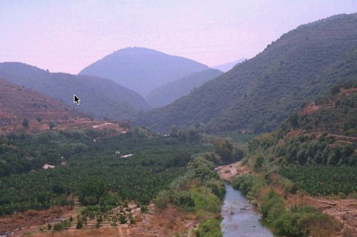
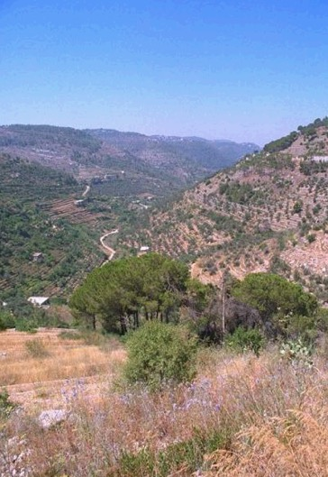
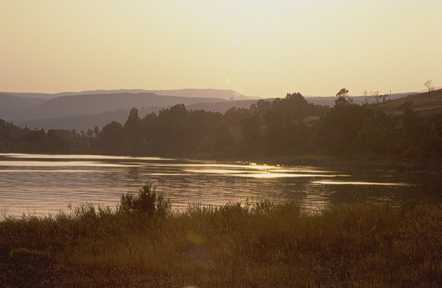
Mish. 13
HAOPHOK
KHAVAI
KHANGARAN
MY
N(A)
H
ATUNGWUI EINA ARUIHONWUI LEBANONWUI AZINGSHONG TAYA…
GN
C
ER
RAKHAYANGA BINGWUI SHONGZA
B
J
NK
MOSES
MN
Shongza
Sinai
E
A - Y - P
Kadesh Barnea
KB
U
40
SK
PG
RS
Ngasoda kazat lairik pg.26-29
18
Notes:
Ana mibingli chija miya Canaan ngaleili vara yang khavai; athum atungshong li aruihon wui azingli khalei Lebanon li ta mei kharda zat vaya. Shongza kazat chili, ngalei katum mathalakkhahai, keinung akha semkashap kapai apong khaleiva phashoka.

Slide 19
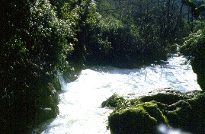
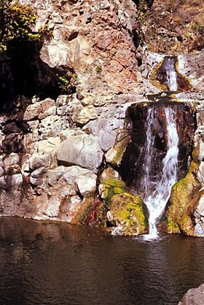
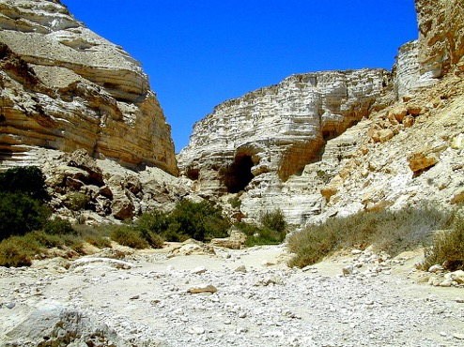
Mish. 13
HAOPHOK
KHAVAI
KHANGARAN
MY
N(A)
H
…AZING-SHONGWUI EINA KADESH BARNEALI HANUNGA.
GN
C
ER
RAKHAYANGA BINGWUI SHONGZA
B
J
NK
MOSES
MN
Shongza
Sinai
E
A - Y - P
Kadesh Barnea
KB
U
40
SK
RS
Ngasoda kazat lairik pg.26-29
19
Notes:
Ara atum atung wui eina azingshong han khaung wui shonza li, chungmeida ngatak ngaheo laga zatua kachi wui kha ngashung chi theiluia. Kiwui vang? Ngaliechi chuplak kahai kakteowa nao wui miyur kala sang na panra kahai keinung. Canaan nao kala katei miyur bing. Varena chija khami wui mangaeina Israelites bing ara athumli ngazek ngahei saki kachi.

Slide 20
Mish. 13:26-14:9
HAOPHOK
KHAVAI
KHANGARAN
ATHUMWUI CHI HITHAYA:
MY
RAKHAYANGA 12: PAO KHANI
RAKHAYANGA 10: KACHUNGAWUI KAPHANING
KHUIRA EINA SEINA KHALONG APAM!
APAM CHILI MI HAKLAK KAHAI LEI!
EGYPTLI HANUNG HAOLU!
RAKHAYANGA 2: KATEOAWUI KAPHANING
KHUIRA EINA SEINA KHALONG APAM!
APAM CHILI MI HAKLAK KAHAI LEI!
VARENA ITHUMLI NGASOMIDA LEIYA!
N(A)
H
GN
C
ER
B
J
NK
MOSES
MN
Shongza
Sinai
E
A - Y - P
Kadesh Barnea
KB
U
40
SK
PG
CHIEINA...ZATUSA!!!!!
RS
Ngasoda kazat lairik pg.26-29
20
12
Notes:
Otshot chi hina: Rayang kazat mi tharada khani bing athum wui kathei pao Moses li Kadesh Barnea kaho apamli ung hang kachitei. //// Athum wui paomi ngachaili munlak kahai katie khani kazang.
//// Chungkhamei athum thara wui kaphaning kakhui
//// Khuira eina seina na pemting khahai ngalei theikahai.
//// Kha! Chila pangshap leilak kahai ya mishan china pemkahai ngalei khaho pak malei mara kachi Israel naobing wui thei khakhui.
//// Athum ngathum da rayang kazat thara bing china chiza mi kahai Vare wui apam chili atam akhali vanzangra kachi mashit kasang.
//// Athum wui hagkhama chin Egypt li hanung haolu kharin na khayui samphang khavai.
Chitha sayi chilala, rayangkazat mira khani chiya, Joshua eina Caleb na paomiya.
//// Sheina eina khuira wui ngalei!!
//// Hakmahalak khahai ngalei
//// Kha chitthasayi chilala, hanghai ya- ngaleichi mi kathei na mung haipai ya. Varei wuili leichinga.
//// Chiwui vang itum phapta ngarumlui shitsachili!!!
//// Nawuili report khani leihaira- chiya- paokhami khani- ningkhapahaning khani.
//// kha mbing hi varewul kankha mi ngaran khamilishitsang la? maning mana.
//// Mibing na chung khamei (spies) bing wui, paonga na khuida khangachi khangacham zang haoda vare wui nga teihang kahai kala ngashitmi kahai tuingashit chili kahang manganã thui mana.

Slide 21
Mish. 14:20
HAOPHOK
KHAVAI
KHANGARAN
ATHUMWUI CHI HITHAYA:
MY
RAKHAYANGA 12: PAO KHANI
RAKHAYANGA 10 : KACHUNGAWUI KAPHANING
KHUIRA EINA SEINA KHALONG APAM!
APAM CHILI MI HAKLAK KAHAI LEI!
EGYPTLI HANUNG HAOLU!
RAKHAYANGA 2: KATEOAWUI KAPHANING
KHUIRA EINA SEINA KHALONG APAM!
APAM CHILI MI HAKLAK KAHAI LEI!
VARENA ITHUMLI NGASOMIDA LEIYA!
N(A)
SHONGZA KATATHAIRA!
H
GN
C
ER
B
J
NK
MOSES
MN
Shongza
Sinai
E
A - Y - P
Kadesh Barnea
KB
U
40
SK
PG
CHIEINA...ZATUSA!!!!!
RS
Ngasoda kazat lairik pg.26-29
21
Notes:
Chi wui ngahan kaka athishurda, moses canaan vazang khavai khamaya mami thuwa kala khamsa haowa. luiram chili vazang khavai hun na kha wui vang cancelled sasa hao wa.

Slide 22
7
Mish. 32:13
MOSES
ca. 1500 B.C.
SHONGZA
SINAI
AJMJ
A - Y - P
KADESH BARNEA
40
MOSES
Shongza
Sinai
A - Y - P
Kadesh Barnea
40
40
Ngasoda kazat lairik pg.26-29
22
Notes:
Hili masing hangmati. Moses wui kazip hai lairik li ithum na ngarum sanga. athum na Vare li khangahang makhanga na kala shitkasang khavat wui vang, vare na Israel nao bingli lamhang kahakli zingkum hang mati vang chiho sang hao wa.

Slide 23
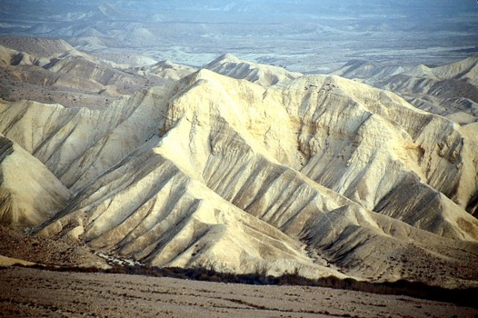
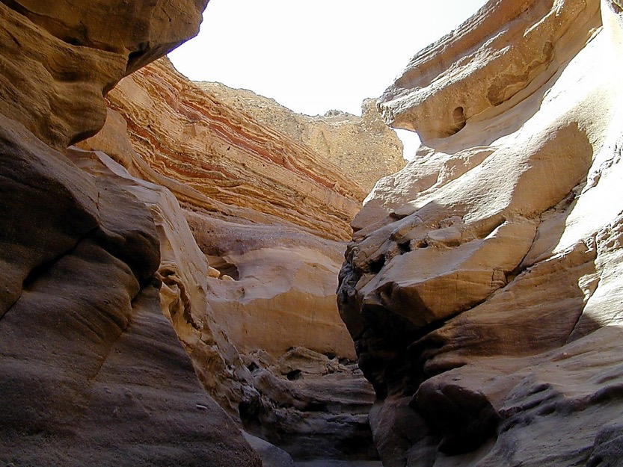
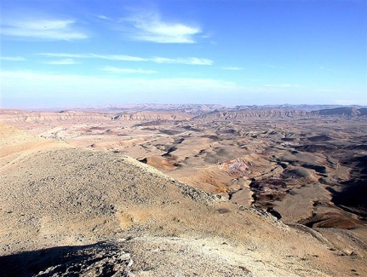
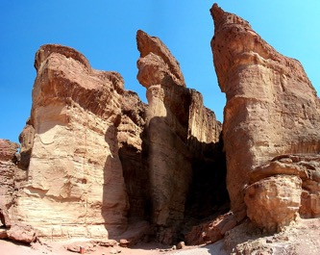
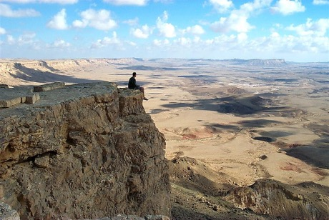
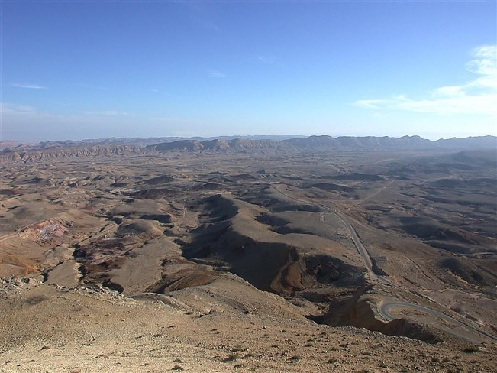
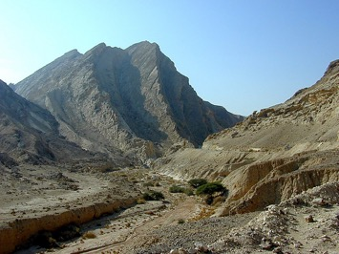
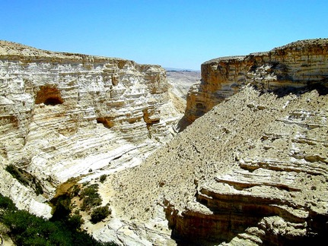
Mish. 32:13
HAOPHOK
KHAVAI
KHANGARAN
NANA KAHANGVA… ZINGKUM 40? APAM HILI?
NANA KAHANGVA… ZINGKUM 40? APAM HILI?
NANA KAHANGVA… ZINGKUM 40? APAM HILI?
MOSES
Shongza
Sinai
A - Y - P
Kadesh Barnea
40
40
Ngasoda kazat lairik pg.26-29
23
1
Notes:
Vareli khahang makhangana Israel nao sakhora zingkum maka wui atung bing thiser haowa. Katonga kahang makhanaga na thot bing chlli maka zang athum bing chi rayang kazatpa khani Joshua eina Caleb, Moses kala awui shimkhur bing.
//// Mibing na hanga… nawui khakhalat nava zingkum hangmati apam Chiliva? Ma mashunga Zingkum hangmati! Varena semi kahai kala sangmeida machuk vakhahai khangaran chili mibing na shitkasang khuat wui vang. Kala mamailai lui kachia, zingkum khamati zatshok kachili kather Israel nao kachung khala rphara haora.

Slide 24
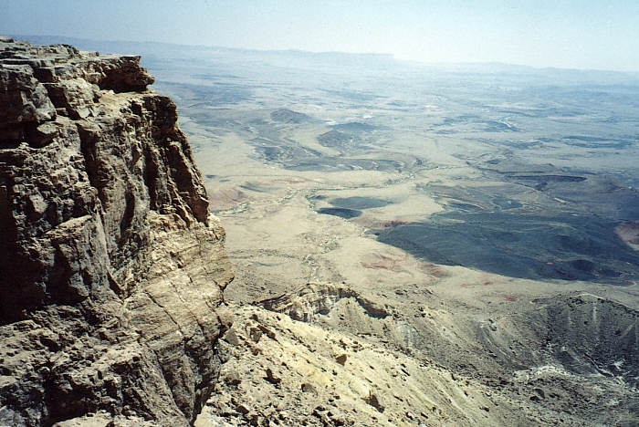
Mish. 32:13
HAOPHOK
KHAVAI
KHANGARAN
KHIWUIVANG?
KAHANG MAKHANGANA!
13
35
34
24
33
30
9
28
25
8
31
5
26
29
27
40
32
4
6
3
10
23
22
39
7
2
21
16
15
20
19
38
18
14
17
11
1
36
12
37
MOSES
Shongza
Sinai
MASHITKASANG!
A - Y - P
Kadesh Barnea
40
40
LAMHANGLI MAKAZAT
Ngasoda kazat lairik pg.26-29
24
3
Notes:
Kala china kanalak kahai maram sada ramsa thada yaokazat phaning ung khavai.
//// Khi wui vang eina Isreal nao bing li zingkum hangmati khamasai lamhangli ramsasak thada yaozat nggasak hao?
//// Khahang makhangana kala mashit kasang!! Vare na tuija mikahai kala ngakhami eina ngashoda ngashit khahai Kazama Abraham wui ngaleili khangshok mira kachili mashitshang kala ngana wui vang.
//// Hi wui mathang mathang wui masing li thada machuk yanglu. Zingkum hangmati (40yrs) lang kathi ngayi ngalemli khamasai lamhang li yao kazat zingkum wui tungli zingkum hotna kazat zingkum, khareiya Moses Israel nao bingli thankha shokma zingkum shakha maka kashung haira saya.

Slide 25
Khal. 32: 48-49
HAOPHOK
KHAVAI
KHANGARAN
MY
N(A)
H
GN
C
EK
NK
B
J
NK
MOSES
MN
Shongza
Sinai
E
A - Y - P
KB
Kadesh Barnea
40
U
40
SK
PG
RS
Ngasoda kazat lairik pg.26-29
25
Notes:
Chi eina athumna zingkum hangmati Kadesh Barnea eina Mount Nebo wui ngachaili yaokazatna, kha, Moses khare wui vang alila ngashit kahai ngalei li mavazang ngasak thuwa. Nam hailu yaokazat shongza leirat chili.

Slide 26
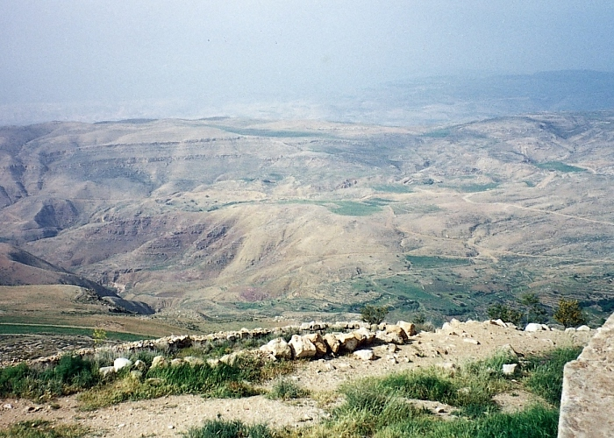
Khal. 34:1
MOSES
Shongza
Sinai
A - Y - P
Kadesh Barnea
40
40
“Ngashit kahai ngalei chili” Nebo kaphungton eina ngashankazang
Ngasoda kazat lairik pg.26-29
26
1
Notes:
Ramsa thada zingkum hangmati zat kahai wui thili Moses na mibingli Mount Nebo kaho apamli khuiraya. Mosesna ngashit kahai ram hi wui khaphungton li khangashan samphanga. Kali nganingsa!! Moses kaphungton Nebo kaho, chi nathum/ ithum na thei hai saya. Mosesli mamaya lak thumana apam chili vazang khavai.
//// Varena Mosesli chija miya, Israelnao bing ara atam rahaira Canaan ram vazang khavai kala athum wui mashun wui somkhara/ pan khavai.

Slide 27
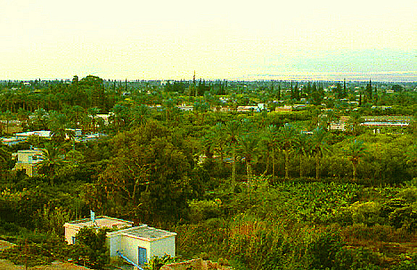
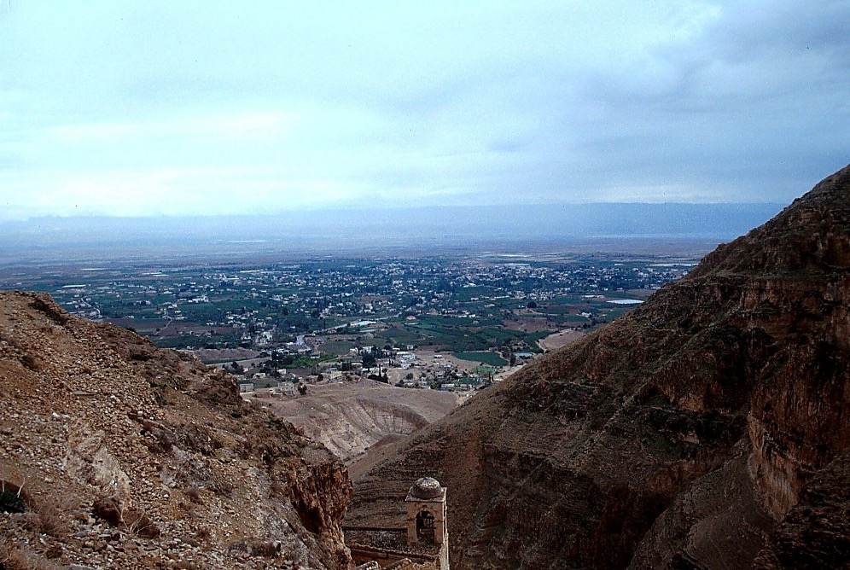
Khal. 34:1
Nebo kaphungwui eina Jordan makanlaga ngashan kazang
MOSES
Shongza
Sinai
A - Y - P
Kadesh Barnea
40
40
Jerichowui eina...
Jordan Kong makanlaga Nebo kaphungli ngashankhava
Ngasoda kazat lairik pg.26-29
27
1
Notes:
Ara Jericho wui tungli, zingtun li kha lei Mt. Nebo ngalem wui hak lak kahai lamhangli tara wok khalei; ngalei katum; arui hon wui kakashun shim sem kakali hailak hailaga…
//// Tara khalong apam khaneinai kala katum ngalei hili ithumna teomeida Mt. Nebo wui eina zingsho shong wui Jordan kong kankhava wui apam chi thei.

Slide 28
7
MOSES
ca. 1500 B.C.
SHONGZA
SINAI
AJMJ
A - Y - P
KADESH BARNEA
40
MOSES
NT
Shongza
TAMKACHITHEI 5
Sinai
A - Y - P
Kadesh Barnea
40
40
Tamkachithei 5
Khal. 30: 1-10
NGALEIPAMWUI TUINGASHIT
KHALATLUI: AIN KAKHANE!
NGATEIHANG KAHAI YURWUI KASAKHAVA!
ATHUMWUI VARE KHIPAKHALA?
ATHUM KATHADA RINGRAKHALA!
KADHAR KALA NGANUIKHAMEI THOTLI
ATHUM KHIPAKHALA!
Ngasoda kazat lairik pg.26-29
28
8
Notes:
Ara chciwui thili, Moses mathei chao ranglaka kazip akha Mt. Nebo li khui kaya Israelnao bingli phaning ung khangasak ain kala panra kahai wui matang li china.
//// Kather eina khanui thot
//// Varewui matnagli chiji khami
//// Athum khipa khala kachi pao
//// Athum wui ngakeikei khang kahai yur wui
//// Kala ngashit kahai ramli kathada vatara. Kakazip wui tuiza phanga hina Deuteronomy wui kakhalat va “kakhanea ain”. Awui kha naowa tamkachithei .
//// Moses na yaoshoka Vare eina mibing wui ngashit khami ngalei khangarok wui… Atam kachida Abraham wui naotun wui vang aruihon matailak eina khonchar khangarok!!
//// Machut hailu “LC” wui kakhalat ngalei sakhi Moses wui lairik kazip chi wui katang vak samphang ra. Deuteronomy 30:1-10, li kapi haiya varena matheilak la Israel bingli ngashitha: ngalei chi katang makhavai Israel wui vang ngashitmi. Chiwui vang eina, ngashit kahai thuk meida ngalei hi wui matek akha. ABRAHAMIC TUINGASHIT Vare eina Abraham wui hashokra.

Slide 29
7
KHALATLUI 30
NGALEIPAMWUI (PALESTINE) TUINGASHIT
⁵ Kala nawo ngarana pamkasa pam chili somlui khavai nathumli khuiungluida nawo ngarali chungmeida okthuiluira.
MOSES
Shongza
⁶ Nathumwuila, naongarawuila, ara-azawuila Prohona ning tharmihaida, ning yang tongtingda ali leishira, kala Israel malingluishitra.
Sinai
A - Y - P
Kadesh Barnea
40
40
Tamkachithei 5
Ngasoda kazat lairik pg.26-29
29
2
Notes:
Hi wui li na alunga (LC) ngalei wui tuingashit kachi Deuteronomy 30 wui eina samphangra. Tuicha phanaga eina tharuk li.
“Kaphanga Tuicha” ana khuiava mi kikakchi
//// Ngalei ngashava wuili kazang va wui ngalei kala nana singki kaachi. Avana mashan kharar kaphaning ungshung mira nasha va wuili lang meida.
//// Katharuk tuicha (6) Reikha mataiya Vare china na uklungli khuinam mi kala achinala naotun chi wui vang eina na ali nawui wuklung horshang da okthuilu.

Slide 30

Abrahamwui Tuingashit
(“Awui Kaho”)
Haokaphok 12: 1-3
MOSES
NGALEI
ATHA
SOKHAMI
Shongza
Sinai
A - Y - P
Kadesh Barnea
Ngalei
40
40
Tamkachithei 5
Khalatlui
30: 1-10
30
Notes:
Ara hiwui maya khangarok tuilepli ngasoda varewui takhamei tuingashit- ithum na thei Abrahamic tuingashit khare akhum chili meisa meida thei ngashit kahai ngalei. Israel wui zatkhava mirin hakashok, atha eina sokhami. Abrahamic wui tuingashit mari leingarok a Moses na awui mi phanga kazip khangarum wui thizang thi haowa, kala Varena Chija mi kahai zikhur pam chili chizan haowa. Kachizan apam arui hon wui mibing khipa kha mathei mana.

Slide 31
7
Hao. 1- Khal. 34
OKATHUI KASEM
ROTKHAMARAT
1st Mayarnao & Shanao
O
1st Morei
1st Pao Kapha
1st Shimkhur
WUNGNAO
(1000 B.C.)
1st Sakathat
Tara kaphong/changimahut
Tolan Shim
ABRAHAM
O 7 V J
Awui KAHO
AT
N - A - S
3 MISHANG
I - I
J - E
12
NARKAHAI
7 = 4 + 3
JOSEPH
MOSES
Rao kasa
Shongza
4 MIKUMO
430
Sinai
A - Y - P
MOSES
(500 B.C.)
Kadesh Barnea
40
Shongza
V
S
VARI KAHAI
40
Sinai
Tamkachithei 5
A - Y - P
Kadesh Barnea
JESU
40
40
NT
Tamkachithei 5
J
JOSHUA
31
Notes:
Chithada sada ara ithum na kupsang haira kasema laga haklak kahai mi kathum wui ngatha khara: Abraham awui haokapok kasenga ngashit kahai chiwui thili Joseph eina Moses, meisa meida ngalei wui mayakhanga rok tuitak chiwui reikasasangli. Phaning hailu chiya, ithum mesia eina mamachuk mana… nganing sing kahai otshot kala kharar thot bing wui kharar chanli ngatheo kata na. Athumwui kazip khahai lairik kala kachi cha wui ning ot kasem na. katei katonga ngarum laga meikasa ngaziplak kahai leipam. Apam kala mental map hikatha eina biblical ningzot eina zan shap khavai.

Slide 32
7
Josh. 1:1
AJMJ
MI 4 chiwui eina
KHAMATEPA
chi :
?
32
Notes:
Ara ithum khanaowa kazip kahai lairik, chili aata maman Katanga AJMJ wui mathang mathang. Na maphaning ungkha la hiwui mathang kala khanaowa aming?

Slide 33
7
Josh. 1:1
AJMJ
MI 4 chiwui eina
KHAMATEPA
chi :
“JOSHUA”
33
Notes:
Awui ming na… “JOSHUA”

Slide 34
Josh. 1:1
HAIRAPKAHAI TARIK:
ABRAHAM-JOSEPH 2000 B.C.
MOSES-JOSHUA 1500 B.C.
34
Notes:
Ara ithumna khare wui atam 1500 B.C wui thot, akhashi phaning unglaga munlak eina ngaran ngayei sasa. Hi ithum wui katam kasha li darkar salak haowa.

Slide 35
7
Josh. 1:1
OKATHUI KASEM
ABRAHAM
ABRAHAM
ABRAHAM
JOSEPH
“Aja Jesu
Mirin Jesu”
ABRAHAM
MOSES
JOSHUA
ROTKHAMARAT
WUNGNAO
NARKAHAI
VARI KAHAI
JESU
Ngasoda kazat lairik pg.29-31
35
Notes:
Bichar kasa chiya bichar saphalungra… khanaowa “J” … Ara hili Varewui kadhara tui wui mathangli Joshua wui kazip kahai lairik china.

Slide 36
7
Josh. 1:1
JOSHUA
AJMJ
JOSHUA
Ngasoda kazat lairik pg.29-31
36
Notes:
Chieina…. Kashunglak kahaiya Israel wui kathana Joshua, Moses wui kathana mahut shisin haowa. Phaning unglu chiya, paying kazat mi tharada khani wui ngachaili matailak kahai khani kazang mi akhapachi Joshua na. Zingkum hangmiti zingham zingrot matei la kazat atam Canaan vazang khavai

Slide 37
Josh. 1:4
HAOPHOK
KHAVAI
KHANGARAN
MY
VARENA JOSHUALI NGASHIT KAHAI:
N(A)
H
LAMHANGWUI EINA THUILAGA LEBANON EINA TANGDA…
GN
C
EK
B
J
NK
JOSHUA
MN
E
KB
U
…EUPHRATES KONGWUI EINA THULAGA “MEDITERRANEAN NGAYI” EINA TANGDA.
SK
PG
RS
Ngasoda kazat lairik pg.29-31
37
2
Notes:
Varena Joshua li thukkhamei tuingshit saya.
//// Ana ali mirada sayai, azing wui lamhang eina thuda Lebanon kala…
//// Euphrates kong wui eina thuida Mediterranean ngayi vasungda hakhamaha ngayi acha laga wui atamli zatna kasa. Kha! Chiwui tuinagshit panava; Joshua eina kapang khui kahai miping chi remeida yuikhuira.

Slide 38
Josh. 1:11
HAOPHOK
KHAVAI
KHANGARAN
MY
N(A)
APAM CHI
H
GN
“JOSHUA…
ZANGLAGA
NGALEI CHILI
PAMHAOLU!”
C
EK
B
J
NK
JOSHUA
MN
E
KB
U
SK
PG
RS
Ngasoda kazat lairik pg.29-31
38
Notes:
Joshua li chija mihaira “zatlu kala ngalei china wui ngasalu.”

Slide 39
Josh. 1:11
HAOPHOK
KHAVAI
KHANGARAN
MY
N(A)
APAM CHI
H
GN
C
EK
B
J
NK
NEBO KAPHUNGWUI EINA… JOSHUAWUI RAIMI JORDAN KONG KANPHALUNGRA
JOSHUA
MN
Jericho/Ai
E
KB
U
SK
PG
RS
Ngasoda kazat lairik pg.29-31
39
Notes:
Chiwui vangeina kakhalat nava, Mt. Nebo’s wui apam wui eina thuida, Joshua wui raimi bing Jordan kong makan laga Canaan naobing wui pam khavai panda khalei ngashit kahai ramchi mungkhui haolu chiya, atung eina thuida azing tashungda.

Slide 40
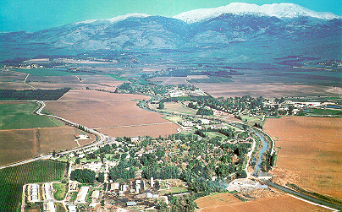
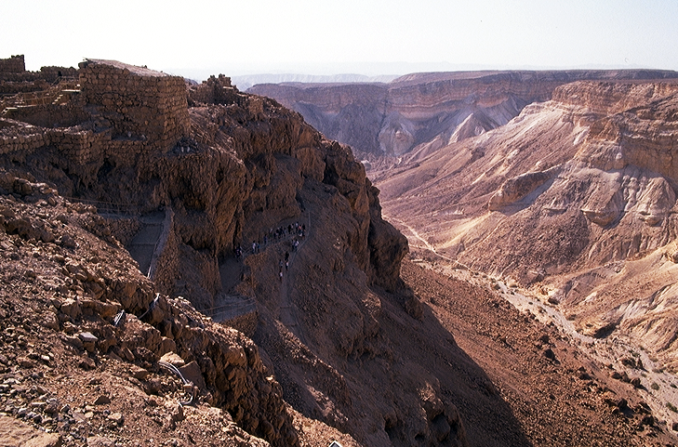
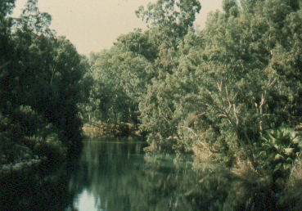

Josh. 1:16
Joshuana ngararki kachiwui kasakbing...
JOSHUA
Y i r e i
Jericho/Ai
Ngasoda kazat lairik pg.29-31
40
4
Notes:
Chiwui athishurda, chuilak khahai ngalei Mt. Nebo wui ngalemli kathana Joshua na raimi bing ngaran haowa…
//// Kala ngasung ki kachi kha ngaran saser bing haira!! Joshua na Israel nao bingli thanlaga Jordan kong kanda arui hon achalaka wui konung ho kasa Jericho zangda thana.
//// Latlui da akhashi Varena tara ngaphao chili kan milu shita. Ajawui hiva kaho kaphor ngayi mani kha Jordan kongna. Mibingli latlui da katheng eina khanshok khangashak tara apam wui eina katheng ngaleili. Moses li thuikhahai Egypt wui eina mi kachungkha ngapak laga ngathan khangarok wui atam wui thada
//// Israel naobing Canaan ngalei li vazang haowa apamli… Atung wui eina ngalei katum tampak kala tara oak kachung sam khaphang apmli //// Azingli thai razanglak eina kazat eina kazat ara chi haira. Ara athum naolak eina atung azing ngashit kahai ram chiwui khayuiya zingkum shakha lang kanthui kahai ngashit kala mamangli Abrahamic tuingashit li theimili.

Slide 41
7
Josh. 6-8
JOSHUA
JERICHO / AI
AJMJ
JOSHUA
Jericho/Ai
Ngasoda kazat lairik pg.29-31
41
Notes:
Remei thuida, athumna mathalak kahai konung khani wui yui khui chi ya Jericho chi wui thili salak eina raimi khom khuilaka ai konung li yuikhui.

Slide 42

MACHI NGAYI
JORDAN KONG
ARUIHONWUI JERICHO
JOSHUA
Jericho/Ai
ACHALAKHAWUI JERICHO
Jerichowui eina...
Jordan Kong makanlaga zingshoshong yangkaka
Ngasoda kazat lairik pg.29-31
42
Notes:
Hi aja wui Jericho na. Nana pailak eina machuk shapa chiya, Joshua wui raimi bing zingsho shong thing thing kankada zingkum shini ngararva khavai muiva talei.

Slide 43
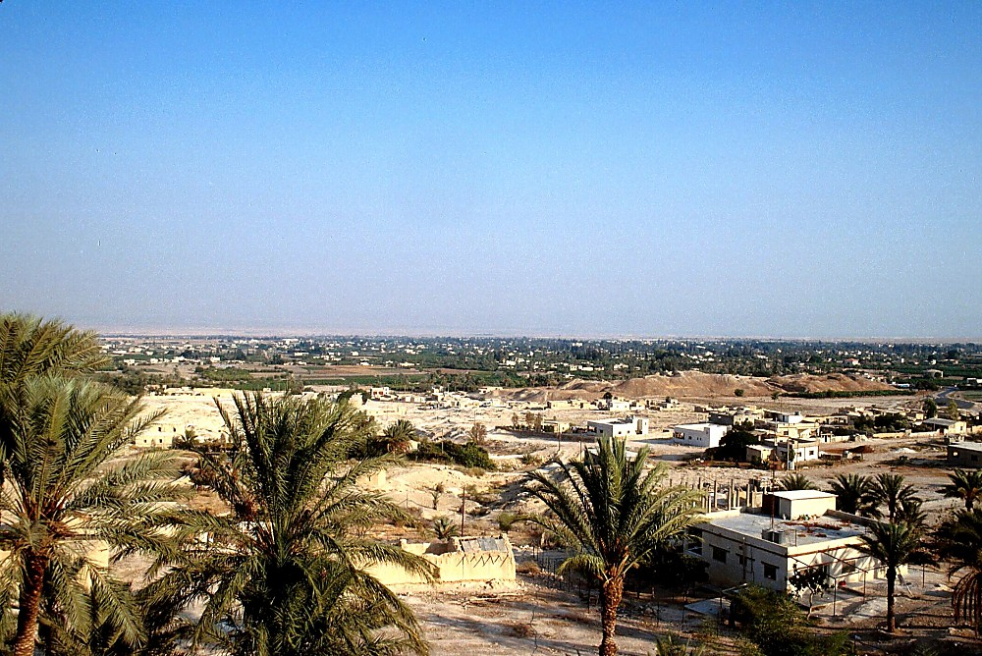
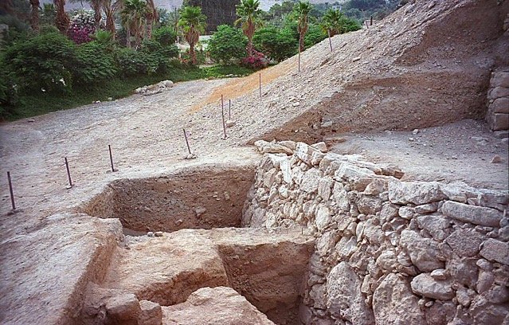
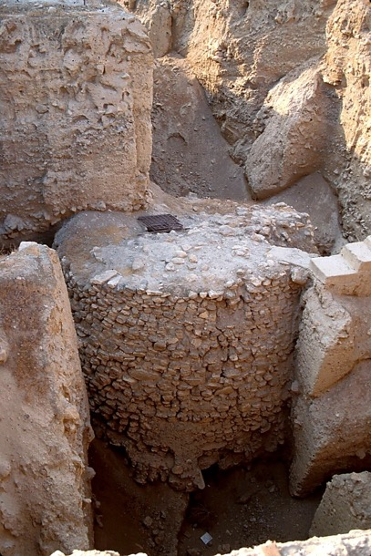
JOSHUA
Jericho/Ai
Jericho: Achalakhawui leikasabing
Ngasoda kazat lairik pg.29-31
43
1
Notes:
Situi wui kaphung ama wui alungli khalei china chitheiya achala kha wui Jericho konung aja nganing da khalei konung Jericho chi. Shitsang paiya chiya acha laga wui ngashanra kahai kala machut haikasa ngalem wui eina phakashok athisurda, naolak eina phashsoka Jericho wui ngavei sakhai mi kahai chi mathum rar mana thui kahai wui chikhur kashok.

Slide 44
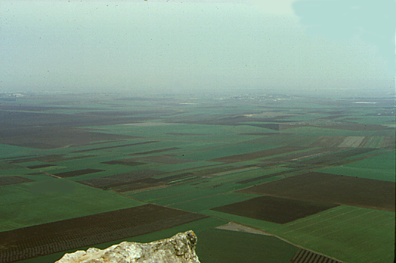
7
Josh. 17:16
Tabor Kaphungwui eina Jezreel kaho tampakli yangkata
JOSHUA
Jericho/Ai
Khuira kala seina chi hina!
Ngasoda kazat lairik pg.29-31
44
Notes:
Ara chithalaka; Joshua wui raimi bing zingkum shini ngalei chili zat ungzat vasai… hina phaolak kahai tampak Jezreel; Mount Tabor wui atongli kathei aja wui apam Galilee kaho atungshhong wui Israel na. HINA KHAMASHUNGA SEINA EINA KHIURA KHALONG APAMNA!

Slide 45
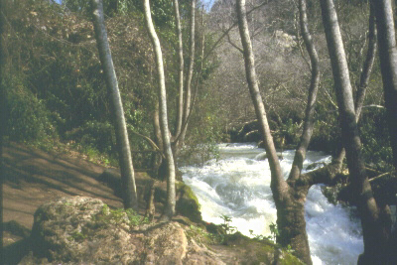
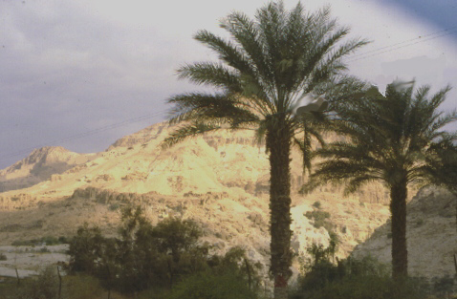
…Atungshongwui Dan kachi pam eina haophoklaga...
Y i r e i
Zingkum 7 Rai saklak eina ngararlaga kakhuina…
JOSHUA
Jericho/Ai
…Azingshongwui Beersheba eina tangda...
Ngasoda kazat lairik pg.29-31
45
2
Notes:
Zingkum shini makanda saklak kahai rai atung shong eina thuida azing takapai, Joshua wui raimi bing phasa wui khangaatei kala khangashung kachung kha hi zanga…
//// Atung shong wui ngalei tara mathalak eina khalei kala athei khamathei ngalei lakhavak azingshong khamashai kala ngazak yang kahai lamhang
//// Atungshong Dan wui eina haophokda azingshong Beersheba tasungda. Yang pang shap kachung kha zang laga ngarar rar hailala Joshua wui raimi bing Canaan wui ngalei katoonga mayui kahuirar thumana Varena chija khami athisshurda masa rar thumana. Hiwui kashoi nare wui chija khami makhanga na hina khanaoli chithei miya kahaka khayon chi konung mirin li.

Slide 46
7
Josh 14:5
JOSHUA
JERICHO / AI
NGALEI KHANGAYAR
AJMJ
JOSHUA
Jericho/Ai
Ngalei Khangayar
Ngasoda kazat lairik pg.29-31
46
Notes:
Isreal nao bing hi sipai wui ungakashung kachung kha leiya. Chieina zingkum shini anaolam shong Joshua wui sipai bingna ngalie ramung haowa, kala akhum tharada khani yurzat tharada khani Israel wui ming eina Jacob wui naomayar a bingli ngayar ta mi haowa.

Slide 47
7
Josh. 13:1-21: 13:43
Mediterranean Yirei
ASHER
NAPHTALI
ZEBULON
Galileewui Ngayi
Israel shangnao katonga ngasamkhui haowa, Abrahamli ngashit kahai apam chili ringkhavai ngaran haowa.
Carmel Kaphung
Tabor Kaphung
CANAAN NGALEI HI NGAYAR HAOWA!
ISSACHAR
JOSEPHWUI NAONGARA
Gilboa Kaphung
MANASSEH
MANASSEH
JOSHUA
EPHRAIM
Jericho/Ai
Ngalei khangayar
DAN
BENJAMIN
GAD
JUDAH
Hebron
LEVI: Pan khavai apam miya; Athumna tabernacle yanga!
Machi Ngayi
REUBEN
SIMEON
Ngasoda kazat lairik pg.29-31
47
13
Notes:
Kala… kaphaning ungshung haisalala, yurzat wui ngachaili ngalei ngayar ta mi ki kachu hi pailak kahai otngarut maningmana.
//// Yurzat kachiva/shang pantaki kachi, tamkhui haira ngalei katherli kapan/ kharing okathui hi Abraham wui naotun wui na. Ngalei khami kalamikahai athum bing chiya…
//// Asher
//// Zebulon
//// Naphtali
//// Issachar
//// Joseph wui naomayar bing hina yurzat khani ngasa haowa (Ephraim eina Manasseh) theihai lui chiya, Manasseh wui naochitun chiya Jordan kong wui amareili khanin ni vakna leikasa bing chiya:
//// Gad
//// Dan
//// Reuben
//// Simeon
//// Judah eina Benjamin
//// Levi wui miyur liva ngalei mayar ta hai mana. Athumli ram kaho kaphor ngalei mang miya sakei hai khavai wui vang. Levi bing hi khorum khavai chonshim wui kathar pao tami bing na. Kapi kahdi lairik na hanga… “Vareli chikat kahai lan bing chi athum wui ngasaya, ana ngashit khami athishurda.”

Slide 48
7
Wungva-Wungva 17:6
Mediterranean Yirei
ASHER
NAPHTALI
ZEBULON
“Kachichawui mashun ning eina sakhangai sasai.”
ISSACHAR
MANASSEH
MANASSEH
JOSHUA
EPHRAIM
Jericho/Ai
Ngalei Khangayar
DAN
BENJAMIN
GAD
LEVI:
Pan khavai apam miya; Athumna tabernacle yanga!
JUDAH
REUBEN
SIMEON
Ngasoda kazat lairik pg.29-31
48
Notes:
Kha hili thei hailu kapikahai lairik china hanghaiya, chi wui atam li “mi kachi va na saya athum khalat da wui mashun kathei mang eina” kala hina kana lak kahai tuyar sada chitheimiya Isreal nao bing manga vak mirin kaatharli kasak kachung kha leiya Varewui ngaahit khami ram/ngaleili.

Slide 49
HAIRAPKAHAI TARIK:
ABRAHAM-JOSEPH 2000 B.C.
MOSES-JOSHUA 1500 B.C.
JOSHUA
Jericho/Ai
Ngalei Khangayar
49
Notes:
Ningli phumhailu hairep kahai Tarik athumwui kharing kharak kala marii khalei otshot bing vang. Tairik bingna phaning ung pai lak laka hairep eina Zingkum shaphanga (500yrs) sip matailak kahai atam bing chi.
ABRAHAM eina JOSEPH: Zingkum thing-khani (2000) B.C. maikha christa mara ranglaga
MOSES eina JOSHUA: Zingkum thingkha sha- phanga sakha (1500) B.C. Christa mara rang laga

Slide 50
7
Hao 1 - Josh 24
OKATHUI KASEM
ROTKHAMARAT
1st Mayarnao & Shanao
1st Morei
O
1st Pao Kapha
1st Shimkhur
WUNGNAO
(1000 B.C.)
1st Sakathat
Flood/Rainbow
Tolan shim
ABRAHAM
(2000 B.C.)
Awui KAHO
AT
O 7 V J
N - A - S
3 MISHANG
I - I
J - E
12
NARKAHAI
7 = 4 + 3
JOSEPH
JOSHUA
Rao Kasa
Jericho/Ai
4 MIKUMO
Ngalei khangayar
430
MOSES
(1500 B.C.)
(500 B.C.)
Shongza
V
S
VARI KAHAI
Sinai
A - Y - P
Kadesh Barnea
JESU
40
40
NT
Tamkachithei 5
J
JOSHUA
Jericho/Ai
Ngalei Khangayar
50
2
Notes:
Ara ithum na Varewui tui wui lairik kazip tang khai kupsang haira… teomeikha mathasek eina semkaka kala Varewui tui kashok kazang mathang mathang eina ngaran shok haiara/ kapi shok haira. Ithum kupsang haira.
//// Semkashok lairik kakzip ashang va mi mati eina ngasoda:
//// Abraham, Joseph, Moses eina Joshua- Abraham wui tui nagashit kala awui teokha mei tuingashit ngalei wui tuingashit Moses wui atam hikatha ngarum serda kupsang haira.

Slide 51
9.6.03c.
©2005 TBBMI
51

