Slide 1


Lotha
ETE BIBLE…
ELAROENA
Designed by Dr. John Fryman, Texas, USA • BibleBasically.org
Taught by Dr. Rick Griffith, Singapore Bible College
All files in many languages for free download at BibleStudyDownloads.org
©2004 TBBMI
9.65.01.
01

Slide 2

JISU
“...khato lea
kvüthung
yuta ji bencho ...”
Gal. 4:4
Potsow na Abraham phyochak bi si unzu othung eni silo....
LYUYINGO
ABRAHAM
ABRAHAM
ABRAHAM
JOSEPH
ABRAHAM
MOSES
JOSHUA
Tssolup phyolup
Untsontsow
Potsow
Lhi-ünsung
ethan
Roza Pfüchi
RHUMAE EVAN
JISU
YING YING
JISU
Okhe kako pg. 39-41
01
3
Notes:
Two thousand years after His promise to Abraham…
//// …the Creator's timetable progresses to the grand climax of the Bible's chronology. This is the time determined by the Father as appropriate to bring to the Earth His Own Son to present the Gospel to all men…
//// …In its vast Biblical story line, the tenth and last folder in THE BIBLE FILE is the one toward which all of our work has been directed.
History progresses toward…
//// …the culmination of God's new program with man, the appearance of the Lord Jesus Christ.…the JESUS file. Through this Good News, every one can reclaim for eternity that close, intimate relationship to the Creator lost by our early parents. Salvation is to be made known to all mankind through the Gospel of the Lord Jesus Christ.
This is the point where all the pieces come together in the appearance of the Messiah and the inauguration of God's New Program with Man, begun with his ancient promise to Abraham.

Slide 3
7
Mathi, Mark, Luke, John
JISU
EKUM
DONPHEN
EKHUM KI
JISU
POTSOE NA ABRAHAM OCHUM ÜNCHEAO PHYOCHAK BIO JI
HE JO ELAROE NA UNTSONTSOW JIANG ZETACHO…. TOPVU JO MEK
Okhe kako pg. 39-41
02
5
Notes:
The New Testament opens directly with the birth of JESUS, the Savior. We begin to see the further development of
//// the unconditional promises of THE ABRAHAMIC COVENANT 2,000 years earlier. A question: how can we mentally process and organize all the facts and details, all the implications, all the instruction, everything…absolutely everything that we ought to know about the Lord?
//// Don't forget that this study is NOT a journey into detail, but a directory for organizing all that we may know and all that we will ever know. Again, only the overview…no details!
//// The JESUS file can be divided into three main parts:
His LIFE,
//// His experience at and the implications of the CROSS, and
//// The resulting mysterious new organism, the CHURCH.

Slide 4
7
Mathi, Mark, Luke, John
JISU
EKUM
• Nongothung Jo : “Galilean”
• 1st JERUSALEM Ministry
• GALILEE Khochi cho
• CAPERNAUM Headquarters
• PEREAN Ministry
• Okhato JERUSALEM Ministry
JISU
Ekum
Okhekako pg. 39-41
03
6
Notes:
About his LIFE: it is helpful to divide your view of Our Lord's LIFE into:
//// his childhood, born and brought up as a “Galilean,”
//// his early or first ministry in Jerusalem,
//// his movements north toward and into Galilee,
//// his long Galilean ministry centered at Capernaum,
//// the brief Perean ministry, and finally,
//// that last week of His life, the second or last Jerusalem ministry.

Slide 5
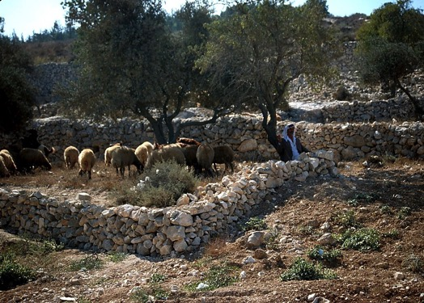
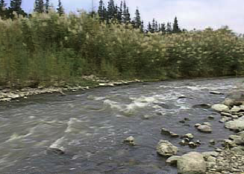
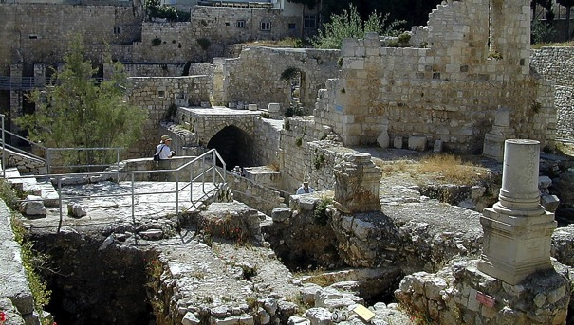
Mathi. 4:11-16
Bethlehem unthung olyu-enhuyang
Capernaum unthungi meta
JISU
EKUM
Jordan zukhvu omhawoe
Bethesda meta
Ete Opvui n vanmo meta ji...
Meta hiang no ete Opvui na ombo omhyak na hüngo jiang.
Okhekako pg. 39-41
04
Notes:
The backdrop of Our Lord's life was the Land in which he lived…
…the Land of Abraham's Promise. These are views He would have seen with his own eyes! Experience proves that our knowledge of geography is also a powerful tool toward organizing vast amounts of information This makes it easily available for mental recall and processing and helps in teaching or witnessing to others. The Lord walked in these places.

Slide 6
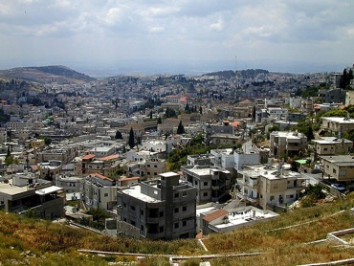
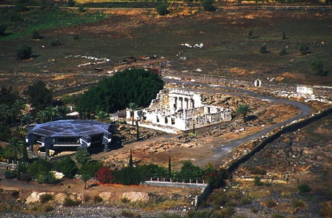

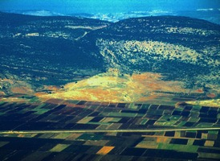
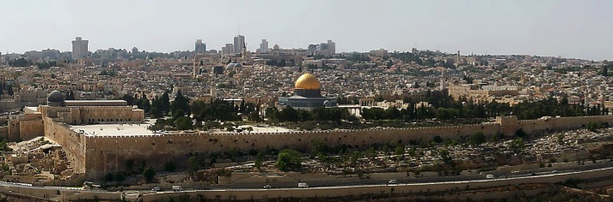
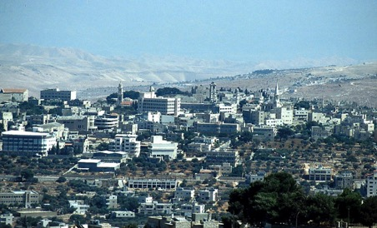
7
Kha thung unzanchi phen #07
CAPERNAUM
JISU’ EKUM LO OPVU TIROK META TONA YENTSAO DO JI
NAZARETH
GALILEE
CANA
JISU
Ekhm
JERUSALEM
BETHLEHEM
Okhekako pg. 39-41
05
6
Notes:
Because of the importance of geography…we'll focus on Jesus' travels around the Israel of his day…helping to organize his life for easier mental recall.
There are six geographic focal points to remember. Beginning at…
//// Bethlehem, his birthplace, the ancient city of David, south of Jerusalem;
//// Nazareth, where he was raised into his adult life and the site of the very beginnings of his ministry,
//// Capernaum, where most of his ministry years were headquartered…
//// and, of course, Jerusalem, the theological and political focal point of Judaism, its history and traditions and the birthplace of early Christianity and the Church.
//// Do remember, though, that Jesus Christ was first and foremost a Galilean, a man NOT of Jerusalem and its worldly sophistication, but a Galilean of the people, from a place in Israel with a reputation for its willingness to entertain new ideas... new philosophies.
//// And there was Cana…where the Lord's ministry had its “official” beginning.

Slide 7
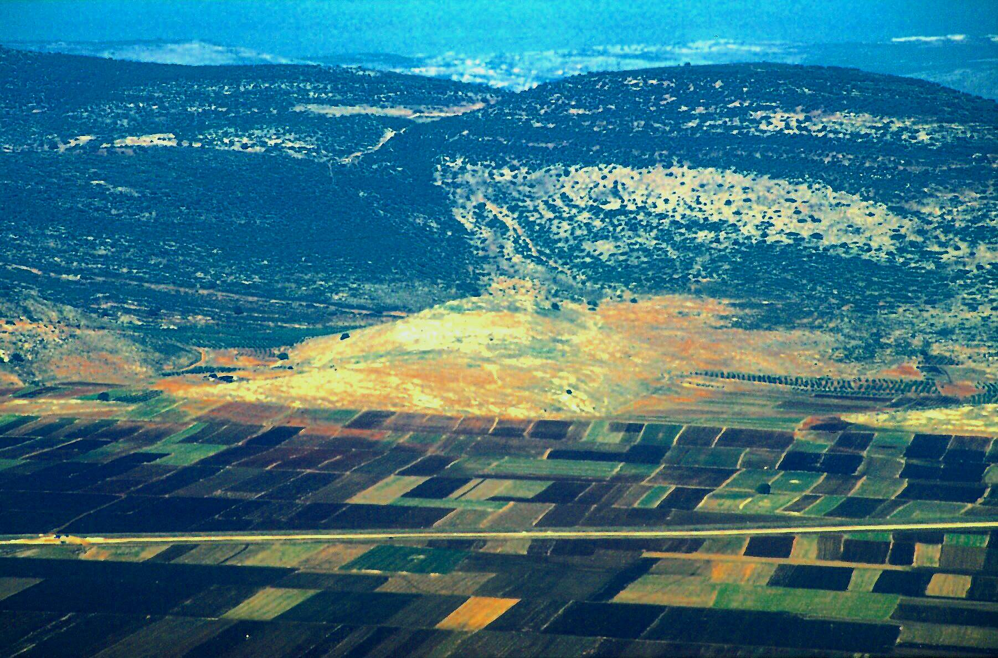
John 2:1-11
JISU
JISU
Ekum
JISU Traveled His LIKO:
Cana:JISU na chethev elhi ovϋngo tsoe meta ji
06
Notes:
The remains of Cana lie beneath this Israeli “tell,” an archeological mound -- the ruins of centuries of earlier civilizations, stacked on top of each other much like a layer cake.

Slide 8




7
JISU
Ehum
Unchuma thera ümbum esua...
Okhekako pg. 39-41
07
1
Notes:
So now…with geography in mind…think of the shape of a thistle...rather round and prickly.
//// On top of that shape overlay a sketch of the basic outline of a thistle that might look like this…

Slide 9
7
ELHI 9:31
JISU
Ekum
JISU na sanphio meta jiang no ümbum esua tuv...
Okhekako pg. 39-41
08
1
Notes:
Then superimpose that thistle shape over a map of ancient Israel -- with regions on that map named as they were in the Roman times of the Messiah.
//// JUDEA…SAMARIA…and GALILEE. These are the Palestinian provincial regions by which Rome administered the government and economy of the Land 2,000 years ago.

Slide 10
7
John 2:13-25
EKHA KAKO#07
JISU
Ekum
1. Opvu na
Ovungo to
MINISTRY
Tsoe ji jo
Metae
JERUSALEM
JISU na sanphio meta jiang no ümbum esua tuv......
Okhekako pg. 39-41
1
09
Notes:
Using Study Help #7, around the oval of that thistle shape we can map out the route of Jesus' travels during his life -- and get yet another handle on organizing what we already know or will ever learn about his life and ministry.
//// Begin at the base of the thistle, in the city of Jerusalem where the Lord began his ministry...called The First Jerusalem Ministry.

Slide 11
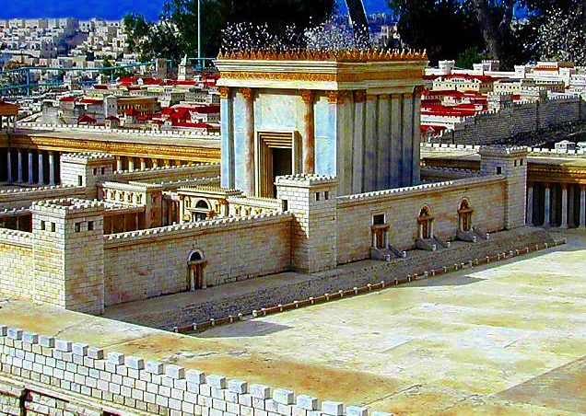
John 2:13-25
7
JISU
Ekum
Untson tsoe Herod’ Jerusalem Khumphen ki
Okhekako pg. 39-41
10
Notes:
What was life like then? Here is a model of the Great Jerusalem Temple, built by Herod the Great – where Jesus, the rabbi, taught the multitudes –– on the same Mt. Moriah site as Solomon's Temple 1,000 years earlier…the same Mt. Moriah on which Abraham was about to sacrifice his son, Isaac, before the Lord stopped him. This one building had become the tightly focused point of all theology and all politics in ancient Israel. Look at the building and the city behind it...and conceive in your mind…

Slide 12

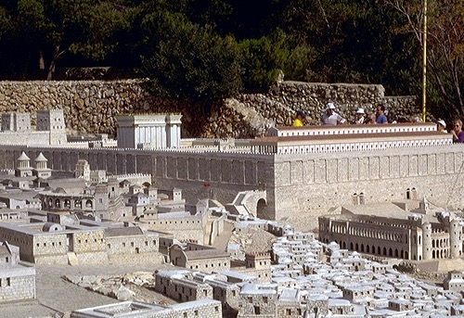
John 2:13-25
JISU ECHUNGI
JERUSALEM YANTSU JI
JISU
Ekum
Meta unkyonjan jang
Mount Khumphen ki, Khumphen ki, Antonia metatsu ji
Location Credit: HolyLIKO Hotel, Jerusalem
Okhekako pg. 39-41
11
Notes:
...the social infrastructure...the economic base that must be present to allow operation of such an enormous complex as the Great Temple. And there you have some idea of ancient Jerusalem's society –– propelled by the remarkable technologies and social forms of the new Roman society.

Slide 13
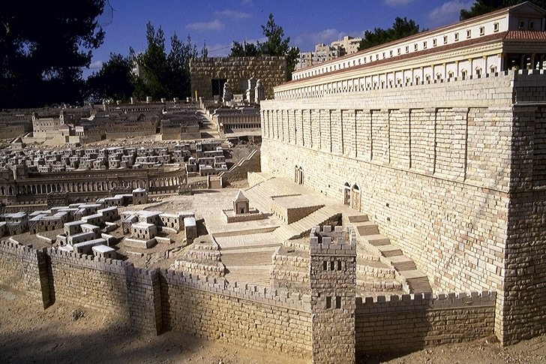

Mark 11:27
JISU ECHUNGI
JERUSALEM YANTSU JI
JISU
EKUM
Mount’s khumphen ki eng rha lan mo ji
Engkhfüwoe kepyung
Meta hejo : Ntho Liko Unchenphen, Jerusalem
Okhekako pg. 39-41
12
Notes:
These new ideas confronted Jesus' early ministry. The Gospels indicate that he quickly realized his message would be better received were he to move from Jerusalem to some other location.

Slide 14
7
John 4
2. ENI DO JO
SAMARITAN
META LO VO CHO
JISU
Ekum
1. OPVU NA
OVUNGO TO
ELHI TSOE JI
JERUSALEM
SHILOH: Tabernacle ji
JISU na sanpheo meta meta osi olan ji...
Okhekako pg. 39-41
13
3
Notes:
On his way north to plant his new ministry headquarters,
//// he passed from Judea through the region north of Jerusalem known as Samaria. Historically, this is the region where, 1000 years earlier, the Northern Kingdom of Israel had planted its capital after the nation split apart following Solomon's death. That was during the ROYALTY period.
//// Remember Samaria following Israel's NATIONAL SPLIT?
This is "the Lord's Samaritan transit" and here he had the famous conversation with the Samaritan woman at the well.
//// He was also very near the site at Shiloh -- where Israel's ancient Tabernacle had stood prior to construction of Solomon's great new Temple in Jerusalem a thousand years later.

Slide 15
Mat. 4:13-16; 9:1
3. GALILEAN META
LO ELHI TSO CHO
CAPERNAUM
OYAN JI LO
2. ENI DO JO
SAMARITAN
META LO VO
CHO
JISU
JISU
EKUM
1. OPVU NA
OVUNGO TO
ELHI TSOE JI
JERUSALEM
JISU na sanpheo meta meta osi olan ji...
Okhekako pg. 39-41
14
Notes:
The Lord finally arrived in the beautiful and well-watered region of northern Galilee, eventually taking up residence in the simple fishing village of Capernaum…on the shores of the Sea of Galilee.

Slide 16
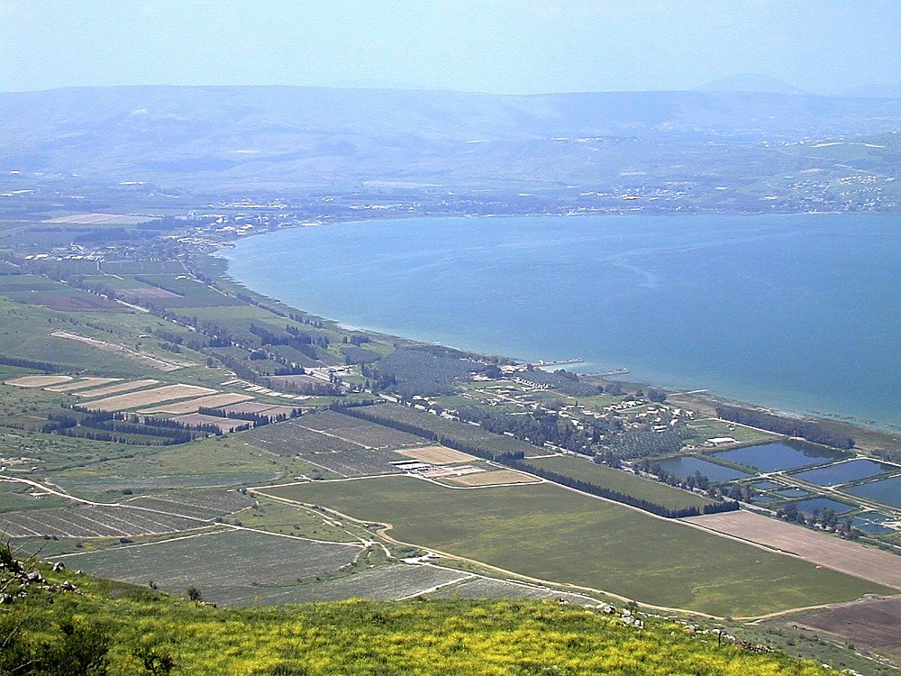
Capernaum: Elitsoe thung Meta opvuji
JISU
JISU
Ekum
JISU na meta yentsoa ji:
Northwestern jürani, Galilee Jϋmang
15
Notes:
Scripture indicates he lived in the home of Simon Peter in Capernaum.
Here we are approaching Capernaum on the northwestern shore of the Sea of Galilee…

Slide 17
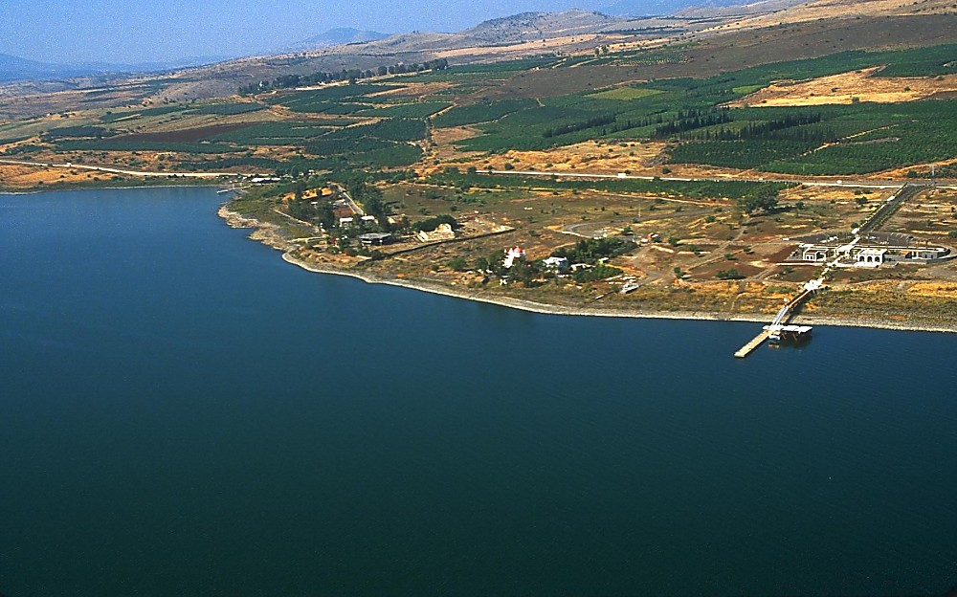
JISU
JISU
Ekum
JISU na meta yentsoa ji :
Capernaum Meta ji Ephya wae na evoni zeta cho
16
Notes:
From the east, approaching the village, the gentle highlands of the Galilee rise in the distance…

Slide 18
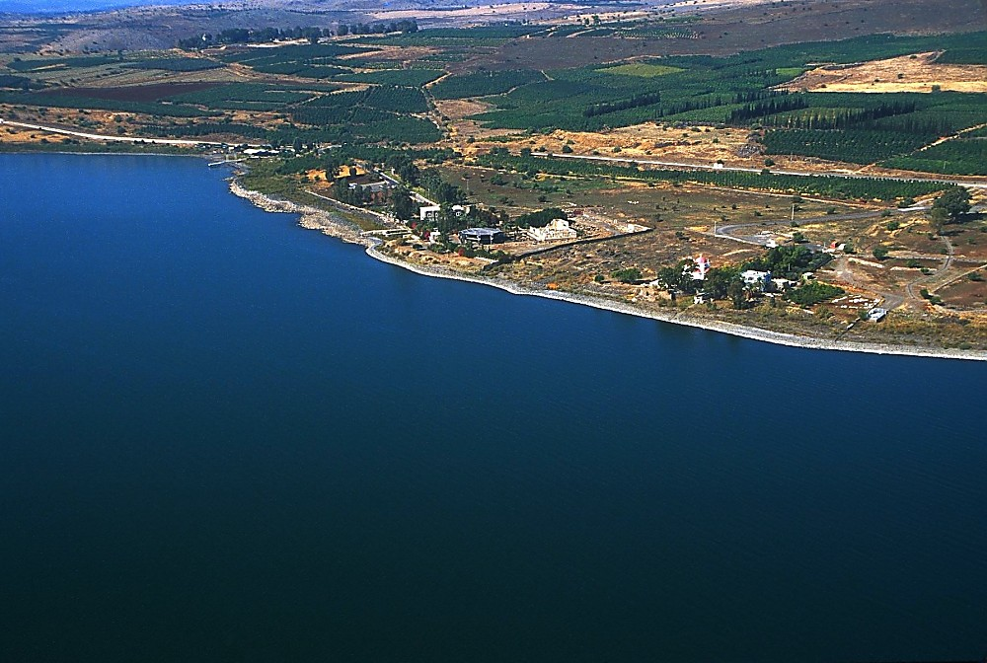
JISU
JISU
Ehum
JISU na meta yentsao ji :
Capernaum Meta ji Ephya wae na evoni zeta cho
17
Notes:
We begin to see the old synagogue…and the gray concrete structure that now covers and protects the ruins of Peter's house.

Slide 19
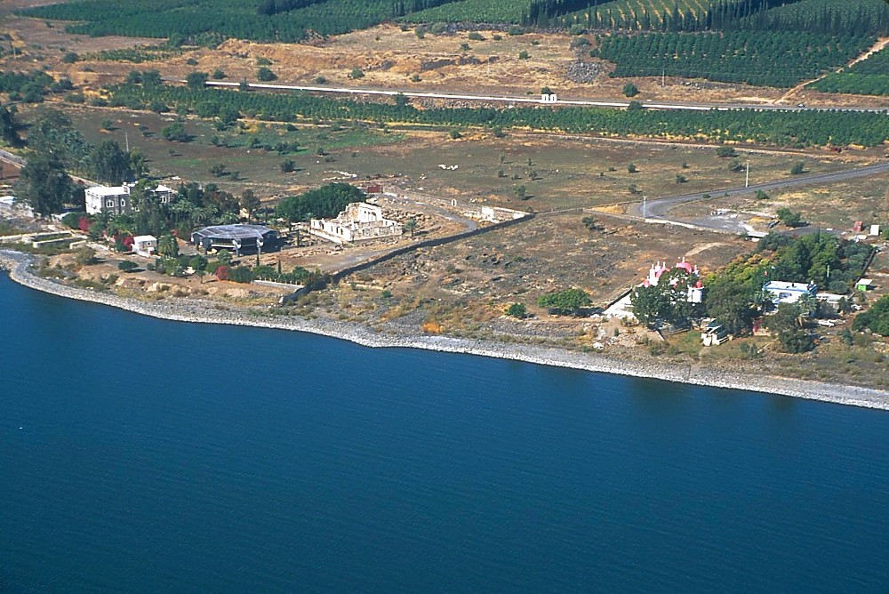
JISU
JISU
Ekum
JISU na meta yentsoa ji :
Capernaum Meta ji Ephya wae na evoni zeta cho
18
Notes:
…as here…pulling closer to the archeological site preserved and restored by the Roman Catholic Franciscan archeologists.
.

Slide 20
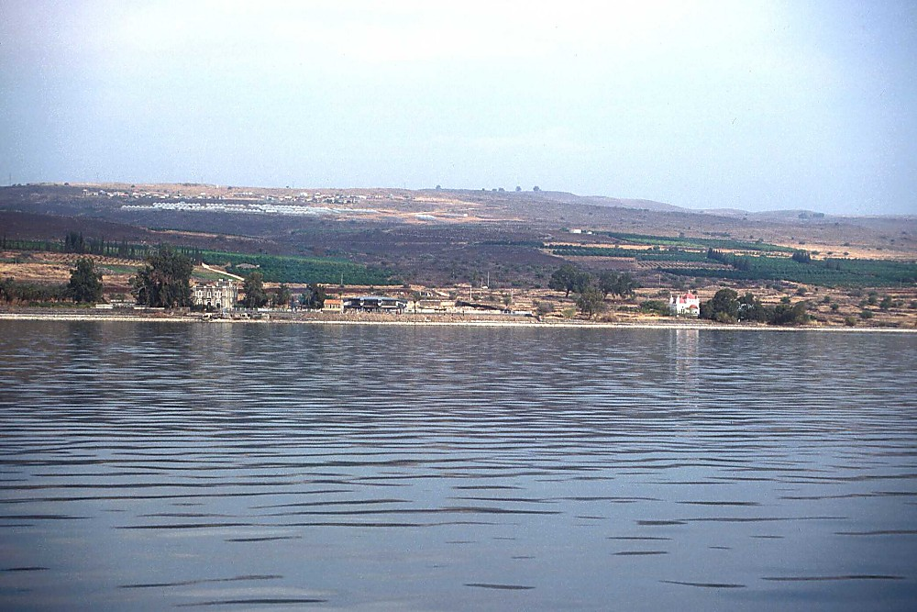
JISU
JISU
Ekum
JISU na meta yentsoa ji :
Capernaum Meta ji Orhungi na evoni zeta cho
19
Notes:
If you approach by water from the south…the rising fields and orchards show the fertility of the Galilee and its ancient volcanic soil…

Slide 21
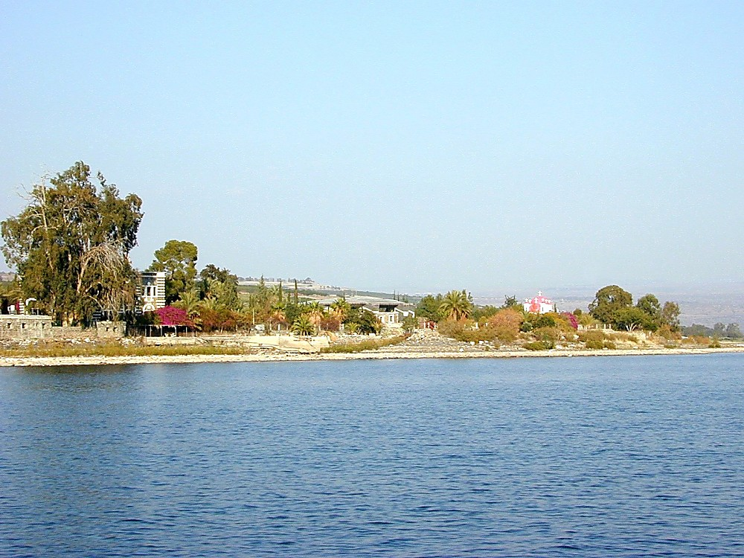
JISU
JISU
Ekum
JISU na meta yentsoa ji :
Capernaum Meta ji Orhungi na evoni zeta cho
20
Notes:
…and we pull closer still…

Slide 22
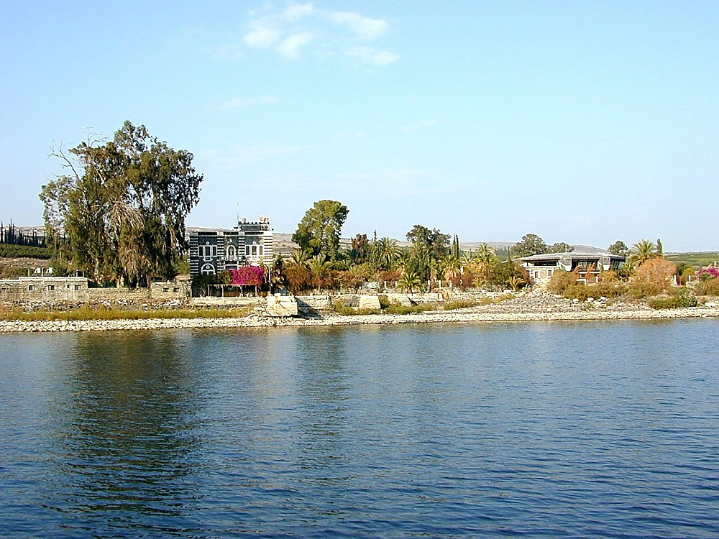
JISU
JISU
Ekum
JISU na meta yentsoa ji :
Capernaum Meta ji Ephya wae na evoni zeta cho
21
Notes:
…finally coming to dockside to visit the ancient site…

Slide 23
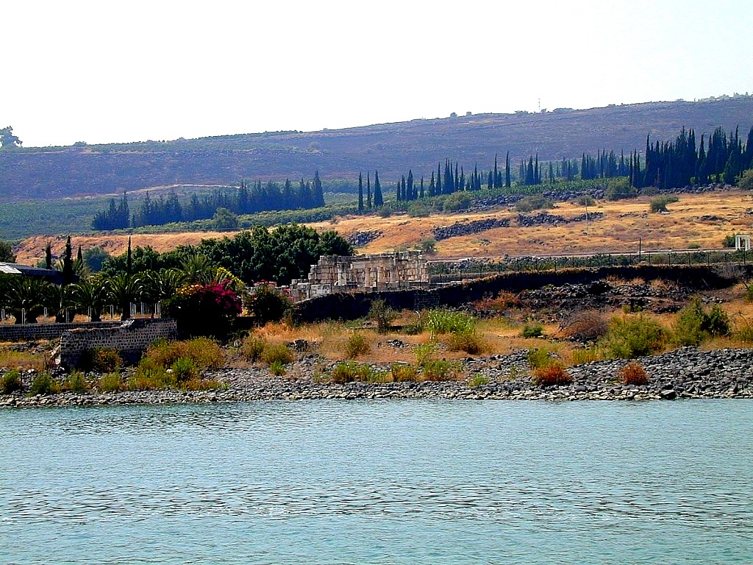
JISU
JISU
Ekum
JISU na meta yentsoa ji :
Capernaum ji jana la:Synagogue Meta
22
Notes:
…and to explore the very streets where the Lord walked. As many as 10,000 Galileans are thought to have lived in Capernaum in Jesus' time.

Slide 24
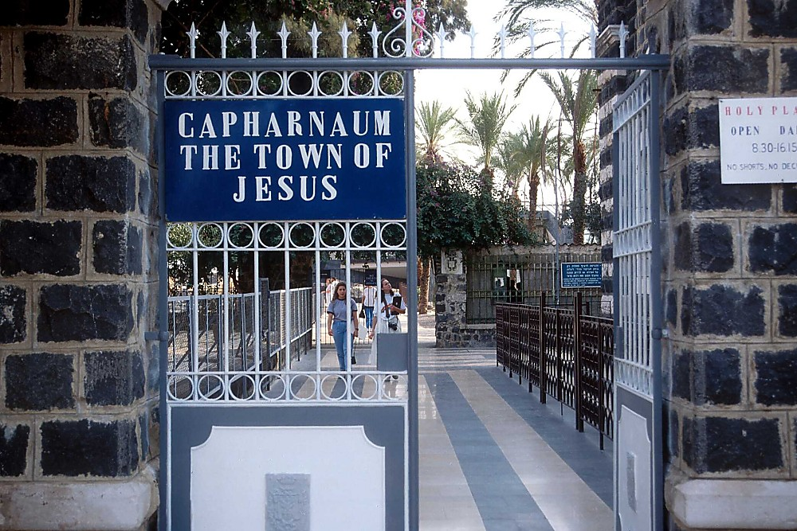
JISU
JISU
EKUM
JISU na meta yentsoa ji :
Rhovota ka “JISU Oyan ji”
23
Notes:
Today's city gates of Capernaum look a bit different than those of Jesus' day. The city's black stone is characteristic of the volcanic basalt that underlies most of the lands here. Gentle Capernaum…what a contrast with busy, chaotic and noisy Jerusalem in the South.

Slide 25
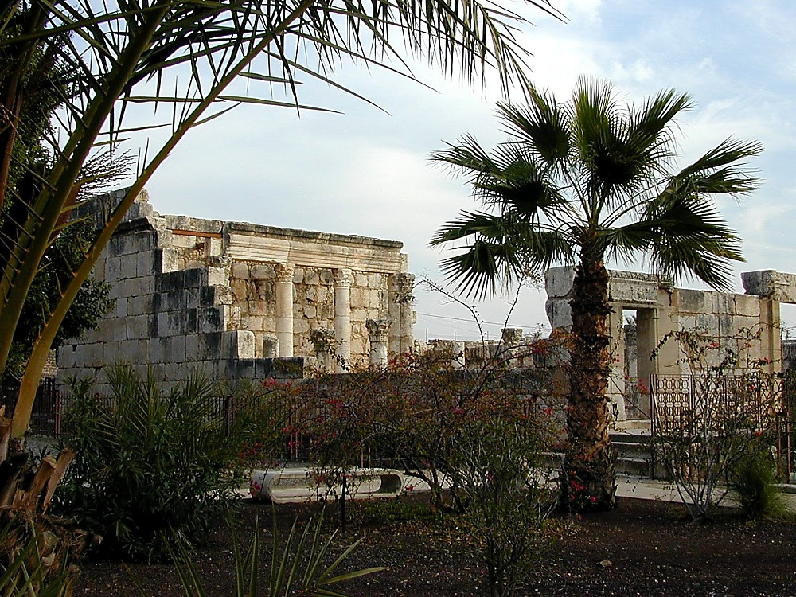
JISU
JISU
Ekum
JISU na meta yentsoa ji :
Enhunga Capernaum Synagogue Meta ji
24
Notes:
The restored Synagogue in Capernaum…not the one, however, in which Jesus taught. This one was built in the Second Century after Christ's birth. We do know, however, that the earlier synagogue –– the one in which Jesus did teach –– was located on this same site, the highest point in the city. Notice the Greek flavor of the architecture…

Slide 26
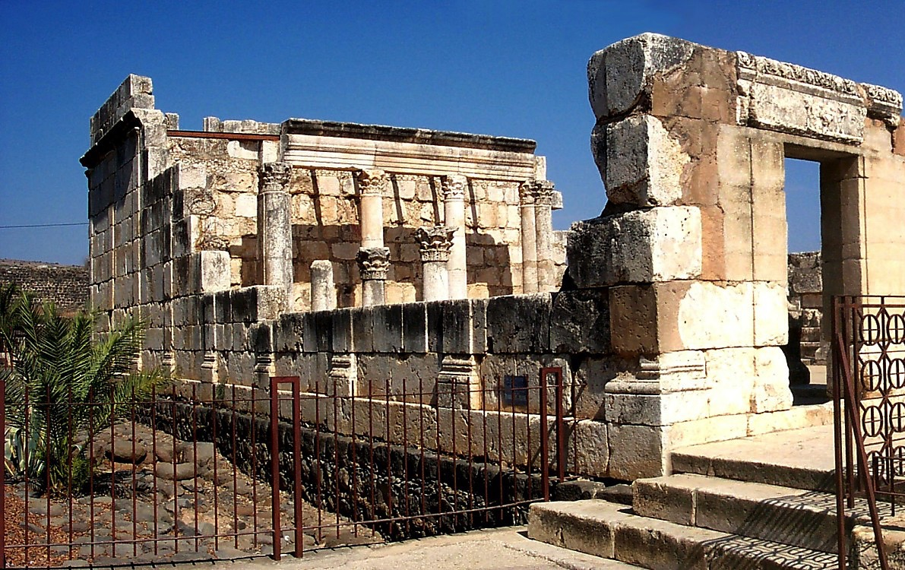
JISU
JISU
EKUM
JISU na meta yentsoa ji :
Enhunga Capernaum Synagogue Meta ji
25
Notes:
That’s the influence of Alexander’s Hellenism…doing things the Greek way made obvious in this restoration of that Capernaum synagogue. There is no doubt, however, that this is the very ground on which the synagogue of Jesus’ day was located. He taught on this very spot!

Slide 27
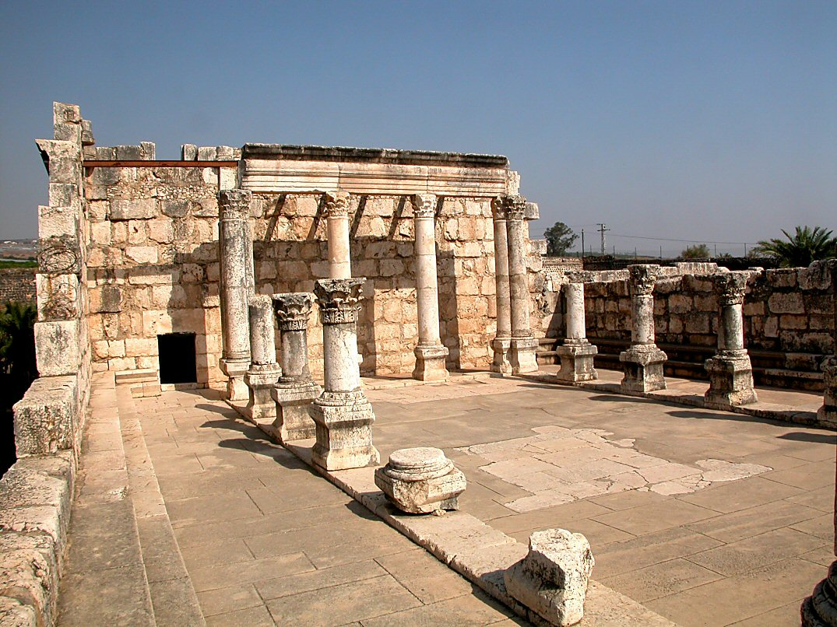
Mark 1:21; John 6:59
JISU
EKUM
JISU na meta yentsoa ji :
Enhunga Capernaum Synagogue Meta ji
26
Notes:
More evidence of Greek styling, even though paid for by a local Roman centurion and built with Roman construction methods.

Slide 28
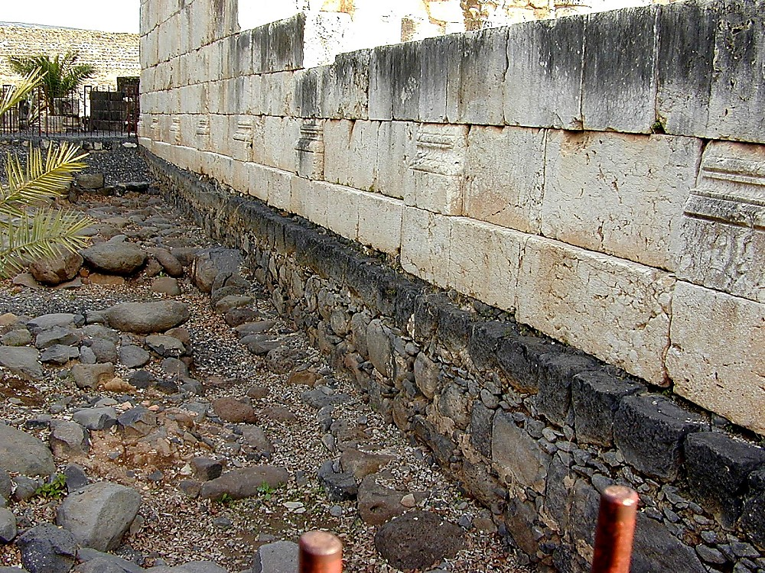
JISU
JISU
Ekum
JISU na meta yentsoa ji :
Olong lan Capernaum meta ji lo evo tsukona
27
Notes:
Next to the synagogue are these basalt-paved streets, many original stones still in place today…

Slide 29
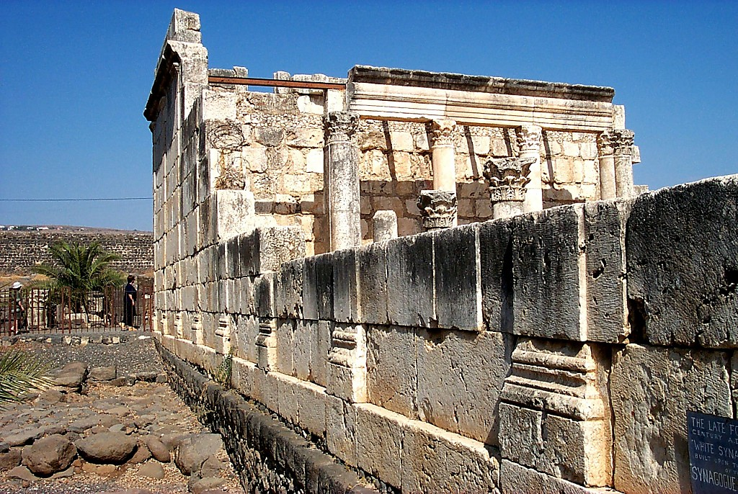
JISU
JISU
Ekum
JISU na meta yentsoa ji :
Olong lan Capernaum meta ji lo evo tsukona
28
Notes:
… where the Lord walked and ministered to his disciples and to all the others from the region who came to hear his teaching.

Slide 30
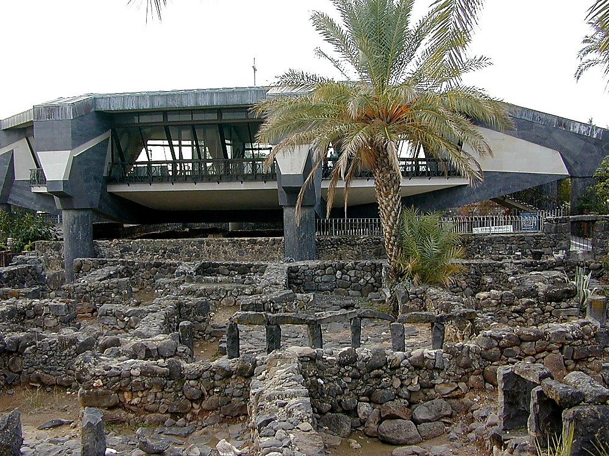
JISU
JISU
Ekum
JISU na meta yentsoa ji :
Capernaum meta lo Peter’s oke ji talangi vata cho
29
Notes:
This is a Catholic church built in this unusual shape in order to protect the home of the Lord…over the preserved remains of an ancient octagonal church. The design of this current Catholic church above the ruins remembers that ancient shape.

Slide 31
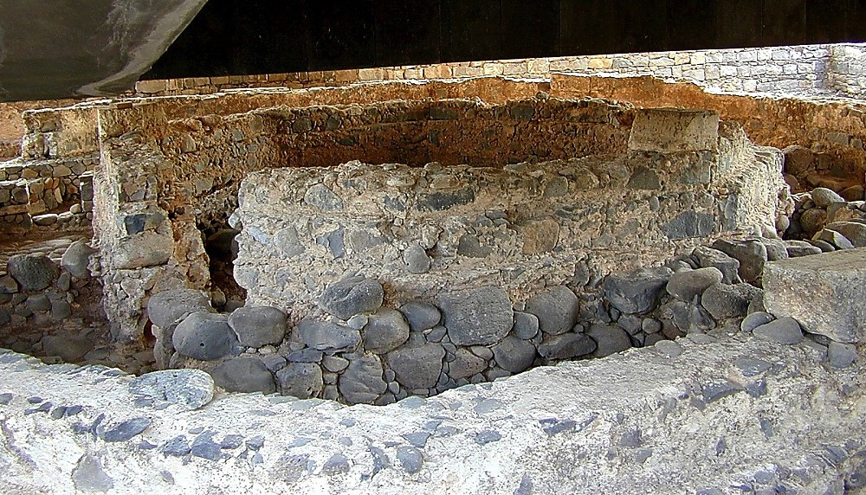
JISU
JISU
Ekum
JISU na meta yentsoa ji :
Capernaum meta lo Peter’s Oki Enhyolan chi eli ji
30
Notes:
…which lies underneath. The ruins of the home of Peter. Scholars believe Jesus lived here for about two years.

Slide 32

JISU
JISU
Ekum
JISU na meta yentsoa ji :
Galilee Tsümang ji lo eyng rhetan mo ji
31
Notes:
He would have seen many sunsets just like this at the end of a long day of ministry in Capernaum…

Slide 33
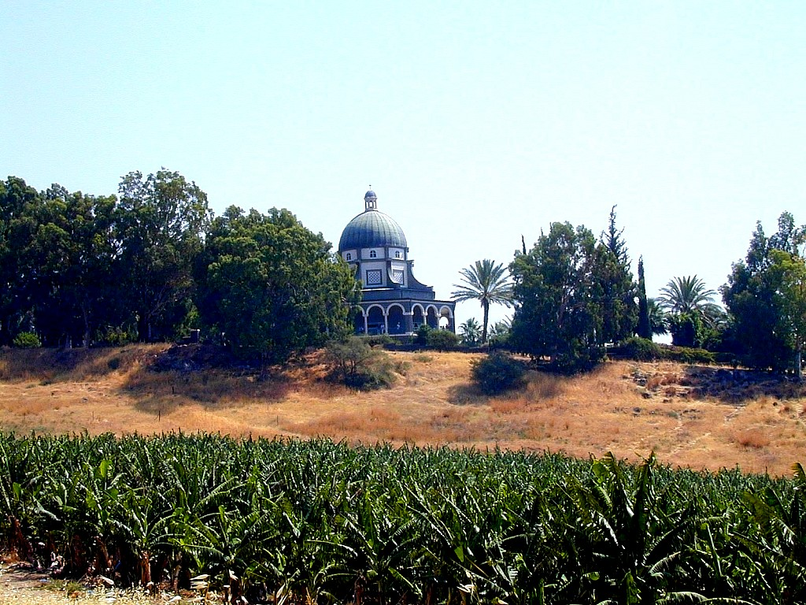
JISU
JISU
EKUM
JISU na meta yentsoa ji :
Meta hi omying jo Mount of the Beatitudes
32
Notes:
This natural amphitheatre, a site east of Capernaum out on the surrounding hillsides, is today's Mount of the Beatitudes. We know that Jesus attracted huge crowds on these gentle slopes...delivering his great Sermon on the Mount...The Beatitudes…feeding the many thousands. Truly a place of rare significance in the history of early Christianity and the lessons of ministry and the training of his followers.

Slide 34
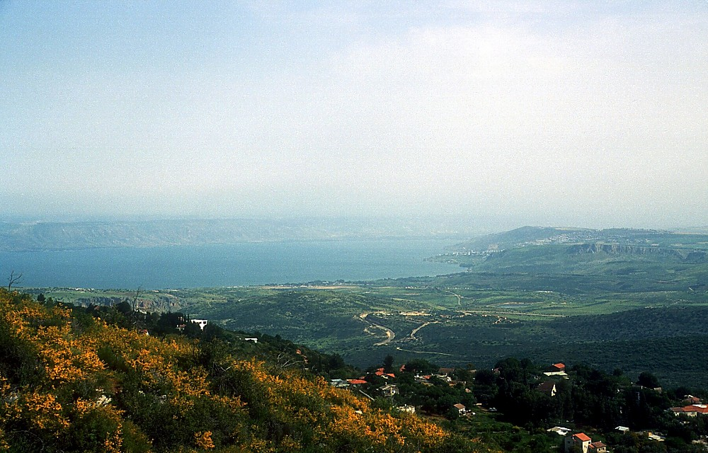
JISU
JISU
EKUM
JISU na meta yentsoa ji :
Galilee Meta ji Phunglan ni na Chani ze cho
33
Notes:
Scripture recounts how Jesus traveled widely during his ministry years...through these highlands above the Sea of Galilee.

Slide 35
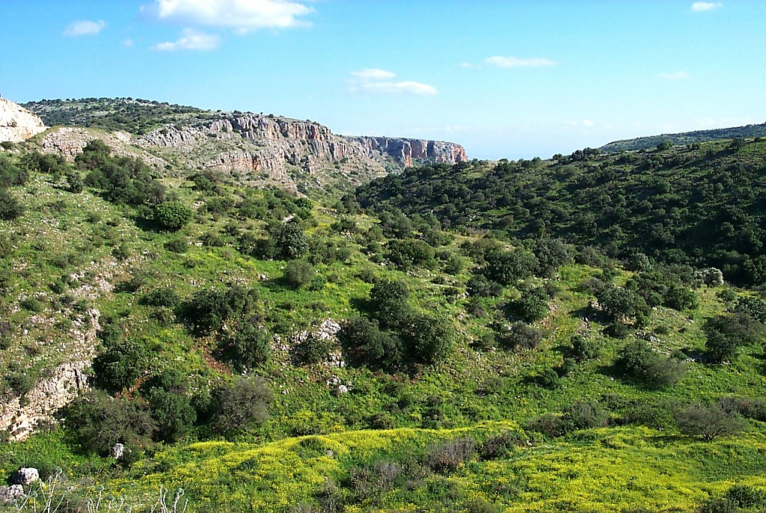
JISU
JISU
EKUM
JISU na meta yentsoa ji :
Oyan tsai Galilee’s Meta jiang
34
Notes:
Travel was difficult and time consuming…requiring many days to arrive at distant places of ministry.

Slide 36
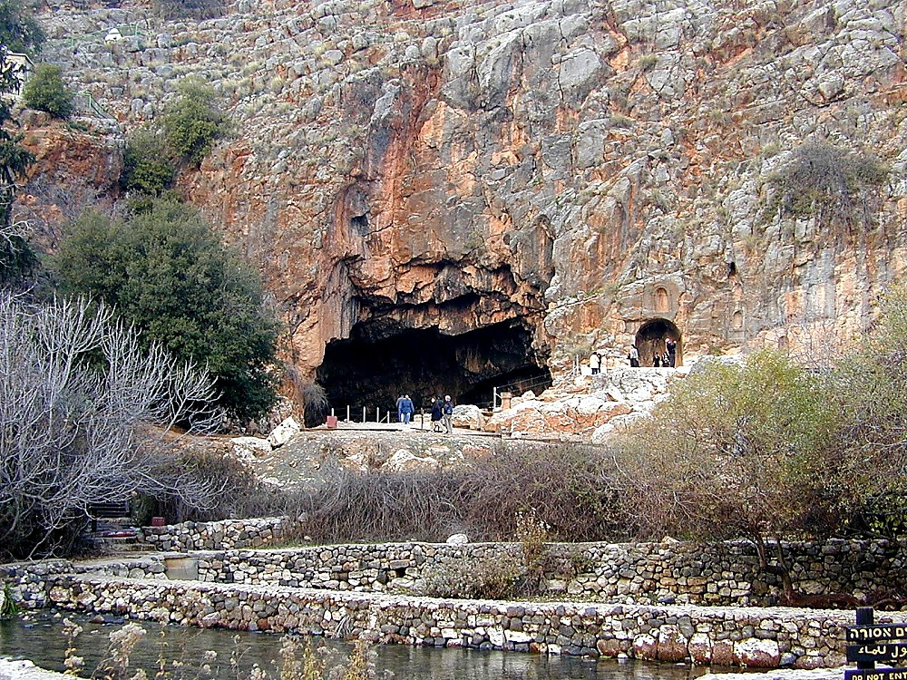
Mat 16:13-17
JISU
JISU
EKUM
JISU na meta yentsoa ji :
Caesarea Philippi -- Peter: “…Olung ji boni !”
35
Notes:
…such as this natural spring at Caesarea Philippi, the Biblical site where Jesus promised Peter that “upon this rock” He would build his church.

Slide 37
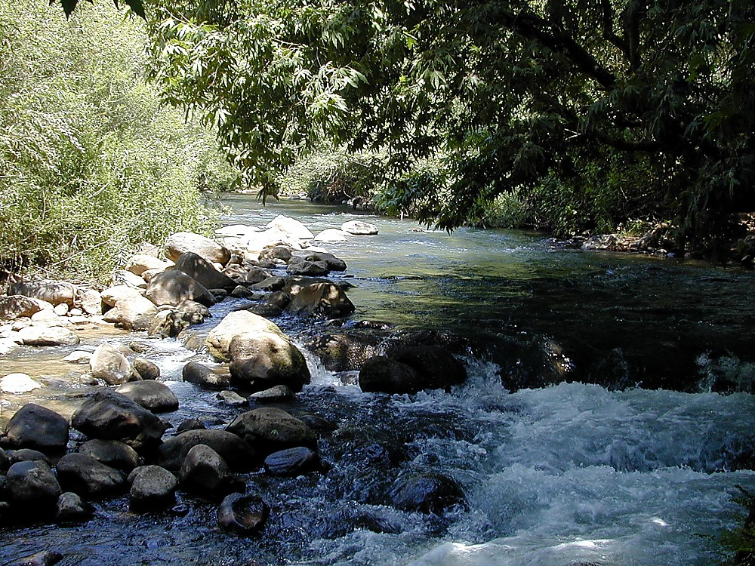
JISU
JISU
Ekum
JISU na meta yentsoa ji :
Jordan Zykhvui omha woe ji
36
Notes:
The abundant waters of the Upper Jordan became a familiar metaphor for Jesus as he supplied the “water of life” to all who would listen and follow.

Slide 38
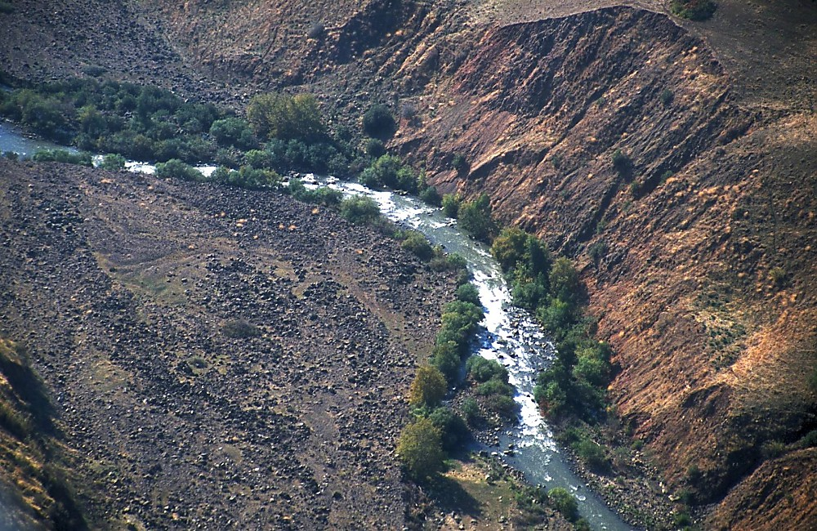
JISU
JISU
Ekum
JISU na meta yentsoa ji :
Jordan Zykhvu ji Eng rhelan mo tsua je yi la
37
Notes:
…and here the Jordan moves south toward Samaria, through Judea on toward the Dead Sea.

Slide 39
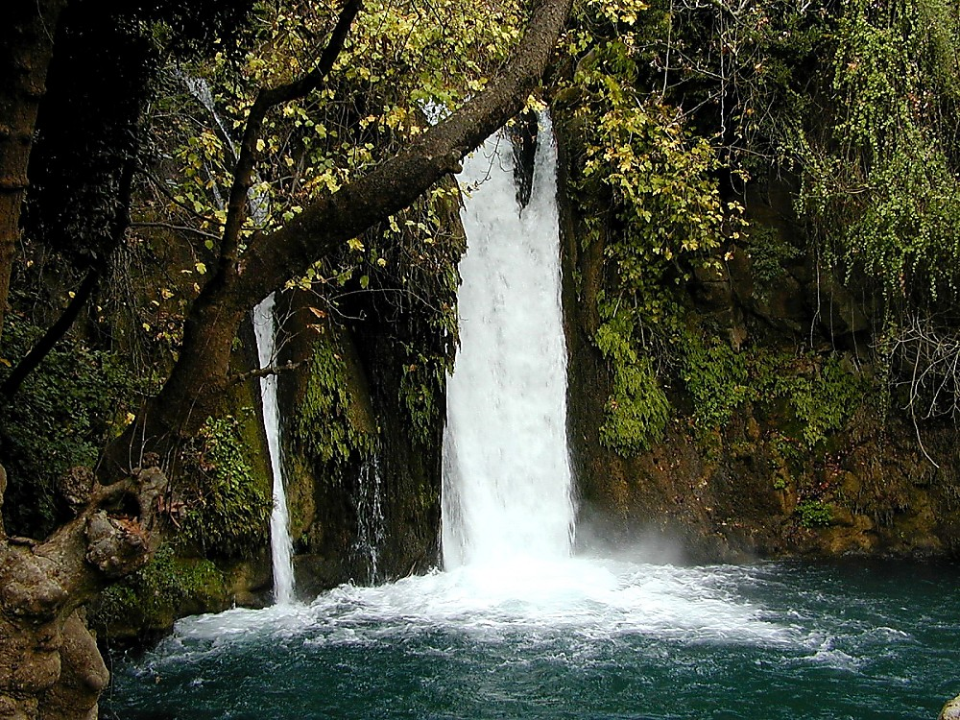
JISU
JISU
Ekum
JISU na meta yentsoa ji :
Galilee's chürani
38
Notes:
Here and there along the way, he encountered lovely waterfalls and sites of incredible natural beauty.

Slide 40
Mat. 4:25; Mark 7:31
3. CAPERNAUM
JILO
GALILEAN
MINISTRY
2. SAMARITAN
DONGPHI
OLAN
JISU
Ekhum
1. OPVU NA
MINISTRY
OVUNGO TSOE
JI JO
JERUSALEMI
JISU Na Meta Yentsao Ji...
...
39
2
Notes:
From time to time, the Lord would make forays into the surrounding country for teaching and ministry…
//// ….north into Phoenicia…
//// ….and into the region known as the Decapolis…ten cities…built and organized along Hellenistic or Greek styles of living…it was THE thing to do…

Slide 41
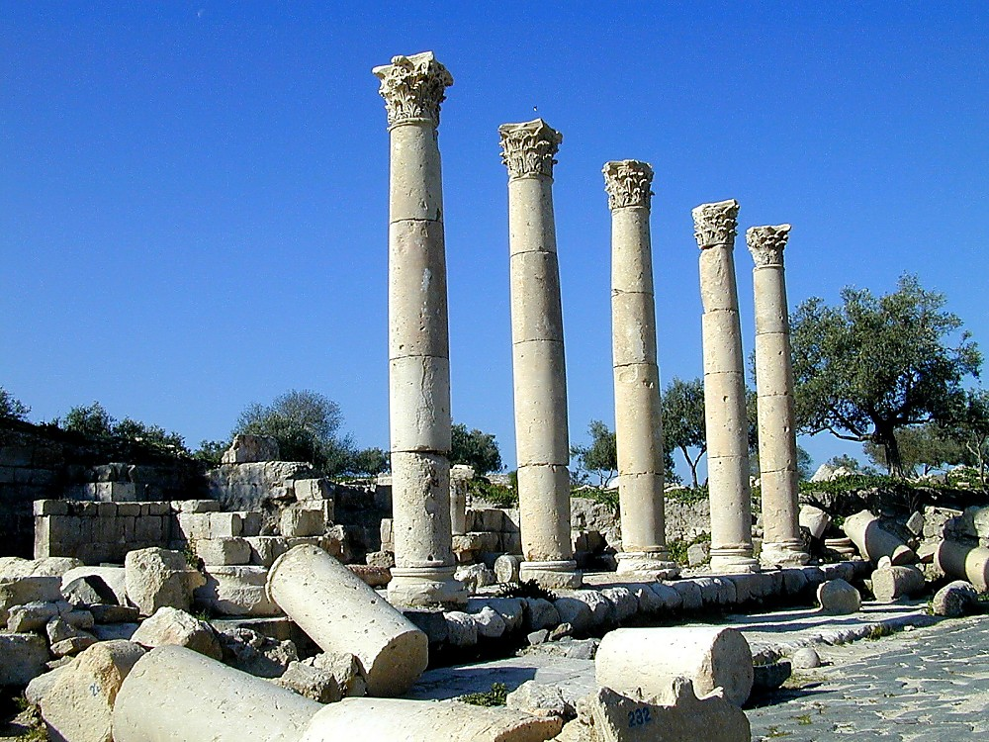
Mark 5:1; Luke 8:26-37; Mat 8:28-34
JISU
JISU
Ekum
JISU na meta yentsao ji:
Gadara metae Greek meta esua tuv
40
Notes:
…such as the city of Gadara. Even the columns in this restoration show the Corinthian style typical of the influence of Greek architecture.

Slide 42
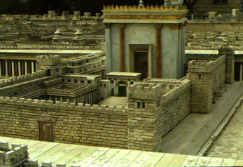
John 2:23; 4:45; 5:1-2; 10:22; 12:12
3. CAPERNAUM
JILO
GALILEAN
MINISTRY
Capernaum meta
2. SAMARITAN
DONGPHI
OLAN
JISU
EKUM
1. OPVU NA
MINISTRY
OVUNGO TSOE
JI JO
JERUSALEMI
Jerusalem
JISU Na Meta Yentsao Ji...
41
2
Notes:
Jesus made many trips out into the surrounding country...teaching... healing...and ministering….
//// ….from Capernaum and the Galilee down to Jerusalem...fulfilling every aspect of the Mosaic regulations.
//// Which included his faithful attendance throughout every Jewish calendar of annual feasts in the Jerusalem temple. Jesus would travel to the great city probably ON FOOT…

Slide 43
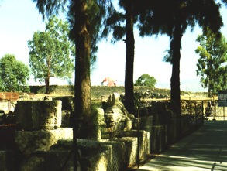

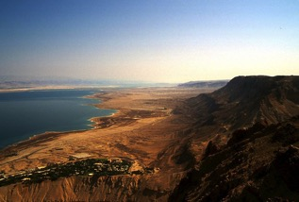
John 2:23; 4:45; 5:1-2; 10:22; 12:12
CAPERNAUM TONA JERUSALEM: JO 80 MILES
GALILEE JUMUNJG, JORDAN ZYKHVU TONA ECHU JU: JO 75 MILES
JISU
JISU
Okhe kakp. 39-41
42
2
Notes:
To give you an idea of these distances…for traveling on foot or on the back and of a donkey…
//// …from Capernaum to Jerusalem…80 miles…or 129 kilometers.
//// from the Sea of Galilee outlet of the Jordan River to the Dead Sea…75 miles….or 121 kilometers.
Travel was no easy task in the days of our Lord's ministry on earth!

Slide 44
Luke 19:1-26
3. CAPERNAUM
JILO
GALILEAN
MINISTRY
2.SAMARITAN
DONGPHI
OLAN
4. PEREAN
MINISTRY
JISU
Ekum
1. OPVU NA
MINISTRY
OVUNGO TSOE
JI JO
JERUSALEMI
JISU Na Meta Yentsao Ji...
43
Notes:
And then as His time was drawing near...he left Galilee permanently, to return to Jerusalem through the region of Perea...specifically we know…

Slide 45
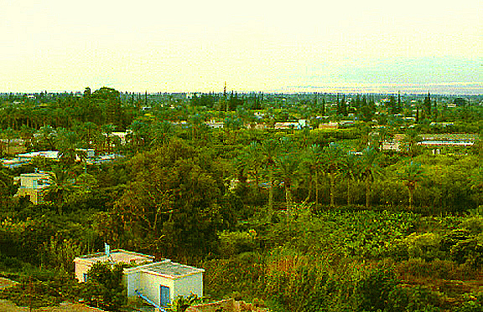
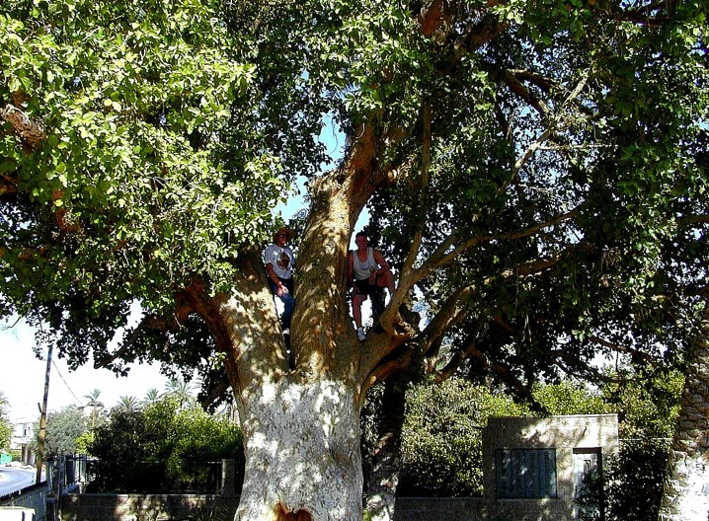
Luke 19:2-10
JISU
Ekum
JISU Na Ombo meta Ji Yentsa Cho:
Nitsothi dung Zacchaeus na Chungo ji
Okhekako pg. 39-41
44
1
Notes:
…he moved through ancient Jericho…that historic oasis city through which Joshua entered the Land to subdue it some 1500 years earlier!
//// There -- in this city of Jericho … ...Jesus had his famous encounter with small Zacchaeus hiding in a sycamore tree such as this.

Slide 46
Mat 21:10-16; John 12:13
3. CAPERNAUM
JILO
GALILEAN
MINISTRY
2. SAMARITAN
DONGPHI
OLAN
4. PEREAN Ni
MINISTRY TSOE
jI
JISU
Ekum
1. OPVU NA
MINISTRY
OVUNGO TSOE
JI JO
JERUSALEMI
5, JERUSALEM
MINISTRY
OKHAO DO JI
JISU Na Meta Yentsao Ji...
45
Notes:
And finally...the time had come for his return to Jerusalem, to face the inevitable events that were beginning to unfold. Thus...his final Jerusalem ministry.

Slide 47
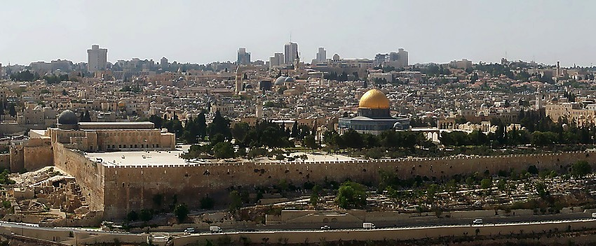
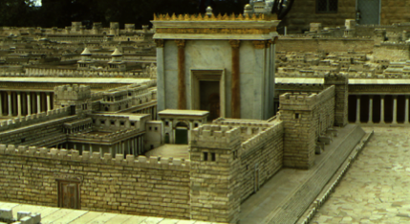
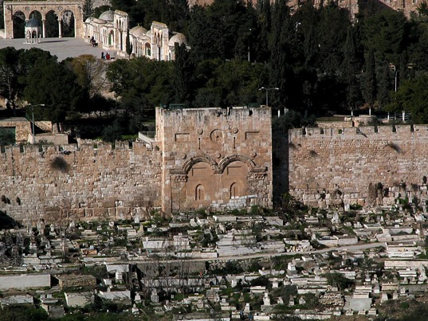
Mat 21:12-16
Enhunga Jerusalem's Khumphen Ki JI
JISU
Ekum
Eastern Gate Mount khumphen ni evo tsuko na
Abraham's Mt. Moriah:
Meta hi jo Jewish Khumphen Jiang
Okhekako pg. 39-41
46
2
Notes:
On that famous Palm Sunday of his last week, he entered this city, moving toward the great Herodian Temple on Mt. Moriah, the
Temple Mount, where the Dome of the Rock stands today…
//// …a crowd expected him to become Israel's new King and political ruler. You'll recall from the ROYALTY file folder this enormous pavement on which stood Solomon's and later –– this one –– Herod's great Temple during Jesus' day.
//// Scholars tell us that he would have entered the Temple Mount area through the Eastern Gate...now rebuilt and closed by later conquerors and occupants of the Temple Mount.

Slide 48
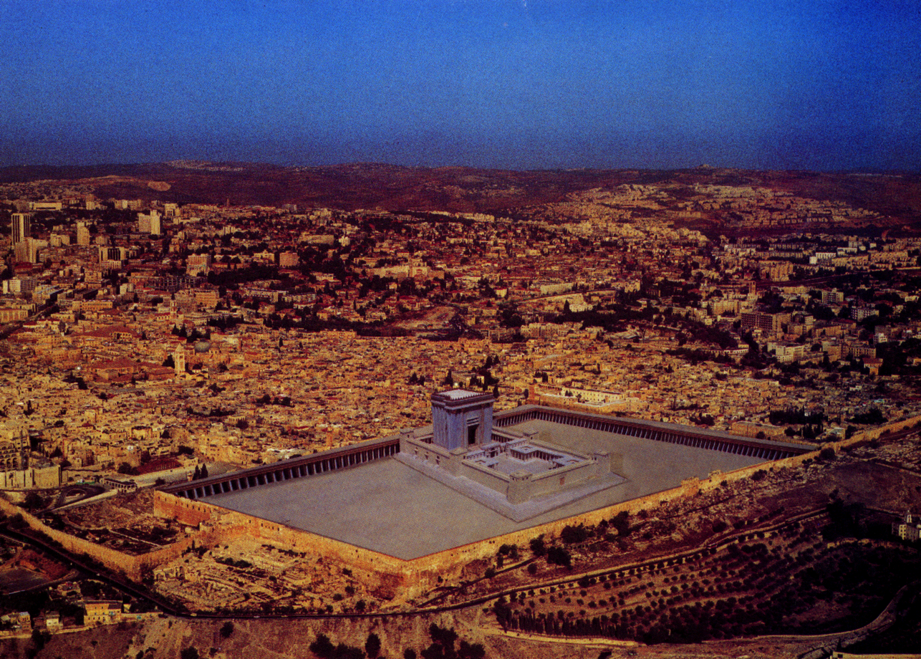
Mat 21:12-16
JISU
Ekhum
Ete Opvu Yuta Lo Khkumphen Ki jiang enhunga ha le vo Kvuto Tsoe...
Okhekako pg. 39-41
47
Notes:
And what if...just what if...that great Temple as known in Jesus' time were occupying that same site in today's Jerusalem? One artist has conceived that it would look like this. In this way...we can realize more easily the vastness of the Temple complex and the brittle, unyielding corporate, political and theological structure confronting Jesus. Within hours of entering the city, the Lord was brought before both Jewish and Roman authorities, setting in motion those tragic events that would eventually lead to…

Slide 49
7
Mat. 26:28; Mark 14:24; Luke 22:20
JISU
EKUM
DONPHEN
• Phyochak Ethan
JISU
Ekum
Donphen
Okhekako pg. 39-41
48
Notes:
…THE CROSS. This element of the JESUS file is well summarized by his announcement at the Last Supper –– the beginning of THE NEW COVENANT.

Slide 50
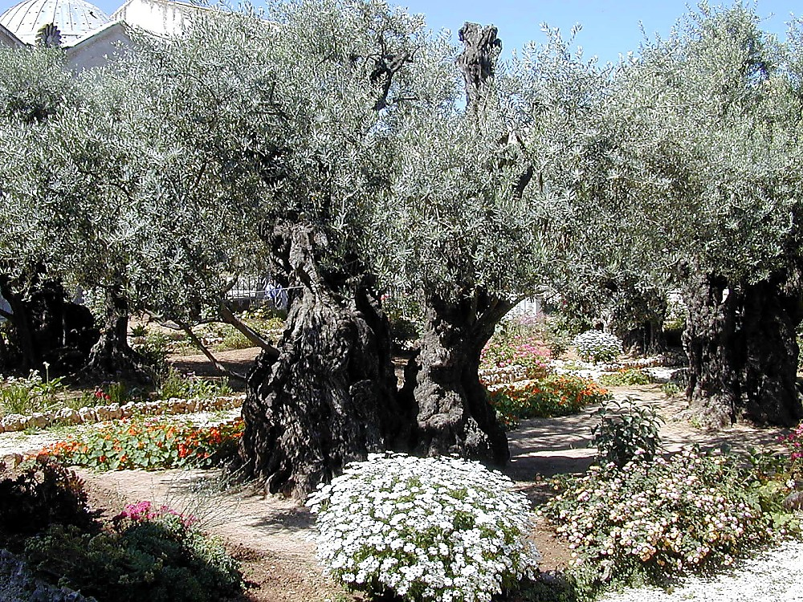
Luke 22:39-44
7
JiSU
EKUM
Donphen
Mount Olives Phunglan Ji: Gethsemane Phari
“Apo, Ni Lüm erüng lina nungra pvü shi khi a siya,Tolea a Lüm Erüng mek, ni lüm erüng tssothoka.”
Okhekako pg. 39-41
49
1
Notes:
Here in this ancient olive grove, today's Garden of Gethsemane, across the Kidron Valley from the Herodian Temple, Jesus went to pray when He knew his moment was approaching. There he implored,
//// "Father, if you are willing, take this cup from me; yet not my will, but yours be done.

Slide 51
7
Mat. 26-28; Mark 14-16; Luke 23-24; John 19-20
JISU
EKHUM
DONPHEN
• Phyochak Ethan
• “Methak thaka.”
JiSU
EKUM
• Jisu Chüo Ji
Donphen
• Jisu Jutheo Ji
• Kümchelamo JI
Okhekako pg. 39-41
50
4
Notes:
Here we also encounter all the events of the last hours of JESUS' ministry leading to his death on the Cross…
//// The phenomenal implications of his final statement, "IT IS FINISHED” –– much more on this later!
//// His death and
//// burial…and
//// His glorious resurrection.
We are witnesses to his unfathomable sacrifice and condescension from his everlasting place with the Father…far beyond any of our attempts to understand its total implications for our lives now and eternally in the presence of God.

Slide 52
7
Mat 16:18; 28:19
JISU
EKUM
Donphen
Khumphen ki
• "Ekhumkho" –
"Echumporo tsao jiang"
JISU
EKUM
Donphen
Khumphen ki
• Jerusalemi na benka cho.
to lue limhae topvu lo vocho…
Okhekako pg. 39-41
51
4
Notes:
Finally, the CHURCH element...containing all those world-changing events signaled by
//// the formation of the ecclesia,
//// — the called-out ones,
//// …beginning in Jerusalem with James and Peter and their devoted associates,
//// and then out into the world, with Paul, Luke, Barnabas and all the others.

Slide 53
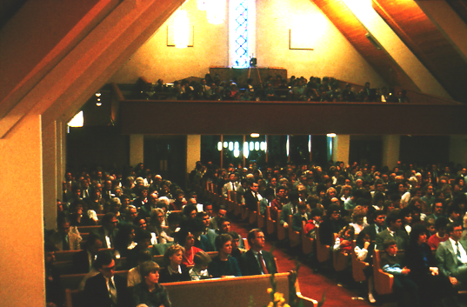
Khumphen ki:
Ete vanmo ji na khumphen ki ji licho
JISU
EKUM
Donphen
Khumphen ki
Okhekako pg. 39-41
52
2
Notes:
And here we find ourselves...discovering our own role in the great Plan of the Ages that God initiated through old Abraham. Here...
//// in the church today...the contemporary Body of Christ. The Church has moved not one inch farther forward than where it is at this very moment. Therefore…
//// We are the crest of that wave! For which the monumental question arises:

Slide 54
The Khumphen ki:
“…Tolea Kvüthung Nthomon ji ntelo joroa sana etho na nte pyinguv osi ntena a tsükona Jerusalem, Judea,Samaria osi limha ochum jana a enhungpvüiden tssov..”
Ete no Khumphen
ki ji tsuko na
nto ludan cho la ?
JISU
EKUM
Donphen
Khumphen ki
ELHI 1:8 (NIV)
Okhekako pg. 39-41
53
1
Notes:
WHAT ARE WE DOING ABOUT IT? Are we just coming to church, soaking it up and going away for the next seven days? Or...are we accepting the dynamic challenge of Our Lord to take the message to the farthest corner of each one's own world?
//// Remember His parting words: “…and you will be my witnesses in Jerusalem, and in all Judea and Samaria, and to the ends of the earth.”

Slide 55
7
Mati, Mark, Luke, John
Untsa &
Theology
JISU
EKUM
DONPHEN
KHUMPHEN KI
YITHEN MMHON
JISU
EKUM
Donphen
Khumphen ki
Yithen Mhon
Okhekako pg. 39-41
54
Notes:
All these titanic events are recounted, first, in the Gospels as ...
THE FACTS AND THEOLOGY OF THE NEW ERA OF JESUS CHRIST.

Slide 56
7
Apostles Elhi jiang
Untsa &
Theology
JISU
EKUM
DONPHEN
Khumphen ki
Motsü
KHUMPHEN KI
YITHE MMHON
JISU
ELHI
EKUM
Donphen
Khumphen ki
Yithen Mhon
ELHI
Okhekako pg. 39-41
55
Notes:
Immediately following is CHURCH HISTORY...as recounted in the Acts,

Slide 57
7
Romans through Jude
Untsa &
Theology
JISU
EKUM
Donphen
Khumphen ki
Motsü
Khumphen ki
Yithen Mhon
JISU
EKUM
ELHI
Khumphen ki
Issues
Donphen
Khumphen ki
CHITI
Yithen Mhon
ELHI
CHITI
Okhekako pg. 39-41
56
Notes:
…followed by an extensive collection of writings – the Epistles – concerning the Issues OF THE EARLY CHURCH ...the many Epistles or usually circular letters of the apostles to that early and hitherto unknown organism, the church. These are letters to the early churches, giving us insight and instruction into how the infant CHURCH was to operate in that early time AND in our own.

Slide 58
7
Hungthuk
Untsa&
Theology
JISU
EKUM
DONPHEN
Khumphen ki
Motsü
KHUMPHEN KI
YITHEN MMHON
JISU
Ekhumkho Emhok
Elum
ELHI
EKUM
Donphen
Khumphen ki
CHITI
Yithen Mhon
ELHI
CHITI
HUNGTHUK
Hungthuk
Ekum echung
Ochu Ovungi
Okhekako pg. 39-41
57
Notes:
...and finally...THE REVELATION...the Biblical finale...giving us a brief glimpse into the mystery and grandeur of ETERNITY FUTURE…

Slide 59
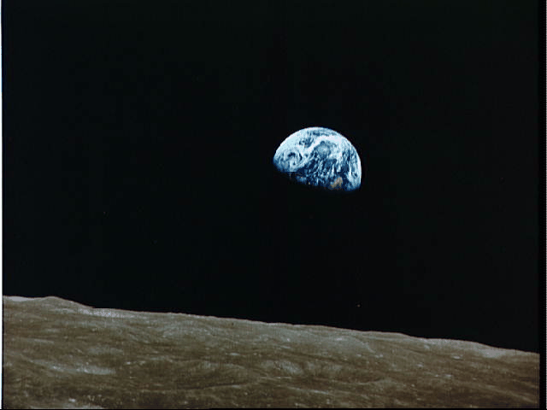
“Ete na kvuto hungan cho sana hoji esua do dae, ete ntho kako Hungthuk ji lo na emhokthao ochu echie ji jancho.
Ete na yithak ko jiang lona zae zeta na Potsow ochumünli Phyochak osi Motsü jiang topvu rümto ochum echai lani yian na
Nto phyochak cho sana jiang topvu benkhan thaka.
JISU
EKUM
Donphen
Khumphen ki
Yithen Mhon
ELHI
CHITI
Ovungthung na kvuto Potsow tona ombo Oshum, ABRAHAM do engathae cho sa no ho ji benthaka."
Hungthuk
John Walvoord
Okhekako pg. 39-41
58
3
© 2006 TBBMI
PHOTO ©NASA
8.0.03f.
Notes:
About the Revelation, the beloved late theologian, John Walvoord wrote this: "Such is the scenario as the Bible reaches its glorious conclusion in the Book of the Revelation.
//// There, in the millennial context, all the many streams of history and God's unconditional covenants flow together toward completion.
//// All that was promised has been fulfilled.
//// That ancient understanding between God and his friend, ABRAHAM, is accomplished."

Slide 60

Abraham Ntsata
(“Etsa Ji”)
Benkaden 12:1-3
JISU
LIKO
MOJU
MMHA
EKUM
Donphen
Khumphen ki
Yithen Mhon
ELHI
LIKO
Davidic
Ethan
CHITI
Hungthuk
Shikhfü Enioto
30:1-10
2 Samuel
7:4-16
Jeremiah
31:31-33
Okhekako pg. 39-41
59
Notes:
And so…THE ABRAHAMIC COVENANT progresses with fulfillment of the LAND, SEED, and BLESSING promises:

Slide 61
Abraham Ntsata
(“Etsa Ji”)
Benkaden 12:1-3
JISU
LIKO
MOJU
MMHA
EKUM
Donphen
Khumphen ki
Yithen Mhon
ELHI
LIKO
Davidic
Ethan
CHITI
Hungthuk
Shikhfu Enioto
30:1-10
2 Samuel
7:4-16
Jeremiah
31:31-33
Okhekako pg. 39-41
60
Notes:
In that millennial context,
Israel is seen permanently settled in The LAND for all time-
and so completing the LAND COVENANT;

Slide 62
Abraham Ntsata
(“Etsa Ji”)
Benkaden 12:1-3
JISU
LIKO
MOJU
MMHA
EKUM
Donphen
Khumphen ki
Yithen Mhon
ELHI
LIKO
Davidic
Ethan
CHITI
Hungthuk
Shikhfu Enioto
30:1-10
2 Samuel
7:4-16
Jeremiah
31:31-33
Okhekako pg. 39-41
61
Notes:
JESUS CHRIST, the righteous SEED of DAVID, is seen reigning permanently on the Throne of DAVID in Jerusalem — completing the DAVIDIC COVENANT; and

Slide 63
Abraham Ntsata
(“Etsa Ji”)
Benkaden 12:1-3
JISU
LIKO
MOJÜ
MMHA
EKUM
Donphen
Khumphen ki
Yithen Mhon
ELHI
Liko
Davidic
Ethan
CHITI
Hungthuk
Shikhfu Enioto
30:1-10
2 Samuel
7:4-16
Jeremiah
31:31-33
Okhekako pg. 39-41
62
1
Notes:
All men are seen living in the light of the BLESSING that emerges from this future time when, once again, Our Lord is living upon the earth — thus completing THE NEW COVENANT.
//// Bringing completion to every element of the great Abrahamic Promises of Genesis 12:1-3...that contractual arrangement between God and Abraham that laid the ancient groundwork for the appearance and ministry of the Lord Jesus Christ.

Slide 64
Abraham Ntsata
LYUYINGO
(“Etsa Ji”)
ABRAHAM
JOSEPH
Benkaden 12:1-3
MOSES
JOSHUA
Tssolup phyolup
Roza Pfüchi
RHUMAE EVAN
JISU
LIKO
MOJU
MMHA
EKUM
Donphen
YING YING
Khumphen ki
Yithen Mhon
JISU
ELHI
LIKO
Davidic
Ethan
CHITI
Hungthuk
Shikhfu Enioto
30:1-10
2 Samuel
7:4-16
Jeremiah
31:31-33
Okhekako pg. 39-41
63
1
Notes:
So…into your mental JESUS file now go all things connected with the Christian life, all of your studies, all of your reading, thinking, prayer life, and life's experiences as you grow and mature in your faith.
Here is the organized location for all those great persons of the New Testament, for the incomparable events of the Savior's life, and for the founding and expanding of His CHURCH.
//// An absolute core realization from the JESUS file is this: connectedness and outgrowth from ALL THE OTHER FILES that have preceded it. Scripture is a unity –– a grand program is seen in operation. With a comprehension of that unity there follows a personal and spiritual connection for every one of us to all that has gone before ––– and all that will come after.

Slide 65
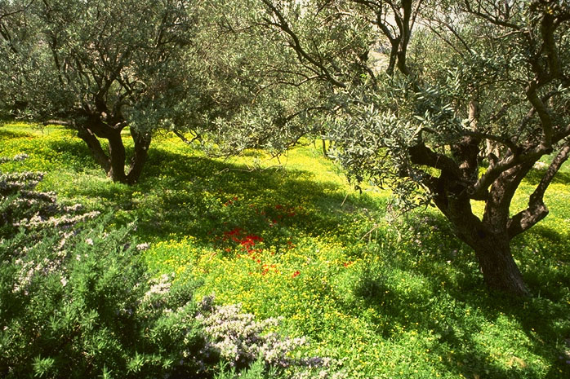
Kuma Kvüto la ?
JISU
EKUM
Donphen
Khumphen ki
Yithen Mhon
ELHI
CHITI
Hungthuk
Gethsemane Phari,
Mount Olives, Jerusalem
64
1
Notes:
As we look at these ancient olive trees in the place where Christ gave his impassioned prayer of relinquishment…we can boil it all down to a set of simple statements. Beginning with a…
//// …crucial question: a big SO WHAT? What is the meaning of all this in the life of plain people…not the theologians…not the historians…but the people…those all around us on all sides?

Slide 66
“…Jilo na Benkae Jisu ma heto püngnov benka cho: Nte mmen jiang lona kjhopitava, ntiotsole Potsow ekhüngyan ji enhyabnthaka.. Jisu na meta topvulo owo sSynagogue jiang lona onte shiuka osi Potsow ekhungyan tsukona yithenmmhom ji püngno cho…' Mat. 4:17, 23
JISU
EKUM
Donphen
Khumphen ki
Yithen Mhon
ELHI
CHITI
Hungthuk
65
Notes:
What was Jesus saying to us? In Matthew's fourth chapter, we are told that “Jesus began to preach and say: 'Repent, for the kingdom of heaven is at hand…Jesus was going throughout all Galilee, teaching in their synagogues and proclaiming the gospel of the Kingdom…'”
What is that Kingdom? What did he mean?

Slide 67
“Ji thüngina jo, ekhüngyan tona ombo ntsantho to yandentave, tona shiang hetopvü nte echi tssov .”
Mat. 6:33
JISU
EKUM
Donphen
Khumphen ki
Yithen Mhon
ELHI
CHITI
Hungthuk
66
Notes:
Two chapters later, Matthew reports Jesus saying, “But seek first His Kingdom and His righteousness, and all these things will be added to you.”

Slide 68
“Ombona emüng metae na e shanchoe ombo tsoe ji ekhüngyani e vanthokcho.”
Kol. 1:13
JISU
EKUM
Donphen
Khumphen ki
Yithen Mhon
ELHI
CHITI
Hungthuk
67
Notes:
Paul then writes in his Colossian letter: “For He has rescued us from the domain of darkness, and transferred us to the kingdom of His beloved Son.”
This Kingdom…where is that and how do we get there?

Slide 69
Olan eni Potsow yi ji lo na ete topvu e ezoan mo ji jo :
#1: Mungyanchi & Etsüka Potsow Pvütson Ji
JISU
EKUM
Donphen
Khumphen ki
Yithen Mhon
ELHI
#2: Olan a so la Potsow Ekhüngyani Ji
CHITI
Hungthuk
68
2
Notes:
We are instructed by two overarching messages of Scripture…first
//// the message of the Book portrays for us in words we can clearly strive to comprehend, celebrate and demonstrate “THE GLORY OF GOD!”
//// Upon our understanding and upon our surrendering to the leadership of the Holy Spirit…we are lead steadily toward the Kingdom of God…which is simply regaining that close and intimate relationship that was surrendered by our original parents in that ancient Garden.

Slide 70
JISU na moni evanmo jiang shancholo rocho…kumali ochun unil ekum pi tsukona, hoji tsukona ete na Potsow yi ji khichoe shikvu
JISU
EKUM
Donphen
Khumphen ki
Yithen Mhon
ELHI
CHITI
Hungthuk
HOJI TSUKONA: ETE NA OWO POTSOW YI JE EZOA !
69
1
Notes:
Scripture says flatly that…
Jesus Christ came to save that which was lost…and that to acquire eternal life, one must come to it through belief in the gospel message of the Messiah.
If we believe…if we truly believe the words of our Book…then our commission is very simple:
//// WE MUST GO AND TELL! We must be willing to share our faith with others, to offer to them the assurance of the life everlasting that, if believers, we hold ourselves. NOT TO DO THAT is to disobey and disregard the clear command of Our Lord as He left his disciples for His heavenly throne…leaving his blessing “to all families of the earth” just as had been promised to old Abraham 2,000 years earlier.

Slide 71



7
Benkaden through Hungthuk
LYUYINGO
Tssolup phyolup
Epoe osi Eloe ovungo ji
Judges
Mmen ovungo ji
350
C
Motsu Mmhon ovungo ji
350
Wopan ovungo ji
(1000 B.C.)
Tatsung Nungtsung Ovungo ji
Roza Pfüchi
(1000 B.C.)
Jüvaktsü/süngrüka
S - D - S
DC
••• chesu cho •••
DC
Babel Vanjüng
North South
(2000 B.C.)
ABRAHAM
(2000 B.C.)
Israel
Judah
AC
10 2
OKHO ETHUM
NC
L 7 Y J
Etsa Ji
AC
THE PROPHETS
DC
L - M - M
20-J 20-R
…
I - I
200 350
J - E
Assyria Babylon
12
RHUMAE EVAN
7 = 4 + 3
JOSEPH
Unzyu 70
JISU
Ezu
Olan 3
EKUM
430
100 Years / 50,000
Donphen
KYONG MEZU
100 Years / 50,000
Khumphen ki
Z - E - N
Yithen Mhon
(1500 B.C.)
ELHI
MOSES
(1500 B.C.)
(500 B.C.)
CHITI
Y
S
YING YING
(500 B.C.)
Hungthuk
khochuk
Alex the Greek
Sinai
Roman shikvu
M - C - C
Kadesh Barnea
LC
JISU
40
LC
EKHA KAKO#04 & #31
40
EKUM
5 Sermons
J
Donphen
JOSHUA
Khumphen ki
Yithen Mhon
Jericho/Ai
ELHI
LIKO JANTACHO
CHITI
HUNGTHUK
70
19
Notes:
Now...to sum up...on Study Helps Number 4 and 31…
The bare skeleton of your entire Bible is now revealed in a digestible form…arranged here as a mental filing system…awaiting only your own mental application, recall, and attention.
FIRST…
//// CREATION
//// 4 PEOPLE
//// 3 SOCIETIES
//// SILENCE
//// JESUS
SECOND… The names of ten Bible File folders…they are:
//// CREATION
//// ABRAHAM
//// JOSEPH
//// MOSES
//// JOSHUA
//// ANARCHY
//// ROYALTY
//// CAPTIVITY
//// SILENCE
//// and JESUS.
THIRD…with all these events bound together by the four unconditional covenants found in your own Bible!
//// THE ABRAHAMIC COVENANT of Genesis…
ITS AMPLIFIED SUBCOVENANTS:
//// THE LAND COVENANT of Deuteronomy…
//// THE DAVIDIC COVENANT of Second Samuel…
//// AND THE NEW COVENANT of Jeremiah.

Slide 72
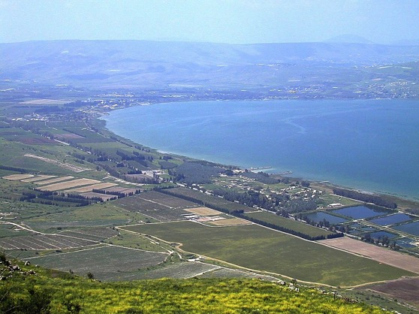


Benkaden Lona Hungthuk kako na Undang
7
LYUYINGO
Tssolup phyolup
Epoe osi Eloe ovungo ji
Judges
Mmen ovungo ji
350
Motsu Mmhon ovungo ji
350
Wopan ovungo ji
(1000 B.C.)
Tatsung Nungtsung Ovungo ji
Roza Pfüchi
(1000 B.C.)
Jüvaktsü/süngrüka
S - D - S
DC
••• chesu cho •••
DC
Babel Vanjüng
North South
(2000 B.C.)
ABRAHAM
(2000 B.C.)
Israel
Judah
AC
10 2
NC
Etsa Ji
AC
THE PROPHETS
DC
L - M - M
20-J 20-R
I - I
200 350
J - E
Assyria Babylon
12
RHUMAE EVAN
JOSEPH
70 Years
Ezu
3 Treks
430
100 Years / 50,000
100 Years / 50,000
Z - E - N
(1500 B.C.)
MOSES
(1500 B.C.)
(500 B.C.)
YING YING
(500 B.C.)
khochuk
Alex the Greek
Sinai
Roman Systems
M - C - C
Kadesh Barnea
LC
JISU
40
LC
40
EKUM
5 Sermons
Donphen
JOSHUA
Khumphen ki
Yithen Mhon
Jericho/Ai
ELHI
LIKO Jantacho
CHITI
Hungthuk
71
Notes:
All of it culminating…REACHING ITS CAPSTONE…in the life and gospel ministry of the Lord Jesus Christ in ancient Israel.

Slide 73


7
Ete na Israel osu duk ki leo he lo na ejukae zeta ka.
Ekha Kako Zeta#08
72
2
Notes:
One final illustration...Study Help #8…its purpose to bind everything together and to provide a strong and sturdy intellectual basis for the credibility of our faith. Here is a loom…familiar to all of us. On it is a piece of woven cloth…from Israel, by the way.
//// What about this woven fabric from the Holy Land? It's a handy illustration. Just watch as we develop it.
//// As we know, weaving a cloth requires strings or threads going in one direction…then another set woven between them in a direction perpendicular to the first set.

Slide 74


Hi jo Israeli osi elum etho lua tuv duk ki vacho …
WEFT
(WOOF)
WARP
…nto na onte ji rum do rhumae vancho la ?
73
5
© 2006 TBBMI
8.0.03f.
Notes:
Here's a close-up of that same cloth.
//// Now think about this strong loom-woven Israeli cloth.
//// What is it that holds it together? What is it that allows us to stretch it and pull it...but yet the cloth remains in one secure piece?
//// Simply because there is a set of threads strung vertically and another set strung horizontally and locked together by each other! That's why!
//// The vertical threads…we call the WARP of the loom.
//// The horizontal set…called the WEFT…sometimes referred to as the WOOF. The WARP AND THE WEFT OF THE LOOM.

Slide 75


HUNGKUTA NE A OSI DUK KVU TSUKONA OYUNG ELONA LA
NTHO KAKO JIANG RONG ECHUMBO BITA KA
74
1
© 2006 TBBMI
8.0.03f.
Notes:
Now…imagine you are threading a loom on which to weave
a piece of work called
//// A FABRIC OF THE BIBLE'S CHRONOLOGY. The pegs are there…just waiting for you to do the weaving…the WARP and the WEFT.

Slide 76
HUNGKUTA NE A OSI DUK KVU TSUKONA OYUNG ELONA LA
NTHO KAKO JIANG RONG ECHUMBO BITA KA
75
© 2006 TBBMI
8.0.03f.
Notes:
So let's thread this loom and get ready to weave a MENTAL fabric of the Bible's great story!

Slide 77
HUNGKUTA NE A OSI DUK KVU TSUKONA OYUNG ELONA LA
10
5
76
© 2006 TBBMI
8.0.03f.
Notes:
It will be a fabric of 15 threads in the WARP…TEN threads of one color, FIVE threads of a second color…with more colors yet to come!

Slide 78
HUNGKUTA NE A OSI DUK KVU TSUKONA OYUNG ELONA LA
LYUYINGO
ABRAHAM
JOSEPH
MOSES
JOSHUA
Tssolup phyolup
Roza Pfüchi
RHUMAE EVAN
YING YING
JISU
OCHUM TSUNGON
ENHYANTHAKA
77
2
© 2006 TBBMI
8.0.03f.
Notes:
Like this one. Keep an eye on it. Its thread color stands out from all the rest!
//// The first ten threads will represent the ten words of the BIBLE FILE: representing CREATION, ABRAHAM, JOSEPH, MOSES, JOSHUA, ANARCHY, ROYALTY, CAPTIVITY, SILENCE, and JESUS.
//// While the final five threads represent that future time when world history will be concluded…many believers call it THE END TIMES.

Slide 79
NTHO KAKO JIANG RONG ECHUMBO BITA KA
7
L 7 Y J
4P
3S
J
L
A
J
M
J
T
R
R
Y
LYUYINGO
ABRAHAM
JOSEPH
MOSES
JOSHUA
Tssolup phyolup
Roza Pfüchi
RHUMAE EVAN
YING YING
JISU
78
4
© 2006 TBBMI
8.0.03f.
Notes:
First let's develop the ten threads on the left…there is the familiar 7 with the dash through the stem…
//// And there you see the C-7-S-J idea…
//// …then the 4 PEOPLE and 3 SOCIETIES…
//// ….single letters representing the first nine BIBLE FILE FOLDERS…CREATION through SILENCE…
//// …with the final J for JESUS.

Slide 80
NTHO KAKO JIANG RONG ECHUMBO BITA KA
7
L 7 Y J
4P
3S
J
L
A
J
M
J
T
R
R
Y
79
© 2006 TBBMI
8.0.03f.
Notes:
Next…just for a moment we will remove three of the threads…then replace them…as you'll see…right now.

Slide 81
NTHO KAKO JIANG RONG ECHUMBO BITA KA
7
L 7 Y J
4P
3S
J
L
A
J
M
J
T
R
R
Y
ABRAHAMIC PHYOCHAK
Benkaden 12 & 15
80
2
© 2006 TBBMI
8.0.03f.
Notes:
Into the WEFT of the loom – horizontally through the vertical threads – we'll weave a wide, sturdy cloth band.
//// We'll label it: THE ABRAHAMIC COVENANT.
//// Weaving it in at the ABRAHAM thread…just as we find it Biblically at Genesis 12 and 15.

Slide 82
NTHO KAKO JIANG RONG ECHUMBO BITA KA
7
L 7 Y J
4P
3S
J
L
A
J
M
J
T
R
R
Y
ABRAHAMIC PHYOCHAK
LIKO PHYOCHAK
Shikhfu Enioto 30
81
2
© 2006 TBBMI
8.0.03f.
Notes:
Next, at the MOSES thread, we weave in another band…
//// This is the LAND COVENANT band at the MOSES thread...
//// …we know now that that arrangement is found in Deuteronomy 30.

Slide 83
NTHO KAKO JIANG RONG ECHUMBO BITA KA
7
L 7 Y J
4P
3S
J
L
A
J
M
J
T
R
R
Y
ABRAHAMIC PHYOCHAK
LIKO PHYOCHAK
DAVIDIC PHYOCHAK
2 SAMUEL 7
82
2
© 2006 TBBMI
8.0.03f.
Notes:
Followed in order, at the ROYALTY THREAD…
//// …by the DAVIDIC COVENANT…
//// …with its Biblical reference at 2 Samuel 7.

Slide 84
NTHO KAKO JIANG RONG ECHUMBO BITA KA
7
L 7 Y J
4P
3S
J
L
A
J
M
J
T
R
R
Y
ABRAHAMIC PHYOCHAK
LIKO PHYOCHAK
DAVIDIC PHYOCHAK
Ethan PHYOCHAK
JEREMIAH 31
83
3
© 2006 TBBMI
8.0.03f.
Notes:
And finally…still at the ROYALTY thread of the loom, we weave in
//// …the NEW COVENANT…
//// …found in the 31st chapter of the prophet Jeremiah. It is clear that both the DAVIDIC AND NEW COVENANT bands are woven into the fabric at the same crossing point…
//// …of the ROYALTY thread. Taken together, we can see that the four covenant bands of the fabric illustrate how the covenant promises of the Old Testament become the historic engines that drive the progress of every Biblical event, setting the stage for the appearance of the Lord Jesus Christ. You can see that the thick covenant bands continue to run through the fabric beyond that JESUS thread.
Why? Because, from the time of Abraham right on up to, through and beyond this moment of our own lives those promises continue in effect. THEY WILL COME TO PASS IN COMPLETE FULFILLMENT! Much more on this later.

Slide 85
NTHO KAKO JIANG RONG ECHUMBO BITA KA
7
L 7 Y J
EARTHLY REIGN OF CHRIST
4P
3S
MARRIAGE SUPPER
OF THE LAMB
Ethan HEAVEN, Ethan EARTH
GREAT WHITE THRONE
JUDGMENT
J
THE SECOND COMING
L
A
J
M
J
T
R
R
Y
ABRAHAMIC PHYOCHAK
OCHUM TSUNGON
ENHYANTHAKA
LIKO PHYOCHAK
DAVIDIC PHYOCHAK
Ethan PHYOCHAK
84
5
© 2006 TBBMI
8.0.03f.
Notes:
Now…about THE END TIMES. There are widely varying views of that end-time scenario...but the order of events shown here in THE BIBLE...BASICALLY is generally agreed upon by a vast majority of Christian believers, teachers and scholars. They are reported in the final chapters of The Revelation to the Apostle John in the New Testament.
Those five threads of the fabric…the END TIMES…beyond the JESUS thread…are labeled in order…
//// THE MARRIAGE SUPPER OF THE LAMB…
//// THE SECOND COMING OF OUR LORD…
//// THE THOUSAND YEAR REIGN OF CHRIST…
//// THE GREAT WHITE THRONE JUDGMENT…
//// AND FINALLY…THE NEW HEAVEN AND THE NEW EARTH.

Slide 86
NTHO KAKO JIANG RONG ECHUMBO BITA KA
7
L 7 Y J
EARTHLY REIGN OF CHRIST
4P
3S
MARRIAGE SUPPER OF
THE LAMB
Ethan HEAVEN, Ethan EARTH
GREAT WHITE THRONE
JUDGMENT
J
THE SECOND COMING
L
A
J
M
J
T
R
R
Y
?
ABRAHAMIC PHYOCHAK
HE LO UNTO SANA TSOAN NA!
LIKO PHYOCHAK
DAVIDIC PHYOCHAK
Ethan PHYOCHAK
85
3
© 2006 TBBMI
8.0.03f.
Notes:
Each of those covenants then...being LITERAL, ETERNAL AND UNCONDITIONAL…are running at this very moment...and will continue to do so until earth history is concluded...until after the END TIME events….
//// …when they will be finished...and the fabric of the chronology stitched up and completed.
//// The NEW HEAVEN AND THE NEW EARTH will then begin.
And THAT is something about which we know very little. Which is probably a good thing…else we would be more captivated by – and curious about -- the life ahead than the life we live here on Earth…while carrying out our own assignment to spread the Gospel of the Lord Jesus Christ to the very ends of the earth!
//// But what is very clear is this: SOMETHING IS GOING ON HERE. Seen in the context of Biblical chronology, backed by the four foundational covenants or legal agreements between God and man…THERE IS A PROGRAM AT WORK HERE…a program in which each of us has his own particular assignment.

Slide 87
NTHO KAKO JIANG RONG ECHUMBO BITA KA
7
L 7 Y J
EARTHLY REIGN OF CHRIST
4P
3S
MARRIAGE SUPPER OF
THE LAMB
Ethan HEAVEN, Ethan EARTH
GREAT WHITE THRONE
JUDGMENT
J
THE SECOND COMING
L
A
J
M
J
A
R
C
S
ABRAHAMIC PHYOCHAK
LIKO PHYOCHAK
NTO LUE
DAVIDIC PHYOCHAK
Ethan PHYOCHAK
NTO LA
86
1
© 2006 TBBMI
8.0.03f.
Notes:
So then…the vertical threads of this loom illustrate in order THE WHAT of the Biblical Chronology...the TEN WORDS of the Bible File At the same time…
//// …the horizontal threads put in place the WHY of that chronology. The WHAT and the WHY give an enormous boost to the credibility of the Biblical record…and our witness to others about it!

Slide 88
NTHO KAKO JIANG RONG ECHUMBO BITA KA
7
L 7 Y J
EARTHLY REIGN OF CHRIST
4P
3S
MARRIAGE SUPPER OF
THE LAMB
Ethan HEAVEN, Ethan EARTH
GREAT WHITE THRONE
JUDGMENT
J
THE SECOND COMING
C
A
J
M
J
T
R
R
Y
ABRAHAMIC PHYOCHAK
wARP
LIKO PHYOCHAK
DAVIDIC PHYOCHAK
Ethan PHYOCHAK
WEFT
© 2006 TBBMI
87
1
Notes:
So the WARP…
//// …and the WEFT…come together to build your mental fabric of the Bible's chronology. Which means…

Slide 89
NTHO KAKO JIANG RONG ECHUMBO BITA KA
7
L 7 Y J
EARTHLY REIGN OF CHRIST
4P
3S
MARRIAGE SUPPER
OF THE LAMB
Ethan HEAVEN, Ethan EARTH
GREAT WHITE THRONE
JUDGMENT
J
THE SECOND COMING
L
A
J
M
J
T
R
R
Y
ABRAHAMIC PHYOCHAK
WARP
LIKO PHYOCHAK
DAVIDIC PHYOCHAK
Ethan PHYOCHAK
WEFT
88
© 2006 TBBMI
8.0.03f.
Notes:
….that every time you see a piece of cloth…you are reminded that the cloth is hard to tear apart because it is woven of the threads of the WARP and WEFT.
In that every same way…in our minds…when we weave together the WHAT of the chronological events…even in their briefest form…together with the WHY…the unconditional covenants…your faith in the credibility of scripture will be enormously enhanced!
Your witness before others will be made unassailable! We have woven a strong and sturdy view of history and the credibility of Scripture…a view not easily torn apart by doubt and uncertainty …by those arrows and spears of doubt and uncertainty which the world and the enemy of our souls is certain to throw into the belief systems of us all. Now we can see…

Slide 90
NTHO KAKO JIANG RONG ECHUMBO BITA KA
7
L 7 Y J
EARTHLY REIGN OF CHRIST
4P
3S
MARRIAGE SUPPER
OF THE LAMB
Ethan HEAVEN, Ethan EARTH
GREAT WHITE THRONE
JUDGMENT
J
THE SECOND COMING
L
A
J
M
J
A
R
C
S
ABRAHAMIC ETUM EZU JI OVUNGI YIAN NA
ABRAHAMIC PHYOCHAK
WARP
LIKO PHYOCHAK
DAVIDIC PHYOCHAK
Ekha Kako Zeta#08
Ethan PHYOCHAK
WEFT
89
© 2006 TBBMI
8.0.03f.
Notes:
//// THE GREAT PLAN OF THE AGES IS MOVING FORWARD! THERE IS MEANING TO THE PLAN -- EACH OF US HAS A UNIQUE AND PARTICULAR ROLE TO PLAY AS THAT GREAT PLAN IS REALIZED! But always bear in mind the central message of the chronology…a program is at work…THE GREAT PLAN OF THE AGES. Its capstone is the timeless gospel ministry and message of the Lord Jesus Christ…backed by His marching orders to us…to take His Gospel to every corner of the earth!

Slide 91


ROA, OPVU JISU!
THE BASIC DOCUMENT OF OUR FAITH!
90
1
Notes:
Ω9.65.03F.90 [1] (ANIMATED BEADS REASSEMBLE)
And here again is Our Book...THE BASIC DOCUMENT OF OUR FAITH…with all of its scattered parts coming together with new meaning and continuity. We have suggested a limited number of events, a limited number of people and verses, few dates, each person, place, and event seen in its proper relationship to every other event or action on the great planetary stage.
Here forming before us…that string of Henrietta's pearls now complete…a coherent view of the marvelous, redemptive story line of Scripture, perhaps for you a new view of the Bible's timeless message of faith, hope and promise…a message from the Father that stretches with continuity and logic from Genesis all the way through to the Revelation. And there, in that grand letter to the seven churches…and to us… it closes with a heartfelt appeal…
//// “Come, Lord Jesus!” We join that request…
YES, LORD JESUS….COME QUICKLY!

Slide 92


EKHA KAKO#09
HE JO EKYOLOKA NTO TSO CHO SANA JIANG ZEAPHEN
91
Notes:
Finally…to further help you…Study Help #9 provides a useful set of flash cards to cut apart and use to master the chronological event sequences of THE QUICK CHRONOLOGY.

Slide 93

Enhungo ne na Ete Bible Elaroe na ji ni Kichuk ji vae lea.
• Ne Kichuk ke lea“Ntho kako Kako”
• Hoji chongchi tsukona ünchuma “Ntho kako Kako”…L 7 Y J
•Kichuk ki vata nto nto opvü tso cho sa na ete Ntho kaka ji lo
•Ntho kako “MOTSÜ” Opvu: “Ekhyolaka zeaphen ”
• YICHAK
• EDÜM EZI
• DÜMKA ZUKA
• POHYOCHAK
92
4
Notes:
Now…by this time in the study…you have the idea called THE BIBLE FILE…THE MENTAL KEY TO OPEN IT…THE ABILITY TO MAKE YOUR OWN MAP OF THE MIDDLE EAST FROM MEMORY…AND NOW…THE BIBLE'S STORY CORE… “THE QUICK CHRONOLOGY.”
Next we will answer the question: what holds all this together with meaning and purpose across more than 4,000 years? Because…
//// …There is meaning…
//// …there is a reason…
//// …there is a purpose…
//// …there is assurance…in every word, verse, chapter and book of Scripture in its full context! And we find it all in the ministry of the Lord Jesus Christ backed by the unconditional covenant agreements between God and man. What an adventure!
Now…we move on to study more and to dig in deeper!

Slide 94
Lotha
ETE BIBLE…
ELAROENA
Designed by Dr. John Fryman, Texas, USA • BibleBasically.org
Taught by Dr. Rick Griffith, Singapore Bible College
All files in many languages for free download at BibleStudyDownloads.org
©2004 TBBMI
9.65.01.
01

Slide 95


Ete Bible elaroe na ji helona hung BibleStudyDownloads.org
Ne na hi kako ji kya man hungka !
Notes:
The Bible…Basically (bb)

Slide 96
94
©2006 TBBMI
9.65.03f.

