Slide 1


Baibal… Kabiswmei
©2006 TBBMI
Kasiamhloumei rui Dr. John Fryman, Texas, USA
Nchamloumei rui Dr. Rick Griffith, Singapore Bible College
Lat bai-baihmei swna BibleStudyDownloads.org khou rui nsaa latow puni

Slide 2

“...kaganv tei guang pukhou...”
Gal. 4:4
Gandaih Abraham khou latryan swloumei khou rui tingkwm 2,000 tangv…
JISU
2,000 years after God's Promise to old Abraham…
DAMHMEI
ABRAHAM
ABRAHAM
ABRAHAM
JOSEPH
ABRAHAM
MOUSI
JOSHUA
KAGUAKCMEI
RINGHPOUC TUANG CHAMRAENG THANH GUANGTANGHMEI!
GUANGHDIC
NYMLOUMEI
JISU
KARIMMEI
JISU
Baansinbuk kadip 39-41
01
3
Notes:
LIANVLOUMEI LIPH KHOU NTHEIHLOUMEI LAT RIANG TEI THAYLOUO! BAIBAL MAENG TEI THUIPAT LANA KATHEI KHOU NAIMEI LAT RIANG TEI HANLOU O. KALIPH PAENG KHOU Gandaih Abraham khou latrianv swloumei khou rui tingkwm 2,000 tangv twna HYLOU BAMMEI TEI THE.
Gandaih Abraham khou latryan swloumei khou rui tingkwm chingnei tangv…
//// …Damhmeipu rui machakloumei ganv Baibal tuang ruanvry khou karucsinghmei ganv khou tatgut bam the. Miganv hei Pu rui Kanac mpouh ta Kandih khou Gaychamv tiphungc guanglou khang charaphmei ganv kiu the twna riatloumei ganv tei khwan e…
//// …Baibal tuang daickanmei paryluanv khou, BAIBAL KHUKH khou ruhmei khatni nkhamhmei thuaph hei rui aniu rui taanvlou kanmei kaguai tei guang kaduailoupui bamv e.
Patkanmei ruanvry hei mibiak tatgut bam e…
//// …Manseina khang Ravguangc tuang chamraeng thanh guangtanghmei... Kaipouc Jisu Khrista guangmei…JISU tumei thuaph hei nai the. Aniu pupouc rui sw amaanlou kanmei Damcloumeipu lev bam tuanhmei, maniatmei riang tei Gaychamv paan rui, meicguaya rui tingsaeng khang latowdat nuh the. Kaipouc Jisu Khrista tuang Gaychamv rui Ringhbamv hei meic kathuicna khou tithaylou khang e.
Heitwnhei the kakiak guai tei Messia guangmei khou khatni Ravguangc tuang Chamraeng Thanh sinthauloumei khou guang kariuloumei hei –– Abraham khang tiloumei reynungc latrianv khou rui kahouh the.

Slide 3
7
Metthiu, Mark, Luk, Jahon
JISU
PANTY
KROS
PHUAMLING
JISU
ABRAHAM LATDYNG TUANG GIUGAMAKMEI LATRYAN NUNC!
KALUAIHNA…LATDWN SWMEI NADE…SAENGHMEI HAMH E.
Baansinbuk kadip 39-41
02
5
Notes:
Guloumeipu JISU puanc guangmei khou rui Latdyng Thanh hei laancpat the. Aniu rui kalam daickuna howmei hei
//// Tingkwm 2,000 huthangc giugamakna ABRAHAM khang tiloukanmei LATDYNG khou e. Lat thanv: aniu lung khou tukumhna mi tuang pat changh kanmei lam guai, taancnuhmei guai, nchamloumei guai...Kaipou lam khou thaynuhmei guaina hei kaduan naina lungning khou titatku, duanckulou kho cho?
//// Amuc rikho tumei thu, mituang kathaimei duanv hei kalam saengcna kathai khang HAMH E, tiki thaynuhmei khatni thay guangnimei lam duancthau khang kadwn swmei tei e. Kaluaihna tithay e, latdwn swmei nade…kalam saenghmei hamh e!
//// JISU twmei thuap tihei kalangv kathumh swpat nuh e:
• Katuang PANTY,
//// • Kamei rui KROS khou taancpatloumei khatni mituang thai
//// • Kathancmei thayngam makmei ringhmei pumc nai guangmei, PHUAMLING twmei hei e.

Slide 4
7
Metthiu, Mark, Luk, Jahon
JISU
LIFE
PHUAMLING
• Alauc panty:“Galilimei” the
• 1mei JERUSALEM Duanv
• GALILEE guang lunghmei
• CAPERNAUM Taanvbamv
• PEREAMEI Duanv
• Nkhamhmei JERUSALEM Duanv
JISU
Panty
Baansinbuk kadip 39-41
03
6
Notes:
Katuang PANTY lam khou: Aniw ta makumh nkhavlou khang Poubauhmei PANTY tihei kalangv heikumcna tipat nuh e:
//// Alauc panty, “Galilimei” swna puanclou, daicthau e,
//// Katuang reymei Jerusalem duanv,
//// Kamei dihpy biak nganghna Galili khou gutmei,
//// Katuang saengc kanmei Galili duanv Capernaum khou,
//// nduinamei Perea khou duanv, kumna nkhamhmei khou,
//// Kapanty tuang nkhamhmei kanitdak, kaneimei khatni nkhamhmei Jerusalem duanv.

Slide 5

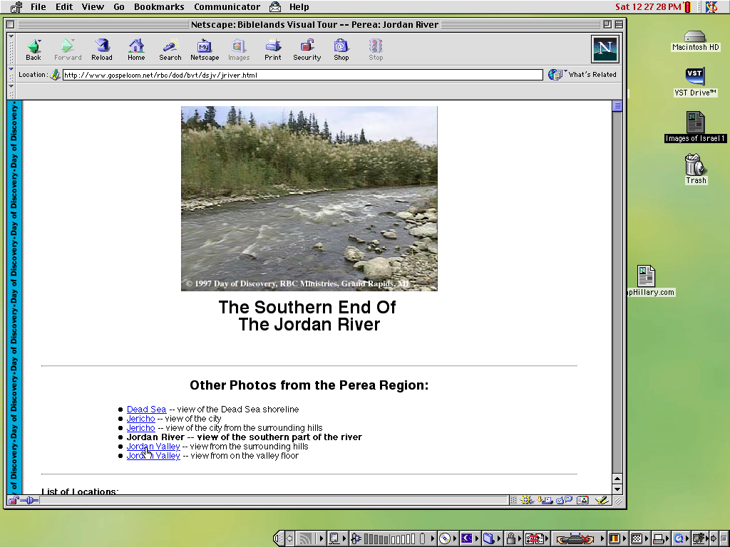

Met. 4:11-16
Bethlehem daeng khou lauziu gaenghmei
Capernaum daeng khou chingh phay
JISU
Panty
Jordan Duithuak karuc biak
Bethesda tuang zeic
Poubauhmei tuang neih-khat panty bamv...
Guloumei pu mik kahak rui how kanmei bamv nunc.
Baansinbuk kadip 39-41
04
Notes:
Poubauhmei panty chaengluanv tei kamei lungcloumei Dic khou e… Abraham khou nrianhloumei dic khou tei e. Mibamv guai hei kamik rui howkanmei bamv e! Ramhbamv lam thaymei hei kalam mpeyna duanc chuylou khang ngam naimei baansin akhat re twmei hei thayna taanbammei guai rui sakhi e. Mirui ningtow gay khang, machak chuy khang, nchamlou khang khatni sakhi khang kalam nunc hei chiwnana tiphanglou e. Poubauhmei mibamv nunc khou hei tatruanlou kan e.

Slide 6
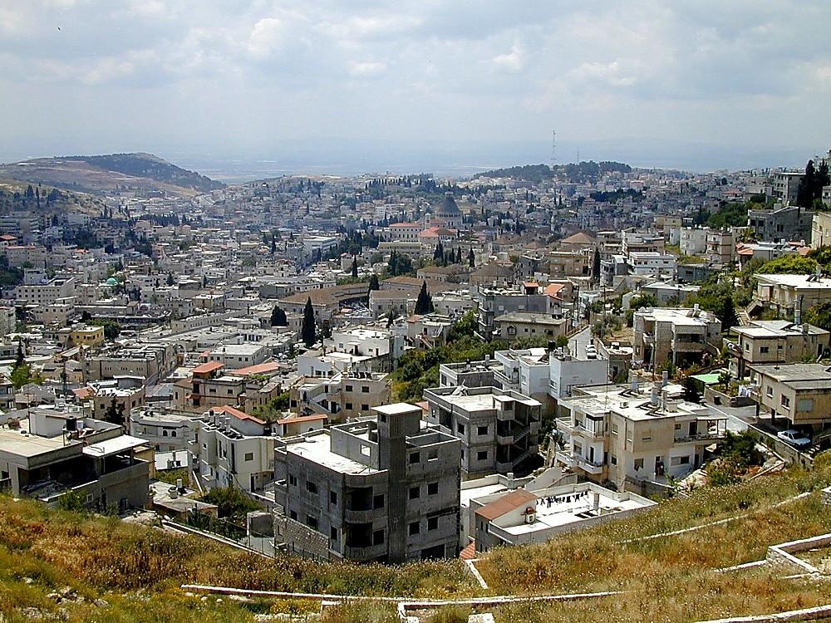
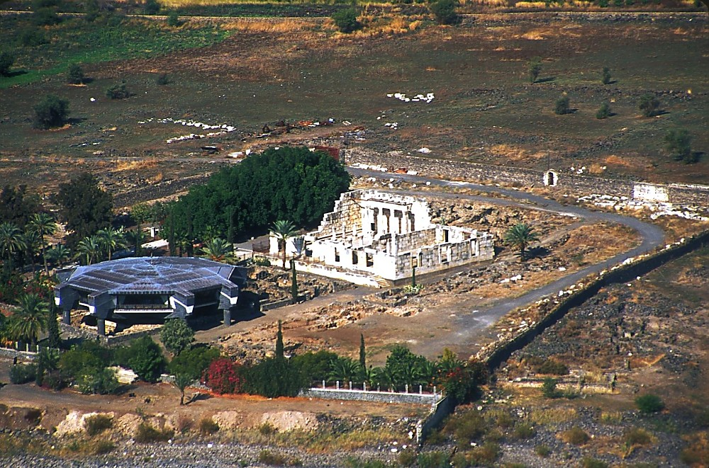

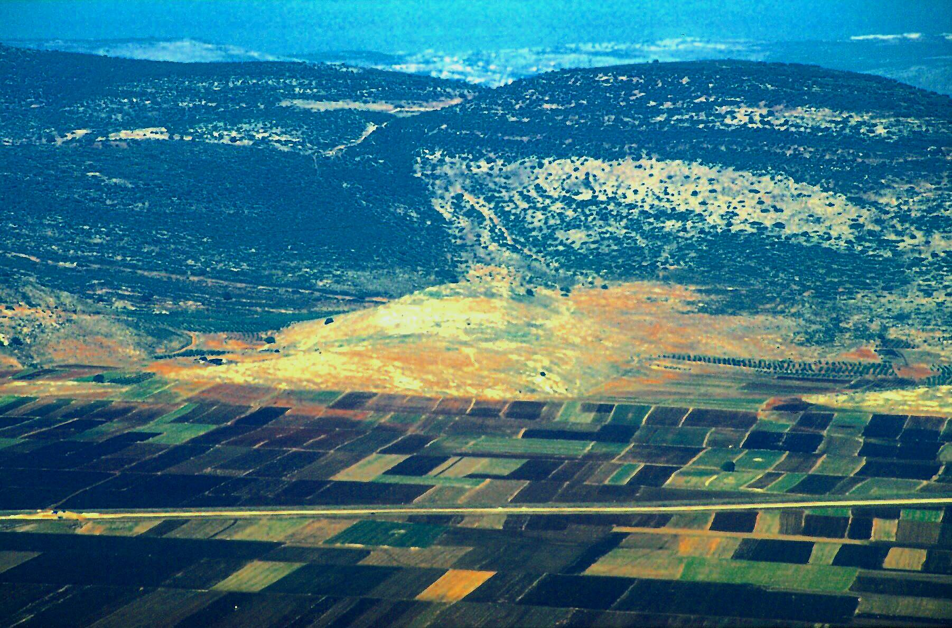
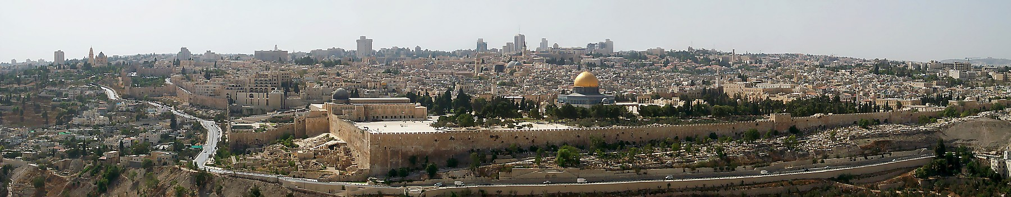
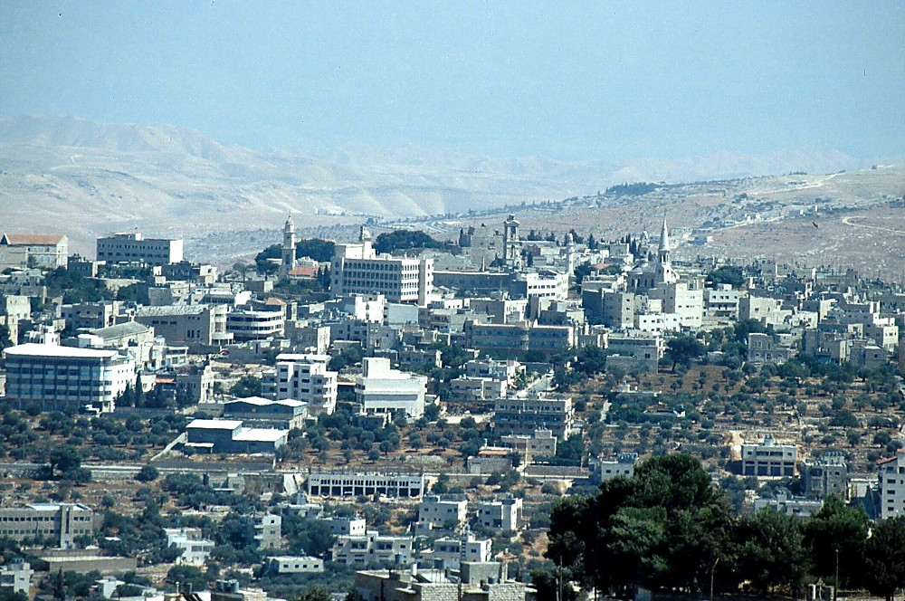
7
KATHAI NKHAVMEI #07
CAPERNAUM
JISU PANTY KHATNI KAMEI RUI KADAI SWNA TATLOU KANMEI BAMV CHANEI
NAZARETH
GALILI
CANA
JISU
Panty
JERUSALEM
BETHLEHEM
Baansinbuk kadip 39-41
05
6
Notes:
Kabamv lam thaymei hei nthukmei zaeng rui…Jisu rui Israel lungc khou tabui bui bamv tat ruanlou cho tumei zaucminc puni…kapanty tei kaduan naina lou nkhavmei hei aniu ningtow gay khang e.
Kabamv charuk hei ningtowlou khang nai the. Mikhou rui kahouh lakho …
//// Bethlehem hei, kata puancloupuibamv e, kaguangcmei David kaidai, Jerusalem dicba khou e;
//// Nazareth hei, kamei lungcdaicthaumei bamv e khatni katuang duanv kahouh reychuymei bamv e,
//// Capernaum hei, kaduanv geihmei taancpatlou duhmei bamv e…
//// kumlana, kiu the, Jerusalem hei, Jihudimei tuang Ravchap lam kathaimei khatni dic sinmei bamv, katuang ruanvry khatni chapriak bamv, Khristian swthaureymei khatni Phuamling lingcthauloureymei bamv e.
//// Ningtowlou o, Reyliangmei khou Jisu Khrista hei Galilimei e, Jerusalem khou rui lungcdaic thaumak bam sinih, kamei hei Galili tuang charuangcmei akhat re, Palestinmei, ramhthanh khatni ningting thanh lanimei khou kazanc tatmei ramc khou rui e.
//// Heitangv Cana naithe…Poubauhmei rui kaduanv “sihsingna” kahouhkanmei bamv e.

Slide 7
Jahon 2:1-11
JESUS
JISU
Panty
Jesus Traveled His Land:
Cana: Jisu tuang reyliangna hyloumei Charynmei taanv!
06
Notes:
Aseic Cana tuang nailouduhmei hei Israel tuang “tell,” tumei kaguangcmei puat phupatmei nunc rui gaeklou bammei luangcbut khou e – mikhou hei rey khou daicthaumei ganv azuh tei khat khat ruc khou cake tuang mathuan kumcna naibinna naibam e.

Slide 8
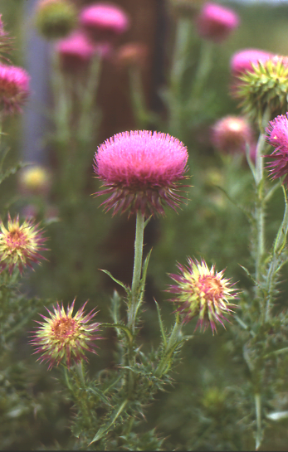
7
JISU
Panty
Sauhpuang lwn makumh kho...
Baansinbuk kadip 39-41
07
1
Notes:
Ntauthu…kabamv lam hei ningtowlana…sauh puang lwn hei makumhlou dat kho...ngguic sisimei khou kasau pitpatna nai e.
//// Mipuangv ruc khou tei mihei luicna hiaklou o...

Slide 9
7
Latdiu. 9:31
JISU
Panty
Sauhpuang luihmei Jisu Chaengluanv...
Baansinbuk kadip 39-41
08
1
Notes:
Ntau saucpuang khou rui hiakpatloumei maengc tei Reynungc Israel tuang dic hiak khou hiaklou tho – kabamv zanc nunc tei Messia lungcloumei Rommei ganv khou kawmei zanc nunc e.
//// JUDEA…SAMARIA…khatni GALILI. Heinunc hei tingkwm 2,000 huthangc Rom rui Palestin khou kadic khatni kalanv sinbin kanmei ramv nunc the.

Slide 10
7
Jahon 2:13-25
KATHAI NKHAVMEI #07
JISU
Panty
1. POUBAUHMEI TUANG
REYMEI
JERUSALEM
DUANV
Sauhpuangv luihmei Jisu Chaengluanv...
Baansinbuk kadip 39-41
09
1
Notes:
Kathai nkhavmei #7 hei sinlana, mituang zuanghmei sauc puang maengc daeng nkuaymei khou Jisu rui kapanty khou tatloukanmei chaengluanv nunc hiak keylou nuh the – kumna kapanty lam khou aniu rui thaylou kanmei khatni thayguangnimei ta makumh chuylou gay khang baansin akhat muai e.
//// Sauhpuangv bangbi khou tei rui kahouh tho, Jerusalem kaidai khou tei, Poubauhmei rui katuang duanv kahouhkanmei bamv e...Reymei Jerusalem Duanv twna kaw the.

Slide 11
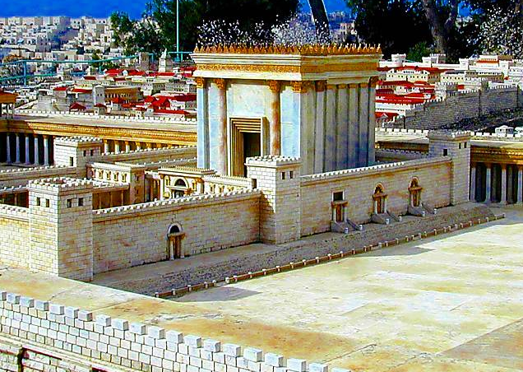
Jahon 2:13-25
7
JISU
Panty
Daihmei Herod tuang Jerusalem Ravkai
Baansinbuk kadip 39-41
10
Notes:
Miganv tuang panty tei akumhbucho? Mihei Daihmei Jerusalem Ravkai maeng e, Daihmei Herod rui kasiamhloumei e– khoutei dinhpouc Jisu, kamei rui, meic kangdai khou dinc ndauh kan e –– mihei tingkwm 1,000 huthangc Moria Luangcbut dwn Solomon Ravkai bamv khou e …Abraham rui kanac mpouh, Isaac ta, nringh kaipat swkhang katmei ganv khou Ringhpouc rui khaemloumei bamv Moriah Luangcbut tei muay e. Mituang kaibamv hei reynungc Israel khou ravchap-ravriak lam kathaimei khatni dihphunghmei lam guay naimei katwntuhmei bamv swguang kan e. Kaibamv tei lev kathei khou naimei kaidai tei zauc o...kumna nanglung khou phungc bam o...

Slide 12

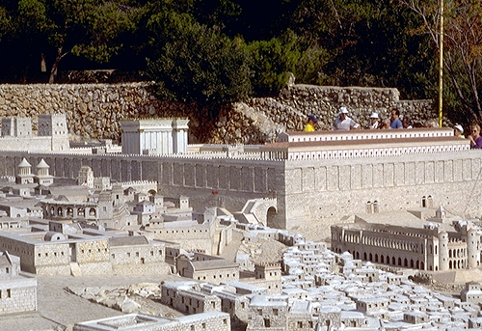
Jahon 2:13-25
JERUSALEM JISU GANV KHOU
JISU
Panty
Nai nkuaimei kaidai
Ravkai Chyngbut, Ravkai, Antonia Ricgaek kai
Kabamv maengc tiloumei: Holyland Hotel, Jerusalem
Baansinbuk kadip 39-41
11
Notes:
...charuangc thiak akumh... siandui nab-bi guangmei thiak akumh tumei rui kabi swna heikumhmei daickanmei Rakai bamv tihei makuatlouna taanv titaancpat kan e. Mihei rui reynungc Jerusalem tuang charuangc lam asaekc the –– Rommei tuang kauh kanmei thiamv khatni charuangc thiaknunc rui mitihei thuigancna lyn kan the.

Slide 13
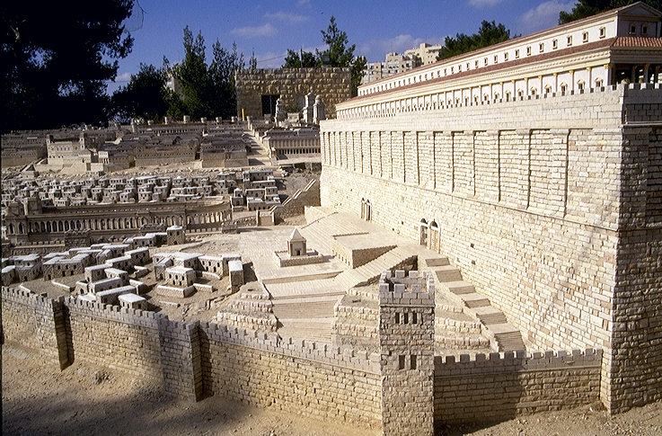

Mark 11:27
JERUSALEM JISU GANV KHOU
JISU
Panty
Ravkai Chyngbut tuang Dihba phaykhuat nunc
Neihpat Raengkat
Kabamv maengc tiloumei: Holyland Hotel, Jerusalem
Baansinbuk kadip 39-41
12
Notes:
Mituang makumc kathanc nunc tei rui Jisu tuang taancthau reymei duanv ta adang kan e. Katuang gaychamv tei Jerusalem khou rui tatpatna baihmei bamv dinc ndauh pukhou lalou chuy puni tumei kamei katumcna thaypat kan e tumei Gaychamv rui dinc e.

Slide 14
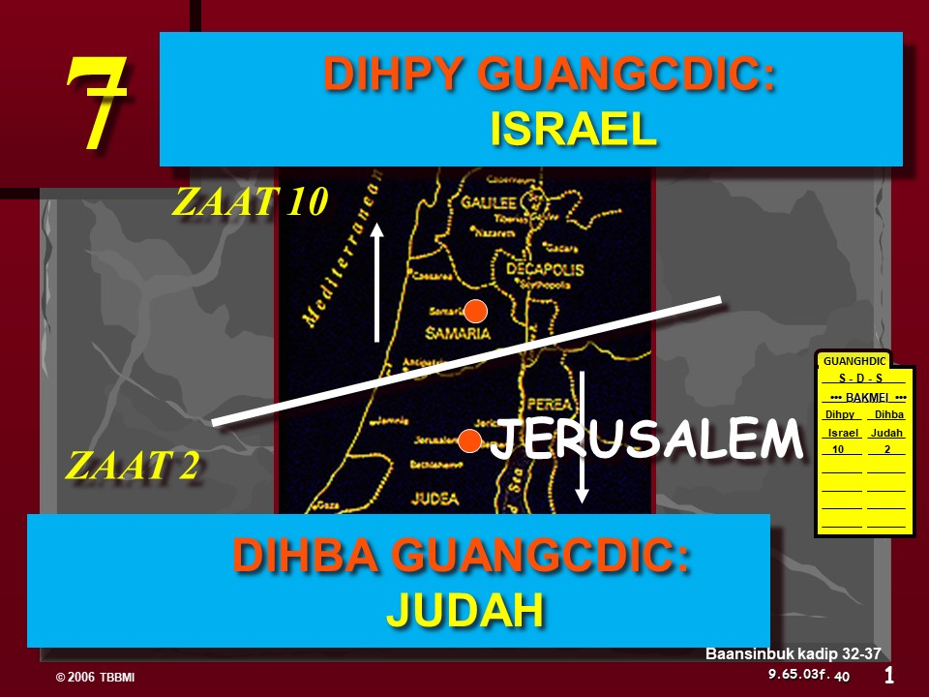
7
Jahon 4
2.SAMARIAMEI
CHAENG
JISU
Panty
1. KAIPOUC TUANG
REYMEI
JERUSALEM
DUANV
SHILOH: PHEYKAI
Sauhpuangv luihmei Jisu Chaengluanv...
Baansinbuk kadip 39-41
13
3
Notes:
Katuang duanv kathanc tei taancthaupuibamv swkhang dihpy biak tat nganghmei chaeng khou tei,
//// Judea tatkaan patna Jerusalem tuang dicpy Samaria twna kawmei bamv tat ruan kan e. Patkanmei ruanvry thei layna, tingkwm 1000 huthangc mibamv hei, Kadic bakmei ganv khou Solomon theickanmei tangv, Israelmei tuang Dihpy Guangcdic rui katuang kaidai lingcthaulou kanmei bamv e. Aniu rui GUANGHDIC tuloumei ganv tei e.
//// Israelmei KANDIC BAK KANMEI tangv Samaria ta ningtow dai?
Mihei "Poubauhmei tuang Samariamei chaeng" e khatni mibamv khou khou hei aniw thaychui bammei pary Poubauhmei rui Samariameipui akhat ta duikhun daeng khou kachuc kanmei bamv tei e.
//// Kamei Shiloh bamv daeng khou ni tat ana guanglou e – mikhou tei tingkwm ching mbu tangv Jerusalem khou Solomon tuang daihmei kathancmei Ravkai kasiamh thau mak khou Israelmei tuang kaguangcmei Pheykai nailou khwan e.

Slide 15
Met. 4:13-16; 9:1
3. GALILI DUANV
CAPERNAUM KHOU DUANV
2. SAMARIAMEI
CHAENG
JESUS
JISU
Panty
1. POUBAUHMEI TUANG REYMEI
JERUSALEM
DUANV
Sauhpuangv luihmei Jisu Chaengluanv...
Baansinbuk kadip 39-41
14
Notes:
Nkhamhliang khou howgay kanmei duigaymei Dihpy Galili ramv khou Poubauhmei guanglou khwan e, chamckanmei khav nymmei kailuangc Capernaum khou lungc nkhamh lou kan e…mitei Galili duitin khou e.

Slide 16
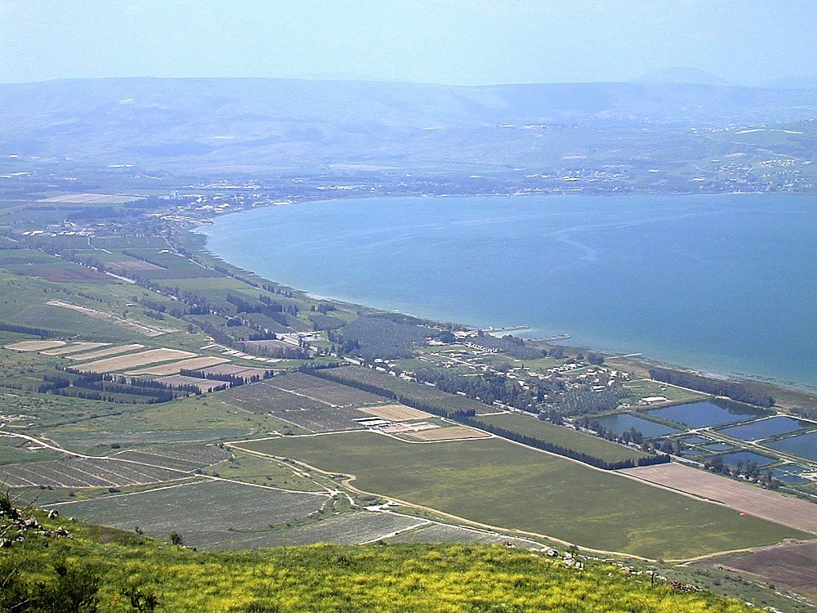
Capernaum: Duanv Taancpatpuibamv
JESUS
JISU
Panty
Jisu Kadic Tatruanlou Kan e:
Dihpy-neihkey Duitin, Galili Zeiclat
15
Notes:
Kamei Capernaum khou Simon Peter kai khou lungclou e twna nthanmei Latrik rui lianv e
Mihei aniu Capernaum daeng khou Galili Zeiclat tuang duitin khou dihpy-neihkey biak rui guang pukhou e…

Slide 17
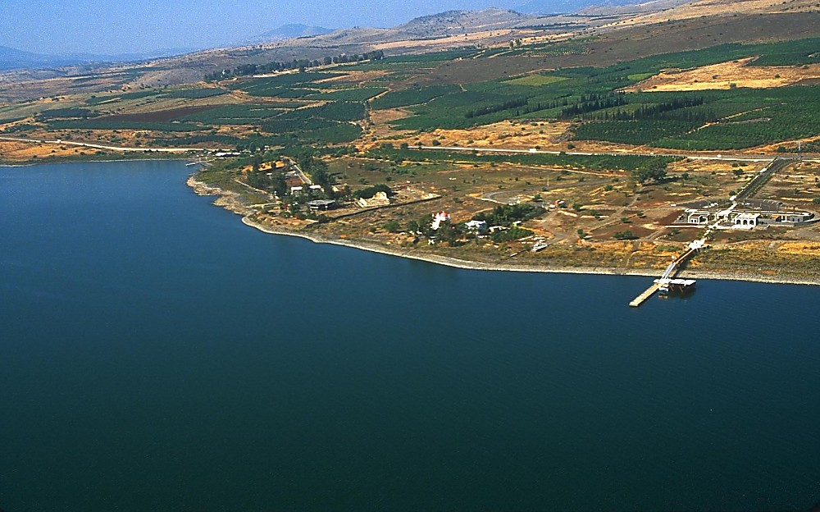
JESUS
JISU
Panty
Jisu Kadic Tatruanlou Kan e:
Capernaum daeng tingpuk khou rui zauc keymei
16
Notes:
Neihpat biak thangc rui, namv daeng guang ana pukhou, Galili tuang kauhmei ramv tei duh thang phaengc how e…

Slide 18
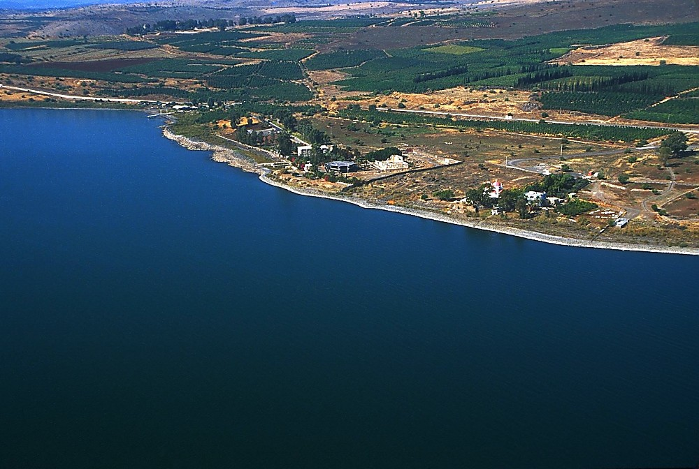
JESUS
JISU
Panty
Jisu Kadic Tatruanlou Kan e:
Capernaum daeng tingpuk khou rui zauc keymei
17
Notes:
Kaguangcmei synagog tei phaengc how kahouh the…kumlana mbut machuc tuang concret kai rui nailouduhmei Peter kai ta gumbinlouna gaeklou bammei tani how e.

Slide 19
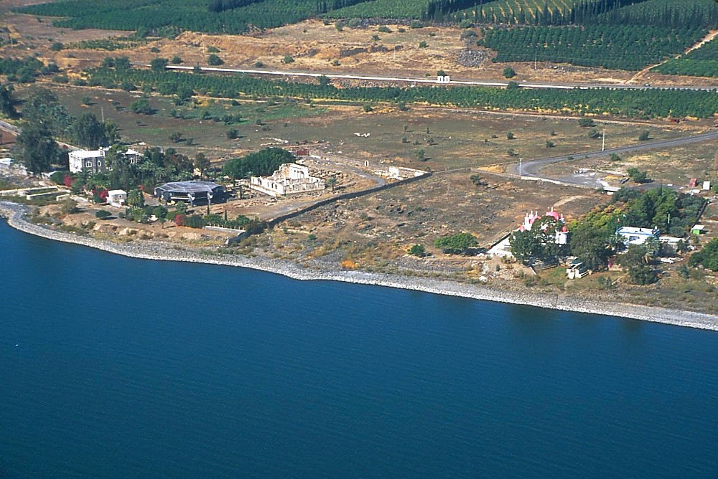
JESUS
JISU
Panty
Capernaum daeng tingpuk khou rui zauc keymei
18
Notes:
…mikhou how kumc…kaguangcmei puat phupatloumei bamv, Roman Catholicmei Franciscan archeologist nunc rui daeklouna kasiamh chuiloudatmei bamv daeng khou guang anaana bam the.

Slide 20
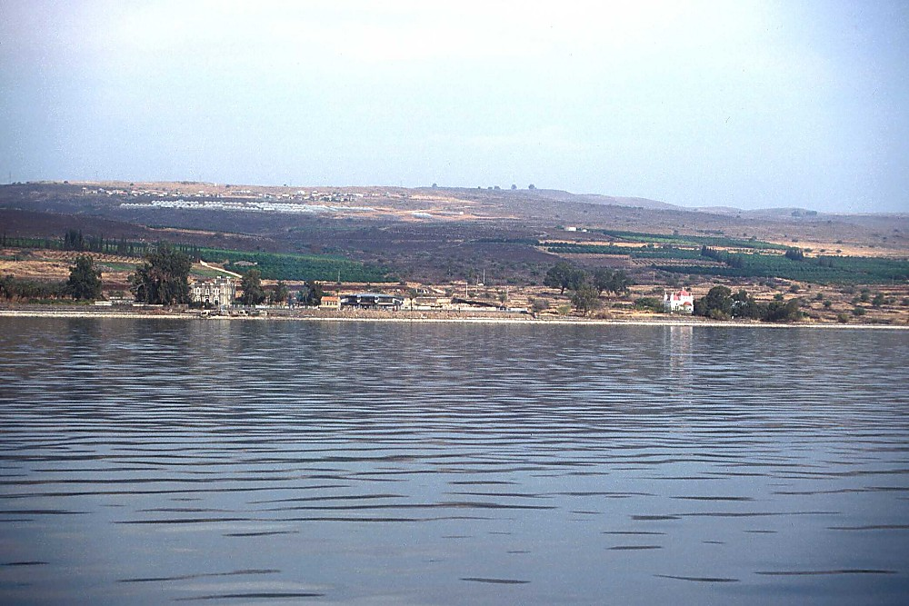
JESUS
JISU
Panty
Hih khou rui zauckaanpatmei
19
Notes:
Dihba biak thangc duichaeng khou rui guang ethei…laupung khatni tingthaibang nunc rui Galili tuang kathav gaymei khatni katuang reynungc mai chyng bic gaymei ta lianv e…

Slide 21
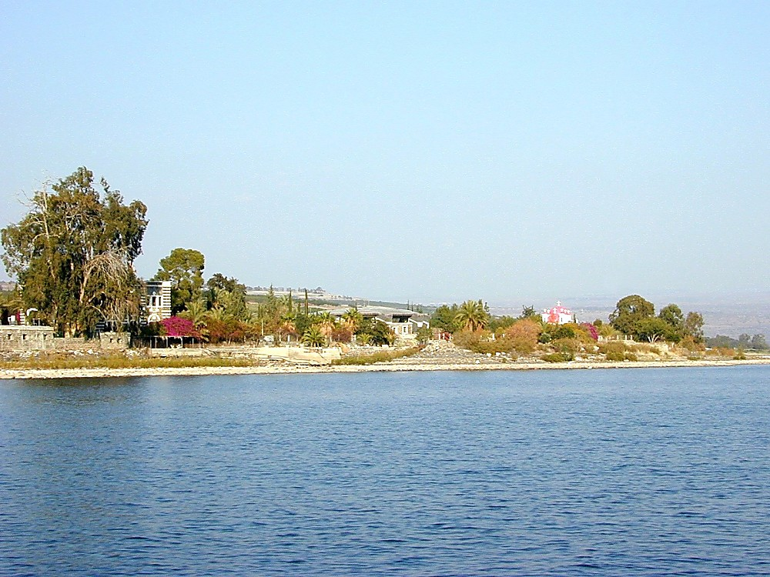
JESUS
JISU
Panty
Jisu Kadic Tatruanlou Kan e:
Hih khou rui zauckaanpatmei
20
Notes:
…kumna aniu guang anaa ranv datna…

Slide 22
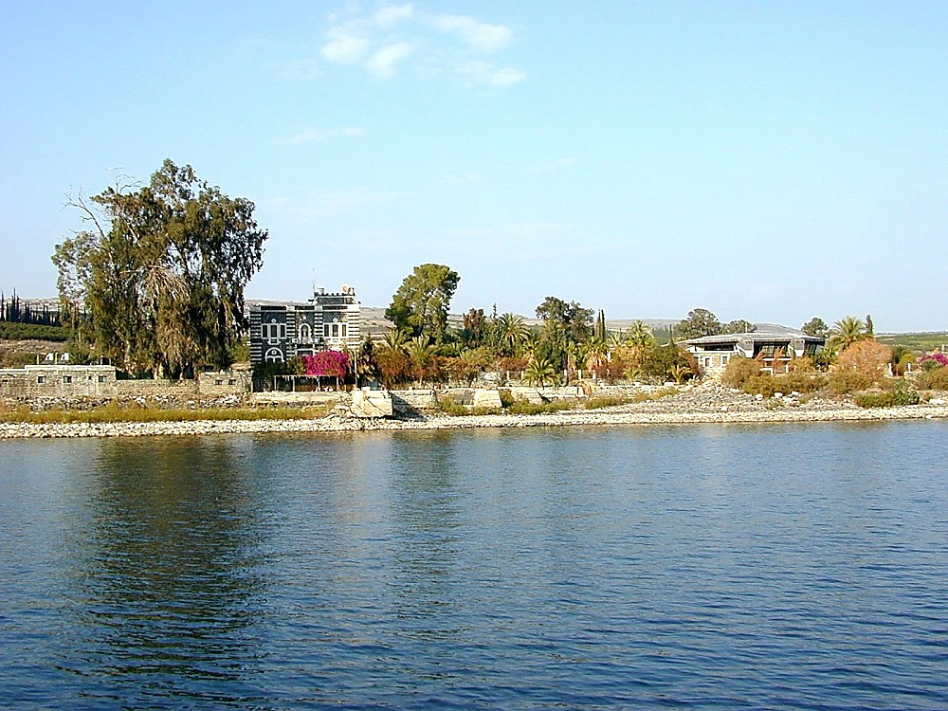
JESUS
JISU
Panty
Jisu Kadic Tatruanlou Kan e:
Hih khou rui zauckaanpatmei
21
Notes:
…nkhamh khou runghthaekcbamv tangcna reinungc dic tat puni the…

Slide 23
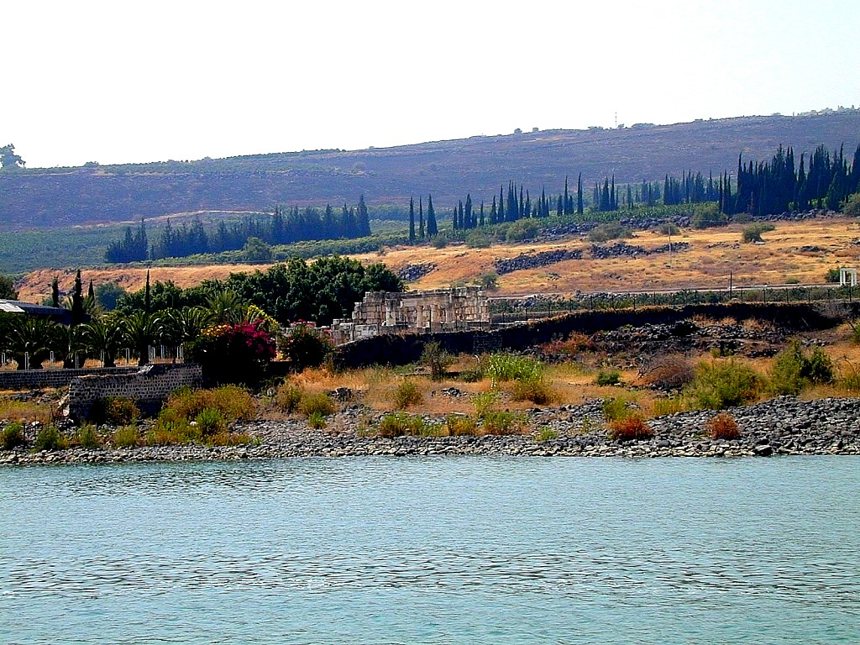
JESUS
JISU
Panty
Jisu Kadic Tatruanlou Kan e:
Capernaum guangmei: Synagog tei e
22
Notes:
…kumna Poubauhmei tatloumei chaeng nunc phupat khang the. Galilimei 10,000 mbu hei Jisu ganv khou Capernaum khou lungclou e tumei hei meicnunc rui machakpatlou e.

Slide 24
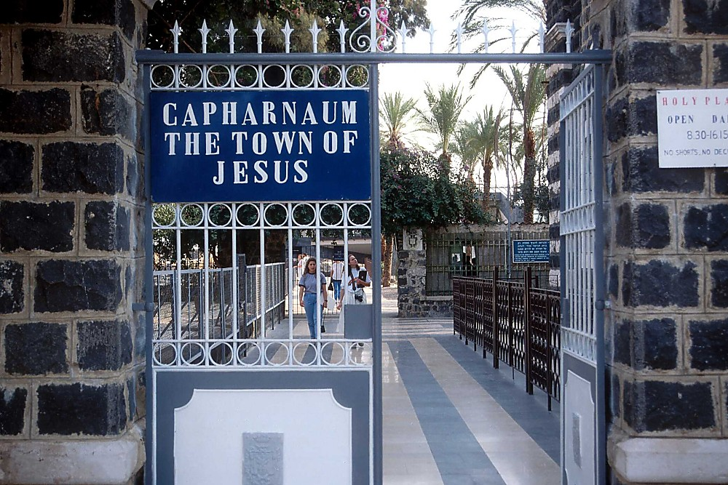
JESUS
JISU
Panty
Jisu Kadic Tatruanlou Kan e:
“Jisu lunghmei kaidai” gutmei
23
Notes:
Aseic Capernaum tuang kaidai raengc hei Jisu ganv khou lev katitna baicmaih the. Kaidai tuang miwmei tauc rui mai chyng tuang basalt tauc, mituang kaidai geihmei bangc khou lungc binlou bam e twmei lianv e. Niamhgaymei Capernaum…taanv-tyn, kasuakc-kaguakcmei lev raa-ring geihmei Dihba thangc Jerusalem lev adih baic kantucho.

Slide 25
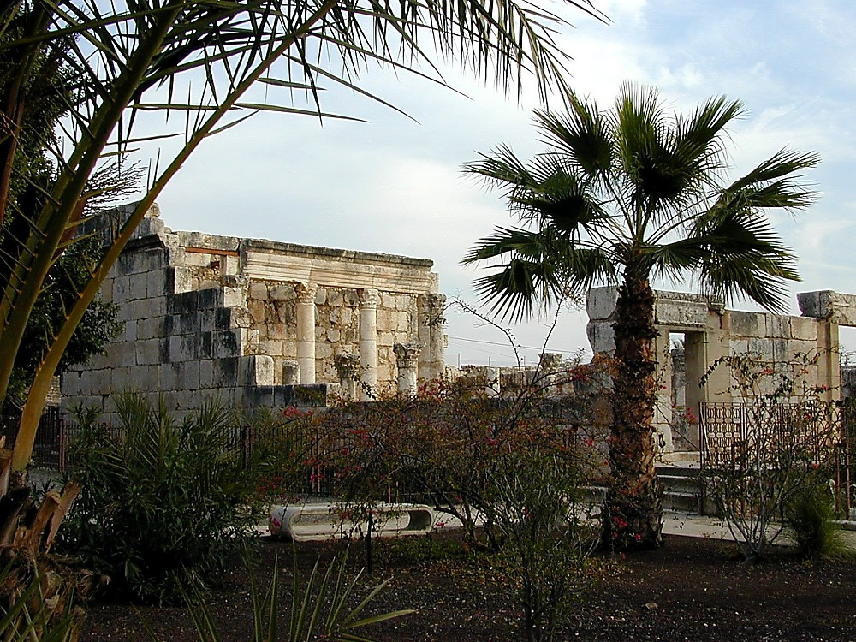
JESUS
JISU
Panty
Jisu Kadic Tatruanlou Kan e:
Nkhamhmei Capernaum tuang Synagog
24
Notes:
Capernaum khou kasiamh kaluaihlou datmei Synagog… Tiki, Jisu rui dinclou kanmei bamv tei thu hamh the. Mihei thu tingkwm phaynei khou Khrista puanhmei tangv swthaulou kanmei e. Tiki aniw thay e tumeithu kahuthangc nailoumei synagogue tei –– Jisu rui dincloumei bamv e –– kabamv khou tei nailou muai e, mitei kaidai tuang kauhliangmei bamv e. Grikmei kai thiak khou kasiamhloumei tihei thaylou o…

Slide 26
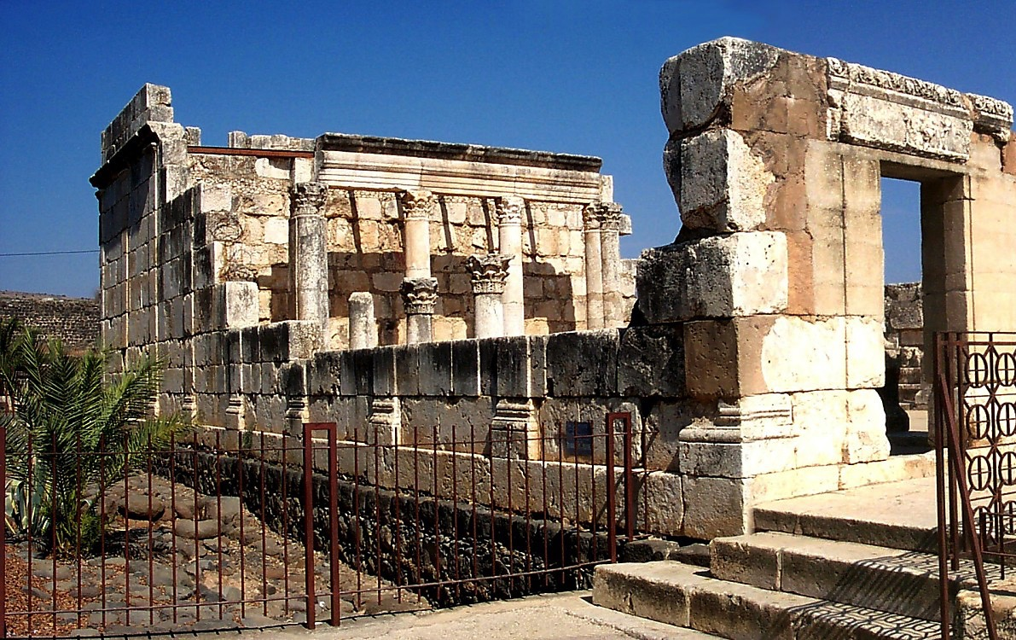
JESUS
JISU
Panty
Jisu Kadic Tatruanlou kan e:
Nkhamhmei Capernaum tuang Synagog
25
Notes:
Mihei Alexander tuang Hellenism rui tipatloumei tuang e. Grikmei thiak khou taanclou geic e tumei hei Capernaum tuang synagog kasiamh kaluaihloumei thiak khou rui thay e. Tiki lumsi khang maekmei thu mibamv kahak khou tei Jisu ganv tuang synagog nailou e tumei hei the. Mibam khou tei raph de kamei rui dinc kanmei!

Slide 27
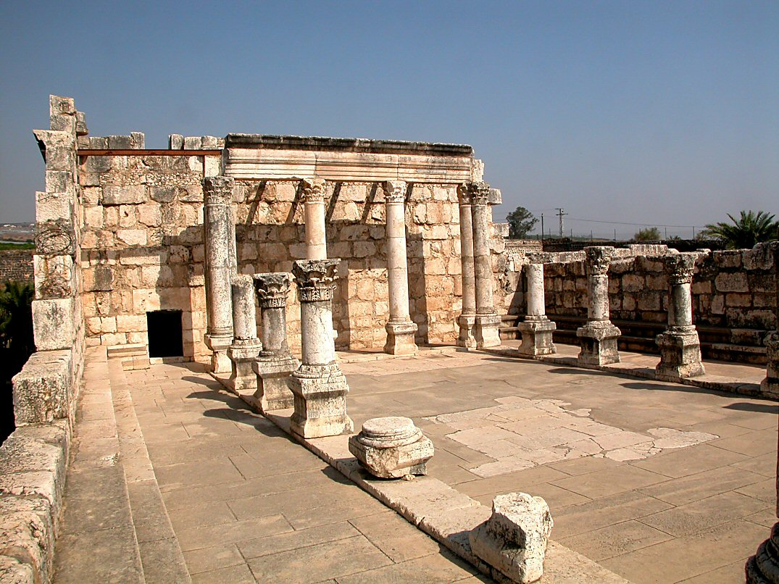
Mark 1:21; Jahon 6:59
JISU
Panty
Jisu Kadic Tatruanlou Kan e:
Nkhamhmei Capernaum tuang Synagog
26
Notes:
Rommei Sipai rui kasianv keyna Rommei kaiswmei thiak sinswna bamsini, Grikmei thiak khou kasiamhlou e tumei howpatmei lam peyna nai e.

Slide 28
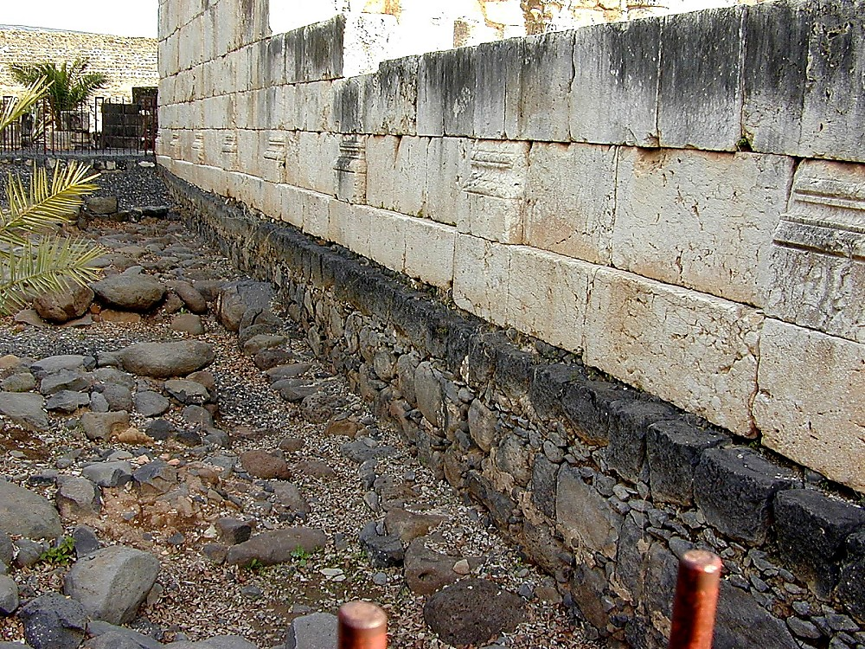
JESUS
JISU
Panty
Jisu Kadic Tatruanlou Kan e:
Basalt rui kasiamhmei Capernaum Chaeng
27
Notes:
Synagog daeng khou tei basalt rui kasiamhloumei chaeng naithe, ntau nganv kaguangcmei tauc mpeyna kabamv khou naina bam dihe…

Slide 29
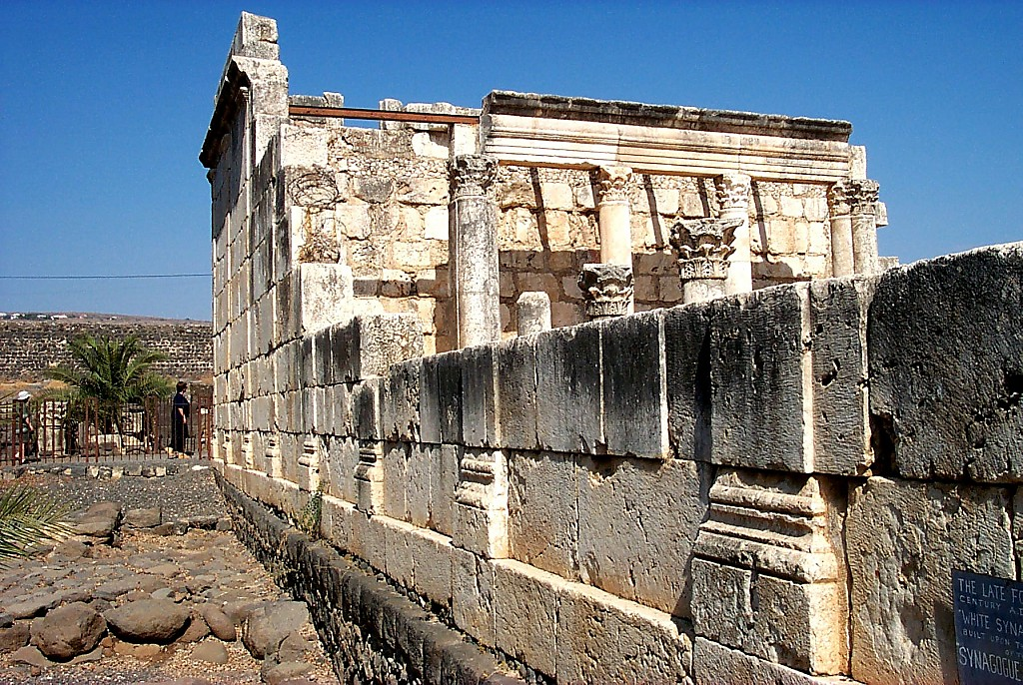
JESUS
JISU
Panty
Jisu Kadic Tatruanlou Kan e:
Basalt rui kasiamhmei Capernaum Chaeng
28
Notes:
…khoutei Poubauhmei rui tatruan lana kaziapnunc khatni khoutei bammei kalat nking khang guangmei meic baihmei guai khou dinc ndauh kan e.

Slide 30
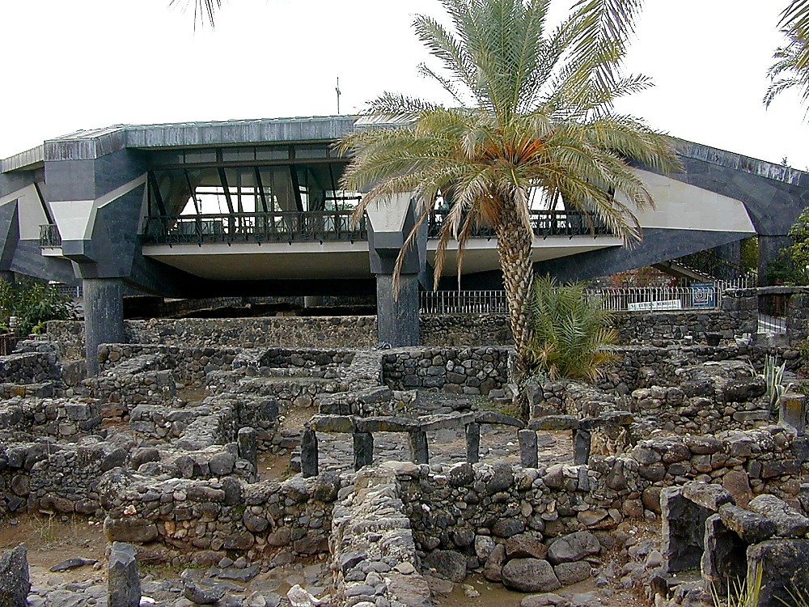
JESUS
JISU
Panty
Jisu Kadic Tatruanlou Kan e:
Capernaum khou Peter kai gaekloubammei
29
Notes:
Mituang Catholicmei phuamling hei kadatdatmei thiak khou kasiamhloumei hei Poubauhmei rui lungcloumei kai tateic gaek khang rui e…katung tachatmei reinungc tuang phuamling ruc khou e. Ntau naibammei Catholicmei phuamling hei reinungc tuang phuamling tuang lwn ta tiningtowlou khang kasiamhloudat tuang e…

Slide 31
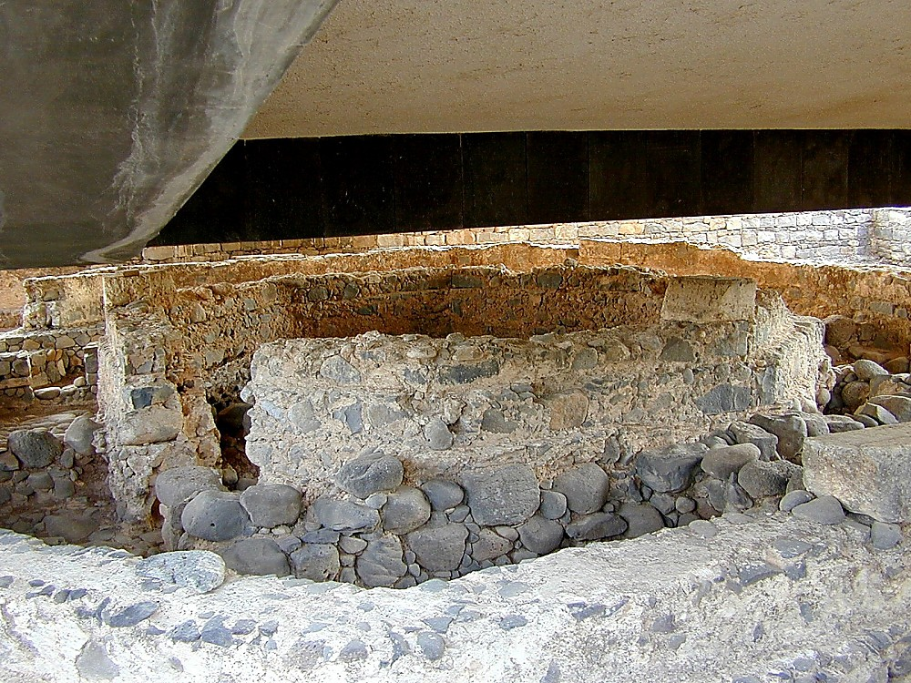
JESUS
JISU
Panty
Jisu Kadic Tatruanlou Kan e:
Capernaum khou nailouduhmei Peter kai
30
Notes:
…kabangc khou naimei hei the. Peter kai nailouduhmei e. Phuminhmei nunc rui Jisu mikhou hei tingkwm kanei lungclou e twna lwm e.

Slide 32

JESUS
JISU
Panty
Jisu Kadic Tatruanlou Kan e:
Galili Zeiclat khou neihkey bammei
31
Notes:
Kamei heikumhmei neihkeymei lwm tihei Capernaum khou neihmaryn duanv luaina tingzin key pukhou how katup bam kan e…

Slide 33
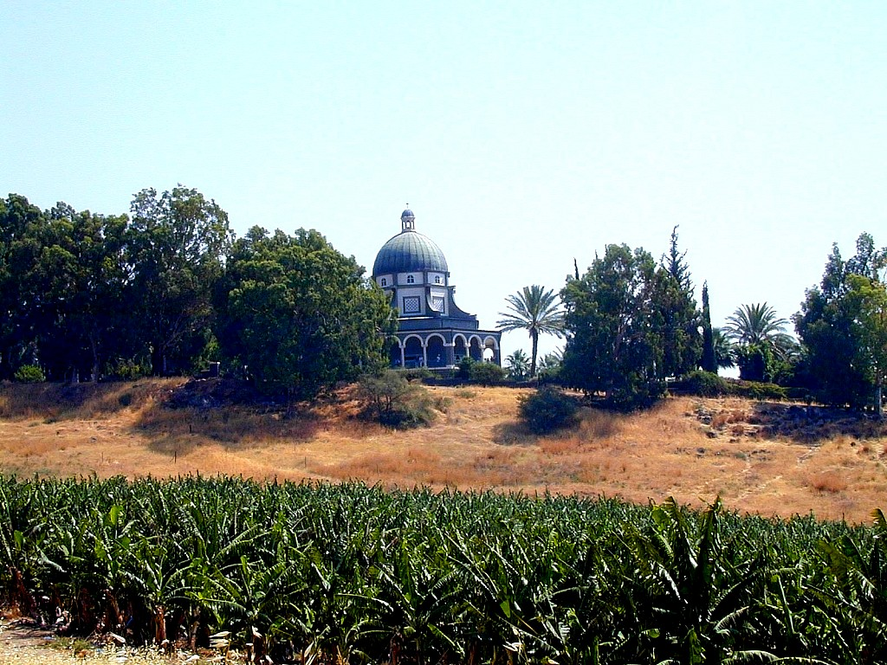
JESUS
JISU
Panty
Jisu Kadic Tatruanlou Kan e:
Zaenggaimeinunc tumei gaychamv luangcbut
32
Notes:
Mituang kalwnlungh tuang amphitheatre hei, Capernaum tuang neihpat biak thangc, chyng rui nai nkuaimei bamv e, mihei nseic tuang Zaengaymei gaychamv luangcpung the. Mituang kapung sisimei bamv khou Jisu rui meic kangdai ta ti guang kaduai kan e tumei aniu thay e...kamei rui Luanghbut khou gaichamv dai dinc ndauh kan e...Zaenggaymei nunc tumei tei e…meic ching-aching ta titulou kan e. Kalingna mibamv hei patkanmei Khristian ruanvry khou kathuk naimei bamv, Gaychamv dinh khang thayduanv swmei khatni katheilaymeinunc ta chadaaloumei bamv e.

Slide 34
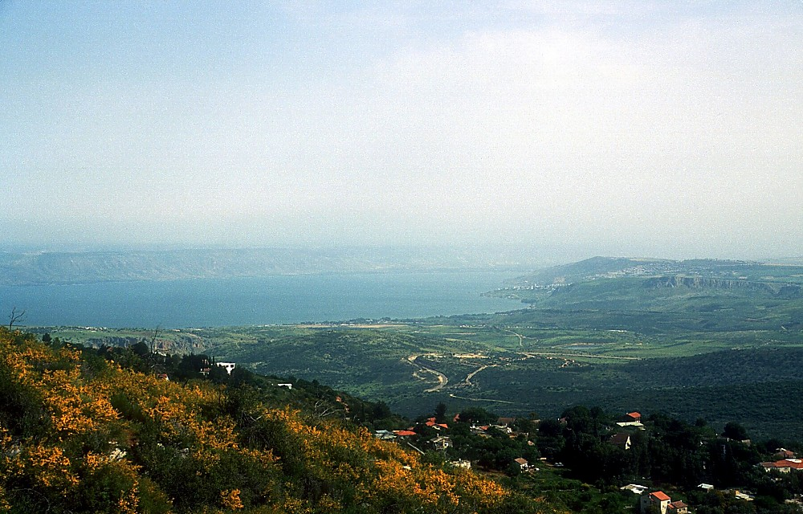
JESUS
JISU
Panty
Jisu Kadic Tatruanlou Kan e:
Galili tuang kauhmei tuanv
33
Notes:
Jisu rui katuang duanv taancpat khang tat geicna tatmei hei Nthanmei Latrik rui lianv e... Galili Zeiclat ruc khou naimei kauhmei tuanv mikhou hei e kamei rui tatruanloumei.

Slide 35
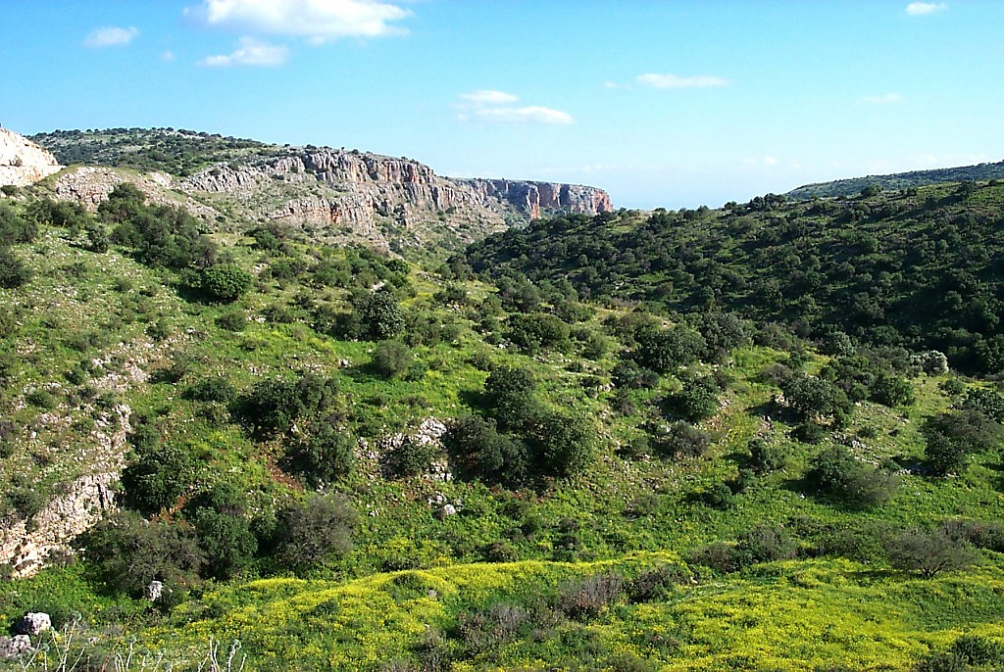
JESUS
JISU
Panty
Jisu Kadic Tatruanlou Kan e:
Galili Tuang Kauhmei Namv
34
Notes:
Tatruan tatmei tei kungcsihna, kaganv gutna tat khuanv e… kabamv akhat khou rui duhmei bamv akhat khou tatnimei hei timik geicsih laa khuanv e…

Slide 36
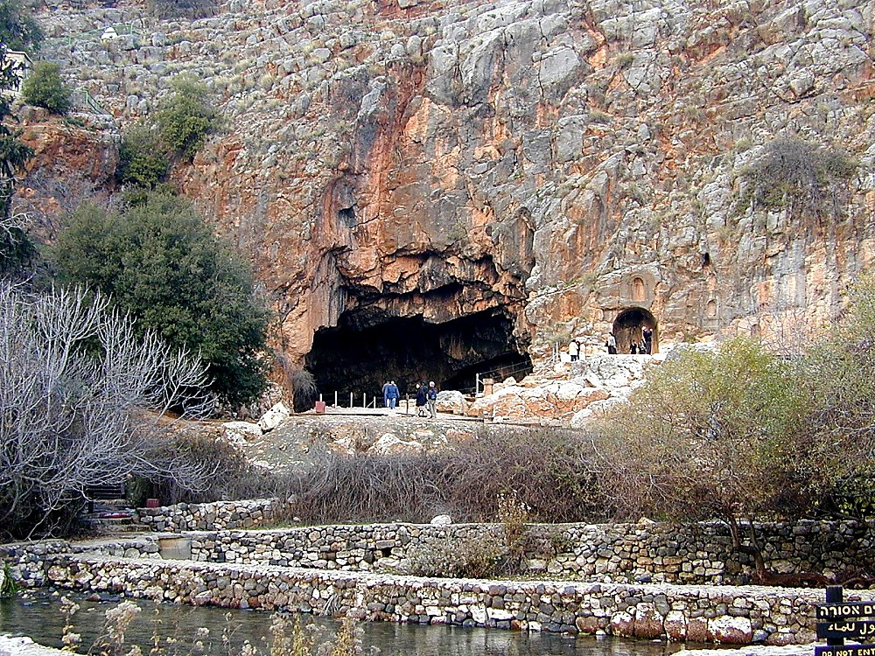
Met 16:13-17
JESUS
JISU
Panty
Jisu Kadic Tatruanlou kan e:
Caesarea Philippi – Peter khou: “…mi taucbut ruc khou!”
35
Notes:
…heikumhmei kalwnlungh tuang Caesarea Philippi khou naimei duipuakkai hei Jisu rui Peter khou latrianv swlou kanmei bamv “mitaubut ruc khou” kamei rui phuamling kasiamh thau puni tumei Baibal khou hyloumei bamv tei e.

Slide 37
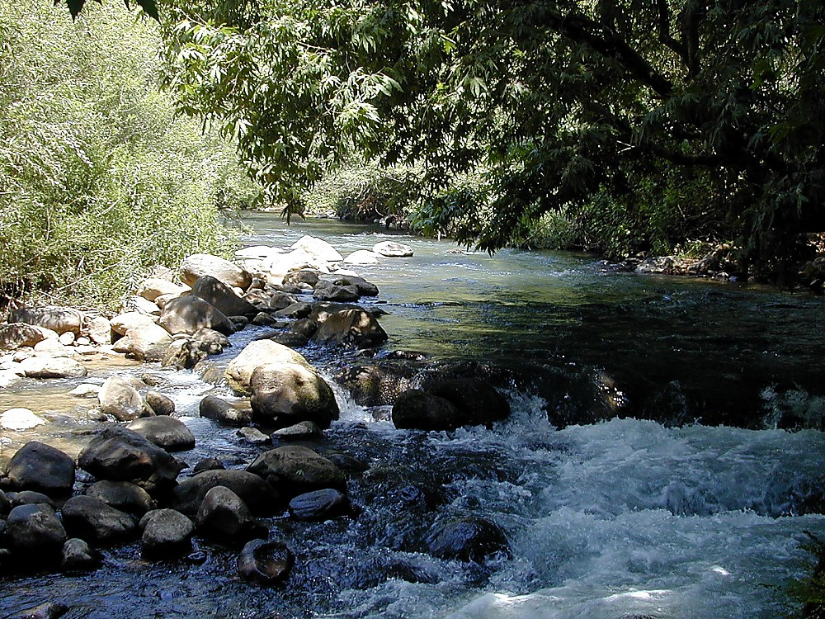
JESUS
JISU
Panty
Jisu Kadic Tatruanlou Kan e:
Jordan karucbiak tuang duithuat
36
Notes:
Duigaykanmei Jordan karucbiak khou tei rui lapatna Jisu rui katuang latchap khou sinsw katupna sinna “ringhmei dui” kalat chuna kathei laymei guayna khou ti e…

Slide 38
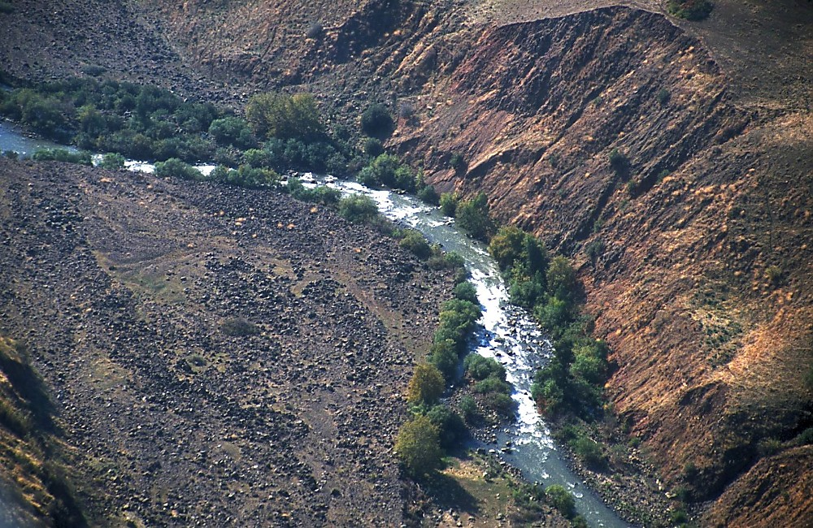
JESUS
JISU
Panty
Jisu Kadic Tatruanlou Kan e:
Jordan Duithuak Dihba biak luangckeymei
37
Notes:
…Jordan hei duiba biak luangc keyna Samaria luangc ruan e, Judea luangc kaana Theihmei Duipui khou luangclou e.

Slide 39
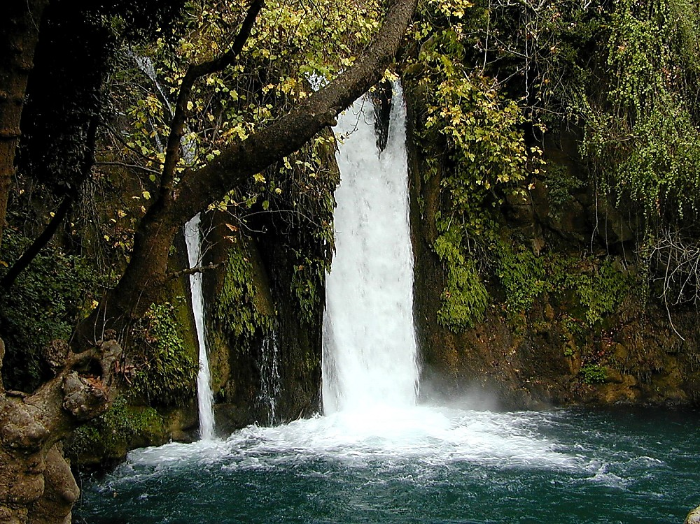
JESUS
JISU
Panty
Jisu Kadic Tatruanlou Kan e:
Galili tuang giugamakmei Duisav
38
Notes:
Kabamv azuh tatruan guangmei khou, duisav howgai-gaymei khatni kalunlungh tuang howgay hak-hakmei bamv kamei tatriu kan e.

Slide 40
Met. 4:25; Mark 7:31
3. GALILI DUANV
CAPERNAUM KHOU TAANCPATMEI
2. SAMARIAMEI
CHAENG
JESUS
JISU
Panty
1. POUBAUHMEI TUANG REYMEI
JERUSALEM
DUANV
Sauhpuang luihmei Jisu Chaengluanv...
39
2
Notes:
Kaganv kaganv khou, Poubauhmei rui mituang gaengzaengc khou tei gaychamv dinc ndauh khang rui kabamv thanh zauc tat re…
//// ….dihpy biak thangc Phoenicia…
//// …. Kumna Decapolis khou…Mi bamv hei Grikmei hamhthei Hellenmei lunghriak thei layna kasiamh thauloumei kaidai ruh e…mihei taancpat khang swloumei akhat khuanv e…

Slide 41
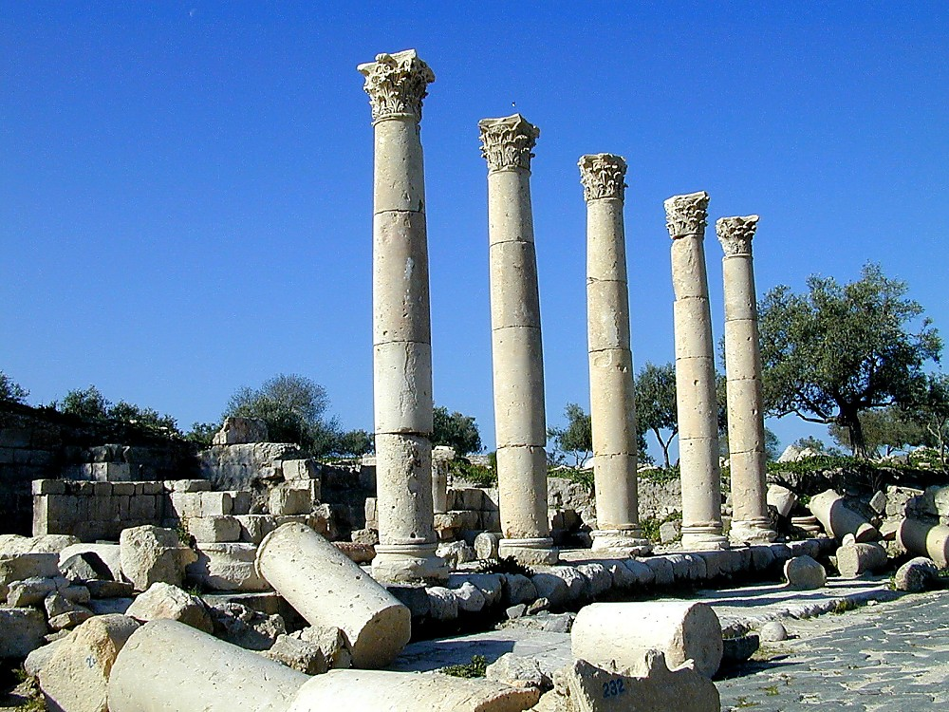
Mark 5:1; Luk 8:26-37; Met 8:28-34
JESUS
JISU
Panty
Jisu Kadic Tatruanlou kan e:
Grikmei Thiak Khou Swloumei Gadara Kaidai
40
Notes:
…Gadara twmei kaidai ni akhat the. Kasiamh katamvloumei tiangc nunc tei Korinmei thiak, katwntucna Grikmei thiak khou swlou e.

Slide 42

Jahon 2:23; 4:45; 5:1-2; 10:22; 12:12
3. GALILI DUANV
CAPERNAUM KHOU TAANCPATMEI
Capernaum nailouduhmei
2. SAMARIAMEI
CHAENG
JESUS
JISU
Panty
1. POUBAUHMEI TUANG REYMEI
JERUSALEM
DUANV
Jerusalem
Sauhpuang luihmei Jisu Chaengluanv...
41
2
Notes:
Jisu rui namv daeng nkuaymei kaluan geic si tatruanlana...dinclou... tigaylou...khatni …tanv gaymei azuh taanclou kan e.
//// …Capernaum khou rui Galilee khou keyna Jerusalem nganv tatruan lana...Mousi tuang riak guay tiguangtangclou khuanv e.
//// Milungc khou tei kamei rui taekmakna Jihudimei tuang kalendar khou naimei tingkwm ngai kaguai Jerusalem Ravkai khou kazauh kan e. Kaidai daihmei khou tei Jisu KAPHAY rui tatbam kan e…

Slide 43
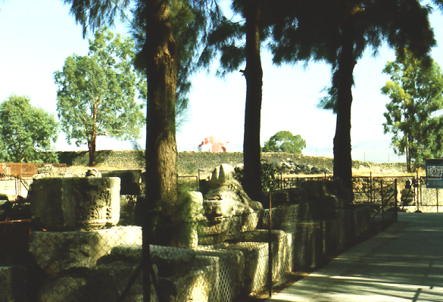
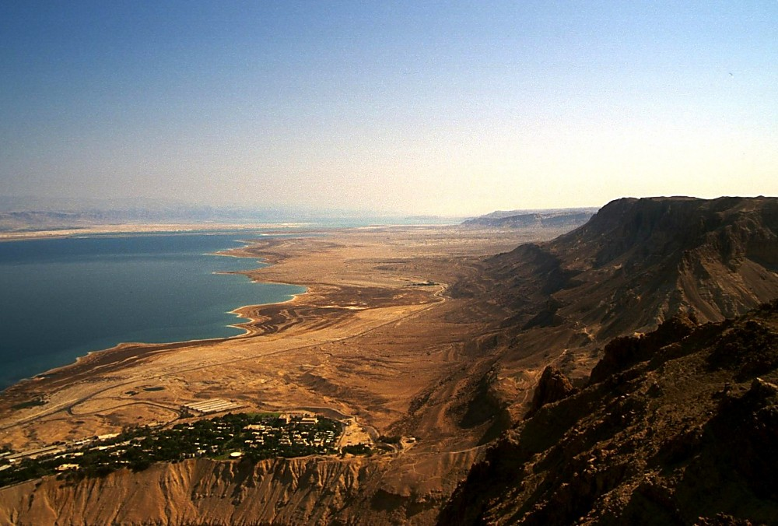
Jahon 2:23; 4:45; 5:1-2; 10:22; 12:12
CAPERNAUM KHOU RUI JERUSALEM: MILE 80
CAPERNAUM KHOU RUI JERUSALEM: MILE 80
GALILEE ZEICLAT, JORDAN DUIRIANG KHOU RUI THEIHMEI DUIPUI: MILE 75
GALILEE ZEICLAT, JORDAN DUIRIANG KHOU RUI THEIHMEI DUIPUI: MILE 75
JESUS
JISU
Panty
Baansinbuk kadip 39-41
42
2
Notes:
Mirui kabamv nunc adih duc cho tumei tithaylou khang rui e…phaychaeng hamhthei gadha tingkhou dungcna tatmei khang…
//// …Capernaum khou rui Jerusalem hei…mile 80 the…hamhthei kilometer 129 e.
//// Jordan Duiriang tuang Galili Zeiclat mun khou rui Theihmei duipui…mile 75…hamhthei kilometer 121 e.
Poubauhmei rui kandih khou kaduanv taancpatmei ganv khou tat kalwmei hei chiwmak kan e!

Slide 44
Luk 19:1-26
3. GALILI DUANV
CAPERNAUM KHOU TAANCPATMEI
2. SAMARIAMEI
CHAENG
4. PEREAN
DUANV
JESUS
JISU
Panty
1. POUBAUHMEI TUANG REYMEI
JERUSALEM
DUANV
Sauhpuang luihmei Jisu Chaengluanv...
43
Notes:
Kumna katingmik tei guang ana pukhou...Perea tatkaanna Jerusalem tat khang rui…Galili mpatlou duc the...twmei nthanna aniw thay the…

Slide 45
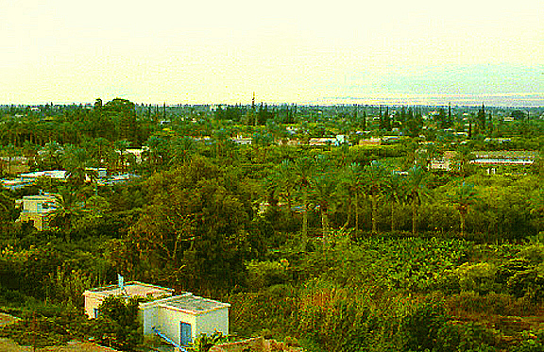
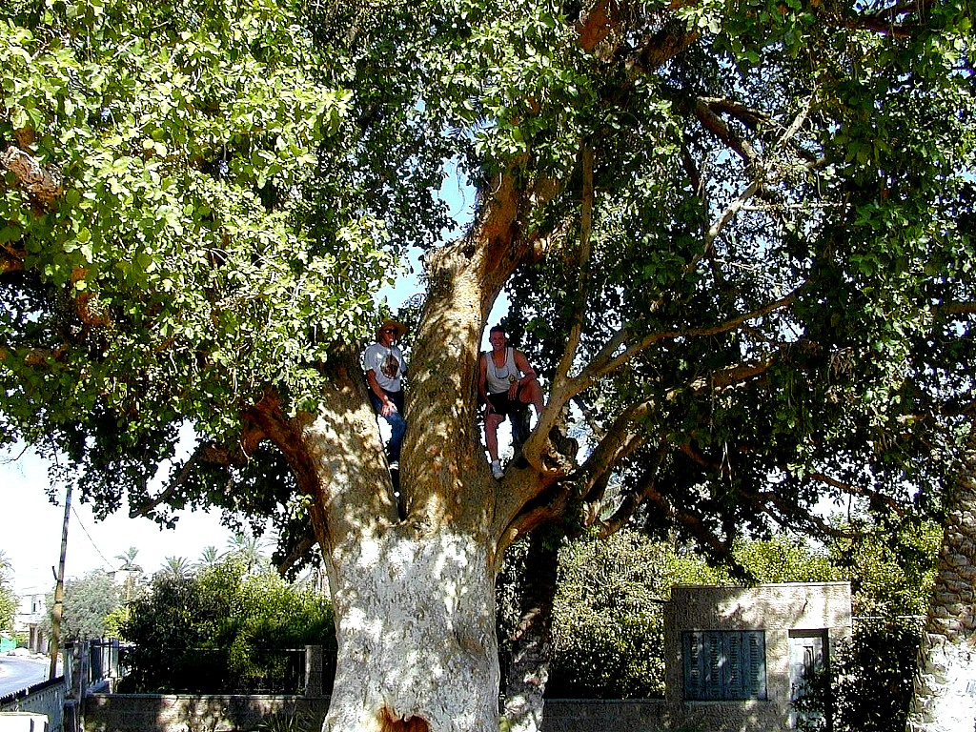
Luk 19:2-10
JESUS
JISU
Panty
Jisu Kadic Tatruanlou Kan e:
Zacchaeus Mbubang kumei
Baansinbuk kadip 39-41
44
1
Notes:
…Kaguangcmei Jericho tei tatkaanna tat the… Tingkwm 1500 dougei huthangc kadic gutlaanimei ganv khou Joshua rui tatkaan kanmei kathuknaimei zaengthaekcpui kaidai e!
//// Heikhoutei – tumeithu Jericho kaidai khou tei …Jisu rui meithiamvmei Zacchaeus mbubang khou nkamh bammei ta ariukanmei tuang kazanc tatkanmei pary tei heikumhmei mbubang khou e.

Slide 46
Met 21:10-16; Jahon 12:13
3. GALILI DUANV
CAPERNAUM KHOU TAANCPATMEI
2. SAMARIAMEI
CHAENG
4. PEREAN
DUANV
JESUS
JISU
Panty
1. POUBAUHMEI TUANG REYMEI
JERUSALEM
DUANV
5.NKHAMHMEI
JERUSALEM
DUANV
Sauhpuang luihmei Jisu Chaengluanv...
45
Notes:
Nkhamh khou...kamei Jerusalem hanguangdat nimei ganv tangcpat khuan e, duaknuhmakmei duanv guang kahouhmei tateic ariu khang e. Kumna...mihei katuang nkhamhmei Jerusalem duanv the.

Slide 47
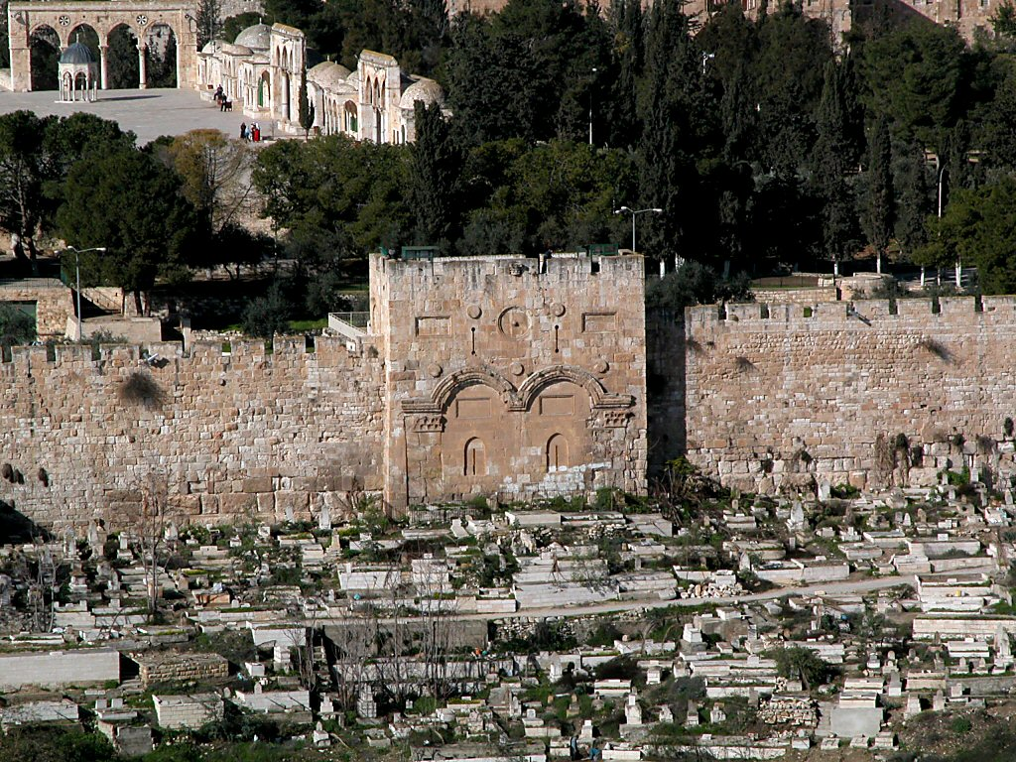
Met 21:12-16
Aseicdou Jerusalem Ravkai Chyngbut
JESUS
JISU
Panty
Ravkai chyngbut tuang neihpat raengckat
Abraham tuang Moria chyng:
Jihudimei ravkai bamv
Baansinbuk kadip 39-41
46
2
Notes:
Katuang nkhamhmei kanitdak tuang kazanc tatkanmei Tadan Neihneic khou, kamei kaidai khoutei gut the, Daihmei Herod tuang Ravkai Moriah Chyng biak nzuanv gut the, Ravkai Chyngbut, ntau thu tauh Kai swna dingbam e…
//// …Meickang tei rui kata Israelmei khang guanghthanh khatni dihsinpouc swpunithe twna lwmgaybam khuanv e. GUANGDIC thuap khou naimei tei ningtow ethei Solomon nih mituang chaengdai khou tei dinglou khuanv e kumna katangv thangc –– mihei ––Herod tuang daimei Ravkai swna Jisu ganv khou nai kan e.
//// Kathaichuymei nunc rui kamei Ravkai Chyngbut khou tei Neihpat Raengckat biak gut khuang e twna dinc e...ntauthu katangv thangc ramvlagutmei nunc khatni guanglungc nkhamhmei nunc rui kasiamh katamvlou datna mbanghlou kan the.

Slide 48
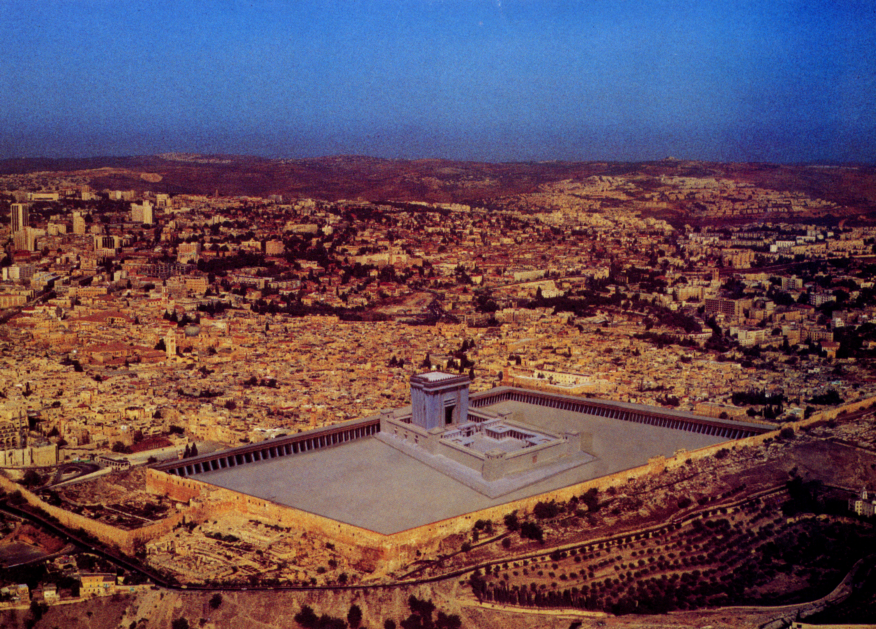
Met 21:12-16
JESUS
JISU
Panty
Jisu Douc Tuang Ravkai Aseic Nganv Dingbam Khuanv Ethei Akumh Punicho...
Baansinbuk kadip 39-41
47
Notes:
Jisu ganv tuang Ravkai daihmei tei aseic ni Jerusalem khou naibam tuang khuan ethei...akumh punicho? Maengh hiakmei gankhat rui mihei kumc puni twna hiaklou e. Heikumna...aniw Ravkai tei adih daic cho tumei, khatni bakchiwnamei, lunghning tanhmei dihmeinunc, dihluanv khatni ravchapluanv rui Jisu ta athungmei tei chiwnana thayngam e. Kaidai khou gutmei tangv khuangh ganv azuh tangv, Poubauhmei ta Jihudimei khatni Rommei ngamv phunghmei nunc hu khou laguang the, lunghrianramei thouduak tei kahouh the, mirui nkhamh khou phungc guanglou nimeihei...

Slide 49
7
Met. 26:28; Mark 14:24; Luk 22:20
JISU
PANTY
KROS
• Latdyng thanh
JISU
Panty
Kros
Baansinbuk kadip 39-41
48
Notes:
…CROSS KHOU E. JISU tumei thuap khou naimei lam hei Nkhamhmei Maniat taektu khou nthanna ndauhlou e –– LATDYNG THANH tuang bangbi e.

Slide 50
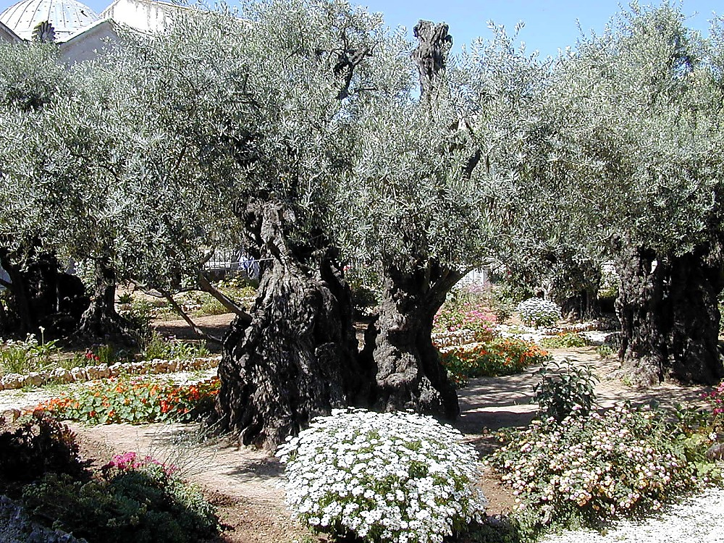
Luk 22:39-44
7
JISU
Panty
Kros
Olive luangcbut ruc khou: Gethsemane pikuan
“Apule nang rui nuh ethei mibuangc hei akhou rui laganclou o; tiki ai ningmei hamh e, nang ningmei swkandio.”
Baansinbuk kadip 39-41
49
1
Notes:
Reynungc mituang Olive thingbang rak khou, aseic naibammei Gethsemane pikuan khou, Herod tuang Ravkai khou rui Kidron nzaengc tatkaana, kaganv tei guang the tumei thayna mikhou tei Jisu huaineykhang tat khuan e. Khoutei kamei rui ney the,
//// "Apule, nang rui nuh e thei mibuangc hei akhou rui laganclou o; tiki ai ningmei hamh e, nang ningmei swkandio."

Slide 51
7
Met. 26-28; Mark 14-16; Luk 23-24; Jahon 19-20
JISU
PANTY
KROS
Latdyng Thanh
• “Luai the.”
JISU
Panty
• Jisu Theihmei
Kros
• Kata Mbeihmei
• Kamei Ringhthaumei
Baansinbuk kadip 39-41
50
4
Notes:
Mikhou hei JISU tuang nkhamhmei duanv, kata Kros khou theih khang zayguangloumei nkhamhmei ganv tuang thouduak guai ariu e…
//// Katuang nkhamhmei latsav, "LUAI THE” tumei hei rui nthukna lianvloumei–– katangv thangc hei khang suang mbuna kathai puni!
//// Kamei theihmei khatni
//// mbeihmei…khatni
//// Kamei hymdaicna ringthaumei.
Aniw mituang chakdat ngammakmei katpatloumei khatni Kapu tuang tingsaengzaeng bamv mpatloumei tihei thaymeinunc e…Ntau khatni tingsaengzaeng Ravguangc mav khou piunuhmei lam thay khang aniu rui karamc bammei paengc thangc e.

Slide 52
7
Met 16:18; 28:19
JISU
PANTY
KROS
PHUAMLING
• “Ecclesia” kaw e--
“Kawpatloumei nunc” ta
JISU
Panty
Kros
Phuamling
• Jerusalem khou rui thauna…
Mbaanv kapumv khou.
Baansinbuk kadip 39-41
51
4
Notes:
Nkhamhmei khou, PHUAMLING lam nai the...mikhou mbaanv kalaic guang nimei thouduak kaguai ta, mihei rui lianvhulou e
//// ecclesia naiguang kanmei,
//// — kawpatloumei nunc,
//// …James lev Peter khatni kata ningmei mei azuh rui Jerusalem khou kahouh kan e,
//// kumlana mbaanv kapwm khou rui, Paul, Luke, Barnabas khatni baihmei guai rui kahouhlou e.

Slide 53
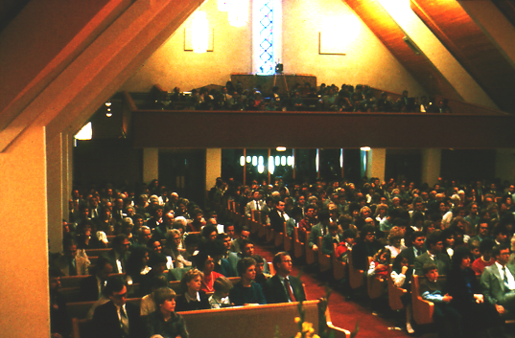
PHUAMLING:
ANIU HEI DUITHUAT TUANG PUNGKUMEI TEI E!
JISU
Panty
Kros
Phuamling
Baansinbuk kadip 39-41
52
2
Notes:
Heikhou hei aniu tabui khou bam tha tumei thay the...Ravguangc rui gandaih Abraham khou rui kahouhna zuk guay khang Chamraeng daihmei raengcloumei khou aniu dam tabui nai cho tumei phupat bam the. Khou hei...
//// Aseic phuamling hei...ntau khang Khrista tuang pumc e. Phuamling hei ntau naibammei khou rui inchi akhatna sinih tat mbugut mak he. Mizaeng rui…
//// Aniu hei duithuat tuang pungkumei tei e! Heikhang rui lathanv daihmei akhat nai the:

Slide 54
“…Jerusalem khou, Judia lev Samaria kapwm khou, khatni kandih tintou nganvna nangniw alam khou dinh khang e.”
The Church:
What are we doing about it?
JISU
Panty
Kros
Phuamling
Acts 1:8 (NIV)
Baansinbuk kadip 39-41
53
1
Notes:
MILAM KHANG HEI ANIU TABUI SWBAM TUANG? Aniu phuamling khou guangmei hei, minungc tei na lagutngam lana zaeng chanei guangdatmak khang cho? Kumh mak ethei... aniu Poubauhmei tuang gaychamv hei kakwn gutducliangmei bamv nunc khou phungc tat ro twmei karing naimei duanv tihei piuni cho?
//// Katuang ntammei latsav tei ningtow o: “……Jerusalem khou, Judia lev Samaria khou, khatni kandih tintou nganvna nangniw alam khou dinh khang e.”

Slide 55
7
Metthiu, Mark, Luk, Jahon
Patchanghmei lev
Theology
JISU
PANTY
KROS
PHUAMLING
GAYCHAMV
JISU
Panty
Kros
Phuamling
Gaychamv
Baansinbuk kadip 39-41
54
Notes:
Mituang thouduak daihmei guai hei reymei khou Gaychamv rui mithiak khou nai e...
KALINGMEI KHATNI JISU KHRISTA TUANG KATHANHMEI ZUK TUANG THEOLOGY....

Slide 56
7
Latdiutatmeinunc tuang taanv
Patchanghmei lev
Theology
JISU
PANTY
KROS
Phuamling Ruanvry
PHUAMLING
GAYCHAMV
JISU
LATDIUTATMEI
Panty
Kros
Phuamling
Gaychamv
Latdiutatmei
Baansinbuk kadip 39-41
55
Notes:
Mitangv rap khou naimei hei PHUAMLING RUANVRY E...Latdiutatmei khou hylou the,

Slide 57
7
Rommei khourui Juda nganv
Patchanghmei lev
Theology
JESUS
LIFE
CROSS
Phuamling Ruanvry
CHURCH
GOSPELS
JISU
ACTS
Phuamling Lat-lu
Panty
Kros
Phuamling
EPISTLES
Gaychamv
Latdiutatmei
Tatdyn
Baansinbuk kadip 39-41
56
Notes:
…mitangv hei lat-hy mpeyna nai key the – Tatdyn nunc – mihei PHUAMLING TUANG kaguakcmei lam khou e... Kahouhpatlou reymei khatni kalwn thaymakmei guangnimei karing naimei phuamling khang tatdyn nunc hamh ethei paac kaluan khang tiguangmei latdiutatmeinunc tuang tatdyn nunc e. Suamcthaulou reymei phuamling nunc khang tatdyn hei rui tukumhna alauc kanmei PHUAMLING rui kaganv khou tei KHATNI ntau ganv khang nganvna, kaluanthau bam khang howduhmei tinailou e khatni nchamlou e.

Slide 58
7
Ndauhloumei
Patchanghmei lev
Theology
JISU
PANTY
KROS
Phuamling
Ruanry
PHUAMLING
GAYCHAMV
JISU
LATDIUTATMEI
Phuamling
Lat-lu
Panty
Kros
Phuamling
TATDYN
Gaychamv
Latdiutatmei
Tatdyn
NDAUHLOUMEI
Ndauhloumei
Tingsaeng
Guangnimei
Baansinbuk kadip 39-41
57
Notes:
...kumna nkhamhliangmei hei...NDAUHLOUMEI the...Baibal tuang nganvloumei e...Thaytangc ngammakmei guangnimei kanganv makmei tuang hymdaihmei tei mirui duinana tihowlou e...

Slide 59
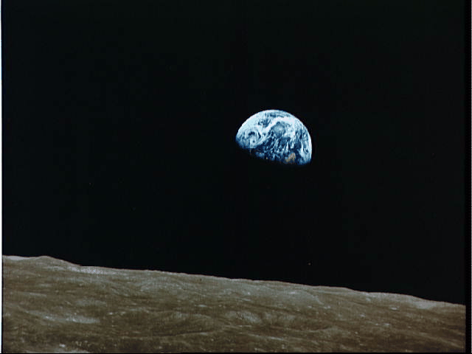
“Baibal hei Ndauhloumei Buk khou hymdaicna luailoumei hei mituang lwnlung khou e.
Tingkwm aching ganv khou tei, kalangv baicna naimei ruanvry kaguai tei Ringhpouc tuang giugamakmei latdyng lev guangkariuna luailou puni.
JISU
Panty
Kros
Nrianhloumei guai guangtangc kan e.
Phuamling
Gaychamv
Latdiutatmei
Reynunc Ravguangc lev kapammei, ABRAHAM, kak khou alamloumei tei guangtangc kan the."
Tatdyn
Ndauhloumei
John Walvoord
Baansinbuk kadip 39-41
58
3
© 2006 TBBMI
PHOTO ©NASA
8.0.03f.
Notes:
Ndauhloumei lam khou, nzianmei mak kanmei theologian, John Walvoord rui kumna hylou e: "Baibal hei Ndauhloumei buk khou hymdaicna luailoumei hei mituang lwnlung khou e.
//// khoutei, tingkwm aching ganv khou tei, kalangv baicna naimei ruanvry kaguai tei Ringhpouc tuang giugamakmei latdyng nunc lev guang kariuna luailou e.
//// Nrianhloumei guay guang tangc kan e.
//// Reynungc Ravguangc lev kapammei ABRAHAM kak khou alamloumei tei guang tangc kan the."

Slide 60

Abraham Latdyng
(“Kawloukanmei")
Thaureymei 12:1-3
JISU
KADIC
KATHW
SUAIHIAM
Panty
Kros
Phuamling
David tuang
Gaychamv
Latdiutatmei
Dih
Kathanc
Tatdyn
Ndauhloumei
Riakdanv
30:1-10
2 Samuel
7:4-16
Jeremia
31:31-33
Baansinbuk kadip 39-41
59
Notes:
Heizaengrui…ABRAHAM LATDYNG hei KADIC, KATHW khatni SUAIHIAM latrianv tiguang tangcloumei khou tatgutna bam e:

Slide 61
Abraham Latdyng
(“Kawloukanmei")
Thaureymei 12:1-3
JISU
KADIC
KATHW
SUAIHIAM
Panty
Kros
Phuamling
David tuang
Gaychamv
Latdiutatmei
Dih
Kathanc
Tatdyn
Ndauhloumei
Riakdanv.
30:1-10
2 Samuel
7:4-16
Jeremia
31:31-33
Baansinbuk kadip 39-41
60
Notes:
Tingkwm ching lunghmei ganv khou tei,
Israel tei KADIC khou taekmakna lungc bammei ta how the -
Mirui KADIC LATDYNG tiguangtangclou the;

Slide 62
Abraham Latdyng
(“Kawloukanmei")
Thaureymei 12:1-3
JISU
KADIC
KATHW
SUAIHIAM
Panty
Kros
Phuamling
David tuang
Gaychamv
Latdiutatmei
Dih
Kathanc
Tatdyn
Ndauhloumei
Riakdanv.
30:1-10
2 Samuel
7:4-16
Jeremia
31:31-33
Baansinbuk kadip 39-41
61
Notes:
JISU KHRISTA, nzihmei DAVID TUANG KATHW swmei, rui tingsaeng khang DAVID Guangcbamv khou guanghtu bammei how the
— mirui DAVID LATDYNG tiguang tangclou e; kumna

Slide 63
Abraham Latdyng
(“Kawloukanmei")
Thaureymei 12:1-3
JISU
KADIC
KATHW
SUAIHIAM
Panty
Kros
Phuamling
David tuang
Gaychamv
Latdiutatmei
Dih
Kathanc
Tatdyn
Ndauhloumei
Deuteronomy
30:1-10
2 Samuel
7:4-16
Jeremiah
31:31-33
Baansinbuk kadip 39-41
62
1
Notes:
Meic kaguaina mituang guangnimei ganv Poubauhmei rui kandih khou guang lungcdatmei nimei ganv tuang SUAIHIAM riw khou lungc bammei ta how e,
— heirui KATHANCMEI LATDYNG guangtanghmei e.
//// Thaureymei 12: 1-3 khou Abraham latrianv kaguai tei tiguang tangclou the...Ravguangc lev Abraham kak khou naikanmei latdyng khou reynungc rui Jisu Khrista guangnimei kantni katuang duanv khang kasiamh chamdaanvloumei tei e.

Slide 64
Abraham Latdyng
DAMHMEI
(“Kawloukanmei")
ABRAHAM
JOSEPH
Thaureymei 12:1-3
MOUSI
JOSHUA
KAGUAKCMEI
GUANGHDIC
JISU
KADIC
KATHW
SUAIHIAM
Panty
SEED
NYMLOUMEI
Kros
Phuamling
David tuang
KARIMMEI
Gaychamv
Kathanc
Latdiutatmei
Dih
Tatdyn
JISU
Ndauhloumei
Riakdanv.
30:1-10
2 Samuel
7:4-16
Jeremia
31:31-33
Baansinbuk kadip 39-41
63
1
Notes:
Kumna…nanglung tuang JISU thuap khou tei Khristian panty khou kage naimei kaguai nai the, nang rui kathailoumei guai, pacloumei guai, makumhmei, huaineymei panty, lungc guangmei panty khou latowmei azuh khatni lwmmei khou daickumei guaina hei e.
Mikhou hei Latdyng Thanh khou naimei meic daihmei kaguai ta kabamv chana duancloumei bamv e, kida khang maekmei Guloumeipu panty khou patnimei khatni Katuang PHUAMLING lingcthaulounimei lev daicthaunimei khang e.
//// JISU tuang thuaph khou rui nthukliangna thaypatmei hei mihei e: Kahuthangc BAIHMEI THUAPNUNC suangc alam chuy e khatni daic ranv e. Nthanmei Latrik hei akhatna swna nai e –– Kauhkanmei chamraeng hei taancpatna bammei mikhou how e. Akhatna swmei kabac thaymei tangv khou charai khatni bumaengh alammei tumei hei huthangc tatkanmei nunc khatni guangnimei mei kaguaina rui latow e.

Slide 65
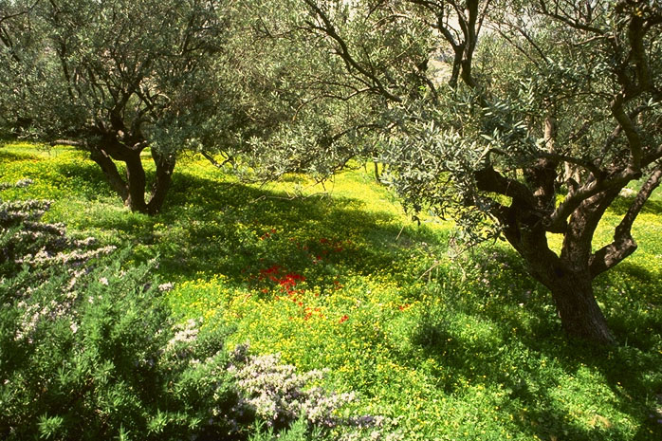
KUMETHEI AKUMHNI?
JISU
Panty
Kros
Phuamling
Gaychamv
Latdiutatmei
Tatdyn
Ndauhloumei
Gethsemane Pikuan,
Olive Luangcbut, Jerusalem
64
1
Notes:
Jisu Khrista rui kalung kabiuna katpatmei ravsuai suaic kanmei reinungc olive bang nunc tihei zauc pukhou…kaguaina tei chiwnamei latbamvnunc swna kasiamh nuh e. Mikhou rui kahouh kho…
//// …nthukmei lat thanv daihmei: KUMETHEI AKUMHNI? Mei chamhmei nunc khang miguai tuang kabac hei tabui cho…theologian nunc hamhmakmei…ruanvry kathaimei nunc hamhmakmei… tiki meicnunc…aniw daeng lungc kaning bammei guaina khang hei?

Slide 66
“…Jisu miganv khou tei rui thauna: ‘Nangniw lungh laic tho, Tingkauh guangcdic ana the,” twna dinc thau the…Jisu tei synagog guay khou nchamlouna, guanghdic tuang gaychamv dincna… Galili ramv kapwm khou ruanlou the.' ”
Met. 4:17, 23
JISU
Panty
Kros
Phuamling
Gaychamv
Latdiutatmei
Tatdyn
Ndauhloumei
65
Notes:
Jisu rui aniu ta tabui sabam tucho? Metthiu kalangv padeih khou, kumna salou e “Jisu mi ganv khou tei rui thauna, ‘Nangniw lungh laic tho, tingkauh guangcdic ana the,” twna dinc thau the…Jisu tei synagog guay khou nchamlouna, guanghdic tuang gaychamv dincna…Galili ramv kapwm khou ruanlou the’.”
Mi guangcdic kiu tabui cho? Kamei sabammei hei tabui kabac cho?

Slide 67
“Tiki Ravguangc guangcdic khatni katuang ravchaptatmei ta phurey o, kumethei miguay hei nangniw khang tii puni.”
Matt. 6:33
JISU
Panty
Kros
Phuamling
Gaychamv
Latdiutatmei
Tatdyn
Ndauhloumei
66
Notes:
Kalangv kanei tangv, Metthiu rui Jisu heikumna saloumei hylou e, “Tiki Ravguangc guangcdic khatni katuang ravchaptatmei tei phu rey o, kum e thei mi guay hei ni nangniw khang tii puni.”

Slide 68
“Kamei rui aniu ta zinghmei pumtan khou rui kanlouna, kamei rui nzianmei kaNac Mpouh tuang guangdic khou phungc guanglou the.”
Kol. 1:13
JISU
Panty
Kros
Phuamling
Gaychamv
Latdiutatmei
Tatdyn
Ndauhloumei
67
Notes:
Paul rui katuang Kolossimei tatdyn khou kumna hylou e: “Kamei rui aniu ta zinghmei pumtan khou rui kanlouna, kamei rui nzianmei kaNac Mpouh tuang guangcdic khou phungc guanglou the.”
Mi Guangcdic hei…tabui khou cho khatni tabui kumh guangtangc ni?

Slide 69
Hyloumei kaguai khou karuc liangmei chamv kanei:
#1: Ravguangc hym thuanhmei khatni taanc ndauhmei
JISU
Panty
Kros
Phuamling
Gaychamv
Latdiutatmei
#2: Ravguangc Guangcdic khou aniu ta zay guangloumei
Tatdyn
Ndauhloumei
68
2
Notes:
Aniu khang Nthanmei Latrik rui kabiswmei chamv kanei nchamlou e…reiymei khou
////Kabuk khou naimei chamv hei aniu rui kabah thaykhang karamc nuhmei latnunc khou khatni mikhou neihlalounuhmei khatni “RAGUANGC HYM” lungc lianvpat nuhmei chamv swna lianvlou e.
//// Aniu rui kabah thaymei khatni Bumaengh Nthanmei rui zayloumei bangc khou tatmei thei layna…aniuta Ravguangc Guangdic khou zayguanglou puni… tumeithu aniu tuang reyliangmei puipu rui reynungc pikuan khou mpatloukanmei maniatmei riang tei guanglaadat khang e.

Slide 70
Jisu Khrista guangmei hei amaanmei ta gulou khang…khatni ringsuangmei panty tii khang rui guang e, Mitei Messia tuang gaychamv khou lwmloumei paan rui latow khang e.
JISU
Panty
Kros
Phuamling
Gaychamv
Latdiutatmei
Tatdyn
Ndauhloumei
HEIZAENG RUI: ANIW TATNA DINC NDAUH NINA THE!
69
1
Notes:
Nthanmei Latrik rui nthanthiakna heikumna salou e…
Jisu Khrista guangmei hei amaan kanmei ta gulou khang e…kumna ringsuangmei panty hei, Messia tuang gaychamv khou lwmloumei paan rui laatow khang e.
Aniw lwmlou ethei…Aniu tuang Latrik khou naimei hei kachangcna lwmlou ethei…aniu khou nsinloumei duanv hei nchiwna de:
//// ANIU TATNA DINC NDAUH NINA THE! Aniu tuang lwmmei hei meicbaihmei nunc khou raclou nina e, mirui kaniu khang ringsuangmei panty, aniu lwmloumeinunc rui laatowmei kumc tumei hei tithaylou khang e. MITEI TAANHMAKMEI HEI Poubauhmei tuang nthanthiakmei latdanv liammei khatni chakhuang swloumakmei e, kamei rui kaziapnunc ta mpatlouna katuang tingkauc guangcbamv nzuanv kanmei tangv…tingkwm 2,000 huthangc gandaih Abraham khou nrianhlou kumc katuang suaihiam “kandihmei kaikhunc guai khang” ganclou duc e.

Slide 71



7
Thaureymei khou rui Ndauhloumei nganv
DAMHMEI
KAGUAKCMEI
1mei ngganmei
le ntumei
1mei Paap
LATZANPOUCNUNC
350
D
1st Gaychamv
350
1st Kaikhunc
(1000 B.C.)
1st Meidow
GUANGHDIC
(1000 B.C.)
Duidai/Muangsingc
S - D - S
DL
Ramphaankai
••• BAKMEI •••
DL
Dihpy Dihba
(2000 B.C.)
ABRAHAM
(2000 B.C.)
Israel
Judah
DIHZAAT 3
KAWLOUKANMEI
AL
10 2
AL
LT
D 7 K J
MUHZWNGNUNC
LT
K - K - S
20-J 20-R
…
I - I
200 350
J - E
Assyria Babylon
12
NYMLOUMEI
7 = 4 + 3
JOSEPH
Tingkwm 70
JISU
Nymloumei
Kaluanv 3
Panty
MEICKANG 4
Kros
430
Kwm 100 / 50,000
Phuamling
Z - E - N
Gaychamv
(1500 B.C.)
Latdiutatmei
MOUSI
(1500 B.C.)
(500 B.C.)
Tatdyn
Tatpatmei
K
S
KARIMMEI
(500 B.C.)
Ndauhloumei
Sinai
Grikmei Alex
Rommei lunghlwn
K - G - N
Kadesh Barnea
KL
JISU
40
KL
40
Panty
5 PARY
J
Kros
JOSHUA
Phuamling
KATHAY NKHAVMEI#04 & #31
Gaychamv
Jericho/Ai
Latdiutatmei
Kadic Nzanhmei
Tatdyn
Ndauhloumei
70
19
Notes:
Ntauthu...lou kariuna zauc kho...kathai nkhavmei kasing 4 lev 31 khou…
Baibal kapwm tuang karou nah bammei tei ntau thu howgaymei lwn howpat the…lungning khou kalangv naina duancthaulou tho…nanglung khou piuloumei, ningtow kaluaihmei, lunghgutloumei nah ta nkhuanbam tuang e.
REYMEI KHOU…
//// DAMHMEI
//// MEICKANG 4
//// DIHZAAT 3
//// KARIMMEI
//// JISU
KANEIMEI KHOU… Baibal khukh khou kathuap ruh zanc nunc…minunc tei:
//// DAMHMEI
//// ABRAHAM
//// JOSEPH
//// MOUSI
//// JOSHUA
//// KAGUAKCMEI
//// GUANGHDIC
//// NYMLOUMEI
//// KARIMMEI
//// khatni JISU.
KATHUMHMEI KHOU…mituang thouduak guaihei nangtuang Baibal khou mphangmei giugamakmei latdyng padeih rui nsui kariulou e!
//// Thaureymei tuang ABRAHAM LATDYNG…
MIKHOU RUI TUDAICPATLOUMEI LATDYNG NUNC:
//// Riakdanv Kaluaihmei tuang KADIC LATDYNG…
//// Kaneimei Samuel tuang DAVID LATDYNG…
//// Jeremiah tuang LATDYNG THANH.

Slide 72
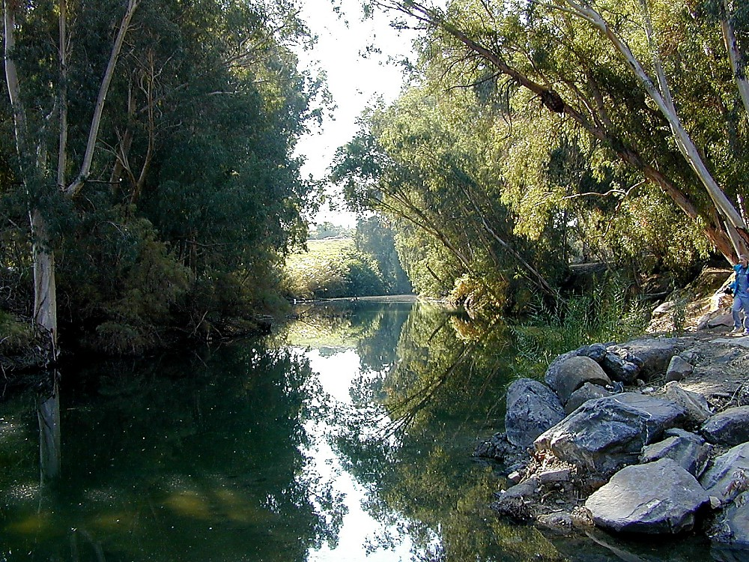
Thaureymei khou rui Ndauhloumei nganv
7
DAMHMEI
KAGUAKCMEI
1mei ngganmei
le ntumei
Latzanpoucnunc
1mei Paap
350
1st Gaychamv
350
1st Kaikhunc
(1000 B.C.)
1st Meidow
GUANGHDIC
(1000 B.C.)
Duidai/Muangsingc
S - D - S
DL
Ramphaankai
••• BAKMEI •••
DL
Dihpy Dihba
(2000 B.C.)
ABRAHAM
(2000 B.C.)
Israel
Judah
KAWLOUKANMEI
AL
10 2
AL
LT
MUHZWNGNUNC
LT
K - K - S
20-J 20-R
I - I
200 350
J - E
Assyria Babylon
12
NYMLOUMEI
JOSEPH
Tingkwm 70
Nymloumei
Kaluanv 3
430
Kwm 100 / 50,000
Z - E - N
(1500 B.C.)
MOUSI
(1500 B.C.)
(500 B.C.)
Tatpatmei
KARIMMEI
(500 B.C.)
Sinai
Grikmei Alex
Rommei lunghlwn
K - G - N
Kadesh Barnea
KL
JISU
40
KL
40
Panty
5 PARY
Kros
JOSHUA
Phuamling
Gaychamv
Jericho/Ai
Latdiutatmei
Kadic Nzanhmei
Tatdyn
Ndauhloumei
71
Notes:
Miguai guangtangc bammei…KATUANV KUTANGC BAMMEI HEI… Reynungc Israel khou Poubauhmei Jisu Khrista panty khatni katuang gaychamv dinhmei duanv khou e.

Slide 73
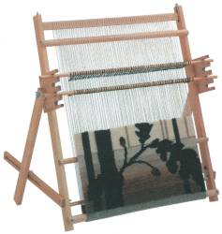

7
Israel khou rui mituang dakloumei Ramh hiw phey hei akumhcho?
KATHAI NKHAVMEI #08 ZAUC O
72
2
Notes:
Nkhamhmei swna saachaploumei...Kathai Nkhavmei #8…ramh guai ta nsui kariu khang swloumei khatni aniu tuang lwmmei phaydyng tichagangvloumei ningting bangbi tisw khang e. Khou hei pheydakmei naa nai the…meicguayna rui thayna bammei tei e. Khou hei dakloumei phey kiak akhat dakloubam the…Israel khou rui e.
//// Nthanmei Kandic khou rui mi phey hei akumh cho? Mihei saachap gay khang e. Aniu rui kasiamh thau nimei tihei zauc o.
//// Aniu rui thay e, phey dakmei khou langh hei raanv ndunghloumei kage nai e…kumlana raanvloumeita teic phai mphaih khang kalangv khat kage nai e.

Slide 74
Dak ntiploumei Israelmei phey tihei machak zauc o
Phailoumei
Phey dung
…tabui rui tii tamianglou cho?
73
5
© 2006 TBBMI
8.0.03f.
Notes:
Ntaumei phey tateic zauc diangc na zauc pukhou kumna how e.
//// Ntauthu dak ntip hak loumei Israelmei phey hei machak zauc o.
//// Tabui rui tii tamianglou bam tucho? Aniu rui phey tateic pincna thaekbam sinih…kaek makna bammei lam tabui nai tina cho?
//// Samna saa pukhou, kalamthu langh tei kadung kaphai mphay tarina khat-khat khou phianc ntip bam tina e! Kumtina the!
//// raanv ndunghloumei tei…aniu rui pheydakmei ganv khou PHEYDUNG kaw e.
//// Kaphai tatmei tei rui…PHAILOUMEI twna kaw the… PHEYDAKMEI KHOU PHEYDUNG LEV PHAYLOUMEI TWTHE.

Slide 75


PHEY DAK KHANG PHEY RAANV BAM TUANG E TWLAKHO...
BAIBAL RUANVRY TUANG PHEY-LANGH
74
1
© 2006 TBBMI
8.0.03f.
Notes:
Ntauthu…phey kiak akhat raanv thauthe twna ning lakho, kazanc rui
//// BAIBAL RUANVRY TUANG PHEYLANGH. Goulou nimei bamv nai the…nang rui raanv thaunimei ta nkhuanv bam the… PHEYDUNG raanvloumei lev PHAYLOUMEI ta teic e.

Slide 76
PHEY DAK KHANG PHEY RAANV BAM TUANG E TWLAKHO...
BAIBAL RUANVRY TUANG PHEY-LANGH
75
© 2006 TBBMI
8.0.03f.
Notes:
Phey raanv thauna dak khang swlakho kumna mikhou tei Baibal Pary daihmei tuang LUNGNING pheylangc dak khang swlakho!

Slide 77
PHEY DAK KHANG PHEY RAANV BAM TUANG E TWLAKHO...
10
5
76
© 2006 TBBMI
8.0.03f.
Notes:
PHEYDUNG khou tei langhriang 15 raanvlou puni…langhru RUH hei machu khatna puni, langhru PANGUH rui machu akhatdat puni…baihmei machucni guang punidihe!

Slide 78
PHEY DAK KHANG PHEY RAANV BAM TUANG E TWLAKHO...
DAMHMEI
ABRAHAM
JOSEPH
MOUSI
JOSHUA
KAGUAKCMEI
GUANGHDIC
NYMLOUMEI
KARIMMEI
JISU
NKHAMH-MEI GANV
77
2
© 2006 TBBMI
8.0.03f.
Notes:
Mihei kumcna e. zauc chuylou tho. Langhru machu teic baihmei guai khou rui baic tap-taph bam the!
//// Reymei langcru ruh tei rui BAIBAL KHUKH tuang latkaeng ruh tei the: DAMHMEI, ABRAHAM, JOSEPH, MOUSI, JOSHUA, KAGUAKCMEI, GUANGHDIC, NYMLOUMEI, KARIMMEI, khatni JISU ta lianvmei swna e.
//// Heikhouruina langhriang panguh tei rui guangnimei ganv tumeithu kandih ruanvry hei luai pukhou e…lwmloumeinunc mpeyna rui NKHAMHMEI GANV tuna kawmei tei e.

Slide 79
BAIBAL RUANVRY TUANG PHEY-LANGH
7
D 7 K J
M4
D3
J
D
A
J
M
J
K
G
N
K
DAMHMEI
ABRAHAM
JOSEPH
MOUSI
JOSHUA
KAGUAKCMEI
GUANGHDIC
NYMLOUMEI
KARIMMEI
JISU
78
4
© 2006 TBBMI
8.0.03f.
Notes:
Reyliangmei khou langhriang ruh tei mbaibiak khou kasiamh thaulakho…aniu thaybammei kasing 7 katang khou hiat phaihloumei…
//// how bam the D-7-K-J makumc…
//// …kumdatlana MEICKANG 4 khatni DIHZAAT 3 …
//// ….lat hiak akhatna rui BAIBAL KHUKH khou reymei THUAP chakiu ta lianv e…DAMHMEI khou rui KARIMMEI…
//// …nkhamhmei J rui JISU tutuang e.

Slide 80
BAIBAL RUANVRY TUANG PHEY-LANGH
7
D 7 K J
M4
D3
J
D
A
J
M
J
K
G
N
K
79
© 2006 TBBMI
8.0.03f.
Notes:
Mitangvdat khou…kaganv kasaekc khang langhriang kathumh hei laganclou kho…baihmei rui lynlou kho…ntau how puni the.

Slide 81
BAIBAL RUANVRY TUANG PHEY-LANGH
7
D 7 K J
M4
D3
J
D
A
J
M
J
K
G
N
K
ABRAHAM LATDYNG
THAUREYMEI 12 & 15
80
2
© 2006 TBBMI
8.0.03f.
Notes:
Phailoumei khou– raanv ndunghloumei khou tei phai mphaihlou puni – karaek daihmei, chagangvmei pheypaek akhat aniu dak puni the.
//// kazanc hei rui: ABRAHAM LATDYNG.
//// ABRAHAM langc khou phai gut punithe…aniu rui Baibal khou Thaureymei 12 lev 15 khou mphangmei tei e.

Slide 82
BAIBAL RUANVRY TUANG PHEY-LANGH
7
D 7 K J
M4
D3
J
D
A
J
M
J
K
G
N
K
ABRAHAM LATDYNG
KADIC LATDYNG
RIAKDANV. 30
81
2
© 2006 TBBMI
8.0.03f.
Notes:
Katangvdat khou, MOUSI tuang langcru khou, kapaek akhat phaigutlou dat punithe…
//// Mihei rui KADIC LATDYNG paek MOUSI langcru khou e...
//// …aniu thay e, mihei Riakdanv Kaluaihmei 30 khou nai the.

Slide 83
BAIBAL RUANVRY TUANG PHEY-LANGH
7
D 7 K J
M4
D3
J
D
A
J
M
J
K
G
N
K
ABRAHAM LATDYNG
LAND COVENANT
DAVID LATDYNG
2 SAMUEL 7
82
2
© 2006 TBBMI
8.0.03f.
Notes:
Kaluan keyna, GUANGHDIC LANGCRU khou tei…
//// …DAVID LATDYNG rui phai khang e…
//// …Baibal puatbamv rui 2 Samuel 7 khou nai e.

Slide 84
BAIBAL RUANVRY TUANG PHEY-LANGH
7
D 7 K J
M4
D3
J
D
A
J
M
J
K
G
N
K
ABRAHAM LATDYNG
KADIC LATDYNG
DAVID LATDYNG
LATDYNG THANH
JEREMIA 31
83
3
© 2006 TBBMI
8.0.03f.
Notes:
Kumna nkhamhliangmei khou…GUANGHDIC langcru khou tei dihe, phailoudatnimei hei
//// …LATDYNG THANH e…
//// … Jeremiah kalangv 31 khou nai e. DAVID LATDYNG KHATNI LATDYNG THANH hei kabamv akhatna khou phai kariulou e tumei nthanna nai the…
//// …mitei GUANGHDIC LANGRU khou e. Zauc kariu pukhou, latdyng padeih pheypaek rui saachaploumei hei, akumhna Latdyng Guangc tuang latdyng latrianv rui ruanvry tuang thouduak guai ta huthangc titatgut ngammei bansin swna, Poubauhmei Jisu Khrista guangnimei khang bamv chamdaanvlou cho tumei thay khang e. Latdyng tuang nsudimei langcpaek hei JISU langcru phaituanvna phailouna how e.
Tabuizaeng? kalamthu, Abraham ganv khou rui thauna miganv khou aniu panty khou nganvna latrianv guay tei rui taanvswlou bam e. KAGUAY TEI GUANGTANGC NTHUIH PUNI! Mbuna katang khou nai key puni.

Slide 85
BAIBAL RUANVRY TUANG PHEY-LANGH
7
D 7 K J
DAIHMEI MPHWANMEI GUANGC BAMPAENG LATZAN
M4
D3
LAIZIU NAC NOWSUANH NGAI TAEKTU
KATHANCMEI TINGKAUC LEV KATHANCMEI KANDIC
KHRISTA KANDIH KHOU GUANGHTU NIMEI
J
GUANG KANEIMEI
D
A
J
M
J
K
G
N
K
ABRAHAM LATDYNG
NKHAMH-MEI GANV
KADIC LATDYNG
DAVID LATDYNG
LATDYNG THANH
84
5
© 2006 TBBMI
8.0.03f.
Notes:
Ntauthu…NKHAMHMEI GANV lam nai the. Nkhamhmei ganv khou akumh punicho tumei kathiak bai-baicna salou e...tat kaluan key bammei thouduak BAIBAL…KABISWMEI khou tiloumei hei Khristian lwmloumeinunc, dinhpouc nunc, ncham kauhmei nunc geihmei rui nuhloumei e. Mihei Latdyng Thanh tuang Latdiutatmei John khou Ndauhloumei tuang nkhamhmei langv khou tei hylouna nai the.
Phey tuang langhru panguh tei…NKHAMHMEI GANV…JISU langcru tangv…kazanc kaluan keymei swna lou the…
//// LAUZIU NAC NOUSUANH NGAI TAEKTU…
//// POUBAUHMEI GUANG KANEIMEI…
//// KHRISTA TINGKWM CHINGKHAT GUANGHTU NIMEI…
//// DAIHMEI MPHUANVMEI GUANGCBAMPAENG LATZAN…
//// NKHAMHMEI KHOU…KATHANCMEI TINGKAUC LEV KATHANCMEI KANDIC

Slide 86
BAIBAL RUANVRY TUANG PHEY-LANGH
7
D 7 K J
DAIHMEI MPHWANMEI GUANGC BAMPAENG LATZAN
M4
D3
LAIZIU NAC NOWSUANH NGAI TAEKTU
KATHANCMEI TINGKAUC LEV KATHANCMEI KANDIC
KHRISTA KANDIH KHOU GUANGHTU NIMEI
J
GUANG KANEIMEI
D
A
J
M
J
K
G
N
K
?
ABRAHAM LATDYNG
KHOU HEI RAMHKHAT PATNA BAM E!
KADIC LATDYNG
DAVID LATDYNG
LATDYNG THANH
85
3
© 2006 TBBMI
8.0.03f.
Notes:
Latdyng guai hei...KALINGMEI, TINGSAENGHMEI KHATNI GIUGAMAKMEI thei layna…ntau dyng khou ni naina bam e...kumna kandih luaimak saanv naina bam puni...NKHAMHMEI GANV tuang thouduak guai tangv nganvna naipuni…
//// …Miguay hei luai pukhou...Ruanvry tuang pheylangh hei huilouna luai puni the.
//// Heitangv e thei KATHANCMEI TINGKAUC LEV KATHANCMEI KANDIC kahouh the.
Tiki MILAM tihei aniu katitna thay e. Kumhmei khou gaymei nai e tunuh e…kalamthu kumhmakgethei kandih kapwm khou Poubauhmei Jisu Khrista tuang gaychamv dinc ndauh bammei ganv khou ntau lungc bammei panty ta suangc guang nimei lam thaynimei rui aniuta bangclou bam nuh e!
//// Tiki nthan thiakmei akhat thu mihei e: HEIKHOU RAMH KHAT PATNA BAM E. Baibal ruanvry khou howmei, Ravguangc lev mansei kak khou kabiswmei latdyng padeih khou ngangvlouna …MIKHOU CHAMRAENG AKHAT TAANCPATNA BAM E…Katuang-tuang thouc taancpat bam khang naimei chamraeng e.

Slide 87
BAIBAL RUANVRY TUANG PHEY-LANGH
7
D 7 K J
DAIHMEI MPHWANMEI GUANGC BAMPAENG LATZAN
M4
D3
LAIZIU NAC NOWSUANH NGAI TAEKTU
KATHANCMEI TINGKAUC LEV KATHANCMEI KANDIC
KHRISTA KANDIH KHOU GUANGHTU NIMEI
J
GUANG KANEIMEI
D
A
J
M
J
K
G
N
K
ABRAHAM LATDYNG
KADIC LATDYNG
TABUIZAENG
DAVID LATDYNG
LATDYNG THANH
TABUI
86
1
© 2006 TBBMI
8.0.03f.
Notes:
Kumethei…Pheybamv khou raanv ndunghlou bammei langcrununc hei rui TABUI tumei tihei kalangv naina Baibal Ruanvry khou duanclou e ...Baibal Khukh tuang LATKAENG RUH tei the. Heikhouruina…
//// …Phailoumei langc tei rui ruanvry khou TABUIZAENG tumei ta kabamv chana lou e. TABUI tumei lev TABUIZAENG tumei rui Baibal khou hyloumei tihei lwmnuhmei swkhang kalam daicna tii e …khatni aniu rui mitateic sakhi daicna swngam e!

Slide 88
BAIBAL RUANVRY TUANG PHEY-LANGH
7
D 7 K J
DAIHMEI MPHWANMEI GUANGC BAMPAENG LATZAN
M4
D3
LAIZIU NAC NOWSUANH NGAI TAEKTU
KATHANCMEI TINGKAUC LEV KATHANCMEI KANDIC
KHRISTA KANDIH KHOU GUANGHTU NIMEI
J
GUANG KANEIMEI
D
A
J
M
J
K
G
N
K
PHEYDUNG
ABRAHAM LATDYNG
KADIC LATDYNG
DAVID LATDYNG
LATDYNG THANH
PHAILOUMEI
© 2006 TBBMI
87
1
Notes:
Kumna PHEIDUNG hei…
//// …khatni PHAYLOUMEI hei… guang kariuna lungning khou Baibal ruanvry tuang pheylangh taanh khang the. Mi kabac kiu thu…

Slide 89
BAIBAL RUANVRY TUANG PHEY-LANGH
7
D 7 K J
DAIHMEI MPHWANMEI GUANGC BAMPAENG LATZAN
M4
D3
LAIZIU NAC NOWSUANH NGAI TAEKTU
KATHANCMEI TINGKAUC LEV KATHANCMEI KANDIC
KHRISTA KANDIH KHOU GUANGHTU NIMEI
J
GUANG KANEIMEI
D
A
J
M
J
K
G
N
K
PHEYDUNG
ABRAHAM LATDYNG
KADIC LATDYNG
DAVID LATDYNG
LATDYNG THANH
PHAILOUMEI
88
© 2006 TBBMI
8.0.03f.
Notes:
….nang rui pheykiak howpuisik…phey tei siatkaek kungc e kalamthu pheydung tateic langhru rui phaina daklou tina e tumei ningtow e. Heitei kumcna…aniu lung khou ni…Ruanvry khou patbammei TABUI tumei tihei …duinamei bamsinih…TABUIZAENG tumei…giugamakmei latdyngnunc lev daklou pukhou…Nthanmei Latrik khou nang rui ngangvlou mbu chuy thau puni! Meickairammei khou nang tuang sakhi ta adang ngamnimei maek puni! Aniu rui ruanvry khatni Nthanmei latrik tuang luwmnuhmei tihei tanhmei khatni chagangvmei mikphaengv swna daklou the…mi mikphaengv tihei lwmsimei rui chiwnana siat ntam ngan nituang hamh the… kumna mbaanv khatni aniu bumaengc ta zauczihmei rui suaimakna aniu kaguai tuang lwmmei phaydyng khou tilwmsilou khang karamcna lwmsimei lucpai thing khatni khwn azuh suaimakna phianguang pusinih kaniu ngammak ge. Ntauthu aniu mihei how nthan the…

Slide 90
BAIBAL RUANVRY TUANG PHEY-LANGH
7
D 7 K J
EARTHLY REIGN OF CHRIST
M4
D3
MARRIAGE SUPPER
OF THE LAMB
NEW HEAVEN, NEW EARTH
GREAT WHITE THRONE
JUDGMENT
J
THE SECOND COMING
D
A
J
M
J
K
G
N
K
PHEYDUNG
ABRAHAM LATDYNG
ABRAHAM TUANG CHAMRAENG HEI TATGUTNA BAM E!
KADIC LATDYNG
DAVID LATDYNG
KATHAI NKHAVMEI #08 ZAUC O
LATDYNG THANH
PHAILOUMEI
89
© 2006 TBBMI
8.0.03f.
Notes:
//// TINGSAENG CHAMRAENG DAIHMEI HUTHANGC TATGUTNA BAM E! CHAMRAENG KHOU KABAH NAI E – CHAMRAENG HEI GUANGTANGC PUKHOU ANIU KAGUAINA KHANG TAANCPAT NUH MEI THOUC NAI E! Tiki kabi swmei latbamv tei ningtow tantan bam o…duanv hei tatkeybam the… TINGSAENG CHAMRAENG DAIHMEI. Mituang kauhliangmei hei kanganv maekmei gaychamv duanv khatni Poubauhmei Jisu Khrista tuang chamv e…aniu ta tatgut khang katuang ladanv rui nkhavlou e…Katuang gaychamv kandih kwm likna phungctat khang rui e!

Slide 91


GUANG THO, KAIPOUC JISU!
ANIW LWMMEI TUANG KABISWMEI LATZY!
90
1
Notes:
Khou hei aniu tuang Buk naibam dat the...ANIU LWMMEI KHANG KABANGBI SWMEI LAT HY E…zintat kanmei kiak guai guang kariuna kabah thanh khatni kaluankeymei nai e. Thouduak kasaekc, meicnunc khatni puatbamv kasaekc, kating kasaekc hei saa ndauhlou the, meic khat khat, kabam khatni thouduak hei kandih kapwm khou patna bammei baihmei thouduak hamh ethei taanduanv lev kariang naichuyna nai e.
Aniu hu khou duanclouna naithe…Henrietta tuang pearl riang hei nthuihna naithe…Charynmei kanloumei Nthanmei Latrik tuang nthanthiakmei pary, nang khang swna baibal tuang kanganv maekmei lwmmei, rigwnmei khatni latrianv chamv hei kathancmei mikphaengv swbam nuh e…mihei Pu rui timei chamv Thaureymei khou rui Ndauhloumei nganv tat kaluan key bammei tuang e. Kumna mituang kahym naimei phuamling khang tatdyn chanei khou tei, …aniu khang ni e… lungsuhmei zaenghuay rui luailou e…
//// “Guang tho, Poubauhmei Jisu!” Mituang zaenghuay hei aniu ni huay kazauh e…NGUAY, POUBAUHMEI JISU…GUANG KATUMC THO!

Slide 92
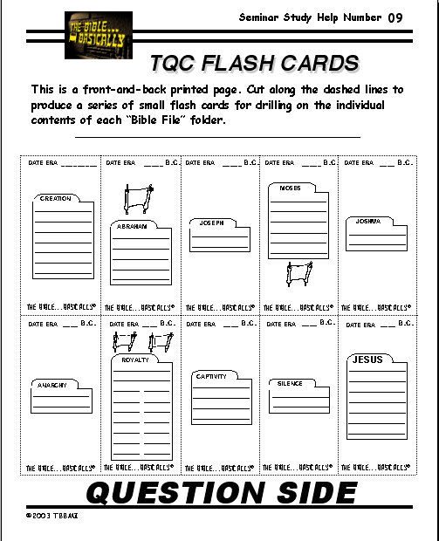
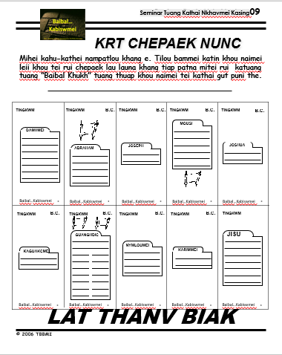
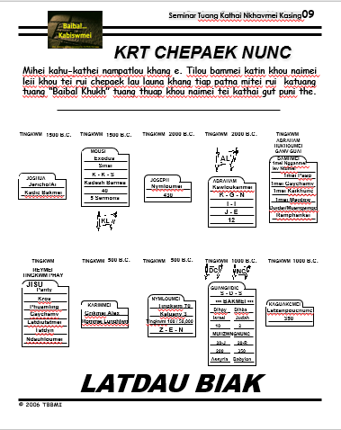

KATHAI NKHAVMEI #09
KATUMHMEI RUANVRY TUANG CHEPAEK NUNC
91
Notes:
Nkhamhmei khou…nangta nkhavlou kaluaih khang…kathai nkhavmei #9 rui kage naimei flash card duai tiap pat lana KATUMHMEI RUANVRY tuang thouduak guai kalangv naina duanc thai khang tipuni.

Slide 93

Ntau nganv khou Baibal…Kabiswmei, nanglung khou naimei hei…
• “Baibal Khukh” twmei makumc
• “Baibal Khukh” laanh khang Lungning So-thing …D 7 K J
•Makumc Dichiak rui Baibal lam daihmeinunc dinc e.
•Baibal “PARY” tuang Kanga: “Katumhmei Ruanvry”
• KABAH
• KALAM
• TAMHMEI
• RIANHLOUMEI
92
4
Notes:
Ntauthu…kathai keymei lung khou…BAIBAL KHUKH tumei makumc hei naithe…LAANCPAT KHANG LUNGNING SOTHING …NEIHPAT KACHUNG TUANG DIH HIAK NANG RANA ZAUHMAKNA HIAK THAYMEI …KUMNA NTAU RUI…BAIBAL PARY NGA… “KATUMHMEI RUANVRY” the.
Katangv khou aniu rui mundaunimei hei mi lat thanv ta e: Tingkwm 4,000 mbu miguay tihei kabah khatni tamhmei naina tabui rui nsuk kariuloubam tuang cho? Kalamthu…
//// …kabah nai e…
//// …kalam nai e…
//// …tamhmei nai e…
//// …Rianhloumei nai e…latkaeng kathuic khou, karian, kalangv khatni kabuk Hyloumei khou padikna nai e! Mihei aniu rui Poubauhmei tuang duanv kaguaina khou naimei thay e, Ravguangc lev mansei kak khou giugamakmei latdyng latrianv rui nkhavloumei swna nai e. charynmei chaengtat re!
Ntauthu…kathai mbuna chau nthuk ranv gut puni the!

Slide 94
Baibal… Kabiswmei
Bibal…Kabiswmei Tanvduanv International Inc. Fort Worth, Texas tuang Lianvloumei Duanv
www.biblebasically.com
93
©2006 TBBMI
9.65.03f.

Slide 95
94
©2006 TBBMI
9.65.03f.

