Slide 1


Baibal… Kabiswmei
©2006 TBBMI
Kasiamhloumei rui Dr. John Fryman, Texas, USA
Nchamloumei rui Dr. Rick Griffith, Singapore Bible College
Lat bai-baihmei swna BibleStudyDownloads.org khou rui nsaa latow puni

Slide 2


Thaureymei khourui Esthar nganv
7
DAMHMEI
KAGUAKCMEI
1mei ngganmei
le ntumei
1mei Paap
LATZANPOUCNUNC
350
D
1st Gaychamv
350
1st Kaikhunc
(1000 B.C.)
1st Meidow
GUANGHDIC
(1000 B.C.)
Duidai/Muangsingc
S - D - S
DL
Ramphaankai
••• BAKMEI •••
Dihpy Dihba
(2000 B.C.)
ABRAHAM
(2000 B.C.)
Israel
Judah
DIHZAAT 3
KAWLOUKANMEI
AL
10 2
LT
D 7 K J
K - K - S
MUHZWNGNUNC
I - I
20-J 20-R
J - E
200 350
Assyria Babylon
12
NYMLOUMEI
7 = 4 + 3
JOSEPH
Tingkwm 70
Nymloumei
Kaluanv 3
MEICKANG 4
430
Kwm 100 / 50,000
Z - E - N
(1500 B.C.)
MOUSI
(1500 B.C.)
(500 B.C.)
Tatpatmei
K
S
KARIMMEI
Sinai
K - G - N
Kadesh Barnea
JISU
40
40
KL
5 PARY
J
JOSHUA
Jericho/Ai
KADIC NZANHMEI
01
2
53
Notes:
//// BAIBAL KHUKH kathai keymei lungc khou…aniw DAMHMEI tumei thuap naikan the…MEICKANG DAIHMEI PADEIH…DIHZAAT KATHUMH…MITUANG KABAC KHATNI KALAM TA GIUGAMAKMEI BAIBAL LATDYNG PADEIH RUI BANG KARIULOUMEI…ntauthu Nthanmei Latrik paengc khou pat puni the tiki…miganv khou hei… Latdyng Guangc lev Latdyng Thanh tihei nsui kariulou bammei patkanmei lamnunc khou rui kadwn swmei langv zauc key puni.
//// Miganv tihei aniw rui Baibal tuang KARIMMEI ganv twna laa e.

Slide 3
RAVRAAMEI KWM:
ABRAHAM-JOSEPH 2000 B.C.
MOUSI-JOSHUA 1500 B.C.
KAGUAKCMEI-
GUANGHDIC 1000 B.C.
NYMLOUMEI-
KARIMMEI 500 B.C.
02
Notes:
Miganv hei Baibal tuang kaganv rian khou 500 B.C. gei khou e.
Ruanvry khou howgaymei ganv tei guang the, patnimei dwan khang kabamv kasiamh the. Ningtow kho Guloumeipu guangnimei khang rui mbaanv tihei chamdanvlou the…tiki tingkwm phay kasaekc mbuna naidihe. Patbammei hei rui chaeng kasiamhlou punicho? Nguay, kum the…kum changh the! Lavpat nimei tihei zauc kho.

Slide 4
7
K
D 7 J
(LG) Tingkwm 400 dou (LT)
Baansinbuk kadip 38-39
03
2
Notes:
Mihei Baibal tuang KARIMMEI ganv twna saa the… D 7 K lev J khou K tei e.
//// Latdyng Kaguangc le Kathanc kak khou hei Tingkwm 400 nai the, tiki kanei-neimei hei kathuk khatni kalam bai-baicna nai e.
//// Protestantmei nunc tuang Baibal khou heipui zuk khou hei Ravguangc rui tabui lyan mbulou cho twmei hykeylou mak ge. Latdyng Thanh khou Methiu tuang Gaychamv hukhou naimei lam khatsini hylou makge.
Muhzwng Daniel rui mi ganv khou patnimei lam tei howduclou rey the. Tiki, Protestantmei tuang Baibal khou, nthanthiakmei buk swna thu, bai-baihmei bamv khou KARIMMEI ganv lam hyloumak ge.

Slide 5
Malakai lev Metthiu kak khou
LATDYNG GUANGC
DAMHMEI
ABRAHAM
ABRAHAM
ABRAHAM
JOSEPH
ABRAHAM
MOUSI
JOSHUA
KAGUAKCMEI
GUANGHDIC
NYMLOUMEI
KARIMMEI
JISU
LATDYNG THANH
Baansinbuk kadip 38-39
©2006 TBBMI
04
2
Notes:
Mihei Baibal Khukh khou khuamkaduailou bammei pangc khou KARIMMEI THUAPH the. Tiki ningtowlou kho...Latdyng kanei kak khou naimei ganv tihei BAIBAL TUANG KARIMMEI GANV twna kawbam khou tei, mbaanv kapwm tuang ruanvry heini, baicthuaimakna rimh-rim bam khwan e.
//// Baibal Khukh tuang KARIMMEI twmei thuap tei Latdyng Guangc…
//// ….khatni Latdyng Thanh tuang…JISU tumei thuap kak khou lou chuyna lou bam the.

Slide 6
7
KARIMMEI
ca. 500 B.C.
GRIKMEI ALEX
LG K LT
KARIMMEI
GrIkmei Alex
Baansinbuk kadip 38-39
05
1
Notes:
KARIMMEI tuang kaganv rian tei… 500 B.C gei khou e.… Baibal Khukh tuang nsaamei bamv kanei rui mituang ganv khou Baibal KHATNI mbaanv tuang ruanvry lianv e…. mihei Baibal lam thaymei khou peihna kage naimei nthukna kalaic guangmei ganv e.
//// GRIKMEI ALEX khou rui kahouh lakho – tabui zaeng cho tumei tei kaganv kasaekna khang swna latdwn tiloudat puni e.

Slide 7
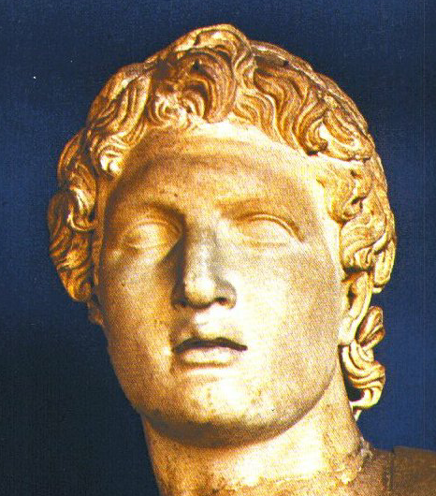
7
KARIMMEI
GrIkmei Alex
Daihmei Alexander
Baansinbuk kadip 38-39
06
Notes:
Aniw ntau sabammei hei, nchumh the, DAIHMEI ALEXANDER ta the…Swchuihakmei chabuan e, Greekmei ningting kanmei ricmei mbaanv tuang ruanvry tikailaiclou kanmeipu tei the.

Slide 8
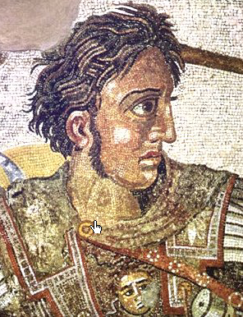
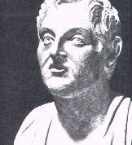
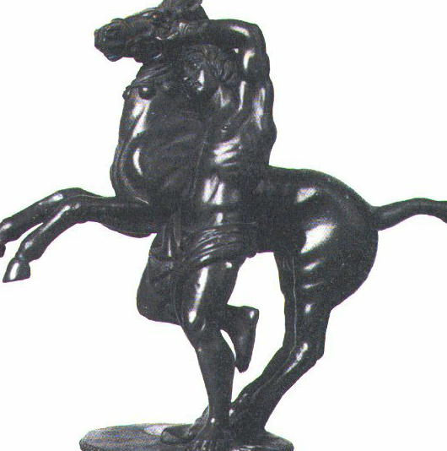
Daihmei Alexander
Alexander rui Bucephalus ta nchamlou e
KARIMMEI
GrIkmei Alex
Aristotle, katuang dinhpouc
Baansinbuk kadip 38-39
07
Notes:
Chabuan Alexander lam asaekc thaylounuhmei: Aristotle bangc khou kamei ncham khwan e, nkhamh khou katuang phauh kanmei takuanc Bucephalus khou dungc lana rihngam daicna ngam kan e.

Slide 9

MACEDONIA: ALEXANDER PUANHMEI BAMV
SILENCE
ca. 500 B.C.
OT S NT
ASIA
MEDITERRANEAN DUIPUI
ISRAEL
KARIMMEI
GrIkmei Alex
“HELLENISM”… GRIKMEI CHAPRIAK LEV “GRIKMEI THIAK”
ARABIA
Ancient Philippi
AFRICA
Baansinbuk kadip 38-39
08
5
Notes:
ALEXANDER Macedonia khou puanclou khwan e… Jisu Khrista puanh mak khou tingkwm 300 mbu huthangc e…
//// …hei tei kaguangcmei kaidai Philippi khou e, Guangh Philip nac mpouh e. Alexander tei kahu khou khatni kathei thangcmei gansaekc kumc muayna, mbaanv tuang ruanvry tihei kauhmei thaek khou zinvlik ngammei sw kan e. Katuang ricmei kang rui kaganv khou tei kazanc tatmei kandic azuh ta adou lik tat khwan the.
//// Katingkwm 33 khou kamei theihmei ganv anaguang khou tei…Alexander rui Europe khatni Asia kandic ta daicna laagut kan e …Africa dicpy khou rui ntau Turkey kawbammei bamv nganv, Ntau Greece tuang dicpy twna thay bammei bamv khou rui India nganv e. Tatkanmei ruanvry khou kida khang maekmei kalingna charynmei panty swna lungclou duc e.
//// Alexander rui dih lagutmei tuang kachung zaengc khou katuakcmei kandic launa Israel hamh ethei Canaan, katangv thangc Palestine twna Rommei ganv khou kawdat kanmei kandic nai ruak the. Alexander tuang ningmei khou Abraham kandic tateic zinvbin chuyna zinvbinlou kan e.
//// Kamei tatlouloumei bamv khou, Alexander rui "Hellenism" tuang tatnahmei tei phungc lik tat re, milat hei kathuk naimei lat re kabah rui GRIKMEI THIAK RIAK tatmei tumei tuang e. Kamei rui latow kanmei kaguaina ruc khou naimei hei…kamei rui laagutloumei kandic kathuic khou ALEXANDER rui katuang nthukliangmei chapriak ganclou duhmei hei the…
//// …Gaychamv lam khou sa e thei: Greekmei lat...lat thiak hei kazanc Kaithianv lat hamh ethei Koine (KOIN-AY) Greek twna kaw e.

Slide 10
Latdiutatmei (Latdiu.)17:16-34
KARIMMEI
ca. 500 B.C.
GRIKMEI ALEX
Grikmei ningting-takmeinunc ta khatsinih amuc rio!
KARIMMEI
GrIkmei Alex
Paul rui amuc kan makge!
Baansinbuk kadip 38-39
09
1
Notes:
Heizaengrui aniw rui Baibal Khukh khou GRIKMEI ALEX twna loumei tuang e. Mediterranean gaengzaengc khou Grik lat saamei hei rui Latdiutatmei Paul katuang nkhamhmei gaychamv dinhmei chaengtat khou mituang duduhmei bamv nunc guai khou alam chiwnana alam kan e.
//// Aniw ganv khang tiningtowloumei: Grikmei ningting-takmei nunc ta khatsinih amuc rio. Paul rui amuc kan makge. Kamei rui Greekmei tuang kauhkanmei ningting ta amuc makge tumei hei Latdiutatmei buk nahei pa pukhou thay puni… kaniw ningting tei nchumhmei Racguangc ta thaymakmei chwn khatni bumaengh zinghmei rui su mphuam bam bam sinih ningtowlou kan e.

Slide 11
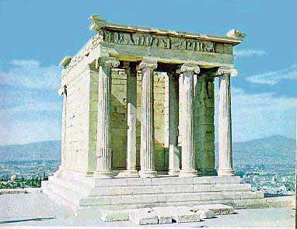
Latdiu. 17:16-34; Latdiu. 18
7
KARIMMEI
ca. 500 B.C.
GRIKMEI ALEX
Korin
KARIMMEI
GrIkmei Alex
Athens: The Acropolis &
The Temple of Athena Nike
Baansinbuk kadip 38-39
10
Notes:
Grik lat hei kabamv kathuina khou zinlikmei na hamhna…akhatni ningtowlou kho, Hellenism rui taanc tangclou kanmei guai tei...Grikmei tuang kaisw-pumhswmei thiamv guai tei kazauh the... thaynuh e: Athenmei Acropolis khatni Nike tuang thiamvmaihmei ravkai. Reynunc Korin nailou duhmei…Paul khou tei lungclou e…mitei aseic nganv naina bam e!

Slide 12
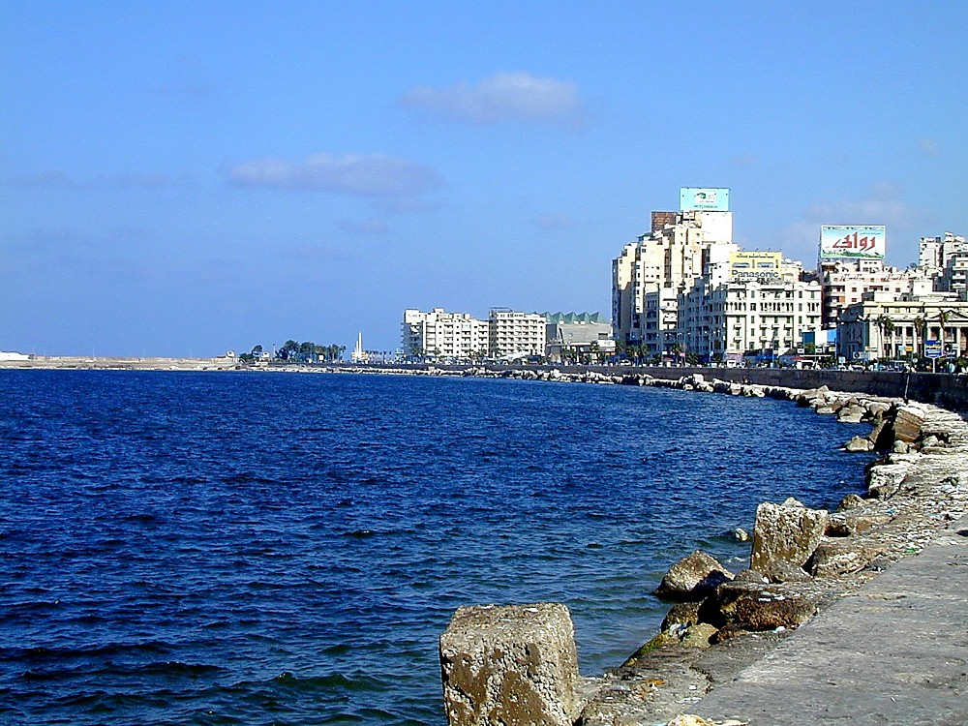
SILENCE
ca. 500 B.C.
OT S NT
Alexander rui lagutloumei dicnunc
ASIA
MEDITERRANEAN DUIPUI
KARIMMEI
GrIkmei Alex
Egypt tuang Alexandria
ARABIA
AFRICA
Baansinbuk kadip 38-39
11
2
Notes:
Alexander rui kaguangcdic kathuihna khou, kamei rui kasiamh thauloumei kaidai mpeyna ta teic, karana kazanc titat khang rui kazanc swna phuakloumei nai e.
//// Kapangc khou tei Nile duimun khou naimei Egypt tuang Alexandria heini akhat the.
//// Alexandria twna aseic nganv naina bam e. Mituang daickanmei kaidai thanh tei Mediterranean duitin khou e, Alexander rui kandih kapwm khang nchammei bamv khatni languanhmei bamv swna kasiamhlou tuang e.

Slide 13
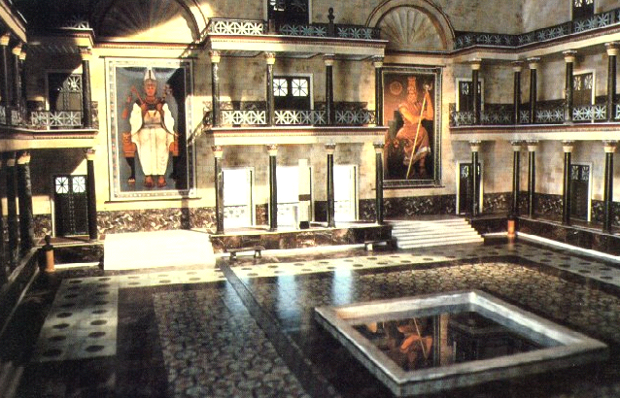
KARIMMEI
GrIkmei Alex
Alexandria khou daihmei Latrik Kai
Baansinbuk kadip 38-39
12
Notes:
Reicnungc lam hylouna naimei rui samei hei miganv dak khou tei Alexandria tuang latrik kai tei kandih kapwm tuang ningting taanvpuibamv sw khwan e. Kwm 272 A.D. khou zangsimei thouduak khou mairui Latrik kai tei ntou mut kan tuang e...heikhou tei Grikmei dinhpouc daihmeinunc, chwnhymei nunc, laamhymei nunc kahak rui hyloumei lat-hy azuh kazauh kan e. Zanh chancloumei latzy tei Krore tangkhai tangc duanhmei zu e, kamanv chak bamdat ngammakmei zu amaan kan e!

Slide 14
KATHAI NHAVMEI #05
SILENCE
ca. 500 B.C.
LATDYNG KANEI KAK TUANG TAANCPATMEI BAMV TEI ZAUC LO
OT S NT
Alexander rui lagutloumei dicnunc
ASIA
MEDITERRANEAN SEA
KARIMMEI
GrIkmei Alex
ARABIA
AFRICA
Baansinbuk kadip 38-39
13
1
Notes:
Aseic nganvna, Daihmei Alexander rui taancloumei khatni laatowloumei kaguai tihei Kandih daihmei kaguaina tuang ruanry hymei azuh rui howkahaw bam e.
//// Latdyng kanei kak khou naimei taancpatnimei bamv ta zauc ethei – Kathai Nkhavmei #5 lev zauc kaluan pukhou–– mi mansei akhat hei rui Kaipouc Jisu Khrista guangnimei khang Mediterranean kandic ta chamdaanvloumei dwan khou kadam daicna la e twmei thaypuni. …khatni kamei hei mbaanv kapwm khou patkanmei ruanvry khangni nthukmei e.

Slide 15
7
Alexander katingkwm...33 khou theic kan e...kwm 300 BC geikhou.
Kaguanghdic tei katuang diangcliangmei ricpy padeih rui nzanh laa kan e.
GREECE:
ASIA MINOR:
Cassander
Lysimachus
SYRIA:
Seleucus
KARIMMEI
GrIkmei Alex
MEDITERRANEAN DUIPUI
KATHAI NKHAVMEI #05
EGYPT
Ptolemy
Baansinbuk kadip 38-39
14
9
Notes:
Alexander katingkwm 33 khou kwm 300 B.C. mbu khou theic kan e.
//// Kaguangcdic tei katuang diangcliangmei ricpy padeih rui nzanh laa kan e....
Mediterranean tuang neihpat biak khou nai nkuaibammei kandicnunc kiu mihei khwan e…
//// Greece,
//// Asia Minor,
//// Syria, khatni
//// Egypt...
Mediterranean Duipui daeng nkuaimei mi kandicnunc tei Alenxander tuang ramv bam khuanv e kamei rui miniu guaikhang tipatmei ganv khou tei
//// Rihpy Cassander rui Greece lakan e…
//// Asia Minor tei Rihpy Lysimachus khang ti kan e…
//// Rihpy Seleucus khang Syria ti kan e...
//// khatni Egypt rui Rihpy Ptolemy khang tikan e.

Slide 16
7
Alexander katingkwm...33 khou theic kan e...kwm 300 BC gei khou.
Kaguanghdic tei katuang diangcliangmei ricpy padeih rui nzanh laa kan e.
GREECE:
ASIA MINOR:
Cassander
Seleucid tuang Guanghdaihmeinunc
Lysimachus
SYRIA:
Seleucus
'KANDIH LAA”
KARIMMEI
Greekmei Alex
MEDITERRANEAN SEA
ISRAEL
EGYPT
Ptolemimei Pharaoh nunc
Ptolemy
Baansinbuk kadip 38-39
15
2
Notes:
Kachung raph khou tei, tingkwm ruh mbu katuakc rianramei guangnina naibammei bamv launa, Israel hamhethei Palestine hei nai the—Palestine tei nkhamhna kawguang nimei zanc e.
Aniw rui thaymei kumc raphna, reynungcmei mpeyna ruini mibamv tihei kandih laa twna kawbam khwan e…mbaanv tuang patkanmei ruanvry tateic kachaeng tikalaiclou nimei inthukmei bamv e! Mi Guanghdic nunc hei kasiamh thau kan e
//// Selucid tuang Guanghdaihmei nunc Syria khou khatni
//// Ptolemimei Pharaoh nunc rui Egypt khou guanghtu kan e…Cleopatra twna kazanc tatmei liamav nailou e. Kalingthu kamei Grikmei e!
Mituang guangh kaikhuangv kanei hei Jihudimei khang charynmei simei khatni zaengsimei puakpatpuipamv swguang kan e…mpeyna kadwn swmei thouduak nunc tatkey zaic puni the.

Slide 17
7
APOCRYPHA TUANG KABUK 15
Protestantmei: Mibuknunc khou Ravguangc rui ndauhlou makge.
Roman Catholicmei rui 7 nah 1546 khou lagutlou e.
1546
1546
1546
(LG) Tingkwm 400 dou (LT)
Baansinbuk kadip 38-39
16
3
Notes:
Latdyng Guangc lev Kathanc kak khou naimei tingkwm 400 mbu saenghmei dak khou tei miguai hei ni patkan e…
//// … Apocrypha tuang kabuk 15 books hei patkan e. Mikhou rui kamanv kungc sihmei pary khatni kalamnunc mphang tow e tiki…
//// …Khristian pangc khou Protestantmei langv rui thu mibuknunc tihei Baibal khang rui khuam kaduailoumei buk nunc khou tikazauhlou zat kanmakge …canon khou tei… miniw tei Ravguangc khou rui guangmei HAMH E twna lwmmei zaeng rui e.
//// Roman Catholicmei thu, kumeki, mikhou tei rui kabuk chanei nah kaniw tuang Baibal khang khuam kaduailoumei, canon khou tei lagutlou e…kumna mitei ntau khou rui tingkwm chingkhatna phay panguh mbuna hu khou lagutkanmei tuang e.

Slide 18
7
APOCRYPHA TUANG KABUK 15
Reymei Esdras
Kaneimei Esdras
Tobit
Judith
Esthar tuang buk khou haplou datmei
Solomon tuang Ningting
Ecclesiasticus, hamhthei Sirach nac mpouh Jisu tuang ningting
Baruch
Jeremiah tuang tatdyn
Azariah Ravsuai khatni
ngganv kathumh tuang lu
Susanna
Kaengc khatni Dragon
Mannasseh Ravsuai
Reymei Maccabees
Kaneimei Maccabees...
KARIMMEI
Greekmei Alex
Baansinbuk kadip 38-39
17
1
Notes:
Minunc hei Apocrypha tuang Buknunc zanc e…kagwaina 15 e. kapangc khou tei rui kanei thu kungcna swlounuh e: Reymei khatni Kaneimei Maccabees ta e…kumna minei kak khou ni…
//// …Reymei Maccabees hei rui naireymei buk ge, mihei Karimmei Ganv tuang ruanvry saenghmei thaynuh khang kabi swmei the…

Slide 19
7
APOCRYPHA TUANG KABUK 15
Reymei Esdras
Kaneimei Esdras
Tobit
Judith
Esthar tuang buk khou haplou datmei
Solomon tuang Ningting
Ecclesiasticus, hamhthei Sirach nac mpouh Jisu tuang ningting
Baruch
Jeremiah tuang tatdyn
Azariah Ravsuai khatni
ngganv kathumh tuang lu
Susanna
Kaengc khatni Dragon
Mannasseh Ravsuai
Reymei Maccabees
Kaneimei Maccabees...
Mituang ganv tuang ruanvry hyloumei kaguangcmei Lat hy kanei nai e…
KARIMMEI
Reymei Maccabees
GrIkmei Alex
Josephus rui hyloumei
Baansinbuk kadip 38-39
18
Notes:
Kumetheithu…Karimmei ganv khou patkanmei ruanvry thay khang mi kaguangcmei buk kanei hei naithe, Reymei Macabees…khatni… Josephus rui Hyloumei. Kanei kariuna, Guloumeipu puanhmei ganv huraph khou tuang mbaanv lam thaynuh khang kalam peihna hytowlou the.

Slide 20
7
KATHAI NKHAVMEI #05
DAIHMEI ALEXANDER TUANG ZUK KHOU
ARISTOTLE: ALEXANDER TUANG DINHPOU
ARISTOTLE: LUSUANMEI THIAK
CHINA TUANG RAENGH DAIHMEI
CHINA KHOU NTANH SINSWMEI
ALEXANDRIA: GRIKMEI TUANG NCHAMMEI BAMV
EUCLID: GEOMETRY TAANCPATMEI
ROMMEI TUANG REYMEI PEISA
KORIN LANGUANHMEI BAMV SWMEI
JIHUDIMEI TUANG LANGUANHBAM NUNC EGYPT KHOU NAIMEI
HELLENMEI LEV GRIKMEI KAIDAINUNC
GRIKMEI-LUNGH RIAK
GRIKMEI LAT
KARIMMEI
GrIkmei Alex
Rommei Lungh-lwn
Baansinbuk kadip 38-39
19
12
Notes:
Heikhou hei KARIMMEI ganv khou kadai swna Daihmei Alexander ganv khou khatni katangv thangc mbaanv khou patkanmei thouduak khatni taancpatkanmei kasaekc e...
//// ARISTOTLE hei ALEXANDER TUANG DINHPOUC E
//// ARISTOTLE rui LU NCHAMMEI THIAK kasiamhpatlou e
//// CHINA TUANG RAENGH DAIHMEI taanc thau kan e
//// CHINA KHOU NTANH SINSW THAU KAN E
//// ALEXANDRIA rui GREEKMEI TUANG NCHAMMEI BAM e
//// EUCLID: GEOMETRY lam hypat kan e
//// ROMMEI TUANG REYMEI PEISA sinsw thau kan e
//// KORIN tei DAIHMEI LANGUANGHMEI BAMV sw kan e
//// JIHUDIMEI TUANG LANGUANHBAMV NUNC EGYPT khou naithau kan e.
Kumlana amuc nuhmakmei...
//// HELLENISM zinlikmei khatni GRIKMEI KAIDAINUNC
Mikhou haplou datna
//// GRIKMEI LUNGH RIAK…nthukliangna…
//// GRIK LAT geicna sinsw thaumei hei e.

Slide 21
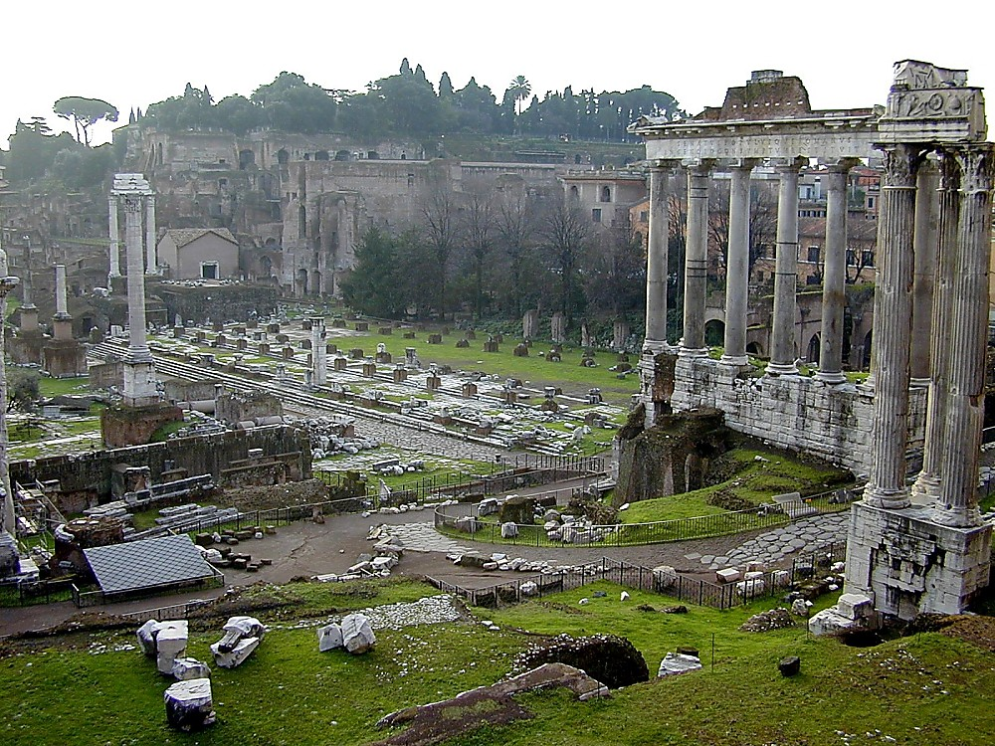
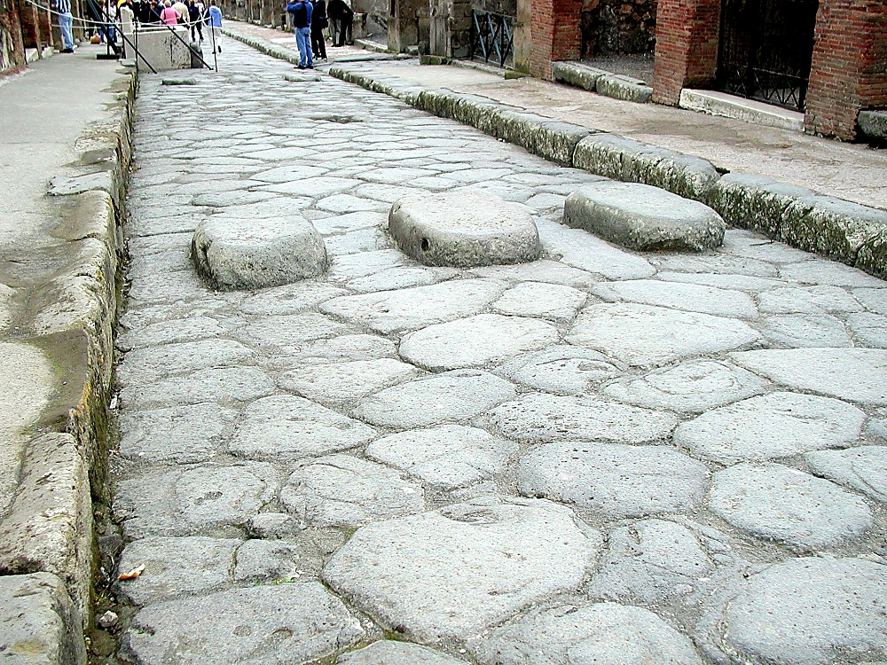
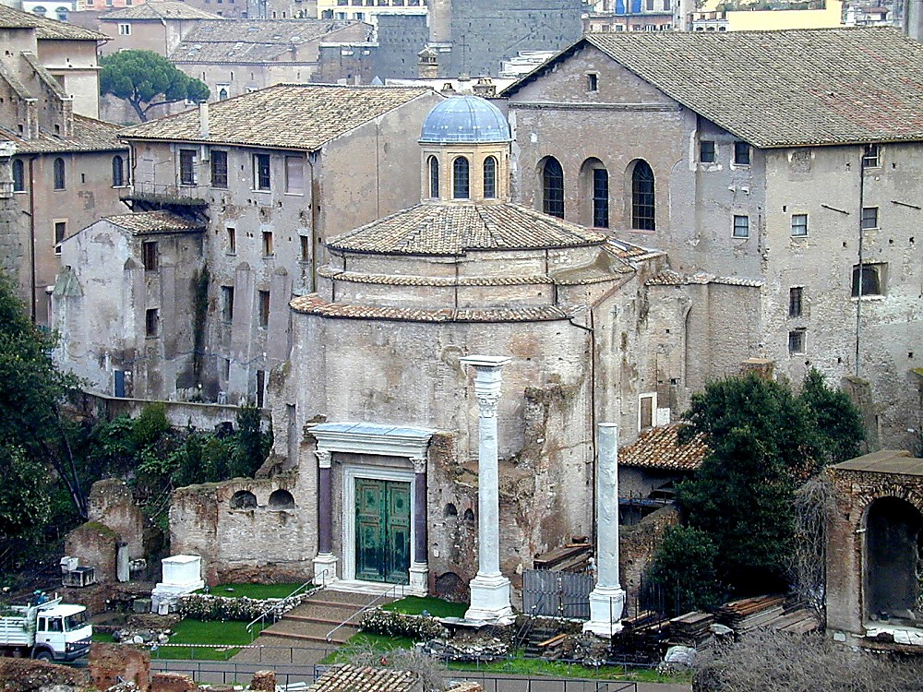
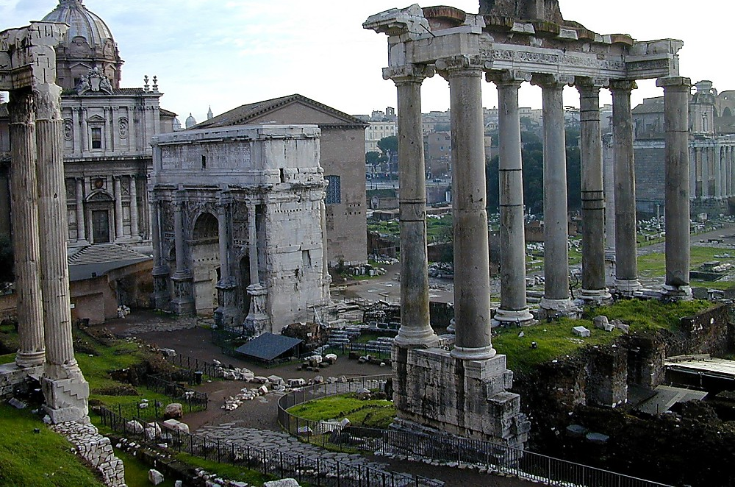
Latdiu. 28: 11-16
KARIMMEI
ca. 500 B.C.
GRIKMEI ALEX
ROMMEI LUNGH-LWN
Meic-chamc lev Rihmei Taanvthiak
Riak
Alammei thiak
Chaeng-dui
Sianv rimei lev Dihkhav
Pax Romana...
KARIMMEI
GrIkmei Alex
Rommei Lungh-lwn
Baansinbuk kadip 38-39
20
6
Notes:
Baibal khukh tuang KARIMMEI lungc khou tei muai e…kwm 500 B.C gei khou tei...ALEXANDER theihmei tangv…ROM GUANGCDIC tei katuang kabangc khou tiloubammei PHUAMV-RIAKNUNC hei phungcna, mbaanv tuang ruanvry khou gut kan e
//// meic-chamc lev rihmei taanv thiak,
//// riak,
//// Alammei thiak,
//// chaeng-dui,
//// Sianv rimei lev dih khav hei e. Kathak simei riak the.
//// Rommei tuang kazanc tatmei Pax Romana, tumeithu Rommei rui timei chuzaenghmei tumei hei, kaganv khou tei kandih daih azuh khou zinlik daicliang kane twna mbaanv rui thaylou e. …tiki mitei kathak simei thiak khwan e!

Slide 22
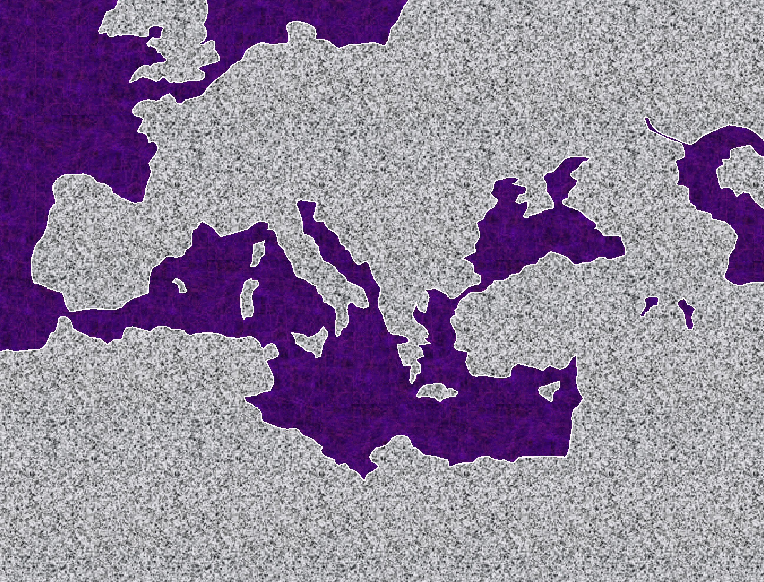

ATLANTIC DUIPUI
EUROPE
ASIA
ROMAN EMPIRE
KARIMMEI
GrIkmei Alex
Rommei Lungh-lwn
MEDITERRANEAN DUIPUI
PALESTINE
ARABIA
AFRICA
Baansinbuk kadip 38-39
21
2
Notes:
Rommei Guangcdic tei England khou rui Arabia Dicpy, khatni
//// Africa Dicpy khou rui aseic naibammei Russia dicba nganv e. Takuanh dungc kalai-laicna tat pukhou, Rom tuang guangc kaidai khou rui ducliangmei thangc naimei kaguangcdic nganv tei kanit dak kanei khou tangc ngam e twna sa e.
//// Naibam dat the, Dihba-neihpat biak thangc guanghdic tuang kakwn akhat khou katuakcmei kandic launa, Israel kandic tei dat the.

Slide 23
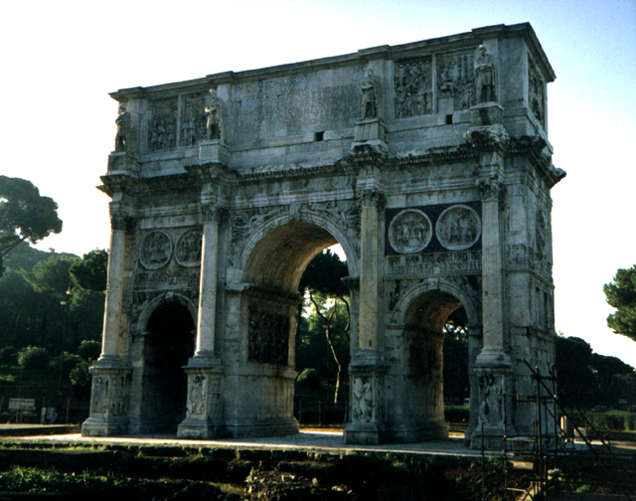
KARIMMEI
GrIkmei Alex
Rommei Lungh-lwn
Rome: Constantine Raengckat
Baansinbuk kadip 38-39
22
Notes:
Rommei tuang kai-pumh taanhmei nunc khatni kaniw tuang ricmeinunc rui taancloumei taanv kaguai hei hahla-la khang nai e. Constantine tuang Raengckat hei aseic nganv Rome khou Coliseum daeng khou dingbam e, khatni Khristian swreymei Rommei Guangcdaihmei Constantine rui kasiamh thauloumei ganv khou tei kumcna aseic ni kagunc amaan makna naibam e.

Slide 24
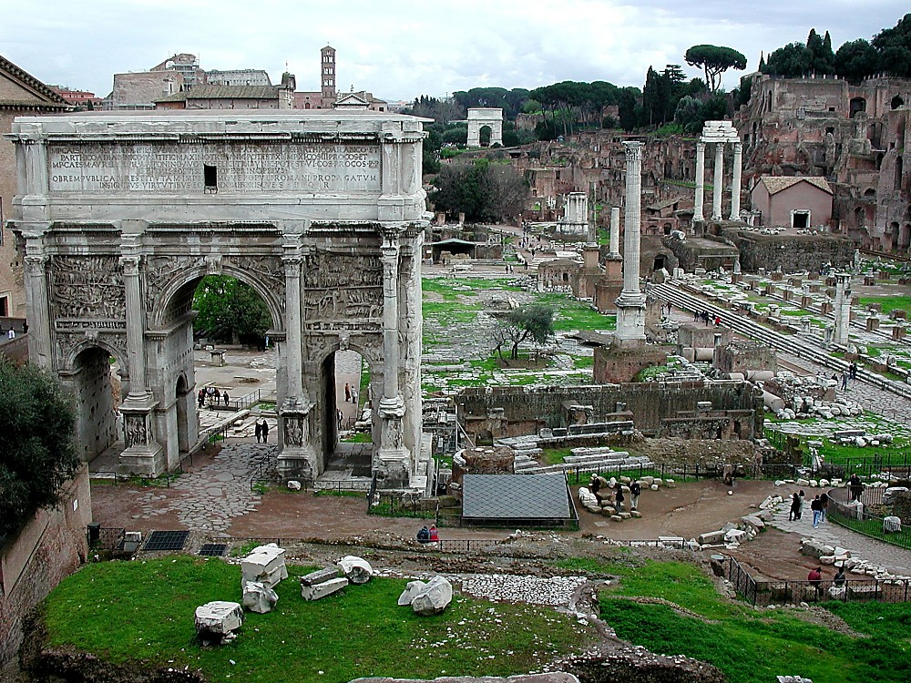
Caesar ta swluaimei
KARIMMEI
GrIkmei Alex
Rommei Lungh-lwn
Rome: Forum twmei kariupuibamv tangclou nimei chaengkuinunc
Baansinbuk kadip 38-39
23
1
Notes:
Rommei Forum twmei kariupuibamv ruini ngamv sinmei Rommei tuang zayloumei bangc khou daicthau daihmei lwnlung khatni kandih sinmei thiamv aniw ta tiningtow daicna tiningtowlou e.
//// Forum Romanum khou kaphoukai launa lyanlou bammei hei rui Julius Caesar ta swluaikanmei bamv tei e.

Slide 25
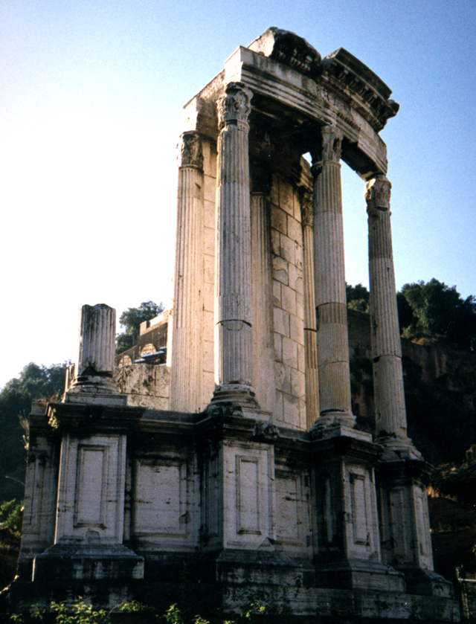
7
KARIMMEI
GrIkmei Alex
Rommei Lungh-lwn
Rome: Howgaykanmei Rommei kaithiak
Baansinbuk kadip 38-39
24
Notes:
Kaibamv daihmei kaguaina tei, tingkwm 2000 tangv dingna bam e, mihei rui nthanvna lianvloumei thu Rommei bangc khou ningting lam, kai-pumh swmei lam, thiamv thaymei khatni charuang taanv tuang thaek tei adih kauhna tikulou cho tumei hei e. Mihei rui mbaanv hei tingkwm phay mbu hu khouna tei chiwnamei panty, daicthaumakmei lwnlung lungc bammei khou rui kalaihmei phaykaemc kaemc daicna kaemc pat the twmei souctunlou e.

Slide 26

Jahon 5:2
KARIMMEI
GrIkmei Alex
Rommei Lungh-lwn
Jerusalem: Bethesda zeic
Baansinbuk kadip 38-39
25
Notes:
Guanghdic kapwm khou, kasing phuloumakmei bamv azuh khou nganv, ROMMEI LUNGH-LWN RUI Mediterranean khatni Europe kandicnunc ta ti guanlihlou khwan e. Jerusalem khou, reynungc lam phumeinunc rui Bethesda tuang zeic phupat khwan e – Rommei rui kasiamhloumei e – mihei rui Baibal khou ngamv naikanmei puatbamv akhat Jahon tuang gaychamv [John 5:2] khang kabamv gaymei tilou e.

Slide 27
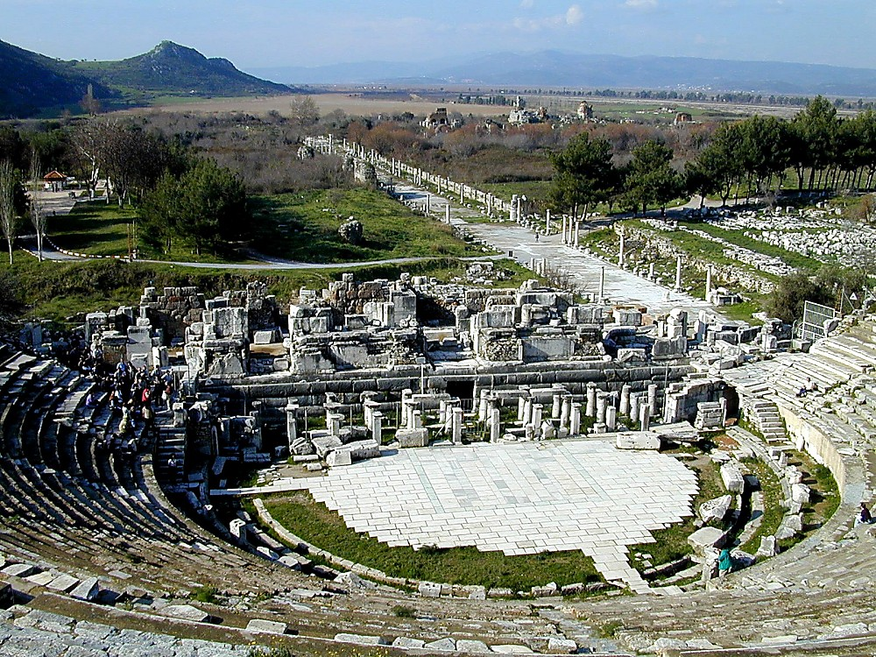
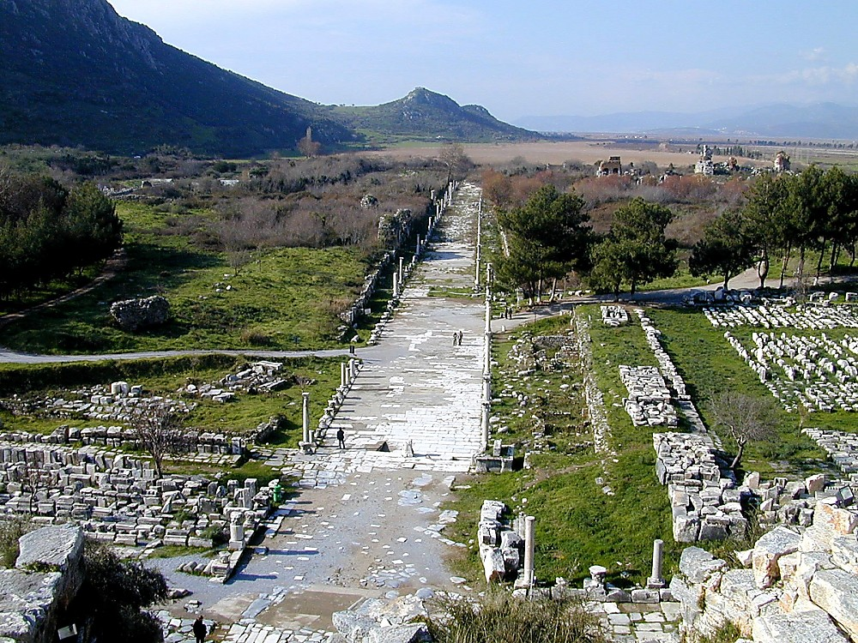
Latdiu. 19: 23-41
KARIMMEI
GrIkmei Alex
Rommei Lungh-lwn
Ephesi: (Paul tuang) Amphitheater
Baansinbuk kadip 38-39
26
1
Notes:
Kumlana duc kanmei Ephesi khou tei, ntau Turkey tubammei khou, mituang amphitheater hei dingbam e. Mibamv hei Paul ru Ravpui Daina tuang baanhthaymeinunc lev adiang kanmei bam tei dinc e.
//// Miganv khou nailoumei duidaeng, ntau thu sy rui padik the, kadaeng khou naimei chaengdai khou tei Paul kachangc changhna tatbam kan e twna la e.

Slide 28
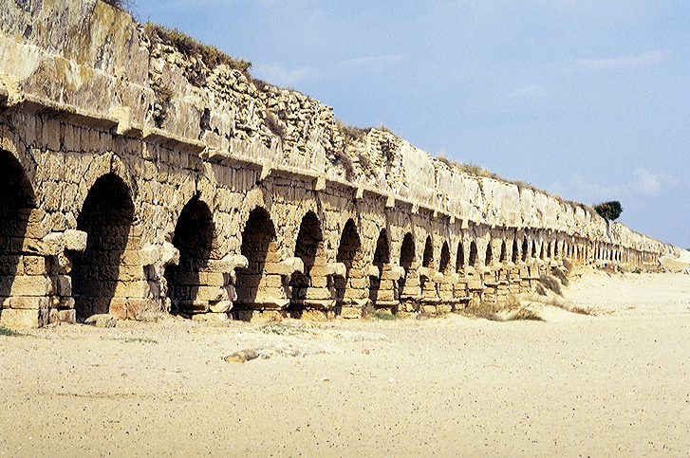
Latdiu. 18:22
KARIMMEI
GrIkmei Alex
Rommei Lungh-lwn
Caesarea Maritima, Israel: Rommei Duichaeng
Baansinbuk kadip 38-39
27
Notes:
Israelmei tuang Mediterranean duitin khou guangdat pukhou, kathaek kauhmei thiamv gutna kasiamhloumei kathuak kaneimei, mail 22 saenghmei duichaeng ntaunganv nai bam e. Rommei kai-pumh taanhmei nunc rui duh thangc Galilee tuang chingbut khou rui Guanghdaihmei zanc laana phuakloumei kaidai thanh Caesarea nganv dui laguang khang rui hiakna kasiamhlou tuang e.

Slide 29
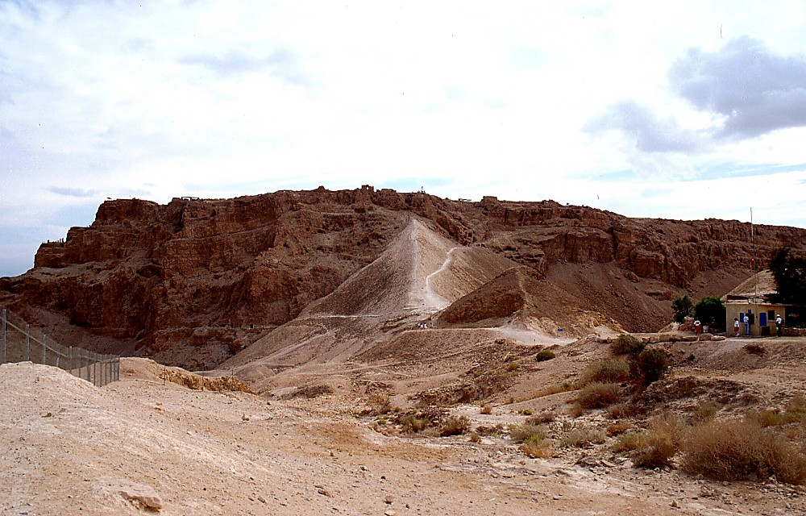
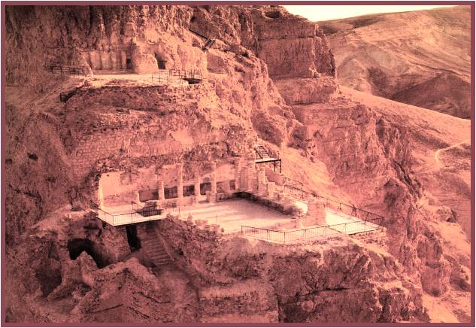
Met. 2:1
KARIMMEI
GrIkmei Alex
Rommei Rihgaek but
Rommei Lungh-lwn
Maengh tiloumei: Massada Ltd. Publishers Givatayim, Israel
Daihmei Herod:
Katuang kaidai-rihgaek kai Masada, Israel khou
28
Notes:
Kumna mihei rui...Daihmei Herod tuang Masada khou naimei daickanmei rigaek kai Theihmei Duipui ta zauckaanpatpui bamv e – mikhang rui Jerusalem tuang rih-thaumeinunc rui Rommei ta tingkwm kathumh athwng kan e. Mith-mitna Israelmei 900 rui A.D. 73 khou Rommei bangc khou bammei suangc twna kaniw panty tii kan e. Aseic nganv, Israel tuang Dih gaekmei rihphwam khang rihmei thanh ta latryan tiswmei ganv khou mibamv khou tisw e....khou tei “Kumdat lak khe!” twna kauc ndauh e.

Slide 30
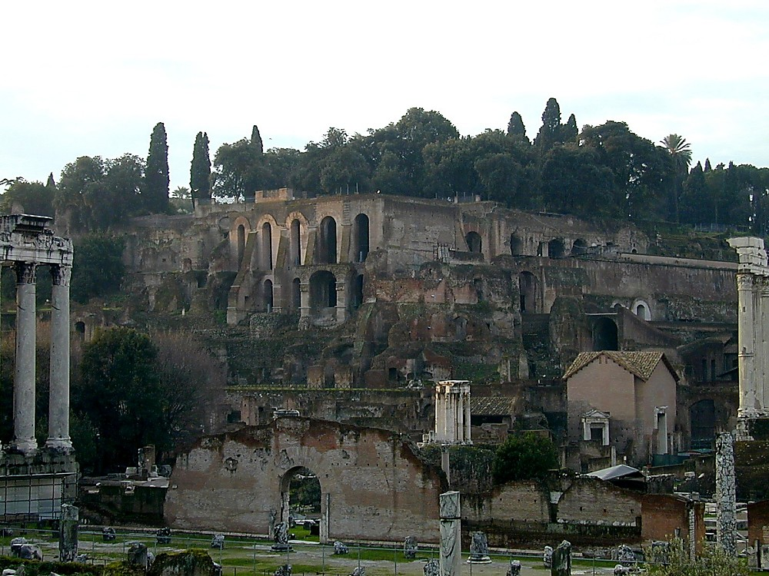
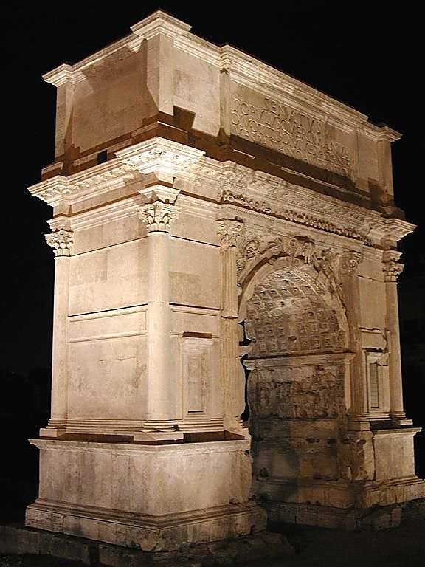
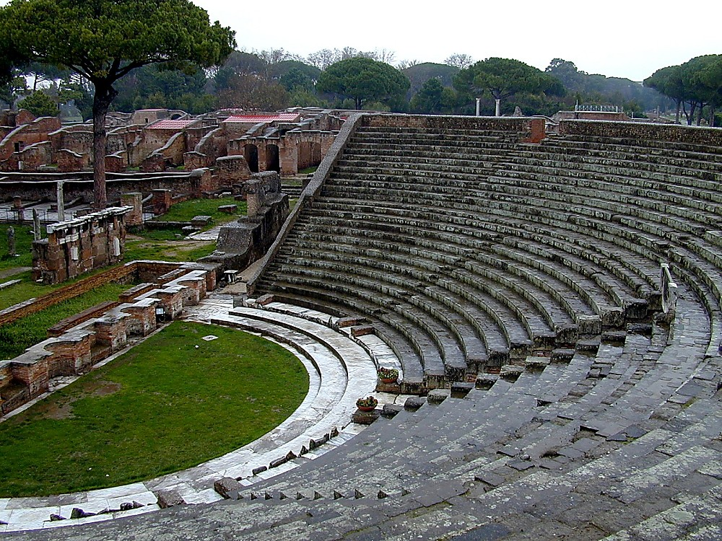
7
KUMLANA…
ROMMEI GANV KHOU TEI:
KATHAI NKHAVMEI #05
DIHSINMEI THIAK
BAANSIN LEV DUI HYANG SINMEI
TRIGONOMETRY KASIAMHPATMEI
DUI RUI KAGANV ZAUHMEI
ROSETTA TAUC HIAKLOUMEI
ALEXANDRIA: THIAMV NCHAMMEI BAMV
ROMMEI SIANV RYMEI THIAK
KAISWMEI THIAK KATHANC
DUICHAENG/NALA THIAK; CONCRETE
KHIUKHINGH KAITHIANV
GUANGHDIC-CHAENGDAI THIAK (53K MI.)
TINGMIK-365 TUANG KALENDAR PIUMEI
LATIN LAT KANDIHPWM KHOU TATMEI
RIHPHWAM KATHIAK THAYNA LOUMEI
PAX ROMANA
ROMMEI-
ISRAEL GUT LAA THE
THE ERA OF ALEXANDER THE GREAT:
ARISTOTLE: ALEXANDER'S TEACHER
ARISTOTLE: MUSIC THEORY
GREAT WALL OF CHINA
IRON USED IN CHINA
ALEXANDRIA: CENTER OF GREEK LEARNING
EUCLID: STANDARD WORK IN GEOMETRY
FIRST ROMAN COINS
CORINTH BECOMES TRADING CENTER
JEWISH TRADING CENTERS IN EGYPT
HELLENISM & GREEK CITIES
GREEK-STYLE LIVING
GREEK LANGUAGE
Baansinbuk kadip 38-39
29
16
Notes:
Kathai nkhavmei #5 khou zauc kaluaih keyna, Baibal tuang KARIMMEI ganv khou Rommei rui dih laadaic gutmei luanv hei duanc kariu louna…hykeyloumei tihei zauc o. Mituang thouduak nunc khatni phungcpatloumei nunc rui mbaanv ta ti guanlihlou the...
//// ROM TUANG DIHSIN CHUYMEI THIAK LEV CHARUANG LWN
//// BAANSIN THIAK KATHANC...DUIHYANG SINSWMEI
//// TRIGONOMETRY KASIAMH PATMEI
//// DUI RUI KAGANV ZAUHMEI
//// ROSETTA NTAUH HIAKLOUMEI
//// ALEXANDRIA KHOU THIAMV NCHAMMEI BAMV
//// ROMMEI SIANV RYMEI THIAK
//// KAISWMEI THIAK KATHANC
//// DUICHAENG/ NALA THIAK…CONCRETE
//// KHIUKHINGH KAITHIANV KHATNI SIANV LANVMEI
//// GUANGHDIC CHAENGDAI LWN
//// TINGMIK 365- TUANG KALENDAR PIUMEI
//// LATIN LAT KANDIH KAPWM KHOU TATMEI
//// RIHPHWAM KATHIAK THAYNA LOUMEI
//// PAX ROMANA phungcpatmei, khatni, kiu the, Caesar sianphai khou sauh swbammei …
//// ISRAEL TA ROMMEI RUI LAA THE

Slide 31
KUMLANA…
ROMMEI GANV KHOU TEI:
7
DIHSINMEI THIAK
BAANSIN LEV DUI HYANG SINMEI
TRIGONOMETRY KASIAMHPATMEI
DUI RUI KAGANV ZAUHMEI
ROSETTA TAUC HIAKLUAIMEI
ALEXANDRIA: THIAMV KHUAMKADUAIMEI
ROMMEI SIANV RYMEI THIAK
KAISWMEI THIAK KATHANC
DUICHAENG/NALA THIAK; CONCRETE
SIANV KAITHANV
GUANGHDIC-CHAENGDAI THIAK (53K MI.)
TINGMIK-365 KALENDER PIUMEI
LATIN LAT KANDIHPWM KHOU TATMEI
RIHPHWAM KATHIAK THAYNA LOUMEI
PAX ROMANA
ROMMEI-
ISRAEL KHOU GUT THE
DAIHMEI ALEXANDER ZUK KHOU:
ARISTOTLE: ALEXANDER TUANG DINHPOU
ARISTOTLE: LUSUANMEI THIAK
CHINA TUANG RAENGH DAIHMEI
CHINA KHOU NTANH SINSWMEI
ALEXANDRIA: GREEKMEI TUANG NCHAMMEI BAMV
EUCLID: GEOMETRY TAANCPATMEI
ROMMEI TUANG REYMEI PEISA
KORIN LANGUANHMEI BAMV SWMEI
JIHUDIMEI TUANG LANGUANHBAM NUNC EGYPT KHOU NAIMEI
HELLENMEI LEV GREEKMEI KAIDAINUNC
GREEKMEI-LUNGHMEI THIAK
GREEKMEI LAT
Baansinbuk kadip 38-39
30
Notes:
Ntau thu…kahuthangc Grikmei rui taancpatlou kanmei guai tei Rommei rui nkhamhna ningting khatni thiamv khou duanvgay gutmei daeng khou lou daclou tho. Khat khat swna kalangv kalanv zauc kida key kho…kalam nthanna howpat puni the!

Slide 32

CHARYN SIHNA KALAIHMEI KANDIC!
Baansinbuk kadip 38-39
4
03
9.65.3e.
© 2006 TBBMI
31
Notes:
Mbaanv hei Kaguangcmei Latdyng tangv tingkwm phay padeih mbu guangmei lungc khou tei mpeyna kalaic guang khwan e!

Slide 33
KATHAI NKHAVMEI #06
7
“Karimmei” Ganv
MALAKAI LEV METHIU KAK KHOU
DAICTHAUMEI KHOU KALAM DAIHMEI PADEIC:
NTHANMEI LATRIK TUANG SWMEI:
RWANRY TUANG SWMEI:
Ibrimei
Canon
Daihmei
Alexander
1. ______ ______ (Latdyng Guangc) luailou the.
3. ___________ _____________ rui Hellenmei thiak kamei rui ramlaloumei bam guai khou dincdaic pat the.
KARIMMEI
GrIkmei Alex
Grikmei
Rommei Lungh-lwn
2. Latdyng guangc tei _______ lat khou hancpatlou the.
Rommei
4. Israelmei rui ______ baanc khou gutkanmei tei _________ mbu kuhak bammei ganv khou khatni thayna bammei mbaanv khou (Pax Romana) tuang rouhsimei _____________ tibammei ganv khou e.
thiamvthay
(Septuagint hei-- “LXX” twna kathai kida khang lou the)
chuzaenghmei
…KUMNA RINGHPOUC RUI ABRAHAM KHOU SWLOUMEI DAIHMEI LATRYAN TEI GUANGTANGH KHANG KABAMV KASIAMHLOUMEI… MESSIA GUANGMEI, KAIPOUC JISU KHRISTA!
32
5
Notes:
Kathai nkhavmei #6 lev zauc kho –– Latdyng Guangc khou Malakai khatni Latdyng Thanh tuang Mathiu khou –– Nthukna taancpatloumei lam padeih rui Abraham latrianv khou Messiah guangnimei ta kahitow diangc siakloumei nai e …Nthanmei Latrik khou kanei, Ruanvry khou kanei e…
//// Reymei khou, Jihudimei rui Ibrimei tuang Canon lagut ntanghlou the…KARIMMEI ganv lungc khou, Latdyng Guangc tuang buknunc tihei ngamvziw tinailoumei kauc ndauhlou kan e.
//// Kaneimei khou, Ibrimei Latdyng Guangc hei reyliangmei swna Grikmei lat khou hanpatlou e, mihei rui Baibal hanmei taanv khou kabi swguangmei hei aseic nganv swna bam e. Kazanc hei SEPTUAGINT twna kaw e, Rommei lat khou kasing “LXX” twna ncham kauhkanmeimei ganv 70 rui Alexandria khou lat hanpatloumei tateic lyan tuang e.
//// Kathumhmei khatni ruanvry thei layna, DAIHMEI ALEXANDER RUI Grikmei thiak, latni kazauh the, Mediteranian duimun khou khatni mikhou tei rui tat ducna nzanh liklou the.
//// Padeihmei khatni nkhamhmei khou…Israel tei ROM tuang taanv-daanvmei khatni kangamv bangc khou gut the, heitei lev kazauhna kauhmei thaek tuang thiamv thaymei guang kan e, tiki guanghdic kapwmna khou kathak simei piumakna nuhmakmei CHUZAENGHMEI riak tipiulou khwan e.
//// miguay hei kariulouna, thouduak nunc hei rui Abraham khou Ravguangc rui latryan swloumei tei tiguang tangh khang kabamv kasiamhlou the…Kaipouc Jisu Khrista, Messia guangnimei ta e!

Slide 34
Thaureymei khourui Esthar nganv; liamhmei rui Malakai nganv
7
DAMHMEI
KAGUAKCMEI
1mei ngganmei
le ntumei
1mei Paap
LATZANPOUCNUNC
350
D
1st Gaychamv
350
1st Kaikhunc
(1000 B.C.)
1st Meidow
GUANGHDIC
(1000 B.C.)
Duidai/Muangsingc
S - D - S
DL
Ramphaankai
••• BAKMEI •••
Dihpy Dihba
(2000 B.C.)
ABRAHAM
(2000 B.C.)
Israel
Judah
DIHZAAT 3
KAWLOUKANMEI
AL
10 2
LT
D 7 K J
K - K - S
MUHZWNGNUNC
I - I
20-J 20-R
J - E
200 350
Assyria Babylon
12
NYMLOUMEI
7 = 4 + 3
JOSEPH
Tingkwm 70
Nymloumei
Kaluanv 3
MEICKANG 4
430
Kwm 100 / 50,000
Z - E - N
(1500 B.C.)
MOUSI
(1500 B.C.)
(500 B.C.)
Tatpatmei
K
S
KARIMMEI
Sinai
Grikmei Alex
K - G - N
Rommei Lwnlung
Kadesh Barnea
JISU
40
40
KL
5 PARY
J
JOSHUA
Jericho/Ai
KADIC NZANHMEI
33
3
Notes:
Aniw mikhou bam the…aniw rui phupatna raengclou the…
DAMHMEI…MEICKANG PADEIH…DIHZAAT KATHUMH…
//// … tihei KABISWMEI BAIBAL LATDYNG PADEIH rui bang kariulou e, ABRAHAM TUANG SWMEI latdyng latrianv nunc ta tisaengpatloumei lam kathumh…Kadic, David tuang swmei, khatni Latdyng Thanh e.
//// Kumlana, DAIHMEI ALEXANDER rui chapriak zinlikloumei khatni dih khou ROMMEI GUANGCDIC rui kalaic daihmei phung guangloumei hei rui…
//// …ntauthu Baibal khuk khou nkhamhliangmei thuap khang tei kabamv kasiamh luailou the, mikhou aniw rui Gankhat---Messia tateic zawlev zaw ariu puni the… Kakhang hei rui hymdaihmei ruanvry guay hei ndauhlou kan tuang e khatni aniw khang Ntanmei Latrik tuang Latdyng Guangc lev Kathanc khou ryloubam tuang e

Slide 35


Baibal…Kabiswmei ta alam khang BibleStudyDownloads.org
Mituang lianvloumei hei nsana latho!
Notes:
Baibal…Kabiswmei (bk)

Slide 36
34
©2006 TBBMI
9.65.03e.

