Slide 1

Burmese
or®musrf;pm tkwfNrpf
or®musrf;pm
tkwfNrpf
Texas jrdk.rS or®musrf;pm-tkwfjrpf (edkifiHwumtrSkawmfaqmifvkyfief;)
\ wifjycsuf
www.biblebasically.org
Dr ရက္ခ္ ဂရီဖိတ္၊ စကၤပူဓမၼေကာလိပ္ • www.BibleStudyDownloads.org
©2004 TBBMI
01
8.0.01.

Slide 2
owd… þoifwef;umvtwGif; w,fvDzkef;tp&Sdonfh qufoG,fa&;u&d,mrsm;tm;vkH;
acwÅydwfxm;yg/
aus;Zl;wifygonf/
8.0.01.
02
1

Slide 3
©
tNynfNynfqdkif&m taNccHor®musrf;pmavhvmNcif; trIawmfvkyfief;
tquftpyf
Dr. John Hannah
Distinguished Professor of Historical Theology
Dallas Theological Seminary
Dallas, Texas
Dr. Rick Griffith
Lecturer in Biblical Studies
Director, ThM Programme
Singapore Bible College
Singapore, Republic of Singapore
Dr. William R. Bright
Late Founder
Campus Crusade for Christ
Orlando, Florida
John Maisel Kurt Nelson
President Exec. Vice President
East/West Ministries
Dallas, Texas
Rev. Douglas Valenzuela
Senior Pastor, Conservative Baptist Missions
Chiesa Battista Evangelica di Casoria
Naples, Italy
Vasily Dimitrievski
Director for Russia
Global Missions Fellowship
Penza, Russia
Dr. David Bertch
Former President
Tyndale Theological Seminary
Amsterdam, The Netherlands
Dr. William Tolar
Distinguished Professor of Biblical Backgrounds
Southwestern Baptist Theological Seminary
Ft. Worth, Texas
Karyn Granger
Director of Bible Studies
Southwest Christian Schools
Ft. Worth, Texas
Dr. Kenneth Horton
Senior Pastor
McKinney Memorial Bible Church
Ft. Worth, Texas
8.0.01.
©2004 TBBMI
02

Slide 4
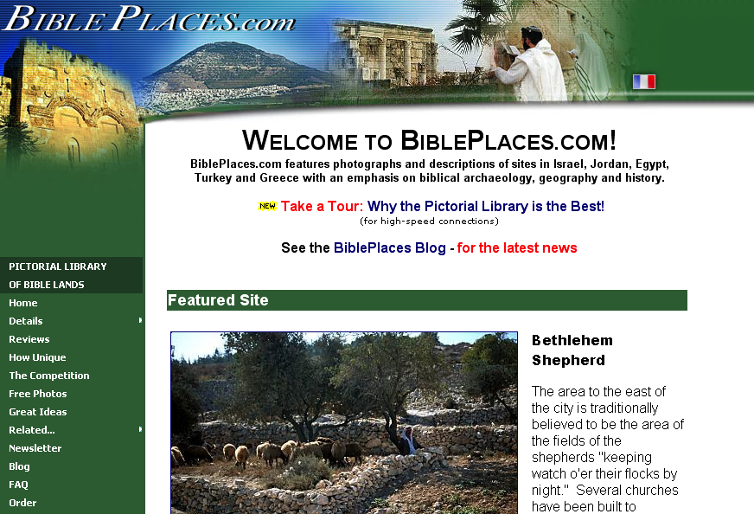
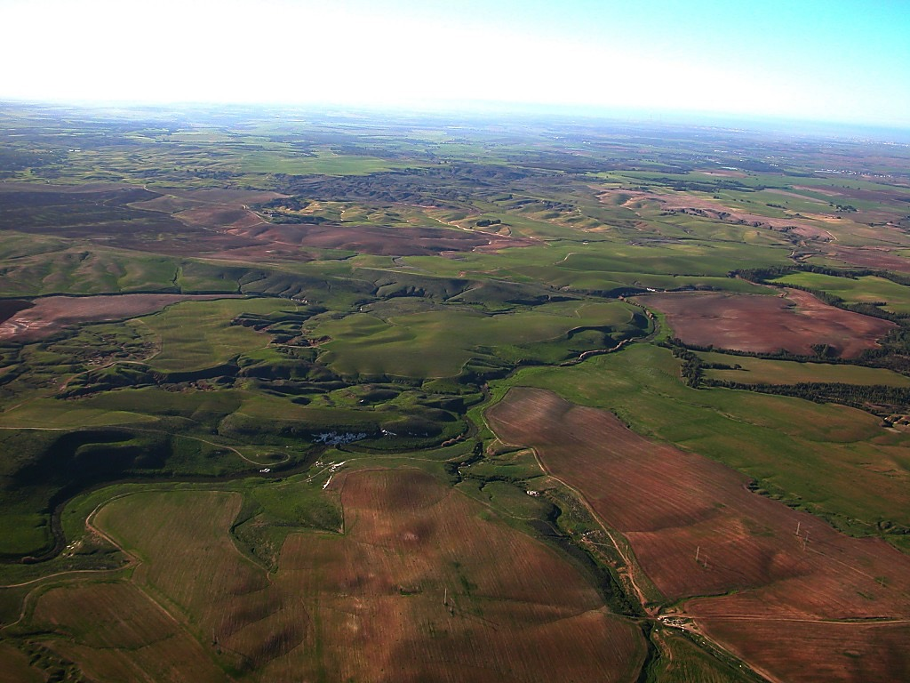
The Pictorial Library of Bible Lands
Our ministry is deeply indebted to Todd Bolen, creator of the Pictorial Library of Bible Lands, for his generous permission to use photo resources throughout THE BIBLE…BASICALLY®. TBB users are urged to visit BiblePlaces.com and explore the thousands of photo resources available: from the Holy Land, throughout the Aegean and Mediterranean Basin to Southern Europe where the Christian faith took root. BiblePlaces.com offers teachers and visual producers an incomparable array of high-resolution digital photographic resources. Please visit! Thanks, Todd!
Notes:
This presentation has been granted use of almost 150 pictures from the BiblePlaces.com website. We thank Todd Bolen for his support!

Slide 5
or®musrf;pmtkwfjrpf trIawmfaqmifvkyfief;? *ReftDz&dkifref; (John E. Fryman, Ph.D) \wifqufrI/
ul;,lwifqufrI © 2004 ormusrf;pmtkwfjrpf (edkifiHwumtrIawmfaqmifvkyfief;), Ft. Worth, Texas jrdKU
Oya'cGif.jyKcsuf&/ / tar&duefedkifiH\ ul;,lwifqufrItufOya'abmif\ umuG,frI,lxm;onf/ udk;um;rIpmrleSif. jyefvnfoHk;oyfjcif;rSvGJí pmjyKpkol\cGif.jyKcsufrygbJ tjcm;rnfonf.ul;,lwifqufrIrScGif.jyKrnfr[kwfyg/
tcsdKUcGif.jyKxm;aom tydkifu@rsm;udkrl ausmif;ol? ausmif;om;rsm;\ vdktyfaomtcsufrsm;ay:wGifrlwnfí txl;cGif.jyKcsufay;oGm;rnfjzpfygonf/ þtrIawmfvkyfief;wpfckvHk;ü
"gwfyHkrsm;toHk;jyKcGif.ay;aom £oa&vedkifiH&Sd a,&k&SvifjrdKU? rwfpfwmaumvdyfrS a'gufwmawm.bdkvif (Dr. Todd Bolen) tm;txl;aus;Zl;wif&Sdygonf/ um'uf&SfbmeD;,m; (Kadesh-Barnea) \ "gwfyHkcGif.jyKcsufrSm atmfpaBw;vD;,m;edkifiH a[mfwdk&kefeuf'ef;e,f (Hawthornedene) rS a'gufwmvdef;&pfr,f,m; (Dr. Leen Ritmeyer) \ cGif.jyKcsufjzpfygonf/ ul;,lrIjyKvdkygu cGif.jyKcsuf&,lay;yg&ef trIawmfaqmifvkyfief;rS arwÅm&yfcHtyfygonf; ul;,laompmrltwdtustm;vnf; today;apvdkygonf/ taBumift&if;rSm pmom;aomfvnf;aumif;? ajryHkaomfvnf;aumif; w&m;r0iful;,lrIrsm;tm; a&Smif&Sm;ap&efjzpfygonf/ q&m?q&mrrsm;eSif. Bumaewqif.cHjyo? oGefoifrIjyKolrsm;onf þyg0gyGdKif.wGif&Sdaom tcsufrsm;tm; jyKjyifjcif;? tcsuftvufajymif;a&TUpDrHjcif;? uGefjyLwmqdkif&majymifvJrIjyKjcif; rsm;udk pmjyKpkol\ cGif.jyKcsufrygbJ rjyKvkyf&ay/
tar&duefedkifiHrSxkwfa0onf/ edkifiHwumtcGif.ta7;qdkif&m todtrSwfjyKjyD;/
8.0.01.
©2004 TBBMI
03

Slide 6
Burmese
or®musrf;pm
tkwfNrpf
Texas jrdk.rS or®musrf;pm-tkwfjrpf (edkifiHwumtrSkawmfaqmifvkyfief;)
\ wifjycsuf
www.biblebasically.org
©2004 TBBMI
04
8.0.01.

Slide 7



(or®musrf;pm&nf&G,fcsufudk &Sif;vif;pGmydkif;Ncm;wwfap&ef)
or®musrf;pm tkwfNrpf
®
tydkif; 1
or®musrf;pmudk
“pwifzGifhvSpfNcif;”
©2004 TBBMI
8.0.01.
05

Slide 8
az:NyygtaMumif;t&mrsm;\t&if;tNrpfubmvJ…
?
c&pf,mefbmomoGefoifcsuf
þtpDtpOfudk tawG;tac:rsm;pGmESifhtpNyK
MuygpdkU
c&pf,mef\,HkMunfcsufoGefoifyHk
usrf;pmtaNcNyKonfhpmtkyf
usrf;pmausmif;pmMunfhwdkuf
vlxkpmMunfhwdkuf
yk*¾vdupmMunfhwdkuff
wuúodkvfpmMunfhwdkuff
urÇmw0Sef;vHk;
bmompum;wkdif;
eSifh
usrf;pmukdaNccHaom awG;ac:rI
pMum0VmtwGif;&Sd ,HkMunfoleSifh r,kHMunfolwdk.\tawG;tac:rsm;
8.0.01.
15
©2004 TBBMI
06

Slide 9
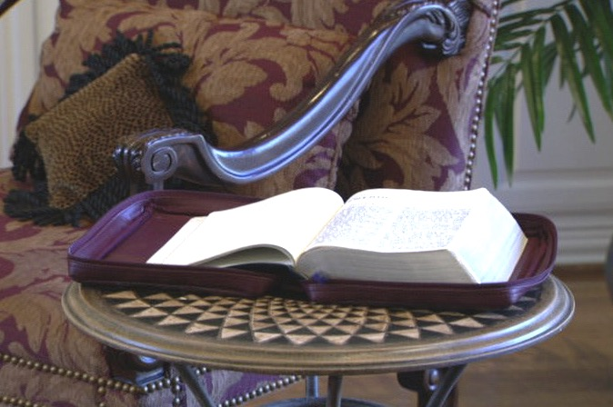
uRefKyfwdkY,HkMunfNcif;\ taNccH
taxmuftxm;rsm;
Handbook pg. 6
07
2

Slide 10

Dr. Henrietta Mears \pmtkyfwGif
or®musrf;pm&Sd taMumif;t&myg tm;vHk;udk a&;om;xm;ygonf/
Handbook pg. 6
08

Slide 11
tcsKdUaomolwdkU\ usrf;pmA[kokwonf vSyaomykvJuHk;wpfuHk;eSifh
wlygonf/
odkYaomftcsKdUaomolwdkY\todwGifrlum;
Handbook pg. 6
09

Slide 12

…ykvJvHk;av;rsm;onf oD;Ncm;pDuGJNym;vQuf&SdNyD; pkpnf;rIr&Sdyg/ tpOfvdkufpkpnf;xm;aomusrf;pmtaMumif;t&mrsm;onfvnf; tpOfwdkif;rNzpfawmhbJ
&IyfaxG;ukefygonf!
Handbook pg. 6
10

Slide 13
Handbook pg. 6
11

Slide 14
s
usrf;pm\twdrfteuf
uGJNym;aomteuft"dyÜg,f
oefY&Sif;aom0dnmOfawmftm;Nzifh
eufeJpGmavhvmoif,lNcif;
12
2

Slide 15
?
?
?
bk&m;ocif\a&G;eIwfNcif;tpDtpOf?
tmNA[HeSifha&S;ueOD;uúKoa&vvlrsKd;?
ocifa,&Iay:xGef;awmfrlNcif;?
toif;awmfpwifarG;zGm;Ncif;?
?
?
?
?
?
?
13
5

Slide 16





  Þþrnfaom usrf;pmtkyfrsm;udk avhvmMunf.yg!
14

Slide 17
þpmtkyfrsm;onf Nyoemrsm;\tpyifNzpfonf!
aNz&Sif;í rNyD;NywfedKifaomykpämrsm;Nzpfonf!
• axmifaomif;ruaomtaMumif;t&mrsm;
• &meSif.csDaomZwfaumifrsm;
• pmvHk;a7aygif; 170, 000
• tcef;MuD;aygif; 1,200
• tceff;i,faygif; 31,000
• ra&wGufedKifaombmomNyef
pmtkyfrsm;pGm&Sdonf
15
7

Slide 18
b,folubmvkyfovJ?
b,folubmaNymovJ?
pmtkyfrsm;
bmNzpfwmvJ?
vlrsm;
&ufpGJrsm;
b,fol/ b,fvdk qufpyfrI&SdygovJ?
16
7

Slide 19
ulnDDBuygOD;
b,folubmaNymovJ? ?
b,folubmvkyfovJ? ?
pmtkyfrsm;
bmNzpfvdkYvJ?
vlrsm;
&ufpGJrsm;
b,fol/b,fvdk qufpyfrI&SdygovJ? ?
17

Slide 20
ulnDNuygOD;!
usGefawmfrwwf
Ekdifawmhbl;?
oif;tkyfq&myJ
vkyfygapawm.!
18

Slide 21
b,folu
wm0ef,lrvJ?
19

Slide 22
'Dvkdqdk&if
b,fvkdvkyfrvJ
20

Slide 23
uRefkyfwdkU\,HkBunfcH,lcsufonftrSefw&m;ay:wGiftajcrcHygu rSeff;qjcif;?t,lao;rI?eSif. xifNrifcsuffrQomNzpfygvdrf.rnf”
Miles Stanford
Principles of Spiritual Growth
trSefw&m;
rSef;qjcif;
t,lao;rI
xifNrifcsuf
21
4

Slide 24
oifMum;Ncif;\ta&;ygaomausmufql;
xdkYtNyifrdrd\,HkMunfcsufxufvGefuJpGmtouf&SifvdkufavQmuf
rnfr[kwfyg.”
“uRefKyfwdkYonf rdrdodxm;onfxuf
,HkMunfrnfr[kwf,
Albert Mohler, President
The Southern Baptist Seminary Louisville, KY
22

Slide 25

So… here we go!
(And don’t miss a single session. Each builds toward the next!)
23
1
©2006 TBBMI
9.65.01.
Notes:
Which brings us to the study that lies ahead. We are about to embark on a Biblical voyage named: THE BIBLE…BASICALLY. It’s a quick tour through ALL of Scripture, leaving you well equipped to THINK BIBLICALLY and to help others acquire that same skill!
You will have a new set of mental tools that can reshape your view of God’s Word and his message for your life and the lives of others around you…both believers and those still searching for life’s answers!
//// So here we go…and try to attend every session or class because each new idea steadily builds on those that have gone before!

Slide 26
taNccHususav.vmNcif;onf
®
rSefuefpGmpOf;pm;qifNcif Ncif;vnf;Nzpfonf!
24
Notes:
CHANGED FROM THE ORIGINALS (TQC)

Slide 27
taNccHususav.vmNcif;Nzif.
®
usrf;pmudkrSefuefpGmudkifwG,fav.vm
oHk;oyfwwfvmygvdrf.rnf
25
Notes:
CHANGED FROM THE ORIGINALS (TQC)

Slide 28
taNccHususav.vmNcif;
®
ta&;ygaomtaMumif;t&m?
olwyg;tm; oifay;edKifonfht&m&Sdygonf!
z7vlY a,
oufaocHbdkYb,fvdkrsm; p7ygvdrf.!!!
26
1
Notes:
CHANGED FROM THE ORIGINALS (TQC)

Slide 29
taNccHususav.vmNcif;
®
“oif.usrf;pmrSwfpkpmtkyf”
udkzGif.vdkufyg
27
Notes:
CHANGED FROM THE ORIGINALS (TQC)

Slide 30
28

Slide 31
29

Slide 32
30

Slide 33
31

Slide 34
32

Slide 35
?
,ck trSm;trSefa&maewJhowif;tcsuf
tvufawGudk b,fvdkpNyD; a&G;cs,frvJ?
?
?
?
33
5

Slide 36
b,fvkdrSr
pOf;pm;wwf
awm.bl;!
b,fup&yg.rvJ?
34

Slide 37
7
Handbook pg. 8-14
35

Slide 38
7
7
Handbook pg. 8-14
36
1

Slide 39
7
oif.usrf;pmrSwfpk
Handbook pg. 8-14
37

Slide 40
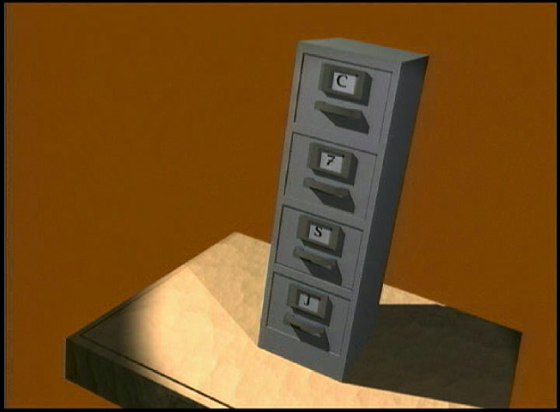
7
File Cabinet Movie w/ narration
38

Slide 41
7
1
2
3
4
5
6
7
8
9
10
Handbook pg. 8-14
39

Slide 42
“oif.usrf;pmrSwfpk” udk zGif.vdkufyg
7
7
7
7
7
7
zefvla,
zefvla,
zefvla,
zefvla,
Handbook pg. 8-14
40
4

Slide 43
“oif.usrf;pmrSwfpk” udk zGif.vdkufyg
7
7
= 3+4
Handbook pg. 8-14
41
2

Slide 44
7
“oif.usrf;pmrSwfpk” udk
zGif.vdkufyg
zef 3 4 qdwf a,
zef 3 4 qdwf a,
Handbook pg. 8-14
42
1

Slide 45
pmvHk;twdkaumuf 5ckeSif.qdkvdk&if;rsm;
7
zef = zefqif;Ncif;
4 = vlrsKd;
3 = vlUtzGJUtpnf;
qdwf = qdwfNidrfumv
a, = a,&I
Handbook pg. 8-14
43
5

Slide 46
pmvHk;twdkaumuf 5ckeSif.qdkvdk&if;rsm;
7
zef = zefqif;Ncif;
3 = vlUtzGJUtpnf;
4 = vlrsKd;
qdwf = qdwfNidrfumv
a, = a,&I
Handbook pg. 8-14
44
6

Slide 47
pmvHk;twdkaumuf 5ckeSif.qdkvdk&if;rsm;
7
zef = zefqif;Ncif;
4 = vlrsKd;
3 = vlUtzGJUtpnf;
qdwf = qdwfNidrfumv
a, = a,&I
Handbook pg. 8-14
45

Slide 48
vlrsKd; 4 rsKd;rsm;rSm
7
tm NA[H
a,m oyf
arm a&S
a,m &I
Handbook pg. 8-14
46
5

Slide 49
7
A
JUDGE
MUST
JUDGE!
Handbook pg. 8-14
47

Slide 50
vlrsKd; 4 rsKd;rsm;rSm
7
a,m oyf
tm NA[H
A
arm a&S
JUDGE
a,m &I
MUST
JUDGE
Handbook pg. 8-14
48
8

Slide 51
7
zefqif;Ncif;
tmNA[H
a,moyf
arma7S
a,m7I
Handbook pg. 8-14
49
5

Slide 52
pmvHk;twdkaumuf 5ckeSif.qdkvdk&if;rsm;
7
zef = zefqif;Ncif;
4 = vlrsKd;
3 = vlUtzGJUtpnf;
qdwf = qdwfNidrfumv
a, = a,&I
Handbook pg. 8-14
50

Slide 53
7
rif;?bk&if?odrf;
Handbook pg. 8-14
51
2

Slide 54
vlUtzGJUtpnf; 3 rsKd;rsm;rSm
7
rif; rJ.umv
bk&if tkyfpdk;Ncif;
odrf; ydkufcH&Ncif;
Handbook pg. 8-14
52
6

Slide 55
zefqif;Ncif; tmNA[H a,moyf arma&S a,m&I rif;rJ.umv bk&iftkyfpdk;Ncif; odrf;ydkufcH&Ncif;
7
Handbook pg. 8-14
53

Slide 56
7
7
NyefvSefNcif;...
zef vla,
7
Zef 3 4vla,
Handbook pg. 8-14
54
3

Slide 57
zefqif;Ncif; vlrsKd; 4 rsKd; vlUtzGJUtpnf; 3 ck qdwfNidrfumv a,&I
7
Handbook pg. 8-14
55

Slide 58
7
zefqifNcif;
tmNA[H
a,moyf
arma&S
a,m&I
rif;rJhumv
bk&iftkyfpdk;Ncif;
odrf;ydkufcH&jcif;
qdwfNidrf7mumv
a,&I
Handbook pg. 8-14
56
2

Slide 59
oif. “usrf;pmrSwfpk”
zefqif;Ncif;
CREATION
ABRAHAM
ABRAHAM
tmNA[H
ABRAHAM
JOSEPH
ABRAHAM
MOSES
JOSHUA
a,moyf
ANARCHY
arma&S
ROYALTY
CAPTIVITY
a,m&I
SILENCE
JESUS
rif;rJhumv
bk&iftkyfpdk;Ncif;
odrf;ydkufcH&Ncif;
qdwfNidrfumv
a,&I
Handbook pg. 8-14
57
11

Slide 60
7
Handbook pg. 8-14
58

Slide 61
7
Handbook pg. 8-14
59

Slide 62
7
Handbook pg. 8-14
60

Slide 63
7
Handbook pg. 8-14
61

Slide 64

7
ajymif;vJaeaomurmMuD;
Handbook pg. 8-14
62

Slide 65




7
zefqif;Ncif;
CREATION
ABRAHAM
ABRAHAM
tmNA[H
ABRAHAM
ABRAHAM
ABRAHAM
a,moyf
JOSEPH
ABRAHAM
ABRAHAM
arma&S
MOSES
a,m&I
JOSHUA
rif;rJhumv
ANARCHY
bk&iftkyfpdk;Ncif;
ROYALTY
odrf;ydkufcH&Ncif;
CAPTIVITY
qdwfNidrf&mumv
SILENCE
a,&I
JESUS
63

Slide 66

64

Slide 67

C
65
10

Slide 68
{
C
zef 7 Nidrf a,&I
}
vlrsKd; 4 rsKd;
3
vlUtzGJUtpnf;
66

Slide 69
oif.usrf;pmrSwfpk!
CREATION
ABRAHAM
JOSEPH
av.vmyg
MOSES
JOSHUA
ANARCHY
pkHvifpGmyg0ifaom
ROYALTY
CAPTIVITY
SILENCE
JESUS
em;vnfvG,faom
67
4

Slide 70

,ckcsdefwGif taNccHusususrf;pmav.vmNcif; eSif.ywfoufí, oifpOf;pm;rdaomt&monf…
•usrf;pmrSwfpk eSif.
•xdkusrf;pmrSwfpkudk pwifzGif.ay;rnfht&m…zef 7 vlY a, Nzpfonf
1. bmawGNzpfysufcJhovJ!
aNzqdk&efvdktyfaomar;cGef; 3 ck
2. bm.aMumif.vJ!
3. usrf;pmwGifyg0ifaom taMumif;t&mrsm;ay:rSm b,favmufvTrf;rdk;NyD;em;vnfrI&SdovJ!
68
4

Slide 71
zef
7
Nidrf
a,
zefqif;Ncif;
qdwfNidrfcsdefff
a,&I
{
tmNA[H
tmNA[H
a,moyf
a,moyf
arma&SSS
arma&S
a,m&I
a,m&I
{
STUDY HELP #01
rif;rJhumv
rif;rJhumv
bk&ifumv
bk&ifumv
odrf;ydkufcH&csdef
odrf;ydkufcH&csdef
20
©2004 TBBMI
8.0.01.
69

Slide 72
STUDY HELP #02
...
©2004 TBBMI
8.0.01.
9
70

Slide 73
7
71

Slide 74
taNccHusus usrf;pmav.vmNcif;
®
“oif.usrf;pmrSwfpk” udkpzGif.&ef aom.csuf
72

Slide 75
vufawGUprf;oyfMunfh&ef… uRefKyfwdkUav.vmaeaomt&m…
•xdkt&mudk “usrf;pmrSwfpk” [kac:onf
•todOmPfu “usrf;pmrSwfpk” udkpwifzGif.ay;onf- zef 7 vl a,
•usrf;pmyg t"dutNzpftysufrsm;onf todOmPfxJwGif &Sdonf
•”usrf;pmtNzpftysuf” a'gifvdkuf? “tpOfvdkuf NzpfysufyHkav.vmNcif;”
•usrf;pm\ t"duyk*¾KdvfNzpfaom tmNA[Honf ocifa,&I\trIawmfvkyfief;udk wdkuf&kdufaz:Nyaeonf
•usrf;pm\ tkwfjrpfonf rSefuefaomtNzpftysufrsm;ay:wGif wnfaqmufxm;onf
• "r®a[mif;eSif. "r®opfrsm;\ t"duoGefoifcsufrsm;
 
73
7

Slide 76
Burmese
or®musrf;pm-
tkwfNrpf
Texas jrdk.rS or®musrf;pm-tkwfjrpf (edkifiHwumtrSkawmfaqmifvkyfief;)\ wifjycsuf
www.biblebasically.org
©2004 TBBMI
8.0.01.74
8.0.01.
©2004 TBBMI
75

Slide 77


တရားေဟာျခင္းအ တတ္ပညာ • BibleStudyDownloads.org
အခမဲ့အဘို့ဤတင်ပြချက်
Notes:
Preaching (pr)
Homiletics

Slide 78
Black

