Slide 1

バイブル ベイシック
A Presentation of The Bible…Basically Ministries International Inc.
Fort Worth, Texas
Designed by Dr. John Fryman, Texas, USA • BibleBasically.org
Taught by Dr. Rick Griffith, Singapore Bible College
All files in many languages for free download at BibleStudyDownloads.org
9.65.01.
©2004 TBBMI
04
Notes:
Japanese title slide

Slide 2
おおまかな年代:
アブラハム～ヨセフ 2000 B.C.
モーセ～ヨシュア 1500 B.C.
01
Notes:
Time-line Date: a change…now about 1500 B.C. We have now moved about 500 years closer in our own historic time. Remember: the dates are heavily rounded!

Slide 3
7
出エジプト 2:10
天地創造
ABRAHAM
アブラハム
ABRAHAM
“審判は
下されなくて
はならない。
ヨセフ
ABRAHAM
モーセ
ヨシュア
無政府
王制
捕囚
沈黙
イエス
Handbook pg. 26-29
02
Notes:
The memory tool…A JUDGE MUST JUDGE…leads to the M of the sentence, which stands for…MOSES. And here is the MOSES folder in the familiar Bible File line up.

Slide 4

7
出エジプト 8:1
私の民を去らせてください!
MOSES
ca. 1500 B.C.
“４人の人”
の３番目は：
AJMJ
モーセ
40
Handbook pg. 26-29
03
1
Notes:
MOSES’ file folder appears...as the third in the group of four great people...with a number of items to be added his file folder.
After centuries of Israelite bondage, MOSES moves to center “stage of the action.” Repeatedly he approaches the Pharaoh to…
//// “…LET MY PEOPLE GO.” And only after MOSES calls down on Egypt a series of devastating plagues does the Pharaoh finally release the Israelites.

Slide 5
7
出エジプト 12:31
モーセ
ca. 1500 B.C.
出エジプト
出エジプト!
“４人の人の”
３番目は:
AJMJ
モーセ
出エジプト
40
Handbook pg. 26-29
04
1
Notes:
Under MOSES’ direction those masses of Israelite slaves and their families are permitted to leave Egypt…perhaps as many as two million people according to many scholars and teachers. And that’s called the well-known EXODUS.
//// And that’s the first item on the Moses file folder

Slide 6
出エジプト 12:31; 19:2
舞台準備
MS
N(A)
H
SG
C
ER
B
J
MN
モーセ
DS
出エジプト
出エジプト!
E
KB
U
40
MS
PG
RS
Handbook pg. 26-29
05
Notes:
That line tracing ancient travel on your map now turns east and then south toward the traditional site of Mount Sinai…right there between the fat rabbit ears on your hand-made map.

Slide 7
出エジプト 13:18
舞台準備
MS
N(A)
H
SG
C
ER
B
現在のスエズ運河に立ち寄ってみましょう。
J
MN
モーセ
DS
出エジプト
E
葦の海:
“ヤム スーフ”
U
40
KB
MS
PG
RS
Handbook pg. 26-29
06
2
Notes:
Led by MOSES, the Israelites cross what is traditionally called the Red Sea.
/// However, many scholars call it – and, we believe, correctly –
the Sea Of Reeds -- or Yam Suph. It was a body of water on the border between Egypt and the Sinai Peninsula, called in later centuries the Bitter Lakes.
//// That would be the same region through which today’s Suez Canal transfers the world's commerce to every corner of the planet.
God allows MOSES to lead the people through those waters on dry land while the Pharaoh's Egyptian forces pursued them. The Egyptians were drowned as the waters returned to their normal levels following the Israelites’ crossing.

Slide 8
7
出エジプト 19章
モーセ
ca. 1500 B.C.
出エジプト
シナイ
AJMJ
モーセ
出エジプト
シナイ
40
Handbook pg. 26-29
07
1
Notes:
Safely on the other side, MOSES makes that right-hand turn toward SINAI…leading the Children of Israel southward.
//// Eventually they arrive at MOUNT SINAI, deep in the Sinai Peninsula...there between the rabbit’s ears.

Slide 9
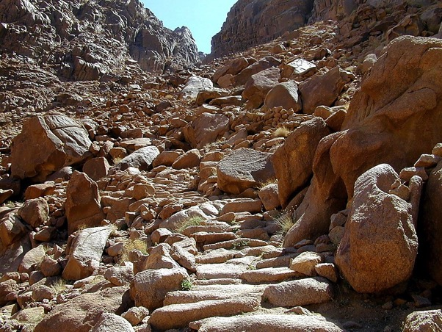
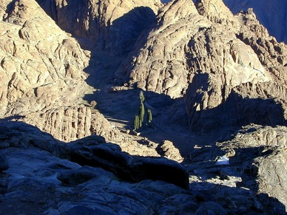
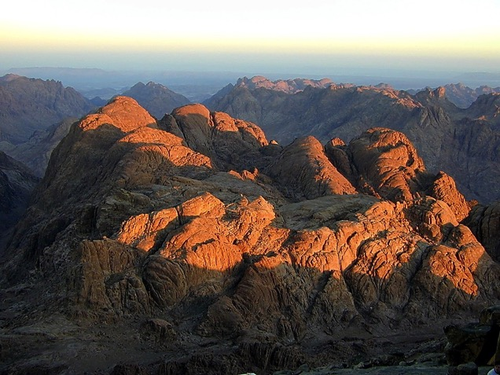
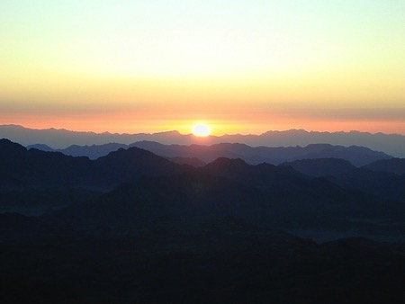
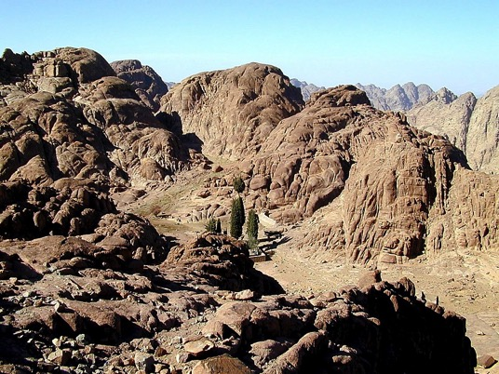
出エジプト 19:2
モーセ
出エジプト
シナイ
40
シナイ山:
十戒が与えられたと伝えられる場所
Handbook pg. 26-29
08
Notes:
This is the traditional site of Mt. Sinai, near today's Monastery of St. Catherine. Regularly modern pilgrims climb to the top of the mountain to watch the Egyptian sunrise. Note the extreme desolation and austere beauty!
Here God spoke to the people through his first prophet, MOSES. Here he gave to them The Law, the Torah, as it’s known in Hebrew.

Slide 10
7
出エジプト 20～ 31章
モーセ
ca. 1500 B.C.
出エジプト
シナイ
AJMJ
道徳・民事・儀式
モーセ
出エジプト
シナイ
道徳・民事・儀式
40
MORAL・道徳
CIVIL・民事
CEREMONIAL・儀式
Handbook pg. 26-29
09
3
Notes:
Here God…Yahweh…issues His Law to MOSES in three sections: M…. C…. C
//// the Moral,
//// the Civil
//// and the Ceremonial….
…the three parts of the Law delivered directly to Moses from the hand of God at the top of Mt. Sinai…TWICE!
Remember that order with these letters on the MOSES folder: M-C-C.

Slide 11
7
出エジプト 20 ～31章
律法 (トーラ)
３つの観点からなる神の教育:
モーセ
出エジプト
シナイ
道徳・民事・儀式
40
Handbook pg. 26-29
10
Notes:
Known in Hebrew as THE TORAH, the Lord’s great gift to the Israelites is a godly education in three parts.

Slide 12
7
出エジプト 20章1 ～17節
律法 (トーラー)
３つの観点からなる神の教育:
MORAL（道徳）: 今日の法律の基礎となった十戒。
モーセ
出エジプト
シナイ
道徳・民事・儀式
40
Handbook pg. 26-29
11
Notes:
The MORAL part of the Law we know as the Ten Commandments.
Much of our present legal system is based on that great document.

Slide 13
7
出エジプト 21-24章
律法 (トーラー)
３つの観点からなる神の教育:
MORAL（道徳）: 今日の法律の基礎となった十戒。
CIVIL（民事）: 新たな社会構造のもと、人々がどのように共存するか。
モーセ
出エジプト
シナイ
道徳・民事・儀式
40
Handbook pg. 26-29
12
Notes:
The CIVIL part of the Law spells out – by divine regulation -- how the people are to live with each other both in the future desert wanderings and later when they arrive in the Promised Land requiring a more complicated life-style. At this point, the Israelites don’t know that the 40 years of wilderness wandering lie ahead of them. God is preparing them for that time with a set of civil rules that will insure their survival across the difficult years to come.

Slide 14
7
出エジプト 25-31章
律法 (トーラー)
３つの観点からなる神の教育:
MORAL（道徳）: 今日の法律の基礎となった十戒。
CIVIL（民事）: 新たな社会構造のもと、人々がどのように共存するか。
CEREMONIAL（儀式）: 新たな社会構造のもと、どのように神を礼拝するか。
モーセ
出エジプト
シナイ
道徳・民事・儀式
40
Handbook pg. 26-29
13
Notes:
In the CEREMONIAL part of the Law God instructs His people how to go about worshiping him in the new desert Tabernacle and later in the great Temple to be built in Jerusalem. The complex rituals required in the new form of worship also prefigure future relationships between men and the coming Messiah. We’ll find out much more about The Law as this study moves forward.

Slide 15
民数記 20:13
舞台準備
MS
N(A)
H
SG
C
ER
B
J
MN
現在のエジプトにある
カデシュ・バルネアのオアシス
モーセ
DS
出エジプト
シナイ
E
道徳・民事・儀式
KB
U
40
MS
PG
RS
Handbook pg. 26-29
14
2
Notes:
After God gives them the new Law, MOSES organizes the tribes,
//// leading them northward toward a resting place at KADESH BARNEA,
//// a welcomed oasis -- as it appears here in today’s Egyptian desert not far from its border with Israel. At Kadesh Barnea they establish a camp, awaiting God's next direction for their northward movement -- back toward the Land of Abraham -- through the harsh wilderness of the Negeb and the Sinai.

Slide 16
7
民数記 32:8; 申命記 1:19
モーセ
ca. 1500 B.C.
出エジプト
シナイ
AJMJ
道徳・民事・儀式
カデシュ・バルネア
モーセ
出エジプト
シナイ
道徳・儀式・民事
カデシュ・バルネア
40
Handbook pg. 26-29
15
Notes:
So, KADESH BARNEA appears on the MOSES file folder. Finally, the people are on their way back into the Promised Land of their forefathers, The Land of ABRAHAM, ISAAC, and JACOB.

Slide 17
7
民数記 13章
モーセは新たな情報が必要!
モーセは部族の代表たちを呼び集める。
モーセM
出エジプト
Ｓにナチ
カデシュ・バルネア
道徳・民事・儀式
40
荒野の幕屋
Handbook pg. 26-29
16
2
Notes:
While at KADESH BARNEA, all the tribes of Israel camped out IN AN ORDERED FORMATION around the tabernacle -- that remarkable worship center that had been built in the desert…all according to God's specific directions in the CEREMONIAL part of the LAW given at Sinai.
//// Now…Moses needs new information! Any good leader must have dependable intelligence or information about the tasks ahead.
//// God sends a command to MOSES….to assign a representative from each of the 12 tribes...to go out and explore the land of Canaan.

Slide 18
7
民数記 13章; 申命記 1:19-23
基礎的な疑問…
“その地” とはどんな場所か?
どのような人々か?
川や泉は?
丘や森は?
モーセ
出エジプト
シナイ
カデシュ・バルネア
道徳・民事・儀式
肥沃な農地は?
40
食物は?
Handbook pg. 26-29
17
6
Notes:
Here are some of the basic questions for which Moses needed dependable answers…
//// What is that land like?
//// What of the people?
//// Are there rivers and springs?
//// Hills? Forests?
//// Are there fertile farmlands?
//// Is there food available immediately?

Slide 19
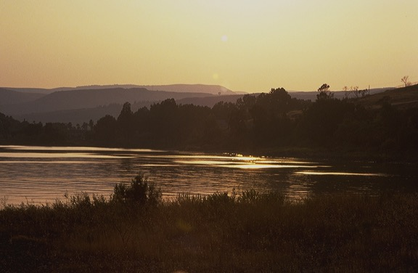
民数記 13章
舞台準備
MS
N(A)
H
今日の南レバノンまで北上…
SG
C
ER
スパイたちの行程
B
J
MN
DS
モーセ
E
出エジプト
Sinai
KB
U
道徳・民事・儀式
Kaカデシュ・バルネア
40
MS
PG
RS
Handbook pg. 26-29
18
Notes:
He instructs the men to go over into Canaan to “spy out the land.” They travel northward as far as today’s southern Lebanon. Along their route, the spies discover a fertile and beautiful land, filled with enormous potential for nation building.

Slide 20
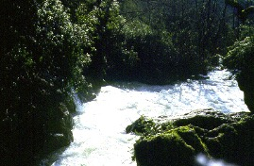
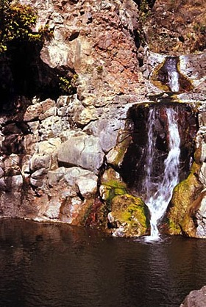
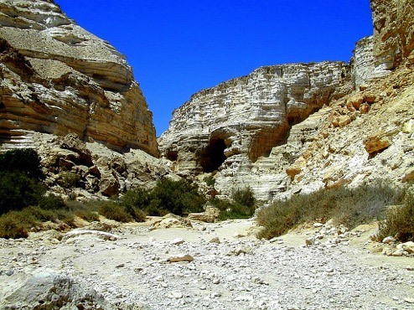
民数記 13章
舞台準備
MS
N(A)
H
…そしてカデシュ・バルネアに南下して戻る
SG
C
ER
スパイの行程
B
J
MN
MOSES
DS
出エジプト
シナイ
E
道徳・民事・儀式
カデシュ・バルネア
KB
U
40
MS
RS
Handbook pg. 26-29
19
Notes:
As they turn back southward -- on the return journey -- they see even more evidence of the challenges that lie ahead. Why? Because the land is heavily populated by small tribes and kingdoms -- the Canaanites and other tribal groups and clans. The Israelites must be dealt with as they prepare to enter the Land -- and to subdue it under God's direct command.

Slide 21
民数記 13:26-14:9
舞台準備
調査結果:
MS
１２人のスパイ: ２人のレポート
１０人のスパイ: 多数の意見
乳と蜜の流れる地!
巨人の住む地!
エジプトに戻ろう!
２人のスパイ: 少数意見
乳と蜜の流れる地!
巨人の住む地!
神が共におられる!
N(A)
H
SG
C
ER
B
J
MN
DS
MOSES
出エジプト
シナイ
E
道徳・民事・儀式
U
カデシュ・バルネア
KB
40
MS
PG
さあ...行こう!!!!!
RS
Handbook pg. 26-29
20
12
Notes:
Here’s the situation…
//// The twelve spies return to report their findings to MOSES at KADESH BARNEA. They have two sharply differing reports following their mission.
//// There is a majority opinion: ten spies or scouts report
//// having found The Land filled with “milk and honey.”
//// But it is also filled with a population of enormous strength...giants in the land, they say...such that, in their sight, the children of Israel are but mere grasshoppers. These 10 spies do not believe they can go in and subdue The Land as God has instructed — and live to tell about it.
//// Their advice: turn back to Egypt and be done with all these plans for conquest.
//// However, two remaining scouts -- their names are JOSHUA and CALEB -- give a minority report: the facts of the case are indeed true, they say.
//// Land of milk and honey!
//// Giants in the land...all true.
//// But, yet, they declare, God is with us. The Land can be subdued!
//// SO LET'S GET ON WITH IT!
//// There you have it...two reports...two opinions...
But do the people believe God for His protection and provision?
No, they do not.
//// The people throw their support behind the spies with the MAJORITY REPORT! They are too fearful and, therefore, are in disobedience to God’s specific plan and promise.

Slide 22
民数記 14:20
舞台準備
調査結果:
MS
１２人のスパイ: ２人のレポート
１０人のスパイ: 多数の意見
乳と蜜の流れる地!
巨人の住む地!
エジプトに戻ろう!
２人のスパイ: 少数意見
乳と蜜の流れる地!
巨人の住む地!
神が共におられる!
N(A)
H
SG
C
ER
旅は中止!
B
J
MN
DS
MOSES
Ｓｙつエジプト
シナイ
E
道徳・民事・儀式
U
カデシュ・バルネア
KB
40
MS
PG
さあ...行こう!!!!!
RS
Handbook pg. 26-29
21
Notes:
In response, MOSES does not give the command to enter Canaan and subdue it. THE TRIP INTO THE LAND WAS CANCELLED! FOR THE TIME BEING.

Slide 23
7
民数記 32:13
モーセ
ca. 1500 B.C.
出エジプト
シナイ
AJMJ
道徳・民事・儀式
カデシュ・バルネア
40
MOSES
出エジプト
シナイ
道徳・民事・儀式
カデシュ・バルネア
40
40
Handbook pg. 26-29
22
Notes:
Here we add the number 40 to the Moses folder.
As a result of their disobedience and their lack of belief, God sends the Israelites into the desert wilderness to wander for 40 years —

Slide 24
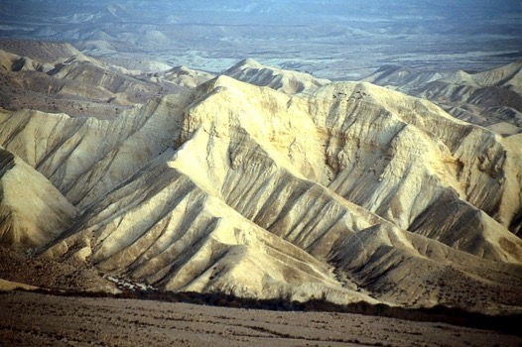
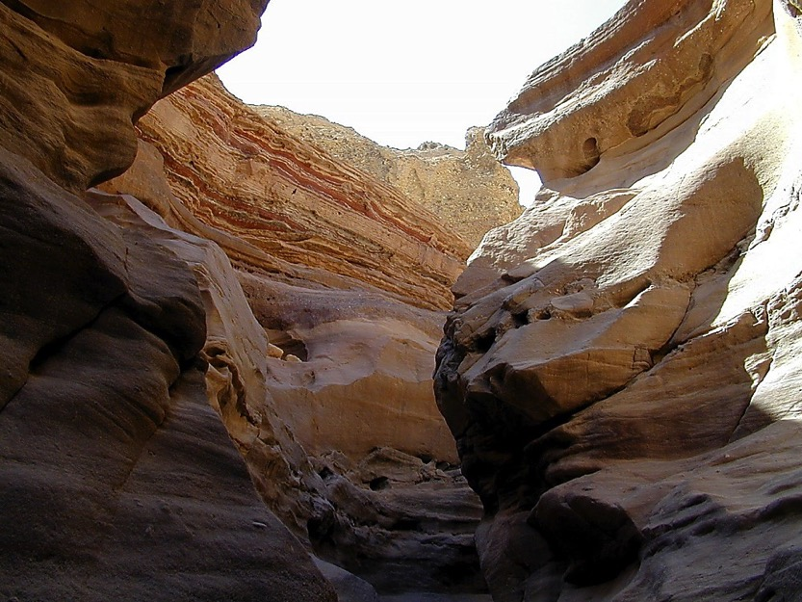
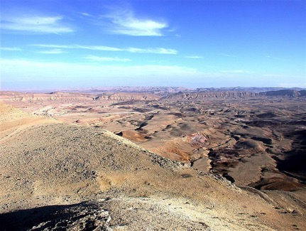
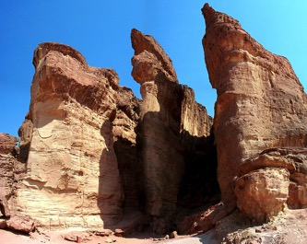
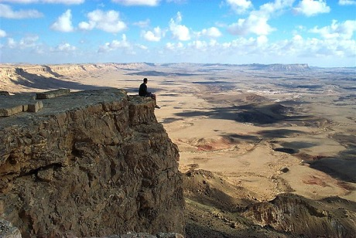
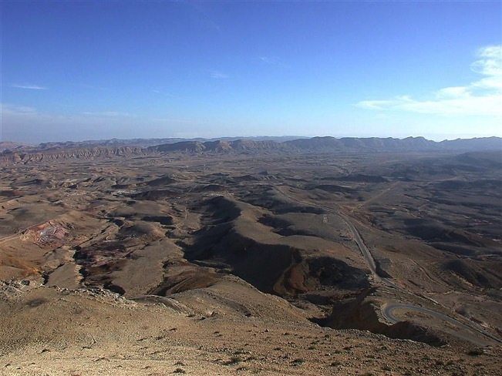
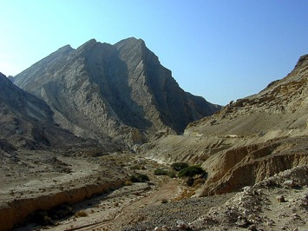
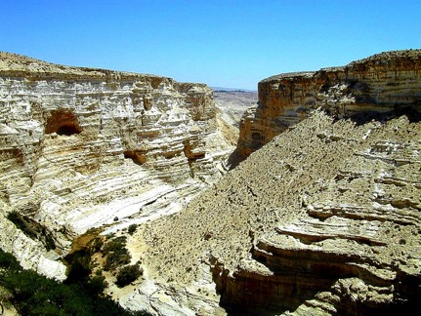
民数記 32:13
舞台準備
４０年も？
ここに？
置き去りに？
モーセ
出エジプト
シナイ
M - C - C
カデシュ・バルネア
40
40
Handbook pg. 26-29
23
1
Notes:
…until every grumbling, disobedient Israelite above the age of 20 years dies off. Everyone in that “disbelieving generation” – everyone, that is, except JOSHUA, Caleb, -- the two spies of the “minority report” -- MOSES and their families.
//// The people said…DO YOU MEAN…40 YEARS OUT HERE? That’s right…40 long years! And all because of their lack of faith in God’s provision and His long-range plan. And don’t forget that through those 40 years, many NEW Israelites would be born to the people during that long desert trek.

Slide 25
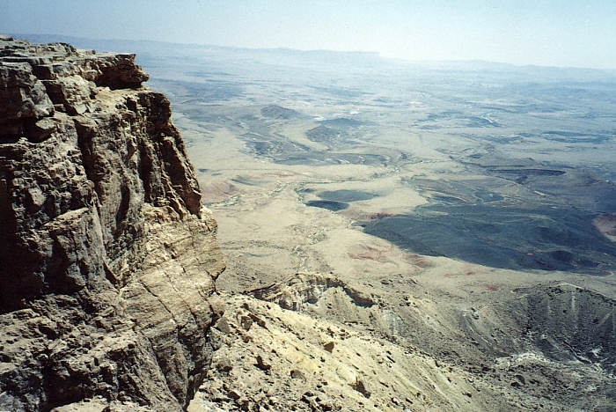
民数記 32:13
舞台準備
何故?
不従順!
13
35
34
24
33
30
9
28
25
8
31
5
26
29
27
40
32
4
6
3
10
23
22
39
7
2
21
16
15
20
19
38
18
14
17
11
1
36
12
37
不信仰!
モーセ
出エジプト
シナイ
道徳・民事・儀式
カデシュ・バルネア
40
40
荒野でのさまよい
Handbook pg. 26-29
24
3
Notes:
And that’s a crucial point to remember about the wilderness wanderings…
//// WHY were the Israelites sentenced to 40 years of wandering in the desert wilderness?
//// Disobedience and unbelief! Disobedience to God’s direction and unbelief in his ability to protect them and safely deliver them into the land promised to old Abraham.
//// [THIS NUMBER SEQUENCE REQUIRES SOME 20 SECONDS TO PLAY THROUGH.] Just think of it. After those 40 long years of wandering in the desert near the Dead Sea – year after year after trying year. Of course, during those years, Moses the great deliverer of Israel, was nearing the end of his 120 years of life.

Slide 26
申命記 32: 48-49
舞台準備
MS
N(A)
H
SG
C
ER
ネボ山
B
J
DS
モーセ
出エジプト
シナイ
E
道徳・民事・儀式
カデシュ・バルネア
カデシュ・バルネア
U
40
40
MS
PG
RS
Handbook pg. 26-29
25
Notes:
So they spent 40 years wandering between KADESH BARNEA and, finally, MOUNT NEBO. But because of Moses own earlier disobedience, even he is not destined to enter that Promised Land himself. Mark that route of wandering on your map.

Slide 27
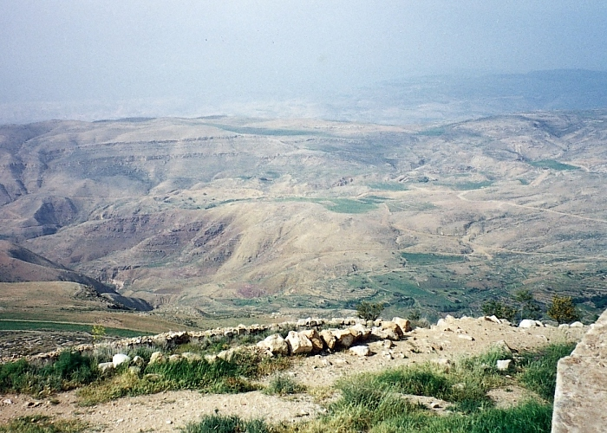
申命記 34:1
モーセ
出エジプト
シナイ
道徳・民事・
カデシュ・バルネア
40
40
「約束の地」をネボ山から眺める
Handbook pg. 26-29
26
1
Notes:
At the end of the 40 years in the wilderness, Moses brings the people to the region of Mt. Nebo. Moses was able to view the Promised Land from an area near here on that mountaintop. Were we to stand by Moses on top of Nebo, this is what he would have seen…but would never be allowed to enter.
//// God instructs MOSES that the time has come for the Israelites to go into the land of Canaan, to subdue it, and to claim it as their own rightful inheritance.

Slide 28
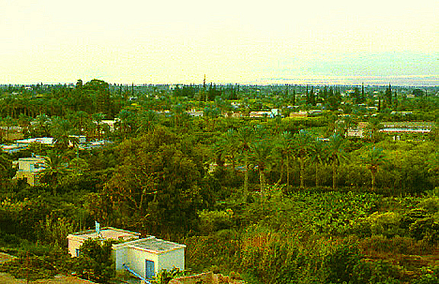
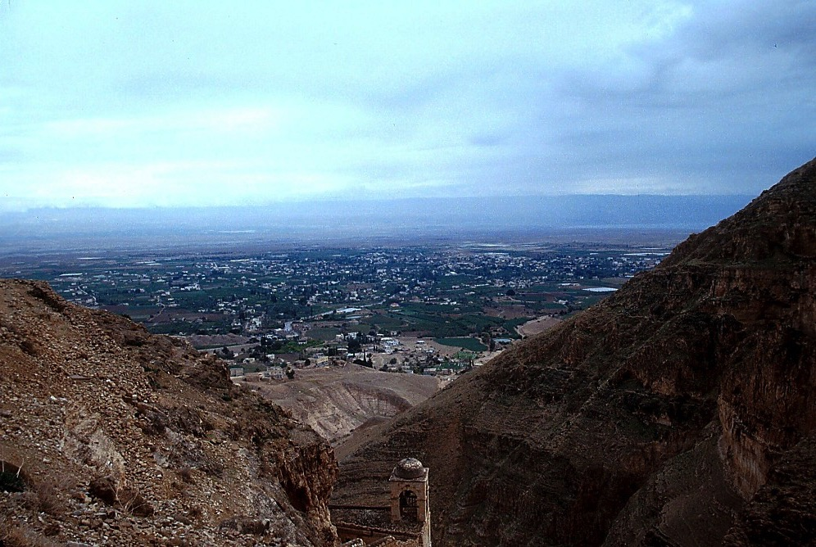
申命記 34:1
ネボ山はヨルダン川の向こう側に
MOSES
Exodus
Sinai
M - C - C
Kadesh Barnea
40
40
エリコから...
ヨルダン川の向こうのネボ山を臨む
Handbook pg. 26-29
27
1
Notes:
While over in Jericho, west of Mt. Nebo, that huge Jericho oasis would have looked then much as it does today...except for the modern buildings…a land rich with water…
////…date palms and fertile soil. Here we can see the approximate location of Mount Nebo to the east beyond the Jordan River.

Slide 29
7
モーセ
ca. 1500 B.C.
出エジプト
シナイ
AJMJ
道徳・民事・儀式
カデシュ・バルネア
契約の地
40
モーセ
契約の地
出でじぷと
５つの説教
シナイ
道徳・民事・儀式
カデシュバルネア
40
40
申命記: 第２の律法!
５つの説教
申命記３０章１～１０節
どのように生きるべきか!
ユニークな国民遺産!
彼らは誰？
彼らの神とは?
新たな若い世代へ
Handbook pg. 26-29
28
8
Notes:
And then…just before Moses dies, he delivers a series of 5 SERMONS near Mt. Nebo. He reminds the Israelites of their Law and the unusual heritage of their people. He speaks to
//// a new and younger generation,
//// instructing them about their God,
//// about who they are,
//// their unique national heritage,
//// and how they should live as they move into their Promised Land. //// These 5 SERMONS make up the book of Deuteronomy -- which means “Second Law”. At the end of his teaching…
//// MOSES issues the great LAND COVENANT…that eternal promise to Abraham’s descendants for all time. That land inheritance forms the core of world conflict to this very day!
//// Note the “LC” scroll at the end of the MOSES file folder – standing for the LAND COVENANT. At Deut. 30: 1-10, Scripture describes God’s unconditional promise to Israel: the Land is to be her inheritance in perpetuity. Thus this promise amplifies or further explains the "Land" portion of the ABRAHAMIC COVENANT between God and Abraham.

Slide 30
7
申命記 30 章
土地 (パレスチナ) の約束
⁵ あなたの神、主は、かつてあなたの先祖のものであった土地にあなたを導きいれ、これを得させ、幸いにし、あなたの数を先祖よりも増やされる。
モーセ
出エジプト
⁶ あなたの神、主はあなたとあなたの子孫の心に割礼を施し、心を尽くし、魂を尽くして、あなたの神、主を愛して命を得ることが出来るようにしてくださる。 (新共同訳)
シナイ
道徳・民事・儀式
カデシュ・バルネア
40
40
５つの説教
Handbook pg. 26-29
29
2
Notes:
Here is the very heart of that Land Covenant from Deuteronomy 30,
verses 5 and 6…
5 "He will bring you to
//// the land that belonged to your fathers, and you will take possession of it. He will make you more prosperous and numerous than your fathers.
//// 6 The Lord your god will circumcise your hearts and the hearts of your descendants so that you may love him with all your heart and with all your soul and live.”

Slide 31

アブラハムの契約
(“召命”)
創世記 12章: 1-3節
モーセ
土地
種
祝福
出エジプト
Sinai
道徳・民事・儀式
カデシュ・バルネア
土地
40
40
５つの説教
申命記
30章: 1-10節
30
Notes:
And with this covenant -- this further promise from God – we see an amplification of that first part of the Abrahamic Covenant -- the promise of a LAND. As Israel's future unfolds, the SEED and BLESSING portions of the Abrahamic will also be amplified in yet more promises to God's special Old Testament people…but each one related to that original Abrahamic contract or covenant. Soon after Moses delivers his five sermons or discourses…he dies and is carried by God to a burial site unknown to any man to this day.

Slide 32
7
創世記 1章- 申命記 34章
天地創造
天地創造
天地創造
無秩序
始めの男性と女性
始めの男性と女性
始めの男性と女性
1st Sin
1st Sin
1st Sin
始めの福音
始めの福音
C
始めの福音
始めの家族
始めの家族
始めの家族
王制
(1000 B.C.)
始めの殺人
始めの殺人
始めの殺人
洪水と虹
洪水と虹
洪水と虹
塔r
塔r
塔r
アブラハム
アブラハム
アブラハム
召命
召命
C 7 S J
召命
AC
土地・種・祝福
土地・種・祝福
土地・種・祝福
I - I
３つの社会
I - I
I - I
J - E
J - E
J - E
12
12
12
捕囚
ヨセフ
ヨセフ
7 = 4 + 3
ヨセフ
モーセ
奴隷
奴隷
奴隷
出エジプト
430
シナイ
430
430
４人の人々
道徳・民事・儀式
モーセ
カデシュ・バルネア
モーセ
モーセ
(500 B.C.)
40
出エジプト
S
S
静寂
40
出エジプト
出エジプト
５つの説教
シナイ
シナイ
シナイ
道徳・民事・儀式
道徳・民事・儀式
道徳・民事・儀式
カデシュ・バルネア
カデシュ・バルネア
カデシュ・バルネア
イエス
40
40
40
40
40
40
LC
５つの説教
５つの説教
５つの説教
J
JOSHUA
31
Notes:
So now...we've finished CREATION and moved through three of the great people: ABRAHAM – with the original Abrahamic Promises – then JOSEPH and MOSES, developing the amplified Land Covenant.
Remember that we’re not concerned with detail…only a stable skeletal framework of the entire Bible based on its chronological story line. The file folders and their individual component items begin to form that skeletal mental framework on which all OTHER Biblical details have a firm location…a place…a mental map…around which to fit your Biblical thinking!

Slide 33
7
ヨシュア記 1:1
AJMJ
４人目の人とは:
?
32
Notes:
Now we've come at the last File Folder of the four Great People...
the last in the AJMJ series. Do you recall this next and final name?

Slide 34
7
ヨシュア記 1:1
AJMJ
四人目の人とは:
“ヨシア”
33
Notes:
His name is... “JOSHUA”

Slide 35
ヨシュア記 1:1
おおまかな年代:
アブラハム～ヨセフ 2000 B.C.
モーセ～ヨシュア 1500 B.C.
34
Notes:
Let's maintain the timeline in the 1500 B.C. era. Once again, that's close enough for our purposes in this study.

Slide 36
7
ヨシュア記 1:1
天地創造
ABRAHAM
アブラハム
ABRAHAM
ヨセフ
ABRAHAM
“審判は
下さらなくては
ならない。”
モーセ
ヨシュア
無政府
王制
捕囚
沈黙
イエス
Handbook pg. 29-31
35
Notes:
A JUDGE MUST JUDGE…the final “J”…here is Joshua's file folder in The Bible File sequence.

Slide 37
7
ヨシュア記 1:1
Ｊ＝ヨシュア
AJMJ
ヨシュア
Handbook pg. 29-31
36
Notes:
So…the great Israeli general, JOSHUA succeeds MOSES in leadership. Recall that JOSHUA was one of the two faithful spies who gave that minority report to MOSES 40 years earlier ... after the 12 spies' inspection trip through Canaan.

Slide 38
ヨシュア記 1:4
舞台準備
MS
ヨシュアへの
神の約束:
N(A)
H
荒野から
レバノンへ…
SG
C
ER
B
J
MN
ヨシュア
DS
E
KB
U
...ユーフラテスから “グレートシー
（=地中海）“へ
MS
PG
RS
Handbook pg. 29-31
37
2
Notes:
God made a further promise to Joshua.
//// He would give him all the land from the southern desert to Lebanon...and …
//// from the Euphrates River to the Mediterranean Sea, known as the Great Sea in ancient times. But that promise meant that Joshua and the Chosen People must first conquer it!

Slide 39
ヨシュア記 1:11
舞台準備
MS
N(A)
その土地
H
SG
“ヨシュアは…入り行きその地を得る!”
C
ER
B
J
MN
ヨシュア
DS
E
KB
U
MS
PG
RS
Handbook pg. 29-31
38
Notes:
Joshua was instructed to “go in and to possess the Land.”

Slide 40
ヨシュア記 1:11
舞台準備
MS
N(A)
その土地
H
SG
ネボ山より…
ヨシュアの部隊ははヨルダン川を渡らなくてはならない。
C
ER
B
J
MN
ヨシュア
DS
エリコ//アイ
E
KB
U
MS
PG
RS
Handbook pg. 29-31
39
Notes:
That means that from Mt. Nebo’s region, Joshua's armies must cross the Jordan River, and then subdue the Canaanites who dwelled throughout the Promised Land – from the North to the South.

Slide 41
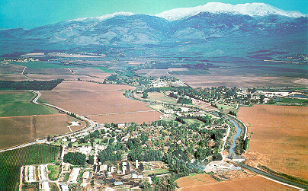
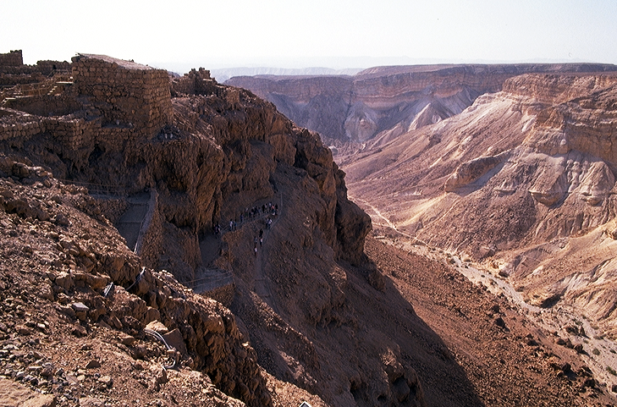
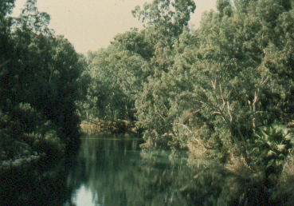
ヨシュア記 1:16
ヨシュアの地理的困難...
ヨシュア
エリコ/アイ
Handbook pg. 29-31
40
4
Notes:
So, from the highlands near Mt. Nebo, General Joshua marshaled his forces…
//// … and prepared for the challenges that lay ahead! He leads the Israelites across the Jordan River near today’s ancient city of Jericho.
//// Once again, God holds back a flood of water…this time, not the Sea of Reeds, but the Jordan River…allowing the people, once again, to cross on dry land -- just as he had done for MOSES during the great Exodus from Egypt.
//// The Israelites then enter the land of Canaan, today’s Israel, ...from the fertile valleys and plentiful water resources in the north...
//// …to the desolate wilderness with great thirst in the south.
They are finally on their way to reclaim their Promised Land...from the North to the South...all the Land unconditionally promised to ABRAHAM centuries earlier in THE ABRAHAMIC COVENANT.

Slide 42
7
ヨシュア記 6-8
ヨシュア
エリコ・アイ
AJMJ
ヨシュア
エリコ/アイ
Handbook pg. 29-31
41
Notes:
At first, they conquer two principal cities, JERICHO, followed by a difficult campaign against the city of AI.

Slide 43

死海
ヨルダン川
近代エリコ
ヨシュア
エリコ/アイ
古代エリコ
エリコから...
ヨルダン川を越える東の眺め
Handbook pg. 26-29
42
Notes:
Here is Jericho today. You can easily imagine Joshua's forces crossing the distant river to the east with his thousands upon thousands of armed men ready for the seven years of battle that lay ahead.

Slide 44
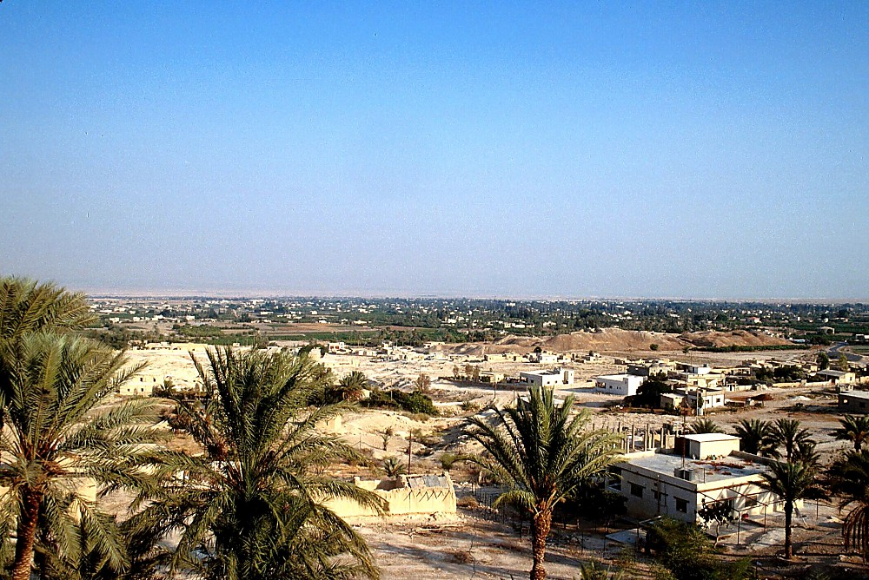
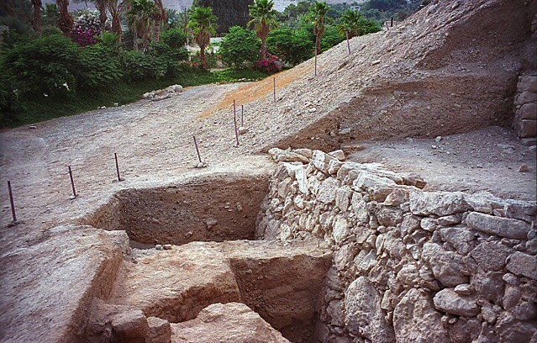
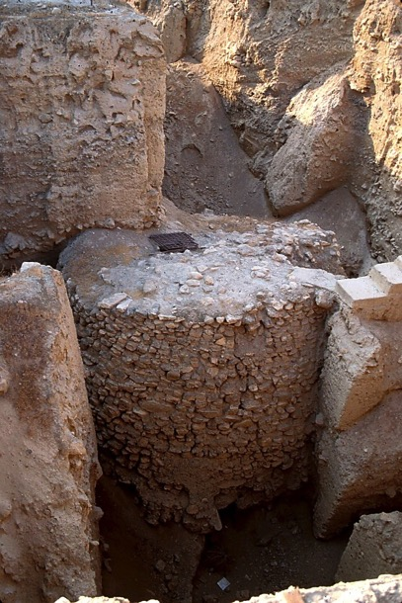
ヨシュア
エリコ/アイ
エリコ: 古代を今に残す
Handbook pg. 29-31
43
Notes:
The sandy hills in the middle of this picture show the remains of the ancient city of Jericho -- as they stand today. It’s possible that some ancient watchmen observed Joshua's forces from this Neolithic watchtower as they neared the city, eventually to bring down these actual walls of Jericho…uncovered here in past excavations…

Slide 45
7
ヨシュア記 17:16
タボ山から眺めるジェズリエル・バレー
ヨシュア
エリコ/アイ
これが乳と蜜の流れる地!
Handbook pg. 29-31
44
Notes:
And so, for seven years Joshua's armies ranged up and down the land. Here is the famed Valley of Jezreel seen from the top of Mount Tabor deep in today's region of Galilee in northern Israel. THIS IS TRULY THE MILK AND THE HONEY!

Slide 46
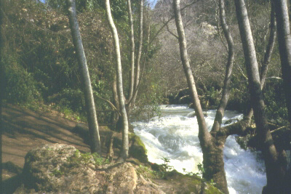
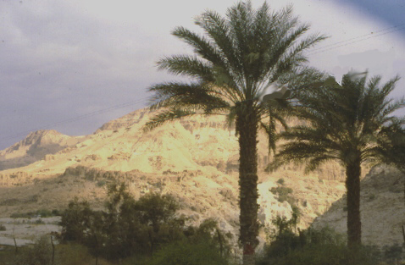
…北部のダンから...
困難な７年の闘いを乗り越えて…
ヨシュア
エリコ/アイ
…南部のベルシェバに...
Handbook pg. 29-31
45
2
Notes:
Across those seven years of hard-fought battles North to South,
Joshua's forces had to contend with enormous physical contrasts and challenges….
//// the lands of the north….well watered and fruitful….while in the south, a place of desolation and loneliness.
//// From Dan in the North to Beersheba in the south.
In spite of all their efforts, though, Joshua's armies do not completely rid the land OF ALL THE Canaanites as God had instructed. This failure to completely obey God’s directive later proves to be a great mistake in the future development of Israel's national life.

Slide 47
7
ヨシュア記 14:5
ヨシュア
エリコ/アイ
土地を分ける
AJMJ
ヨシュア
エリコ/アイ
土地を分ける
Handbook pg. 29-31
46
Notes:
The Israelites have many military successes. Then…at the end of seven years of JOSHUA's military campaigns the LAND is finally subdued…and DIVIDED among the 12 tribes of Israel named for Jacob’s 12 sons.

Slide 48
7
ヨシュア記 13:1-21: 13:43
グレートシー（・地中海
アシェル
ナフタリ
ゼブルン
ガリラヤ湖
各部族はアブラハムの嗣業の地に落ち着き、新たな生活のために学ぶ準備をしました。
タボ山
カナンの土地は分けられた!
カルメル山
イッサカル
ヨセフの子孫
ギルボア山
マナセ
マナセ
ヨシュア
エフライム
エリコ/アイ
ダン
土地を分ける
ベニヤミン
ガド
ユダ
ヘブロン
レビ:住む為の町だけが与えられ、聖所の任務にあたった。
死海
ルベン
シメオン
Handbook pg. 29-31
47
13
Notes:
And…dividing that land among the tribes was no easy task. As it was accomplished…
//// …each tribal unit or clan then settled down, ready to learn to live in the new land of Abraham’s inheritance. As to the land assignments, there were…
//// ASHER
//// ZEBULON
//// NAPHTALI
//// ISSACHAR
//// THE SONS OF JOSEPH BECAME TWO TRIBES…EPHRAIM AND MANASSEH. NOTE THAT MANASSEH’S INHERITANCE WAS ON BOTH SIDES OF THE JORDAN RIVER.
There was
//// GAD
//// DAN
//// REUBEN
//// SIMEON
//// JUDAH and
//// BENJAMIN.
//// As for the tribe of LEVI...no land inheritance was made...they were given only towns to live in with pasturelands for their flocks and herds. The Levites were the priests of the tabernacle and...as Scripture says..."...the offerings made by fire to the Lord...are their inheritance, as he promised them."

Slide 49
7
士師記17:6
グレートシー・地中海
アシェル
ナフタリ
ゼブルン
“それぞれが自分の目にただしいとすることを行った。”
イッサカル
マナセ
マナセ
ヨシュア
エフライム
エリコ/アイ
土地を分ける
タン
ベニアミン
ガド
ユダ
レビ:住む為の町だけが与えられ、聖所の任務にあたった。
ルベン
シメオン
Handbook pg. 29-31
48
Notes:
But note also the Scripture says that at that time "each man did that which was right in his own eyes." And that very important phrase leads directly to Israel’s future difficulties in their new life in The Promised Land.

Slide 50
おおまかな年代:
アブラハム-ヨセフ 2000 B.C.
モーセ-ヨシュア 1500 B.C.
ヨシュア
エリコ／アイ
土地を分ける
49
Notes:
Keep in mind the approximate dates for these lives and related events. The dates are easy to remember in broad groups of roughly 500 years for each major period:
ABRAHAM & JOSEPH: around 2000 B.C.
MOSES & JOSHUA: around 1500 B.C.

Slide 51
7
創世記 1章- ヨシュア記 24章
天地創造
始めの男性と女性
無秩序
1st Sin
始めの福音
C
始めの家族
始めの殺人
王制
(1000 B.C.)
洪水・虹
塔
ABRAHAM
(2000 B.C.)
召命
土地・種・祝福
C 7 S J
AC
I - I
３つの社会
J - E
12
ヨセフ
捕囚
7 = 4 + 3
奴隷
ヨシュア
430
エリコ/アイ
４人の人々
土地を分ける
モーセ
(1500 B.C.)
出エジプト
S
S
沈黙
(500 B.C.)
Sinai
道徳・民事・儀式
カデシュバルネア
40
40
イエス様
５つの説教
LC
ヨシュア
J
エリコ/アイ
土地を分ける
50
2
Notes:
Now we have finished half of your Bible File -- that basic architectural and dramatic layout of God's Word. We've completed
//// the CREATION file, followed by the group of Four People:
//// ABRAHAM, JOSEPH, MOSES and JOSHUA…together with the Abrahamic Covenant and its first sub covenant…the Land Covenant during the time of Moses.

Slide 52
9.7.03c.
©2005 TBBMI
51

Slide 53


バイブル ベイシック • BibleStudyDownloads.org
無料でダウンロードどうぞ
Notes:
The Bible…Basically (bb)

