Slide 1
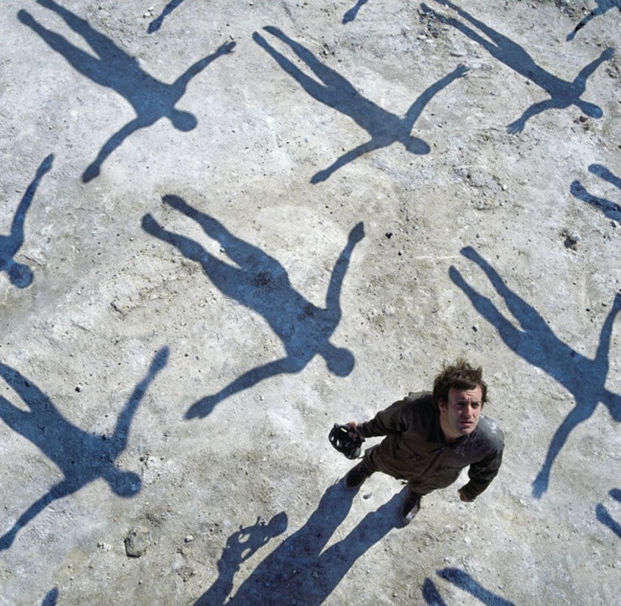
1 Thessalonians
1 Tesalonika
Presentasi Kelas Dr. Rick Griffith • Singapore Bible College • BibleStudyDownloads.org

Slide 2
Kata Kunci
203
Pengangkatan
1 Tesalonika

Slide 3
Ayat Kunci
203
“May the Lord make your love increase and overflow for each other and for everyone else, just as ours does for you. May he strengthen your hearts so that you will be blameless and holy in the presence of our God and Father when our Lord Jesus comes with all his holy ones” (1 Thessalonians 3:12-13).
1 Tesalonika

Slide 4

Summary Statement
203
Paul prepares the Thessalonians for the Rapture by defending his motives for starting the church (to silence accusations of greed) and instructing the believers (to strengthen the church's doctrinal and relational foundation so it can continue to grow).

Slide 5

1 Thessalonians Kingdom Statement
27a
Kingdom teaching is practical: “We pleaded with you, encouraged you, and urged you to live your lives in a way that God would consider worthy. For he called you to share in his Kingdom and glory” (2:12).

Slide 6

Covenant in 1 Thessalonians
27a
The fullest explanation of the Rapture in Scripture appears in this letter (4:13–5:11) where believers during the Church Age who have “fallen asleep in Jesus” will rise to meet Jesus at his return (4:14).

Slide 7

Redemption in 1 Thessalonians
27a
Jews at Thessalonica not only disbelieved but tried to hinder Paul from preaching so that Gentiles might be saved (2:16), for salvation in Jesus (noted 16 times) is our hope, not wrath (5:8-9).

Slide 8
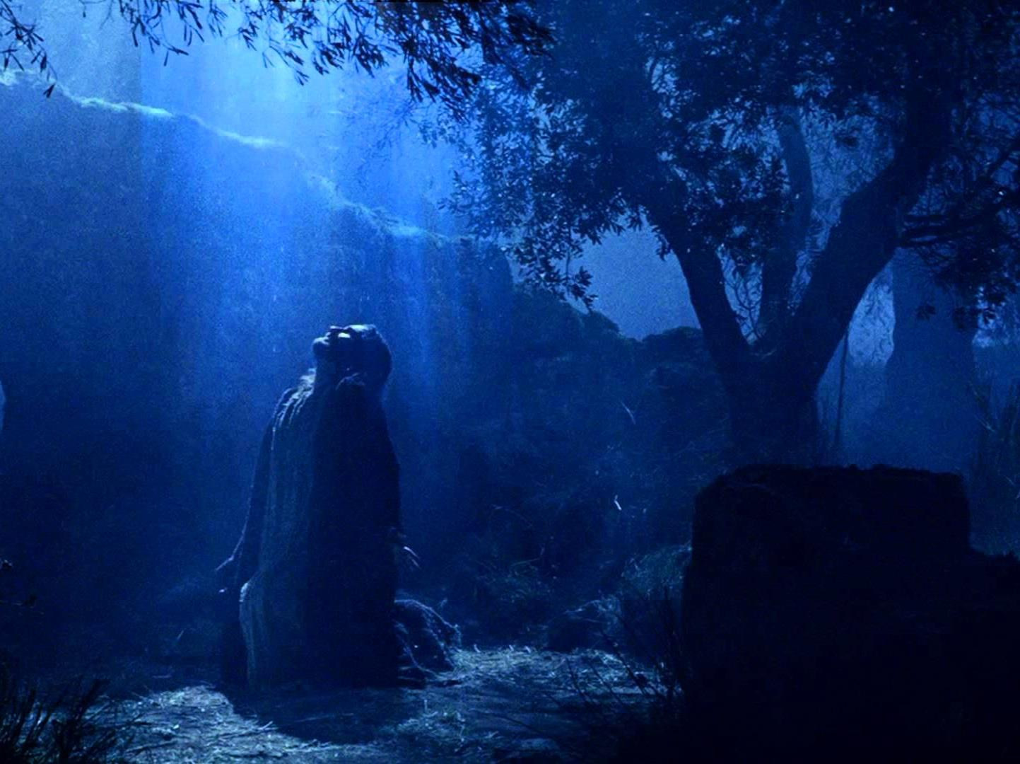
Prophecy in 1 Thessalonians
(Lord, Deity)
27a
Jesus is called “Lord” 24 times in five short chapters of only 89 verses, emphasizing that “He is the Sovereign who is to be obeyed” (Thomas L. Constable, “1 Thessalonians,” in The Bible Knowledge Commentary, 2:690).

Slide 9
Book Chart
1 Thessalonians: Preparation for the Rapture
Innocence of Greed |  |  | Principles for Growth
Chapters 1–3 |  |  | Chapters 4–5
Personal |  |  | Practical
Silence Slanders |  |  | Strengthen Stand
Historical |  |  | Hortatory
Reflections |  |  | Exhortations
Looking Back |  |  | Looking Forward
Commendation 1:1-10 | Conduct 2:1-16 | Concern 2:17–3:13 | Love 4:1-12 | Eschatology 4:13–5:11 | Church Life 5:12-28
"You're great!" | "I'm innocent!" | "I care for you" | "Please God" | "Be comforted but watchful" | "Live holy"
Corinth
Early Summer AD 51 (on second missionary journey)
203

Slide 10
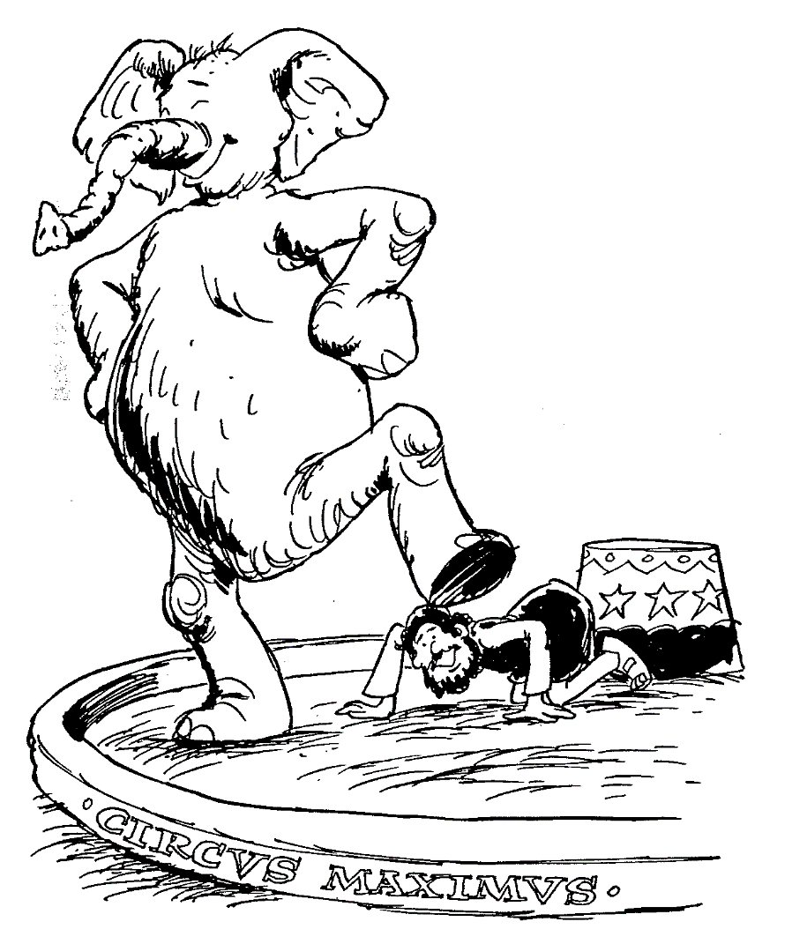
1
2
3
4
5
Faith of Thessalonian church
Apostolic labors in Thessalonica
Investigation of church's welfare
True love between Christians
Hope in Christ's return
FIRST THESSALONIANS
Barry Huddleston, The Acrostic Bible

Slide 11
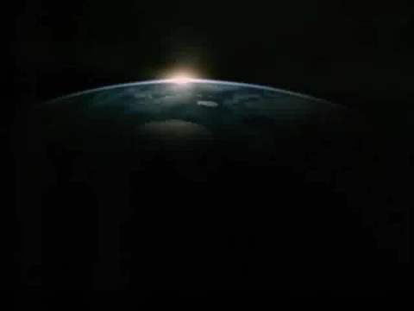

Slide 12

1 Tesalonika
205
Persiapan
Pengangkatan
Tema umum apa yang saudara temukan di akhir dari kelima pasal?
Meskipun Paulus kelihatannya menulis tentang 5 masalah yang berbeda di dalam suratnya, ada suatu topik yang terus ia ulangi: Pengangkatan.
--> Pengharapan akan Pengangkatan orang-orang untuk berjumpa dengan Tuhan menandai akhir setiap pasal:
1:10 – “…dan untuk menantikan kedatangan Anak-Nya dari sorga…”
2:19 – “…Yesus, Tuhan kita, pada waktu kedatangan-Nya…”
3:13 – “…pada waktu kedatangan Yesus, Tuhan kita, dengan semua orang kudus-Nya.”
4:16-18 – “…kita yang hidup, yang masih tinggal, akan diangkat bersama-sama dengan mereka dalam awan menyongsong Tuhan di angkasa…”
5:23 – “…pada kedatangan Yesus Kristus,Tuhan kita.”

Slide 13
Tinjauan PB (Surat-Surat Paulus)
38
124
39-41
“sampai ke ujung bumi” (Kis 1:8)
Kis 9 13 14 15 16 18 21 27 28
Apr 48-
Sep 49
1
Galatia
Apr 50-
Sep 52
2
Agean
Apr 53-
Mei 57
3
Asia
Feb 60-
Mar 62
1
Roma
M. Semi 62-
M. gugur 67
4
Spanyol
M. gugur 67-
M. semi 68
2
Roma
Mei 35-
Agst 37
Damaskus
Antiokhia
Musim gugur 49
SIDANG
Mei 57-
Agst 59
Tantangan
M. Semi 68
Perluasan Gereja
35 48 49 50 52 53 57 60 62 67 68 95
Mat
Lukas
Kis
Markus
Yohanes
Gal
1 Tes
Injil & Kis
Surat-surat Paulus
Pauline

Slide 14

204
Presentasi ini akan fokus kepada:-
1) Latar Belakang
Kota Tesalonika
Penulisan
Kapan Surat ini ditulis
Berapa lama Paulus tinggal di sana
2) Isi
Tujuan Penulisan
Tema yang menyatukan
3) Tinjauan
4) Penerapan

Slide 15
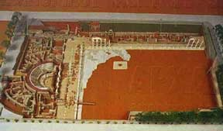
Tesalonika
(sekarang disebut Salonika atau Tesalonika)
Contoh Kota Tesalonika Kuno
    Dibangun oleh Jenderal Cassander tahun
    315 sM
    Dinamakan sesuai nama isterinya, Thessalonike, putri dari Filipus II dan saudara tiri Alexander Agung.
    Di tahun 167 s.M, menjadi salah satu kota utama dari 4 distrik di Makedonia
    Di tahun 146 s.M, menjadi sebuah provinsi dan menjadi pusat pemerintahan
    Dari 42 s.M, dinyatakan sebagai sebuah kota mandiri, diperintah oleh gubernurnya (Politarch) sendiri

Slide 16
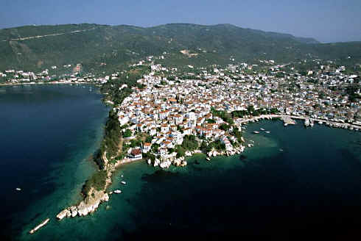
Kota Pelabuhan di Teluk Termaik
    Merupakan gabungan dari dua puluh enam desa
    Pelabuhan utama dan basis armada laut Makedonia
    Gerbang uatama ke Makedonia melalui pelabuhan dan jalan Egnatia
    Jalan Egnatia (Via Egnatia) melintasi kota NW ke SE
    - Rute utama darat melintasi daerah ini.
    - membentang sejauh 493 mil [790 km]

Slide 17
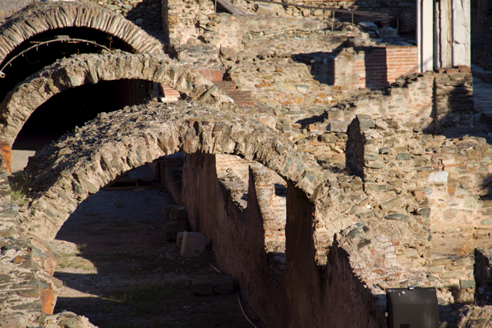
Thessalonica Arches

Slide 18
204
Kepenulisan
Kepenulisan
Kontroversi 1

Slide 19
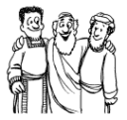
204
Kepenulisan
Kepenulisan
Tulisan bersama dari Paulus, Timotius dan Silas?
Ada yang mengatakan bahwa ayat 1 : “Paulus, Silas dan Timotius, kepada jemaat orang-orang Tesalonika...” menunjukkan mereka menulis bersama-sama
Tetapi bukti ini tidak cukup kuat.

Slide 20
204
Kepenulisan
Kepenulisan
Penulis | Bukti Eksternal | Bukti Internal | Keberatan | Respon
Paulus | Kanon Marcianus (sekitar 140 M) Kanon Muratonian Bapa-bapa gereja – Irenaeus (180 M) | Surat ini menyebutkan Paulus sebagai penulisnya. Organisasi gereja sesuai dengan zaman Paulus Tidak ada penulis berikutnya yang mungkin memakai nama Paulus mengenai harapan yang belum terpenuhi untuk tetap hidup melihat pengangkatan orang-orang suci. | Kurangnya tema-tema tulisan Paulus & kutipan dari PL. Acuan kepada waktu jatuhnya Jerusalem thn 70 Sesudah Masehi, yang menempatkan surat ini setelah kematian Paulus (AD 68). Banyak kosa kata yang baru yang tidak dipergunakan Paulus di surat lainnya | Anggota gereja kebanyakan bukan orang Yahudi jadi PL tidak banyak dikutip Acuan kepada jatuhnya Jerusalem masih bersifat spekulasi. Merupakan salah satu tulisan Paulus yang paling awal jadi tidak menunjukkan kosa kata teologi yang mirip dengan surat-surat berikutnya.

Slide 21
205
La,amanya Paulus Menetap
Lamanya Paulus Menetap
Kontroversi 2

Slide 22

205
Lamanya Paulus Menetap
Lamanya Paulus Menetap
Selama 3 Minggu
Bukti: Paulus mengajar selama 3 hari sabat di sinagoge (Kis 17:2).
Penolakan: Tulisan Lukas di Kisah Para Rasul memang tepat dan bisa dipercaya tetapi hanya memilih informasi yang berhubungan dengan maksud utama penulisannya.
Selama 3 bulan (Nov 50-Jan 51)
Bukti: Cukup waktu bagi Paulus untuk membangun gereja (1 Tes. 1:1) dengan para pemimpin lokal (1 Tes. 5:12).
Bukti: Mungkin untuk memulai suatu gereja dalam waktu yang singkat tetapi tidak cukup waktu untuk pengajaran firman Tuhan yang mengakibatkan ketegangan dengan para pemimpin (1 Tes. 5:12).

Slide 23
Book Chart
1 Thessalonians: Preparation for the Rapture
Innocence of Greed |  |  | Principles for Growth
Chapters 1–3 |  |  | Chapters 4–5
Personal |  |  | Practical
Silence Slanders |  |  | Strengthen Stand
Historical |  |  | Hortatory
Reflections |  |  | Exhortations
Looking Back |  |  | Looking Forward
Commendation 1:1-10 | Conduct 2:1-16 | Concern 2:17–3:13 | Love 4:1-12 | Eschatology 4:13–5:11 | Church Life 5:12-28
"You're great!" | "I'm innocent!" | "I care for you" | "Please God" | "Be comforted but watchful" | "Live holy"
Corinth
Early Summer AD 51 (on second missionary journey)
203

Slide 24
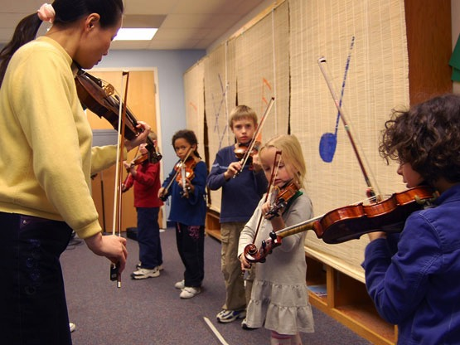
Metode Suzuki

Slide 25
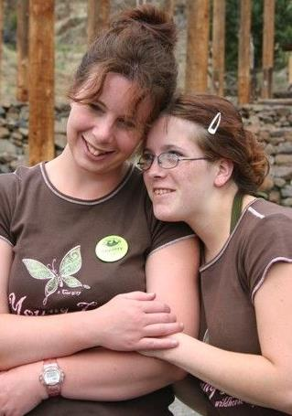
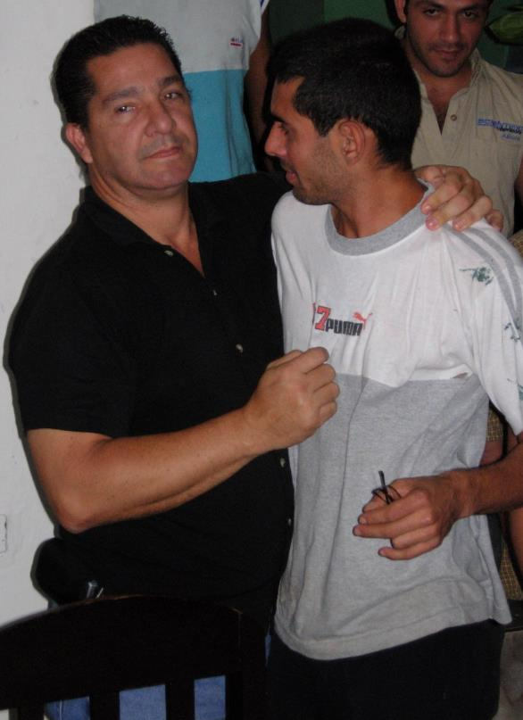
How can we strengthen others?

Slide 26
Slides on
1 Tesalonika 1

Slide 27
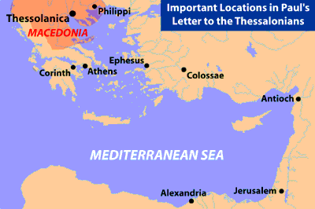
Beberapa Informasi Geografis
139
Beberapa Lokasi penting dalam surat Paulus kepada jemaat di Tesalonika
Filipi
Tesalonika
Makedonia
Efesus
Korintus
Athena
Kolose
Antiokia
LAUT MEDITERANIAN
Aleksandria
Yerusalem

Slide 28
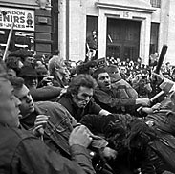
Lemparkan dia
ke penjara!
Ikut seperti
Paulus!
Bersambung.....

Slide 29
205
Saya sangat bangga dengan mereka! Saya harus menulis untuk menguatkan mereka!

Slide 30
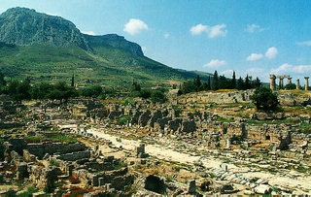
Kota Korintus
204

Slide 31
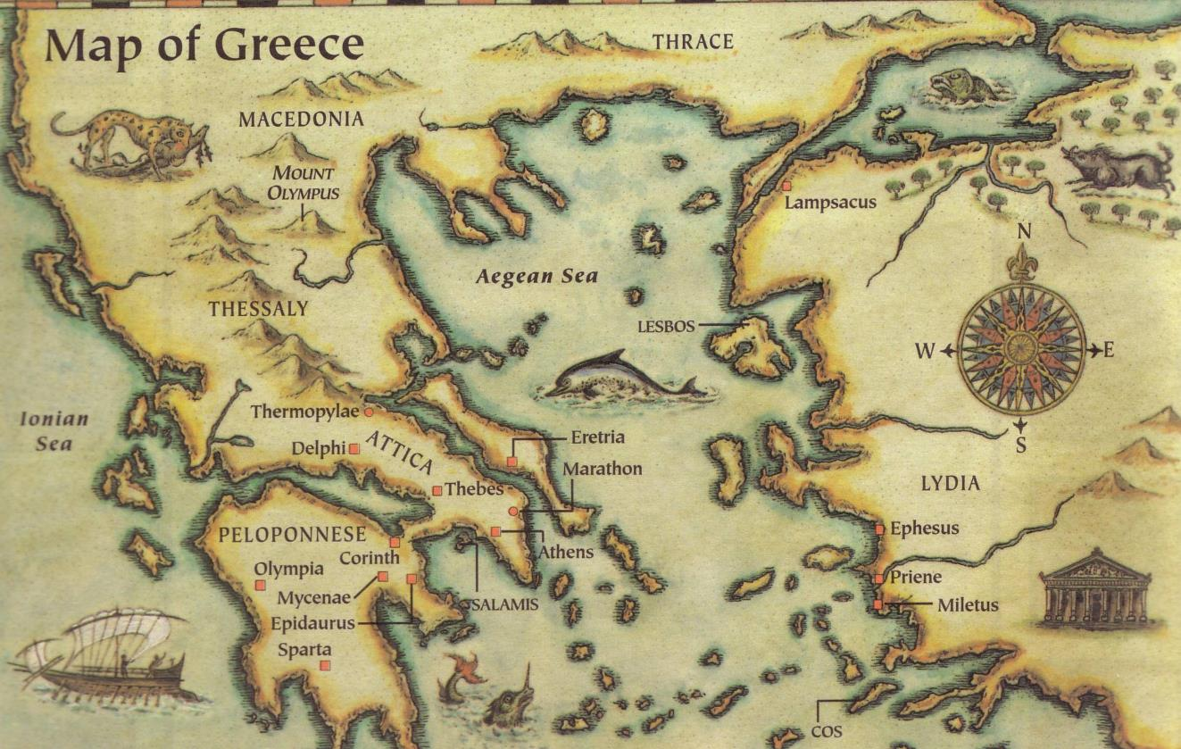
This epistle was written in AD 51
Thessalonica
Berea
Athens
Corinth
Three ways we can encourage others...
Written in Corinth after hearing Tim's report

Slide 32
Paul's Advice to Troubled Thessalonians: Focus on God!
215
Focus on God in the Thessalonian Epistles
Total Verses | "God" | "Jesus" | "Lord" | "Christ" | Total
1 Thess. (89) | 36 | 16 | 24 | 10 | 86
2 Thess. (47) | 18 | 13 | 22 | 10 | 63
Total (136) | 54 | 29 | 46 | 20 | 149
Number of Greek occurrences from Elwell & Yarbrough,
Encountering the New Testament, 332

Slide 33
Slides on
1 Tesalonika 2

Slide 34
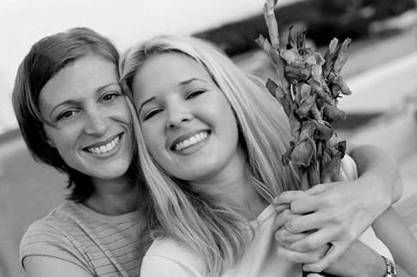
I. Go in person (2:17-20).
How can we strengthen others?
Black

Slide 35
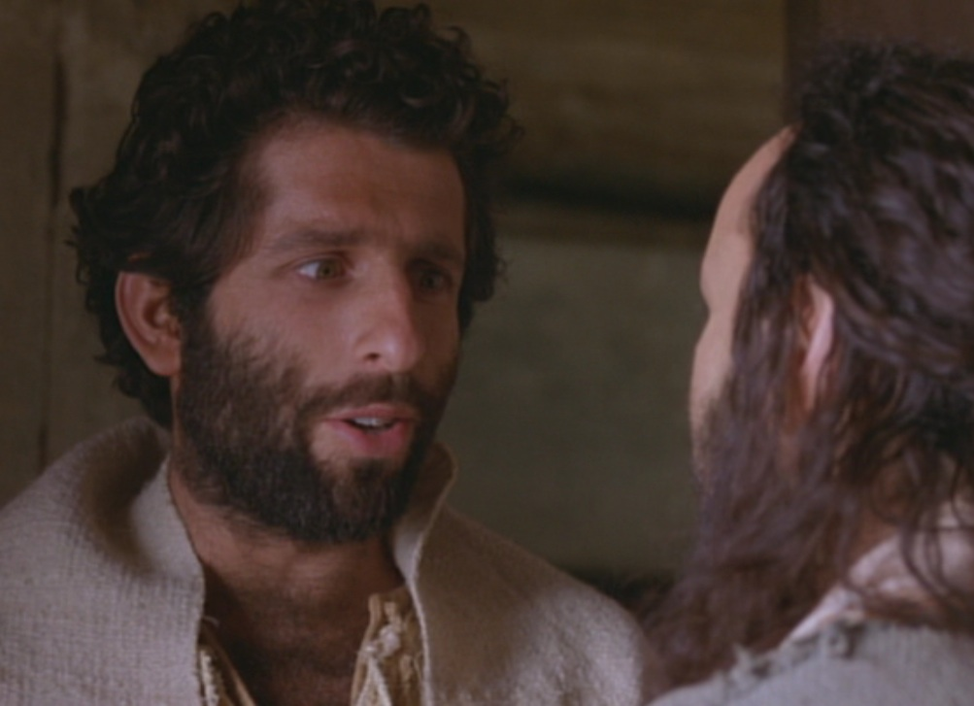
Paul Tried to Go in Person
But, brothers, when we were torn away from you for a short time (in person, not in thought), out of our intense longing we made every effort to see you. ¹⁸For we wanted to come to you—certainly I, Paul, did, again and again—but Satan stopped us" (1 Thess 2:17-18 NIV)

Slide 36
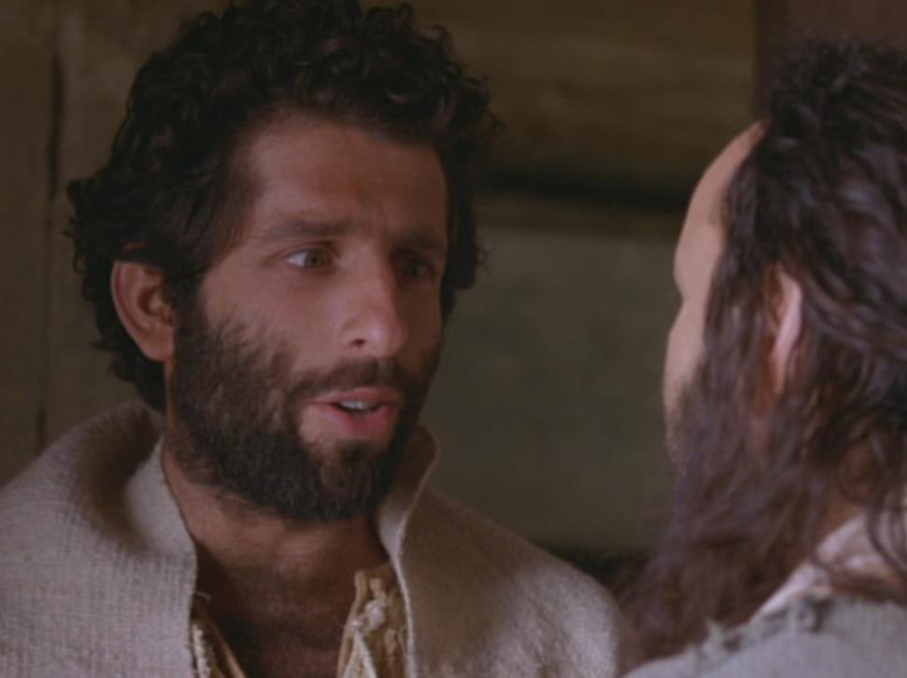
Paul's greatest blessing = People!
"For what is our hope, our joy, or the crown in which we will glory in the presence of our Lord Jesus when he comes? Is it not you? ²⁰Indeed, you are our glory and joy"
(1 Thess 2:19-20 NIV)
Notes:
Paul was a people person who saw these new believers as
his hope (his future, like a parent lives to see his kids grow into maturity),
his joy (what greater satisfaction is there than seeing people become all God wants them to be?), and his crown (the symbol of God's blessing on his life).

Slide 37

The best way to show people how valuable they are is in person

Slide 38
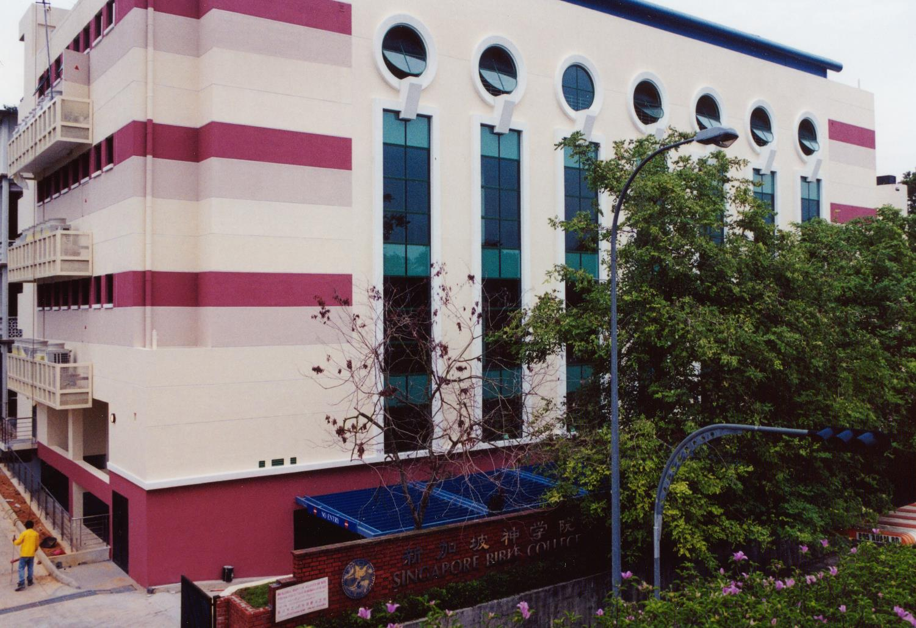
SINGAPORE BIBLE COLLEGE
Notes:
I've served as a seminary professor with 30 other faculty at Singapore's largest training school: Singapore Bible College

Slide 39
I. Go in person (2:17-20).
How can we strengthen others?
Black

Slide 40
Slides on
1 Tesalonika 3

Slide 41

II. Bring others into their lives (3:1-9).
How can we strengthen others?

Slide 42
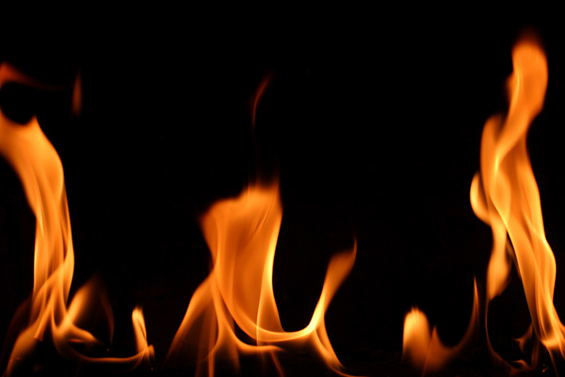
Paul sent Timothy to strengthen the church (3:1-5)
So when we could stand it no longer, we thought it best to be left by ourselves in Athens. ²We sent Timothy, who is our brother and God's fellow worker in spreading the gospel of Christ, to strengthen and encourage you in your faith, ³so that no one would be unsettled by these trials. You know quite well that we were destined for them.

Slide 43
Paul sent Timothy to strengthen the church (3:1-5)
⁴In fact, when we were with you, we kept telling you that we would be persecuted. And it turned out that way, as you well know. ⁵For this reason, when I could stand it no longer, I sent to find out about your faith. I was afraid that in some way the tempter might have tempted you and our efforts might have been useless.
Notes:
Paul could have just written a letter, which he was obviously doing in this epistle, but he always carefully chose the men who carried the letter.
Not "just anybody" could accomplish a mission such as this one to encourage these suffering Christians—but Timothy fit the bill.
Timothy was with Paul when they planted the church.
Timothy was also a sensitive man who could genuinely feel for these persecuted believers.

Slide 44
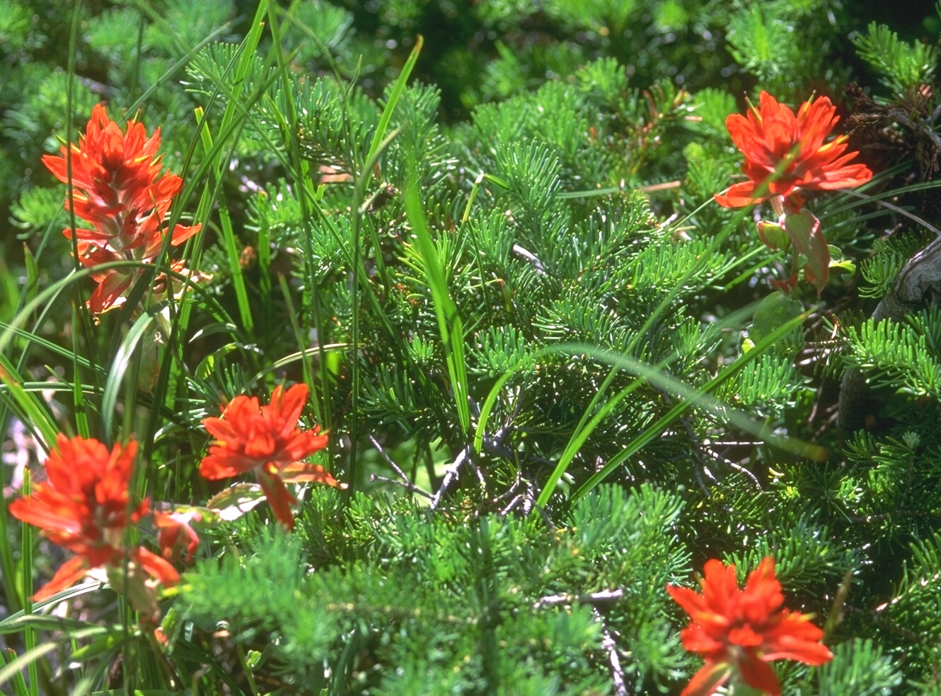
Paul was encouraged (3:6-9)
⁶But Timothy has just now come to us from you and has brought good news about your faith and love. He has told us that you always have pleasant memories of us and that you long to see us, just as we also long to see you. ⁷Therefore, brothers, in all our distress and persecution we were encouraged about you because of your faith. ⁸For now we really live, since you are standing firm in the Lord. ⁹How can we thank God enough for you in return for all the joy we have in the presence of our God because of you?

Slide 45

Send others when you can't go

Slide 46

Send Others Through Good Books
Notes:
46

Slide 47


Link survey PB di BibleStudyDownloads.org
Dapatkan slide ini tanpa biaya
Notes:
New Testament Survey PPT in Bahasa Indonesia

Slide 48
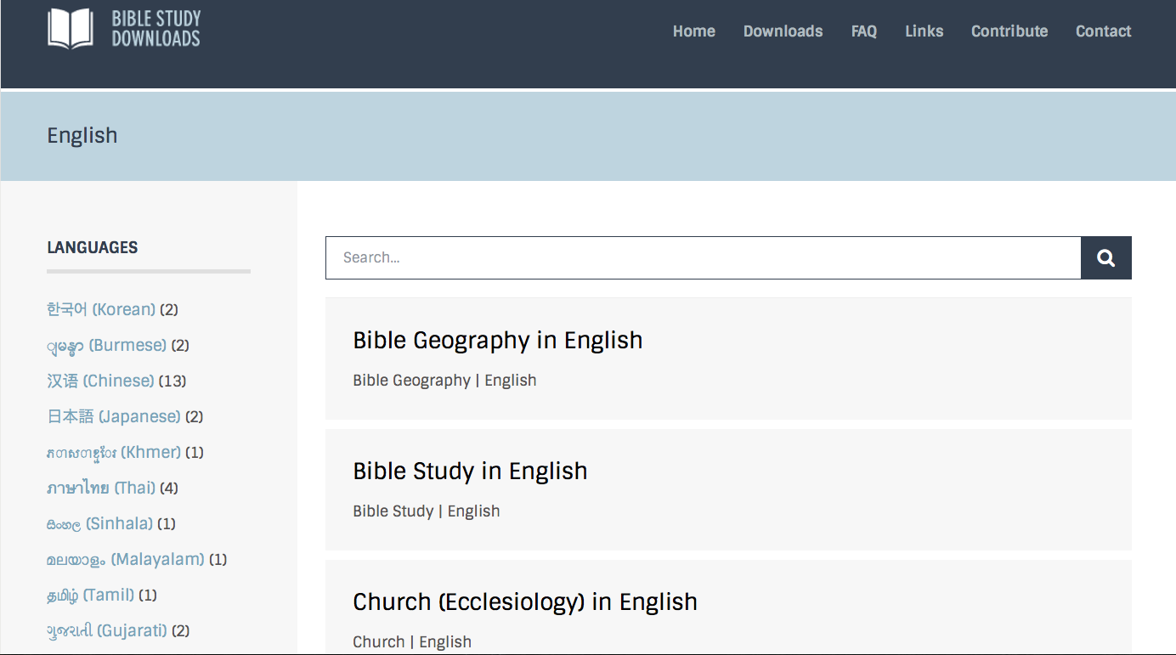
BibleStudyDownloads.org
7
Notes:
This has resulted in Bible teaching and study materials—mostly PowerPoint—in 42 languages! All a teacher needs to do is to click on a file and it downloads for free to teach any book of the Bible and many other subjects.

Slide 49
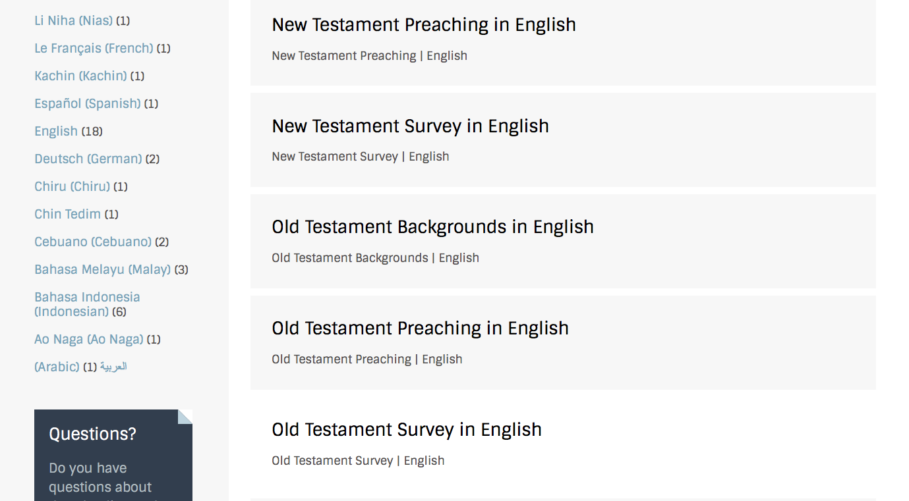
BibleStudyDownloads.org
7
Notes:
This has resulted in Bible teaching and study materials—mostly PowerPoint—in 42 languages! All a teacher needs to do is to click on a file and it downloads for free to teach any book of the Bible and many other subjects.

Slide 50
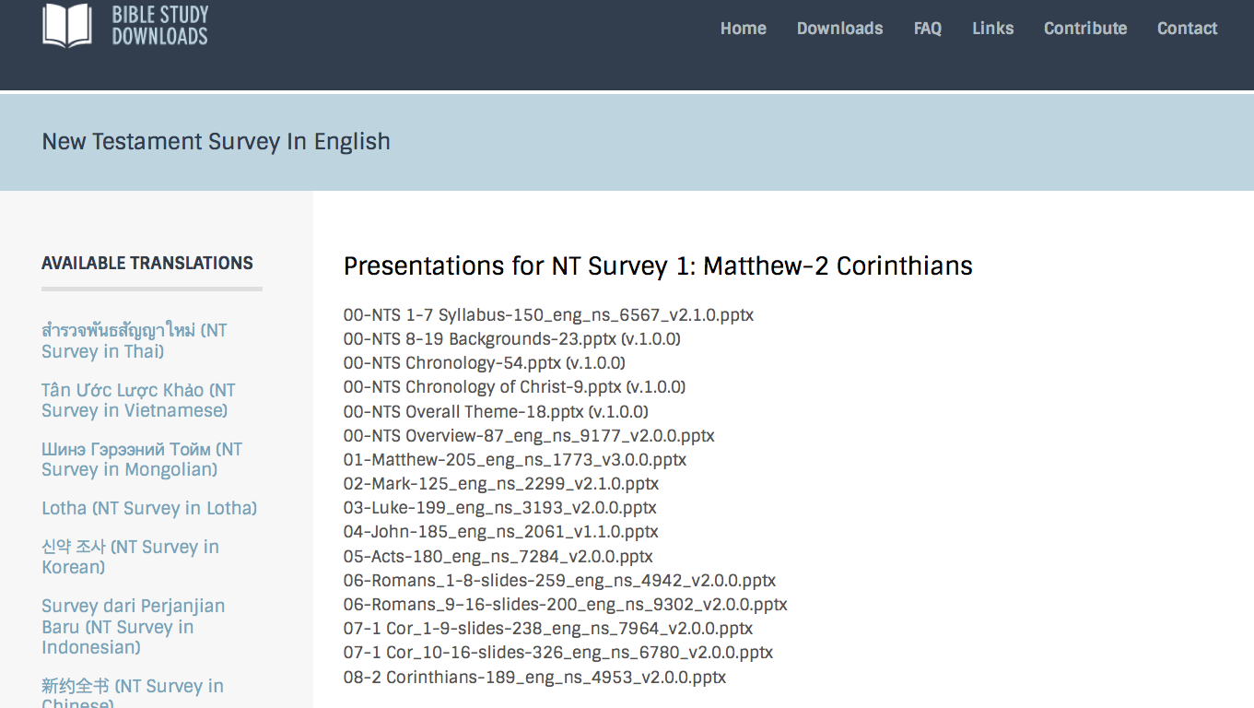
BibleStudyDownloads.org
7
Notes:
This has resulted in Bible teaching and study materials—mostly PowerPoint—in 42 languages! All a teacher needs to do is to click on a file and it downloads for free to teach any book of the Bible and many other subjects.

Slide 51
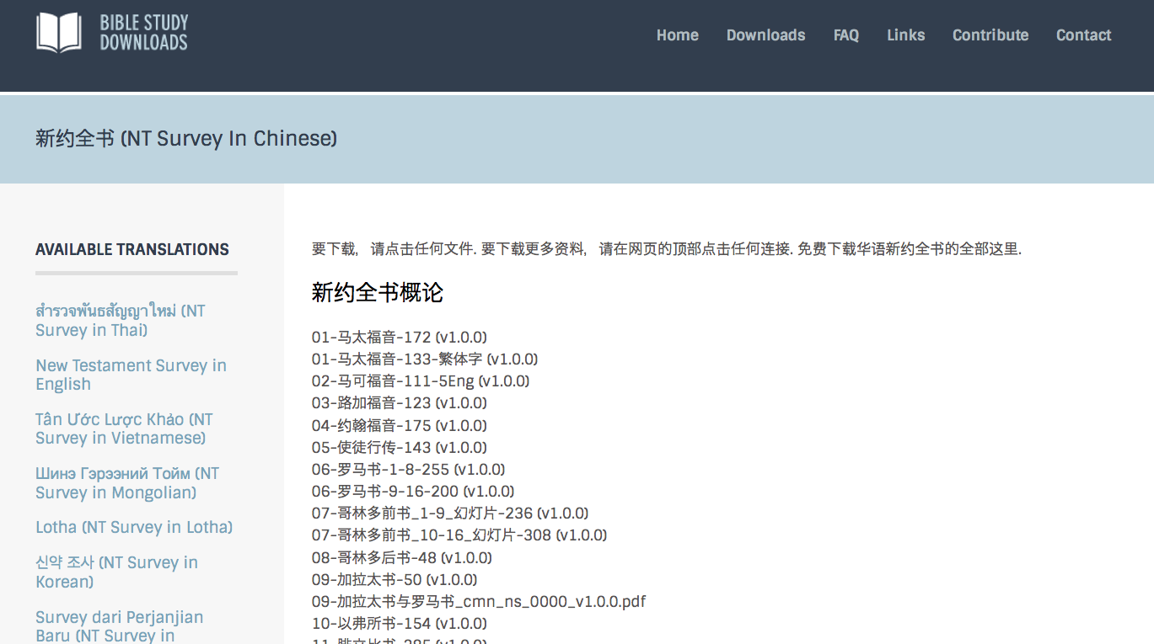
BibleStudyDownloads.org
7
Notes:
This has resulted in Bible teaching and study materials—mostly PowerPoint—in 42 languages! All a teacher needs to do is to click on a file and it downloads for free to teach any book of the Bible and many other subjects.

Slide 52
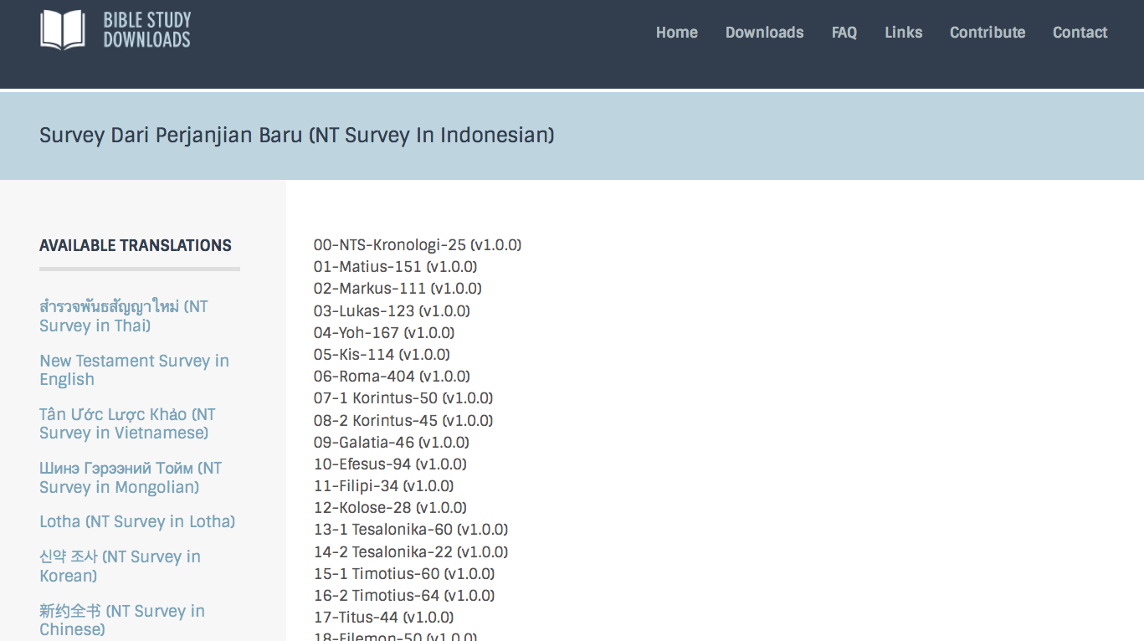
BibleStudyDownloads.org
7
Notes:
This has resulted in Bible teaching and study materials—mostly PowerPoint—in 42 languages! All a teacher needs to do is to click on a file and it downloads for free to teach any book of the Bible and many other subjects.

Slide 53
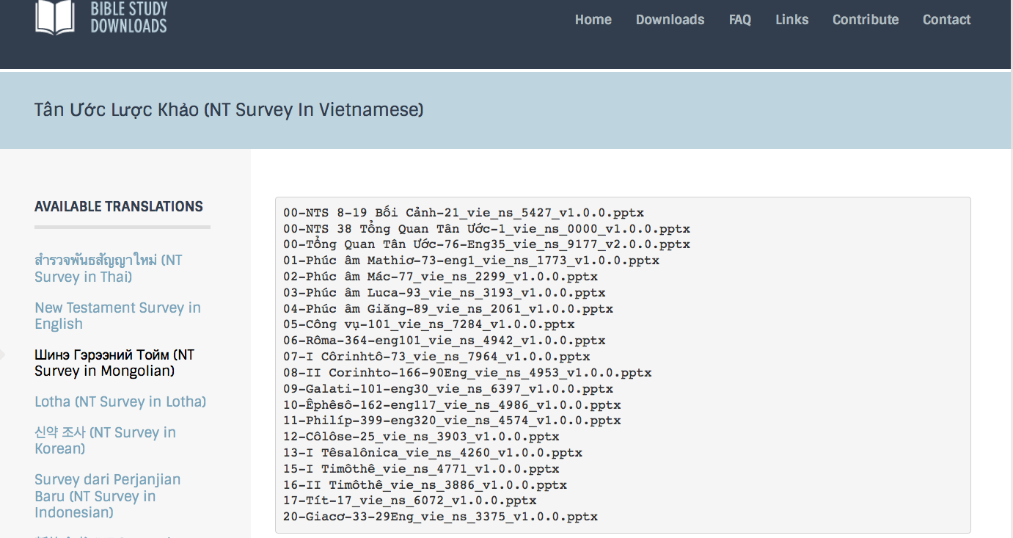
BibleStudyDownloads.org
7
Notes:
This has resulted in Bible teaching and study materials—mostly PowerPoint—in 42 languages! All a teacher needs to do is to click on a file and it downloads for free to teach any book of the Bible and many other subjects.

Slide 54
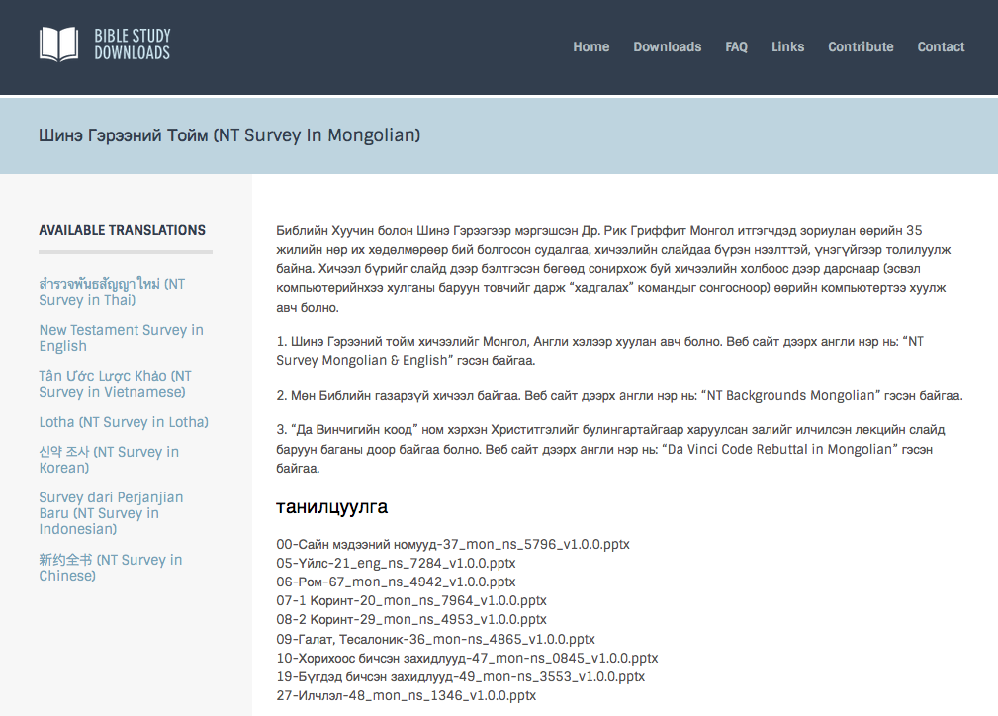
BibleStudyDownloads.org
7
Notes:
This has resulted in Bible teaching and study materials—mostly PowerPoint—in 42 languages! All a teacher needs to do is to click on a file and it downloads for free to teach any book of the Bible and many other subjects.

Slide 55
I. Go in person (2:17-20).
How can we strengthen others?
Black

Slide 56
II. Bring others into their lives (3:1-9).
How can we strengthen others?
Minister with others as peers (3:1-2a).
Minister as a partner with God (3:2b).
Minister as an encourager during other's trials (3:2c-4).
Minister face-to-face in person (3:5).
Send others when you can't go in person (3:6-9).

Slide 57
204
Karena Paulus tidak bisa secara pribadi kembali ke Tesalonika karena adanya penolakan, ia khawatir bahwa jemaat di sana tidak mendapat ajaran yang cukup. Maka ia mengirim Timotius untuk memeriksa perkembangan mereka

Slide 58
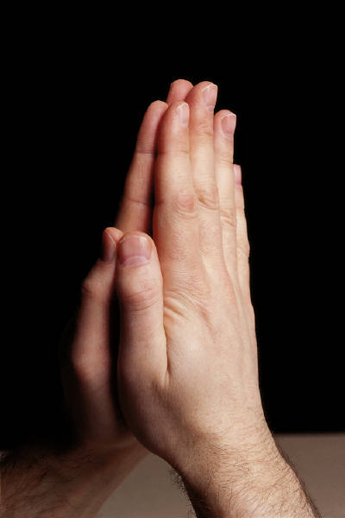
III. Pray for them (3:10-13).
How can we strengthen others?
¹⁰ Night and day we pray most earnestly that we may see you again and supply what is lacking in your faith.
¹¹ Now may our God and Father himself and our Lord Jesus clear the way for us to come to you.

Slide 59
III. Pray for them (3:10-13).
How can we strengthen others?
¹² May the Lord make your love increase and overflow for each other and for everyone else, just as ours does for you.
¹³ May he strengthen your hearts so that you will be blameless and holy in the presence of our God and Father when our Lord Jesus comes with all his holy ones.

Slide 60
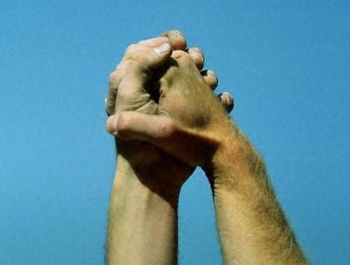
Main Idea:
Strengthen others to show you care for them
How?
• Visits: Go in person (2:17-20)
• Co-laborers: Bring others (3:1-9)
• Prayer: Pray for them (3:10-13)
Notes:
Application: Who do you know that needs encouragement today?
Which of these three ways can you infuse strength into that person?

Slide 61

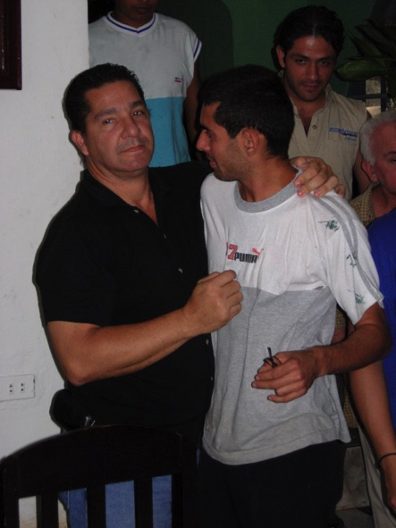
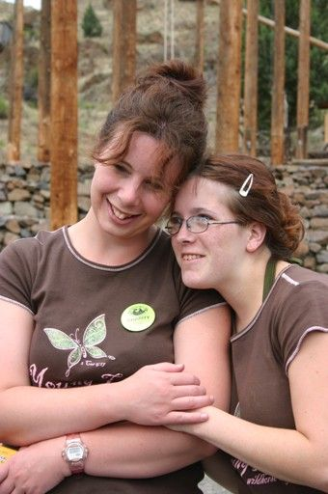
Dorongan
Menjadi Pendorong

Slide 62
205
Sungguh berani para pemfitnah ini! Saya harus membela pelayanan ini dalam surat saya kepada jemaat

Slide 63
205
Saya lebih baik menguatkan jemaat untuk bertekun dlm iman mereka.

Slide 64

Nasehat/Teguran
Juga disebut karunia menguatkan

Slide 65
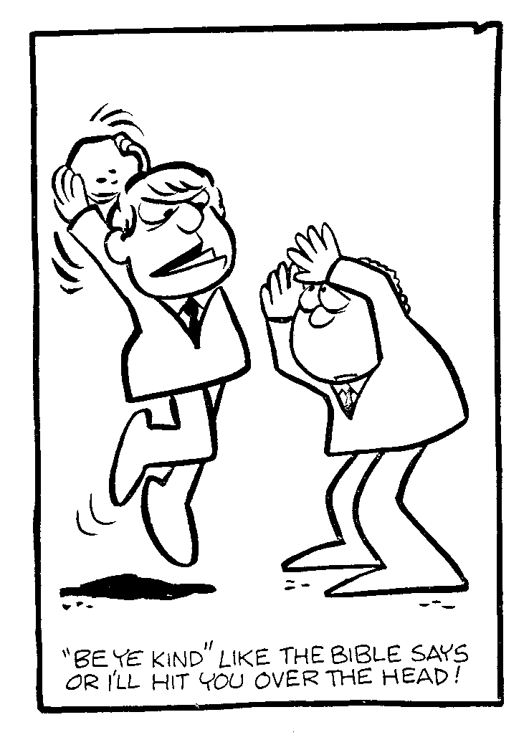
Nasehat?
Jadilah baik seperti yang Alkitab katakan atau saya akan memukul kepalamu!

Slide 66

Defenisi “Dorongan”
“Sementara seorang guru menyampaikan fakta-fakta dan kebenaran Firman Allah, sang pendorong mampu menggerakkan pendengar untuk melakukan apa yang ia telah dengar. Guru memberikan isi Alkitab, sang penggerak memberikan cara”
(Swindoll, 4)

Slide 67

Seperti apa dorongan itu?
Langkah-langkah Tindakan
Aplikasi/Penerapan
Optimisme
Kepercayaan

Slide 68
Kisah ini bersambung....

Slide 69
Slides on
1 Tesalonika 4

Slide 70
1 Tesalonika
205
Persiapan
Pengangkatan
Tema umum apa yang saudara temukan di akhir dari kelima pasal?
Meskipun Paulus kelihatannya menulis tentang 5 masalah yang berbeda di dalam suratnya, ada suatu topik yang terus ia ulangi: Pengangkatan.
--> Pengharapan akan Pengangkatan orang-orang untuk berjumpa dengan Tuhan menandai akhir setiap pasal:
1:10 – “…dan untuk menantikan kedatangan Anak-Nya dari sorga…”
2:19 – “…Yesus, Tuhan kita, pada waktu kedatangan-Nya…”
3:13 – “…pada waktu kedatangan Yesus, Tuhan kita, dengan semua orang kudus-Nya.”
4:16-18 – “…kita yang hidup, yang masih tinggal, akan diangkat bersama-sama dengan mereka dalam awan menyongsong Tuhan di angkasa…”
5:23 – “…pada kedatangan Yesus Kristus,Tuhan kita.”

Slide 71
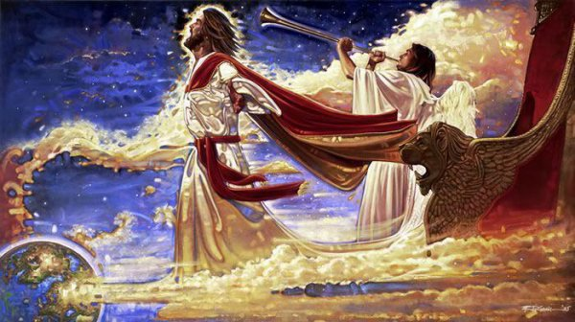
Pengangkatan

Slide 72
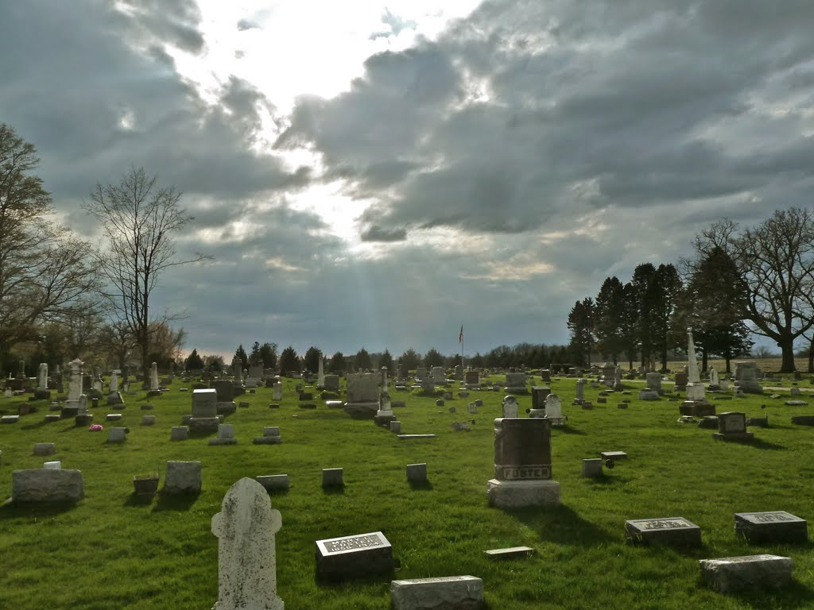
Pengangkatan
"And now, dear brothers and sisters, we want you to know what will happen to the believers who have died so you will not grieve like people who have no hope. ¹⁴For since we believe that Jesus died and was raised to life again, we also believe that when Jesus returns, God will bring back with him the believers who have died" (1 Thess. 4:13-14 NLT).

Slide 73
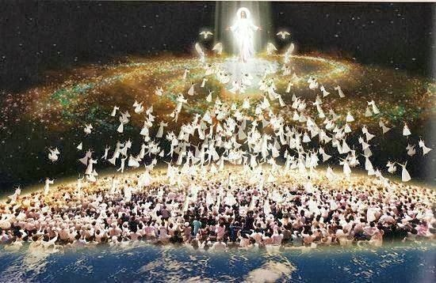
Pengangkatan
"For the Lord himself will come down from heaven with a commanding shout, with the voice of the archangel, and with the trumpet call of God. First, the Christians who have died will rise from their graves. ¹⁷Then, together with them, we who are still alive and remain on the earth will be caught up in the clouds to meet the Lord in the air. Then we will be with the Lord forever. ¹⁸So encourage each other with these words" (1 Thess. 4:16-18 NLT).

Slide 74
Premilenialisme
208
433
208
433
Kedatangan Kedua
Advent
=
Kedua
Penganiayaan
Milenium
Masa Gereja
Kerajaan Kekal
7 tahun
1000 tahun
SELURUH 5 PANDANGAN PENGANGKATAN ADALAH PREMILLENNIAL
Penghakiman

Slide 75
Pembebasan dari Kesengsaraan
208
362
208
362
KedatanganKedua
Israel
Masa Gereja
Kesengsaraan
Milenium
Kerajaan Kekal
7 tahun
1000 tahun
Penghakiman

Slide 76
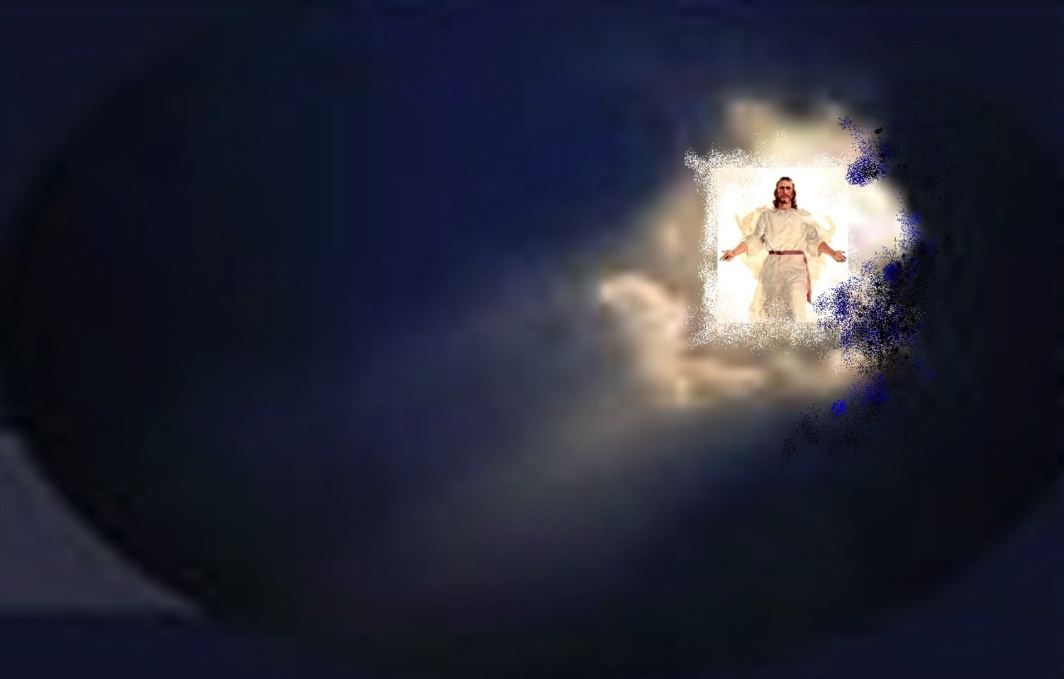
Kapan Pengangkatan Terjadi?

Slide 77
Pengangkatan “Pre-Trib”
208
Kedatangan Kedua
Pengangkatan
Tribulasi
Milenium
Zaman Gereja
Kerajaan Kekal
7 tahun
1000 tahun
Penghakiman

Slide 78
Mengapa Saya Pretrib?
209
Orang-orang percaya akan dilindungi dari (evk) “hari” atau periode ini (Rev. 3:10)

Slide 79

Christ promises honor before enemies (Rev 3:9).
"I have given you an open door that no one can shut" (3:8)
"Look, I will force those who belong to Satan’s synagogue—those liars who say they are Jews but are not—to come and bow down at your feet. They will acknowledge that you are the ones I love."

Slide 80

Philadelphia (Rev. 3:7-13)
57
Promise
Christ promised Philadelphia believers benefits for their perseverance (3:9-13)
Warning
None
Pergamum
Thyatira
Exhortation
Hold on to what you have
Rebuke
None!
Commendation:
Deeds, keeps Christ's word and does not deny His name, endures patiently
Christ:
Holy and true, holds the key of David
Smyrna
Sardis
Ephesus
Philadelphia
Laodicea

Slide 81
Pengangkatan “Pre-Trib”
208
Kedatangan Kedua
“Aku akan melindungi engkau dari (evk) hari pencobaan yang akan datang atas seluruh dunia untuk mencobai mereka yang diam di bumi”
(Rev. 3:10)
Pengangkatan
Tribulasi
Milenium
Masa Gereja
Kerajaan Kekal
7 tahun
1000 tahun
Penghakiman

Slide 82
Pembebasan dari Kesengsaraan
208
362
208
362
KedatanganKedua
Israel
Masa Gereja
Kesengsaraan
Milenium
Kerajaan Kekal
7 tahun
1000 tahun
Penghakiman

Slide 83
Preposisi Bahasa Yunani
209
361
209
361
"dari, di luar, jauh dari"
ek
peri
dia
"sekitar"
"melalui"
eis
"ke"
Notes:
"Frequently, but not always, ek means from within, while apo means from in a more general way (e.g., from the outside of, from the vicinity of)" (Eugene Van Ness Goetchius, The Language of the New Testament [New York: Charles Schribner's Sons, 1965], 151).

Slide 84
Pengangkatan "Pre-Trib"
209
362
209
362
1. "Akupun akan melindungi engkau dari (ek) hari pencobaan yang akan datang atas seluruh dunia untuk mencobai mereka yang diam di bumi"
(Why 3:10)
Pengangkatan
Kedatangan Kedua
"dari, di luar, jauh dari"
ek
Penganiayaan
Milenium
dia
Eternal Kingdom
Masa Gereja
"melalui"
7 tahun
1000 tahun
eis
"ke"
Judgment
Notes:
"Frequently, but not always, ek means from within, while apo means from in a more general way (e.g., from the outside of, from the vicinity of)" (Eugene Van Ness Goetchius, The Language of the New Testament [New York: Charles Schribner's Sons, 1965], 151).

Slide 85
Satu-satunya kemunculan "Melindungi Dari" (tereso ek) di PB
209
362
209
362
Gagasan tentang dibawa keluar dari dunia berhubungan dengan dimusnahkan dari dunia
1. "Aku tidak meminta, supaya Engkau mengambil mereka dari (ek) dunia, tetapi supaya Engkau melindungi mereka dari pada (ek) yang jahat"
(Yoh 17:15)
wilayah "kejahatan"
ek
"dari, di luar, jauh dari"
Tidak berada di wilayah Satan
sama dengan
tidak berada pada masa penganiayaan
Notes:
"Frequently, but not always, ek means from within, while apo means from in a more general way (e.g., from the outside of, from the vicinity of)" (Eugene Van Ness Goetchius, The Language of the New Testament [New York: Charles Schribner's Sons, 1965], 151).

Slide 86
209
209
Pengangkatan "Pre-Trib"
2. "Akupun akan melindungi engkau dari (ek) hari pencobaan yang akan datang atas seluruh dunia untuk mencobai mereka yang diam di bumi"
(Why 3:10)
Kedatangan Kedua
Pengangkatan
Penganiayaan
Milenium
Masa Gereja
Kerajaan Kekal
7 tahun
1000 tahun
Setiap kali "frase ini muncul… musuh-musuh gereja selalu dipikiran”
(Mounce, 120)
Penghakiman

Slide 87



Mengapa Saya Pretrib?
209
209
Orang-orang percaya akan dilindungi dari (ek) "hari" atau periode ini (Why 3:10)
Tribulasi/Aniaya dimaksudkan untuk mencobai orang tidak percaya (3:10) yang berada di bawah murka Allah (6:16-17)
Pekerjaan Roh Kudus yang menahan kejahatan akan absen pada waktu (2 Tes. 2:6-7).
("yang menahan" = neuter, 2:6 = pemberitaan Injil)
("Dia yang menahan" = maskulin, 2:7 = sebuah pribadi)
("Roh" = kata benda netral [neuter noun] tapi digunakan untuk pribadi)

Slide 88
Mengapa Saya Pretrib?
209
209
4. Gereja tidak pernah disebut dalam pasal-pasal Tribulasi (Why 4–19) kecuali sebagai "Kemah Allah" di dalam surga (13:6; cf. Efs. 2:21-22).
5. Gereja tidak pernah berada di bawah murka Allah (Yohanes 5:24, Rom. 5:9; 8:1; 1 Tes. 1:10; 5:9). Penganiayaan dan murka total berbeda!

Slide 89
Pengangkatan "Pre-Trib"
209
209
Kedatangan Kedua
5. Gereja tidak akan muncul dari murka Tuhan:
• Yoh 5:24
• Rom. 5:9; 8:1
• 1 Tes. 1:10; 5:9
• Way. 6:15-17
• Way. 11:18
• Way. 14:10, 19
Pengangkatan
Penganiayaan
Milenium
Masa Gereja
Kerajaan Kekal
7 tahun
1000 tahun
Penghakiman

Slide 90
Mengapa Saya Pretrib?
209
6. Pengangkatan amatlah dekat ("dapat terjadi kapan saja"), jadi juga seharusnya sebelum penganiayaan:
a. "…bahwa hari Tuhan datang seperti pencuri pada malam" (1 Tes. 5:2)
b. "Aku akan datang kembali dan membawa kamu ke tempat-Ku" (Yohanes 14:3) = "Saya datang" segera tanpa tanda
c. Yakobus 5:8-9; Tit. 2:13; Ibr. 9:28; 1 Pet. 1:6-7; 1 Yoh. 2:28; 3:2-3; Why 22:10, 12
Notes:
90

Slide 91
Tahap-tahap Kedatangan Kedua
210
 | Pengangkatan/Repture | Penyataan/
1 | Pre-tribulasi (Wah. 3:10) | Post-tribulasi (Wah. 19:11-21)
2 | Kristus akan datang di udara(1 Tes. 4:16) | Kristus akan datang ke bumi, kaki-Nya akan berpijak di Bukit Zaitun (Zak 14:4)
3 | Kedatangan untuk orang kudus (Yoh 14:1-2; 1 Tes. 4:15-17) | Kedatangan bersama orang kudus(Mat. 25:31; 1 Tes. 3:13; Wah. 19:14)
4 | Orang-orang Kudus (yg mati atau hidup) akan diangkat(“raptured”) dari bumi bertemu Tuhan di udara dan diangkat ke surga (1 Tes. 4:16-17) | Orang-orang Kudus yang sudah ada di bumi akan menetap di bumi(tidak ada pengangkatan) masuk ke dalam Kerajaan Seribu Tahun (Kis 15:16; Wah. 5:10; bd. Mat. 6:10; ps. 24)
5 | Menimbulkan kedamaian dan harapan (1 Tes. 4:18) | Menimbulkan ketakutan dan tuduhan (Mat. 24:27-31; Luk 21:20-28; Wah. 6:15-17)

Slide 92
Tahap-tahap Kedatangan Kedua
210
 | Pengangkatan/Rapture | Penyataan/Revelation
6 | Misteri kebenaran hanya dinyatakan dalam masa Perjanjian Baru (1 Kor. 15:51) | Pusat di dalam nubuat PL di buat jelas dalam PB (Yr. 30:7; Zak 14:1-3; Mat. 24:30; Kol. 3:4)
7 | Tubuh jemaat kudus dimuliakan(1 Kor. 15:51-58; Flp. 3:20-21) dan dibawah ke surga (1 Tess. 4:17) | Bodies of tribulation saints left in mortal state to continue to live on the earth in the millennium (Matt. 25:31-34)
8 | Iminen, tidak ada tanda (1 Thess. 4:16) | Tidak iminen tetapi didahului dengantanda-tanda spektakuler di langit dan di (Mat. 24:29-31; Luk 21:25-28; Kis 2:19-21; Wah. 1:7; ps. 6-19)
9 | Tujuan utama adalah membebaskan orang kudus dari dunia ini(1 Thes. 1:10) | Tujuan utama adalah menghakimi orang-orang yang tidak(Matt. 25:31-46)

Slide 93
Tahap-tahap Kedatangan Kedua
210
 | Pengangkatan/Rapture | Penyataan
10 | Tidak terlihat dan pribadi, hanya orang percaya yang dapat melihat Kristus dan Allah mengirim penyesatan yang luar biasa melalui Antikristus. (2 Tes. 2:11) | Tampak dan bersifat umum. “setiap mata akan melihat DIA” (Wah. 1:7)
11 | Pemenuhan janji kepada Gereja dimana tidak ada pembedaan Yahudi-Gentile (non-Yahudi) (1 Tes. 4:15; bd. Yoh 14:1-3; Ef. 2:11-16) | Pemenuhan janji dari Perjanjian Israel yang dibuat dalam Perjanjian Lama(Kej. 12:1-3; Mzm. 89; Yes. 11:11-14; bd. Rom. 11:26-27)
12 | Kejahatan meningkat(2 Tes. 2:1-12) | Kejahatan ditahan (2 Tes. 1:7; Mzm. 37:9-10)
13 | Gereja diangkat (1 Tes. 4:13-18) | Setan dilenyapkan (Rev. 20:1-3)

Slide 94
Tahap-tahap Kedatangan Kedua
210
 | Pengangkatan/Repture | Penyataan
14 | Kristus dipandang sebagai Kepala Gereja dan segala sesuatu (Ef. 1:10, 22; 4:15; Kol. 1:18; 2:10) | Kristus sebagai Mesias utk Israel (Za. 14:3-4; bd. Kis 1:6 dg v. 11)
15 | Penghakiman Tahta Kristus utk orang percaya (2 Kor. 5:10; 1 Kor. 3:13) | Penghakiman untuk Israel dan orang tidak percaya (Yeh. 20:34-38; Mat. 25; Za. 14:4; bd.hal. 160)
16 | Tuhan sudah dekat (Flp. 4:5) | Kerajaan Surga sudah dekat (Mat. 24:14)
17 | Nature subsequently ruined (Why. 6–16) | Nature subsequently restored (Rom. 8:19-22; Yes. 11:6-9; 35:9; 65:25)

Slide 95
Pengangkatan “Mid-Trib”
208
Kedtgn Kedua
Pengangkatan
Tribulasi
Milenium
Masa Gereja
Kerajaan Kekal
7 tahun
1000 tahun
Penghakiman

Slide 96
Pengangkatan “Parsial”
208
Kedtgn Kedua
Pengangkatan
Tribulasi
Milenium
Masa Gereja
Kerajaan Kekal
7 tahun
1000 tahun
Penghakiman

Slide 97
Pengangkatan “Post-Trib”
208
Kedtgn Kedua
Pengangkatan
Tribulasi
Milenium
Masa Gereja
Kerajaan Kekal
7 tahun
1000 tahun
Penghakiman

Slide 98
Mengapa Saya Pretrib?
209
8. Jika post-trib, maka domba baru akan dipisahkan dari kambing (Mat. 25:31-46).
9. Beberapa orang dalam Kerajaan 1000 tahun akan mati (Yes. 65:20), tetapi seorang post-trib percaya tubuh kemuliaan utk semua orang percaya; oleh karena itu, beberapa orang harus percaya Kristus dalam masa Sengsara/Aniaya dan masuk ke dalam Kerajaan dengan tubuh fana mereka.

Slide 99
Pengangkatan“Pra-Murka Besar”
208
PengangkatanPra-Murka
Kedtgn Kedua
Murka Allah
(Hari Tuhan)
Permulaan Masa Sengsara
Masa Sengsara Besar
Milenium
Masa Gereja
Kerajaan Kekal
Karena engkau telah menjaga firman-Ku
Aku akan menjaga engkau dari masa ini
Murka Allah & Hari Tuhan setelah ujian
1000 tahun
Penghakiman
7 tahun

Slide 100

“Kita akan dibangkitkan untuk bertemu dengan-Nya”

Slide 101

The Marriage Supper of the Lamb

Slide 102

Kita akan berjumpa dengan DIA di awan-awan

Slide 103
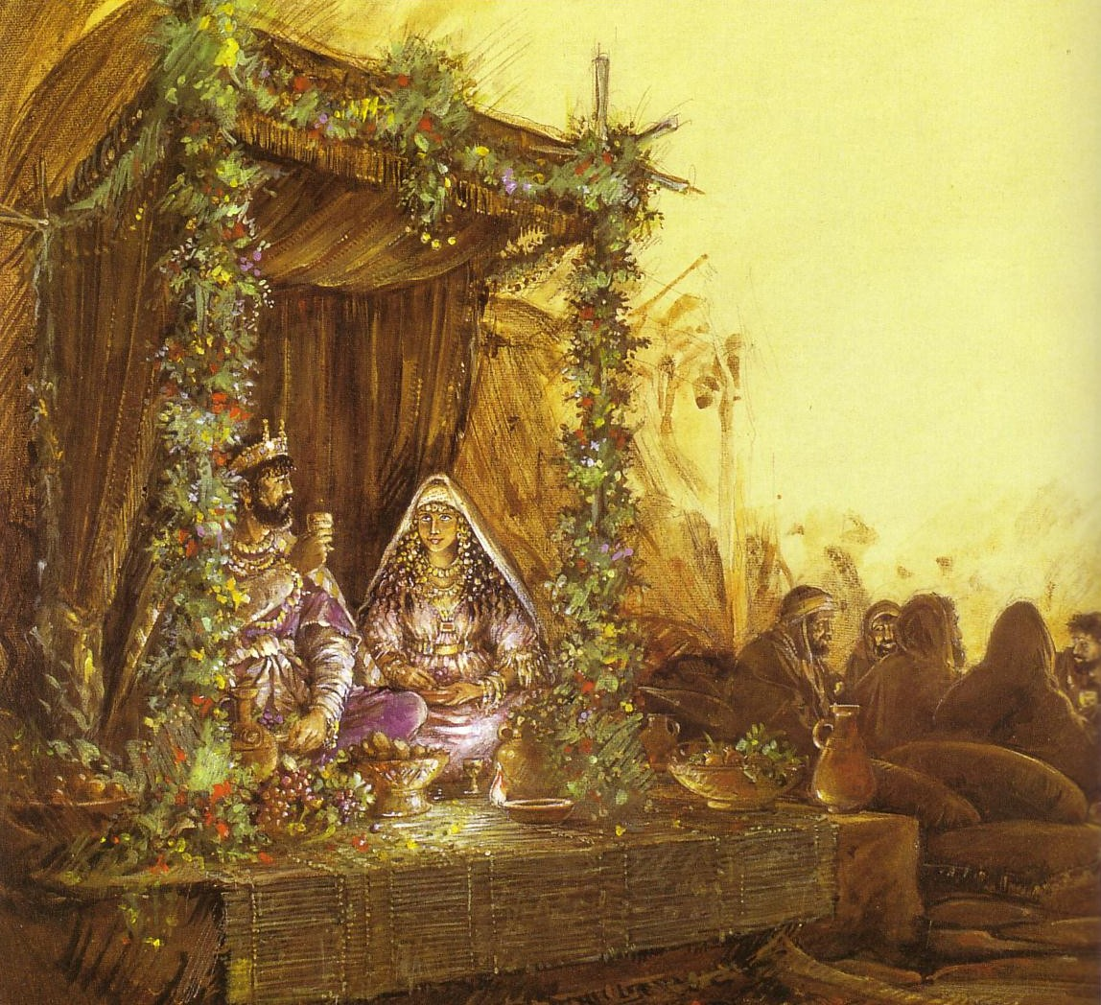
Marriage Backgrounds in Jewish Literature
Marriage depicts Christ's love for the church (Eph. 5)
The order of marriage customs parallels church eschatology

Slide 104
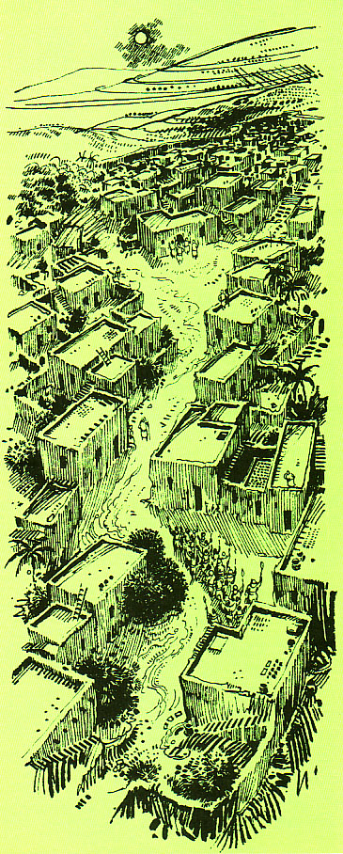
The First Century Wedding Procession
415
Groom's House
The procession parallels Christ's return for His Bride, the Church
Bride's House

Slide 105
Marriage & the Church Timeline
Marriage & the Church Timeline
415
Election God the Father chose those to be saved (Eph. 1:5, 11) | Purchase Christ paid the Father His blood to redeem the church (1 Pet. 1:18) | Sign New covenant began with the cup of the Supper (Luke 22:20) | Our Job Holiness for Christ during church age (2 Cor. 11:2) | Christ's Job Preparing heaven for church until He returns (John 14:1-3) | Rapture Christ brings church to heaven at unexpected time w/ shout (1 Thess. 4:14-18) | Wedding Church cleansed & presented unspotted (rewarded) in heaven (Eph. 5:26) | Supper to Come Church unites with Christ & glorifies Him for imparting righteousness (Rev. 19:7-9) | Second Coming & Supper Saints & Christ return to earth to reign (Rev. 19:11-20:6)
Church Age
Tribulation
Millennium
(Separation of Church & Christ)
Betrothal Period
(Separation of Bride & Groom)
Choice (Shiddukhin) Father chose a bride for his son (Tobit 4.12-13; 7.9-13; Ecclesiast. 7.23; Sirach 7.25; Mishna Kiddushin 2.1) | Purchase (Mohar) Groom paid bride's father gold & silver or service as dowry (Tobit 8.21; Jub. 28.2) | Sign (Ketubah) Marriage covenant began with contract & cup of betrothal (Tobit 7.14-15; Kidd. 2.2; Ketuboth 1.2) | Bride's Job (Kedeshet) Maintained virginity (set apart for groom) one year (Mishna Sotah 1.1, 5; 5.1; Sirach 42.10) | Groom's Job (Huppah) Prepared bridal chamber and place in home of his father (1 Macc. 3.56; 2 Enoch 61.2) | Procession (Nissuim) Groom unexpectedly arrived, called bride & escorted her to his father's house (Adam & Eve 22.3; 4 Ezra 6.23) | Wedding (Sheva Brachot = 7 Nuptial blessings) bride washed, adorned, presented by groom as beautiful virgin (Tobit 7.13) & declared married | Wedding Supper Intercourse (Mishna Ketuboth 1.1; 3 Macc. 1.19; 4.6) began a 7-14 day feast (Tobit 8.19-20; 9.6); guests given white linen & groom praised for beauty given to the bride | Married Life Bride & groom lived in society to serve God together (Gen. 2:24; Matt. 19:4-6) 9th ed. 22-May-03

Slide 106
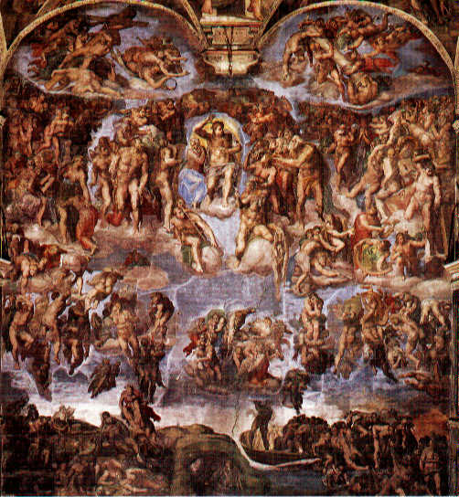
Sistine Chapel

Slide 107
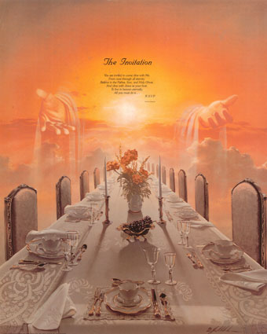
The Invitation in Revelation 19:7-9
    ⁷ "Let us rejoice and be glad and give the glory to Him, for the marriage of the Lamb has come and His bride has made herself ready."
    ⁸ It was given to her to clothe herself in fine linen, bright and clean; for the fine linen is the righteous acts of the saints.
⁹ Then he said to me, "Write, 'Blessed are those who are invited to the marriage supper of the Lamb.' " And he said to me, "These are true words of God."
NASB Updated 1995
415
Notes:
107

Slide 108
Pengangkatan "Post-Trib"
208
208
Kedatangan Kedua
Pengangkatan
Tribulasi
Milenium
Masa Gereja
Kerajaan Kekal
7 tahun
1000 tahun
Penghakiman

Slide 109
The Marriage & Supper Contrasts (19:7-9)
416
Symbols | Wedding | Feast
Verse | 7 | 9
Tense | Aorist (past) | Present
Involvement | Church as Bride | Israel as Guests
Time Period | Tribulation | Millennium
Place | Heaven | Earth
Characteristics | Procession, Wedding | Friends invited to Wedding Feast
Explanation | Bride/Church brought to Father's house | Bride/Church introduced to friends/Israel
Scripture | Rom. 7:1-4; 1 Cor. 6:17; 2 Cor. 11:2; Eph. 5:27 | Isa. 25:6-8; Matt. 8:11; 26:29; Luke 12:35-37
Notes:
109
NLT adds "feast" to 19:7

Slide 110
We will join him in the clouds

Slide 111
Slides on
1 Tesalonika 5

Slide 112
205
Sepertinya saya juga harus menjelaskan beberapa pertanyan mereka dlm surat ini.

Slide 113
Tujuan Paulus
203
Dlm Menulis
Dorongan untuk bertum-buh
Pembelaan terhadap para penyerang
Penghiburan untuk bertekun
Petunjuk/Arahan untuk hidup saleh
Penjelasan terhadap pertanya-an
Pujian
1:1-10
Cara bersikap 2:1-10
Perhatian 2:17-
3:13
Kasih
4:1-12
Eskatologi 4:13-5:11
Kehidupan Jemaat 5:12-28

Slide 114
205
Saya harus memasukan berapa arahan dlm surat ini tentang bagaimana membangun kehidupan jemaat yang sehat

Slide 115
Kesatuan Tema
Kesatuan Tema
Kontroversi 3

Slide 116

Melawan
Gnostisisme?
    Pandangan yang kurang populer menyatakan bahwa Paulus menulis untuk melawan ajaran Gnostik awal yang dihadapi orang Kristen Yahudi (W. Lutgert).
    Pendukung pandangan ini menyatakan bahwa Paulus menulis untuk melawan ajaran Gnostik Yahudi:
    a) Sebuah “eskatologi yg sudah terealisasi/terwujud”
    b) Kebangkitan bukan sebuah peristiwa nyata tapi
    hanya sebuah peristiwa yang bersifat rohani
Walter Schmithals juga berpendapat bahwa para pengajar gnostik menentang Paulus dlm dua hal:
a) Paulus berbicara tanpa kuasa Roh Kudus.
b) Paulus berbicara hal yang salah dan menipu

Slide 117
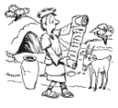

204
Kuiz
Kuiz
Kuiz
Kuiz
Kuiz
Dimana & Kapan I Tesalonika ditulis?
Jawab: 51 Masehi dari Korintus

Slide 118
205
Kuiz
Kuiz
Kuiz
Kuiz
Kuiz
Sebutkan dua pandangan mengenai berapa lama Paulus tinggal di Tesalonika?
Jawab: Pandangan pertama:3 minggu. Pandangan kedua: 3 bulan

Slide 119
205
Kuiz
Kuiz
Kuiz
Kuiz
Kuiz
Apa tema yang mungkin dari surat ini dan mana yang lebih populer?
Jawab: Melawan Gnostisisme atau Persiapan Pengangkatan

Slide 120

203
Penerapan
Surat ini mempengaruhi kita secara positif:
Beritakan Injil dengan cermat dan terencana .

Slide 121
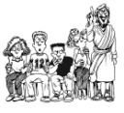
203
Penerapan
Ajarkan seluruh Firman Tuhan secara sistematis.

Slide 122

203
Penerapan
Muridkan (Gembalakan) petobat baru dengan baik.

Slide 123
203
Conclusion
Kesimpulan
HIDUPLAH SEOLAH-OLAH PENGANGKATAN AKAN TERJADI HARI INI,
RENCANAKANLAH SEOLAH-LAH PENGANGKATAN AKAN TERJADI SERATUS TAHUN LAGI.

Slide 124
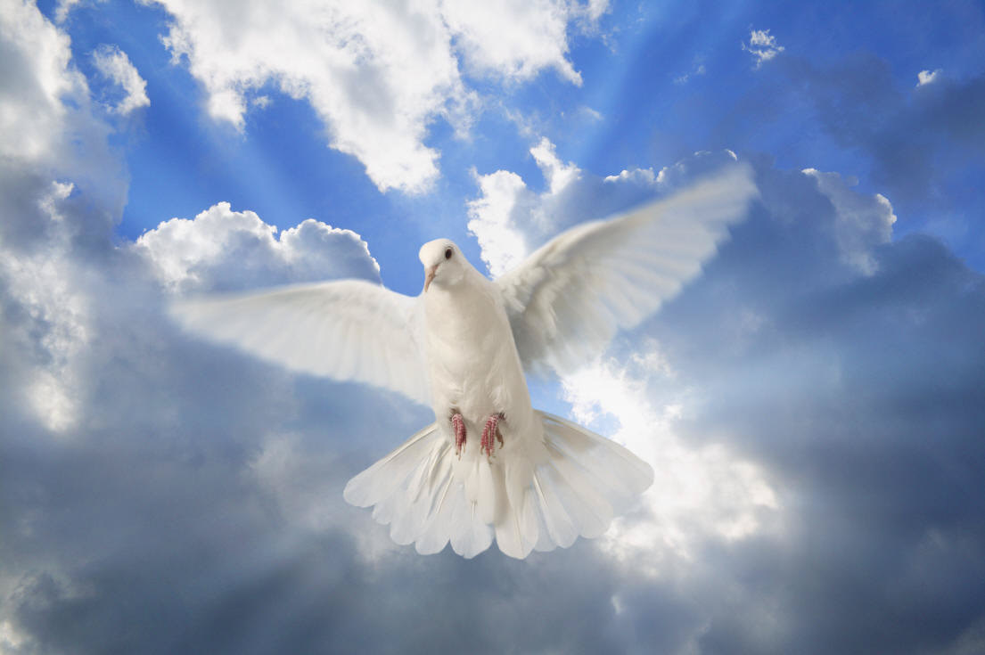
"We Shall Behold Him"
Sung by Sandi Patti
Notes:
124

Slide 125
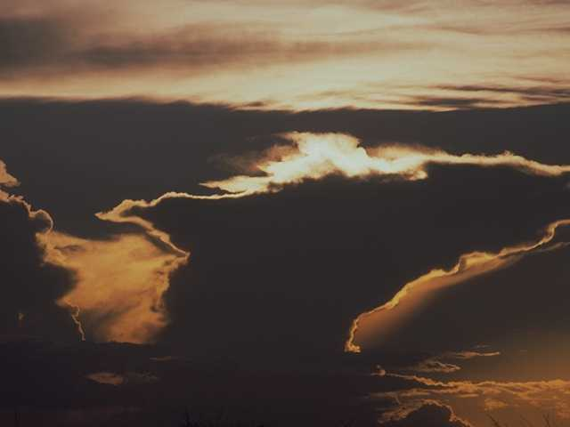
The sky shall unfold…
Notes:
125

Slide 126
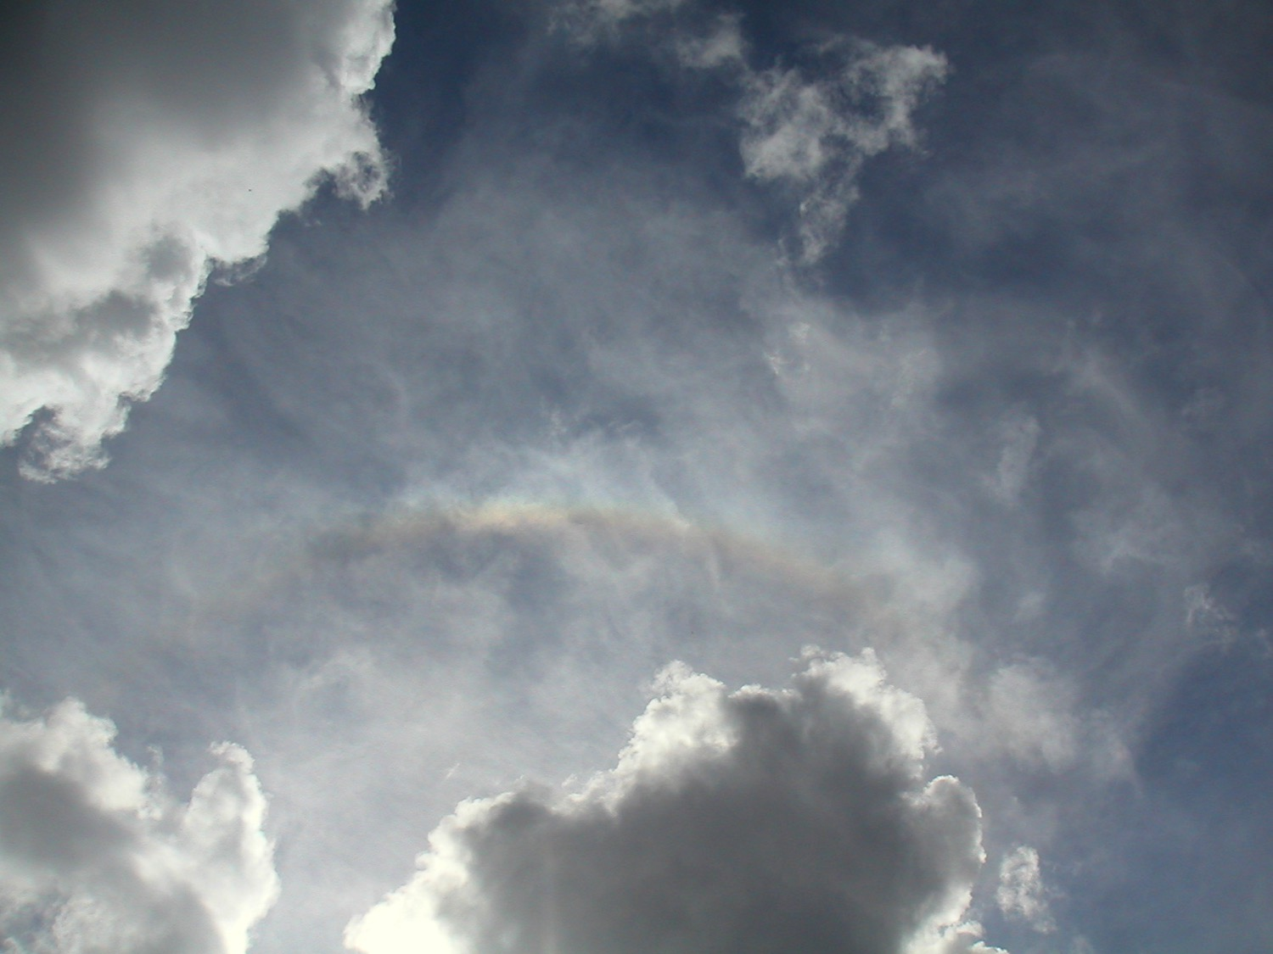
…preparing His entrance
Notes:
126

Slide 127
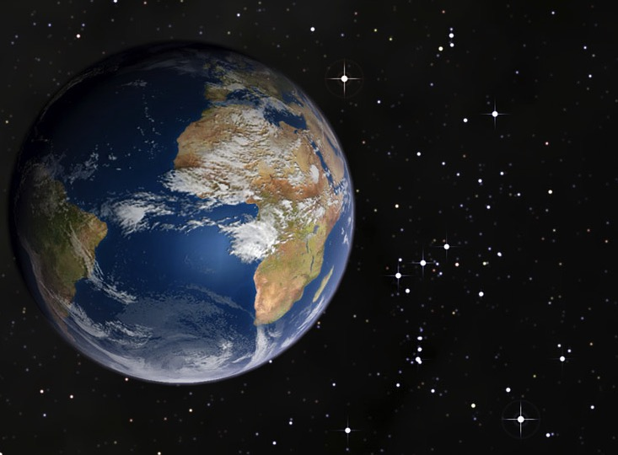
The stars shall applaud Him with thunders of praise

Slide 128
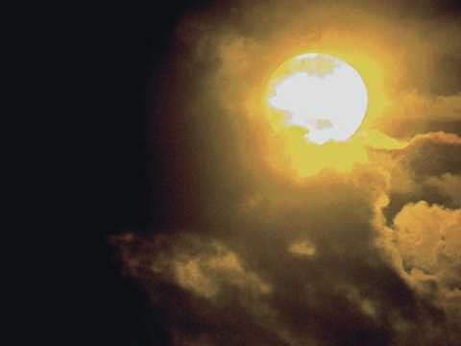
The sweet light in His eyes shall enhance those awaiting
Notes:
128

Slide 129
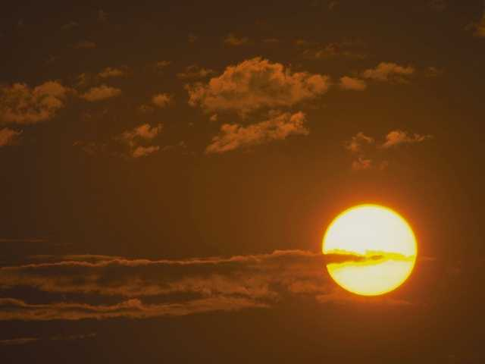
And we shall behold Him then face to face
Notes:
129

Slide 130
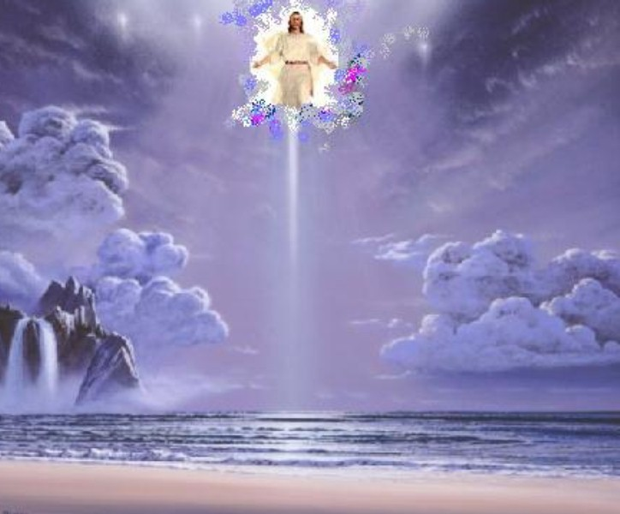
We shall behold Him
We shall behold Him
Notes:
130

Slide 131
…face to face in all of His glory
Notes:
131

Slide 132

We shall behold Him
We shall behold Him
Notes:
132

Slide 133

…face to face, our Savior and Lord
Notes:
133

Slide 134

The angels shall sound the shout of His coming
Notes:
134

Slide 135

The sleeping shall rise from their slumbering place
Notes:
135

Slide 136

And those who remain shall be changed in a moment
Notes:
136

Slide 137

And we shall behold Him then face to face
Notes:
137

Slide 138

We shall behold Him
We shall behold Him
Notes:
138

Slide 139
…face to face in all of His glory
Notes:
139

Slide 140

We shall behold Him
We shall behold Him
Notes:
140

Slide 141

…face to face, our Savior and Lord
Notes:
141

Slide 142

We shall behold Him, our Savior and Lord!
Notes:
142

Slide 143

...our Savior and Lord!
Notes:
143

Slide 144
Presentasi ini diambil dari proyek kelas oleh…
Alvin
Jimaia
Solomon
Kam Kheun
The Blessedlonians
1 Thessalonians

Slide 145
Black

Slide 146
Link survey PB di BibleStudyDownloads.org
Dapatkan slide ini tanpa biaya
Notes:
New Testament Survey PPT in Bahasa Indonesia

