Slide 1
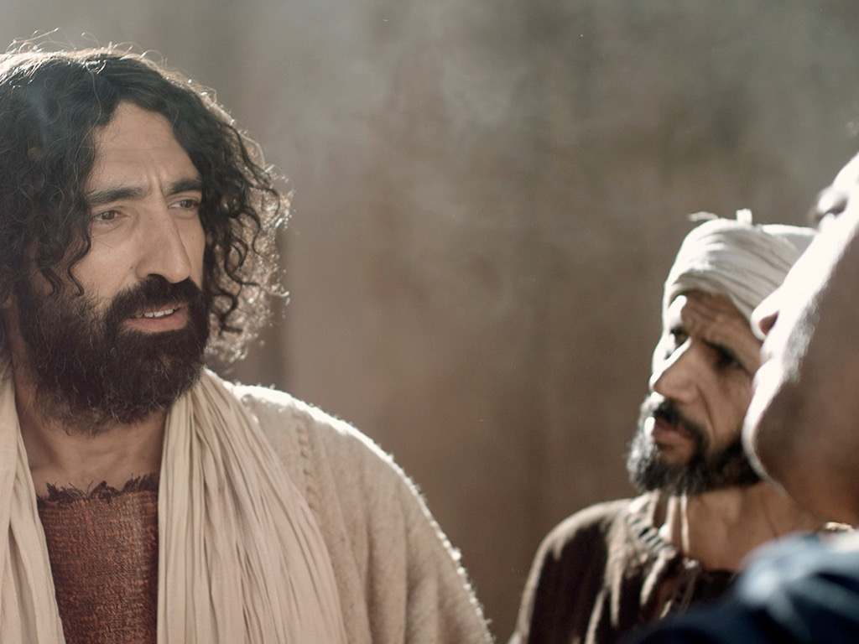
Matius 15–28
Dr Rick Griffith • Singapore Bible College • BibleStudyDownloads.org

Slide 2
Slides on
Matius 15

Slide 3
Slides on
Matius 16

Slide 4
16:13–20:34
Garis Besar
73
IV. (11:1–16:12) Kristus ditolak sebagai Mesias dalam mengantisipasi penolakan penyaliban terakhir, maka Dia memperkenalkan masa antara kedatangan kembali sebelum penerimaan masa depanNya dan pelayanan ke orang non Yahudi untuk mengajarkan penundaan kerajaan.
V. (16:13–20:34) Kristus mempersiapkan murid-muridNya tentang PribadiNya dan rencana dalam hal predikat otoritas MesiasNya yang mungkin didelegasikan kepada mereka
setelah kematianNya.

Slide 5
Slides on
Matius 17

Slide 6
Slides on
Matius 18

Slide 7
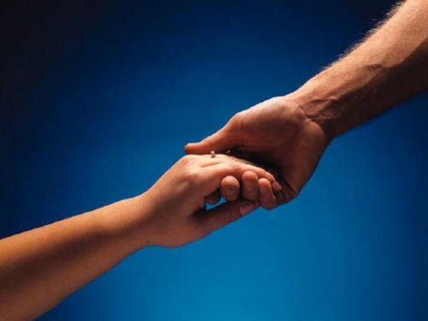

Bagaimana memperbaiki hubungan
Matius 18:15-20
Garis Besar Eksegesis
10 December 2006
6 March 2011
Notes:
09.31 EO only
16.11

Slide 8
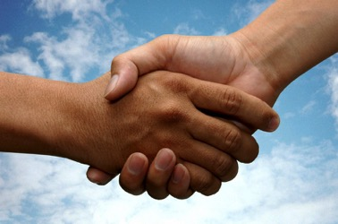
(15-17) Cara yang seharusnya dilakukan gereja untuk memulihkan secara tepat orang Kristen yang berdosa adalah menjaga rahasianya serapat mungkin.
34c
  (15) Dosa pribadi mesti diselesaikan hanya oleh diantara mereka yang terlibat langsung sehingga dapat tercipta pemulihan dariorang yang bersalah dengan lebih mudah.
  (16) Orang yang tidak bertobat setelah konfrontasi pribadi mesti dibuka kepada hanya satu atau dua orang lagi untuk memfasilitasi pemulihan dari sang pendosa.
  (17a) Orang yang tidak bertobat setelah pencobaan pemulihan dalam mesti dibawa di hadapan seluruh jemaat sebagai pencegahan dosa berkelanjutan.
  (17b) Orag yang tidak mau bertobat setelah dibawa ke jemaat mesti meminta peretujuan setiap anggota gereja untuk menyatakan pendosa sebagai orang yang tidak percaya (ini termasuk pencabutan keanggotaan).
Notes:
HOM 09.33
HSB 20.33; 25.09

Slide 9
(18-20 ) Sebab gereja boleh memulihkan atau terus berusaha untuk memulihkan orang yang beriman yang tidak bertanggungjawab kerana ia bertindak sebagai lanjutan daripada kuasa ALLAH sendiri.
34c
  (18-19) Gereja yang berdoa untuk memulihkan atau
  terus berusaha untuk memulihkan orang yang beriman
  yang berdosa bertindak di tempat Bapa.
    (18) Gereja mesti mengumumkan bersalah atau
    tidak bersalah berdasarkan apa yang ALLAH telah
    tentukan.
    2. (19) Pemimpin Gereja yang berdoa membuat
    pertimbangan yang boleh mempunyai keyakinan
    bahwa mereka telah bertindak mengikut kehendak
    Tuhan.
  B. (20) Gereja yang memulihkan atau terus berusaha
  untuk memulihkan orang yang beriman yang berdosa
  bertindak di hadapan Yesus.
Notes:
HOM 09.34
HSB 20.34; 25.10

Slide 10

Ide Eksegesis: Sebab gereja harus memulihkan seorang Kristian berdosa dengan betul kerana pemulihan ini dilakukan sebagai lanjutan daripada kuasa Tuhan.
34c
  (15-17) Cara di mana gereja betul perlu memulihkan seorang Kristian berdosa adalah dengan menjaga perkara itu sebagai perkara seperibadi yang mungkin.
  (18-20 ) Sebab gereja boleh memulihkan atau terus berusaha untuk memulihkan orang yang beriman yang tidak bertanggungjawab kerana ia bertindak sebagai lanjutan daripada kuasa ALLAH sendiri.
Notes:
HOM 09.35; 11.24
HSB 18.09; 20.31; 25.07

Slide 11
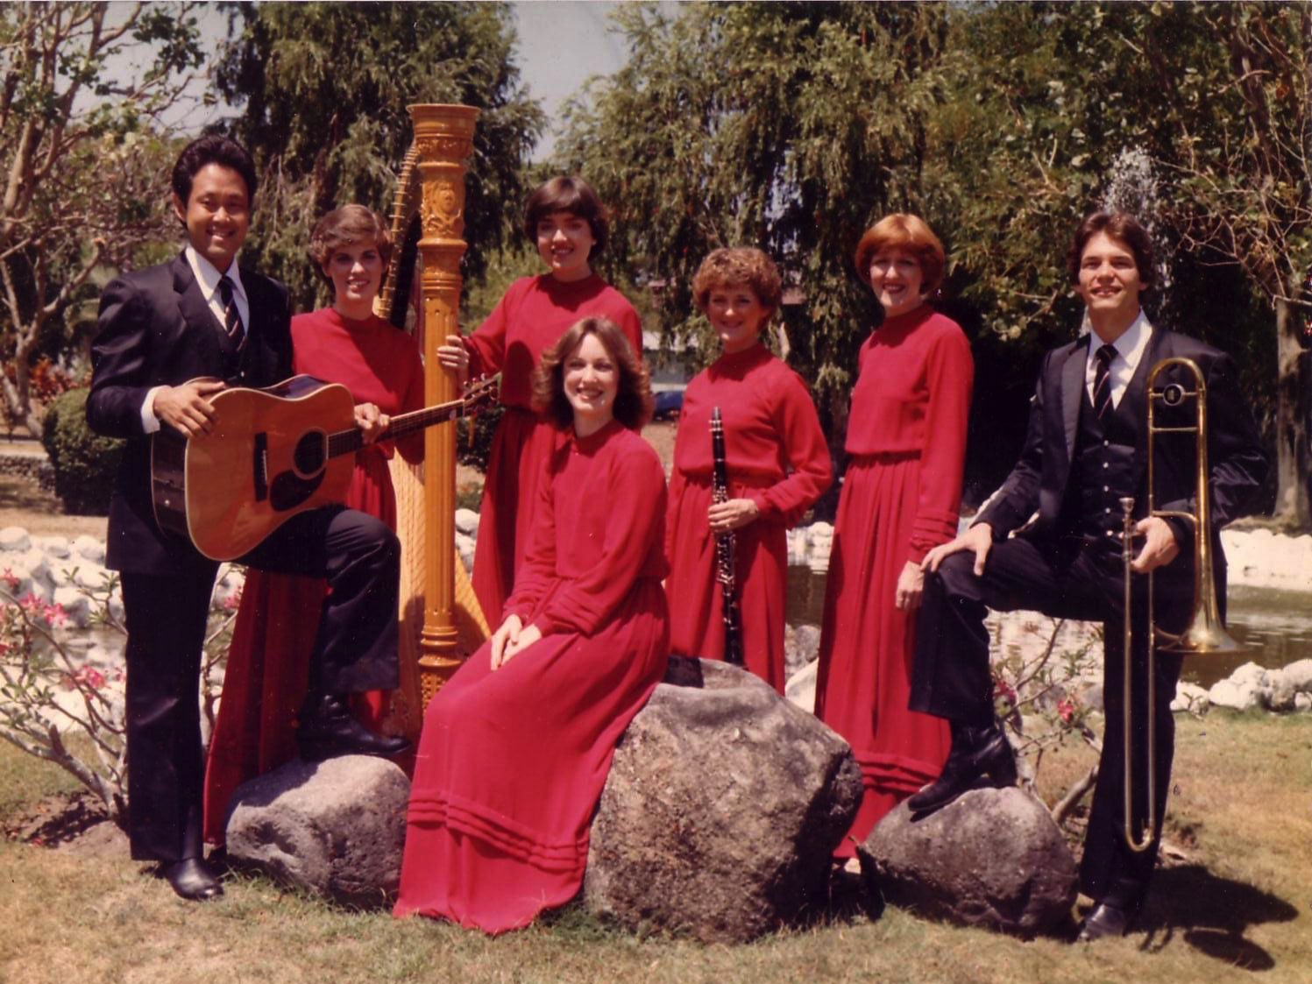
The Crossroads (1981-83)
Notes:
Some 35 years ago I sang on a music team of seven musicians called Crossroads. If you can't tell, I am the guy who is not Japanese.

Slide 12
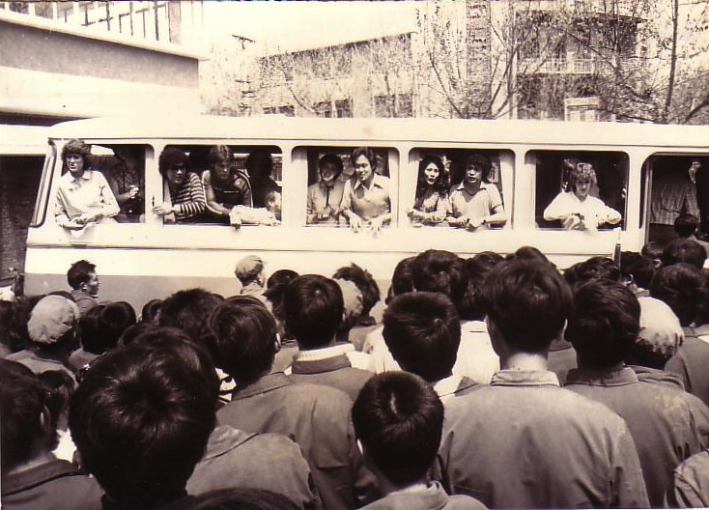
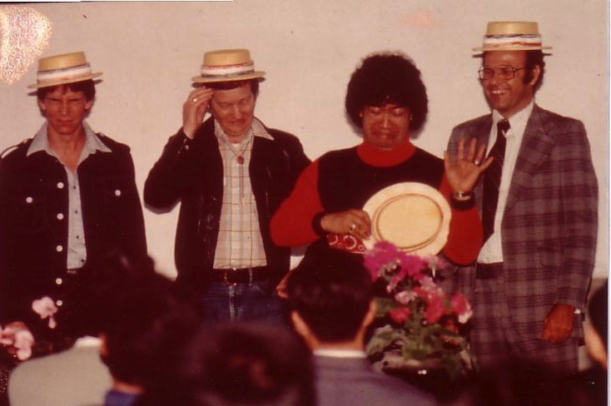
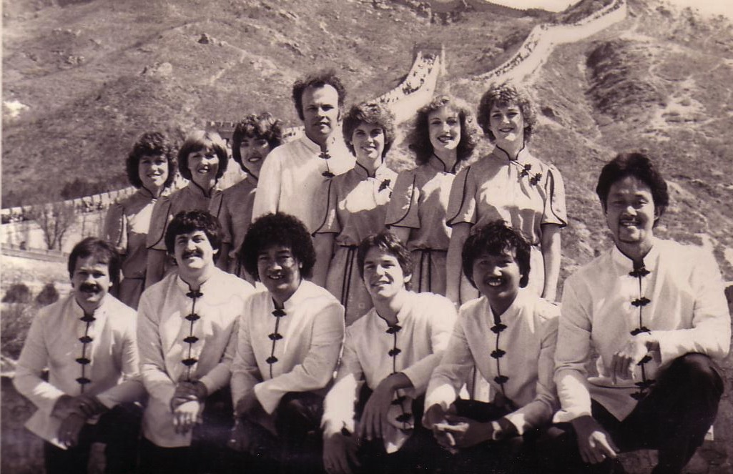
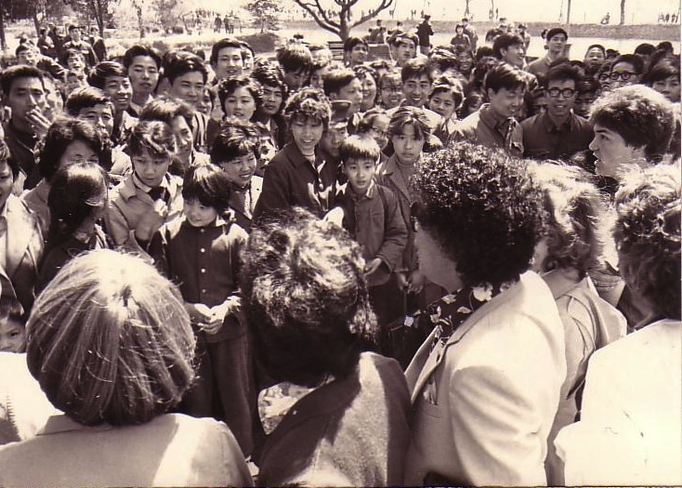
China, 1981
Notes:
We shared the gospel in China and—praise God—we reached over 600 people per concert!

Slide 13
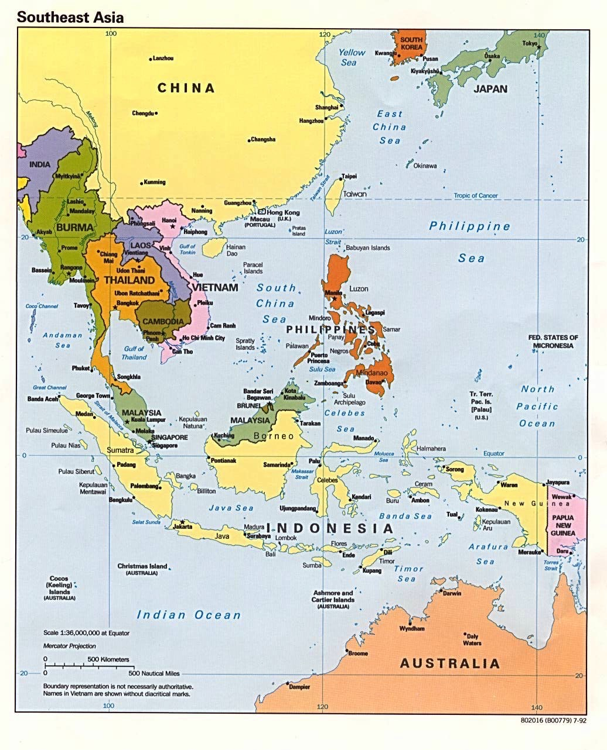
Crossroads Ministry
Korea
China
Japan
Hong Kong
Taiwan
Macau
Thailand
Philippines
Malaysia
Singapore
Indonesia
Notes:
The Crossroads team shared the gospel in 11 Asian nations and saw over 10,000 people trust Christ as indicated in comment cards at our 269 concerts.

Slide 14
This is war.
Notes:
If you know anything about spiritual warfare, it is that the enemy of our souls concentrates his efforts on believers who are having an impact for Christ.
In our team, the opposition came from within—relationships that were a challenge. On that team was one particular woman named Kay. She was a godly woman but we didn't see eye-to-eye at all. In fact, many times she felt that I just a "mister-know-it-all.” She didn't like my mannerisms, my clothes, or my insights in our group Bible studies. She avoided being around me and it seemed that I could do nothing right! She saw me as really arrogant.
So what do you do when you are forced into a working relationship with someone who just plain does not like you? I found that I couldn't really avoid Kay. After all, every day we had four hours of music practice with the team. I had to sing in harmony with her—literally! But discord often reigned. Then we had a concert to give and had to work together.

Slide 15

Relational Pillars
Relational Pillars
for believers
Notes:
God ministered to me then through two texts in Matthew that became "relational pillars" that I want to share with you today. These texts literally changed my life.

Slide 16

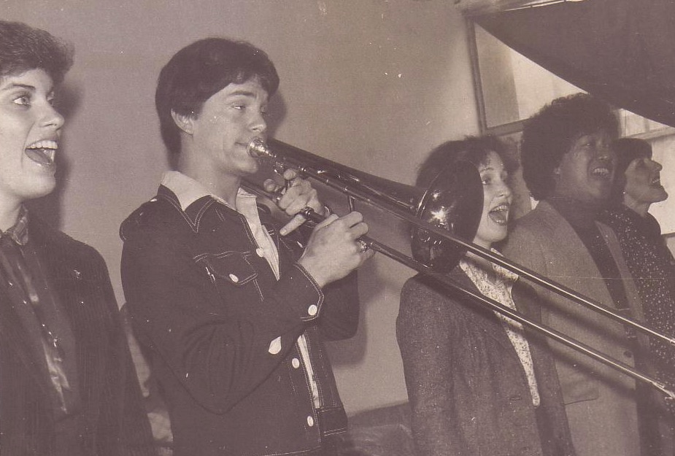
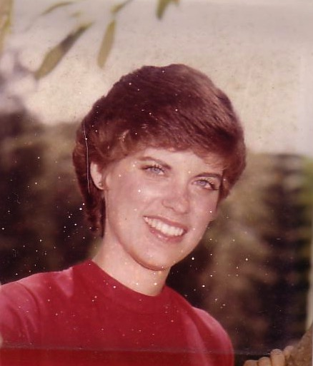
Romance, 1982
Notes:
They enabled Kay and me to reconcile our differences—so much so that three years after our initial differences Kay actually said "yes" to marrying me!

Slide 17
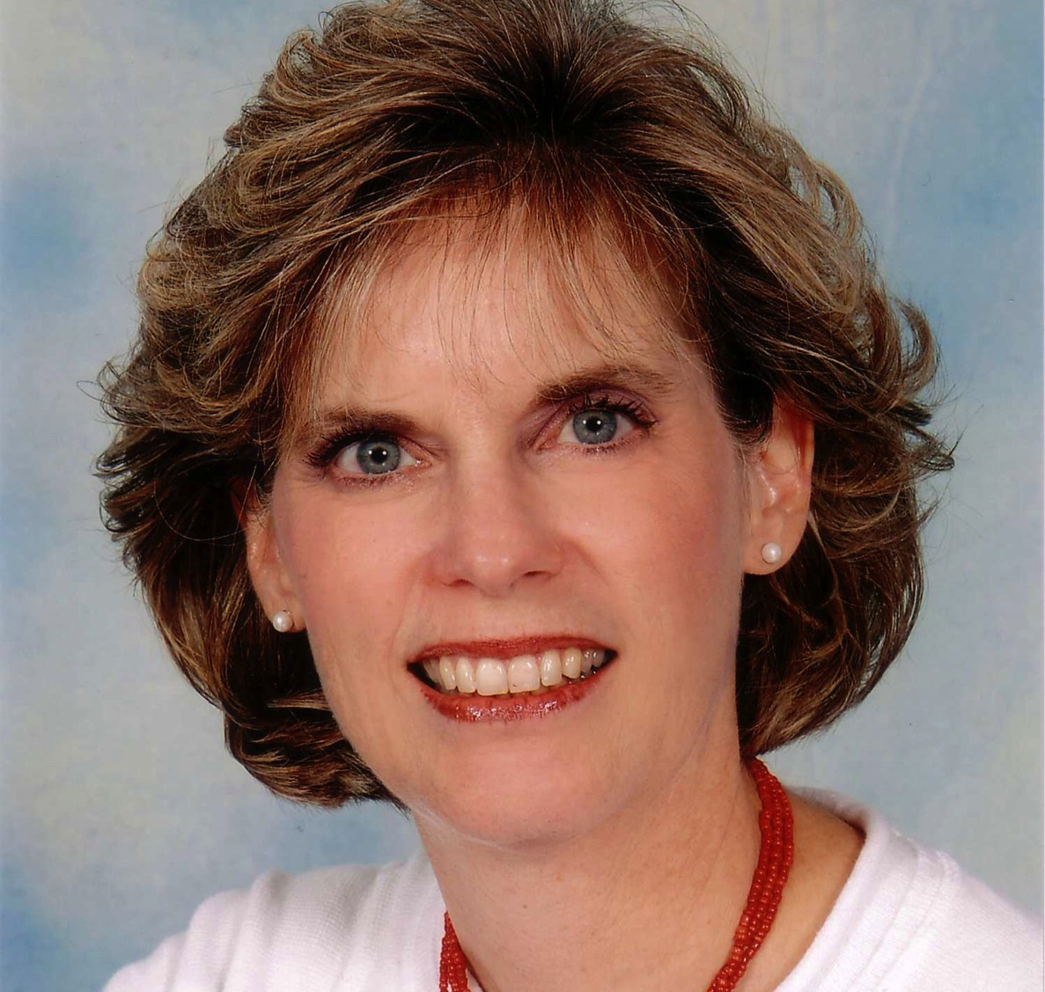
Susan Kay Griffith
Notes:
Yes, Kay is her middle name. Her full name is now Susan Kay Griffith.

Slide 18

Matthew's Relational Pillars
Matthew's Relational Pillars
5:23-24
You are:
Offender
Issue:
General
Notes:
Have you ever had a problem with another believer? (If you say "no," then I wonder which planet you have been living on!) Are you in fellowship with every Christian that you know now—your family members, your work colleagues, your neighbors and friends? If you're not in harmony, what should you do?
• If you hurt the other person, Matthew 5 tells you what to do in any general issue dividing you.

Slide 19


Matthew 5:23-24
Notes:
Let's read it.
God places the responsibility to reconcile on you if you are the offender.

Slide 20
Matthew 5:23-24
?
"Therefore if you are presenting your offering at the altar, and there remember that your brother has something against you, leave your offering there before the altar and go; first be reconciled to your brother, and then come and present your offering."
Notes:
The last I checked, believers weren't offering up sacrifices at the altar. So what does the "altar" refer to today?

Slide 21
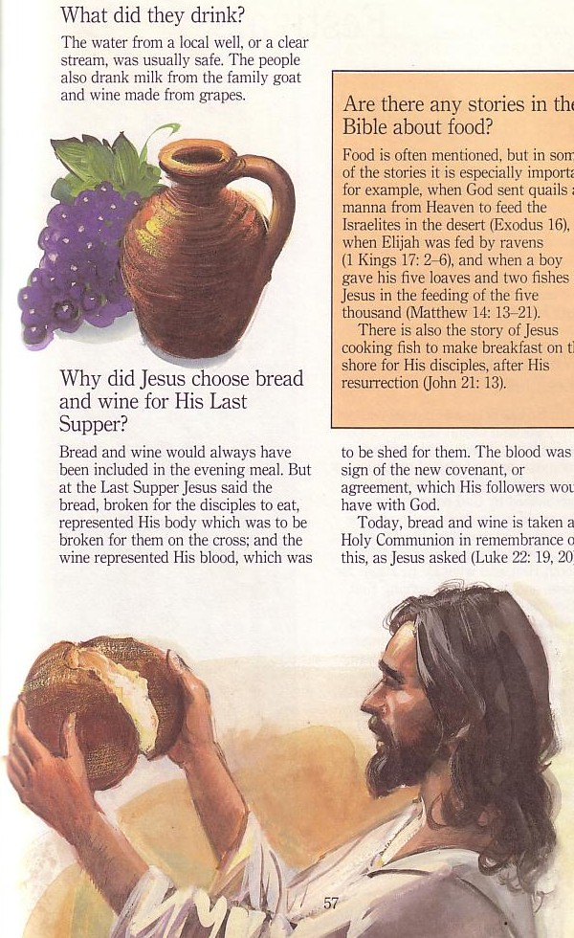
Paskah & Perjamuan Kudus
143

Slide 22
Matthew's Relational Pillars
Matthew's Relational Pillars
5:23-24
18:15-17
You are:
Offender
Offended
Issue:
General
Sin
Notes:
However, in some situations, you are the offended. The other person is guilty of sin. Every church eventually encounters problems with believers living in sin. In these cases a loving body will restore them to God's holiness.

Slide 23


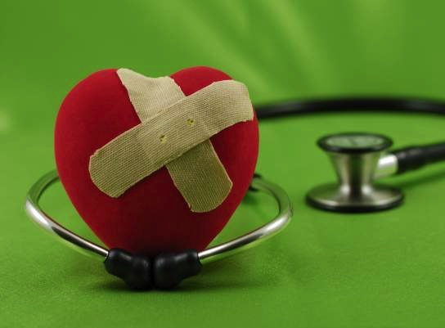
Bagaimana kita memulihkan pendosa Kristen dengan benar?
Pertanyaan Pertama Kita Hari Ini (untuk ayat 15-17)
34d
Notes:
Fill in your bulletin outline

Slide 24
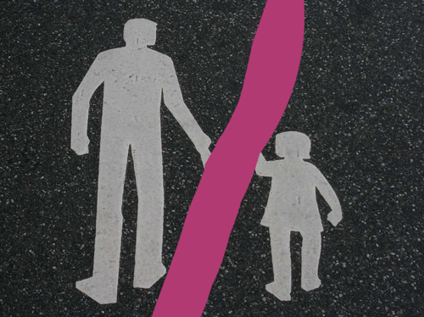

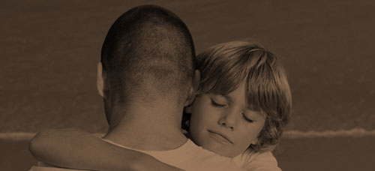
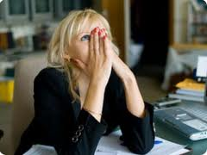
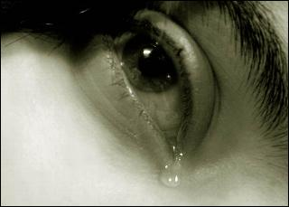
Other Relationships
Notes:
This doesn't just refer to marriage, nor to serious sins—it's any kind of sin that can hurt any relationship among believers.

Slide 25
Black
Notes:
Why I am talking about resolving relational problems now?
I just know that issues surface in every relationship, including ours. At some point, I am going to offend you and you will offend me. So what should we do?

Slide 26
Matthew 18
The Value of
One
1
1
Child (1-9)
1
Sheep
(10-14)
1
Sinner
(15-20)
1
Debtor
(21-35)
Notes:
So our key text today is Matthew 18. The context of Matthew 18 is the value of one—
• one child (1-9), one sheep (10-14), one sinner (15-20), one debtor (21-35).
• At the heart of this chapter is verses 15-20…

Slide 27
Matius 18:15-20
Jika saudara kamu bersalah terhadap engkau, pergi dan beritahukan kesalahannya, diantara kalian berdua. Jika dia mendengar nasihatmu, maka kamu telah memenangkan kembali saudaramu. ¹⁶Tetapi apabila dia tidak mau mendengar, bawalah satu atau dua orang lain bersamamu, sehingga ‘setiap perkara yang terjadi dapat disaksikan oleh dua atau tiga orang saksi.’ ¹⁷Jika dia menolak untuk mendengar mereka, beritahukan hal ini kepada gereja; dan jika dia menolak untuk mendengar bahkan dari gereja, perlakukanlah dia selayaknya penyembah berhala lain atau seorang pemungut cukai.
¹⁸Kuberikan kamu kebenaran ini, apapun yang kamu ikat di dunia ini akan kamu ikat juga di surga, dan apapun yang kamu lepaskan di bumi akan kamu lepaskan juga di surga. ¹⁹Sekali lagi, Aku katakan kepadamu jika dua diantara kamu di bumi menyetujui apapun yang kamu minta, hal ini akan dikabulkan oleh Bapa-Ku di surga. ²⁰Karena ketika dua atau tiga orang dari kamu berkumpul atas nama-Ku, Aku ada ditengah-tengah mereka.
Bagaimana Memulihkan15-17
Mengapa Memulihkan
18-20
Notes:
09.32
16.12 focuses only on verses 15-17

Slide 28

The Point of Verses 15-17
34d
I. Simpan permasalahanseprivat mungkin (15-17).

Slide 29
Tujuan Kita:
34d
Tujuan Kita:
Pemulihan!

Slide 30

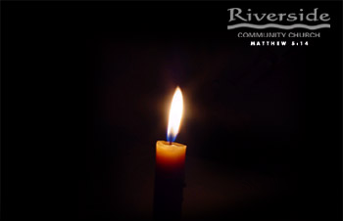
Restore People in Sin
Pulihkan Orang Berdosa
72
“Saudara-saudara, kalaupun seorang kedapatan melakukan suatu pelanggaran, maka kamu yang rohani, harus memimpin orang itu ke jalan yang benar dalam roh lemah lembut.”
Galatia 6:1

Slide 31
4-tahap pemulihan dari Tuhan…
34d
34d
4
3
2
1
…membuka permasalahan ke lebih banyak orang per tahap

Slide 32
Step 1 to Restoration
Talk to the person by yourself
M
M
M
M
M
M
M
M
M
M
M
M
M
M
M
M
S
M
M
M
M
M
M
M
M
M
M
M
S = Sinner
M = Member
Notes:
What's our human tendency here?
• It is to tell others about the problem instead of the one involved.
• God commands us to keep the issue as private as possible.

Slide 33
Matthew's Relational Pillars
Matthew's Relational Pillars
5:23-24
18:15-17
You are:
Offender
Offended
Issue:
General
Sin
Notes:
This differs from Matthew 5 in that you're not an offender, but the offended.
Note also that in Matthew 5 sin may not be in the picture, but Matthew 18 deals specifically with a believer living in sin. This does not refer simply to differences of opinion on debatable matters.

Slide 34
Matthew's Relational Pillars
Matthew's Relational Pillars
5:23-24
18:15-17
You are:
Offender
Offended
Issue:
General
Sin
Initiative:
You!
You!
Notes:
Earlier we saw from Matthew 5:23-24 that God places the responsibility to reconcile on you if you are the offender. Now whose job is it to initiate if you are the offended?
• Yes, again it is your responsibility again! You say, "That's not fair! Why is it my job in both situations? Whether I am the offender or the offended I still have to make the first move?" Well, if relationships are not resolved between believers, it has to be through the fault of both—as both have the command of God to resolve it!

Slide 35
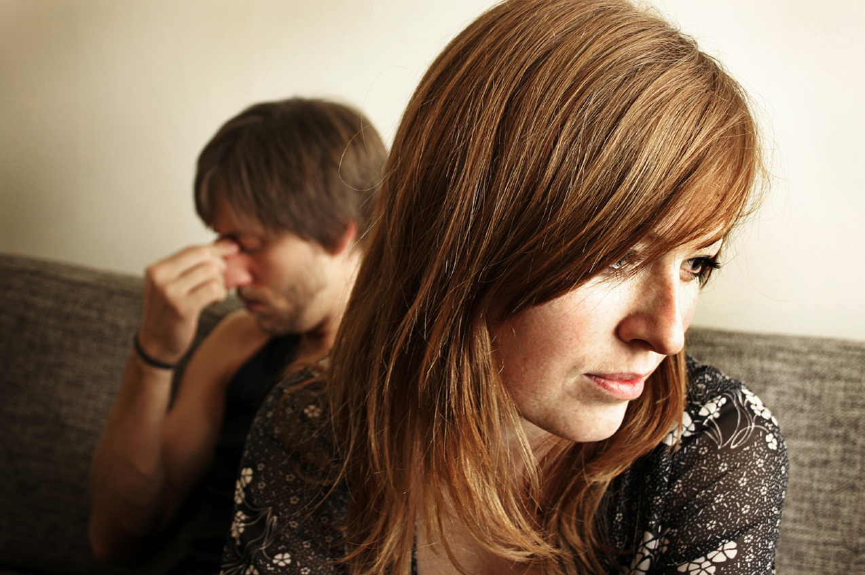
Go in Person
Not:
• email
• SMS
• letter
• phone
Notes:
While letter writing was very popular in the time of Christ, our Lord specifically says to deal with these sensitive matters face-to-face. Today this means confrontation should never be handled via email, SMS, letter, or phone calls. It also prohibits the cowardice of anonymous communication.

Slide 36
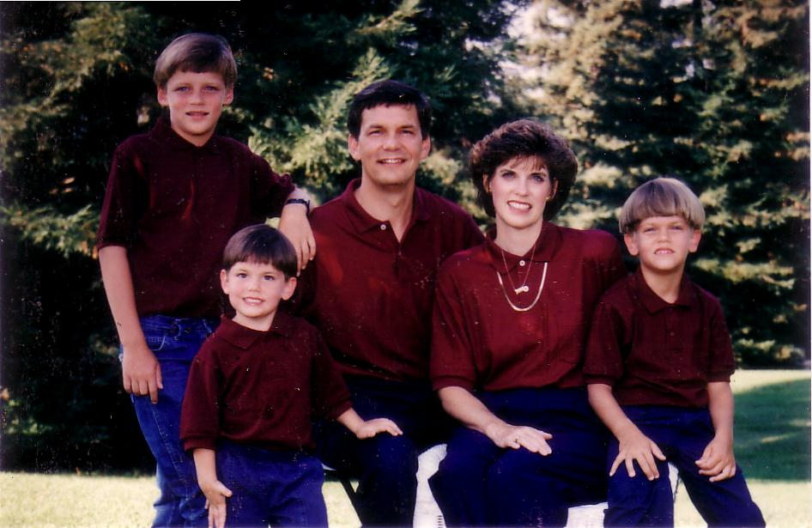
1996
Notes:
Our family has tried to do this since our three sons were young—not to let them do the "Mom! Dad! So-and-so did such-and-such to me!" We just told him, "Matthew 18, bud. If you can't solve it, we'll be step 2…" They rarely came back to us!

Slide 37
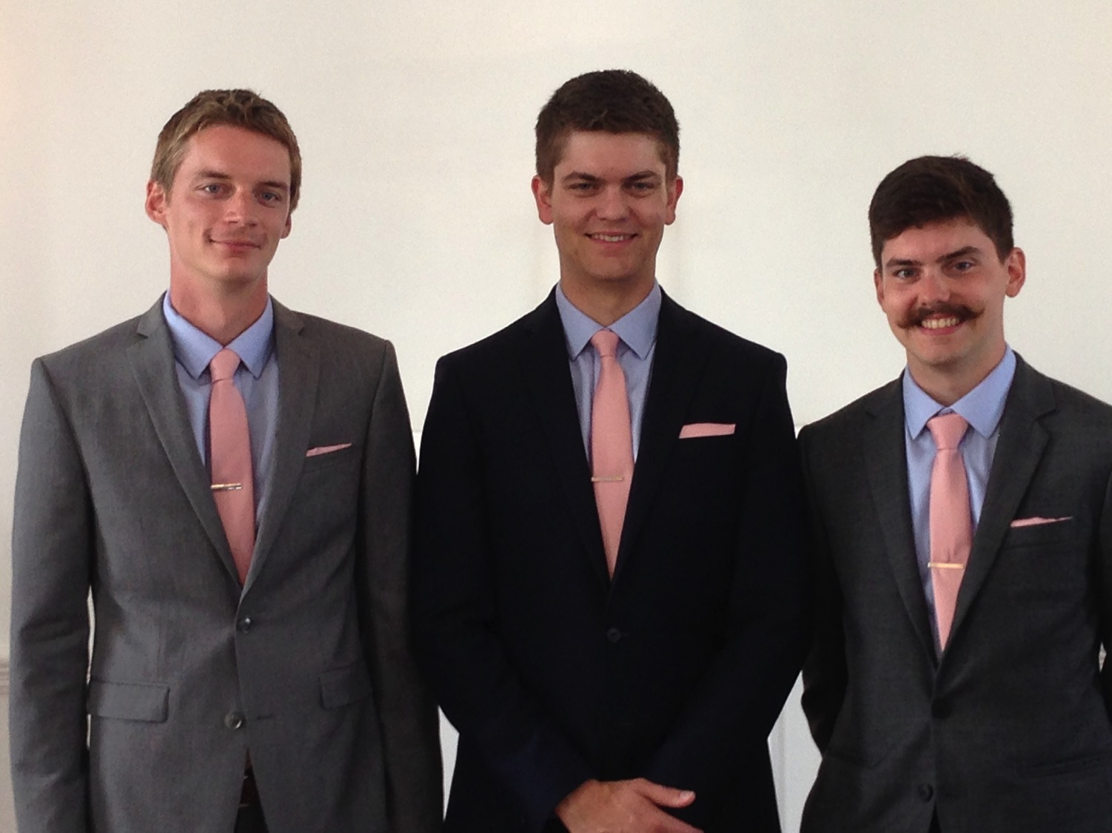
Brothers…
Notes:
Now that they are older, they solve the problems among themselves without our intervention. Some friends were amazed that Kurt and Stephen moved to the US for college and decided to stay as roommates—for 7 years until they married!

Slide 38

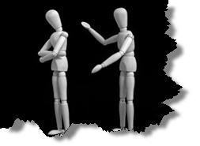
Why don't we confront others?
Ignorance
Doubt
Failure
Fear
Excuses
Impurity
Unsocial
Notes:
However, most of the time believers don't keep issues private—or we don't address them at all. Why do you think don't we confront others? Tell the person next to you why! (Small groups for 1 min.) Why not?
• ignorance of what God commands here?
• doubt that it will work?
• failure of past confrontations that didn't work?
• fear that we might look bad?
• excuses that we can't get together?
• impurity in our own life?
• unsocial in that we just don't care enough to risk it?

Slide 39
Step 1 to Restoration
Talk to the person by yourself
M
M
M
M
M
M
M
M
M
M
M
M
M
M
M
M
S
M
M
M
M
M
M
M
M
M
M
M
S = Sinner
M = Member
Notes:
So… you should talk to the person by yourself—even though our tendency is to tell others instead. But what if the offender does not repent? We need step 2 where we…

Slide 40
Step 2 to Restoration
Take 1-2 others along
M
M
M
M
M
M
M
M
M
M
M
M
M
M
M
M
S
M
M
M
M
M
M
M
M
M
M
M
S = Sinner
M = Member
Notes:
Take one or two others along (16).

Slide 41
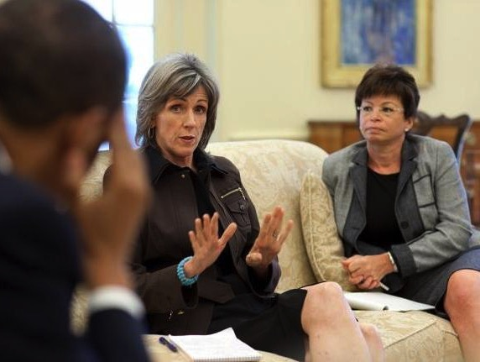
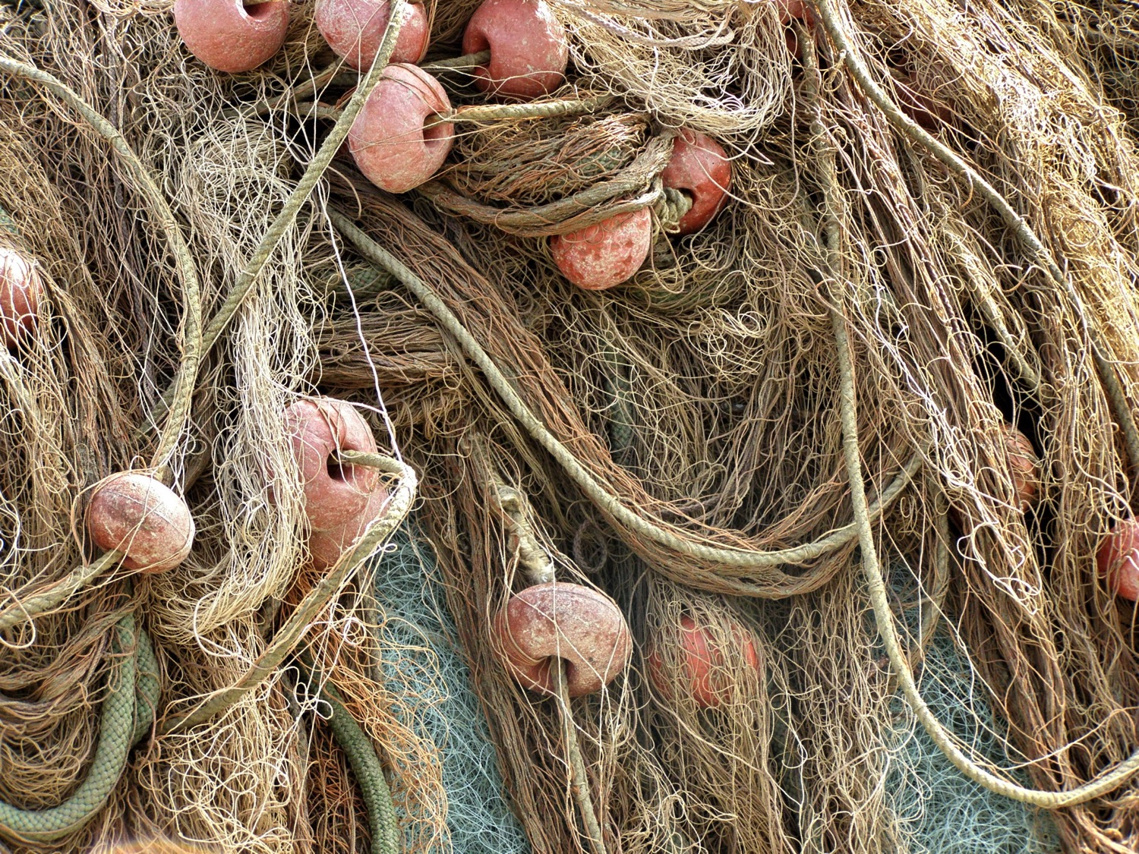
B. Ilustrasi yang lebih baik memakai suatu konsep karena berhubungan dengan area yang sama dengan kehidupan.
72
Restore nets
Pulihkan Orang
Notes:
Instead of restoring nets, share about a genuine reconciliation between people.
08.27 adapted in 16.20

Slide 42
Deut. 19:15
"One witness is not enough to convict a man accused of any crime or offense he may have committed. A matter must be established by the testimony of two or three witnesses."
Notes:
The OT law prohibited conviction of crimes based on only one person's testimony (read Deut. 19:15). The NT teaching is the same, protecting the offender from an easily offended or lying accuser.
What if the offender still does not repent? Go to step 3…

Slide 43
Step 3 to Restoration
Expose the sin to the entire church
M
M
M
M
M
M
M
M
M
M
M
M
M
M
M
M
S
M
M
M
M
M
M
M
M
M
M
M
S = Sinner
M = Member
Notes:
The church leadership certainly must be involved at this point before the matter is brought to the congregation. They also must see the issue isn't just a difference of opinion between two parties; the biblical basis for the offender living in sin must be clearly shown with specific passages.

Slide 44
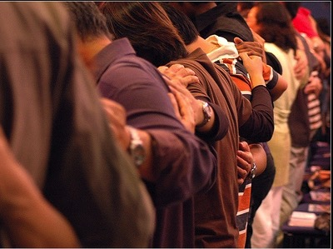
Why tell the whole church?
Notes:
Bringing the matter to the entire church is vital, since without it the sinning person will be able to find fellowship in other smaller groups within the larger church who do not know of his/her sin. Such gossip situations inevitably bring disunity, which lead to factions that can split the body.
What, then, should the entire church do once discipline has been determined? Step 4…

Slide 45
Step 4 to Restoration
Treat the person as an unbeliever
M
M
M
M
M
M
M
M
M
M
M
M
M
M
M
M
S
M
M
M
M
M
M
M
M
M
M
M
S = Sinner
M = Member
S

Slide 46

Sins Worthy of Discipline
Bukan Cara Menghukum
MENGKUCILKAN!
Notes:
Sometimes we can show what to do by also telling first what NOT to do…
08.32
16.14

Slide 47

Sins Worthy of Discipline
Bagaimana Menghukumnya
34d
Jangan akui dia sebagai orang Kristen.
Injili.
Larang dia ikut Perjamuan Kudus.
Keluarkan dia dari keanggotaan.
Jangan biarkan dia berperan dalam peran di gereja.
Bukan Orang Percaya
“Serahkan kepada Iblis” orang yg jatuh dalam dosa seksual (1 Kor. 5:5).
Jangan makan/minum dengannya (1 Kor. 5:11).
Larang untuk datang ke gereja?
Buruk
Notes:
08.33
16.15

Slide 48
The Point of Verses 15-17
I. Keep the matter as private as possible (15-17).
I. Usahakan membicarakan secara pribadi (15-17).
Notes:
12.19

Slide 49
4-tahap pemulihan dari Tuhan…
34d
34d
4
3
2
1
…membuka permasalahan ke lebih banyak orang per tahap

Slide 50
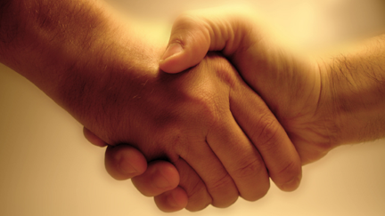
Transisi dari Poin Utama 1:Pertanyaan kedua kita terjawab di ayat 18-20:
Mengapa kita perlu memulihkan pendosa Kristen dengan benar?
34d

Slide 51

Kunci dari ayat 18-20
34d
II. Alasan gereja dapat memulihkan atau terus mendekati orang Kristen yang berdosa, karena gereja berfungsi sebagai bagian dari otoritas Tuhan!

Slide 52
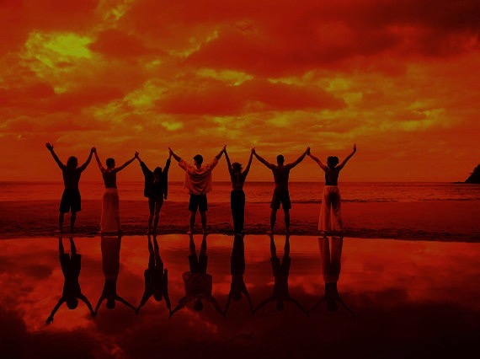
Why discipline?
When we seek to restore someone…
We act in the place
of the Father
(18-19)
Notes:
We act in the place of the Father when we seek to restore someone (18-19).

Slide 53
A Better Translation…
NAU is a Better Translation…
NIV "I tell you the truth, whatever you bind on earth
will be {or have been} bound in heaven, and whatever you loose on earth will be {or have been} loosed in heaven."
NAU "Truly I say to you, whatever you bind on earth shall have been bound in heaven; and whatever you loose on earth shall have been loosed in heaven."
Notes:
Too often today's churches act as if they have no authority under God, and yet "binding" here refers to disciplining (a guilty verdict) while "loosing" refers to releasing from discipline (an innocent verdict).

Slide 54

Matthew 18:19
"Again, I tell you that if two of you on earth agree about anything you ask for, it will be done for you by my Father in heaven"
(NIV).
Notes:
We should trust that our prayerful judgments are God's will.

Slide 55
Psalm 82:1, 6
(to Israel's rulers/gods)
"I said, 'You are "gods"; you are all sons of the Most High… but you will die like men…"
Notes:
Ps. 82:6 has a similar idea where Israel's rulers are called "gods" in that they rule others.
Why should we trust this process in discipline situations? Verse 20 says that…

Slide 56
Why discipline?
When we seek to restore someone…
We act in the place
of the Father
(18-19)
We act in the presence & authority of Christ
(20)
Notes:
When we seek to restore someone, we act in the presence and authority of Christ (20).

Slide 57
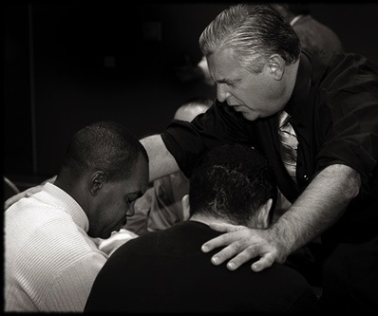
Matthew 18:20
"For where
two or three come together in my name, there I am with them" (NIV).
Notes:
The "two or three" refers to the witnesses whose testimony enacted discipline (v. 16).
The point of Christ being "in their midst" is that local church discipline acts with the presence and authority of Christ Himself.

Slide 58
Bagaimana kita memulihkan pendosa Kristen dengan benar?
Pertanyaan Pertama Kita Hari Ini (untuk ayat 15-17)
34d
Notes:
Fill in your bulletin outline

Slide 59
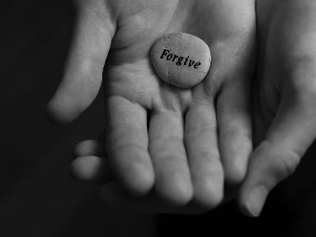
Ide Utama:
34d
Ide Eksegetikal: Alasan gereja harus memulihkan orang Kristen yang berdosa adalah karena pemulihan ini dilakukan atas otoritas Tuhan.
Kita memulihkan jemaat yg berdosa dengan benar karena kita bertindak atas nama Tuhan

Slide 60
Matthew's Relational Pillars
Matthew's Relational Pillars
5:23-24
18:15-17
You are:
Offender
Offended
Issue:
General
Sin
Initiative:
You!
You!
Notes:
God expects each of us to take the initiative—

Slide 61
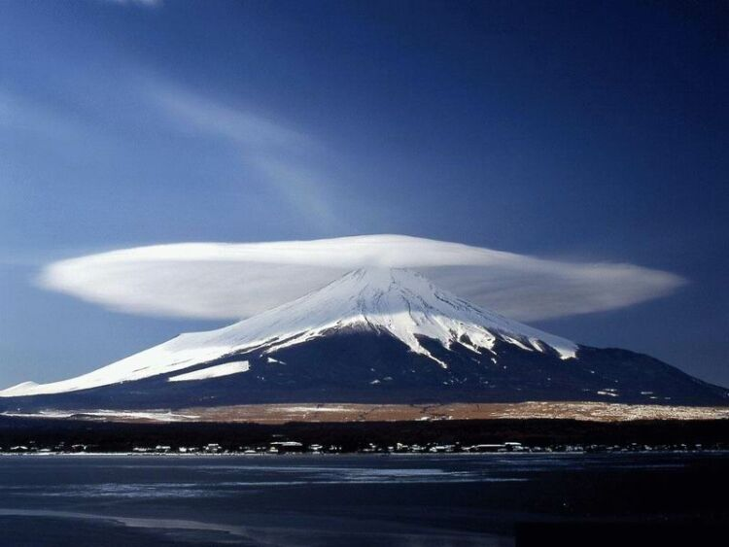
The Overall Principle
"If possible, as far as it depends on you, be at peace with all men"
Romans 12:18
Notes:
—and to do so as far as possible, as Romans 12:18 says [read]. This verse is a great encouragement to do all we can even if others are not responsive.

Slide 62
Matthew's Relational Pillars
Matthew's Relational Pillars
5:23-24
18:15-17
The Overall Principle: Romans 12:18
You are:
Offender
Offended
Issue:
General
Sin
Initiative:
You!
You!
Notes:
This verse is a great overall principle in relationships.

Slide 63
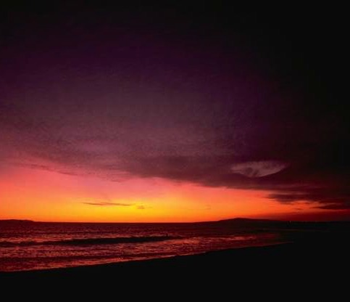
Make us one 3/3
Make us one, Lord,
make us one,
Holy Spirit, make us one.
Let Your love flow
so the world will know
we are one in You.
Notes:
God desires us to truly live out the chorus "Make Us One, Lord"

Slide 64
Apa yang Tuhan katakan padamu?
a. Tubuh Gereja
M
M
M
M
M
M
M
M
M
M
M
M
b. Hidupmu Sendiri
M
M
M
M
S
M
M
M
M
M
M
M
M
c. Bantu Orang Lain
M
M
M
Notes:
Apply restoring relationships in at least three areas…

Slide 65
Slides on
Matius 19

Slide 66
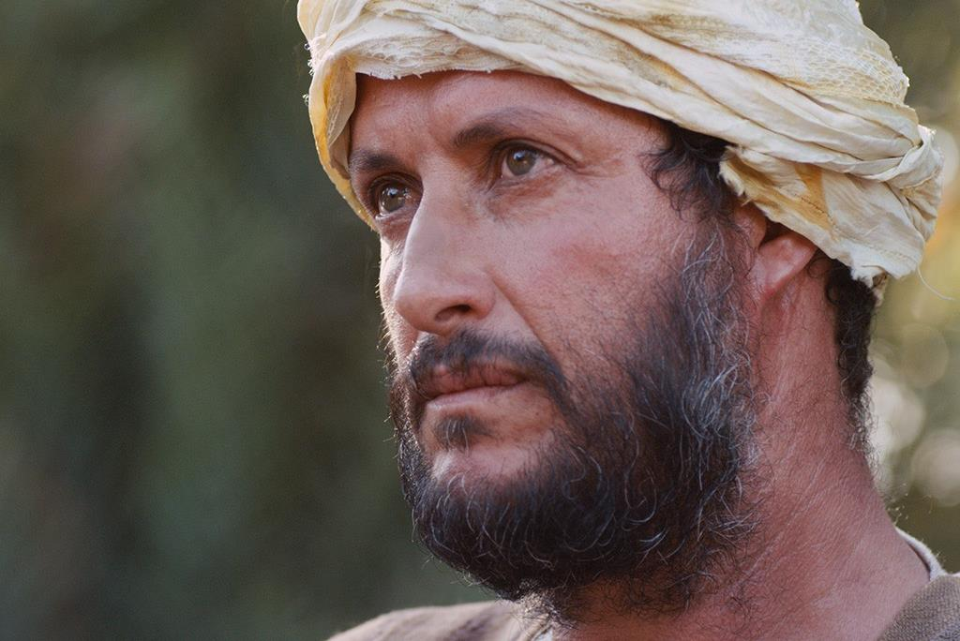

Free
Bible
images
A RICH YOUNG MAN QUESTIONS JESUS
Matthew 19:16-30; Mark 10:17-31; Luke 18:18-30

Slide 67


Slide 68


Slide 69


Slide 70


Slide 71


Slide 72


Slide 73


Slide 74


Slide 75


Slide 76


Slide 77

Used with Permission
THE
GOSPEL
——OF—— MATTHEW
THE
GOSPEL
——OF—— MARK
THE
GOSPEL
——OF—— LUKE
THE
GOSPEL
——OF—— JOHN
Due to the Lumo Project producing its own publishing material we regret to inform you that we cannot license our photos to other clients outside of freebibleimages.org.
These images are not licensed for reuse in video, epublishing or other media. Downloaded pictures and files cannot be redistributed through any other website than freebibleimages.org or used in any context where the accompanying message is undermining of the Christian faith and gospel.
Photos can only be used on educational presentations, blogs and social media, all of which should be accompanied with reference to www.LumoProject.com.
Picture courtesy of BBM
© All Rights Reserved.
www.bigbookmedia.com

Slide 78
Slides on
Matius 20

Slide 79
Slides on
Matius 21

Slide 80
Ps. 21–27
Garis Besar
73
IV. (11:1–16:12) Kristus ditolak sebagai Mesias dalam mengantisipasi penolakan penyaliban terakhir, maka Dia memperkenalkan masa antara kedatangan kembali sebelum penerimaan masa depanNya dan pelayanan ke orang non Yahudi untuk mengajarkan penundaan kerajaan.
V. (16:13–20:34) Kristus mempersiapkan murid-muridNya tentang PribadiNya dan rencana dalam hal predikat otoritas MesiasNya yang mungkin didelegasikan kepada mereka setelah kematianNya.
VI. (Chs. 21–27) Penyajian resmi Kristus dan penolakan sebagai Raja Israel dalam penebusan di atas kayu salib menunjukkan alasan kerajaan ditunda sampai kedatanganNya kembali.

Slide 81
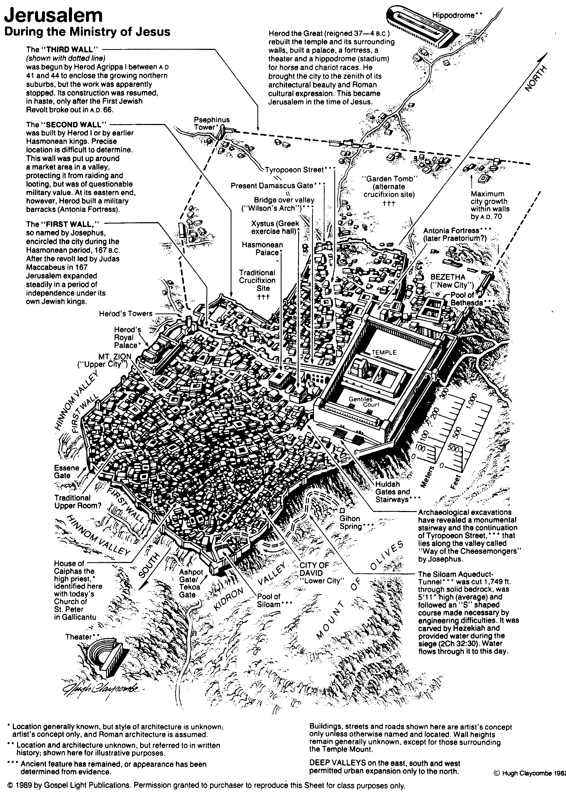
Yerusalem pada masa Pelayanan Yesus
80

Slide 82


Matthew 21:1-11
Mark 11:1-11
Luke 19:28-44
John 12:12-19
THE EASTER STORY
TRIUMPHAL ENTRY (Palm Sunday)

Slide 83


Slide 84


Slide 85


Slide 86


Slide 87


Slide 88


Slide 89


Slide 90


Slide 91


Slide 93


Slide 94


Slide 95


Slide 96


Slide 97


Slide 98


Slide 99


Slide 100


Slide 101


Slide 102

Gambar
Alkitab
Gratis
KATA-KATA TERSIRAT DALAM GAMBAR

Slide 103
Used with Permission
THE
GOSPEL
——OF—— MATTHEW
THE
GOSPEL
——OF—— MARK
THE
GOSPEL
——OF—— LUKE
THE
GOSPEL
——OF—— JOHN
Due to the Lumo Project producing its own publishing material we regret to inform you that we cannot license our photos to other clients outside of freebibleimages.org.
These images are not licensed for reuse in video, epublishing or other media. Downloaded pictures and files cannot be redistributed through any other website than freebibleimages.org or used in any context where the accompanying message is undermining of the Christian faith and gospel.
Photos can only be used on educational presentations, blogs and social media, all of which should be accompanied with reference to www.LumoProject.com.
Picture courtesy of BBM
© All Rights Reserved.
www.bigbookmedia.com

Slide 104

Matthew 21:12-17
Mark 11:15-19
Luke 19:45-48
John 2:13-24
THE EASTER STORY
CLEANSING THE TEMPLE
Free
Bible
images

Slide 105


Slide 106


Slide 107


Slide 108


Slide 109


Slide 111


Slide 112


Slide 113


Slide 114


Slide 115


Slide 116


Slide 117


Slide 118


Slide 119


Slide 120


Slide 121
Gambar
Alkitab
Gratis
KATA-KATA TERSIRAT DALAM GAMBAR

Slide 122

Palm Sunday
Notes:
Palm Sunday is an interesting name for the day, isn't it?

Slide 123


Palm Sunday
Notes:
We know that today recalls the palm branches waved at Jesus as he entered Jerusalem at the beginning of his last week of his life. Yet the focus really isn't the tree palms, but the hand palms of Jesus that would stretch out on a cross but a few days later.

Slide 124

Palms to Cross
Notes:
Tree palms were but a prelude to the cross.

Slide 125


Triumphant Entry
Matthew 21:9
Notes:
Even the alternate name—Triumphant Entry—is also perplexing.

Slide 126

Triumphal Entry
Notes:
True, Jesus rode into Jesus and the crowds cheered his arrival.

Slide 127

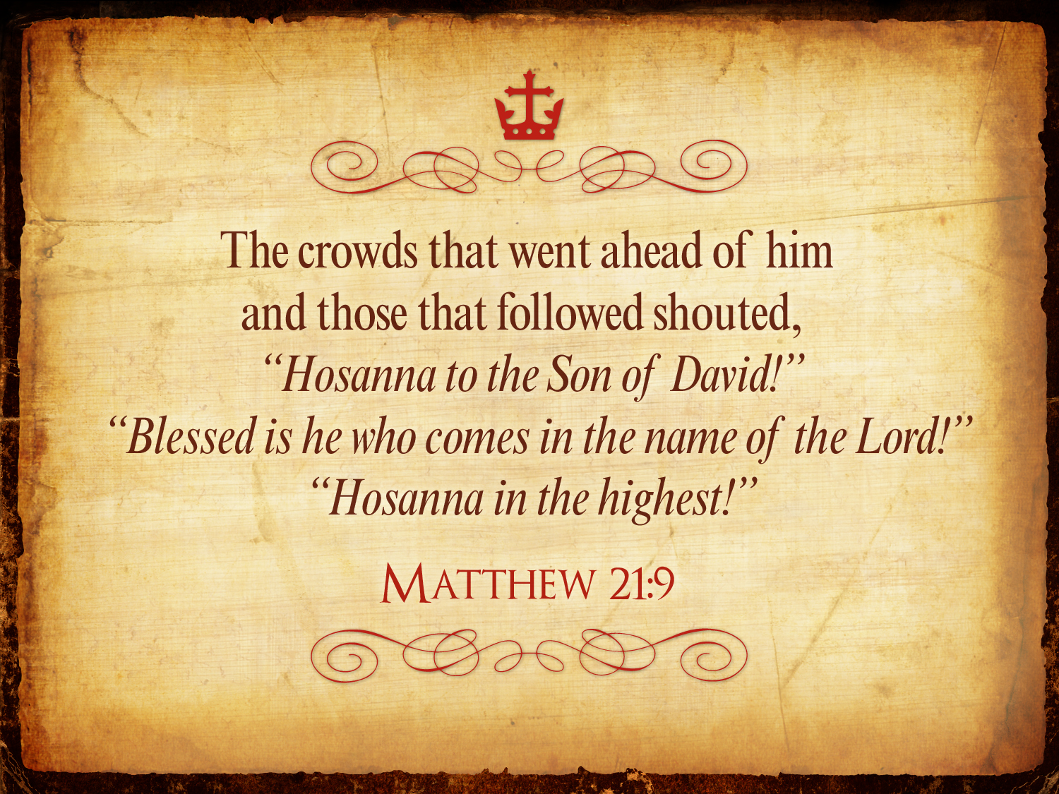
Triumphant Entry
Matthew 21:9
Notes:
Matthew 21:9 says the crowds that went ahead of him and those that followed shouted, "Hosanna to the Song of David!" "Blessed is he who comes in the name of the Lord!" "Hosanna in the highest!"

Slide 128

Palms to Palms
Notes:
Normally a king rode into the city as the victor over his enemies, while that very week would culminate in Jesus' death on Friday, which we call Good Friday.

Slide 129

What's so good about Good Friday?
Notes:
But that name is equally puzzling. Why is Good Friday called "good"?
Our leader died on that day, so it seems strange to call the day "good." No other religion refers to the death of their leader as "good."
We believe that his death was good. How was that?

Slide 130

How is Christ's death better than any sacrifice?

Slide 131
Slides on
Matius 22

Slide 132

Minggu Paskah
Sen
Sel
Rab
64
Jum
Kam
Min
Jum
Sab
Sab
Min

Slide 133
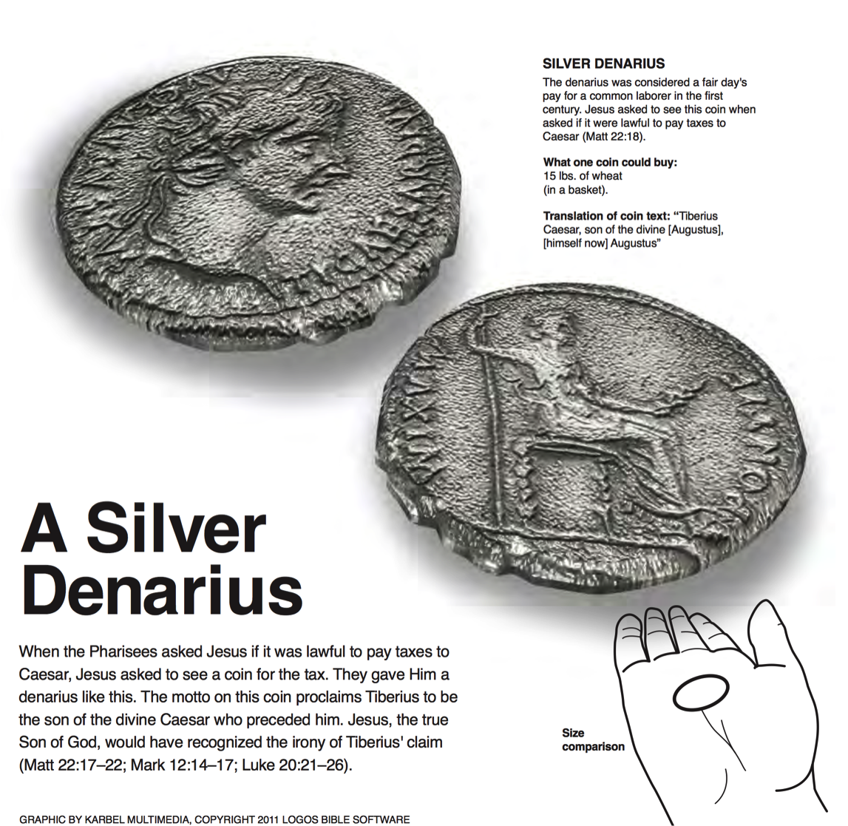
A Silver Denarius
SILVER DENARIUS
The denarius was considered a fair day's pay for a common labor in the first century. Jesus asked to see this coin when asked if it were lawful to pay taxes to Caesar (Matt 22:18).
What one coin could buy:
15 lbs. of wheat (in a basket)
Translation of coin text: "Tiberius Caesar, son of the divine [Augustus], [himself now] Augustus"
When the Pharisees asked Jesus if it was lawful to pay taxes to Caesar, Jesus asked to see a coin for the tax. They gave him a denarius like this. The motto on this coin proclaims Tiberius to be the son of the divine Caesar who preceded him. Jesus, the true Son of God, would have recognized the irony of Tiberius's claim (Matt 22:17-22; Mark 12:14-17; Luke 20:21-26).
Logos Bible Software

Slide 134
Slides on
Matius 23

Slide 135
Slides on
Matius 24

Slide 136
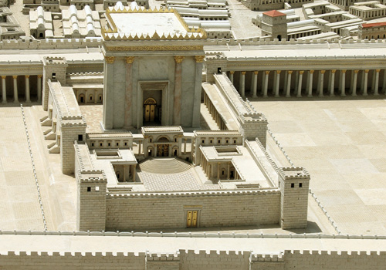
Disciples: What a fantastic temple! (24:1)
Jesus: "Not one stone here will be left on another" (24:2)
Disciples: When? What sign? (24:3)

Slide 137
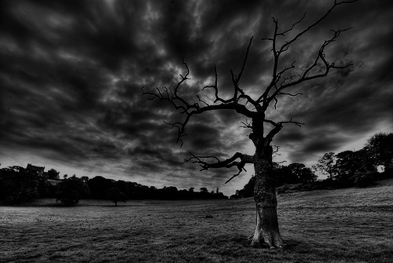
The Olivet Discourse (Matthew 24–25)
78
Adapted from Mark L. Bailey, DTS class notes, 1986
Second Coming (27-31):
Signs in the Heavens (29-30)
Coming of the Son of Man (27, 30)
Bird Supper (28)
Salvation of Elect (31)
Abomination of Desolation
(15-20)
False Christs
& Prophets
(23-26)
Beginning of Birth Pangs
(4-8)
Great Tribulation
(9-14, 21-22)
Judgment of the Nations
Sheep
Goats
Correlation with Revelation
12:7-12
13:14
12:8-17
8:1–19:10
(Matt. 25:31-46)
6:1–8:5
19:11-21

Slide 138
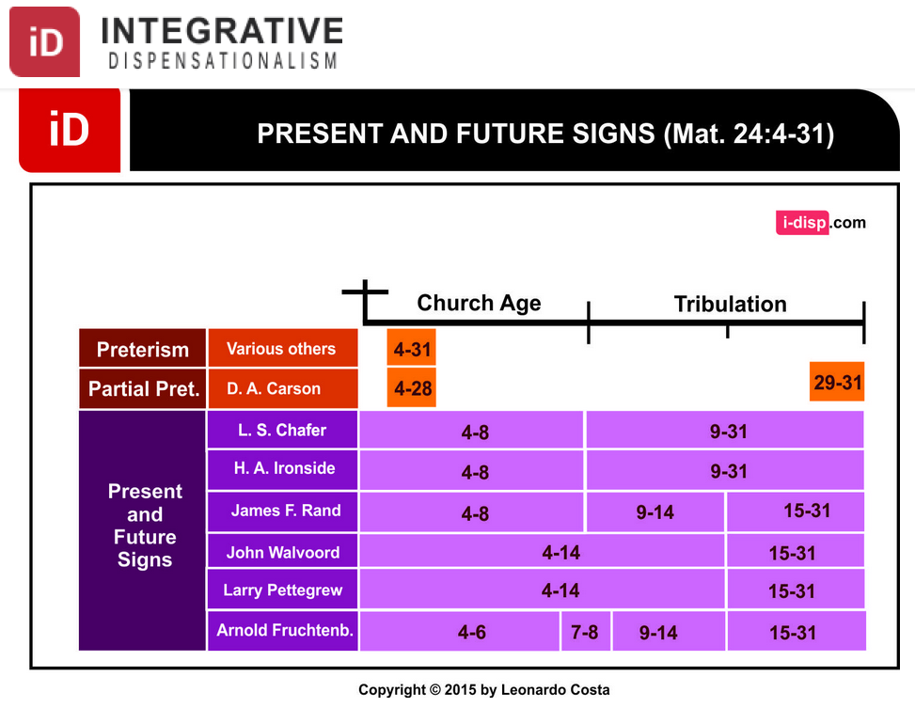
Dispensational Views on Matthew 24
Notes:
Leonardo Costa, "The Fulfillment of Matthew 24:4-31 in Dispensational Tradition," Integrative Dispensationalism website
http://i-disp.com/the-fulfillment-of-matthew-244-31-in-dispensational-tradition/ accessed 24 July 2015

Slide 139
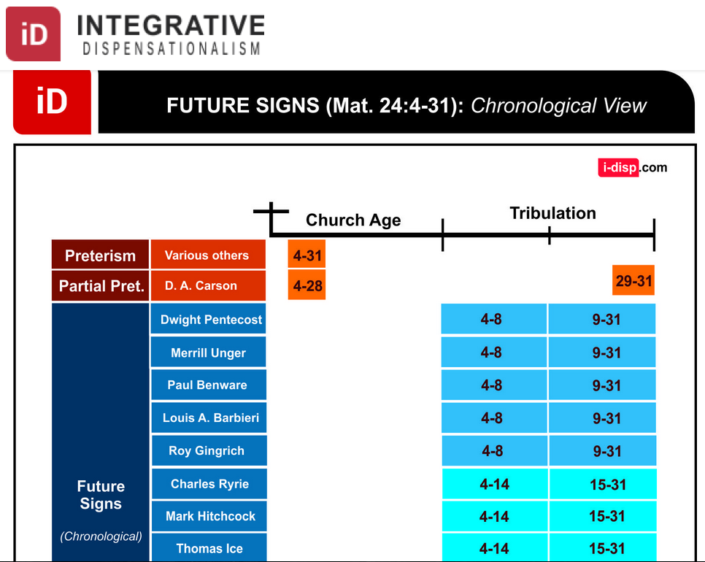
Dispensational Views on Matthew 24
Notes:
Leonardo Costa, "The Fulfillment of Matthew 24:4-31 in Dispensational Tradition," Integrative Dispensationalism website
http://i-disp.com/the-fulfillment-of-matthew-244-31-in-dispensational-tradition/ accessed 24 July 2015

Slide 140
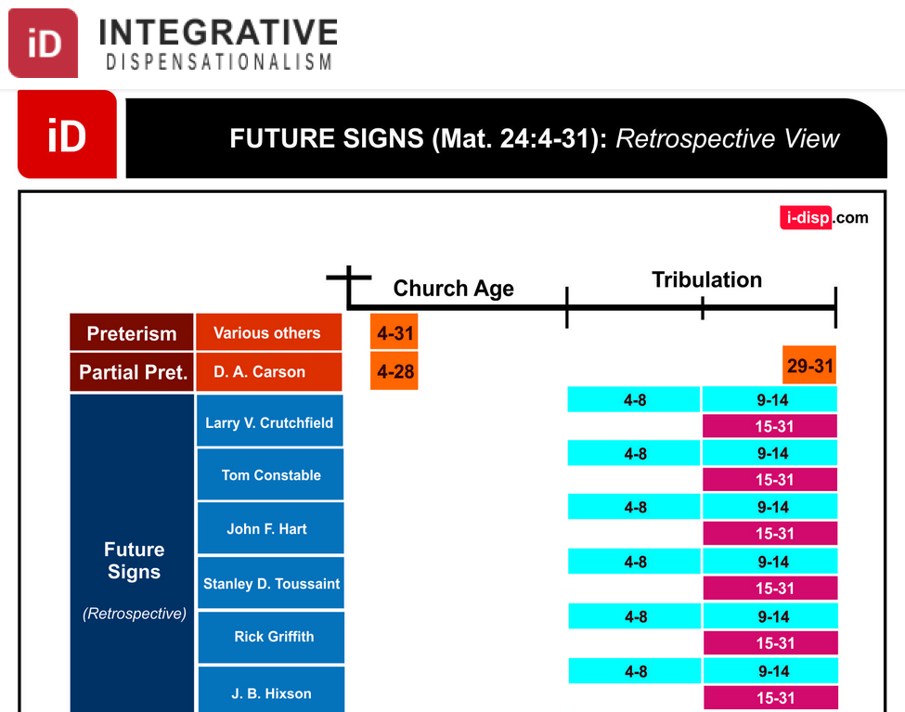
Dispensational Views on Matthew 24
Notes:
Leonardo Costa, "The Fulfillment of Matthew 24:4-31 in Dispensational Tradition," Integrative Dispensationalism website
http://i-disp.com/the-fulfillment-of-matthew-244-31-in-dispensational-tradition/ accessed 24 July 2015

Slide 141
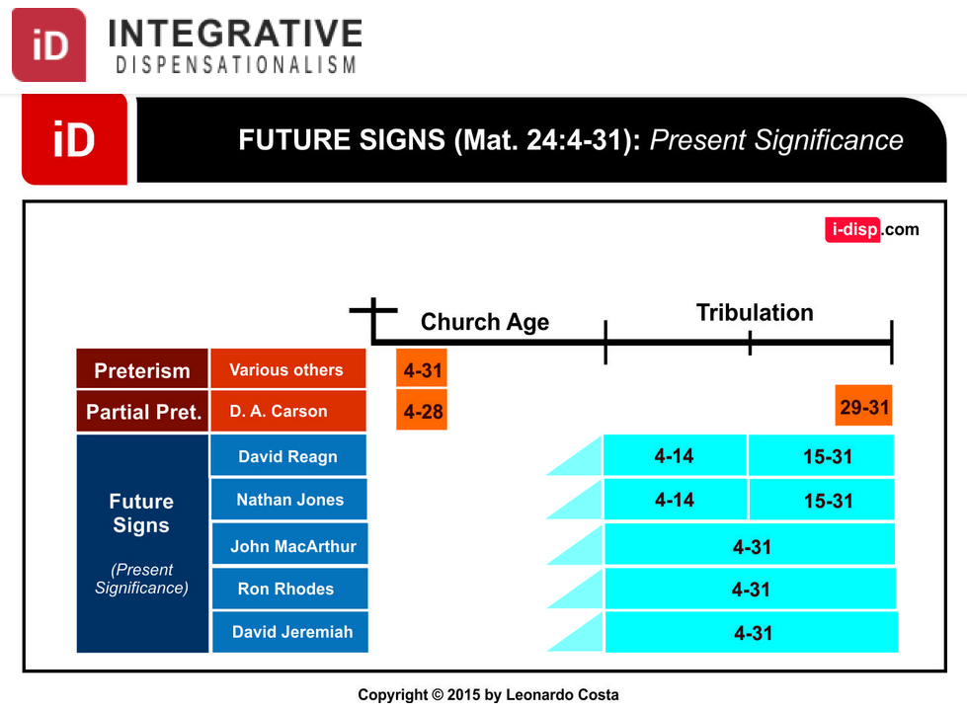
Dispensational Views on Matthew 24
Notes:
Leonardo Costa, "The Fulfillment of Matthew 24:4-31 in Dispensational Tradition," Integrative Dispensationalism website
http://i-disp.com/the-fulfillment-of-matthew-244-31-in-dispensational-tradition/ accessed 24 July 2015

Slide 142
Slides on
Matius 25

Slide 143
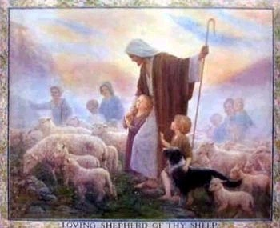
Judgment of the the Nations
(Sheep & Goats)
160
NLT Matthew 25:31 "But when the Son of Man comes in his glory, and all the angels with him, then he will sit upon his glorious throne. ³²All the nations will be gathered in his presence, and he will separate them as a shepherd separates the sheep from the goats. ³³He will place the sheep at his right hand and the goats at his left. ³⁴Then the King will say to those on the right, 'Come, you who are blessed by my Father, inherit the Kingdom prepared for you from the foundation of the world.'"

Slide 144
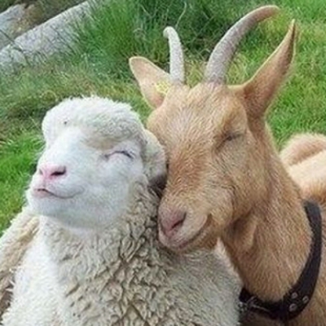
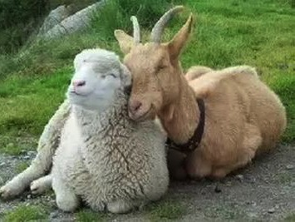
Aren't Sheep & Goats the Same?

Slide 145
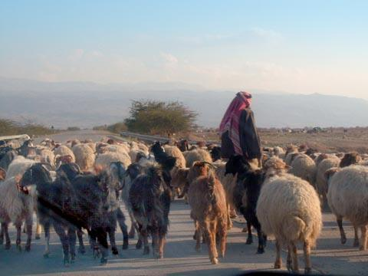
Judgment of the Nations
"All the nations will be gathered in his presence, and he will separate the people as a shepherd separates the sheep from the goats. ³³He will place the sheep at his right hand and the goats at his left"
(Matt. 25:31-32).

Slide 146

Judgment of Living Gentiles
³¹ "But when the Son of Man comes in his glory, and all the angels with him, then he will sit upon his glorious throne.
³² All the nations will be gathered in his presence, and he will separate the people as a shepherd separates the sheep from the goats. ³³ He will place the sheep at his right hand and the goats at his left.
³⁴ "Then the King will say to those on his right, 'Come, you who are blessed by my Father, inherit the Kingdom prepared for you from the creation of the world" (Matt. 25:31-34 NLT).

Slide 147
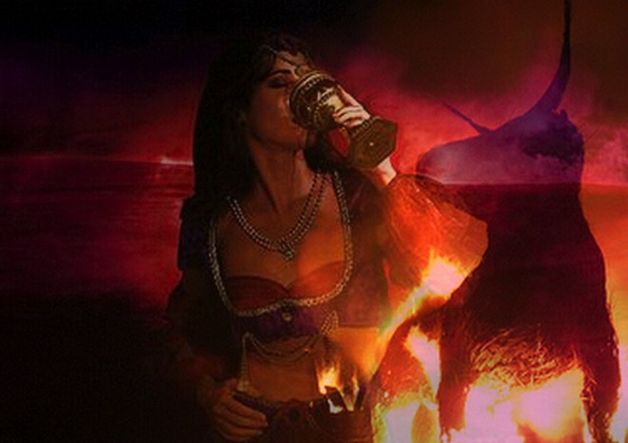
Judgment of Living Gentiles
⁴¹ "Then the King will turn to those on the left and say, 'Away with you, you cursed ones, into the eternal fire prepared for the devil and his demons. ⁴² For I was hungry, and you didn't feed me. I was thirsty, and you didn't give me a drink.
⁴³ I was a stranger, and you didn't invite me into your home. I was naked, and you didn't give me clothing. I was sick and in prison, and you didn't visit me.'
⁴⁴ "Then they will reply, 'Lord, when did we ever see you hungry or thirsty or a stranger or naked or sick or in prison, and not help you?'
⁴⁵ "And he will answer, 'I tell you the truth, when you refused to help the least of these my brothers and sisters, you were refusing to help me.' ⁴⁶ "And they will go away into eternal punishment, but the righteous will go into eternal life" (Matt. 25:41-46 NLT).

Slide 148
Olivet Discourse Overview
(Matt. 24–25)
27
First
Fall of Jerusalem
586 BC
Second
Fall of Jerusalem
AD 70
Rapture
1 Thess.
4:14-17
Third
Fall of Jerusalem
Second Coming with the Saints
Matt. 23:39; 24:30
Israel
Church Age
Tribulation
Millennium
The Great Tribulation
Dan. 9:27
Matt. 24:15
Judgment
of the Gentile Nations
Matt. 25:31-46
Israel Scattered Luke 21:24
Return to the Land
606 B.C.
Times of the Gentiles
Luke 21:24
Adapted from Salem Kirban
Charts on Revelation (1979), 48

Slide 149
Garis Besar Selesai
73
IV. (11:1–16:12) Kristus ditolak sebagai Mesias dalam mengantisipasi penolakan penyaliban terakhir, maka Dia memperkenalkan masa antara kedatangan kembali sebelum penerimaan masa depanNya dan pelayanan ke orang non Yahudi untuk mengajarkan penundaan kerajaan.
V. (16:13–20:34) Kristus mempersiapkan murid-muridNya tentang PribadiNya dan rencana dalam hal predikat otoritas MesiasNya yang mungkin didelegasikan kepada mereka
setelah kematianNya..
VI. (Chs. 21–27) Penyajian resmi Kristus dan penolakan sebagai Raja Israel dalam penebusan di atas kayu salib menunjukkan alasan kerajaan ditunda sampai kedatanganNya kembali.

Slide 150
Slides on
Matius 26

Slide 151
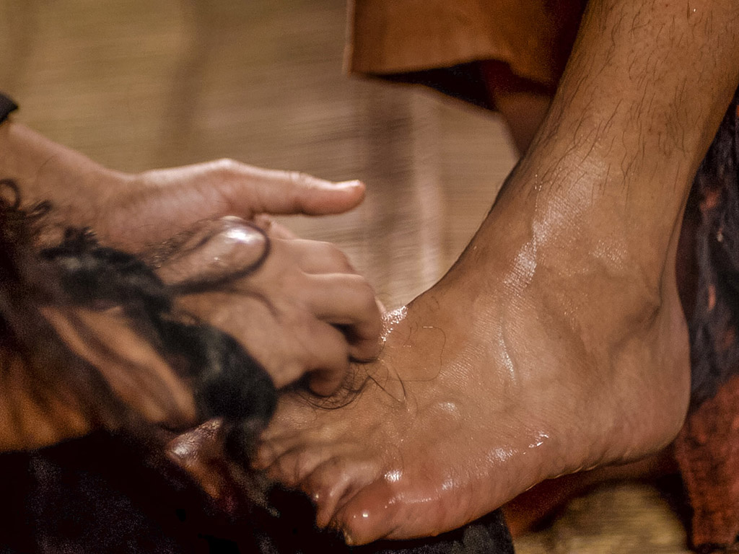
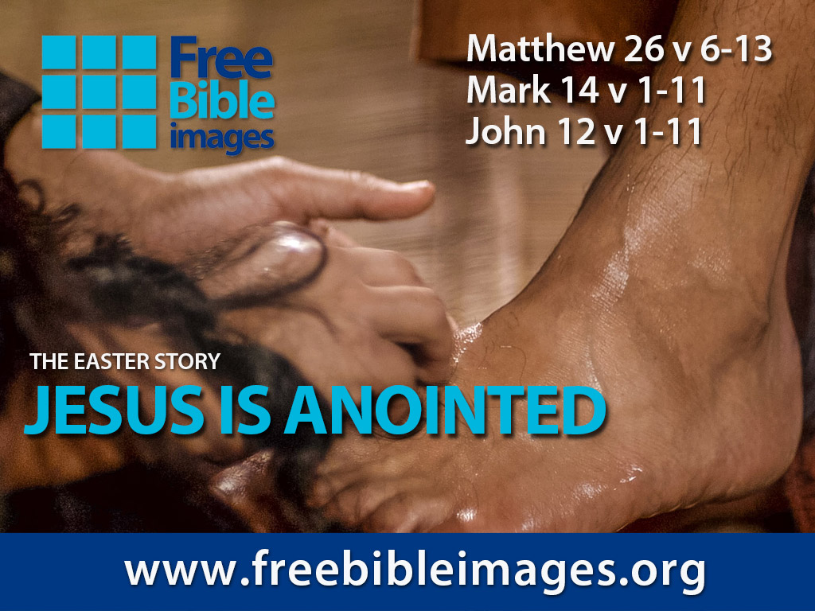

Hancur & Dicurahkan
Gambar
Alkitab
Gratis
Matius 26:6-13
Markus 14:1-11
Yohanes 12:1-11
Ditampilkan oleh Steve Green
YESUS DIURAPI

Slide 152
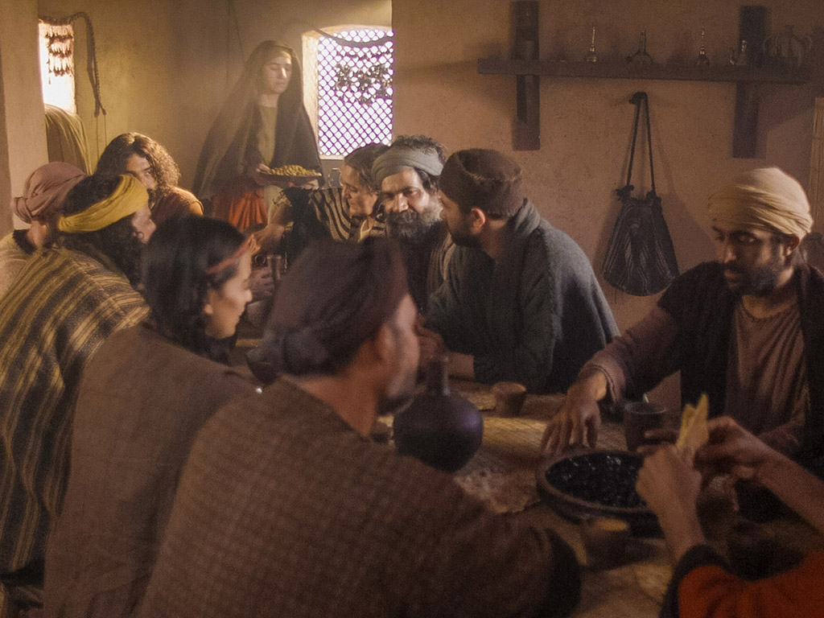
Notes:
Music background 1 of 2

Slide 153

Notes:
Music background 1 of 2

Slide 154

Suatu hari seorang gadis desa yang polos, didasari atas kasihnya kepada Tuhannya

Slide 155

Tanpa segan-segan terlihat menuangkan sebotol minyak wangi berharga, mengabaikan cibiran orang-orang

Slide 156
Dan ketika minyak wangi itu pecah dan tercurah
Keharumannya mengisi seisi ruangan.
Seperti seorang tawanan terbebaskan dari belenggu
Seperti roh yang lepas dari pusara

Slide 157

Hancur dan dicurahkan, hanya karena kasih akan Engkau, Yesus
Harta karun paling berharga dari hidup ini dipersembah-kan kepadaMU

Slide 158

Hancur dan dicurahkan, dan dituangkan di atas kakiMu
Dalam kesia-siaan yang manis, biarkan aku tertumpah dan dan dihabiskan bagi Engkau

Slide 159

Tuhan, Engkau adalah harta Bapa yang paling berharga, AnakNya yang terkasih dan sempurna.
Dikirim untuk kumelihat kasih Bapa, dilakukanNya hanya demi kasih.

Slide 160

Walaupun Engkau sempurna dan suci
Dengan rela Engkau menyerahkan diriMu
Berapapun harganya Kau bayar untuk pengampunanku
Demi aku, Engkau dihabisi dan dibuang

Slide 161

Hancur dan tercurah
Hanya karena kasihMu padaku, Yesus ––
Harta Bapa yang paling berharga dihamburkan bagiku

Slide 162

Hancur dan tercurah dan dituangkan di atas kakiku.
Dalam kesia-siaan yang manis,
Tuhan, Engkau dicurahkan
dan dihabisi untukku

Slide 163

Dalam kesia-siaan yang manis, biarkan aku tertumpah dan dihabiskan bagi Engkau

Slide 164

Gambar dipersembahkan oleh Big Book Media
Semua adalah Hak Cipta.

Slide 165
Gambar
Alkitab
Gratis
KATA-KATA TERSIRAT DALAM GAMBAR

Slide 166

Free
Bible
images
Matthew 26:17-35
Mark 14:12-31
Luke 22:7-38
John 13:18-38
THE EASTER STORY
THE LAST SUPPER

Slide 167


Slide 168


Slide 169


Slide 170


Slide 171


Slide 172


Slide 173


Slide 174


Slide 176


Slide 177


Slide 178


Slide 179


Slide 180


Slide 181


Slide 182
Gambar
Alkitab
Gratis
KATA-KATA TERSIRAT DALAM GAMBAR

Slide 183


Gambar
Alkitab
Gratis
Matius 26:69-75
Markus 14:66-72
Lukas 22:54-62
Yohanes 18:15-27
Sebuah cerita Paskah
PETRUS MENYANGKAL YESUS

Slide 184


Slide 185


Slide 186


Slide 187


Slide 188


Slide 189


Slide 190


Slide 191


Slide 192


Slide 194
Gambar dipersembahkan oleh Big Book Media
Semua adalah Hak Cipta.

Slide 195
Gambar
Alkitab
Gratis
KATA-KATA TERSIRAT DALAM GAMBAR

Slide 196


Was Mary Magdalene the Woman with the Alabaster Jar?
The WOMAN
with the
ALABASTER JAR
Mary Magdalen and the Holy
Grail
No. In Luke she is not named but in the other gospels she is clearly Mary of Bethany
As featured in The
Da Vinci Code

Slide 197

John 12 Events
64
656
Unbelief Summary
12:37-50
Predicts Death
12:21-36
Triumphal Entry
12:12-20
Anointing at Bethany
12:1-11

Slide 198

Luke 7:36-50
Jesus and the Sinful Woman

Slide 199

Yesus Diurapi
Persamaan pada empat Kitab Injil:
Dikunjungi seorang perempuan
Mengurapi kepala dan/atau kaki Yesus
Membasuh kakiNya dengan rambutnya
Keluhan pemborosan oleh murid/Yudas
Murid-murid ditegur Yesus
Di rumah seorang yang bernama Simon
Buli buli pualam (kecuali di Yohanes)

Slide 200

Dua Pengurapan Yesus
Lukas 7:36-50
Awal Pelayanan
Menangis
Untuk penyembahan
Dosa wanita itu
diampuni (Luke 7:48)
Oleh seorang perempuan
Berdosa yang tak dikenal
Di rumah Simon orang Farisi
(Luke 7:40)
Yoh 12:1-11
Mat. 26:6-13; Markus 14:3-9
Selama Minggu Paskah
Tidak tercatat ada tangisan
Untuk penguburan, sang wanita tidak membutuhkan pengampunan
Oleh Maria, saudara lazarus, di rumah Simon si Kusta (Mat. 26:6; Markus 14:3)

Slide 201

Free
Bible
images
Matthew 26:36-56
Mark 14:32-52
Luke 22:39-53
John 18:1-12
THE EASTER STORY
JESUS PRAYS IN GETHSEMANE

Slide 202


Slide 203


Slide 204


Slide 205


Slide 206


Slide 208


Slide 209


Slide 210


Slide 211


Slide 212


Slide 213


Slide 214


Slide 215


Slide 216


Slide 217


Slide 218


Slide 219


Slide 220


Slide 221


Slide 222
Gambar
Alkitab
Gratis
KATA-KATA TERSIRAT DALAM GAMBAR

Slide 223
Used with Permission
THE
GOSPEL
——OF—— MATTHEW
THE
GOSPEL
——OF—— MARK
THE
GOSPEL
——OF—— LUKE
THE
GOSPEL
——OF—— JOHN
Due to the Lumo Project producing its own publishing material we regret to inform you that we cannot license our photos to other clients outside of freebibleimages.org.
These images are not licensed for reuse in video, epublishing or other media. Downloaded pictures and files cannot be redistributed through any other website than freebibleimages.org or used in any context where the accompanying message is undermining of the Christian faith and gospel.
Photos can only be used on educational presentations, blogs and social media, all of which should be accompanied with reference to www.LumoProject.com.
Picture courtesy of BBM
© All Rights Reserved.
www.bigbookmedia.com

Slide 224

Free
Bible
images
Matthew 26:57-67
Mark 14:53-65
Luke 22:66-71
John 18:15-27
THE EASTER STORY
JESUS BEFORE
THE SANHEDRIN

Slide 225


Slide 226


Slide 227


Slide 229


Slide 230


Slide 231


Slide 232


Slide 233
Gambar
Alkitab
Gratis
KATA-KATA TERSIRAT DALAM GAMBAR

Slide 234
Used with Permission
THE
GOSPEL
——OF—— MATTHEW
THE
GOSPEL
——OF—— MARK
THE
GOSPEL
——OF—— LUKE
THE
GOSPEL
——OF—— JOHN
Due to the Lumo Project producing its own publishing material we regret to inform you that we cannot license our photos to other clients outside of freebibleimages.org.
These images are not licensed for reuse in video, epublishing or other media. Downloaded pictures and files cannot be redistributed through any other website than freebibleimages.org or used in any context where the accompanying message is undermining of the Christian faith and gospel.
Photos can only be used on educational presentations, blogs and social media, all of which should be accompanied with reference to www.LumoProject.com.
Picture courtesy of BBM
© All Rights Reserved.
www.bigbookmedia.com

Slide 235
Slides on
Matius 27

Slide 236

Free
Bible
images
Matthew 27:27-37
Mark 15:16-25
Luke 23:26-34
John 19:16-27
THE EASTER STORY
JESUS IS CRUCIFIED

Slide 237


Slide 238


Slide 239


Slide 240


Slide 241


Slide 242


Slide 243


Slide 244


Slide 245


Slide 246


Slide 247


Slide 248


Slide 249


Slide 250


Slide 251


Slide 252


Slide 253
Gambar
Alkitab
Gratis
KATA-KATA TERSIRAT DALAM GAMBAR

Slide 254
Used with Permission
THE
GOSPEL
——OF—— MATTHEW
THE
GOSPEL
——OF—— MARK
THE
GOSPEL
——OF—— LUKE
THE
GOSPEL
——OF—— JOHN
Due to the Lumo Project producing its own publishing material we regret to inform you that we cannot license our photos to other clients outside of freebibleimages.org.
These images are not licensed for reuse in video, epublishing or other media. Downloaded pictures and files cannot be redistributed through any other website than freebibleimages.org or used in any context where the accompanying message is undermining of the Christian faith and gospel.
Photos can only be used on educational presentations, blogs and social media, all of which should be accompanied with reference to www.LumoProject.com.
Picture courtesy of BBM
© All Rights Reserved.
www.bigbookmedia.com

Slide 255

Free
Bible
images
Matthew 27:38-66
Mark 15:25-47
Luke 23:35-56
John 19:28-42
THE EASTER STORY
JESUS DIES ON THE CROSS

Slide 256


Slide 257


Slide 258


Slide 259


Slide 260


Slide 261


Slide 262


Slide 264


Slide 265


Slide 267


Slide 268


Slide 269


Slide 270


Slide 271


Slide 272


Slide 273


Slide 274
Gambar
Alkitab
Gratis
KATA-KATA TERSIRAT DALAM GAMBAR

Slide 275
Used with Permission
THE
GOSPEL
——OF—— MATTHEW
THE
GOSPEL
——OF—— MARK
THE
GOSPEL
——OF—— LUKE
THE
GOSPEL
——OF—— JOHN
Due to the Lumo Project producing its own publishing material we regret to inform you that we cannot license our photos to other clients outside of freebibleimages.org.
These images are not licensed for reuse in video, epublishing or other media. Downloaded pictures and files cannot be redistributed through any other website than freebibleimages.org or used in any context where the accompanying message is undermining of the Christian faith and gospel.
Photos can only be used on educational presentations, blogs and social media, all of which should be accompanied with reference to www.LumoProject.com.
Picture courtesy of BBM
© All Rights Reserved.
www.bigbookmedia.com

Slide 276

Tabir Bait Suci

Slide 277

Tabir Bait Suci terbelah (27:51)

Slide 278
Slides on
Matius 28

Slide 279
Garis Besar Selesai
73
IV. (11:1–16:12) Kristus ditolak sebagai Mesias dalam mengantisipasi penolakan penyaliban terakhir, maka Dia memperkenalkan masa antara kedatangan kembali sebelum penerimaan masa depanNya dan pelayanan ke orang non Yahudi untuk mengajarkan penundaan kerajaan.
V. (16:13–20:34) Kristus mempersiapkan murid-muridNya tentang PribadiNya dan rencana dalam hal predikat otoritas MesiasNya yang mungkin didelegasikan kepada mereka
setelah kematianNya.
VI. (Chs. 21–27) Penyajian resmi Kristus dan penolakan sebagai Raja Israel dalam penebusan di atas kayu salib menunjukkan alasan kerajaan ditunda sampai kedatanganNya kembali.
VII. (Ch. 28) Kemenangan Kristus atas kematian menegaskan diriNya sebagai Mesias yang harus dipercaya oleh seluruh dunia.

Slide 280

Matthew 28:1-15
Mark 16:1-20
Luke 24:1-47
John 20:1-29
Free
Bible
images
THE EASTER STORY
JESUS IS ALIVE

Slide 281


Slide 283


Slide 284


Slide 285


Slide 286


Slide 287


Slide 288


Slide 289


Slide 290


Slide 291


Slide 292


Slide 293


Slide 294


Slide 295


Slide 296


Slide 297


Slide 298


Slide 299
Gambar
Alkitab
Gratis
KATA-KATA TERSIRAT DALAM GAMBAR

Slide 300
Used with Permission
THE
GOSPEL
——OF—— MATTHEW
THE
GOSPEL
——OF—— MARK
THE
GOSPEL
——OF—— LUKE
THE
GOSPEL
——OF—— JOHN
Due to the Lumo Project producing its own publishing material we regret to inform you that we cannot license our photos to other clients outside of freebibleimages.org.
These images are not licensed for reuse in video, epublishing or other media. Downloaded pictures and files cannot be redistributed through any other website than freebibleimages.org or used in any context where the accompanying message is undermining of the Christian faith and gospel.
Photos can only be used on educational presentations, blogs and social media, all of which should be accompanied with reference to www.LumoProject.com.
Picture courtesy of BBM
© All Rights Reserved.
www.bigbookmedia.com

Slide 301


Sedadu Disuap (28:12)

Slide 302

Matthew 28:18-20 NLT
¹⁸ Yesus mendekati mereka dan berkata: "Kepada-Ku telah diberikan segala kuasa di sorga dan di bumi.¹⁹ Karena itu pergilah, jadikanlah semua bangsa murid-Ku dan baptislah mereka dalam nama Bapa dan Anak dan Roh Kudus,²⁰ dan ajarlah mereka melakukan segala sesuatu yang telah Kuperintahkan kepadamu. Dan ketahuilah, Aku menyertai kamu senantiasa sampai kepada akhir zaman."

Slide 303

Since Jesus is king, then believers will rule with him!

Slide 304


Believers will rule the earth
(Rev. 5:10 NLT).
"And you have caused them to become a Kingdom of priests for our God. And they will reign on the earth."

Slide 305


Revelation 20:4-6 Diagrammed
424
^{4b}and they came to life and reigned with Christ for a thousand years.
^{4a}Then I saw thrones, and they sat on them, and judgment was given to them. And I saw the souls of those who had been beheaded because of their testimony of Jesus and because of the word of God, and those who had not worshiped the beast or his image, and had not received the mark on their forehead and on their hand…
1000 years
^{5b}This is the first resurrection. ^{6a}Blessed and holy is the one who has a part in the first resurrection; over these the second death has no power…
^{6b}but they will be priests of God and of Christ and will reign with Him for a thousand years.
^{5a}The rest of the dead did not come to life until the thousand years were completed.

Slide 306

Since Jesus fulfilled all the requirements to be Israel's king, we will rule with him!
Main Idea

Slide 307


Do you trust the King right now?
Before we can pray, "Lord, Thy kingdom come," we must be willing to pray, "My kingdom go."

Slide 308

Will you stand?

Slide 309

Jesus is both Lamb and Lion

Slide 310

"I trust in your death for me."

Slide 311

Are you ready to rule?

Slide 312

Be faithful NOW

Slide 313


Link survey PB di BibleStudyDownloads.org
Dapatkan slide ini tanpa biaya
Notes:
New Testament Survey PPT in Bahasa Indonesia

Slide 314
Black

