Slide 1
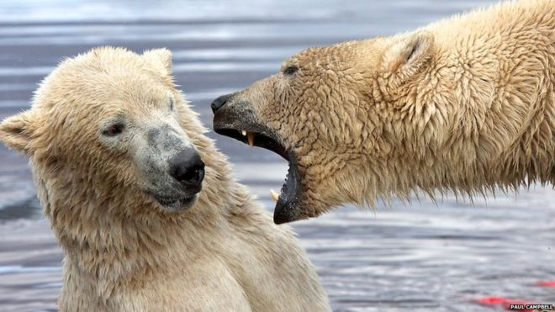
Finding a Mate
Topical Message
Dr. Rick Griffith, Crossroads International Church Singapore cicfamily.com & BibleStudyDownloads.orgç

Slide 2
Black
Notes:
Black

Slide 3
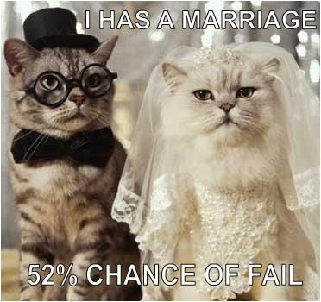
How can you walk together with the right marriage partner?
Notes:
Good grammar is a good start!

Slide 4
I. Walking with the right person begins with being the right person

Slide 5
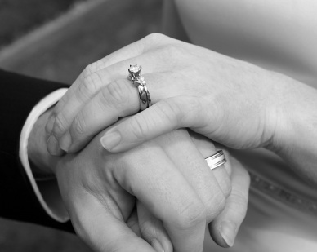
How to be the right person…
• Seek God, not a mate

Slide 6
Balance
“He who finds a wife finds a good thing” (Prov. 18:22)
“Are you married? Do not seek a divorce. Are you unmarried? Do not look for a wife” (1 Cor. 7:27)

Slide 7
How to be the right person…
• Seek God, not a mate
• Seek selflessness
• Be willing to remain single for life

Slide 8
II. Don’t try to help God find a mate for you—He doesn’t need your help!

Slide 9
1976 Graduation
Grade 12
Notes:
My high school graduation was one of the most fulfilling days of my life. God’s grace had transformed my whole value system so that the guys I my Bible study had shared with almost all the guys in my graduating class of 100 young men.

Slide 10
“Hay U”
California State University, Hayward
Notes:
University life at “Hay U” helped me see what happened when I put a plastic bag over my face—as well as how to rebuild the steering system in my car. But my involvement with Campus Crusade was probably most significant under Bob & Kathy—our campus leaders.

Slide 11
The Crossroads (1981-83)
Notes:
After college it seemed the natural thing to do to join Campus Crusade staff in the Philippines on a seven-member music team.

Slide 12
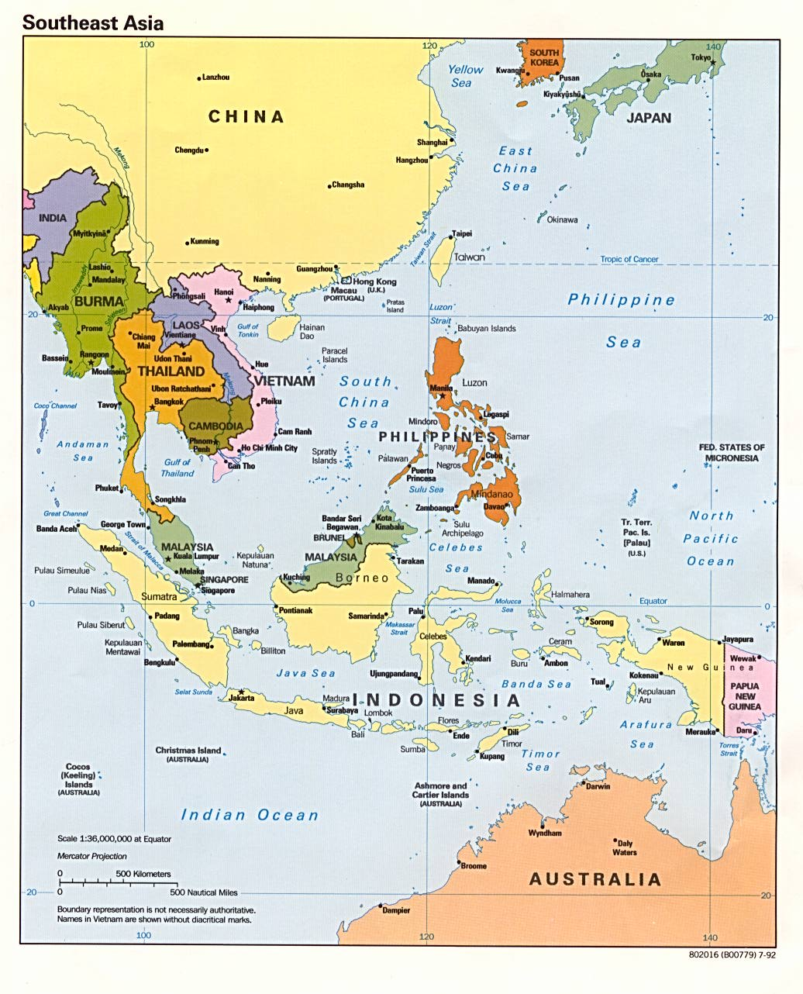
Crossroads Ministry
Korea
China
Japan
Hong Kong
Taiwan
Macau
Thailand
Philippines
Malaysia
Singapore
Indonesia
Notes:
The Crossroads team shared the gospel in 11 Asian nations and saw over 10,000 people indicate decisions to trust Christ! Again I was amazed at God’s grace!

Slide 13
Black
Notes:
Black

Slide 14
III. Compatibility in calling is a must.

Slide 15
The Unequal Yoke
2 Corinthians 6:14… “Do not be yoked together with unbelievers. For what do righteousness and wickedness have in common? Or what fellowship can light have with darkness?”
Notes:
Black

Slide 16
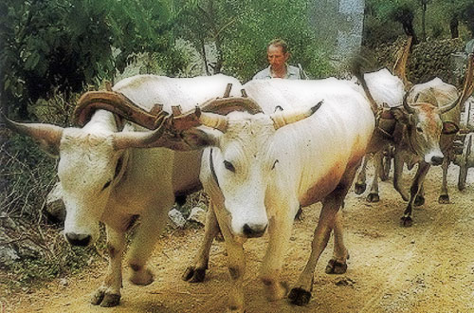
The Equal Yoke
Notes:
Black

Slide 17
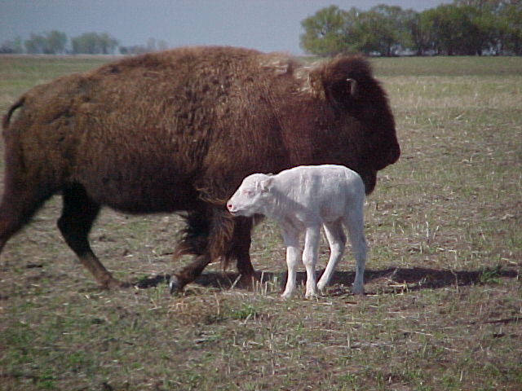
The Unequal Yoke
Notes:
Black

Slide 18
The Unequal Yoke
2 Corinthians 6:14…
“Do not be yoked together with unbelievers. For what do righteousness and wickedness have in common? Or what fellowship can light have with darkness?”
Notes:
Black

Slide 19
Black
Notes:
Black

Slide 20
China, 1981
Notes:
Our first tour to China we were celebrities as the first Christian musical team to visit the New China. We sang in music conservatories, parks, and even from the bus! God began to open my eyes to the needs of East Asia…

Slide 21
Romance, 1982
Notes:
God also began to open my eyes to the woman singing next to me! She initially despised me but after a year or so she saw the light. That’s our engagement picture. In 1983 we returned to the USA..

Slide 22
Seminary
My 7-year Tribulation was from 1983-1990
Notes:
I married her and took her to Dallas Seminary a few days later. Three years later our first son was born on his grandpa’s 70th birthday, so we named him Kurt in honor of Susan’s father. I also pastored a church, had a ministry to international students, and served as a chaplain.

Slide 23
Black
Notes:
Black

Slide 24
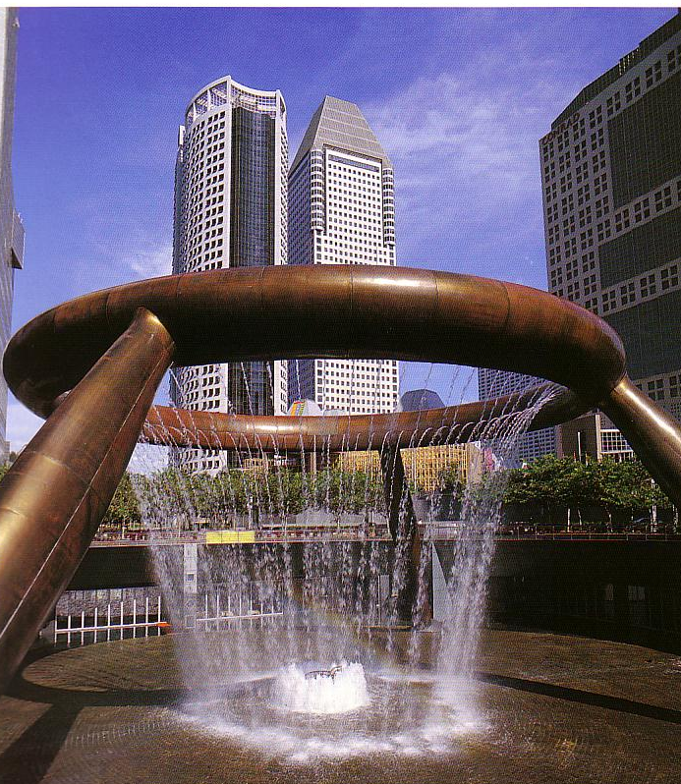
The City-State of Singapore
Notes:
But Asia (where I had courted Susan) was still on our hearts, so we were appointed with another mission called CBInternational to come to Singapore.

Slide 25
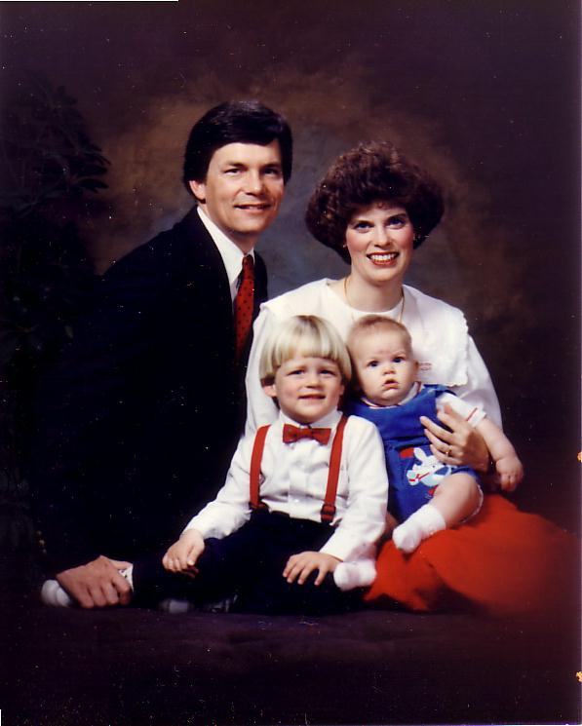
1991: Move to Singapore
Rick, 33
Susan, 30 something
Kurt, 4
Stephen, 1
Notes:
So 10 years after our first move to Asia as singles, we arrived as a family of four.

Slide 26
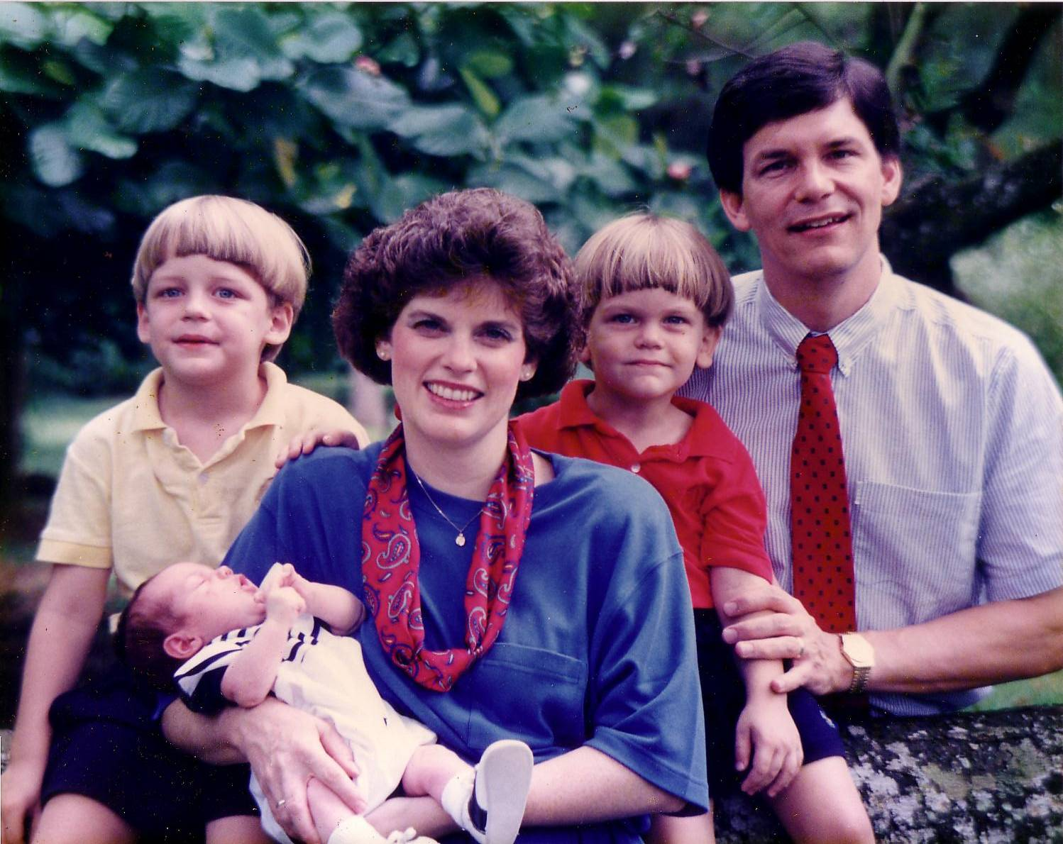
1992
Notes:
In our second year here, our third son John was born.

Slide 27
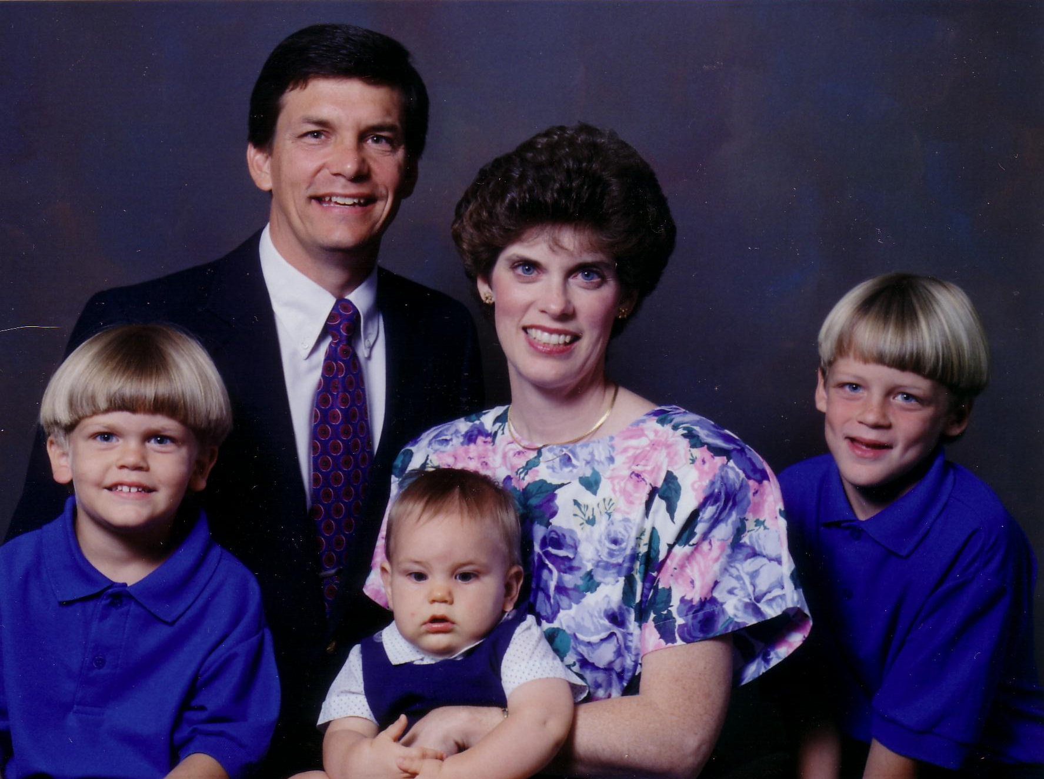
1993
Notes:
The boys continued to grow…

Slide 28
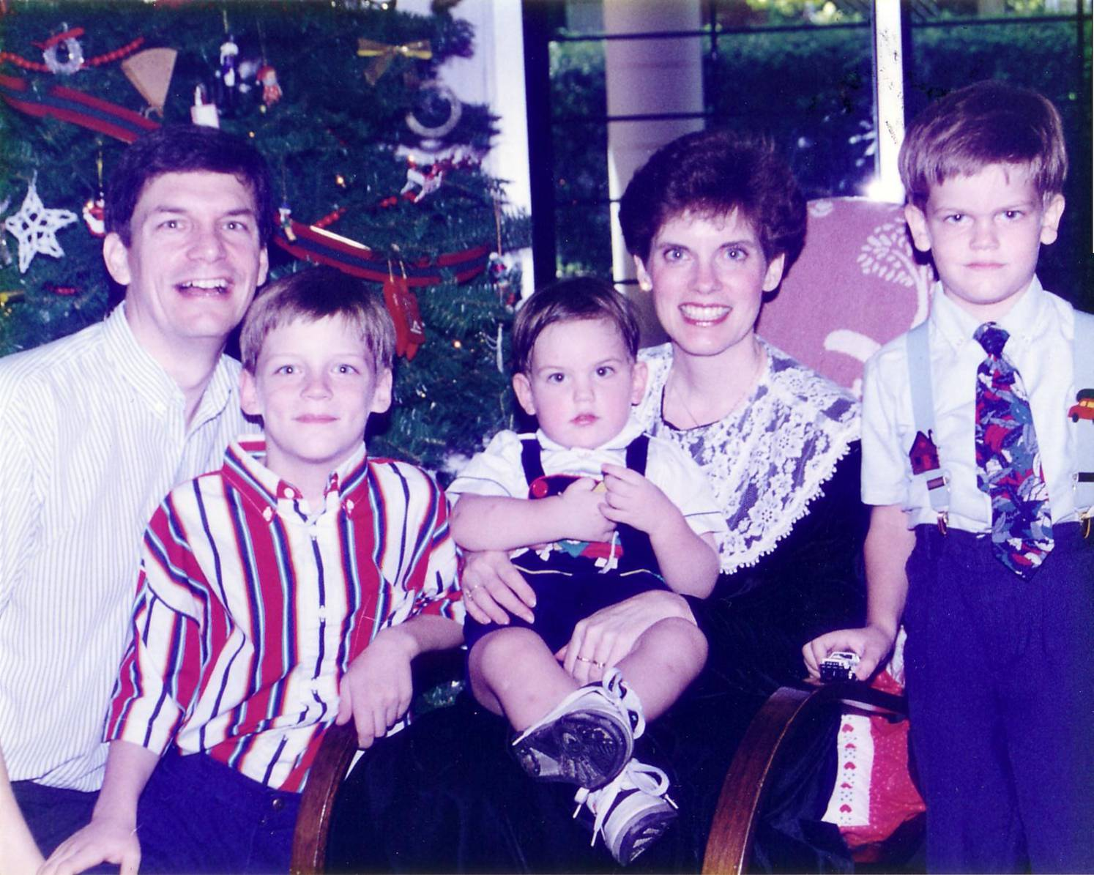
1994
Notes:
It seems natural to spend holidays here…

Slide 29
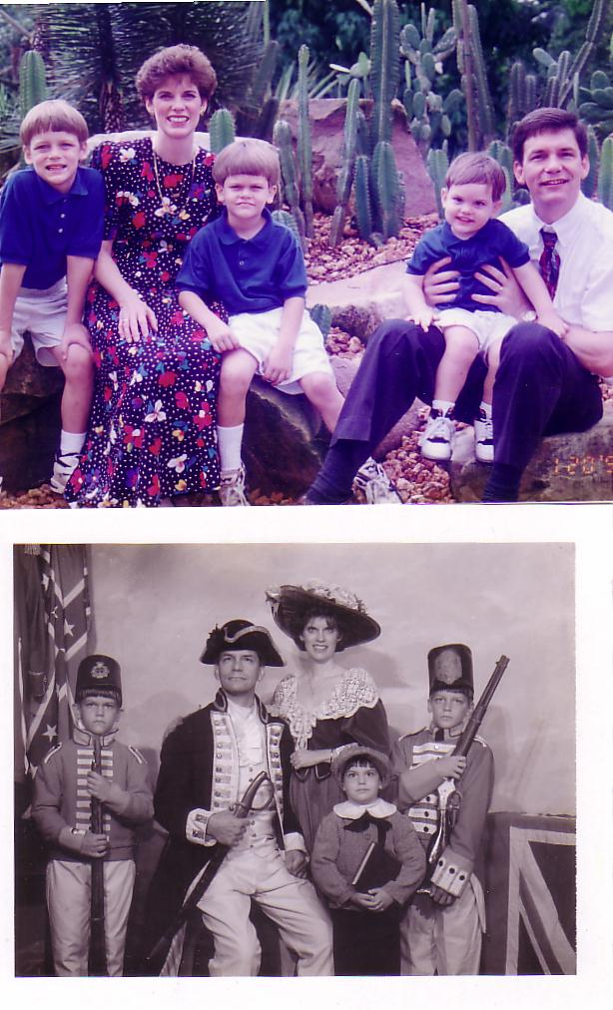
1995
Notes:
When we want dry climate we visit the cactus at the Botanic Gardens!

Slide 30
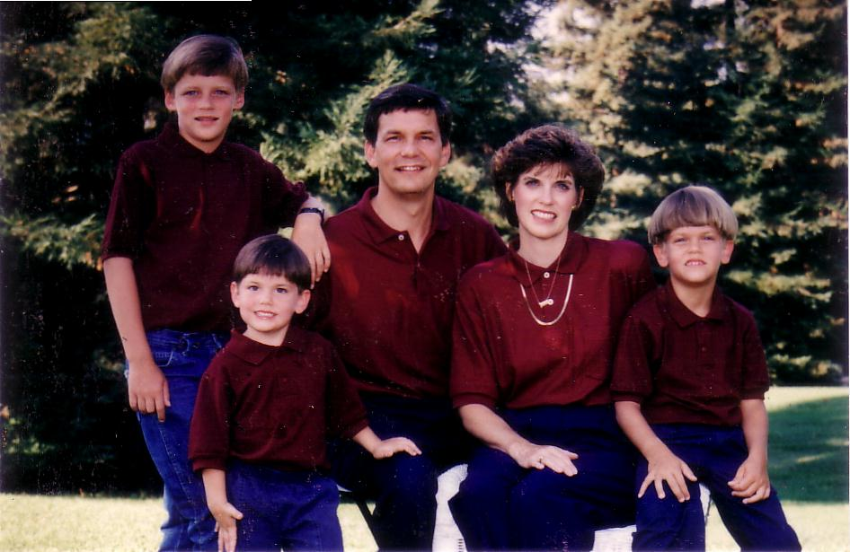
1996
Notes:
We have lived briefly in the USA the past 12 years.

Slide 31
1997
Notes:
These trips remind us of our cultural heritage.

Slide 32
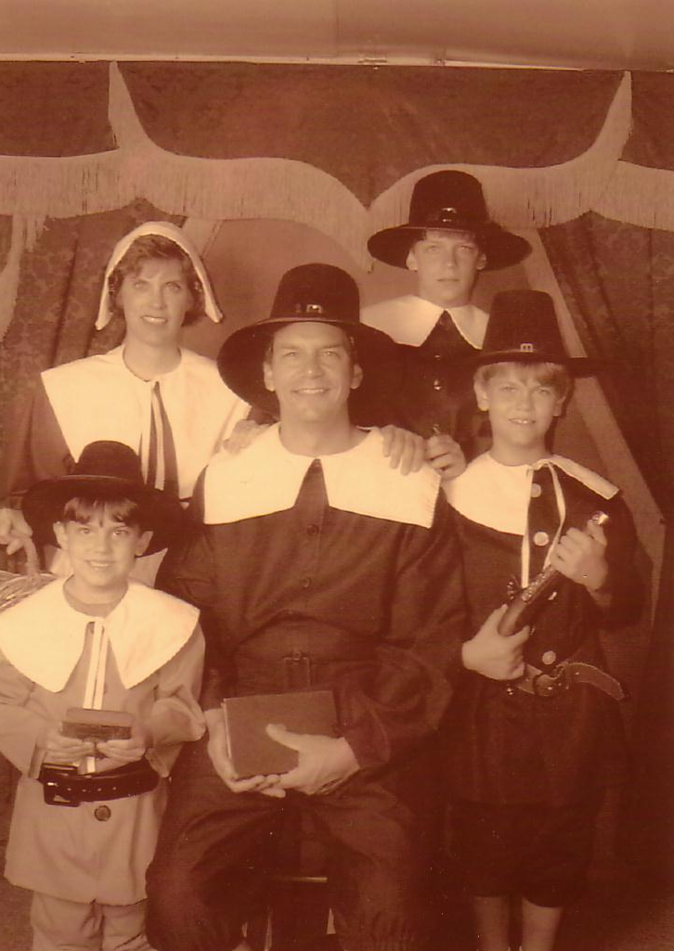
1999
Notes:
After all, my ancestors were Puritans who immigrated to the USA from England in the 1650s.

Slide 33
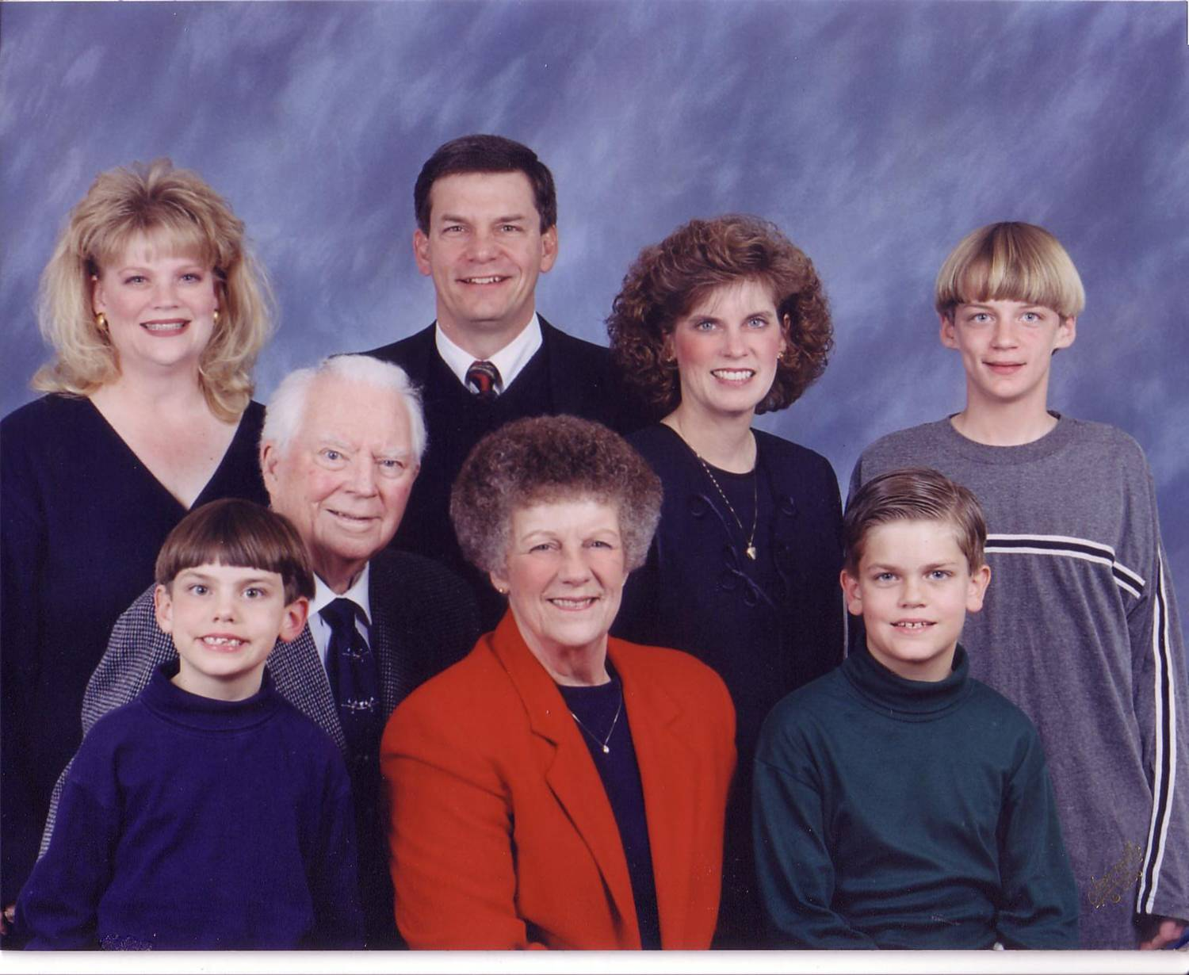
2000
Notes:
So while Singapore is our home, we don’t have any family here.

Slide 34
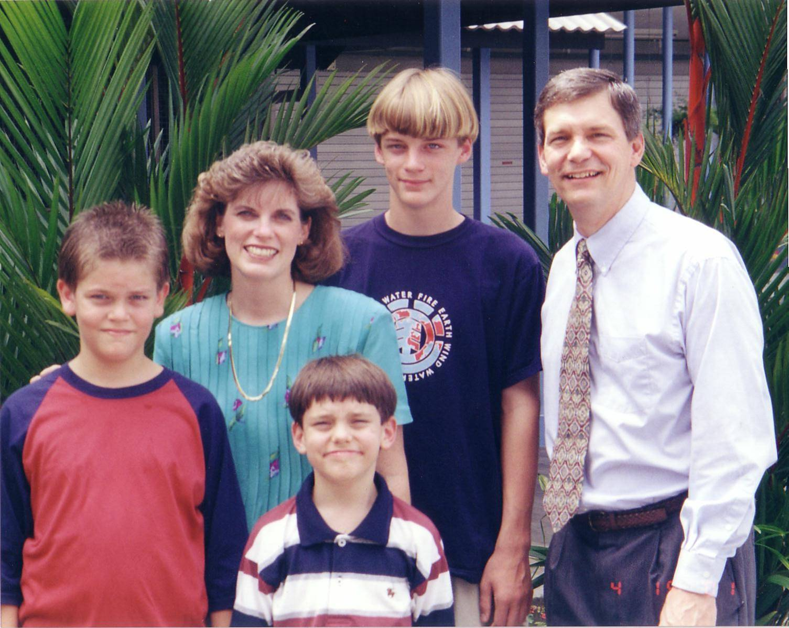
2001
Notes:
As the boys have gotten taller, their family is right in their own home.

Slide 35
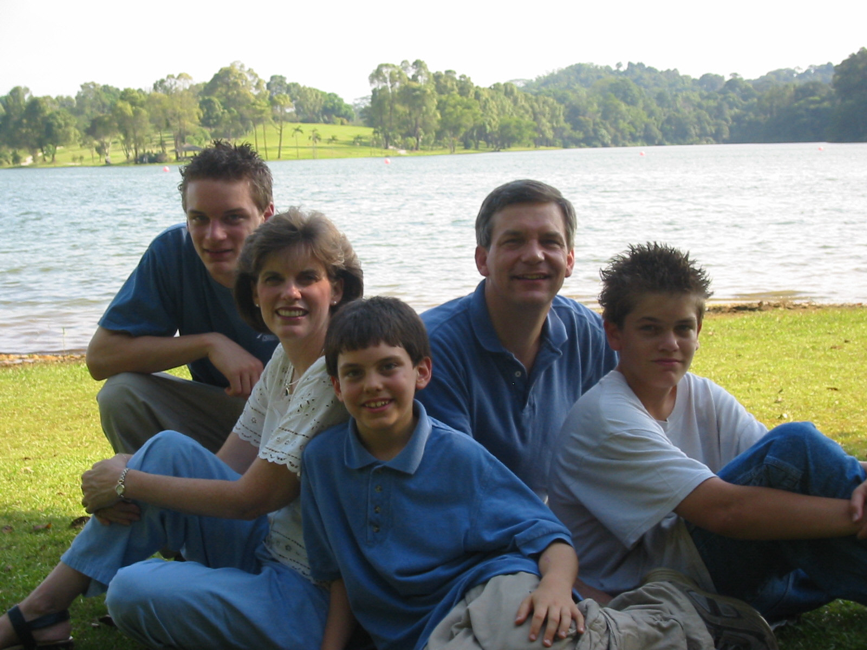
2002
Notes:
As the boys have gotten taller, their family is right in their own home.

Slide 36
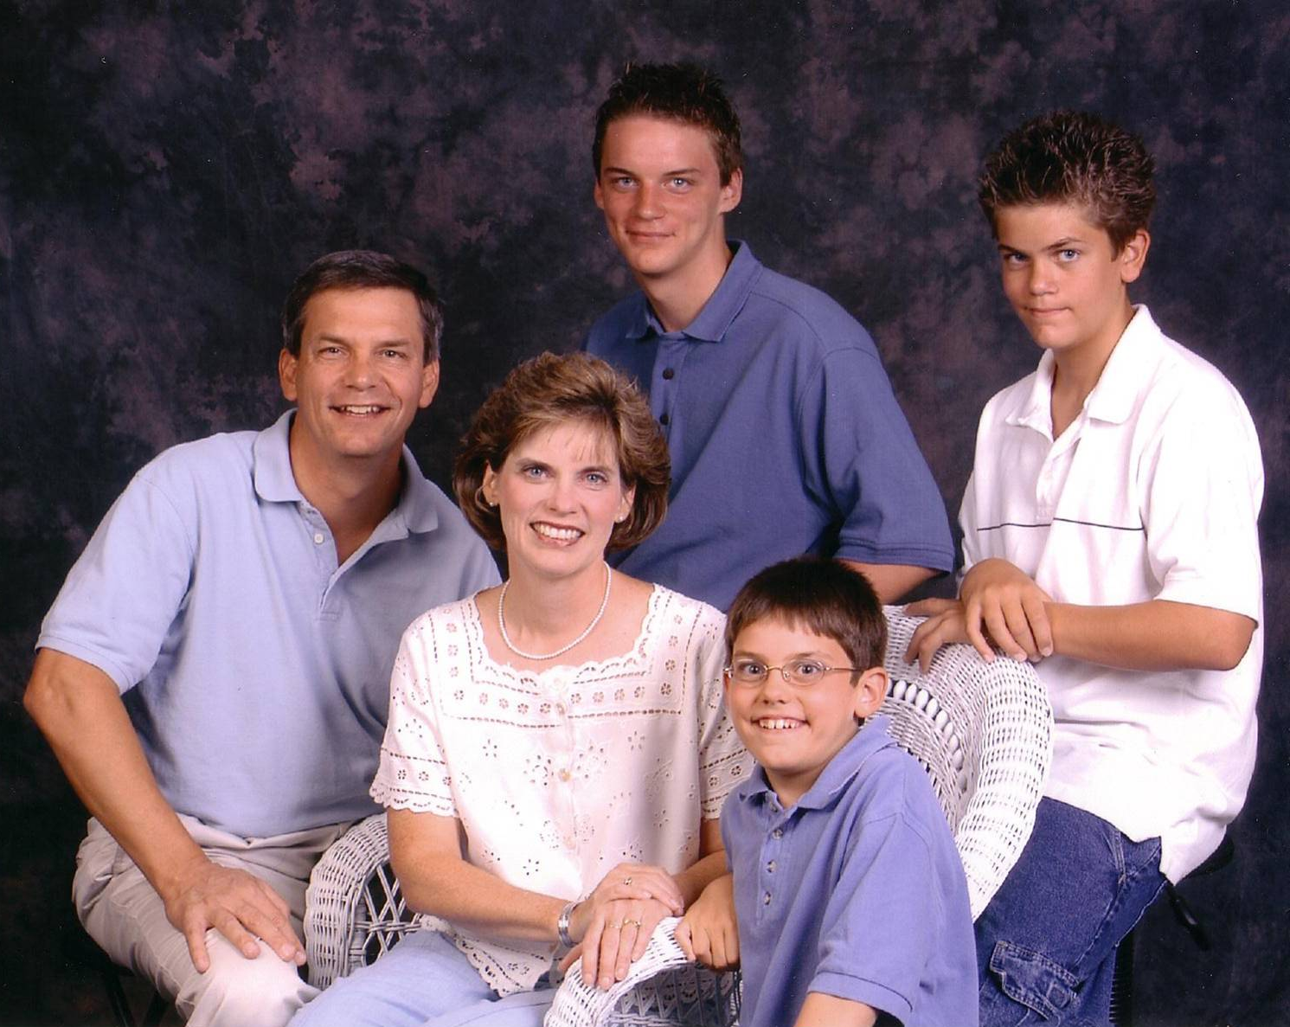
2003
Notes:
And now we’re preparing for our oldest to go to college in the states in less than two years.

Slide 37
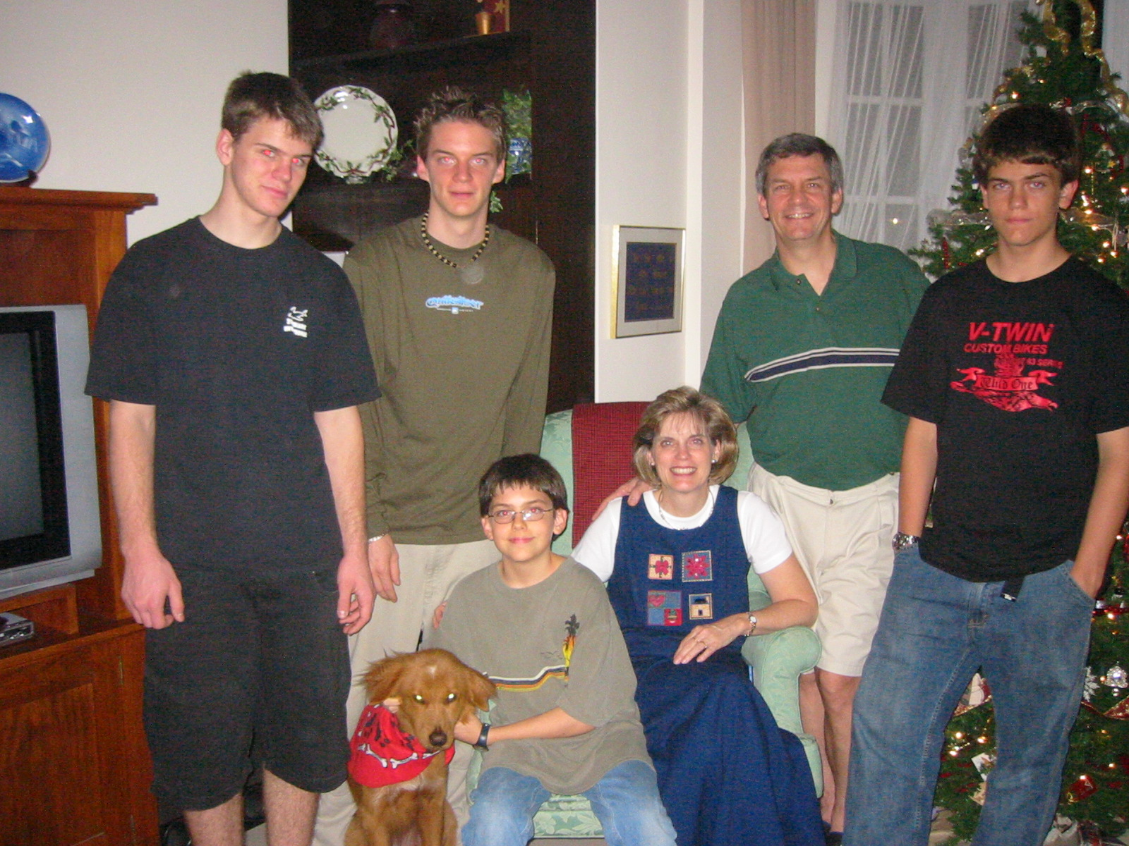
2004
Notes:
As the boys have gotten taller, their family is right in their own home.

Slide 38
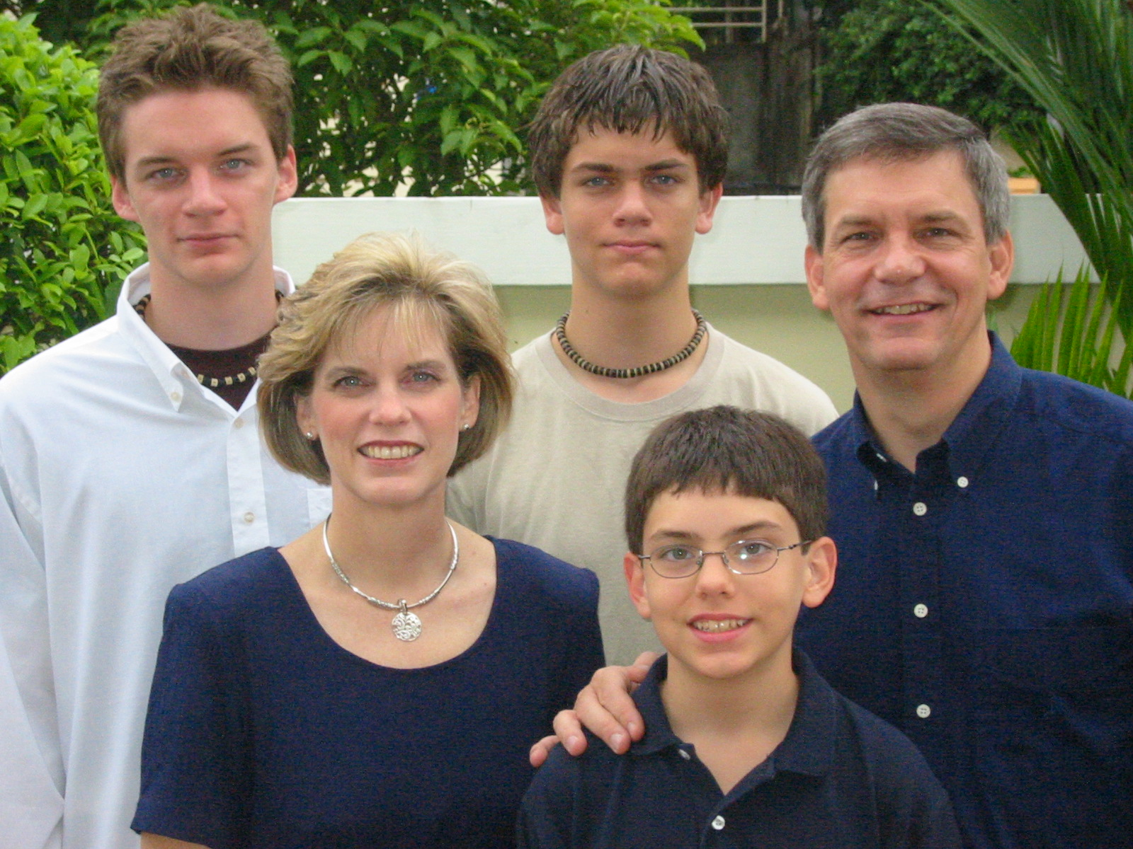
2005
Kurt
Stephen
Rick
Susan
John

Slide 39
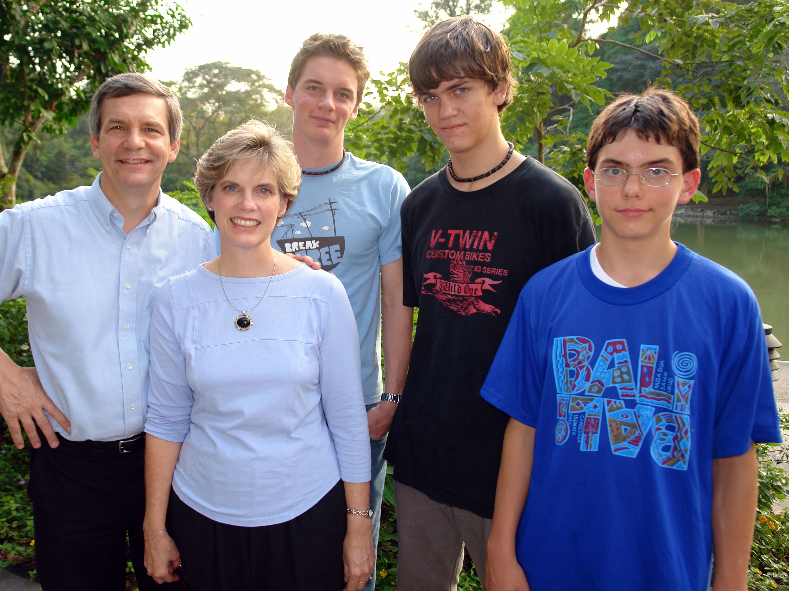
2006

Slide 40
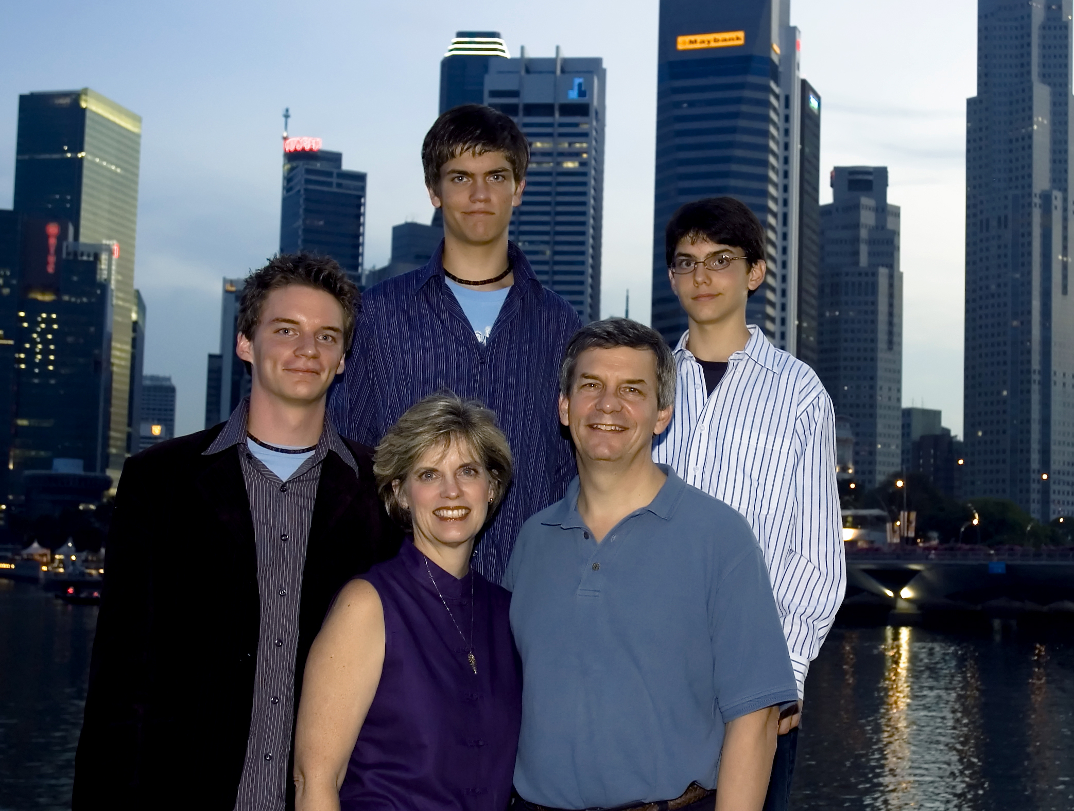
2007

Slide 41
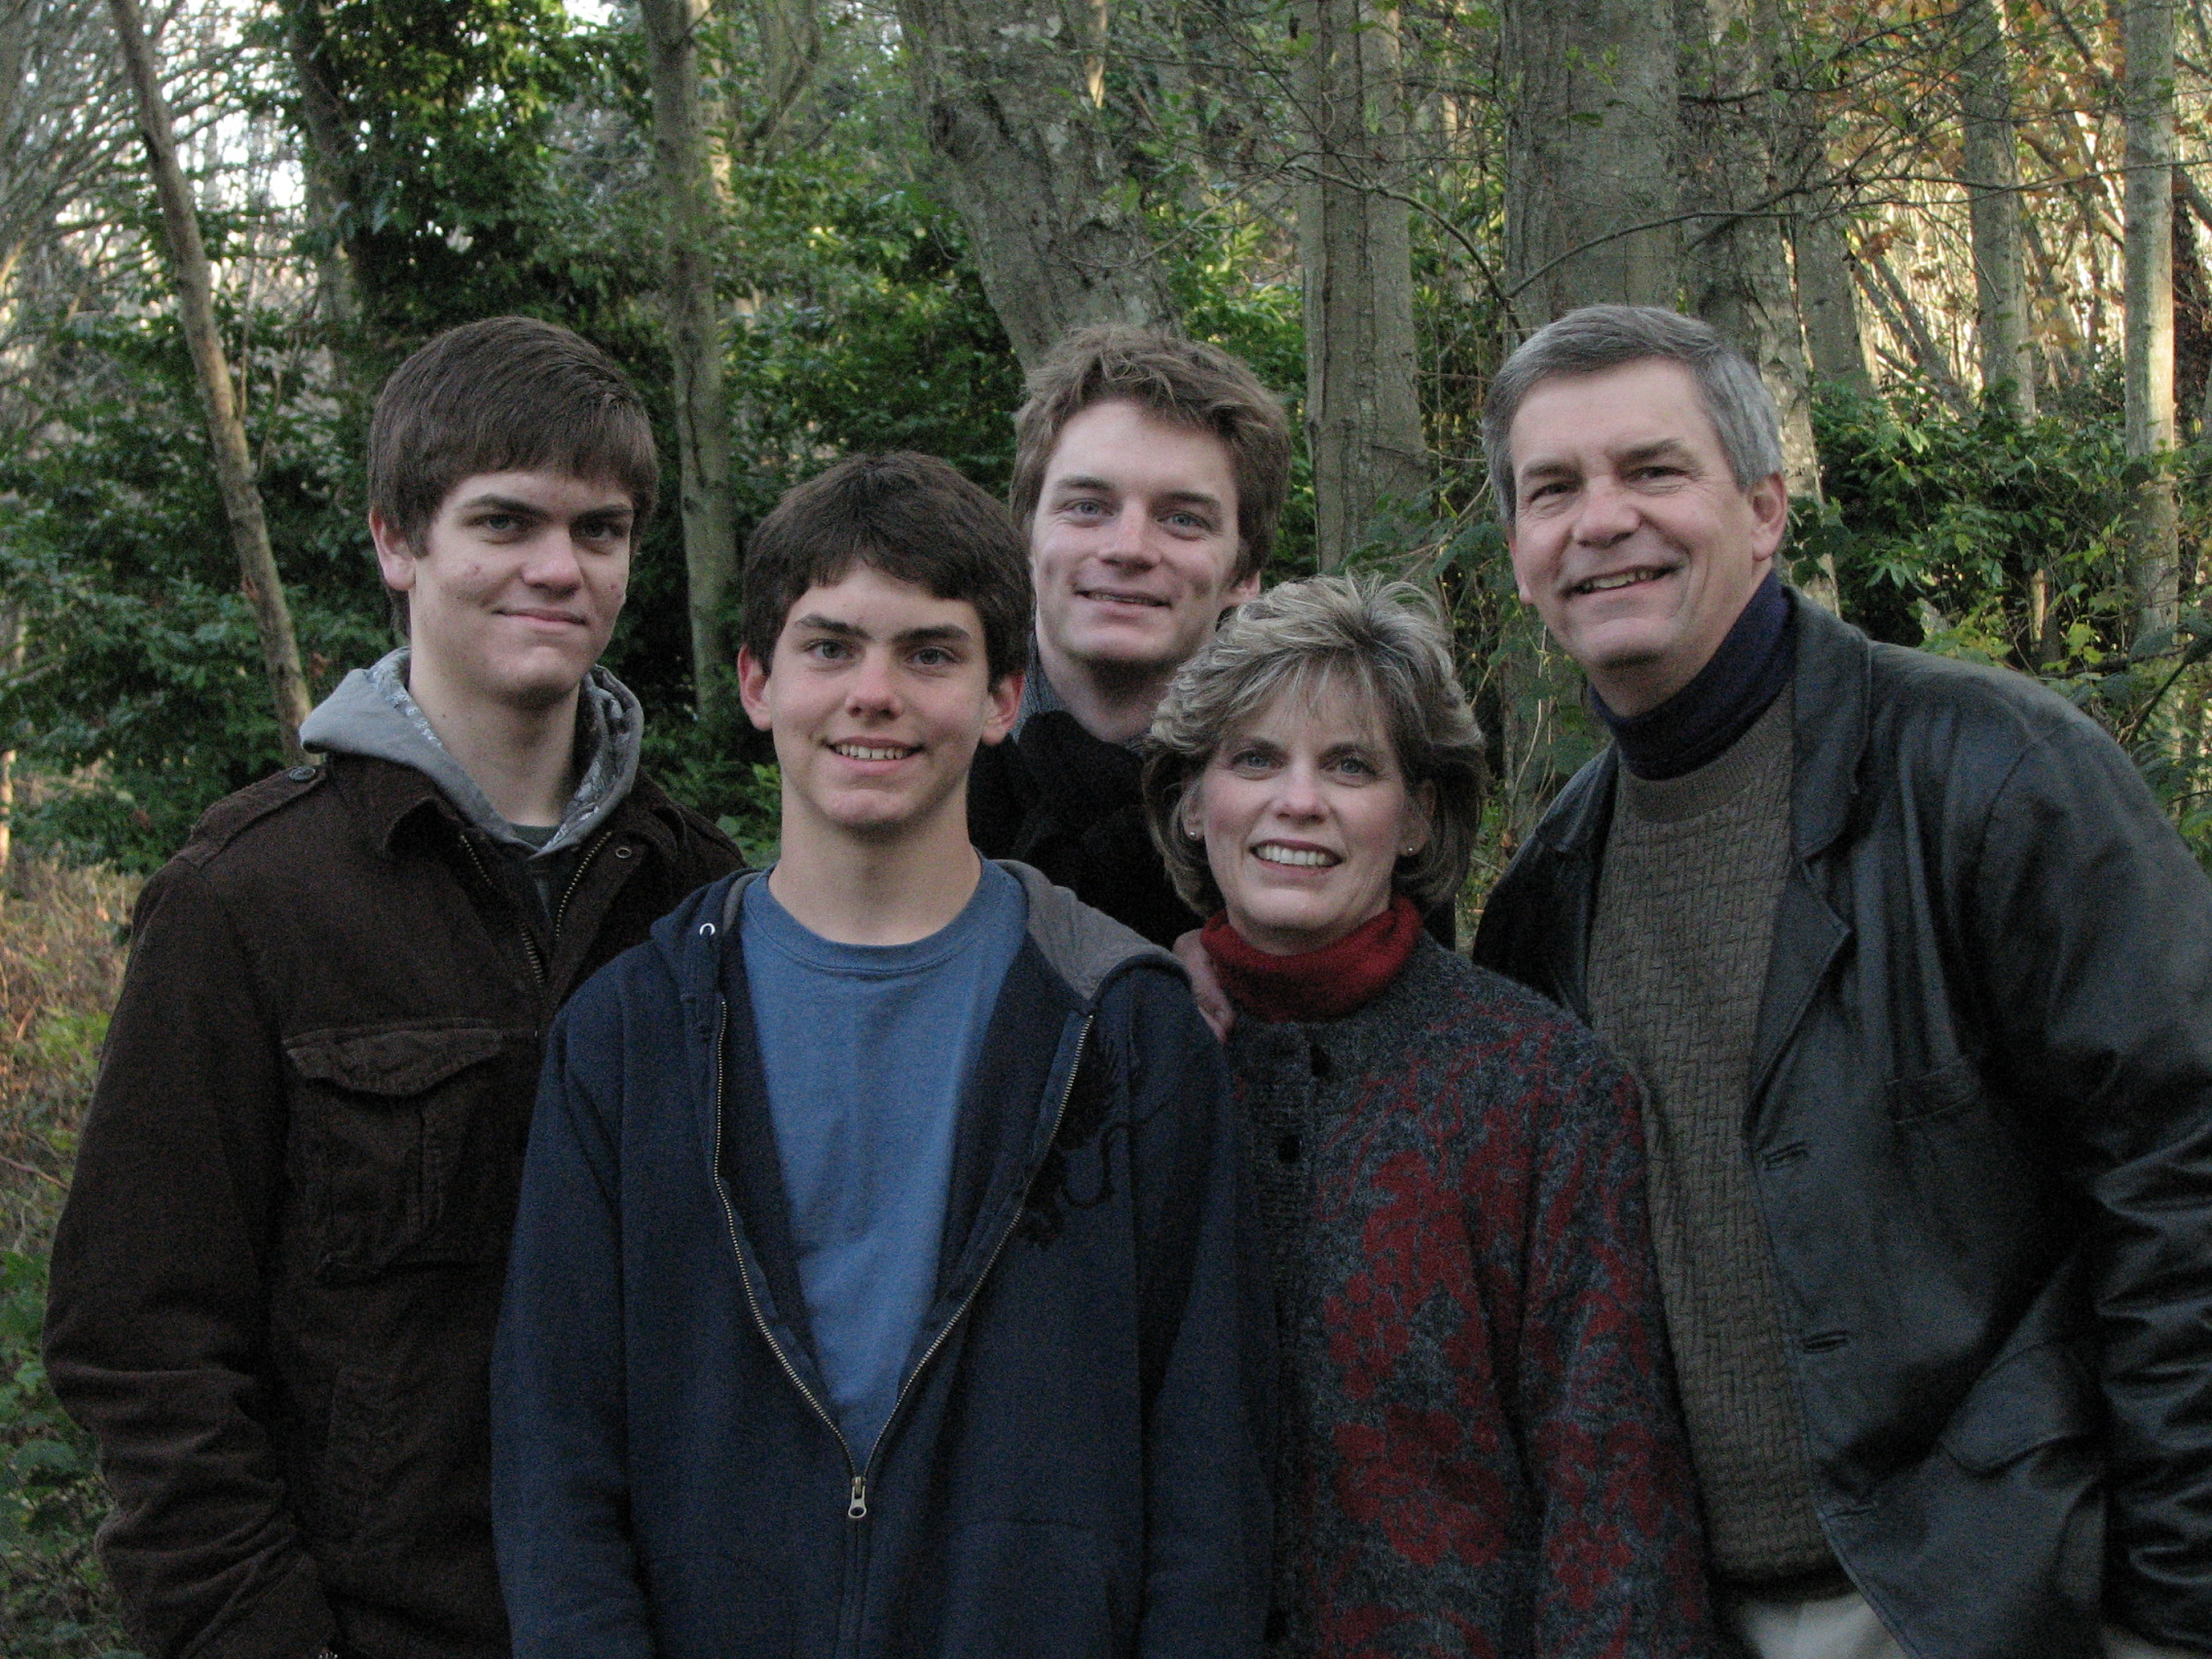
2008

Slide 42
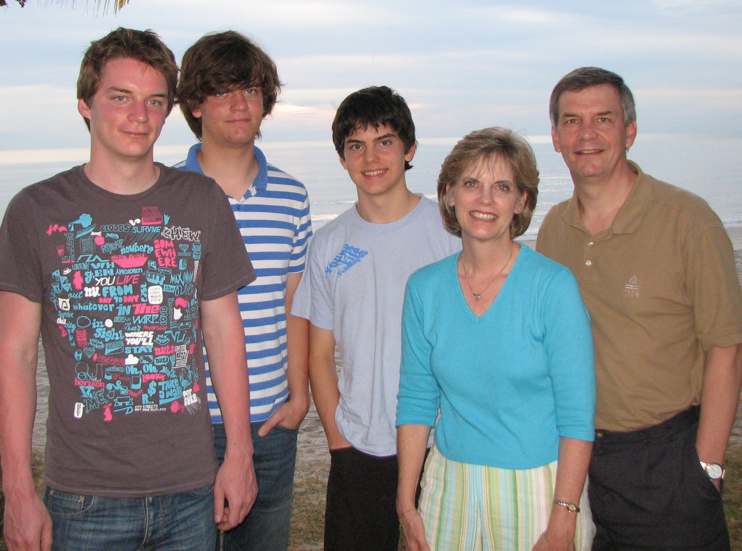
2009

Slide 43
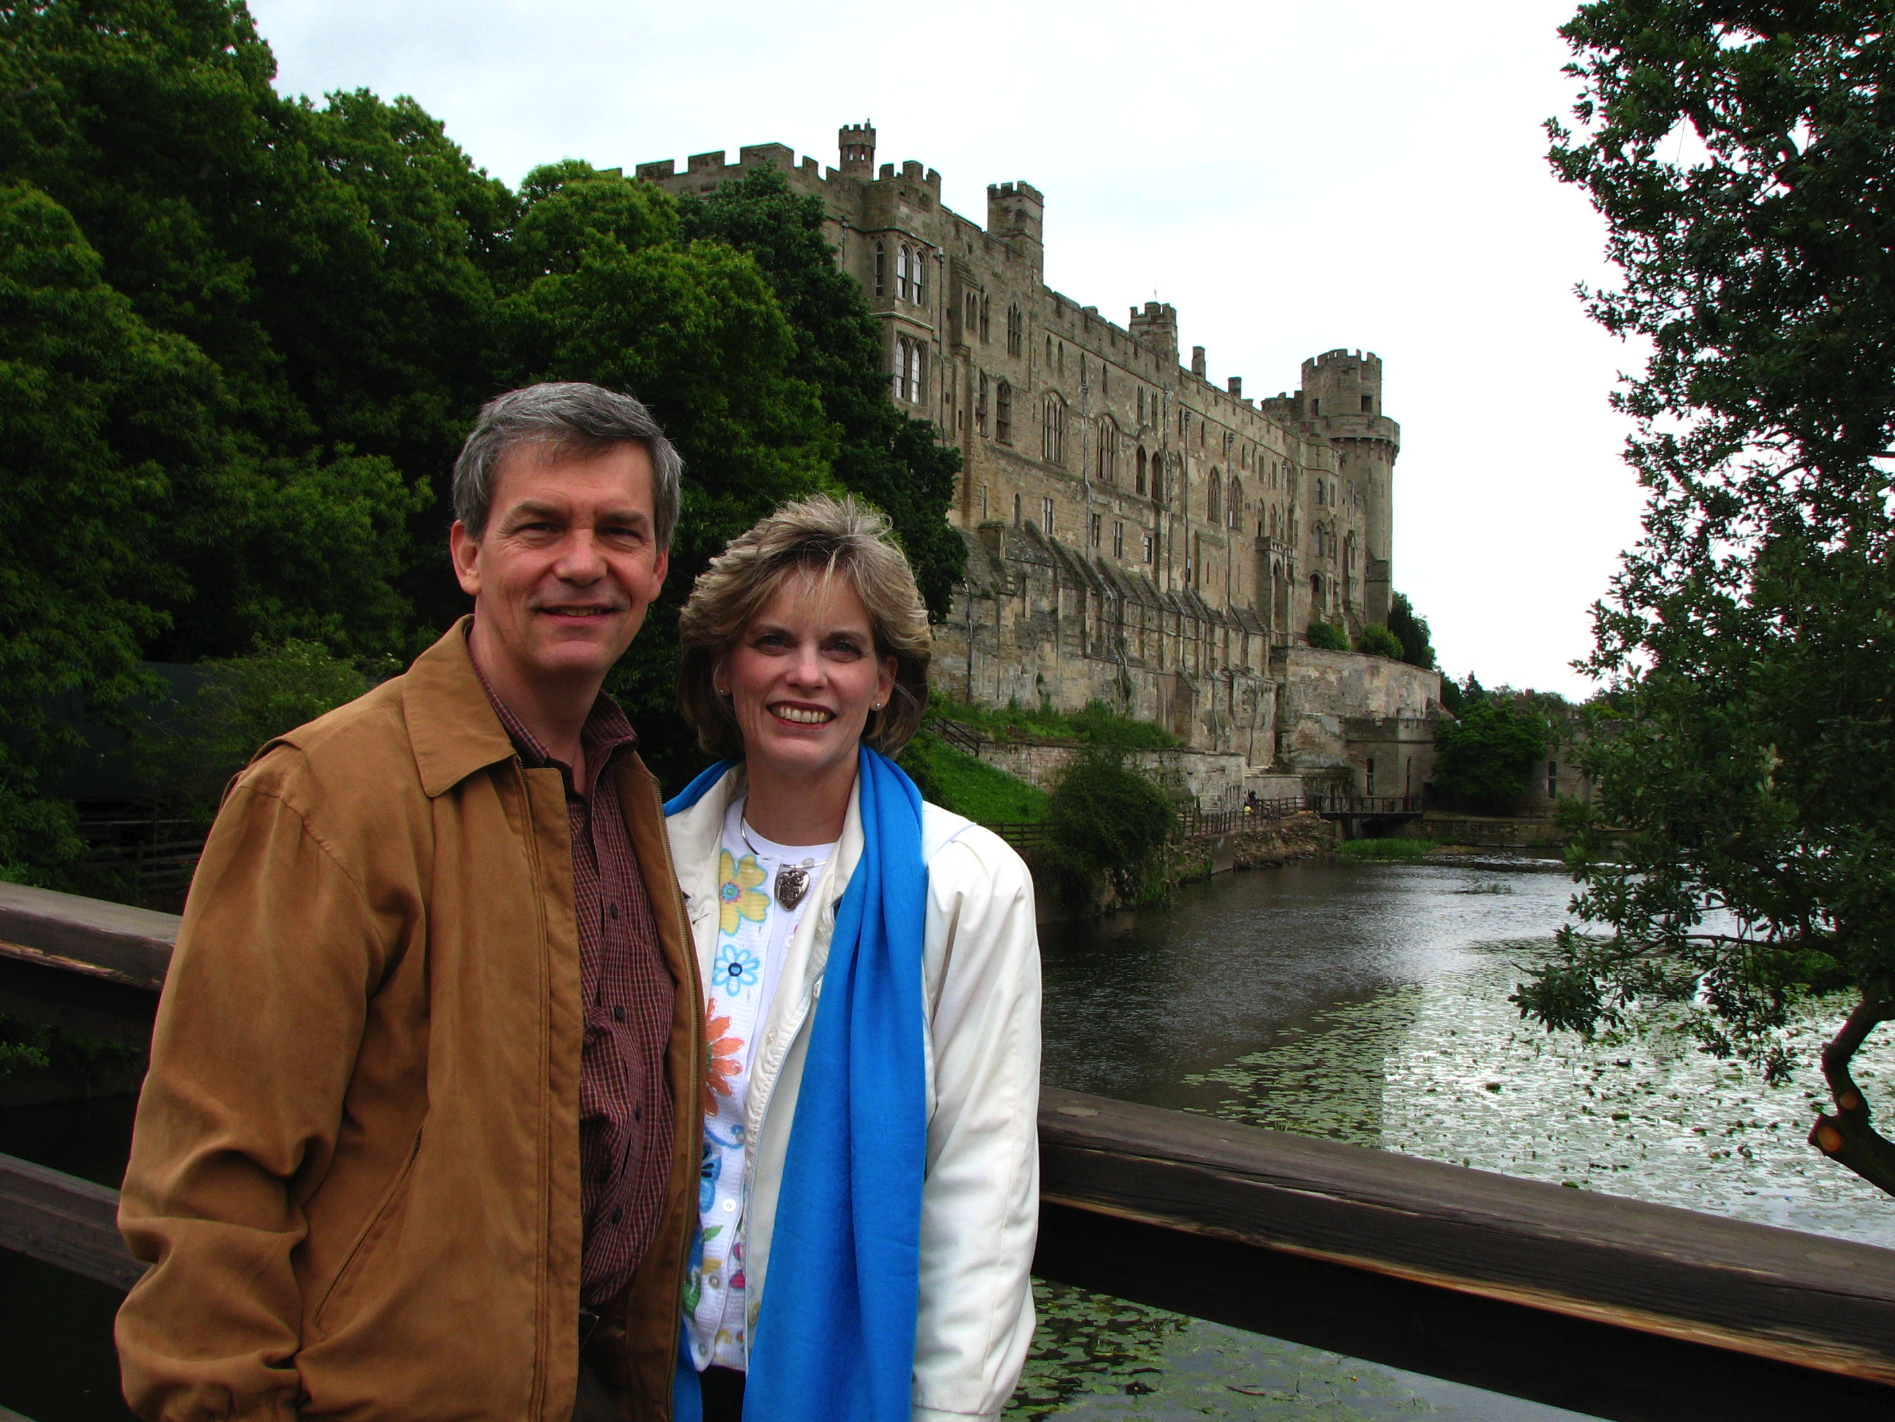
Warwick Castle 25th Anniversary Trip
Main Idea: The issue is not finding the right person but being the right person as you trust God for a mate.

Slide 44
2010
Notes:
Or we joined them in Hawaii, where we climbed Diamond Head.

Slide 45
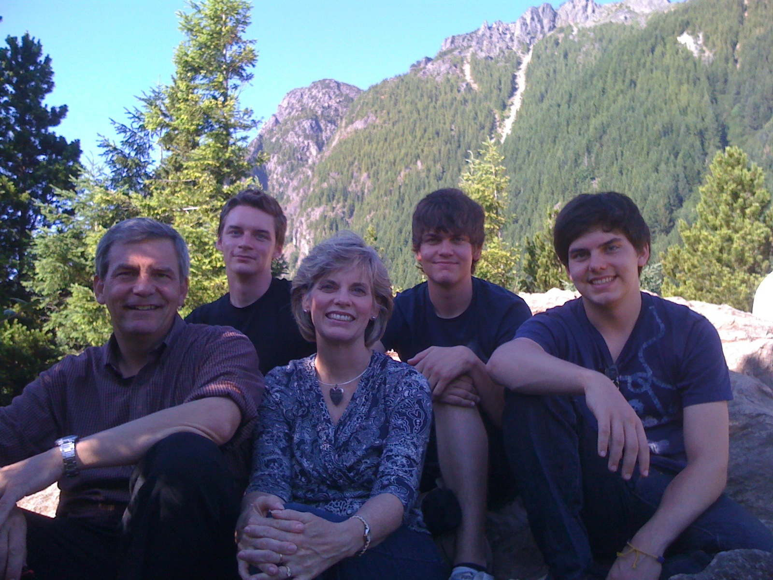
2011
Notes:
We love hiking together in the mountains of Washington!

Slide 46
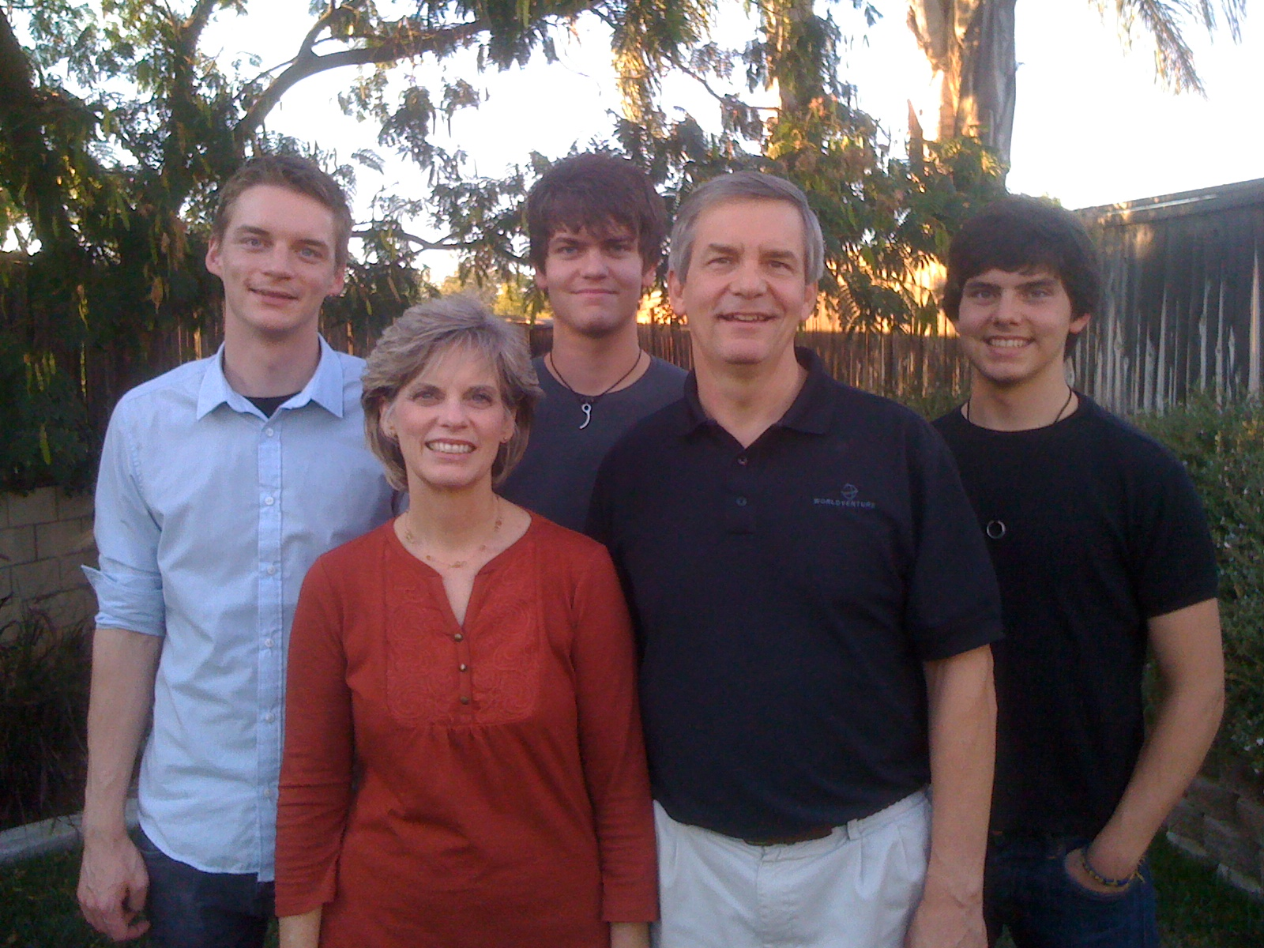
The Griffith Family Oct 2011
2011
Stephen 22
John 19
Kurt 24
Susan
Rick
Notes:
God continues working in our family as we see Him work in our three sons. Our two older ones work in Seattle and our youngest (John) attends Biola University in Southern CA. We lived close by in 2011 during his first semester, pretending that he needed us until we return to Singapore in January.

Slide 47
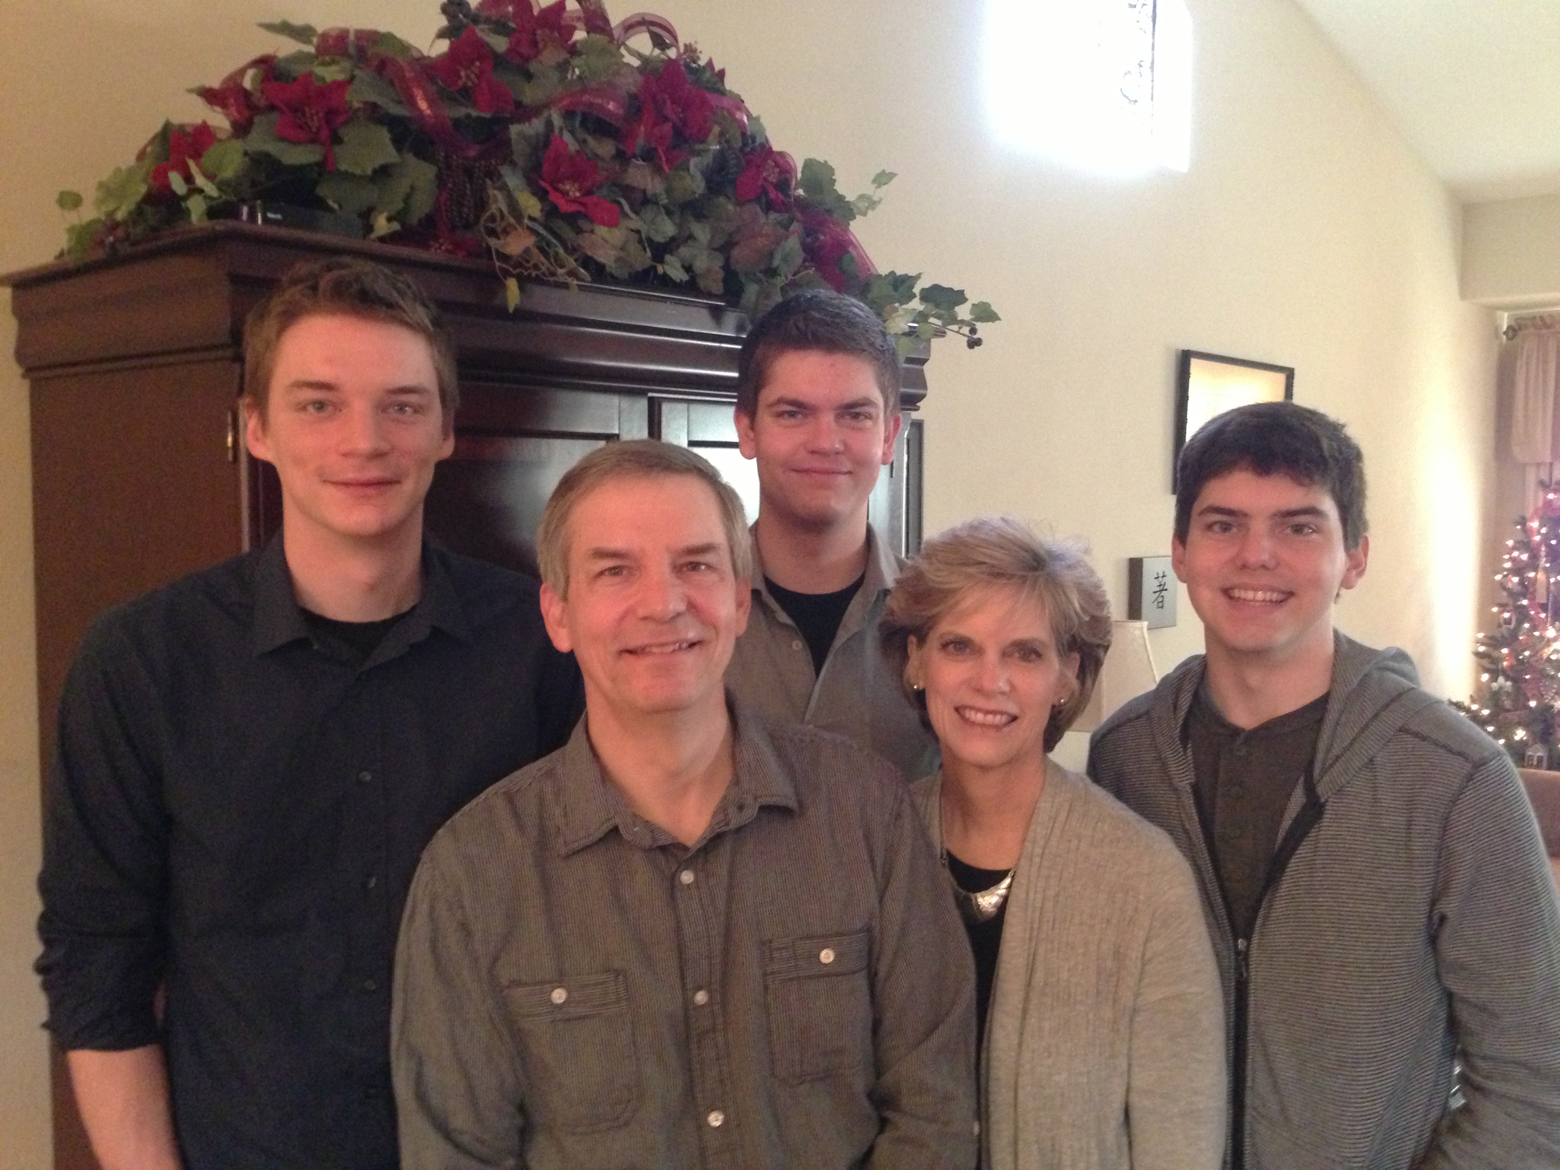
The Griffith Family Dec 2012
2012
Stephen 23
John 20
Kurt 25
Rick
Susan
Notes:
Now Mom and Dad are the shortest in the family.

Slide 48
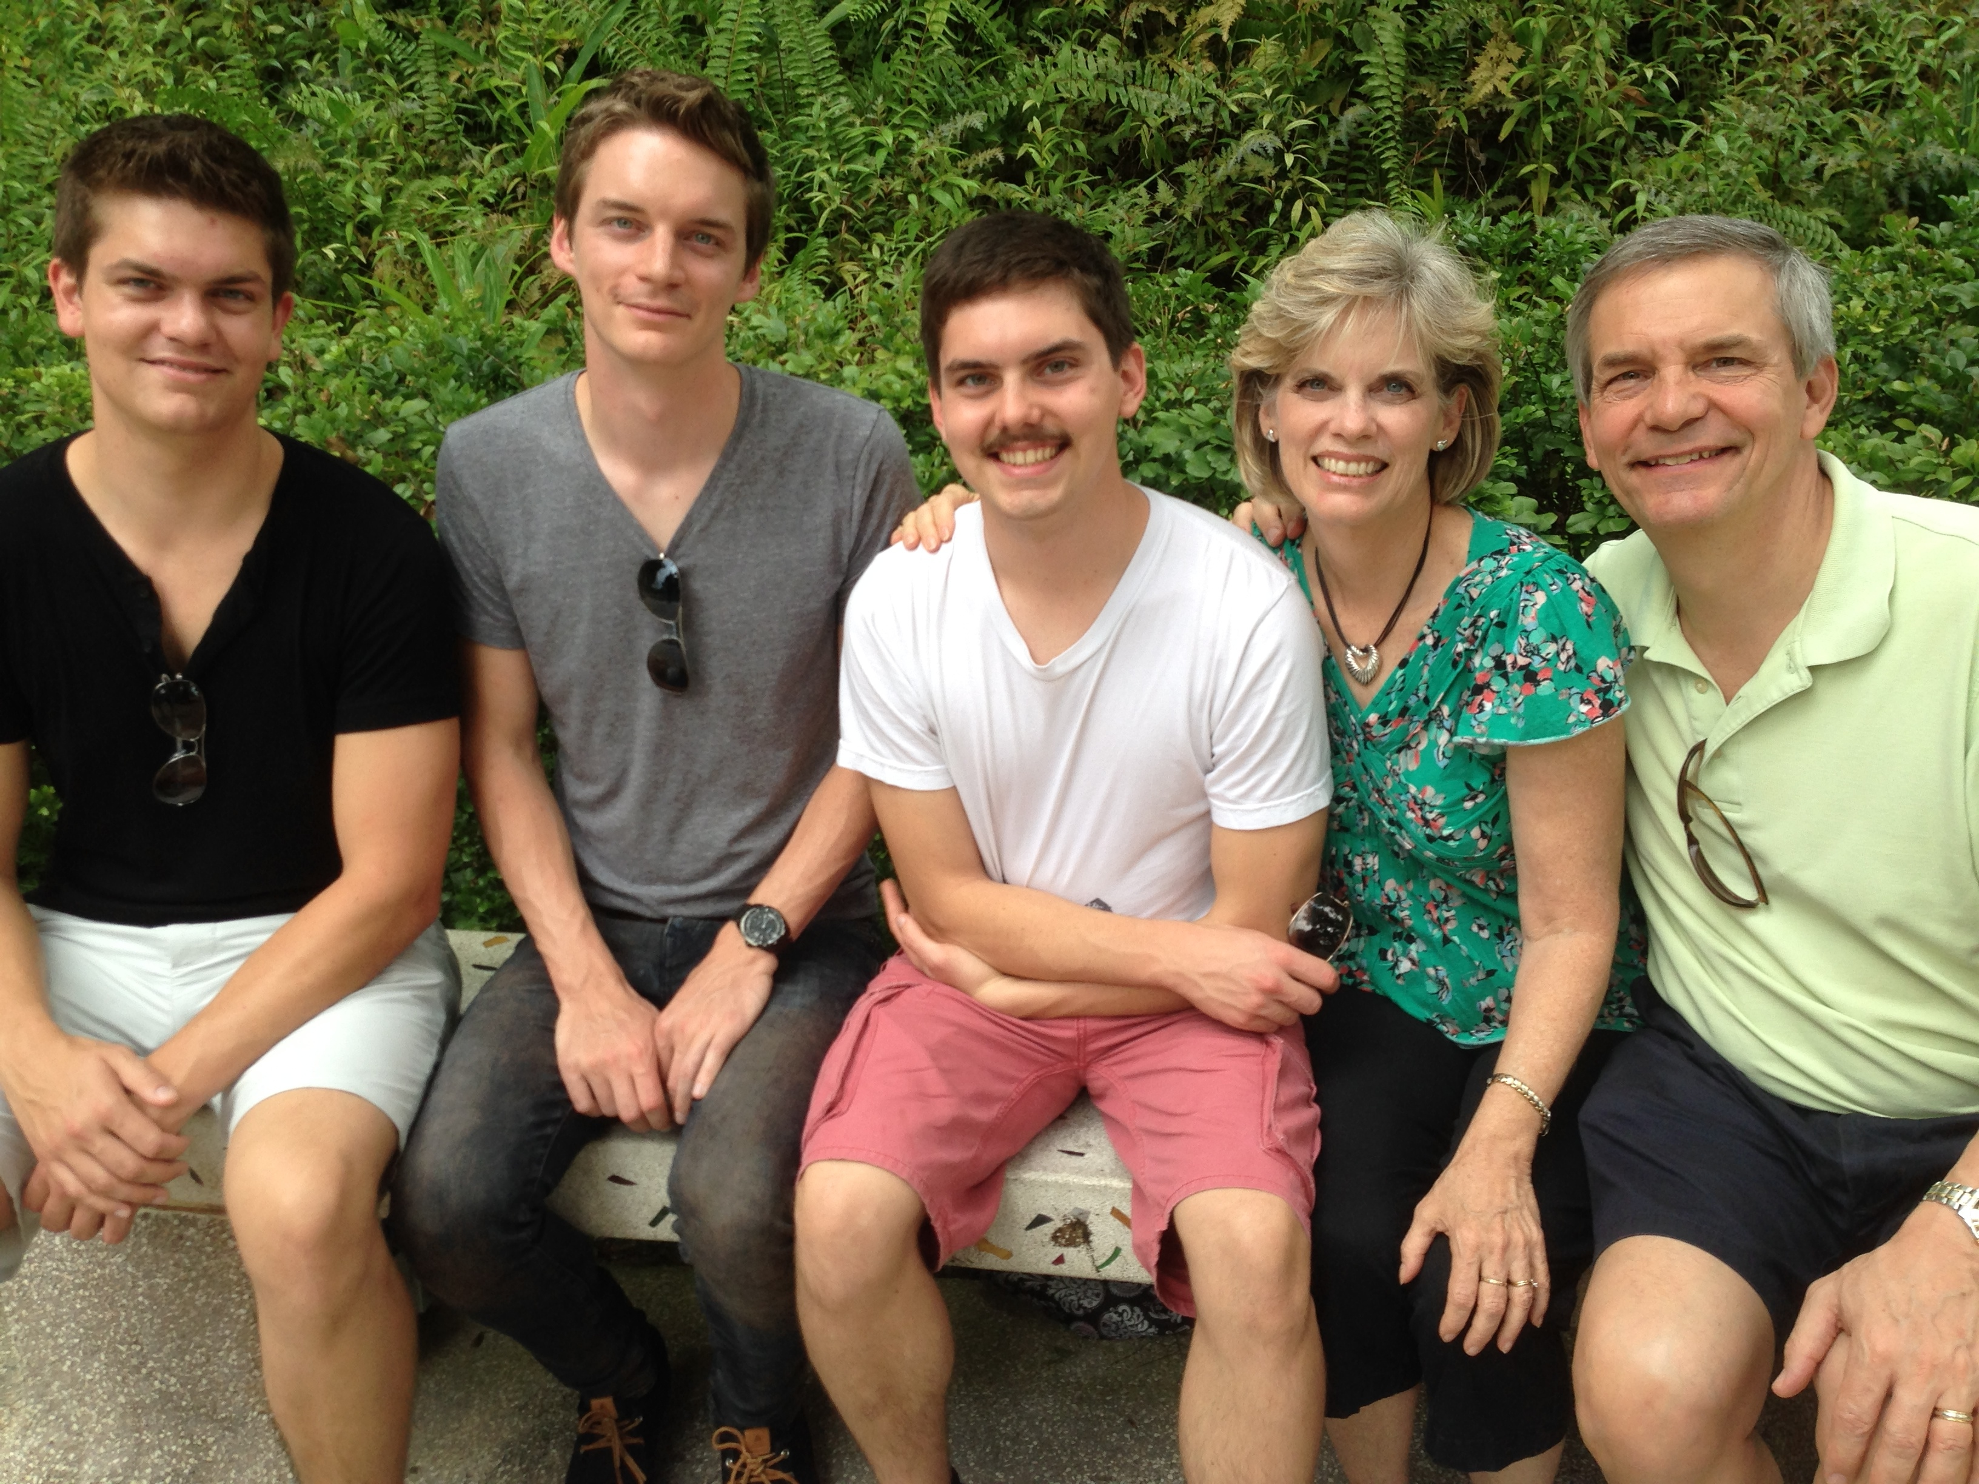
The Griffith Family Dec 2013
2013
Susan
John 21
Stephen 24
Rick
Kurt 26
Notes:
John also got hairy on his nose so he doesn’t look so young.

Slide 49
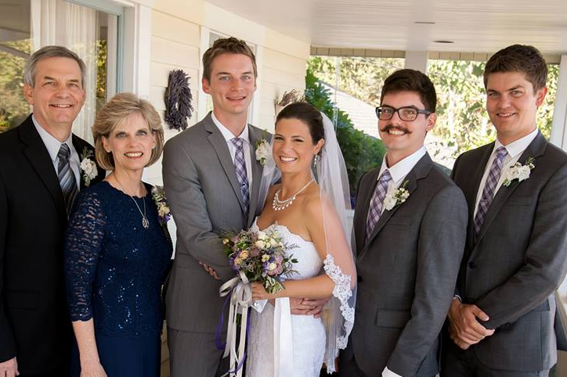
The Griffith Family Sept 2014
2014
Rick
Stephen 25
Susan
John 22
Kurt & Cara 28

Slide 50
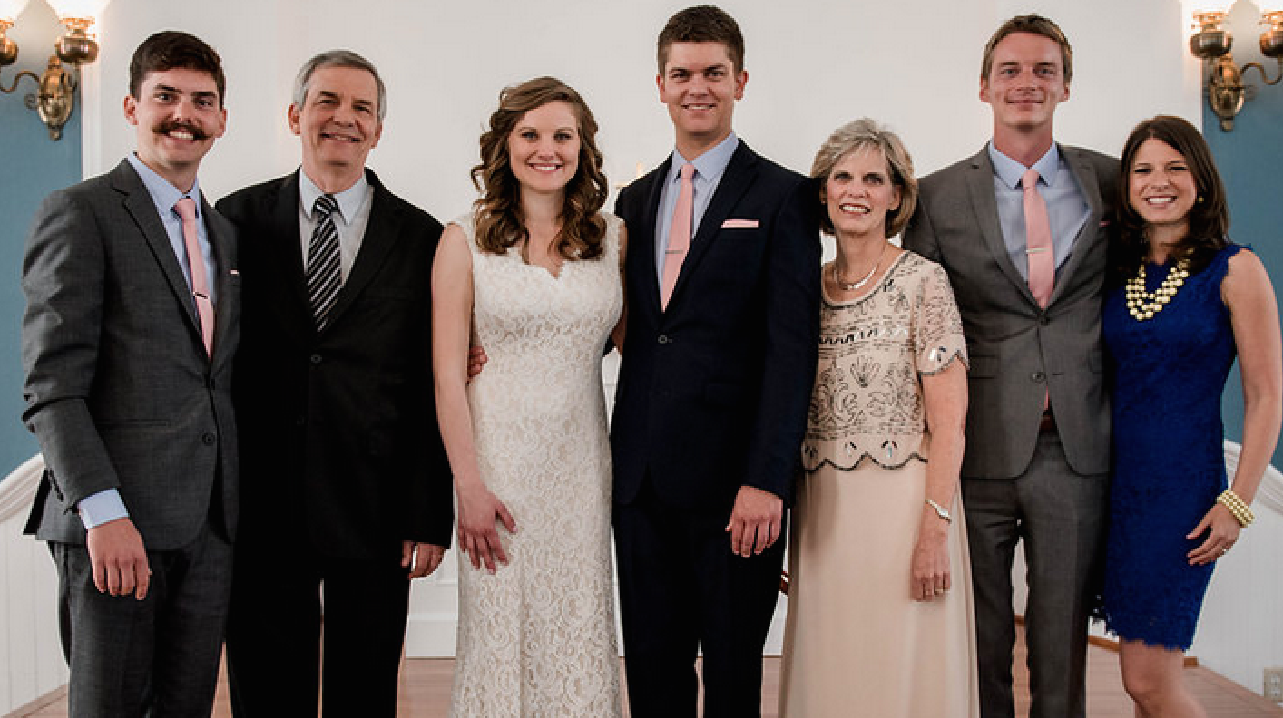
The Griffiths May 2015
2015
Kurt & Cara (28)
John (22)
Rick
Susan
Stephen & Katie (25)

Slide 51
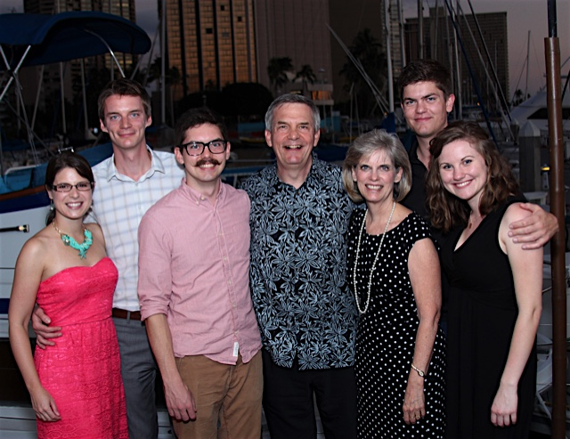
The Griffiths 9 Jan 2016
2016
John (23)
Rick & Susan
Kurt & Cara (29)
Stephen & Katie (26)

Slide 52
Black
Notes:
So how did I answer Albert that night before my marriage when he asked, “Rick, are you 100% sure that it is God’s will for you to marry Susan?”
I told him, “I don’t think anyone can ever say with 100% certainty that he knows God’s will in an area that is not specifically revealed by God in His Word.
“I heard of a groom who was killed in an automobile accident on his way to his wedding—and then the bride married someone else.
“So I can’t say I’m 100% sure now. But within 24 hours I’ll be 100% sure that He wants me to make the very best of the marriage that I have!”

Slide 53
Can two walk 1/5
Can two walk together except they let God lead them?
Can two walk together except He guide their way?
Can there be unity? Can there be harmony, until they both agree that He shall have full sway?

Slide 54
Can two walk 2/5
Can two walk together without the Lord to guide them?
Who sees the darkest future as if that dark were day?
For He and He alone, can master the unknown, and lead them safely on through dangers yet to be.

Slide 55
Can two walk 3/5
Only lives that live to do His will shall come to fullest flow’ring.
Only lives that find their strength in Him will have the power to grow.
Only love that joins itself to God will ever be enduring,
For all true oneness finds its source in Him.

Slide 56
Can two walk 4/5
Can two walk together unless they give allegiance to Christ as their Saviour, their Master, Lord and King?
Can they walk side by side if loyalties divide-- if one or both decide to thwart His kind control?

Slide 57
Can two walk 5/5
Can two walk together without God’s presence leading them? Can two walk together except He light their way?
How can they learn to see what they are meant to be and find their destiny, unless they walk with God?

Slide 58
Black
Notes:
Black

Slide 59
Topical Preaching link at BibleStudyDownloads.org
Get this presentation for free!
Notes:
The Bible…Basically (bb)

