Slide 1
To look forward to
Preached by Dr. Jim Harmeling at Crossroads International Church Singapore • cicfamily.com Uploaded by Dr. Rick Griffith • Singapore Bible College Files in many languages for free download at BibleStudyDownloads.org

Slide 2
To look forward to
Fixing our sight on God’s revelation of the future

Slide 3
Question 1: How do I look forward to the future when life looks like it will get worse and not better?
Question 2: How do I look forward to the future when something horrible happens without any warning?
Question 3: What kind of future am I looking forward to?

Slide 4
Question 1: How do I look forward to the future when life looks like it will get worse and not better?

Slide 5
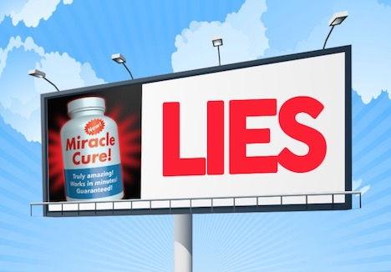

Slide 6
False Advertising?

Slide 8
Faith is . . .
focused on God as He reveals Himself
directed to the future based on the past

Slide 9
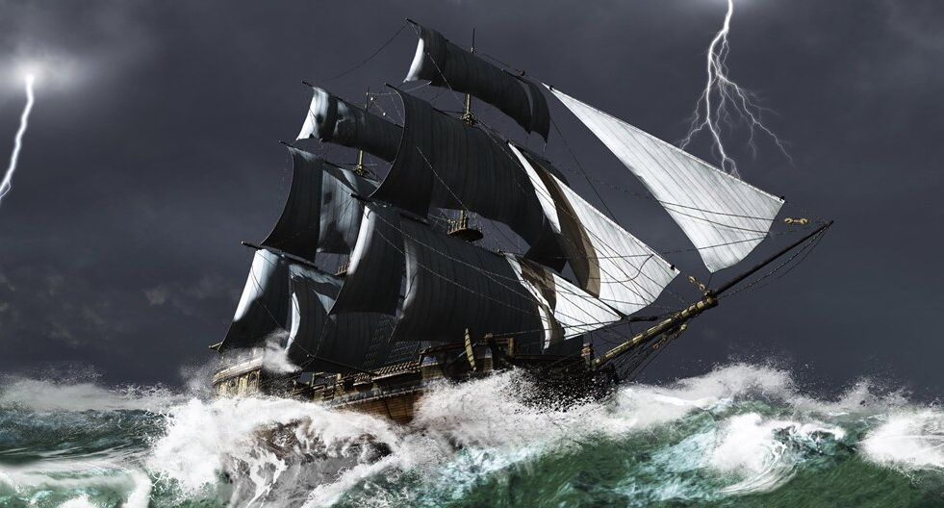
Believe truth about God despite His people’s disbelief (1:1-4)
“They insinuate that the wrongdoers are able to use the law so as to wrong other people who are less adept at working the legal system. It seems that the usual rule holds that the powerful and clever people in the community and the people who exercise authority there are themselves heavily involved in the wrongdoing, in fraud and violence. Community life is totally broken down.”
John Goldingay

Slide 10
Believe truth about God despite His people’s disbelief (1:1-4)
Believe truth about God despite His sovereign plan appearing to make matters worse (1:5–2:5)

Slide 11
“but the righteous shall live by his faith”
Theodicy = God’s work in the world appearing to contradict His revealed nature
Romans 1:17
Galatians 3:11
Hebrews 10:32-39

Slide 12
Believe truth about God despite His people’s disbelief (1:1-4)
Believe truth about God despite His sovereign plan appearing to make matters worse (1:5–2:5)
Believe truth about God despite the sinful world appearing to succeed (2:6-20)

Slide 13
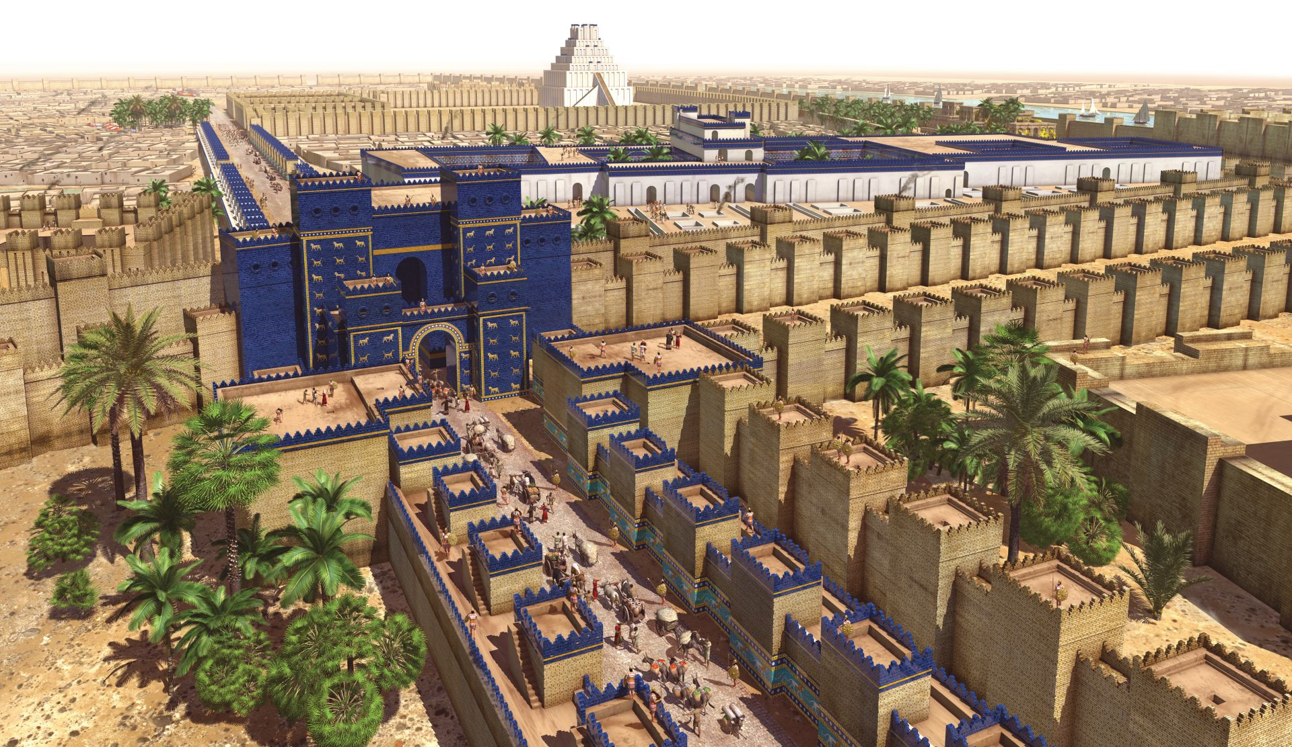
Babylon’s limited success
WOE on those who take advantage of others for personal gain (vs. 6-8)
WOE on those who secure their future by destroying others (vs. 9-11)
WOE on those who build up for themselves through injustice (vs. 12-14)
WOE on those who humiliate or abuse others (vs. 15-17)
WOE on those who make idols that compete with God (vs. 18-20)

Slide 14
Believe truth about God despite His people’s disbelief (1:1-4)
Believe truth about God despite His sovereign plan appearing to make matters worse (1:5–2:5)
Believe truth about God despite the sinful world appearing to succeed (2:6-20)
Believe truth about God because God has been true to His word (3:1-19)

Slide 15
“The Christian faith is solidly based upon facts, not ideas. And if the facts recorded in the Bible are not true, then I have no hope and no comfort. For we are not saved by ideas, but by facts, by events.”
Martin Lloyd-Jones

Slide 16
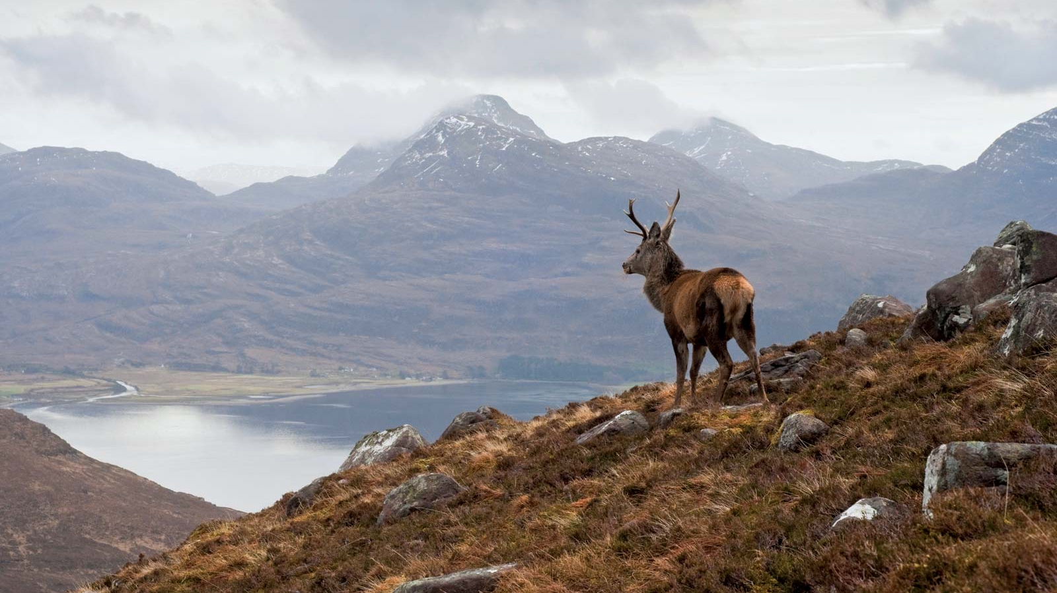
“he makes my feet like the deer’s;
he makes me tread on my high places.”

Slide 17
Black

Slide 18
Topical Preaching link at BibleStudyDownloads.org
Get this presentation for free!
Notes:
The Bible…Basically (bb)

