Slide 1
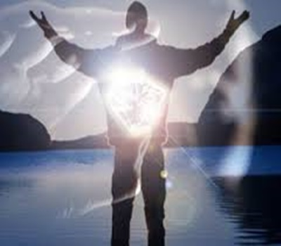
Immanuel
God in Us
Dr. Rick Griffith • Crossroads International Church Singapore
BibleStudyDownloads.org • CICFamily.com

Slide 2
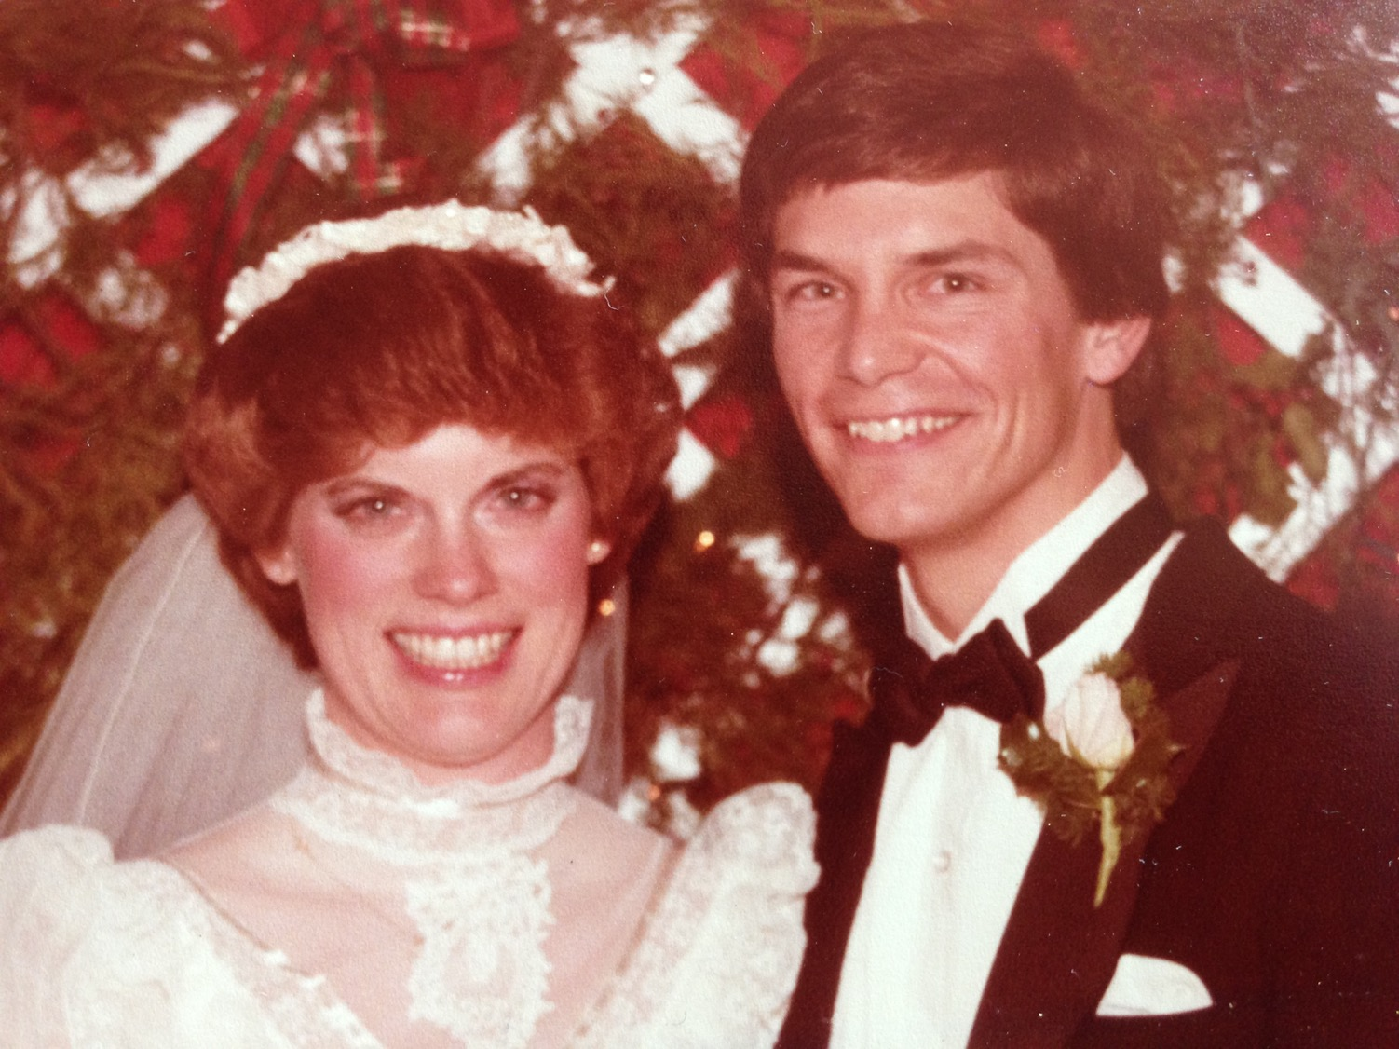
35 Years Today!
(30 Dec 1983 to 30 Dec 2018)
Notes:
Here is a couple none of you ever knew. That is because this picture was taken 35 years ago—TODAY!

Slide 3
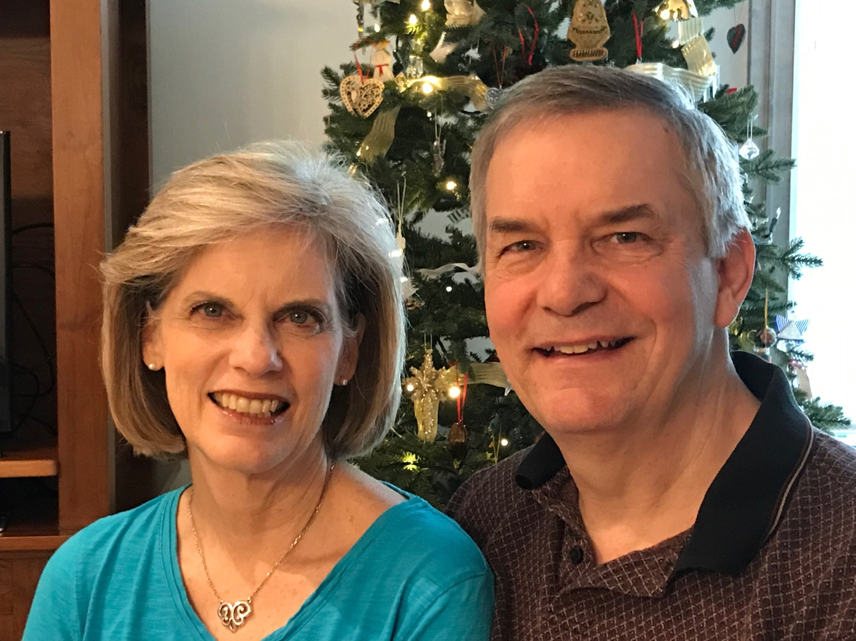
35 Years Today!
(30 Dec 1983 to 30 Dec 2018)
Notes:
More familiar to you is a 60—something couple that shows some battle scars but also God's sustaining grace!

Slide 4
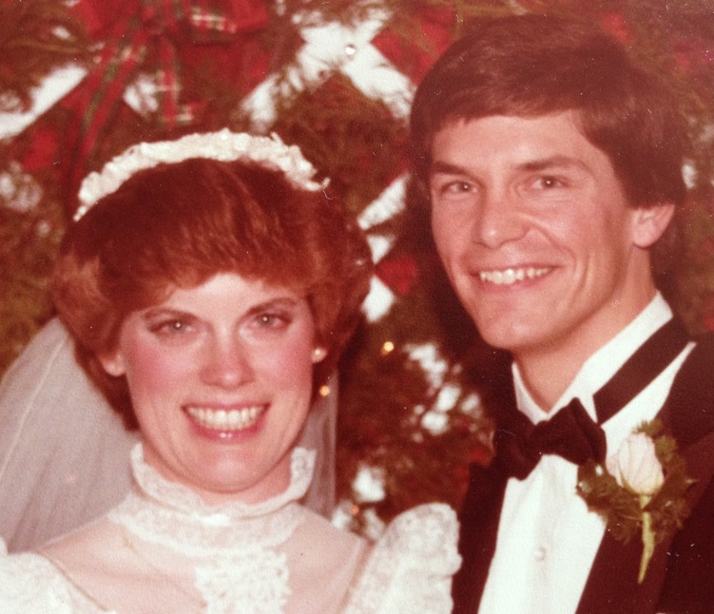
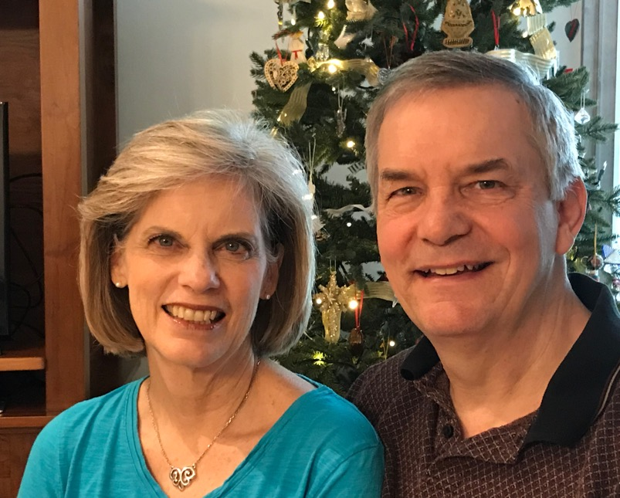
35 Years Ago Today!
(30 Dec 1983 to 30 Dec 2018)
Notes:
Congratulations, my Beloved Susan, for putting up with me for 35 years today. In case you're wondering, you have now been married to me for 12,783 days. That means I need to say thank you for over 25,000 delicious meals! You committed to serve the Lord Jesus with me wherever God led, little realizing that this would include 38 countries to invest in people speaking 49 languages. Your tireless ability to serve others still amazes me. You are still the best listener I have ever met. (I guess I get some credit here since I have given you so much listening practice!) You live by faith instead of by fear. You see the best in others. You have given me three wonderful sons and now even a grandson on the way in May. We have walked together since our 20s and I would love to walk life's road into our 90s, God willing. I love you increasingly each day.

Slide 5
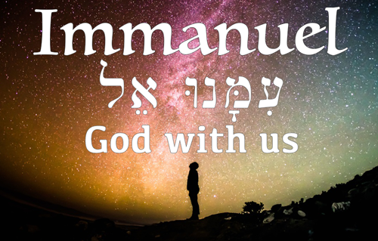
Immanuel: God With Us!
Notes:
Everyone needs to know that someone wants to be near him or her. This is true of human love—so I am thankful that my wife has wanted to be near me for 35 years now. But how much more so is this true of the one whom we all long for most?

Slide 6
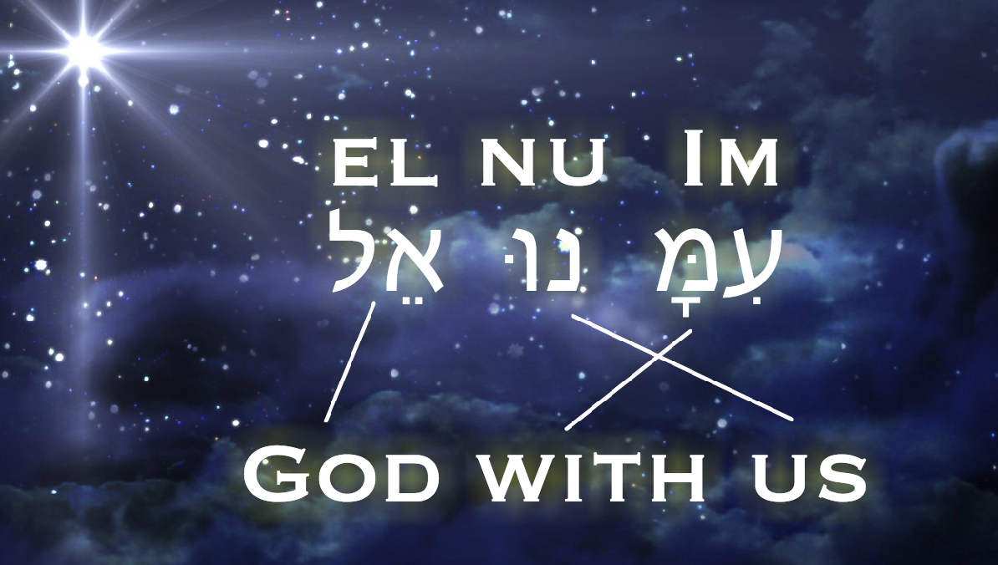
Immanuel: God With Us!
Notes:
He said nearly 2000 years ago that he would be "God with us." That is what "Immanuel" means.

Slide 7
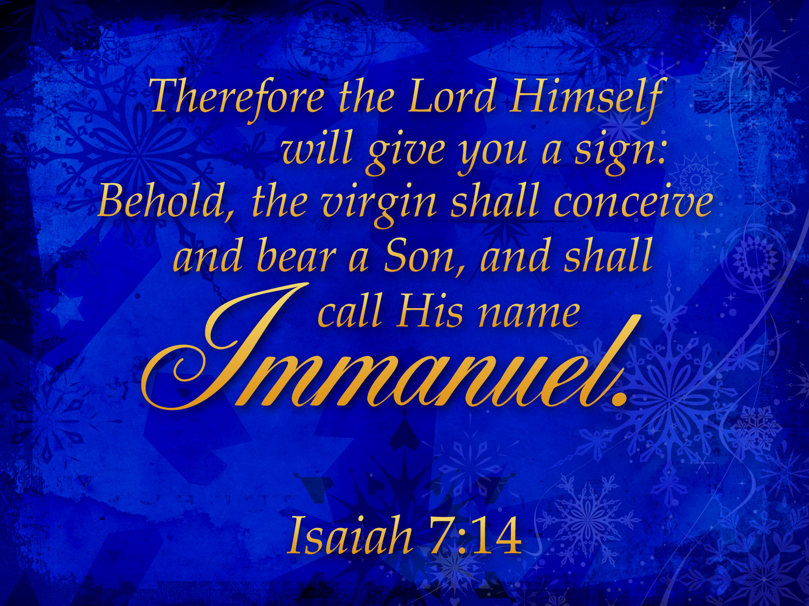
Notes:
The word “Immanuel” comes from Isaiah 7:14 where God promised that a virgin would conceive a baby boy. It would be so amazing that he would be called “God with us”!

Slide 8
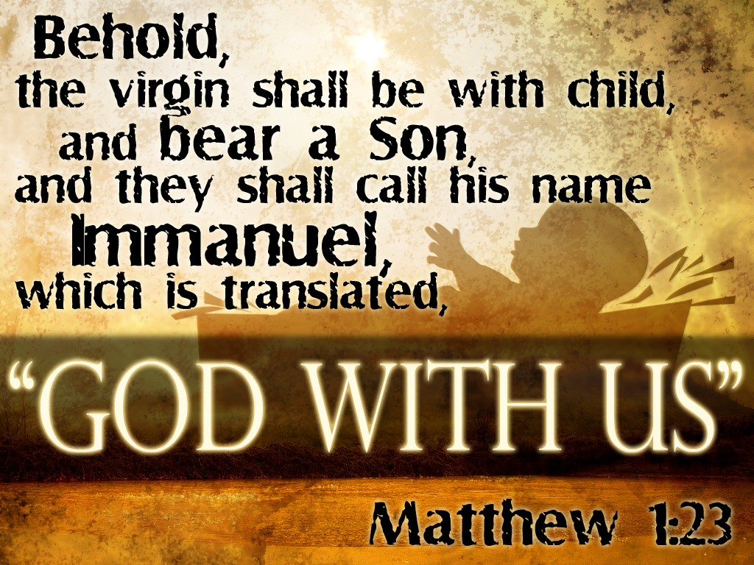
Matthew 1:23 God With Us
Notes:
God's promise came true 700 years later when Jesus was also called "Immanuel," meaning "God with us."

Slide 9
Do you want to sense God’s presence?
Notes:
But do you sense God’s presence with you today? Do you want to sense God’s presence?
I dare say, even though we walk through times when it doesn’t seem like God is near, he still is near.
Years ago, a Native American tribe had a ritual that they require
d of every boy turning into a man. The young boy would have to spend the entire night out in the jungle alone. Imagine being exposed to the elements and to any predator that might stalk in the night. Scary! What the boy did not know, though, was his father also spent that night just a stone’s throw away in the dark, bow and arrows ready to protect the young lad.
It’s like that with our God. We may not sense his presence, but that does not change the fact that he is ever near—even in the darkness. But…

Slide 10
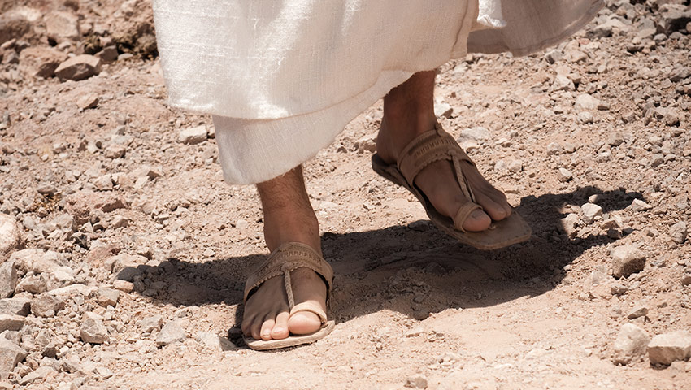
How can you know God is with you (Immanuel) in the coming year?
Notes:
What way can you assure that the Lord will show up in your life?

Slide 11
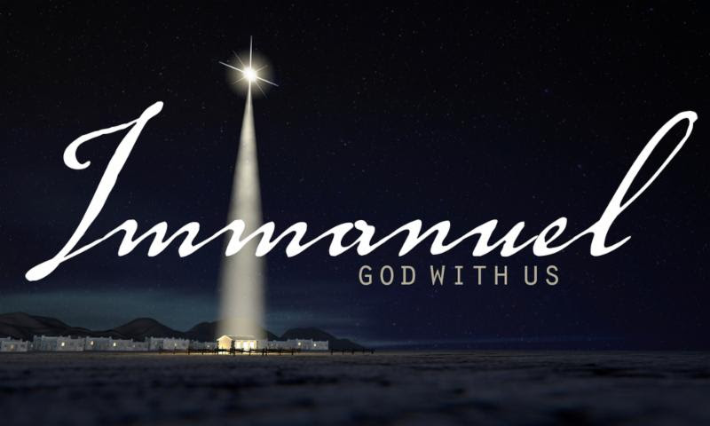
God in…
Place
Notes:
Our three-week Christmas series this month seeks to unpack the meaning of "Immanuel: God With Us” by answering these questions:
• God in Place was week 1. Why Bethlehem? Why did God choose this place for Jesus to arrive? Last week we saw that the answer the “where” question was that Bethlehem was the perfect place for Jesus to enter this world.

Slide 12
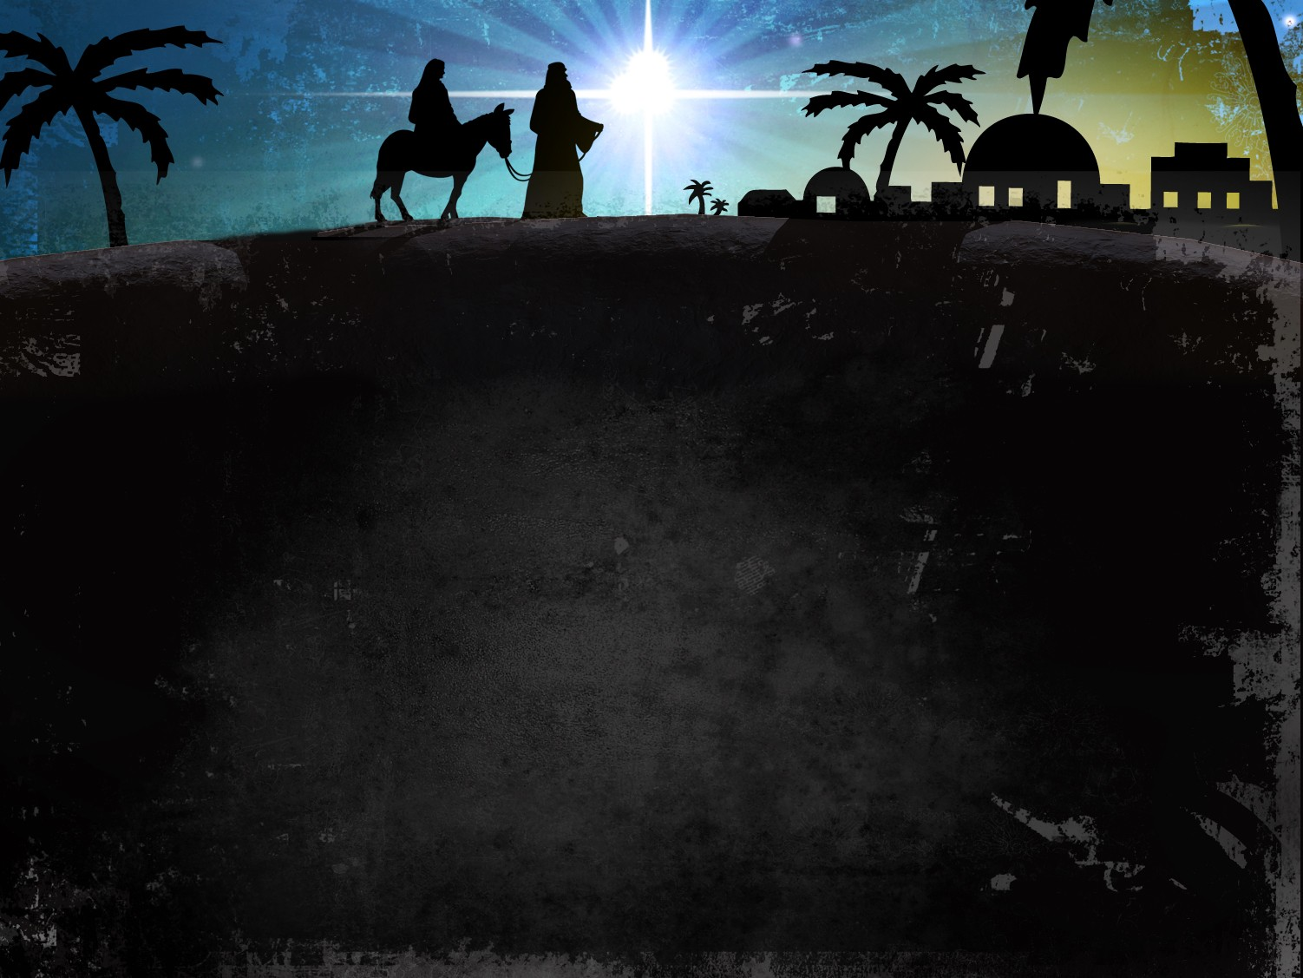
Why Bethlehem?
Why did God choose this place for Jesus to arrive?
Notes:
Why did God select Christ to be born in Bethlehem?

Slide 13
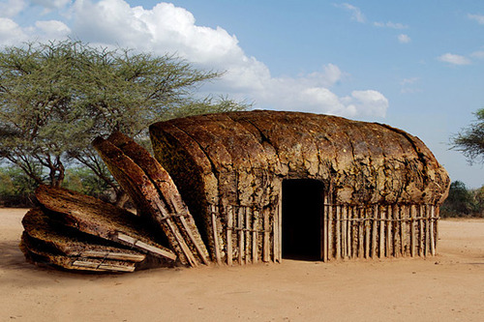

Bethlehem = "House of Bread"
Notes:
This town had a positive name—house of bread—but a shameful reputation.

Slide 14
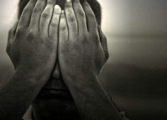
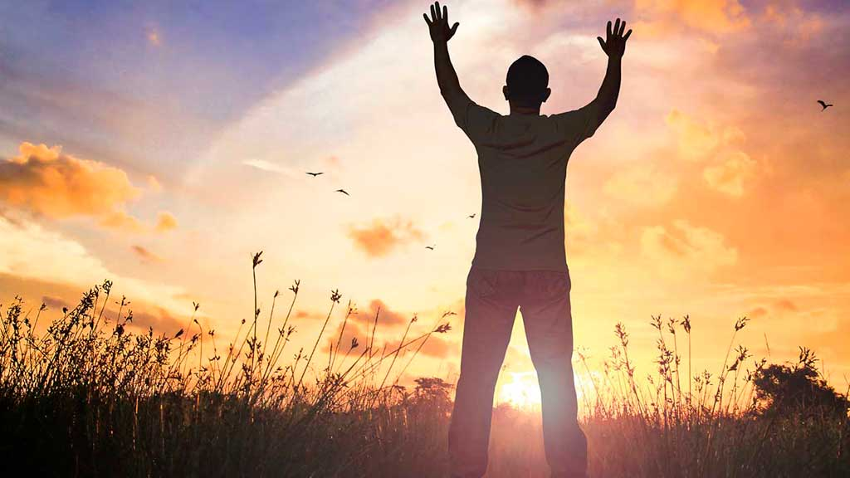
Main Idea in Week 1:
God transforms our shame into honor.

Slide 15
God in…
Place
Time
Notes:
• God in Time was last week. Why then? Why did Jesus come at the time he did? We answered the “When” question by exploring how 2000 years ago was the exact right time for Christ to come. The take-away for us was…

Slide 16

Main Idea
God’s timing is always perfect.
Notes:
He is rarely early and never late—but always on time.

Slide 17
God in…
Place
Time
Us
Notes:
• God in Us is our subject today. Why within? We will answer the “How” question to see how God works.

Slide 18
God in Us
Old Testament
New Testament
Today
Notes:
Today we will reflect back at the Christmas story from the perspective of God’s presence with us. We will first see how the Spirit worked in the OT, then the NT and then see the implications of the Spirit’s indwelling for us today.
So how can you know God is with you [Immanuel] in the coming year? Let’s first see how he was with his people all the way back to the beginning…)

Slide 19
How can you know God is with you (Immanuel) in the coming year?

Slide 20
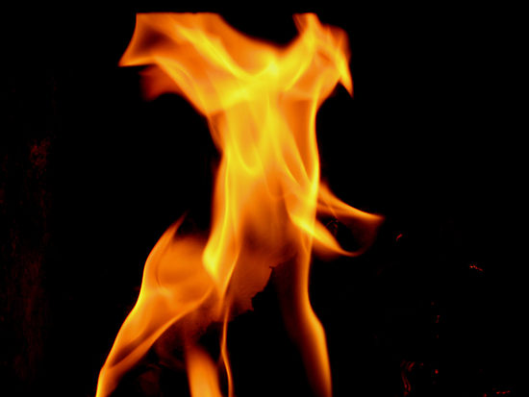
I. The Spirit in the OT was with God’s people.
Notes:
God didn’t abandon Israel but lived among them—mainly for power and ministry.

Slide 21
"Now the earth formless and empty, darkness was over the the surface of the deep…"
"…and the Spirit of God was hovering over the waters."
Genesis 1:2 NIV
Notes:
The Spirit presided over creation (Gen 1:2).
But what is God’s glory? The idea is one of God’s weight or God’s presence.

Slide 22

The Tabernacle
7
God sets up a place for Him to dwell as King
MOSES
Exodus
Sinai
M - C - C
Kadesh Barnea
40
The Tabernacle in the Wilderness
Handbook pg. 26-29
2
16
Notes:
God’s glory or presence then appeared at the tabernacle made for him to dwell as king.

Slide 23
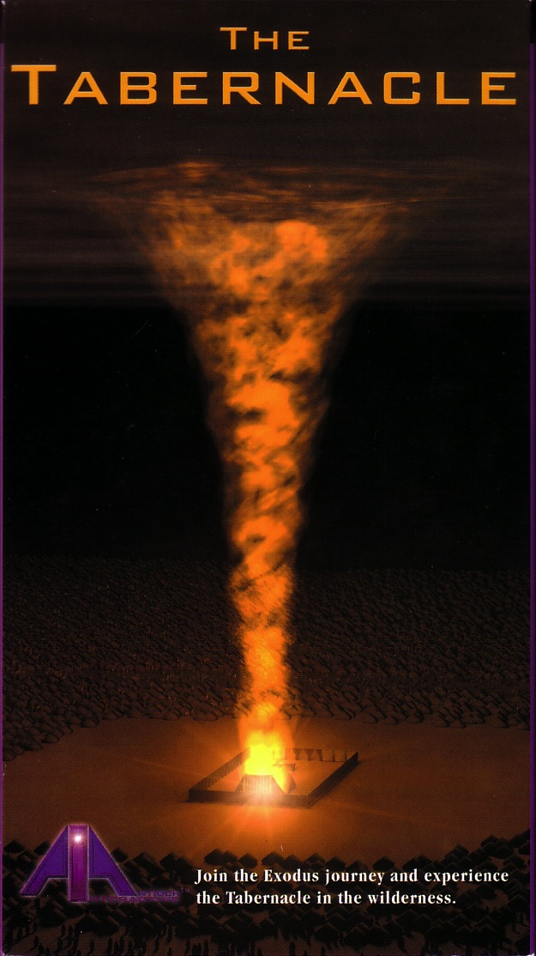

God's presence filled his new palace!
Then the cloud covered the tent of meeting, and the glory of the LORD filled the tabernacle.
Exodus 40:34 ESV
Notes:
The Spirit indwelt the tabernacle (Exod 40:34).

Slide 24
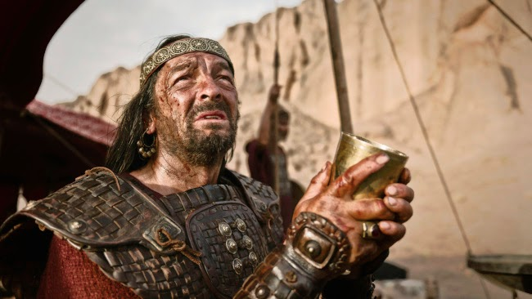
"When Saul heard their words, the Spirit of the God came upon him in power, and he burned with anger."
1 Sam. 11:6
Notes:
Sadly, the Spirit later left Saul, as 1 Sam 16:14 notes, "Now the Spirit of the Lord had left Saul, and the Lord sent a tormenting spirit that filled him with depression and fear."

Slide 25

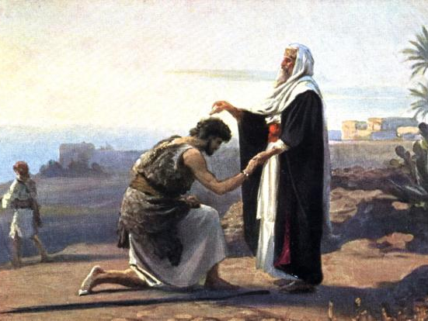
David was Anointed King
198
1 Samuel 16:12-13
Notes:
The Spirit came upon Saul and David (1 Sam 11:6; 16:12-13)
“So Jesse sent for him. He was dark and handsome, with beautiful eyes. And the Lord said, This is the one; anoint him.’
13 So as David stood there among his brothers, Samuel took the flask of olive oil he had brought and anointed David with the oil. And the Spirit of the Lord came powerfully upon David from that day on. Then Samuel returned to Ramah” (1 Sam 16:12-13).
Even if we see this as an indwelling, it was temporary. It was also unrelated to a person's spiritual condition, since Jephthah was an idolater and Samson a carnal man, yet the Spirit came upon and used each (Paul Enns, Moody Handbook of Theology, 261).

Slide 26
The Holy Spirit Filled the Temple!
“When the priests came out of the Holy Place, a thick cloud filled the Temple of the LORD. ¹¹The priests could not continue their service because of the cloud, for the glorious presence of the LORD filled the Temple. ¹²Then Solomon prayed, ‘O LORD, you have said that you would live in a thick cloud of darkness. ¹³Now I have built a glorious Temple for you,
a place where you can live forever!’”(1 Kings 8:10-13 NLT).
Notes:
After Solomon built the temple, God was pleased to fill it.

Slide 27

God's Presence Filled Solomon's Temple
Notes:
The people could know that God's Spirit lay just behind those doors within his palace to dwell with them as King. Amazing!

Slide 28
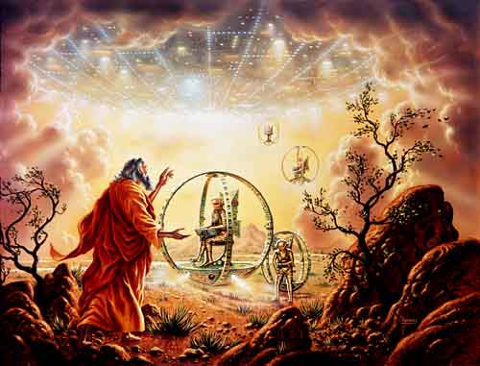
Ezekiel 1
Notes:
Now in Ezekiel 1 we see God’s presence in his glory appearing to Ezekiel.

Slide 29

¹ In my thirtieth year, in the fourth month on the fifth day, while I was among the exiles by the Kebar River, the heavens were opened and I saw visions of God.
² On the fifth of the month—it was the fifth year of the exile of King Jehoiachin—
³ the word of the Lord came to Ezekiel the priest, the son of Buzi, by the Kebar River in the land of the Babylonians. There the hand of the Lord was on him.
Ezekiel 1:1-12

Slide 30
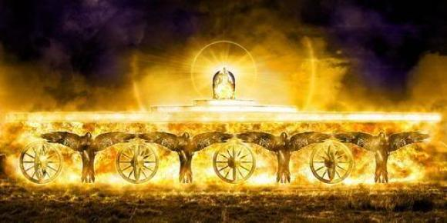
⁴ I looked, and I saw a windstorm coming out of the north—an immense cloud with flashing lightning and surrounded by brilliant light. The center of the fire looked like glowing metal
Ezekiel 1:1-12

Slide 31
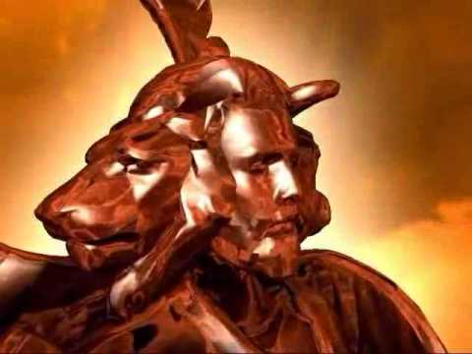
⁵ and in the fire was what looked like four living creatures. In appearance their form was human,
⁶ but each of them had four faces and four wings.
Ezekiel 1:1-12

Slide 32
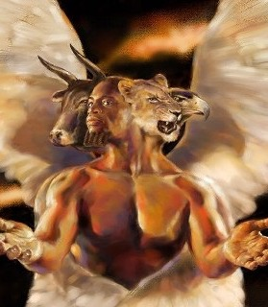
⁷ Their legs were straight; their feet were like those of a calf and gleamed like burnished bronze.
⁸ Under their wings on their four sides they had human hands. All four of them had faces and wings
Ezekiel 1:1-12

Slide 33
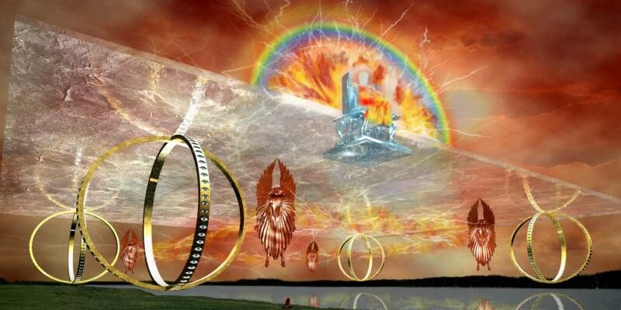
⁹ and the wings of one touched the wings of another. Each one went straight ahead; they did not turn as they moved.
Ezekiel 1:1-12

Slide 34
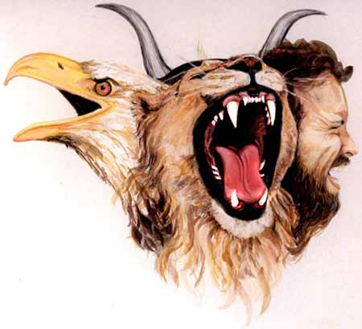
Creatures with Four Faces
(Ezek. 1:10 NLT)
367
"Each had a human face in the front, the face of a lion on the right side, the face of an ox on the left side, and the face of an eagle at the back."
Notes:
God’s glory is depicted in these amazing heavenly beings with four faces!
___________
"I believe that these special creatures symbolize God's creation and are related to God's covenant with Noah (Gen. 9:8–17). The faces of the living creatures parallel God's statement in Genesis 9:10—His covenant is with Noah (the face of the man), the fowl (the face of the eagle), the cattle (the face of the calf), and the beasts of the earth (the face of the lion)" (Wiersbe on Revelation 4:7).

Slide 35
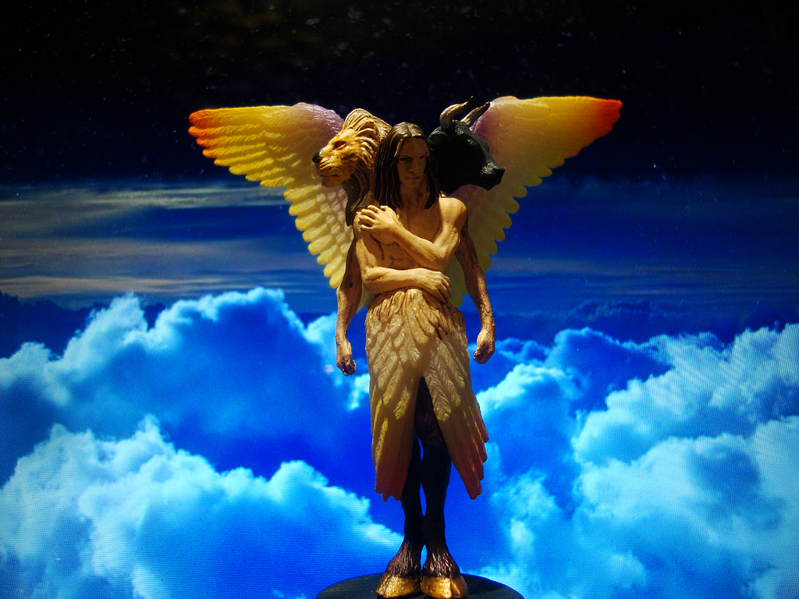
Creatures with Four Faces
(Ezek. 1:11 NLT)
367
"Such were their faces. They each had two wings spreading out upward, each wing touching that of the creature on either side; and each had two other wings covering its body."
Notes:
"I believe that these special creatures symbolize God's creation and are related to God's covenant with Noah (Gen. 9:8–17). The faces of the living creatures parallel God's statement in Genesis 9:10—His covenant is with Noah (the face of the man), the fowl (the face of the eagle), the cattle (the face of the calf), and the beasts of the earth (the face of the lion)" (Wiersbe on Revelation 4:7).

Slide 36
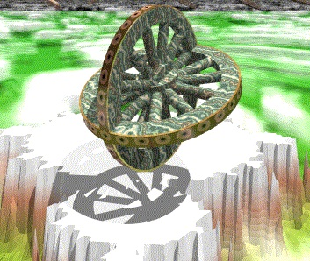
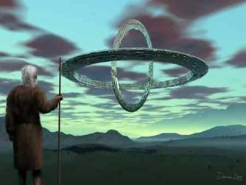
Ezekiel 1:12
"Each one went straight ahead. Wherever the spirit would go, they would go, without turning as they went" (NLT).
Notes:
Each creature was next to an amazing wheel configuration with horizontal wheels within vertical wheels.

Slide 37

Solomon's Temple
502
Ezekiel 10:3
Notes:
Sadly, we see God's glory leave his own temple! “The cherubim were standing at the south end of the Temple when the man went in, and the cloud of glory filled the inner courtyard” (Ezek 10:3 NLT).

Slide 38
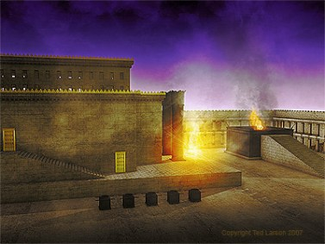
Ezekiel 10:4 NLT
"Then the glory of the LORD rose up from above the cherubim and went over to the door of the Temple. The Temple was filled with this cloud of glory, and the courtyard glowed brightly with the glory of the LORD."
Notes:
Why was God's glory leaving the temple and going into the courtyard? Ezekiel 11 shows pagan ceremonies right in the temple itself!

Slide 39

The Glory Left
502
656
Ezekiel 11:23
Notes:
“Then the glory of the Lord went up from the city and stopped above the mountain to the east” (Ezek 11:23 NLT).

Slide 40
I. The Spirit in the OT was with God’s people.
Notes:
So how can you know God is with you [Immanuel] in the coming year? We saw in the OT that the Spirit was with God’s people.

Slide 41
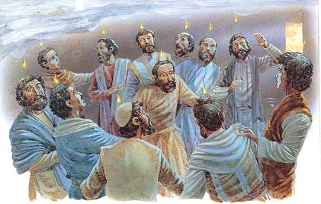
What happened at Pentecost?
Notes:
Now let’s now see how he is with us now. This will show what really happened at Pentecost because now…)

Slide 42
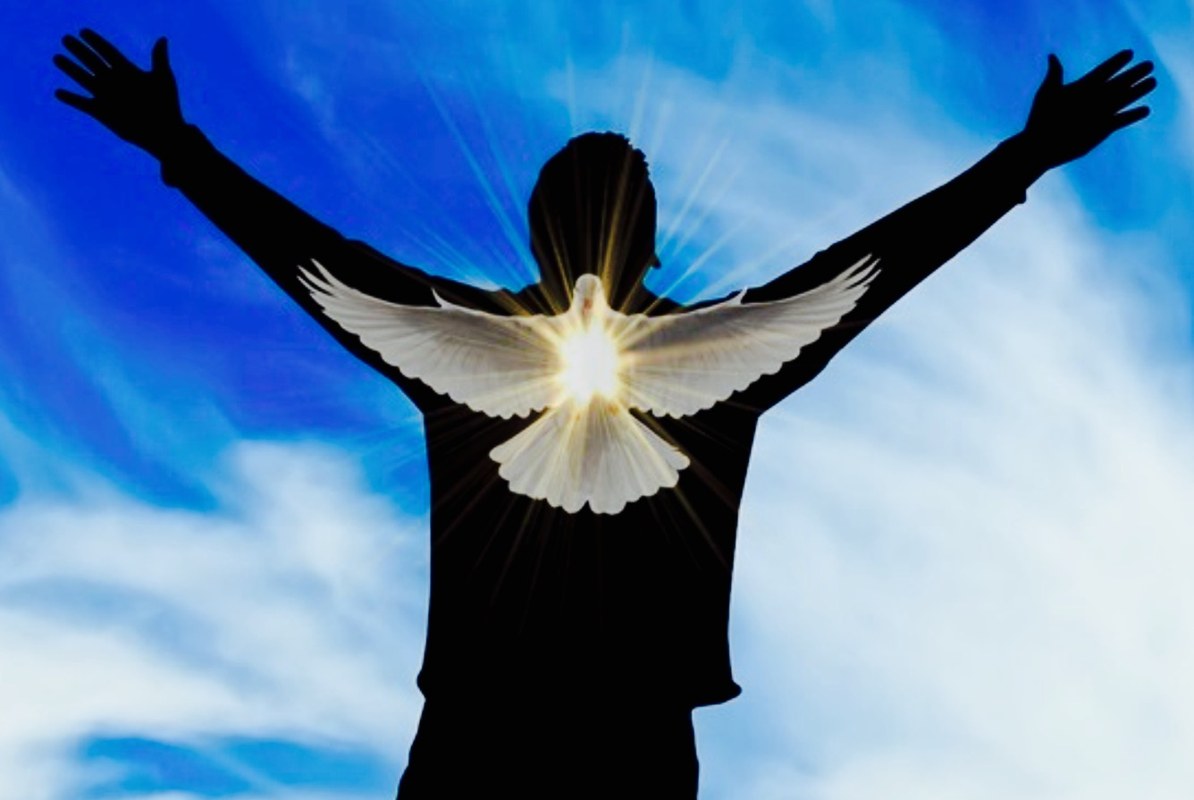
II. The Spirit for NT believers is in God’s people.
Notes:
We have God’s presence not only with us, but inside our bodies!

Slide 43
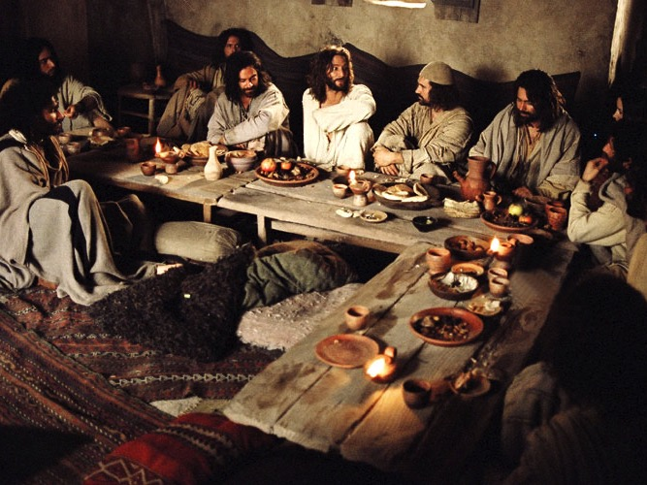
Upper Room Seating
Notes:
Imagine being able to physically be with Jesus. You could ask him any question, you could see how he related to people, you could watch his every move.

Slide 44
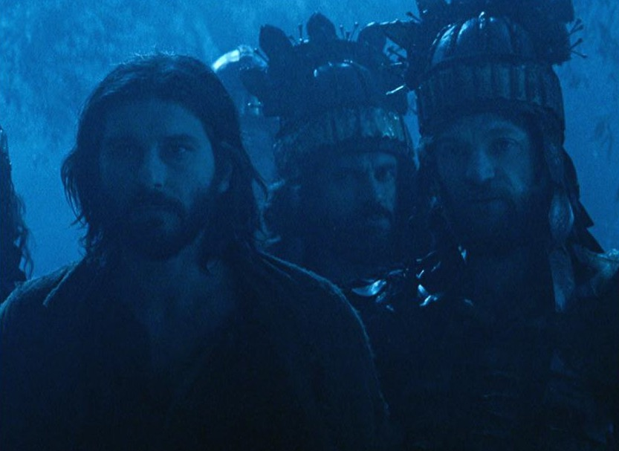
How could the disciples cope without Jesus with them anymore?
Notes:
But then Jesus was suddenly taken away from his disciples—how tragic!

Slide 45
Slides on
John 14
Notes:
Jesus actually had prepared them for his absence in John 14. He told them that he would send the Spirit!

Slide 46
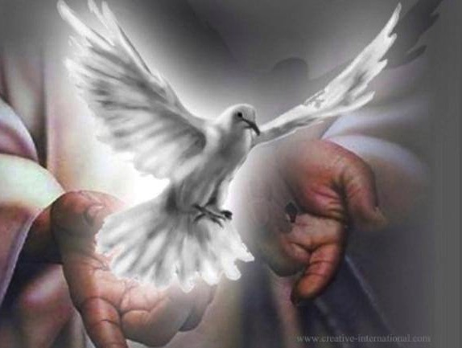
John 14:15-17
xvi
II. D.
¹⁵"If you love me, you will obey what I command. ¹⁶And I will ask the Father, and he will give you another Counselor to be with you forever — ¹⁷the Spirit of truth. The world cannot accept him, because it neither sees him nor knows him. But you know him, for he lives with you and will be in you."
Notes:
46
This indwelling is PERMANENT (forever) and for ALL believers!

Slide 47
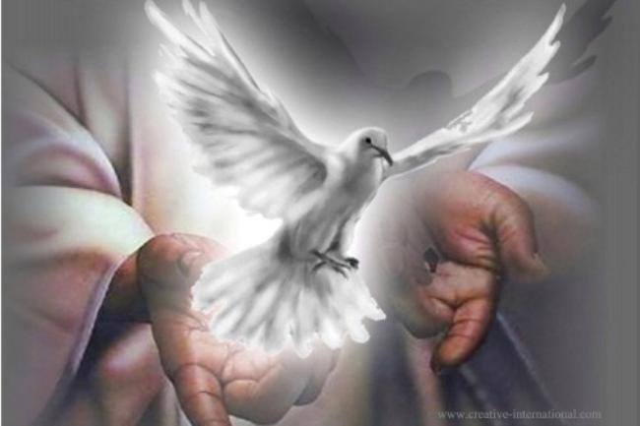
The Paraclete (John 14:16)
Advocate = Counselor = Comforter
Greek = “one who comes alongside”
Greek options for “another”:
Heteros = “another of a different kind”
Allos = “another of the same kind”
The Spirit will come alongside us in the same way as Jesus Himself!

Slide 48
John 14:15-17
xvi
II. D.
The Counselor or Helper is "another of the same kind" (Gr. allos), just like Jesus!
He lives with us and lives in us
Notes:
48
We are actually BETTER OFF than the disciples. They had only three years with Jesus, but he is with us forever. He also lives WITHIN us rather than just being near us.

Slide 49
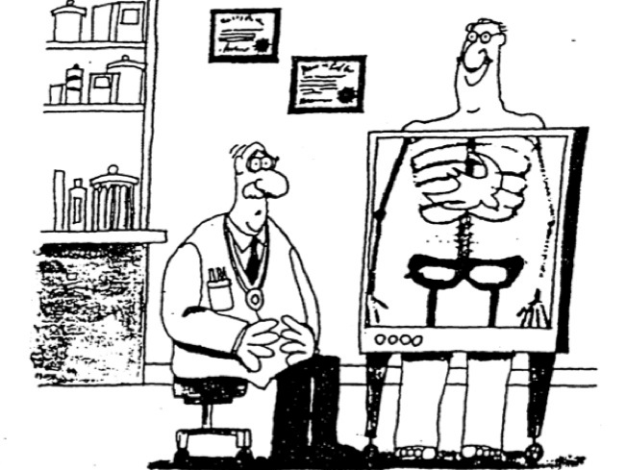

"…those who do not have the Spirit of Christ living in them do not belong to him at all… The Spirit of God, who raised Jesus from the dead, lives in you"
(Romans 8:9, 11)

Slide 50
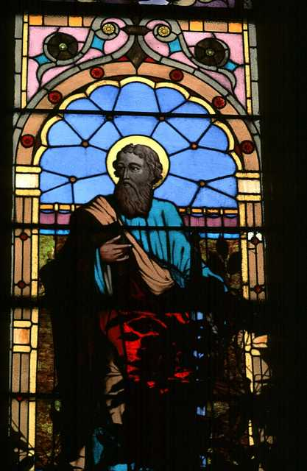
Indwelling
xvi
Paul spoke of the Spirit as "dwelling" in or among the people of God (1 Cor. 6:19; 2 Cor. 6:16)

Slide 51
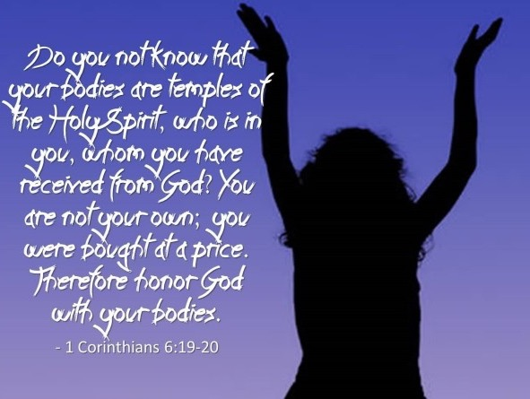

"Do you not know that your body is a temple of the Holy Spirit, who is in you, whom you have received from God? You are not your own; ²⁰you were bought at a price. Therefore honor God with your body"
(1 Cor 6:19-20 NIV).
Notes:
Here we see that even disobedient believers still have the Spirit within them!
__________
Translators, use the alternate verses and runner and delete the embedding image.

Slide 52

What does 2 Cor. 6:14-7:1 mean?
"
136
"Don't team up with those who are unbelievers. How can righteousness be a partner with wickedness? How can light live with darkness? ¹⁵What harmony can there be between Christ and the devil? How can a believer be a partner with an unbeliever? ¹⁶And what union can there be between God's temple and idols? For we are the temple of the living God."

Slide 53
What does 2 Cor. 6:14-7:1 mean?
"
136
"As God said:
'I will live in them
and walk among them.
I will be their God,
and they will be my people.
¹⁷Therefore, come out from among unbelievers, and separate yourselves from them, says the Lord'
(2 Cor. 6:16-17)

Slide 54
Create In Me
John Carter ©1992 Beckenhorst Press, Inc.

Slide 55
Create In Me
Create in me a clean heart, O God
And renew a right spirit within me
(2x)
John Carter ©1992 Beckenhorst Press, Inc.
CCLI #2588988

Slide 56
Create In Me
Cast me not away from Your presence, O Lord
And take not Thy Holy Spirit from me
Restore unto me the joy of Thy salvation
And renew a right spirit within me
John Carter ©1992 Beckenhorst Press, Inc.
Should Christians pray this in light of Romans 8?

Slide 57
II. The Spirit for NT believers is in God’s people.
Notes:
So how can you know God is with you [Immanuel] in the coming year? Because he is IN us! But where does that show up in life?

Slide 58
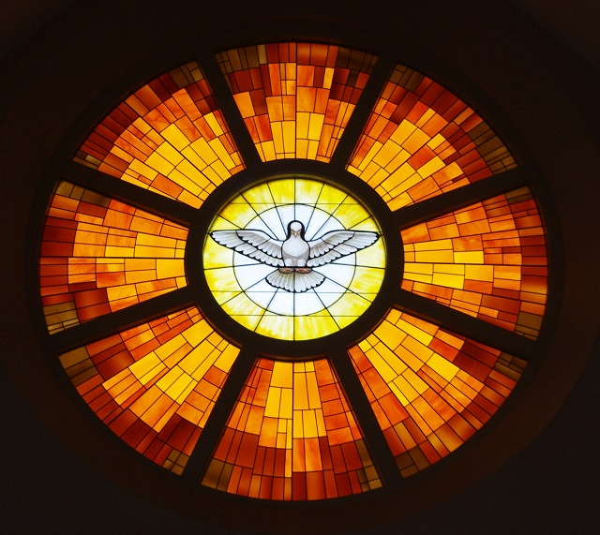
III. The Spirit’s indwelling guarantees our success!
Notes:
God’s presence in us will lead to many other benefits

Slide 59
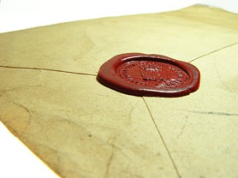
The Spirit indwelling guarantees our full salvation!
"And do not grieve the Holy Spirit of God, with whom you were sealed for the day of redemption"
(Eph. 4:30 NIV).
"Having believed, you were marked in him with a seal, the promised Holy Spirit, ¹⁴who is a deposit guaranteeing our inheritance until the redemption of those who are God's possession—to the praise of his glory"
(Eph. 1:13-14 NIV).
Notes:
His indwelling guarantees our full salvation (Eph 1:13-14).
A seal on an envelope guards the contents and guarantees them until it reaches its destination.
Likewise, the Spirit is our seal or deposit that guarantees our reward in heaven as our destination.

Slide 60
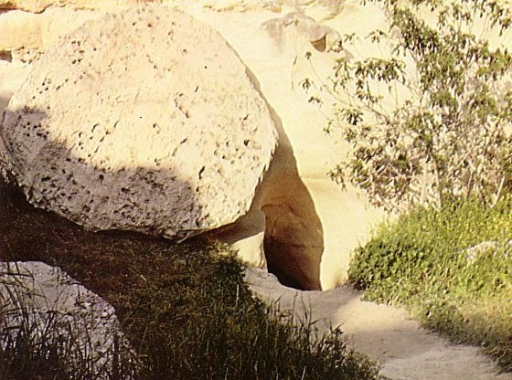
The Spirit Indwelling Guarantees Our Resurrection (Rom 8:11)!
154b
"The Spirit of God, who raised Jesus from the dead, lives in you. And just as God raised Christ Jesus from the dead, he will give life to your mortal bodies by this same Spirit living within you" (NLT).
Notes:
The Spirit gave Jesus a body that cannot die.
The Spirit will also give you a body that cannot die!

Slide 61

The Spirit indwelling guides us into all truth
"But when he, the Spirit of truth, comes, he will guide you into all truth…" (John 16:14)
Notes:
We live in a world of lies, so we need to be able to discern truth from lies.
The Spirit does just that—he guides us into all truth.

Slide 62
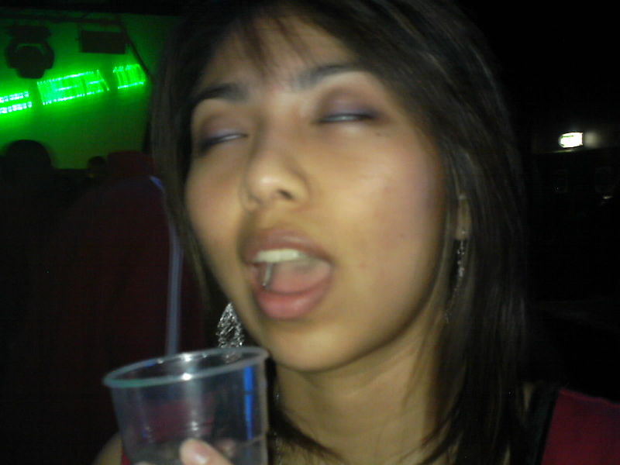
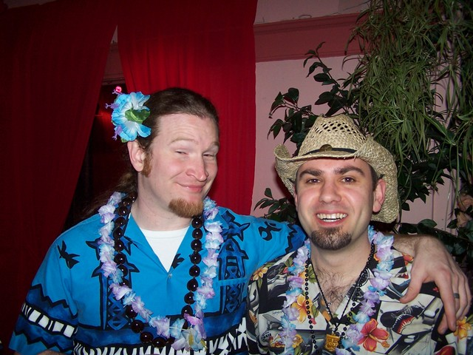
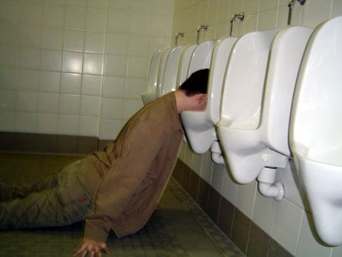
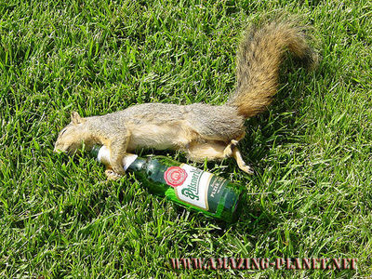
When someone is drunk…
Notes:
Wine controls those who drink too much, right?

Slide 63
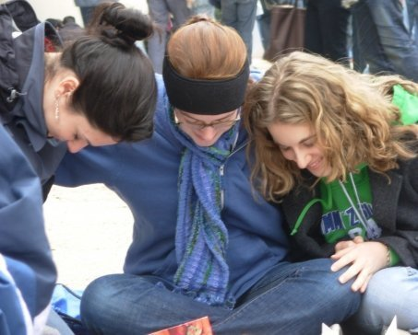
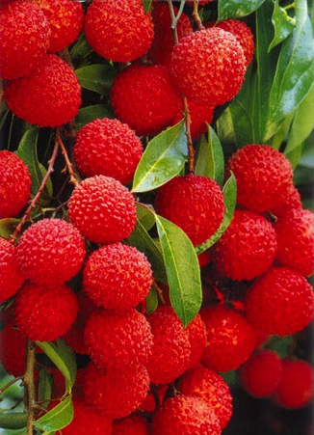
Ephesians 5:18-20 NLT
Don't be drunk with wine, because that will ruin your life.
Instead, be filled with the Holy Spirit,
¹⁹singing psalms and hymns and spiritual songs among yourselves, and making music to the Lord in your hearts. ²⁰And give thanks for everything to God the Father in the name of our Lord Jesus Christ.
Notes:
The Spirit indwelling allows us to be controlled by him (Eph 5:18).

Slide 64
Results of Spirit Filling (Eph 5:18-21)
Be filled with Spirit (5:18)
Sing psalms, hymns and spiritual songs (5:19a)
Make music to the Lord (5:19b)
Always be thankful (5:20)
Submit to one another out of reverence for Christ (5:21)
Notes:
This has many wonderful results, such as singing, thankfulness, and mutual submission.

Slide 65
How can you know God is with you (Immanuel) in the coming year?

Slide 66
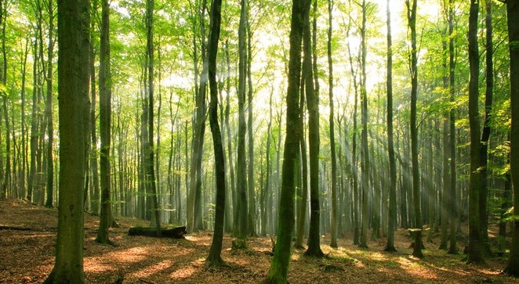
Main Idea
God is with us by being in us.

Slide 67
I. The Spirit in the OT was with God’s people.
Notes:
God didn’t abandon Israel but lived among them—mainly for power and ministry.

Slide 68
II. The Spirit for NT believers is in God’s people.
Notes:
We have God’s presence not only with us, but inside our bodies!

Slide 69
III. The Spirit’s indwelling guarantees our success!
Notes:
God’s presence in us will lead to many other benefits

Slide 70

Wanting to Be Disabled
Notes:
For most, the idea of being wheelchair bound would be a nightmare. Not so for Chloe Jennings-White. It would be her dream come true. Chloe is a 58-year-old able-bodied woman who longs--yes, longs--to lose the use of her legs. She says she has been dreaming of becoming a paraplegic since she was just four years old, after visiting with a relative who was confined to a wheelchair.

Slide 71

Wanting to Be Disabled
Notes:
So driven is she to become disabled, she has engaged in many dangerous activities, like extreme downhill skiing, in the hopes of accidentally-on-purpose injuring herself. She once even rode her bike off a ledge, injuring herself badly, but not quite badly enough. When she realized that she could have hit her head and died, or broken her neck and lost the use of both legs and arms, she decided to pursue a more controlled means to disability--she sought the help of a surgeon to severe the nerves to her legs. She has found one willing to perform the surgery, but doesn't have the nearly $20K necessary for the operation.

Slide 72
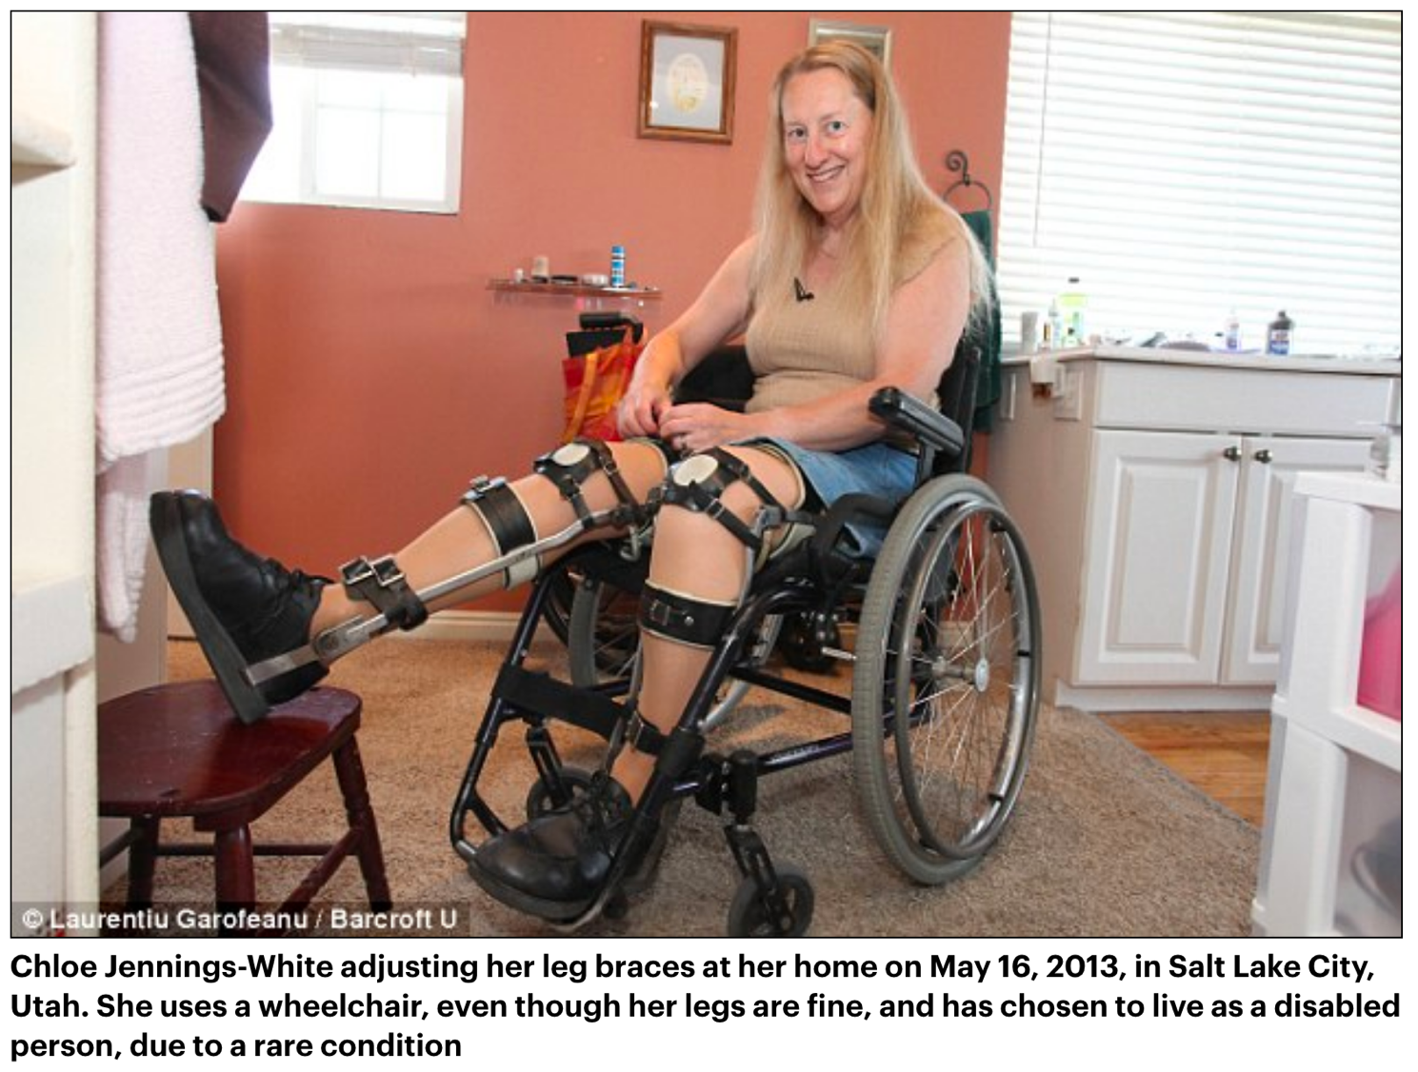
Wanting to Be Disabled
Notes:
She uses a wheelchair, even though her legs are fine!

Slide 73
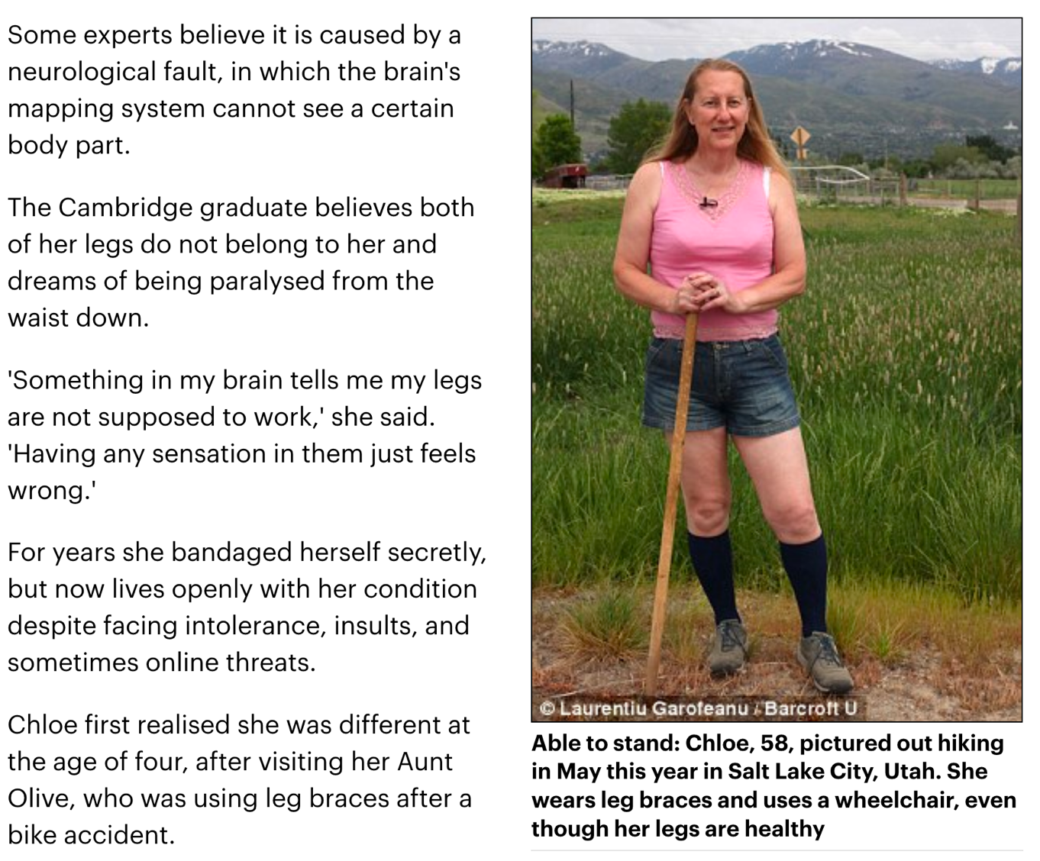
Wanting to Be Disabled
Notes:
She can walk as well as the rest of us.

Slide 74

Wanting to Be Disabled
Notes:
Crazy you say? Well, Chloe has indeed been diagnosed with a very rare psychiatric condition called Body Integrity Identity Disorder, or BIID for short. Sufferers believe that permanent disability is their natural, most comfortable state, as well as their destiny.

Slide 75

Body Integrity Identity Disorder (BIID)
Believer
Notes:
As believers, we are called to "walk in the Spirit." Yet many of us feel more "natural" or "comfortable" walking in the flesh. It's like voluntarily confining ourselves to a wheelchair when we could be climbing on the mountaintops. The notion is as foolish as it is spiritually unhealthy--a virtual form of BIID--"Believer" Integrity Identity Disorder!
"So I say, walk by the Spirit, and you will not gratify the desires of the flesh" (Galatians 5:16).
—From Illustration Exchange (2013)

Slide 76
How should you respond to the Spirit being in you?
Let the Spirit control you.

Slide 77


"Be controlled by the Spirit" (Eph 5:18)?
Notes:
What does it mean to be filled—or controlled by—the Spirit?
• Does being controlled by (filled with) the Holy Spirit mean that you no longer make any decisions—that you are simply a puppet on strings controlled by the Holy Spirit marionet master?

Slide 78
"Do you not know that your body is a temple of the Holy Spirit, who is in you, whom you have received from God? You are not your own; ²⁰you were bought at a price. Therefore honor God with your body"
(1 Cor 6:19-20 NIV).
Notes:
Actually, being controlled by the Spirit means allowing him to control your body—to honor him by treating your body with care since it is his temple.

Slide 79


ROMANS 12:2
BE TRANSFORMED
BY THE RENEWING OF YOUR MIND
Notes:
Also, being controlled by the Spirit means allowing him to control your mind…

Slide 80


ROMANS 12:2
And do not be conformed to this world,
but be transformed by the renewing of your mind,
that you may prove what is that good
and acceptable and perfect will of God.
Notes:
Allow him to transform your thinking by renewing your thoughts to be his thoughts!

Slide 81
How should you respond to the Spirit being in you?
Let the Spirit control you.
Let the Spirit teach you.

Slide 82
His indwelling guides us into all truth
"But when he, the Spirit of truth, comes, he will guide you into all truth…" (John 16:14)

Slide 83

How can you be more open to the Spirit's teaching ministry in your life?
Notes:
But how does he guide us into truth? He uses the Word of God. Are you in the Word every day?

Slide 84

Black on White
Notes:
Sometimes we get bogged down in certain parts of the Bible when we read straight through. In such cases I suggest that you use the Bible reading plan on the back of your notes. It varies the reading each day but still gets you through the whole Bible in one year. Why not commit to this and start today?

Slide 85

Free Bible Software
Smart Phone
YouVersion
AndBible
ESVBible
OliveTree
E-Sword
FaithLifeStudyBible (Logos)
Notes:
Some of us are more inclined to read on our phones. I suggest the YouVersion app, but others are also good.

Slide 86

Free Bible Software
Computer
Bible.org (NET Bible)
Blue Letter Bible
BibleGateway
E-Sword
FaithComesByHearing
OliveTree
Notes:
You might prefer using your computer. Bible.org is a great place to start.

Slide 87
Black

Slide 88


Topical Preaching • BibleStudyDownloads.org
Get this presentation and script for free!

