Slide 1
Immanuel: God With Us
God in Time
Dr. Rick Griffith • Crossroads International Church Singapore
BibleStudyDownloads.org • CICFamily.com

Slide 2
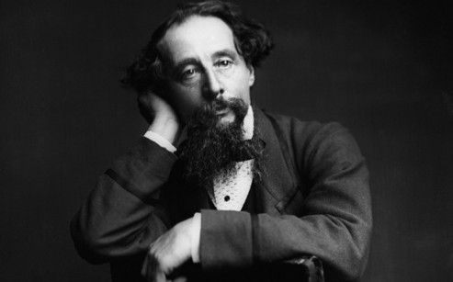
“It was the best of times, it was the worst of times…”
—Charles Dickens,
A Tale of Two Cities (1859)
Notes:
Such were the opening lines of the 1859 classic by Charles Dickens called A Tale of Two Cities. And those cities? The story is set in London and Paris before and during the French Revolution (1789-1799). He continued…

Slide 3
It was the best of times, it was the worst of times, it was the age of wisdom, it was the age of foolishness, it was the epoch of belief, it was the epoch of incredulity, it was the season of light, it was the season of darkness, it was the spring of hope, it was the winter of despair….
Notes:
Posted by Nolan Dalla on Nov 22, 2014 in Blog, Essays, Politics, What's Left | 0 comments
Are These the Best of Times or the Worst of Times?
http://www.nolandalla.com/best-times-worst-times/
Accessed 21 Dec 2018
It was the best of times, it was the worst of times,
it was the age of wisdom, it was the age of foolishness,
it was the epoch of belief, it was the epoch of incredulity,
it was the season of light, it was the season of darkness,
it was the spring of hope, it was the winter of despair….
If he were alive today, Charles Dickens would have plenty of things to write about.
Dickens’ most acclaimed novel, A Tale of Two Cities, depicted common life in London and Paris during the late 18th century. As troublesome as his stark portrayal was to readers during his day, the desperate plight of those earlier times now seems downright gentile compared to the lurking dangers and anxieties of living in a seemingly dystopian modern world now filled with nuclear weapons, global terrorism, and the outbreak of killer epidemics.
In so many ways, it seems we are living in the worst of times. If there’s any doubt, take a look around. Generations before never had to worry about crazed fanatics crashing airplanes into skyscrapers, or releasing biological or chemical weapons into our major cities. Our ancestors lived mostly quiet lives on farms or in urban centers and kept to themselves. They had much simpler lives. Sundays were for church. No one needed a Xanax. Sure, daily life wasn’t always a picnic for ordinary people. Life could certainly be hard. Then again, the average medieval villager never had to endure a TSA search or suffer an IRS audit.
So then, it would seem these are — the worst of times.
But are they really? Let’s think about that for a moment.
Actually, the answer is — no.
In fact, these are the best of times — and by a very wide margin. Living conditions are constantly improving by leaps and bounds each and every year. People are much healthier and safer now than in yesteryear. As hard as this might be to fathom given all we read and hear about all the horrible things going on in the world, compare the status of people living today with any other time in history.
In today’s essay, I shall do precisely that:
GENERAL HEALTH AND WELFARE — Science has eradicated horrible diseases that used to kill and cripple millions. Smallpox, polio, malaria, measles, and many other infectious pathogens which once posed the greatest danger to human life on earth are now all but wiped out. And so long as science continues to make progress (make that, is allowed to proceed in the face of religious opposition), we’ll eventually put an end to other harmful ailments, as well.
Think about this: Even with the sicknesses we can’t cure yet, science through various medications and treatments can still prolong life and make living far more comfortable for those who would have suffered horrible pain in previous times. Even the dying have it better now than before.
FOOD/NUTRITION — People all over the world are eating better now than at any time in history. Starvation and malnutrition used to be commonplace on every continent. While some areas continue to suffer due mostly to overpopulation, the vast majority of the world’s people have never enjoyed better, more balanced diets. In fact, the problem within many developing countries today is the opposite — one of obesity. The diversity of plentiful food products, GMOs, and a globalized network of efficient transportation and delivery systems has enabled most of us to enjoy unparalleled nutritional sustenance.
Think about this: There used to be just one kind of spaghetti sauce. Now, go to a grocery store. Or better yet, a specialty market. There are scores of different flavors available — from sweet to spicy, from meat to vegetarian, from low-fat to gourmet. Food isn’t just more plentiful, it’s also more enjoyable since it’s customized to different tastes.
WAR AND PEACE — Terrible things are certainly happening in the world today. But while we focus on the images that shock us, like beheadings and other horrible acts of violence, more people are actually living in peacetime than ever before. For centuries, Europe was a basket case of conflicts. Now, war between former rivals would be unthinkable. Tribal conflicts that once produced misery for millions have diminished significantly. Consider that a century ago World War I killed 20 million. After that, World War II killed another 60 million. Then, there was the stalemate of the Cold War that could have wiped out the entire planet. While we do face serious threats to peace and some parts of the world remain entangled in chaos, most of the regions of North America, South America, Europe, and Asia aren’t plagued by wars, deaths, and mass population displacement.
Think about this: A few generations ago, all able-bodied adult males in just about every nation would have been compelled serve in the military, and if commanded by superiors, to go off to war, fight in battle, and die. That was the prevailing ethos of all countries and a prerequisite stage for gradual acceptance, even in the most advanced societies. Today, increasing numbers of countries continue to demilitarize.
PERSONAL SAFETY — Our ancestors were faced with constant danger, from being attacked by wild animals to dying from insect bites. Once we eventually began gathering and living together in groups, next we faced the threat of neighboring tribes and fiefdoms invading our space, murdering our families, and stealing our goods. A large segment of the world’s population living on all continents also had to fear being turned into slaves. In more recent times, undeveloped territories were just as dangerous. Cities and towns were centers of violence. Today, most of the world’s population enjoys daily lifestyles where threats to personal safety are minimal.
Think about this: Violent crime in America has been decreasing steadily over the past 20 years. There are similar statistics for most parts of Latin America, Europe, and Asia.
QUALITY OF LIFE — Our ancestors froze in colder climates and were forced to endure sweltering heat during the hottest months. Daily life became a arduous ritual simply to stay warm, keep cool, and be as comfortable as possible. Now thanks to heating and air conditioning, everyplace from our homes to our workplaces to our places of leisure to out transportation systems to our cars are now climate controlled. This advance goes for every developed nation on earth, even in regions with constant turmoil. Counteracting what was once an environmental nuisance has led to increased quality of life for just about everyone. That’s just one measure of how things are much better now than before.
Think about this: The construction of sewers and major advances in waste water treatment has saved millions of lives from infectious disease. Cities would be virtually unlivable today were it not for the modern infrastructure of what we now take for granted — conveniences like toilets, sinks, baths, and showers which constantly recycle fresh water into our lives for readily use. Fortunately, these advances continue in the Third World, which will make the lives of those people better.
INFORMATION/COMMUNICATION — We’ve gone from living in a world where very little of what goes on was recorded or shared, to a virtual world of constant circulation and interaction. With the explosion in numbers of smart phones and social networks, what happens now will almost certainly be captured as an image and shared with the rest of the world. What used to take hours or perhaps even days to disperse now takes just seconds. We now benefit from things like weather and storm warnings to announcements about what’s on sale at the local department store.
Think about this: At this instant, you can text a message to someone positioned on the other side of the world and communicate directly with that person in the form of a conversation. A decade ago, such a conversation would have required a costly long-distance telephone call. A century ago, it would have required a telegram that taken a few days to receive. Before that, global interaction would have been impossible.
ENTERTAINMENT OPTIONS/LEISURE TIME — Most of the world enjoys more free time than ever before. Most modern nations have adapted a 40-hour work week. The most progressive nations even require time off for vacation. This has created more television stations and programs, more movies in different languages, a greater variety of music, more things to read, and in short, more leisure options than we’ve ever been able to enjoy. The rise in popularity of spectator sports (now in just about every nation) is perhaps the best example of more people with more free time on their hands. On the Internet, there are websites for every interest and taste. There’s so much information out there now, it’s become a big challenge to decipher fact from fiction.
Think about this: Advances in machinery and technology have even given many of us more leisure time in the workplace. We no longer have to dig out coal mines by pick and shovel when there are now specialized gadgets to perform the labor with the pull or a level or press of a button. Meanwhile, the heavy machinery operator can listen to music on his iPod.
TRAVEL — In the middle ages, most people never traveled outside the 20-mile radius from where they were born and raised. A trip to another town or village was a really big deal. Now, we’re become thoroughly mobile. We can be anywhere in the world within just a day. We can move around and pack our belongings to any country where we want to live. This convenience of mobility forces us to interact with each other more and inevitably creates relationships which benefit everyone.
Think about this: Not only is travel more readily available to everyone, it’s also much cheaper. Transportation used to be cost prohibitive for many people. Crossing an ocean was limited only to the rich and those who went off to war. Now, with such a vast network of cars, buses, trains, ferries, airplanes, and other mass movers of people, just about anyone can travel a reasonable distance for an affordable cost.
ENLIGHTENMENT — One upon a time, all human thought was restrained. All intellectual pursuit emanated from a political or religious authority, which were often one and the same. The freedom to pursue invention or creativity was non-existent. While such institutionalized retardation continues to afflict many parts of the world, more people in more nations are now able to think freely and pursue paths of self-enlightenment. This is due to increasing networks of information, the frailty of governments to restrict thought and behavior, and the declining role religion and superstition in many modern societies.
Think about this: If you are female, a person of color, or gay — multiply all of the above many times over. Most of the people within these classes, which far outnumbers the rest of the population, lacked the freedoms of opportunities most enjoy today. Discrimination, prejudice, bigotry, and sexism were both ritualized and institutionalized. This made the pursuit of happiness all but impossible for a majority of people on the planet.
Is everything great now? Or course not.
Open up a newspaper, turn on the television, or click a website on the Internet, and the world seems to be falling part. But it really isn’t.
While most of the world is getting better, our perception of what goes on is clouded by the constant ringing of alarm bells. What we’ve actually become is more connected and increasingly aware. Even the news of a teenager harming a kitten will most certainly outrage the world and get million of hits on Facebook. Instances of evil are not increasing, but our awareness of them is.
So long as we continue to care about what goes elsewhere, we’re in pretty good shape. So long as we still concern ourselves with people and places we don’t know, that’s a very good thing. The harbinger of compassion is wisdom.
Even Charles Dickens would have to agree. These are the best of times. And as crazy as it seems, they’re likely to get even better in the future.
Special thanks to Mr. Tony Mangnall who prompted this topic of discussion in a lively debate in a Pittsburgh bar which included lots of alcohol.

Slide 4
What time is it in your life right now?
Notes:
Are you experiencing the best of times?
Is your marriage or situation at home thriving?
Perhaps work is going better than it has in a long time.
Maybe you’re experiencing an increased joy!
Or are you experiencing the worst of times?
Things at home are a real struggle.
Or you need a new line of work.
Or a cloud hangs over you.

Slide 5
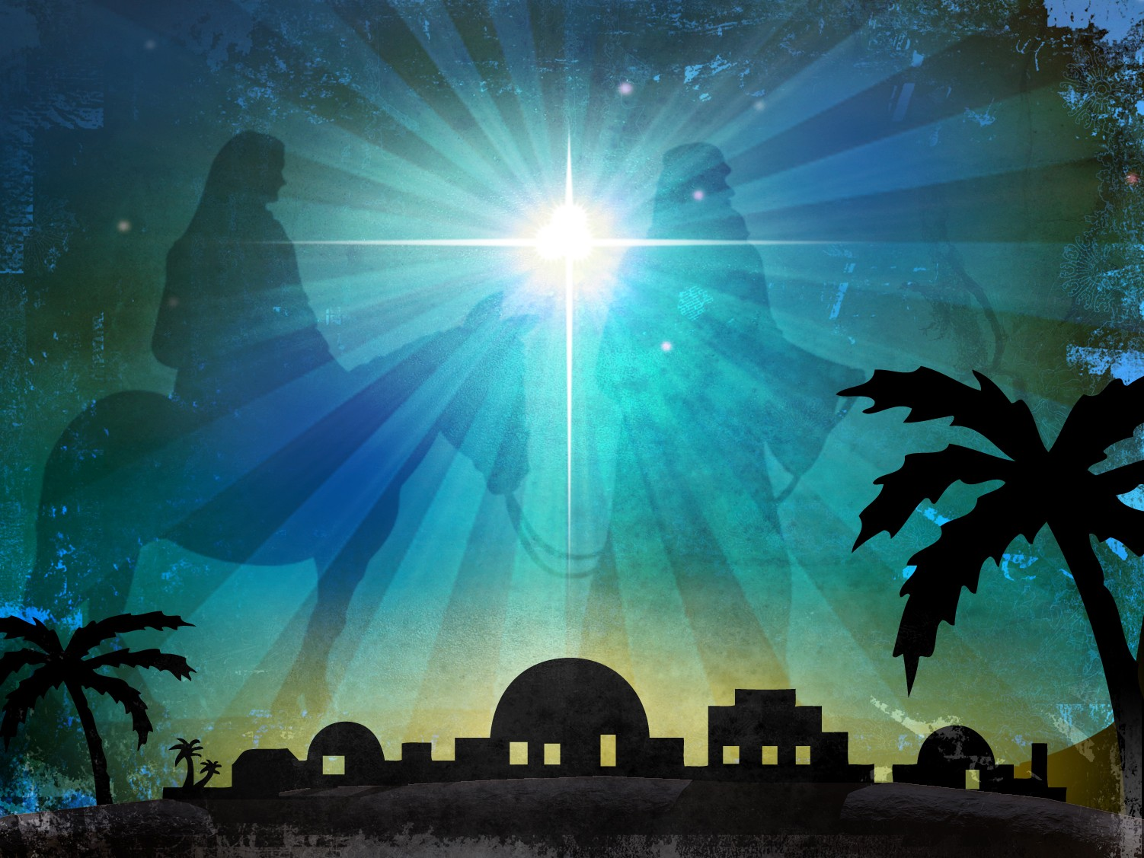
Why did God send Jesus when he did?
Notes:
Today we address the concept of time in relation to the original Christmas. We will answer this question: Why did God send Jesus when he did?

Slide 6
Immanuel: God With Us!
Notes:
Our three-week Christmas series this month will seek to unpack the meaning of "Immanuel: God With Us”

Slide 7
Notes:
The word “Immanuel” comes from Isaiah 7:14 where God promised that a virgin would conceive a baby boy. It would be so amazing that he would be called “God with us”!

Slide 8
God in…
Place
Notes:
Our three-week Christmas series this month seeks to unpack the meaning of "Immanuel: God With Us” by answering these questions:
• God in Place was week 1. Why Bethlehem? Why did God choose this place for Jesus to arrive? Last week we saw that the answer the “where” question was that Bethlehem was the perfect place for Jesus to enter this world.

Slide 9
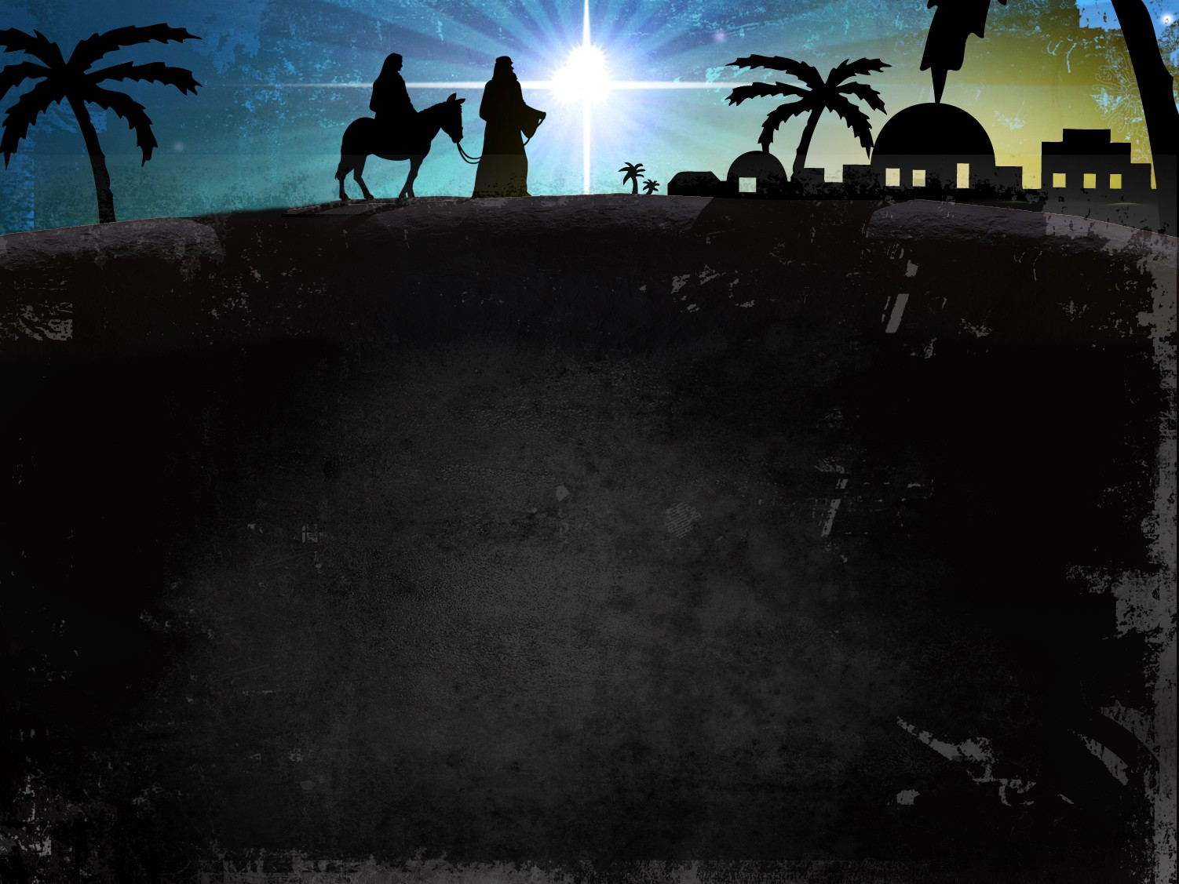
Why Bethlehem? Why did God choose this place for Jesus to arrive?
Notes:
Why did God select Christ to be born in Bethlehem?

Slide 10
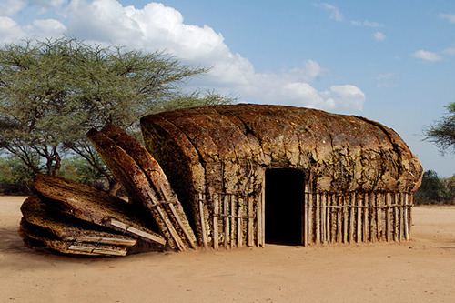
Bethlehem = "House of Bread"
Notes:
This town had a positive name—house of bread—but a shameful reputation.

Slide 11
Main Idea Last Week:
God transforms our shame into honor.

Slide 12
God in…
Place
Time
Us
Notes:
• God in Time is this week. Why then? Why did Jesus come at the time he did? We will answer the “When” question.
• God in Us is week 3. Why within? We will answer the “How” question to see how God works.

Slide 13
Why did God send Jesus when he did?
Notes:
Today we address the concept of time in relation to the original Christmas. We will answer this question: Why did God send Jesus when he did?

Slide 14
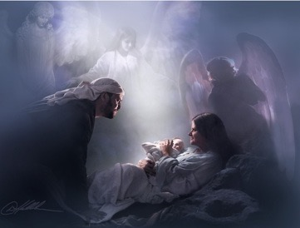
Today’s Preview:
God’s Eternal Perspective
Christ’s Birth
You
Notes:
Today we will try to look at the Christmas story from the perspective of God’s timing.
• We will start big with God’s view in eternity
• Then we will narrow it to the timing of Christ’s birth
• Finally, we will see where it shows up for us today.
(So what is the “big view” that must we know before we can see God’s timing in sending Jesus? It is simply that…)

Slide 15
I. God rules over time between the two eternities.
Notes:
The LORD invented time itself to function between eternity past and future.

Slide 16
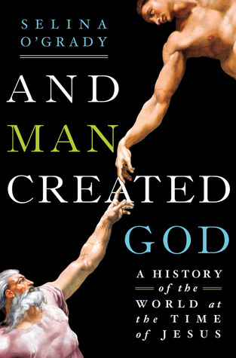
Blasphemy Today
Notes:
Sadly, one recent author has turned it around and claimed that man created God.
______
https://www.goodreads.com/book/show/15793193-and-man-created-god
Hardcover, 416 pages
Published March 26th 2013 by St. Martin's Press (first published September 1st 2012)
ISBN
1250016819 (ISBN13: 9781250016812)
Edition Language
English
URL
http://us.macmillan.com/andmancreatedgod/SelinaOGrady

Slide 17
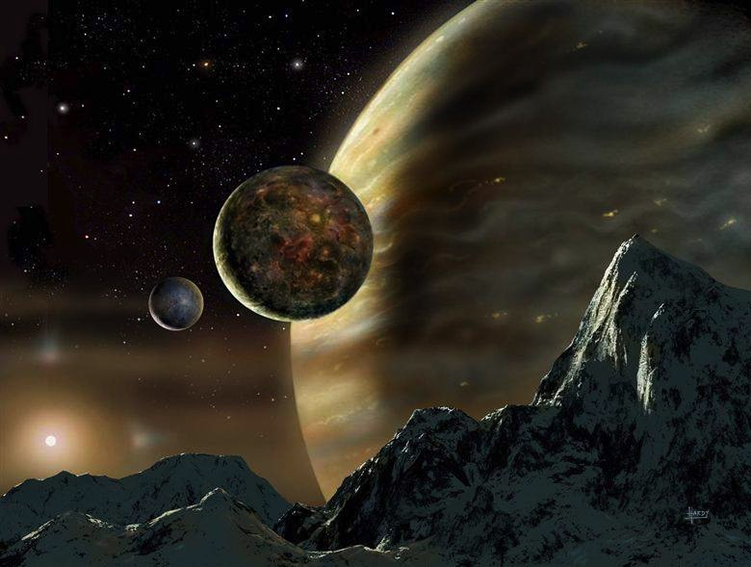
The Consummation of All Things
448
Genesis 1–3
Revelation 20–22
"In the beginning God created the heavens and the earth" (1:1)
"Then I saw a new heaven and a new earth" (21:1)
Notes:
But the first three chapters of Scripture have many parallels in the last three chapters.

Slide 18
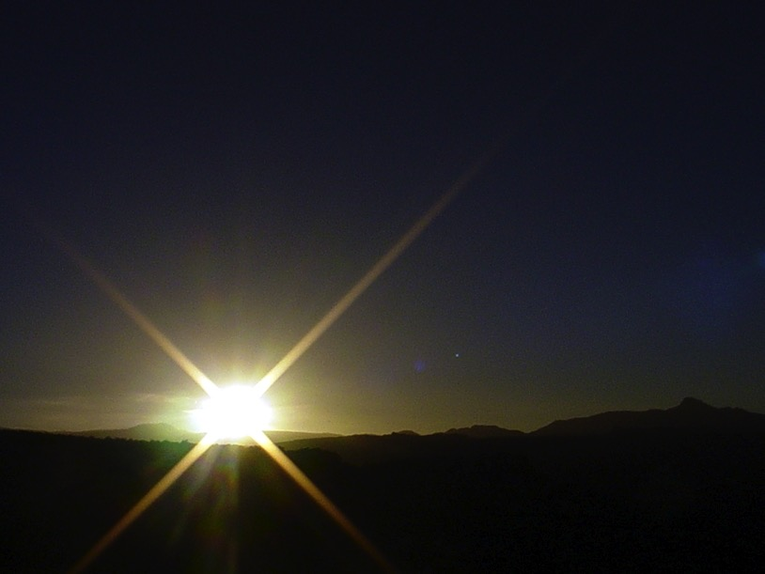
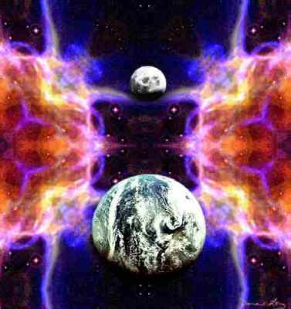
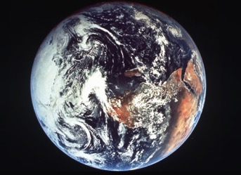
The Bible's Chiasm
446
Repeated Patterns in Reverse Order
Christ's Redemption
Christ's Rule
Man's Rule Lost at Fall
Man's Rule Restored at Millennium
Creation
New Creation
Notes:
• Creation in Genesis 1–2
• is repeated In the Restored, New Creation in Rev 21–22
• Man was created to rule over the fish, birds, and land animals (Gen. 1:28) but he gave over his rule over to the god of this world, Satan (2 Cor. 4:4)
• However, this rule will be restored during the 1000-year reign of the saints (Rev. 20:4-6)
• But Christ is the central Person of history:
• in his first coming as Lamb (Redeemer)
• and in his second coming as Lion (Ruler of all creation in the line of David)

Slide 19
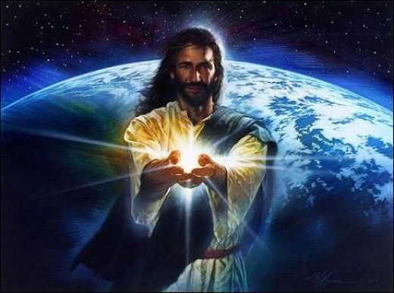
Jesus is Creator!
Notes:
If you are just getting to know about Jesus, you may be surprised to learn that the Bible says that Jesus is Creator God! Really!

Slide 20
John 1:3
JOHN: SUMMING UP THE MESSAGE
CHAPTER 1: 6 GREAT TRUTHS OF
JESUS CHRIST!
VERSE 1: The Pre-existent One
A Distinct Person
He Was and IS God
VERSE 2: Eternally Co-existent
"Through him all things were made; without him nothing was made that has been made."
VERSE 3: Creator of the Universe
25
1
Notes:
Verse 3: He is the Creator of the Universe…
//// "Through him all things were made; without him nothing was made that has been made."

Slide 21
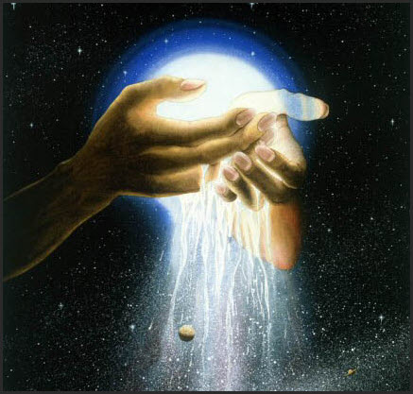
Colossians 1:15
"Christ is the visible image of the invisible God. He existed before anything was created and is supreme over all creation."
Colossians 1:15 (NLT)

Slide 22
Colossians 1:16-18
"For by Him all things were created: things in heaven and on earth, visible and invisible, whether thrones or powers or rulers or authorities; all things were created by Him and for Him. He is before all things, and in Him all things hold together. And He is the head of the body, the church; He is the beginning and the firstborn from the dead, so that in everything He might have the supremacy."
Colossians 1:16-18 (NIV)

Slide 23
Hebrews 1:1-2 NLT
"Long ago God spoke many times and in many ways to our ancestors through the prophets. ²And now in these final days, he has spoken to us through his Son. God promised everything to the Son as an inheritance, and through the Son he created the universe."
Notes:
(But let’s get back to our original question—why did God send Jesus when he did?)

Slide 24
Why did God send Jesus when he did?
Notes:
What was God’s purpose in sending Jesus 2000 years ago? Why not 3000 years ago? 1000? Why didn’t he send him this year, for that matter?

Slide 25
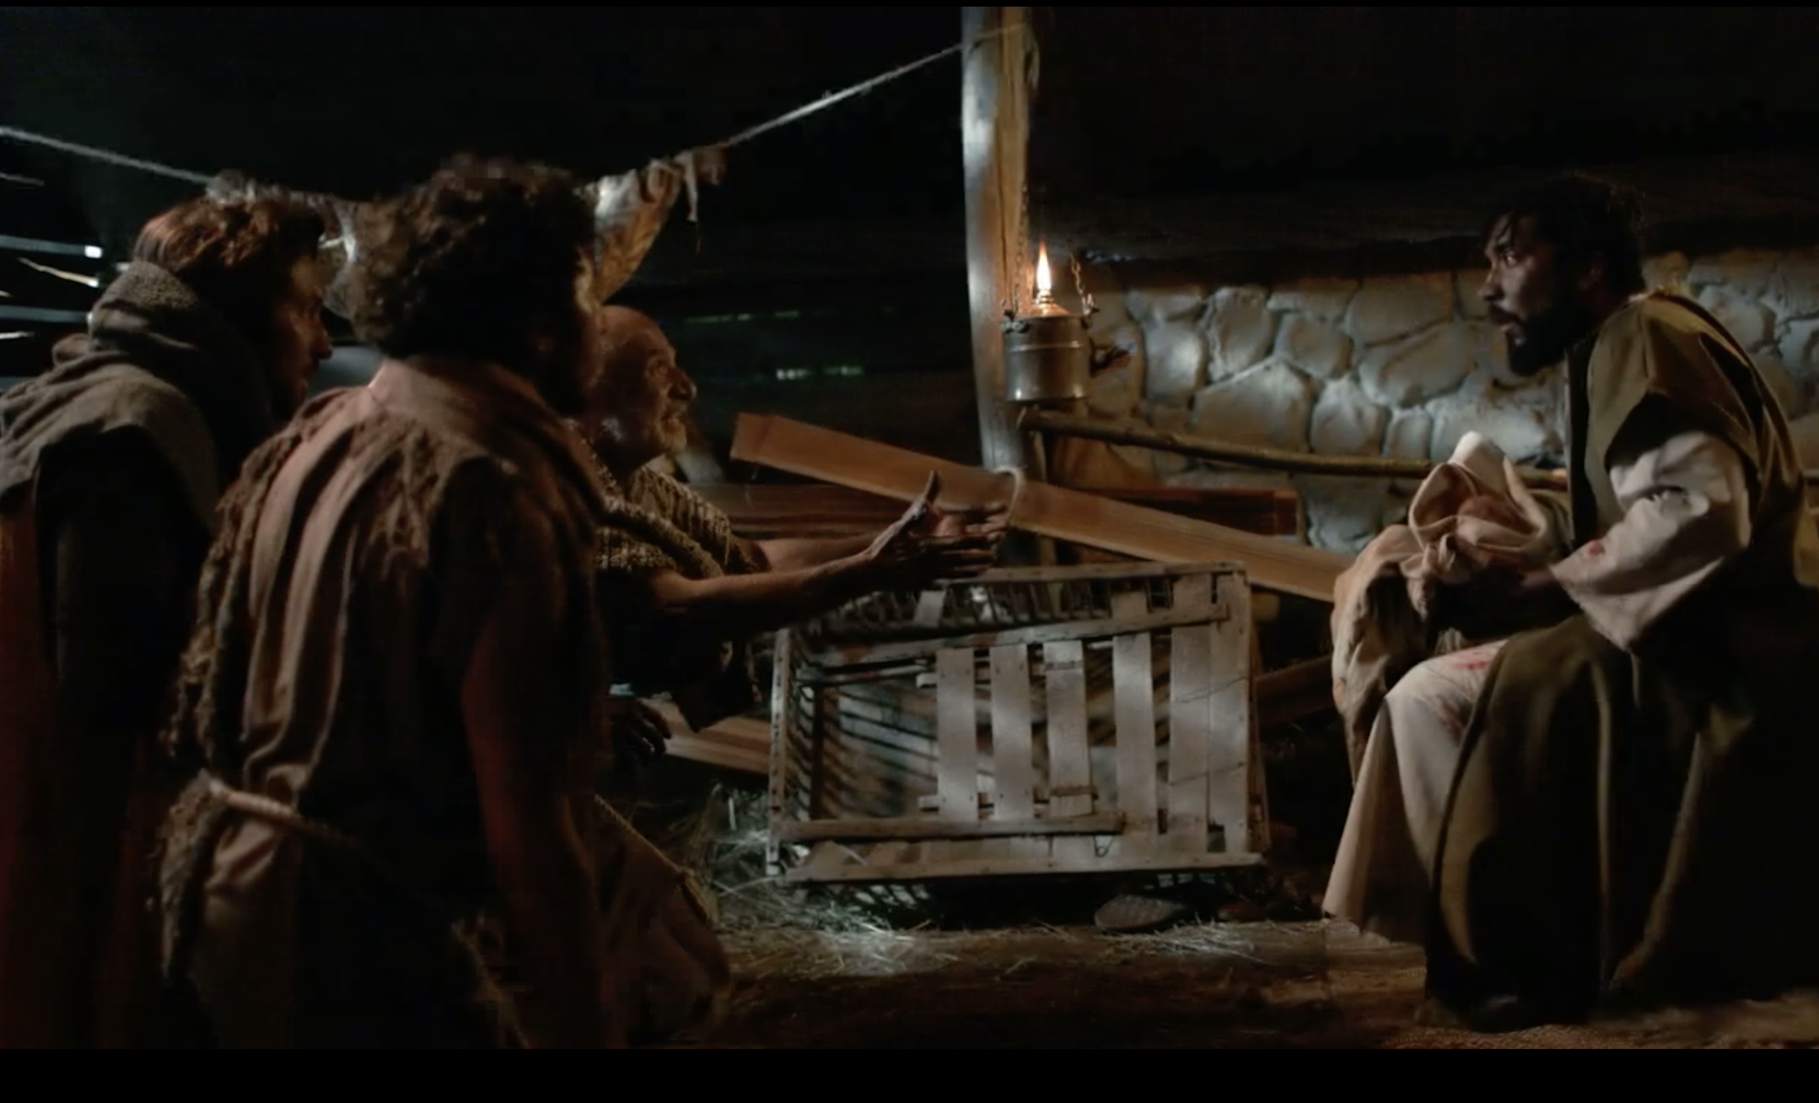
II. God sent Jesus at just the right time (Gal 4:4-5).
Notes:
He could have had Jesus born earlier or later—but neither time was better.

Slide 26
Slides on Galatians 4
Notes:
In Galatians 4 Paul gives illustrations of justification by faith to convince the Galatians to abandon legalism (Gal 4).

Slide 27
"Think of it this way. If a father dies and leaves an inheritance for his young children, those children are not much better off than slaves until they grow up, even though they actually own everything their father had" (Gal 4:1 NLT).

Slide 28
"They have to obey their guardians until they reach whatever age their father set. ³And that’s the way it was with us before Christ came. We were like children; we were slaves to the basic spiritual principles of this world" (Gal 4:2-3 NLT).
Notes:
One write explains it this way: “4:3. Paul applied the illustration in order to show the contrast between the believers’ former position and what they now enjoyed. Formerly, in their state of spiritual immaturity (when we were children…), they were like slaves. The scope of that slavery was described as being under the basic principles (… “elements”) of the world. Though often interpreted as a reference to the Mosaic Law, this view does not fit the Galatians, most of whom were Gentile pagans before conversion and were never under the Law. It seems better to understand the “basic principles” to refer to the elementary stages of religious experience, whether of Jews under the Law or Gentiles in bondage to heathen religions (cf. “weak and miserable principles” in v. 9, and “basic principles of this world” in Col. 2:20) Thus all were enslaved until Christ emancipated them” (Donald K. Campbell, “Galatians,” in The Bible Knowledge Commentary, 2:601).

Slide 29
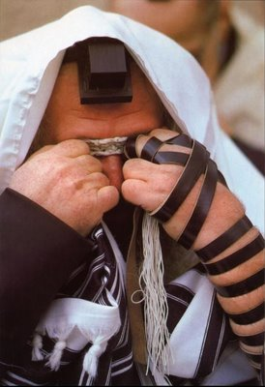
"We were slaves to the basic spiritual principles of this world" (Gal 4:3b NLT).
Is this the Mosaic Law or man’s ceremonial religion?
Notes:
It actually seems to refer to both! It is a broader way of saying that the incarnation (God becoming flesh in the next verse) allowed Jesus to fulfill the Law (cf. Matt 5:17). So we are no longer slaves to obey the OT commandments given to Israel, such as circumcision (5:1-4).
But we are also no longer slaves to Gentile religious demands either, such as salvation by works that Paul fights in Galatians.

Slide 30
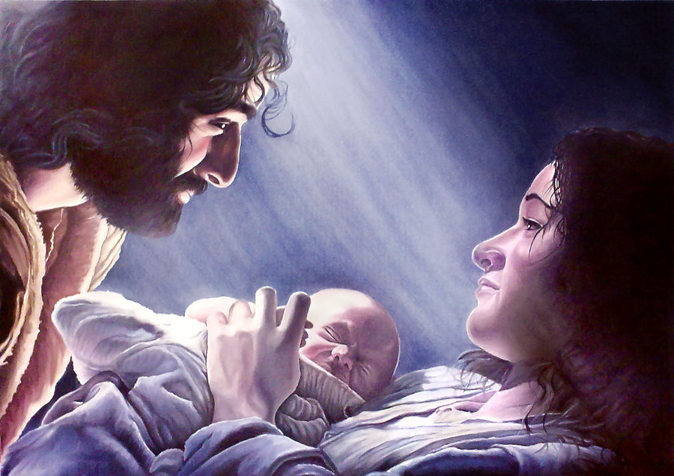
"But when the right time came, God sent his Son, born of a woman, subject to the law" (Gal 4:4 NLT).
Notes:
God’s timing is always perfect. He prepared the world perfectly up to that very first Christmas night! Jesus was not conceived by a man since he was virgin born, but he was born of a woman. In this verse we see the two natures of Christ: his deity as the Son of God (“God sent his Son”) and his humanity “born of a woman.” In this dual sense he was subject to the Mosaic Law in his humanity, yet in his deity he was able to deliver us all from slavery to the Law as in the next verse…

Slide 31
"God sent him to buy freedom for us who were slaves to the law, so that he could adopt us as his very own children" (Gal 4:5 NLT).
Two reasons “God sent his son” (4:5):
To redeem us from slavery to the Mosaic Law
To give us “the full rights of sons” (NIV)
Notes:
One scholar notes, “4:5. The reasons “God sent His Son” are twofold… First, He came to redeem… those under Law… Since Christ redeemed and set free those who were under the Law, why should Gentile converts now wish to be placed under it? Second, Christ’s Incarnation and death secured for believers the full rights of sons (“the adoption of sons,” KJV). All the enjoyments and privileges of a mature son in a family belong to those who have entered into the benefits of Christ’s redemptive work” (Donald K. Campbell, “Galatians,” in The Bible Knowledge Commentary, 2:601).

Slide 32
"But when the right time came, God sent his Son, born of a woman, subject to the law" (Gal 4:4 NLT).

Slide 33
The Intertestamental Era (425 BC—5 BC)
10
Issue /
Time Period
Malachi
(close of OT)
Intertestamental Era
Advent of Christ
Rulers Over Israel
Persia
(208 yrs.)
Greeks (188 yrs.)
Hasmoneans (80 yrs.)
Rome
(58 yrs.)
Political Stability
Peace / autonomy
Many wars
(Dan. 11:1-35)
Peace (but via Rome!)
Expectation of Messiah & Kingdom
Moderate
Increasing
“Two Messiahs”
High
Language in Israel
Hebrew / Aramaic
Greek (Septuagint)
Aramaic / Greek / Latin
Notes:
Let’s see how God prepared the world for Jesus in the 400 years between the Old Testament and the New Testament, often called the “Intertestamental Era.”
“1) Rome had unified much of the world under its government, giving a sense of unity to the various lands.
2) Because the empire was relatively peaceful, travel was possible, allowing the early Christians to spread the gospel. Such freedom to travel would have been impossible in other eras. 3) There was a great anticipation among the Jews of that time that the Messiah would come. The Roman rule over Israel made the Jews hungry for the Messiah’s coming. 4) While Rome had conquered militarily, Greece had conquered culturally. A “common” form of the Greek language (different from classical Greek) was the trade language and was spoken throughout the empire, making it possible to communicate the gospel to many different people groups through one common language.
____________________________ ALSO (Omit) 4) The fact that the many false idols had failed to give them victory over the Roman conquerors caused many to abandon the worship of those idols. At the same time, in the more “cultured” cities, the Greek philosophy and science of the time left others spiritually empty in the same way that the atheism of communist governments leaves a spiritual void today. 5) The mystery religions of the time emphasized a savior-god and required worshipers to offer bloody sacrifices, thus making the gospel of Christ which involved one ultimate sacrifice believable to them. The Greeks also believed in the immortality of the soul (but not of the body). 6) The Roman army recruited soldiers from among the provinces, introducing these men to Roman culture and to ideas (such as the gospel) that had not reached those outlying provinces yet. The earliest introduction of the gospel to Britain was the result of the efforts of Christian soldiers stationed there.”
__________
All the above from What does it mean that God sent Jesus in the "fullness of time"?
https://www.gotquestions.org/fullness-of-time.html
Accessed 21 Dec 2018

Slide 34
The Intertestamental Era (3 slides)
The Intertestamental Era (425 BC—5 BC)
10
Issue /
Time Period
Malachi
(close of OT)
Intertestament Era
Advent of Christ
Ability to Evangelize
Limited
Increased
Extensive
Road System
Very Limited
Expanded
Extensive
Places of Worship
Temple only
Rise of Synagogues
Synagogues / Temple
Religious Leaders
Priests / Levites
Rise of Jewish Sects
Pharisees / Sadducees
Notes:
The early Christians like Paul traveled the entire Roman Empire and shared the gospel in Greek, which they could not have done earlier.
The roads they used were the best of antiquity. Even Martin Luther 1500 years later had worse roads to spread the news!
Gentiles were able to worship as “God fearers” in the synagogues—men like Cornelius, the firs Gentile Christian (Acts 10).
The confusing leadership system of Jews with Pharisees and Sadducees motivated the people to want to know the truth

Slide 35
The Intertestamental Era
The Intertestamental Era (425 BC—5 BC)
10
Issue /
Time Period
Malachi
(close of OT)
Intertestament Era
Advent of Christ
Priesthood achieved by . . .
Genealogy
Fighting illegitimate high priest
Bribes / Executions
Extent of Power
Local Jurisdiction
Rise of Sanhedrin
Corrupt Sanhedrin
Hermeneutic
Literal
Instable + Apocalyptic
Letterism
Authority
OT Law
Rise of Oral Law
Pharisees
Notes:
The corrupt priesthood helped the people long for the pure, High Priest named Jesus
The corrupt Sanhedrin showed Israel that they needed a new leader in the Messiah, Jesus
The Jews not even knowing how to interpret the Bible was seen in them following the letter of the Law rather than its true intent. For example, Deut 6 says to tie God’s Word on their hands and heads, so Pharisees followed the letter by strapping Bible verses on their foreheads and hands but never obeyed them!
This rise in the oral law of the Pharisees helped people to long for the true Word from the lips of Jesus.

Slide 36
The “Kingdom Stage” was Set!
10
The time was right:
Galatians 4:4 NIV
“But when the time had fully come, God sent his Son, born of a woman, born under law, to redeem those under law, that we might receive the full rights of sons.”
Politically
Prophetically
(Dan. 9:25-26)
Linguistically
Emotionally
Religiously
Transportationally
Notes:
• Politically, they were tired of Rome
• Linguistically, they had the Greek language to spread the gospel everywhere
• Religiously, their anticipation of Messiah had never been greater
• Prophetically, Daniel predicted Messiah’s presentation to the nation on 30 March AD 33
• Emotionally, the people were exhausted trying to obey the written law and oral law
• Transportationally (not a real word!), they had roads better than the next 1500 years to spread the good news!
• No wonder Paul wrote that the time had fully come (Gal 4:4)!

Slide 37
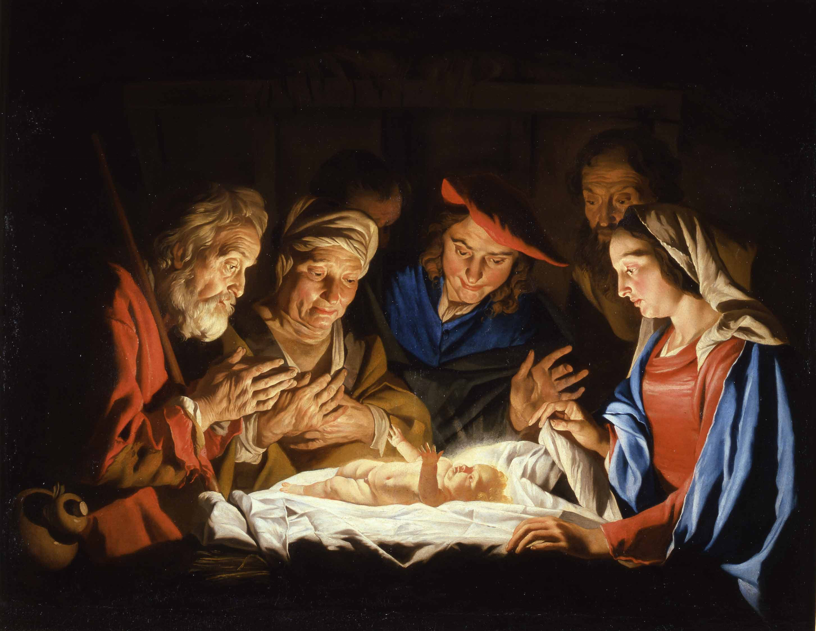
But how does God’s timing for Christ’s arrival relate to me?
Notes:
So this was the perfect time for Jesus to come, you ask. But how does that relate to me? Well…

Slide 38
III. God’s timing is perfect for you too.
Notes:
He has your life right on schedule, never being early, never being late.

Slide 39
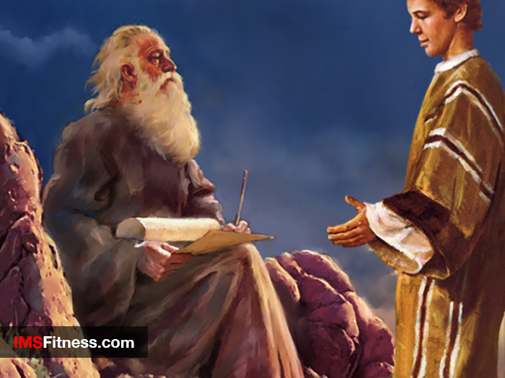
How have you seen God’s timing in your life?
Notes:
The Law was a tutor to lead us to Jesus (cf. Gal 3:24-25), so at Christmas we celebrate his coming to free us from the Law. Just a tutor fulfills his purpose once the student grows into adulthood, so now we lay aside the Law as grown sons ready to receive our rights as sons!

Slide 40
Infant | Grown Son
Under guardian (Law) | Enjoys son-with-father relationship (redeemed)
Status: like a slave with rights of sonship not realized | Status: son and heir with full rights given
Under bondage: external authority of the Law | Free: internal authority of the Spirit of God
Immature: in elementary school of the Law with external motivation | Mature: in secondary school of the Spirit with internal motivation
173c
Ceremonial vs. True Religion (Gal. 4:1-7)
Paul A. Pomerville, Galatians & Romans (Brussels: ICI, 1976), 95
Notes:
A son’s privileges over a slave’s shows a believer's faith over the Law (4:1-11).
In infancy, the son looks like a slave because he has to follow many of the same rules—don’t throw food, don’t talk back, etc.
However, when the infant son grows up, his relationship with the father no longer looks like that of the grown slave. The son owns the estate!

Slide 41
"So be careful how you live. Don’t live like fools, but like those who are wise. ¹⁶Make the most of every opportunity in these evil days. ¹⁷Don’t act thoughtlessly, but understand what the Lord wants you to do" (Eph 5:15-17 NLT).
"Therefore be careful how you walk, not as unwise men but as wise, ¹⁶making the most of your time, because the days are evil. ¹⁷So then do not be foolish, but understand what the will of the Lord is" (Eph 5:15-17 NAU).
Notes:
The New American Standard Updated (1995) gives the more literal sense.
How do you “walk carefully” (cf. KJV)?
The two commands here are “be careful” and “do not be foolish.”
You show care and wisdom by making the most of your time.
And you use your time wisely because many live in sin! These truly are evil days.

Slide 42
How can you “redeem the time”?

Slide 43
Why did God send Jesus when he did?
Notes:
So back to our original question…

Slide 44
Main Idea
God’s timing is always perfect.
Notes:
He is rarely early and never late—but always on time.

Slide 45
I. God rules over time between the two eternities.
Notes:
The LORD invented time itself to function between eternity past and future.

Slide 46
II. God sent Jesus at just the right time (Gal 4:4-5).
Notes:
He could have had Jesus born earlier or later—but neither time was better.

Slide 47
III. God’s timing is perfect for you too.
Notes:
He has your life right on schedule, never being early, never being late.

Slide 48
How can you better submit to God’s timing?

Slide 49
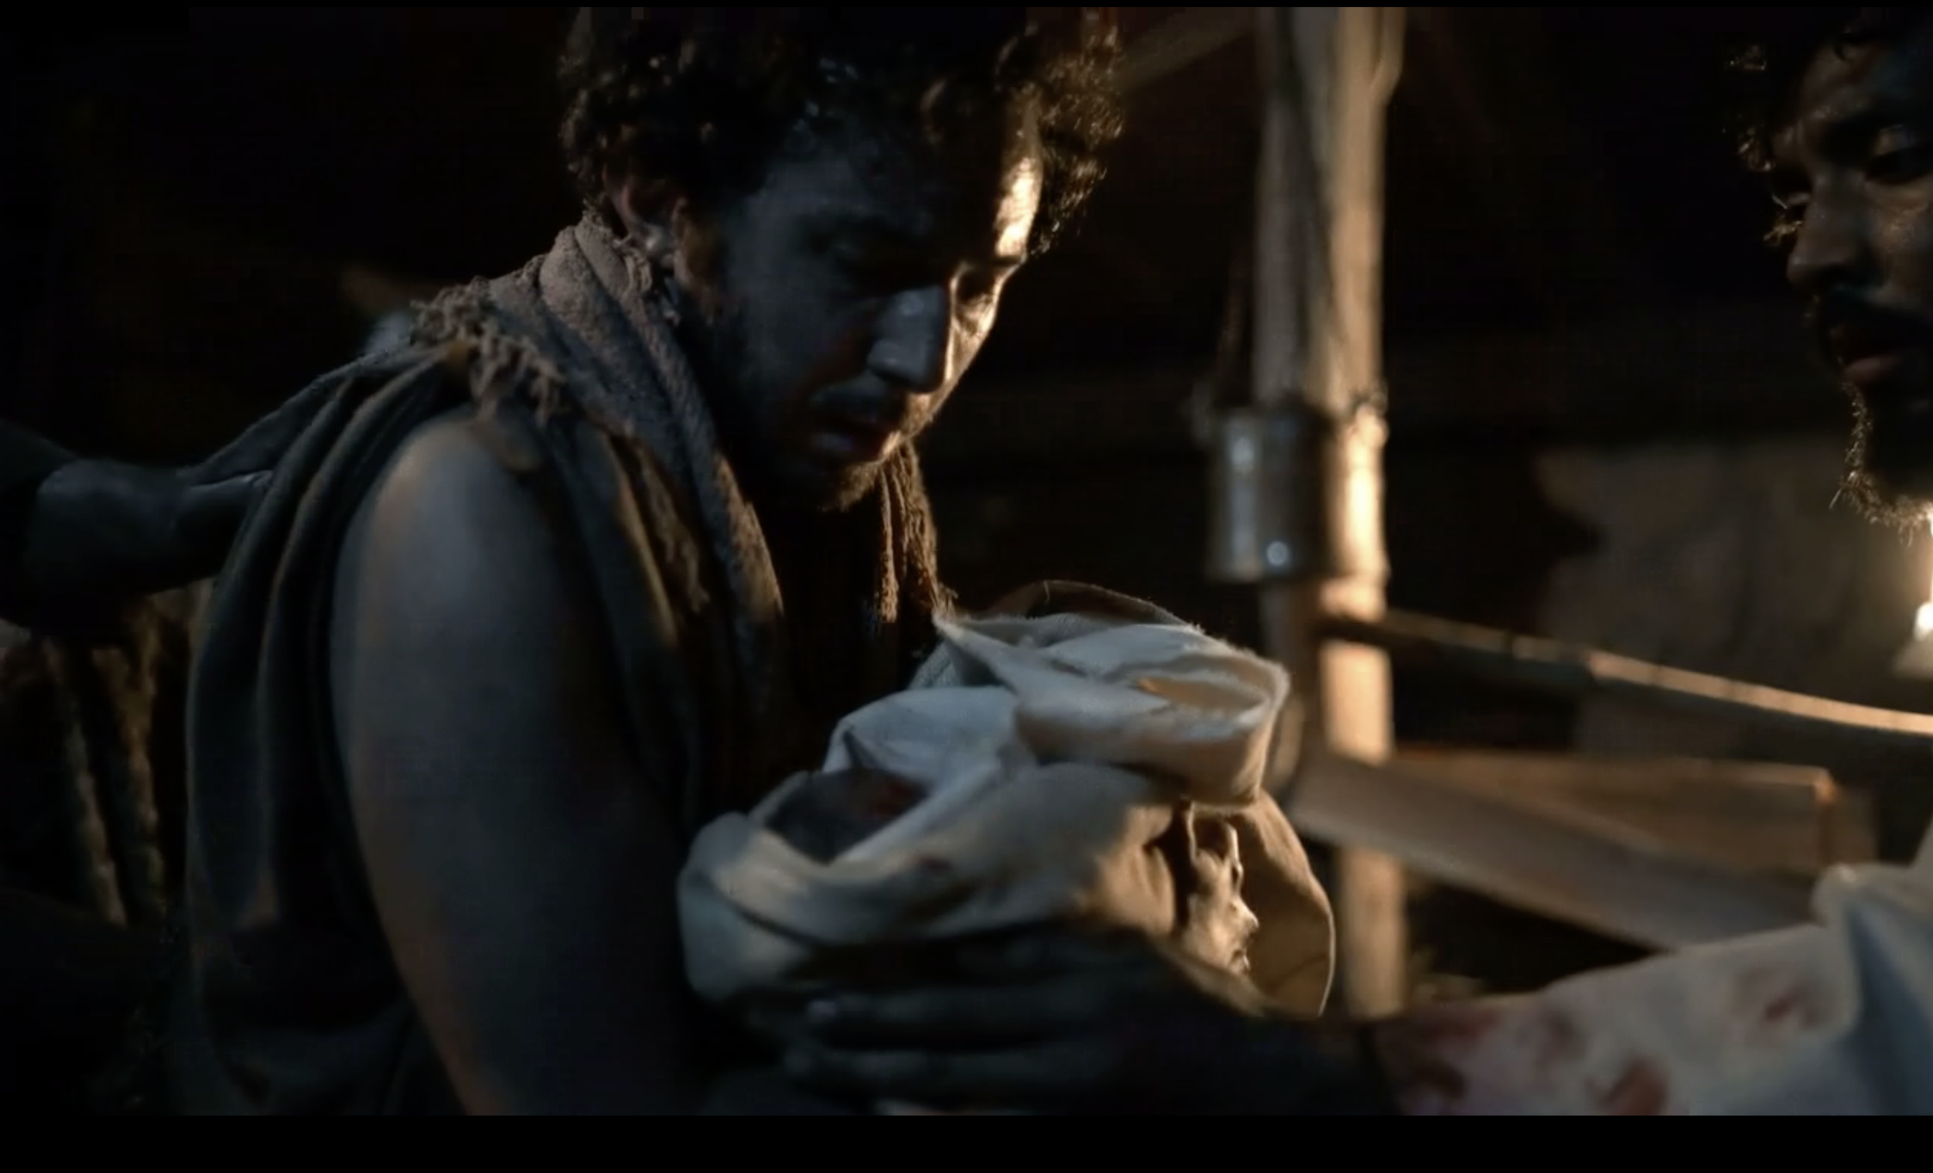
Is it time for you to receive Jesus?
Notes:
The shepherds received him gladly. How about you?

Slide 50
Is it time for you to stop wasting time?
Notes:
Some of us waste an awful amount of time on movies. Maybe we need to limit it to one movie per month, huh? What other activity in your life hinders you from pursuing Eph 5:16 to “make the most of your time because the days are evil”?

Slide 51
How can you better use your time in the coming year?
Notes:
Maybe God is telling you that his timing is perfect as an example of you giving some of that time back to him to get to know him better through his Word! I would like to encourage you as you look to the New Year to commit to a certain goal in reading his Word—even a page a day or a chapter a day or even a verse a day!

Slide 52
Black

Slide 53
Topical Preaching • BibleStudyDownloads.org
Get this presentation and script for free!

