Slide 1
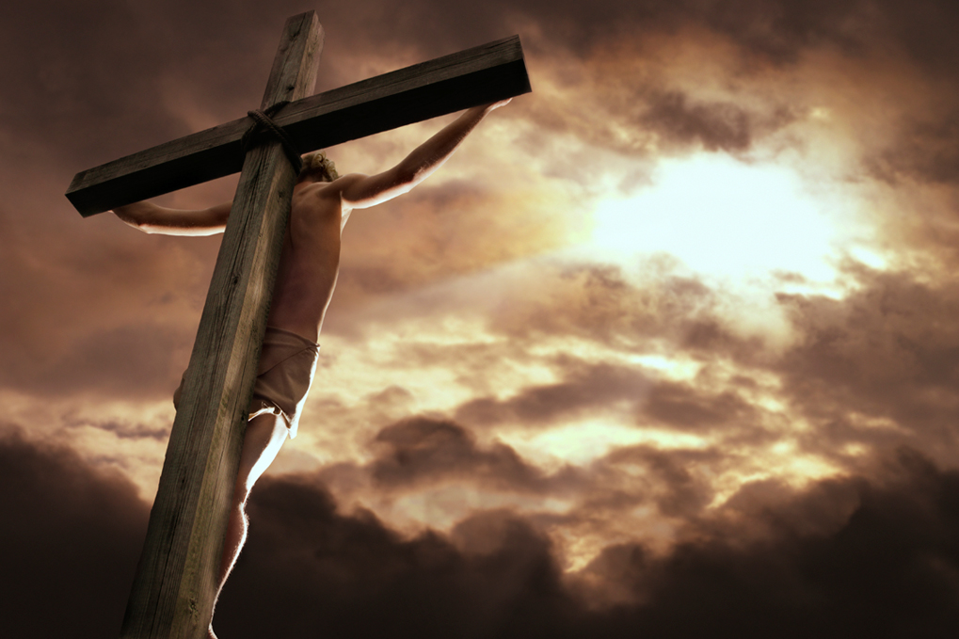
The Meaning of the Death of Christ
Soteriology: God’s Rescue Program
Dr. Rick Griffith • Jordan Evangelical Theological Seminary • BibleStudyDownloads.org

Slide 2
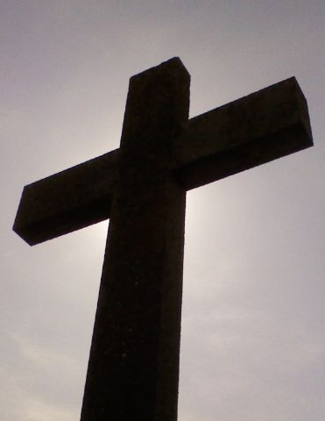
Jesus is Our…
Substitution for Sinners
Redemption in Relation to Sin
Reconciliation in Relation to the World
Propitiation in Relation to God
Ryrie, Basic Theology, 329-42

Slide 3
Your Small Group Presentation
5 minutes: Divide the class into FOUR small groups
20 minutes: Discuss your topic on pages 27-29: either a, b, c, or d
12 minutes: Present for 3 minutes—use lecture, drama, song, visuals, etc.

Slide 4
Jesus is Our…
Substitution for Sinners
Redemption in Relation to Sin
Reconciliation in Relation to the World
Propitiation in Relation to God
Ryrie, Basic Theology, 329-42

Slide 5
Black

Slide 6
Salvation link at BibleStudyDownloads.org
Get this presentation and script for free!

