Slide 1

Research Methodology
Choosing the Sample and Conducting Surveys
Taught by Dr. Sng Bee Bee • Singapore Bible College
Files in many languages for free download at BibleStudyDownloads.org

Slide 2
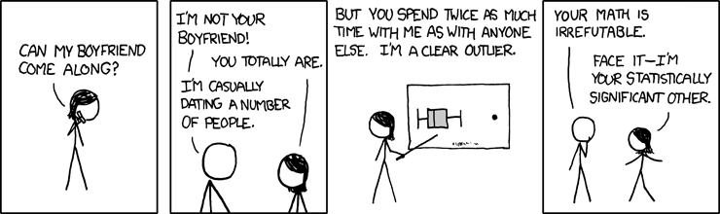
Sunday Fun: Statistically Significant Others
by Lisa Wade, PhD
Share on twitter Share on facebook
Share on reddit Share on stumbleupon Share on tumblr Share on pinterest_share More Sharing Services
img class="aligncenter size-full wp-image-6520" src="http://thesocietypages.org/socimages/files/2009/02/boyfriend2.png" alt="boyfriend2" width="562" height="143" />By xkcd.

Slide 3

Sample Size
It is important to consider the sample size because the readers need this to evaluate:
The significance of your results
Consider your sample size in relation to what you are trying to show.
For example, in investigating psychological conditions, many researchers use a few case studies in order to study these conditions in depth. They need not use a large sample size.

Slide 4

Recruitment, Selection and Response Rate
In selecting people to participate in your study, bear in mind the following points:
attrition rate. The attrition rate is the number of people who do not respond to your questionnaire.
Any bias that may exist in your sample. For example, for certain research questions, you need to have fairly equal number of males and females.

Slide 5
Participants’ Characteristics
It is important to bear in mind the participants’ characteristics such as:
Gender
Race
Nationality
Income distribution
Likely views on your research topic

Slide 6
Informed Consent
Get consent from your participants to take part in your research
In the case of children, seek consent from their parents
Make sure they understand your research aim and what you are going to do with the results, e.g. publish them

Slide 7
TYPES OF SURVEY
QUESTIONNAIRE
Send out self-completion questionnaires
Subject to attrition rate - people not responding
Disadvantages – data collected may lack detail and depth on research topic
- respondents may not give honest answers
- questions have to be carefully designed to get the desired responses. Questions are subject to misinterpretation

Slide 8
Steps in Conducting a Survey
Decide what you want to find out – what your hypothesis is
Define your population
Write your questions
Test your questions
Tally the results
Seek patterns in the raw data

Slide 9
SURVEYS
POPULATION
Every instance included
SAMPLE
small portion of the whole

Slide 10
SURVEYS
Sample has to be carefully selected
Random Sampling
Selection of people at random
Population studied is large
Most likely to provide a representative cross-section of the whole.

Slide 11
SURVEYS
2. Systematic Sampling
Sample chosen based on every ‘nth’ member
3. Stratified Sampling
Every member in the population has an equal chance to be selected in relation to their proportion within the total population. For e.g. in selecting voters for a study on voting behaviour, the researcher selects equal number of subjects from each age group and gender.

Slide 12
SURVEYS
4. Cluster Sampling
Focus on naturally occurring clusters of the research issue that the researcher is studying.
For example, to study young people aged between 11 and 16 years, a secondary school will form a natural cluster.

Slide 13
SURVEYS and SAMPLING
5. Purposive Sampling
Sample is ‘hand picked’ for the research. The researcher already knows the people or events s/he wants to study and select those that will produce the valuable data.
Allows the researcher to home in on the characteristics that s/he is studying.

Slide 14
SURVEYS
6. Convenience Sampling
Sample is chosen according to the people the researcher is in direct contact with or find the most convenient to approach.

Slide 15
Conduct a survey
In your group, design a questionnaire survey to investigate the following situation. Pay attention to your use of language.
Attitudes towards the use of contemporary music in worship services in your church in your country
Design a set of 5 descriptors, e.g “Must be very charismatic”; “Must have contemporary musical instruments”
Design a Likert scale 1 to 5, 1 – Agree Absolutely, 2-Very much agree, to 5-Totally Disagree
Conduct the survey in class

Slide 16
Are the Questions Bias
Present your survey questions in class
The other groups will evaluate if the questions can be misleading or bias

Slide 17
Are the Samples Representative
A geographer is investigating shopping trends in the capital. She interviews 40 shoppers outside a major department store on Saturday morning.
A political party wants to find out if the voters support their policies. It sends out a survey to all its members.
A medical student wants to find out how many children have colds in winter. In January, she decides to go to a local pre-school and see how many children have colds.
The government needs to know the rate people are moving from farms into the cities. They interview 200 people in the capital.
An economist wants to find how earnings relate to qualifications within a large manufacturing company. He puts all the names of the employees in a hat and selects twenty to interview.

Slide 18
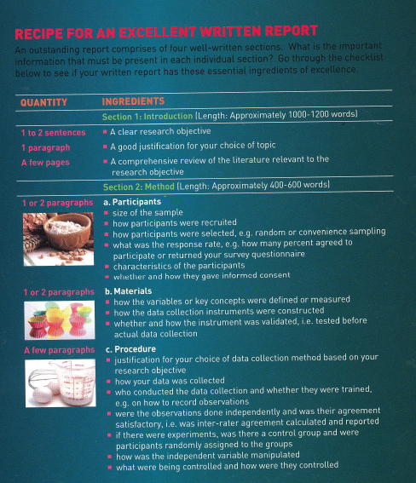

Slide 19
Black

Slide 20


Research & Writing link at BibleStudyDownloads.org
Get this presentation for free!
Notes:
Research & Writing (rw)

