Slide 1
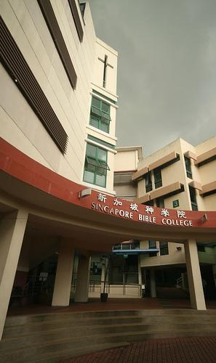
DMin Dissertation Research
Singapore Bible Collage Library
Uploaded by Dr. Rick Griffith • Singapore Bible College BibleStudyDownloads.org

Slide 2
DMin Dissertations of Singapore Bible College
Articles and dissertations are available for download and browsing：
TREN (Theological Research Exchange Network)
E-Thesis (eg. US, UK, Europe, Canada, South Africa)
Ebscohost (ATLAs database)
Articles and dissertations are catalogued but ARE NOT available for download and browsing：RIM（ATLA）

Slide 3
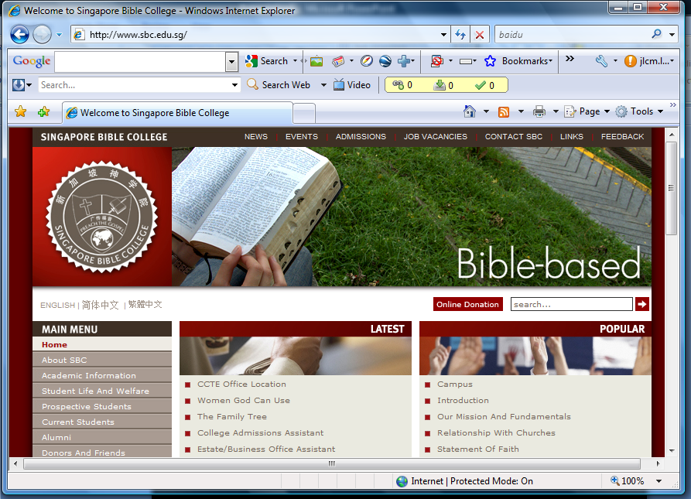
http://www.sbc.edu.sg/
English or Chinese
SBC Main web page

Slide 4
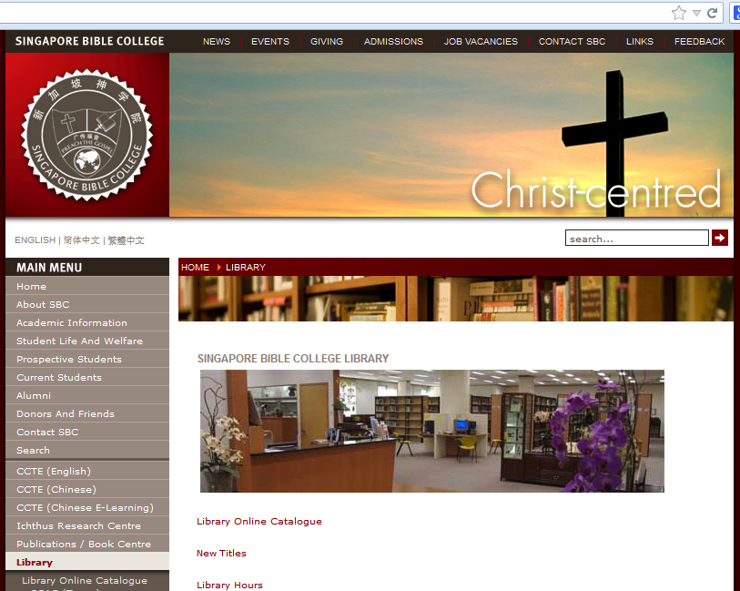
Library
Enter Library Site

Slide 5
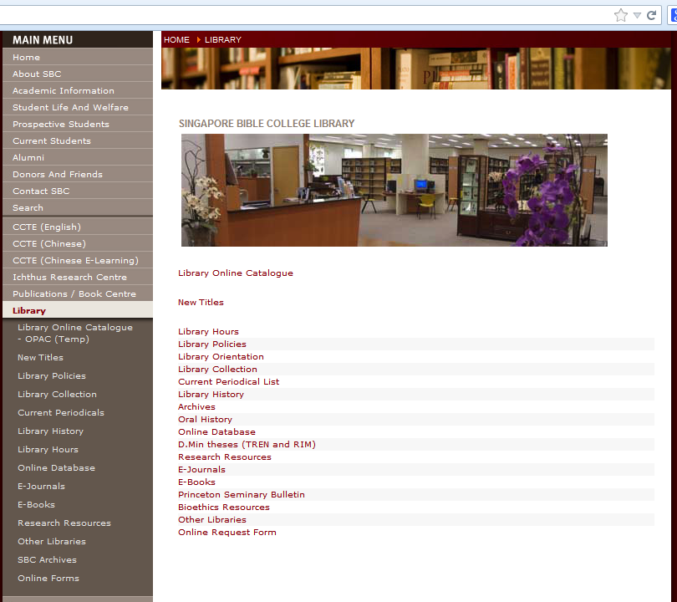
Library Catalog

Slide 6
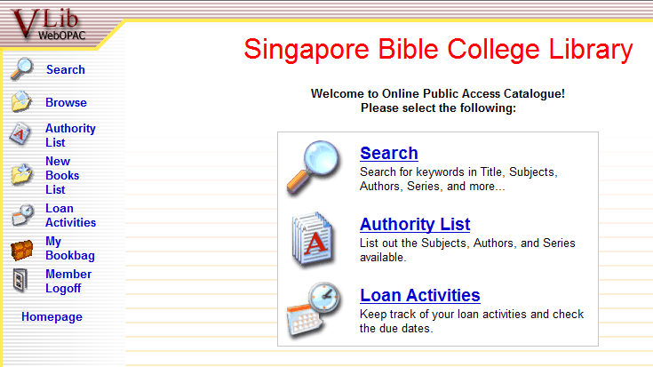
Click here to search Dmin Thesis
Library Catalog Main Page

Slide 7
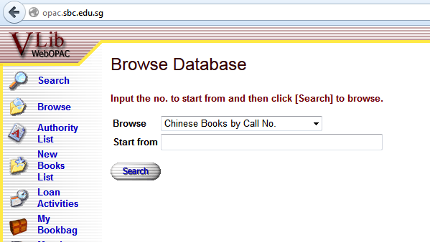
Click here to search Dmin Thesis
At “Browse” : Select “English Books by Call No.”
At “Start from” : Key in “REF D. Min.”

Slide 8
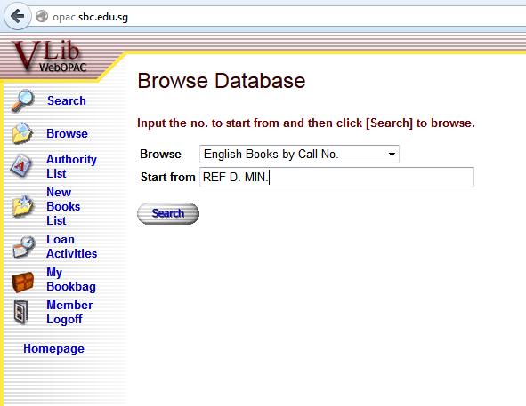

Slide 9
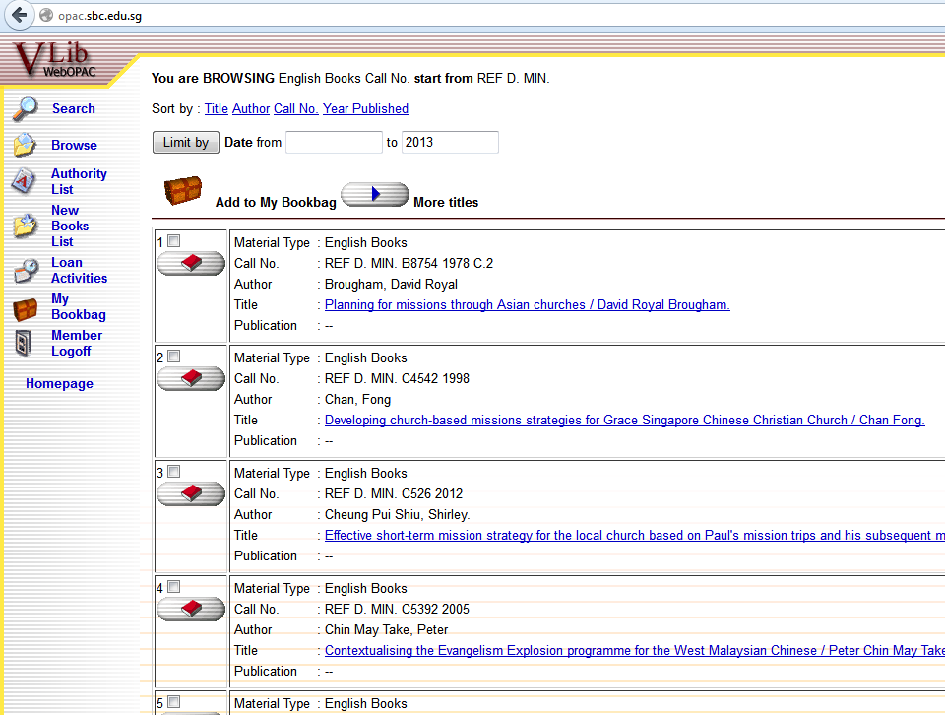
Sort by Title

Slide 10
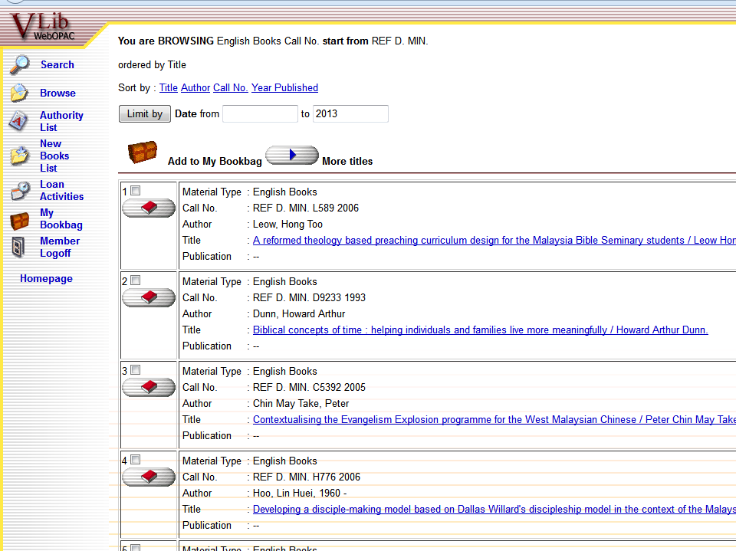

Slide 12
http://www.sbc.edu.sg/
English or Chinese
SBC Main web page

Slide 13
Library
Enter Library Site

Slide 14
D. Min. Thesis

Slide 15
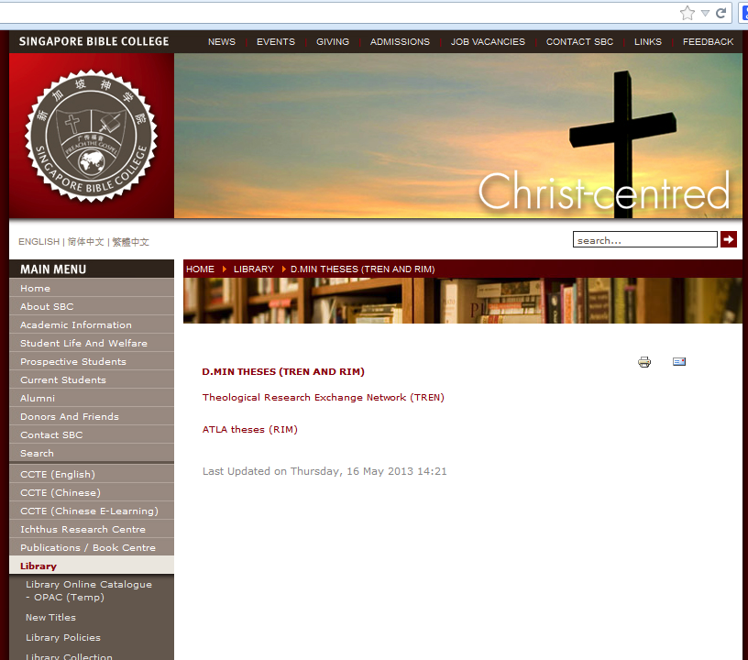
TREN (Theological Research Exchange Network)

Slide 16
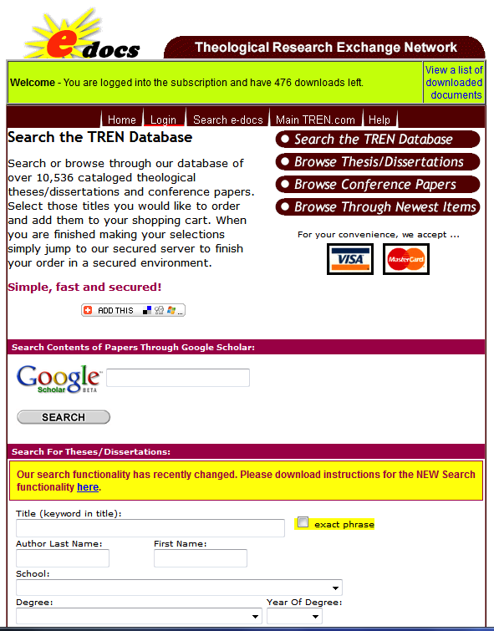

Slide 17
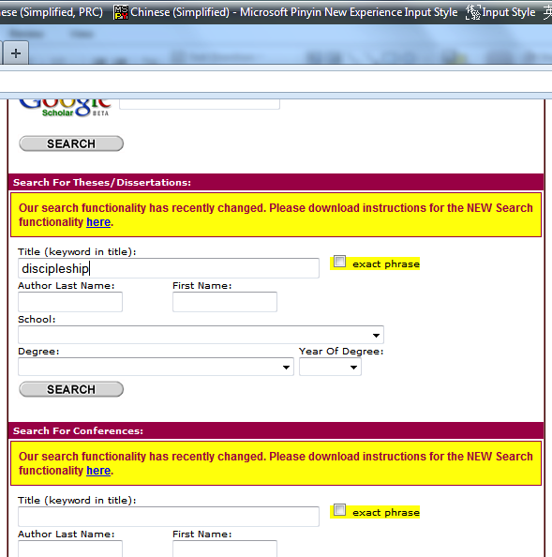
Try by keying in: “discipleship”

Slide 18
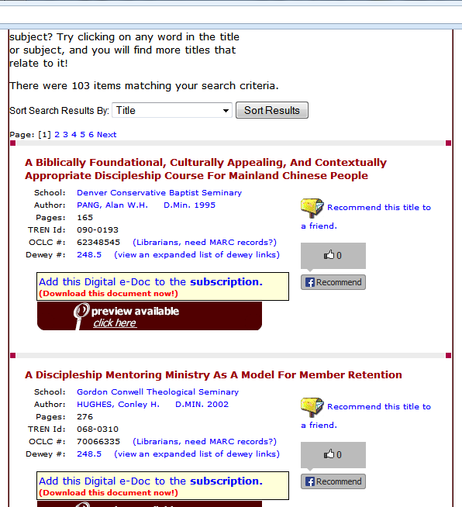
Change sorting order： “Degree”

Slide 19
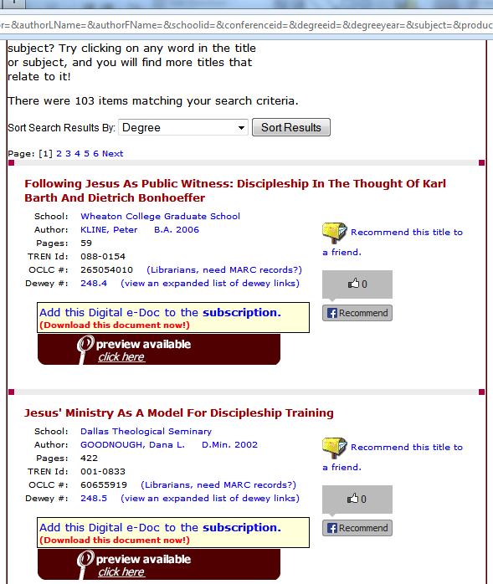
Click here to download

Slide 20
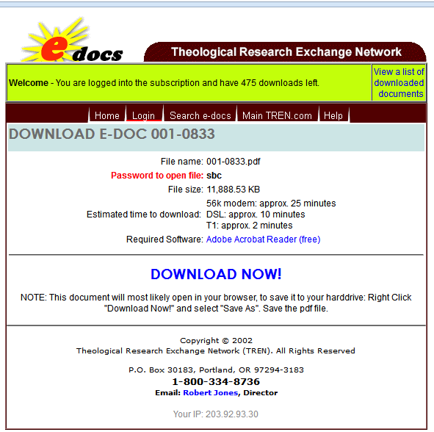
Password to open file：sbc
Click here to download

Slide 21
E-Thesis
US: ProQuest Dissertations and Theses (
PQDT Open http://pqdtopen.proquest.com/ for abstract or download open thesis (IE explorer)
Umi http://disexpress.umi.com/dxweb for purchase)
UK: EThOS (http://ethos.bl.uk)
Europe: Dart (http://www.dart-europe.eu/basic-search.php)
Canada (http://www.collectionscanada.gc.ca/thesescanada/027007-2000-e.html#a)
South Africa: NETD (http://www.netd.ac.za/)

Slide 22
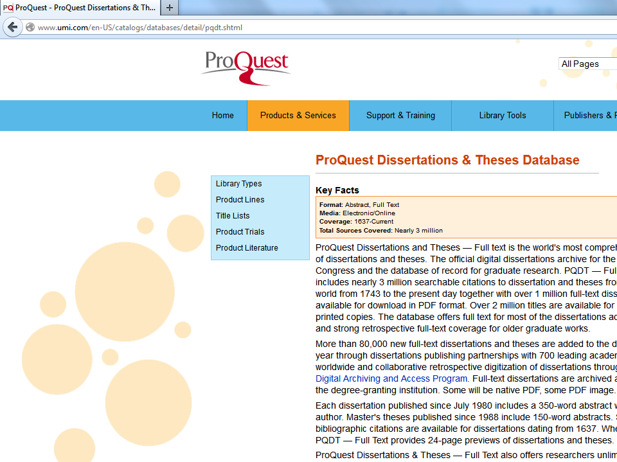

Slide 23
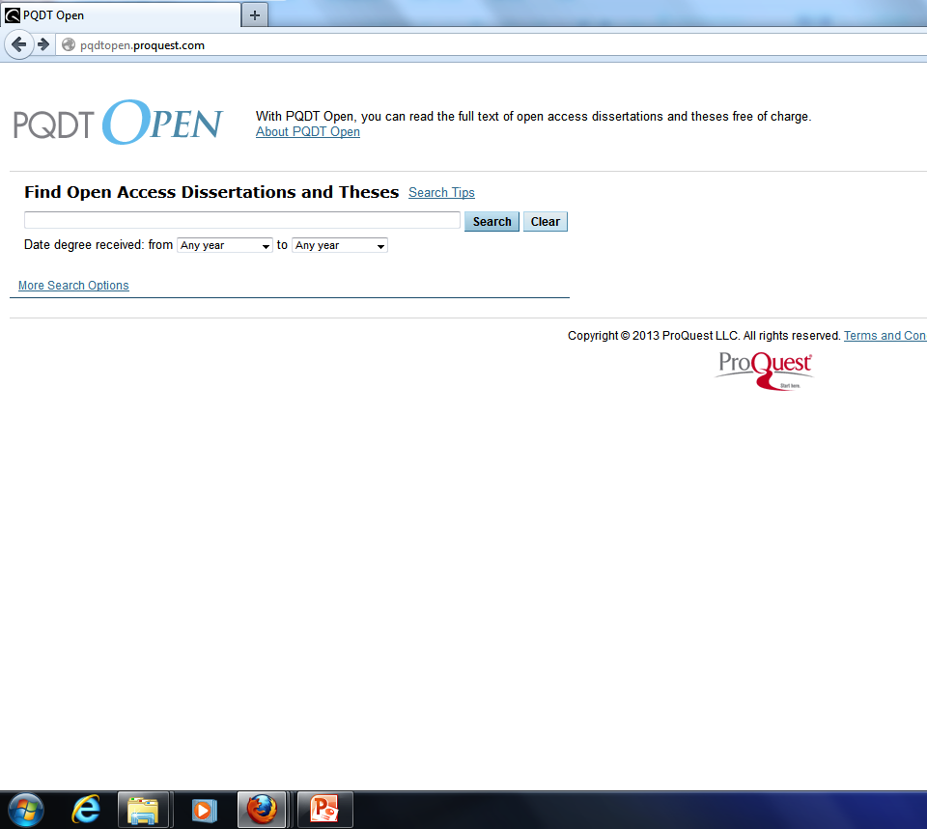

Slide 24
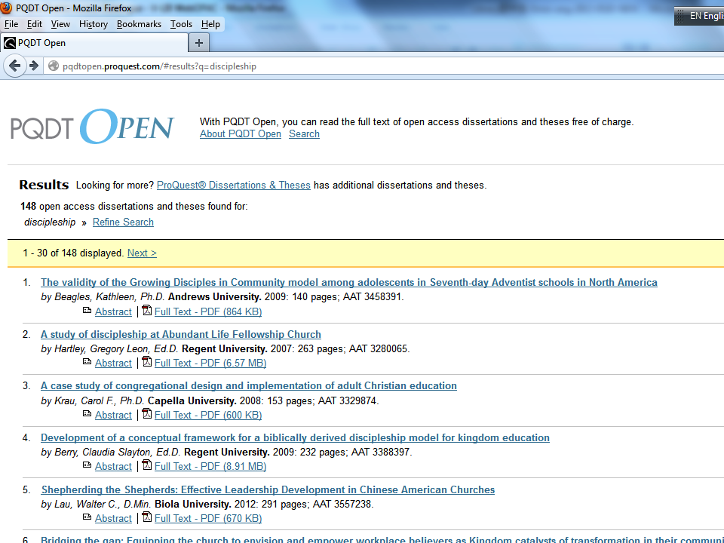

Slide 25
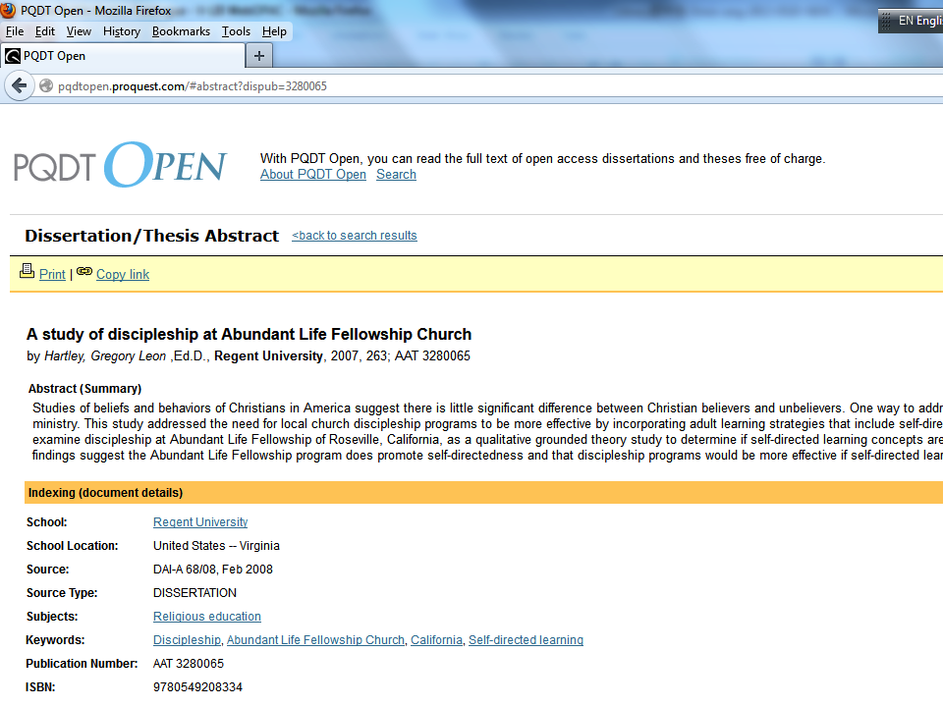

Slide 27
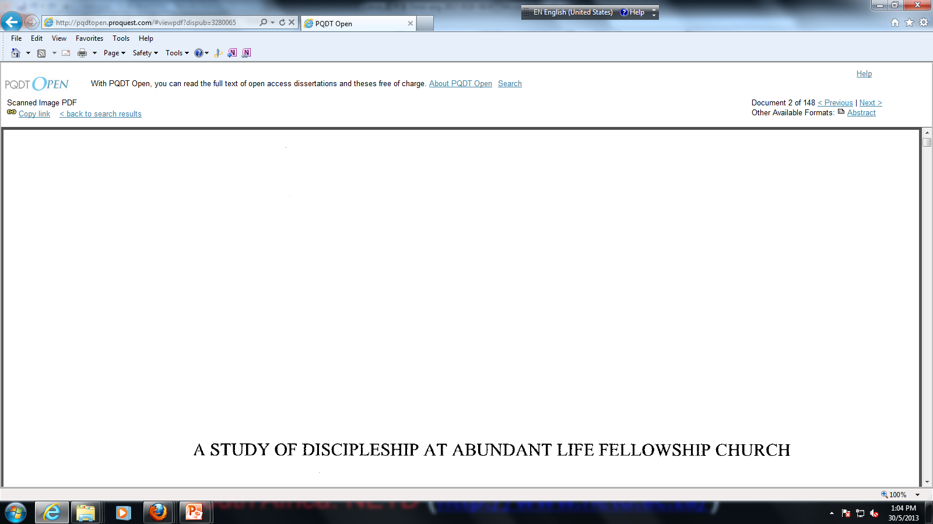
My IE version 9 works, but my Firefox fails

Slide 28
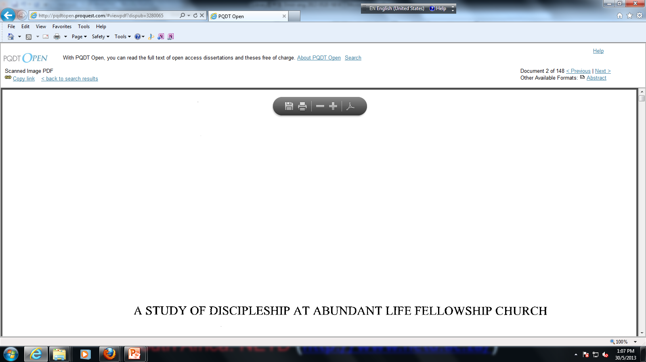
Wait for “Save a Copy” icon appear.

Slide 29
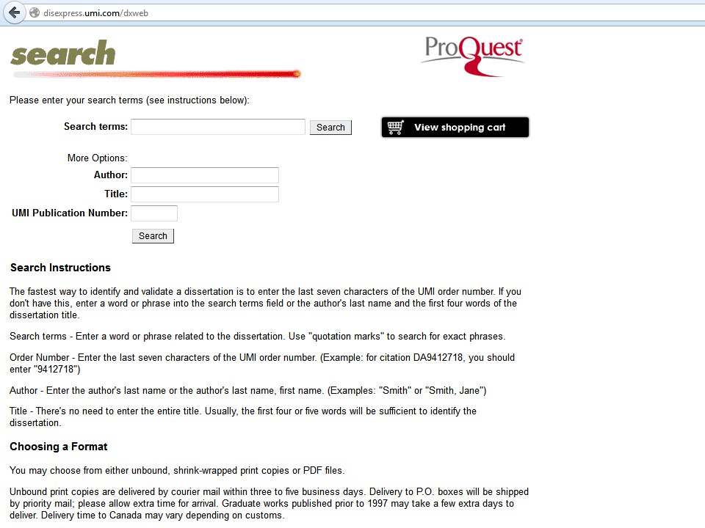
http://disexpress.umi.com/dxweb

Slide 30
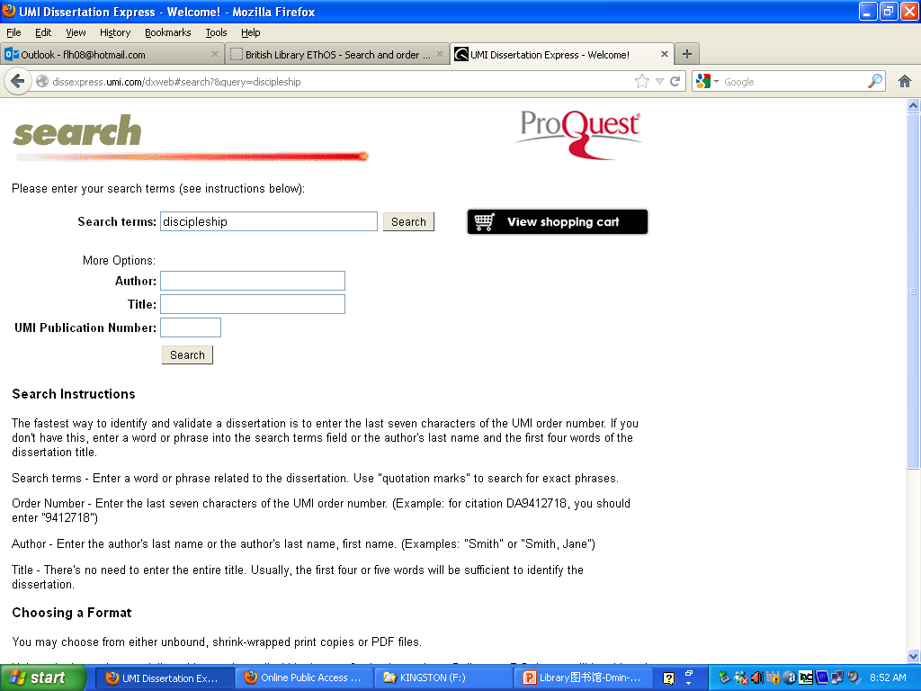
http://disexpress.umi.com/dxweb

Slide 31
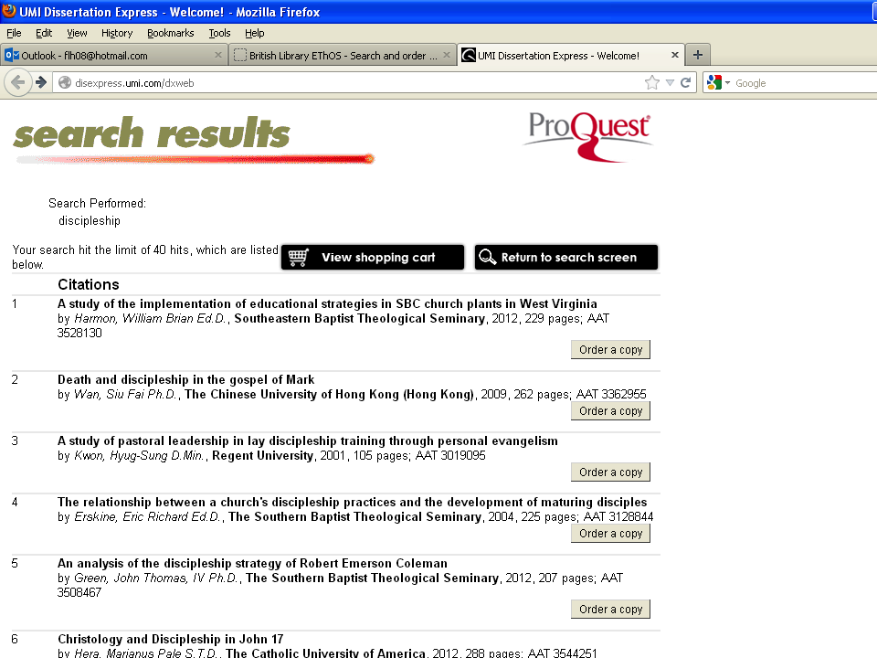

Slide 32
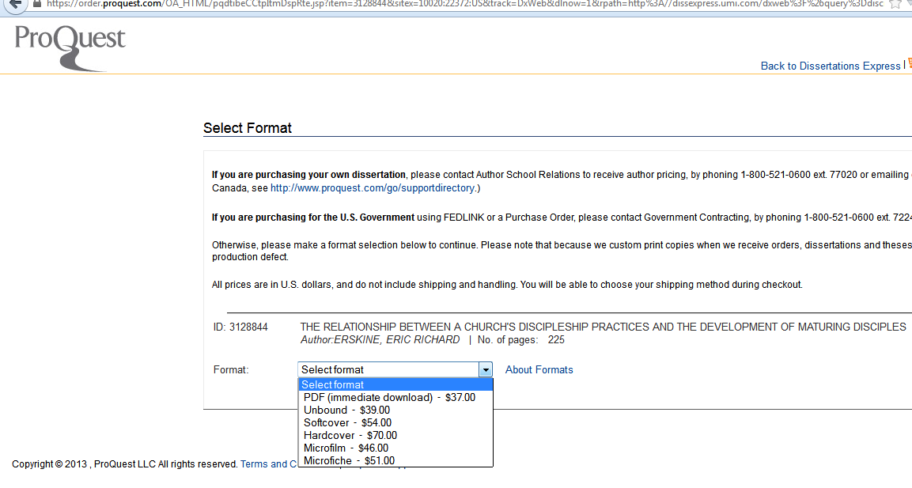

Slide 33
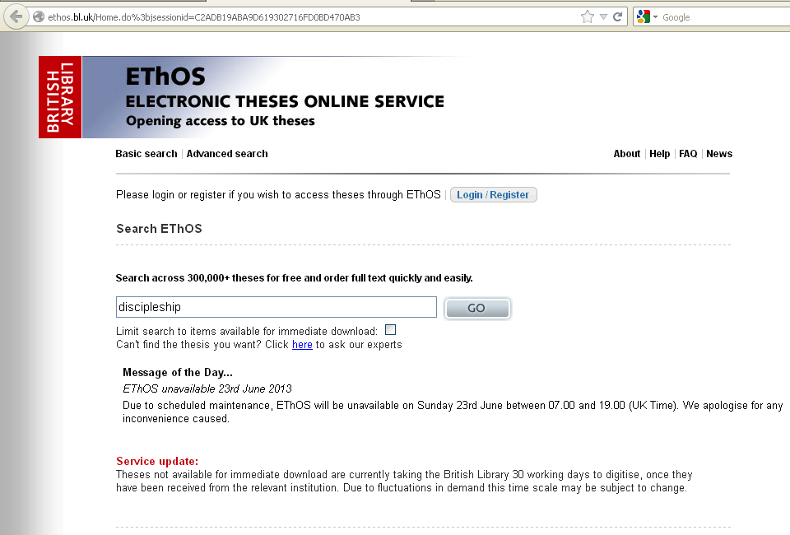
http://ethos.bl.uk

Slide 34
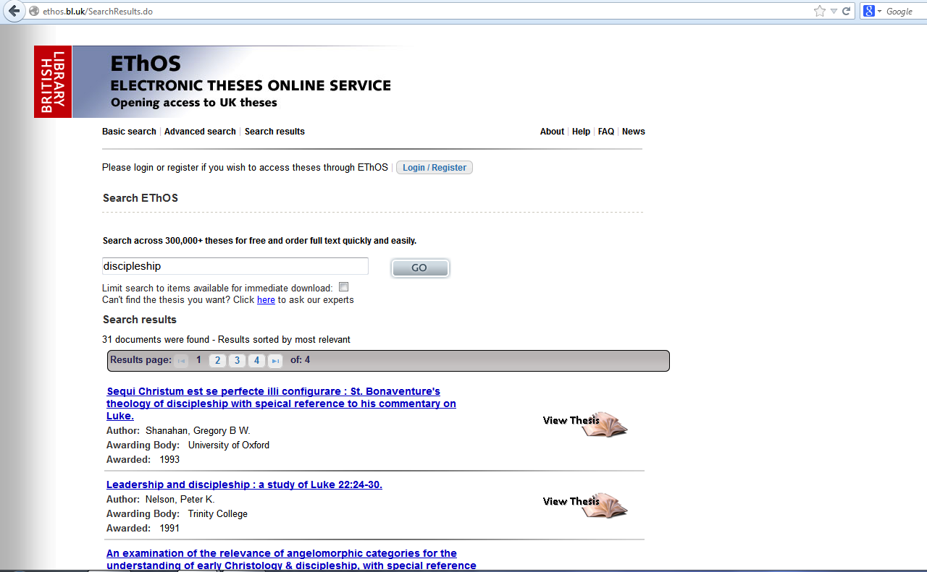

Slide 35
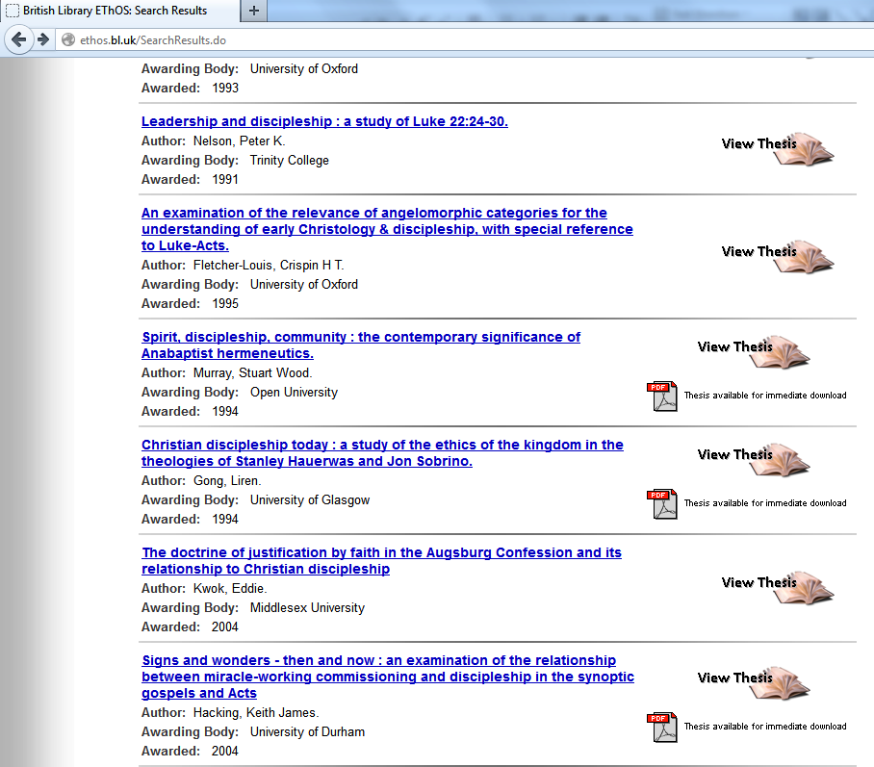

Slide 36
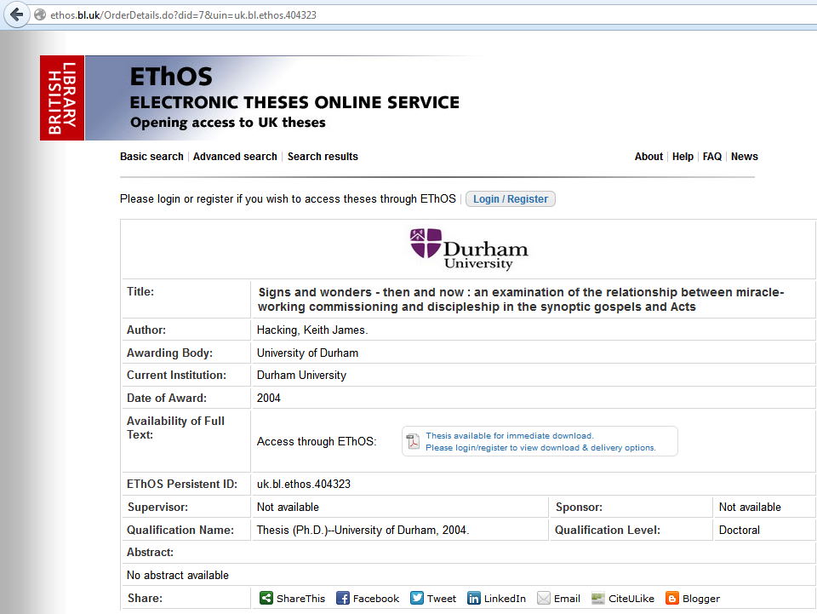
Go to the source to download in this case

Slide 37
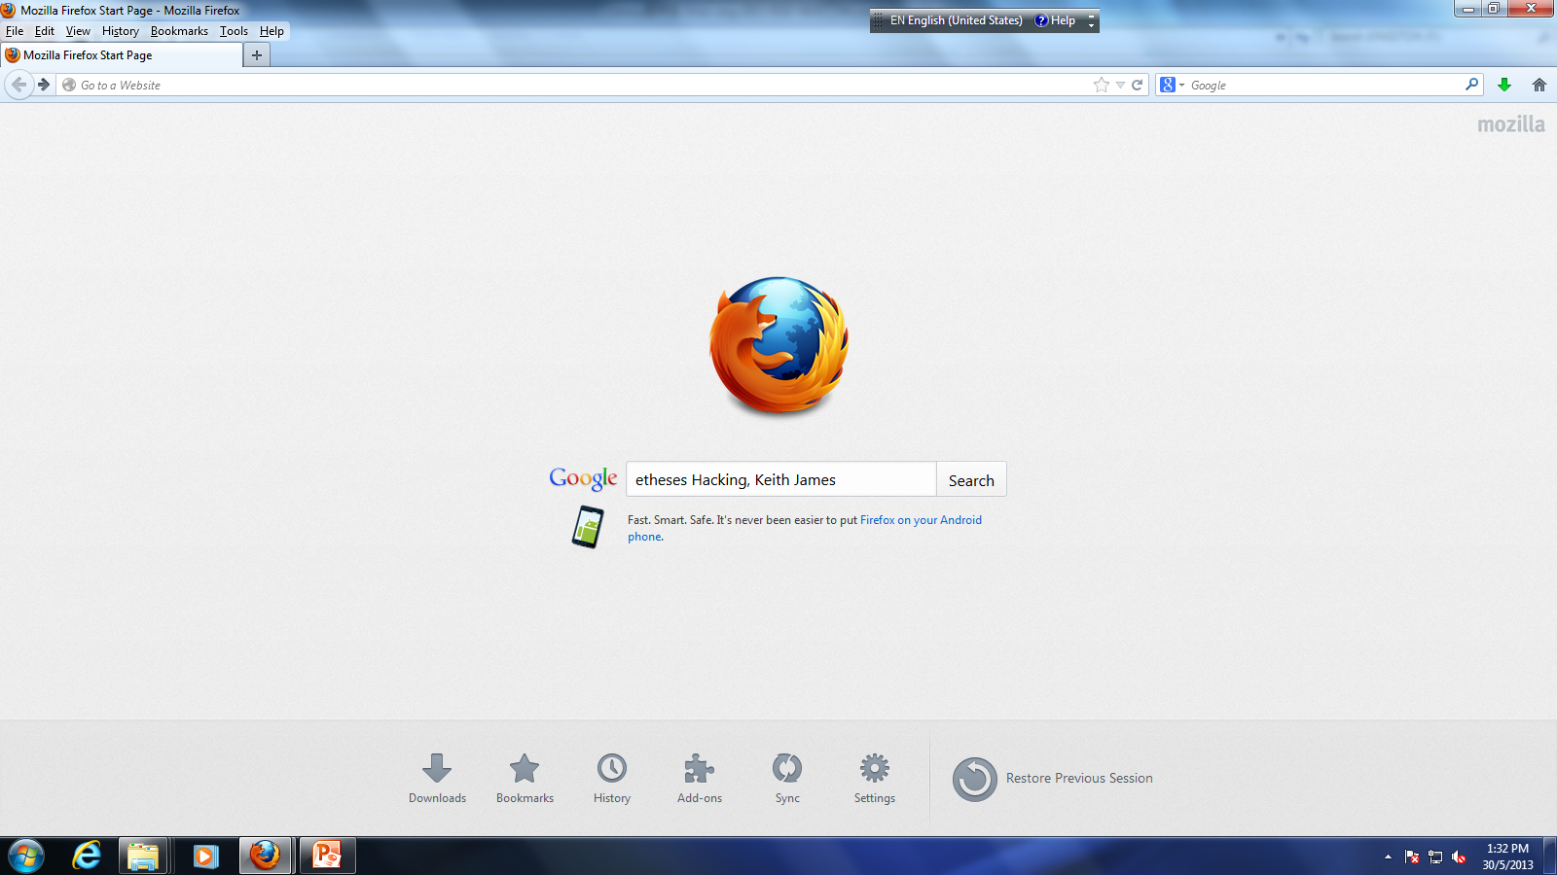

Slide 38
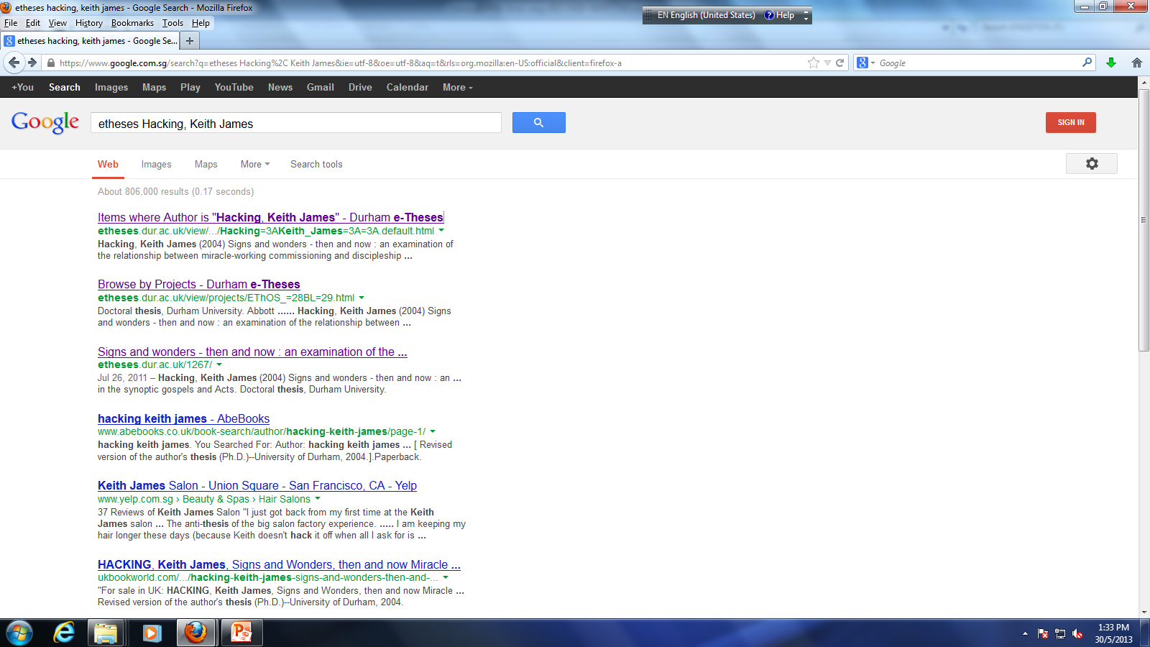

Slide 39
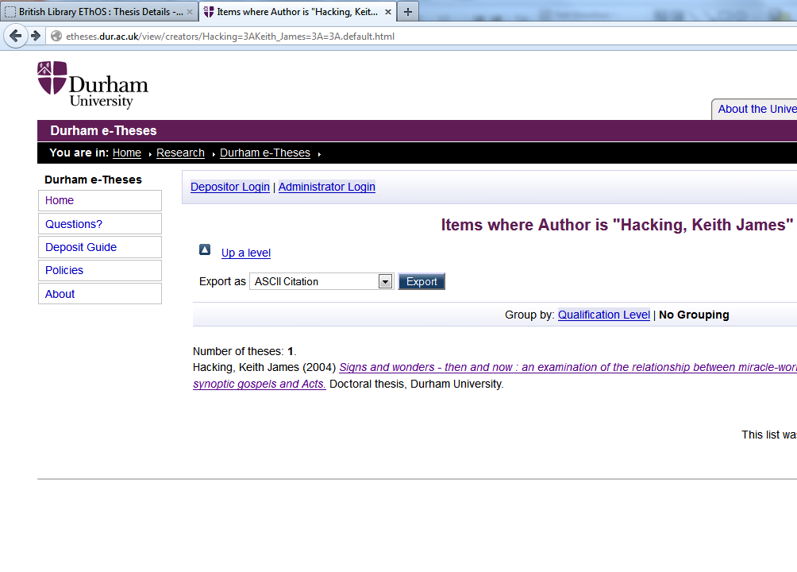

Slide 40
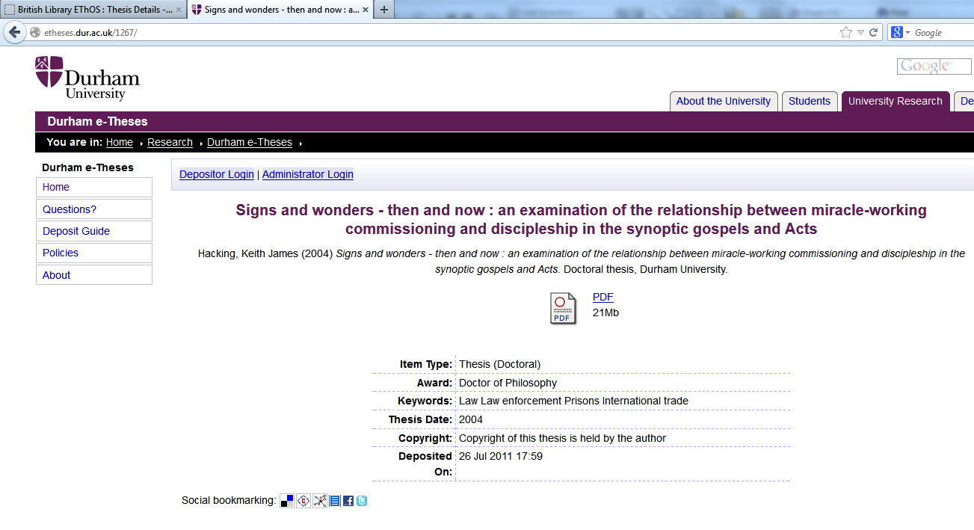
Click here to download

Slide 41
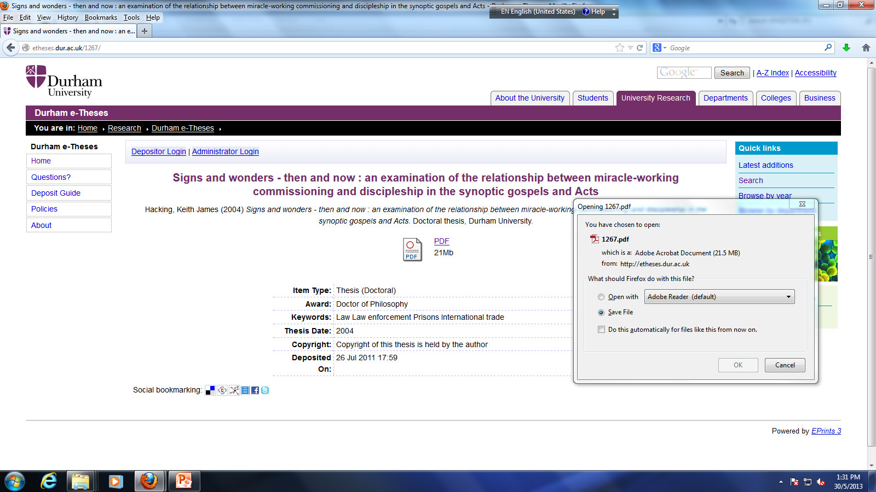

Slide 42
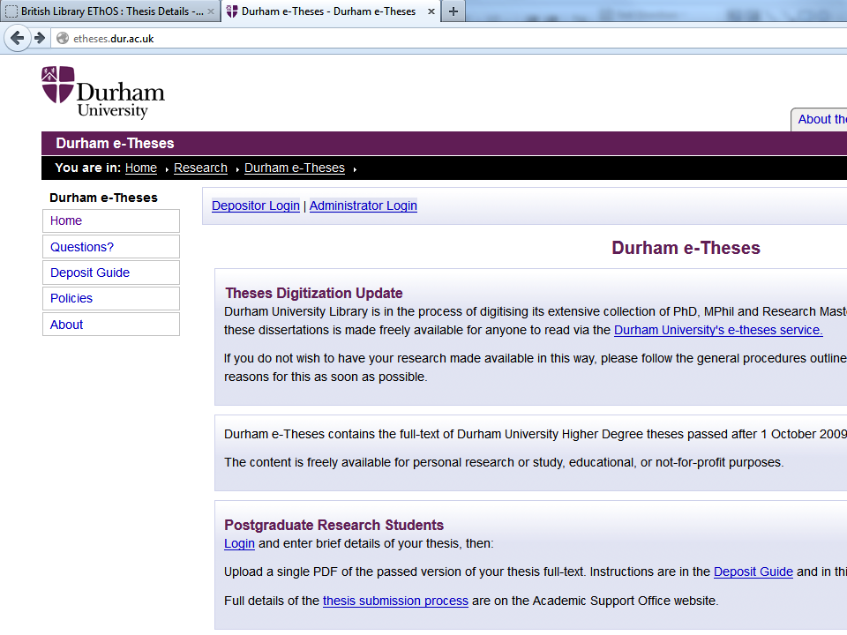
Or you may goto Durham e-Theses

Slide 43
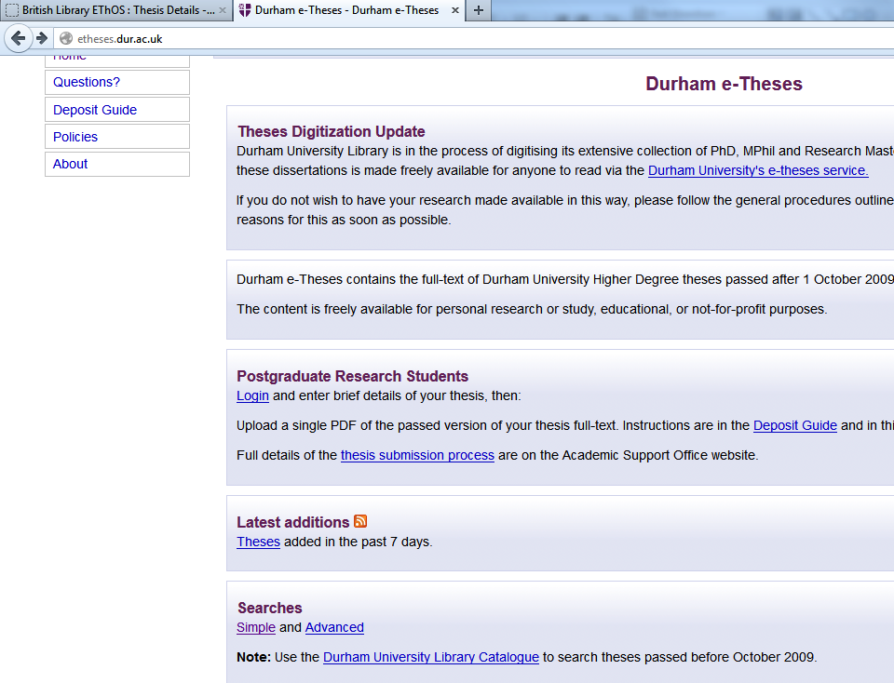

Slide 44
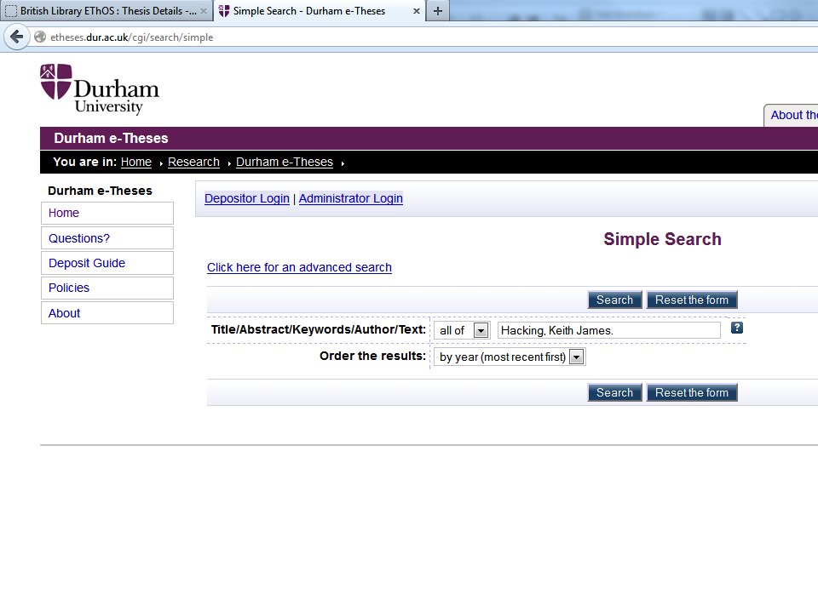

Slide 45
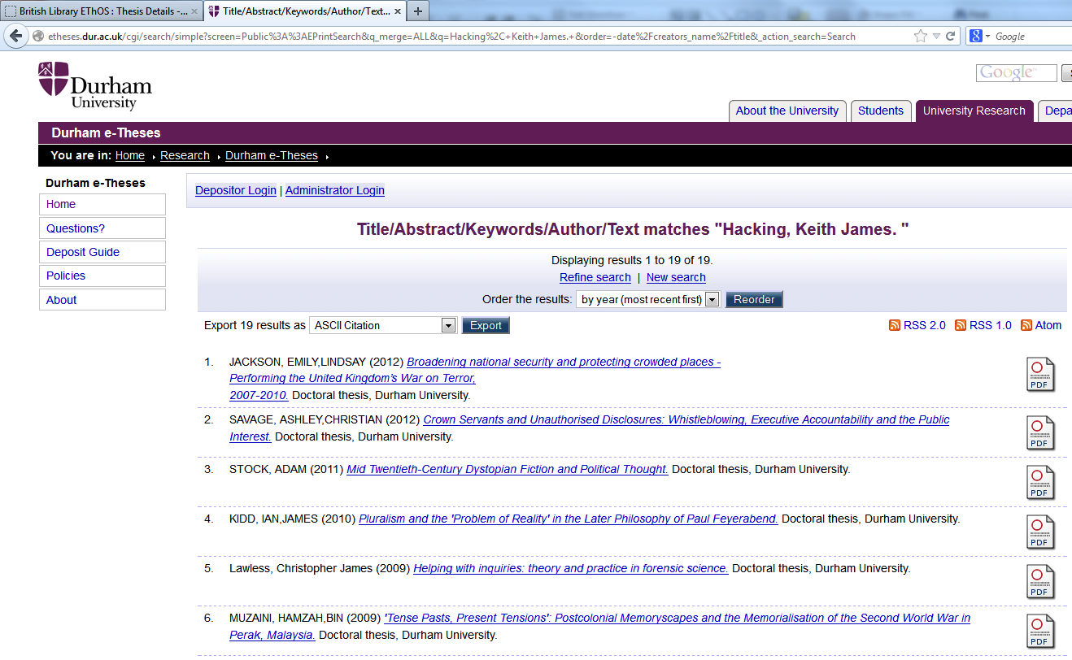

Slide 46
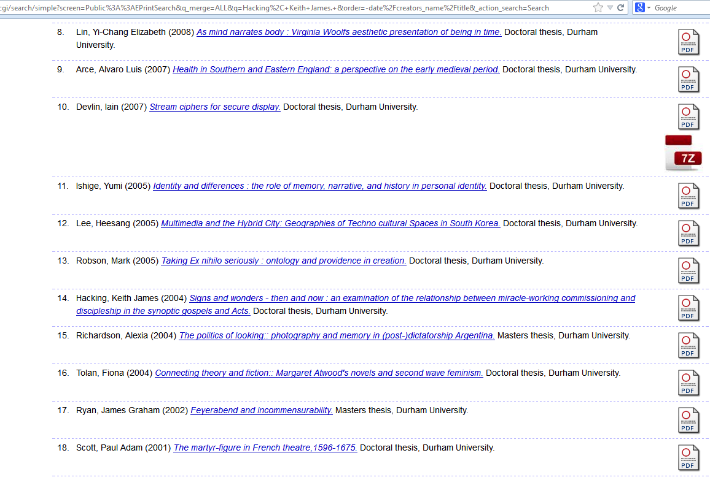
Click here to download

Slide 48
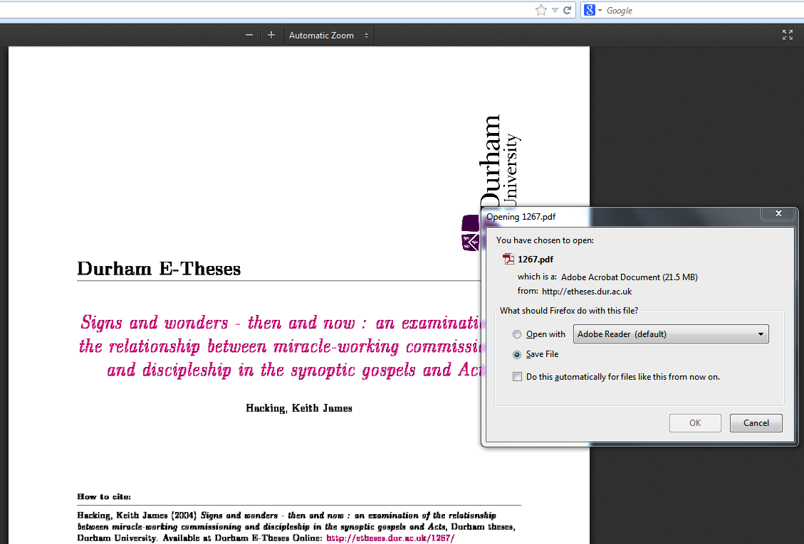

Slide 49
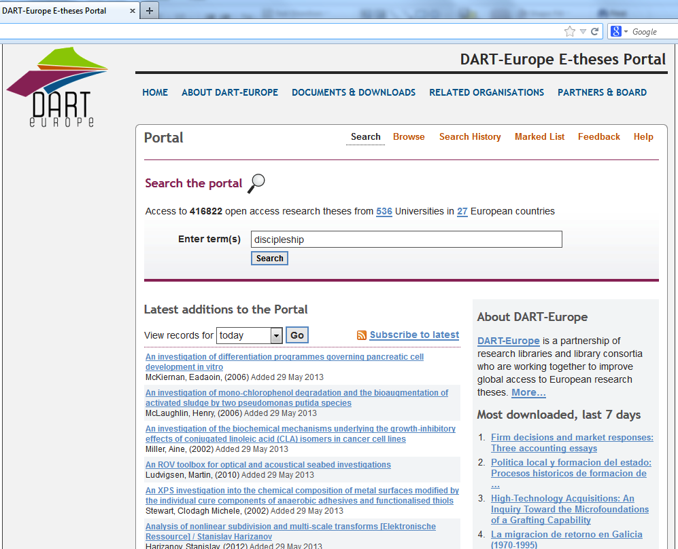
http://www.dart-europe.eu/basic-search.php

Slide 50
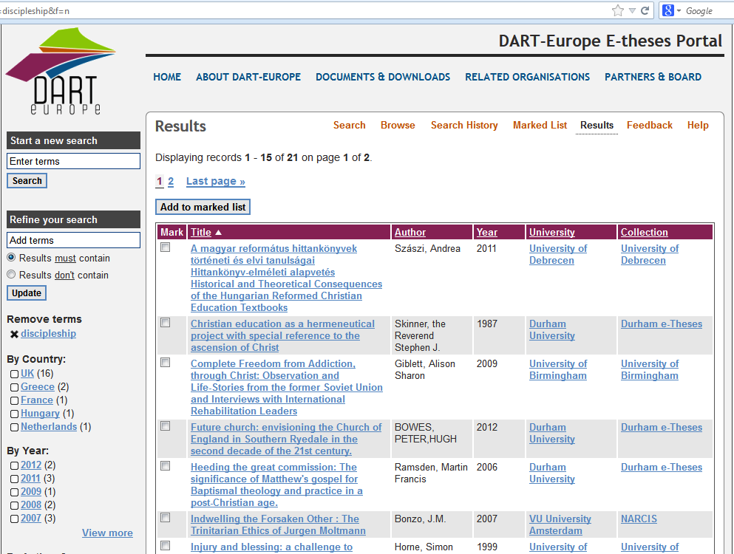

Slide 51
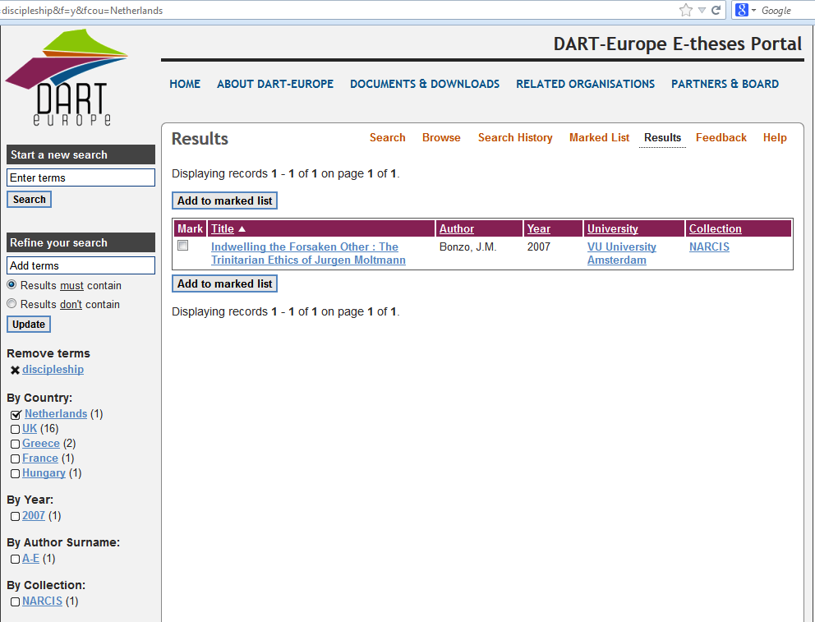

Slide 52
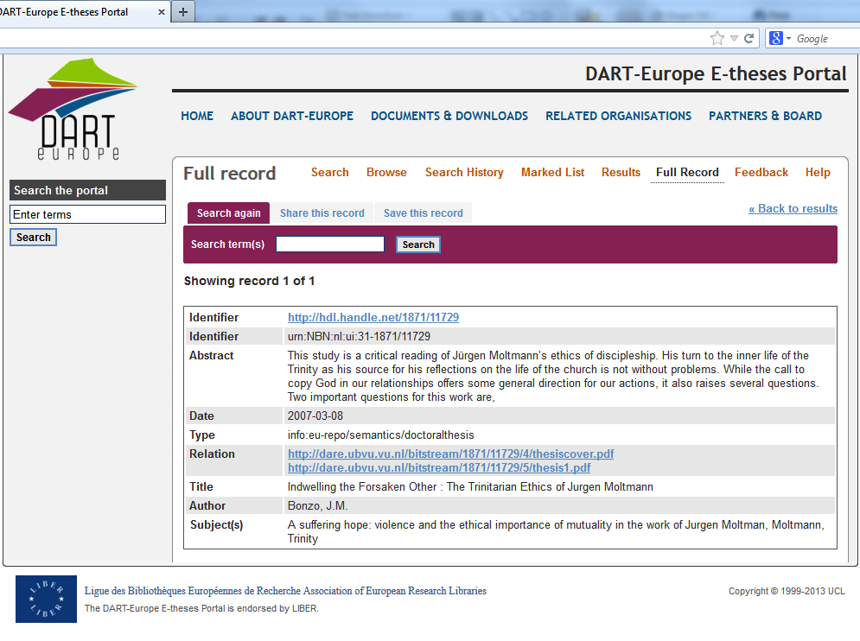
Click here to download

Slide 53
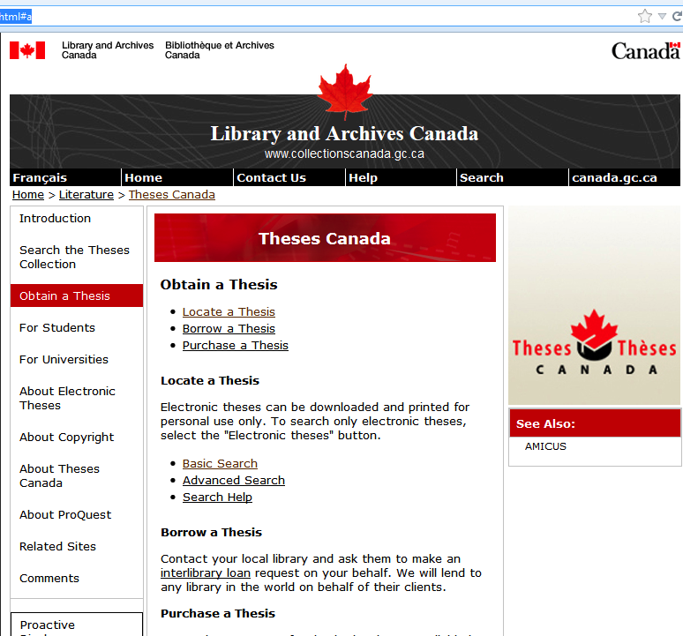
http://www.collectionscanada.gc.ca/thesescanada/027007-2000-e.html#a

Slide 54
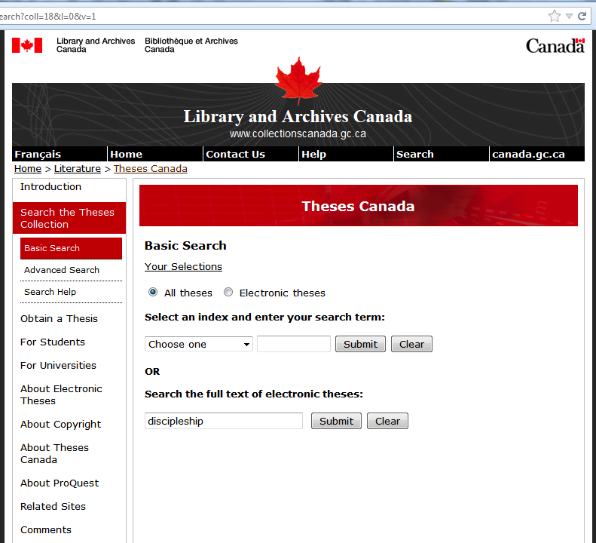

Slide 55
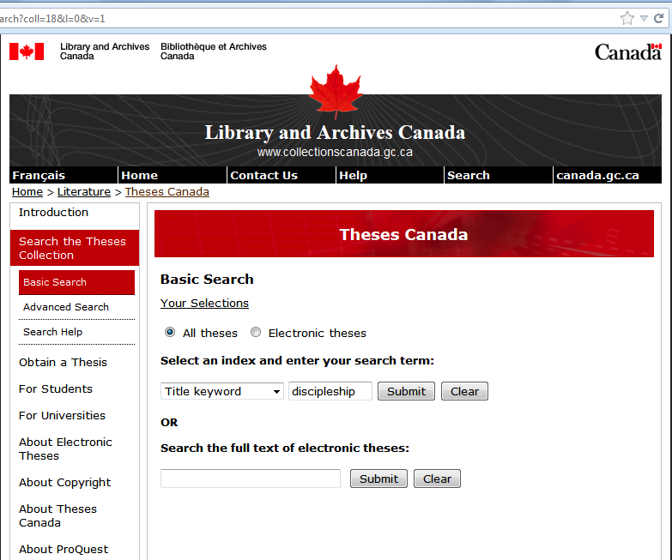

Slide 56
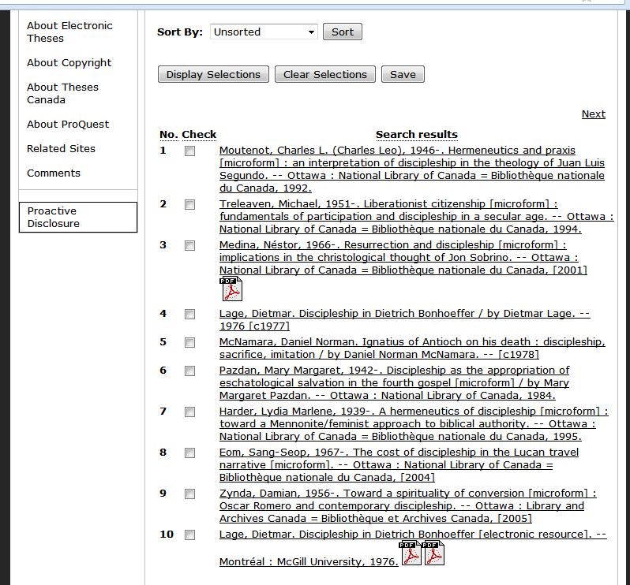
Click here to download

Slide 57
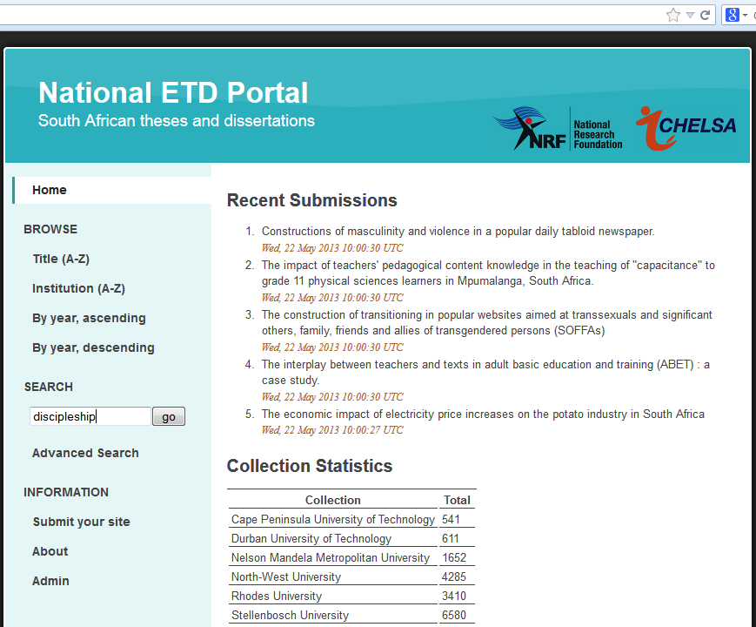
http://www.netd.ac.za/

Slide 58
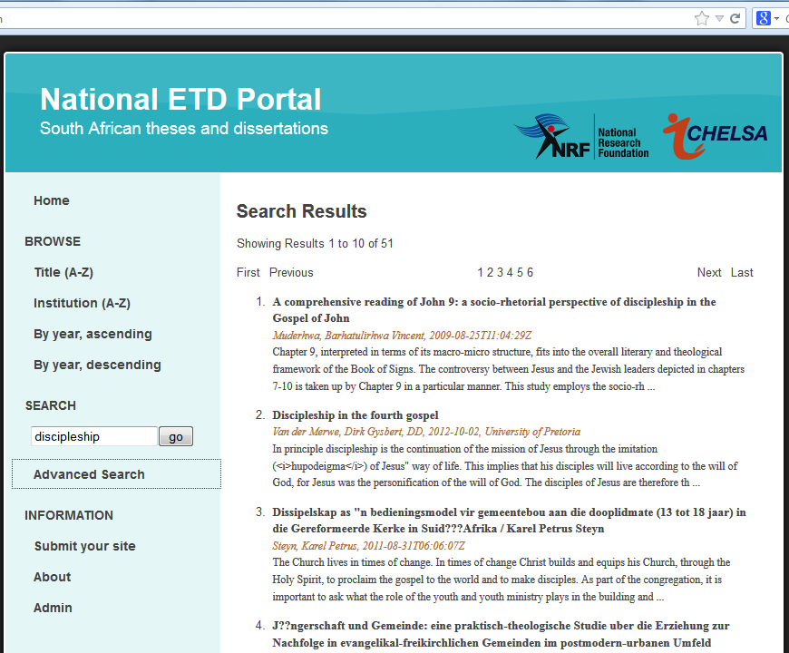

Slide 60
http://www.collectionscanada.gc.ca/thesescanada/027007-2000-e.html#a
Click here to download

Slide 61
Ebscohost
(ATLAs database)

Slide 62
ATLAS Online Database

Slide 63
You see this page only if you search Ebshost off-campus

Slide 64
(Click “Continue”, if you’re not interested in New and Old Testament Abstracts)

Slide 65
Try key in: discipleship
Try by keying in “discipleship”

Slide 66
Check “Full Text”, if you want only those downable ones to be listed.
Click here to download
Only catalog with “Full Text” can be downloaded

Slide 68
Click here to download

Slide 69
Click here to download

Slide 70
Cite your reference

Slide 71
Chicago/Turabian Hunities format
You may delete words starting from “ATLA Religion…”

Slide 72
RIM (ATLA)
Online database

Slide 73
RIM（ATLA) – Can search，but cannot download

Slide 77
Sort by Subject

Slide 78
Sort by Author

Slide 79
Brief Record display

Slide 80
Full record display

Slide 83
End

Slide 84
Research & Writing link at BibleStudyDownloads.org
Get this presentation for free!
Notes:
Research & Writing (rw)

