Slide 1
Primary Data: Observation I
Dr Sng Bee Bee
Reference: Adapted from Gray, D.E. (2009), Doing Research in the Real World (2nd ed.). London: Sage
Taught by Dr. Sng Bee Bee • Singapore Bible College Files in many languages for free download at BibleStudyDownloads.org

Slide 2
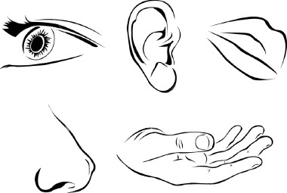
What is Observation as a Research Method?
Use of all 5 senses:
Sight
Smell
Touch
Hearing
Taste
Perception and interpretation from all these 5 senses

Slide 3
What is Observation as a Research Method?
Systematic viewing of people’s actions
Recording, analysis and interpretation of their behaviour
Saunders (2007): difference between participant and structured observation.
Participant observation – largely qualitative and emphasizes meanings that people give to their actions
Structured observation – largely quantitative and focuses on the frequency of their actions. For example, in an observation of a teacher’s teaching, the observer may observe how many times s/he asks the class questions.

Slide 4
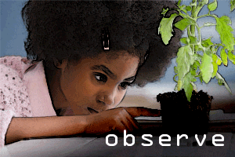
Overt and Covert Observation
Overt Observation: those being observed are aware that the observation is taking place
Covert Observation: participants are unaware of being observed

Slide 5
Practice
Watch a video on detection in a crime scene. What does crime detection and observation as a research method have in common?
https://www.youtube.com/watch?v=467aWZEtCmI
Now, watch another video. What evidence did the juvenile delinquent leave behind:
https://www.youtube.com/watch?v=jxrYybZNPgA

Slide 6
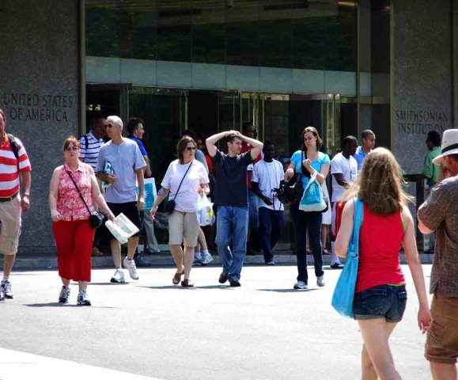
Advantages of Observation as a Research Method
Get beyond people’s opinions and self-interpretations of their own attitudes and behaviour which can occur in interviews and surveys
Unobtrusive – observe people’s behaviour in real-life situations

Slide 7
Disadvantages of Observation as a Research Method
Interpretation of what is observed may be influenced by the mindset of the researcher.
We often see what we want to see and disregard other phenomena that may be important
The presence of the researcher can also influence the behaviour of others, for example, in a classroom, the presence of the researcher may influence the behaviour of the students
Data gathered from observation are rich in evidence, but extracting themes and concepts from the data can be challenging.

Slide 8
Problems
What do you think is the argument against overt observation?
Answer: people can change their behaviour if they know they’re being observed
What do you think is the problem against covert observation?
It can be considered unethical.

Slide 9
Observation research roles
Overt Observation
Announced Participant
Announced Observer
Undercover Participant
Undercover Observer
Participant Observation
Non-participant Observation
Covert Observation

Slide 10
Disclosure
Extent to which participants are informed about being observed ranges:
non disclosure
full disclosure
Usually, it is somewhere in between

Slide 11
Disclosure
Berg (2006) – if participants are given full disclosure, they may be so sensitive that it is impossible to carry out the research.
Most of today’s communication takes place via email and it’s possible to examine these emails.
Consequences may vary between countries.
People reveal different aspects of themselves in social media and communicate their views regarding some issues which they may not reveal in face-to-face communication.
CAUTION
Emails and Social Media

Slide 12
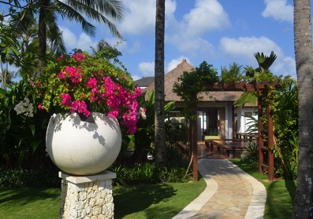
Case Study: How Smart is Covert Observation
A company running a Holiday Village has just introduced a smart card for its customer so that they can:
Check in on arrival using the smart card without having to get out of the car
Pre-book facilities such as bicycle hire and the hire of tennis courts
Open their lodge door
Use the card instead of making credit card or cash transactions

Slide 13
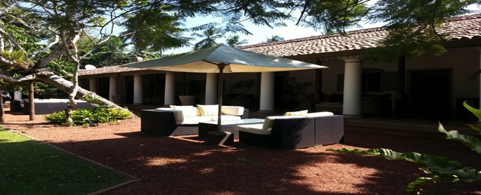
Examine the case. Is covert observation justified here? Could the study have been conducted using overt observation with the same success?
A covert participant researcher with knowledge and expertise in smart card technology enters the Village as a ‘guest’ to observe ‘the customer experience’ in using the cards. As a covert observer, she is able to note some of the problems guests experience with the system including:
A court booking system that does not use real time updating, thus allowing double booking of the system,
Aspects of the system failing to be fully functional when the volume of customers exceeds capacity.
Source: Slack and Rowley, 2001

Slide 14
Participant and Non-Participant Observation
Participant Observation is closely associated with ethnographic methodology
It has its origin in British anthropology and the Chicago School of Sociology

Slide 15
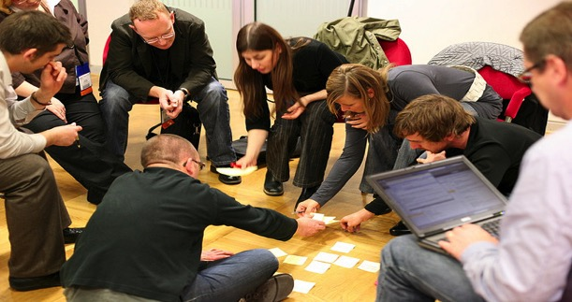
Goal of Participant Observation
Step 1
Generate data through observing and listening to people in their natural setting;
Step 2
Discover their social meanings and interpretations of their own activities

Slide 16
The Process of Participant Observation
The researcher becomes a member of the group that is being researched and tries to understand the situation by experiencing it
The researcher becomes ‘immersed’ in the research setting with the objective of sharing and experiencing people’s lives in order to learn about their world.
This framework is known as ‘symbolic interactionism’.
The researcher reports his/her own experiences, feelings, fears, anxieties and social meanings in engaging with the people in the situation of research (field)

Slide 17
What is Symbolic Interactionism?
Principle
People develop a sense of identity through their interaction and communication with others
Process
Negotiation takes place through which they respond to others and adjust their understanding and behaviours to create a sense of shared reality
Theory
This theory stresses the dynamic nature of social interaction where people change continually as they interact with their environment
A person’s identity is not fixed but is changing as he or she moves in different settings

Slide 18
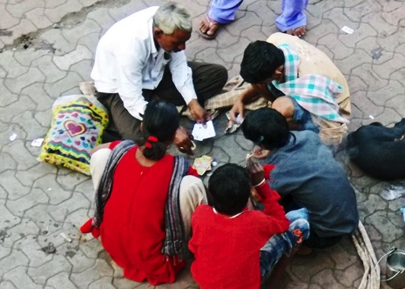
CHALLENGES OF SYMBOLIC INTERACTIONISM
Get physically and emotionally close to them but maintain a professional distance.
Affected by: Gender, Race, Religion, Social Class and Education of Researcher

Slide 19
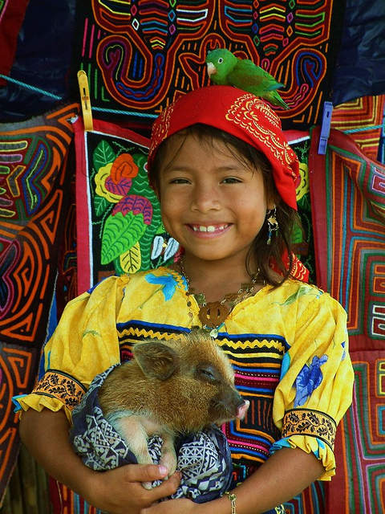
Access to Participants
The more one is like the participants in terms of culture, gender, race, socio-economic class and so on, the more it is assumed that access will be granted, meanings shared and validity of findings assured. (Merriam el al. 2001: 406)

Slide 20
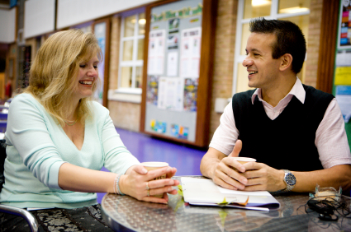
Maintaining a balance
Important to be an insider in order to maintain a rapport with the participants
Boundary between insider and outsider not clearly defined
Researcher needs to negotiate a position to be ‘at home’ and be considered ‘one of the participants’ but not be completely immersed

Slide 21
Value of Participant Observation
Are effective at observing non-verbal behaviour
Are immediate in the sense that they gather data as they happen
Allow for a more natural relationship to develop between the researcher and participants

Slide 22
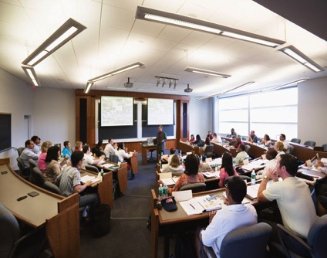
Making Field Notes Adapted from Burgess, 1984
Data Features | Features of a School
Space | Layout of classrooms and offices
Actors | The people involved in the situation and their names
Activities | The various activities of people in the setting
Objects | The physical elements present such as furniture and its position in the room
Acts | The actions of individuals
Events | Activities such as school assemblies
Time | The time sequence of the school, such as lessons, breaks and lunch hours.
Goals | The activities people are attempting to accomplish
Feelings | Emotions in particular contexts

Slide 23
What to watch out for…………….
Fail to take field notes, thinking that you can recall everything after that
Field notes should be written directly after observation
Steps in taking notes:
Mentally capture and remember as much detail as possible: who was at the scene, what they look like, what did they say, how did you feel about them etc.
These make up mental notes, which you can recall later to help you understand your notes

Slide 24
Step 1: Primary Observation
Chronological log – record raw data:
People, their surroundings, behaviour, conversations etc.
Record date and time of occurrence
Record quotes of conversations and your paraphrase of the conversations: distinguish between these

Slide 25
Following Steps
Step 2: Reflection and Recall
Reflect and recall observations from notes and memory
Step 3: Pre-analysis data – ideas and inferences
Themes and insights may start to appear. Do not censor yourself at this stage. Write down everything as occurs to you.
Distinguish between your field notes and your analysis

Slide 26
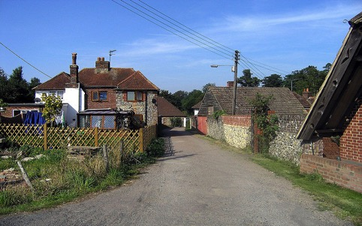
Final Steps
Step 4: Experiential data – impressions and personal feelings
Useful source of analytic data at a later stage.
Write down everything you can think of.
These kinds of notes can be kept as a diary.
Step 5: Forward planning.
This can be planning to revisit the field to collect missing data or plan the next stage of the research project.

Slide 29
Activity
Go to a crowded public space and spend 20 minutes observing people in action, and listening to their conversations. During the observation, make as comprehensive a set of field notes as you can, and write these up as soon as you can. Examine your completed field notes. Do they accurately reflect what you observed? What was the ratio between the time observing and time taken to write up?

Slide 30
Black

Slide 31
Research & Writing link at BibleStudyDownloads.org
Get this presentation for free!
Notes:
Research & Writing (rw)

