Slide 1
How can we have clearer presentations?
Sermon PPT Format
Use this template to save time setting things up and also to help recall the things to put on slides

Slide 2
Title
Passage
Dr. Rick Griffith • Crossroads International Church Singapore
BibleStudyDownloads.org

Slide 3
Need

Slide 4
Subject?

Slide 5
Background

Slide 6
Black on White

Slide 7
I. Main Point

Slide 8
"Scripture" (4: NLT).

Slide 9
II. Main Point

Slide 10
"Scripture" (4: NLT).

Slide 11
II. Main Point

Slide 12
"Scripture" (4: NLT).

Slide 13
Main Idea
Text

Slide 14
Text

Slide 15
Text

Slide 16
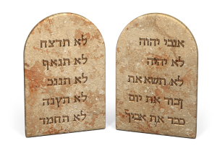
The Big Ten

Slide 17
Worship

Slide 18
Black on White

Slide 19
I. Main Point

Slide 20
"Scripture" (4: NLT).

Slide 21
"Scripture" (4: NLT).

Slide 22
"Scripture" (4: NLT).

Slide 23
"Scripture" (4: NLT).

Slide 24
"Scripture" (4: NLT).

Slide 25
"Scripture" (4: NLT).

Slide 26
Black Text
Website

Slide 27
Title
Explanation

Slide 28
Blue Background
LIVE WELL
LAUGH OFTEN
LOVE MUCH

Slide 29
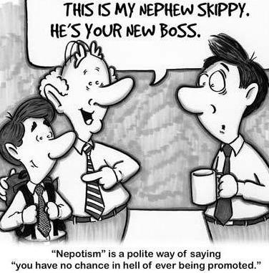
Nephew
Here is the place where the translation goes

Slide 30
Black Text
Website

Slide 31
Title

Slide 32
Title

Slide 33
Black

Slide 34
Black

Slide 35
NT Sermons link at BibleStudyDownloads.org
Get this presentation and script for free!

Slide 36
OT Sermons link at BibleStudyDownloads.org
Get this presentation and others like it for free!

