Slide 1
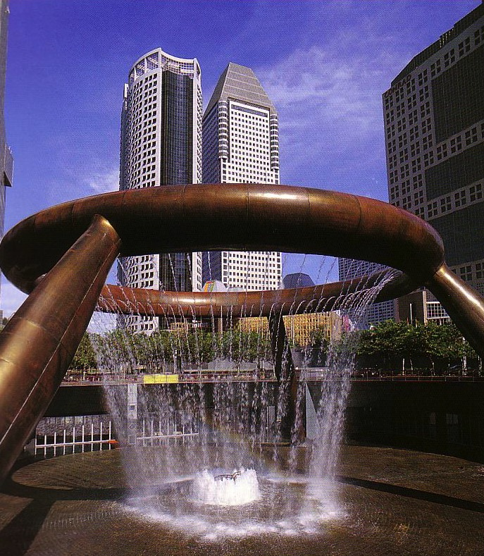
Sermon Structure
Buildings need structure.
Sermons do too!
Dr. Rick Griffith • Jordan Evangelical Theological Seminary • BibleStudyDownloads.org

Slide 2
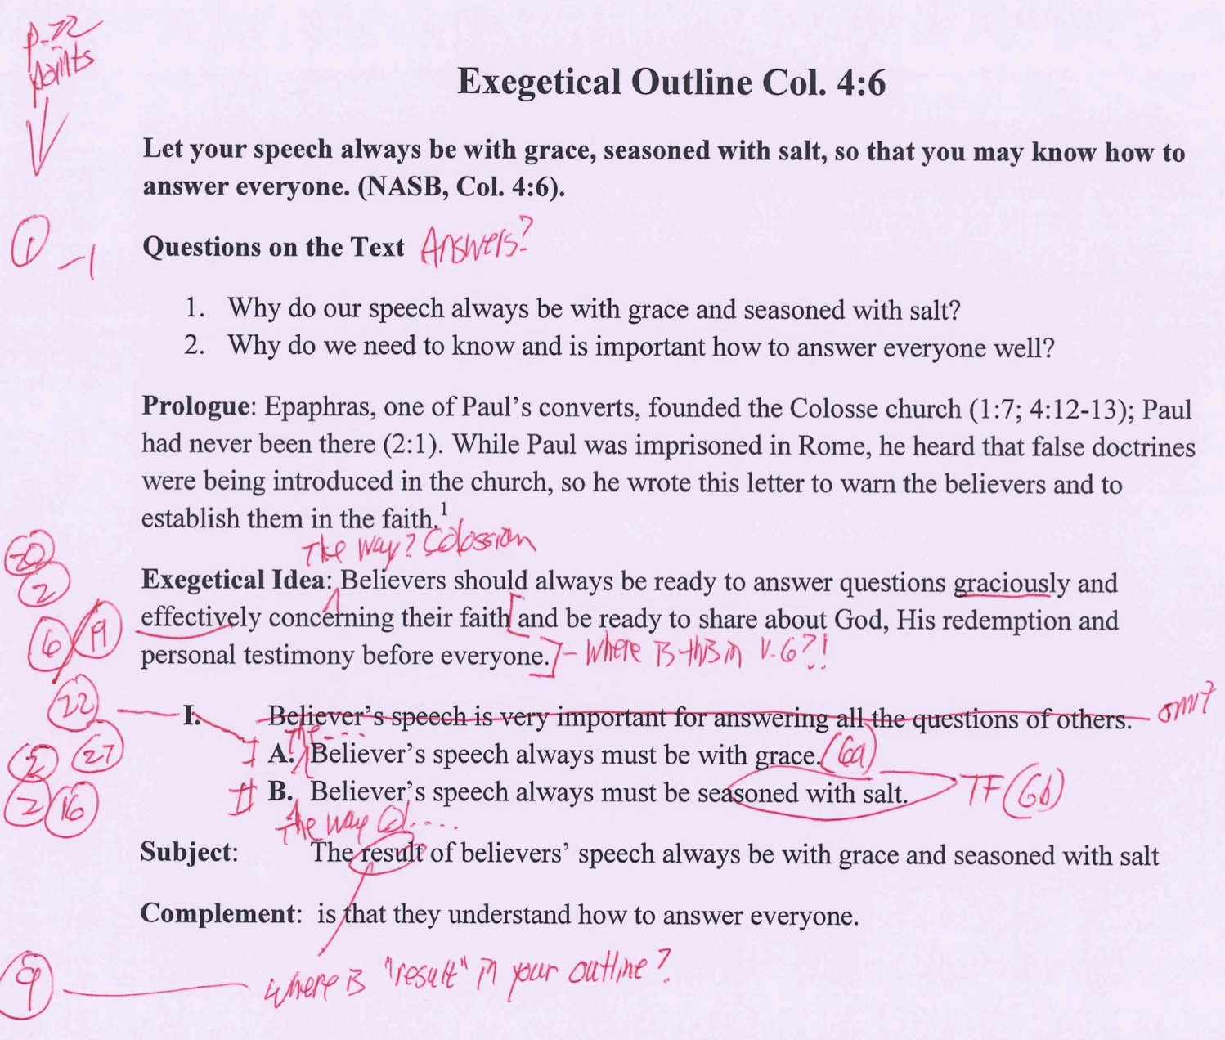
How I grade Col. 4:6 EO (Assign. #4)
22
Make sure you follow each item on the p. 22 checklist
1. Have you written your questions & answers of the text and the text itself at the top (if preaching 1-2 verses)?
2. Are the Exegetical Idea (EI) and Main Points (MPs) all written in proper Z1+X+Z2+Y form?
20. Is the focus the recipients in the past (not present) tense (Write “The way the Colossians should…” not “We should…”) and in active (not passive) voice?
Is the EI and outline exegesis true to the author’s intent? (AI = evaluate Authorial Intent)?
19. Do SPs (or MPs) avoid ideas not in the text (e.g., from cross-references)? (“NP” = not in passage)?
22. Does each point have a coordinating point (“I” has “II”, “A” has “B”; p. 61 [II.A.1.] & p. 55)?
2. Are the Exegetical Idea (EI) and Main Points (MPs) all written in proper Z1+X+Z2+Y form?
27. Does each sentence in the outline include its correct verse, verses, or verse portion (1a, 1b, 1c, etc.)?
Does at least one Z1 in the MPs match that of the EI?
16. Do statements translate figures of speech rather than use the text’s words? (“TF”)
Notes:
Homiletics 12.02 slideTo translate this slide, note that there are 22 boxes that appear one at a time and then exit. Note the little animation numbers from 3 to 12 at the top and 13 to 22 below them. Each is a different box that needs to be moved away from the others first to see what it says to translate it. After translation, put them back in order as on the English.

Slide 3
Some sermons are unsolved mysteries!
"Hi, I'm a reporter from 'Unsolved Mysteries,' and we'd like to do a story on your last sermon…"

Slide 4
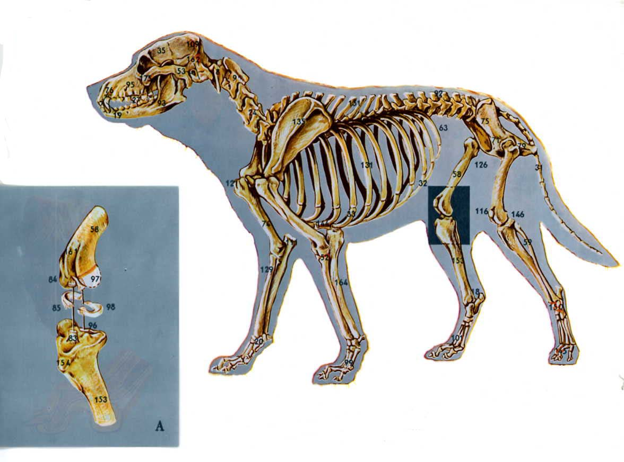
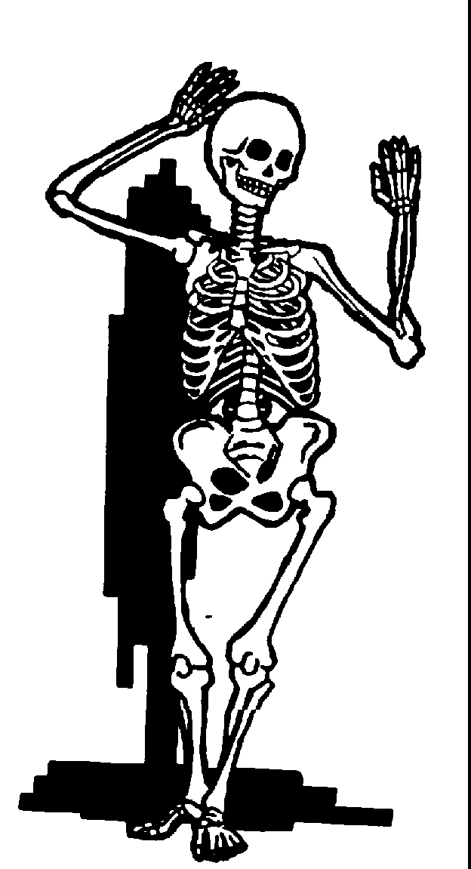
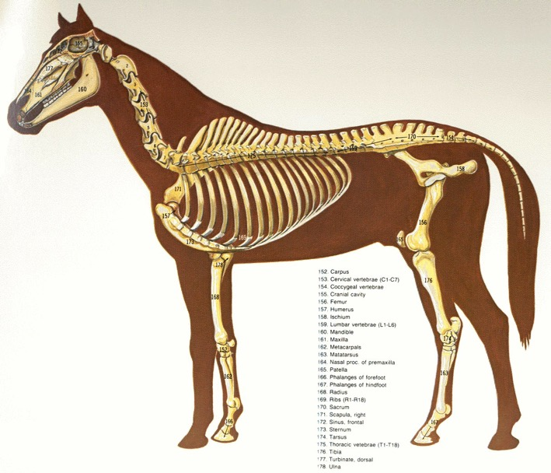
All creatures need a skeleton. Sermons do too!

Slide 5
The Preparing Expository Sermons Process
27-28, 251
Based on Ramesh Richard's text, Preparing Expository Sermons
TEXT
SERMON
5 Desired Listener Response
Brain
4 The Three
Developmental
Questions
Purpose Bridge
3.2 Exegetical Idea
CPT
Heart
CPS
6 Homiletical Idea
7 Homiletical
Outline
8 Clarity
9 Intro/Concl
3.1 Exegetical
Outline
Structure
Skeleton
Structure
2 Analyze Text
Study
Flesh
Preach
10 MSS &
Preach
1 Choose Text
White text shows 10 steps adapted from Haddon Robinson, Biblical Preaching (notes, 105)

Slide 6
How should you structure your sermon?

Slide 7
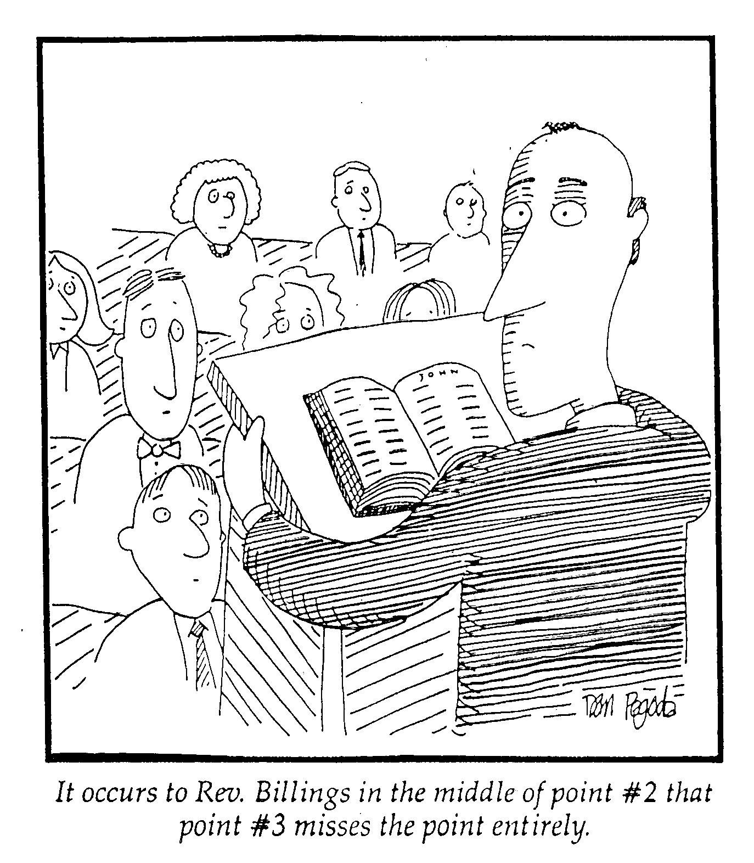
Get your structure done early!
It occurs to Rev. Billings in the middle of point #2 that point #3 misses the point entirely.

Slide 8
Types of Sermon Structure
47
Inductive- Deductive
Deductive
Inductive
Introduction
CPS
Theme
Theme
I
I
I
CPS
Body
II
II
II
III
III
III
Conclusion
Restate CPS
CPS
Restate CPS
Advantages:
Clear
Interesting
Variety
Notes:
Page 138
Question: Which of these structures is the worst one to use? Answer: The one you use all the time!

Slide 9
Keep your points short in number and style!
"To balance last week's 20-point sermon, today's message will be pointless.”
2-4 MPs One line MPs

Slide 10
Deciding Sermon Structure
138
Where is the Application?
Simple
(given once)
Cyclical
(given throughout)
Inductive (end)
Simple Inductive
Cyclical Inductive
Where is the MI?
Deductive (beginning)
Simple Deductive
Cyclical Deductive
Notes:
Question: Which of these structures is the worst one to use? Answer: The on you use all the time!

Slide 11
Simple Inductive (Acts 6:1-6)
49
Subject: When church growth problems arise, how should we solve them?
(I. The apostles solved the growth problem with lay leadership)
(=EI)
Inductively developed MPI
A. Their church was growing (1a) B. They had a food problem (1b) C. They designated leaders (2-6)
(=EI)
II. The solution to the problems of a growing church is lay leaders (MI)
III. The solution to our problems… (APP)
Don Sunukjian, DTS
Notes:
This sermon design goes through the entire passage before applying it. Yet it does not give the EI (Exegetical Idea) summing up the whole text until the speaker arrives at the last section of the passage. Only then is the MI (Main Idea) stated and then applied.
ـــــــــــــ
PR-12-Structure-11
PR-13-Outlining-19
PR-15-Clarity-28

Slide 12
Cyclical Inductive (Acts 6:1-6)
49
Subject: When church growth problems arise, how should we solve them?
P
I. This church, like ours was growing
T
A. Their church was growing (1a) B. We are growing…
A
P
II. But growing churches have problems
T
A. They had a food problem (1b) B. We have these problems…
A
P
III. The solution is to have lay leaders
T
A. They solved their problem (2-6) B. The way to solve our problems…
A
Don Sunukjian, DTS
Notes:
PTA = Principle for the MP level, Text is Bible passage portion, Application shared only for that portion

Slide 13
Simple Deductive (Acts 6:1-6)
50
MI: When church growth problems arise, we should solve them with lay leadership
I. The solution to Jerusalem's growth problem was lay leadership (EI)
A. Jerusalem's church grew (1a) B. They had a food problem (1b) C. They designated leaders (2-6)
II. The solution to our growth problems is to appoint lay leaders (MI)
A. We are growing… B. Our problems are… C. We need to designate lay leaders
Don Sunukjian, DTS

Slide 14
Deciding Sermon Structure
138
Where is the Application?
Simple
(given once)
Cyclical
(given throughout)
Inductive (end)
Simple Inductive
Cyclical Inductive
Where is the MI?
Deductive (beginning)
Simple Deductive
Cyclical Deductive
Notes:
Question: Which of these structures is the worst one to use? Answer: The on you use all the time!

Slide 15
What structure does each sermon have on pages 52-60? Don't read through each message but just skim them to see where the Main Idea and the Application occur. Write its page 138 structure at the top and move quickly to the next sermon.
Judges 1 (pp. 52-53)
Simple Inductive
Psalm 3 (p. 54)
Cyclical Inductive-Deductive
Psalm 16 (pp. 55-56)
Cyclical Inductive-Deductive
Psalm 77 (pp. 57-60)
Simple Inductive (MPI) & Cyclical Inductive (MPII)

Slide 16
Exegetical Idea: The reason the church should restore a sinning Christian correctly is because it extends God's authority.
34c
The manner in which the church should correctly restore a sinning Christian is by keeping the matter as private as possible (15-17) .
The reason the church can restore or continue to seek to restore errant believers is because it extends God’s authority (18-20) .
Matthew 18:15-20
Notes:
PR 07.15. 09.35; 11.25; 12.16; 16:11 HO subject only
BS 18.43; 20.31; 25.11

Slide 17
Converting the EO to the HO
Cyclical Inductive
Passage Outline
Sermon Outline
EI: The reason the church should restore a sinning Christian correctly is because it extends God's authority.
Intro MPI: How do we restore sinning Christians properly?
I. Keep the matter as private as possible (15-17).
I. The manner in which the church should correctly restore a sinning Christian is by keeping the matter as private as possible (15-17) .
(Why can we even seek to restore sinning members?)
II. Our church extends the authority of God Himself (18-20)!
II. The reason the church can restore or excommunicate errant believers is because it extends God’s authority (18-20).
MI: We must restore sinning members properly because we act on God's behalf
Notes:
HOM 12.17; HSB 25.12
After Passage Outline MPII… Question: How should we start the sermon—with the why or the how question? Answer: How is better, even if it is not the subject of the whole passage.
After Sermon Outline MPI… Question: How should we transition into MPII? Answer: Use the interrogative of EO MPII ("reason"), resulting in a "why" transition that gives the subject of HO MPII.

Slide 18
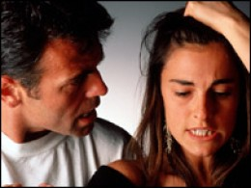
How do we restore sinning Christians properly?
Our First Question Today (for vv. 15-17)
Notes:
08.13
11.25
12.18

Slide 19
The Point of Verses 15-17
34d
Don't blab the problem.
I. Keep the matter as private as possible (15-17).
Notes:
07.18
12.19

Slide 20
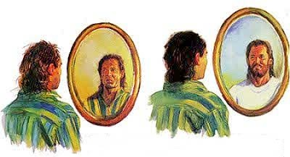
(Transition Statement)
MPI
MPII
But why can we restore sinning members?
Notes:
12.20

Slide 21
The Point of Verses 18-20
Why do we restore sinning Christians properly?
We extend God's authority
II. Our church extends God’s authority.
Notes:
07.20
08.37 but changed to HO SP in:
11.30
12.21

Slide 22
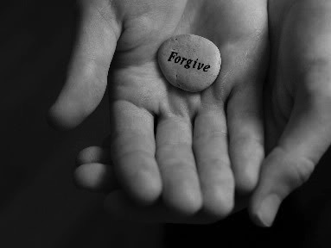
Main Idea:
Restore sinners because you act for God
Restore sinning members properly because you act for God
Notes:
PR 07.21; 08.44 but changed to HO in:
11.31
12.22
Cf. HSB 18.10 adds the EI on top from HOM 12.16

Slide 23
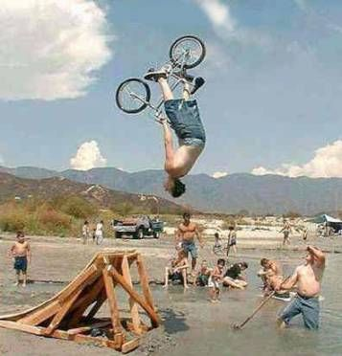
Does structure still look threatening?
Any questions?

Slide 24
Black

Slide 25
Preaching (Homiletics) link at BibleStudyDownloads.org
Get this presentation for free!
Notes:
Preaching (pr)
Homiletics

