Slide 1
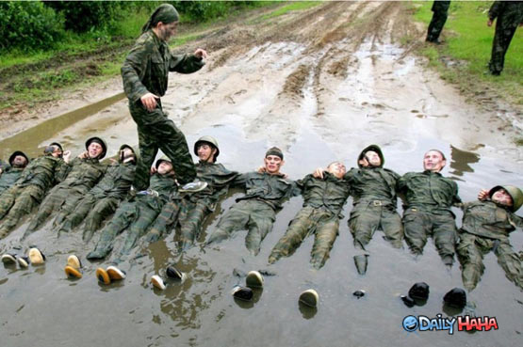
The Purpose Bridge to the Main Idea
Dr. Rick Griffith • Jordan Evangelical Theological Seminary • BibleStudyDownloads.org

Slide 2
The Preparing Expository Sermons Process
27-28, 251
Pop Quiz
On a piece of paper, fill in the 13 blanks below…
TEXT
SERMON
Brain
Purpose Bridge
CPT
Heart
CPS
Structure
Skeleton
Structure
Study
Flesh
Preach
Notes:
Do your own work and from memory without looking at your notes; if you have time, add Robinson's 10 steps too!

Slide 3
Know your purpose!
Our speaker today is an SBC graduate, so we can be sure the message will be clear, well-prepared, and backed by years of understanding.

Slide 4
The Preparing Expository Sermons Process
27-28, 251
Based on Ramesh Richard's text, Preparing Expository Sermons
TEXT
SERMON
5 Desired Listener Response
Brain
4 The Three
Developmental
Questions
Purpose Bridge
3.2 Exegetical Idea
CPT
Heart
CPS
6 Homiletical Idea
7 Homiletical
Outline
8 Clarity
9 Intro/Concl
3.1 Exegetical
Outline
Structure
Skeleton
Structure
2 Analyze Text
Study
Flesh
Preach
10 MSS &
Preach
1 Choose Text
White text shows 10 steps adapted from Haddon Robinson, Biblical Preaching (notes, 105)

Slide 5
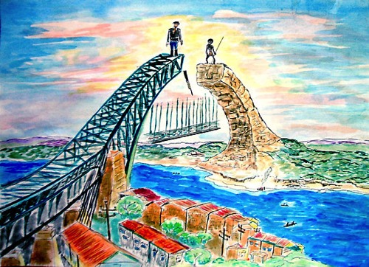
Definitions Review
40
Step 3: The exegetical idea (CPT) summarizes the text's message to the biblical audience
Step 4: The sermon's purpose (desired listener response) is the behavior change you want in the hearers as a result of your preaching the homiletical idea
Step 5: The homiletical idea (CPS) summarizes the sermon for the modern audience
Notes:
11.5
The Purpose Question: On the basis of this text, what does God want my people to hear, understand, and obey?
See separate EO sermon manuscripts on Ps 117:1-2; Matt 28:18-20; Ezra 7:10.

Slide 6
Sermon Purpose Examples
40
"The listeners will…"
Know
Feel
Do
• "thank and appreciate their mothers for the ministry they have had in their lives" (p. 86)
• "gladly do humble tasks for others" (p. 148)
Desired Listener Response

Slide 7
Sermon Purpose Examples
40
"The listeners will…"
Know
Feel
Do
• "see God's priority in missions and commit themselves to be best used in the fulfillment of the Great Commission" (p. 156)
Desired Listener Response

Slide 8
Sermon Purpose Examples
40
"The listeners will…"
Know
Feel
Do
• "rid themselves of ungodly influences which wreck their own spiritual lives and eventually that of the church" (p. 170)
Desired Listener Response

Slide 9
Sermon Purpose Examples
40
Neh. 5: "The listeners will…"
Know
Feel
Do
• "show compassion for the poor instead of greed"
• "see God's compassion through others if they are poor and imitate God's compassion on the poor if they are wealthy"
Desired Listener Response

Slide 10
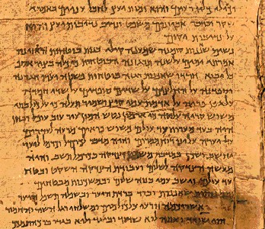
Contrasting the Ideas
40
Issue
Passage
Sermon
Order
First
Second
Place
Study
Pulpit
Steps
Obs/Inter
Prin/App
Concern
Accuracy
Relevance

Slide 11
Contrasting the Ideas
40
Issue
Passage
Sermon
Form
Z₁-X-Z₂-Y
Slogan
Length
2-3 lines
1-2 lines
Outline
Sequential
Logical
To be
Read
Heard

Slide 12
Contrasting the Ideas
40
Issue
Passage
Sermon
Audience
Time bound
Timely
Tense
Past
Present
Mood
Indicative
Imperative
Person
3rd
1st or 2nd

Slide 13
Contrasting the Ideas
40
Issue
Passage
Sermon
Question
God to them
God to us
Needs
Original
Modern
Focus
Textual
Cultural
Purpose
Summarize
Communicate

Slide 14
Comparing the Ideas
40
Write both the CPT & CPS:
• in the active voice
• in full sentences
• with correlating Z₁s & interrogatives
• so they include the whole passage
Notes:
11.14

Slide 15
EO to HO Examples
40
Page 32: A Mighty Fortress (Luther)
Page 34c-d: Matt. 18:15-20 (Discipline)
Page 46: Psalm 23 (God's Care)
Page 116: Nehemiah 1 (Sovereign God)
Page 153: John 13 (Love)
Page 178: Ezra 9 (Intermarriage)
Page 262: 2 Kings 5 (Naaman)

Slide 16
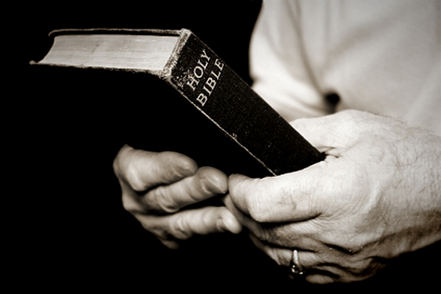
How to Make a Great Idea
40
The Homiletical Idea should be…
• Clear
• Concise
• Compelling
• Creative
Jeffrey Arthurs, Gordon-Conwell Theological Seminary, at SBC 15 Feb 2012

Slide 17
EI to MI Examples
41
"The result of Samson's immorality with Delilah was God's judgment upon his very life in the pagan temple of Dagon."
(Judges 16)
"God judges any 'he-man' with a 'she-weakness.'"
(Chuck Swindoll)
"What does sin bring? Pain!"

Slide 18
EI to MI Examples
41
"The manner in which the disciples were to pray that God rewarded was secretly rather than for public show like the Pharisees."
(Matt. 6:5-8)
"God blesses private prayers more than public."
(#9 on pp. 37 & 42)
"How can you pray with God's blessing? Pray with sincerity, not show."

Slide 19
EI to MI Examples
41
"The reason Jesus washed the disciples' feet was because He sought to set an example of love humbly serving others."
(John 13:1-17)
"When you love people like Jesus, you don't mind dirt" (p. 152)
"Why not mind dirt? To serve humbly with love."

Slide 20
EI to MI Examples
41
"The reason Paul stopped praying for his physical defect to be removed was because he began to value the humility and strength it built in him."
(2 Cor. 12:7-10)
"The thing you most pray that God would remove in your life is the thing you most want to keep."
(Don Sunukjian, Talbot Seminary)
"Why stop praying? To value humility and strength more than answered prayer"

Slide 21
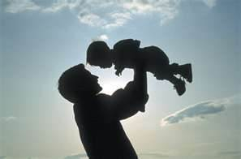
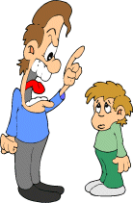
Ephesians 6:4
"Fathers,
do not provoke your children to anger,
but bring them up
in the discipline and
instruction of the Lord" (NAU).
Καὶ οἱ πατέρες,
μὴ παροργίζετε τὰ τέκνα ὑμῶν
ἀλλὰ ἐκτρέφετε αὐτὰ
ἐν παιδείᾳ καὶ
νουθεσίᾳ κυρίου (NA27 GNT 1993)

Slide 22
3. CPT (Exegetical Idea) Eph. 6:4
EI: The way Ephesian fathers should raise their children was by guiding rather than provoking them.
Negative: The way Ephesian fathers should raise their children was by not provoking them (4a).
Positive: The way Ephesian fathers should raise their children was by guiding them in God's ways (4b-c).
They should discipline their children (4b).
They should instruct their children (4c).

Slide 23
4. Purpose Bridge (Eph. 6:4)
Desired Listener Response:
The fathers will replace provoking with guidance
EI: The way Ephesian fathers should raise their children was by guiding rather than provoking them.
MI:
Dads, don't nag—teach!

Slide 24
Psalm 23 Purpose & Outlines
46
Desired Listener Response: The listeners will worship God without fear.
Exegetical Idea: The response of David to God's goodness shown in providing for and exalting him was to fearlessly commune with God at the tabernacle the rest of his life.
Main Idea: God's good to you, so publicly worship Him without fear.

Slide 25
Exegetical Idea: The reason the church should restore a sinning Christian correctly is because it extends God's authority.
34c
(15-17) The manner in which the church should correctly restore a sinning Christian is by keeping the matter as private as possible.
(18-20) The reason the church can restore or continue to seek to restore errant believers is because it extends the authority of God Himself.
Matthew 18:15-20
Notes:
PR 07.15. 09.35; 11.25; 12.16; 16:11 HO subject only
BS 18.43; 20.31; 25.11

Slide 26
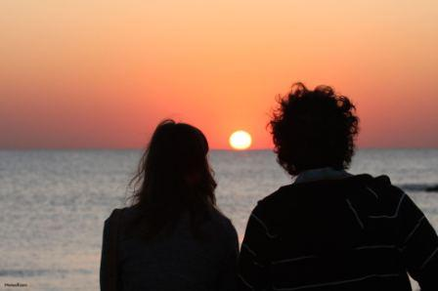
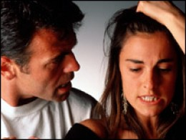
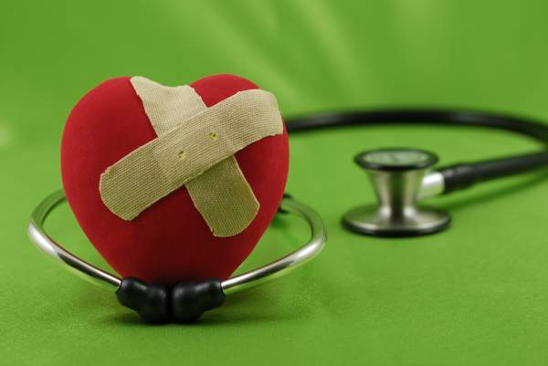
How do we restore sinning Christians properly?
34d
Our First Question Today... (introduces MP I for vv. 15-17)
Notes:
08.13
11.25
12.18

Slide 27
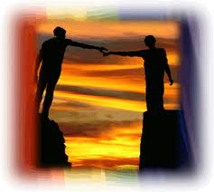
The Point of Verses 15-17
34d
I. Keep the matter as private as possible (15-17).
Notes:
08.16
11.26

Slide 28
Our Goal:
34d
Restoration!
Notes:
08.17
11.27

Slide 29
God's 4-step restoring process…
34d
4
3
2
1
…reveals the issue to more people each step
Notes:
08.35
11.28

Slide 30
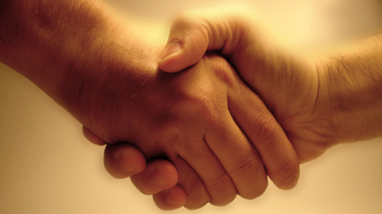
Transition after MPI finished: Our 2nd question is answered in vv. 18-20: Why do we restore sinning Christians properly?
34d
Notes:
08.36
11.29

Slide 31
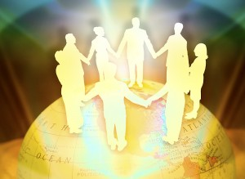
The Point of Verses 18-20
34d
II. Our church extends God’s authority.
Notes:
08.37 but changed to HO SP in:
11.30
12.21

Slide 32
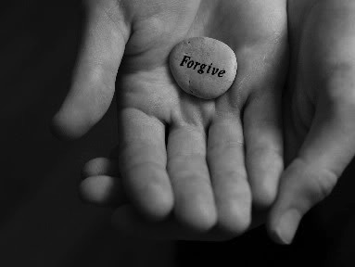
Main Idea:
Exegetical Idea: The reason the church should restore a sinning Christian correctly is because this restoration is carried out as an extension of God's authority.
34d
Restore sinners because you act for God
We restore sinning members properly because we act on God's behalf

Slide 33
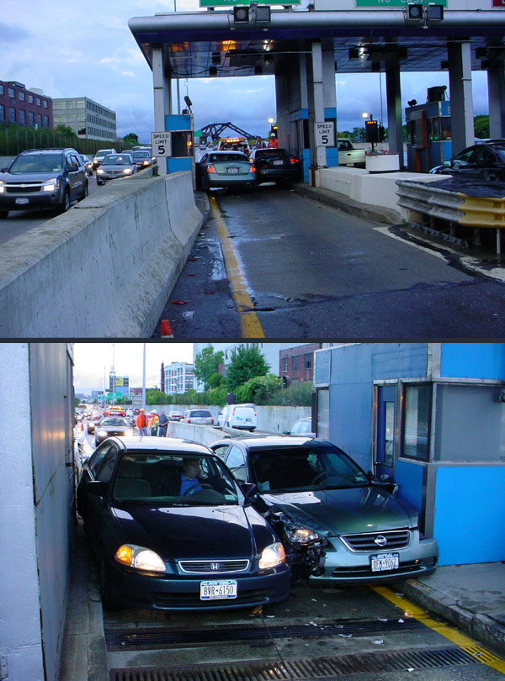
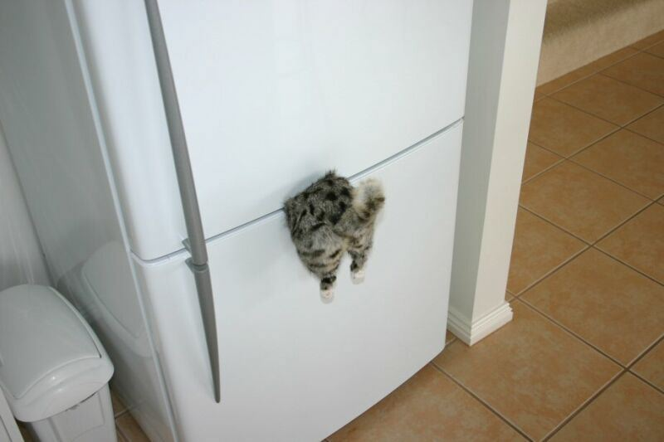
Assignment #3
Don't try to cram everything in!

Slide 34
You'll never lack material!
Preach the Bible and…
PASTOR
"I can't think of anything to preach on!"

Slide 35
Black

Slide 36
Preaching (Homiletics) link at BibleStudyDownloads.org
Get this presentation for free!
Notes:
Preaching (pr)
Homiletics

