Slide 1
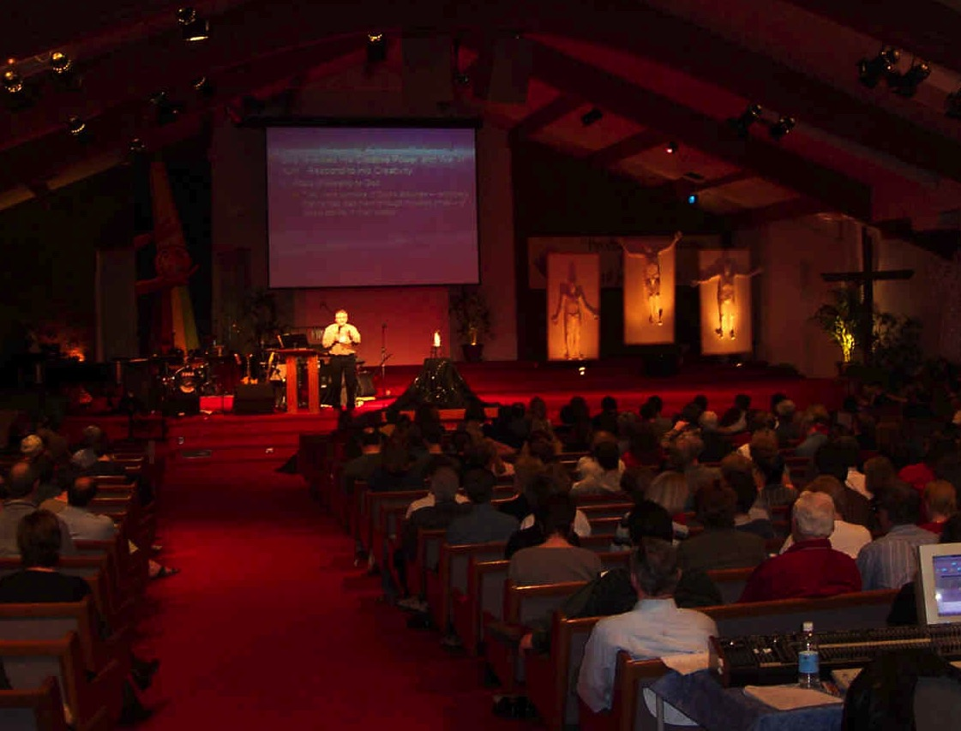
Expository Preaching
3
Advantages
Goals
Difficulties
Contemporary Nature
Dr. Rick Griffith • Jordan Evangelical Theological Seminary • BibleStudyDownloads.org

Slide 2
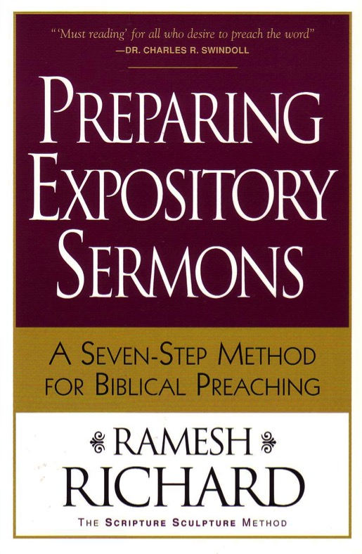
Reading Debrief
What insight in today’s reading was the most helpful to you?
What questions do you have?
Preparing Expository Sermons
A SEVEN-STEP METHOD FOR BIBLICAL PREACHING

Slide 3
The Preparing Expository Sermons Process
251 (cf. 27-28)
Based on Ramesh Richard, Preparing Expository Sermons
TEXT
SERMON
5 Desired Listener Response
Brain
4 The Three
Developmental
Questions
Purpose Bridge
3.2 Exegetical Idea
CPT
Heart
CPS
6 Homiletical Idea
7 Homiletical
Outline
8 Clarity
9 Intro/Concl
3.1 Exegetical
Outline
Structure
Skeleton
Structure
2 Analyze Text
Study
Flesh
Preach
10 MSS &
Preach
1 Choose Text
White text shows 10 steps adapted from Haddon Robinson, Biblical Preaching
Dr. Rick Griffith • Singapore Bible College • BibleStudyDownloads.org
Notes:
This diagram on page 251 shows how to prepare a sermon based on one passage, going from text to sermon. Ramesh Richard compares this to the human body, which starts on the outside (flesh) with words of the text and ends up back on the outside but with words of the speaker. Between these points must come an outline on which to hang these words, whether it be the structure of the text or of the sermon. The heart controls or pumps the flow of blood and should sum up the entire text/sermon, whereas using the brain helps us see the purpose of the EI (CPT) converted to the MI (CPS) to give direction to the message in terms of what to explain, prove or apply (3 Developmental Questions). These "body parts" match a parallel structure of the seven steps in the purple blocks. Haddon Robinson teaches a bit more complicated series of 10 steps that start and lead to the same purpose of preaching from the text. A two-page explanation of this 7-step process is on pages 27-28 of the course notes.

Slide 4
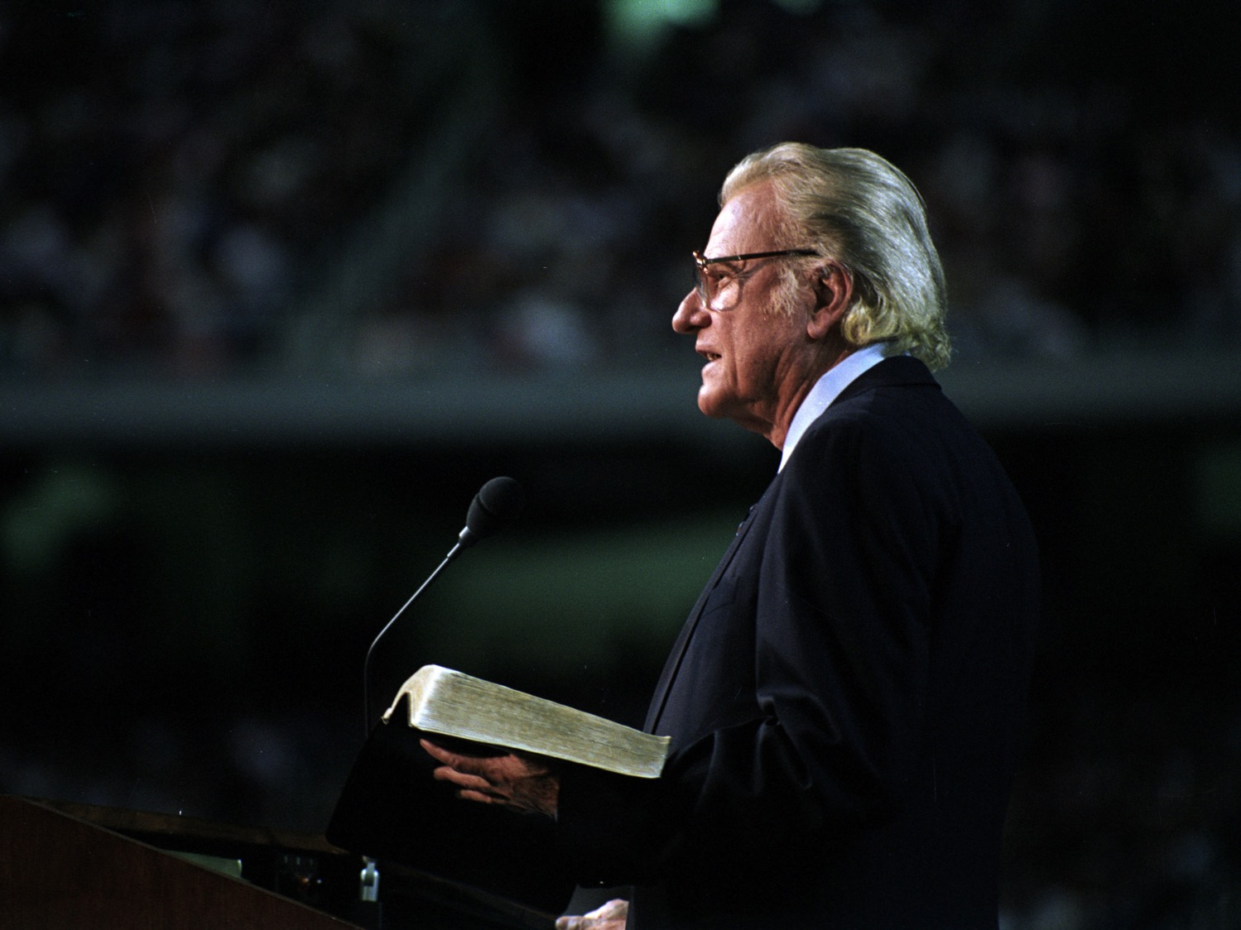
Advantages of Exposition
3
Confidence

Slide 5
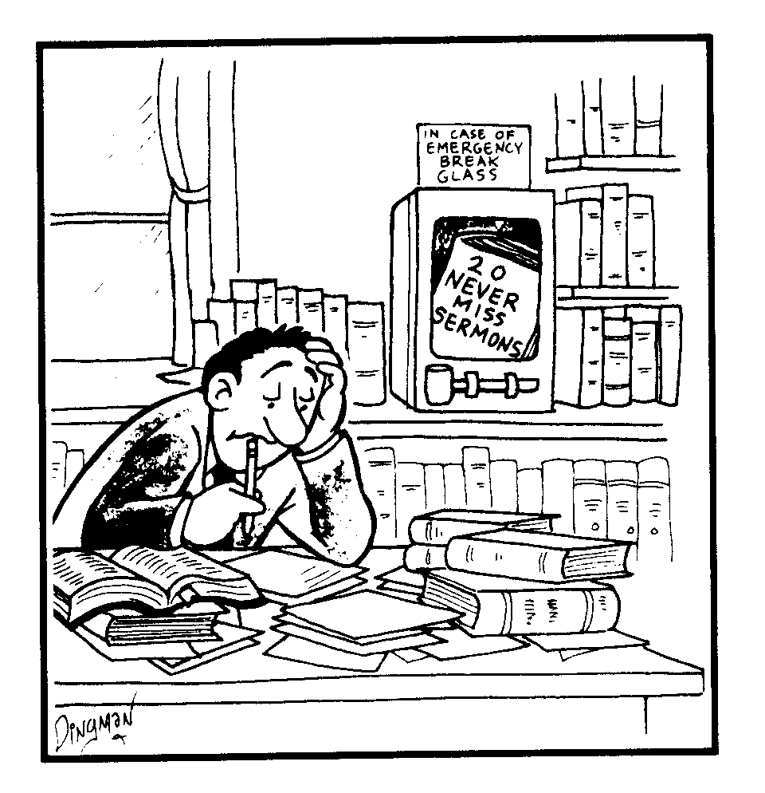
20 NEVER MISS SERMONS
IN CASE OF EMERGENCY BREAK GLASS
Notes:
Translate the two titles

Slide 6
Advantages of Exposition
3
Confidence
Less subjective
Balance
Application
Structure

Slide 7
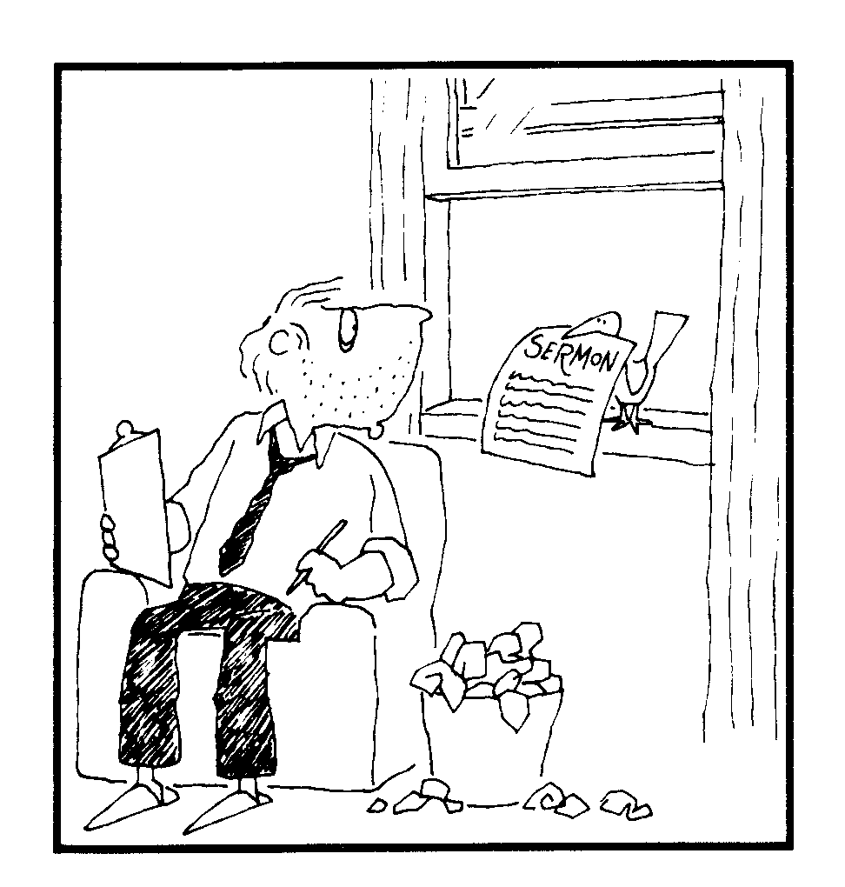
Bird Delivery
SERMON

Slide 8
Advantages of Exposition
3
Confidence
Less subjective
Balance
Application
Structure
Less touchy
Modeling
Saves time
Develops the preacher
Prepares congregation
Better for lambs

Slide 9
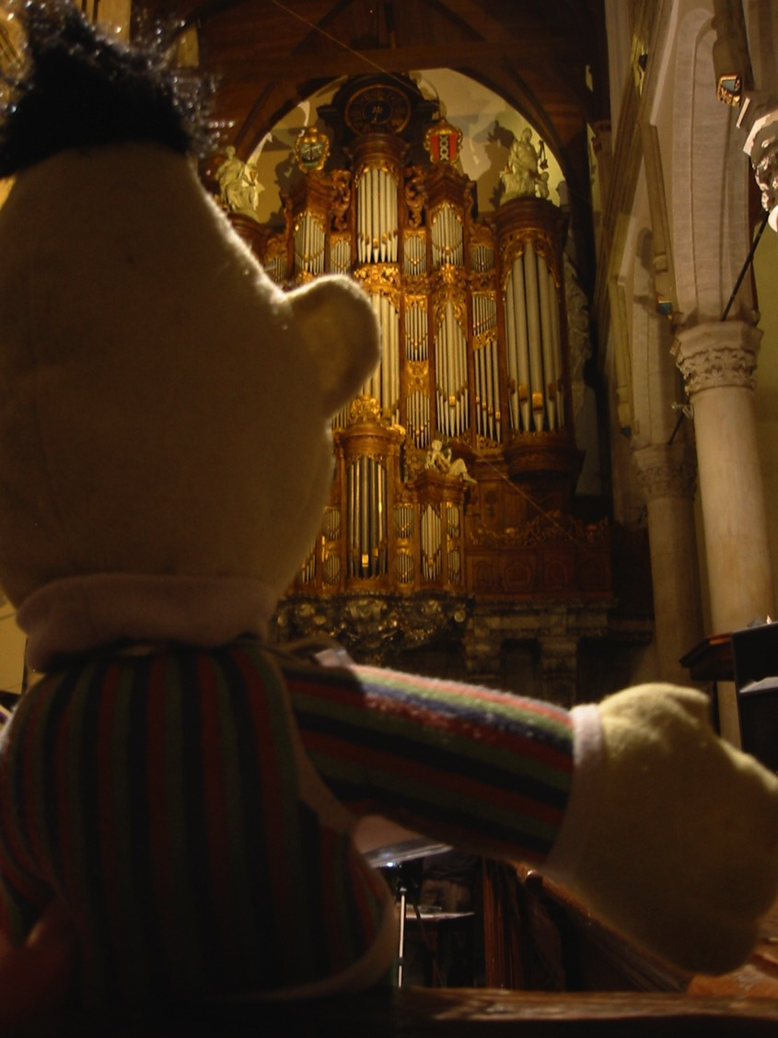
Expository preaching is a learned skill
Even Bert can do it!

Slide 10
Goals of Exposition
3
Evangelism
Meet Human Needs
Declare the Will of God

Slide 11
Decisions
“ BARCLAY OR BROADMAN? SPURGEON OR WIERSBE? ROBERTSON OR KITTEL? PROPHET OR EVANGELIST? REPENTANCE OR LOVE? IMPRESS THAT PULPIT COMMITTEE OR PREACH THE WORD?"
DECISIONS, DECISIONS, DECISIONS

Slide 12
Goals of Exposition
3
Evangelism
Meet Human Needs
Declare the Will of God
Motivate Faith, Obedience, & Growth
Teach Doctrine or Theology

Slide 13
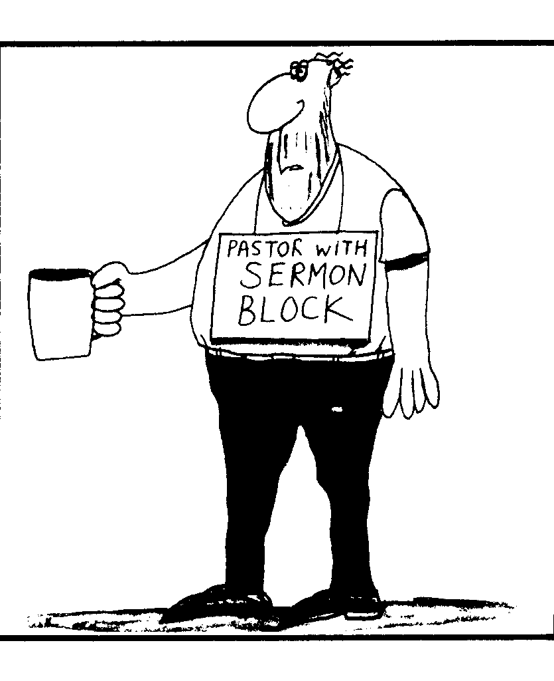
Sermon Block
PASTOR WITH SERMON BLOCK

Slide 14
Goals of Exposition
3
Evangelism
Meet Human Needs
Declare the Will of God
Motivate Faith, Obedience, & Growth
Teach Doctrine or Theology
Worship God & Exalt His Name
Convict of Sin and Rebuild on Grace

Slide 15
Difficulties of Exposition
4
Requires more study
Requires better hermeneutics

Slide 16
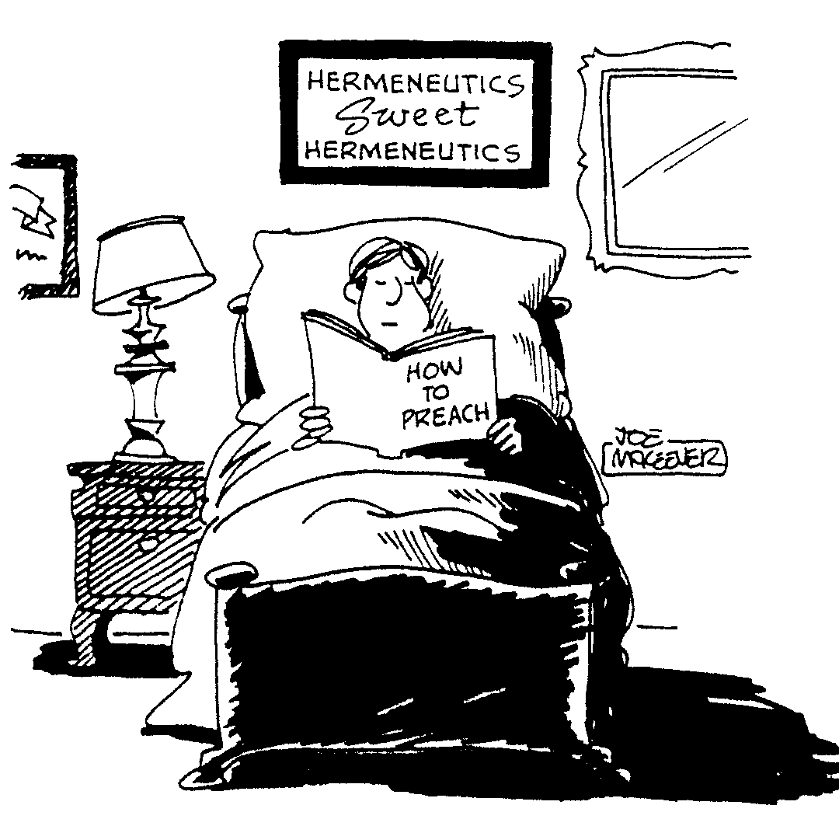
Hermeneutics
HERMENEUTICS SWEET HERMENEUTICS
HOW TO PREACH

Slide 17
Difficulties of Exposition
4
Requires more study
Requires better hermeneutics
Requires context
Requires literary form
Requires discernment

Slide 18
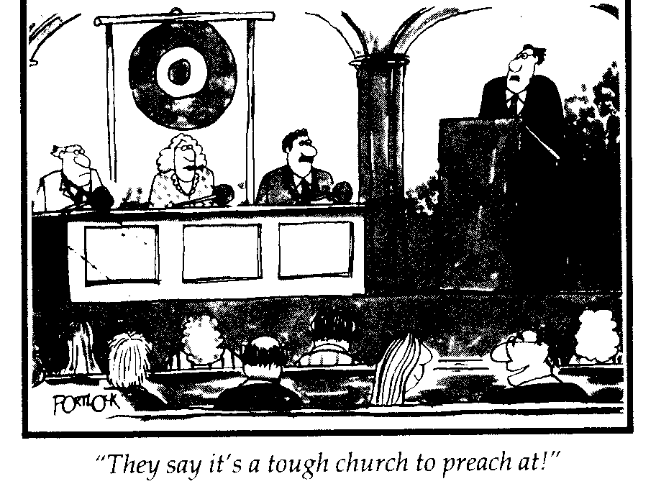
Gong Church
"They say it's a tough church to preach at!"
Notes:
"The Gong Show" in the USA is known for short acts where a judge can immediately stop the singer or speaker by hitting the gong if the act is too painful!

Slide 19
Difficulties of Exposition
4
Requires more study
Requires better hermeneutics
Requires context
Requires literary form
Requires discernment
Requires work to see the Main Idea

Slide 20
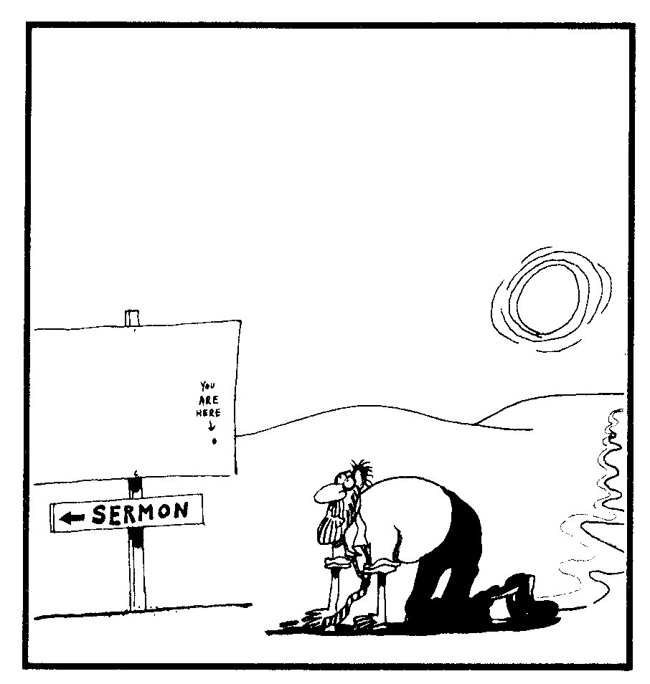
Desert Sermon
YOU ARE HERE
SERMON

Slide 21
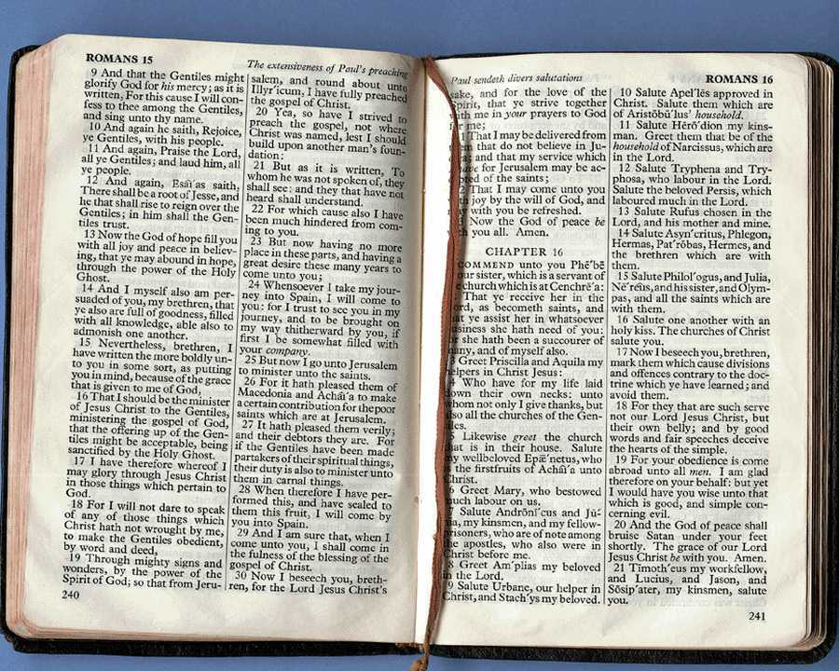
How Can Expository Preaching Be Contemporary?
4
How can we bridge the gap between the ancient and the modern worlds to be relevant?

Slide 22
How Can Expository Preaching Be Contemporary?
4
A. Know both cultures well
How?
Ancient
Modern
Notes:
Tell your neighbor two ideas HOW you can better know your people.

Slide 23
How Can Expository Preaching Be Contemporary?
4
B. Preach the life situation of the passage before abstracting principles.

Slide 24
How Can Expository Preaching Be Contemporary?
4
C. Draw parallels between the passage setting and its modern setting.

Slide 25
Black

Slide 26
Preaching (Homiletics) link at BibleStudyDownloads.org
Get this presentation for free!
Notes:
Preaching (pr)
Homiletics

