Slide 1
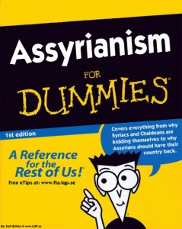
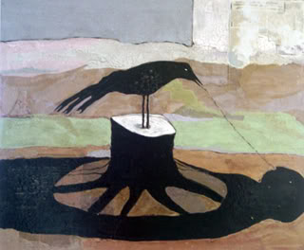
Book of Nahum
The Minor Prophets
Book of Nahum
Assyrianism
Dr. Rick Griffith • Jordan Evangelical Theological Seminary • BibleStudyDownloads.org
DUMMIES

Slide 2
Key Word
621
343
Nineveh
Nahum

Slide 3
Theme
621
Nineveh’s Destruction
Nahum

Slide 4
Key Verse
621
"The LORD is slow to anger and great in power; he will not leave the guilty unpunished" (1:3a).
Nahum

Slide 5
Kingdom Statement
343
God's judgment of Nineveh will demonstrate his rule over all nations (1:3).
Nahum

Slide 6
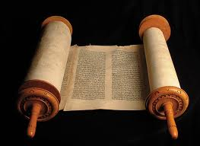
Summary Statement
621
346
God will destroy Assyria for its scheming against God and cruelty against man but comfort Judah that God will powerfully protect it by destroying Nineveh in accordance with His justice.
Nahum

Slide 7
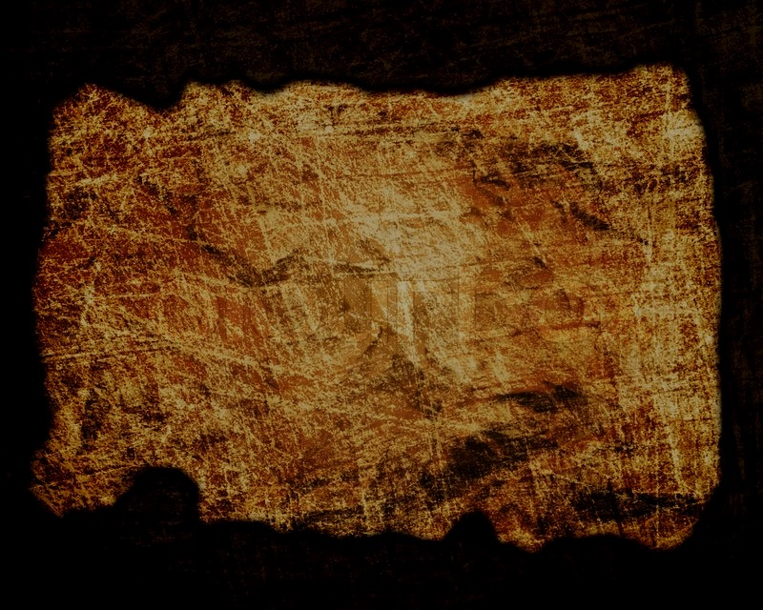
Covenant
347d
Nineveh joined Israel in its covenant with God 100 years earlier under Jonah but became God's enemy when it returned to sin (1:7-8; 3:5-7).
Nahum

Slide 8
Redemption
347d
While sin had run its course for the Assyrians with their inevitable end (1:8, 14; 2:7), restoration will come to Judah (1:15; 2:2).
Nahum

Slide 9
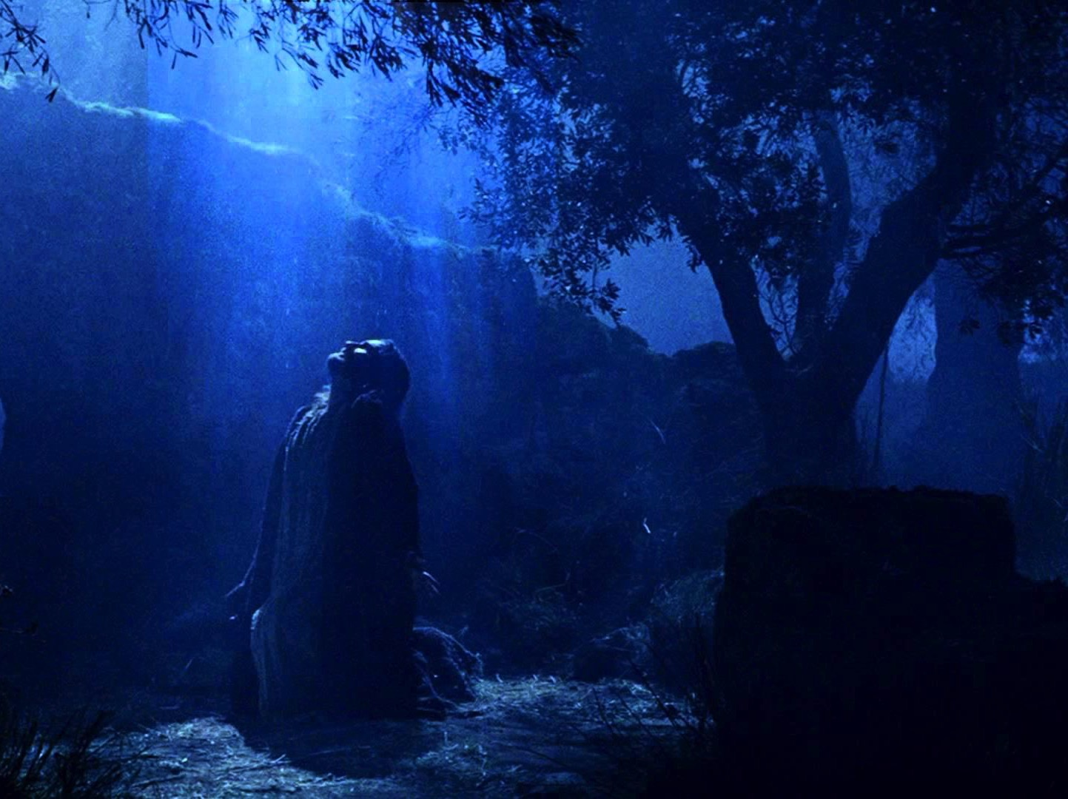
Messiah
347d
The book has no messianic prophecies but parallels Jesus by depicting both God's wrath and grace (1:2-8).
Nahum

Slide 10
Nahum Book Chart
621
Nineveh's Destruction
Certain |  |  |  | Detailed |  | Justified
Chapter 1 |  |  |  | Chapter 2 |  | Chapter 3
Destruction Decreed |  |  |  | Destruction Described |  | Destruction Deserved
Verdict of Vengeance |  |  |  | Vision of Vengeance |  | Vindication of Vengeance
What God Will Do |  |  |  | How God Will Do It |  | Why God Will Do It
God's Anger |  |  |  | God's Actions |  | God's Accusations
God's Predictions for Judah |  |  |  | God's Power for Judah |  | God's Justice for Judah
Title 1:1 | God's Traits 1:2-8 | Plotting Against God 1:9-11 | Destruction is Judah's Deliverance 1:12-15 | Battling vs. Judah's Splendor 2:1-2 | Destruction & Despoiling 2:3-13 | Destruction for Cruelty 3:1-7 | Drunk When Destroyed 3:8-11 | Burned With Fire 3:12-19
In Judah Against Assyria's Capital, Nineveh
c. 660 BC

Slide 11
Barry Huddleston, The Acrostic Summarized Bible (Grand Rapids: Baker, 1992)
Nahum
1 God’s character and judgment
2 Overthrow of Nineveh imminent
3 Details of Nineveh’s judgment

Slide 12
Be Patient
Nahum
Dr. Rick Griffith • Crossroads International Church Singapore
BibleStudyDownloads.org

Slide 13
What mistake do we too often make about God’s patience?
Nahum
Notes:
We’ll answer this question: what mistake do we too often make about God’s patience?

Slide 14
Contrasting Jonah & Nahum
JONAH | NAHUM
First Book (4 chapters) | Sequel (3 chapters)
about 760 BC | about 660 BC
Repentance from Sin | Return to Sin
Nineveh Delivered | Nineveh Destroyed
Israel Responsible | Israel Protected
Chance to Repent | No Chance to Repent
Narrative | Declarative
626
626

Slide 15
100 Years Later…
ASSYRIA
Tiglath-Pilesar
Assyria Strong
Jonah 760
Nahum 660
Nineveh's Fall 612
Israel's Fall 722
Zephaniah 630
1100
900
850
800
750
700
650
600
Nineveh's Relapse
Notes:
Nineveh was weak in Jonah’s time, but then grew incredibly strong 100 years later once again. But how strong? What was next on God’s calendar?
———————
Common-410
OS-00_OT Book Overviews-675
OS-34-Nahum-15
OS-36-Zephaniah-98

Slide 16
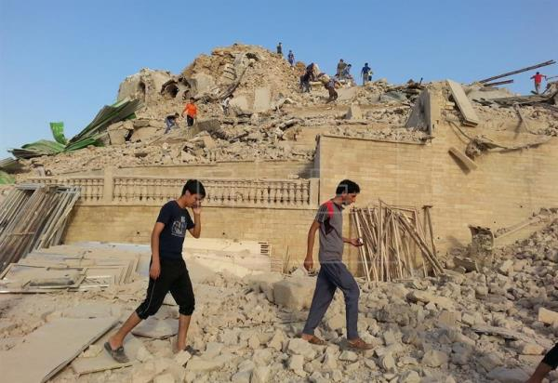
I. God would destroy Nineveh but save Judah (Chapters 1–3).
Nahum
Notes:
The capital of Assyria would have capital punishment for its capital crimes, yet the southern kingdom of Israel could gain comfort from this as the LORD would preserve them.

Slide 17
II. God will judge the wicked and deliver the righteous in the future too.
Be patient.
Nahum
Notes:
The LORD is watching over your future, including his promise to punish all who reject him.

Slide 18
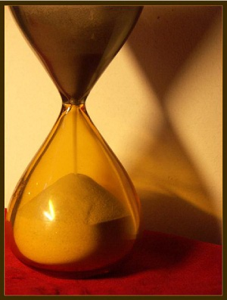
Main Idea
Don’t mistake the patience of God as the impotence of God.
—Huang Sabin
Nahum

Slide 19
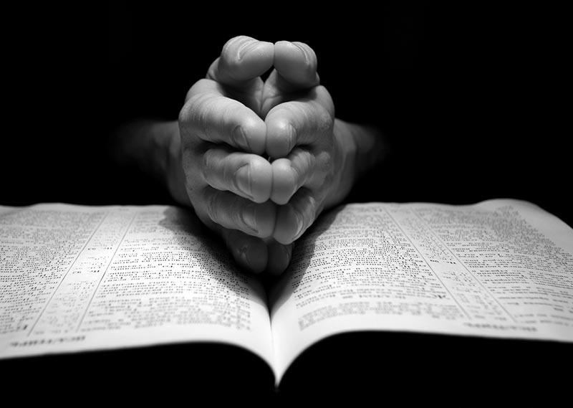
What are you waiting for?
God's 3 answers to your prayers:
Yes.
Not yet.
I have something better.
Nahum

Slide 20
Black

Slide 21
Contents
1. Title
2. Date
3. Authorship
4. Recipients
contents
nahum
5. Historical Background
6. Problem Issue
7. Literary Structure
8. Theology

Slide 22
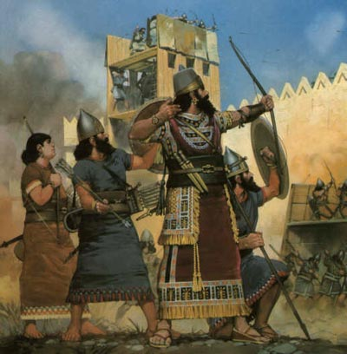
Title & Date
621
Title
Nahum means "consolation" or "consoler"
This symbolizes his message to comfort Judah's oppressed and afflicted people.
Date
Latest: Nineveh's destruction (612 BC)
Earliest: Captivity of No (No-amon or Thebes, the capital of Upper Egypt) in Nahum 3:8 in 663 BC

Slide 23
The Nineveh Metropolis
602
Rehoboth Ir
Size of Singapore
Nineveh Proper
The Great City of Nineveh
Resen
Calah
Genesis 10:11-12
0
kilometers
20
Notes:
That second study was on Jonah. Nineveh was the super-city of antiquity, composed of four cities combined (cf. Gen. 10:11-12).
____________
There's a problem here regarding the three-day's journey (cf. OTS, 602). Nineveh's inner wall was less than eight miles, so the diameter of the city was only two miles—hardly a three-day journey. One day's journey in the open was usually 15-20 miles (Hannah, BKC, 1:1463).
But this isn't really a problem in either of two ways:
"The great city of Nineveh" (1:2; 3:2; cf. 4:11) almost surely included three other towns in the vicinity as well. Four cities (Nineveh, Rehoboth Ir, Calah, and Resen) are mentioned in Genesis 10:11-12 as "the great city" and they still exist today with different names (Kouyunjik, Khorsbad, Nimroud, and Karamles). This can be observed on this map by Austin Henry Layard, Nineveh and Its Remains, 2:40.
If we superimpose a map of Singapore over it, we can see that walking through Nineveh would be like walking in Singapore from the far north in Yishun to Harbourfront in the south. That could take 3 days easily—especially when stopping to preach along the way.
23

Slide 24
Be Patient
Nahum
Dr. Rick Griffith, Crossroads International Church Singapore
BibleStudyDownloads.org

Slide 25
Sequels
Notes:
Sequels are great as they finish stories that we’ve heard.
Hollywood has us hooked—a movie always ends without a real ending, which makes you want to see what happens next, right? So it continues into parts 2 and then 3.
• The Bourne series has three movies. Ice Age had a sequel in Ice Age 2, followed by a sequel-to-the-sequel in Ice Age 3. The same was true for the Star Wars Trilogy, Jaws, and many others

Slide 26
Major Messages, Minor Prophets
God’s Old Message for Our New Day
Notes:
In recent weeks, we have covered five of the 12 Minor Prophets.

Slide 27
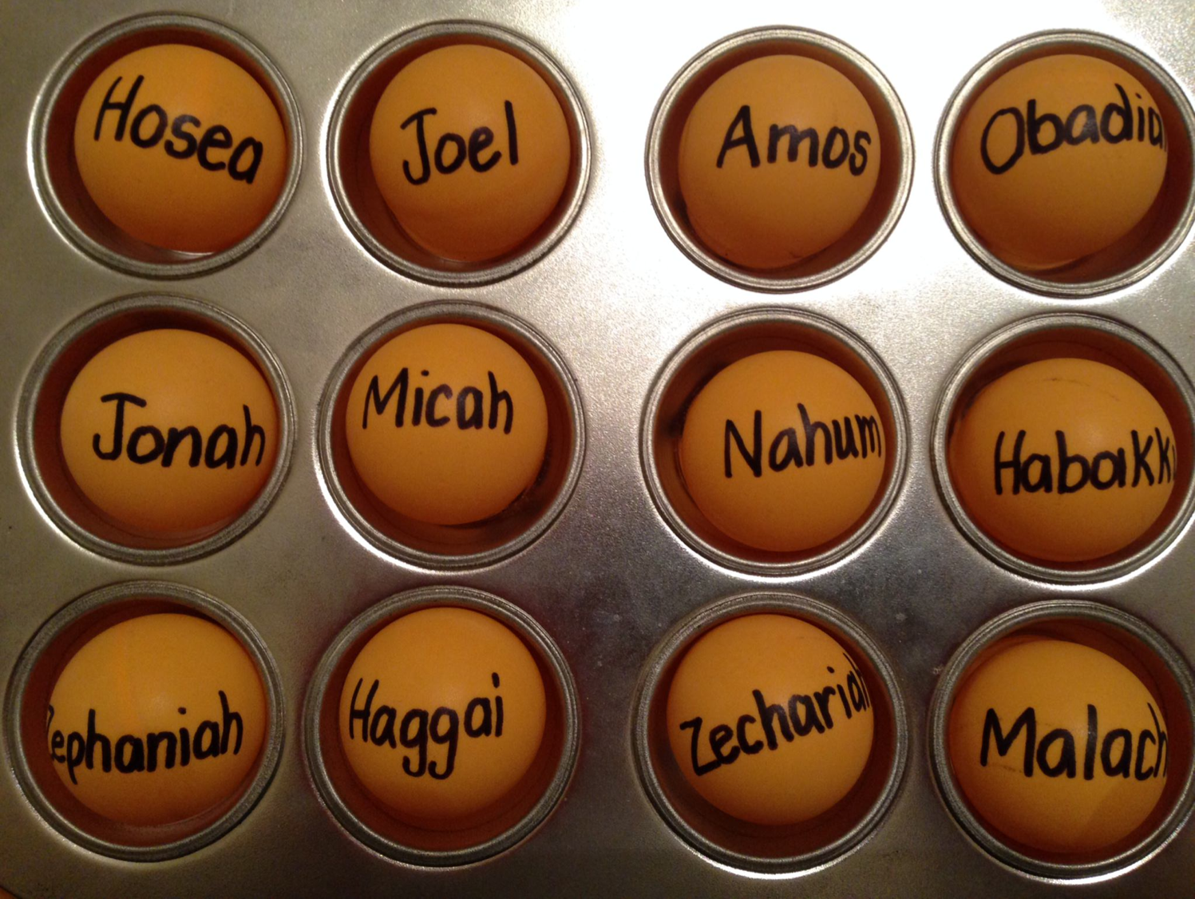
Be...
Loyal
Just
Humble
Caring
Generous
Notes:
So far we have seen 5 “Be” titles:
• Humble—Obadiah taught us not to be proud like the Edomites. Instead, be humble.
• Caring—Jonah warned that God cared for Nineveh, so we also should be caring.
• Just—Amos said that God was just, so we should be just.
• Loyal—Hosea was a great example of God’s loyalty to Israel, so we should be loyal to him.
• Generous—Micah defended the poor as God does, so we also should be generous.

Slide 28
Jonah God's Reluctant Prophet
Notes:
Jonah at first was the reluctant prophet

Slide 29
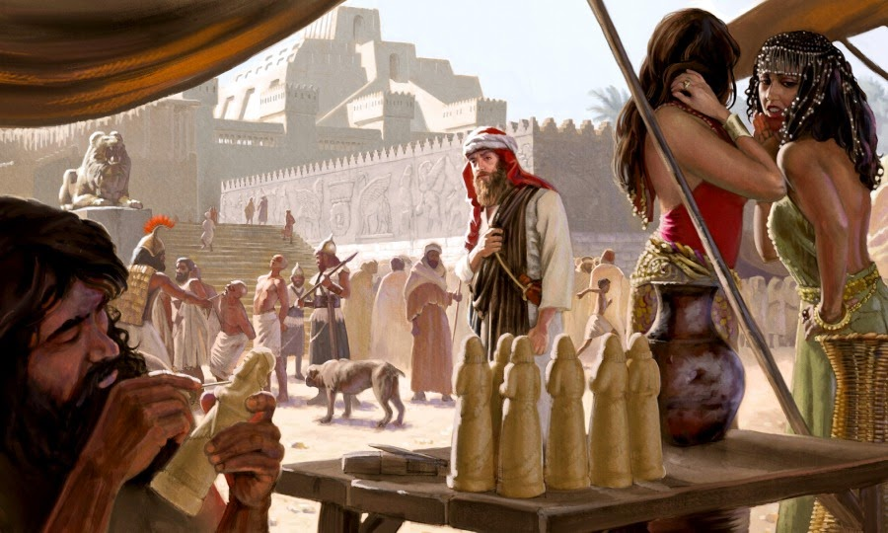
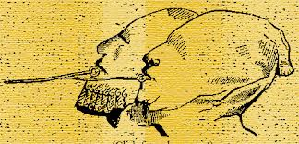
Jonah Wicked Nineveh
Notes:
You can't blame him, in that Nineveh was the epitome of idolatry, immorality, injustice, and torture!

Slide 30
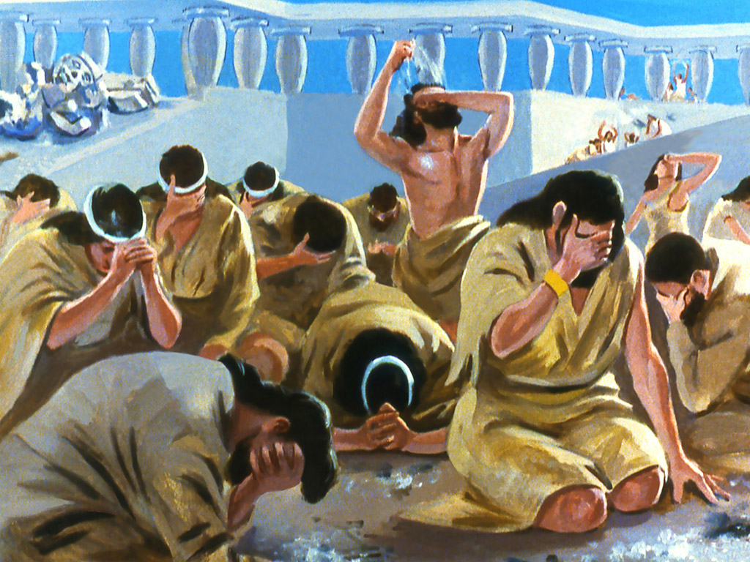
Jonah Amazing Repentance of Nineveh
Notes:
When we studied Jonah we saw at the end that Nineveh repented, God relented…

Slide 31
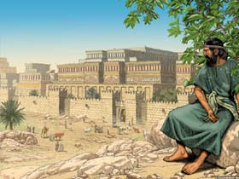
Jonah Waiting for Judgment
So what happened afterwards?
Notes:
…and Jonah resented! So, whatever happened to Jonah and Nineveh?
We left Jonah pouting—but whatever happened to him? Well, we just don’t know! The Bible doesn’t say.

Slide 32
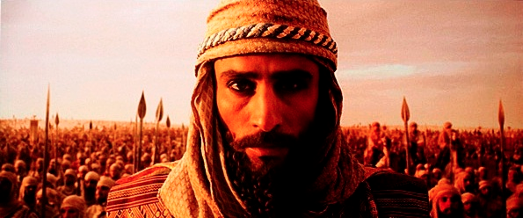
A Prophetic Word for a Day of Military Might
Notes:
But what happened to Nineveh? The Bible does tell us where the city was at spiritually 100 years later—

Slide 33
h
Jonah
Nahum
760
663
660
612
United Kingdom
1050-930
Divided Kingdom
930-722
Solitary Kingdom
722-586
Post- Exile
536-425
1100
1050
1000
950
900
850
800
7 5 0
7 0 0
650
600
550
500
450
Exile 586-536
Notes:
Most OT prophets spoke for God in the Divided Kingdom and especially the Solitary Kingdom.
______________
OS-32-Jonah-211
OS-33-Micah-119
OS-34-Nahum-33

Slide 34
Contrasting Jonah & Nahum
JONAH | NAHUM
First Book (4 chapters) | Sequel (3 chapters)
about 760 BC | about 660 BC
Repentance from Sin | Return to Sin
Nineveh Delivered | Nineveh Destroyed
Israel Responsible | Israel Protected
Chance to Repent | No Chance to Repent
Narrative | Declarative
626
626

Slide 35
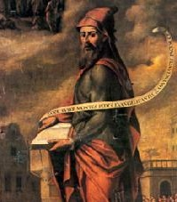
Contrasting Jonah & Nahum
JONAH | NAHUM
Focus on the Messenger | Focus on the Message
Prophet Disobeys | Prophet Obeys
Nineveh Obeys | Nineveh Disobeys
Deliverance from Water | Destruction by Water
Repented then Relented | No Repenting, No Relenting
Jonah's Wrath Refused | Jonah's Wrath Revisited
God's Compassion | God's Judgment
626

Slide 36
Nahum, Zephaniah, & Their Contemporaries
560
660 650 640 630 620 610 600 590 580 570 560 550 540 530 520
Ashuretililani
Sinsharishkun
Ashuruballit ii
Kings of Assyria
Ashurbanipal
Fall of Nineveh
663 BC
Fall of Thebes
Nahum 660
612
609 605 539
World powers
Assyrian
Fall of Jerusalem
Babylonian
Persian
Zephaniah 630
Jehoiakim
zedekiah
586
Kings of Judah
Manasseh
Josiah
Captivity of Judah to Babylon (586)
Return from Exile
Amon
Jehoahaz
Jehoiachin
Habakkuk 606
Notes:
Nahum, Zephaniah, and Habakkuk ministered in turbulent times of transition from Assyria to Babylon near the end of Judah's surviving kingdom (Israel had been destroyed a century earlier). Judah saw their final godly king Josiah killed in 609 while God raised up many prophets to warn the people. In addition to Nahum, Zephaniah, and Habakkuk, others not depicted here include Jeremiah and Joel in Judah and Ezekiel and Daniel in Babylon.
_____________
Common-409
BE-35-Habakkuk-17
OS-34-Nahum-36
OS-35-Habakkuk-43
OS-36-Zephaniah-60

Slide 37
Placing the Prophets
342
Placing the Prophets
Key Dates
931
Obadiah
722
Jonah
Amos
Hosea
Isaiah
Micah
Nahum
586
Notes:
Three prophets preached prior to Israel's fall, and three during that fall. Ninevehin 760 BC, which was repented 100 years earlier than Nahum under Jonah but then went back to its sin in 660 BC. Assyrians had invaded Israel 60 years earlier than Nahum during Isaiah's day and scattered the people. Then they destroyed 46 towns of Judah—all but Jerusalem in 701 BC! But Judah had far more warning than Israel with many more prophets before and during Jerusalem's fall. Even after the fall of Judah, God sent three messengers to his people during exile (Lamentations, Daniel, Ezekiel) and three more after they returned. What more could he have done?
———————
Common-412
OS-11-1 Kings-186
OS-12-2 Kings-51
OS-13-1 Chron-232
OS-14-2 Chron-40
OS-23-Prophets Intro-13
OS-23-Isaiah1-12-slide 107
OS-34-Nahum-37

Slide 38
The Assyrian Threat
Assyrian Expansion
Nineveh
Mediterranean
Sea
Syria
Israel
Judah
Persian
Gulf
Egypt
Notes:
Nineveh repented 100 years earlier under Jonah, but then went back to its sin.
Assyrians invaded Israel 60 years earlier and scattered the people.
Then they destroyed 46 towns of Judah—all but Jerusalem!

Slide 39
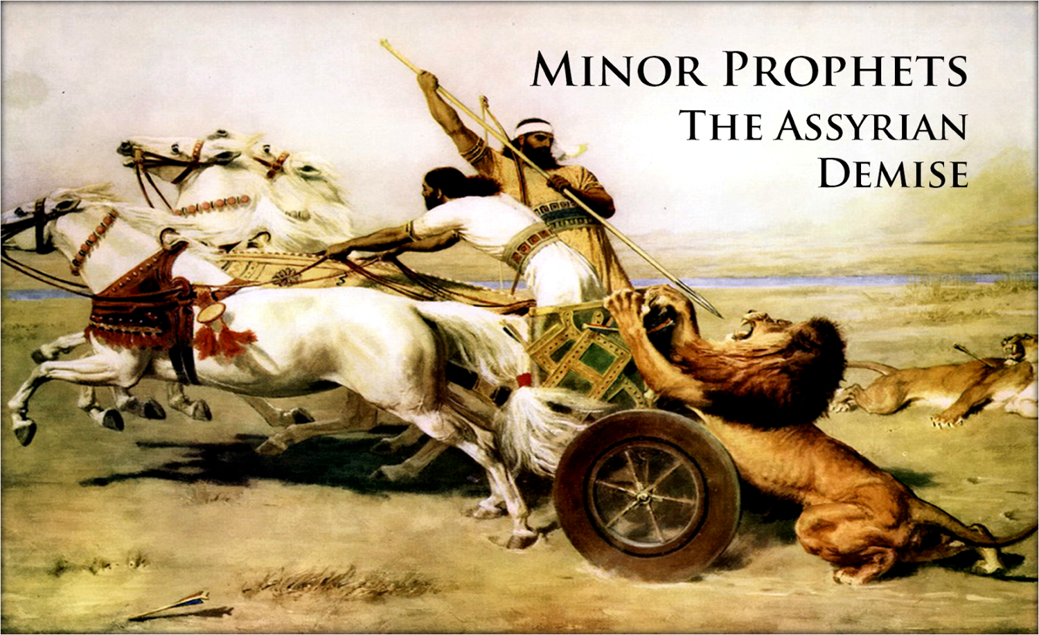
What would God do with short-lived repentance?
MINOR PROPHETS
The Assyrian Demise
Notes:
Would God do anything about this? What happens when repentance is short-lived?

Slide 40
The Incredible Patience of God
Notes:
Today we will study the incredible patience of God, which is the title of a book by Charles Stanley.
__________
BE-34-Nahum-14
OS-34-Nahum-40

Slide 41
What mistake do we too often make about God’s patience?
Notes:
We’ll answer this question: what mistake do we too often make about God’s patience?

Slide 42
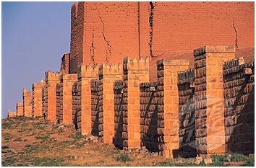
The Sequel to Jonah
Notes:
Our text is the sequel to Jonah called Nahum. It tells us Nineveh’s fate.

Slide 43
100 Years Later…
ASSYRIA
Tiglath-Pilesar
Assyria Strong
Jonah 760
Nahum 660
Nineveh's Fall 612
Israel's Fall 722
1100
900
850
800
750
700
650
600
Nineveh's Relapse
Notes:
Nineveh was weak in Jonah’s time, but then grew incredibly strong 100 years later once again. But how strong? What was next on God’s calendar?

Slide 44
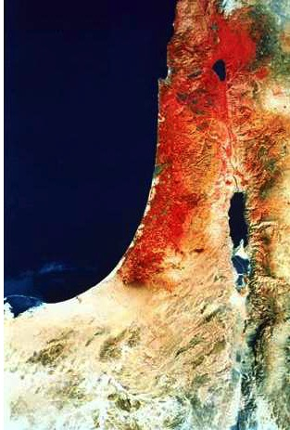
Israel Today (NASA)
Looks red and ripe for judgment!

Slide 45
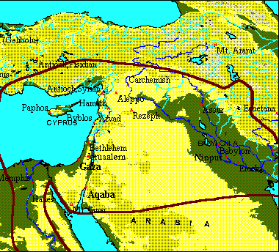
Battle of Carchemish (609 BC)
Assyrians
Babylonians
Megiddo: Josiah dies
Babylonian Empire
Egyptians
Arabia

Slide 46
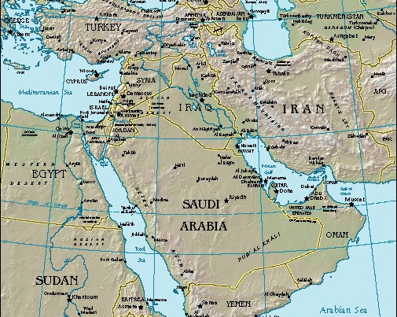
Nahum
Nineveh
Today's Study:
I. Nineveh's Future
II. Our Future
Notes:
Today we will see what would happen to Nineveh, then what will happen in our future too.
And what is that fate? Nahum tells us that…

Slide 47
I. God would destroy Nineveh but save Judah (Chapters 1–3).
Nahum
Notes:
The capital of Assyria would have capital punishment for its capital crimes, yet the southern kingdom of Israel could gain comfort from this as the LORD would preserve them.

Slide 48
Nahum Book Chart
621
Nineveh's Destruction
Certain |  |  |  | Detailed |  | Justified
Chapter 1 |  |  |  | Chapter 2 |  | Chapter 3
Destruction Decreed |  |  |  | Destruction Described |  | Destruction Deserved
Verdict of Vengeance |  |  |  | Vision of Vengeance |  | Vindication of Vengeance
What God Will Do |  |  |  | How God Will Do It |  | Why God Will Do It
God's Anger |  |  |  | God's Actions |  | God's Accusations
God's Predictions for Judah |  |  |  | God's Power for Judah |  | God's Justice for Judah
Title 1:1 | God's Traits 1:2-8 | Plotting Against God 1:9-11 | Destruction is Judah's Deliverance 1:12-15 | Battling vs. Judah's Splendor 2:1-2 | Destruction & Despoiling 2:3-13 | Destruction for Cruelty 3:1-7 | Drunk When Destroyed 3:8-11 | Burned With Fire 3:12-19
In Judah Against Assyria's Capital, Nineveh
c. 660 BC
Notes:
Nineveh’s judgment is certain, so Judah could feel secure (Ch. 1).

Slide 49
Slides on Nahum 1
Notes:
God’s attributes assure Judah (1:2-8).

Slide 50
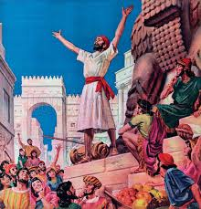
Nahum 1:1 (NLT)
623
"This message concerning Nineveh came as a vision to Nahum, who lived in Elkosh"

Slide 51
Authorship
622
Nothing is known about Nahum except his being an Elkoshite (1:1).
No valid evidence has shown someone else as author.
Four principal suggestions on the location of Elkosh have been advanced:
A modern village Elkush, or Alkosh, not far from the left bank of the Tigris, two days' journey north of the site of ancient Nineveh
A small village in Galilee, at a place identified by many with the modern El-Kauze, near Ramieh
Capernaum, the name of which means "Village of Nahum"
Elkosh in the territory south of Judah

Slide 52
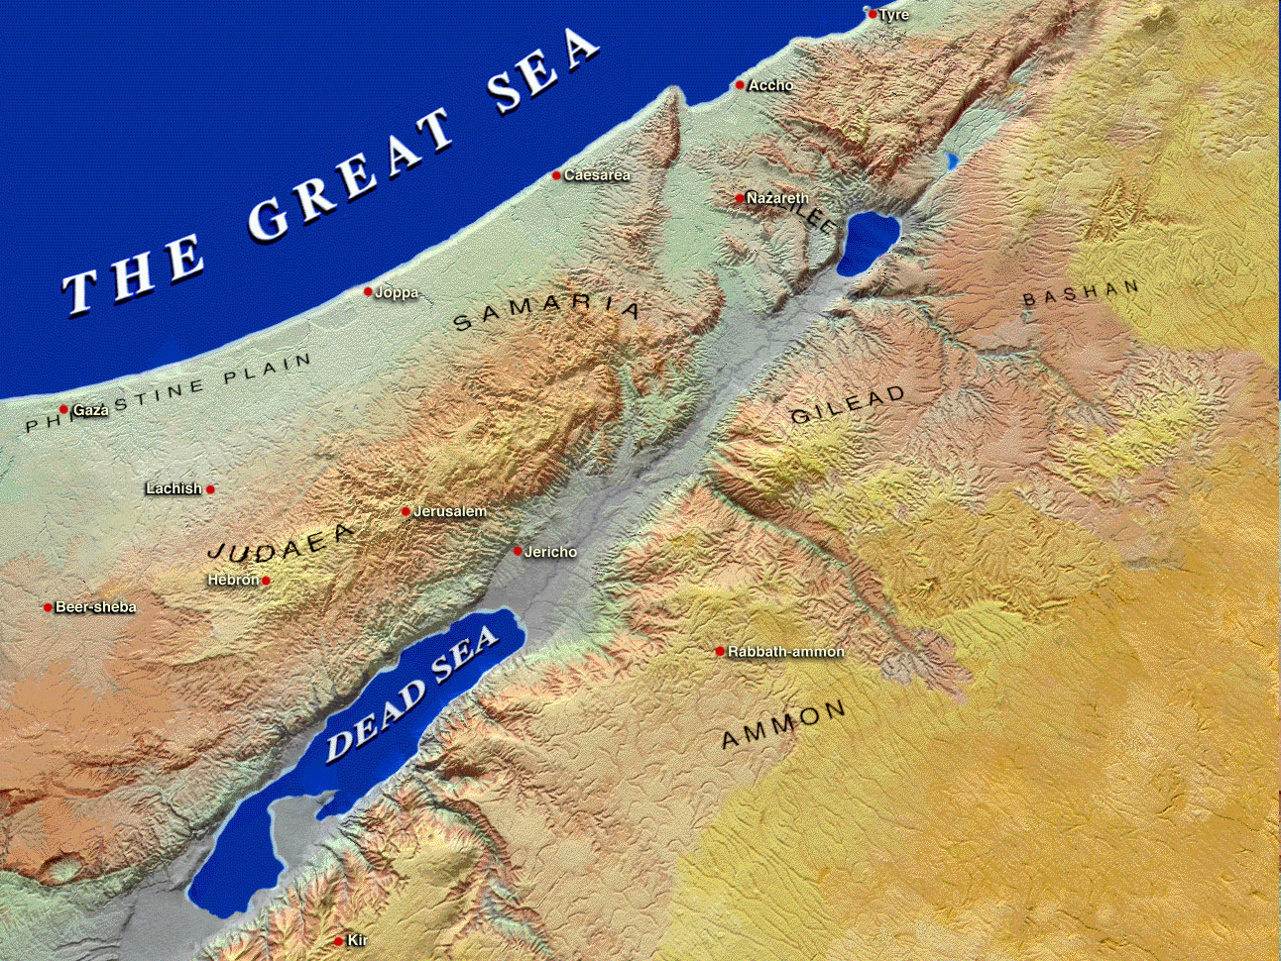
Potential Hometown Locations of Nahum
Capernaum
= "City of Nahum)
Israel
Elkosh
Jerusalem
Judah

Slide 53
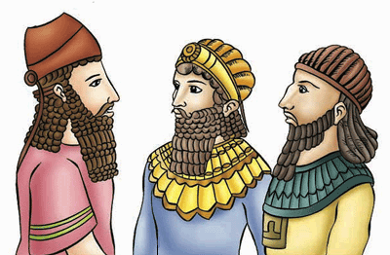
Recipients
622
The message concerned Nineveh, but no record exists of it reaching this empire. It was Judah that needed to know how God would judge the nation that persecuted them.
Historical Background
Contemporaries: Jeremiah, Habakkuk, and Zephaniah
Assyria conquered Israel about 60 years before (722 BC).
Now God purposed to visit the former rod of His anger.
Despite repenting under Jonah, Nineveh was ready for judgment due to her cruelty in war and greed.
The power that had ruled western Asia for some three centuries was now to be broken by the combined might of the Babylonians and the Medes.

Slide 54
God is Just: Nahum 1:2-3
623
"The LORD is a jealous God, filled with vengeance and rage. He takes revenge on all who oppose him and continues to rage against his enemies!
³The LORD is slow to get angry, but his power is great, and he never lets the guilty go unpunished. He displays his power in the whirlwind and the storm. The billowing clouds are the dust beneath his feet" (NLT).
Notes:
God is just—so Nineveh won’t go unpunished (1:2-3).

Slide 55
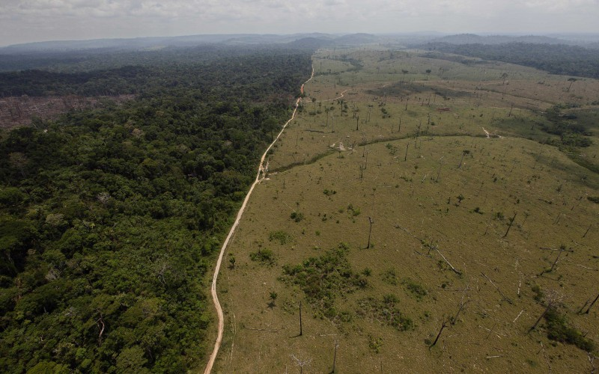
God is All Powerful: Nahum 1:4
623
"At his command the oceans dry up,
and the rivers disappear.
The lush pastures of Bashan and Carmel fade,
and the green forests of Lebanon wither" (NLT).
Notes:
God is all-powerful—so he can handle Nineveh (1:4-6).

Slide 56
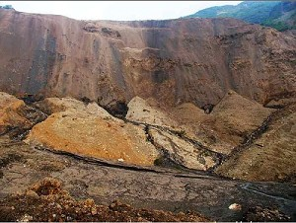
God is All Powerful: Nahum 1:5-6
623
"In his presence the mountains quake,
and the hills melt away;
the earth trembles,
and its people are destroyed.
⁶Who can stand before his fierce anger?
Who can survive his burning fury?
His rage blazes forth like fire,
and the mountains crumble to dust in his presence" (NLT).
Notes:
God is all-powerful—so he can handle Nineveh (1:4-6).

Slide 57
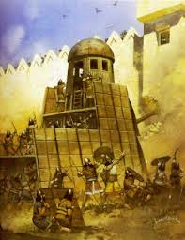
God is Good: Nahum 1:7
623
"The LORD is good, a strong refuge when trouble comes. He is close to those who trust in him" (NLT).
Notes:
God is good—so he will be loyal to Judah (1:7-8).

Slide 58
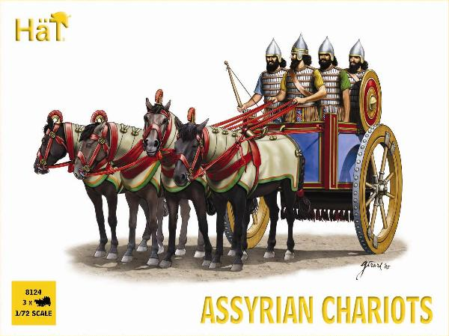
Assyrian Chariots

Slide 59
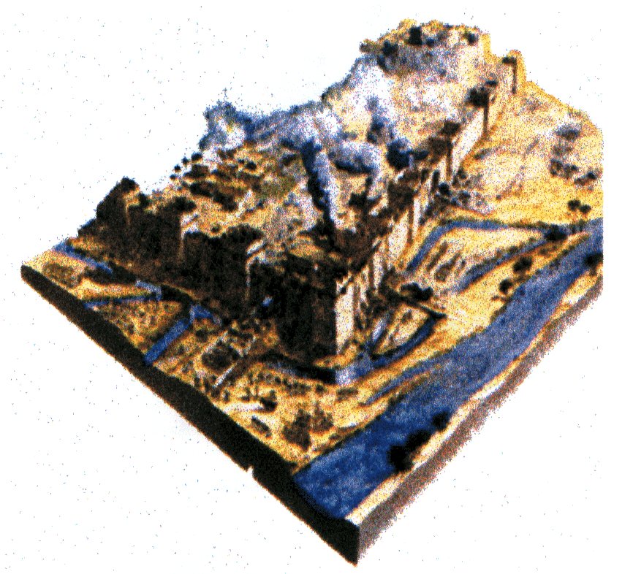
God is Good: Nahum 1:8
623
"But he will sweep away his enemies in an overwhelming flood. He will pursue his foes into the darkness of night" (NLT).

Slide 60
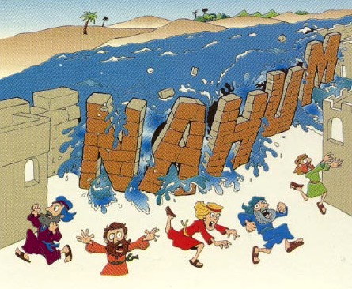
"Flood"
Nahum
Nahum 1:8
Walk Through The Bible ©1989

Slide 61
"Why are you scheming against the LORD? He will destroy you with one blow; he won’t need to strike twice! ¹⁰His enemies, tangled like thornbushes and staggering like drunks, will be burned up like dry stubble in a field" (Nahum 1:9-10 NLT).
Notes:
Nineveh will plot against God the last time (1:9-11).

Slide 62
Nahum's Prophecies Happened
625
Nahum's Prophecies | Historical Fulfillments
"From you, O Nineveh, has one come forth who plots evil against the LORD and counsels wickedness…” (1:11-12) | Sennacherib made arrogant threats in 701 BC against Judah and Jerusalem (cf. 2 Kings 18–19).
"Now I will break their yoke from your neck and tear your shackles away” (1:13) | Judah's service to Assyria ended at Nineveh's demise (2 Kings 18:14; 2 Chron. 33:11).
Hobart E. Freeman, An Introduction to the Old Testament Prophets (Chicago: Moody Press, 1977).

Slide 63
Nahum's Prophecies Happened
625
Nahum's Prophecies | Historical Fulfillments
12. Nineveh's destruction would be final (1:9,14) | 12. Many cities of the ancient Near East were rebuilt after being destroyed (e.g., Samaria, Jerusalem, Babylon) but not Nineveh.
Elliott E. Johnson, “Nahum,” in The Bible Knowledge Commentary (Colorado Springs: SP Pub., 1985), 1:1495.
Notes:
1:9 "Whatever they plot against the LORD
he will bring to an end;
trouble will not come a second time" (NIV)
1:14 "And this is what the LORD says concerning the Assyrians in Nineveh:
“You will have no more children to carry on your name.
I will destroy all the idols in the temples of your gods.
I am preparing a grave for you
because you are despicable!” (NLT)

Slide 64
Nahum's Prophecies Happened
625
Nahum's Prophecies | Historical Fulfillments
11. Nineveh’s images and idols would be destroyed (1:14). | 11. The statue of the goddess Ishtar lay headless in the debris of Nineveh’s ruins (“The British Museum Excavations on the Temple of Ishtar at Nineveh, 1930-1,” Annals of Archaeology and Anthropology 19, pp. 55-56).
Elliott E. Johnson, “Nahum,” in The Bible Knowledge Commentary (Colorado Springs: SP Pub., 1985), 1:1495.
Notes:
1:14 "And this is what the LORD says concerning the Assyrians in Nineveh:
“You will have no more children to carry on your name.
I will destroy all the idols in the temples of your gods.
I am preparing a grave for you
because you are despicable!” (NLT)

Slide 65
"Look! A messenger is coming over the mountains with good news! He is bringing a message of peace. Celebrate your festivals, O people of Judah, and fulfill all your vows, for your wicked enemies will never invade your land again. They will be completely destroyed!" (Nahum 1:15 NLT).
Notes:
Nineveh's destruction will bring peace to Judah (1:12-15).

Slide 66
Theology of Nahum
God as Sovereign King
God rules the universe. He controls both nature and nations, judging them and using them as instruments of judgment by His will. Not even mighty Assyria, earth's superpower in Nahum's day, could withstand the LORD's judgment. The LORD would destroy Nineveh's idols (1:14), showing His sovereignty over the Assyrian gods.

Slide 67
Theology of Nahum
God as Warrior
The LORD is Divine Warrior par excellence. The book begins with a terrifying portrayal of the angry, avenging warrior in a storm frightening all of nature with His battle cry (1:2-6). In these verses, Nahum used many of the same words used by Assyrian kings to describe their prowess and exploits in battle. This emphasized that the LORD, not Assyria's king, was the most powerful warrior. The "LORD Almighty," or "LORD of Armies," personally announced He would defeat Nineveh (2:13; 3:5).

Slide 68
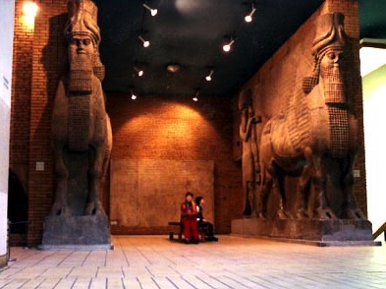
Problem: The Unity
622
The only problem concerning the book is that of its unity.
The unity and integrity of Nahum was unchallenged until the 19th century.
Due to an alleged discovery by Gunkel of the remnants of an old alphabetic poem in chapter 1, many deny the originality of Nahum 1:2–2:2 (2:3 in Hebrew), with the exception of 2:1, which is considered the beginning of Nahum's utterances.

Slide 69
Nahum Book Chart
621
Nineveh's Destruction
Certain |  |  |  | Detailed |  | Justified
Chapter 1 |  |  |  | Chapter 2 |  | Chapter 3
Destruction Decreed |  |  |  | Destruction Described |  | Destruction Deserved
Verdict of Vengeance |  |  |  | Vision of Vengeance |  | Vindication of Vengeance
What God Will Do |  |  |  | How God Will Do It |  | Why God Will Do It
God's Anger |  |  |  | God's Actions |  | God's Accusations
God's Predictions for Judah |  |  |  | God's Power for Judah |  | God's Justice for Judah
Title 1:1 | God's Traits 1:2-8 | Plotting Against God 1:9-11 | Destruction is Judah's Deliverance 1:12-15 | Battling vs. Judah's Splendor 2:1-2 | Destruction & Despoiling 2:3-13 | Destruction for Cruelty 3:1-7 | Drunk When Destroyed 3:8-11 | Burned With Fire 3:12-19
In Judah Against Assyria's Capital, Nineveh
c. 660 BC
Notes:
Nineveh’s judgment is detailed to show Judah that God will protect them (Ch. 2).

Slide 70
Slides on Nahum 2

Slide 71
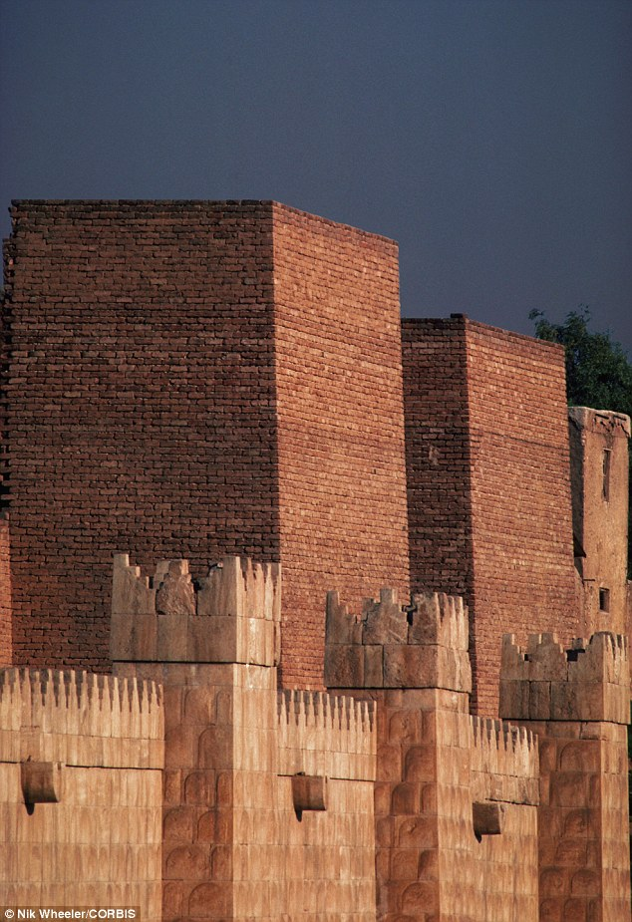
"Your enemy is coming to crush you, Nineveh. Man the ramparts! Watch the roads! Prepare your defenses! Call out your forces! ²Even though the destroyer has destroyed Judah, the LORD will restore its honor. Israel’s vine has been stripped of branches, but he will restore its splendor" (Nahum 2:1-2 NLT).
Notes:
Attacked: Nineveh should prepare for battle because God considers Judah's splendor a “done deal” (2:1-2).

Slide 72
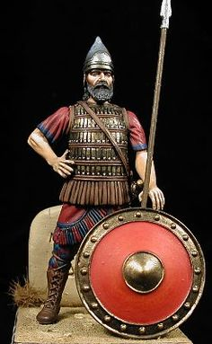
"Shields flash red in the sunlight! See the scarlet uniforms of the valiant troops! Watch as their glittering chariots move into position, with a forest of spears waving above them. ⁴The chariots race recklessly along the streets and rush wildly through the squares. They flash like firelight and move as swiftly as lightning" (Nahum 2:3-4 NLT).
Notes:
Defeated: The destruction of the city graphically visualizes God's power over the puny Assyrians (2:3-8).
"2:3-4. Nahum spoke of the equipment and speed of the “attacker” (v. 1) and his soldiers and chariots. His in the first line of verse 3 probably refers not to the defending Assyrian king but to the unidentified “attacker.” The shields of the Medes and Babylonians were red either from blood, or from red-dyed leather over the wooden shields, or by being covered with copper. The warriors’ scarlet- colored attire (cf. “red” in Ezek. 23:14) would make them awesome in appearance. (Xenophon wrote about the Persians in Cyrus’ army being dressed in scarlet, Cyropaedia 6. 4. 1.) The metal on the chariots glistened in the sun, as the soldiers’ wooden spears were brandished (swung) in their wild attack" (Johnson, "Nahum," BKC).

Slide 73
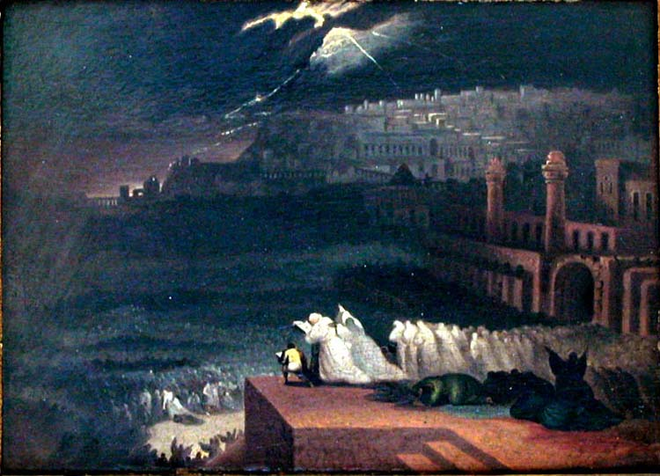
Nahum 2:5-6 (NLT)
623
"The king shouts to his officers; they stumble in their haste, rushing to the walls to set up their defenses.
⁶The river gates have been torn open!
The palace is about to collapse!"
Notes:
Defeated: The destruction of the city graphically visualizes God's power over the puny Assyrians (2:3-8).

Slide 74
Nahum's Prophecies Happened
625
Nahum's Prophecies | Historical Fulfillments
9. When Nineveh would be captured its people would try to escape (2:8): "Nineveh is like a leaking water reservoir! The people are slipping away. 'Stop, stop!' someone shouts, but no one even looks back" (NLT). | 9. “Sardanapalus [another name for King Sin-shar-ishkun] sent away his three sons and two daughters with much treasure into Paphlagonia, to the governor of Kattos, the most loyal of his subjects” (Diodorus, Bibliotheca Historica 2.26.8).
Elliott E. Johnson, “Nahum,” in The Bible Knowledge Commentary (Colorado Springs: SP Pub., 1985), 1:1495.

Slide 75
Nahum's Prophecies Happened
625
Nahum's Prophecies | Historical Fulfillments
5. Nineveh would be destroyed by a flood (1:8; 2:6, 8) | 5. Nineveh weakened by an unusually heavy & long flood of the Tigris. This carried away a huge section of the rampart around the city, allowing the enemy in. Terrifying thunder (presumably with a storm) accompanied the capture (Diodorus, Bibliotheca Historica 2.26.9; 2.27.13; Xenophon, Anabasis 3.4.12).
Elliott E. Johnson, “Nahum,” in The Bible Knowledge Commentary (Colorado Springs: SP Pub., 1985), 1:1495.

Slide 76
Nineveh's Water System Destroyed
637
"And He will stretch out His hand against the north and destroy Assyria, and He will make Nineveh a desolation, parched like the wilderness" (Zeph. 2:13)
The prophesied destruction of Nineveh (Zeph. 2:13), the capital of Assyria in what is now Iraq, fell in 612 BC into the hands of the neighboring Babylonians, with the whole empire taken by 605 BC. The prediction that God would leave Nineveh "dry as a desert" is remarkable in view of the fame of the city's great irrigation system.

Slide 77
Nahum's Prophecies Happened
625
Nahum's Prophecies | Historical Fulfillments
8. Plundering and pillaging would accompany the overthrow of the city (2:9-10). | 8. According to the Babylonian Chronicle, “Great quantities of spoil from the city, beyond counting, they carried off. The city [they turned] into a mound and ruin heap” (Luckenbill, Ancient Records of Assyria and Babylonia, 2:420).
Elliott E. Johnson, “Nahum,” in The Bible Knowledge Commentary (Colorado Springs: SP Pub., 1985), 1:1495.
Notes:
Pillaged: The plundering of the city shows how God will humble the proud city (2:9-10).

Slide 78
Chiastic Structure of Nahum
a Yahweh, like a terrible force of nature, avenges his enemies (1:2-10)
b Yahweh will destroy Nineveh but restore Judah (1:11-15)
c Vivid description of the attack upon Nineveh (2:1-10)
d CENTER: Lament over fall of Nineveh (2:11-13)
c' Vivid description of the looting of Nineveh (3:1-7)
b' Nineveh will be destroyed: it is vulnerable, like Thebes (3:8-13)
a' Nineveh, likened to a force of nature, will be destroyed (3:14-19)
Adapted from David A. Dorsey, The Literary Structure of the Old Testament: A Commentary on Genesis – Malachi (Grand Rapids: Baker, 1999)
Dorsey reveals that the placement of the eulogy over the "lion's den" in the book's highlighted central position reinforces the sense of certainty of Nineveh's fall.

Slide 79
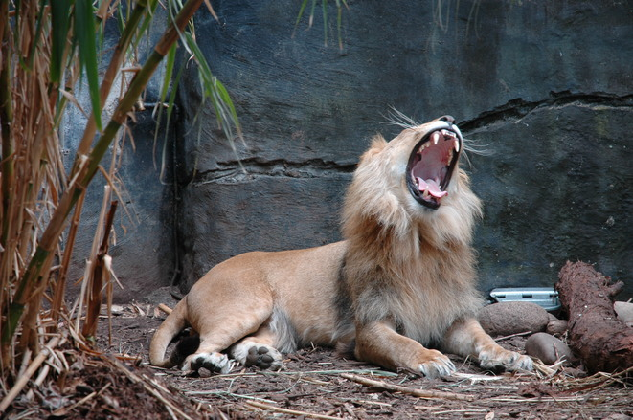
Lion Imagery (2:11-13)
Notes:
Illustrated: God would destroy the powerful Ninevites like destroying a fearless lion in its den (2:11-13).

Slide 80
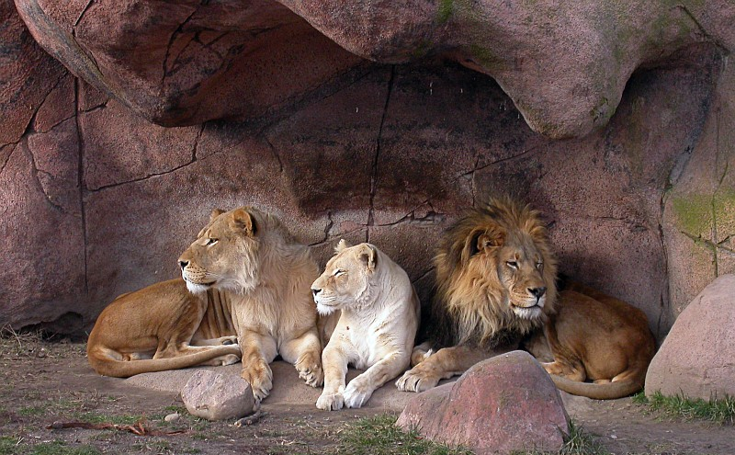
Nahum 2:11-13 (NLT)
623
"Where now is that great Nineveh,
that den filled with young lions?
It was a place where people—like lions and their cubs—
walked freely and without fear."

Slide 81
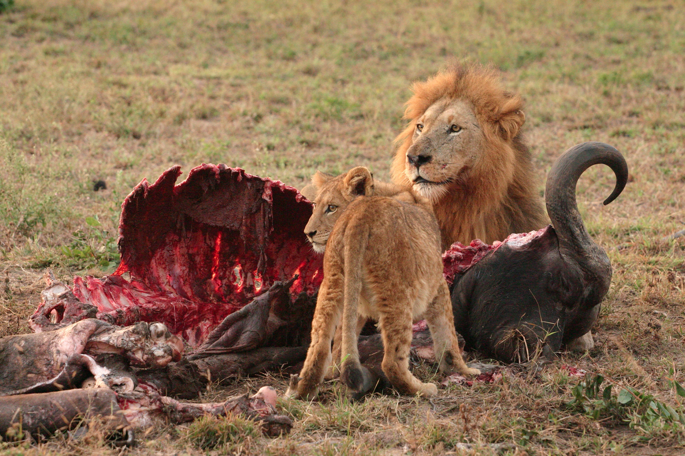
Nahum 2:12 (NLT)
623
"The lion tore up meat for his cubs
and strangled prey for his mate.
He filled his den with prey,
his caverns with his plunder."

Slide 82
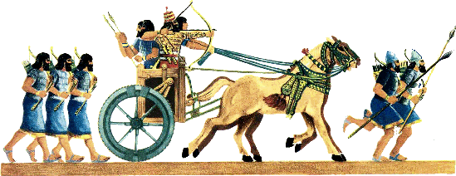
Nahum 2:13 (NLT)
"'I am your enemy!'
says the LORD of Heaven's Armies.
'Your chariots will soon go up in smoke.
Your young men will be killed in battle.
Never again will you plunder conquered nations.
The voices of your proud messengers will be heard no more'" (2:13).
623

Slide 83
Nahum's Prophecies Happened
625
Nahum's Prophecies | Historical Fulfillments
6. Nineveh would be destroyed by fire (1:10; 2:13; 3:15). | 6. Archaeological excavations at Nineveh have revealed chard wood, charcoal, and ashes. “… about 2 inches thick...” (R. Campbell Thomson and R. W. Hutchinson, A Century of Exploration at Nineveh. London: Luzac, pp. 45, 77).
Elliott E. Johnson, “Nahum,” in The Bible Knowledge Commentary (Colorado Springs: SP Pub., 1985), 1:1495.

Slide 84
Nahum Book Chart
621
Nineveh's Destruction
Certain |  |  |  | Detailed |  | Justified
Chapter 1 |  |  |  | Chapter 2 |  | Chapter 3
Destruction Decreed |  |  |  | Destruction Described |  | Destruction Deserved
Verdict of Vengeance |  |  |  | Vision of Vengeance |  | Vindication of Vengeance
What God Will Do |  |  |  | How God Will Do It |  | Why God Will Do It
God's Anger |  |  |  | God's Actions |  | God's Accusations
God's Predictions for Judah |  |  |  | God's Power for Judah |  | God's Justice for Judah
Title 1:1 | God's Traits 1:2-8 | Plotting Against God 1:9-11 | Destruction is Judah's Deliverance 1:12-15 | Battling vs. Judah's Splendor 2:1-2 | Destruction & Despoiling 2:3-13 | Destruction for Cruelty 3:1-7 | Drunk When Destroyed 3:8-11 | Burned With Fire 3:12-19
In Judah Against Assyria's Capital, Nineveh
c. 660 BC
Notes:
Nineveh’s judgment is justified because God's justice had to punish them (Ch. 3).

Slide 85
Slides on Nahum 3

Slide 86
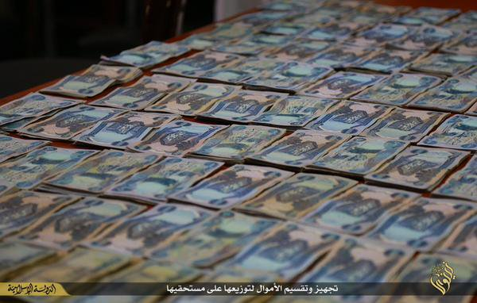
Nahum 3:1 (NLT)
623
"What sorrow awaits Nineveh, the city of murder and lies!
She is crammed with wealth and is never without victims."
Notes:
Nineveh’s bloodshed, lying and greed humiliated enemies (3:1-4).

Slide 87
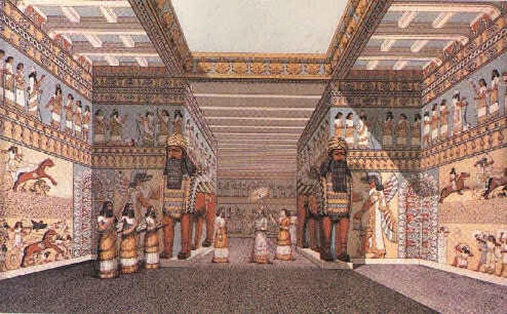
Nineveh Interior of Sennacherib's Palace

Slide 88
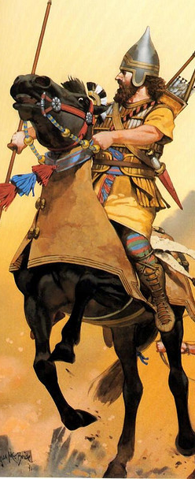
"Hear the crack of whips, the rumble of wheels! Horses’ hooves pound, and chariots clatter wildly. ³See the flashing swords and glittering spears as the charioteers charge past! There are countless casualties, heaps of bodies—so many bodies that people stumble over them" (Nahum 3:2-3 NLT).

Slide 89
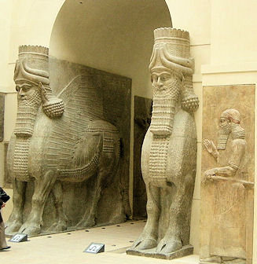
Llamsu Guarded Nineveh's Gates
British Museum

Slide 90
Nahum's Prophecies Happened
625
Nahum's Prophecies | Historical Fulfillments
7. The city’s capture would be attended by a great massacre of people (3:3). | 7. “In two battles fought on the plain before the city the rebels defeated the Assyrians… So great was the multitude of the slain that the flowing stream, mingled with their blood, changed its color for a considerable distance” (Diodorus, Bibliotheca Historica 2.26.6-7).
Elliott E. Johnson, “Nahum,” in The Bible Knowledge Commentary (Colorado Springs: SP Pub., 1985), 1:1495.

Slide 91
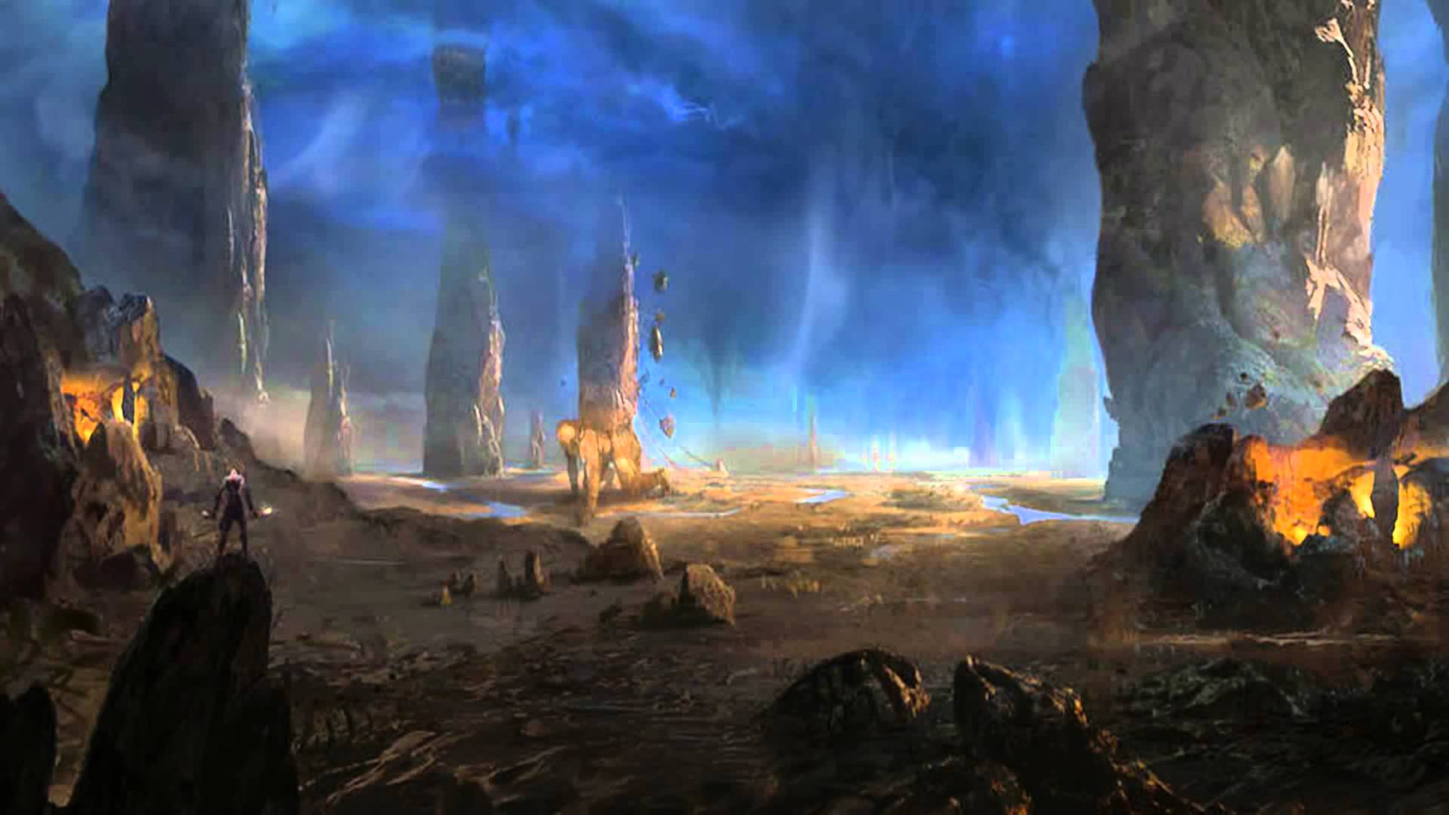
Nahum 3:4 (NLT)
623
"All this because Nineveh,
the beautiful and faithless city,
mistress of deadly charms,
enticed the nations with her beauty.
She taught them all her magic,
enchanting people everywhere."

Slide 92
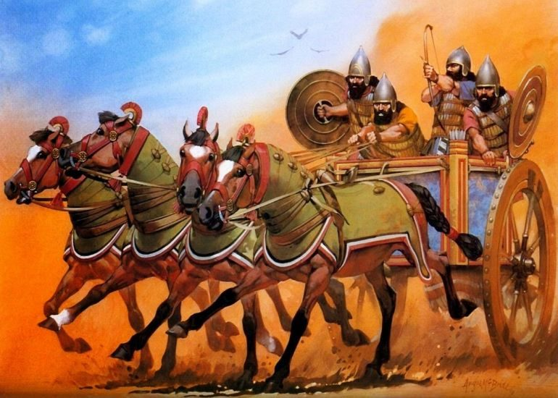
Assyrian Chariots Humbled (3:5-7)
Notes:
The Babylonians will publicly humiliate Nineveh (3:5-7).
3:5-7 Shame
“I am your enemy!”
says the Lord of Heaven’s Armies.
“And now I will lift your skirts
and show all the earth your nakedness and shame.
⁶ I will cover you with filth
and show the world how vile you really are.
⁷ All who see you will shrink back and say,
‘Nineveh lies in ruins.
Where are the mourners?’
Does anyone regret your destruction?”

Slide 93
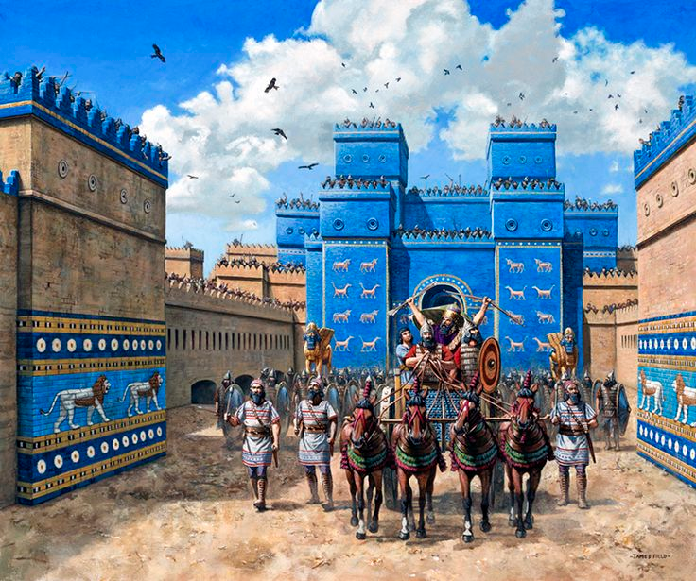
Ishtar Gate of the Conquering Babylonians

Slide 94
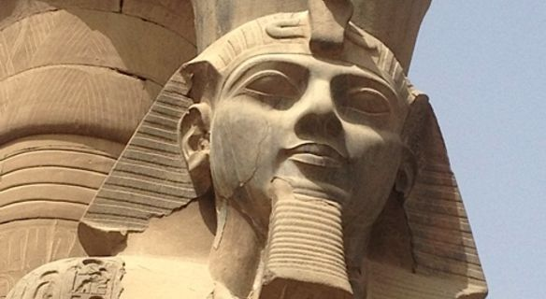
The Benefit of Egyptian Chronology
Notes:
Nineveh will be drunk when destroyed and will go into hiding for its cruel treatment of Thebes in Egypt in 663 BC (3:8-11).

Slide 95
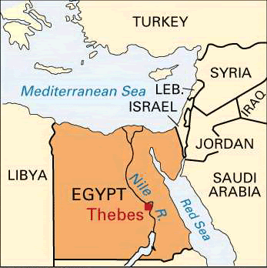
Fall of Thebes (663 BC)
Nahum 3:8-10
Notes:
"Are you any better than the city of Thebes,
situated on the Nile River, surrounded by water?
She was protected by the river on all sides,
walled in by water" (NLT).

Slide 96
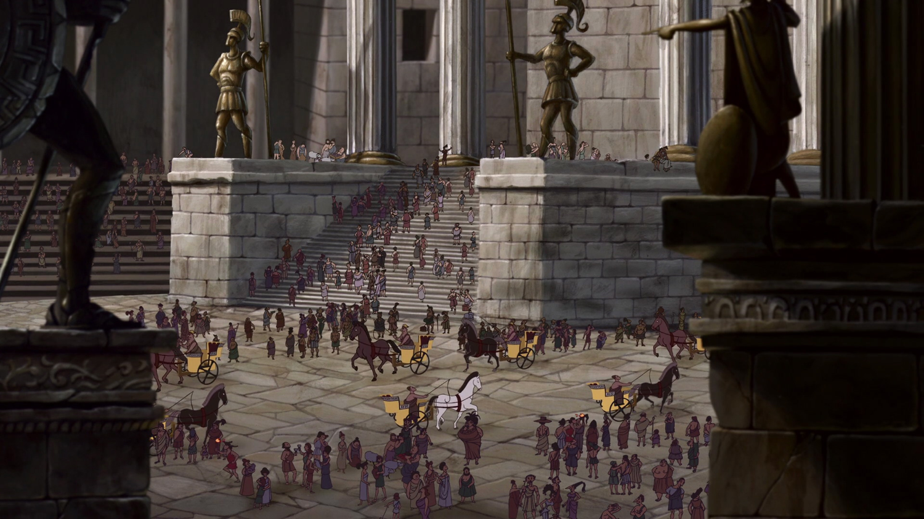
Fall of Thebes (663 BC)
Notes:
Nahum 3:9
"Ethiopia and the land of Egypt
gave unlimited assistance.
The nations of Put and Libya
were among her allies" (NLT).

Slide 97
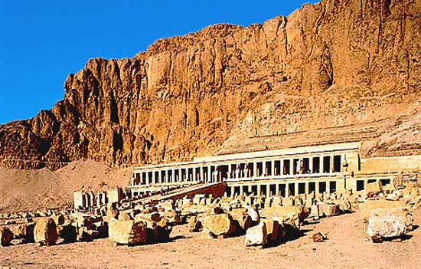
Fall of Thebes (663 BC)
Notes:
¹⁰ Yet Thebes fell,
and her people were led away as captives.
Her babies were dashed to death
against the stones of the streets.
Soldiers threw dice to get Egyptian officers as servants.
All their leaders were bound in chains" (NLT).

Slide 98
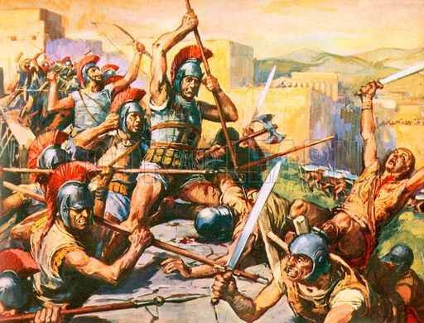
Thebes Conquered again by Alexander in 335 BC

Slide 99
Nahum's Prophecies Happened
625
Nahum's Prophecies | Historical Fulfillments
1. The Assyrian fortresses surrounding the city would be easily captured (3:12) | According to the Babylonian Chronicle the fortified towns in Nineveh’s environs begin to fall in 614 BC, including Tabris, present-day Sharis-Khan, a few miles northwest of Nineveh.
Elliott E. Johnson, “Nahum,” in The Bible Knowledge Commentary (Colorado Springs: SP Pub., 1985), 1:1495.

Slide 100
Nahum's Prophecies Happened
625
Nahum's Prophecies | Historical Fulfillments
2. The besieged Ninevites would prepare bricks and mortar for emergency defense walls (3:12). | 2. A. T. Olmstead reported: “To the south of the gate, the moat is still filled with fragments of stone and of mud bricks from the walls, heaped up when they were breached” (History of Assyria, Chicago: University of Chicago Press, 1951, p. 637).
Elliott E. Johnson, “Nahum,” in The Bible Knowledge Commentary (Colorado Springs: SP Pub., 1985), 1:1495.

Slide 101
Nineveh Destroyed by Flood (3:14) & Fire (3:12)

Slide 102
Nahum's Prophecies Happened
625
Nahum's Prophecies | Historical Fulfillments
3. The city gates would be destroyed (3:13). | 3. Olmstead noted: “The main attack was directed from the northwest and the brunt fell upon the Hatami gate at this corner… Within the gates are traces of the counter wall raised by the inhabitants in their last extremity” (History of Assyria, Chicago: University of Chicago Press, 1951, p. 637).
Elliott E. Johnson, “Nahum,” in The Bible Knowledge Commentary (Colorado Springs: SP Pub., 1985), 1:1495.

Slide 103
Nahum's Prophecies Happened
625
Nahum's Prophecies | Historical Fulfillments
4. In the final hours of the attack the Ninevites would be drunk (1:10; 3:11) | 4. After the Assyrians had repulsed the enemy's attack, they got drunk and feasted, and as a result were surprised by the Medes and the city was taken. (Diodorus, Bibliotheca Historica 2.26.4).
Elliott E. Johnson, “Nahum,” in The Bible Knowledge Commentary (Colorado Springs: SP Pub., 1985), 1:1495.

Slide 104
Nahum's Prophecies Happened
625
Nahum's Prophecies | Historical Fulfillments
10. The Ninevites officers would weaken and flee (3:17). | 10. The Babylonian Chronicle states that “[the army] of Assyria deserted [lit., ran away before] the king” (Luckenbill, Ancient Records of Assyria and Babylonia, 2:420).
Elliott E. Johnson, “Nahum,” in The Bible Knowledge Commentary (Colorado Springs: SP Pub., 1985), 1:1495.

Slide 105
Nahum 3:19 Final Verse (NLT)
623
"There is no healing for your wound; your injury is fatal.
All who hear of your destruction will clap their hands for joy.
Where can anyone be found who has not suffered from your continual cruelty?"

Slide 106
Detail of relief from the North Palace of Ashurbanipal, Nineveh, northern Iraq.

Slide 107
God has spoken by His prophets

Slide 108
II. God will judge the wicked and deliver the righteous in the future too.
Be patient.
Notes:
The LORD is watching over your future, including his promise to punish all who reject him.

Slide 109
Be patient.
Notes:
God is a God of holiness who must judge sin—so just be patient.

Slide 110
And more patient.

Slide 111
Some Nineveh Walls Remained

Slide 112
Modern Map
Mosul, Iraq, surrounds Nineveh’s ancient ruins

Slide 113
Nineveh ISIS captured Modern-Day Mosul

Slide 114
Nineveh ISIS forced out 200,000 Christians

Slide 115
Nineveh Walls destroyed by ISIS in 2015
Notes:
January 2015 before ISIS invasion

Slide 116
Nineveh Walls destroyed by ISIS in 2015
Notes:
January 2015
Ancient: Ruins at the ancient Assyrian city of Nineveh, which Islamic State militants have vowed to destroy when the Iraqi army comes to try to liberate Mosul, Iraq's second largest city Read more: http://www.dailymail.co.uk/news/article-2900530/ISIS-plan-destroy-walls-Nineveh-capital-Assyrian-Empire-one-important-archaeological-sites-Iraq.html#ixzz4LcEZWyuW Follow us: @MailOnline on Twitter | DailyMail on Facebook
Over the past month the Islamic State has seized hundreds of Assyrian relics from Mosul's cultural museum as well as destroyed Assyrian monuments in the city, which it claims 'distort Islam', AINSA reported.
Assyrians believe themselves to be Iraq's original indigenous people, with a documented history stretching back to 4750 BC. They now comprise 95 per cent of the country's Christian population.
Nearly 200,000 were forced to flee their homes around the Nineveh plain last summer as Islamic State made its lightning advance across Iraq.
Most now live as refugees in Iraq's Kurdish areas.
Read more: http://www.dailymail.co.uk/news/article-2900530/ISIS-plan-destroy-walls-Nineveh-capital-Assyrian-Empire-one-important-archaeological-sites-Iraq.html#ixzz4LcEENuP2 Follow us: @MailOnline on Twitter | DailyMail on Facebook

Slide 117
Nineveh Jonah’s Tomb Destroyed by ISIS

Slide 118
The Recapture of Mosul (2017)
Hey, ISIS!
Remember us?
We’re back!
Support the NPU

Slide 119
Oprah Winfrey
Notes:
Lakeside Church in Houston, Texas, is the largest church in the USA with 40,000 attending. The pastor, Joel Osteen, is often featured on the cover of Success magazine.

Slide 120
Joel Osteen
No preaching on sin
Led in prayer at gay "wedding"
Notes:
One key rule in the pulpit there is: you cannot talk about sin or judgment.

Slide 121
Motivational Speaking
Magical prayers, feel good messages, have it your way theology; surely this is too awesome to be what Paul warned us about
http://www.conservativecut.com/blog/?tag=false-teacher
Notes:
http://www.conservativecut.com/blog/?tag=false-teacher

Slide 122
THE JUDGMENT OF GOD
Notes:
But at our church, we are not afraid to talk about what God warns us about—and judgment is all over the Bible.
God told Ezekiel that he must warn the people—and if he didn’t, then their blood was on his head (cf. Ezek. 33:1-9)!
Hey, I don’t want your blood on my head, so we preach the full gospel here, including God’s wrath!
Who really wants the mamby-pamby God that does not hold people accountable?
Do you have respect for parents that do not discipline their children?
Do you respect governments that let people get away with murder?
Then why do we have a problem with God being a God of justice?

Slide 123
We have a tremendous future ahead of us in Christ (Rev. 20:1-6).
Second Coming
Second Advent
=
Tribulation
Millennium
Church Age
Eternal Kingdom
7 years
1000 years
Judgment
Judgment
Notes:
123

Slide 124
A Literal, Political Kingdom
"Jesus replied, 'I assure you that when the world is made new and the Son of Man sits upon his glorious throne, you who have been my followers will also sit on twelve thrones, judging the twelve tribes of Israel'" (Matt. 19:28 NLT)

Slide 125
Our Future
Jesus will bring worldwide truth, peace, prosperity, holiness and protection

Slide 126
Main Idea
Don’t mistake the patience of God as the impotence of God.
—Huang Sabin
Nahum

Slide 127
Be patient

Slide 128
Wait. It's biblical.
JOSEPH WAITED 13 YEARS. ABRAHAM WAITED 25 YEARS.
MOSES WAITED 40 YEARS.
JESUS WAITED 30 YEARS.
IF GOD IS MAKING YOU WAIT, YOU"RE IN GOOD COMPANY.
Notes:
But don’t let your impatience make you think God can’t resolve things. This issue isn’t that God can’t solve issues. It’s that he is more patient than you give him credit for. He had many people through history have to wait (Joseph 13 years, Abraham 25 years, Moses 40 years, Jesus 30 years).

Slide 129
I. God would destroy Nineveh but save Judah (Chapters 1–3).
Nahum
Notes:
The capital of Assyria would have capital punishment for its capital crimes, yet the southern kingdom of Israel could gain comfort from this as the LORD would preserve them.

Slide 130
II. God will judge the wicked and deliver the righteous in the future too.
Be patient.
Nahum
Notes:
The LORD is watching over your future, including his promise to punish all who reject him.

Slide 131
Key Verse
621
"The LORD is slow to anger and great in power; he will not leave the guilty unpunished" (1:3a).
Nahum

Slide 132
What are you waiting for?
God's 3 answers to your prayers:
Yes.
Not yet.
I have something better.
Nahum

Slide 133
Black

Slide 134
OT Preaching link at BibleStudyDownloads.org
Get this presentation and script for free!

Slide 135
Micah & Isaiah Alike
616
Exact parallels
Messiah prominent
Wrote from Jerusalem
Wrote about both Israel and Judah
Influenced Hezekiah
Stressed the kingdom
Contemporaneous
In like manner, Jonah & Nahum are alike

Slide 136
REVIEW QUIZ on Nahum
Nahum prophesied the destruction of _________.
Nahum's prophecy completes the story begun by the prophet ______.
Nahum uses vivid imagery (e.g., _____).
This book teaches that each generation must experience a fresh _______.

Slide 137
REVIEW QUIZ on Nahum
Nahum prophesied the destruction of Ninevah (Assyria).
Nahum's prophecy completes the story begun by the prophet ______.
Nahum uses vivid imagery (e.g., _____).
This book teaches that each generation must experience a fresh _______.

Slide 138
REVIEW QUIZ on Nahum
Nahum prophesied the destruction of Ninevah (Assyria).
Nahum's prophecy completes the story begun by the prophet Jonah.
Nahum uses vivid imagery (e.g., _____).
This book teaches that each generation must experience a fresh _______.

Slide 139
REVIEW QUIZ on Nahum
Nahum prophesied the destruction of Ninevah (Assyria).
Nahum's prophecy completes the story begun by the prophet Jonah.
Nahum uses vivid imagery (e.g., lion).
This book teaches that each generation must experience a fresh _______.

Slide 140
REVIEW QUIZ on Nahum
Nahum prophesied the destruction of Ninevah (Assyria).
Nahum's prophecy completes the story begun by the prophet Jonah.
Nahum uses vivid imagery (e.g., lion).
This book teaches that each generation must experience a fresh revival.

Slide 141
Nahum's Prophecies Happened
625
Nahum's Prophecies | Historical Fulfillments
"From you, O Nineveh, has one come forth who plots evil against the LORD and counsels wickedness…” (1:11-12) | Sennacherib made arrogant threats in 701 BC against Judah and Jerusalem (cf. 2 Kings 18–19).
"Now I will break their yoke from your neck and tear your shackles away” (1:13) | Judah's service to Assyria ended at Nineveh's demise (2 Kings 18:14; 2 Chron. 33:11).
Hobart E. Freeman, An Introduction to the Old Testament Prophets (Chicago: Moody Press, 1977).

Slide 142
Nahum's Prophecies Happened
625
Nahum's Prophecies | Historical Fulfillments
1. The Assyrian fortresses surrounding the city would be easily captured (3:12) | According to the Babylonian Chronicle the fortified towns in Nineveh’s environs begin to fall in 614 BC, including Tabris, present-day Sharis-Khan, a few miles northwest of Nineveh.
Elliott E. Johnson, “Nahum,” in The Bible Knowledge Commentary (Colorado Springs: SP Pub., 1985), 1:1495.

Slide 143
Nahum's Prophecies Happened
625
Nahum's Prophecies | Historical Fulfillments
2. The besieged Ninevites would prepare bricks and mortar for emergency defense walls (3:12). | 2. A. T. Olmstead reported: “To the south of the gate, the moat is still filled with fragments of stone and of mud bricks from the walls, heaped up when they were breached” (History of Assyria, Chicago: University of Chicago Press, 1951, p. 637).
Elliott E. Johnson, “Nahum,” in The Bible Knowledge Commentary (Colorado Springs: SP Pub., 1985), 1:1495.

Slide 144
Nahum's Prophecies Happened
625
Nahum's Prophecies | Historical Fulfillments
3. The city gates would be destroyed (3:13). | 3. Olmstead noted: “The main attack was directed from the northwest and the brunt fell upon the Hatami gate at this corner… Within the gates are traces of the counter wall raised by the inhabitants in their last extremity” (History of Assyria, Chicago: University of Chicago Press, 1951, p. 637).
Elliott E. Johnson, “Nahum,” in The Bible Knowledge Commentary (Colorado Springs: SP Pub., 1985), 1:1495.

Slide 145
Nahum's Prophecies Happened
625
Nahum's Prophecies | Historical Fulfillments
4. In the final hours of the attack the Ninevites would be drunk (1:10; 3:11) | 4. After the Assyrians had repulsed the enemy's attack, they got drunk and feasted, and as a result were surprised by the Medes and the city was taken. (Diodorus, Bibliotheca Historica 2.26.4).
Elliott E. Johnson, “Nahum,” in The Bible Knowledge Commentary (Colorado Springs: SP Pub., 1985), 1:1495.

Slide 146
Nahum's Prophecies Happened
625
Nahum's Prophecies | Historical Fulfillments
5. Nineveh would be destroyed by a flood (1:8; 2:6, 8) | 5. Nineveh weakened by an unusually heavy & long flood of the Tigris. This carried away a huge section of the rampart around the city, allowing the enemy in. Terrifying thunder (presumably with a storm) accompanied the capture (Diodorus, Bibliotheca Historica 2.26.9; 2.27.13; Xenophon, Anabasis 3.4.12).
Elliott E. Johnson, “Nahum,” in The Bible Knowledge Commentary (Colorado Springs: SP Pub., 1985), 1:1495.

Slide 147
Nahum's Prophecies Happened
625
Nahum's Prophecies | Historical Fulfillments
6. Nineveh would be destroyed by fire (1:10; 2:13; 3:15). | 6. Archaeological excavations at Nineveh have revealed chard wood, charcoal, and ashes. “… about 2 inches thick...” (R. Campbell Thomson and R. W. Hutchinson, A Century of Exploration at Nineveh. London: Luzac, pp. 45, 77).
Elliott E. Johnson, “Nahum,” in The Bible Knowledge Commentary (Colorado Springs: SP Pub., 1985), 1:1495.

Slide 148
Nahum's Prophecies Happened
625
Nahum's Prophecies | Historical Fulfillments
7. The city’s capture would be attended by a great massacre of people (3:3). | 7. “In two battles fought on the plain before the city the rebels defeated the Assyrians… So great was the multitude of the slain that the flowing stream, mingled with their blood, changed its color for a considerable distance” (Diodorus, Bibliotheca Historica 2.26.6-7).
Elliott E. Johnson, “Nahum,” in The Bible Knowledge Commentary (Colorado Springs: SP Pub., 1985), 1:1495.

Slide 149
Nahum's Prophecies Happened
625
Nahum's Prophecies | Historical Fulfillments
8. Plundering and pillaging would accompany the overthrow of the city (2:9-10). | 8. According to the Babylonian Chronicle, “Great quantities of spoil from the city, beyond counting, they carried off. The city [they turned] into a mound and ruin heap” (Luckenbill, Ancient Records of Assyria and Babylonia, 2:420).
Elliott E. Johnson, “Nahum,” in The Bible Knowledge Commentary (Colorado Springs: SP Pub., 1985), 1:1495.

Slide 150
Nahum's Prophecies Happened
625
Nahum's Prophecies | Historical Fulfillments
9. When Nineveh would be captured its people would try to escape (2:8): "Nineveh is like a leaking water reservoir! The people are slipping away. 'Stop, stop!' someone shouts, but no one even looks back" (NLT). | 9. “Sardanapalus [another name for King Sin-shar-ishkun] sent away his three sons and two daughters with much treasure into Paphlagonia, to the governor of Kattos, the most loyal of his subjects” (Diodorus, Bibliotheca Historica 2.26.8).
Elliott E. Johnson, “Nahum,” in The Bible Knowledge Commentary (Colorado Springs: SP Pub., 1985), 1:1495.

Slide 151
Nahum's Prophecies Happened
625
Nahum's Prophecies | Historical Fulfillments
10. The Ninevites officers would weaken and flee (3:17). | 10. The Babylonian Chronicle states that “[the army] of Assyria deserted [lit., ran away before] the king” (Luckenbill, Ancient Records of Assyria and Babylonia, 2:420).
Elliott E. Johnson, “Nahum,” in The Bible Knowledge Commentary (Colorado Springs: SP Pub., 1985), 1:1495.

Slide 152
Nahum's Prophecies Happened
625
Nahum's Prophecies | Historical Fulfillments
11. Nineveh’s images and idols would be destroyed (1:14). | 11. The statue of the goddess Ishtar lay headless in the debris of Nineveh’s ruins (“The British Museum Excavations on the Temple of Ishtar at Nineveh, 1930-1,” Annals of Archaeology and Anthropology 19, pp. 55-56).
Elliott E. Johnson, “Nahum,” in The Bible Knowledge Commentary (Colorado Springs: SP Pub., 1985), 1:1495.

Slide 153
Nahum's Prophecies Happened
625
Nahum's Prophecies | Historical Fulfillments
12. Nineveh's destruction would be final (1:9,14) | 12. Many cities of the ancient Near East were rebuilt after being destroyed (e.g., Samaria, Jerusalem, Babylon) but not Nineveh.
Elliott E. Johnson, “Nahum,” in The Bible Knowledge Commentary (Colorado Springs: SP Pub., 1985), 1:1495.

Slide 154
Black

Slide 155
OT Survey link at BibleStudyDownloads.org
Get this presentation and script for free!

