Slide 2
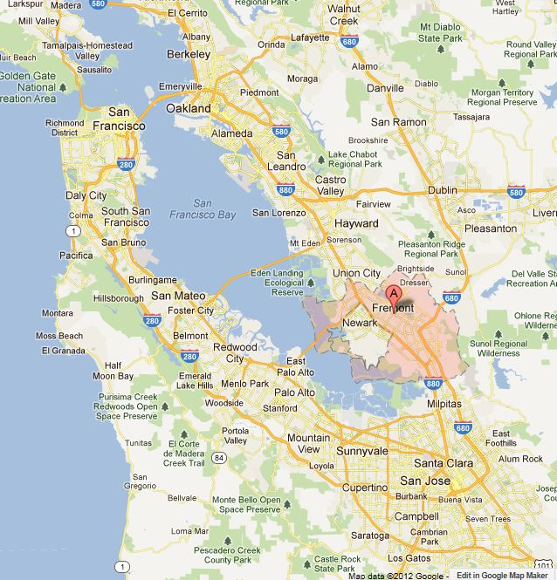

Slide 17
Louis Zamperini
January 26, 1914 — July 2, 2014

Slide 22
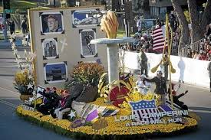

Slide 23
When you forgive it's like it never happened. True forgiveness is complete and total.
- Louis Zamperini

Slide 32
Psalm 90
Make Your Life Count

Slide 33
Get a God-Perspective
¹ Lord, through all the generations you have been our home! ² Before the mountains were born, before you gave birth to the earth and the world, from beginning to end, you are God.

Slide 34
Get a God-Perspective
Remember, Life is Short
³ You turn people back to dust, saying, “Return to dust, you mortals!” ⁴ For you, a thousand years are as a passing day, as brief as a few night hours. ⁵ You sweep people away like dreams that disappear. They are like grass that springs up in the morning.

Slide 35
Get a God-Perspective
Remember, Life is Short
Avoid Sin – It Makes Life Hard
⁷ We wither beneath your anger; we are overwhelmed by your fury. ⁸ You spread out our sins before you— our secret sins—and you see them all. ⁹ We live our lives beneath your wrath, ending our years with a groan.
¹⁰ Seventy years are given to us! Some even live to eighty. But even the best years are filled with pain and trouble; soon they disappear, and we fly away. ¹¹ Who can comprehend the power of your anger? Your wrath is as awesome as the fear you deserve.

Slide 36
Get a God-Perspective
Remember, Life is Short
Avoid Sin – It Makes Life Hard
Re-Align Your Life Priorities
¹² Teach us to realize the brevity of life, so that we may grow in wisdom.

Slide 37
Get a God-Perspective
Remember, Life is Short
Avoid Sin – It Makes Life Hard
Re-Align Your Life Priorities
¹³ O Lord, come back to us! How long will you delay? Take pity on your servants! ¹⁴ Satisfy us each morning with your unfailing love, so we may sing for joy to the end of our lives.

Slide 38
Get a God-Perspective
Remember, Life is Short
Avoid Sin – It Makes Life Hard
Re-Align Your Life Priorities
¹⁵ Give us gladness in proportion to our former misery! Replace the evil years with good. ¹⁶ Let us, your servants, see you work again; let our children see your glory. ¹⁷ And may the Lord our God show us his approval and make our efforts successful. Yes, make our efforts successful!

Slide 39
How will you live your dash?

Slide 45
Ron Nakamura
July 21, 1957– June 1, 2013

Slide 49
How will you live your dash?

