Slide 1

Be Wise
Proverbs
Dr. Rick Griffith • Crossroads International Church Singapore
CICFamily.com • BibleStudyDownloads.org

Slide 2

What are people passionate about?
Notes:
Money—so Singapore has the highest percentage of millionaires worldwide (16.5%)
Education—few feel you could be overeducated
Power—many are not happy with their job
Sex—few people remain with one person for life
Fun—the last experience didn’t satisfy, so try another
Travel—never before have so many traveled
Food—some travel across the country for a certain stall
Sports—depression if their team loses, elation if it wins

Slide 3

Do you want to be wise?
Notes:
But have you ever met someone who said he or she was passionate about gaining wisdom? Are you passionate about pursuing wisdom?
God gave Solomon one wish (since God is not a genie who gives three wishes!).
Solomon had the wisdom to want wisdom (1 Kings 3).
How much do you want wisdom?
But even if you desire to be wise, it still won’t just happen, so…

Slide 4

How can you be wise?
Notes:
What is the way for you to gain true wisdom? Not knowledge, but discernment in life—the question we'll address today is HOW this type of prudence is gained. Such sense will not keep trouble from finding you, but it will keep you from finding trouble.

Slide 5

Let's Study Through Scripture
The Bible: Book by Book
Notes:
We are in a study through the whole Bible right now, book by book. The goal is to give us a basic understanding of each book of the Bible.

Slide 6
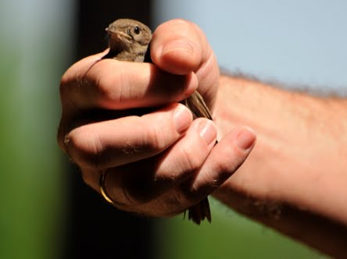
Modern Day Proverbs
"A bird in the hand is worth two in the bush!"
Notes:
Today we study the book of Proverbs. This may seem strange to be studying short, pithy sayings, but actually, you and I encounter proverbs all the time. Can you think of the proverb associated with this picture?
• Yes, a bird in the hand is worth two in the bush.
This proverb isn't just talking about birds. It means we should be satisfied with the blessing that we have rather than long for those we will never have. You may like the two birds over in a bush, but try going after them and they will fly away. It's better to be satisfied with the chicken you have to eat today than chase after two Peking ducks that you'll never catch.

Slide 7
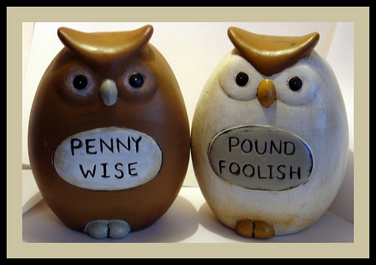
Modern Day Proverbs
"Penny-wise but pound foolish!"
Notes:
Don't spend one British pound to save one penny. Wisdom is allowing yourself to waste something small to preserve something big. That's why we all pay money for insurance.

Slide 8

Modern Day Proverbs
"Waste not, want not!"
Notes:
If you don't spend friviously, then you won't have financial woes in the future.

Slide 9

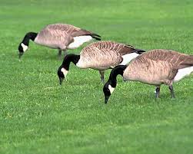

Modern Day Proverbs
"Birds of a feather flock together."
Chavez &
Ahmadinejad
Notes:
People like to be with people who are like them.
We typically do not seek out others who differ from us in values and priorities.

Slide 10

JUST DO IT.
Notes:
Stop procrastinating.
Don’t think about things or plan ahead—hmmm, do you think Nike follows their own slogan? Not on your life!

Slide 11

"Time is money."
Notes:
What you do with every minute of the day is your best investment.

Slide 12
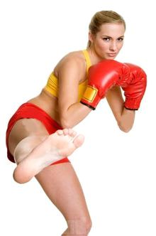

"Different strokes for different folks"
Notes:
Use varying strategies depending on whom you are relating to.
"The earliest use of DIFFERENT STROKES FOR DIFFERENT FOLKS that I could find was from 1966 (see quote below) by boxer and world heavyweight champion Muhammad Ali (Cassius Marcellus Clay, Jr.). Rhythm and soul singer Syl Johnson (father of Syleena) released the single titled 'DIFFERENT STROKES' in 1967 with the line also appearing in the song. But its appearance in Sly and the Family Stone's 1968 big hit single Everyday People is probably what put the phrase on the map. Additional exposure of the expression was burned into our collective psyches with the television comedy Diff'rent Strokes [1978-86] (an often used abbreviated form of the expression, but without the apostrophe) about a millionaire white widower who adopts two Black boys (one of which was that cute little guy Gary Coleman), and which was subsequently shown in the U.K where, so I've read, when the expression is used, the word folks may sometimes be replaced by blokes.
<1966 [quoting boxer Cassius Clay]" I got DIFFERENT STROKES FOR DIFFERENT FOLKS."—Great Bend Daily Tribune (Kansas), 11 November, page 6>
<1969 "The Adult has something to work on: what must I do to gain their STROKES, or their approval?"—I'm OK, You're OK by T. A. Harris, iii. page 45>
<1973 "The popular saying around the P[almer]D[rug]A[buse]P[rogram] is 'DIFFERENT STROKES FOR DIFFERENT FOLKS,' and that's the basis of the program."—Houston Chronicle Magazine, 14 October, page 4/1>
<1978 "He started off dishing out some nice STROKES. With an admiring smile he told me how smart I was, how honest, so absolutely reliable."—Fools Die by Mario Puzzo, xi. page 122>
<1981 "Let's face it, everybody needs their STROKES and that would be very ego-satisfying."—TV Picture Life, March, page 12/3>
<1986 "The whole point, says John Poindexter, [[President]] Reagan's national security adviser, is DIFFERENT STROKES FOR DIFFERENT FOLKS. 'We need different policies toward Communist dictatorships . . . , . . . for non-democratic regimes that are slowly evolving toward democracy, and different policies for non-democratic regimes in which there is no viable democratic center . . .'"—in New York (magazine), "How Reagan Does It" by Michael Kramer>
<1999 "There are a hundred times as many people addicted to alcohol, antidepressants and nicotine as there are to heroin or Charlie [cocaine]. DIFFERENT STROKES FOR DIFFERENT FOLKS, right?"—Spanish Highs by Wayne Anthony, page 65>
<2003 "If one motto sums up the [[weight loss]] industry, it could be 'DIFFERENT STROKES FOR DIFFERENT FOLKS.' At No. 1, with revenues this year expected to reach $1 billion, is 40-year-old Weight Watchers, with its program of weekly meetings and group support. Next comes Slim-Fast, the maker of bar and shake replacement meals. . . ."— U.S. News & World Report, 16 July>
<2008 "Suddenly [[Professor Wolfgang]] Mieder [[renowned expert on proverbs at the University of Vermont]] reminds me that he hasn't yet told me his favorite proverb. Can he really have a favorite? . . . But Mieder is a decisive man. 'DIFFERENT STROKES FOR DIFFERENT FOLKS is my favorite proverb,' he says. . . . 'I would argue it had to grow on American ground, because it doesn't tell you what to do. It says, "Accept the differences in people." . . . 'I think it's a truly liberating proverb.'"—Christian Science Monitor, 6 March>" (accessed 20 Aug 2014) http://www.wordwizard.com/phpbb3/viewtopic.php?f=7&t=20582

Slide 13
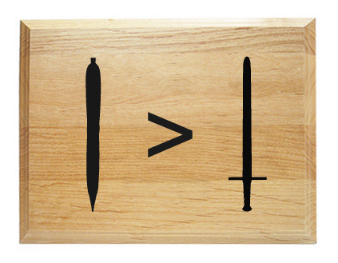
"The pen is mightier than the sword."
Notes:
Books impact us more than armies.

Slide 14
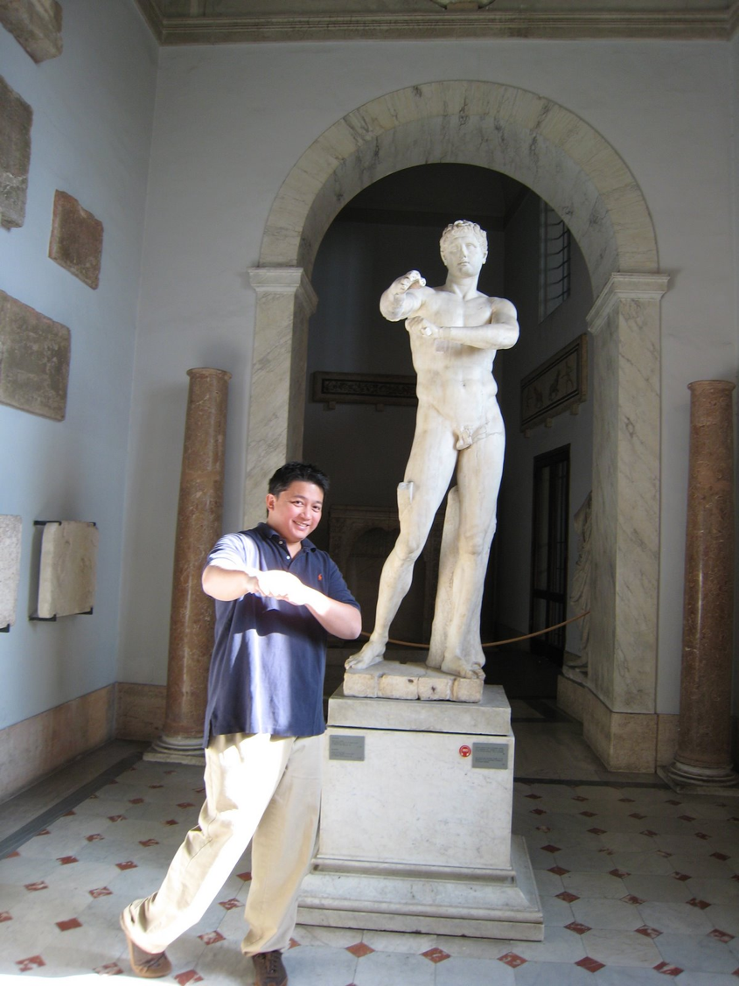
Rome
"When in Rome,
do as the Romans."
Notes:
Fit in when you are in a different environment.
Don’t try to stick out.

Slide 15

"The squeaky wheel gets the grease."
grease
Notes:
The person who makes the most noise generally gets the most attention to his or her concerns.

Slide 16

"No man is an island."
Notes:
No person operates in isolation.
We all need other people.

Slide 17

"People who live in glass houses shouldn't throw stones."
Notes:
Don’t be so critical that you destroy your own reputation or that of your family.

Slide 18
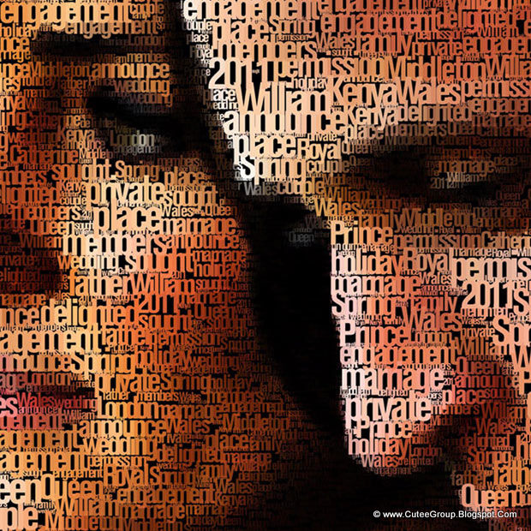
"A picture is worth a thousand words."
Notes:
Visuals sum up reality more than many descriptions.

Slide 19

"There's no such thing as a free lunch."
Notes:
Somebody pays for every benefit that you have.
You may not be paying for something, but someone else did.

Slide 20
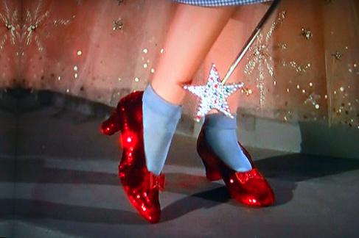
"There's no place like home."
Notes:
We all want the security and familiarity of a place where we belong—typical where we grew up and where our family resides.

Slide 21

Wisdom is good for you
"My son, eat honey, for it is good,
Yes, the honey from the comb is
sweet to your taste;
Know that wisdom is thus for
your soul." ~ Proverbs 24:13-14a
Notes:
We have a natural desire for good food, so we should have the same desire for wisdom.

Slide 22


Key Word of Proverbs:
394
Know
Wisdom
Day
Notes:
The Chinese character for wisdom implies that we know what is appropriate for that day.

Slide 23

Title & Date
Proverbs - Value and Path of Wisdom
Solomon |  |  | Wise Men (Anonymous) | Solomon | Wise Men (Agur, Lemuel, Anonymous)
1:1–22:16 |  |  | 22:17–24:34 | Ch. 25–29 | Ch. 30–31
13 sayings 375 two-line |  |  | 36 sayings | ±100 two-line | 3 sayings
 |  |  | Social & Miscellaneous | Social & Miscellaneous
Pro-logue | Principles of Wisdom |  |  |  | Epilogue
ca. 950-700 BC
394
Contrasts & Godliness
10:1–22:16
Ruling 31:1-9
Aims 1:1-7
Social & Nature Ch. 30
Godly Wife 31:10-31
Value of Wisdom
1:8–9:18

Slide 24
Title of the Book
395
"Proverb" – "to be like" or
"compared with"
A proverb is a statement which makes a comparison or describes a common experience.
Latin title: a proverb is a "word that stands for" many words (i.e., combined into one short saying).

Slide 25

Themes in
Proverbs

Slide 26
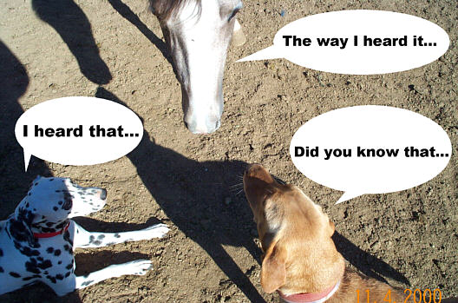
Words and Speech
401
The way I heard it…
"He who goes about as a talebearer
reveals secrets, but he who is
trustworthy conceals a matter"
(Proverbs 11:13)
I heard that…
Did you know that…

Slide 27

Money

Slide 28
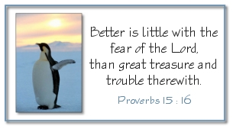
Godliness over Gold
"Better is little with the fear of the LORD
than great treasure and trouble with it."
Proverbs 15:16

Slide 29


True Success
SUCCESS
IN GOD'S
EYES?

Slide 30
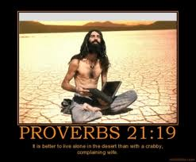
Proverbs 21:19
"It is better to live alone in the desert
than with a crabby, complaining wife."

Slide 31
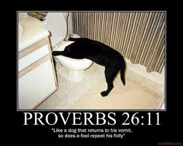
Proverbs 26:11
"Like a dog that returns to his vomit,
so does a fool repeat his folly."

Slide 32

Diligence and Laziness
"The soul of the sluggard craves and gets nothing,
but the soul of the diligent is made fat"
(Prov. 13:4)

Slide 33
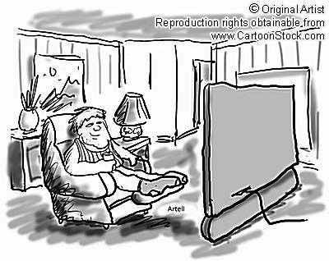
American, idle
American, idle

Slide 34
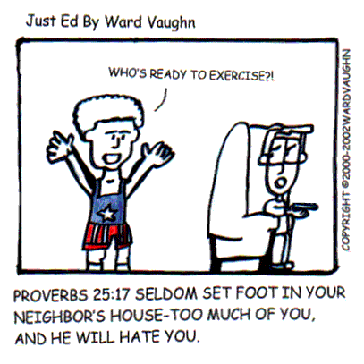
Relationships
Who's ready to exercise?!
Proverbs 25:17 "Seldom set foot in your neighbor's house—too much of you, and he will hate you."

Slide 35
How can you be wise?
Proverbs gives 3 ways.
Notes:
Restatement

Slide 36

I. Learn discipline and fear of the LORD (1:1-7).
How to be wise...
Notes:
Restatement

Slide 37
Slides on
Proverbs 1

Slide 38

Why Read Proverbs?
Check out 1:1-7

Slide 39

¹These are the proverbs of Solomon,
David’s son, king of Israel.
²Their purpose is to teach people wisdom and discipline,
to help them understand the insights of the wise.
³Their purpose is to teach people to live disciplined and successful lives,
to help them do what is right, just, and fair.
Proverbs 1:1-7 NLT

Slide 40
⁴These proverbs will give insight to the simple,
knowledge and discernment to the young.
⁵Let the wise listen to these proverbs and become even wiser.
Let those with understanding receive guidance
Proverbs 1:1-7 NLT

Slide 41
⁶ by exploring the meaning in these proverbs and parables,
the words of the wise and their riddles.
⁷ The fear of the LORD is the foundation of true knowledge, but fools despise wisdom and discipline.
Proverbs 1:1-7 NLT

Slide 42
I. Learn discipline and fear of the LORD (1:1-7).
How to be wise...
Notes:
Restatement

Slide 43

II. Value wisdom that leads to a prosperous life (1:8–9:18).
How to be wise...
Notes:
Restatement

Slide 44
Wisdom
gives honor to keep youth from the shame of foolishness (1:8-9).
Notes:
Text

Slide 45
Wisdom
preserves youth from disaster (1:10-33).
Notes:
Text

Slide 46
Slides on
Proverbs 2

Slide 47
Wisdom
helps maintain moral behavior (Prov 2).
Notes:
Text

Slide 48
Book Chart
Proverbs - Value and Path of Wisdom
Solomon |  |  | Wise Men (Anonymous) | Solomon | Wise Men (Agur, Lemuel, Anonymous)
1:1–22:16 |  |  | 22:17–24:34 | Ch. 25–29 | Ch. 30–31
13 sayings 375 two-line |  |  | 36 sayings | ±100 two-line | 3 sayings
 |  |  | Social & Miscellaneous | Social & Miscellaneous
Pro-logue | Principles of Wisdom |  |  |  | Epilogue
ca. 950-700 BC
394
Contrasts & Godliness
10:1–22:16
Ruling 31:1-9
Aims 1:1-7
Social & Nature Ch. 30
Godly Wife 31:10-31
Value of Wisdom
1:8–9:18

Slide 49
Slides on
Proverbs 3

Slide 50
Wisdom
helps us relate
with God and man (Prov 3).
Notes:
Text

Slide 51

Key Verse
394
"Trust in the LORD with all your heart
Proverbs 3:5-6

Slide 52

Key Verse
394
and lean not on your own understanding;
Proverbs 3:5-6

Slide 53

Key Verse
in all your ways acknow-ledge him
394
Proverbs 3:5-6

Slide 54

Key Verse
and he will make your paths straight."
394
Proverbs 3:5-6

Slide 55
Slides on
Proverbs 4

Slide 56
Wisdom
provides a gracious life (4:1-9).
Notes:
Text

Slide 57
Wisdom
preserves youth from trouble (4:10-19).
Notes:
Text

Slide 58
Wisdom
produces healthy young people (4:20-27).
Notes:
Text

Slide 59
Slides on
Proverbs 5

Slide 60
Wisdom
helps avoid sexual sin (Prov 5).
Notes:
Text

Slide 61

"My son, pay attention to my wisdom; listen carefully to my wise counsel.
²Then you will show discernment, and your lips will express what you've learned" (5:1-2 NLT).

Slide 62

"For the lips of an immoral woman are as sweet as honey, and her mouth is smoother than oil"
(5:3 NLT).
Notes:
(5:3) Immoral people's advances are genuinely enticing in touch and sound.

Slide 63

SIGN UP FOR
COVENANT EYES
SOFTWARE

Slide 64

Covenant Eyes

Slide 65
Slides on
Proverbs 6

Slide 66
Wisdom
preserves from poverty (6:1-11).
Notes:
Text

Slide 67
Wisdom
preserves from dissension (6:12-19).
Notes:
Text

Slide 68
Wisdom
preserves youth from sexual immorality
(6:20–7:27).
Notes:
Text

Slide 69
Slides on
Proverbs 8

Slide 70
Wisdom
has valuable virtues, rewards and was used in creation (Prov 8).
Notes:
Text

Slide 71
Slides on
Proverbs 9

Slide 72
Wisdom
is valuable compared to the claims of foolishness (Prov 9).
Notes:
Text

Slide 73
I. Learn discipline and fear of the LORD (1:1-7).
How to be wise...
Notes:
Restatement

Slide 74
II. Value wisdom that leads to a prosperous life (1:8–9:18).
How to be wise...
Notes:
Restatement

Slide 75

III. Heed advice of wise men on relationships
(Prov 10–31).
How to be wise...
Notes:
Restatement

Slide 76
Slides on
Proverbs 10

Slide 77

About 375 two-line proverbs of Solomon teach the practical benefits of wisdom over wickedness in everyday life (10:1–22:16).
Notes:
Text

Slide 78
Slides on
Proverbs 11

Slide 79
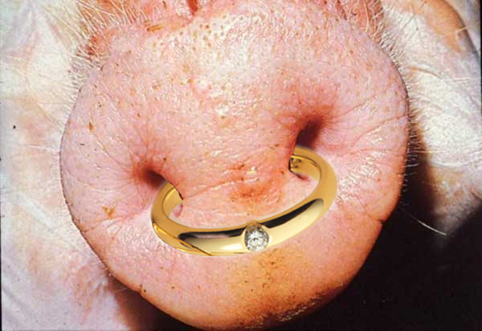

VERY Descriptive!
"As a ring of gold in a swine's snout, so is a beautiful woman who lacks discretion"
(Proverbs 11:22)

Slide 80
Slides on
Proverbs 22

Slide 81

Wisdom
Longer sayings of wise men admonish practical wisdom in many areas
(22:17–24:34).
Notes:
Text

Slide 82
Slides on
Proverbs 25

Slide 83

Wisdom
The final collection of Solomon's proverbs by Hezekiah's scribes 250 years later guide social relationships and various activities (Prov 25–29).
Notes:
Text

Slide 84
Slides on
Proverbs 30

Slide 85

Wisdom
Sayings of Agur to Ithiel and Ucal show insights from nature and social relationships (Prov 30).
Notes:
Text

Slide 86

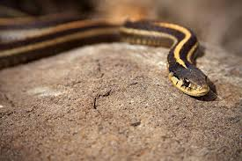
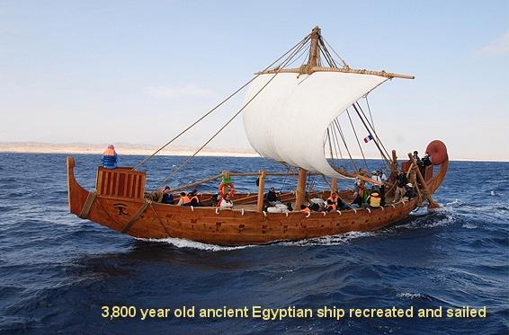

Proverbs 30:18-20 (NIV)
"There are three things that are too amazing for me, four that I do not understand:"
the way of an eagle in the sky,
the way of a snake on the rock,
the way of a ship on the high seas,
and the way of a man with a maiden

Slide 87
Slides on
Proverbs 31

Slide 88

Wisdom
The unknown Lemuel’s mother prepares him for kingship by advising him to avoid the excesses of women and wine, and to protect the rights of the underprivileged (31:1-9).
Notes:
Text

Slide 89

Wisdom
An acrostic and anonymous poem of a noble wife exhorts young women to be godly and diligent and exhorts young husbands to praise these qualities in their wives (31:10-31).
Notes:
Text

Slide 90
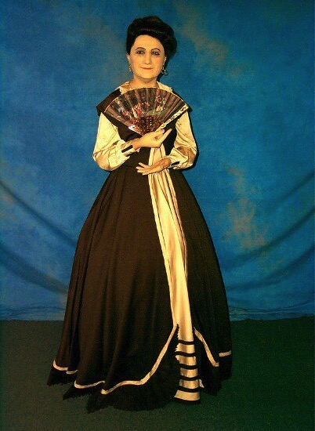
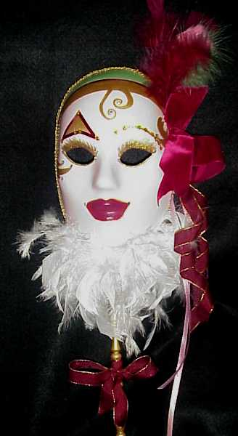
The Two Women:
Wisdom & Folly

Slide 91

Proverbs 31
The Wise Woman

Slide 92

Each society has its ideal woman
"The model of women in tribal patriarchalism is a brood mare;
in hedonistic naturalism, she is the bunny or plaything;
in feminist ideology, she is the self-sufficient career woman;
in romanticism, she is the fairy princess or maiden in distress waiting to be rescued;
in biblical faith, she is the partner in ministry."
Theologian Donald Bloesch (1928-2010)

Slide 93

"Who can find a virtuous and capable wife? She is more precious than rubies"
(Prov. 31:10 NLT).

Slide 94
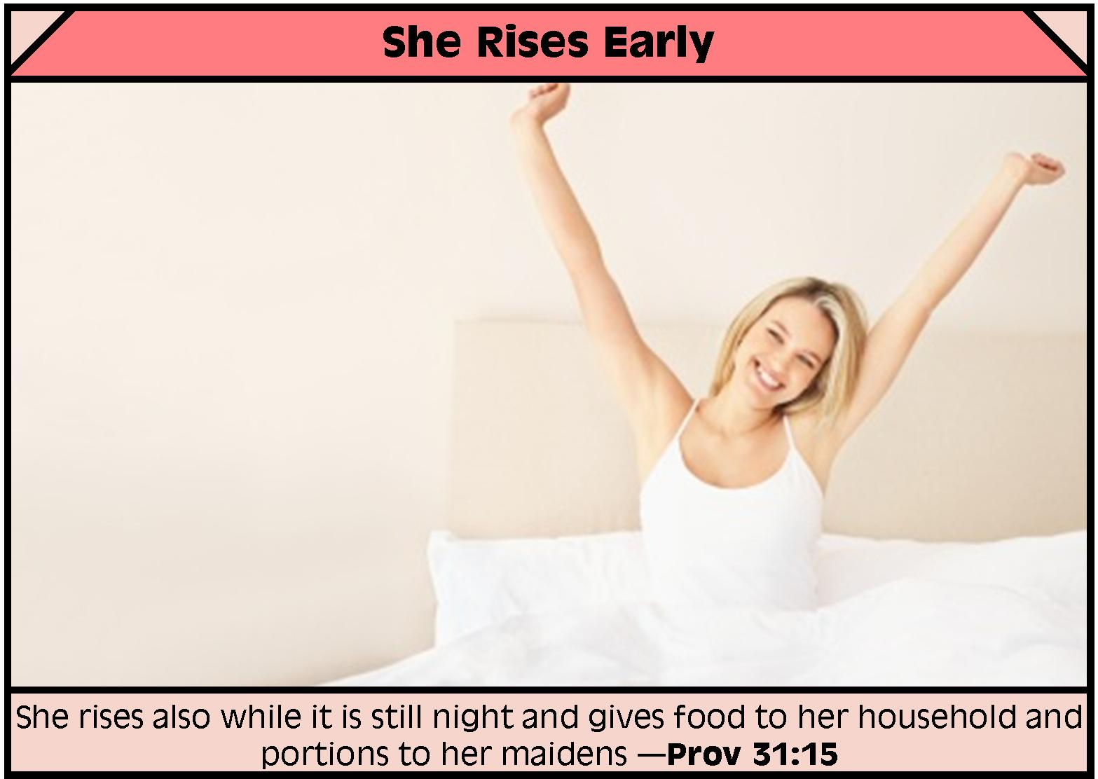
Proverbs 31
She Rises Early
"She rises while it is still night and gives food to her household and portions to her maidens" (Prov. 31:15)

Slide 95

Proverbs 31
She Smiles at Her Future
"Strength and dignity are her clothing, and she smiles at the future" (Prov. 31:25)

Slide 96



She is deemed the best model

Slide 97

Stop comparing yourself to the Proverbs 31 woman.
http://924jeremiah.wordpress.com/2014/03/21/stop-comparing-yourself-to-the-proverbs-31-woman/ advises…
Learn who invented the Proverbs 31 woman and why this list of "ideal" qualities doesn't align with God's priorities for you.
Notes:
For all you women who are trying to please God but feel utterly despaired every time someone whips out Proverbs 31: take heart! God is not comparing you to this fictitious female, nor should you be interpreting this passage as His personal calling on your life. To put this passage in perspective, you need to put the whole book of Proverbs in perspective. A proverb is simply a saying. The Holy Spirit will make it clear to you when a particular proverb has any value for you in a given moment. But let's be clear about the kind of effect the Holy Spirit's Voice has on us. When He speaks to your heart, you don't end up feeling beat down, discouraged, and hopelessly flawed. So as you're reading through Proverbs 31, if it feels like someone is shoveling wet cement onto your back and you're feeling more and more burdened with every word you read, then you're not hearing from the Holy Spirit. You're hearing from that nasty old deceiver Satan, or one of his many sordid friends.
Demons are the ones who want you to go through life feeling like a flop because you don't live up to someone's fantasy woman. And fantasy is what we're dealing with in Proverbs 31, because the woman described there has magically escaped the burden of carnal flesh. Not only is this woman utterly selfless, she's also in perfect health, she's got bundles of energy, she's super social, she's physically strong, and she clearly has more than 24 hours in a day. And as this charming lady is busy making everything from scratch and running a charity house for the poor out of her home, she's also super wealthy (since she and her children only wear the best of threads), plus she's politically powerful. Her husband is one of the leaders in the land (v23), which puts her hobnobbing in higher society. And to top it all off, this lady who weaves her own fabric and sews everything she owns from scratch also gets by on only a few hours of sleep. We're told she works late into the night and is up before the sun feeding the servant girls. She never wastes her time (v27), and she gives her husband everything he needs. So of course her family praises her and everyone thinks this lady is fabulous. And by the time she's done making wardrobes from scratch, planting vineyards, cooking meals and running a booth at the local marketplace, we wonder what those servant girls do besides get up before dawn to eat their pre-made breakfast.
So how do we put things in perspective here? Well, for one thing, let's remember how credit is assigned to people in the Old Testament. For example, we're told that King Solomon built God's Temple, per the instructions of his father King David. But while Solomon gets all the glory for creating that massive structure, what did he really contribute besides a long prayer on dedication day? In real life King Solomon didn't lift a single stone—he just told other people to go and build the Temple while he went off and parked in a nice shaded room with lots of goodies and soft sofas. When all the laborers were done sweating and slaving under the hot sun, their accomplishments were recorded as Solomon's accomplishments. This is how it works when you're the king or the head of a household. In Proverbs 31, the woman being described is running a rich household. That means she'd have a bunch of servants who she'd get to boss around all day. Would a woman in her position really be trimming wool off the sheep and weaving it into thread? No, because such tasks are beneath her. What we really have being described in Proverbs 31 is a good delegator—someone who is definitely busy, but she's also telling everyone else what to do all day and then taking the glory for both their work and hers. Well, no wonder she gets so much done.
Look up rich people in the Bible and you'll find they are credited for all sorts of things that they didn't do. In a culture where women got the credit for the babies their slave girls birthed, we have to read records of accomplishments with caution.
So who wrote Proverbs 31, anyway? It's a man named King Lemuel who is sharing things his mother drilled into his brain. In verse 1 we're told: "These are the words of King Lemuel, the message his mother taught him." Lemuel's mom then starts off by telling her son to stay away from liquor because kings don't rule well when they're drunk. Then she tells him to look out for the needs of the poor. This is certainly sound advice. Interestingly in verse 3, Mom doesn't sound very keen on women in general, for she tells her son:
"Don't waste your strength on women, or your time on those who ruin kings."
The way poetry works in the Bible, these two phrases are meant to be descriptions of the same people: Mom is defining women as "those who ruin kings." Now we all know that rich men become targets for Delilah type vipers. Mom sounds pretty protective, and she has good reason to be. There's a reason kings have harems—once a guy gets some rank, his hormones have a way of taking him over and pretty soon he cares more about sex than he does about his kingdom and God. This is what happened with King Solomon and his 1,000 recorded lovers (plus who knows how many unrecorded flings). Solomon has had a lot more airtime in the book of Proverbs. We only hear about Lemuel here at the end, when Mom pipes up to tell her son "no wine and no women." Rather harsh. One wonders if Mom is ruling out all women or just the shady ones. It's interesting that she doesn't use any extra adjectives to pinpoint what percentage of her own gender she disapproves of. The way her words are written, it sounds like Mom's pretty much anti-female. Perhaps she's been burned in the past by seeing evil women corrupt those she cares about and she's not going to let that happen to her Lemuel.
Now it's not very realistic to think Lemuel isn't going to get married, so after Mom tells him to stay away from women in general, she then supplies a long, detailed definition of an acceptable wife. Because Lemuel is crediting Mom for everything he's saying in this passage, we have to assume that this perfect wife is something she's come up with—and this would make sense because the passage has a very female tone to it. Women are the nurturing gender and we hear the nurturing instinct coming through in a comment about the woman being concerned for her family's warmth in the winter months (v21), plus we hear an awful lot about clothes and cooking. The Proverbs 31 perspective is very much that of a homemaker and not at all that of a busy king. Clearly Lemuel's mom is a fan of the textile industry for we hear all about fabric in this passage—weaving it, sewing it, and selling it. We hear about raw material: wool and flax. We hear about the quality of the finished product: fine linen. And we hear about colors: scarlet and purple. With such a strong focus on fabric, it's quite possible that Lemuel's inherited wealth came from the clothing business. So what we find in Proverbs 31 is not a description of God's ideal woman, but of one king's mother's ideal vision for the kind of woman she wants her son to marry. What mother doesn't hope for the stars when it comes to marrying off her pride and joy? And with Mom's hostility towards women in general so openly expressed, it's no wonder that she's demanding the best of the best for her son. She wants Lemuel to find a woman who will satisfy his every need, make him a bunch of money, and be a total workaholic. With her daughter-in-law working hard day in and day out, she certainly wouldn't be much competition for Lemuel's attention. When we realize who is really supplying the words of this passage, it's interesting to wonder about all the ulterior motives that went into painting a picture of an "ideal" woman—a woman who clearly doesn't exist. Obviously Mom isn't in any rush for grandchildren. And clearly she isn't going to be an easy sell to anyone Lemuel tries to bring home for dinner.
"An excellent wife, who can find?" (v10)
Indeed, and as we read through Mom's list of impossible requirements, we wonder if she ever wants Lemuel to get a wife. It's really Mom's character that's coming through in this passage more than anything else. Whoever Lemuel's mother was, she clearly felt that lollygagging about was a major sin. She sounds like a very driven woman—obsessed with productivity and very concerned with social reputation. What does God tell us about these themes elsewhere in the Bible? Well, when Martha complained that her sister Mary was slacking with the household chores, Jesus took the side of the slacker. Productivity is all fine and well, but God tell us not to store up our treasures here on earth, or to spend our lives focused on accumulating wealth.
As for all people thinking well of us—this is another dream that both Yahweh and Jesus shoot down. As Christians, we don't want to be agitating others just to do it. But God's truth is a divisive thing, and His influence is often greeted with great hostility. Jesus said He didn't come to bring peace to the world, but to cause division and strife (Lk 12:51). The more we mature in the faith, the more division we will cause as well. Lukewarm Christians are generally tolerated by the world, but fully devoted ones are met with opposition in both the world and the Church. Who was it that really pushed for Jesus to be crucified? It was the religious leaders, not the lay people. It was the ancient Jewish equivalent of our modern pastors, theologians and elders. The more like Christ we are, the more we can expect the same hostile treatment He received. So while Lemuel's mom dreams of a daughter-in-law who is both righteous in character and super popular, in real life, these two

Slide 98
Proverbs 31
Is this for women only?
Not really. It gives an example of what wisdom looks like in a woman.
Men need the same qualities!

Slide 99
How can you be wise?
Proverbs gives 3 ways.
Notes:
Restatement

Slide 100

Main Idea of Proverbs
Fear God by heeding his proverbs on the value and path of wisdom.
Notes:
Restatement

Slide 101
I. Learn discipline and fear of the LORD (1:1-7).
How to be wise...
Notes:
Restatement

Slide 102
II. Value wisdom that leads to a prosperous life (1:8–9:18).
How to be wise...
Notes:
Restatement

Slide 103
III. Heed advice of wise men on relationships
(Prov 10–31).
How to be wise...
Notes:
Restatement

Slide 104
Applications
394
Teach youth (& children) proverbs
Memorize proverbs to promote wise living
Read ONE chapter from Proverbs every day of the month (31 days for 31 chapters)

Slide 105
Black

Slide 106


OT Preaching link at BibleStudyDownloads.org
Get this presentation and script for free!

