Slide 1

Supermom
Proverbs 31:10-31
Dr. Rick Griffith • Crossroads International Church Singapore
CICFamily.com • BibleStudyDownloads.org

Slide 2
Online Job Applications
Position:
Director of Operations
Notes:
(Begin without speaking—just show the slide)

Slide 3

Online Job Applications
Position:
Director of Operations
Notes:
(Automatically starts)

Slide 4
A Fair Pay
Position Years Annual Pay Total Owed
Teacher 25 $50k $1.25 million
Cook 25 $50k $1.25 million
Counselor 9125 days $100/session $912,500
Maid 36 $25k $900,000
Chauffer 25 $30k $750,000
Notes:
How much would you have to pay a wife and mother to do what she does?
• My wife taught our sons from 1987 to 2011. She helped begin their school, homeschooled them for a few years, and tutored them for their homework thousands of times. Her teacher pay should be about $50k a year, so those 25 years would total $1.25 million.
• But she also was their chief cook. Cooks for three meals a day would also make at least $50k annually too, so let’s add another $1.25 million.
• Counselors are not cheap, though. At $100 a session and the fact that her childrearing lasted 9,125 days, I would say she counseling them at least once a day. That would add another $912,500.
• But wait—what about cleaning the house? That’s not cheap either. The going rate for a full-time maid is maybe $25k. It looks like I owe you $900,000 for the past 36 years.
• But wait—you have also been chauffer par excellence for thousands of trips to school, to our son’s plays, to our son’s sports events, and numerous other activities. The going rate for a safe, caring chauffer must be at least $30k annually, so over 25 years of parenting, I would owe you $750,000. Wow, I must be rich!

Slide 5

Proverbs 31:10-31
Rare & Priceless

Slide 6
Supermom
Proverbs 31:10-31
Notes:
Must every wife be Supermom—able to leap tall buildings at a single bound?

Slide 7

Proverbs 31:10-31 NIV
¹⁰ A wife of noble character who can find? She is worth far more than rubies.
“noble” (NIV)
“excellent” (NASB95)
“virtuous and capable” (NLT)
Notes:
What does it mean to have “noble character” (10a)? How is this different from being nobility? Or does this mean she acts like a godly queen?

Slide 8
The word for noble character is translated “capable” in Exodus 18:21
“But select from all the people some capable, honest men who fear God and hate bribes. Appoint them as leaders over groups of one thousand, one hundred, fifty, and ten”
(Exod 18:21 NLT).
Notes:
Ruth was called “a woman of noble character” (Ruth 3:11)—BKC

Slide 9

The same word is used in Proverbs 12:4
“An excellent wife is the crown of her husband,
but she who shames him is like
rottenness in his bones” (NAU).
“A worthy wife is a crown for her husband,
but a disgraceful woman is like
cancer in his bones” (NLT).

Slide 10
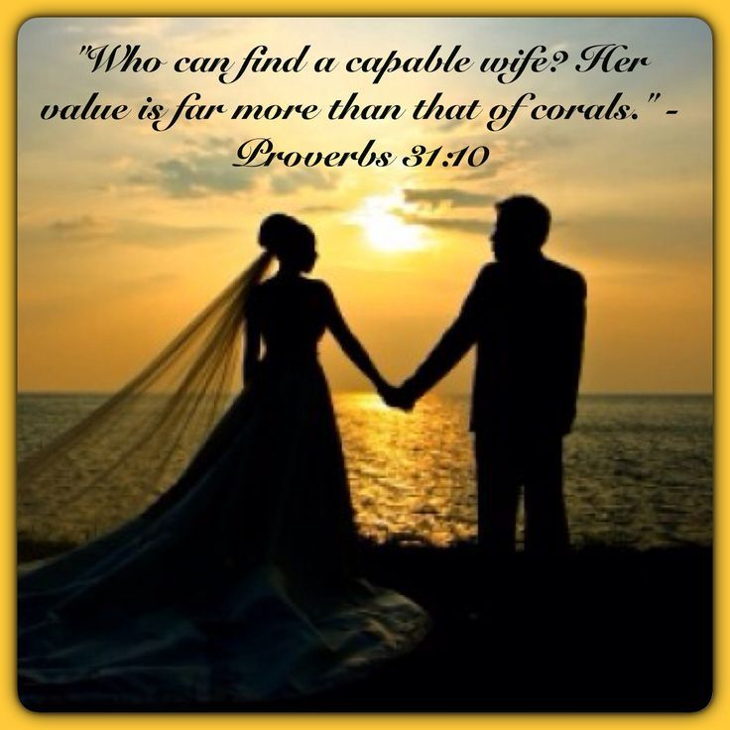
Capable
Notes:
Literally the Hebrew reads “corals” as a figure of value—but translations today render it ”rubies” (NIV) or “jewels” (NAU)>

Slide 11

"Who can find a virtuous and capable wife? She is more precious than rubies"
(Prov. 31:10 NLT).
Notes:
Is the implied question “who can find?” negative—that no man actually can find a wife like this (10b)?
“The question who can find? (cf. Prov. 20:6) does not suggest that such women are nonexistent but that they should be admired because they, like noble men, are rare” (BKC).
“Also they are more valuable than rubies (cf. a similar statement about wisdom in 8:11)” (BKC).

Slide 12

How is a capable wife rare and priceless?
Notes:
This passage describes a competent, exceptional woman of great value.

Slide 13


The List
Notes:
Warning: I once gave my girlfriend my list of the ideal wife. It was 4 pages long! Big mistake!
It even required that she enjoy snow skiing—a skill that I later imposed on Susan during our honeymoon.
This dream of mine ended when the ski instructor on the bunny slope told Susan that he wouldn’t recommend even the bunny slope for her!
I look back at this now and thank God that I have learned a few things in 36 years of marriage. For one like me who likes to make lists, here is one list that I regret.
Besides that, little did I realize that God’s plan for me was to live three decades in the tropics!
Susan has forgiven me for my foolishness and still hasn’t learned to snow ski, but she really enjoys the hot tea at the lodge when our three sons and I hit the slopes once every few years or so when we are back in the USA.

Slide 14

Do ladies have to do everything in this chapter?
It is not a litmus test where every single trait must be imitated to the letter.
Notes:
The focus is on a wife but the description is of her also as a mother.
Yet it gives ways that people can become capable.

Slide 15
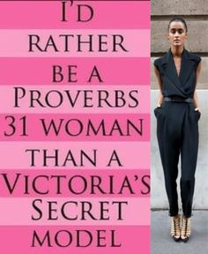


She is deemed the best model
Notes:
—despite the many Bible studies ladies can find on “being a Proverbs 31 woman.”

Slide 16
Stop comparing yourself to the Proverbs 31 woman.
http://924jeremiah.wordpress.com/2014/03/21/stop-comparing-yourself-to-the-proverbs-31-woman/ advises…
Learn who invented the Proverbs 31 woman and why this list of "ideal" qualities doesn't align with God's priorities for you.
Notes:
For all you women who are trying to please God but feel utterly despaired every time someone whips out Proverbs 31: take heart! God is not comparing you to this fictitious female, nor should you be interpreting this passage as His personal calling on your life. To put this passage in perspective, you need to put the whole book of Proverbs in perspective. A proverb is simply a saying. The Holy Spirit will make it clear to you when a particular proverb has any value for you in a given moment. But let's be clear about the kind of effect the Holy Spirit's Voice has on us. When He speaks to your heart, you don't end up feeling beat down, discouraged, and hopelessly flawed. So as you're reading through Proverbs 31, if it feels like someone is shoveling wet cement onto your back and you're feeling more and more burdened with every word you read, then you're not hearing from the Holy Spirit. You're hearing from that nasty old deceiver Satan, or one of his many sordid friends.
Demons are the ones who want you to go through life feeling like a flop because you don't live up to someone's fantasy woman. And fantasy is what we're dealing with in Proverbs 31, because the woman described there has magically escaped the burden of carnal flesh. Not only is this woman utterly selfless, she's also in perfect health, she's got bundles of energy, she's super social, she's physically strong, and she clearly has more than 24 hours in a day. And as this charming lady is busy making everything from scratch and running a charity house for the poor out of her home, she's also super wealthy (since she and her children only wear the best of threads), plus she's politically powerful. Her husband is one of the leaders in the land (v23), which puts her hobnobbing in higher society. And to top it all off, this lady who weaves her own fabric and sews everything she owns from scratch also gets by on only a few hours of sleep. We're told she works late into the night and is up before the sun feeding the servant girls. She never wastes her time (v27), and she gives her husband everything he needs. So of course her family praises her and everyone thinks this lady is fabulous. And by the time she's done making wardrobes from scratch, planting vineyards, cooking meals and running a booth at the local marketplace, we wonder what those servant girls do besides get up before dawn to eat their pre-made breakfast.
So how do we put things in perspective here? Well, for one thing, let's remember how credit is assigned to people in the Old Testament. For example, we're told that King Solomon built God's Temple, per the instructions of his father King David. But while Solomon gets all the glory for creating that massive structure, what did he really contribute besides a long prayer on dedication day? In real life King Solomon didn't lift a single stone—he just told other people to go and build the Temple while he went off and parked in a nice shaded room with lots of goodies and soft sofas. When all the laborers were done sweating and slaving under the hot sun, their accomplishments were recorded as Solomon's accomplishments. This is how it works when you're the king or the head of a household. In Proverbs 31, the woman being described is running a rich household. That means she'd have a bunch of servants who she'd get to boss around all day. Would a woman in her position really be trimming wool off the sheep and weaving it into thread? No, because such tasks are beneath her. What we really have being described in Proverbs 31 is a good delegator—someone who is definitely busy, but she's also telling everyone else what to do all day and then taking the glory for both their work and hers. Well, no wonder she gets so much done.
Look up rich people in the Bible and you'll find they are credited for all sorts of things that they didn't do. In a culture where women got the credit for the babies their slave girls birthed, we have to read records of accomplishments with caution.
So who wrote Proverbs 31, anyway? It's a man named King Lemuel who is sharing things his mother drilled into his brain. In verse 1 we're told: "These are the words of King Lemuel, the message his mother taught him." Lemuel's mom then starts off by telling her son to stay away from liquor because kings don't rule well when they're drunk. Then she tells him to look out for the needs of the poor. This is certainly sound advice. Interestingly in verse 3, Mom doesn't sound very keen on women in general, for she tells her son:
"Don't waste your strength on women, or your time on those who ruin kings.”
The way poetry works in the Bible, these two phrases are meant to be descriptions of the same people: Mom is defining women as "those who ruin kings." Now we all know that rich men become targets for Delilah type vipers. Mom sounds pretty protective, and she has good reason to be. There's a reason kings have harems—once a guy gets some rank, his hormones have a way of taking him over and pretty soon he cares more about sex than he does about his kingdom and God. This is what happened with King Solomon and his 1,000 recorded lovers (plus who knows how many unrecorded flings). Solomon has had a lot more airtime in the book of Proverbs. We only hear about Lemuel here at the end, when Mom pipes up to tell her son "no wine and no women." Rather harsh. One wonders if Mom is ruling out all women or just the shady ones. It's interesting that she doesn't use any extra adjectives to pinpoint what percentage of her own gender she disapproves of. The way her words are written, it sounds like Mom's pretty much anti-female. Perhaps she's been burned in the past by seeing evil women corrupt those she cares about and she's not going to let that happen to her Lemuel.
Now it's not very realistic to think Lemuel isn't going to get married, so after Mom tells him to stay away from women in general, she then supplies a long, detailed definition of an acceptable wife. Because Lemuel is crediting Mom for everything he's saying in this passage, we have to assume that this perfect wife is something she's come up with—and this would make sense because the passage has a very female tone to it. Women are the nurturing gender and we hear the nurturing instinct coming through in a comment about the woman being concerned for her family's warmth in the winter months (v21), plus we hear an awful lot about clothes and cooking. The Proverbs 31 perspective is very much that of a homemaker and not at all that of a busy king. Clearly Lemuel's mom is a fan of the textile industry for we hear all about fabric in this passage—weaving it, sewing it, and selling it. We hear about raw material: wool and flax. We hear about the quality of the finished product: fine linen. And we hear about colors: scarlet and purple. With such a strong focus on fabric, it's quite possible that Lemuel's inherited wealth came from the clothing business. So what we find in Proverbs 31 is not a description of God's ideal woman, but of one king's mother's ideal vision for the kind of woman she wants her son to marry. What mother doesn't hope for the stars when it comes to marrying off her pride and joy? And with Mom's hostility towards women in general so openly expressed, it's no wonder that she's demanding the best of the best for her son. She wants Lemuel to find a woman who will satisfy his every need, make him a bunch of money, and be a total workaholic. With her daughter-in-law working hard day in and day out, she certainly wouldn't be much competition for Lemuel's attention. When we realize who is really supplying the words of this passage, it's interesting to wonder about all the ulterior motives that went into painting a picture of an "ideal" woman—a woman who clearly doesn't exist. Obviously Mom isn't in any rush for grandchildren. And clearly she isn't going to be an easy sell to anyone Lemuel tries to bring home for dinner.
"An excellent wife, who can find?" (v10)
Indeed, and as we read through Mom's list of impossible requirements, we wonder if she ever wants Lemuel to get a wife. It's really Mom's character that's coming through in this passage more than anything else. Whoever Lemuel's mother was, she clearly felt that lollygagging about was a major sin. She sounds like a very driven woman—obsessed with productivity and very concerned with social reputation. What does God tell us about these themes elsewhere in the Bible? Well, when Martha complained that her sister Mary was slacking with the household chores, Jesus took the side of the slacker. Productivity is all fine and well, but God tell us not to store up our treasures here on earth, or to spend our lives focused on accumulating wealth.
As for all people thinking well of us—this is another dream that both Yahweh and Jesus shoot down. As Christians, we don't want to be agitating others just to do it. But God's truth is a divisive thing, and His influence is often greeted with great hostility. Jesus said He didn't come to bring peace to the world, but to cause division and strife (Lk 12:51). The more we mature in the faith, the more division we will cause as well. Lukewarm Christians are generally tolerated by the world, but fully devoted ones are met with opposition in both the world and the Church. Who was it that really pushed for Jesus to be crucified? It was the religious leaders, not the lay people. It was the ancient Jewish equivalent of our modern pastors, theologians and elders. The more like Christ we are, the more we can expect the same hostile treatment He received. So while Lemuel's mom dreams of a daughter-in-law who is both righteous in character and super popular, in real life, these two…
http://924jeremiah.wordpress.com/2014/03/21/stop-comparing-yourself-to-the-proverbs-31-woman/ advises…

Slide 17

Proverbs 31
Is this for women only?
Not really. It gives an example of what wisdom looks like in a woman.
Men need the same qualities!
Notes:
But the qualities here are traits that every believer should seek.

Slide 18
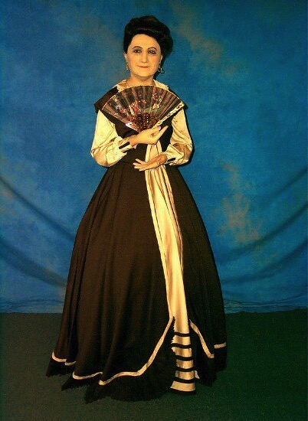
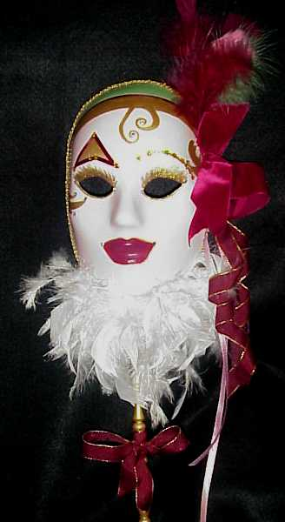
The Two Women:
Wisdom & Folly
Notes:
The Book of Proverbs constantly contrasts foolishness under the image of the ”woman of folly” with wisdom personified by “lady wisdom.” The climax of the Book of Proverbs is this last section to illustrate that wisdom leads to a capable life—one that is selfless as it looks out for others and is virtuous or godly. This is what we should praise!

Slide 19
Where we’re going today…
How
she
is
priceless
How
we
should
respond
Notes:
Preview: Let’s see how wisdom under the image of a capable wife is priceless—and then how to respond. And let’s also apply this to our lives, whoever we are!
Text: Proverbs 31:11-27 help us identify such a rare and priceless woman—and anyone like this, for that matter.
(Verses 11-27 tell us how a capable wife is priceless...)

Slide 20

I. A capable wife has godly selfless deeds (11-27).
Notes:
The godly wife and mother helps other people instead of herself.

Slide 21

4 ways a capable wife has
godly selfless deeds
1. She works hard for others (11-24).

Slide 22
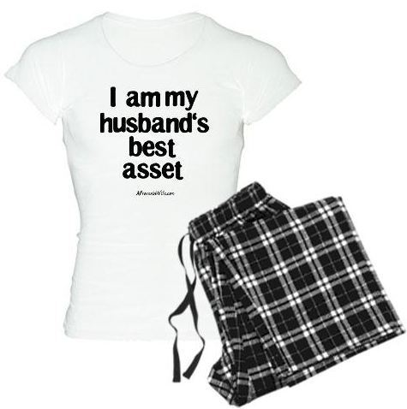
How does a capable woman work hard for others (11-24)?
1. She is an asset to her husband (11-12).

Slide 23
Proverbs 31:10-31 NIV
¹¹ Her husband has full confidence in her and lacks nothing of value.
¹² She brings him good, not harm, all the days of her life.

Slide 24

Each society has its ideal woman
"The model of women in tribal patriarchalism is a brood mare;
in hedonistic naturalism, she is the bunny or plaything;
in feminist ideology, she is the self-sufficient career woman;
in romanticism, she is the fairy princess or maiden in distress waiting to be rescued;
in biblical faith, she is the partner in ministry."
Theologian Donald Bloesch (1928-2010)
Notes:
Susan’s thoughtfulness and “bringing good to her husband” has been shown thousands of time. One of the latest is her leaving the last yoghurt while shopping. Only two were left and she could have bought both, but she considered the disappointment of the next person to see an empty shelf.
Being married to me hasn’t been easy. I felt that we should sell our home 30 years ago to come to Singapore so we could serve unencumbered. She agreed.
Our challenges raising three boys here without house help or family nearby amazed my students over the years.
But it started when we brought our firstborn son Kurt home from the hospital in a freezing January in Texas. We had no idea how to wash him in the cold—so we cranked up the heat all the way, but he was still cold. We switched to wash him in the kitchen sink with the blazing oven opposite to keep him warm, but that didn’t work either. Finally, we figured that if she handed him to me while I took a shower, he could enjoy it and still get clean while remaining warm.
Susan has been my greatest asset for 36 years now.

Slide 25

How does a capable woman work hard for others (12-24)?
"Scripture" (6: NLT).
1. She is an asset to her husband (11-12).
2. She cares for her family (13-22).

Slide 26
Proverbs 31:10-31 NIV
¹³ She selects wool and flax
and works with eager hands.
¹⁴ She is like the merchant ships,
bringing her food from afar.
Notes:
She works with her hands (13).
She feeds her family well (14).

Slide 27

Proverbs 31
She rises early to care for her family
"She rises while it is still night and gives food to her household and portions to her maidens" (Prov 31:15)

Slide 28
Proverbs 31:10-31 NIV
¹⁶ She considers a field and buys it; out of her earnings she plants a vineyard.
¹⁷ She sets about her work vigorously; her arms are strong for her tasks.
¹⁸ She sees that her trading is profitable, and her lamp does not go out at night.
Notes:
She supplies her family from afar (16-18).

Slide 29

Sarah Sekho
Notes:
29
29
Sarah is our youngest mother but also one who exemplifies this truth of living in many worlds.
Some of us have followed the journey of Sarah leaving her comfortable small community in UK to marry Noah and commit to serve by his side among his small people group in India.
Her challenges are many as she supplies her family from afar—trying to get a passport for little Keziah, visa issues, separation from Noah for a time. But she does it with a capable and trusting spirit.

Slide 30
Proverbs 31:10-31 NIV
¹⁹ In her hand she holds the distaff and grasps the spindle with her fingers.
²⁰ She opens her arms to the poor and extends her hands to the needy.

Slide 31
Proverbs 31:10-31 NIV
²¹ When it snows, she has no fear for her household; for all of them are clothed in scarlet.
²² She makes coverings for her bed; she is clothed in fine linen and purple.
Notes:
One of the outstanding traits of my mother is her industry—“eager hands” (13), hard worker (17), not “eating the bread of idleness” (27b). As far back as I can remember, she was always doing something useful.

Slide 32
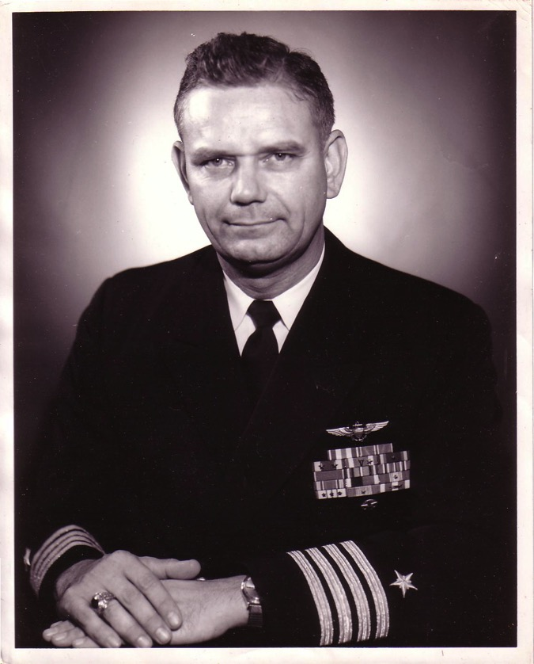
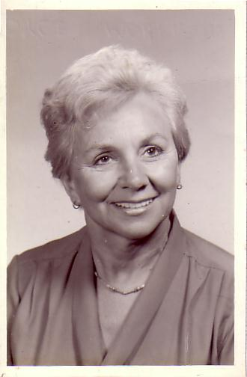
The Divorce
1962
Navy Commander
Harold F. Griffith (alias Dad)
Social Worker
Joyce I. Griffith (alias Mom)
Notes:
After my younger brother's birth my Mom concluded that my Dad was actually married to the Navy, so she divorced him. Ironically, she became a social worker to help other families put their lives together.

Slide 33
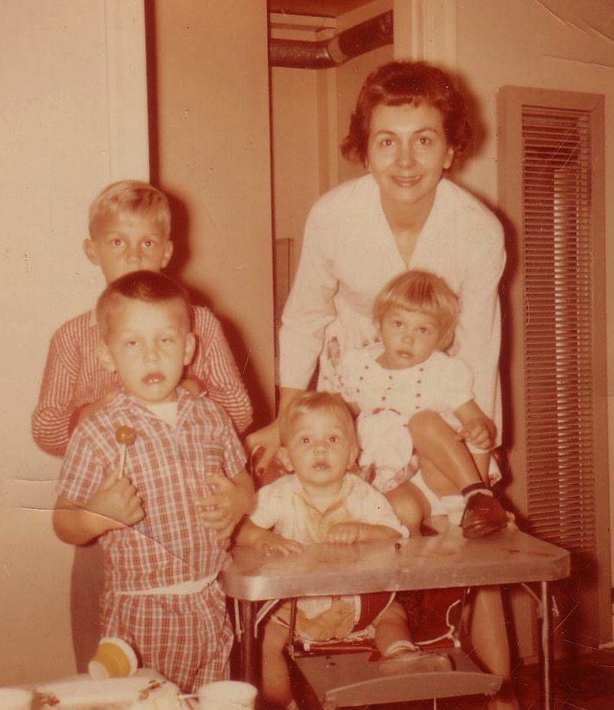
Divorce for Mom was tough…
Bobby, 6
Ricky, 4
Kathy, 3
Tommy, 1
Notes:
Those were tough years for Mom as a single mother with four kids age 6 and under. Yes, I'm the good looking one with the sucker!

Slide 34

…and the band concert

Slide 35

Knitting again

Slide 36
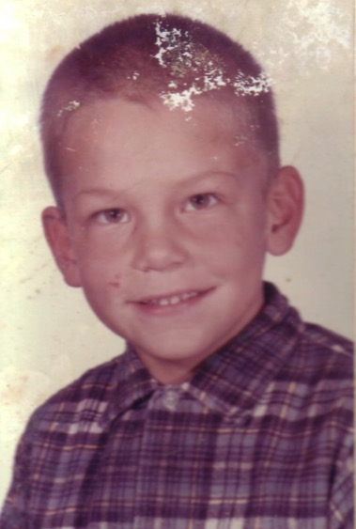
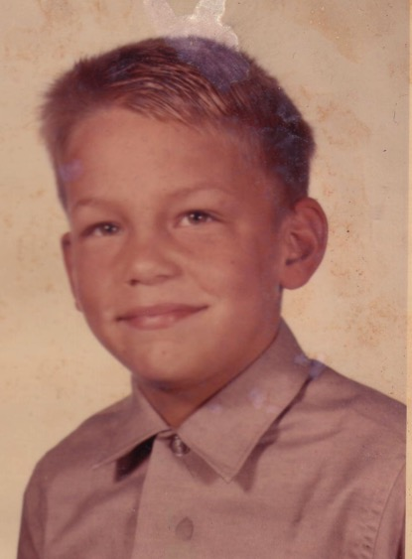
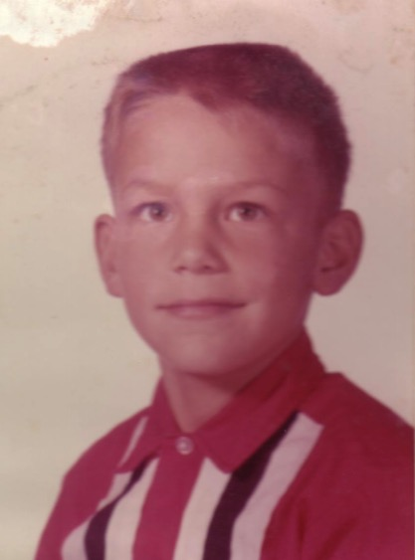
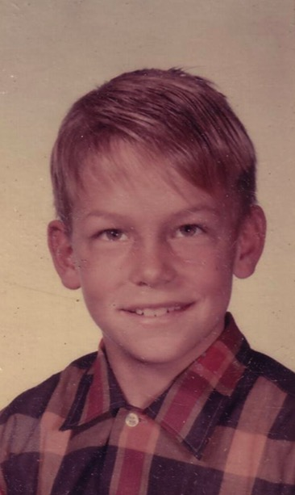
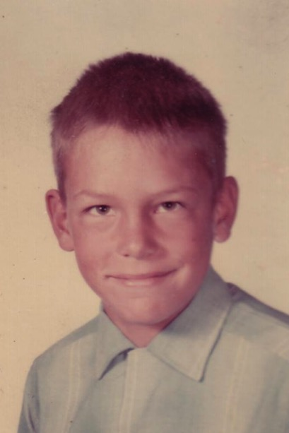
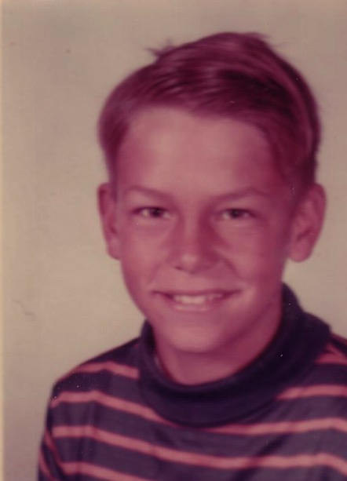
School Pictures
Kindergarten
Grade 1
Grade 2
Grade 3
Grade 4
Grade 5
Notes:
Life went on and, despite my rotten family background, I sensed that there was a God—so I figured that I better be a good boy. I obeyed my parents and did well in school and sports over the years.

Slide 37
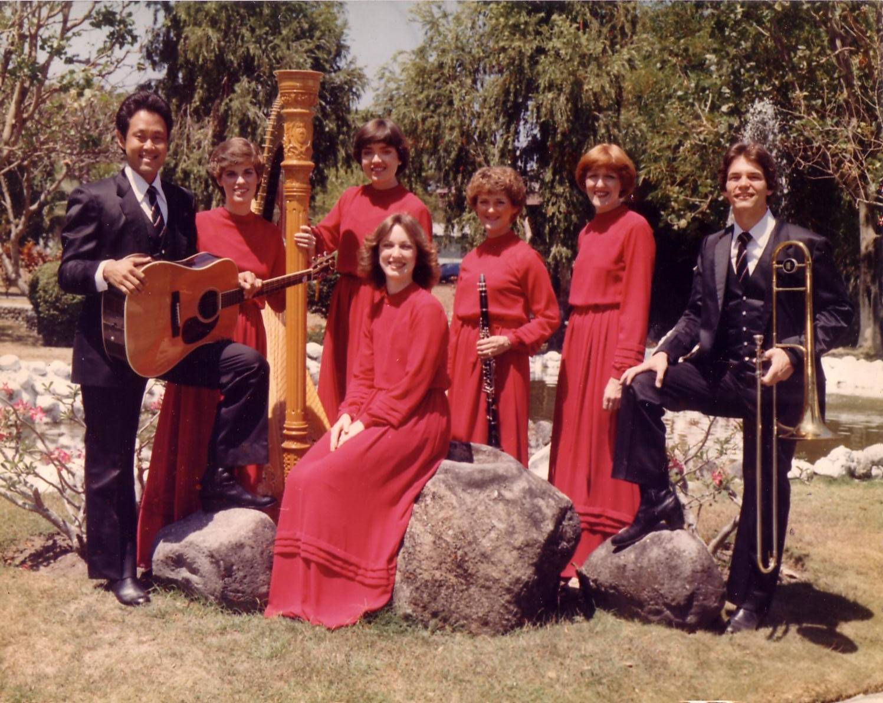
The Crossroads (1981-83)
Notes:
After college it seemed the natural thing to do to join Campus Crusade staff in the Philippines on a seven-member music team.

Slide 38

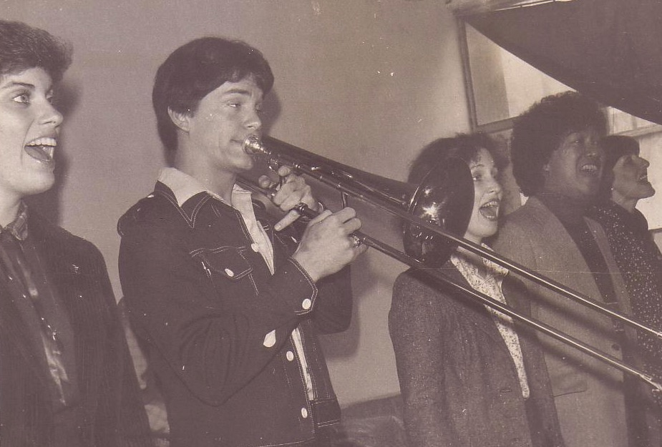
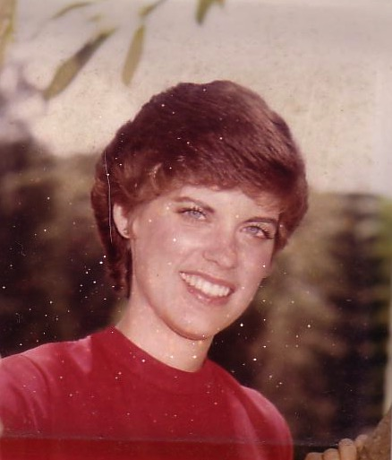
Romance, 1982
Notes:
God also began to open my eyes to the woman singing next to me! She initially despised me but after a year or so she saw the light. That's our engagement picture. In 1983 we returned to the USA..

Slide 39
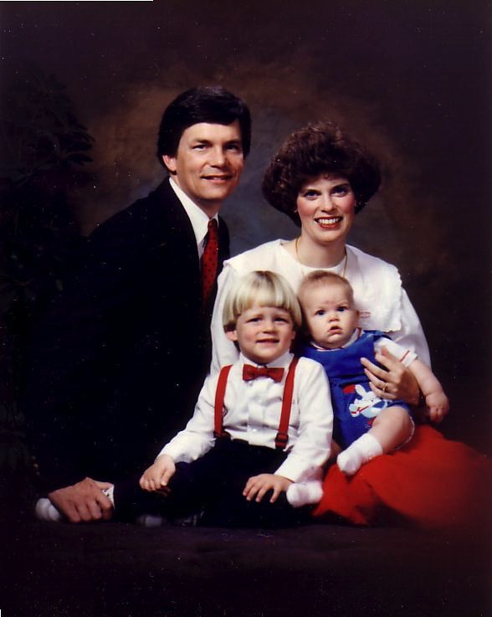
1991: Move to Singapore
Rick, 33
Susan, 30 something
Kurt, 4
Stephen, 1
Notes:
So 10 years after our first move to Asia as singles, we arrived as a family of four.

Slide 40

The Griffiths
28 Nov 2019
2019
John
(27)
Rick & Susan
Kurt & Cara (32)
Stephen, Katie & Jesse (30)

Slide 41

How does a capable woman work hard for others (12-24)?
1. She is an asset to her husband (11-12).
2. She cares for her family (13-22).
3. She helps her husband lead (23).
Notes:
People often ask how I have managed full-time ministry for 40 years now.
The answer is simply two words—God and Susan!

Slide 42
Proverbs 31:10-31 NIV
²³ Her husband is respected at the city gate, where he takes his seat among the elders of the land.

Slide 43
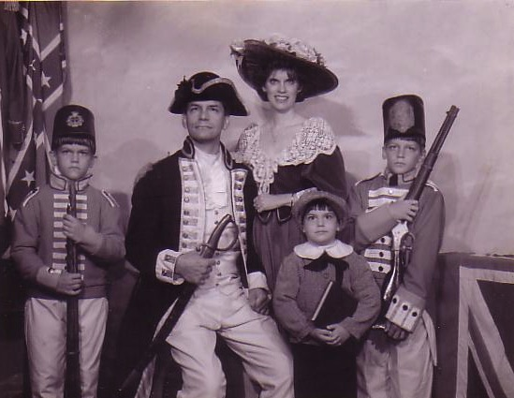
1997
Notes:
Susan has always looked to me as her “captain.”

Slide 44

Grandson Jesse

Slide 45

How does a capable woman work hard for others (12-24)?
1. She is an asset to her husband (11-12).
2. She cares for her family (13-22).
3. She helps her husband lead (23).
4. She is productive (24).

Slide 46
Proverbs 31:10-31 NIV
²⁴ She makes linen garments and sells them, and supplies the merchants with sashes.
Notes:
Does the ideal woman have to be a business woman—a buyer (13) and land purchaser (16a) and farmer (16b) and trader (18) and linen worker (24)?
No. But she must have a good work ethic.
The idea here is that God disproves of laziness.

Slide 47


Eunice Ng
Notes:
47
47

Slide 48

Sunday School for Ages 1-8

Slide 49
4 ways a capable wife has
godly selfless deeds
1. She works hard for others (11-24).
2. She is optimistic about the future (25).

Slide 50

Proverbs 31
She Smiles at Her Future
"Strength and dignity are her clothing, and she smiles at the future" (Prov. 31:25)
Notes:
Chrystal Evans Hurst
https://www.proverbs31.org/speakers

Slide 51
4 ways a capable wife has
godly selfless deeds
1. She works hard for others (11-24).
2. She is optimistic about the future (25).
3. She speaks with wisdom (26).

Slide 52
Proverbs 31:10-31 NIV
²⁶ She speaks with wisdom, and faithful instruction is on her tongue.

Slide 53

The Wise Woman

Slide 54
4 ways a capable wife has
godly selfless deeds
1. She works hard for others (11-24).
2. She is optimistic about the future (25).
3. She speaks with wisdom (26).
4. She manages her home diligently (27).

Slide 55
Proverbs 31:10-31 NIV
²⁷ She watches over the affairs of her household and does not eat the bread of idleness.

Slide 56
How is a capable wife rare and priceless?
Notes:
This passage describes a competent, exceptional woman of great value.

Slide 57
Where we’re going today…
How
she
is
priceless
How
we
should
respond

Slide 58
I. A capable wife has godly selfless deeds (11-27).
Notes:
The godly wife and mother helps other people instead of herself.

Slide 59
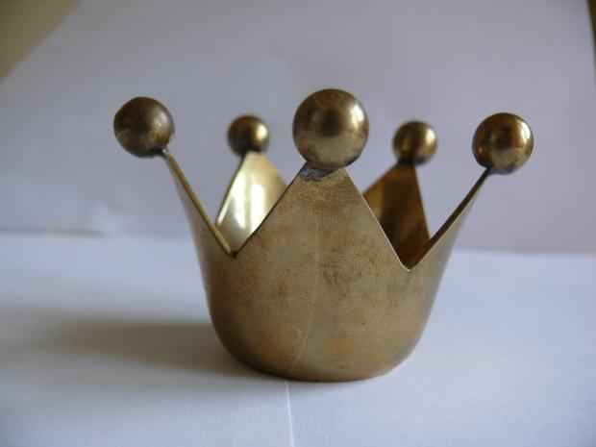
II. We should publicly praise a capable wife (28-31).
Notes:
Let’s be generous with compliments to the virtuous wife and mother.

Slide 60

Proverbs 31:10-31 NIV
²⁸ Her children arise and call her blessed

Slide 61
Proverbs 31:10-31 NIV
²⁸ Her children arise and call her blessed; her husband also, and he praises her:
²⁹ “Many women do noble things, but you surpass them all.”

Slide 62

Proverbs 31:30
"Charm is deceptive…Beauty is fleeting… But a woman who fears the LORD is to be praised"
(Proverbs 31:30).

Slide 63

Proverbs 31:10-31 NIV
³¹ Give her the reward that she has earned, and let her works bring her praise at the city gate.

Slide 64

Wisdom
An acrostic and anonymous poem of a noble wife exhorts young women to be godly and diligent and exhorts young husbands to praise these qualities in their wives (31:10-31).
Notes:
Did you notice that the poem has 22 verses?
And how many letters are there in Hebrew? Yes, 22!
Each verse successively begins with the letter A, then B, etc. to the last letter in Hebrew.
We don’t know who wrote it, but the message is clear that wisdom is capable and selfless.
So we should praise such qualities in women—wives, mothers—and all of us.

Slide 65


Main Idea
Praise a capable wife and mother for her priceless selflessness
Notes:
So how should we treat a capable wife?
Tell her that you appreciate her always thinking of others and working hard for them.

Slide 66

How can you better praise people?
How should you praise your wife? “Give her the reward she has earned” (31:31a NIV).
How should you praise your mother (31:15)? How can you follow verse 28? “Her children arise and call her blessed.”
How should you praise those who have cared for you?
How can you better care for others like this capable wife?

Slide 67
Black

Slide 68


OT Preaching link at BibleStudyDownloads.org
Get this presentation and script for free!

