Slide 1

Be Generous
The Prophecy of Micah
Dr. Rick Griffith, Crossroads International Church Singapore
BibleStudyDownloads.org

Slide 2
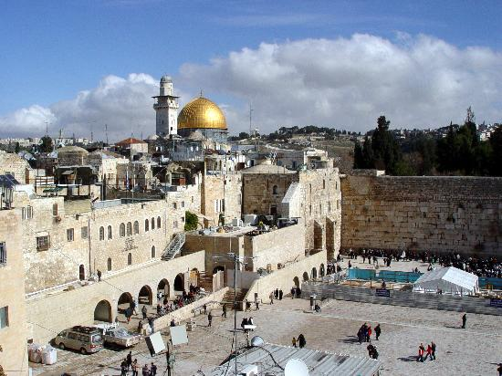
Jerusalem
December 1995
Notes:
God met me in Jerusalem in December 1995.
You see, at that time I had served on the faculty of Singapore Bible College for four years and I started teaching some courses for the fourth time––that can lose its challenge.
But the chance came to lead trips to Israel. I'd never been there before, but 25 daring souls braved to pay the $3000 to come with me.
But at the antiquities shop in Jerusalem I was stunned to see one of my tour members argue with the shop owner about the price of an artifact. "What? You want $20? I saw this for $18 down the street!"
I was so embarrassed that I left the shop, sat down on the curb, and pouted like Elijah. "What are you doing here, Rick?" I sensed God say to me (not audibly, yet still real).
"Lord, I'm bringing Your people to Your land to get to know Your Word."
"No, you're not," I sensed God saying to me. "You can't afford to come Israel so you rounded up 25 wealthy people to pay your way."
Then it struck me how little time Jesus spent in Jerusalem. Sure, he was a faithful Jew who made the required pilgrimages three times a year––and he spent the last week of his life in Jerusalem since he came there to die. But Jesus wasn't impressed with the wealth and power of Jerusalem.
Instead, he wanted to change the world through the poor. Jesus said that he had come to preach the gospel to the poor. And, as I thought about it, I realized that Jesus spent most of his ministry up in the poor north, in Galilee. He spent his time and energy in what people considered to be the place for roughnecks and insurrectionists.
Then I thought about the students that I had at SBC up to that point. I realized that the ones who came from the wealthy churches had to return back to their wealthy churches to pay back these churches for their support during seminary.
However, the ones from the poor countries returned to their countries had a tremendous impact for the cause of Christ.
So I said to the Lord, "OK, Lord, what do you want me to do? Where do you want me to go?"

Slide 3
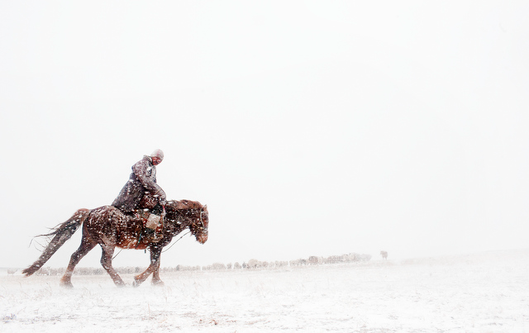
Mongolia
December 1995
Notes:
Then God put on my mind Mongolia. "Mongolia? Are you telling me to go to Outer Mongolia? I don't know a soul in Mongolia!"

Slide 4
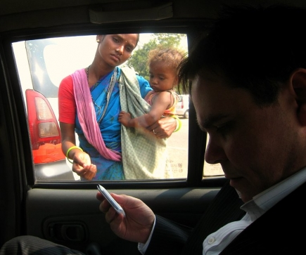
To what extent has your money insulated you?
Notes:
How much time do you devote to your possessions?
Do you own things—or do things own you?
Do you have more friends with less money than you now than you had five years ago?
What goals do you have to use your money for the poor?
Do you believe God wants you to be generous to the poor? He certainly does!

Slide 5
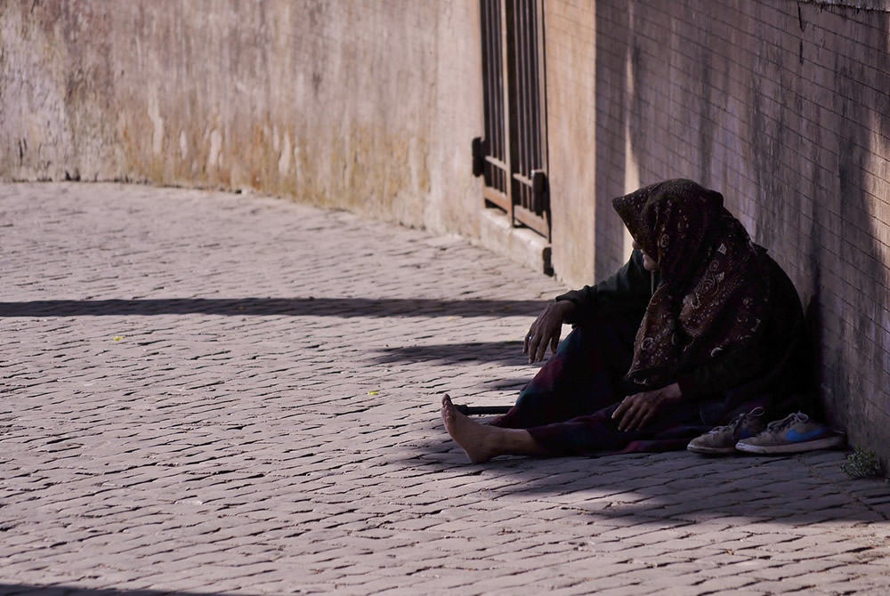
Why does God want you to be generous to the poor?

Slide 6

Background

Slide 7

THE
MINOR
PROPHETS

Slide 8
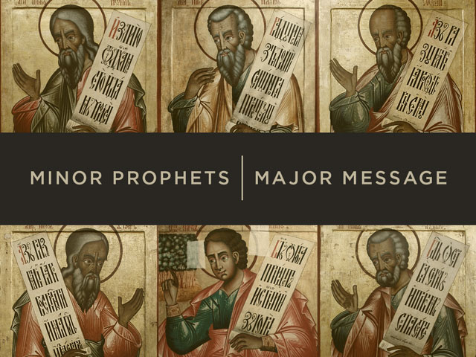
Minor Prophets | Major Message

Slide 9

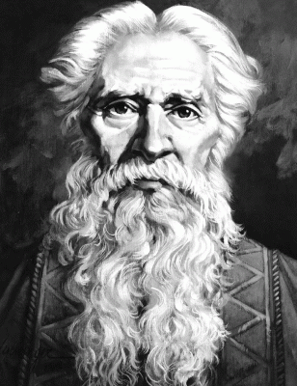
Author
Interesting Facts
616
Micah of Moresheth

Slide 10

The split in 1 Kings would soon leave Judah as the Survivng Kingdom

Slide 11

Chart of OT Kings & Prophets
232 & 342

Slide 12
The Assyrian Threat
454
Assyrian Expansion
Nineveh
Mediterranean
Sea
Aram
Israel
Judah
Isaiah 7
Persian
Gulf
Egypt
Notes:
12

Slide 13
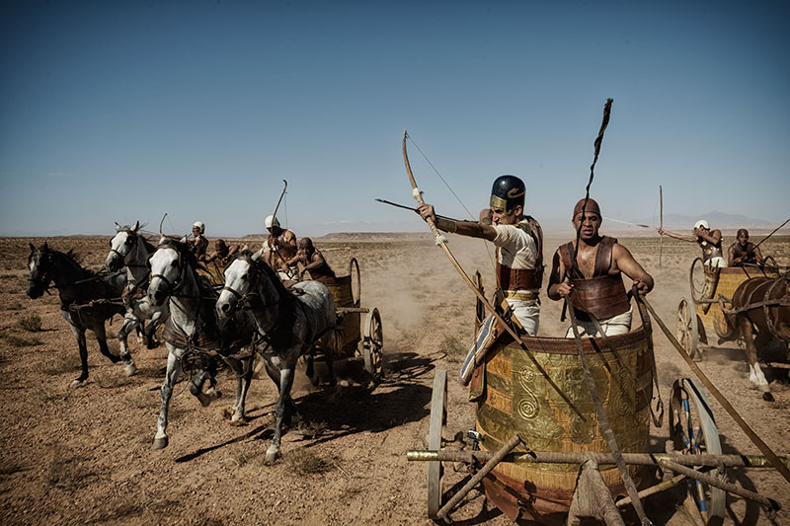
Assyrians conquered Israel in Micah’s Time

Slide 14

When Hosea, Isaiah & Micah Wrote
453
End of the
Kings of Israel
Pekah
Hoshea
Kings of Judah
Uzziah
Jotham
Ahaz
Hezekiah
Isaiah's 60-Year Ministry
(739-680 BC)
Notes:
14

Slide 15
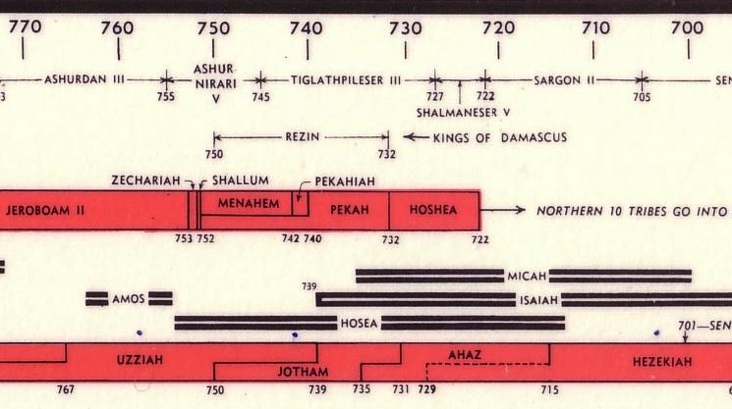
OT Kings & Prophets at Israel's Fall
232 & 342
John C. Whitcomb, 4th ed. (Winona Lake, IN: BMH Books, 1968), 2
HIM = Hosea + Isaiah + Micah

Slide 16
MICAH'S 3 SERMONS
"LISTEN!"
(1:2)
"LISTEN!"
(3:1)
"LISTEN!"
(6:1)
WHY YOU SHOULD BE GENEROUS
Notes:
Today will have an overview of the whole book of Micah where we’ll see three reasons to be generous. These will appear in three sermons in Micah’s prophecy, each that begins with the word “Listen!”

Slide 17

Keep in mind...
BE GENEROUS:
DON'T ASK WHAT'S IN IT FOR YOU.
ASK WHAT'S IN IT FOR THEM.
Notes:
In essence he says three times to have a heart for the poor—but there are also three benefits to us as well.

Slide 18
Slides on
Micah 1

Slide 19
MICAH'S 3 SERMONS
"LISTEN!"
(1:2)
I. God will reward generosity
(Micah 1–2).
WHY YOU SHOULD BE GENEROUS

Slide 20
Structure of Micah
620
Judgment
1:1-7
• God
• Micah
Hope
• God
• Micah
Adapted from Homer Heater, Dallas Seminary

Slide 21
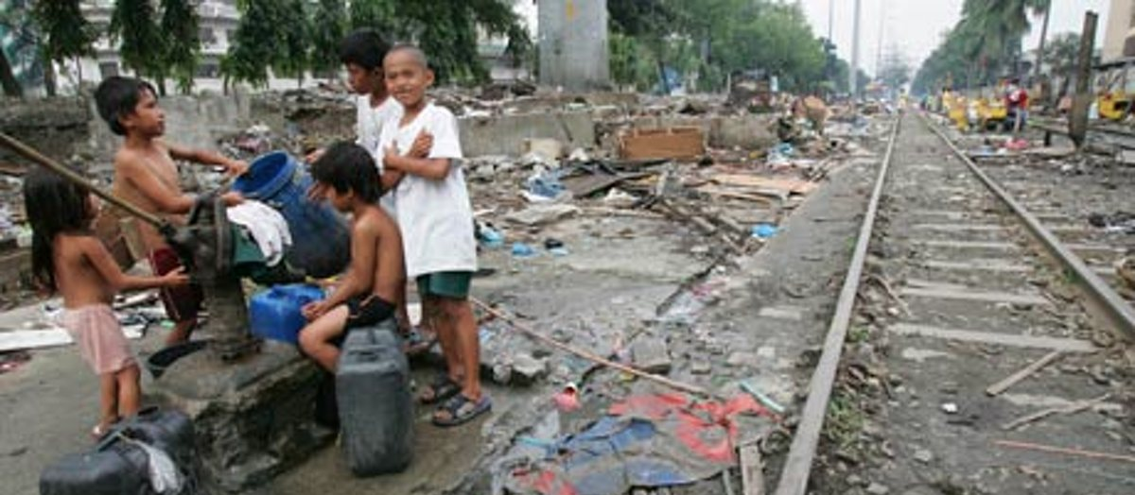
"Attention! Let all the people of the world listen! Let the earth and everything in it hear. The Sovereign LORD is making accusations against you; the LORD speaks from his holy Temple" (Micah 1:2 NLT).

Slide 22
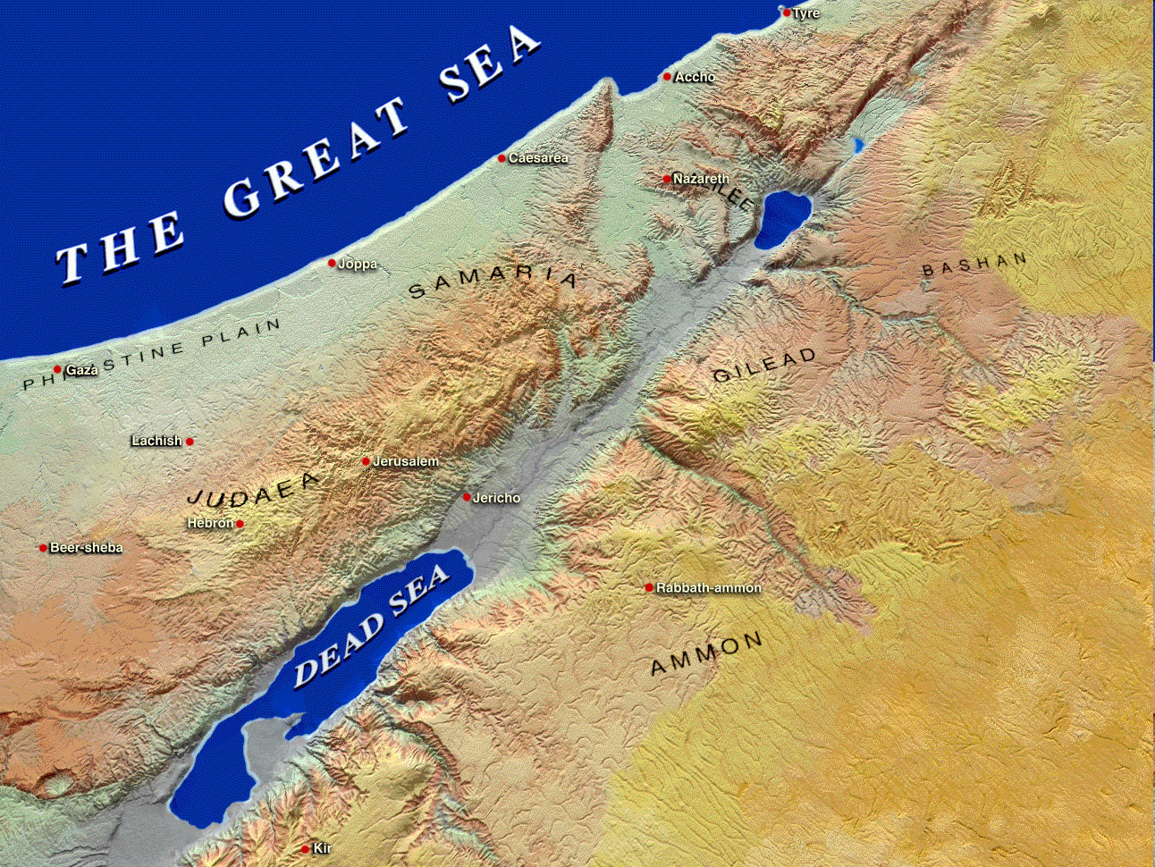
Moresheth-gath
Israel
Samaria
"So I, the Lord, will make the city of Samaria a heap of ruins…" (1:6)
Jerusalem
Judah
"Oh, people of Judah, shave your heads in sorrow,
for the children you love will be snatched away.
Make yourselves as bald as a vulture,
for your little ones will be exiled to distant lands" (1:16).

Slide 23
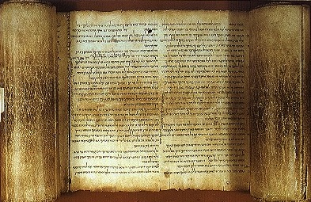


hk'ymi Micah's Lament
Judgment for Exploitation
Judgment for Exploitation
hk'ymi Micah

Slide 24
Structure of Micah
620
Judgment
1:1-7
• God
"Therefore, I will mourn and lament.
I will walk around barefoot and naked.
I will howl like a jackal
and moan like an owl" (1:8 NLT).
• Micah
1:8-16
Hope
• God
• Micah
Adapted from Homer Heater, Dallas Seminary

Slide 25
Key Word
615
343
Exploitation
Micah

Slide 26
Slides on
Micah 2

Slide 27
Structure of Micah
620
Judgment
1:1-7
2:1-5
• God
• Micah
1:8-16
Hope
• God
• Micah
Adapted from Homer Heater, Dallas Seminary

Slide 28
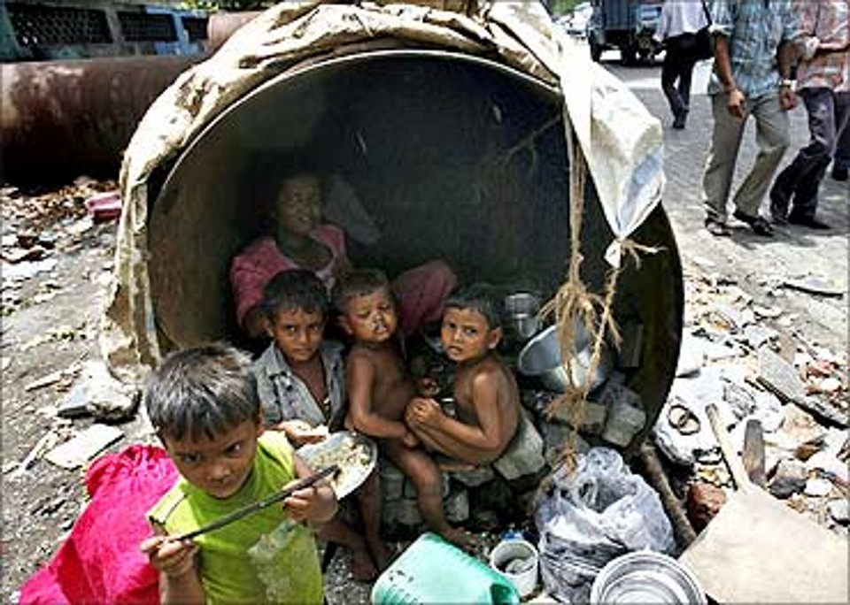
"What sorrow awaits you who lie awake at night, thinking up evil plans. You rise at dawn and hurry to carry them out, simply because you have the power to do so. ²When you want a piece of land, you find a way to seize it. When you want someone’s house, you take it by fraud and violence. You cheat a man of his property, stealing his family’s inheritance" (2:1-2 NLT).

Slide 29
Structure of Micah
620
Judgment
1:1-7
2:1-5
• God
• Micah
1:8-16
2:6-11
Hope
• God
• Micah
Adapted from Homer Heater, Dallas Seminary

Slide 30
Structure of Micah
620
Judgment
1:1-7
2:1-5
• God
• Micah
1:8-16
2:6-11
Hope
2:12-
13
• God
• Micah
Adapted from Homer Heater, Dallas Seminary

Slide 31
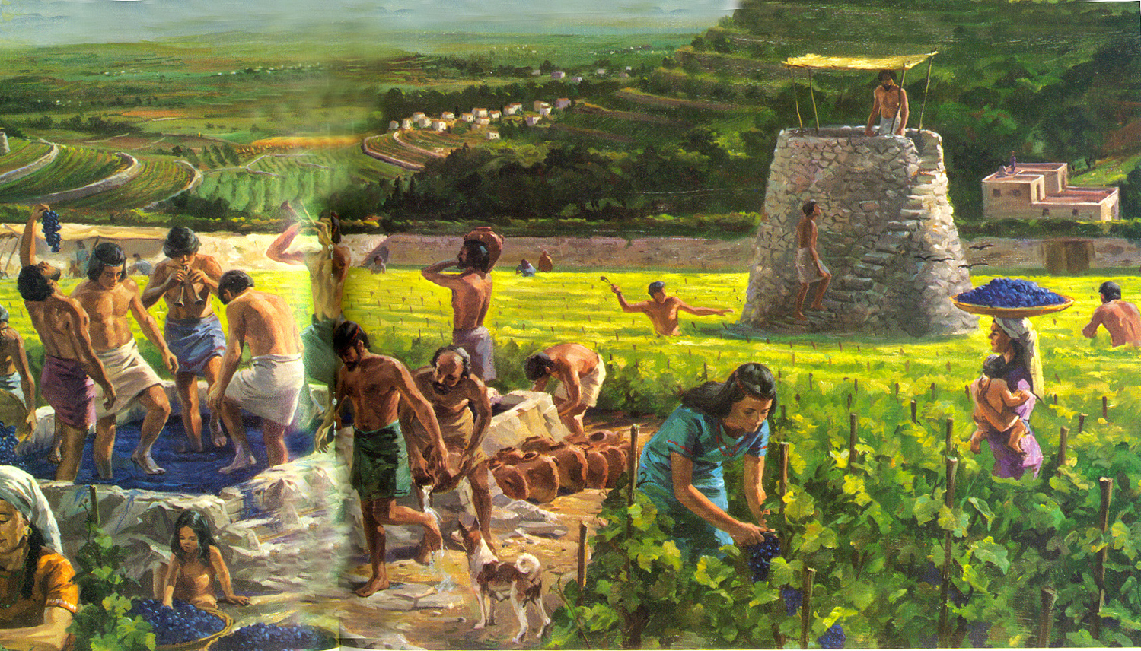
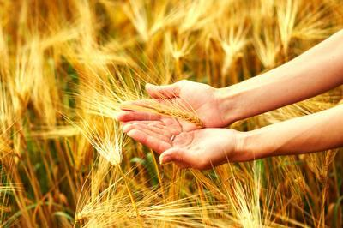

"Someday, O Israel, I will gather you; I will gather the remnant who are left. I will bring you together again like sheep in a pen, like a flock in its pasture. Yes, your land will again be filled with noisy crowds!"
(Micah 2:12 NLT).

Slide 32
"Your leader will break out and lead you out of exile, out through the gates of the enemy cities, back to your own land. Your king will lead you; the LORD himself will guide you" (Micah 2:13 NLT).

Slide 33
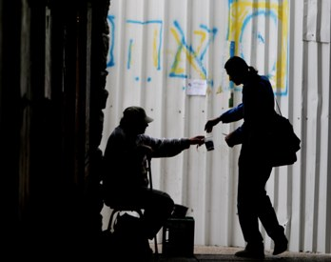
What about us?
God will judge or bless us based on how we treat the poor.

Slide 34

Teaching Ministry 1997-2018
MONGOLIA
JORDAN
KOREA
CHINA
NEPAL
MYANMAR
INDIA
THAILAND
VIETNAM
MALAYSIA
SRI LANKA
SINGAPORE
SBC
INDONESIA
Notes:
From 1997-July 2016 God has seen fit to grant me the privilege to train pastors in 12 other countries on 58 trips. Often pastors in the US team-teach with me on these trips.

Slide 35

Dies den Engelsen

Slide 36

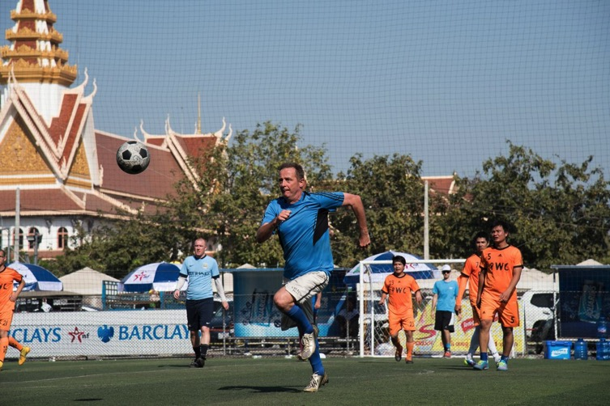
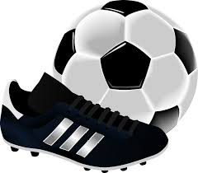
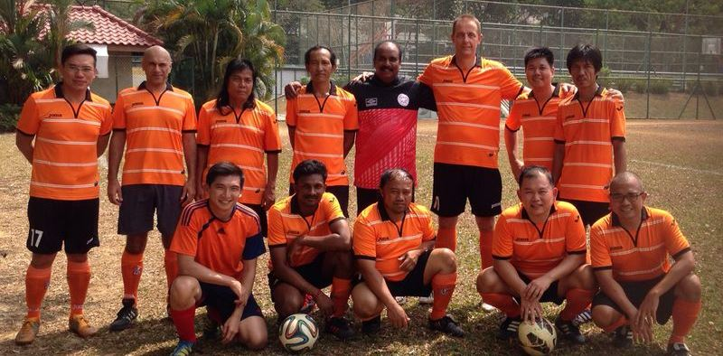

Slide 37
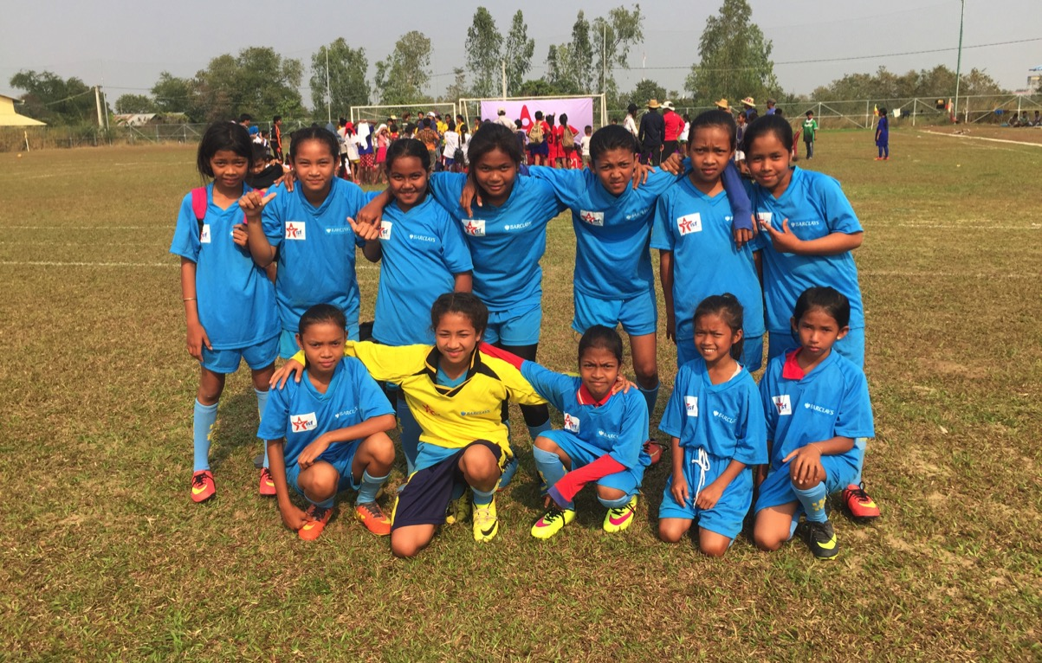







Favourite team ?
Chak Kropop Po Mongkol

Slide 38
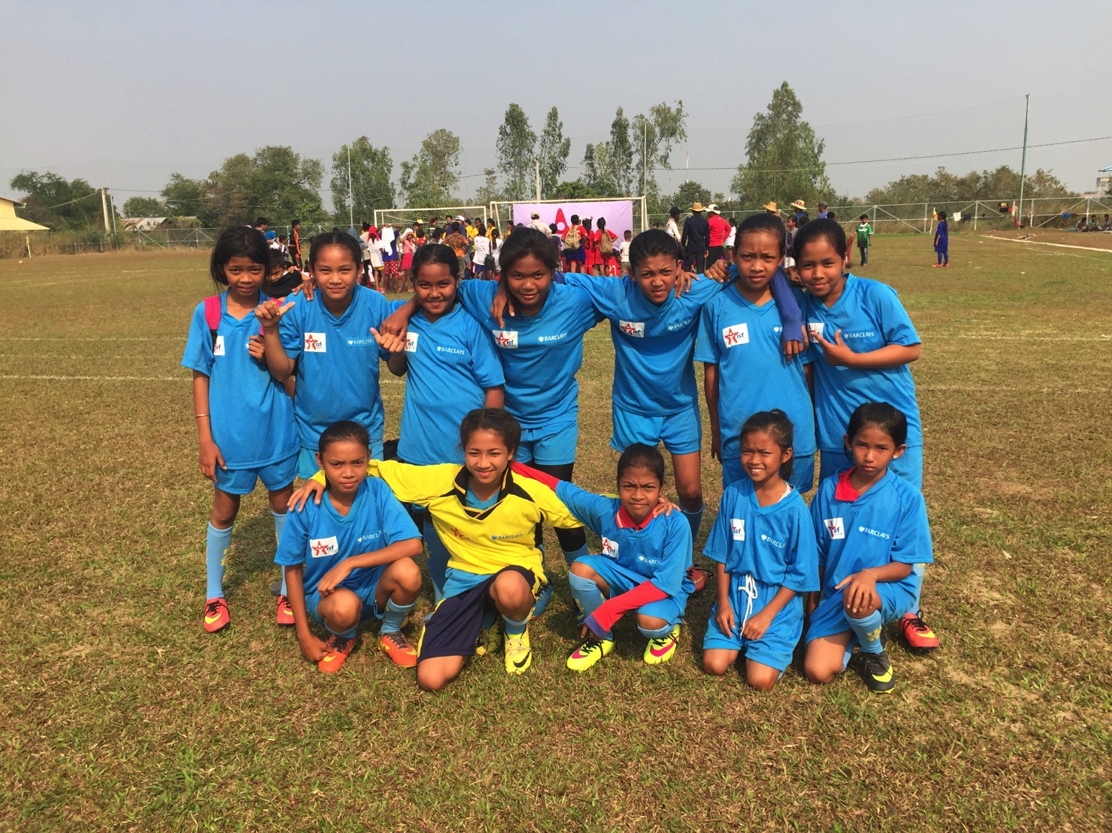

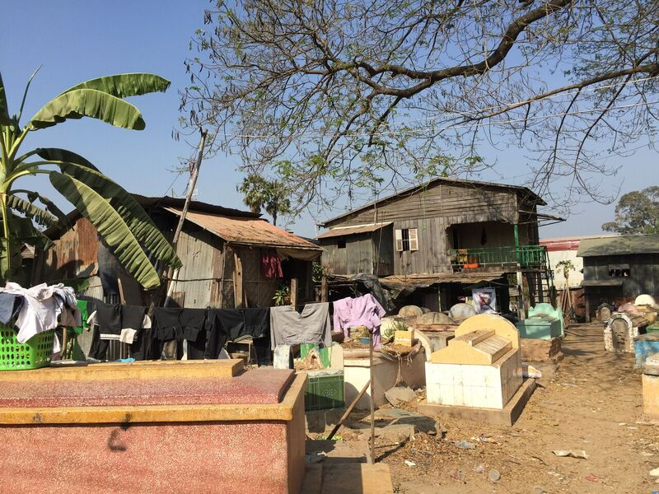
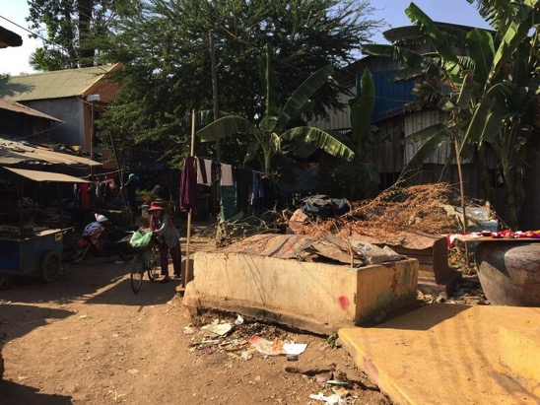
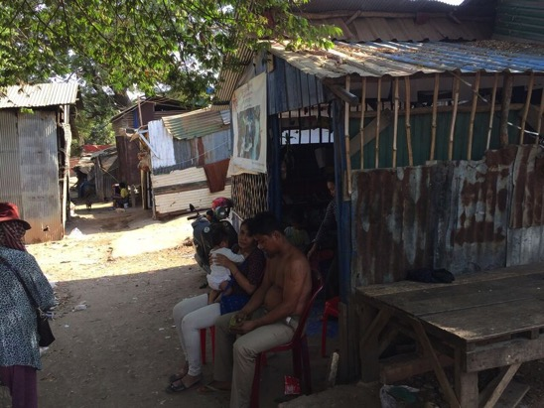

Slide 39

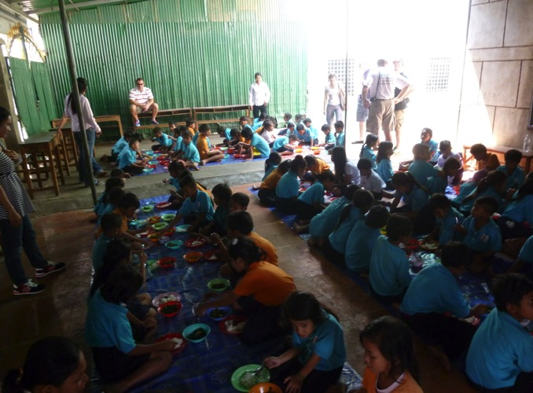
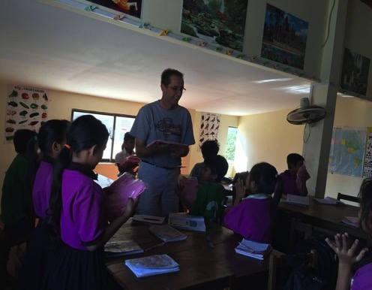
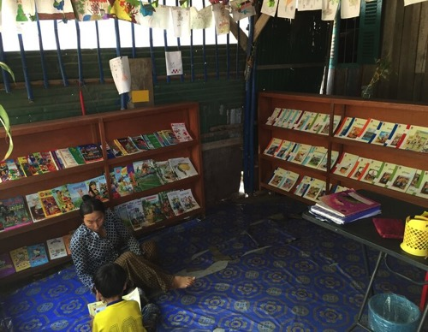

Indochina Starfish Foundation
Education
Medical Care
Nutritious food
School Uniforms
Incentive to the family
Community Service

Slide 40

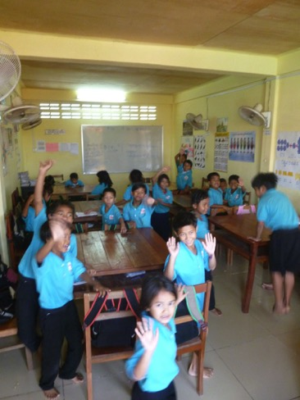
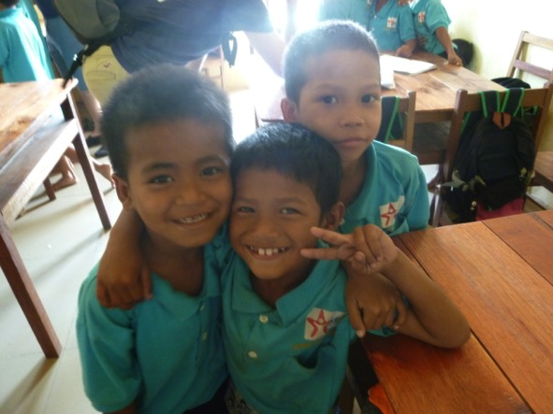
Integration
into
Cambodian Society

Slide 41
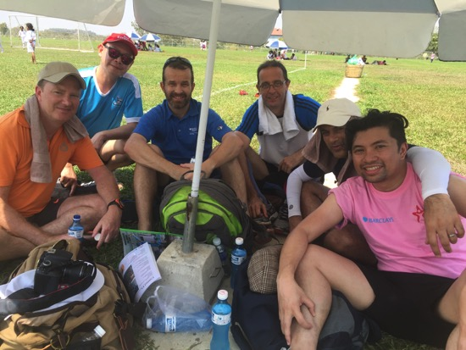
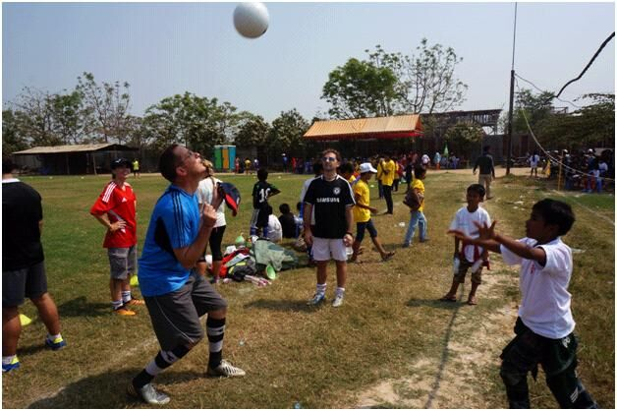

?

Slide 42
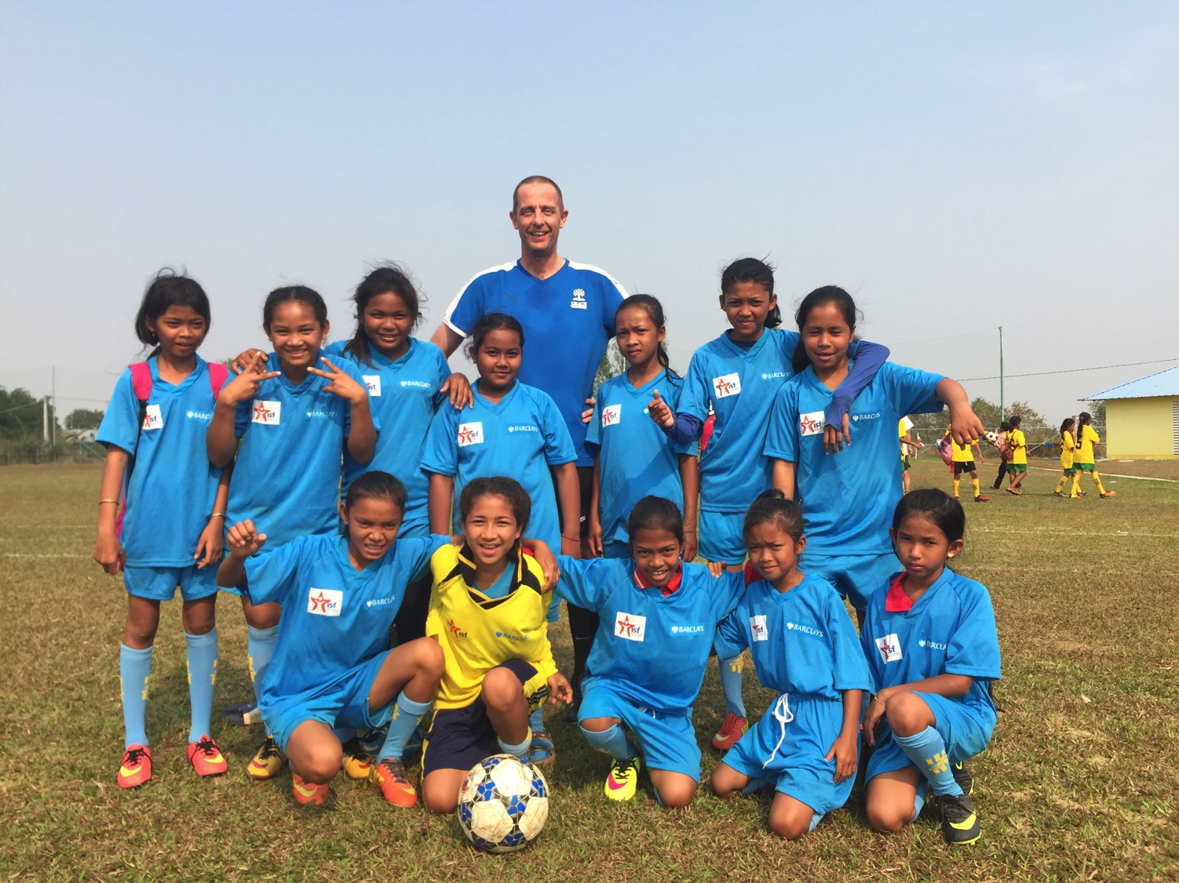

Slide 43
Back To Rick
and the Sermon on Micah

Slide 44

Get others out of their bind.

Slide 45
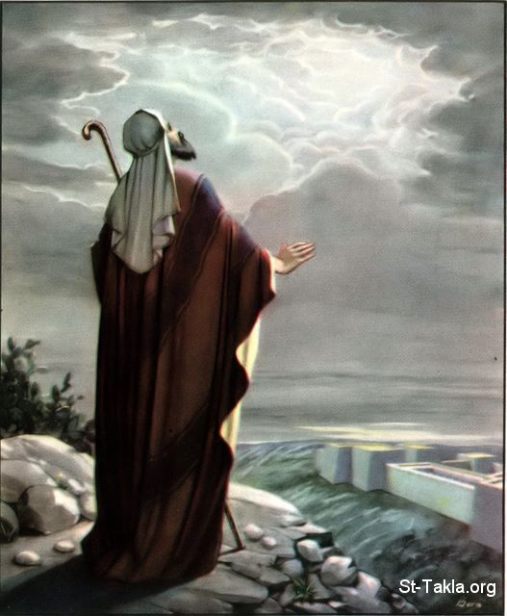
Foretelling Emphasis
Interesting Facts
616
Micah has one of the highest foretelling proportions of the prophetic books (70% of the content). It predicts:
the falls of Samaria and Jerusalem
the future restoration via a remnant leading into the messianic age

Slide 46

Problems & Tips in Interpreting Prophecy
438
Inaccurate Presuppositions
Prophets were mainly covenant enforcers based on the Mosaic law
Ethical
Forthtelling
Mosaic Covenant
Predictive
Foretelling
Abrahamic Covenant

Slide 47
The Prophetic Message
438
The prophets were not pushovers. They went against the tide to preach the word of Yahweh to a rebellious nation.

Slide 48
The Prophetic Message
The Prophetic Message
A major concern posed by the prophets was idolatry.
But they also had social and economic concerns.
They spoke pronouncements of judgments to steer the nation away from the curses.

Slide 49
MICAH'S 3 SERMONS
"LISTEN!"
(1:2)
I. God will reward generosity
(Micah 1–2).
WHY YOU SHOULD BE GENEROUS

Slide 50
MICAH'S 3 SERMONS
II. God comforts the generous (3–5).
"LISTEN!"
(1:2)
"LISTEN!"
(3:1)
WHY YOU SHOULD BE GENEROUS

Slide 51
Slides on
Micah 3

Slide 52
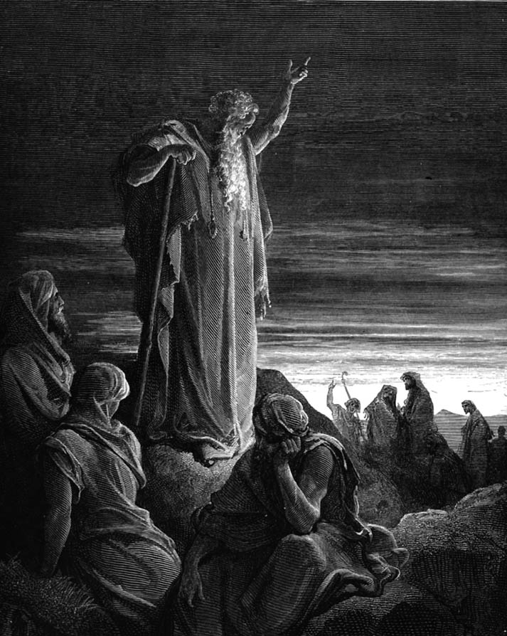
Micah Preached Courageously
Judgment for Exploitation
Judgment for Exploitation

Slide 53
Structure of Micah
620
Judgment
1:1-7
2:1-5
3:1-4
• God
• Micah
1:8-16
2:6-11
Hope
2:12-
13
• God
• Micah
Adapted from Homer Heater, Dallas Seminary

Slide 54
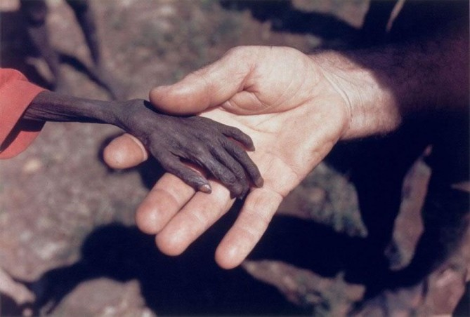
Micah Taught Compassion
Notes:
Here the hand of a missionary reaches out to a starving boy

Slide 55
Micah championed the poor and oppressed
Interesting Facts
616
Social injustice sins in this book include:
Oppression (2:1-2)
Bribery in judges, prophets & priests (3:11)
Exploitation of the powerless (3:2-3)
Covetousness (2:8-9)
Cheating (3:9)
Violence (3:10)
Pride (1:16; 2:6)

Slide 56
Structure of Micah
620
Judgment
1:1-7
2:1-5
3:1-4
• God
• Micah
1:8-16
2:6-11
3:5-12
Hope
2:12-
13
• God
• Micah
Adapted from Homer Heater, Dallas Seminary

Slide 57
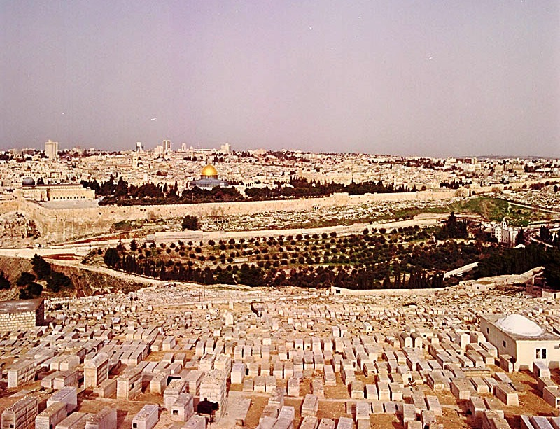
Micah 3:12 on Jerusalem's Fall
"Micah of Moresheth prophesied in the days of Hezekiah king of Judah. He told all the people of Judah, 'This is what the LORD Almighty says:
"Zion will be plowed like a field,
Jerusalem will become a heap of rubble, the temple hill a mound overgrown with thickets."'"
Jeremiah 26:18 (NIV)

Slide 58
Slides on
Micah 4

Slide 59
Structure of Micah
620
Judgment
1:1-7
2:1-5
3:1-4
• God
• Micah
1:8-16
2:6-11
3:5-12
Hope
2:12-
13
4:1–5:15
• God
• Micah
Adapted from Homer Heater, Dallas Seminary

Slide 60
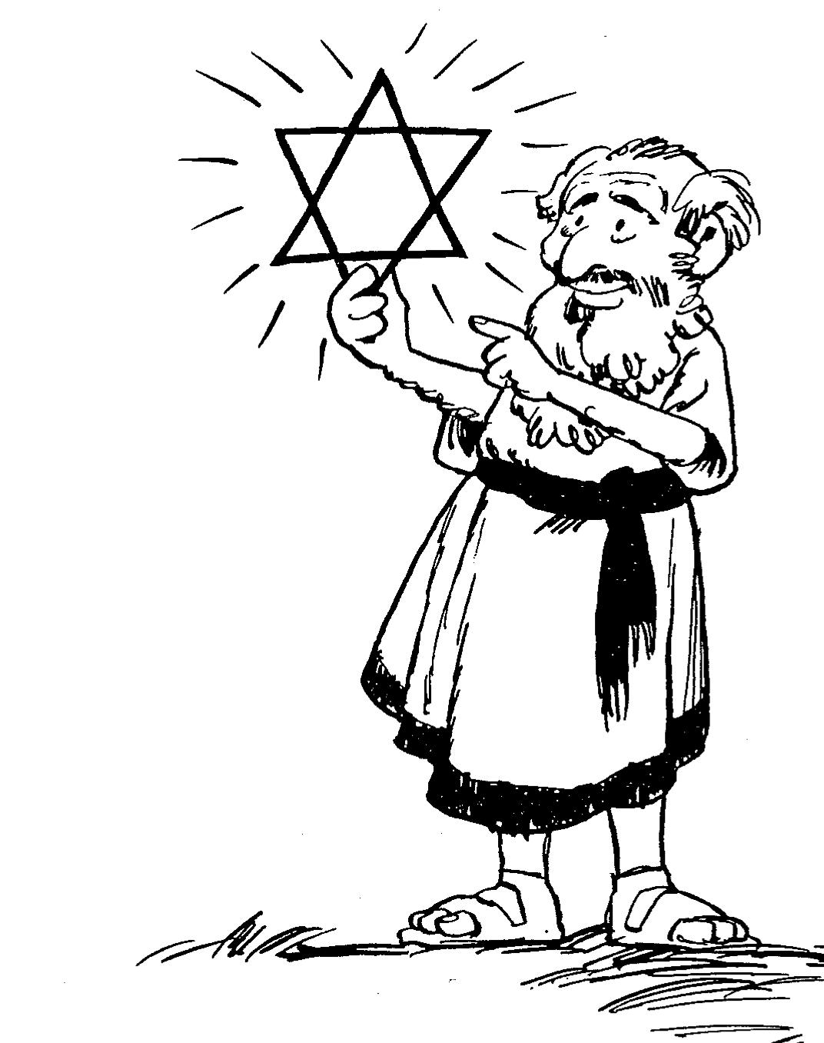
Barry Huddleston, The Acrostic Summarized Bible (Grand Rapids: Baker, 1992)
Micah
1 Messages against Samaria, Jerusalem
2 Evils of Israel's people
3 Sins of Israel's leaders
4 Sovereign king in Zion
5 Introduction of Bethlehem's Messiah
6 Actions of injustice rebuked
7 Hope in God's future

Slide 61
Micah & Isaiah Alike
616
Exact parallels
Messiah prominent
Wrote from Jerusalem
Wrote about both Israel and Judah
Influenced Hezekiah
Stressed the kingdom
Contemporaneous

Slide 62

Millennial Jerusalem (Isaiah)
106
"The law will go out from Zion,
the word of the LORD from Jerusalem"
––Isaiah 2:3

Slide 63
Millennial Jerusalem (Micah)
106
"For out of Zion shall go forth the law, and the word of the LORD from Jerusalem"
––Micah 4:2

Slide 64
Who copied whom?
ESV Isaiah 2:2 It shall come to pass in the latter days that the mountain of the house of the LORD shall be established as the highest of the mountains, and shall be lifted up above the hills; and all the nations shall flow to it,
ESV Micah 4:1 It shall come to pass in the latter days that the mountain of the house of the LORD shall be established as the highest of the mountains, and it shall be lifted up above the hills; and peoples shall flow to it,
Notes:
64

Slide 65
Who copied whom?
ESV Isaiah 2:3 and many peoples shall come, and say: "Come, let us go up to the mountain of the LORD, to the house of the God of Jacob, that he may teach us his ways and that we may walk in his paths." For out of Zion shall go the law, and the word of the LORD from Jerusalem.
ESV Micah 4:2 and many nations shall come, and say: "Come, let us go up to the mountain of the LORD, to the house of the God of Jacob, that he may teach us his ways and that we may walk in his paths." For out of Zion shall go forth the law, and the word of the LORD from Jerusalem.
Notes:
65

Slide 66
Who copied whom?
ESV Isaiah 2:4 He shall judge between the nations, and shall decide disputes for many peoples; and they shall beat their swords into plowshares, and their spears into pruning hooks; nation shall not lift up sword against nation, neither shall they learn war anymore.
ESV Micah 4:3 He shall judge between many peoples, and shall decide for strong nations afar off; and they shall beat their swords into plowshares, and their spears into pruning hooks; nation shall not lift up sword against nation, neither shall they learn war anymore
Notes:
66

Slide 67
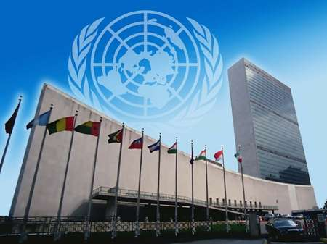
United Nations Building, New York

Slide 68
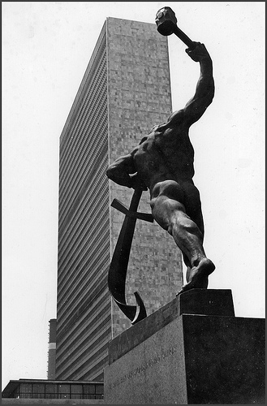
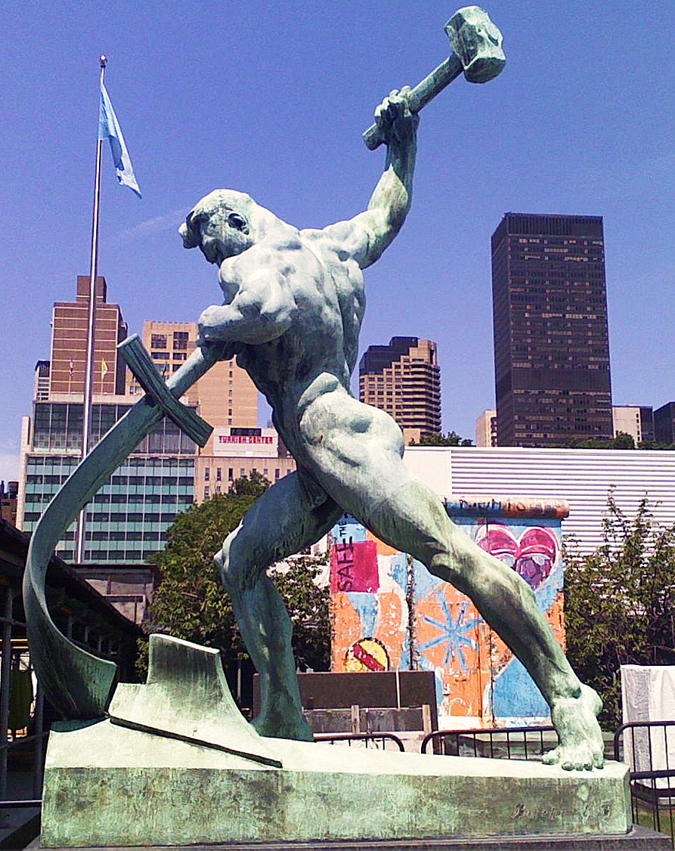
United Nations Building (New York)
Notes:
"Let Us Beat Swords into Plowshares
But first...
What is a plowshare?!
A plowshare is part of a plow. It is the leading edge that cuts
into the earth when turning over the dirt.
Let Us Beat Swords into Plowshares was sculpted
by Yevgeny Vuchetich. It was donated to the UN by the USSR in 1959.
The sculpture stands in the garden of the UN Headquarters."
https://sites.google.com/site/cdaunexploration/let-us-beat-swords-into-plowshares
Accessed 8 July 2015

Slide 69
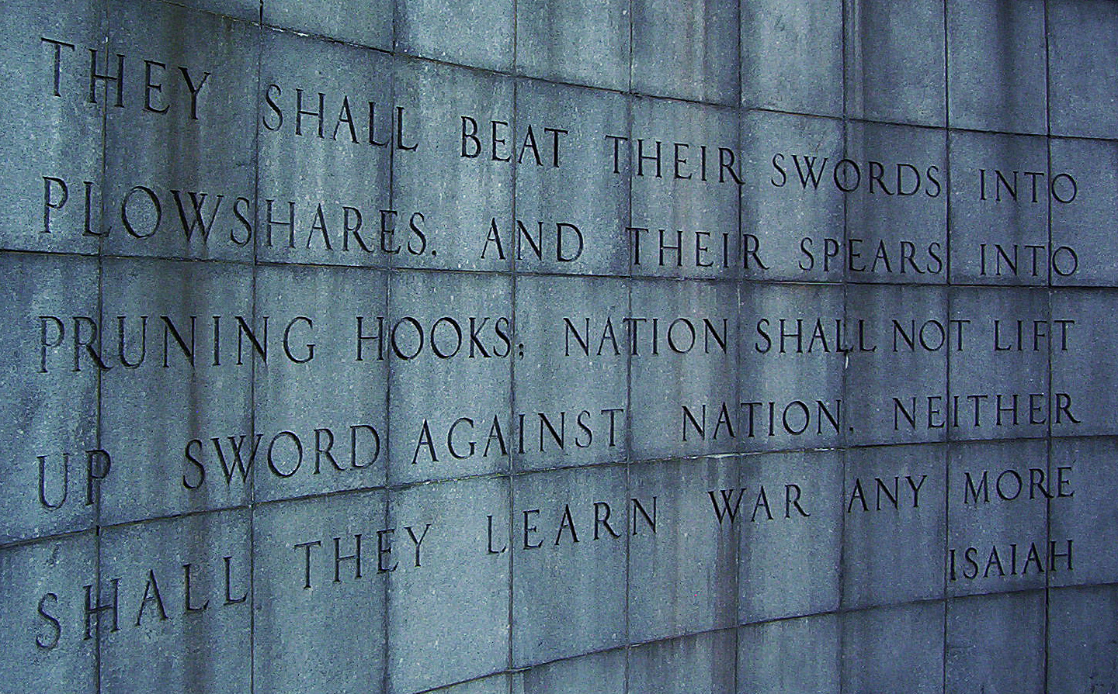
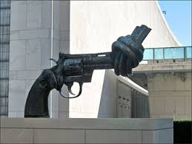
United Nations Building, New York

Slide 70
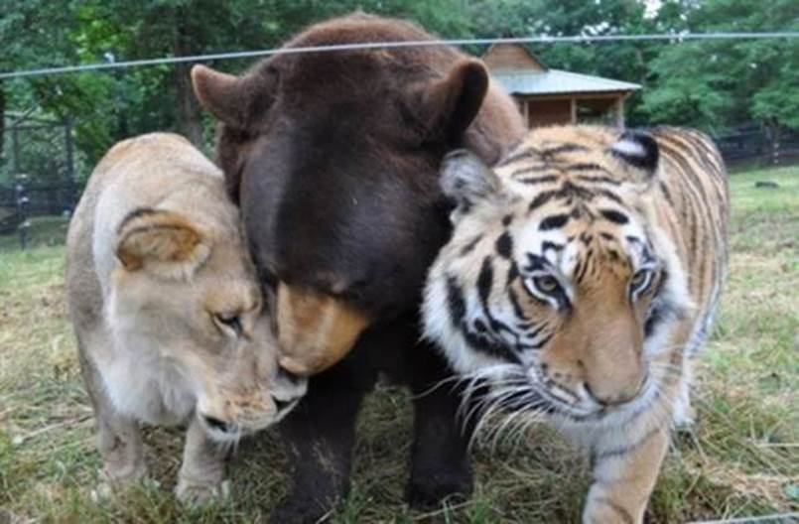
"Lions, Tigers & Bears! Oh, My!"
Notes:
In "The Wizard of Oz," Dorothy exclaims with fear upon thinking that she would have to travel through the forest to get to Oz, "Lions, tigers and bears! Oh, My!" Yes, these are dangerous animals—most of the time!
• We may think that all carnivorous animals must kill to eat, but a peaceful environment even today can be instructive that peace in the animal kingdom doesn’t even have to wait until the millennium.
"An American black bear, a Bengal tiger and an African lion were the victims of animal cruelty...."
________________
How An Abused Lion, Tiger And Bear Became An Unlikely Family (PHOTOS)
The Huffington Post | By Alexandra Zaslow
Posted: 12/03/2013 12:28 pm EST Updated: 12/04/2013 11:57 am EST
http://www.huffingtonpost.com/2013/12/03/lion-tiger-bear-negligence_n_4374091.html
Accessed 30 Sep 2015

Slide 71
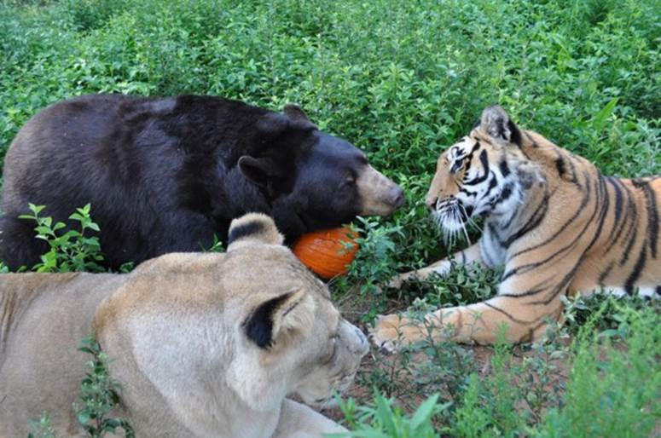
Baloo the Bear, Leo the Lion, and Shere Khan the Tiger (all three known as BLT)
Notes:
"Baloo the bear, Leo the lion, and Shere Khan the tiger (all three known as BLT) were brought together as 2-month-old cubs and have grown up as a family."
_______________
How An Abused Lion, Tiger And Bear Became An Unlikely Family (PHOTOS)
The Huffington Post | By Alexandra Zaslow
Posted: 12/03/2013 12:28 pm EST Updated: 12/04/2013 11:57 am EST
http://www.huffingtonpost.com/2013/12/03/lion-tiger-bear-negligence_n_4374091.html
Accessed 30 Sep 2015

Slide 72
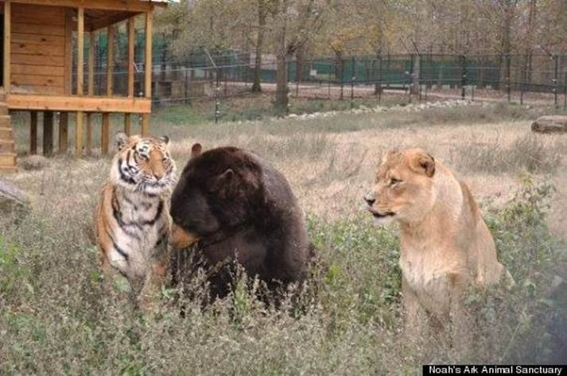
"Lions, Tigers & Bears! Oh, My!"
Notes:
"The trio was originally owned by a drug dealer who didn't properly care for them, leading to neglect, poor health and severe injuries."
_______________
How An Abused Lion, Tiger And Bear Became An Unlikely Family (PHOTOS)
The Huffington Post | By Alexandra Zaslow
Posted: 12/03/2013 12:28 pm EST Updated: 12/04/2013 11:57 am EST
http://www.huffingtonpost.com/2013/12/03/lion-tiger-bear-negligence_n_4374091.html
Accessed 30 Sep 2015

Slide 73
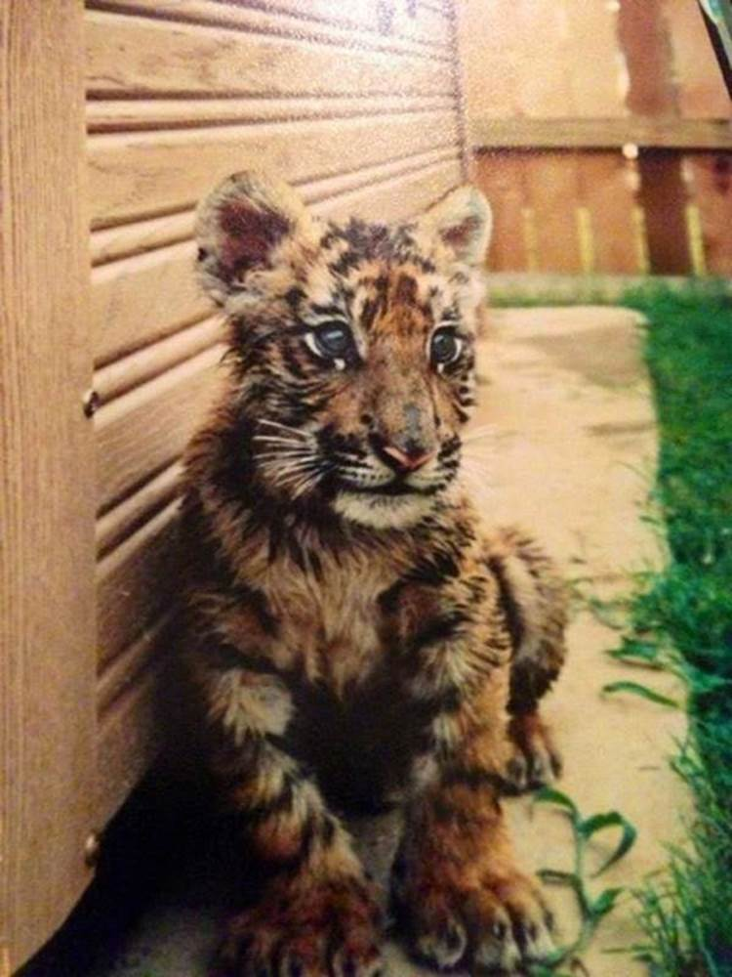
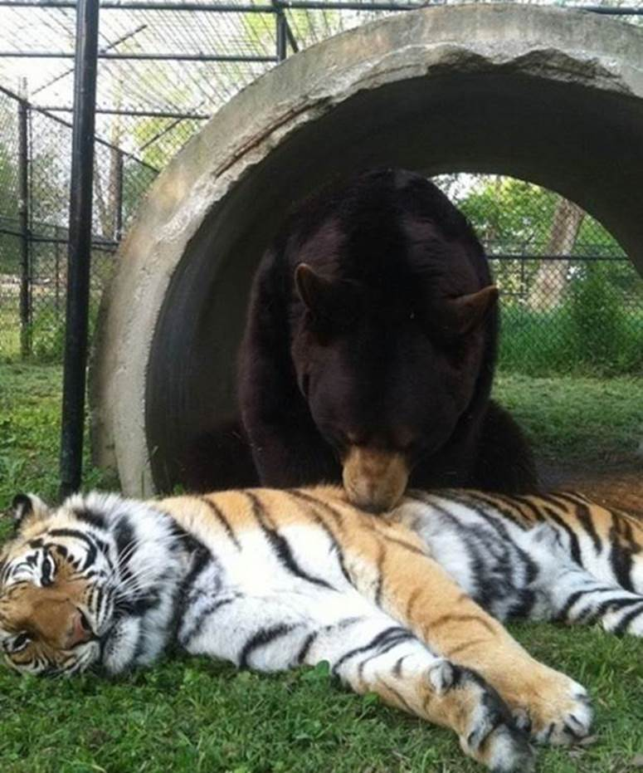
"Lions, Tigers & Bears! Oh, My!"
Notes:
"In 2001, Noah's Ark Animal Sanctuary, a nonprofit that cares for animals in need, came to the rescue, and took them to Locust Grove, Georgia, where they were treated for injuries."
_______________
How An Abused Lion, Tiger And Bear Became An Unlikely Family (PHOTOS)
The Huffington Post | By Alexandra Zaslow
Posted: 12/03/2013 12:28 pm EST Updated: 12/04/2013 11:57 am EST
http://www.huffingtonpost.com/2013/12/03/lion-tiger-bear-negligence_n_4374091.html
Accessed 30 Sep 2015

Slide 74

"Lions, Tigers & Bears! Oh, My!"
Notes:
"We could have separated them," Diane Smith, assistant director of the Noah's Ark Zoo told the Telegraph. "But since they came as a kind of family, the zoo decided to keep them together."
_______________
How An Abused Lion, Tiger And Bear Became An Unlikely Family (PHOTOS)
The Huffington Post | By Alexandra Zaslow
Posted: 12/03/2013 12:28 pm EST Updated: 12/04/2013 11:57 am EST
http://www.huffingtonpost.com/2013/12/03/lion-tiger-bear-negligence_n_4374091.html
Accessed 30 Sep 2015

Slide 75
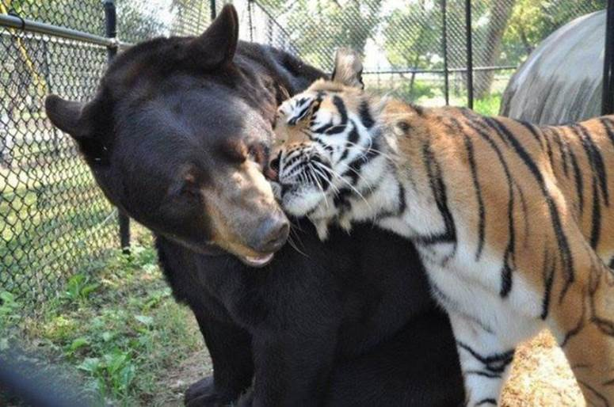
"Lions, Tigers & Bears! Oh, My!"
Notes:
"Baloo required greater care than his two friends -- his former owner had put a harness on him and didn't adjust it as he grew, leading to a deformity, Imgur reports."
_______________
How An Abused Lion, Tiger And Bear Became An Unlikely Family (PHOTOS)
The Huffington Post | By Alexandra Zaslow
Posted: 12/03/2013 12:28 pm EST Updated: 12/04/2013 11:57 am EST
http://www.huffingtonpost.com/2013/12/03/lion-tiger-bear-negligence_n_4374091.html
Accessed 30 Sep 2015

Slide 76
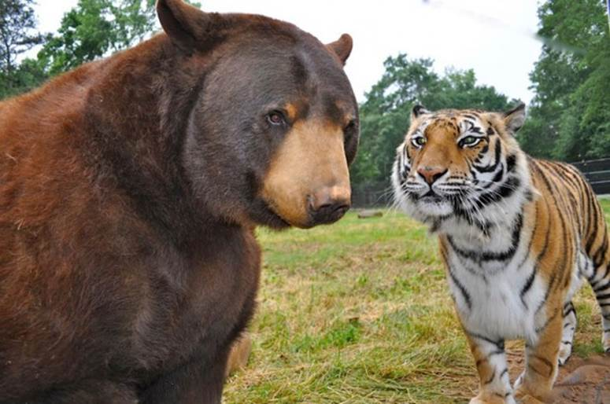
"Lions, Tigers & Bears! Oh, My!"
Notes:
"After arriving in Georgia, Baloo had the harness surgically removed."
_______________
How An Abused Lion, Tiger And Bear Became An Unlikely Family (PHOTOS)
The Huffington Post | By Alexandra Zaslow
Posted: 12/03/2013 12:28 pm EST Updated: 12/04/2013 11:57 am EST
http://www.huffingtonpost.com/2013/12/03/lion-tiger-bear-negligence_n_4374091.html
Accessed 30 Sep 2015

Slide 77
"Lions, Tigers & Bears! Oh, My!"
Notes:
"Given that the trio had found comfort in each other during their years of mistreatment, The Sanctuary's staff realized that they couldn't be separated and fenced them in together."
_______________
How An Abused Lion, Tiger And Bear Became An Unlikely Family (PHOTOS)
The Huffington Post | By Alexandra Zaslow
Posted: 12/03/2013 12:28 pm EST Updated: 12/04/2013 11:57 am EST
http://www.huffingtonpost.com/2013/12/03/lion-tiger-bear-negligence_n_4374091.html
Accessed 30 Sep 2015

Slide 78
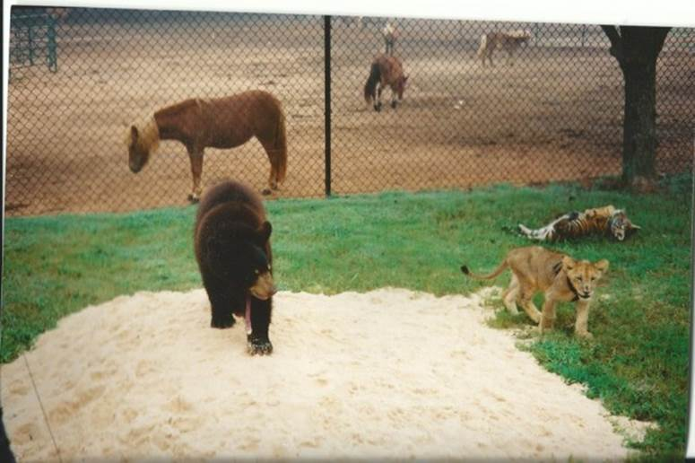
"Lions, Tigers & Bears! Oh, My!"
Notes:
"Unfortunately, the government passed new federal regulations requiring big cat enclosures to have 16 foot fences put up, which would take effect in October of this year. Baloo, Leo and Shere Khan's fence was only 8 feet high. If these regulations weren't met, the three animals would have to split up.
Rebuilding the fence would cost $489,000."
_______________
How An Abused Lion, Tiger And Bear Became An Unlikely Family (PHOTOS)
The Huffington Post | By Alexandra Zaslow
Posted: 12/03/2013 12:28 pm EST Updated: 12/04/2013 11:57 am EST
http://www.huffingtonpost.com/2013/12/03/lion-tiger-bear-negligence_n_4374091.html
Accessed 30 Sep 2015

Slide 79
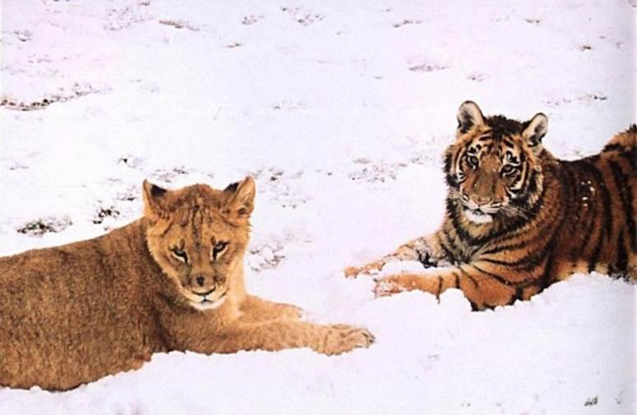
"Lions, Tigers & Bears! Oh, My!"
Notes:
"With October slowly approaching, The Sanctuary entered a contest to help raise money. On August 15, CrowdRise, an online fundraising site, teamed up with RYOT, a social news platform to announce a challenge called #STARTARYOT, according to ncronline.com. They offered $75,000 to the nonprofit that raised the most money in five weeks."
_______________
How An Abused Lion, Tiger And Bear Became An Unlikely Family (PHOTOS)
The Huffington Post | By Alexandra Zaslow
Posted: 12/03/2013 12:28 pm EST Updated: 12/04/2013 11:57 am EST
http://www.huffingtonpost.com/2013/12/03/lion-tiger-bear-negligence_n_4374091.html
Accessed 30 Sep 2015

Slide 80

"Lions, Tigers & Bears! Oh, My!"
Notes:
"On Oct. 10, they had announced that Noah's Ark Animal Sanctuary had won. They even received an extra $10,000 for attracting the most unique visitors during the last week of the challenge.
Additionally, they were able to raise $362,269 through crowd-funding. The installment company even agreed to discount the price of the new fence.
And once more, all is right in the BLT-land."
_______________
How An Abused Lion, Tiger And Bear Became An Unlikely Family (PHOTOS)
The Huffington Post | By Alexandra Zaslow
Posted: 12/03/2013 12:28 pm EST Updated: 12/04/2013 11:57 am EST
http://www.huffingtonpost.com/2013/12/03/lion-tiger-bear-negligence_n_4374091.html
Accessed 30 Sep 2015

Slide 81
Mini-Isaiah
Interesting Facts
616

Slide 82
Slides on
Micah 5

Slide 83
Christ in Micah
Interesting Facts
616
Micah 5:2 is the only OT prophecy that predicts the birthplace of the Messiah as Bethlehem.
Micah also gives the best descriptions of the righteous reign of Christ over the whole world (2:12-13; 4:1-8; 5:4-5).

Slide 84

Bethlehem
"And you, O Bethlehem in the land of Judah, are not least among the ruling cities of Judah, for a ruler will come from you who will be the shepherd for my people Israel"
(Micah 5:2 quoted in Matthew 2:6 NLT)

Slide 85

Journey to Bethlehem

Slide 86

Jewish Loss of Land

Slide 87

The Unseen Hand
Notes:
The Messiah will reunite and restore the nation (5:2-3).
The Messiah will care for the people and give them security (5:4).
The Messiah will destroy Israel’s enemies (5:5-9).
The Messiah will purge Israel of reliance on military power (5:10-11).
The Messiah will destroy false worship within Israel (5:12-15).

Slide 88

"The remnant left in Israel will take their place among the nations.
They will be like a lion among the animals of the forest, like a strong young lion among flocks of sheep and goats, pouncing and tearing as they go with no rescuer in sight. ⁹The people of Israel will stand up to their foes, and all their enemies will be wiped out" (Micah 5:8-9 NLT).
Jesus the Victor
(Revelation 19:11)

Slide 89

Mount of Olives
Eastern Gate
Kidron Valley

Slide 90
Slides on
Micah 6

Slide 91
MICAH'S 3 SERMONS
III. God gives hope to the generous (Micah 6–7).
"LISTEN!"
(1:2)
"LISTEN!"
(3:1)
"LISTEN!"
(6:1)
WHY YOU SHOULD BE GENEROUS

Slide 92
Structure of Micah
620
Judgment
1:1-7
2:1-5
3:1-4
6:1-5
• God
• Micah
1:8-16
2:6-11
3:5-12
Hope
2:12-
13
4:1–5:15
• God
• Micah
Adapted from Homer Heater, Dallas Seminary

Slide 93
Courtroom Drama
Interesting Facts
619
Micah 6:1-8 represents God indicting his people for a breach of covenant. This is presented before the primary witnesses, the mountains, and reminds them of the "saving acts of Yahweh."

Slide 94

"Day in Court"
Micah
Walk Through The Bible ©1989

Slide 95
Structure of Micah
620
Judgment
1:1-7
2:1-5
3:1-4
6:1-5
• God
• Micah
1:8-16
2:6-11
3:5-12
6:6-8
Hope
2:12-
13
4:1–5:15
• God
• Micah
Adapted from Homer Heater, Dallas Seminary

Slide 96
Key Verse
615
"He has shown you, O man, what is good. And what does the LORD require of you? To act justly and to love mercy and to walk humbly with your God" (Micah 6:8).
Micah

Slide 97

Our emphasis on Micah 6:8
Interesting Facts
616
Destruction
Introduction to Micah
Bits that people like to quote
6:8
Notes:
Micah has much to say about judgment upon Judah and the messianic kingdom. However, the exploitation of God’s people has become the focus in the teaching of the book by most preachers and teachers. This makes Micah 6:8 to most preached verse.

Slide 98
Micah 6:8 Song
He has shown you, O man,
what is good and what the LORD requires you (2x)
To act justly,
And to love mercy,
And to walk humbly with your God.

Slide 99
Structure of Micah
620
Judgment
1:1-7
2:1-5
3:1-4
6:1-5
6:9-16
• God
• Micah
1:8-16
2:6-11
3:5-12
6:6-8
Hope
2:12-
13
4:1–5:15
• God
• Micah
Adapted from Homer Heater, Dallas Seminary

Slide 100

Exploitation
"What shall I say about the homes of the wicked filled with treasures gained by cheating? What about the disgusting practice of measuring out grain with dishonest measures?
¹¹How can I tolerate your merchants who use dishonest scales and weights? ¹²The rich among you have become wealthy through extortion and violence. Your citizens are so used to lying that their tongues can no longer tell the truth" (6:10-12 NLT).

Slide 101
Slides on
Micah 7

Slide 102
Structure of Micah
620
Judgment
1:1-7
2:1-5
3:1-4
6:1-5
6:9-16
• God
• Micah
1:8-16
2:6-11
3:5-12
6:6-8
7:1-6
Hope
2:12-
13
4:1–5:15
• God
• Micah
Adapted from Homer Heater, Dallas Seminary

Slide 103

"How miserable I am!
I feel like the fruit picker after the harvest who can find nothing to eat.
Not a cluster of grapes or a single early fig can be found to satisfy my hunger"
(Micah 7:1 NLT).
Exploitation

Slide 104

"The godly people have all disappeared; not one honest person is left on the earth. They are all murderers, setting traps even for their own brothers"
(Micah 7:2 NLT).
Exploitation

Slide 105

"Both their hands are equally skilled at doing evil! Officials and judges alike demand bribes. The people with influence get what they want, and together they scheme to twist justice" (Micah 7:3 NLT).
Exploitation

Slide 106


Exploitation
"Even the best of them is like a brier; the most honest is as dangerous as a hedge of thorns. But your judgment day is coming swiftly now. Your time of punishment is here, a time of confusion" (Micah 7:4 NLT).

Slide 107

Exploitation
"Don’t trust anyone—
not your best friend or even your wife!
⁶For the son despises his father.
The daughter defies her mother.
The daughter-in-law defies her mother-in-law. Your enemies are right in your own household!" (Micah 7:5-6 NLT).

Slide 108
Structure of Micah
620
Judgment
1:1-7
2:1-5
3:1-4
6:1-5
6:9-16
• God
• Micah
1:8-16
2:6-11
3:5-12
6:6-8
7:1-6
Hope
2:12-
13
4:1–5:15
• God
• Micah
7:7-20
Adapted from Homer Heater, Dallas Seminary

Slide 109

"As for me, I look to the LORD for help.
I wait confidently for God to save me, and my God will certainly hear me"
(Micah 7:7 NLT).

Slide 110

Borders of the Land Promised to Abraham
531e
Syria
Lebanon
Israel
Jordan
Genesis 15:18
"On that day the LORD made a covenant with Abram, saying, 'To your offspring I give this land, from the river of Egypt to the great river, the river Euphrates'" (ESV)
India
Egypt
Notes:
God’s promised land stretched northeard from the small wadi of Egypt south in the Sinai to the large Euphrates River in the far north—a HUGE piece of real estate! When today’s boundaries are placed over this land we can see the struggle modern Israel has to claim land from Egypt, Lebanon, Syria and possibly even Jordan on the other side of the Jordan River.

Slide 111
Millennial Jerusalem (Isaiah)
106
"The law will go out from Zion,
the word of the LORD from Jerusalem"
––Isaiah 2:3

Slide 112
Millennial Jerusalem (Micah)
106
"For out of Zion shall go forth the law, and the word of the LORD from Jerusalem"
––Micah 4:2

Slide 113
Millennial Israel Will Bless Nations
531e
Mountains
Assyria
"In that day, Israel, your cities will be rebuilt, and your borders will be extended. ¹²People from many lands will come and honor you— from Assyria all the way to the towns of Egypt, from Egypt all the way to the Euphrates River, and from distant seas and mountains"
(Micah 7:11-12 NLT)
Seas
Israel
Jordan
Egypt
Notes:
God’s promised land stretched northeard from the small wadi of Egypt south in the Sinai to the large Euphrates River in the far north—a HUGE piece of real estate! When today’s boundaries are placed over this land we can see the struggle modern Israel has to claim land from Egypt, Lebanon, Syria and possibly even Jordan on the other side of the Jordan River.

Slide 114
"Where is another God like you, who pardons the guilt of the remnant, overlooking the sins of his special people?
You will not stay angry with your people forever, because you delight in showing unfailing love"
(Micah 7:18 NLT).

Slide 115
"Once again you will have compassion on us. You will trample our sins under your feet and throw them into the depths of the ocean!
²⁰You will show us your faithfulness and unfailing love as you promised to our ancestors Abraham and Jacob long ago"
(Micah 7:19-20 NLT).

Slide 116
Why does God want you to be generous to the poor?

Slide 117

Main Idea
Be generous to others and God will be generous to you.

Slide 118
MICAH'S 3 SERMONS
"LISTEN!"
(1:2)
I. God will reward generosity
(Micah 1–2).
WHY YOU SHOULD BE GENEROUS

Slide 119
MICAH'S 3 SERMONS
II. God comforts the generous (3–5).
"LISTEN!"
(1:2)
"LISTEN!"
(3:1)
WHY YOU SHOULD BE GENEROUS

Slide 120
MICAH'S 3 SERMONS
III. God gives hope to the generous (Micah 6–7).
"LISTEN!"
(1:2)
"LISTEN!"
(3:1)
"LISTEN!"
(6:1)
WHY YOU SHOULD BE GENEROUS

Slide 121

How can you better help those with less money than you?

Slide 122

This 99-Year-Old Man Begs Every Day And Gives It All Away To Churches And Orphanages
Notes:
http://www.huffingtonpost.com/2014/02/27/dobri-dobrev_n_4867974.html
IMPACT 02/27/2014 04:10 pm ET | Updated Mar 14, 2014
To the unfamiliar passerby, Dobri Dobrev, 99, may come off as a haggard beggar who depends on the kindness of strangers to get by in life.
But, for the residents of Sofia, Bulgaria, Dobrev is nothing of the sort. Rather, the area’s fixture has been called a “saint” and a “divine stranger,” according to a website dedicated to Dobrev.
Dobrev lost most of his hearing during World War II, according to Yahoo News Canada. He lives more than 15 miles outside of Sofia, a distance he used to trek by foot, but he now relies on the bus, according to SaintDobry.com. He spends his days asking people for money, but he doesn’t keep a cent.
The generous guy lives off of his monthly pension of 80 euros (about $100) and gives all his donations to institutions that are most dear to him: churches and orphanages.
Photo credit: Laura / Panoramio
Last year, Reddit user Nullvoid123 wrote on the site that he has met Dobrev a number of times and that the beneficent man said he once “did a bad thing,” and is now trying to make up for his past transgressions by helping others.
Dobrev has made a number of generous donations throughout the years to churches, but one of his largest gifts was when he gave 35,700 lev (more than $24,000) to the St. Alexander Nevsky Cathedral, according to a video released by the church. He has also been known to give money to orphanages to help them pay their utility bills.
“The good will is just and true. Everything in it is good,” Dobrev said in the film “Mite,” which was produced in 2000. “We must not lie, nor steal, nor commit adultery. We must love each other as God loves us.”

Slide 123

Don't harden your heart.

Slide 124

Be generous.

Slide 125

Feed the hungry.

Slide 126


Give.

Slide 127

Care.

Slide 128

Listen.

Slide 129
Black

Slide 130


OT Sermons link at BibleStudyDownloads.org
Get this presentation and script for free!

