Slide 1
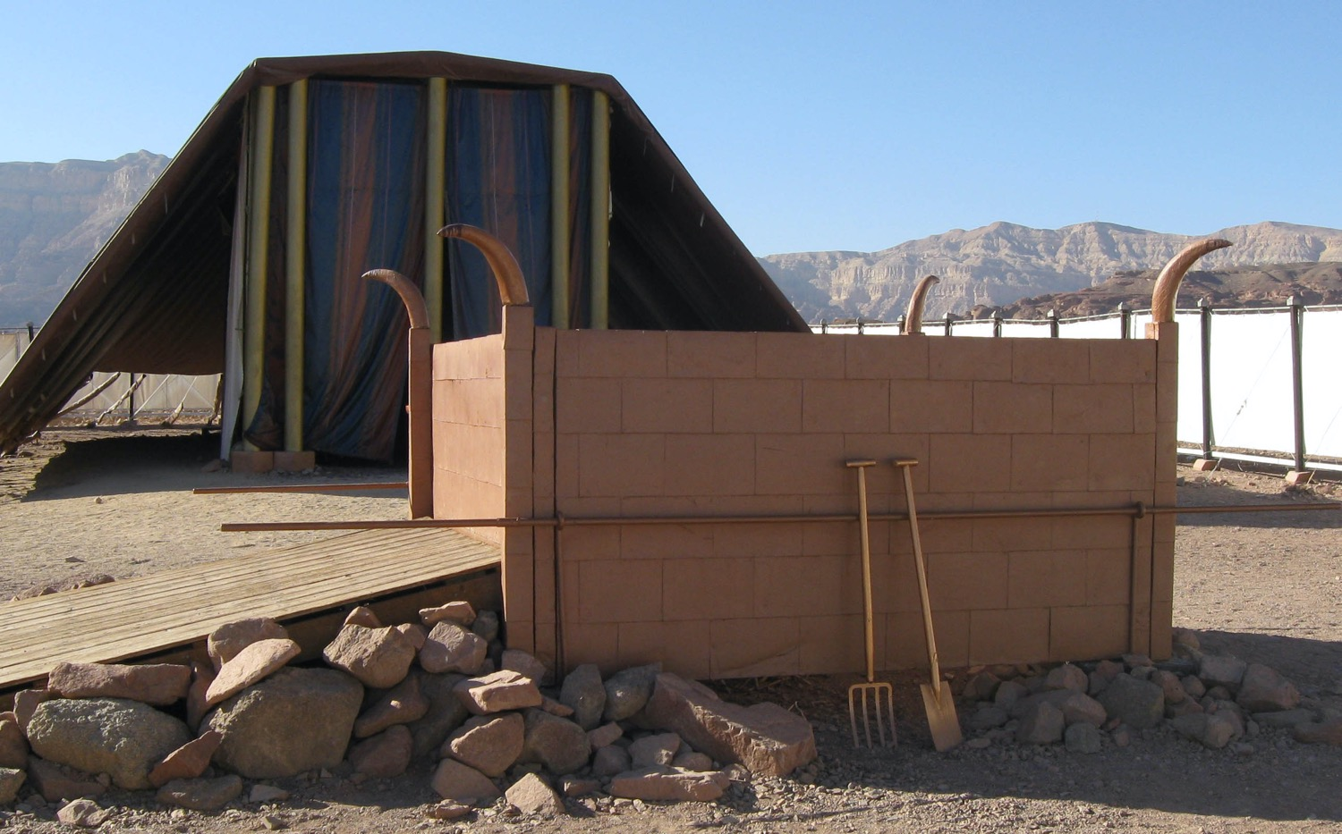
Five Offerings We Bring
献上的五项祭物
Leviticus 1:1–6:7
Dr. Rick Griffith • Crossroads International Church Singapore
Singapore Bible College • CICFamily.com • BibleStudyDownloads.org

Slide 2
Do Christians always act like Christians?
基督徒都这么做吗?
Notes:
Tell your answer to this question to the person next to you.

Slide 3

Even leaders like us cleansed of our sins sometimes get out of fellowship with the Lord.
虽然我们身为领袖已被神洁净可是我们仍然还是会离弃神
So what should we do?
那我们该如何做呢？

Slide 4

NT Forgiveness of Sin
新约中的罪得赦免
121b
Pipe = Relationship with God (never changing)
管道 = 与神的关系（永不改变）
Sin罪
Clog = Fellowship with God (hindered by sin)
堵塞 =与神的团契（被罪阻碍）
Notes:
• Our relationship with God can be compared to a pipe.
• Occasionally the pipe gets a clog—like sin.
• This hinders our fellowship with God.
Do we still have a relationship with God when we sin? Yes!
Sin does not hinder our relationship with God but our fellowship with Him.
• But how do you unclog the pipe?
_________
OB-38-Salvation-11
OS-03-Leviticus-72, 130
OS-04-Numbers-30

Slide 5

So how do you personally sustain your walk with God?
你如何持续的与神同行
Promises? 承诺？
Bible reading? 读经？
Prayer? 祷告？
Something else? 其他方法？
Notes:
• Some people make promises to God that they will go wherever he wants them to go.
• Others vow that they will never miss a day of Bible reading the rest of their life.
• Still others promise daily prayer.
• How do you sustain your walk with God? What should you do?

Slide 6

How can you maintain fellowship with your holy God?
你如何持续与神的交通？

Slide 7
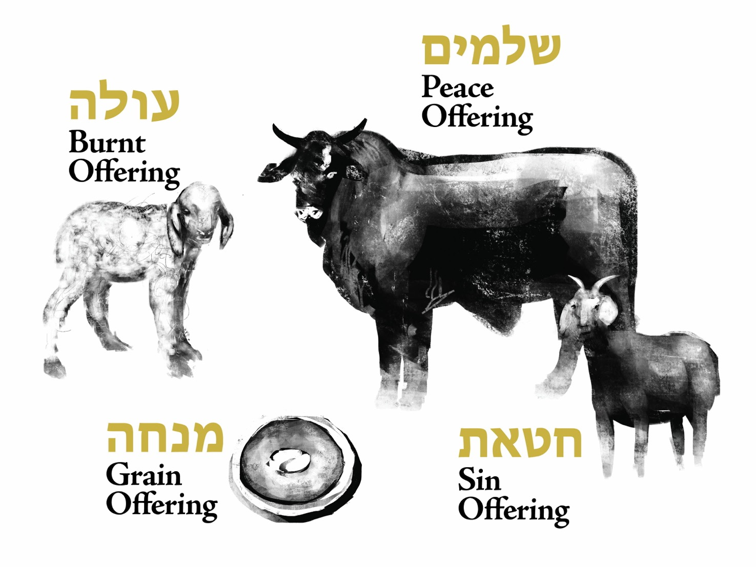
Offerings (Lev 1–7) • 利未记第 1-7 章中的献祭
Fellowship
平安祭
Burnt
全牲的燔祭
Grain
Sin & Guilt
素祭
赎罪祭 & 赎愆祭
Notes:
We can gain insight today from studying the various offerings in the OT book of Leviticus.
How?
OT sacrifices did not establish a relationship with God but rather they restored fellowship with God for Israelites .

Slide 8
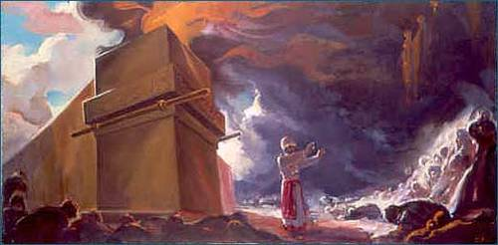
Background
背景
Notes:
Israel already had a relationship with God—the new nation just needed to know how to sustain their fellowship with God.

Slide 9



The Passover Lamb
逾越节的羔羊
Notes:
A year earlier, each Israelite had been saved from death by faith in an innocent lamb.

Slide 10

Passover Protection
逾越节的保护
"The blood will be a sign for you on the houses where you are; and when I see the blood, I will pass over you. No destructive plague will touch you when I strike Egypt."
涂在门上的血是一个记号，我经过的时候，见到这血就会越过。我击打埃及的时候，那灾祸不会落到你们身上。
Exodus 12:13 (NIV)
出埃及记 12:13
Notes:
They shed the Passover lamb’s blood and put it on their doorposts.

Slide 11
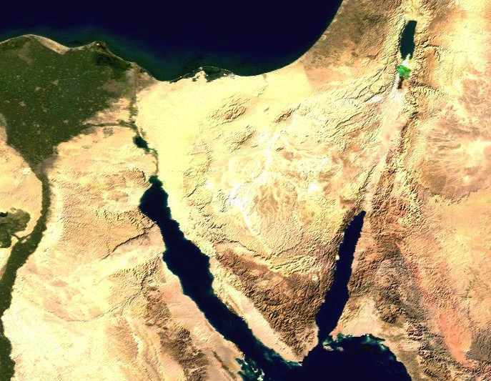
Route of the Exodus
出埃及的路线
107
111a
123
Canaan
迦南
Goshen
歌珊
Desert of Sin
汛的旷野
Marah玛拉
Elim以琳
Midian
米甸
Mt. Sinai
西奈山
Notes:
Then God miraculously parted the Sea and led his people out of Egypt—a picture of salvation for the believers since each of those redeemed had been saved from death by the Passover lamb’s blood. In other words, they had a personal relationship with God.

Slide 12
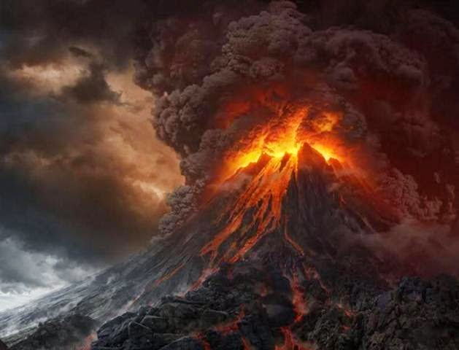
Mount Sinai 西奈山
Notes:
Israel invited God’s presence at Mt. Sinai and God was pleased to dwell with them (Exodus 39:34).
Despite God’s awesome holiness at Sinai, they had come into a relationship with God though the Passover lamb at the Exodus.

Slide 13
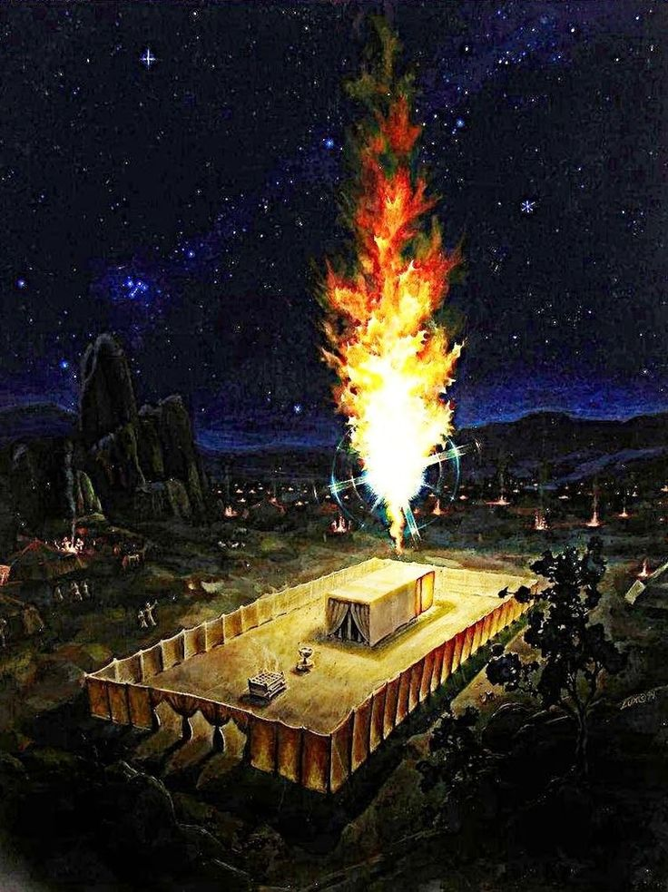
Background
Notes:
Now they stand there at the tabernacle wondering how long this will last. How could they experience God’s blessing, guidance and reality continually?

Slide 14
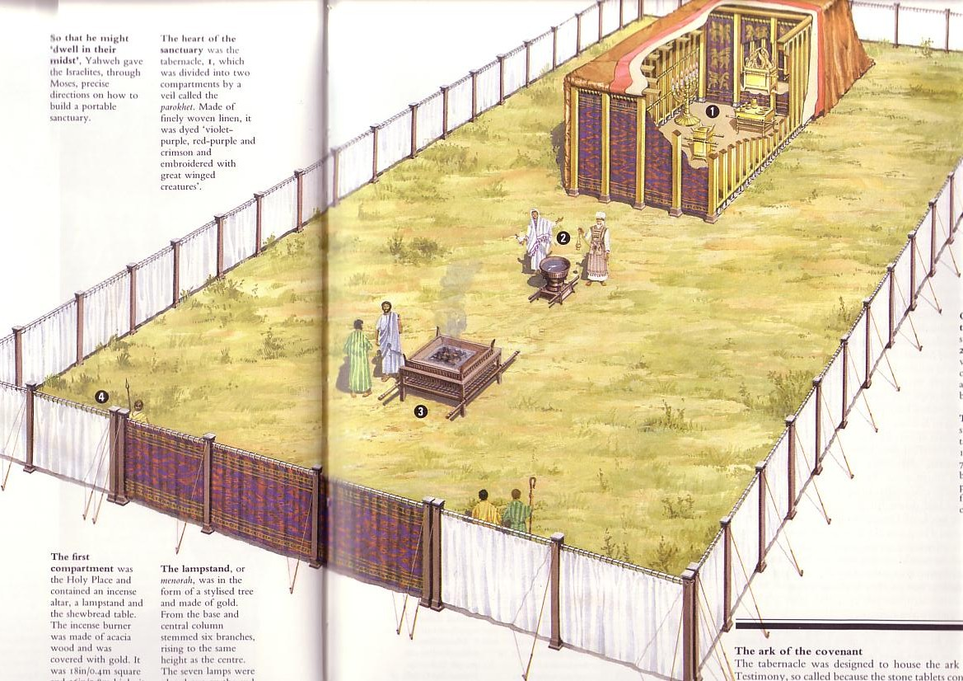
Circumstances When Leviticus Was Written
利未记写作的处境
123
Israel has a new tabernacle built in the book of Exodus.
以色列人在出埃及记刚建好会幕
But they don‘t know how to use it.
但是他们不晓得如何使用它
So Moses wrote Leviticus to explain the worship and walk of the new nation.
摩西写了利未记来解释在新国度里的敬拜和生活
Notes:
The tabernacle was finished but now they needed to know what to do with it!

Slide 15
How can you maintain fellowship with your holy God?
你如何持续与神的交通？
Two Ways
两条进路
利未记第 Leviticus 1:1–6:7
Notes:
(So what is the first way to maintain fellowship with your holy God?)

Slide 16

I. Do what is not required—extra acts of worship.
I. 做你不必做的
—在敬拜中的额外行动
Notes:
Do things that are voluntary to honor the Lord—especially when life is so busy that we don’t do anything optional.

Slide 17
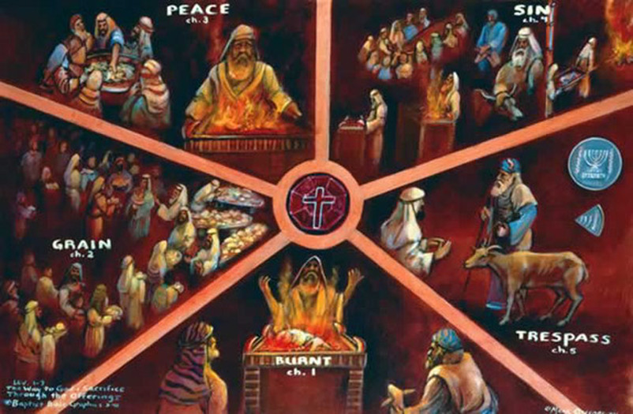
Offerings (Lev 1–7) • 利未记第 1-7 章中的献祭
Fellowship
Sin
平安祭
赎罪祭
I. Do what is not required —extra acts of worship.
I. 做你不必做的
—在敬拜中的额外行动
Grain
素祭
Guilt
Burnt
赎愆祭
全牲的燔祭
Notes:
Israel could continue to enjoy God’s presence by three sacrifices for consecration when in fellowship (Lev 1–3).
We also should express our love to God in new ways.

Slide 18
Slides on
Leviticus 1
利未记 1

Slide 19
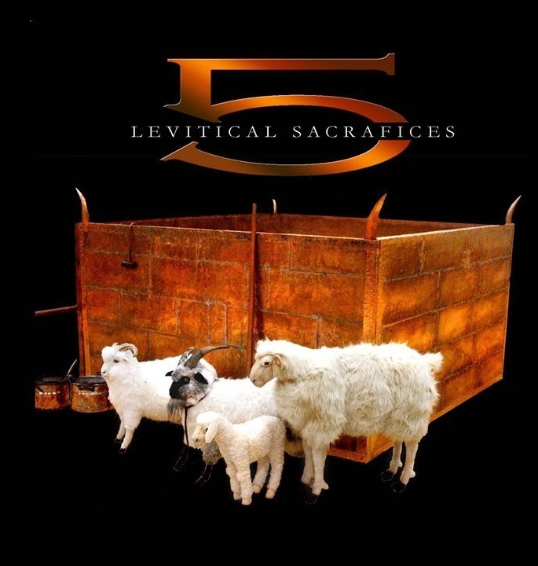
“All I am Belongs to God”
Burnt Offering
Lev 1:3-17
全牲的燔祭
凡我所有都属神
利未记第 1:3-17
Notes:
The burnt offering was a voluntary sacrifice that totally consumed the animal to draw near to God in total dedication (Lev 1).

Slide 20
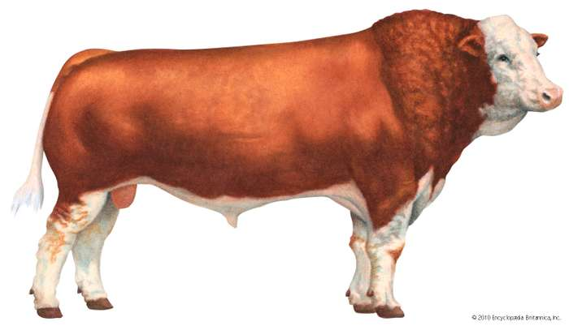
Offerings (Lev 1–7) • 利未记第 1-7 章中的献祭
Burnt Offering
全牲的燔祭
Notes:
The burnt offering begins with instructions to offer a bull. Wow, what an expensive gift to God! This would be several months or even a year or more wages for people!

Slide 21
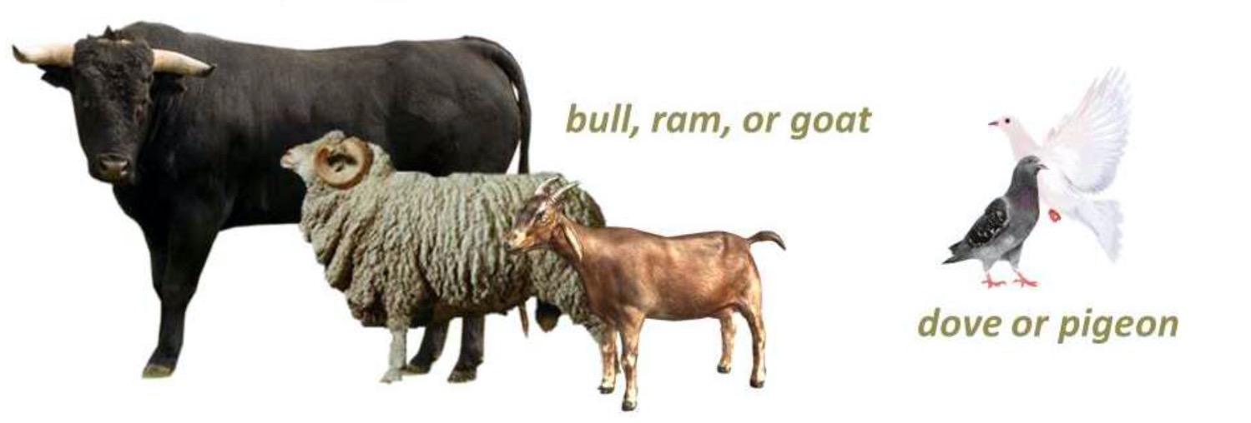
Offerings (Lev 1–7) • 利未记第 1-7 章中的献祭
Burnt Offering
全牲的燔祭
bull, ram or goat
公牛，公绵羊，公山羊
dove or pigeon
鸽子
Notes:
But notice that God allowed various types of animals for the same offering.
“1:2. This verse forms a transition to the law of the burnt offering by referring to an offering (NA;b√r∂q, “that which is brought” to God—a general term covering all sacrifice) from either the herd (i.e., a bull, vv. 3-9) or the flock (i.e., a sheep or goat, vv. 10-13). With the addition of birds (vv. 14-17), this provides the formal outline of the law of burnt offering (see also 6:8-13), the animals of the offering being listed in a descending order of value” (BKC).
God allowed expensive offerings (bulls) for the wealthy, moderate animals for the middle class (lambs, goats), and the poor could offer as simple an animal as a bird. Likewise, he instituted the tithe because he made sure that even the poorest person could live on 90% of his income.

Slide 22
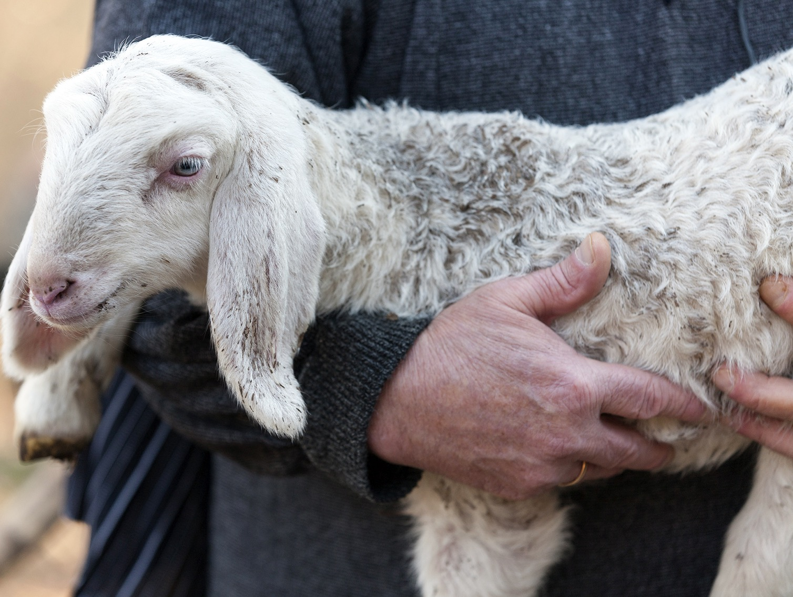
A Perfect Sacrifice
无瑕疵的祭物
Notes:
But one thing that characterized all of these offerings is that they must be perfect animals without defect—just like our Lord Jesus Christ.

Slide 23
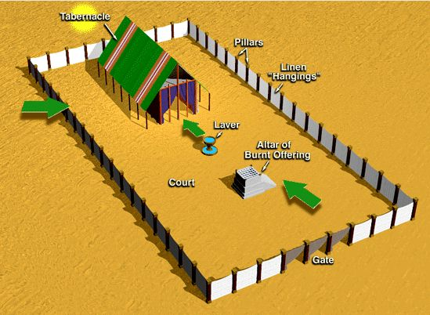
The Tabernacle & Courtyard
会幕 及 院子
Tabernacle
Pillars
会幕
柱子
Linen "Hangings"
Laver
细麻帷子
洗濯盆
Altar of Burnt Offering
Court
燔祭坛
院子
Gate
门
Notes:
The process was also clearly given.

Slide 24
Offering Rituals in Lev. 1–5
利未记第 1–5 中的献祭礼仪
128
The worshipper presents his offering.敬拜者奉上自己的献祭。
He lays his hand(s) upon the victim, and possibly confesses his sin.
他按手在要被宰杀的牺牲物上，大约同 时认罪。
3. The worshipper slaughters the offering. 敬拜者宰杀牺牲物。

Slide 25
Offering Rituals in Lev. 1–5
利未记第 1–5 中的献祭礼仪
128
4. The priest collects the blood in a basin and dashes it against the NE and SW corners of the altar in such a way that all four sides are spattered. The remainder of the blood is then poured out at the base of the altar.
祭司将血接在盆里，并抹在燔祭坛的东北和西南角，让祭坛的四边都溅上血。剩下的血则全倒在燔祭坛脚。

Slide 26
Offering Rituals in Lev. 1–5
利未记第 1–5 中的献祭礼仪
128
5. A portion of the sacrifice is burned.
一部分献祭用来烧在坛上
R. T. Beckwith, New Bible Dictionary, 1962
Notes:
But for a burnt offering, the ENTIRE sacrifice was burned.

Slide 27
Offering Rituals in Lev. 1–5
利未记第 1–5 中的献祭礼仪
128
6. Any remaining portions of the sacrifice were eaten in a sacrificial meal, either by the priests and worshippers (fellowship-offering), or by the priests and their families, or by the priests alone.
所有剩余的献祭则在献祭餐中由祭司或敬拜者（平安祭中）、或是祭司及其家人、或是祭司自己吃掉。
R. T. Beckwith, New Bible Dictionary, 1962

Slide 28
Slides on
Leviticus 2
利未记 2

Slide 29

Grain Offering (Lev 2)
素祭 (利未记第 2)
Notes:
The staple of our diet comes from grain.

Slide 30
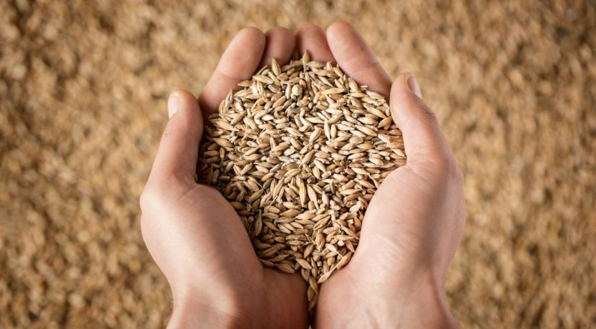
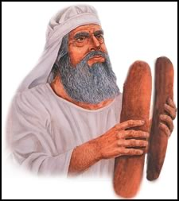
Grain Offering (Lev 2)
素祭 (利未记第 2)
Notes:
When God provided grain, Israelites could offer some back to God to say thank you.

Slide 31
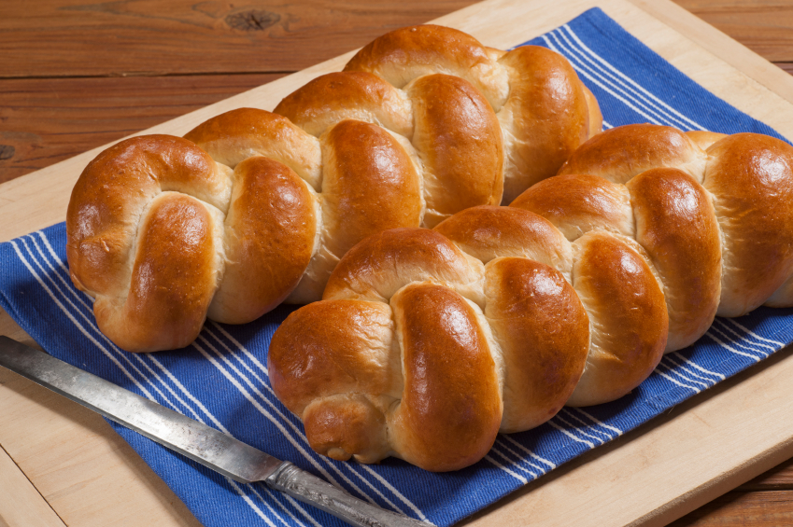
Grain Offering (Lev 2)
素祭 (利未记第 2)
Notes:
Sometimes grain could be in the form of baked loaves.

Slide 32
Old Testament Sacrifices
NAME
OT TEXTS
ELEMENTS
PURPOSE
BURNT OFFERING
Lev 1
6:8-13
8:18-21
16:24
Perfect bull, ram or male bird (dove or young pigeon for poor); wholly consumed
Voluntary act of worship; atone for unintentional sin in general; expression of surrender to God
GRAIN OFFERING
Lev 2
6:14-23
Grain, flour, olive oil, incense, bread, with salt & burnt or fellowship offering
Voluntary act of worship; recognition of God's goodness and provisions; devotion to God
The Bible Visual Resource Book, 29
Notes:
The grain offering was a voluntary act of worship in recognition of God's goodness and provisions. It symbolized our devotion to God in response to his goodness to us.

Slide 33
旧约里的献祭
献祭名
旧约经文
献祭物
意图
燔祭
利 1
6:8-13
8:18-21
16:24
没有残疾的公牛、公羊、或雄鸟 (若是穷人则献斑鸠或雏鸽); 完全烧尽
自愿的敬拜; 为赎普通的无心之失; 表达对神的降伏
素祭
利 2
6:14-23
谷粒，细面，油，乳香，无酵细面饼，用盐调和，与
燔祭和平安祭
同献
自愿的崇拜; 感激神的良善与供应; 表达对神的忠心
圣经资料图书, 29

Slide 34
Slides on
Leviticus 3
利未记 3

Slide 35
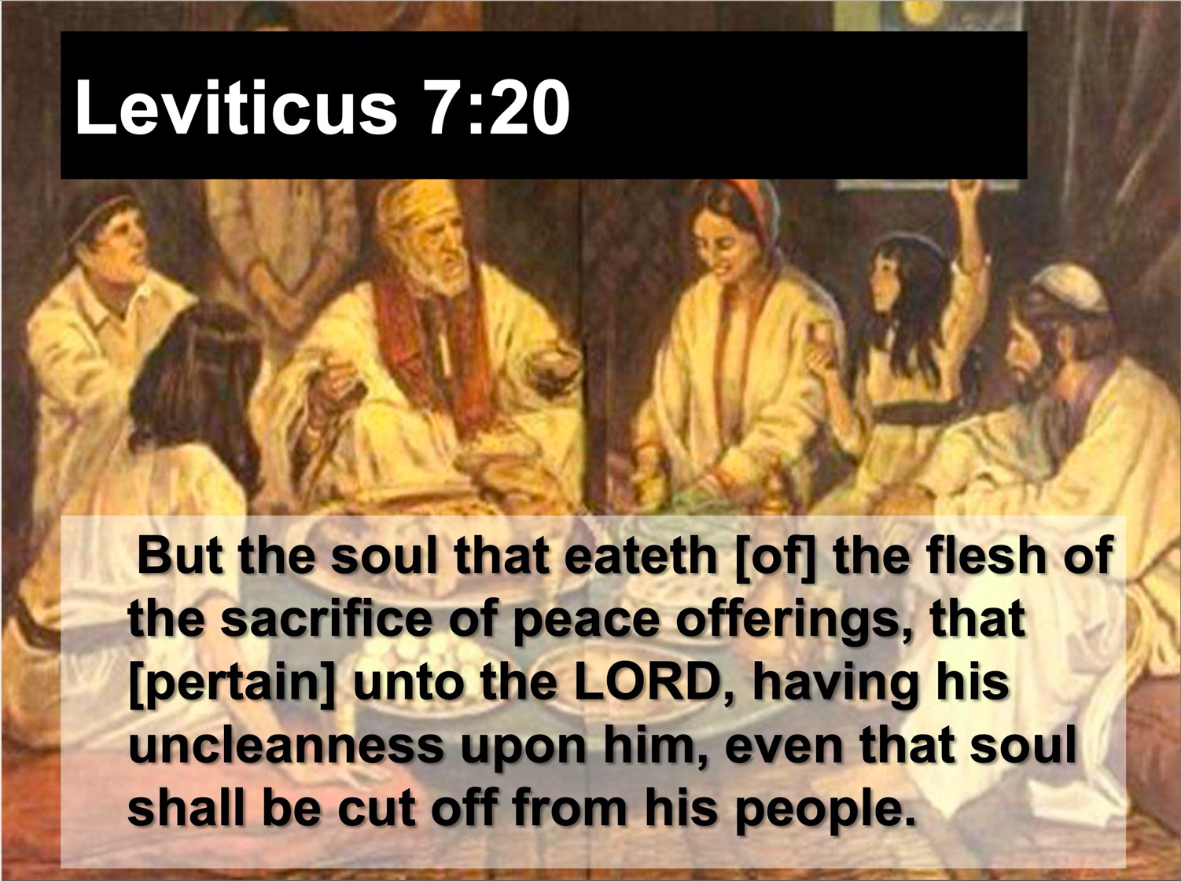
Fellowship Offering (Lev 3) 平安祭 (利未记第 3)
“The meat of the peace offering of thanksgiving must be eaten on the same day it is offered. None of it may be saved for the next morning” (Lev 7:15 NLT)
“为感恩而献的平安祭的肉，只能在献祭那日吃，一点也不可留到早晨” (利未记第 7:15 CNV)
Notes:
“The distinctiveness of the fellowship offering was in the communal meal which the worshiper and his family ate before the Lord (cf. 7:15). It was essentially a voluntary act in which the worshiper accepted the meat from God as a token of His covenant faithfulness and gave God acknowledgment or thankful praise for His past blessings bestowed, whether in answer to prayer, or granted unexpectedly, or the normal blessings [1:180] such as a good harvest” )” (Lindsey, BKC, 1:179-80).

Slide 36
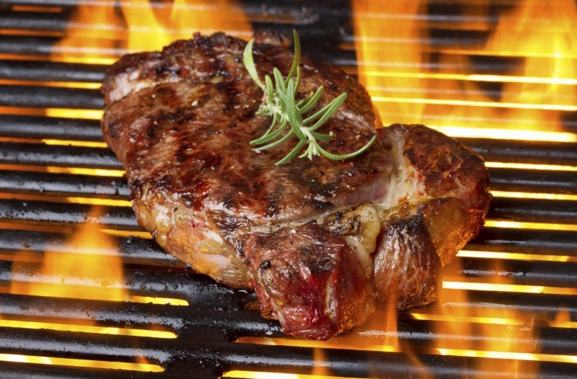
Why “an aroma pleasing to the LORD” (Lev. 1:9, 17; 2:2, 9, 12; 3:5, 16; 4:31)?
为什么神喜悦馨香之气？
Notes:
Why are these offerings called “an aroma pleasing to the LORD” (Lev. 1:9, 17; 2:2, 9, 12; 3:5, 16; 4:31)?
• Simply put, God likes BBQ!
More seriously, the Lord is pleased to see his people follow his ways. All obedience is like a sweet fragrance to God—especially sacrifices that express our love for him or restore our fellowship with him

Slide 37
We also should express our love to God in ways he does not specifically command.
我们应该以他所指定以外的方式来爱神
Notes:
Do things that are voluntary to honor the Lord—especially when life is so busy that we don’t do anything optional.

Slide 38
Romans 12
Righteousness is applied in transformed living
罗马书十二章
义应用在更新的生活

Slide 39

Righteousness in Romans
Theme | Needed | Provided | Imparted | Proved | Applied | Dissem-inated
Intro 1:1-17 | Condem-nation 1:18– 3:20 | Justifi-cation 3:21– 5:21 | Sanctifi-cation 6–8 | Election 9–11 | Trans-form-ation 12:1– 15:13 | Propa-gation 15:14– 16:27
Start | Sin | Salva-tion | Set Apart | Sove-reignty | Service | Send

Slide 40

罗马书里的义
主题 | 需要 | 供应 | 传授 | 证实 | 应用 | 传播
序言 1:1-17 | 定罪 1:18– 3:20 | 称义 3:21– 5:21 | 成圣 6–8 | 拣选 9–11 | 更新 12:1– 15:13 | 宣教 15:14– 16:27
开始 | 犯罪 | 救恩 | 分别为圣 | 主权 | 服事 | 差遣

Slide 41

罗马书 Romans 12:1
"Offer your body as a living sacrifice…”
“。。。要把身体献上，作圣洁而蒙神悦纳的活祭（持续不断地）。。。”
Notes:
Offering our bodies continually is our counterpart to the whole burnt offering (Rom 12:1)—but staying alive on the altar is challenging.

Slide 42


罗马书 ROMANS 12:2
轉化
藉着心意更新
BE TRANSFORMED
BY THE RENEWING OF YOUR MIND

Slide 43

ROMANS 12:2
不 要 效 法 这 个 世 界 ， 只 要 心 意 更 新 而 变 化 ， 叫 你 们 察 验 何 为 神 的 善 良 、 纯 全 、 可 喜 悦 的 旨 意 。
罗馬12:2

Slide 44
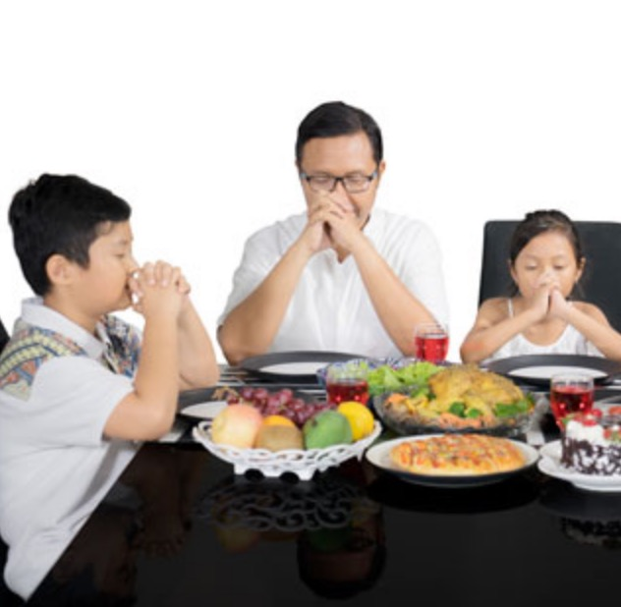
Grain Offering = Giving Thanks
素祭 = 感恩
Notes:
Thanking God for our food parallels the grain offering.

Slide 45

Body Life (Rom. 12)
身体及生命（罗12）
Notes:
Community worship is also a fantastic privilege! Don’t look at church as a burden but as a blessing. That’s why the fellowship offering is also called the peace offering. “The typology of the fellowship offering pictures the fellowship that the New Testament believer has with God and with other believers on the basis of Christ’s death on the cross (1 John 1:3). This is one phase of Christ’s ‘making peace through His blood, shed on the cross’ (Col. 1:20). In fact, ‘He Himself is our peace’ (Eph. 2:14)” (Lindsey, BKC, 1:180).

Slide 46
Old Testament Sacrifices
128
NAME
OT TEXTS
ELEMENTS
PURPOSE
FELLOWSHIP OFFERING
Lev 3
7:11-34
Perfect goat or sheep; variety of breads
Voluntary; thanksgiving with group meal
SIN
OFFERING
Lev 4:1–5:13 6:24-30
8:14-17
16:3-22
Perfect bull, goat, or lamb; dove/pigeon (poor); 1/10 ephah fine flour for very poor
Mandatory; atoned for unintentional sin; confession, forgiveness & cleansing
GUILT OFFERING
Lev 5:14–6:7
7:1-6
Perfect ram or lamb
Mandatory to atone for unintentional sin; pay 20% fine
The Bible Visual Resource Book, 29
Notes:
Peace and fellowship were experienced in a group meal.

Slide 47
旧约里的献祭
128
献祭名
旧约经文
献祭物
意图
平安祭
利 3
7:11-34
没有残疾的
山羊或绵羊;
各种面
自愿的; 通过共餐表达感恩
赎罪祭
利 4:1-5:13
6:24-30
8:14-17
16:3-22
没有残疾的公牛、公羊或母羊; 斑鸠或雏鸽 (穷人); 每个穷人1/10伊法的细面
义务的;
为赎误犯之罪; 为认罪、得赦免、得洁净
赎愆祭
利 5:14-6:7
7:1-6
没有残疾的公羊或羊羔
义务的，为赎误犯之罪；偿还亏欠的加 20%
圣经资料图书, 29
Notes:
Peace and fellowship were experienced in a group meal.

Slide 48
I. Do what is not required—extra acts of worship.
I. 做你不必做的
—在敬拜中的额外行动
Notes:
Do things that are voluntary to honor the Lord—especially when life is so busy that we don’t do anything optional.

Slide 49
Offerings (Lev 1–7) • 利未记第 1-7 章中的献祭
Fellowship
Sin
平安祭
赎罪祭
I. Do what is not required —extra acts of worship.
I. 做你不必做的
—在敬拜中的额外行动
Grain
素祭
Guilt
Burnt
赎愆祭
全牲的燔祭
Notes:
Israel could continue to enjoy God’s presence by three sacrifices for consecration when in fellowship (Lev 1–3).
We also should express our love to God in ways he does not specifically command.

Slide 50
Offerings in Leviticus 1–7
128
Whole burnt offering
Grain offering
Fellowship offering
Sin offering
Guilt offering
Consecration
Voluntary
Cleansing
Obligatory
Notes:
• So the first group of three offerings tell us to do what is not required—
• extra acts of worship from consecration to God.
• But now we will see another group, so what is the difference between this group of sacrifices? Why have two different groups of offerings? The first three simply expressed thanks and worship of God.
• But now the last two enabled worshippers to confess their sin in a very tangible way.
• Sacrifices of consecration were voluntary.
• But sacrifices of cleansing were obligatory.
So what is the second way to maintain fellowship with your holy God? These last two offerings teach us to…

Slide 51
利未记第 1-7 章中的献祭
128
全牲的燔祭
素祭
平安祭
赎罪祭
赎愆祭
成圣
自愿的
洁净
义务的
Notes:
• So the first group of three offerings tell us to do what is not required—
• extra acts of worship from consecration to God.
• But now we will see another group, so what is the difference between this group of sacrifices? Why have two different groups of offerings? The first three simply expressed thanks and worship of God.
• But now the last two enabled worshippers to confess their sin in a very tangible way.
• Sacrifices of consecration were voluntary.
• But sacrifices of cleansing were obligatory.
So what is the second way to maintain fellowship with your holy God? These last two offerings teach us to…

Slide 52

II. Do what is required
—confession of sin.
II. 做我们应当做的—认罪
Notes:
Do things that are compulsory to restore our walk the Lord.

Slide 53
Offerings (Lev 1–7) • 利未记第 1-7 章中的献祭
Fellowship
Sin
平安祭
赎罪祭
II. Do what is required
—confession of sin.
II. 做我们应当做的—认罪
Grain
素祭
Guilt
Burnt
赎愆祭
全牲的燔祭
Notes:
Do things that are compulsory to restore our walk the Lord (Lev 4:1-6:7).
Israel could continue to enjoy God’s presence by sacrifices for cleansing when out of fellowship (4:1–6:7).
Give priority to take time to agree with God about your own sin.

Slide 54
Slides on
Leviticus 4
利未记 4

Slide 55
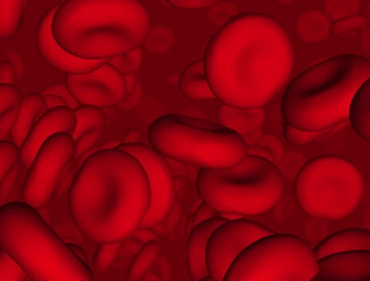
Why did God institute the sacrificial system?
神为什么建立献祭
的体制？
Did the blood actually forgive sin?
（动物的）血真的饶恕
了罪吗？
Notes:
Did these sacrifices forgive sin in the sense that they established a relationship with God?

Slide 56
Did blood sacrifices save Israelites under the Law?
血祭能否拯救人于律法之下?
BLOOD
血
Notes:
The answer is NO, for Israel was already a saved community.

Slide 57
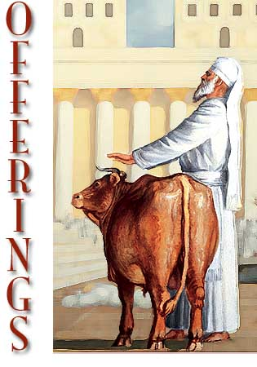
Sacrifices forgave sin 牺牲宽恕罪过
"Through this process, the priest will purify the people, making them right with the LORD, and
they will be forgiven"
(4:20 NLT; cf. 4:26, 31, 35).
"收 拾 这 牛 ， 与 那 赎 罪 祭 的 牛 一 样 。 祭 司 要 为 他 们 赎 罪 ， 他 们 必 蒙 赦 免 "
(利 4:20 和合本; 对比4:26, 31, 35).
Notes:
They only needed to know how to maintain their fellowship with a holy God.

Slide 58
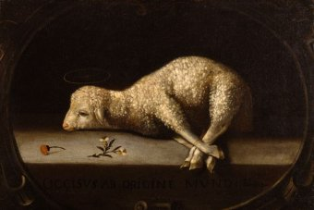
God forgave Israelites through the blood of offerings
(Lev 4:1–5:13; 6:24-30).
神借奉献的血赦免了以色列人
(利未记 4:1 - 5：13; 6:24 - 30)。
Notes:
Jews restored their fellowship with the Lord through sin and guilt sacrifices.

Slide 59
Slides on
Leviticus 5
利未记 5

Slide 60
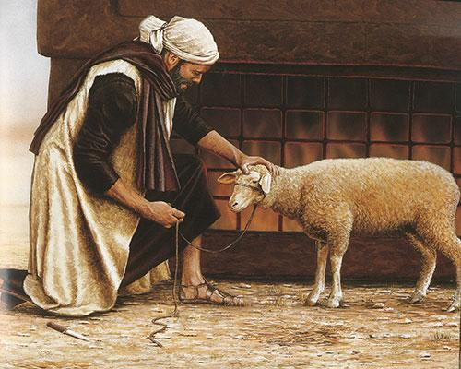
The blood and restitution of the guilt offering forgave unintentional sin
(5:14–6:7; 7:1-10).
+20%
通常是加罰金五分之一
(5:14–6:7; 7:1-10).
Notes:
The guilt (trespass) offering was an obligatory sacrifice to make restitution for withholding proper due from God or man (5:14–6:7).
• It required an additional 20% restitution for doing wrong to someone else.

Slide 61
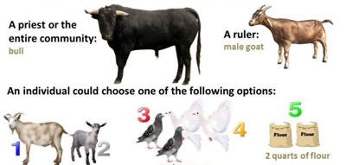
Guilt Offerings (赎愆祭)
WHY: Atone for accidental sins (用意：赎无意中犯的罪)
WHAT: Depends on who the offender is (取决于犯罪者的身份)
A priest or the entire community:
A ruler:
为官长
为大祭司，为全会众
bull 公牛
male goat
公山羊
Other individuals could choose one of the following:
为其他居民
1 female goat or
1 female lamb 母山羊或母羊
2 pigeons or doves
两只鸽子
2 quarts of flour
细面伊法十分之一
Notes:
God made covering one’s guilt possible no matter his social status!

Slide 62
OT Forgiveness of Sin
旧约中的罪得赦免
121b
Pipe = Relationship with God (never changing)
管道 = 与神的关系（永不改变）
Sin
罪
Clog = Fellowship with God (hindered by sin)
堵塞 =与神的交通（被罪阻碍）
Sacrifices = Confession of Sin (sin forgiven to restore fellowship but relationship was never threatened)
献祭 = 承认罪 (罪得赦免恢复与神的交通，但与神的关系不受到威胁）
Notes:
当我们犯罪时我们与神仍然有关系吗？是的！Do we still have a relationship with God when we sin? Yes!
罪不阻碍我们与神的关系但会阻碍我们与神的交通。Sin does not hinder our relationship with God but our fellowship with Him.
旧约中的献祭并不能帮助人与神建立关系，而是帮助人恢复与神的交通。OT sacrifices did not establish a relationship with God but rather they restored their fellowship with God

Slide 63
NT Forgiveness of Sin
新约中的罪得赦免
121b
Pipe = Relationship with God (never changing)
管道 = 与神的关系（永不改变）
"If we confess our sins,
He is faithful and righteous to forgive us our sins and to cleanse us from all unrighteousness"
(1 John 1:9 NAU)
“我 们 若 认 自 己 的 罪 ， 神 是 信 实 的 ， 是 公 义 的 ， 必 要 赦 免 我 们 的 罪 ， 洗 净 我 们 一 切 的 不 义 。”
(约翰一书 1:9 简体和合本)
Clog = Fellowship with God (hindered by sin)
堵塞 =与神的团契（被罪阻碍）
Sin罪
Christ's Sacrifice = The Basis for Confession of Sin (sin is forgiven to restore fellowship but relationship has never been never threatened)基督的牺牲 = 认罪的基础（罪孽被原谅恢复团契，但是从未威胁过与神的关系）
Notes:
• Our relationship with God can be compared to a pipe.
• Occasionally the pipe gets a clog—like sin.
• This hinders our fellowship with God.
Do we still have a relationship with God when we sin? Yes!
Sin does not hinder our relationship with God but our fellowship with Him.
• But how do you unclog the pipe?
• Give priority to take time to agree with God about your own sin.
• The word “confess” (homologeo) means to “say the same” as God does about your sin
_________
OB-38-Salvation-11
OS-03-Leviticus-72, 141
OS-04-Numbers-30

Slide 64
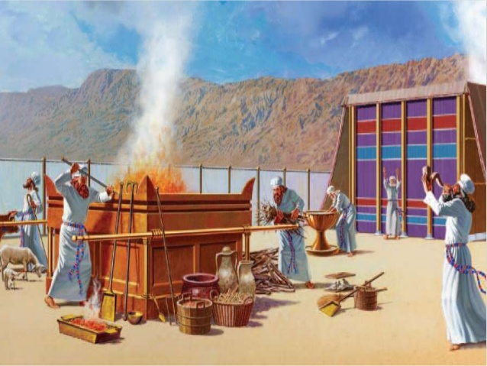
III. Main Point
Notes:
Imagine every sin costing you a month’s pay—would you sin less?

Slide 65
How can you maintain fellowship with your holy God?
你如何持续与神的交通？
Two Ways
两条进路
利未记第 Leviticus 1:1–6:7
Notes:
We began with this simple question.
We saw two ways it is answered.

Slide 66

Main Idea (中心思想)
Worship God & confess your sin.
敬拜神和承认你的罪
Notes:
Reverence Him and agree when you fail [restatement].

Slide 67
I. Do what is not required—extra acts of worship.
I. 做你不必做的
—在敬拜中的额外行动
Notes:
Do things that are voluntary to honor the Lord—especially when life is so busy that we don’t do anything optional.

Slide 68
II. Do what is required
—confession of sin.
II. 做我们应当做的—认罪
Notes:
Do things that are compulsory to restore our walk the Lord.

Slide 69
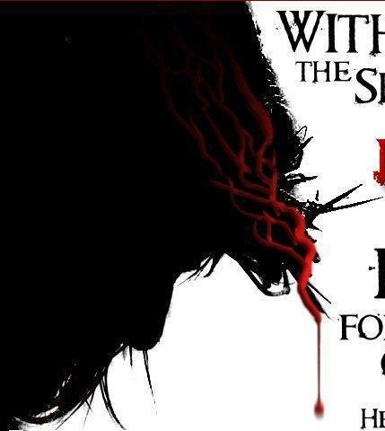
Without the shedding of
BLOOD there is no forgiveness of sins
Hebrews 9:22
“按着律法，几乎所有都是用血洁净的，如果没有流血，就没有赦免”
(来 9:22)
Notes:
Christ made the way for us.
Without the shedding of blood there is no forgiveness.

Slide 70

"This is my body…"
“这是我的身体”
Notes:
We celebrate forgiveness at the Lord’s Supper.

Slide 71

“I did not get here by myself.”
我不是靠自己来到这里的
Notes:
Admit, like a turtle on a fencepost, “I didn’t get here by myself.”

Slide 72

What practice in your life must you confess and purge?
你的生活中有哪些行为需要认罪并除去？
Follow peace with all men, and holiness, without which no man shall see the Lord.
Hebrews 12:14 KJV
你们要追求与众人和睦，并要追求圣洁；非圣洁没有人能见主。
希伯来书12:14 和合本
Notes:
What issue do you need to address with God now?
Telling the Lord that you love him?
Neglecting community?
Resisting his promptings?

Slide 73
Black

Slide 74


旧约全书讲章 • OT Preaching link at BibleStudyDownloads.org
Get this PPT and script for free! 免费获得该讲解!
圣经学习下载
Notes:
OT Preaching (op)

