Slide 1
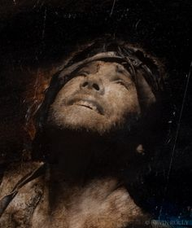
Jephthah:
Ungodly Vow & Precious Sacrifice
Judges 10:17–12:15
Dr. Rick Griffith, Crossroads International Church Singapore
BibleStudyDownloads.org

Slide 2

Moral Relativism
Notes:
We live in a relativistic culture that is getting worse. This means when there exist no absolute standards of right and wrong, we are at the whim of public opinion or whoever holds the power.
For example, this week France outlawed pro-life websites! The penalty for trying to convince a woman not to abort her child is two years imprisonment!

Slide 3

Where do you see relativism?
Notes:
Where do you see relativism? Tell your neighbor.

Slide 4

How do you respond when things just keep getting worse?
Notes:
As an individual, perhaps your just cry out “HELP!”

Slide 5
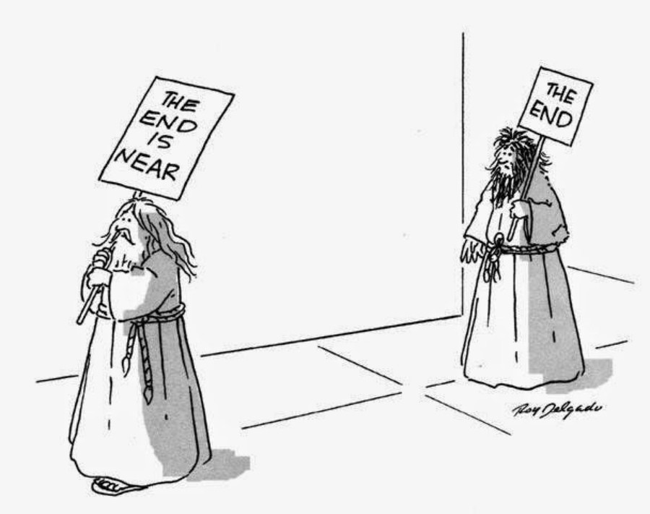
How do you respond when things just keep getting worse?
Notes:
Maybe you just want to hang on until Jesus comes.

Slide 6
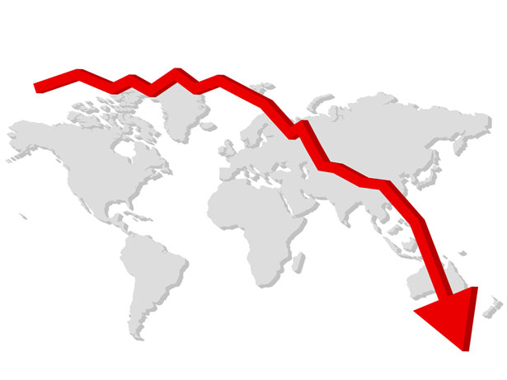
How do you respond when things just keep getting worse?
Notes:
Are you despairing that the whole world seems to be going down the tubes?

Slide 7

Relativism
What God did then.
What we should do now.
Where does it lead?
Notes:
Where does our relativism lead?
When we don’t have actual right-and-wrong standards, what happens?
Today we’ll see that, in response to relativism, what God did to Israel (EI) what we should do (MI in conclusion).

Slide 8

Band-Aids on a Gunshot Wound
Lessons from Judges
Notes:
Today we continue with lesson 7 in our series on Judges called “Band-Aids on a Gunshot Wound.” The title comes from Israel never really getting to the heart of the problem—which is the heart—but only concerning themselves with comfort, money and outward peace. Sound familiar?

Slide 9
Key Verse
172
"In those days Israel had no king;
everyone did as he saw fit
(what was right in his own eyes)"
(Judges 17:6; 21:25)
Judges

Slide 10

The Cycle Repeated in Judges
174
1 Sin
2 Servitude
5 Silence
3 Supplication
4 Salvation

Slide 11
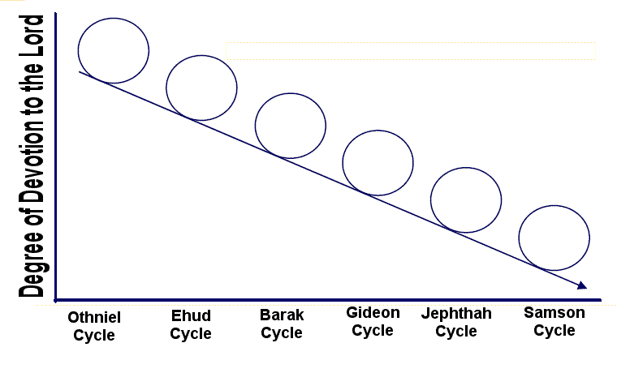
Downward Spiral of the Cycles
Degree of Devotion to the Lord
Othniel
Cycle
Ehud
Cycle
Barak
Cycle
Gideon
Cycle
Jephthah
Cycle
Samson
Cycle

Slide 12
The Jephthah Cycle
174
1 Sin
"Again the Israelites did evil in the LORD's sight. They served the images of Baal and Ashtoreth, and the gods of Aram, Sidon, Moab, Ammon, and Philistia. They abandoned the LORD and no longer served him at all" (10:6).
Notes:
“The Lord had given Israel victory over seven different nations (Judg. 10:11–12)” (Wiersbe, 111)…

Slide 13
"The LORD replied, 'Did I not rescue you from the Egyptians, the Amorites, the Ammonites, the Philistines, ¹²the Sidonians, the Amalekites, and the Maonites? When they oppressed you, you cried out to me for help, and I rescued you. ¹³Yet you have abandoned me and served other gods. So I will not rescue you anymore. ¹⁴Go and cry out to the gods you have chosen! Let them rescue you in your hour of distress!'"
(10:11-14 NLT).

Slide 14

Gods of the Nations
Sidon
140
(Baal & Ashtoreth)
Aram
Judges 10:6 NLT
"…They served the images of Baal and Ashtoreth, and the gods of Aram, Sidon, Moab, Ammon, and Philistia…"
(10:6b).
Israel
Ammon
Philistia
Moab
Egypt
Edom
Notes:
“…but now Israel was worshipping seven different varieties of pagan gods (v. 6)” (Wiersbe, 111).

Slide 15
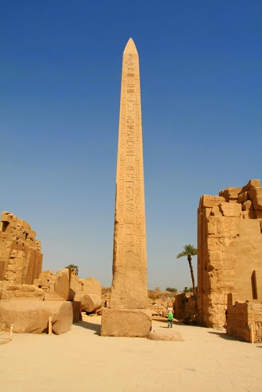
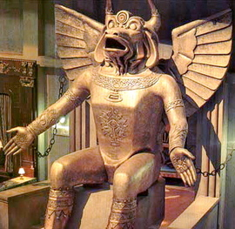
The gods of the nations
Molech
(Ammon)
Baal (Sidon)

Slide 16
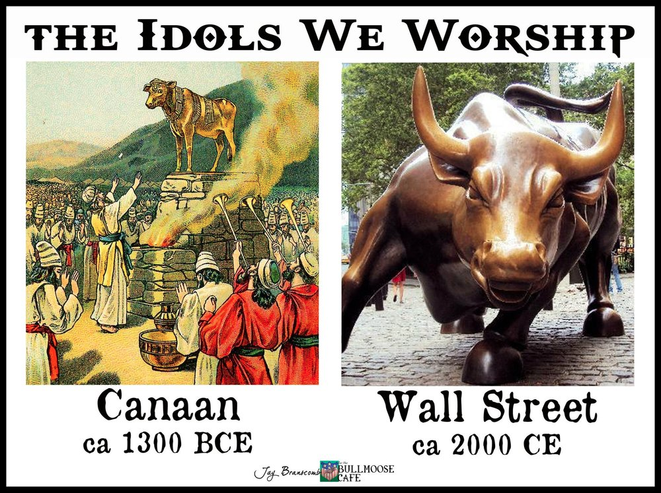
Idols We Worship

Slide 17
The Jephthah Cycle
174
1 Sin
2 Servitude
"So the Lord burned with anger against Israel, and he turned them over to the Philistines and the Ammonites" (10:7).
Notes:
“No wonder God’s anger “was hot against Israel” (v. 7). What foolishness to worship the gods of your defeated enemies! Israel had to be chastened again, and this time God sent the Philistines and the Ammonites to do the job” (Wiersbe, 111).

Slide 18
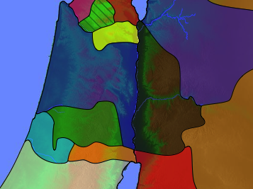
Twin Invasions
(Judges 10:8)
"Philistines and the Ammonites…began to oppress them that year. For eighteen years they oppressed all the Israelites east of the Jordan River in the land of the Amorites (that is, in Gilead)" (NLT).
171
Zebulun
Issachar
Manasseh
Gilead
Manasseh
Ammon
Ephraim
Philistines
Benjamin
Judah
Reuben
Notes:
“The Ammonites were distant relatives of the Jews, being descendants of Abraham’s nephew Lot (Gen. 19:36–38). It must have given the leaders of Ammon and Philistia great joy to subdue their old enemy Israel and oppress them. Their armies invaded the area of Gilead on the east side of the Jordan and then crossed the river and attacked Judah, Ephraim, and Benjamin. It was a devastating and humiliating conquest” (Wiersbe, 111).

Slide 19
Eastern Invasions
(Judges 10:9)
171
"The Ammonites also crossed to the west side of the Jordan and attacked Judah, Benjamin, and Ephraim. The Israelites were in great distress" (NLT).
Zebulun
Issachar
Manasseh
Gilead
Manasseh
Ammon
Ephraim
Philistines
Benjamin
Judah
Reuben

Slide 20
The Jephthah Cycle
174
"Finally, they cried out to the LORD for help, saying, 'We have sinned against you because we have abandoned you as our God and have served the images of Baal'"
(10:10).
1 Sin
2 Servitude
3 Supplication

Slide 21
"The LORD replied, 'Did I not rescue you from the Egyptians, the Amorites, the Ammonites, the Philistines, ¹²the Sidonians, the Amalekites, and the Maonites? When they oppressed you, you cried out to me for help, and I rescued you. ¹³Yet you have abandoned me and served other gods. So I will not rescue you anymore. ¹⁴Go and cry out to the gods you have chosen! Let them rescue you in your hour of distress!'"
(10:11-14 NLT).

Slide 22
"But the Israelites pleaded with the LORD and said, 'We have sinned. Punish us as you see fit, only rescue us today from our enemies.' ¹⁶Then the Israelites put aside their foreign gods and served the LORD. And he was grieved by their misery”
(10:15-16 NLT).

Slide 23
The Jephthah Cycle
174
1 Sin
2 Servitude
Jephthah delivered eastern Israel from the Ammonites but fulfilled a foolish vow by executing his daughter and 42,000 Ephraimites for their jealousy over his victory (10:17–12:6).
3 Supplication
4 Salvation

Slide 24
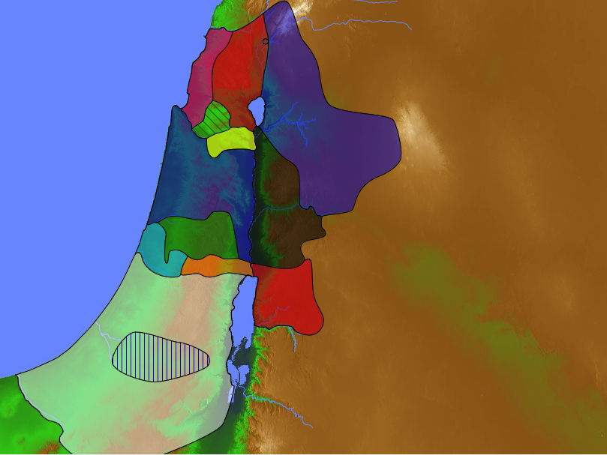
Where did Jephthah judge?
Naphtali
180a
Asher
Zebulun
Manasseh
Issachar
Manasseh
Gad
Jephthah
Ephraim
Dan
Ammonites
Benjamin
Reuben
Judah
Simeon

Slide 25
Ammonite Invasion
171
"At that time the armies of Ammon had gathered for war and were camped in Gilead, and the people of Israel assembled and camped at Mizpah. ¹⁸The leaders of Gilead said to each other, 'Whoever attacks the Ammonites first will become ruler over all the people of Gilead'" (Judges 10:17 NLT).
Zebulun
Issachar
Manasseh
Mizpah
Manasseh
Gilead
Ammon
Ephraim
Benjamin
Judah
Reuben
Notes:
“Israel’s lack of adequate leadership (vv. 17–18). The people were prepared to act, but from all the tribes of Israel, there was nobody to take the lead. Whether in a nation or a local church, the absence of qualified leaders is often a judgment of God and evidence of the low spiritual level of the people. When the Spirit is at work among believers, He will equip and call servants to accomplish His will and bless His people (Acts 13:1–4)” (Wiersbe, 111).

Slide 26
Slides on
Judges 11

Slide 27
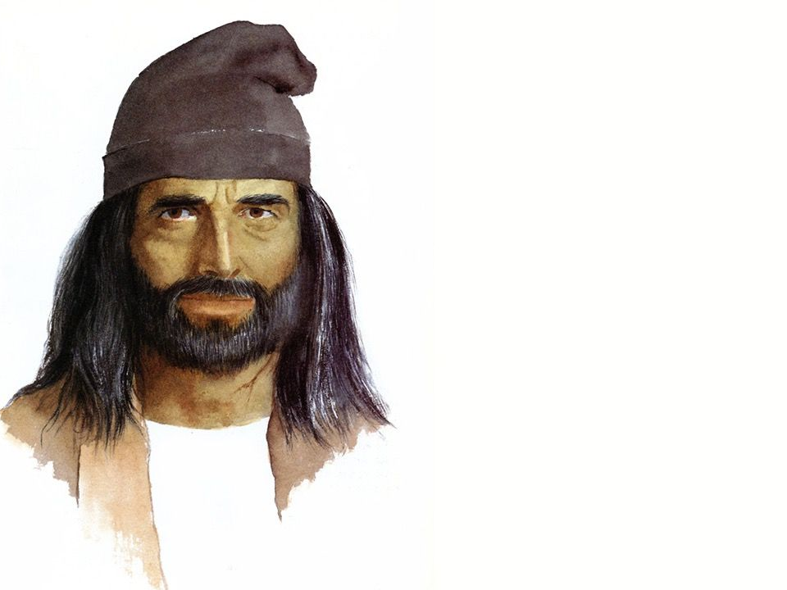
"Now Jephthah of Gilead was a great warrior. He was the son of Gilead, but his mother was a prostitute. ²Gilead’s wife also had several sons, and when these half brothers grew up, they chased Jephthah off the land. ‘You will not get any of our father’s inheritance,’ they said, ‘for you are the son of a prostitute’"
(11:1-2 NLT).

Slide 28
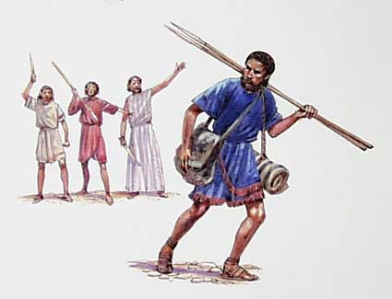
“Gilead’s wife also had several sons, and when these half brothers grew up, they chased Jephthah off the land. ‘You will not get any of our father’s inheritance,’ they said, ‘for you are the son of a prostitute’” (11:2 NLT).

Slide 29
Jepththah Selected (11:1-11)
Tob?
171
Zebulun
Issachar
Manasseh
Mizpah
Manasseh
Gilead
Ammon
Ephraim
Benjamin
Judah
Reuben
Notes:
“Jephthah left his father’s territory and went north to the land of Tob, which was near Syria, and there he became captain of a band of “adventurers” (v. 3 niv). The Hebrew word means “to make empty” and refers to idle people looking for something to do. (See 9:4, the “vain and light persons” who followed Abimelech. Here the word means “to be reckless.”) Jephthah was already known as “a mighty man of valour” (11:1). Thus he had no trouble forming a band of brigands” (Wiersbe, 112).

Slide 30
The Ammonite Complaint (Judges 11:12-13)
"The king of Ammon answered Jephthah's messengers, 'When the Israelites came out of Egypt, they stole my land from the Arnon River to the Jabbok River and all the way to the Jordan. Now then, give back the land peaceably'"
(11:13 NLT).
70a, 70g
Manasseh
Gilead
Jabbok River
Gad
Ammonites
Reuben
Arnon River

Slide 31
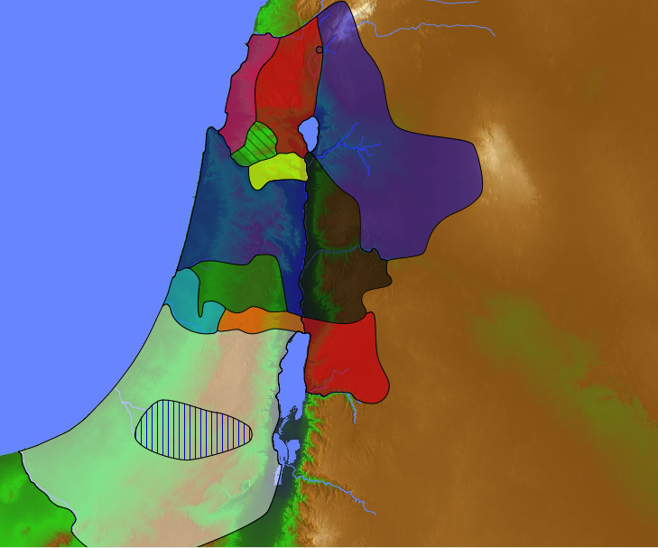
Jephthah's Diplomatic Response (Judges 11:14-24)
"…Israel took control of all the land of the Amorites, who lived in that region, ²²from the Arnon River to the Jabbok River, and from the eastern wilderness to the Jordan. ²³So you see, it was the LORD, the God of Israel, who took away the land from the Amorites and gave it to Israel. Why, then, should we give it back to you?"
(11:21b-23 NLT).
70a, 70g
Manasseh
Gilead
Jabbok River
Gad
Ammonites
Amorite Land
Reuben
Arnon River
Notes:
Wiersbe notes, “The king of Ammon declared that he and his men were only reclaiming land that the Jews, under the leadership of Moses, had stolen from them. If Israel would restore that land, he would call off his troops. But Jephthah presented four compelling arguments that should have convinced the Ammonites that they were wrong.
First, he presented the facts of history (vv. 14–22). Moses and his people had asked the Ammonites for safe passage through their territory, a request that the Ammonites would not grant. This led to war, and God gave the Jews the victory. Israel didn’t steal any land; they captured it from the Ammonites and the Amorites (Num. 21:21–35). Furthermore, the Amorites had originally taken the land from the Moabites (Num. 21:29), so if Israel’s claims to ownership by conquest weren’t valid, neither were the claims of the Amorites!
His second argument was that the Lord had given Israel the land (vv. 23–24). Jephthah was always careful to give the Lord the glory for any victories Israel won (vv. 9, 21, 23–24). When the other nations captured enemy territory, they claimed that it was “the will of their god” that they take the land; and they gave their idols credit for the victory. Jephthah declared that the God of Israel was the true God and that His will had been fulfilled in allowing Israel to take the land. It was Jehovah who gave Israel the victory” (Wiersbe, 115).

Slide 32
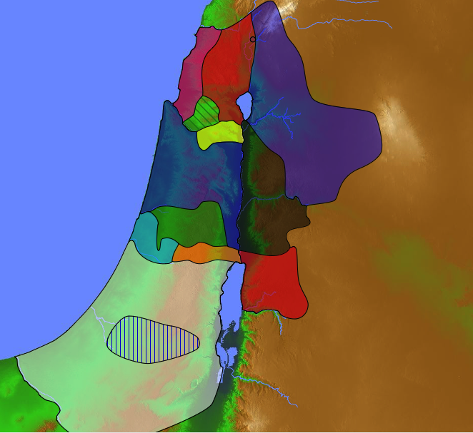
Geography & Chronology
"Israel has been living here for 300 years, inhabiting Heshbon and its surrounding settlements, all the way to Aroer and its settlements, and in all the towns along the Arnon River. Why have you made no effort to recover it before now? ²⁷Therefore, I have not sinned against you. Rather, you have wronged me by attacking me. Let the LORD, who is judge, decide today which of us is right—Israel or Ammon”
(11:26-27 NLT).
70a, 70g
Jephthah 1100 BC
+ 300 yrs
Conquest =
1400 BC
Ammonites
Heshbon
Aroer
Notes:
“Jephthah’s third argument was that Israel had lived on the land for centuries (vv. 25–26). “Three hundred years” is a round figure, but it comes close to the total number of years given in the book of Judges for the periods of oppression and of peace. Israel had dwelt in the Transjordan area for three centuries, and that was reason enough to claim title to the land as their own. Why was the king of Ammon making his claims now? During those three centuries, the people of Ammon didn’t try to reclaim their territory. In fact, back in the days of Moses, even the king of Moab hadn’t tried to get his land back! If the Ammonites had a legitimate claim to the territory, they should have said something centuries ago!
Jephthah’s final argument was that the Ammonites were actually fighting against the Lord (vv. 27–28). Jephthah hadn’t declared war on Ammon; it was Ammon that declared war on Israel. But if God gave Israel the land, then the Ammonites were declaring war on the Lord God, and that could only mean disaster and defeat for Ammon. Jephthah had tried to reason with the king of Ammon, but he wouldn’t listen” (Wiersbe, 116).

Slide 33
An Early Exodus (1446)
FOR
1 Kings 6:1
480 years from Exodus to the building of Solomon's Temple (966)
Judges 11:26 Jephthah assigns 300 years between his day (c.1100) and the Conquest
Exodus 1446 BC
+ 480 yrs
Temple = 966 BC
+ 4 yrs
Reign Began = 970/71

Slide 34
An Early Exodus (1446)
70g
FOR
1 Kings 6:1
480 years from Exodus to the building of Solomon's Temple (966)
Judges 11:26 Jephthah assigns 300 years between his day (c.1100) and the Conquest
AGAINST
a) 480 means 12 generations. Actual no. of yrs is 12 x 25 = 300
b) The text is corrupt
c) Historian had inaccurate facts
This was a generalization or an inaccurate guess as he had no access to historical records

Slide 35
Jepththah Recruited (11:29)
"At that time the Spirit of the Lord came upon Jephthah, and he went throughout the land of Gilead and Manasseh, including Mizpah in Gilead, and from there he led an army against the Ammonites"
(11:29 NLT).
171
Zebulun
Issachar
Manasseh
Mizpah
Manasseh
Ammon
Ephraim
Gilead
Benjamin
Judah
Reuben

Slide 36
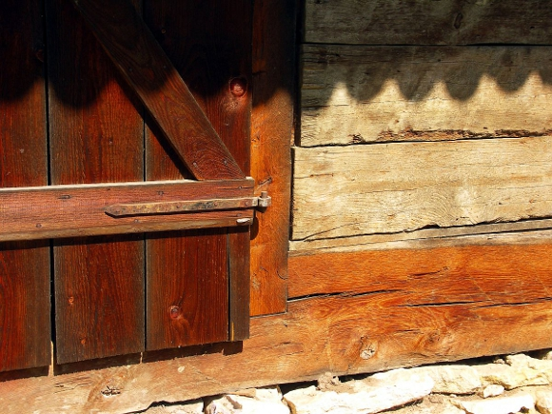
The Vow
"And Jephthah made a vow to the LORD. He said, 'If you give me victory over the Ammonites,
³¹I will give to the LORD whatever comes out of my house to meet me when I return in triumph. I will sacrifice it as a burnt offering'"
(11:30-31 NLT).
Notes:
The Vow of Jephthah
December 19, 2012 By Krisan Marotta
“What did Jephthah expect to see when he returned home?
Jephthah vowed to sacrifice the first thing out of his door if God granted him victory in war (Judges 11). What did Jephthah expect to see when he returned home? Knowing the structure of the typical village home gives us the answer.
In Jesus Through Middle Eastern Eyes, Kenneth Bailey demonstrates that the typical village home had two rooms: the family living quarters and the stable. The stable was lower than living quarters, next to the door, and housed the family animals overnight for warmth and safety. Those more well-off might also have a room exclusively for guests on the other end of the house or on the roof, known as the “upper room” or “prophet’s chamber.”
The family animals were brought inside each night for warmth and to keep them safe from predators and thieves. In the morning the family cow, donkey and few sheep would be released back into the family courtyard and the family stable would be cleaned for the day.
Which brings us to Jephthah. On his way to war against the king of Ammon, Jephthah made a rash vow: If God will grant him victory in battle, upon his return home he will sacrifice the first thing that comes out of his house.
‘Now the Spirit of the LORD came upon Jephthah, so that he passed through Gilead and Manasseh; then he passed through Mizpah of Gilead, and from Mizpah of Gilead he went on to the sons of Ammon. Jephthah made a vow to the LORD and said, “If You will indeed give the sons of Ammon into my hand, then it shall be that whatever comes out of the doors of my house to meet me when I return in peace from the sons of Ammon, it shall be the LORD’S, and I will offer it up as a burnt offering.” So Jephthah crossed over to the sons of Ammon to fight against them; and the LORD gave them into his hand.’ Judges 11:29-32
“What did Jephthah expect to see when he returned home? Knowing the style of the typical homes tells us that he probably expected to arrive in the early morning when the family animals would leave the house after their nightly confinement. His vow — though rash — is not barbaric. If his home provided shelter only for humans, it is likely he would never have made this vow. We should assume he was horrified to see his daughter exit the house first. Indeed he reacts with extreme anguish, as if it never crossed his mind that a family member would be first out the door.
When Jephthah came to his house at Mizpah, behold, his daughter was coming out to meet him with tambourines and with dancing. Now she was his one and only child; besides her he had no son or daughter. When he saw her, he tore his clothes and said, “Alas, my daughter! You have brought me very low, and you are among those who trouble me; for I have given my word to the LORD, and I cannot take it back.” Judges 11:343-35
To vow or not to vow?
The story is tragic in part because he expected an animal, but also because his vow reveals his lack of faith in God.
Rather than trusting God, Jephthah bargained with Him. Jephthah attempted to secure a specific answer to his prayer by means of a vow. Essentially he promised, do something great for me and I’ll do something great for you.
The burnt offering symbolized his total devotion to the Lord. So why not offer the burnt offering before the battle? Because Jephthah is not fully devoted.
Jephthah will only give the Lord his devotion if the Lord delivers him on his terms. Rather than humbly trust the Lord, Jephthah attempts to manipulate Him, as if the God of Abraham is simply another pagan god or a cosmic vending machine that produces the proper “candy” when we offer the proper “coin.”
Granted, many people start their journey of faith by promising to do something for God if He does something for them. In many cases, like Jephthah, it appears that God answers their prayers. Fortunately for us, our merciful God tends to meet us where we are.
However, as we grow in faith and knowledge, we should move beyond “tit for tat” prayers. At some point, condition-based vows cease being a step of exploratory faith and become manipulation. As our faith matures, eventually we should cease our efforts to control the future and begin trusting God for it.”
http://www.wednesdayintheword.com/the-vow-of-jephthah/
Accessed 9 October 2016

Slide 37
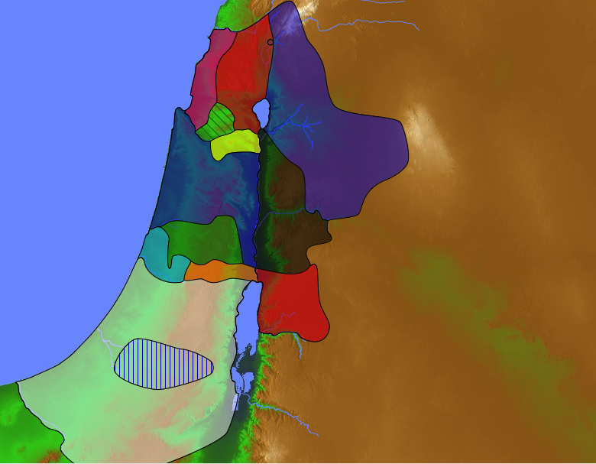
Jephthah's Victory
"So Jephthah led his army against the Ammonites, and the LORD gave him victory. ³³He crushed the Ammonites, devastating about twenty towns from Aroer to an area near Minnith and as far away as Abel-keramim. In this way Israel defeated the Ammonites”
(Judges
11:32-33 NLT).
70a, 70g
Ammonites
Heshbon
Aroer

Slide 38
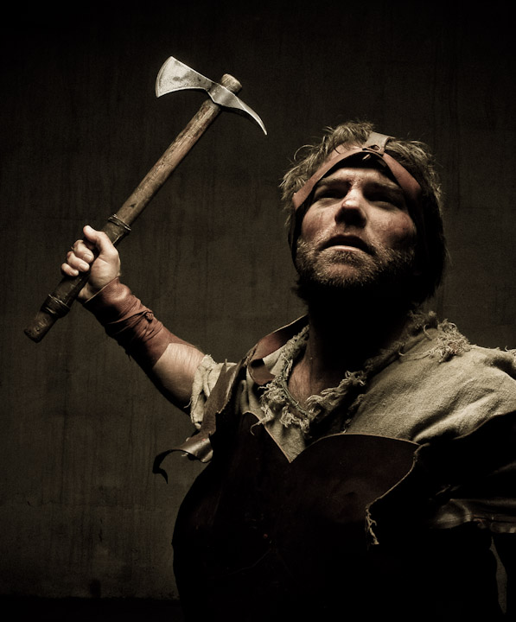
Jepththah's Victory (11:29-33)

Slide 39

"When Jephthah returned home to Mizpah, his daughter came out to meet him, playing on a tambourine and dancing for joy. She was his one and only child; he had no other sons or daughters. ³⁵When he saw her, he tore his clothes in anguish. 'Oh, my daughter!' he cried out. 'You have completely destroyed me! You've brought disaster on me! For I have made a vow to the LORD, and I cannot take it back'" (11:34-35 NLT).

Slide 40
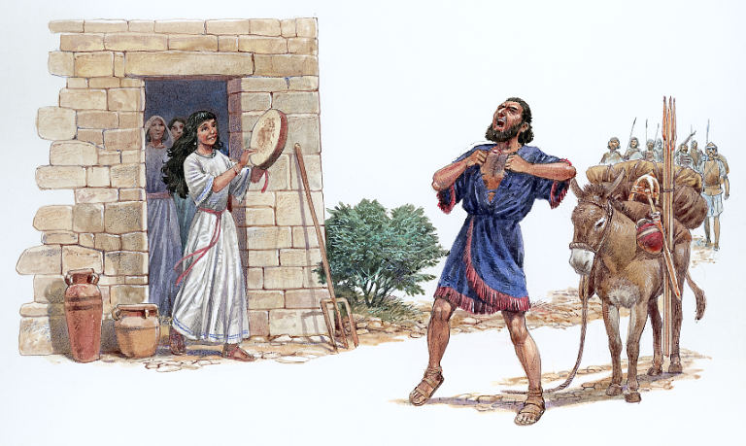
Jepththah's Daughter Greets Him (11:34)

Slide 41

"And she said, 'Father, if you have made a vow to the LORD, you must do to me what you have vowed, for the LORD has given you a great victory over your enemies, the Ammonites. ³⁷But first let me do this one thing: Let me go up and roam in the hills and weep with my friends for two months, because I will die a virgin'"
(11:36-37 NLT).

Slide 42
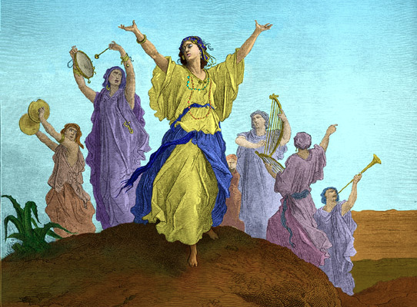
Mourning 60 Days
"'You may go,' Jephthah said. And he sent her away for two months. She and her friends went into the hills and wept because she would never have children. ³⁹When she returned home, her father kept the vow he had made, and she died a virgin. So it has become a custom in Israel ⁴⁰for young Israelite women to go away for four days each year to lament the fate of Jephthah's daughter" (11:38-40 NLT).

Slide 43
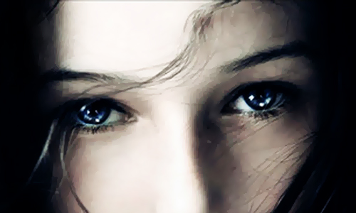
Did Jephthah really kill his daughter?

Slide 44
Views on Jephthah's Daughter (Judg. 11)
183
DEDICATED | SACRIFICED
Being a judge, Jephthah must have been God-fearing, so he would not have violated God's law | 1. Promise of a simple animal sacrifice would hardly be a convincing vow in this situation
2. The Spirit of the Lord comes on Jephthah; he is noted in Heb. 11 so he would not have violated Law | 2. The mention of something coming out of the house implies that human sacrifice was intended
3. Daughter bewails her virginity and 11:39 makes comment that "she knew not a man" | 3. The burnt offering ('olah) involves death in all 286 OT occurrences
Adapted from John H. Walton, Chronological and Background Charts of the OT, 2d ed., 104

Slide 45
Views on Jephthah's Daughter (Judg. 11)
183
DEDICATED | SACRIFICED
4. Evidence of women in service of tabernacle— Ex. 38:8; 1 Sam. 2:22 | 4. If it was frequent practice to have women enter tabernacle service, why the commendation?
5. Human sacrifice would have been clearly understood as a violation of God's Law, and public opinion would have disallowed it even if Jephthah wanted to proceed | 5. Human sacrifice is seen as a last ditch effort in battle (2 Kings 3:27)
Adapted from John H. Walton, Chronological and Background Charts of the OT, 2d ed., 104

Slide 46
Views on Jephthah's Daughter (Judg. 11)
183
DEDICATED | SACRIFICED
6. Lev. 21:1-8 allows for redemption of humans vowed for sacrifice | 6. The conjunction in 11:31 is one of apposition: "will be the LORD's, that is, I will sacrifice it as a burnt offering"
7. The conjunction in 11:31 should be rendered "or," showing Jephthah considered various situations | 7. There is little evidence of Jephthah's spirituality or knowledge of the Law
Adapted from John H. Walton, Chronological and Background Charts of the OT, 2d ed., 104

Slide 47
Slides on
Judges 12

Slide 48
Ephraimite Jealousy
171
"Then the people of Ephraim mobilized an army and crossed over the Jordan River to Zaphon. They sent this message to Jephthah: 'Why didn't you call for us to help you fight against the Ammonites? We are going to burn down your house with you in it!'"
(Judges 12:1 NLT).
Zebulun
Issachar
Manasseh
Mizpah
Manasseh
Zaphon
Gilead
Ammon
Ephraim
Benjamin
Judah
Reuben

Slide 49
Hebrew Exam
(Judges 12:5-6)
"They would tell him to say 'Shibboleth.' If he was from Ephraim, he would say 'Sibboleth,' because people from Ephraim cannot pronounce the word correctly. Then they would take him and kill him at the shallow crossings of the Jordan. In all, 42,000 Ephraimites were killed at that time" (12:6 NLT).
Zebulun
Issachar
Manasseh
Manasseh
Gilead
Zaphon
"Sibboleth"
"Shibboleth"
Ephraim
Benjamin
Judah
Reuben

Slide 50
The Jephthah Cycle
174
"Jephthah judged Israel for six years. When he died, he was buried in one of the towns of Gilead" (12:7).
1 Sin
2 Servitude
5 Silence
3 Supplication
4 Salvation

Slide 51
Where did Izban judge?
Naphtali
180a
Asher
Zebulun
Manasseh
Issachar
Manasseh
Gad
Ephraim
Dan
Benjamin
Izban
Reuben
Judah
Simeon

Slide 52
Where did Elon judge?
Naphtali
171
Asher
Zebulun
Manasseh
Elon
Issachar
Manasseh
Gad
Ephraim
Dan
Benjamin
Reuben
Judah
Simeon

Slide 53
Where did Abdon judge?
Naphtali
180a
Asher
Zebulun
Manasseh
Issachar
Manasseh
Abdon
Gad
Ephraim
Dan
Benjamin
Reuben
Judah
Simeon

Slide 54

What’s the Point of the Jephthah Story?
Notes:
The heart of this cycle is the deliverance by Jephthah (10:17–12:4). He experiences military victory but family tragedy as it results in him vowing to kill his only daughter. But what’s the lesson here?
Fulfill stupid vows? In other words, don’t make stupid vows because you might have to fulfill them? Athena Gorospe, Associate Professor, Asia Theological Seminary, Manila, Philippines published her commentary in 2016 on the book of Judges for the Asia Bible Commentary. She candidly noted in “My Experience Writing the Commentary on Judges,” ATA News (July-Sep 2016), 6: “I think what drew me first to the book were the many stories about women. They range from those who were passive, exploited, and forcibly violated to those who were active agents, who initiated and were empowered to take on cultural and religious roles that were traditionally assigned to men. Apart from the stories of women, there are other puzzles in the book that intrigued me.”
“First, what do we make of Jephthah’s vow and the sacrifice of his daughter in Judges 11? Is the point of the story that we should fulfill our vows no matter what it costs—even to the point of sacrificing a loved one?”
Another option for the Lesso is, “Don’t prejudice against men from bad backgrounds like Jephthah because they actually can make good leaders!”

Slide 55
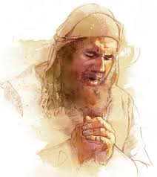
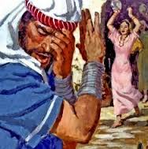
Was Jephthah honorable?
Great warrior (11:1)
Overcame his past (11:11)
Diplomatic (11:12-28)
Spirit-empowered (11:29)
Sought God (11:30)
Kept his vow (11:39)
Man of faith (Heb. 11:32)
———————
Rash vow (11:31)
Vengeful (12:1-7)
= Mixed bag (like you & me)

Slide 56
Relativism
Shows faithfulness.
What God did then.
What we should do now.
Don’t be stupid.
Where does it lead?
Notes:
Where does our relativism lead?
When we don’t have actual right-and-wrong standards, what happens?
Today we’ll see that, in response to relativism, what God did to Israel (EI) what we should do (MI in conclusion).

Slide 57
Main Idea
God is faithful to us, but when we reject him, our stupid actions
hurt those we love.
Notes:
For Jephthah:
Even though he was a “mixed bag” with some admirable qualities, he is known for his rash vow that hurt his daughter!
His vengeance on the Ephraimites slaughtered an additional 42,000 fellow Israelites!

Slide 58

Who is being hurt by your own stupid stuff?
          The prodigal teenager creates havoc for the parents that raised him or her.
          An adulterous man hurts the very wife and children he vowed to protect.
          The workaholic begins to honorably provide for his family, but in the end neglects the ones he loves.

Slide 59


Slide 61


OT Survey link at BibleStudyDownloads.org
Get this presentation for free!
Notes:
OT Survey (os)

