Slide 1
FROM VALLEY TO DOOR <Joshua 7 : 1 - 26>

Slide 2
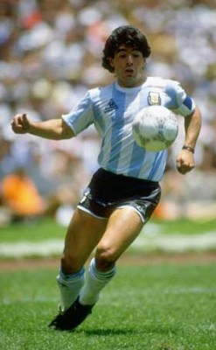
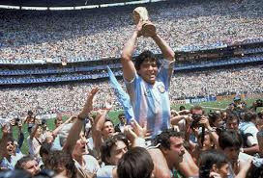

Slide 3
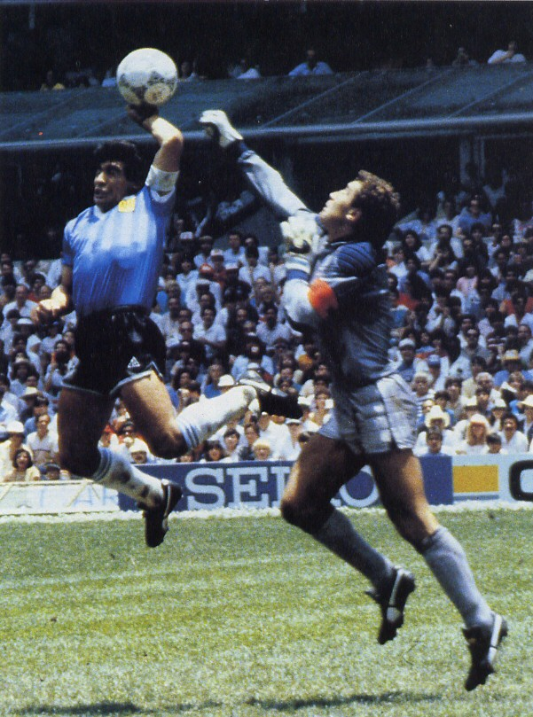

Slide 4
“The LORD was with Joshua, and his fame was in all the land (6:27).”

Slide 5
Israelites lost the war to Amorites at Ai because of belittling the enemy as Achan belittled God’s command.

Slide 6
Battle of Jericho (Ch.2) | Battle of Ai (Ch.7)
1 Joshua the son of Nun sent two men secretly from Shittim as spies, saying, "Go, view the land, especially Jericho." | 2 Joshua sent men from Jericho to Ai, which is near Beth-aven, east of Bethel, and said to them, "Go up and spy out the land." And the men went up and spied out Ai.
23 Then the two men returned…to Joshua the son of Nun, and they told him all that had happened to them. 24 And they said to Joshua, “Truly the LORD has given all the land into our hands. And also, all the inhabitants of the land melt away because of us." | 3 And they returned to Joshua and said to him, “Do not have all the people go up, but let about two or three thousand men go up and attack Ai. Do not make the whole people toil up there, for they are few.”
(6:2) And the LORD said to Joshua, “See, I have given Jericho into your hand, with its king and mighty men of valor. You [all] shall march around the city, all the men of war going around the city.” | 4 So about 3,000 men went up there from the people. And they fled before the men of Ai, 5 and the men of Ai killed about thirty-six of their men…And the hearts of the people [Israel] melted and became as water.”

Slide 7
But the people of Israel broke faith in regard to the devoted things, for Achan…took some of the devoted things (herem). And the anger of the LORD burned against the people of Israel.” (v.1)
“Israel has sinned; they have transgressed my covenant that I commanded them; they have taken some of the devoted things; they have stolen and lied and put them among their own belongings.” (v.11)

Slide 8
“Corporate Solidarity”

Slide 9
But Peter said, "Ananias, why has Satan filled your heart to lie to the Holy Spirit and to keep back for yourself part of the proceeds of the land?” (Acts 5:3)
… When Ananias heard these words, he fell down and breathed his last…And great fear came upon the whole church and upon all who heard of these things.(Acts 5:5, 11)

Slide 10
God wants the church to be holy as his bride in the covenant of blood.

Slide 11
Israel has sinned; they have transgressed my covenant that I commanded them; they have taken some of the devoted things; they have stolen and lied and put them among their own belongings. Therefore the people of Israel cannot stand before their enemies. They turn their backs before their enemies, because they have become devoted for destruction. I will be with you no more, unless you destroy the devoted things from among you (vv.11-12).

Slide 12
And he who is taken with the devoted things shall be burned with fire, he and all that he has, because he has transgressed the covenant of the LORD, and because he has done an outrageous thing (nevala) in Israel.' (v.15).

Slide 13
Joshua and all Israel with him took Achan the son of Zerah, and the silver and the cloak and the bar of gold, and his sons and daughters and his oxen and donkeys and sheep and his tent and all that he had. And they brought them up to the Valley of Achor. And Joshua said, "Why did you bring trouble on us? The LORD brings trouble on you today." And all Israel stoned him with stones. They burned them with fire and stoned them with stones. And they raised over him a great heap of stones that remains to this day. Then the LORD turned from his burning anger. Therefore, to this day the name of that place is called the Valley of Achor. (vv.24-26)

Slide 14
And there I will give her her vineyards and make the Valley of Achor a door of hope. And in that day, declares the LORD, you will call me 'My Husband,' and no longer will you call me 'My Baal.' (Hos. 2:15-16)

Slide 15
And I will betroth you to me forever. I will betroth you to me in righteousness and in justice, in steadfast love and in mercy. I will betroth you to me in faithfulness. And you shall know the LORD. (2:19-20)

Slide 16
When we come into the land, you shall tie this scarlet cord in the window through which you let us down, and you shall gather into your house your father and mother, your brothers, and all your father's household…. And she said, "According to your words, so be it." Then she sent them away, and they departed. And she tied the scarlet cord in the window (Jos. 2:18, 21).

Slide 17
She tied the scarlet cord in the window. → She tied the scarlet hope in the window.

Slide 18
Jesus
Scarlet
Hope
Blood
Cord
I will make the Valley of Achor
a door of hope.
(Hosea 2:15)
She tied the scarlet cord in the window.
(Joshua 2:21)
She tied the hope of the blood in the window.
(Trans: Joshua 2:21)

Slide 19
Just as sin entered the world through one man, and death through sin, and in this way death came to all men, because all sinned… If, by the trespass of the one man, death reigned through that one man, how much more will those who receive God's abundant provision of grace and of the gift of righteousness reign in life through the one man, Jesus Christ. Therefore, as one trespass led to condemnation for all men, so one act of righteousness leads to justification and life for all men (Rom. 5:12, 17-18).

Slide 20
Tie the scarlet hope in your heart and in your church to be the holy bride of Christ Jesus.

