Slide 1
Obedience By Law
Joshua 1:1-18

Slide 2
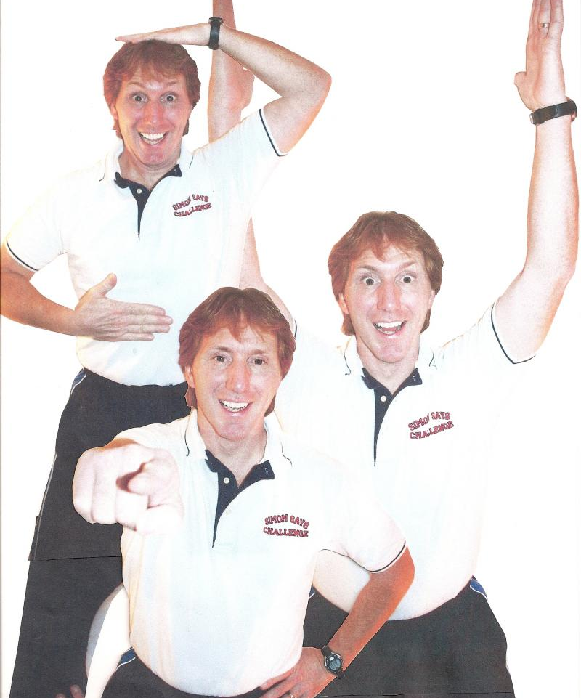
Simon says!
Obey what Simon says.

Slide 3
What is obedience to God?
How should we live after we believe?

Slide 4
I. Submit to spiritual authority (1:1-9)
God led the Israelites via His designated leader, Joshua.
God was encouraging Joshua to “Be strong and courageous” regarding the Law.
Joshua was to lead Israel on God’s term.

Slide 5
Chiasm of 1:7-9
A. Be strong and courageous, being careful to act in accordance with all the law that my servant Moses commanded you (v. 7a-b)
B. Do not turn from it to the right hand or to the left, so that you may be successful wherever you go (v. 7c)
C. This book of the law shall not depart out of your mouth (v. 8a)
C`. You shall meditate on it day and night (v. 8b)
B`. so that you may be careful to act in accordance with all that is written in it. For then you shall make your way prosperous, and then you shall be successful (v. 8c-d)
A`. I hereby command you: Be strong and courageous; do not be frightened or dismayed, for the LORD your God is with you wherever you go (v. 9)

Slide 6
I. Submit to spiritual authority (1:1-9)
God led the Israelites via His designated leader, Joshua.
God was encouraging Joshua to “Be strong and courageous” regarding the Law.
Joshua was to lead Israel on God’s term.
We need to submit to spiritual leaders in our lives.
Parents, Pastors & Peers

Slide 7
II. Rally God’s people (1:10-11)
Joshua transmitted God’s commandments through the “officers of the people”.
We need to mobilise the people of God to be faithful to God’s Word.
Personal Bible Study
Sharing of God’s Word

Slide 8
III. Seek unity among God’s people (1:12-15)
Joshua united the 12 tribes of Israel for the conquest of the Promised Land.
We need to be united in support of the leadership in spite of differences.
Unity in diversity and not uniformity.
Unity does not mean unqualified compliance.

Slide 9
IV. Obey God by obeying Jesus (1:16-18)
Israel expressed faithfulness to God by obeying Joshua.
We are faithful to God when we submit to spiritual leaders.
Not as blind followers but exercise discernment.
Leaders need to be congruent with God’s Word.

Slide 10
Gordon T. Smith, Courage & Calling
“We are called to accountability and submission; we are called to live in gracious harmony within the Christian community; and this means that we need to let leaders lead. But we must never equate the voice of leadership with the voice of God”

Slide 11
Conclusion
Obey God by faithfully studying and sharing His Word.
Submit to spiritual authority with regards to matters of faith.
Seek unity among God’s redeemed people.

